Slide 1
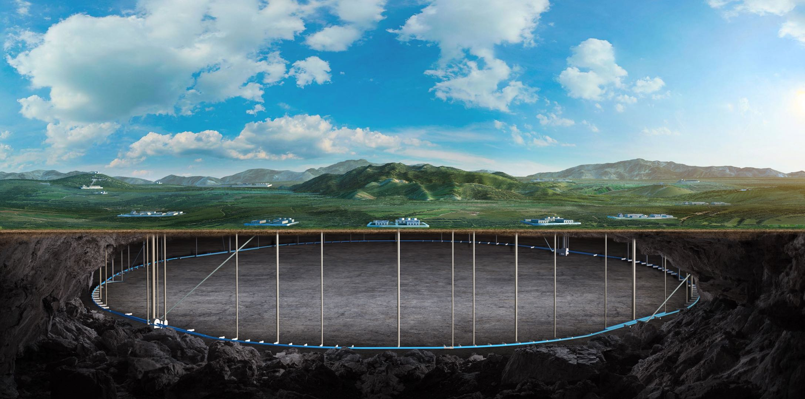
CEPC MDI Superconducting magnets development
Yingshun Zhu
On behalf of CEPC MDI SC magnet system
12-16. June. 2023, Hongkong, CEPC Accelerator TDR International Review

Slide 2
Content
Introduction
Design of superconducting quadrupoles in CEPC MDI
Design of Anti-solenoid
Development of 0.5m single aperture short model quadrupole
Summary

Slide 3
Introduction
This talk is about the superconducting magnet system in CEPC MDI
This talk relates to the TDR chapter 4.3.4
The content relates to the “charge letter” item 1, 3, 6

Slide 4
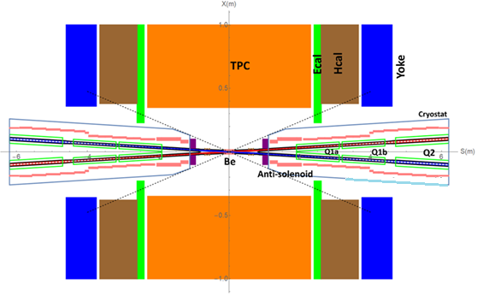
Requirement List
In CEPC, there are four combined-function Superconducting magnets, around each side of the IP point, including double aperture high gradient quadrupole and anti-solenoid.
TDR requirements of CEPC Final Focus quadrupoles are based on L* of 1.9 m, beam crossing angle of 33 mrad.

Slide 5
Requirement List
Quadrupole magnets are operated inside the Detector solenoid with a central field of 3.0 T.
To cancel the effect of the detector solenoid field on the beam, anti-solenoids before Quadrupole and outside Quadrupole are needed.
Total field generated by detector solenoid and accelerator anti-solenoid is zero.
Table 1: TDR requirements of Interaction Region quadrupole magnets for Higgs
Magnet | Field gradient (T/m) | Magnetic length (m) | Width of GFR (mm) | Minimal distance between two aperture beam lines (mm)
Q1a | 142.3 | 1.21 | 14.92 | 62.71
Q1b | 85.4 | 1.21 | 18.17 | 105.28
Q2 | 96.7 | 1.5 | 24.48 | 155.11
Field gradient of other modes doesn’t exceeded the one of Higgs mode

Slide 6
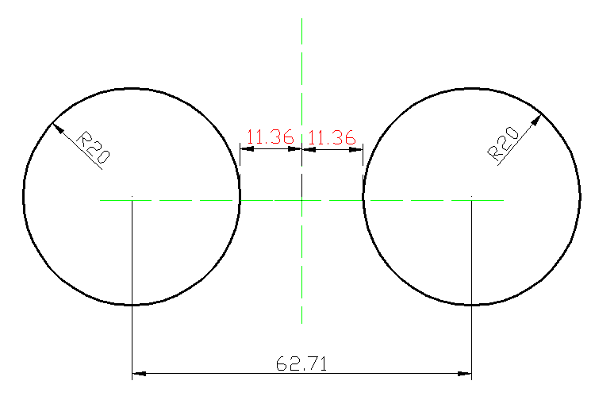
Design of superconducting quadrupoles in CEPC MDI
1 Design of Q1a
Minimal distance between two aperture beam lines: 62.71 mm
Inner radius of beam pipe: 10mm
Leaving space for beam pipe, helium vessel, quadrupole coil inner radius: 20 mm
It is challenging to meet stringent design requirement
1) High field gradient: 142.3T/m
2) Limited radial space
Limited radial space in the magnet middle:
R: [20mm, 31.36mm], only 11.36mm available
3) Magnetic field crosstalk between two apertures
High order field harmonics <5×10⁻⁴
Dipole field: as small as possible

Slide 7
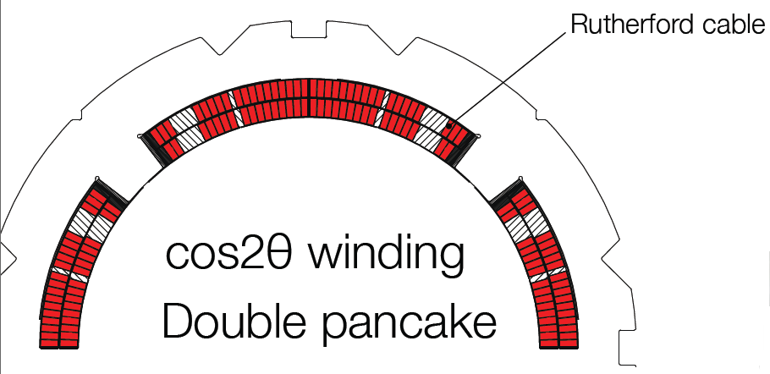
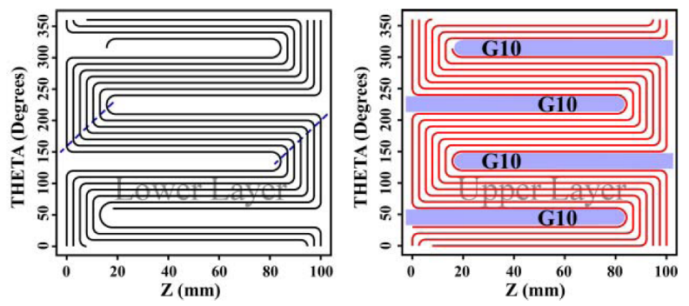
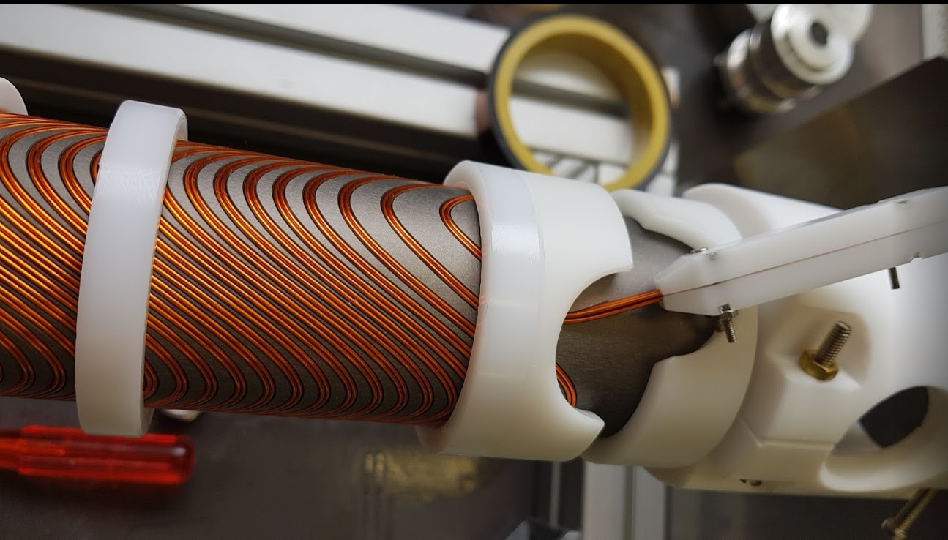
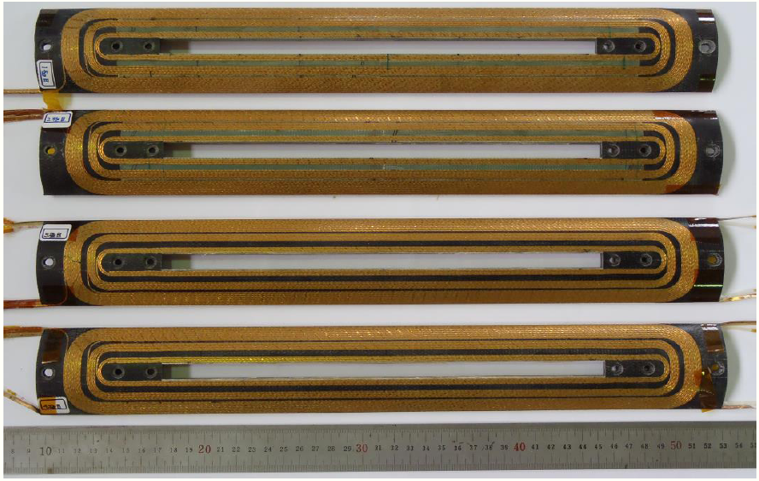
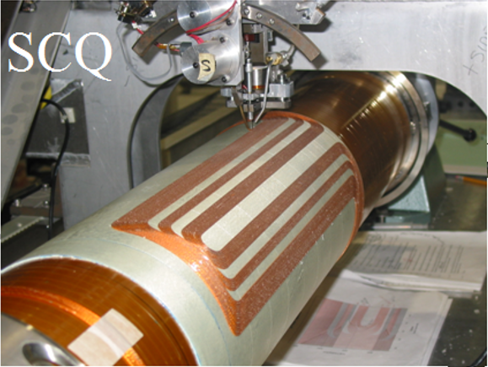
Design of Q1a
Magnetic design of Q1a with 3 kinds of quadrupole coil structures, including cos2θ coil, CCT coil, and Serpentine coil.
Cos2θ coil
(SuperKEKB)
CCT coil
(FCC-ee)
Serpentine coil
(BEPCII)

Slide 8
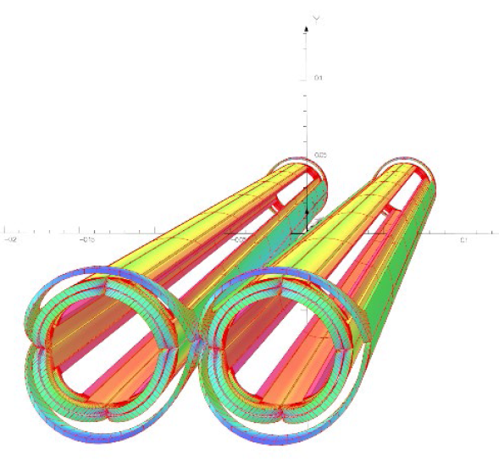
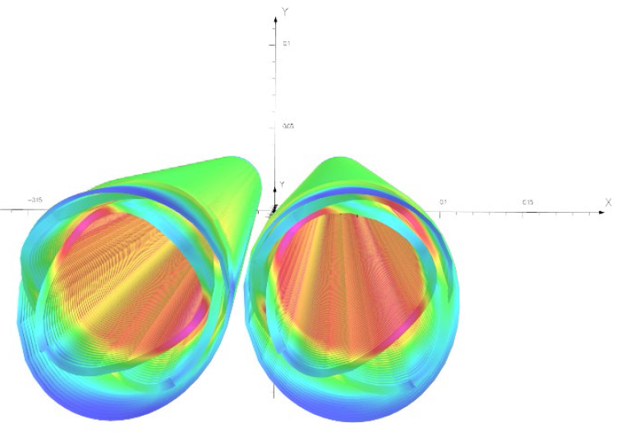
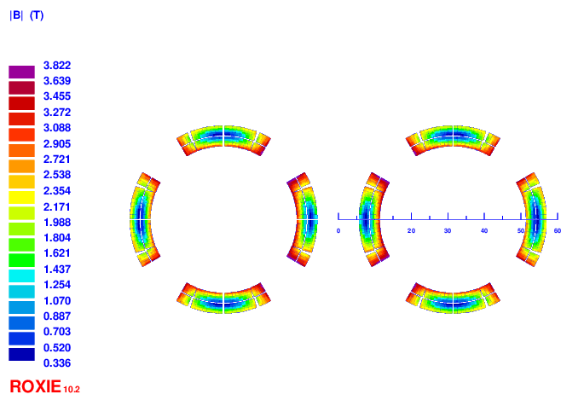
Design of Q1a: Cos2θ option
Option 1: Iron free design
Round 0.5mm strand, HTS Bi-2212 or LTS NbTi
HTS: higher heat load resistant, larger critical current, higher temperature
Two layers cos2θ quadrupole coil using Rutherford, with 10 NbTi strands
Inner diameter of the coil 40mm. Current 2650A
Cable width 2.5mm, 21 turns and four coil blocks in each pole.
Use corrector coil to adjust the integrated dipole field and field harmonics to 0
Field crosstalk between two apertures introduces a local dipole field >200Gs

Slide 9
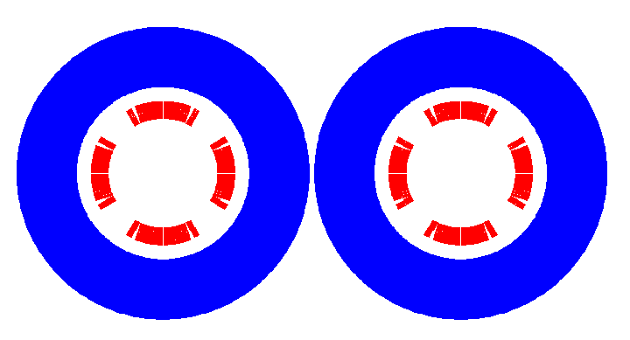
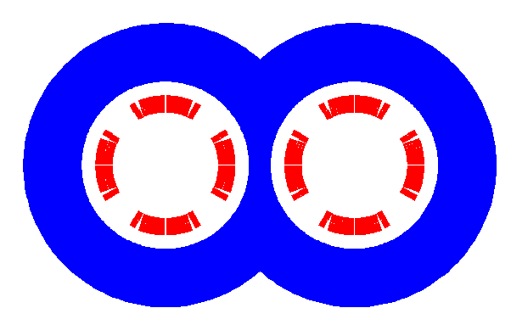
Design of Q1a
Option 2: With iron design
In quadrupole region, the net solenoid field is almost zero.
Iron yoke FeCoV with high saturation field is added outside the coil, to
(1) enhance the field gradient (2) reduce the current (3) and shield the field crosstalk
Not enough space to place two single apertures side by side
Compact design: Iron core in the middle part is shared by two apertures
One or two layers corrector coils will be added inside quadrupole coil, using 0.33mm wire

Slide 10
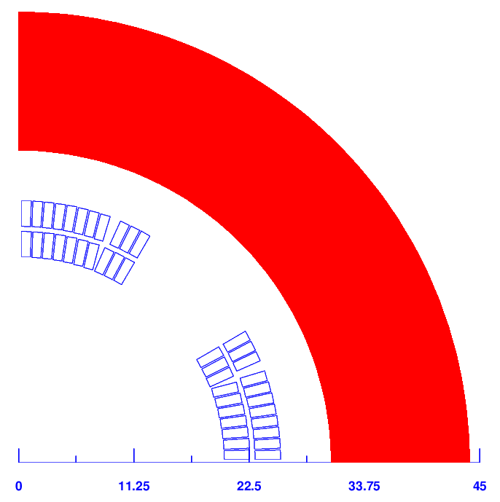
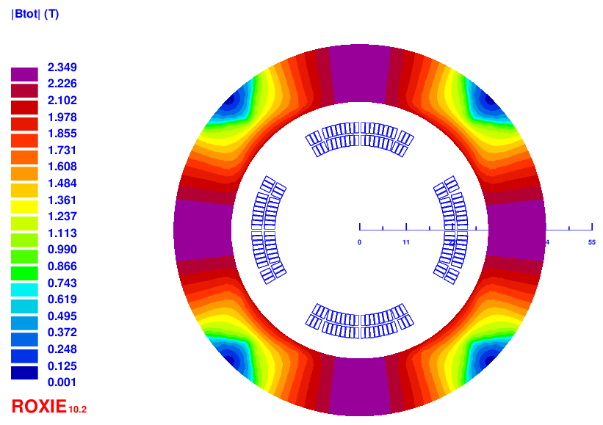
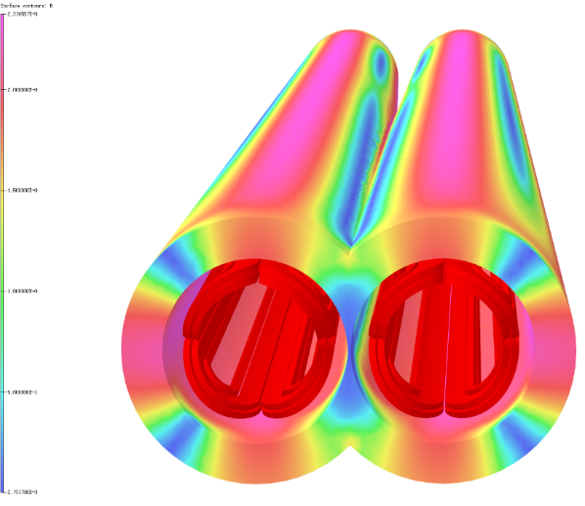
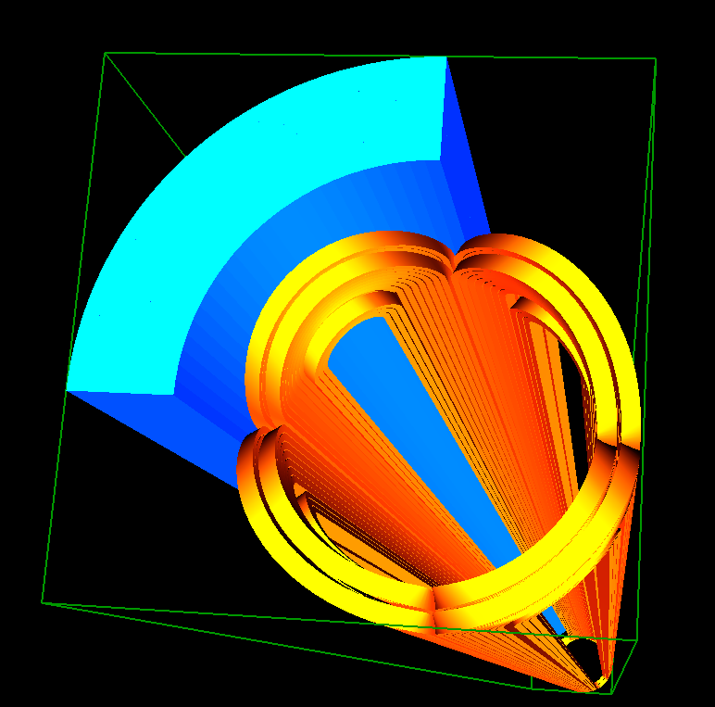
Q1a design with iron
The field harmonics as a result of field crosstalk in each aperture is < 1×10⁻⁴.
Dipole field at each aperture center is smaller than 25 Gs.
Compared with iron-free design, the excitation current is reduced to 2020A.
Double aperture cos2θ quadrupole with iron yoke shared by two apertures, with crossing angle 33mrad.

Slide 11
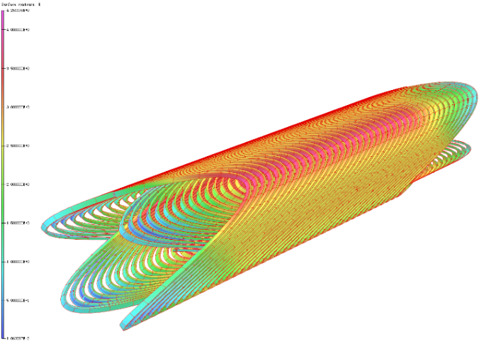
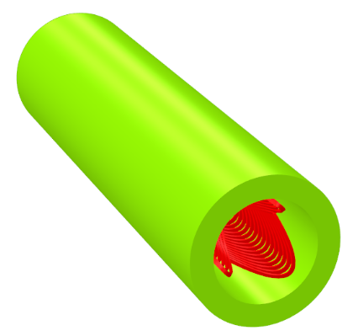
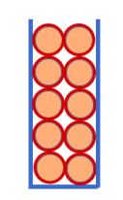
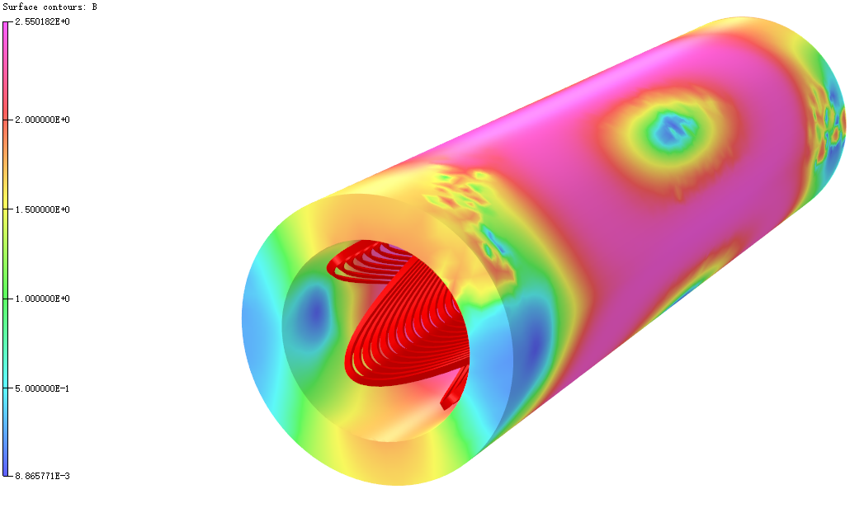
2) CCT option of Q1a
0.5mm round wire, HTS Bi-2212 or LTS NbTi.
Two layers CCT quadrupole coil. The inner radius of the spar is 20mm.
Groove on the spar: 1×2.5mm; 10 wires in a groove.
Conductor canted angle: 16 deg. Excitation current: 324A.
Field gradient is calculated using theoretical formula, and OPERA-3D.
Each integrated multipole field in single aperture is smaller than 1×10⁻⁴.

Slide 12
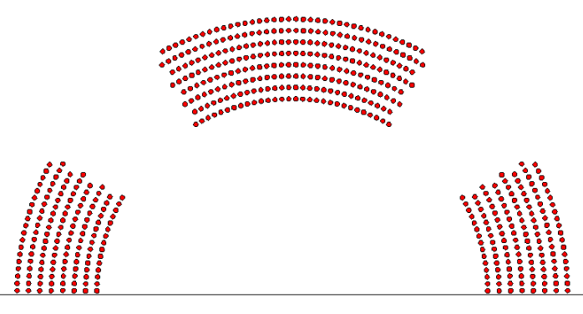
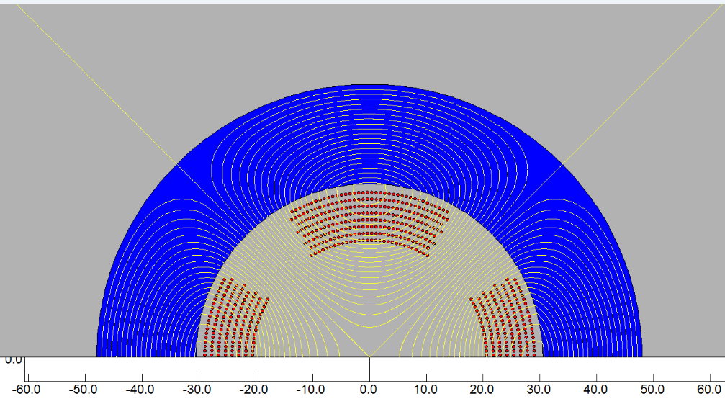
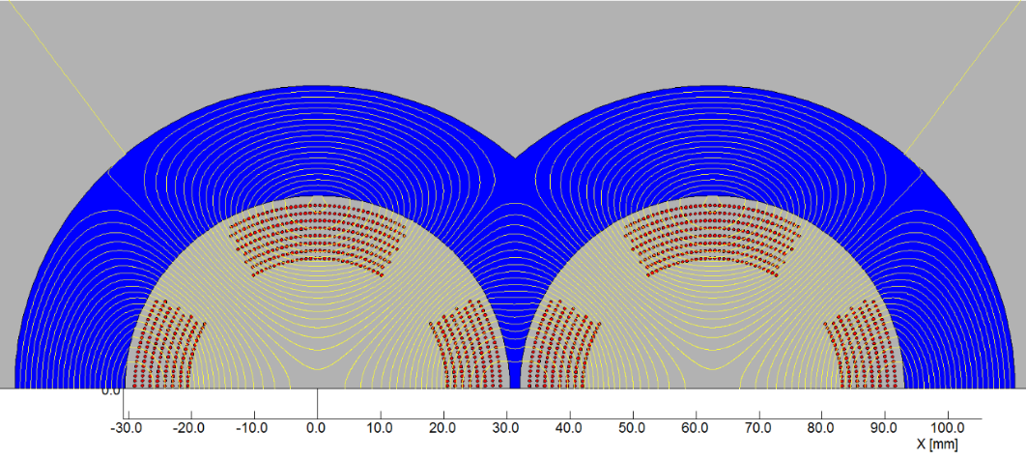
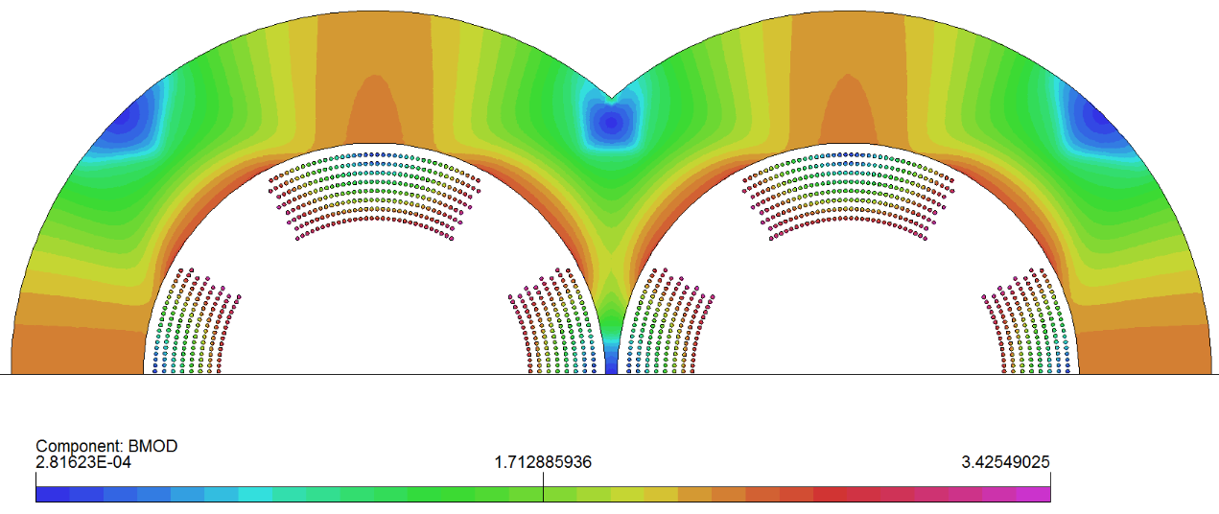
3) Serpentine option of Q1a
0.5mm round wire, HTS Bi-2212 or LTS NbTi.
8 layers Serpentine quadrupole coil. The inner radius of the coil is 20mm.
2D calculation, each multipole field in single aperture is smaller than 1×10⁻⁴.
Excitation current: 334A (with iron)

Slide 13
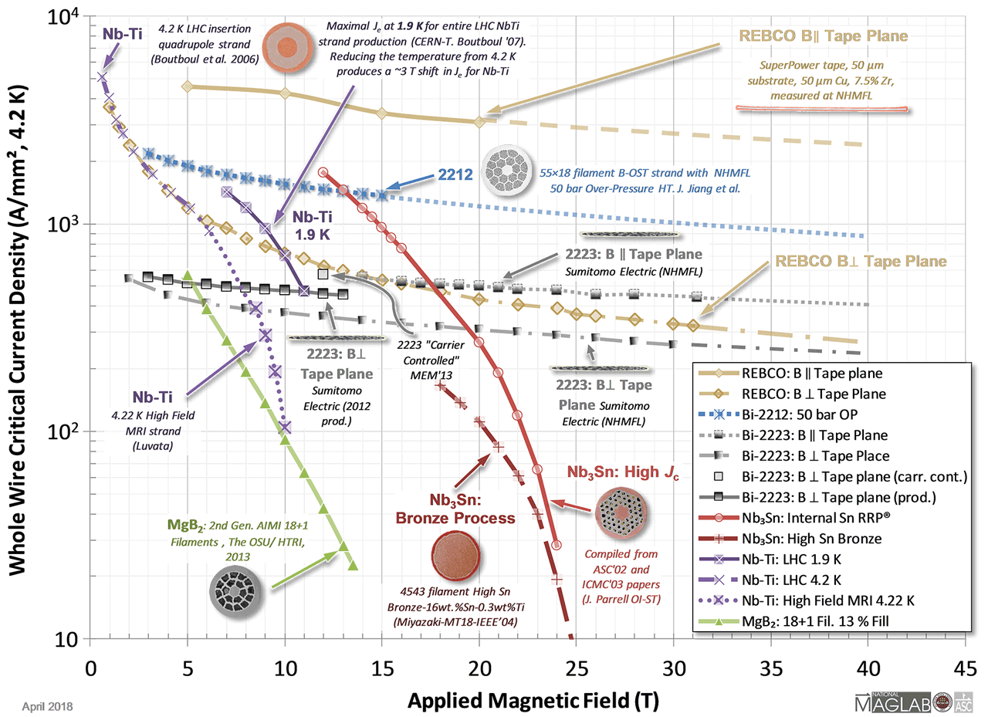
For a fixed field gradient in bore, smaller current density and smaller peak field in coil are advantageous.
From USPAS 2018

Slide 14
Comparison of three design options of Q1a
1) Comparison of three design options of Q1a (142.3T/m, no iron)
2) Comparison of three design options of Q1a (142.3T/m, with iron)
Current is reduced about 24%~30% using iron.
From the comparison, Cos2θ coil has lower peak field and lower current density.
Cos2θ coil with iron as baseline design, CCT and Serpentine coil (iron-free or with iron) as alternative design.
Q1a option | Cos2θ coil | CCT coil | Serpentine coil
Excitation current in strand (A) | 265 | 472.5 | 480
Current density Je on wire (A/mm²) | 1350 | 2406 | 2445
Peak field in coil (T) | 3.6 | 4.3 | 4.2
Q1a option | Cos2θ coil | CCT coil | Serpentine coil
Excitation current in strand (A) | 202 | 324 | 334
Current density Je on wire (A/mm²) | 1029 | 1650 | 1701
Peak field in coil (T) | 3.5 | 3.8 | 3.8

Slide 15
Design parameters of Q1a
Design parameters of the cos2θ Q1a quadrupole magnet with iron yoke
Magnet name | Q1a double aperture
Field gradient (T/m) | 142.4
Magnetic length (mm) | 1211.80
Coil turns per pole | 21
Excitation current (A） | 2020
Coil layers | 2
Conductor (HTS or LTS) | Rutherford Cable, width 2.5 mm, mid thickness 0.93 mm, keystone angle 2.1 deg, 10 strands
Maximum dipole field at aperture center (mT) | 2.5
Stored energy (KJ) | 11.5
Inductance (mH） | 5.64
Peak field in coil (T) | 3.42
Load line @4.2K | 78.8%
Integrated field harmonics | b₆ = -0.61 b₁₀ = -0.24
Coil inner diameter (mm) | 40
Coil outer diameter (mm) | 51.3
Yoke inner diameter (mm) | 61
Yoke outer diameter (mm) | 88
X direction Lorentz force/octant (kN) | 62.33
Y direction Lorentz force/octant (kN) | -58.59
Net weight (kg) | 93

Slide 16
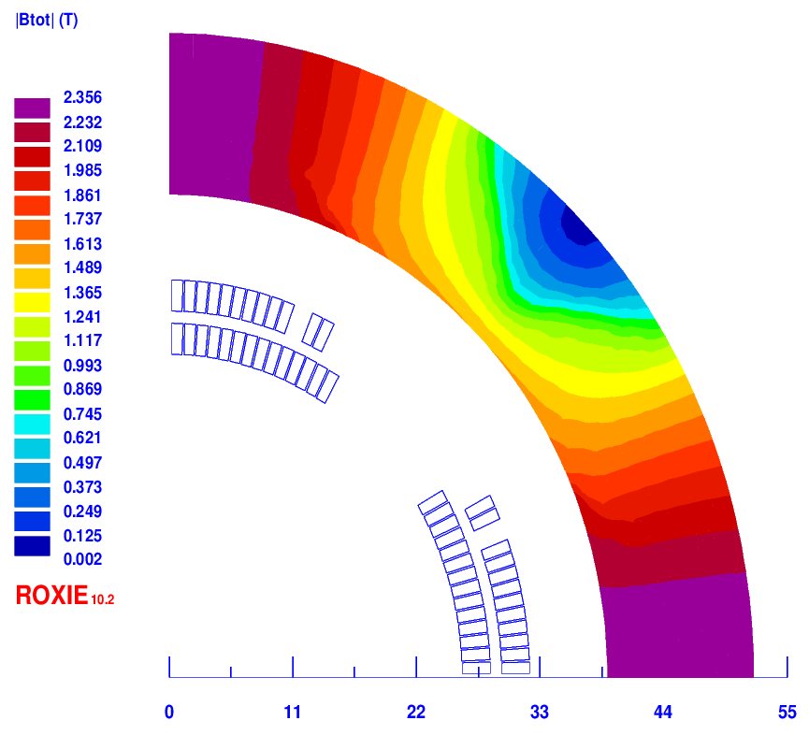
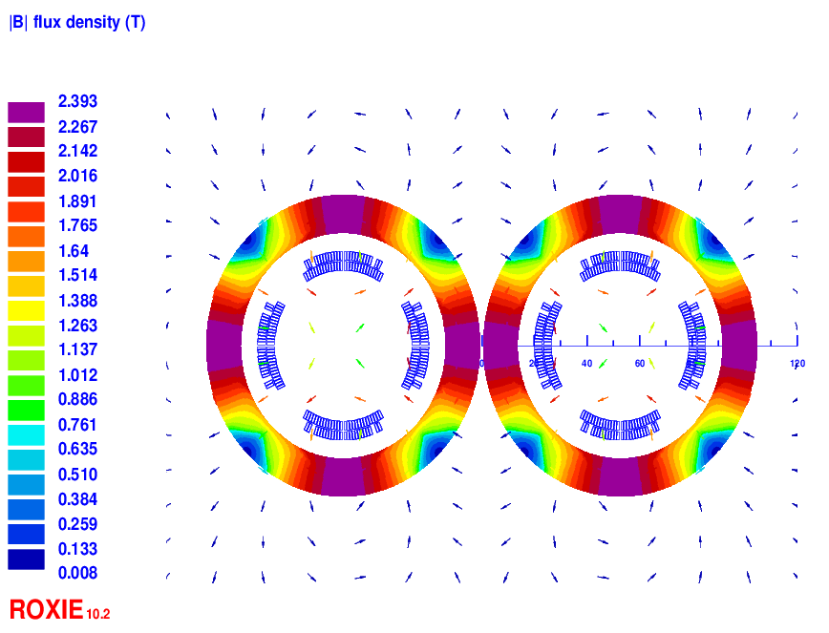
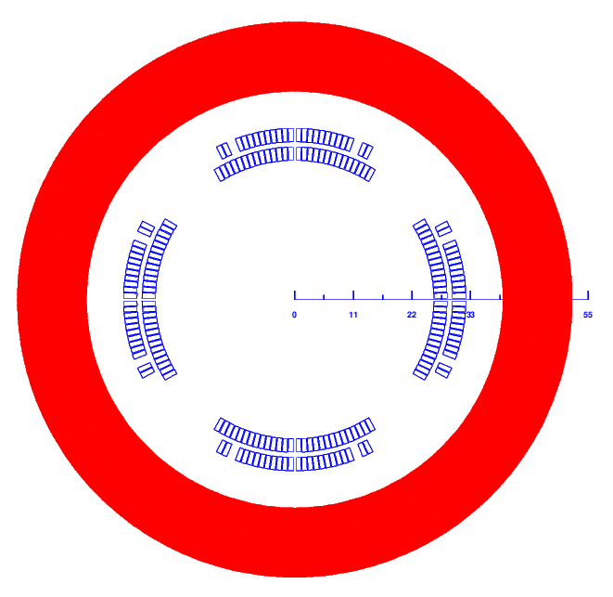
2 Design of Q1b
Baseline design: Cos2θ coil; CCT and Serpentine coil as alternative design
Round 0.5mm strand, HTS Bi-2212 or LTS NbTi
Q1b: two layers cos2θ quadrupole coil using Rutherford cable with iron yoke
The inner radius of the coil is 26 mm.
Cross section is optimized with three coil blocks in two layers.
Width of the cable is 3 mm, 26 turns in each pole.
The excitation current of Q1a is 1590A. Dipole field <30 Gs
Two apertures do not need to share the iron yoke like Q1a.
Two layers corrector coils will be added inside quadrupole coil, using 0.33mm wire.

Slide 17
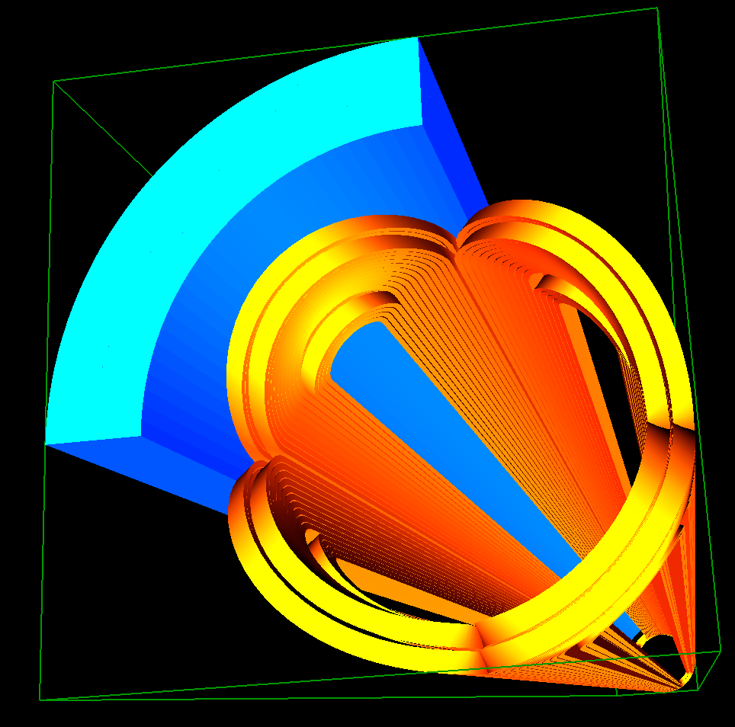
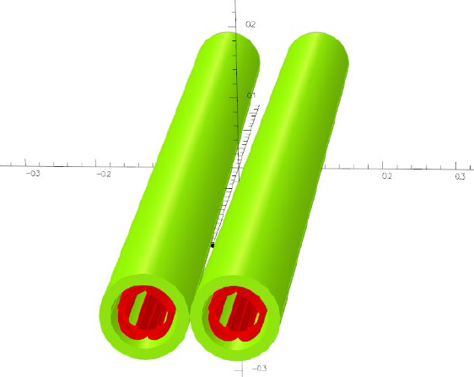
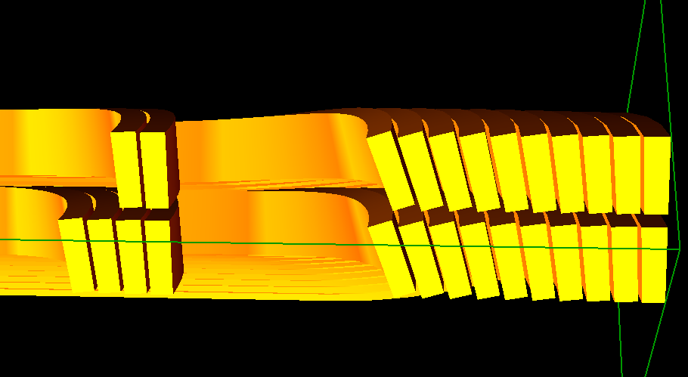
Design of Q1b
3D design of Q1b
3D magnetic field is modeled and analyzed using ROXIE and OPERA.
Coil end detailed shaped is optimized and determined.
Field gradient 85.4T/m, each integrated field harmonics is smaller than 2×10⁻⁴.
The 3D magnetic field performance meets requirement.
Calculation model in 3D

Slide 18
Design parameters of Q1b
Design parameters of the cos2θ Q1b quadrupole magnet with iron yoke
Magnet name | Q1b double aperture
Field gradient (T/m) | 85.5
Magnetic length (mm) | 1211
Coil turns per pole | 26
Excitation current (A） | 1590
Coil layers | 2
Conductor (HTS or LTS) | Rutherford Cable, width 3 mm, mid thickness 0.93 mm, keystone angle 1.9 deg, 12 strands
Maximum dipole field at aperture center (mT) | 2.3
Stored energy (KJ) | 11.0
Inductance (mH） | 8.75
Peak field in coil (T) | 2.7
Load line @4.2K | 56%
Integrated field harmonics | b₆ = 0.25 b₁₀ = -0.14
Coil inner diameter (mm) | 52
Coil outer diameter (mm) | 64.3
Yoke innerdiameter (mm) | 78
Yoke outer diameter (mm) | 103.4
X direction Lorentz force/octant (kN) | 45.86
Y direction Lorentz force/octant (kN) | -44.69
Net weight (kg) | 124

Slide 19
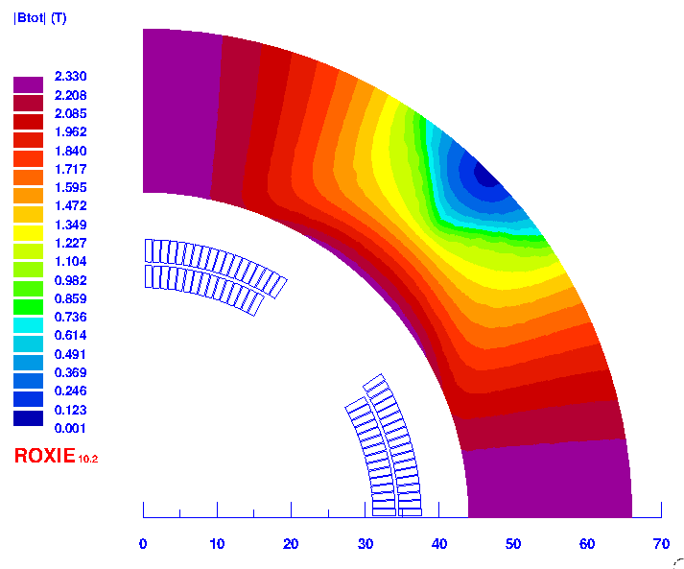
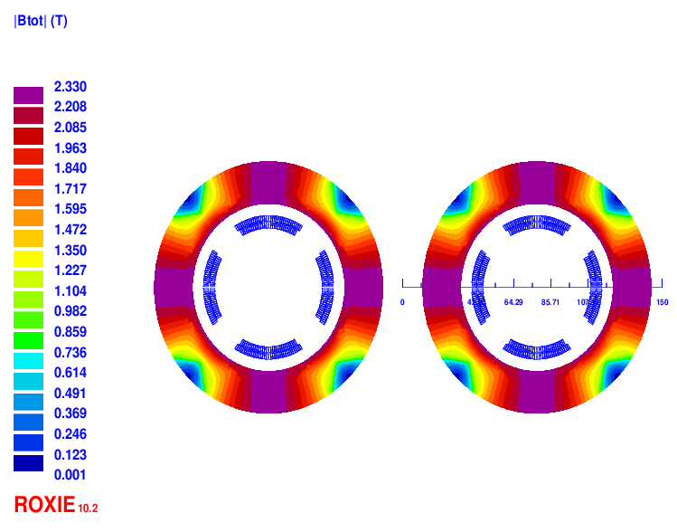
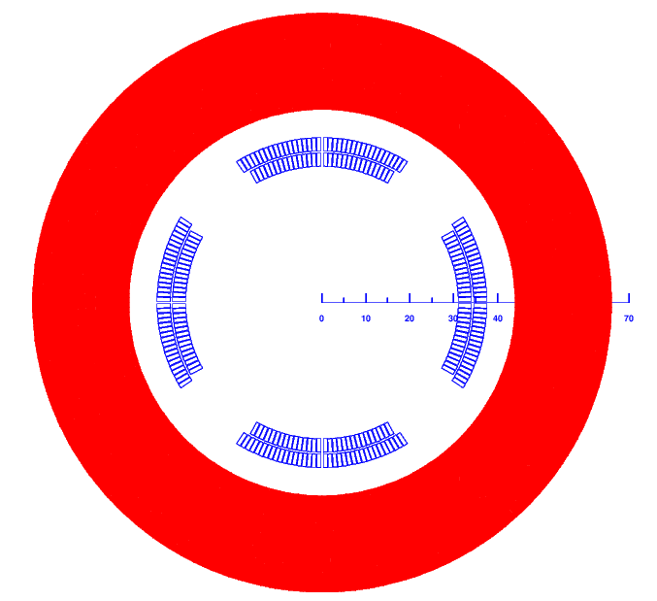
3 Design of Q2
Baseline design: Cos2θ coil; CCT and Serpentine coil as alternative design
Round 0.5mm strand, HTS Bi-2212 or LTS NbTi
Q2: two layers cos2θ quadrupole coil using Rutherford cable with iron yoke.
The inner radius of the coil is 31mm.
Single aperture cross section is optimized with two coil blocks in two layers.
33 turns in each pole. The excitation current is 1925A
Each multipole field in single aperture is smaller than 1×10⁻⁴ in 2D.
Two apertures do not need to share the iron yoke. Dipole field <30 Gs
Two or three layers corrector coils will be added inside quadrupole coil, using 0.33mm wire.

Slide 20
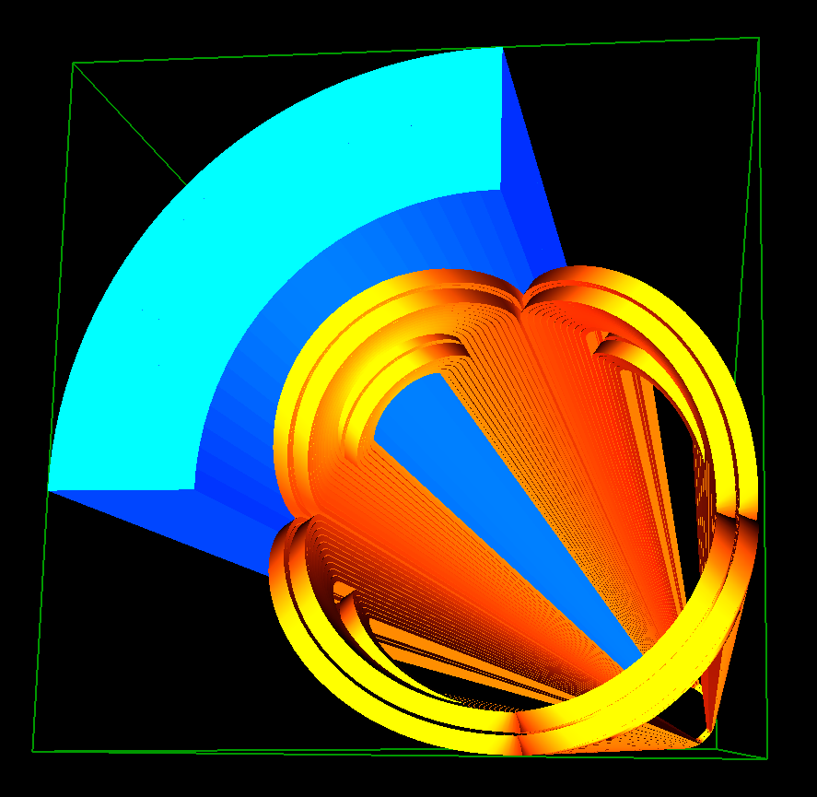
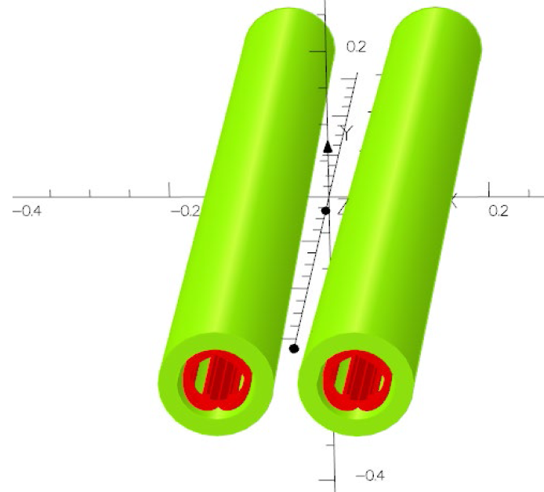
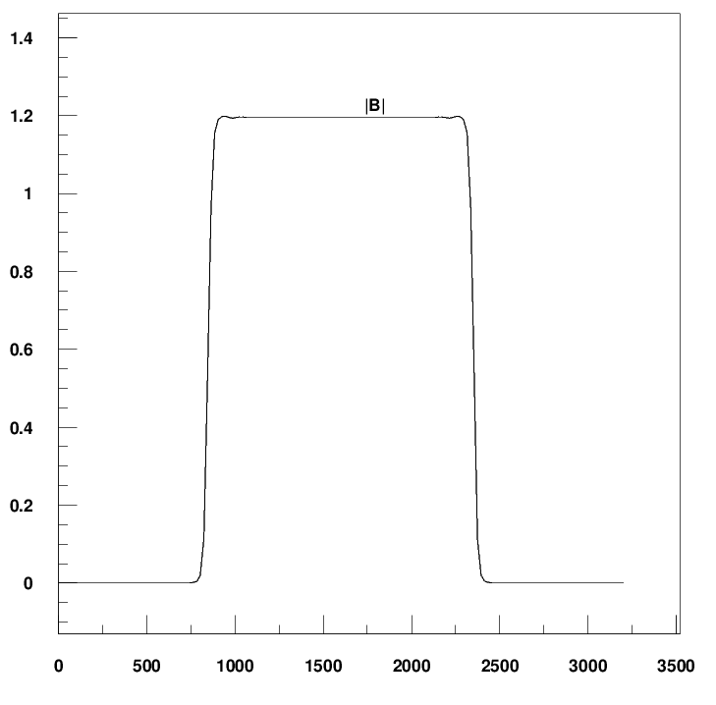
Design of Q2
3D design of Q2
3D magnetic field is modeled and analysed.
Coil end detailed shaped is optimized and determined.
Field gradient 96.7T/m, each integrated field harmonics is smaller than 2×10⁻⁴.
The 3D magnetic field performance meets requirement.
Calculation model in 3D

Slide 21
Design parameters of Q2
Design parameters of the cos2θ Q2 quadrupole magnet with iron yoke
Magnet name | Q2 double aperture
Field gradient (T/m) | 97.7
Magnetic length (mm) | 1502
Coil turns per pole | 33
Excitation current (A） | 1925
Coil layers | 2
Conductor (HTS or LTS) | Rutherford Cable, width 3 mm, mid thickness 0.93 mm, keystone angle 1.9 deg, 12 strands
Maximum dipole field at aperture center (mT) | 2.5
Stored energy (KJ) | 33.2
Inductance (mH） | 18.2
Peak field in coil (T) | 3.7
Load line @4.2K | 72%
Integrated field harmonics | b₆ = -0.52 b₁₀ = -0.49
Coil inner diameter (mm) | 62
Coil outer diameter (mm) | 75.3
Yoke inner diameter (mm) | 88
Yoke outer diameter (mm) | 126.4
X direction Lorentz force/octant (kN) | 126.94
Y direction Lorentz force/octant (kN) | -112.68
Net weight (kg) | 235

Slide 22
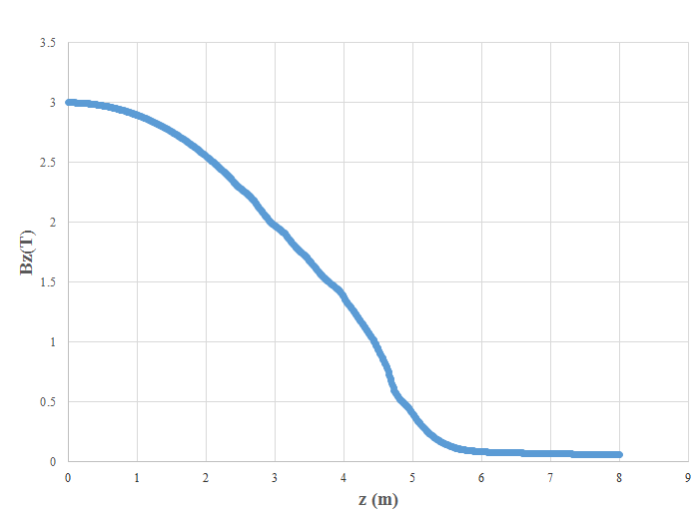
Design of superconducting anti-solenoid
The design requirements of the anti-solenoids in the CEPC Interaction Region are summarized below:
1) The total integral solenoid field generated by the detector solenoid and anti-
solenoid coils is zero.
The solenoid field inside Q1a, Q1b and Q2 should be smaller than a few
hundred Gauss at each longitudinal position.
The distribution of the solenoid field along longitudinal direction should meet
the requirement of the beam optics for emittance.
The field of the Detector solenoid is not constant; it decreases slowly.
Field of detector solenoid

Slide 23
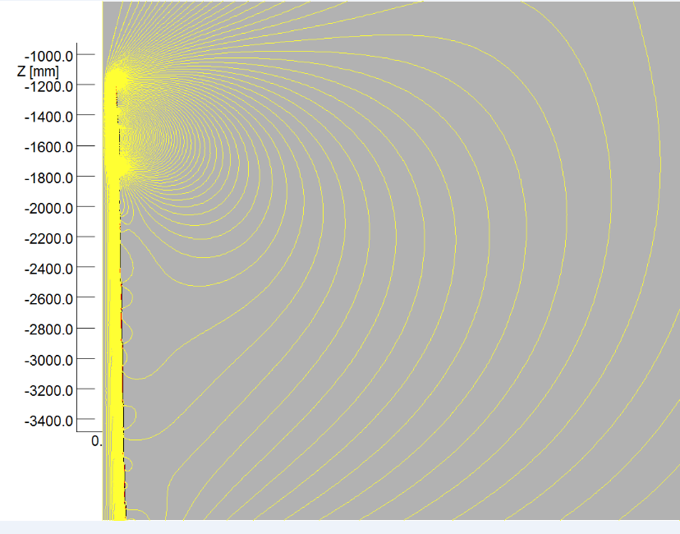
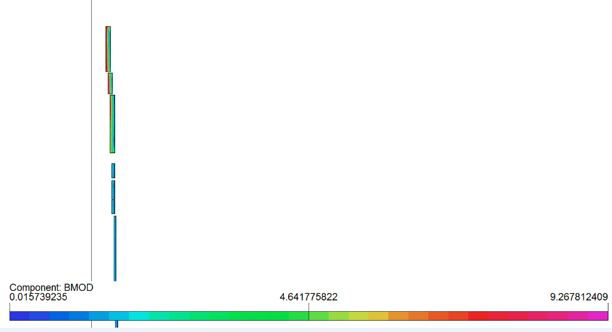
In order to reduce the magnet size, energy and cost, the anti-solenoid is divided into a total of 29 sections with different inner coil diameters.
These sections are connected in series, but the current of some sections can be adjusted using auxiliary power supplies.
Magnetic field calculation and optimization is performed using axi-symmetric model in OPERA-2D.
The central field of the first section of the anti-solenoid is the strongest, with a peak value of 8.8T.
2D flux lines
Magnetic flux density distribution

Slide 24
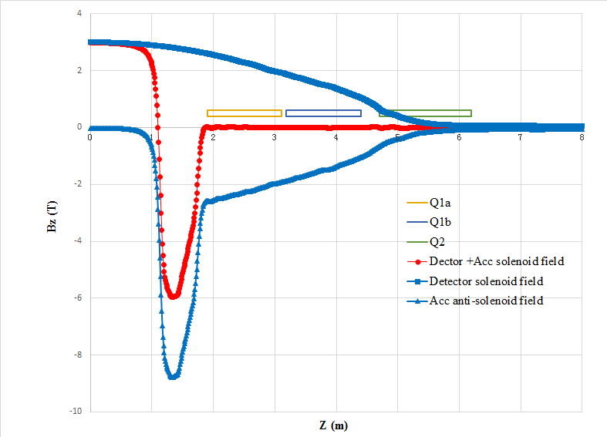
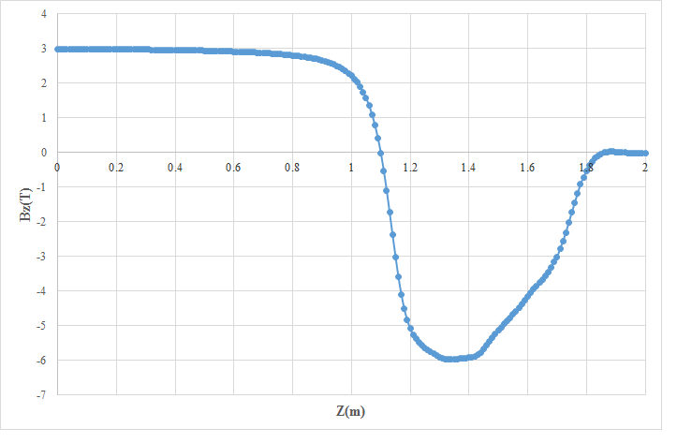
The outer coil diameter of anti-solenoid is 380 mm, and the excitation current of anti-solenoid is 1300A.
Combined field of Anti-solenoid and Detector solenoid is fine tuned to meet the requirement of beam emittance.
The total integral longitudinal field is almost zero.
The net solenoid field inside quadrupole magnet at each longitudinal position is smaller than 300 Gs.

Slide 25
Design parameters of Anti-solenoid:
Table 2: Design parameters of Anti-solenoid
Central field（T） | 8.8 (max)
Magnetic length（m） | 5.1
Conductor (mm, HTS YBCO or LTS Nb₃Sn) | 2.5×1.5
Excitation current（A） | 1300
Stored energy (KJ) | 630
Inductance（H） | 0.75
Peak field in coil (T) | 9.3
Load line @4.2K | 50%
Number of sections | 29
Solenoid coil inner diameter (mm) | 140
Solenoid coil outer diameter (mm) | 380
Lorentz force Fz on anti-solenoid under detector solenoid (kN) | -200
Net weight (kg) | 302

Slide 26
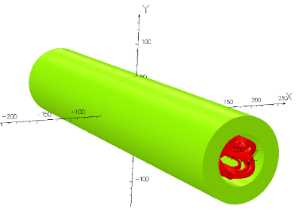
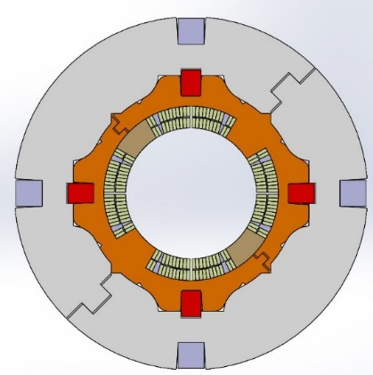
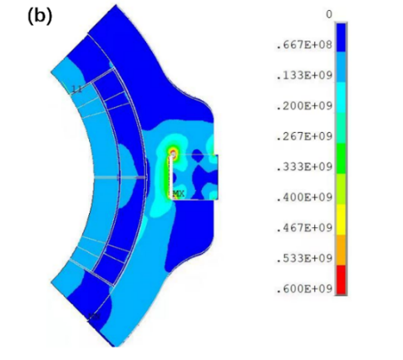
Development of 0.5m single aperture short model quadrupole
In R&D, the first step is to study and master main key technologies of superconducting quadrupole magnet, by developing a short LTS model magnet.
NbTi, ∅ 40mm, 142T/m, L= 0.5m, in collaboration with HeFei KEYE Company
Main purpose: verify if high magnetic field gradient can be achieved

Slide 27
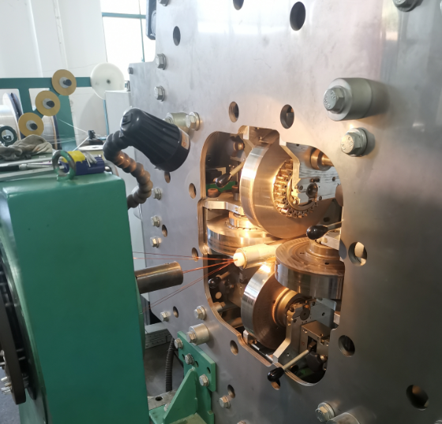
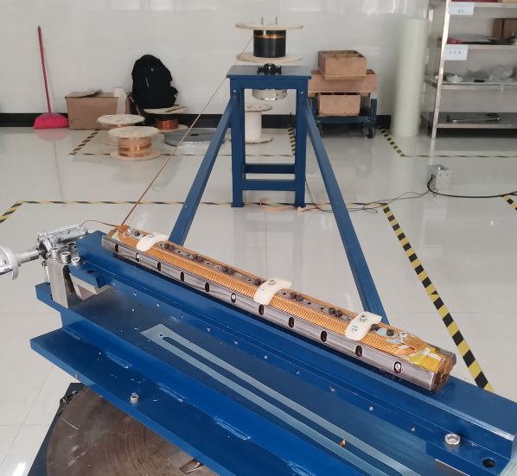
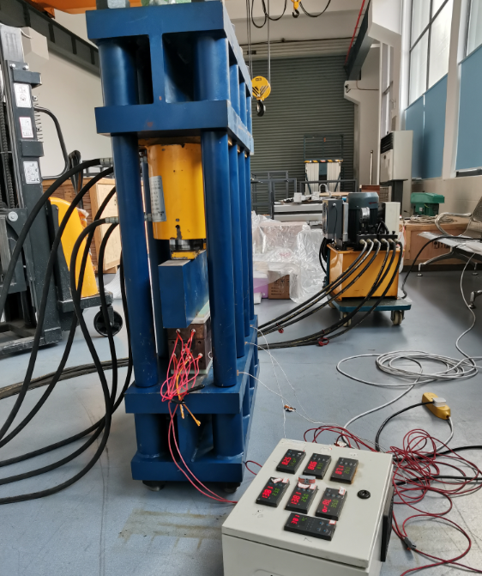
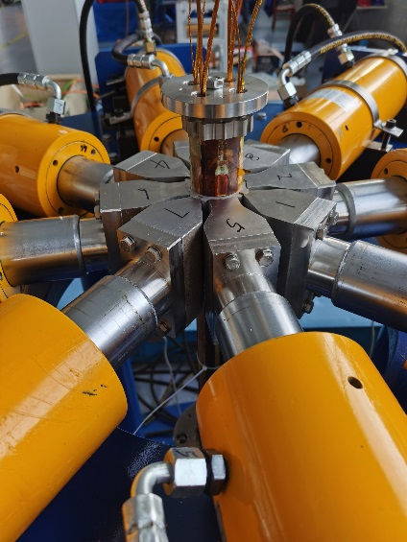
Development of 0.5m single aperture short model quadrupole
Manufacture of all hardware is completed.
NbTi Rutherford cable (12 strands)
Winding machine
Coil heating and curing system
Coils assembly system

Slide 28
Development of 0.5m single aperture short model quadrupole
Many test on the winding and curing of quadrupole coils were performed.
Four SC quadrupole coils have been wound and cured.
Iron yoke has been assembled with the collared-coil.
Coil resistance, ground insulation test, and room temperature field measurement have been performed.
Manufacture of 0.5m short model quadrupole was completed in August 2022.

Slide 29
Development of 0.5m single aperture short model quadrupole
Cryogenic excitation test at 4.2K in vertical Dewar: to verify whether high field gradient can be achieved. (Nov.10, 2022)
The excitation current successfully reached 2500 A (Max current of leads), and operates stably for 30 minutes.
No quench occurred during the whole excitation process.
Measured inductance about 2mH; consistent with the design value.
The corresponding field gradient at 2500 A exceeds the gradient in the TDR stage (142.3 T/m).

Slide 30
Summary
For CEPC superconducting quadrupole magnets, it is challenging to meet stringent design requirements: 1) field gradient 142T/m
2) limited space 3) field crosstalk between two apertures
HTS and LTS, Iron free and with iron option have been considered.
Three coil types have been studied: Cos2θ coil, CCT coil, Serpentine coil.
Cos2θ coil as baseline design, CCT and Serpentine coil as alternative design.
The designed magnetic performance of superconducting quadrupole and anti-solenoid meet the requirements.
CEPC 0.5m single aperture short model quadrupole has been developed.
Excitation current successfully reached 2500 A at 4.2K in vertical Dewar.
High field gradient of 142 T/m for CEPC quadrupole can be achieved.
Field strength of anti-solenoid can be achieved using current magnet technology.
The magnet technologies for CEPC MDI will be ready before 2026.

Slide 31
Thanks for your attention!

