Slide 1
Ncount Correction with First Cluster Time
Shuaiyi Liu, Yaxin Shen, Guang Zhao, Linghui Wu, Mingyi Dong

Slide 2
One mistake in 45° track figure in last slides
z
y
O
x
z
y
y
O
O
x

Slide 3
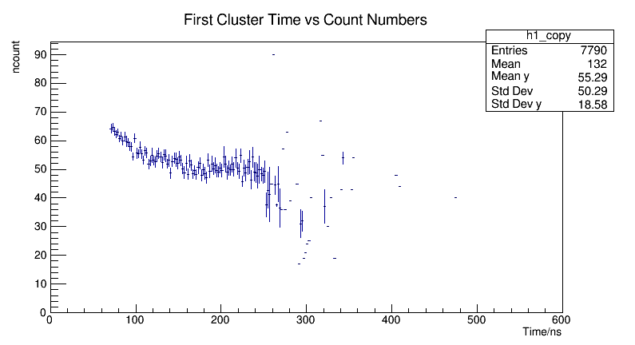
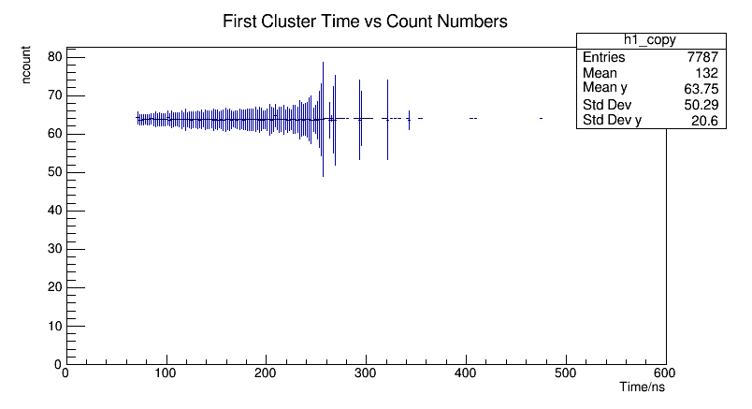
Dependency on $t_{F}$(First Cluster Time) and correction
Run16+17+18, 65000 events, Sampling rate 1.5G, 45°
Correct ncount to ncount($t_{0}$)

Slide 4
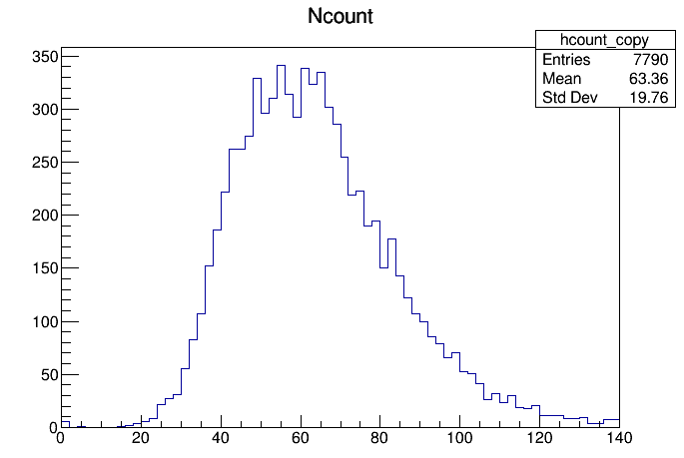
Ncount Comparison ($t_{F}$ Correction)
Before correction
18.3/55.18=33.16%
After correction
19.76/63.36=31.19%

Slide 5
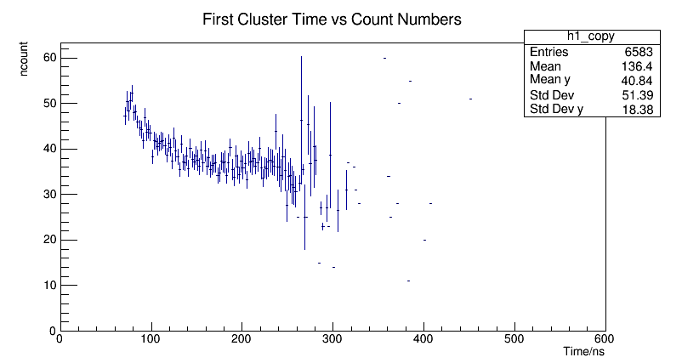
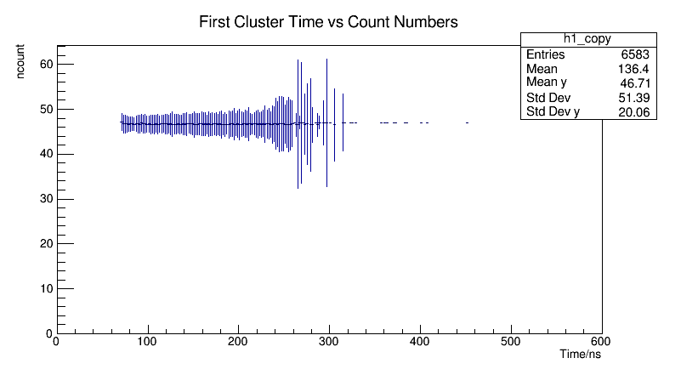
Dependency on $t_{F}$(First Cluster Time) and correction
Run12+13, 60000 events, Sampling rate 1.5G, 0°
Correct ncount to ncount($t_{0}$)

Slide 6
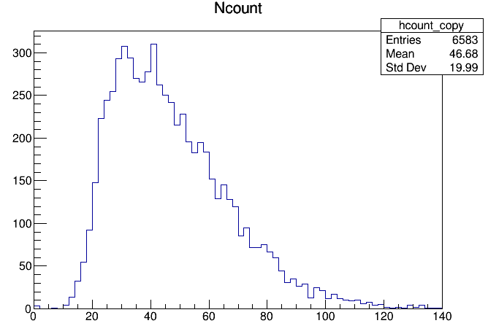
Ncount Comparison ($t_{F}$Correction)
Before correction
18.29/40.81=44.82%
After correction
19.99/46.68=42.82%

Slide 7
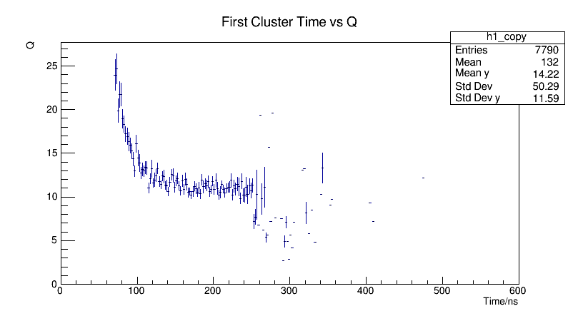
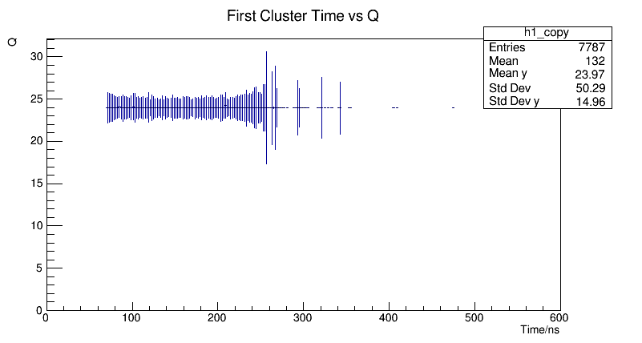
dE/dx Correction Dependency on $t_{F}$
Q’s unit is not converted
45° Run16+17+18
Correct dEdx to dEdx($t_{0}$)

Slide 8
dE/dx Correction 45° Run16+17+18
9.713/13.79=70.44%
12.22/23.06=52.99%

Slide 9
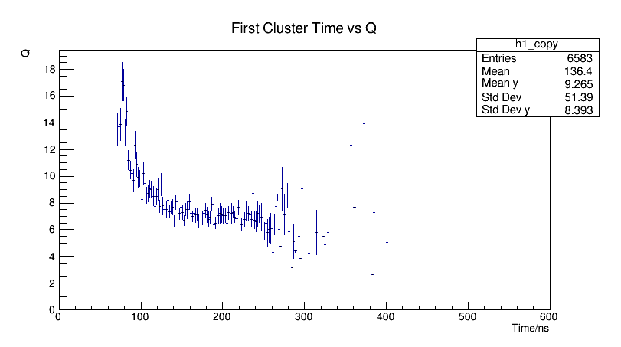
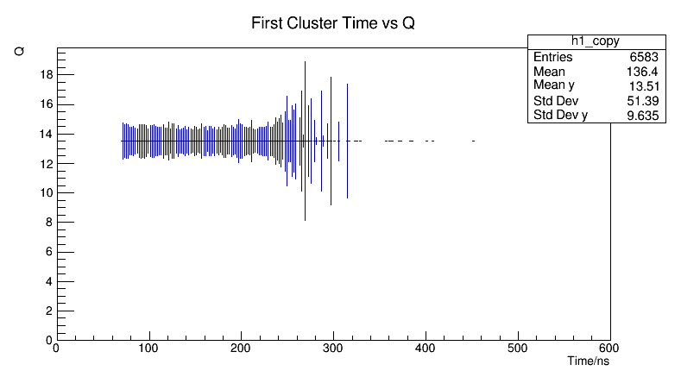
dE/dx Correction Dependency on $t_{F}$
0° Run12+13
Correct dEdx to dEdx($t_{0}$)

Slide 10
dE/dx Correction 0° Run12+13
8.068/9.201=87.69%
9.213/13.41=68.70%

Slide 11
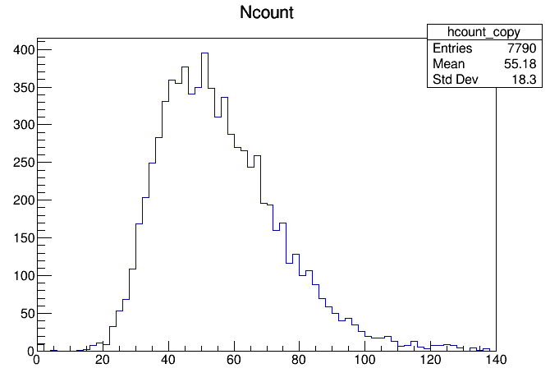
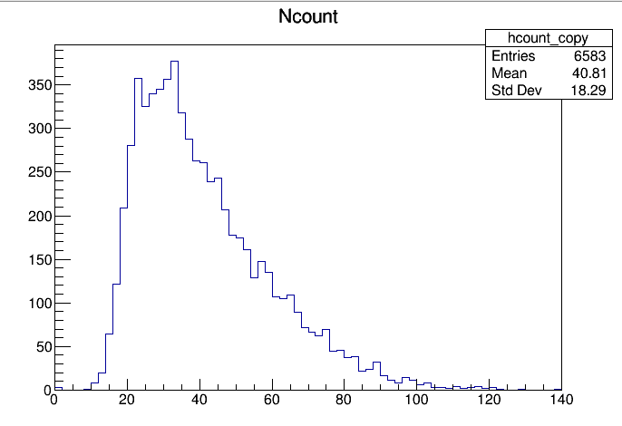
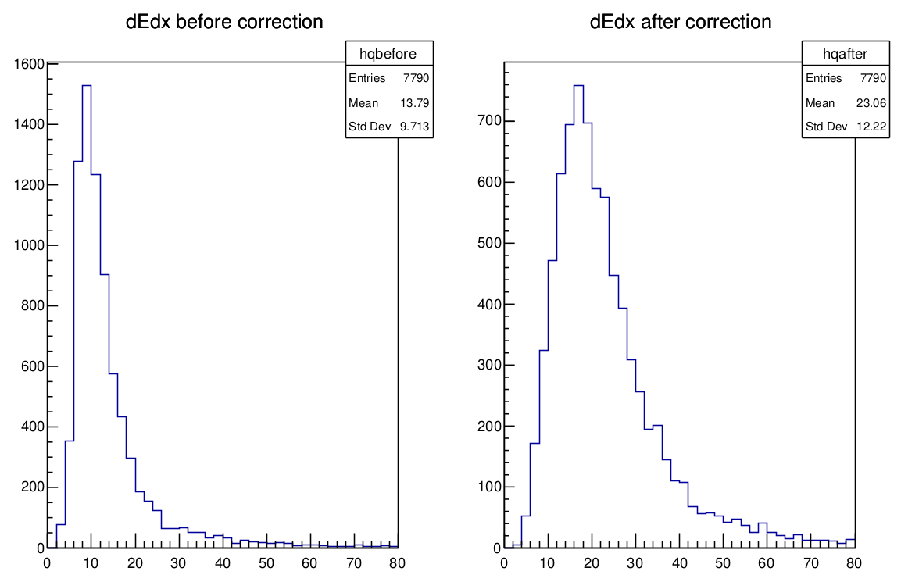
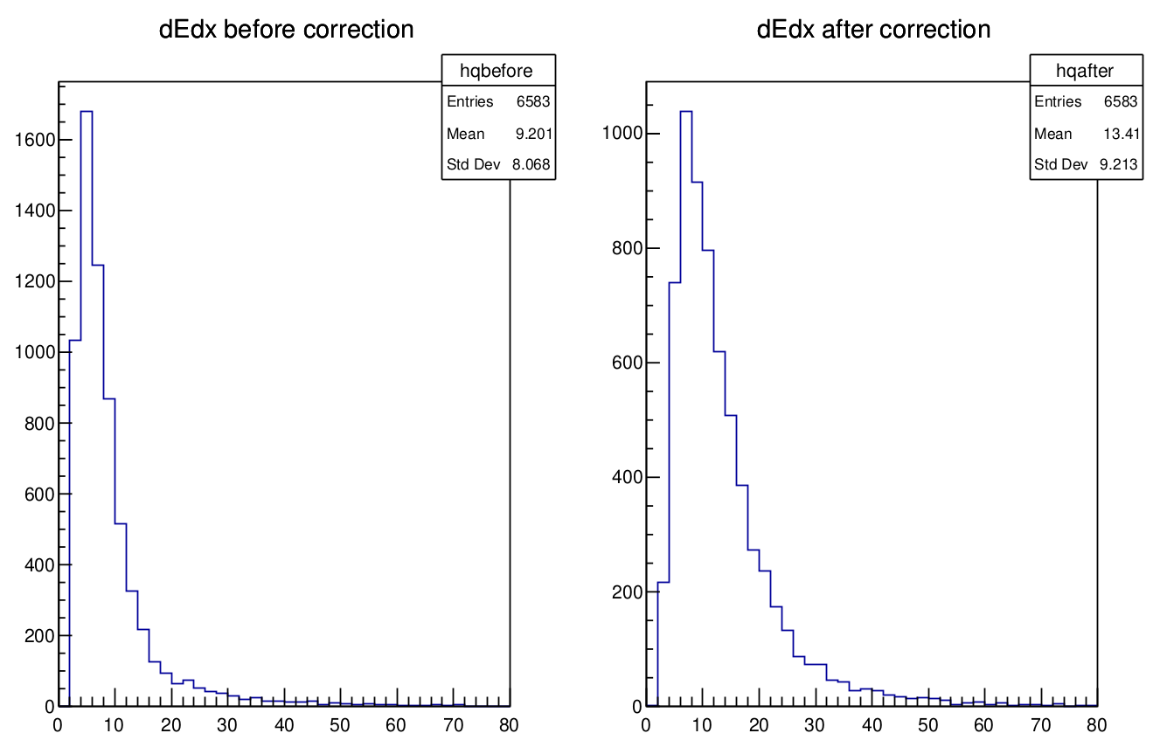
Comparison between dN/dx and dE/dx: Before Correction
Ncount 45°
18.3/55.18=33.16%
Ncount 0°
18.29/40.81=44.82%
dE/dx 45°
dE/dx 0°
8.068/9.201=87.69%
9.713/13.79=70.44%

Slide 12
Comparison between dN/dx and dE/dx: After Correction
Ncount 45°
19.76/63.36=31.19%
Ncount 0°
19.99/46.68=42.82%
dE/dx 0°
9.213/13.41=68.70%
dE/dx 45°
12.22/23.06=52.99%

Slide 13
Summary
Correction on the dependency of $t_{F}$ to dN/dx
Gas 90/10, sampling rate 1.5G, ch5 1cm, 45°/0°
>60000 events, ~7000 signal events in each group
Resolution is improved.
Correction on the dependency of $t_{F}$ to dE/dx
Resolution is improved.
Next
Clustering in dN/dx analysis

Slide 14
Backup

Slide 15
dE/dx & dN/dx 2D Histogram

Slide 16
t0

Slide 17
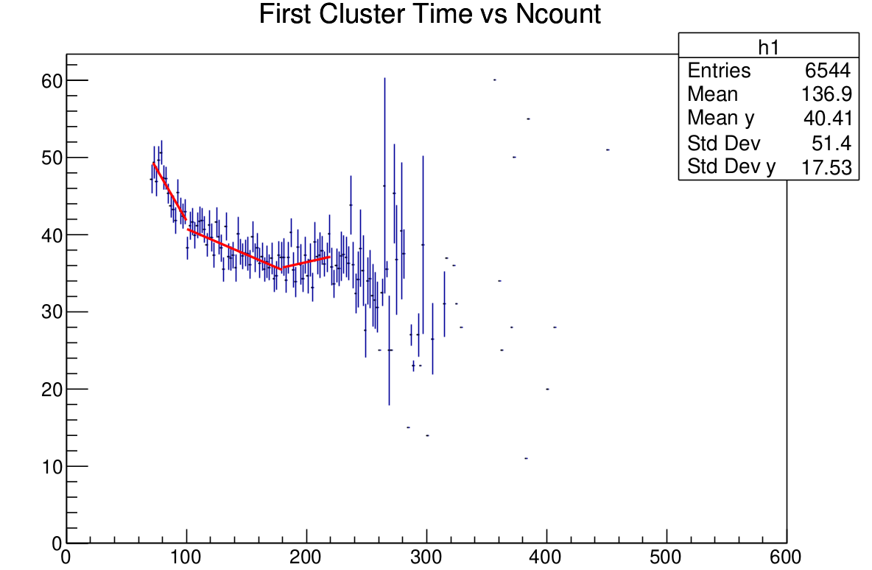
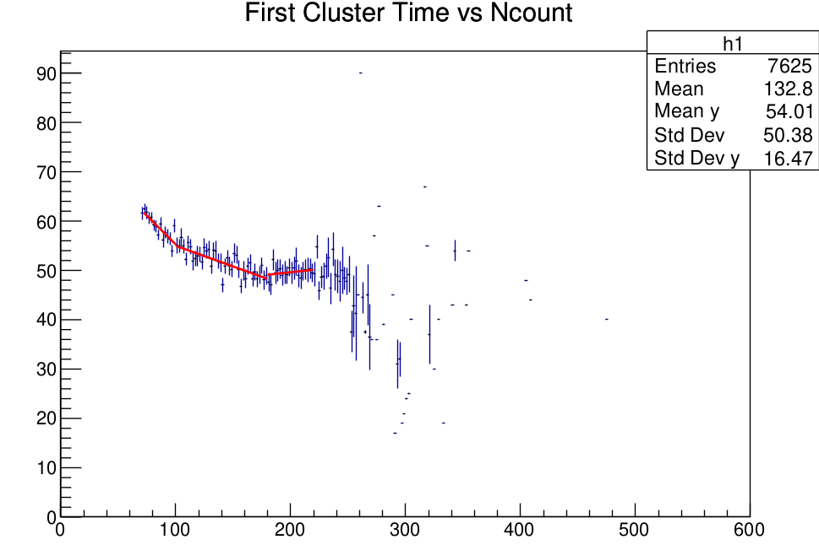
Line Fit
0°
45°

