Slide 1


Neutrino Theory: Seesaw Models & EFTs
Shun Zhou
(IHEP & UCAS, Beijing)
1. Seesaw Models for Neutrino Masses
2. Majorana Nature of Massive Neutrinos
3. Seesaw Effective Field Theories
Shandong University, Jinan, 2023-8-2

Slide 2
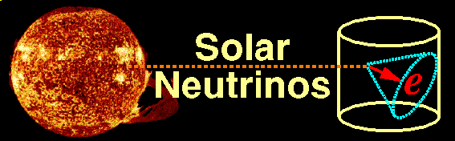
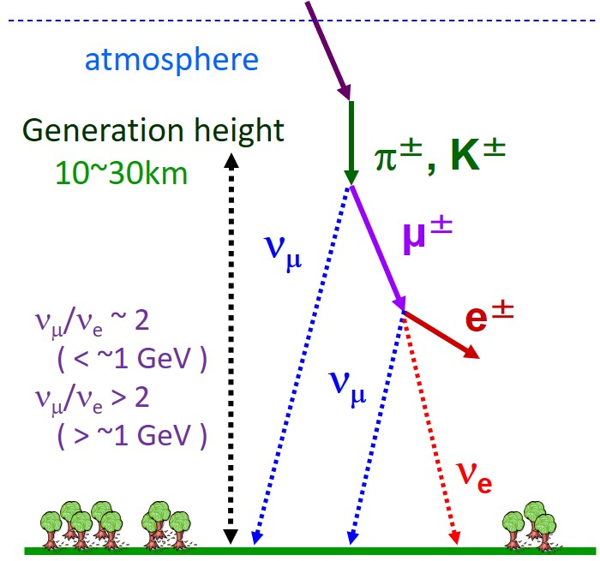
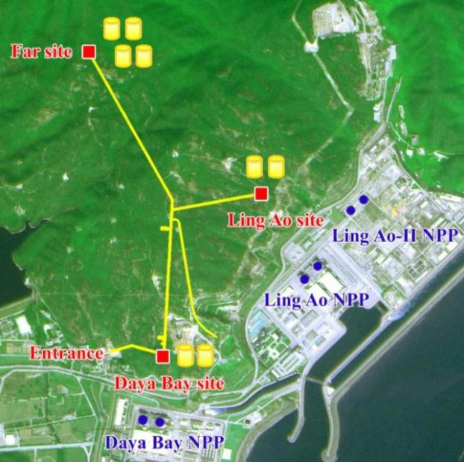
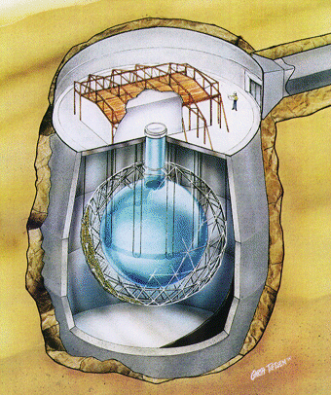
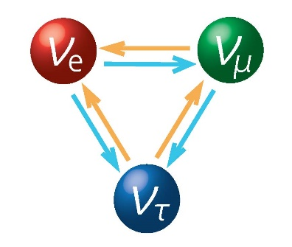
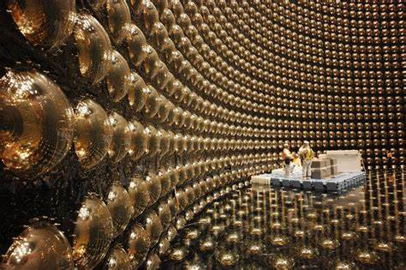

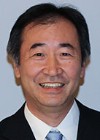
New Physics beyond the SM
Daya Bay
SNO
Neutrinos are massive !!!
Lepton flavor mixing exists
Super-K
Nobel Prize in 2015

Slide 3
Current Status of Neutrino Oscillations
Basic neutrino parameters
Esteban et al., 2007.14792, NuFIT 5.2 (2022)
Future neutrino oscillation experiments will measure the octant of θ₂₃, the CP-violating phase δ, and the neutrino mass ordering (@JUNO)
The most restrictive bound on absolute neutrino masses is coming from cosmological observations: m₁ + m₂ + m₃ < 0.12 eV (Planck)

Slide 4

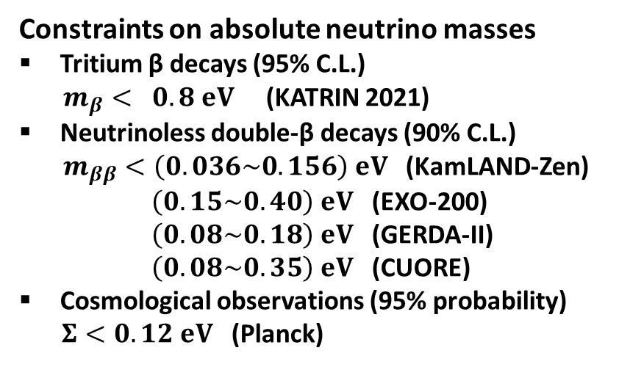


Current Status of Absolute Neutrino Masses
m₁ < m₂ < m₃ (NO) or m₃ < m₁ < m₂ (IO)
$m_{β}={\left(Σ_{i}{\left|U_{ei}\right|}^{2}m_{i}^{2}\right)}^{1/2}$ [eV]
Constraints on absolute neutrino masses
Tritium β decays (95% C.L.)
$m_{β}< 0.8 eV$ (KATRIN 2021)
Neutrinoless double-β decays (90% C.L.)
$m_{ββ}<\left(0.036\sim 0.156\right) eV$ (KamLAND-Zen)
$\left(0.15\sim 0.40\right) eV$ (EXO-200)
$\left(0.08\sim 0.18\right) eV$ (GERDA-II)
$\left(0.08\sim 0.35\right) eV$ (CUORE)
Cosmological observations (95% probability)
$Σ<0.12 eV$ (Planck)
Tritium β decays (KATRIN)
IO
Cosmological Bound
NO
Capozzi et al., 2003.08511
$m_{ββ}=\left|{Σ_{i}U}_{ei}^{2}m_{i}\right|$[eV]
Abazajian et al., 1907.04473
Neutrinoless double-β decays
IO
Cosmological Bound
NO
$Σ=m_{1}+m_{2}+m_{3}$ [eV]

Slide 5





Dirac vs. Majorana Neutrinos
★ A minimal extension of the SM with three right-handed neutrinos
Dirac Neutrinos
Majorana Neutrinos
Generate Dirac ν masses in a similar way to that for quarks and charged leptons, after the spontaneous gauge symmetry breaking
Generate tiny Majorana ν masses via the so-called seesaw mechanism
$$≈174 GeV$$
$$O(0.1 eV)$$
$$O({10}^{−12})$$
$$O(0.1 eV)$$
$$O({10}^{14} GeV)$$
Need to introduce additional symmetries to the SM to forbid a Majorana mass for right-handed neutrino singlets
Need to explain a strong hierarchy for the Yukawa couplings of the SM fermions
Retain the SM symmetries
GUT or TeV energy scale?
The Majorana nature of massive neutrinos

Slide 6
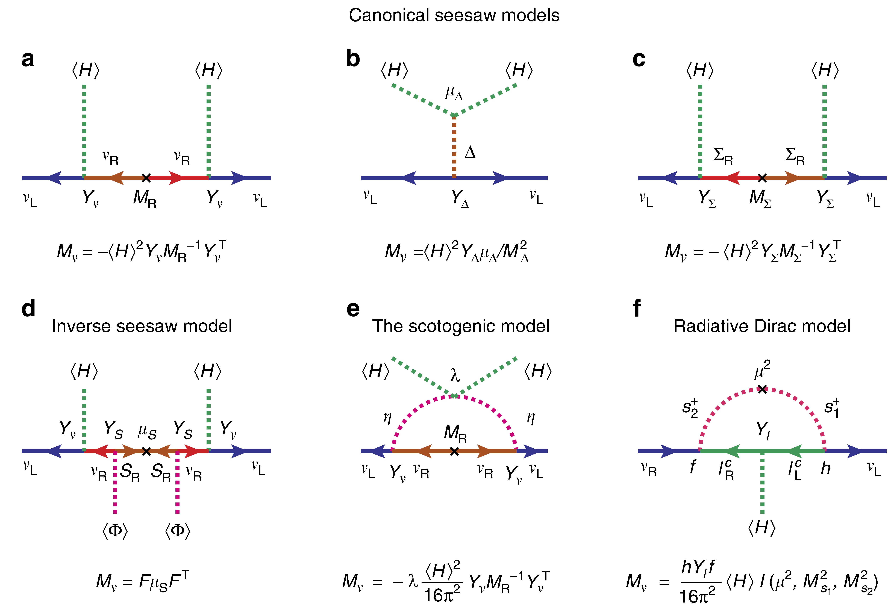
New Physics for Tiny Neutrino Masses
Ohlsson, S.Z., 14
Minkowski 77
Magg, Wetterich,…, 80
Foot, Lew, He, Joshi, 89
Mohapatra, Valle, 87
E. Ma, 06
Kanemura et al, 11
Zee, 80, 86; Babu, 88

Slide 7















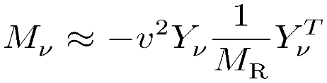
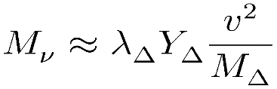

Seesaw Models for Neutrino Masses
Seesaw mechanism: a natural way to understand tiny neutrino masses
Type-I: SM + 3 right-handed Majorana ν’s (Minkowski 77; Yanagida 79; Glashow 79; Gell-Mann, Ramond, Slansky 79; Mohapatra, Senjanovic 79)
Type-II: SM + 1 Higgs triplet (Magg, Wetterich 80; Schechter, Valle 80; Lazarides et al 80; Mohapatra, Senjanovic 80; Gelmini, Roncadelli 80; Cheng, Li, 80)
Type-III: SM + 3 triplet fermions (Foot, Lew, He, Joshi 89)
Can naturally be embedded into the Grand Unified Theories, e.g., SO(10) GUT
Responsible for both tiny neutrino masses and matter-antimatter asymmetry

Slide 8
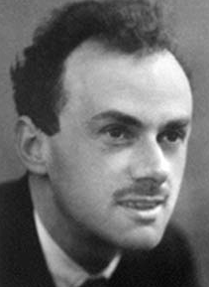
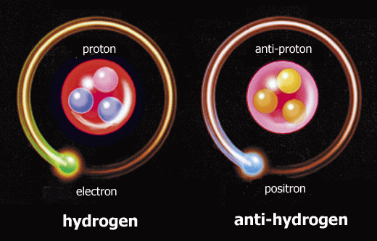
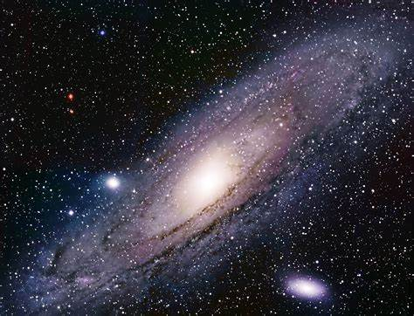
Matter-antimatter Asymmetry
Dirac (1933): a symmetric Universe with matter
and antimatter [Nobel Lecture]
galaxy
anti-galaxy？
Pauli (1933): letter to Heisenberg
I do not believe in the hole theory, since I would like to have the asymmetry between positive and negative electricity in the laws of nature (it does not satisfy me to shift the empirically established asymmetry to one of the initial state). [Quinn & Nir, The mystery of the missing antimatter, 2008]

Slide 9

Observational Evidence
Matter-antimatter asymmetry: Astronomical observations
galaxy
Cohen, Rujula & Glashow, 98
d = 20 Mpc
d = 10³ Mpc
Bounds on the distance d between matter and antimatter regions: >1 Gpc ~ visible universe
anti-galaxy

Slide 10
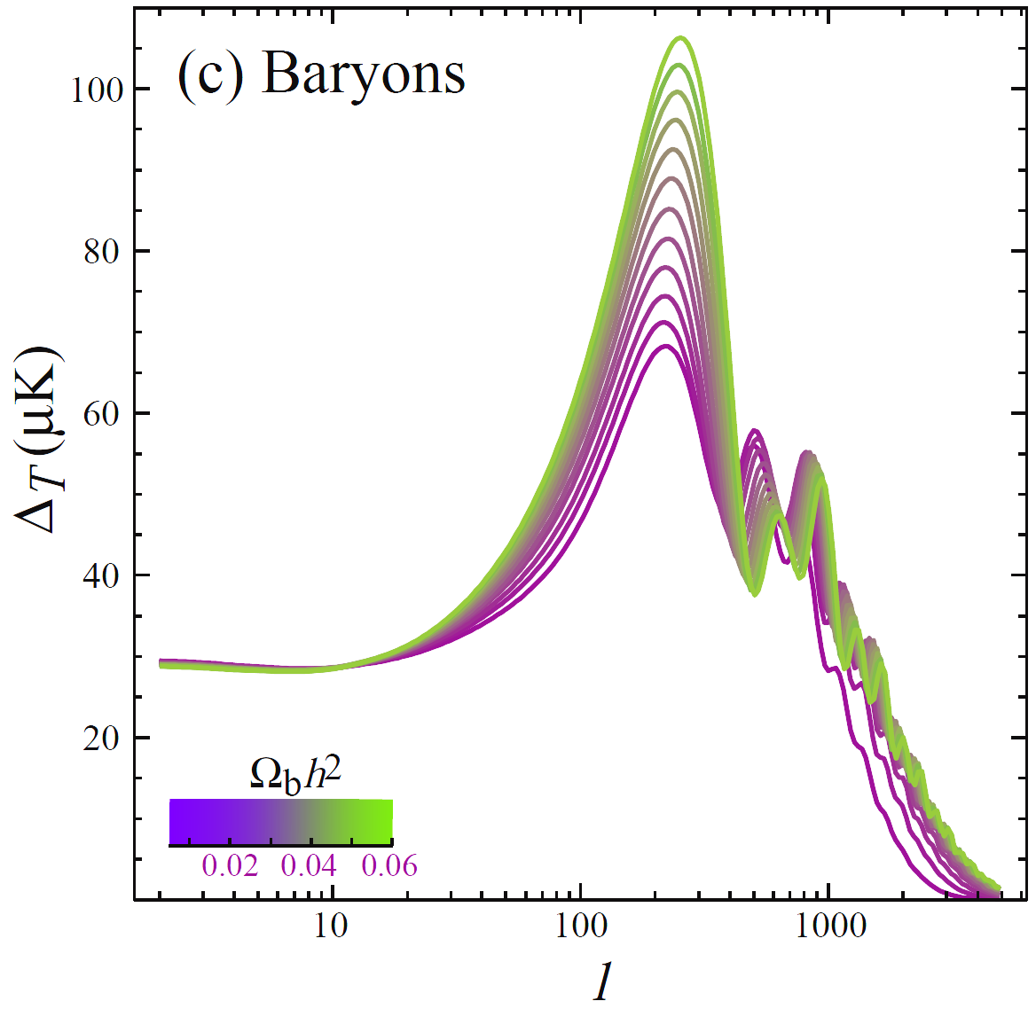

Observational Evidence
Matter-antimatter asymmetry: Cosmological observations
Baryon Asymmetry of Universe
(BAU)
baryon-to-photon ratio
$$η_{\text{B}}≡\frac{n_{\text{b}}−n_{\overline{\text{b}}}}{n_{γ}}=(6.065±0.090)×{10}^{−10}$$
Hu, Dodelson, astro-ph/0110401
Big Bang Nucleosynthesis & CMB

Slide 11
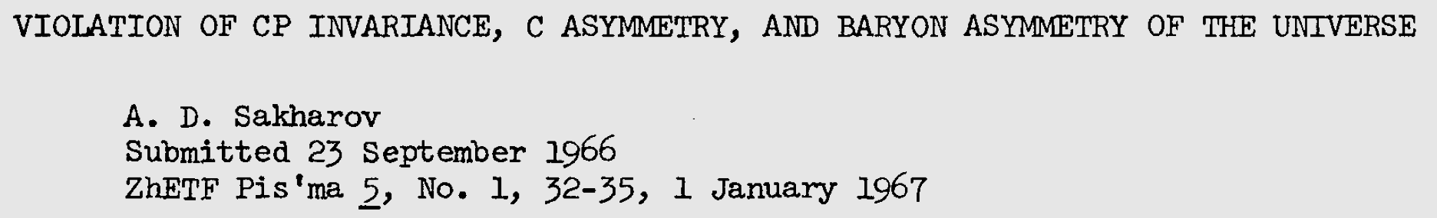
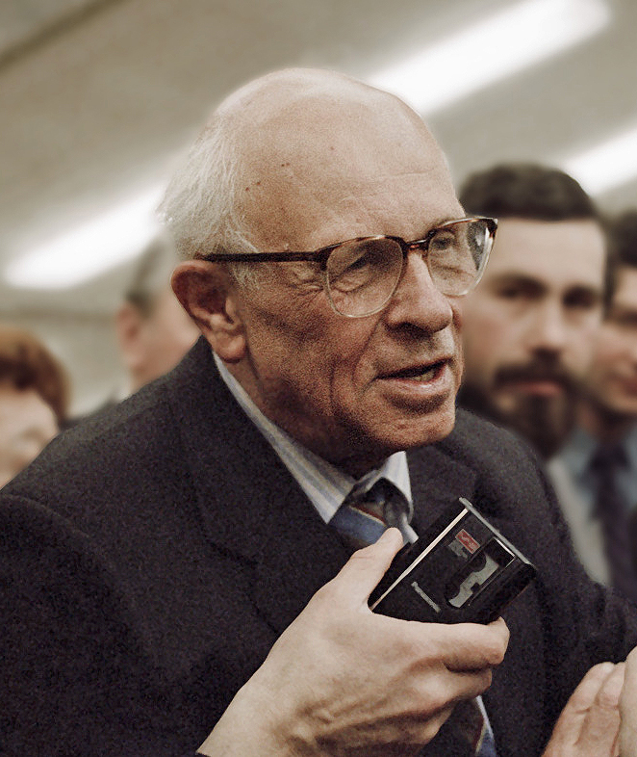
Dynamical Solutions
Pauli (1933): letter to Heisenberg
I do not believe in the hole theory, since I would like to have the asymmetry between positive and negative electricity in the laws of nature (it does not satisfy me to shift the empirically established asymmetry to one of the initial state). [Quinn & Nir, The mystery of the missing antimatter, 2008]
Quest for dynamical solutions to matter-antimatter asymmetry
Sakharov Conditions:
Baryon number (B) violation
Breaking of CP and C symmetries
Out of thermal equilibrium
Dolgov, Phys. Rept., 1992
Boedeker & Buchmueller, Rev. Mod. Phys., 2021

Slide 12
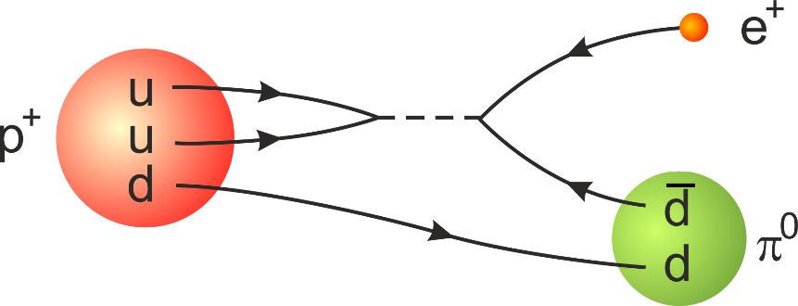
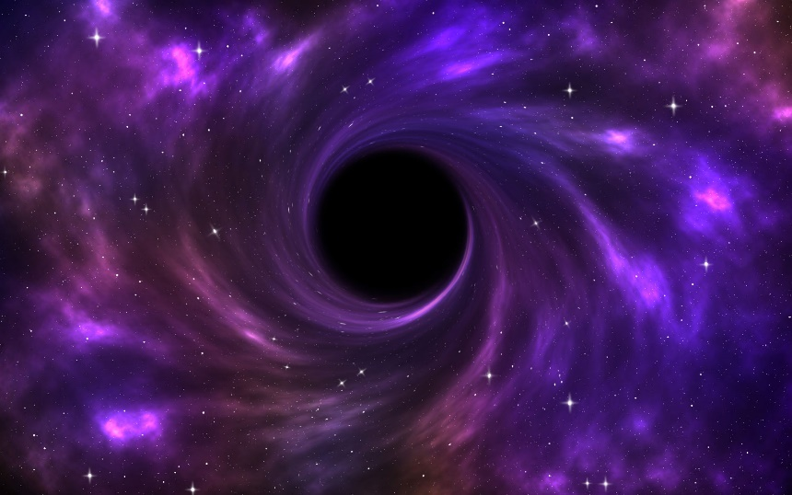
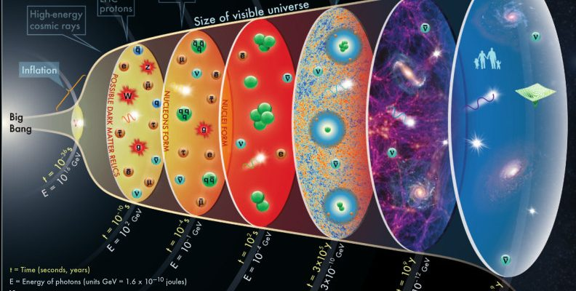
Baryon Number Violation
Grand unified theories: predictions for baryon number violation (BNV)
BNV and lepton number violation (LNV)
C and CP violation as in weak interactions
Out-of-equilibrium in expanding universe
Any global quantum number
violated in black-hole physics?
Planck/GUT Baryogenesis: dead?
BNV processes in thermal equilibrium will erase all existing BAU
Diluting magnetic monopoles but also BAU
Kuzmin, Rubakov & Shaposhnikov, 85

Slide 13
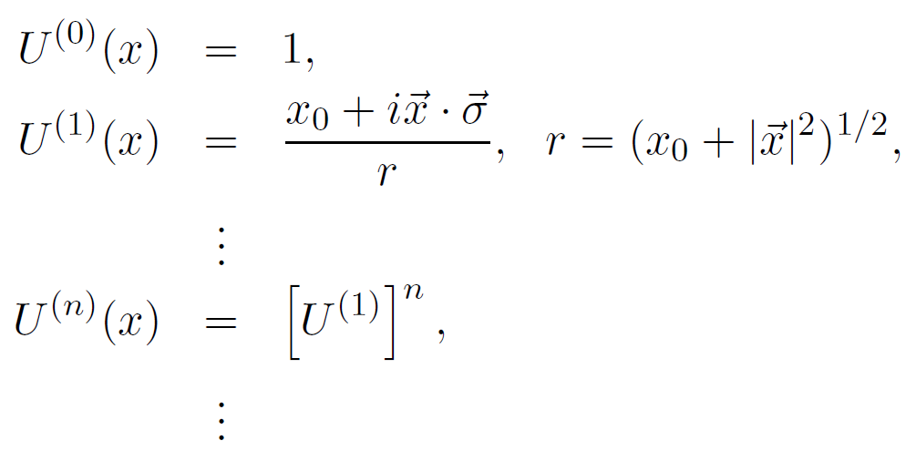
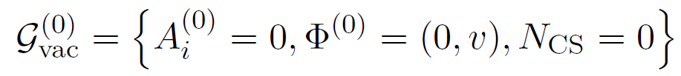
Electroweak Sphaleron
Accidental Symmetries in the SM: Baryon number & Lepton number
Violated at the quantum level due to the axial anomaly
‘t Hooft, 76
Nontrivial topology of the SM vacuum [SU(2) gauge theory]
Infinitely degenerate vacua characterized by the Chern-Simons (CS) number
Rebbi, Jackiw, 76
Manton, 83
Klinkhamer, Manton, 84

Slide 14
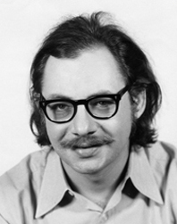
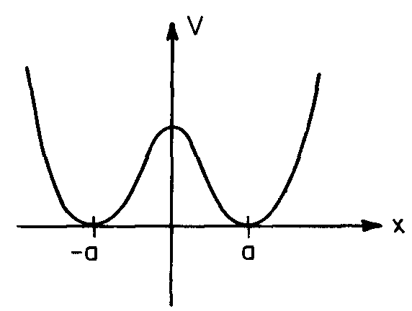
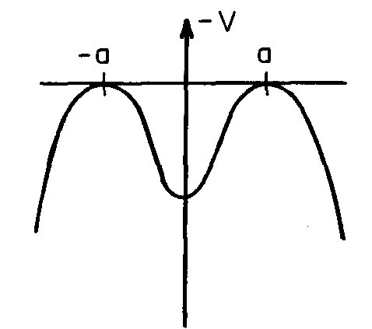
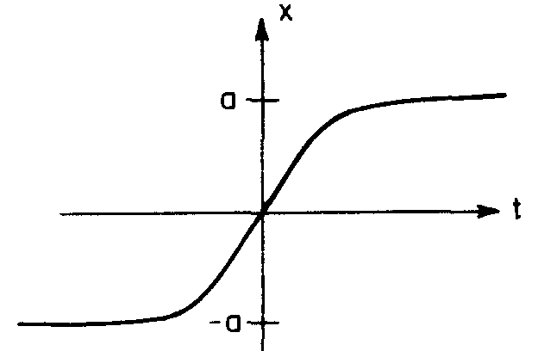
Electroweak Sphaleron
A saddle point solution in the SM: interpolating different vacua
Klinkhamer, Manton, 84
The uses of instantons
Coleman, 77
Finite actions are useful for semi-classical calculation of transition rates between different vacua
Without sphalerons, the transition rate (at zero temperature) is determined by the instanton action:
Hamada, Kikuchi, 20
transition rate
dynamics
solution to the EoM

Slide 15
Electroweak Sphaleron
With sphalerons, the transition rate (at the temperature T) is determined by the sphaleron energy and many other factors [nonperturbative issues]
Sphaleron rate：
Rate in the broken phase
Rate in the symmetric phase
Decoupling temperature:
D’Onofrio, Rummukainen, Tranberg, 14

Slide 16


Baryogenesis via Leptogenesis
Seesaw mechanism: a natural way to understand neutrino masses
Type-I: SM + 3 right-handed Majorana ν’s (Minkowski 77; Yanagida 79; Glashow 79; Gell-Mann, Ramond, Slanski 79; Mohapatra, Senjanovic 79)
Type-II: SM + 1 Higgs triplet (Magg, Wetterich 80; Schechter, Valle 80; Lazarides et al 80; Mohapatra, Senjanovic 80; Gelmini, Roncadelli 80)
Type-III: SM + 3 triplet fermions (Foot, Lew, He, Joshi 89)
Attractive picture: heavy Majorana neutrinos in the early Universe could successfully generate the BAU
Fukugita & Yanagida (1986)

Slide 17
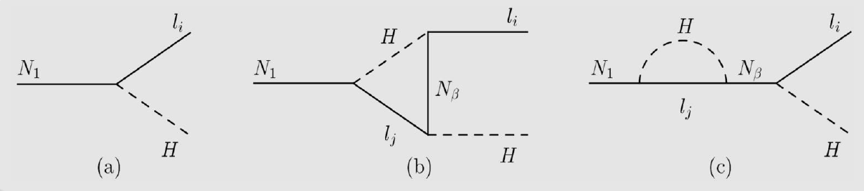
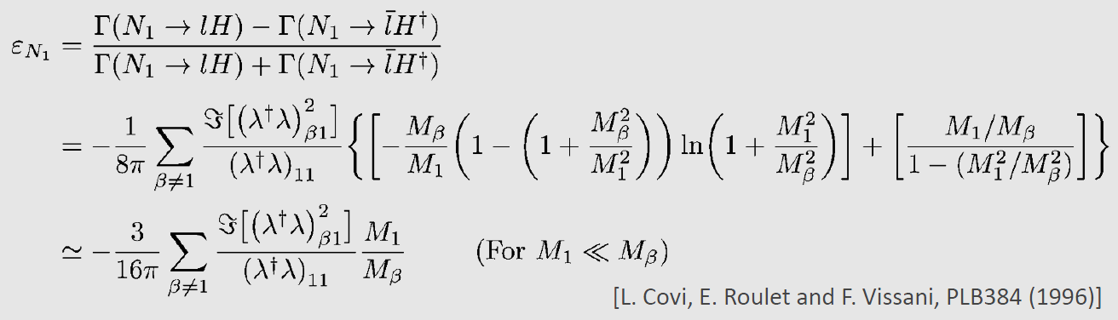
Baryogenesis via Leptogenesis
Basic ideas: (1) Sphaleron-BNV (in thermal equilibrium 10² GeV – 10¹² GeV)
(2) Yukawa couplings for extra CPV; (3) expanding Universe
Seesaw
Leptogenesis
Neutrino masses
Right-handed neutrinos
BAU

Slide 18
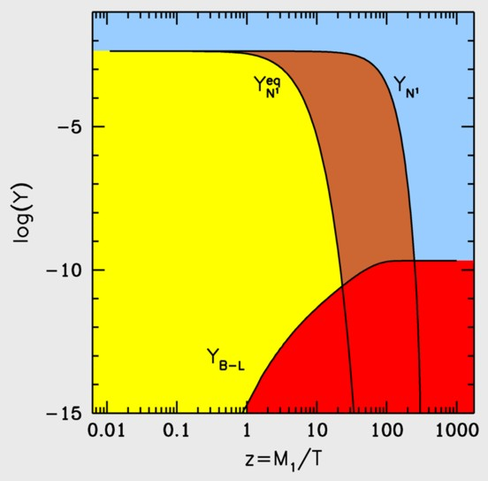
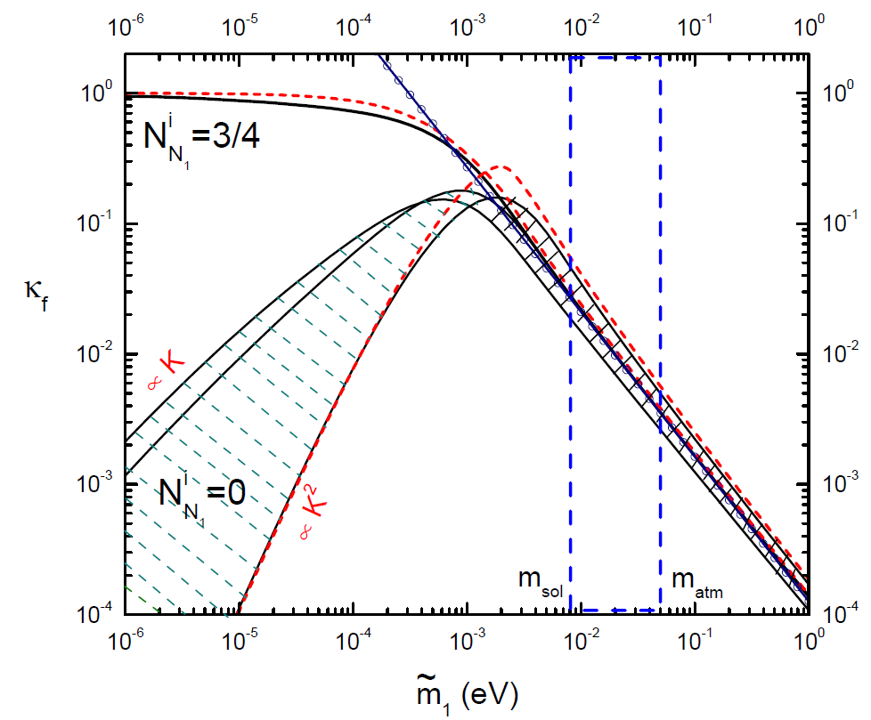

Baryogenesis via Leptogenesis
Solving the Boltzmann equations
$$η_{\text{B}}≈−0.96×{10}^{−2}κ_{f}ε_{1}$$
Buchmueller et al., 2004
Equilibrium
abundance of
heavy Majorana
neutrinos
Real abundance
determined by decay rate
Created
lepton-number
abundance
Strong washout region: compatible with observed neutrino masses & independent of initial abundances
Resonant leptogenesis: enhanced CPV
Asymmetry of individual lepton flavor
Non-equilibrium thermal field theories

Slide 19
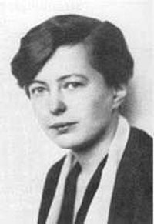
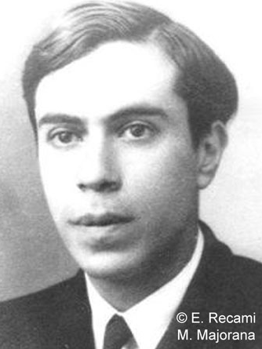
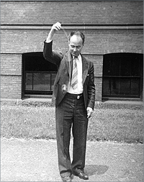


Searches for 0ν2β Decays
Ettore Majorana
(ν=ν^{C}? 1937)
Wendell Furry
(1907 – 1984)
Importance of 0ν2β Decays
$${}_{Z}^{A}N→{}_{Z+2}^{A}N+2e^{−}$$
★ Lepton number violation: clue to origin of neutrino masses
★ New features of elementary particles: Majorana fermions
★ Constrain ν masses and mixing parameters: Majorana CP phases?
Schechter-Valle Theorem (82): If the 0ν2β decay occurs, there must exist an effective Majorana ν mass term.
$$δm_{ν}≲O({10}^{−28} eV)$$
Duerr, Lindner, Merle, JHEP, 2011;
Liu, Zhang, S.Z., PLB, 2016

Slide 20

Effective Neutrino Mass for 0ν2β Decays
$${}_{}^{136}{Xe}→{}_{}^{136}{Ba}+e^{−}+e^{−}$$
Gomez-Cadenas et al., 1109.5155
Light ν mediated 0ν2β
The 0νββ-decay half-life
Experimentalists: fix the half-life
Nuclear theorists: calculate NME
Particle theorists: effective mass
ν masses & Majorana CP phases
Phase space
Nuclear Matrix Element
Effective ν mass

Slide 21
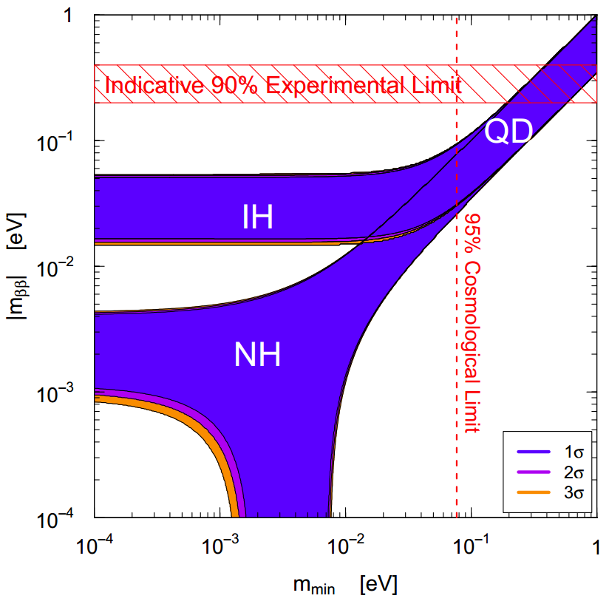


Effective Neutrino Mass for 0ν2β Decays
Jun Cao et al., 1908.08355
IO
$1$0 meV
NO
$1$ meV
Effective ν mass
We assume Majorana neutrinos with NO, and observe no signal events
If this is true even for future 1 meV sensitivity, then what can we learn?

Slide 22
Lightest Neutrino Mass
Xing, Zhao, Y.L. Zhou, 1504.05820; Ge, Lindner, 1608.01618;Xing, Zhao, 17; Penedo, Petcov, 18; Ge, Zhu, 20
1 meV frontier of 0ν2β decays
Jun Cao et al., 1908.08355

Slide 23




Sensitivity Studies
Motivation for two setups
J. Zhao, L.J. Wen, Y.F. Wang, J. Cao, 1610.07143
Setup I: JUNO Xe-LS
$@3σ$ C.L.
Setup II: Ideal scenario
$$=$$
$$=$$
$@3σ$ C.L.

Slide 24
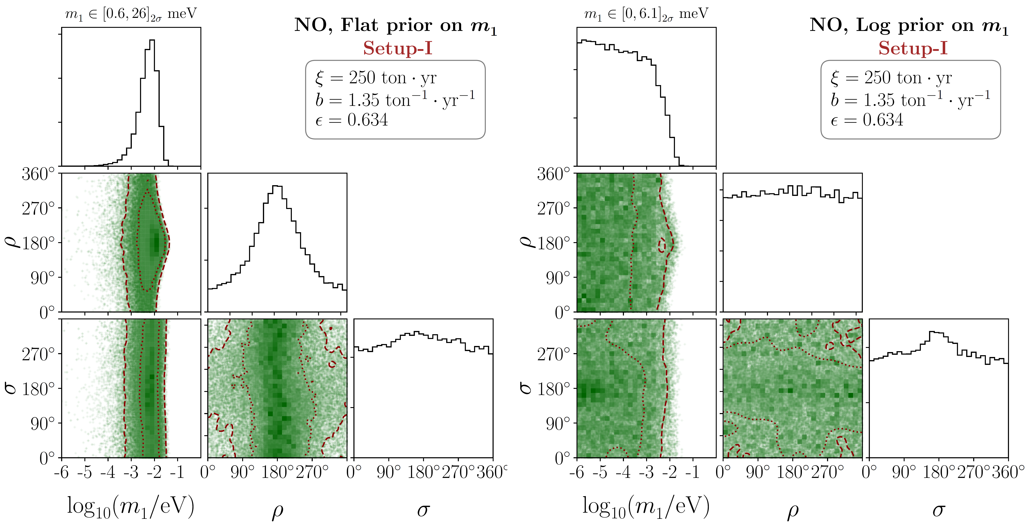
Sensitivity Studies
Final Results for Setup-I
Huang, S.Z., 2010.16281

Slide 25
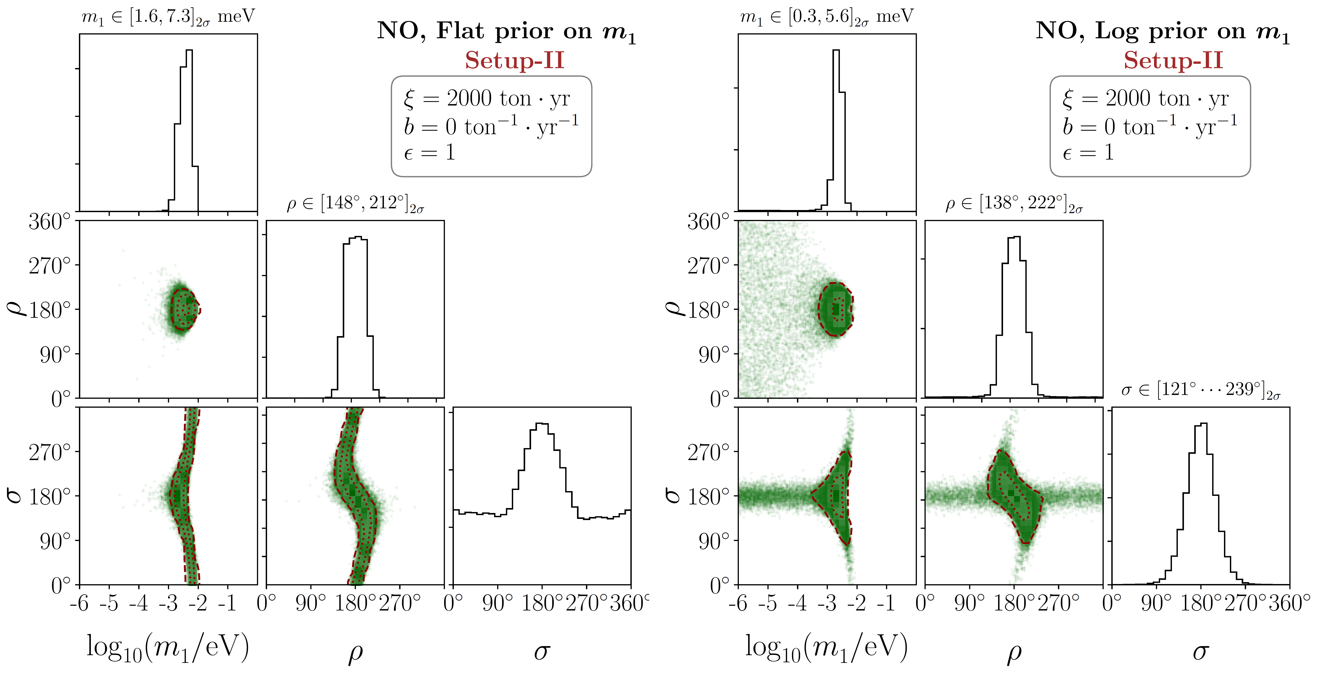
Sensitivity Studies
Final Results for Setup-II
Huang, S.Z., 2010.16281

Slide 26
Sensitivity to Neutrino Masses
The 1 meV sensitivity challenging but quite beneficial (even with null sig.)
The sensitivity to neutrino masses precedes that of future cosmo. probes

Slide 27
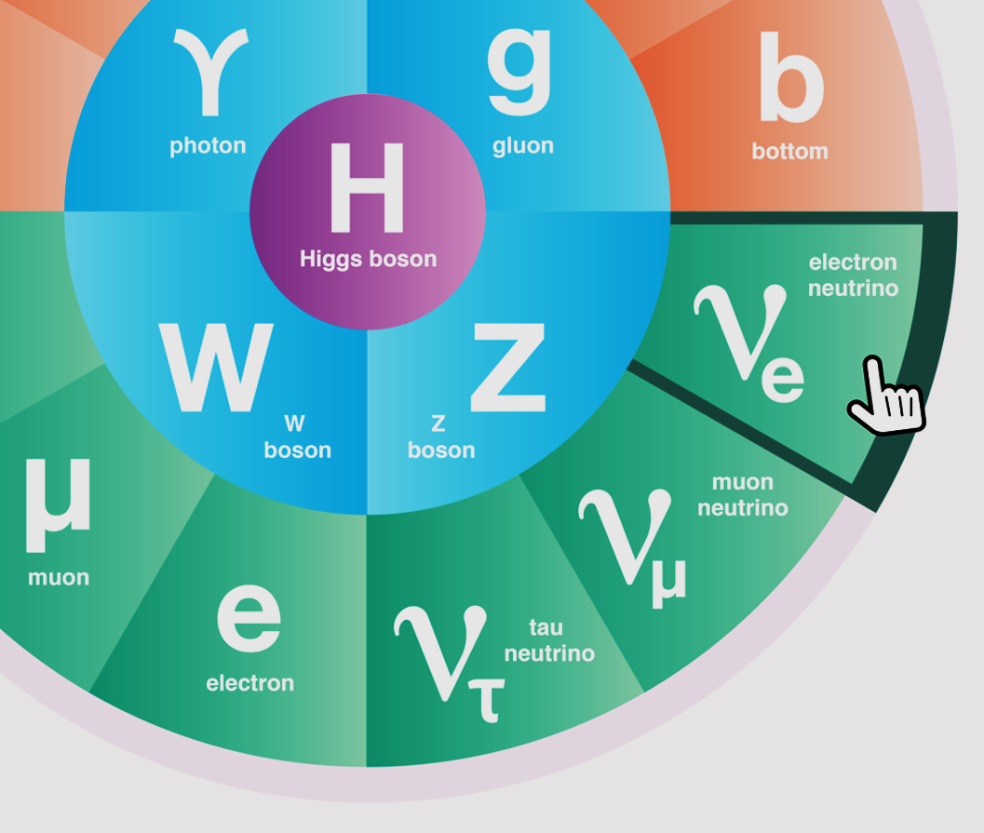
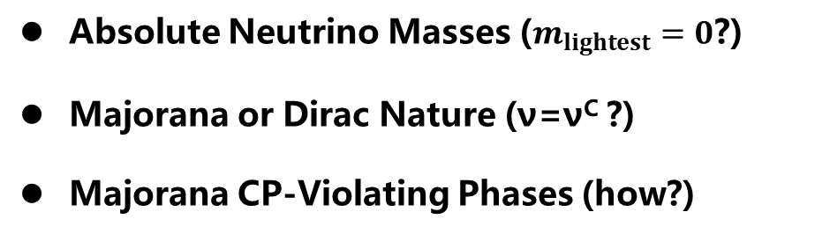
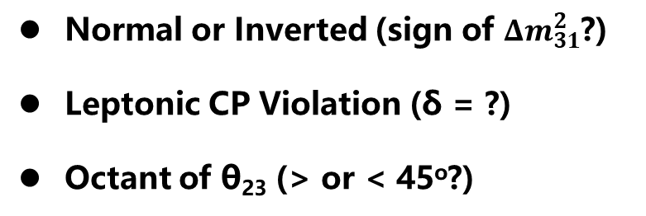
Roadmap for Neutrino Physics
Normal or Inverted (sign of ${Δm}_{31}^{2}$?)
Leptonic CP Violation (δ = ?)
Octant of θ₂₃ (> or < 45º?)
Absolute Neutrino Masses ($m_{lightest}=0$?)
Majorana or Dirac Nature (ν=ν^{C} ?)
Majorana CP-Violating Phases (how?)
ν Roadmap: mass ordering + 0ν2β (Majorana) + LNV/LFV+Colliders+SMPT
Extra Neutrino Species
Exotic Neutrino Interactions
Various LNV & LFV Processes
Leptonic Unitarity Violation
Origin of Neutrino Masses
Flavor Structure (Symmetry?)
Quark-Lepton Connection
Relations to DM and/or BAU

Slide 28
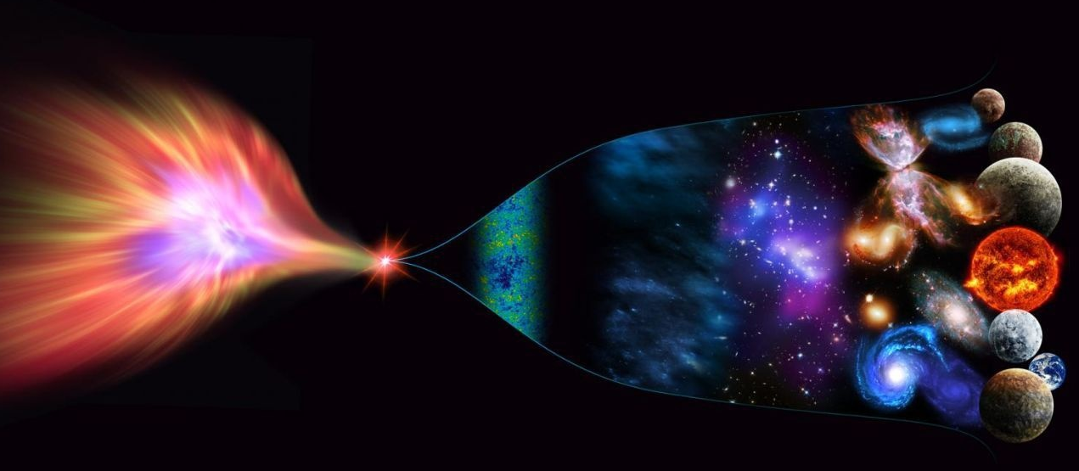
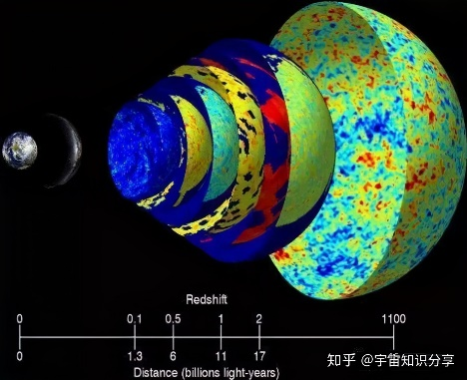

The Energy Scale of New Physics
New Physics
Cosmic Frontier：Matter-antimatter asymmetry/CMB/LSS
10¹⁹ GeV
Planck scale
10¹⁶ GeV
GUT scale
High-intensity Frontier：
Construct low-energy effective field theories (EFTs)，do precision calculations, compare with experimental data
Seesaw scale？
High-energy Frontier: Direct searches at colliders
10³ GeV
TeV
EW
10² GeV
ν oscillations → ν masses → NP
Cai, Han, Li, Ruiz, Front. in Phys. 6 (2018) 40

Slide 29
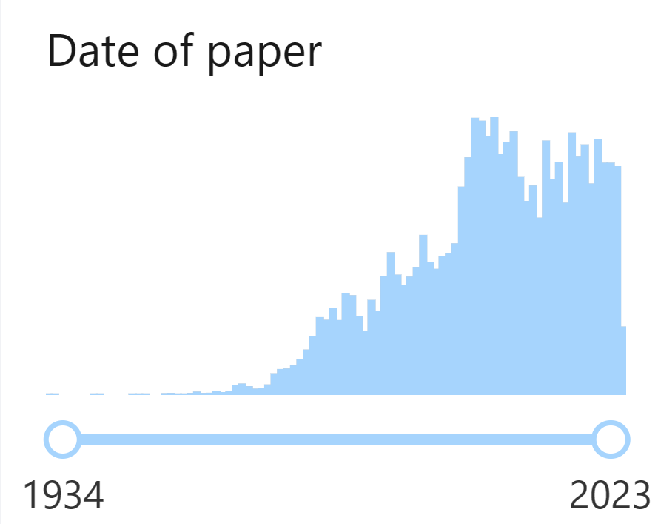
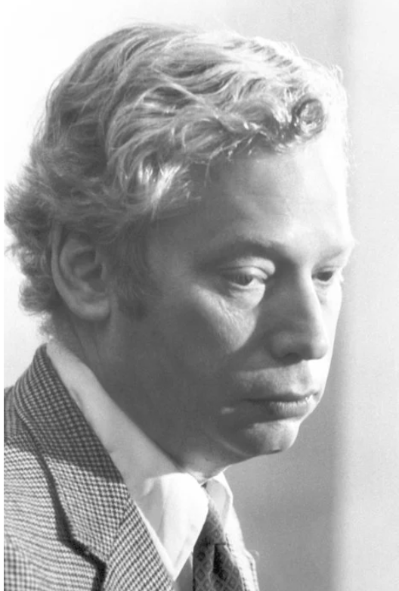
Neutrino Effective Field Theories
1243 papers in 2003
1998-2008: discovery of neutrino oscillations
Weinberg, 79
INSPIRE-HEP
find t neutrino
Unique dim-5 Weinberg operator
for Majorana neutrino masses
Integrate out heavy Majorana neutrinos
Derive RGE for the Wilson coefficient of the Weinberg operator
Antusch et al., 2001; Xing, Phys. Rept, 2020

Slide 30
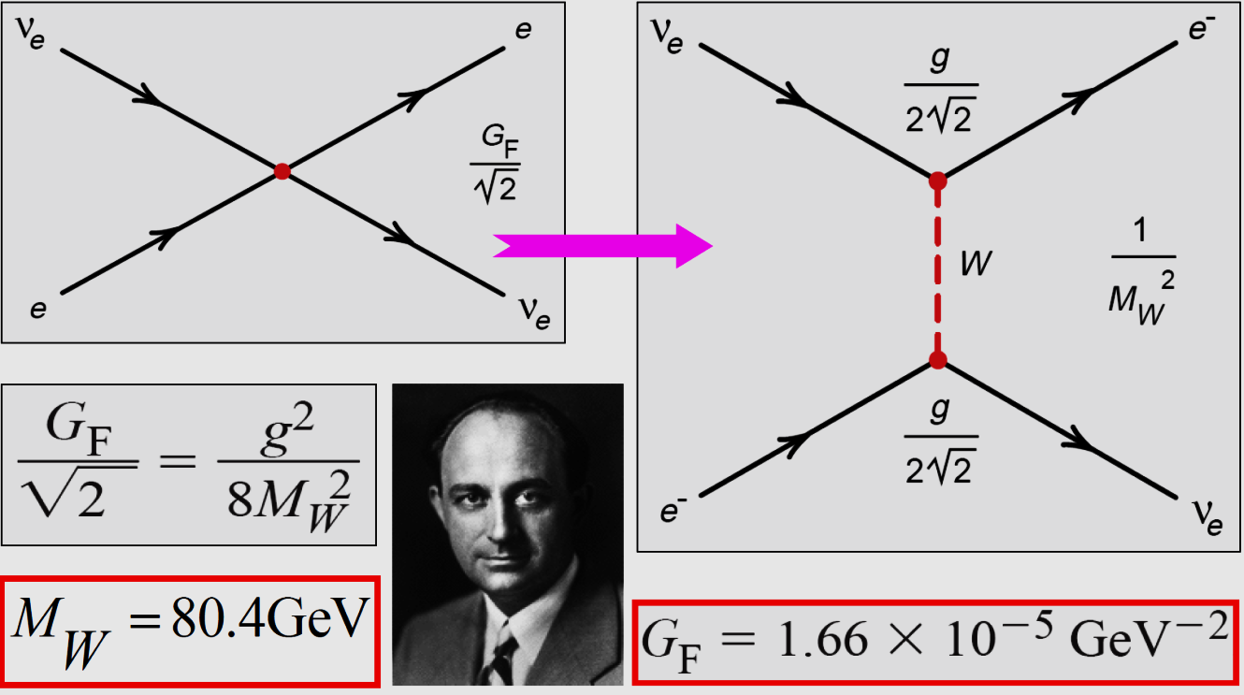

Why EFTs?
Bottom-up approach to new physics
Top-down approach to precision tests of UV-complete models
$$1.166$$

Slide 31
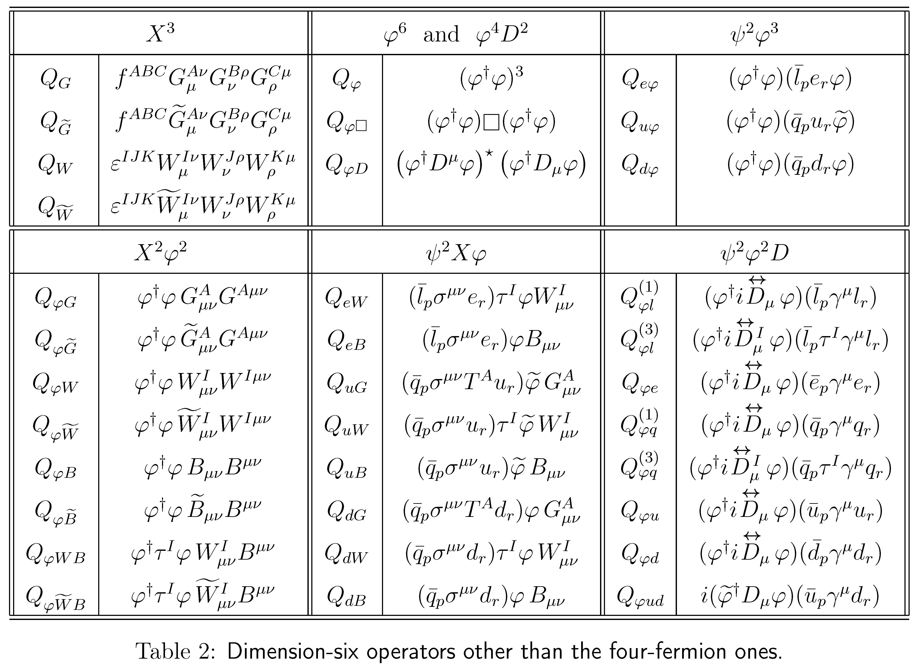
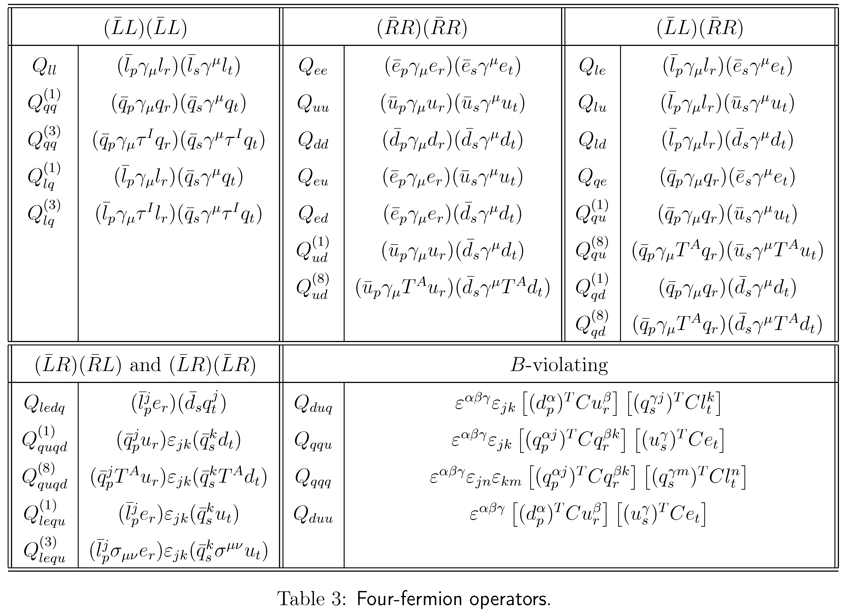
SM Effective Field Theory
Buchmüller & Wyler, 86
Dim-6 operators in the Warsaw basis
Brivio & Trott, Phys. Rept. 793 (2019) 1
Grzadkowski, Iskrzynski, Misiak, Rosiek, 1008.4884
Too many free parameters?

Slide 32
Seesaw Effective Field Theory
The type-I seesaw model as a UV-complete theory
Tree-level matching: simply applying the EOM
Expansion up to M⁻² (dim-6 operators)
Seesaw Effective Field Theory (SEFT) @ tree level
Neutrino masses &
flavor mixing
Unitarity violation of
flavor mixing matrix

Slide 33

Low-energy Tests of Type-I Seesaw Model
After the spontaneous gauge symmetry breaking
Normalization:
Diagonalization:
$$U=V^{†}U_{0}$$
The SEFT Lagrangian in the mass basis:
Non-unitary flavor mixing
Minimal unitarity violation (MUV) “equivalent” to SEFT @ tree level
Non-unitarity
Antusch et al., hep-ph/0607020; Antusch & Fischer, 1407.6607

Slide 34
Low-energy Tests of Type-I Seesaw Model
LFV decays of charged leptons in the MUV scheme
The decay width
Xing & Zhang, 2009.09717
However, the calculation in the full theory for M_{i} >> M_{W} gives
Question: What goes wrong with tree-level SEFT? EFT must give the same result as UV theory for low-energy observables

Slide 35
Seesaw Effective Field Theory @ one-loop
Answer: Radiative decays at one-loop require one-loop matching!
Another two relevant dim-6 operators @ one loop
Zhang & S.Z., 2102.04954
leading to the direct EM-dipole vertex
exactly reproducing the result in the full theory (with M_{i} >> M_{W})

Slide 36
Seesaw Effective Field Theory @ one-loop
Choose relevant Feynman diagrams
Zhang & S.Z., 2102.04954
Calculate the amplitudes in the UV theory (hard-momentum)/expansion by regions
Beneke, Smirnov, 98; Smirnov, 02; Jantzen, 11

Slide 37
Seesaw Effective Field Theory @ one-loop
Calculate the amplitudes in the EFT (Green basis)
Matching betwen the amplitudes
Compute more diagrams and match to derive the Wilson coefficients of relevant operators in the Green basis

Slide 38
Seesaw Effective Field Theory @ one-loop
Apply the EoMs to convert into the Warsaw basis
Derive the final WCs for the dipole operators
At one-loop level, two additional operators contribute
One-loop matching necessary for precision tests at the low-energy scale

Slide 39
Seesaw Effective Field Theory @ one-loop
Matching between UV theory and EFT
Cohen, Lu & Zhang, 2011.02484
Functional method for one-loop matching
Covariant Derivative Expansion (CDE)
Expansion by Regions (hard and soft loop momentum)
Gaillard, 86; Chan, 86; Cheyette, 88
Beneke & Smirnov, 98; Smirnov, 02

Slide 40
Seesaw Effective Field Theory @ one-loop
Matching the UV theory with EFT
Zhang & S.Z., 2107.12133
Expansion by Regions
Fuentes-Martin et al., 2212.04510
Fuentes-Martin et al., 2012.08506

Slide 41
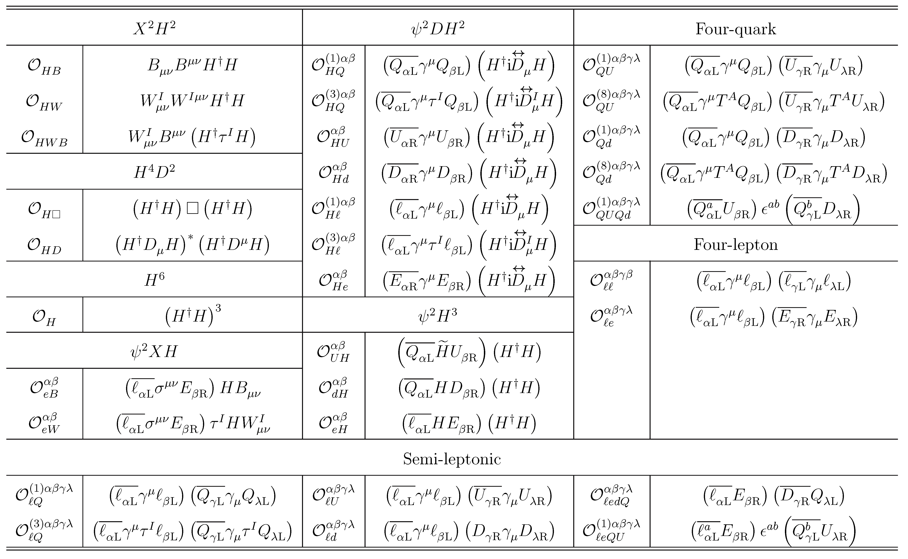
Seesaw Effective Field Theory @ one-loop
Zhang & S.Z., 2107.12133
Out of 59 operators in the Warsaw basis, 31 dim-6 operators in type-I SEFT

Slide 42
RGEs for SEFT
Physical Parameters in SEFT： (12 + 9 from C₆=21)
Yu & S.Z., 2203.10121
3 charged-lepton masses + 3 ν masses+ 15 non-unitary mixing = 21
Physical Parameters in Seesaw:
3 charged-lepton masses + 3 heavy Majorana ν masses + 15 Yukawa Y_{ν} = 21
Though 31 dim-6 operators at 1-loop level, all Wilson coefficients correlated
Strategy for precision tests of seesaw models @ 1-loop
Matching scale
Low-energy scale
Renormalization-group (RG) Running
One-loop
31 dim-6 operators
Wang, Zhang & S.Z., 2302.08140
19 dim-6 operators RGE-induced
A self-consistent framework for precision calculations up to dim-6/at 1-loop
RG Running
Tree-level
operators
+ corrections
12 dim-6 operators

Slide 43
RGEs for SEFT
19 dim-6 operators: double (single) insertion of dim-5(-6) operators
Jenkins, Manohar, Trott, 2016;
Liao, Ma, 2019
9 dim-6 operators as conterterms for double insertions of dim-5 op.
10 dim-6 operators as conterterms for single insertion of dim-6 op.
Dim-5 op. contributions same for three types of SEFTs
Corrections to the RGEs of SM parameters

Slide 44
RGEs for SEFT
Wang, Zhang & S.Z, 2302.08140
Tree-level matching:
Matching conditions:
Mass terms & weak interactions
Vanishing @ matching scale
Different RGEs leading to FCNC terms
LFV Z-decays

Slide 45
Summary & Outlook
EFTs serve as an independent approach to new physics beyond the SM and an efficient tool for low-energy tests of neutrino mass models
# of dim-6 operators
One-loop matching completed with all dim-6 operators & Wilson coefficients for SEFT
Red
Blue
SEFT-I = 31
One-loop RGEs for the Wilson coefficients of operators up to dim-6 derived for SEFT
SEFT-II = 41
SEFT-III = 33
Lepton-flavor-violating processes at the high-intensity frontier/future collider searches
Experimental observations to probe new physics associated with neutrino masses (e.g., νSMEFT)
Experimental observations to distinguish among different neutrino mass models (beyond seesaw, e.g., the scotogenic model also for dark matter)
Liao, Ma, JHEP, 2022; Zhang, JHEP, 2023
Thanks a lot for your attention!

