Slide 1
Tutorials towards HEP Data Physicist
Jie Ren
Jinan, Aug 4, 2023
[DATA & CODE] https://gitee.com/jieren21/hepml-tutorials

Slide 2
New career: Data Physicist
Benjamin Nachman, When, Where, and How to Open Data A, Personal Perspective (arXiv:2208.07910)
In particular, I think the trend in open data provides further and strong evidence for the need for a new type of HEP scientist that is neither an “experimentalist” or a “theorist” - they are a “Data Physicist”.
These scientists have the core skills to understand and interrogate data as well as the computational and theoretical background to relate these data to underlying physical properties.
Unlike a traditional “experimentalist”, a Data Physicist will likely not have extensive (or any) hands-on instrumentation experience
Unlike a traditional “theorist”, they may not have extensive (or any) experience with complex higher-order cross section calculations.
It is not enough to make data easily accessible and well-documented - we also need to train a cohort of scientists who are well-equipped to use these data for science.
In particular, I expect the Data Physicist to have a HEP background, but extensive training in statistics/data science/machine learning and scientific computing.
Software and computing are becoming commensurate with instrumentation and it is important and necessary physics research to work on these topics for maximizing the science from our data.

Slide 3
New career: Data Physicist
Benjamin Nachman, When, Where, and How to Open Data A, Personal Perspective (arXiv:2208.07910)
Significant and long term investment (‘base funding’) in Data Physicists at all levels (undergraduate, graduate, postdoc, and tenure-track faculty/staff).
This funding should be different than existing experimental/theoretical sources;
data physicists are not ‘experimentalists’ who do not touch detectors and are not ‘theorists’ who do data analysis - they have dedicated training and a focused research program.
Data Physicists are also not engineers, although they are also critical for enabling the science.

Slide 4
Familiar with Data Types
Multi-dimensional Array
Data table: event/jet properties
Image: Calorimeter image
List
Particles in an event
Tree
Jet substructure
Graph
Parton showering and hadronization

Slide 5
Familiar with Algorithms
Fundamentals
Search and sort
Machine learning
Classification
Regression
Clustering
Generation
Others
File IO
Parallel computing

Slide 6
Tutorial 1: Higgs boson discovery (BDT)
Task: Classification
Background: $H→VV\left(γγ, WW, ZZ\right)$
Signal: $H→τ\left(→e/μ+2ν\right) τ\left(\text{hadrons}\right)$
[2014 DATA] https://www.kaggle.com/c/higgs-boson
[TUTORIAL CODE] https://gitee.com/jieren21/hepml-tutorials

Slide 7
Tutorial 1: Higgs boson discovery (BDT)
Data Type: Table
250000 events
an ID column
30 feature columns
a weight column
a label column
Primitives
Derived
PRI_tau_pt
PRI_tau_eta
PRI_tau_phi
PRI_lep_pt
PRI_lep_eta
PRI_lep_phi
PRI_met
PRI_met_phi
PRI_met_sumet
PRI_jet_num
PRI_jet_leading_pt
PRI_jet_leading_eta
PRI_jet_leading_phi
PRI_jet_subleading_pt
PRI_jet_subleading_eta
PRI_jet_subleading_phi
PRI_jet_all_pt
DER_mass_MMC
DER_mass_transverse_met_lep
DER_mass_vis
DER_pt_h
DER_deltaeta_jet_jet
DER_mass_jet_jet
DER_prodeta_jet_jet
DER_deltar_tau_lep
DER_pt_tot
DER_sum_pt
DER_pt_ratio_lep_tau
DER_met_phi_centrality
DER_lep_eta_centrality

Slide 8
Tutorial 1: Higgs boson discovery (BDT)
Tools
Python3
Python is a programming language that lets you work more quickly and integrate your systems more effectively.
Jupyter
Free software, open standards, and web services for interactive computing across all programming languages.
Scikit-learn
Machine Learning in Python
Simple and efficient tools for predictive data analysis
Matplotlib
A comprehensive library for creating static, animated, and interactive visualizations in Python.

Slide 9
Tutorial 1: Higgs boson discovery (BDT)
Steps
Preprocess data
Format to Nd-array
Split into training set and validation set
Build mode
Train model
Make predictions
Evaluate model

Slide 10
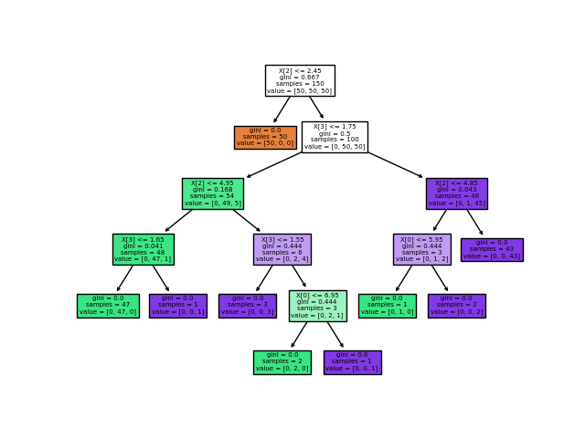
Tutorial 1: Higgs boson discovery (BDT)
Model: BDT
Depth = 4
+
+
Number of estimators = 5
$$y=α_{1}f_{1}\left(x\right)+ε_{1} \\ =α_{1}f_{1}\left(x\right)+α_{2}f_{2}\left(x\right)+ε_{2} \\ =α_{1}f_{1}\left(x\right)+α_{2}f_{2}\left(x\right)+α_{3}f_{3}\left(x\right)+ε_{3} \\ =⋯$$
https://scikit-learn.org/stable/modules/tree.html#classification
https://scikit-learn.org/stable/modules/ensemble.html#adaboost

Slide 11
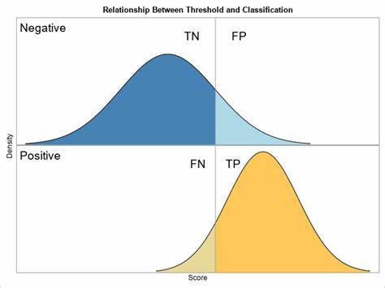
Tutorial 1: Higgs boson discovery (BDT)
Evaluation
Score threshold
Selection efficiencies
TPR for signal
FPR for background
Detection significance
AMS: approximate median significance
background
b: selected background
signal
s: selected signals
10

Slide 12
Tutorial 2: Higgs boson discovery (FCNN)
Tools
Python3
Python is a programming language that lets you work more quickly and integrate your systems more effectively.
Jupyter
Free software, open standards, and web services for interactive computing across all programming languages.
PyTorch
An open source machine learning framework that accelerates the path from research prototyping to production deployment.
Matplotlib
A comprehensive library for creating static, animated, and interactive visualizations in Python.

Slide 13
Tutorial 2: Higgs boson discovery (FCNN)
Steps
Preprocess data
Format
Normalization
Split into training set and validation set
Build mode
Train and validate iteratively
Make predictions
Evaluate model

Slide 14
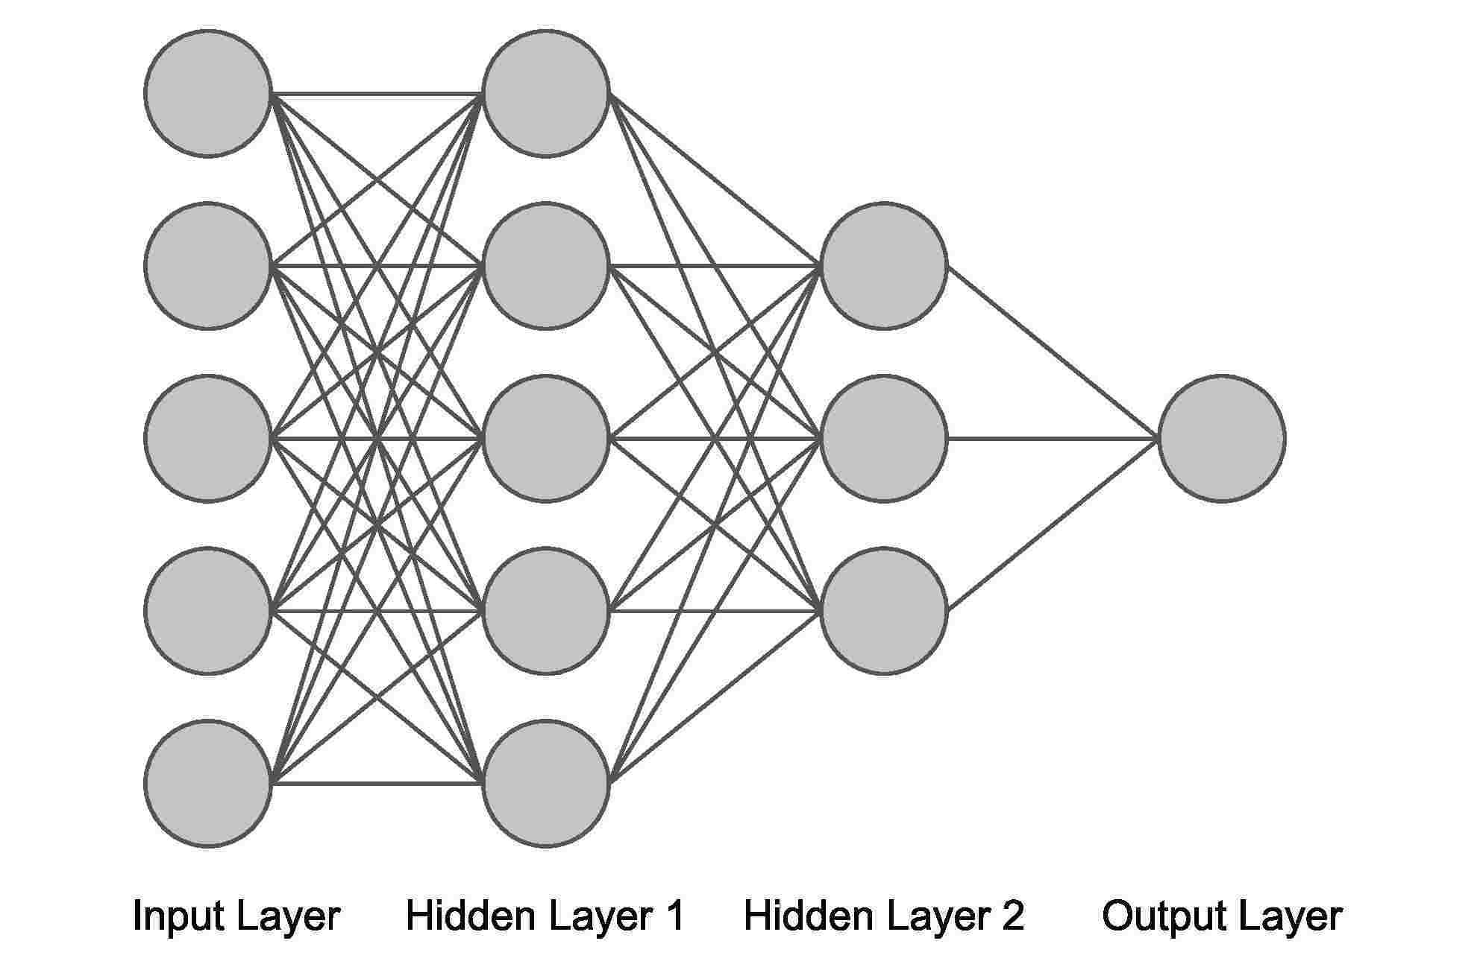
Tutorial 2: Higgs boson discovery (FCNN)
Model: FCNN
Loss function: Binary cross entropy
30
64
128
64
1
ReLU
ReLU
ReLU
Sigmoid
$$L=\frac{1}{N}\sum_{i}{I\left(t_{i}=1\right)\log{y(x_{i})}+I\left(t_{i}=0\right)\log\left(1−y(x_{i})\right)}$$

Slide 15
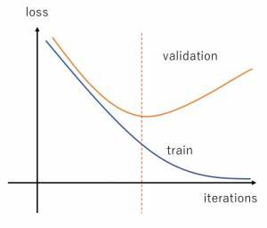
Tutorial 2: Higgs boson discovery (FCNN)
Evaluation
Avoid over-fitting

Slide 16
THANK YOU
Jie Ren
Jinan, Aug 4, 2023

