Slide 1

quasi-PDF
Parton Distribution Functions From Lattice QCD
Wei Wang
Shanghai Jiaotong University

Slide 2

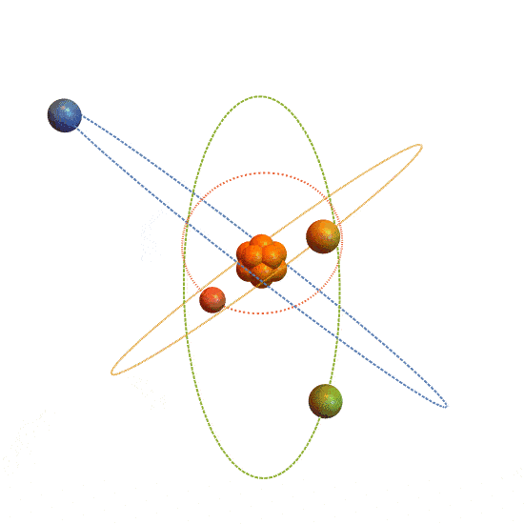
Nucleons
Nucleons (protons and neutrons) make up over 99% of the mass of the visible universe.

Slide 3
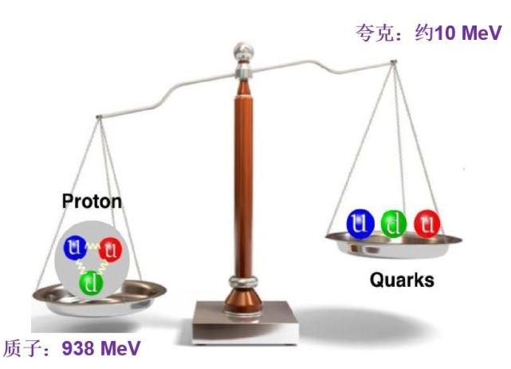

Nucleon : The origin of mass
mu=2.16+0.49−0.26
md=4.67+0.48−0.17
Quark mass $∼$ 10 MeV
Proton mass $∼$ 938 MeV
Neutron mass $∼$ 939.5 MeV
What is the origin of mass？

Slide 4
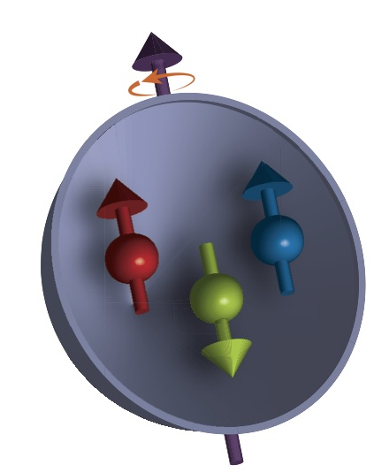
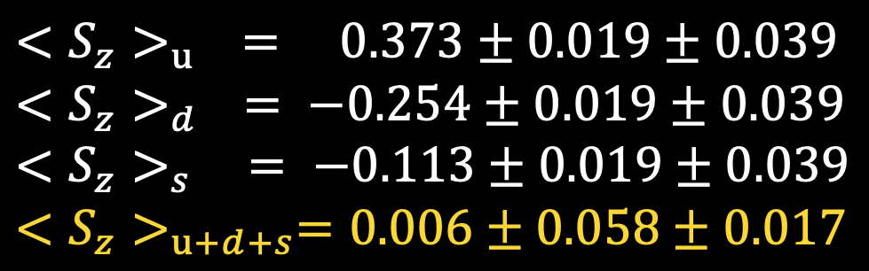
Nucleon : Spin Crisis
${<S_{z}>}_{u} = 0.373±0.019±0.039$
${<S_{z}>}_{d} = −0.254±0.019±0.039$
${<S_{z}>}_{s} = −0.113±0.019±0.039$
${<S_{z}>}_{u+d+s}=0.006±0.058±0.017$
EMC: PLB206 (2): 364-370, 1988
Only a small fraction of the proton’s spin comes from the spin of quarks.

Slide 5
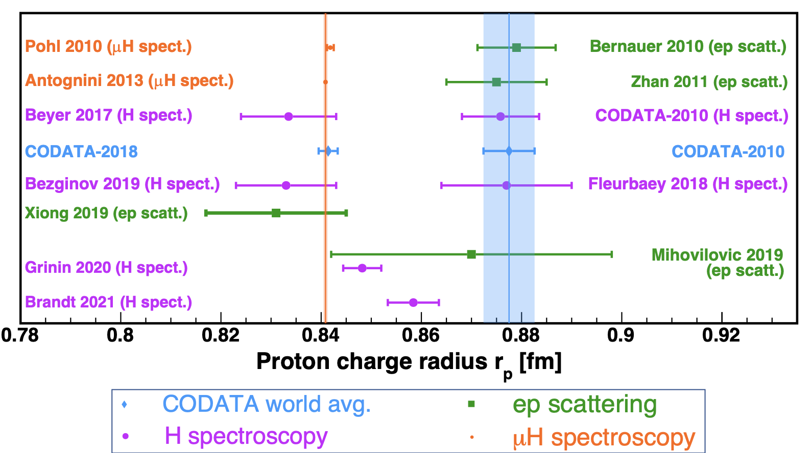
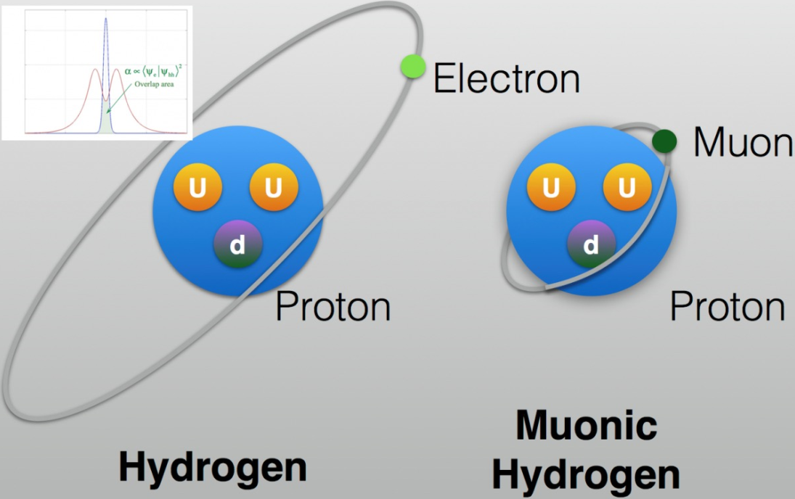
Nucleon : Charge Radius
W. Xiong et al. Nature 575 (2019) 7781，Credit to W.Xiong
Charge radius of proton varies with different experiments.

Slide 6
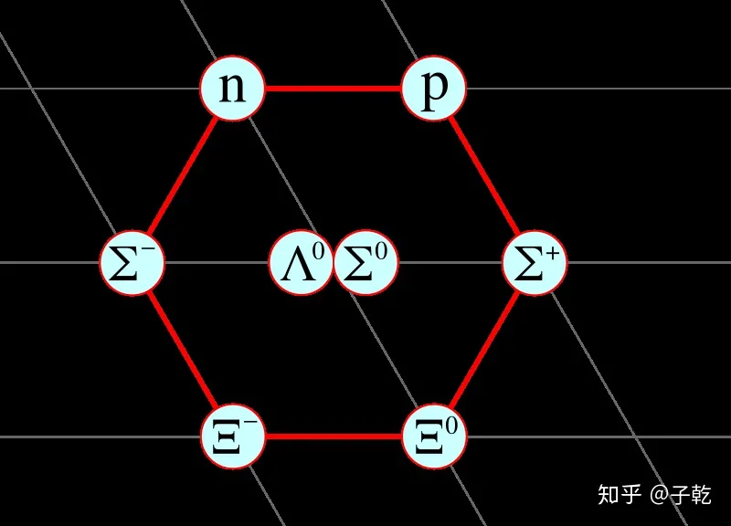
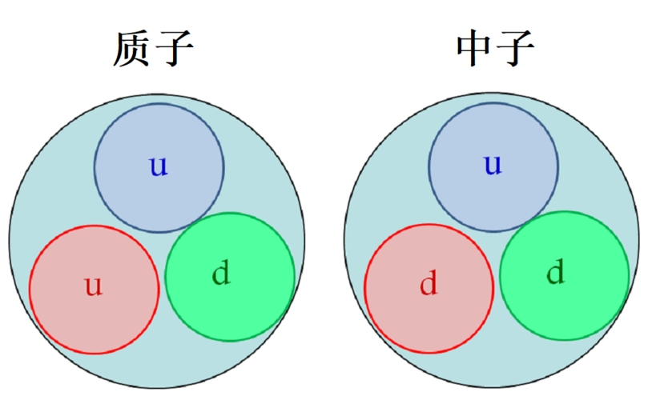
Quark Model
Gell-Mann, Phys.Lett. 8 (1964) 214-215
George Zweig, (1964)CERN-TH-401, CERN-TH-412
Nucleons are made of three quarks.

Slide 7
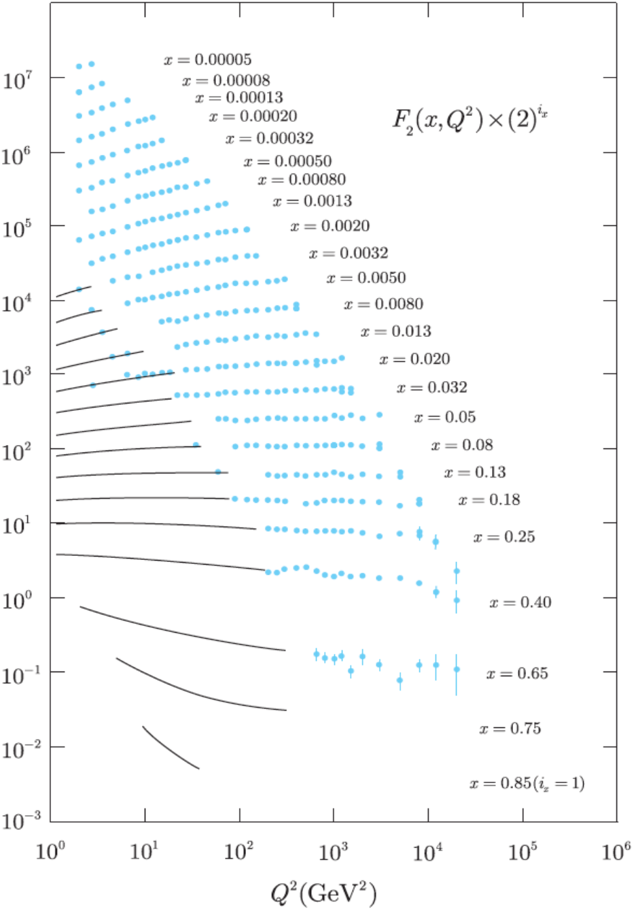
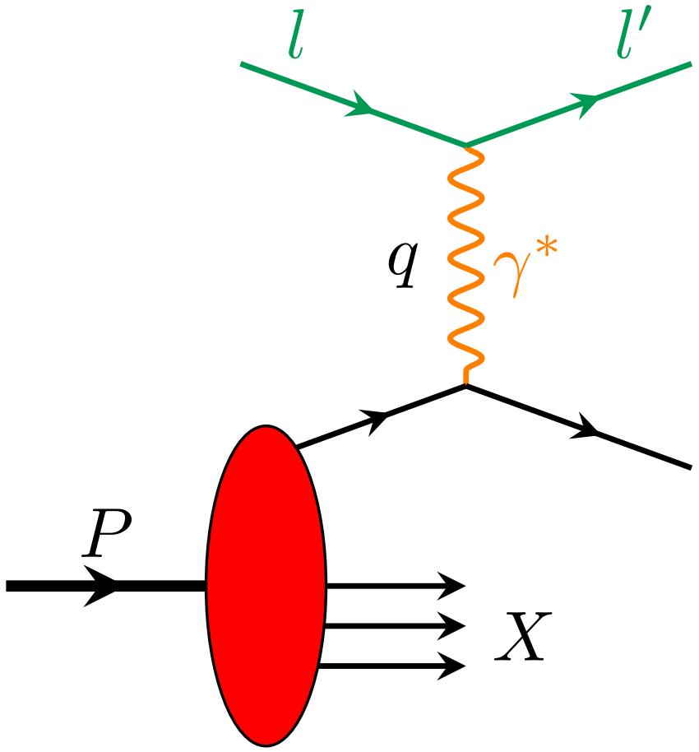
Parton Model
R. P. Feynman, Phys. Rev. Lett. 23, 1415 (1969);
J. D. Bjorken, E. A. Paschos, Phys. Rev. 185, 1975 (1969)
J. D. Bjorken, Phys. Rev. 179, 1547 (1969)
M. Breidenbach, et.al. Phys.Rev.Lett. 23 (1969) 935-939
Nucleons are made of partons in the high energy limit.

Slide 8
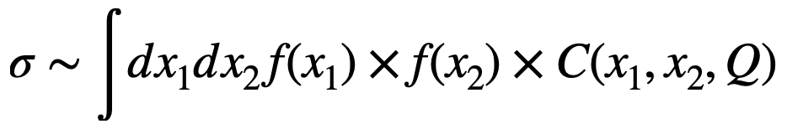
Parton Distributions
8
Factorization theorem:
The cross sections are factorized in terms of PDFs and partonic x-section.
Notes:
8

Slide 9
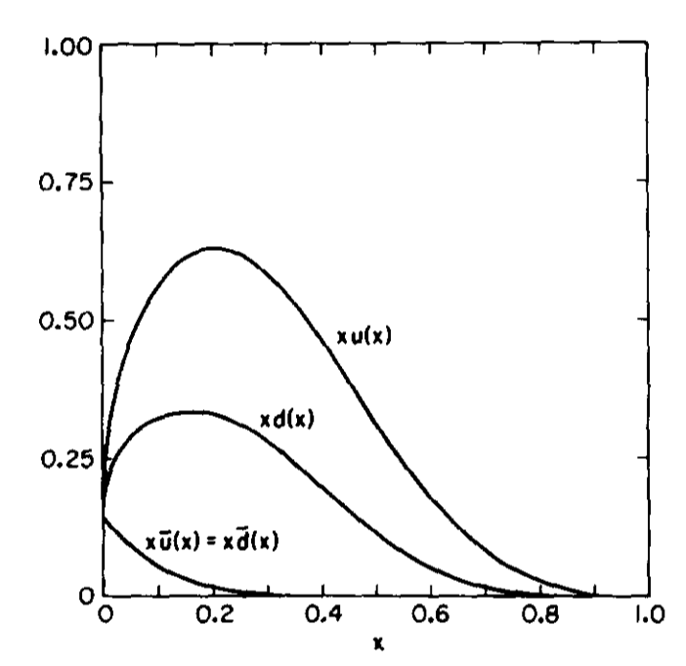
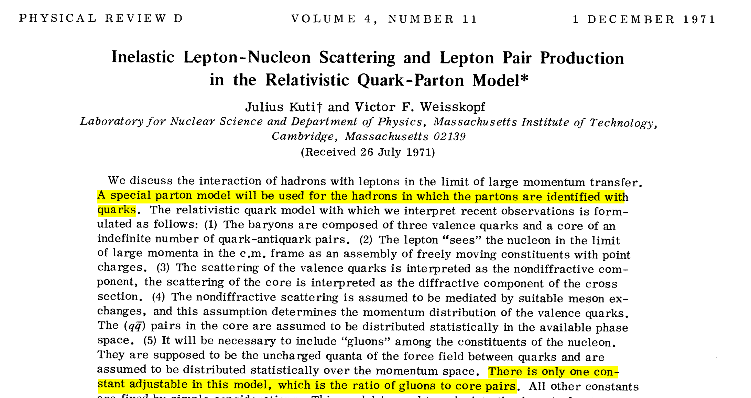
Parton Distributions: Global Fit
Kuti, Weisskopf, PhysRevD.4.3418(1971)
Barger, Phillips, NPB73 (1974) 269-294

Slide 10
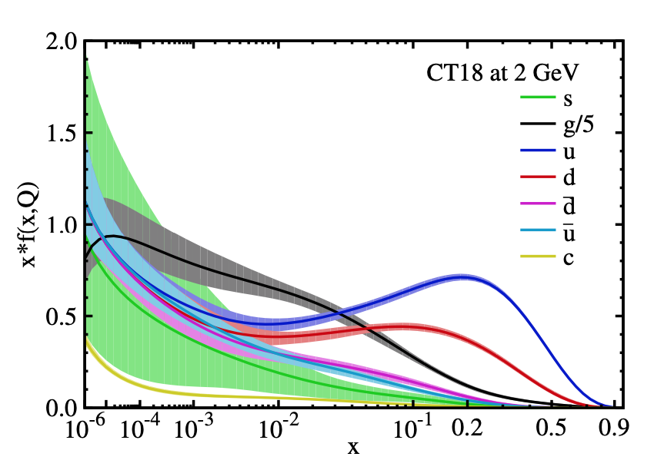
Parton Distributions: Global Fit
CTEQ
MSHT
NNPDF
ABM
…
[CT18, 1912.10053]
[MSHT20, 2012.04684]
[NNPDF4.0, 2109.02653]
1912.10053, T.Hou, J.Gao, et.al

Slide 11
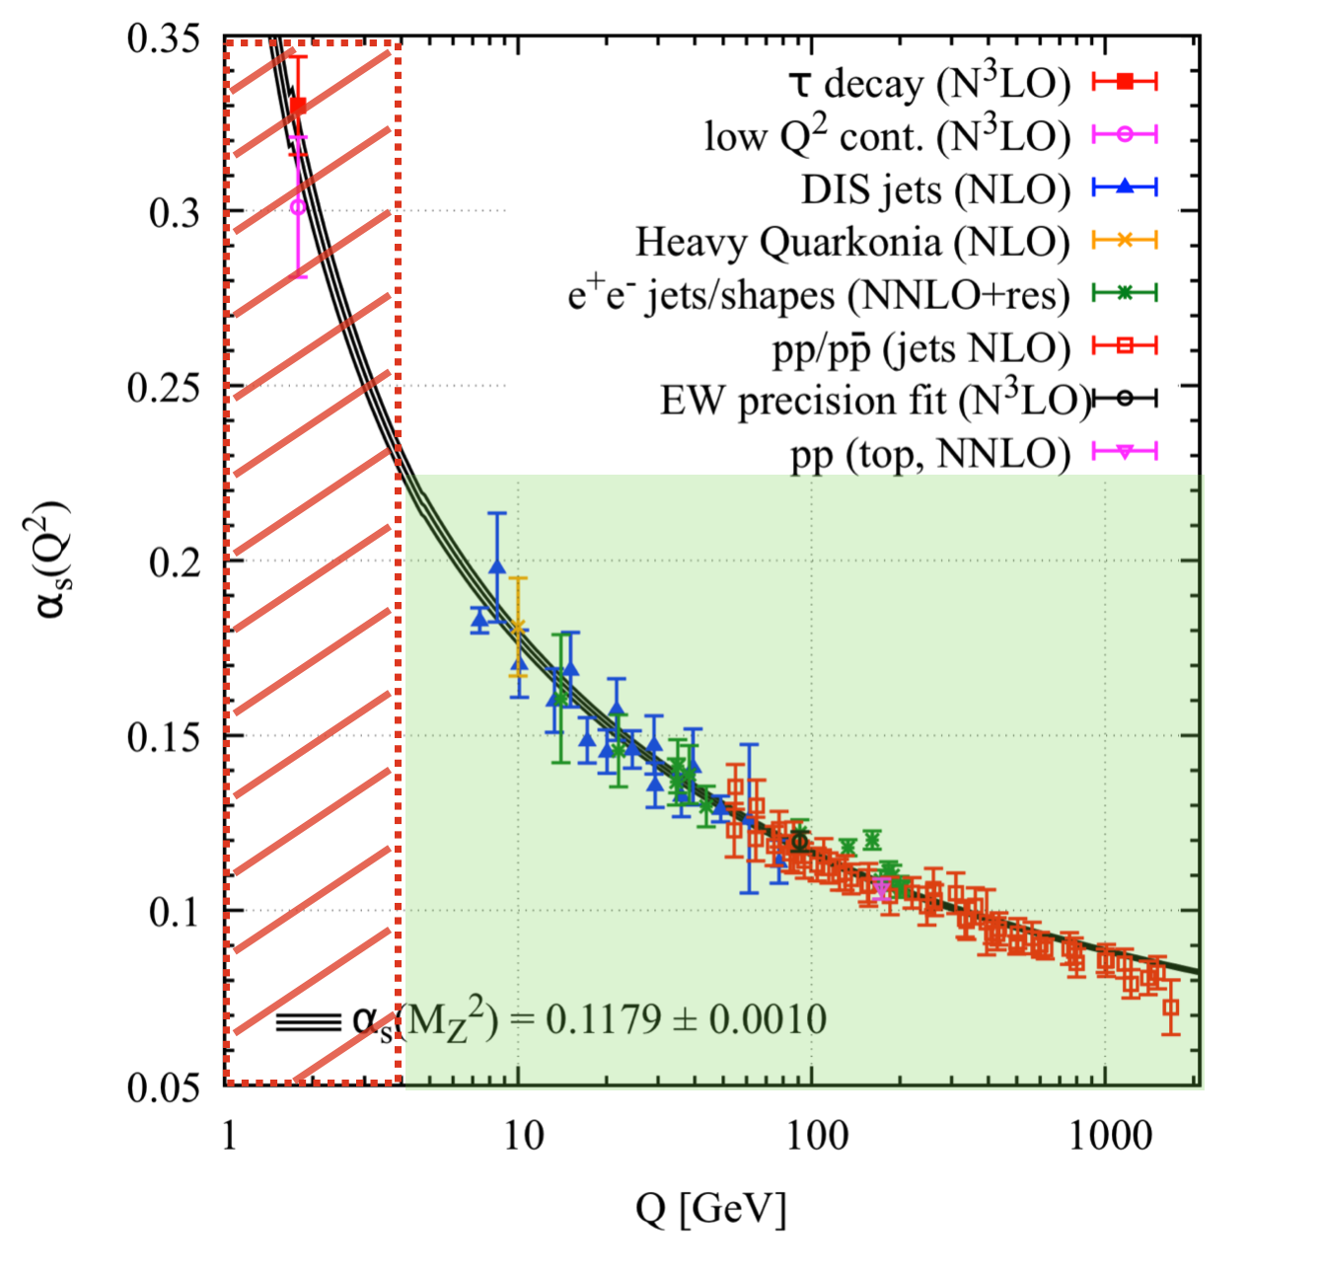
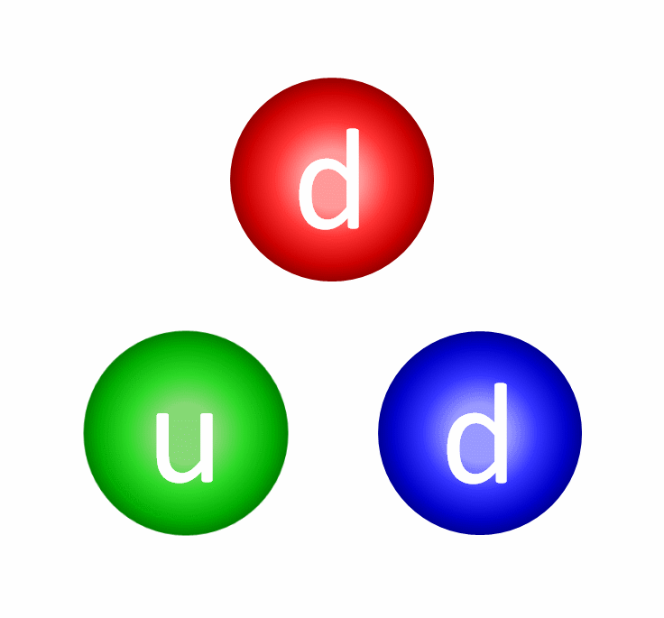
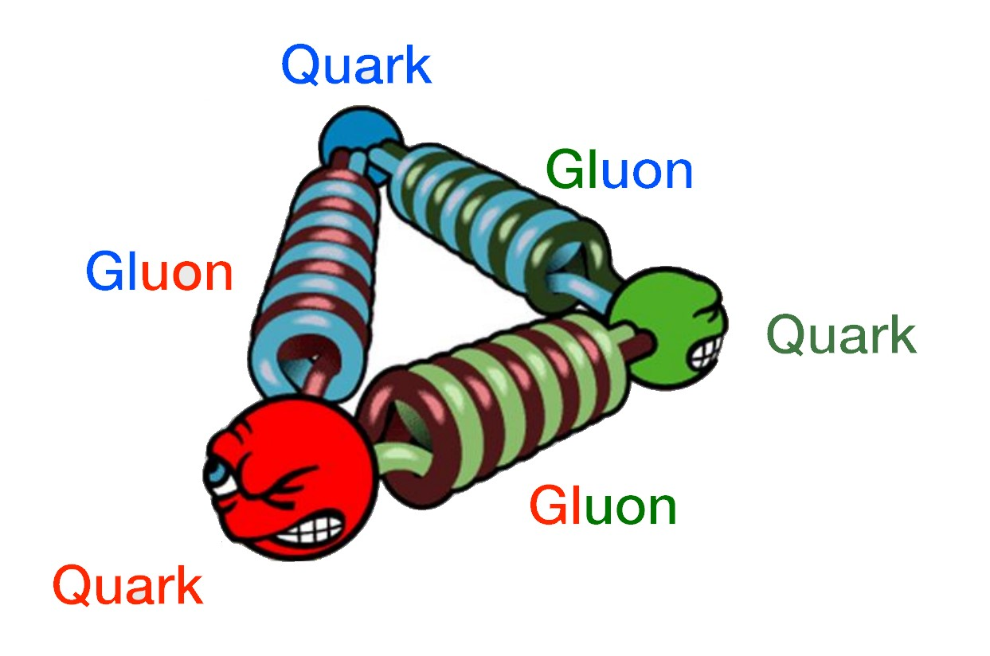

Nucleon : QCD
$$𝓛=\overline{ψ}\left(iγ⋅∂−m_{q}\right)ψ−\frac{1}{4}F^{μν,a}F_{μν}^{a}−g_{s}\overline{ψ}γ.Aψ$$

Slide 12
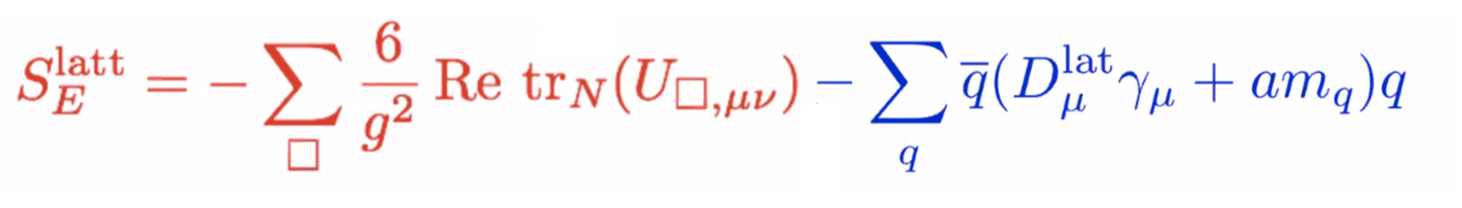
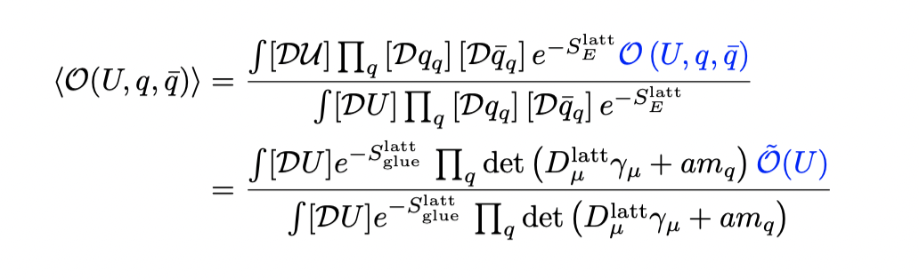
Lattice QCD
Action in Euclidean spacetime:
Wilson gauge action
Lattice fermion action
Correlation functions:
Ken Wilson 1974
(Time-independent) Observables can be obtained from correlation function.

Slide 13
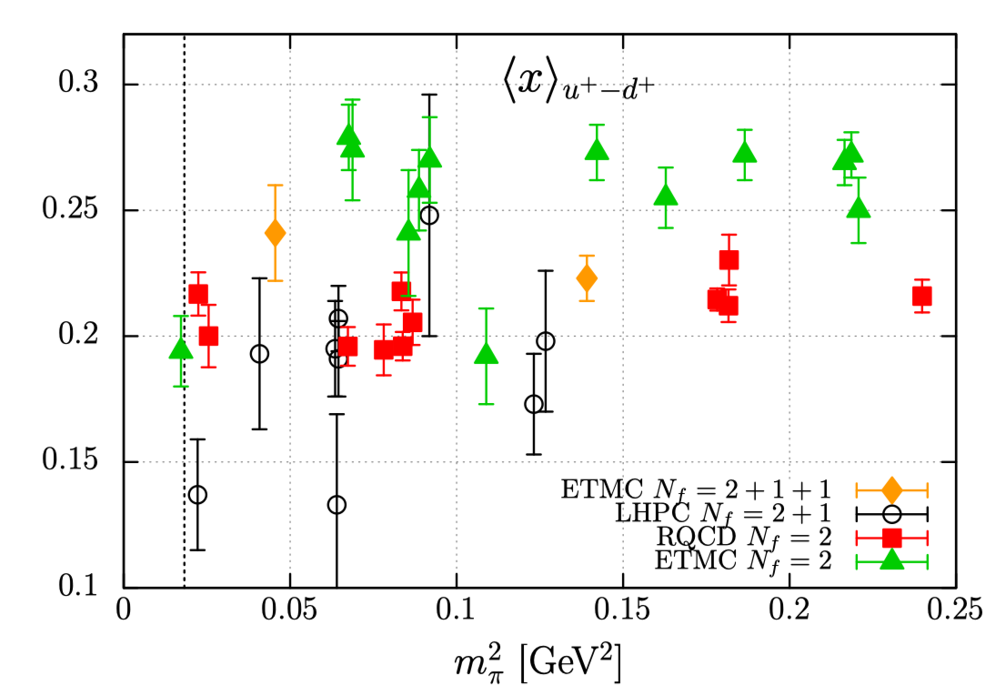
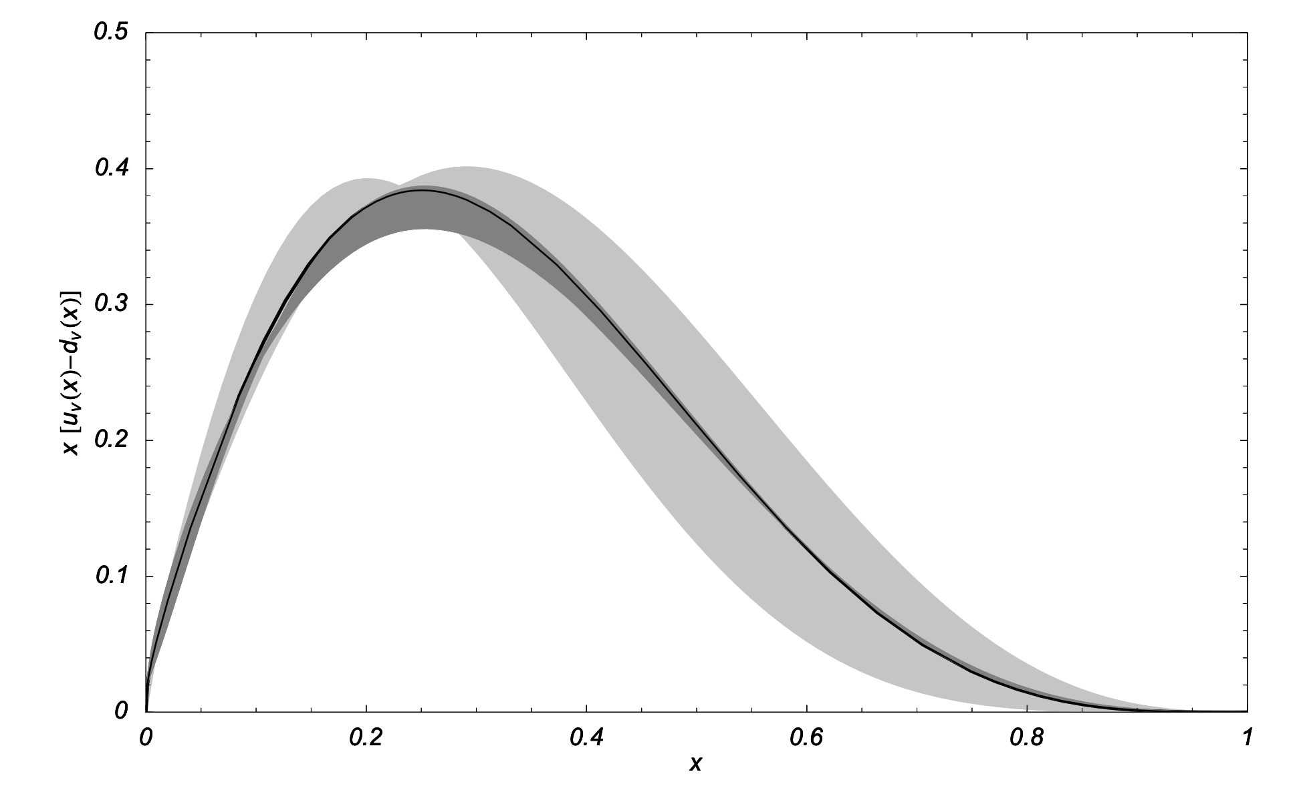
Parton Distributions : Moments
First moments of unpolarized PDFs
H.W. Lin et al., Prog. Part. Nucl. Phys. 100, 107-160 (2018)
Power-divergent mixing between twist-2 operators on lattice;
High-order discrete derivatives are hard to calculate on lattice;
Lattice calculation is limited to the lowest three moments!
Reconstructed with three moments
W. Detmold et al., Mod. Phys. Lett. A18, 2681-2698 (2003)
3 moments are insufficient to fully reconstruct PDFs;
Model dependent;
Only can provide constraints in global extractions of PDFs!

Slide 14
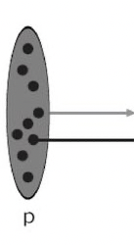
Light-Front Quantization
14
What does an object look like when travelling at infinite momentum or speed of light?
S. Weinberg (scalar QFT)
Dynamics at infinite momentum
Phys. Rev. 150 (1966) 1313-1318
All kinematic infinities can be removed from the calculations, resulting a set of rules for Hamiltonian perturbation theory (“old-fashioned p.t.”)
Notes:
14

Slide 15

Light-Front Quantization
All Weinberg’s rules in the P=∞ limit can be obtained by quantizing the theory with “new coordinates”
$x^{+}=\frac{x^{0}+x^{3}}{\sqrt{2}}$ $x^{−}=\frac{x^{0}−x^{3}}{\sqrt{2}}$
treating $x^{+}$as the new “time”
$x^{−}$as the new “space” dimension.
Forms of Relativistic Dynamics,
Dirac, Rev. Mod. Phys. 21 (1949) 392
Light-front quantization (LFQ)
Connection with LF quantization and LC coordinates immediately recognized!
S. J. Chang and S. K. Ma (1969)
Feynman rules and quantum electrodynamics at infinite momentum,
Phys. Rev. 180 (1969) 1506-1513
J. Kogut and D. Soper
Quantum Electrodynamics in the Infinite Momentum Frame,
Phys. Rev. D 1 (1970) 2901-2913
Notes:
15

Slide 16
Light-Front Quantization
16
All slow-moving stuff in zero- modes (x=0) overlaps with vacuum.
It is a strongly coupled problem!
There is no demonstration that the weak coupling expansion actually works for QCD.
K. Wilson et. al. Phys. Rev. D49 (1994)
There is no controlled approximation.
Notes:
16

Slide 17

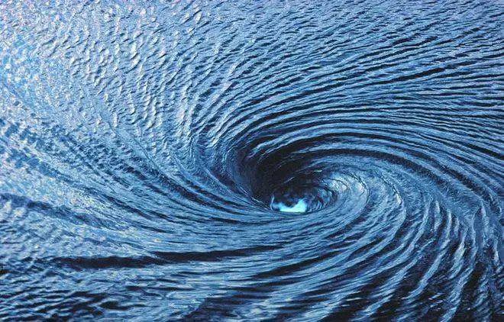

Parton Distribution: Critical Phenomena
In momentum space, PDFs give a small-x behavior
$$f(x)\sim x^{−α}$$
When FT back to position space, one has
$$C\left(λ\right)\sim λ^{α−1}$$
This corresponds to critical phenomena with an “infinite correlation” length:
C(𝜆)~exp(−𝜆/𝜉) with 𝜉→∞
critical phenomena
Partons are concepts that are related to critical phenomena.

Slide 18
Large Momentum Effective Theory
PDF:
light-cone separation;
Cannot be calculated on the lattice
critical phenomena -> Wilson Flow
Ji, 2013

Slide 19
Large Momentum Effective Theory (LaMET)
PDF:
light-cone separation;
Cannot be calculated on the lattice
Quasi-PDF :
Equal-time correlation;
Directly calculable on the lattice
critical phenomena -> Wilson Flow
Ji, 2013

Slide 20
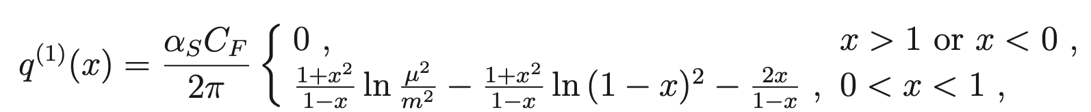
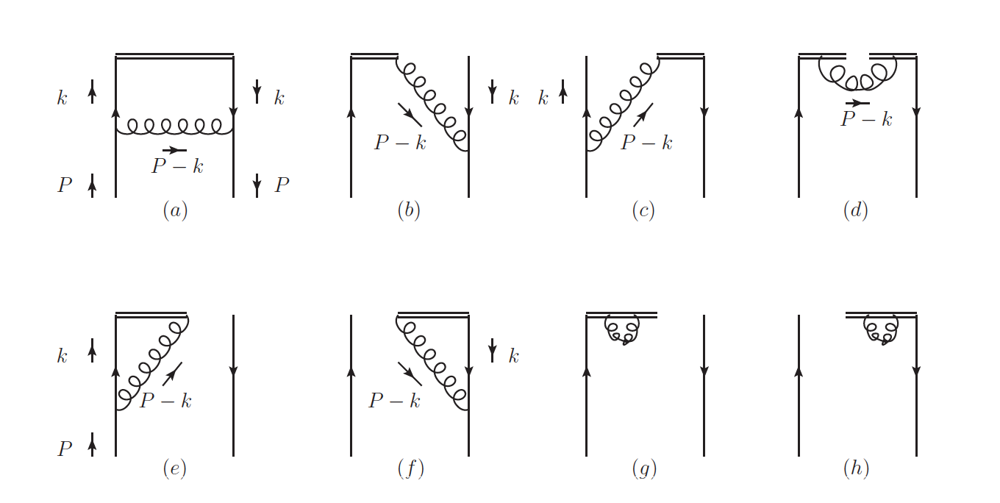
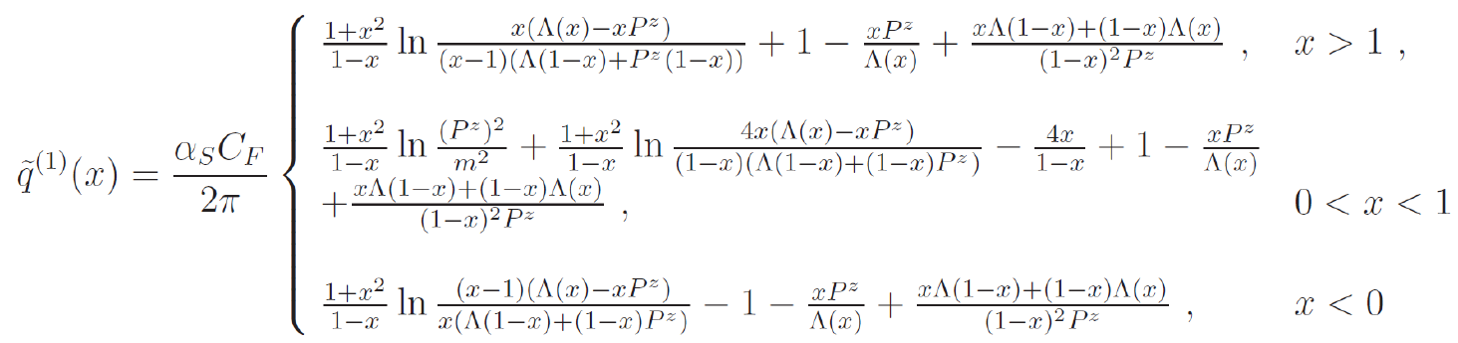
Progress on PDF
Cut off scheme:
(Xiong, et.al, PRD90 (2014) 1, 014051)
Perturbative calculations validate the same infrared structure and allow to compensate the UV difference.

Slide 21

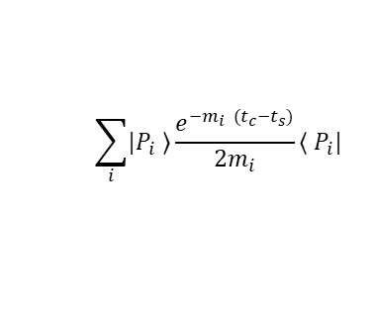
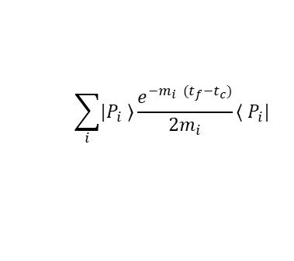
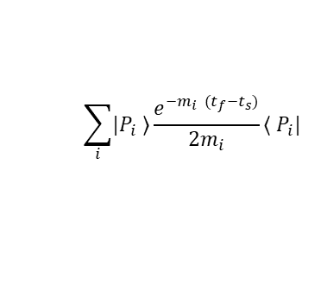
Progress on PDF
Propagate
Z-direction
gauge link
u
u
d
u
u
d
t=0
t=t_{seq}
u
u
d
u
u
d

Slide 22
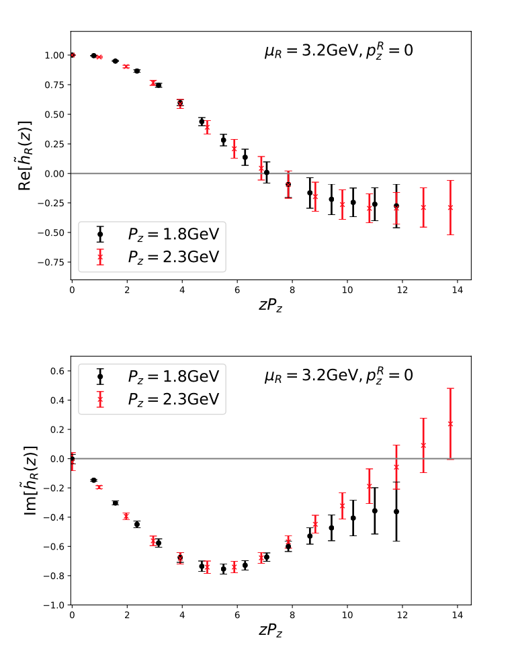
Progress on PDF
CLS H102: 32³ × 96, 2+1 flavor clover fermion ensemble with Lattice spacing a = 0.086 fm, pion mass Mπ = 356 MeV
LPC:PRD 101,034020(2020)

Slide 23
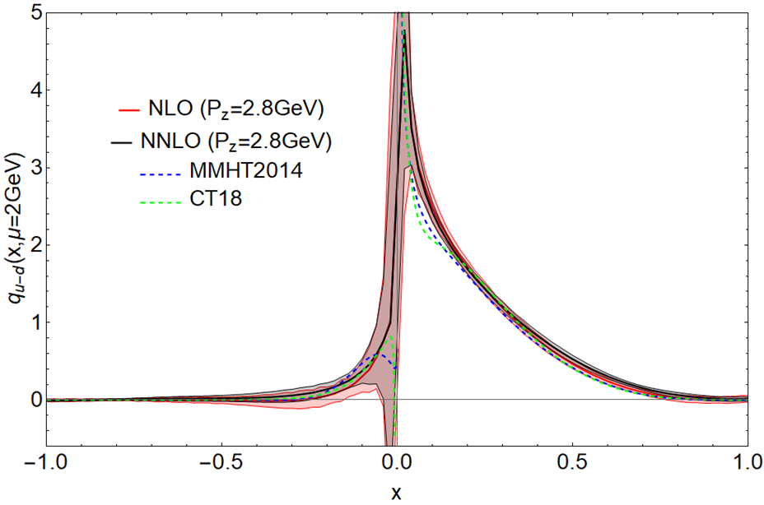
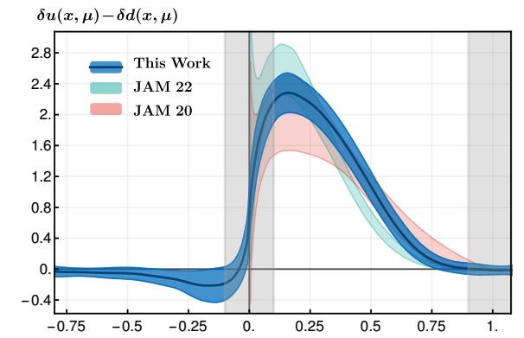
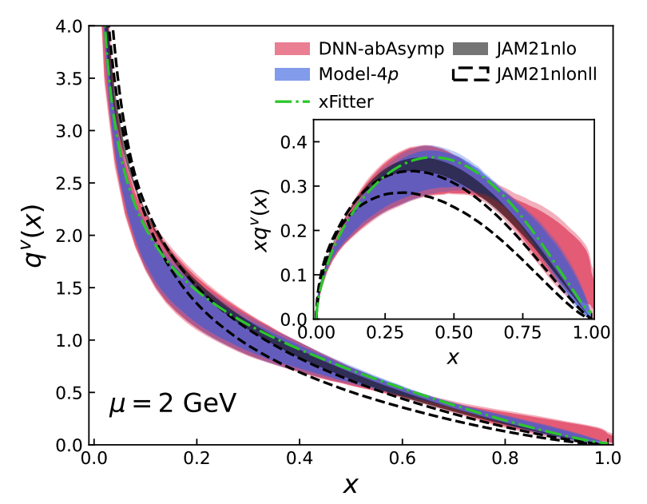
Progress on PDF
Preliminary
Proton unpolarized PDF, in preparation
Proton transversity PDF, 2208.08008
Pion valance PDF, 2208.02297

Slide 24
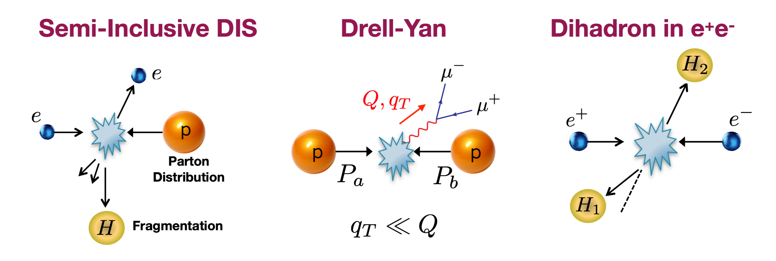
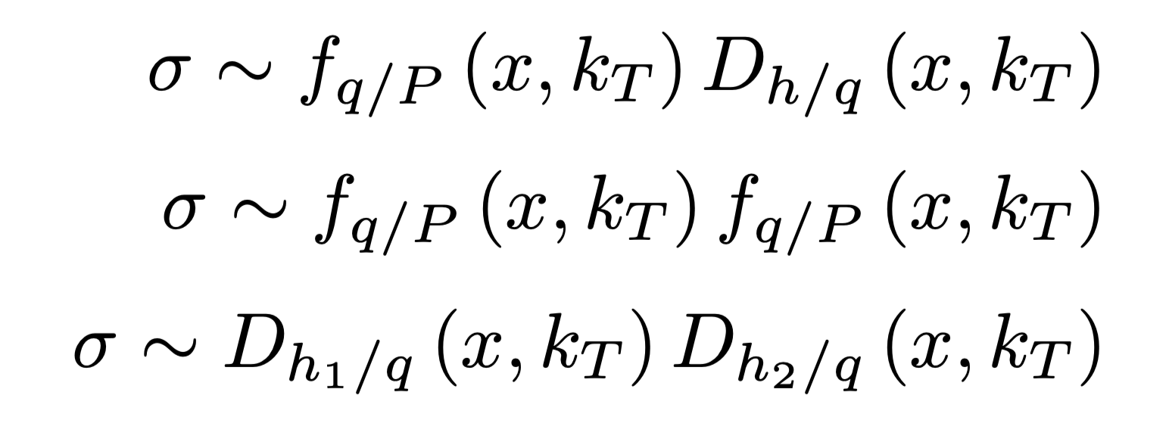
Transverse-Momentum-Dependent PDFs
24
TMD processes:
LHC, FermiLab, RHIC, …
HERMES, COMPASS, JLab, EIC, …
BESIII, Babar, Belle, …

Slide 25
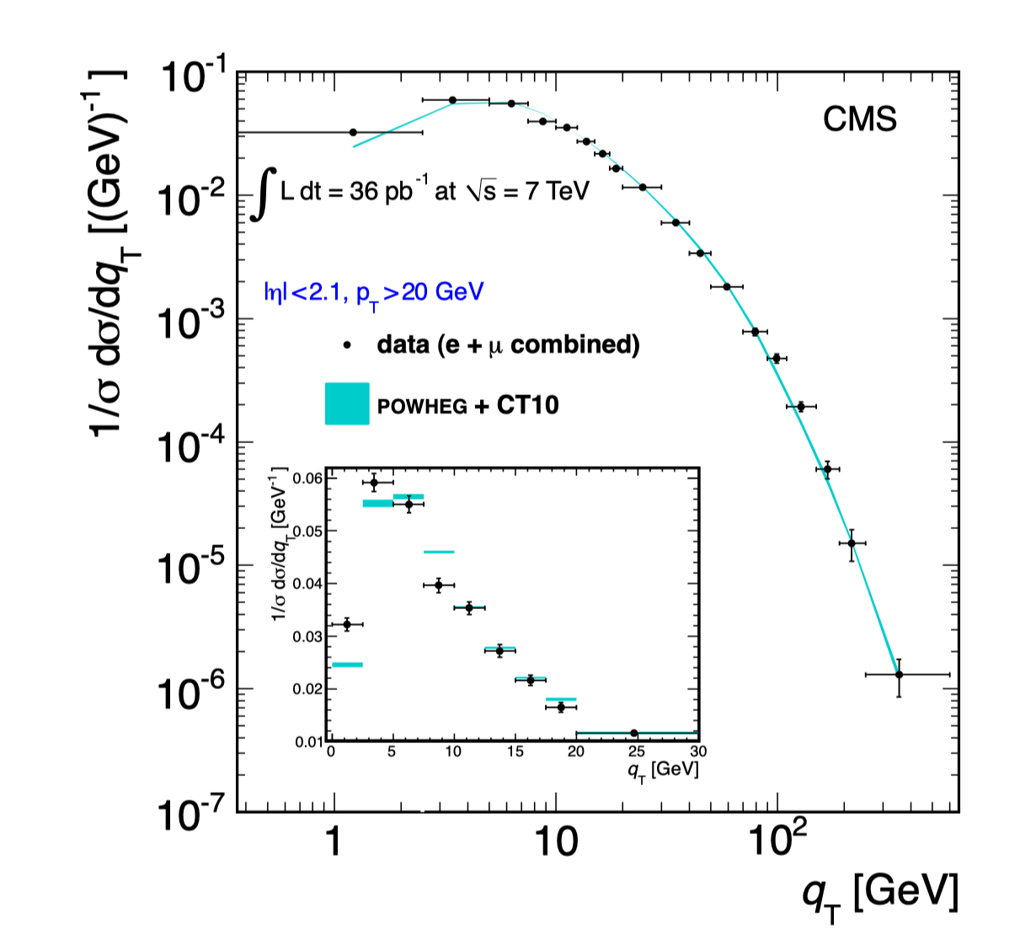





TMDPDFs
Z-production $q_{T}$ spectrum at LHC
Hard
High-$q_{T}$ region:
Collinear factorization => PDF
High-$q_{T}$ region
Phys.Rev. D85 (2012) 032002.
Notes:
25

Slide 26





TMDPDFs
Z-production $q_{T}$ spectrum at LHC
Low-$q_{T}$ region
Soft
High-$q_{T}$ region:
Collinear factorization => PDF
High-$q_{T}$ region
Low-$q_{T}$ region:
TMD factorization
=> Generalize to TMDPDFs
Phys.Rev. D85 (2012) 032002.
Notes:
26

Slide 27
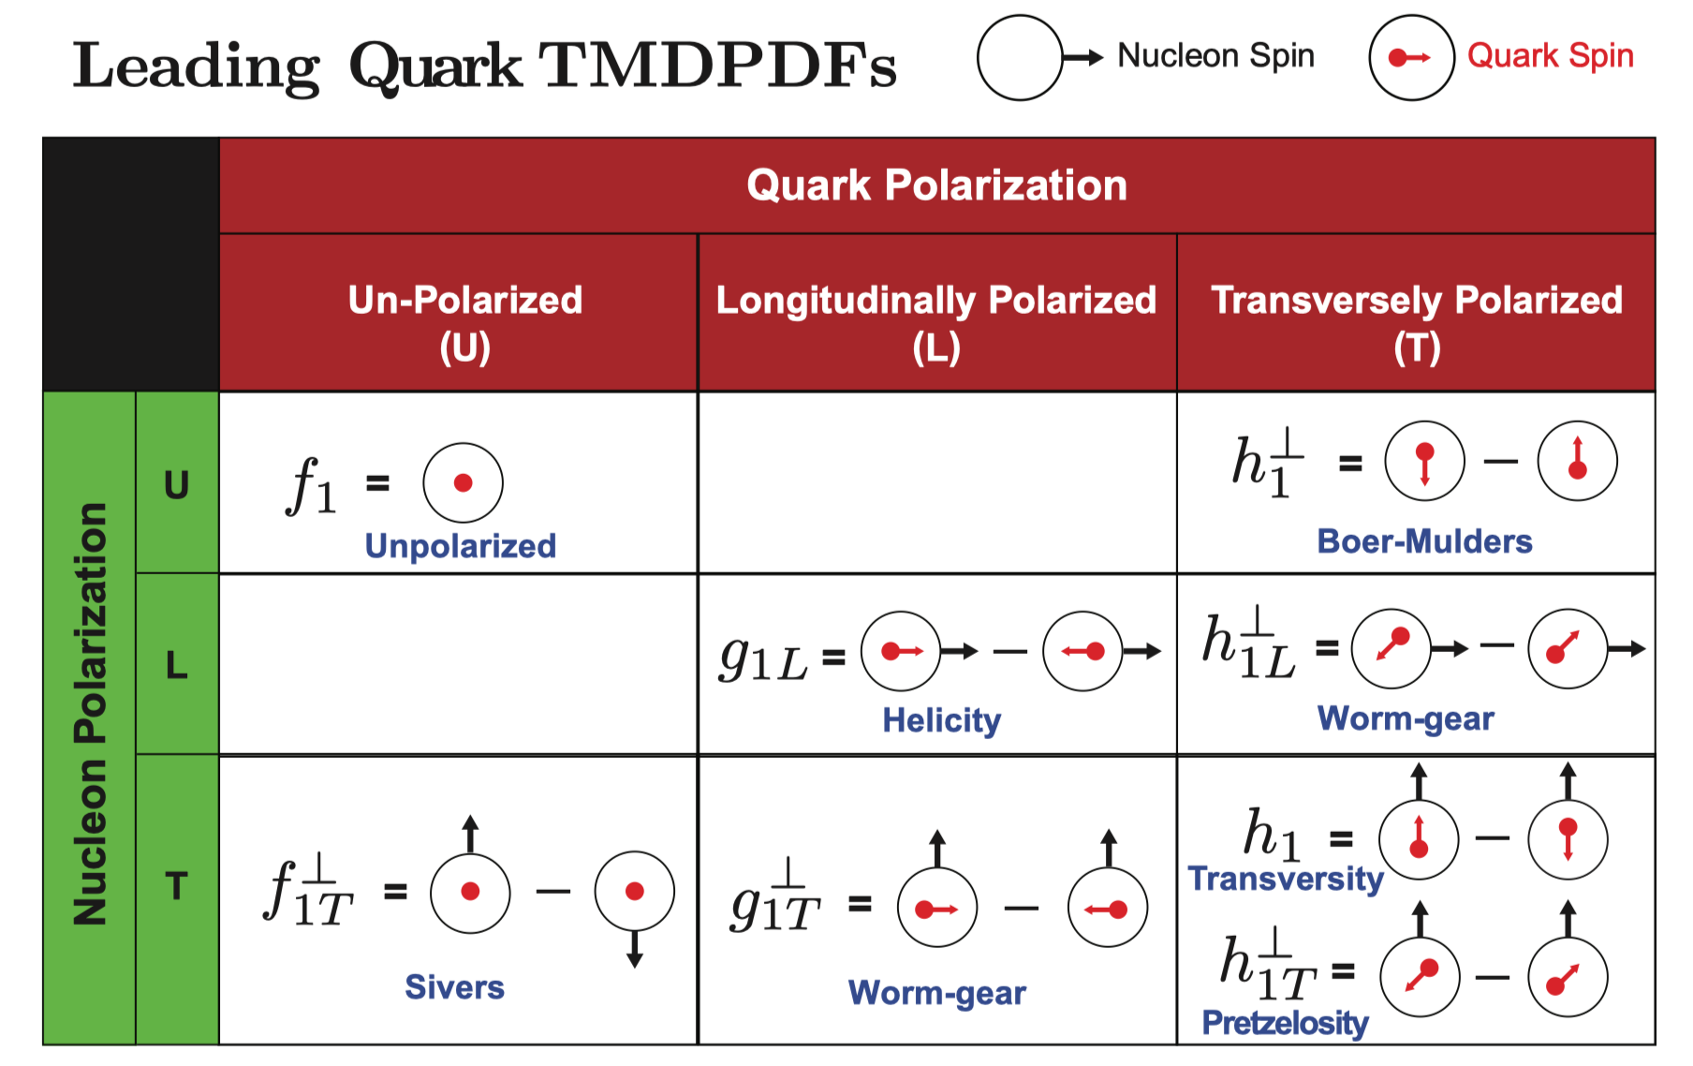
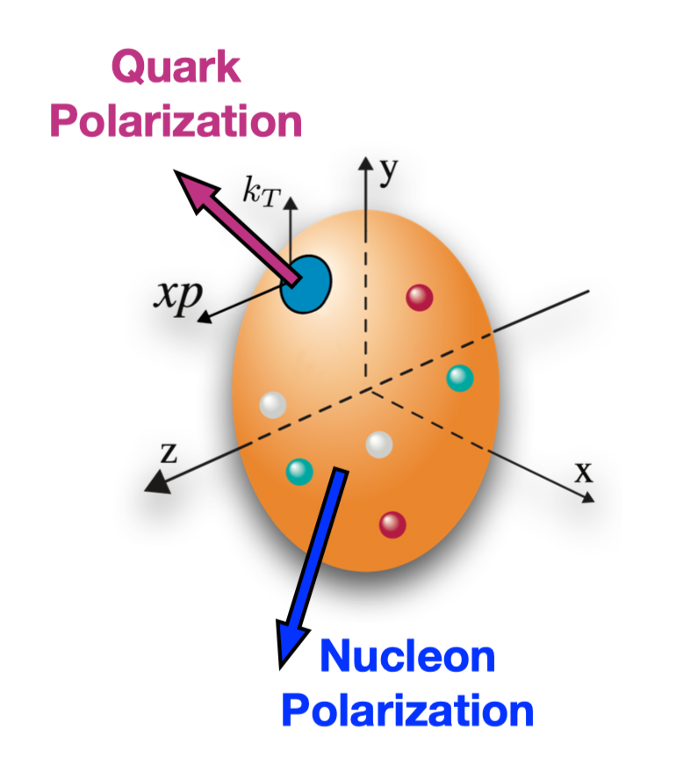
TMDPDF in QCD
TMDPDFs: 3D tomography of nucleon

Slide 28
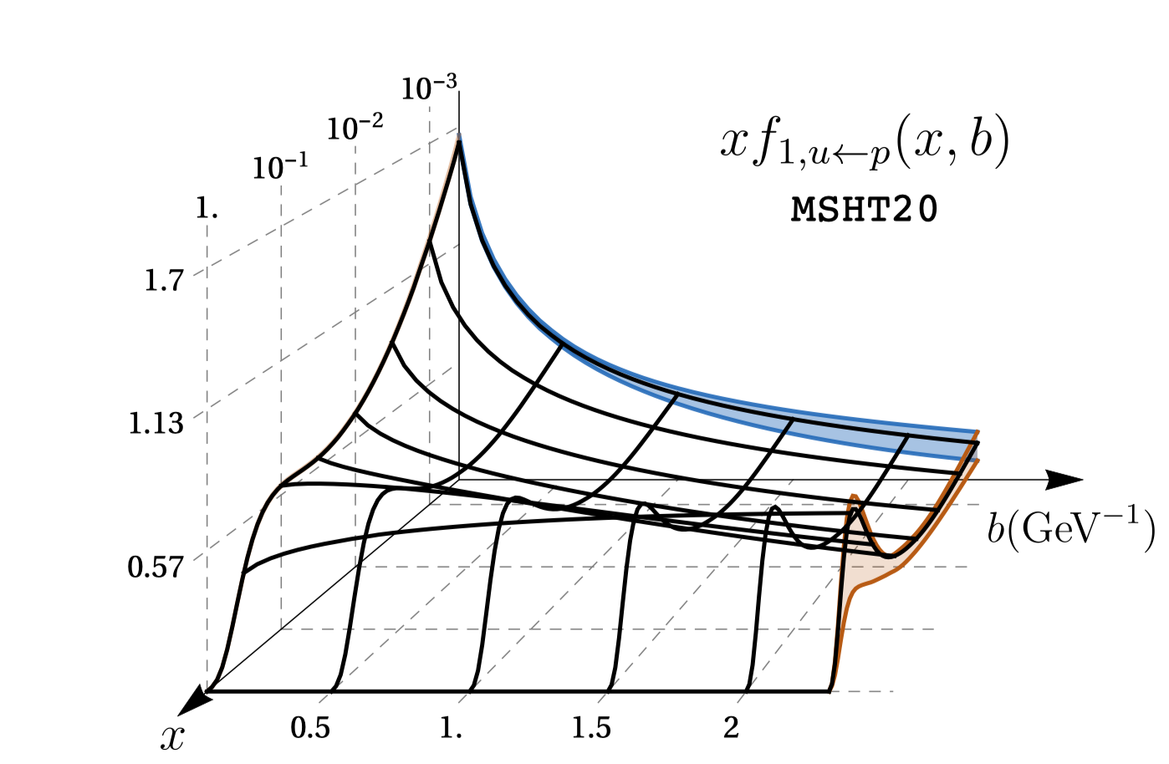
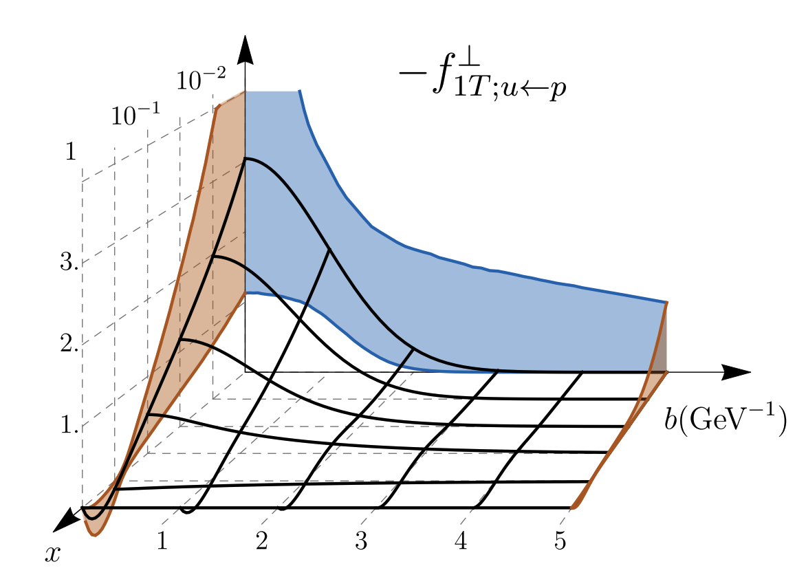
Progresses in the study of TMDPDFs
Theoretical analysis
TMD factorization, evolution and resummation:
Collins, Foundations of perturbative QCD; ……
Phenomenological extractions
Unpolarized:
u-quark unpolarized TMDPDF, 2201.07114
Bacchetta, JHEP06 (2017); Scimem, JHEP06 (2020);
Bury, 2201.07114; Bacchetta, 2206.07598; ……
Sivers:
Bury, PRL126 (2021), JHEP05 (2021) ; ……
Boer-Mulders:
Zhang, PRD77 (2008), Lu, PRD81 (2010) ; ……
Others: worm-gear, gluon TMDs, ……
u-quark Sivers function, PRL126 (2021)
No first-principle calculation
Notes:
28

Slide 29
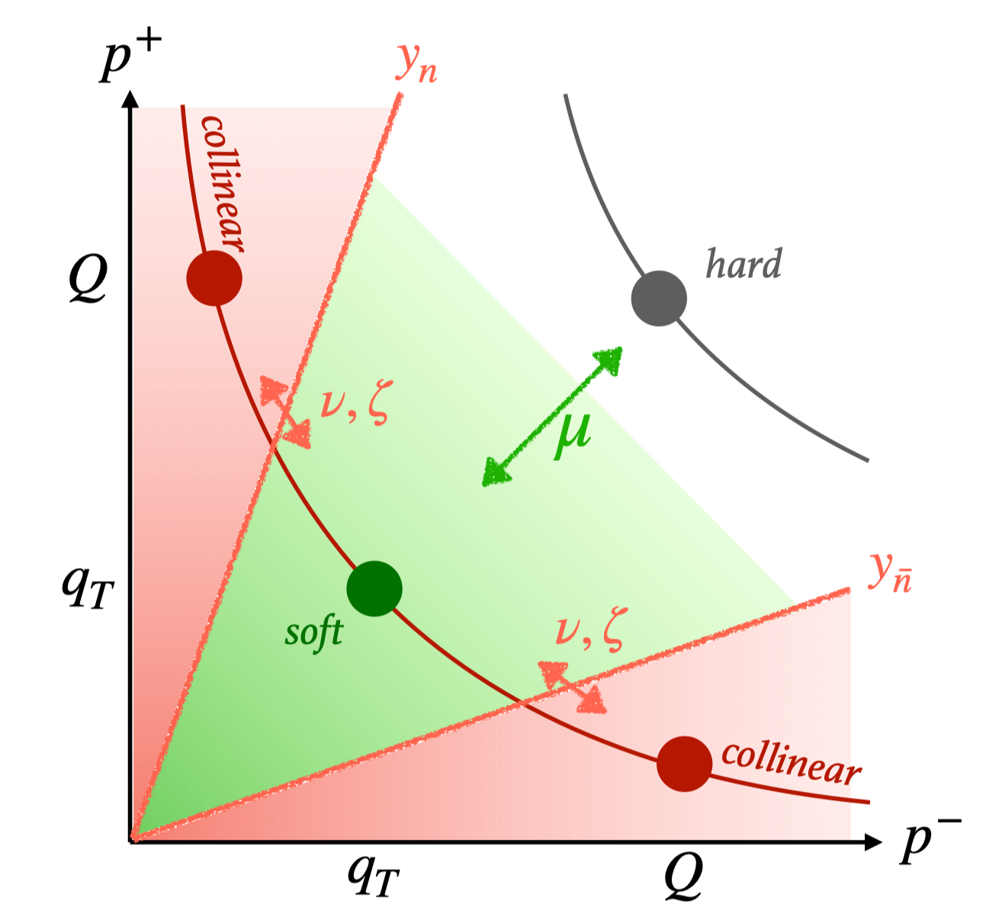
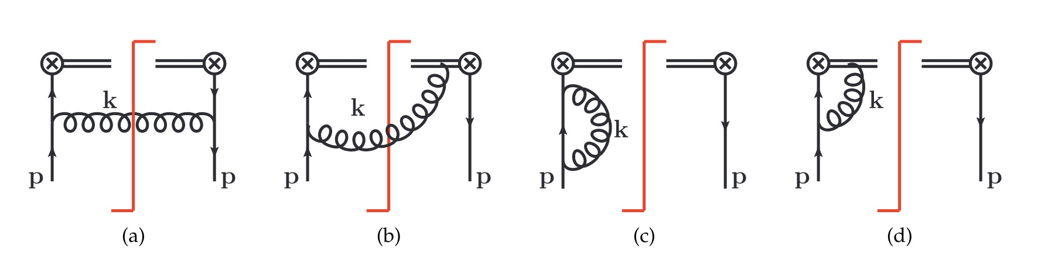
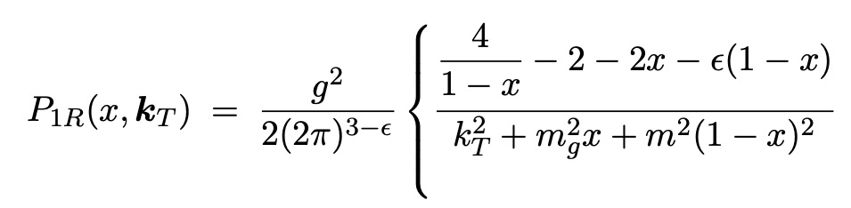
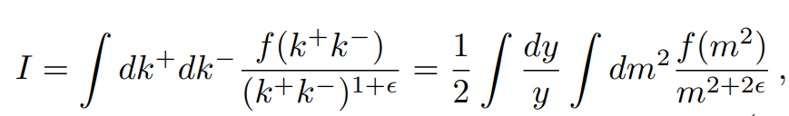

TMDPDF in QCD
29
TMD: rapidity divergence

Slide 30



TMDPDF in QCD
30
TMD: rapidity divergence
Rapidity divergence requires a regulator, and leaves a scale ($ζ$) dependence
$μ$ renormalization group evolution: perturbative
$ζ$-dependence: nonperturbative？
The $ζ$ dependence must be cancelled with a new concept, soft function.

Slide 31
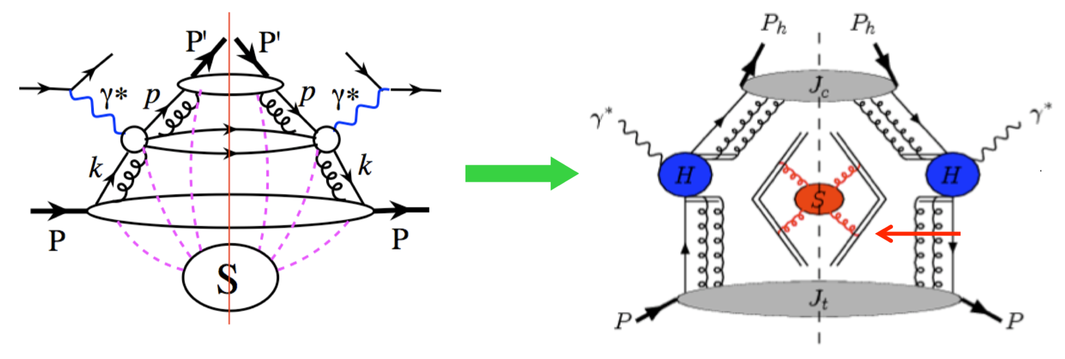
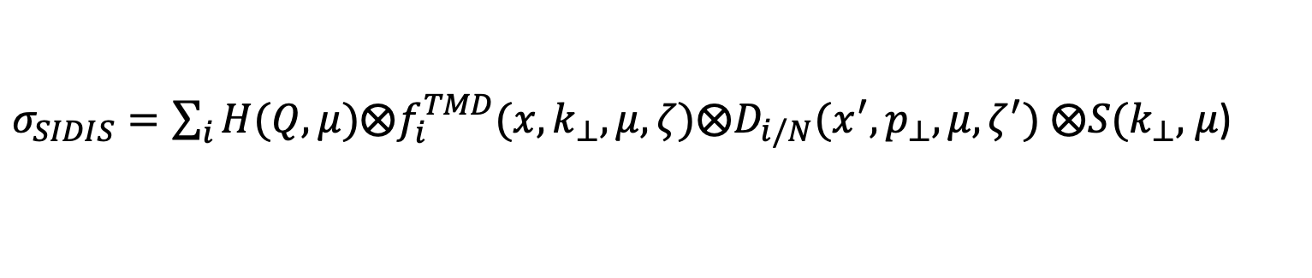
TMDPDF in QCD
31
Semi-inclusive hadron production in deep inelastic scattering:
TMD fragmentation
soft function
TMD parton distribution
$σ_{SIDIS}=\sum_{i}{H(Q,μ)⨂f_{i}^{TMD}(x,k_{⊥},μ,ζ)⨂D_{i/N}(x^{′},p_{⊥},μ,ζ^{′})}$ $⨂S(k_{⊥},$ $μ$)

Slide 32
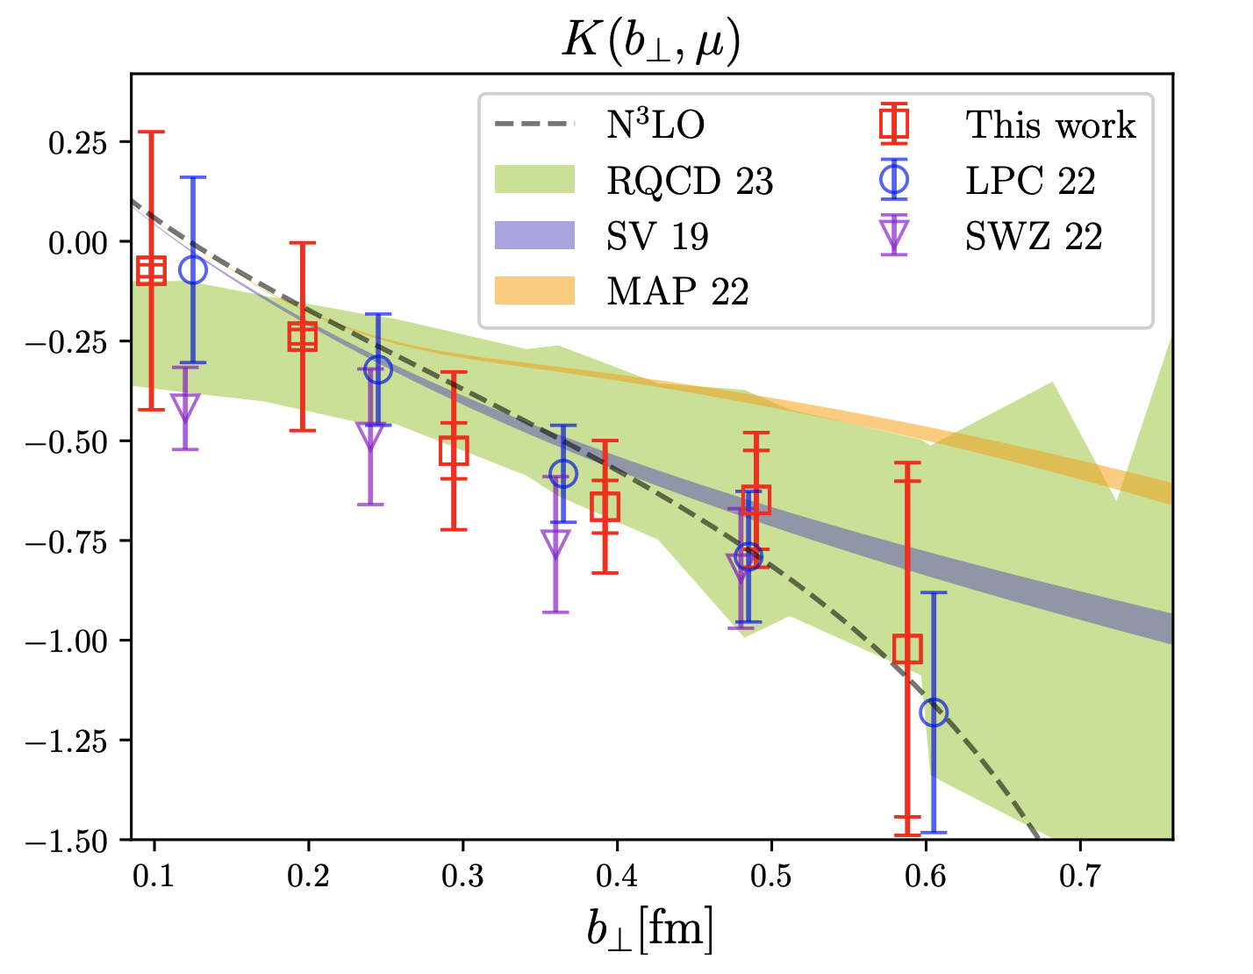
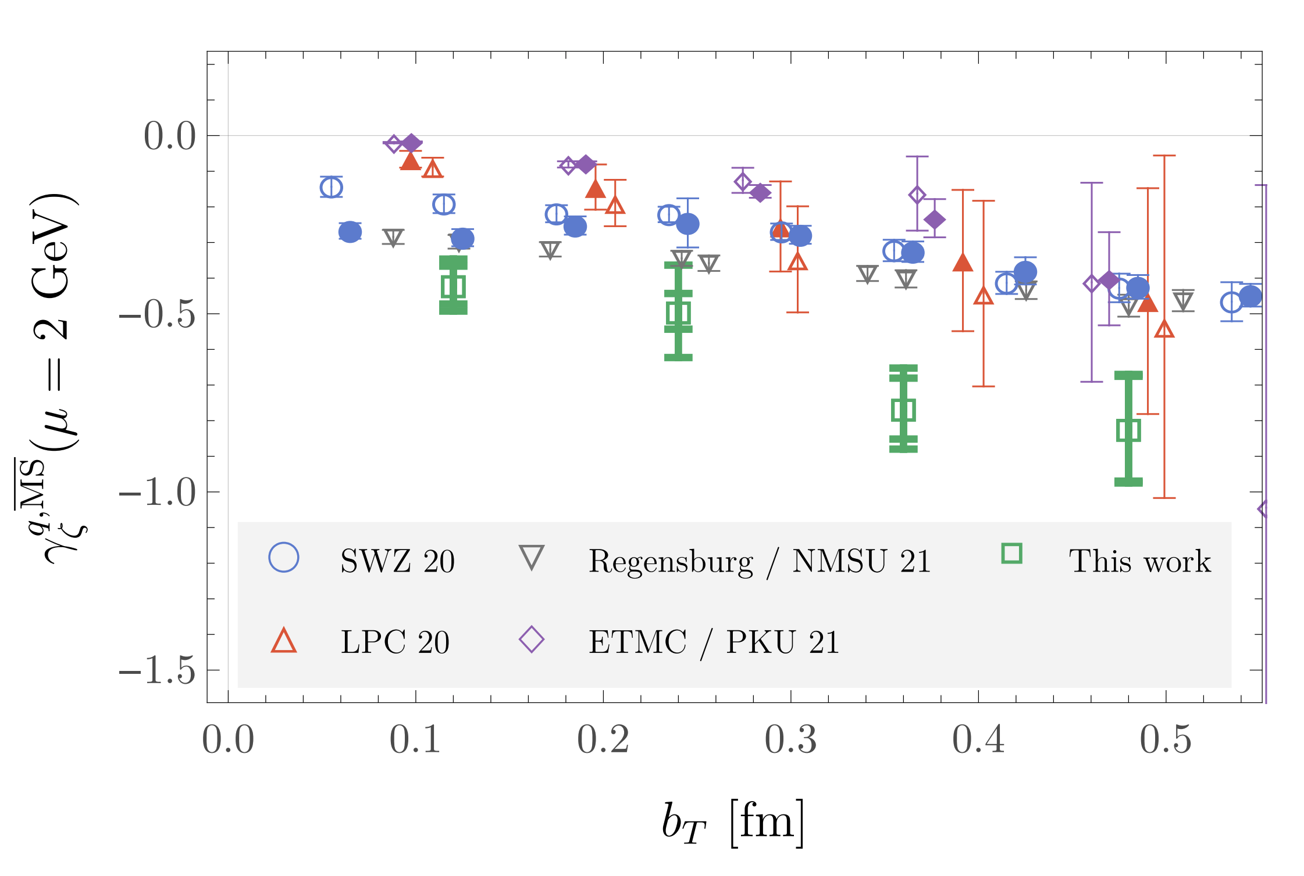
Soft function from Lattice QCD
Rapidity-dependent part: Collins-Soper kernel
From quasi beam function:
Shanahan, PRD104(2021), PRD102(2020);
Schlemmer, JHEP08(2021); ……
From quasi TMDWF:
Chu, 2306.06488, PRD106(2022); Zhang, PRL125(2020);
Li, PRL128(2022); ……
Notes:
32

Slide 33
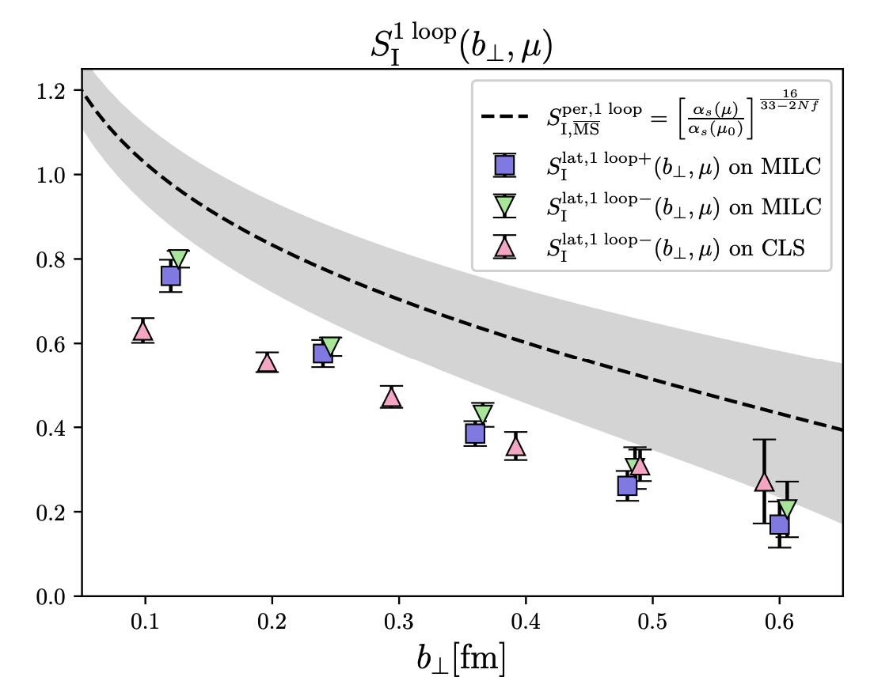
Soft function from Lattice QCD
Rapidity-independent part: intrinsic/reduced soft function
From quasi TMDWF + 4-quark matrix element:
Chu, 2302.09961; Ji, NPB955(2020);
Zhang, PRL125(2020); Li, PRL128(2022);
……
Notes:
33

Slide 34
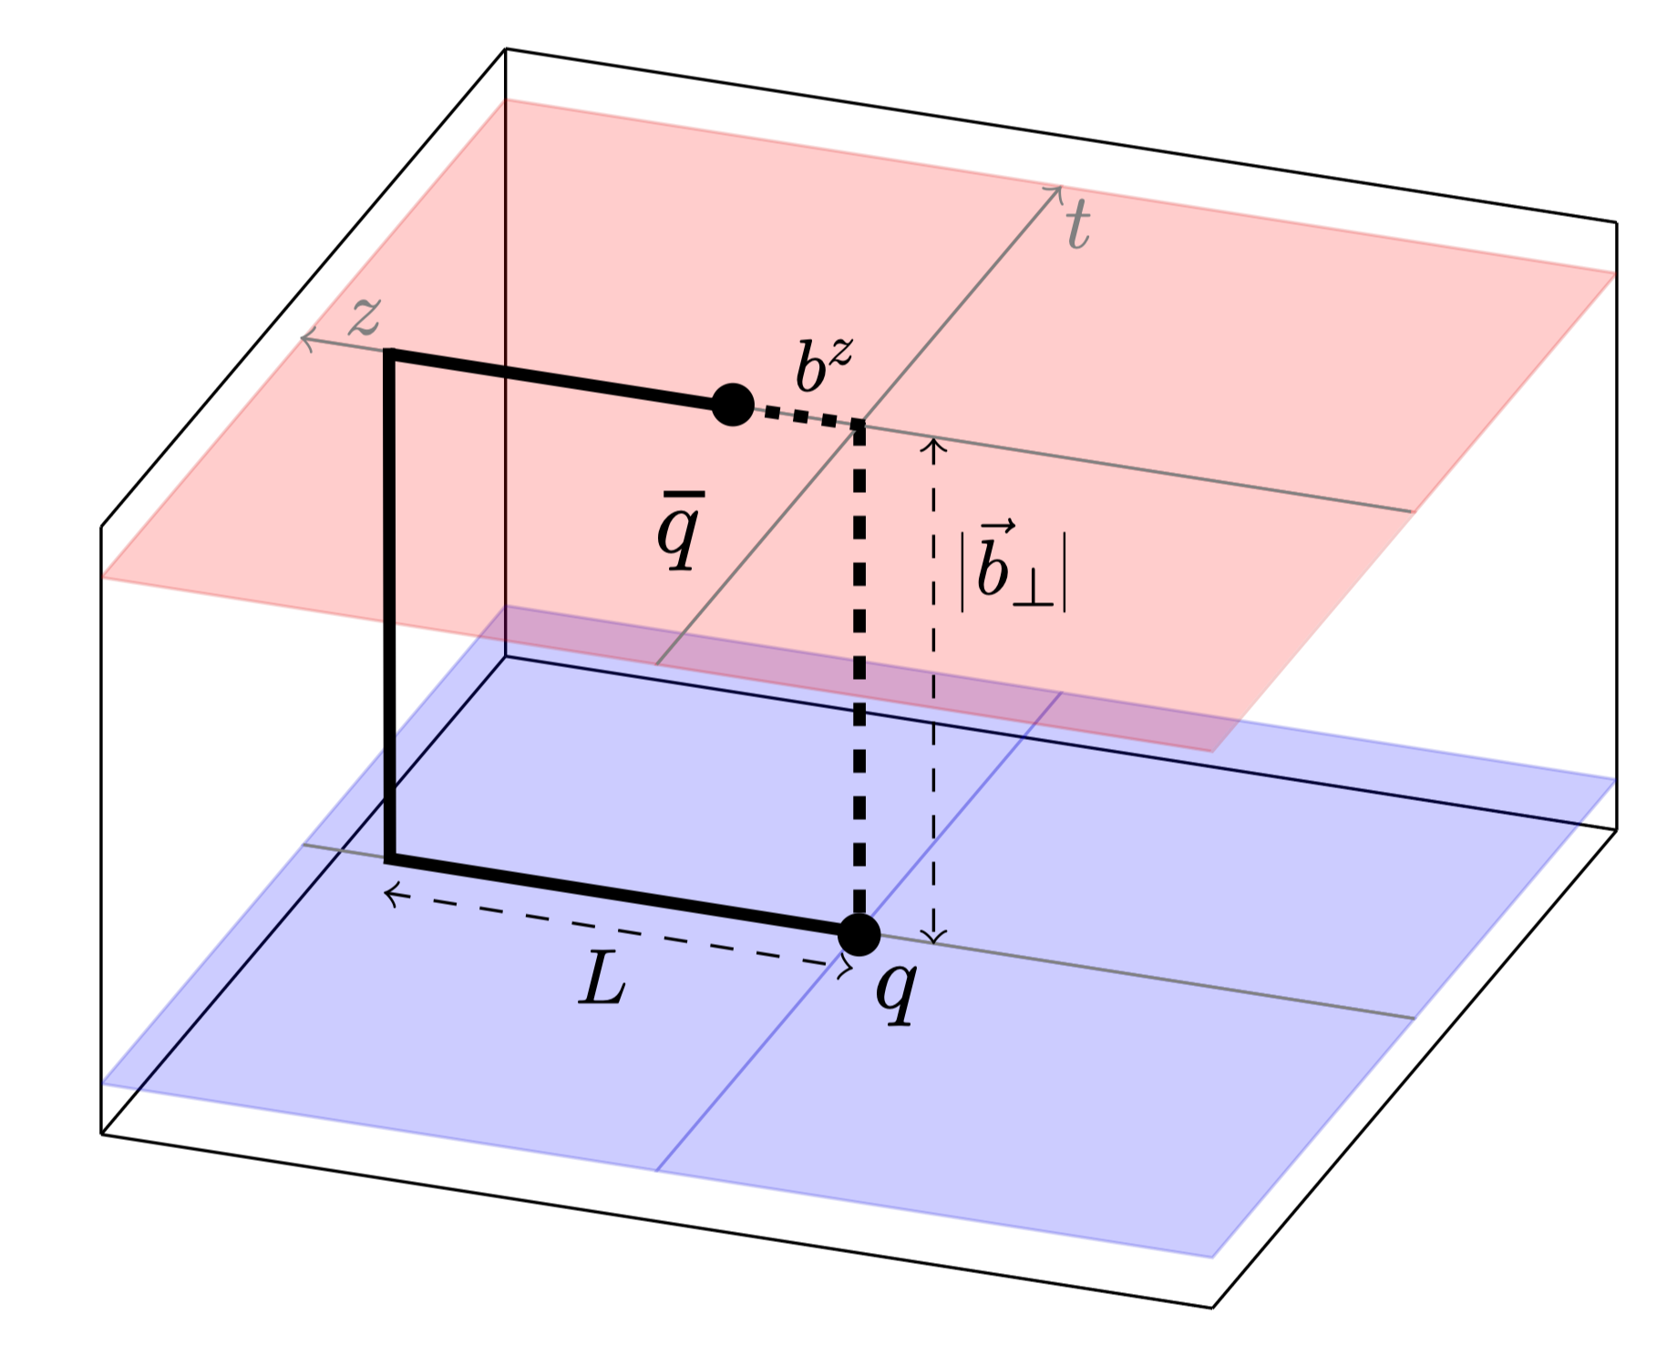





Factorization of quasi TMDPDF
External states
Lorentz boost
$$L→∞$$
Equal-time correlators,
directly calculable on lattice
Space-like correlators,
NO effective method for directly calculation
Connected at large-momentum limit
Matching kernel
Ji, PLB811(2020); Ebert, JHEP04(2022)
Quasi TMDPDF
Intrinsic soft function
Collins-Soper kernel
Light-cone TMDPDF
Notes:
34

Slide 35




Renormalized quasi TMDPDF
FT
Notes:
35

Slide 36


Physical TMDPDF
Physical point & infinite momentum combined extrapolation
Pion mass effect:
310MeV + 220MeV => 135MeV
Power corrections: ~ $O\left({\left(P^{z}\right)}^{−2}\right)$
Notes:
36

Slide 37
Physical TMDPDF
Bacchetta, JHEP06(2019)
Bacchetta, 2206.07598
Scimemi, JHEP06(2020)
Bury, 2201.07114
Notes:
37

Slide 38
Summary
Nucleons make up over 99% of the visible universe, but there are still many open questions.
Various theoretical progresses have been made, and first-principle predictions are needed.
LaMET allows to extract parton distributions from Lattice QCD: PDFs and TMDPDFs.

Slide 39


Outlook
Inclusive: PDF
Exclusive: LCDA
LCDAs provide a complementary role in understanding the structure of the proton.

Slide 40






Outlook
1-d distributions: $\overline{ψ}\left(z\right)Γψ(0)$
Renormalization:
  Large z: linear divergence
  Small z: logarithm divergence
2-d distributions: $ψ^{T}\left(z_{1}\right)Γψ\left(z_{2}\right)ψ\left(0\right)$
Renormalization:
$$z_{2}$$
short
long
$$Z_{S}$$
$$z$$
$$z_{1}$$
Parton Distributions
Lightcone Distribution Amplitudes

Slide 41


Outlook
Heavy-meson LCDA is the crucial input for the study of B meson decays.

Slide 42
Outlook
PRD 127, 062002 (2021)
An attempt is made in heavy quark effective theory, but no first-principle yet.

Slide 43
Backup

Slide 44


Lattice calculations
Lorentz-invariant approach: ratios of Mellin moments
Hagler, EPL88(2009); Musch, PRD85(2012);
Yoon, 1601.05717, PRD96(2017); ……
LaMET formalism:
Preparation I: theoretical framework of calculating TMDPDFs and related intrinsic soft function, Collins-Soper kernel, beam function…
Intrinsic soft function, PRL125(2020)
Ji, RMP93(2021), NPB955(2020), PLB811(2020); Ebert, JHEP04(2022); Deng, JHEP09(2022)……
Preparation II: lattice calculation of intrinsic soft function and Collins-Soper kernel;
LPC, PRL125(2020); Li, PRL128(2022); LPC, PRD106(2022);
Shanahan, PRD104(2021); Schlemmer, JHEP08(2021); ……
Preparation III: Renormalization, resummation
LPC, PRL129(2022); 2209.01236……
Collins-Soper kernel, PRD106(2022)
Notes:
44

Slide 45
LaMET
PDF:
light-cone separation;
Cannot be calculated on the lattice
Quasi-PDF :
Equal-time correlation;
Directly calculable on the lattice

Slide 46

Light-Front Quantization
Naive definition: $f\left(k,p\right)\sim \left\langle p | a_{k}^{†}a_{k} | p\right\rangle$
Every parton has k=∞, however,
x=k/p = finite, x∈ [0,1]
Parton distribution function 𝑓(𝑥)
is the probability of finding parton in a proton, carrying x fraction of the momentum of the parent.

Slide 47
Progress on PDF
Renormalization, self-renormalization

Slide 48

Soft function
Rapidity-independent part: intrinsic/reduced soft function
Ji, NPB955(2020); Zhang, PRL125(2020); Li, PRL128(2022); ……
TMDPDF
<= Zhang, PRL125(2020)
<= Chu, 2211.xxxx
Preliminary
Soft gluon emission => soft function
Notes:
48

Slide 49

Soft function
Rapidity-dependent part: Collins-Soper kernel
From quasi WF:
Chu, PRD106(2022); Zhang, PRL125(2020); Li, PRL128(2022); ……
From quasi beam function:
Shanahan, PRD104(2021); Schlemmer, JHEP08(2021); ……
TMDPDF
Soft gluon emission => soft function
Chu, PRD106(2022)
Notes:
49

Slide 50
Outlook
Difficulty in LCDA: Renormalization
Lattice QCD and pQCD use different regularization, leading to different divergence.
Matching kernel is valid only when the renormalization scheme is the same.
On lattice QCD side: self-renormalization
A scheme convertion factor should be included on Lattice QCD to convert to $\overline{MS}$ scheme
Linear divergence
Log divergence
Discrete effect

