Slide 1
Magnet design for the linac, DR and transport lines of CEPC
Wen Kang
CEPC Day
2023-04-21

Slide 2
Contents
Magnet design for the linac
Magnet design for the transport lines
Magnet design for the Damping Ring
Summary

Slide 3
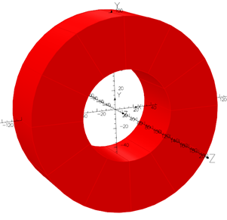
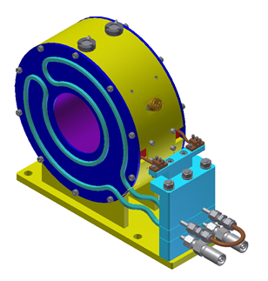
Magnet design for the linac
1) Solenoids
There are 37 solenoids in the linac, which are classified into four families (SOL-I, SOL-II, SOL-III and SOL-IV) based on their apertures. The maximum magnetic fields for SOL-I to SOL-III are 800 Gs, while for SOL-IV, it is 5000 Gs.
Since SOL-I to SOL-III solenoids operate at a relatively low field, they will be wound using enamelled wires with water-cooling plates at the end.
SOL-IV solenoids will be wound using hollow copper conductors with water cooling in the conductors, given their high magnetic fields.

Slide 4
Magnet design for the linac
The main parameters of the solenoids

Slide 5
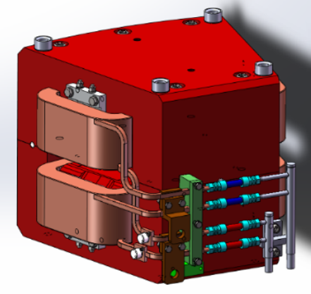
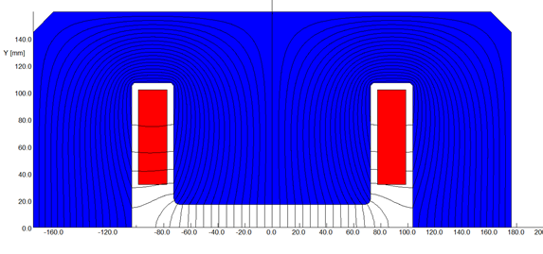
Magnet design for the linac
2) Dipole magnets
The Linac contains 15 dipole magnets that are classified into five families. To control fabrication and cost, the maximum length of the magnet is set to be less than 6 m. So the long AM2/AM5 and AM6/AM7 are divided into multiple magnet units.
The iron cores can be made of low carbon silicon steel laminations or solid steel, while the coils are wound using hollow copper conductors with water cooling.
The cores of the magnets have a curved structure. To install the vacuum chamber, the whole magnet is split into two halves.

Slide 6
Magnet design for the linac
The main parameters of the dipole magnets

Slide 7
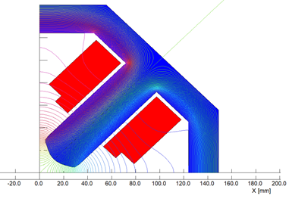
Magnet design for the linac
3) Quadrupole magnets
The quadrupole magnets for the linac are divided into two types: the quadrupole magnets with large aperture and small aperture. The former has an aperture of 150 mm . The latter includes quadrupole magnets divided into four apertures: 24 mm, 34 mm and 60 mm, respectively.
All the quadrupole magnets are DC-excited. The core can be made of silicon steel lamination sheets or DT4 solid iron, while the coils are made using hollow copper conductors.
The maximum field on the pole tips of most magnets is less than 5000Gs, allowing the poles to have a rectangle root and the coils to have a simple racetrack structure.

Slide 8
Magnet design for the linac
The main parameters of the quadrupole magnets

Slide 9
Magnet design for the linac
The main parameters of the quadrupole magnets

Slide 10
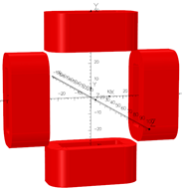
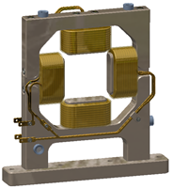
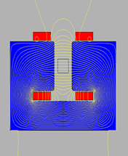
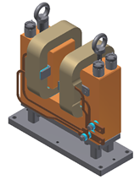
Magnet design for the linac
4) Corrector magnets
In the CEPC Linac, there are seven types of correctors. Three of these, C1, C2, and C3, have very low fields and are designed as correctors without iron cores. The remaining correctors have relatively high fields and are designed as correctors with iron cores.
The coils for all correctors are wound with solid copper conductors, which are installed on the yokes of the cores or supporters made from G10.

Slide 11
Magnet design for the linac
The main parameters of the corrector magnets

Slide 12
Magnet design for the linac
The main parameters of the corrector magnets

Slide 13
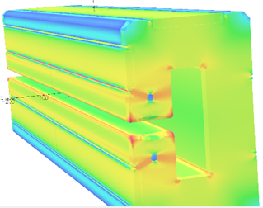
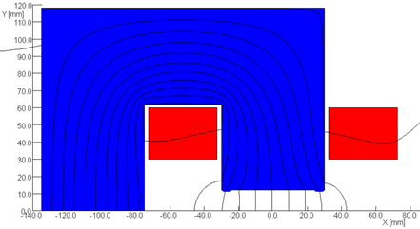
Magnet design for the transport lines
The CEPC Booster features two transport lines, one for electron transport and the other for positron transport. The structures of these transport lines are completely symmetric, with the only difference being the directions of the magnetic fields.
1) Dipole magnets
Each transport line employs four types of dipole magnets, namely BT0 & BT1, Btv, BT2, and BT3, with lengths of 5 m, 28 m, 35 m, and 15 m, respectively.
It is challenging to fabricate very long yokes, so the dipoles with lengths of 15 m and 35 m are divided into three and seven parts, respectively.
The cores of the magnets have a curved C-type structure. So the coils and vacuum chamber could be installed from the side of the cores.

Slide 14
Magnet design for the transport lines
The main parameters of the dipole magnets
Magnet name | BT0&BT1 | BTv | BT2 | BT3
Magnet type | whole | 6in1 | 7in1 | 3in1
Quantity | 48 | 4 | 8 | 4
Magnetic Length (m) | 5 | 5*5+3=28 | 5*7=35 | 5*3=15
Strength of field (T) | 1.5 | 1.5 | 0.426 | 0.81
Gap (mm) | 37 | 37 | 24 | 24
Good field region (mm) | 33 | 33 | 20 | 20
Field uniformity | 0.1% | 0.1% | 0.1% | 0.1%
Excitation amp-turns（At） | 7421 | 7421 | 1418 | 2840
Size of conductor（mm） | 12*12D8 | 12*12D8 | 12*12D8 | 12*12D8
Coils turns on each pole | 24 | 24 | 4 | 8
Current（A） | 310 | 310 | 355 | 355
Current density（A/mm^2) | 3.33 | 3.33 | 3.82 | 3.82
Number of magnet unit | 1 | 6 | 7 | 3
Length of magnet unit (m) | 5 | 5/3 | 5 | 5
Resistance (mOhm）/unit | 218 | 218 | 156 | 156
Voltage drop (V)/unit | 102 | 102 | 31 | 54
Power loss (kW)/unit | 47.9 | 47.9 | 5.8 | 17.8
Total power loss of magnet(kW) | 47.9 | 287.6 | 40.5 | 53.4
Width/Height of core (mm) | 320/500 | 320/500 | 220/323 | 220/323
Weight of magnet unit (ton) | 6.4 | 6.4 | 2.8 | 2.8
Total weight of magnet (ton) | 6.4 | 38.4 | 19.2 | 8.3
Number of cooling circuits | 8 | 8 | 3 | 6
Water pressure drop (kg/cm^2) | 6 | 6 | 6 | 6
Water flow（L/min）/unit | 39.1 | 39.1 | 3.5 | 10.4
Total water flow of magnet (L/min) | 39.1 | 234.8 | 24.5 | 31.2
Temperature rise (deg) | 17.5 | 17.5 | 23.7 | 24.5

Slide 15
Magnet design for the transport lines
2) Quadrupole magnets
The CEPC transport lines require two types of quadrupole magnets. One type has a large aperture of 33 mm and the other has a small aperture of 24 mm.
Since the field gradient is relatively low, the poles of the cores have rectangle roots and the coils are wound by the solid copper conductors without water cooling.
Magnet name | TL-33Q | TL-24Q
Quantity | 80 | 40
Bore diameter（mm） | 33 | 24
Field gradient（T/m） | 14.7 | 27
Magnetic length（m） | 0.9 | 2.0
Ampere-turns per pole（AT） | 1640 | 1593
Coil turns per pole | 72 | 72
Excitation current（A） | 23 | 22
Conductor size（mm） | 8×3 | 8×3
Current density（A/mm²） | 0.95 | 0.92
Resistance（Ω） | 0.44 | 0.93
Inductance（mH） | 25 | 81
Voltage drop（V） | 10.1 | 20.7
Power loss（W） | 229 | 457
Core width/height（mm） | 420/420 | 400/400
Core length（mm） | 888 | 1991
Magnet weight (ton) | 1.36 | 2.79

Slide 16
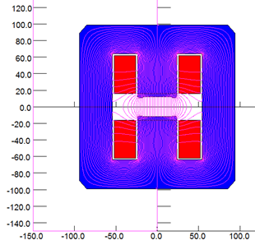
Magnet design for the transport lines
3) Corrector magnets
The CEPC transport lines feature two types of correctors with different gaps: 37 mm and 24 mm.
Because the field precision is 0.1%, the correctors adopt H-type structure cores which can be shimmed to improve the field quality.
Magnet name | TL-37C | TL-24C
Quantity | 24 | 30
Gap [mm] | 37 | 24
Max. Field [Gs] | 1680 | 3000
Magnetic Length [mm] | 200 | 300
Good Field Region [mm] | 33 | 20
Field Uniformity | 0.1% | 0.1%
Ampere turns per pole[At] | 2473 | 2864
Turns per pole | 96 | 112
Max. current[A] | 26 | 26
Size of conductor [mm²] | 8*3 | 8*3
Current density[A/mm²] | 1.07 | 1.07
Resistance(mOhm) | 96 | 153
Power loss (W) | 64 | 100
Voltage[V] | 2.47 | 3.91
Height of core [mm] | 340 | 320
Width of core [mm] | 280 | 300
Core Length [mm] | 180 | 280
Total weight of magnet[kg] | 144 | 226

Slide 17
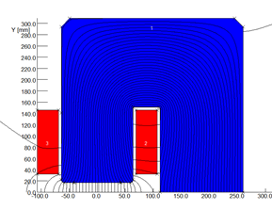
Magnet design for the Damping Ring
1) Dipole magnets
There are 80 dipole magnets in the Damping Ring (DR), each with length of 0.7m or 0.248m. Additionally, there are 28 dipole magnets with length of 2 m for the DR transport line.

Slide 18
Magnet design for the Damping Ring
2) quadrupole magnets
The quadrupole magnets used in both the DR and its transport beam lines have the same design as those for Linac. To facilitate coil installation, the magnets have a four-in-one structure

Slide 19
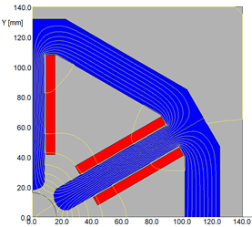
Magnet design for the Damping Ring
3) Sextupole magnets
There are 72 sextupole magnets in DR. The magnet has a two-in-one structure. Due to the low working field and current, the coils are made of solid copper conductors without water cooling.

Slide 20
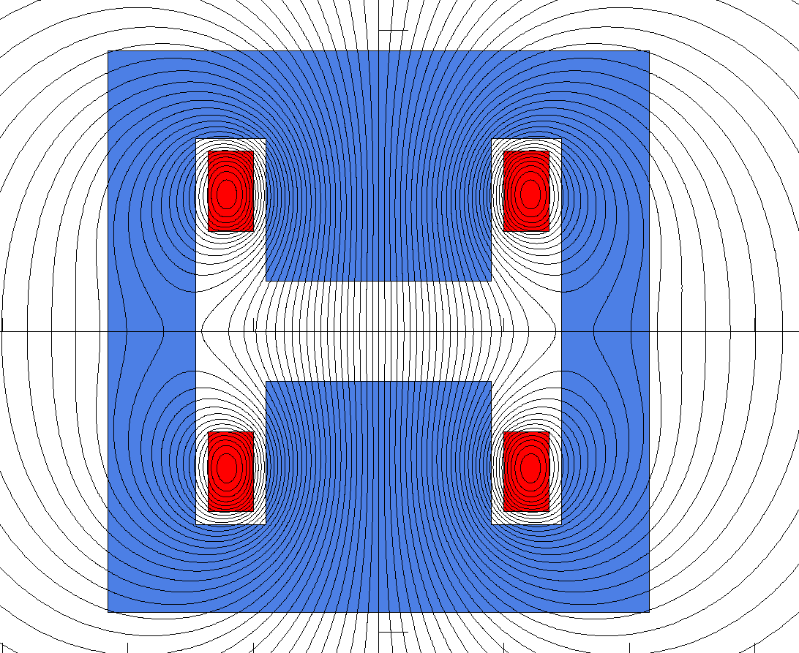
Magnet design for the Damping Ring
4) Corrector magnets
There are 60 correctors in the DR. Since the maximum working field is only 20 Gs, the corrector magnet is designed without iron cores. The coils are made of solid copper conductors, which are supported by a H-type structures made by G10 material.

Slide 21
Summary
The total number of the magnets for linac, DR and transport lines is only 1302, which is a little compared to that of the Booster(18774). But the magnets have 42 types, which are much more than that of the Booster(10).
The length of some dipole magnets is very long, to control the risk of fabrication and cost, the magnets are divided into several units with length less than 5m.
Because all the magnets are DC excited traditional magnets, the design and fabrication of the magnets have no challenging technologies.

