Slide 1
Vacuum system of CEPC
Further interpretation to the Vacuum system cost for the CEPC and the 2nd version of the TDR for the linac/damping ring vacuum system
Yongsheng Ma
2023.4.21

Slide 2
outline
Vacuum System
Linac
Damping ring, Transport line
Collider, Booster
Cost evaluation
TDR report of Linac & damping ring
Conclusion

Slide 3
粒子加速器真空系统构成
真空室
（封闭系统）
真空获得
真空测量
（真空诊断）
束流微波系统
高频系统
注入引出
波纹管
真空测量设备
阀门
真空转接
离子泵
真空计
真空盒
烘烤设备
NEG泵
NEG薄膜
离子泵
分子泵
机械泵
四极质谱仪（RGA）
真空计
检漏仪

Slide 4
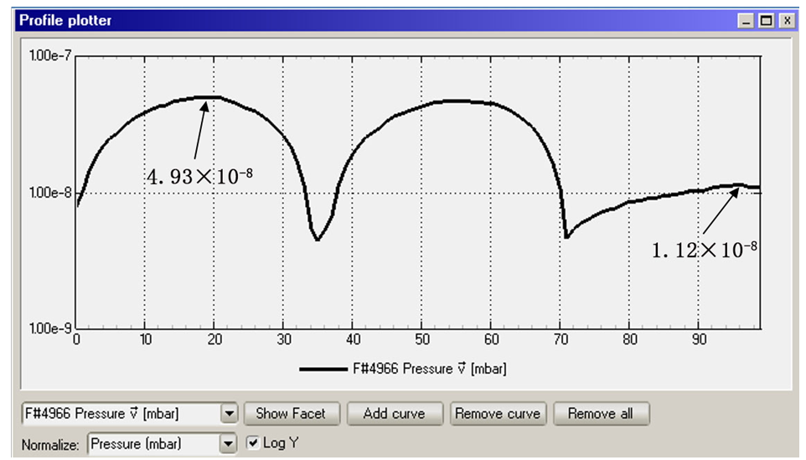
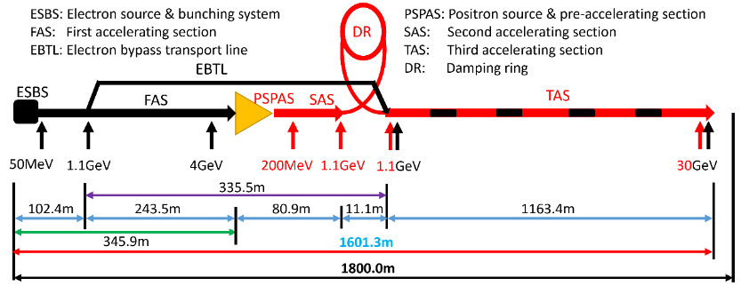
Linac vacuum system
The Linac vacuum system with a length of 2100m is divided into 59 sections. it consists of electron gun, bunching system, accelerating structures .
Sputter ion pumps: 3431; Vacuum gauges: 1352; Gate valves: 60
Section | Static pressure /Torr | Dynamic pressure /Torr
E-gun | <1×10⁻⁹ | <2×10⁻⁸
Buncher | <5×10⁻⁸ | <2×10⁻⁷
Accelerating structure | <5×10⁻⁸ | <2×10⁻⁷
Waveguide | <5×10⁻⁸ | <5×10⁻⁷
Most of the components are made of oxygen-free copper .
The thermal outgassing rate is 1×10⁻¹¹ Torr·l/s·cm².
Notes:
conventional technology

Slide 5
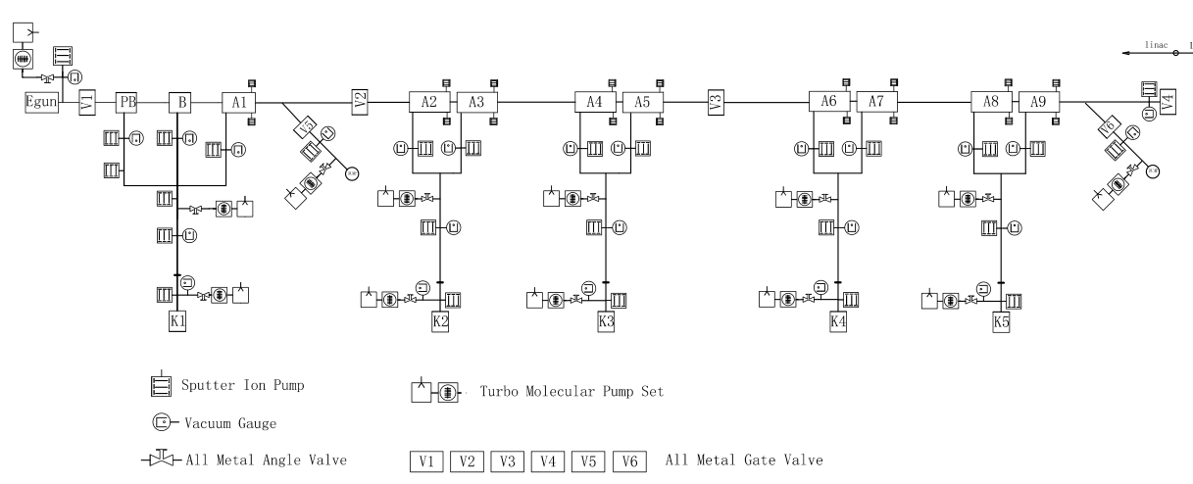
Linac Vacuum system
 | 真空计、离子泵、真空管等数量统计表
序号 | 直线元件 | 直线元件数量 | 真空计 | 离子泵 | 波纹管 | 闸板阀 | 粗抽阀
1 | 加速结构 | 581 | 581 | 1162 | / | 48 | 145
2 | 束调管 | 271 | 271 | 271 | / | / | /
3 | 波导长度 | 4065 | 407 | 1626 | / | / | /
4 | 真空管 | 931 | 93 | 372 | 663 | 11 | 33
 |  | 合计 | 1352 | 3431 | 4094 | 59 | 178
相关系统 | 名称 | 数量 | 孔径/间隙(mm) | 长度/m | 总长/m | 备注(仅粗略估计)
Linac | 波纹管 | 7 | 30 | 0.05645 | 0.39515 | 此波纹管数量仅包括磁铁与加速结构之间的连接，对于EBTL及直线末端预留的长真空盒之间的波纹管连接未考虑
 |  | 350 |  | 0.09500 | 33.25
 |  | 3 |  | 0.09645 | 0.28935
 |  | 4 |  | 0.10950 | 0.438
 |  | 234 |  | 0.13922 | 32.57748
 |  | 62 |  | 0.1495 | 9.269
 | 磁铁相关真空盒 |  | 20-30 | 335 | 334.76102 | 阀门及泵未统计 （加速结构的数量见微波系统）
 | EBTL段长真空盒,（电子bypass） |  | 30 | 335 | 335
 | 直线末端长真空盒 |  | 20/30 | 185 | 185
 | 合计 |  |  |  | 930.98

Slide 6
 | Classification | length/m | 说明
transport line | linac to booster | 3000 | 直线到booster的输运线，正负电子各1500米；
 | booster to colider | 960 | booster到主环的输运线，离轴注入正负电子各240米；在轴注入正负电子各240米。
 | colider to booster | 480 | 主环到booster的输运线，正负电子各240米
 | damping ring | 240 | 进出各120
 | total length | 4680
Damping ring, Transport line
DR | Classification | length/m
 | 标准弧区真空盒长度 | 119.0
 | 直线节 | 14.0
 | 高频代用 | 0.0
 | 高频 | 3.0
 | 注入引出 | 2.8
 | 离子泵接口三通 | 1.5
 | 波纹管 | 1.5
 | BPM | 4.0
 | 真空转接 | 1.5
 | total length | 147.3

Slide 7
Collider, Booster
 | Classification | length/m
booster | 标准弧区真空盒长度 | 78426
 | 直线节 | 11100
 | 高频代用 | 5910
 | 高频 | 96
 | 注入引出 | 198
 | 离子泵接口三通 | 1250
 | 波纹管 | 850
 | BPM | 240
 | 真空转接 | 1930
 | total length | 100000
collider | Classification | length/m
 | 标准弧区真空盒长度 | 78426
 | 直线节 | 4000
 | 高频代用 | 5648
 | 对撞区 | 7000
 | 高频 | 352
 | 注入引出 | 286
 | Manifold for SIP | 1333
 | RF shielded bellows | 2057
 | BPM | 300
 | 对撞点1 | 12
 | 对撞点2 | 12
 | 真空转接 | 574
 | total length | 100000

Slide 8
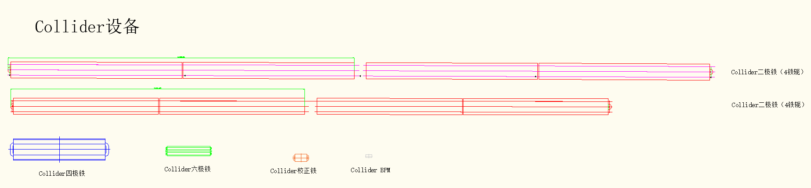
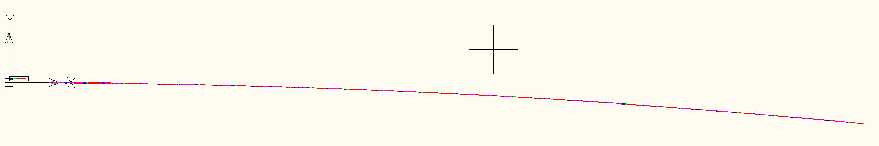
Configuration of Vacuum chamber in collider
Wang YW
LI MX
collider 真空盒的数量与长度统计：根据磁铁长度与布局得到
 | 根据磁铁分类 | 组合数量 | 真空盒长度 |  | 标准单元数量 | 真空盒总数量 | 合计长度 | 备注
标准单元 | 二级铁组合A | 30 | 11.5 | 米 | 64 | 3840 | 44160 | 磁铁组合放2根真空盒
 | 二级铁组合B | 16 | 9.8 | 米 | 64 | 2048 | 20070.4 | 磁铁组合放2根真空盒
 | 四六级铁组合 | 16 | 6.5 | 米 | 64 | 1024 | 6656 | 磁铁组合放1根真空盒
 | 四级，校正铁组合 | 31 | 3.8 | 米 | 64 | 1984 | 7539.2 | 磁铁组合放1根真空盒
弧区汇总 |  |  |  |  |  | 8896 | 78425.6
直线节 |  | 4000 | 11 |  |  | 364 | 4000
高频代用 |  | 5648 | 11 |  |  | 513 | 5648
对撞区 |  | 7000 | 5.5 |  |  | 513 | 7000
直线节汇总 |  |  |  |  |  | 1391 | 16648
合计 |  |  |  |  |  | 10287 | 95074

Slide 9
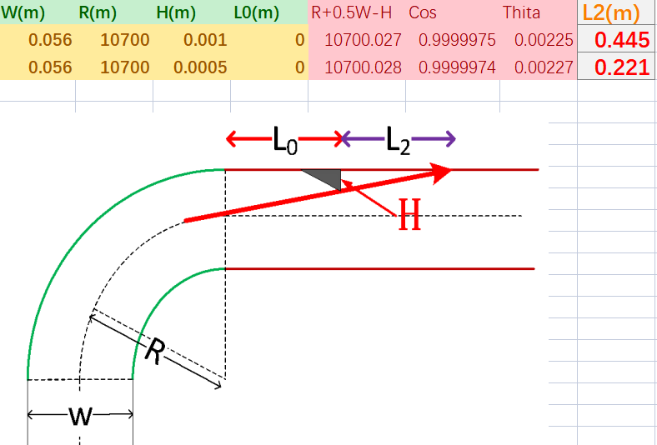
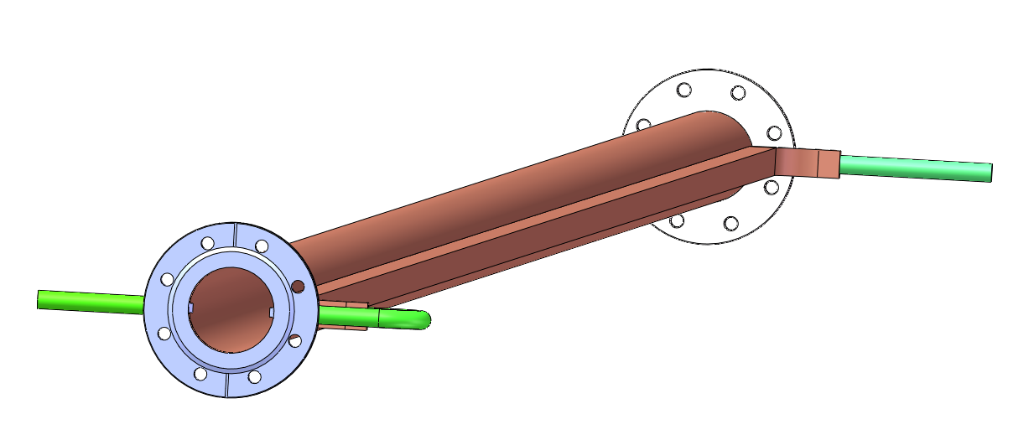
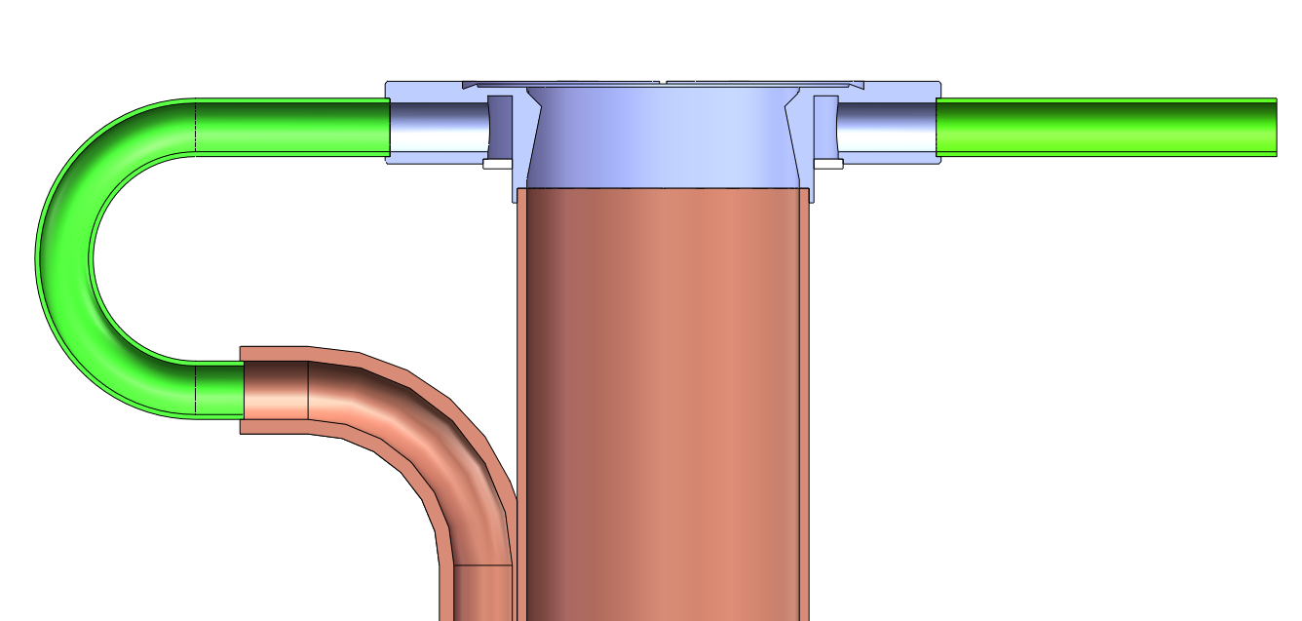
The block and water cooling design for collider
Due to the large bending radius, a 1mm block at the dipole iron outlet can block the synchronous light irradiation in the downstream 0.44m area, theoretically.
The installation accuracy needs to be very high.

Slide 10
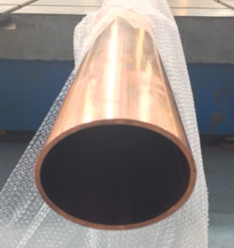
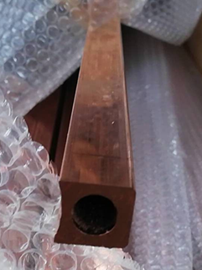
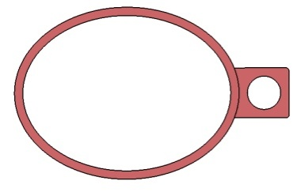
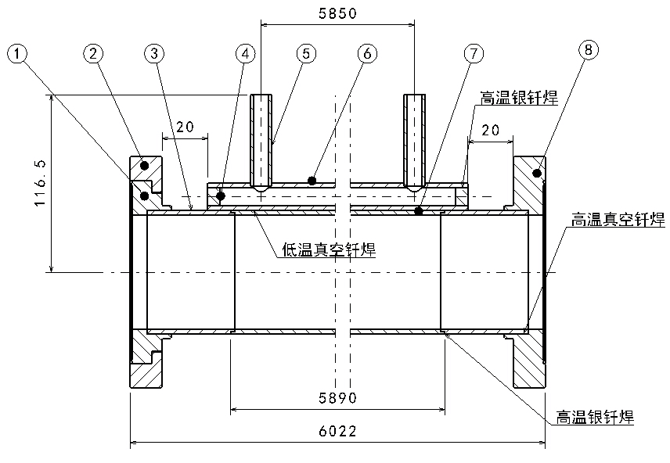
Technique process Cu vacuum chamber
Cu beam pipe and water cooling channel are extruded respectively, and brazed together.
Stainless steel material is used for flanges, and there is a rotatable flange at an end of vacuum chamber.
The flanges and beam pipe are welded by high temperature brazing solder, and low temperature brazing solder are used between the beam pipe and water cooling channel.
Vacuum chamber
Beam pipe +
Cooling channel

Slide 11
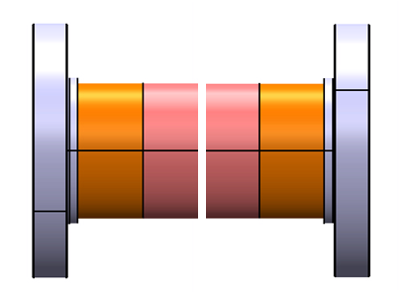
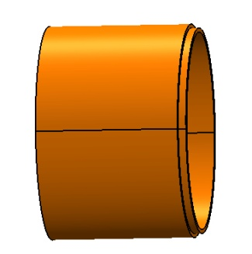
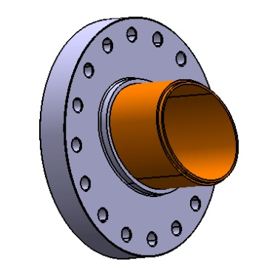
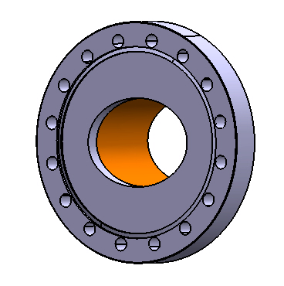
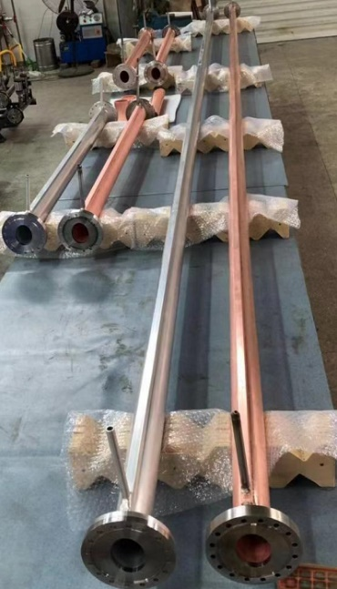
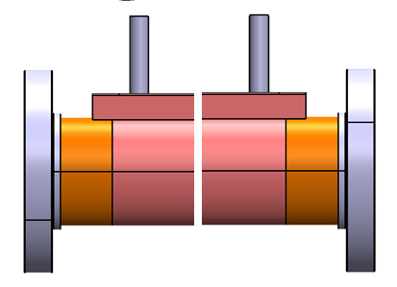
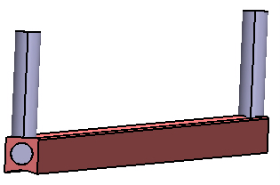
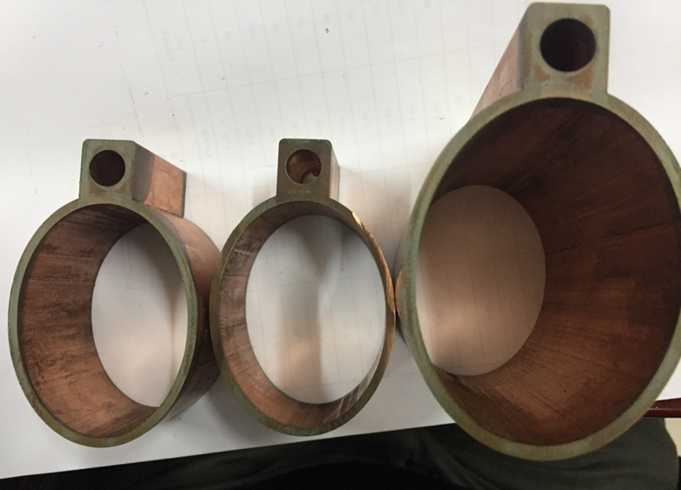
Technique process of Cu vacuum chamber
Leak detection
Transition tube machining
Brazing
Knife edge machining of flange
Silver brazing or EBW
Leak detection
Leak tests for hydraulic pressure and vacuum
Welding between beam pipe and cooling channel with a low temperature brazing solder
Welding of fittings for cooling channel
Cleaning, leak detection, baking and pumping down

Slide 12
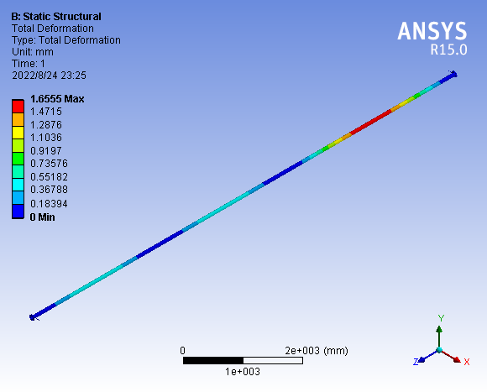
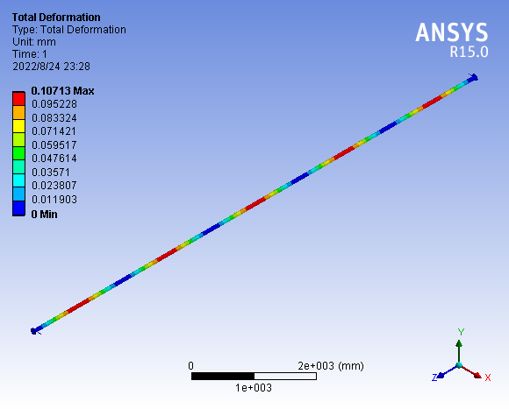
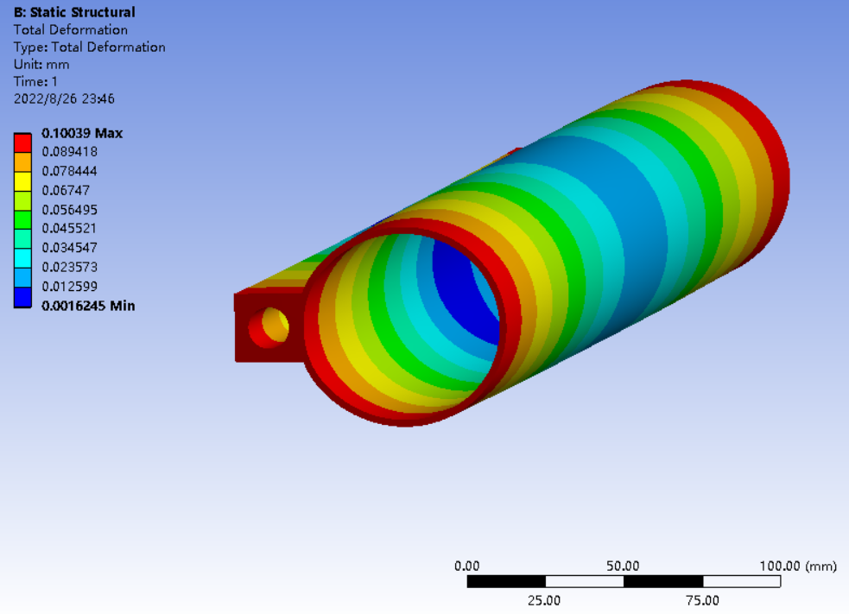
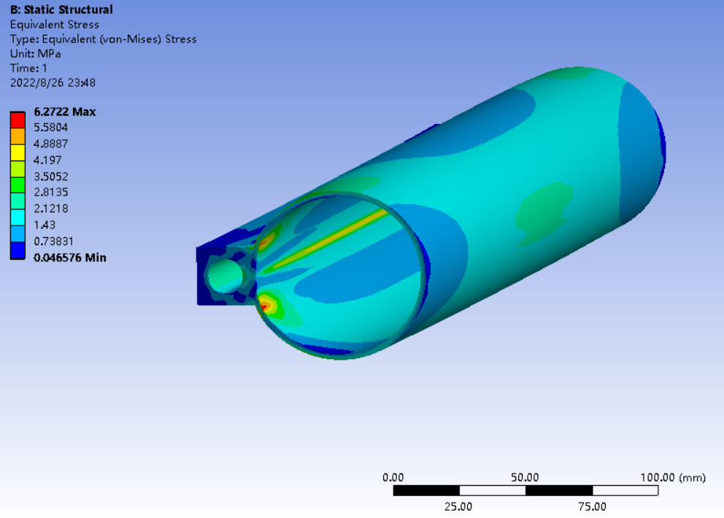
Strength calculation of 10 m vacuum chamber
Good support is an important guarantee to ensure that the 10-meter vacuum chamber does not deform
Every 3m is supported, with a maximum deformation of 1.66mm;
Every 2m is supported, with a maximum deformation of 0.1mm
The RF bellows need enough compression length

Slide 13
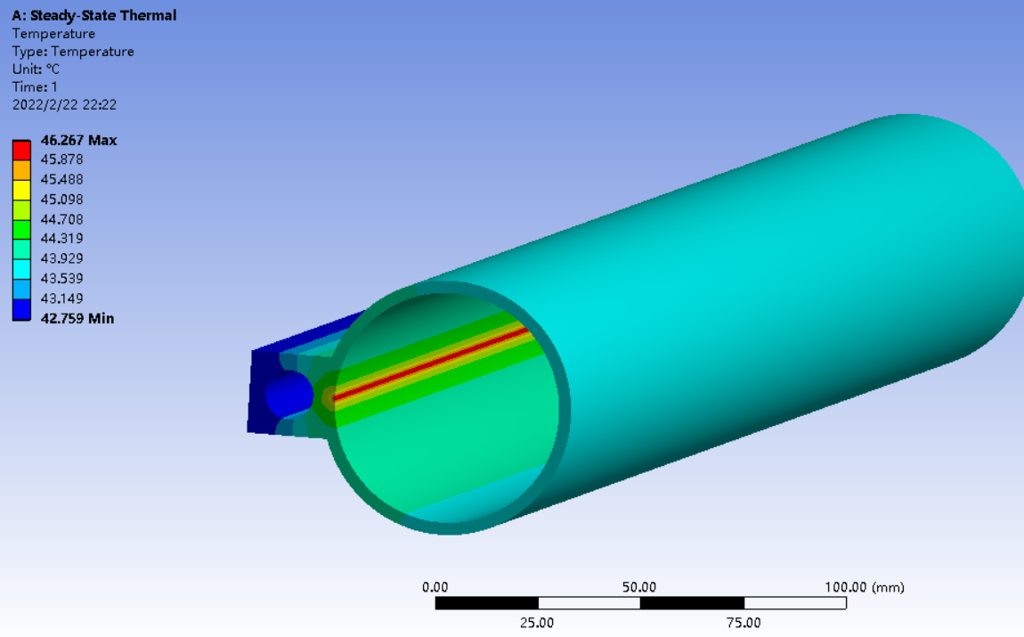
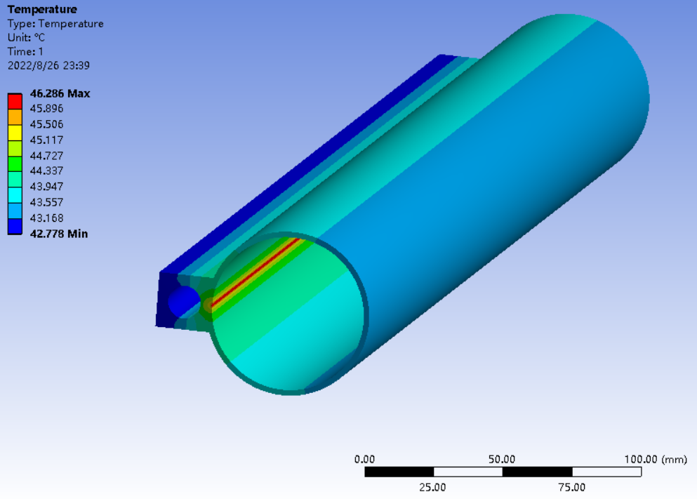
Comparison of temperature rise with different wall thickness
Boundary conditions:
water cooling convection heat transfer coefficient 1000 W/ m²·k,
air natural convection heat transfer coefficient W/ m²·k;
Photon power density 740W/m; The width of photon beam is 0.85mm.
3mm
2mm
Every 2m is supported, with a maximum deformation of 0.1mm
Conclusion:
The water cooling efficiency has a great influence on the temperature
Vacuum chamber Wall thickness has little effect on temperature
the thermal deformation caused by synchronous light mainly depends on the water cooling effect
When the chamber wall is thinner, better support is needed to prevent deformation

Slide 14
铜真空盒预算说明（按单环核算）
 |  | collider d56圆铜真空盒(单环弧区)-2018价格 |  |  |  | collider d56圆铜真空盒(单环直线节)-2018价格 |  | 备注
编号 | 明细项目 | 单位 | 单价（万元/米） | 数量 | 总价（万元） | 数量 | 总价（万元）
1 | 管坯材料 | 米 | 0.20 | 78426 | 15685 | 16648 | 3330 | 按弧区78.4km，直线节、高频区、对撞区共16km计算
2 | 法兰 | 套 | 0.10 | 17792 | 1779 | 2781 | 278
3 | 加工费 | 套 | 0.80 | 8896 | 7117 | 1391 | 1112 | 包括真空管、水道、挡光台阶等的加工，涉及5.5米长冷却水管的低温钎焊
4 | 焊接及装配检测费 | 套 | 1.10 | 8896 | 9786 | 1391 | 1530
5 | 水路配件 | 套 | 0.05 | 8896 | 445 | 1391 | 70
6 | 表面处理费 | 米 | 0.05 | 78426 | 3921 | 16648 | 832 | 需有效去除表面碳氧化层
7 | 包装运输 | 套 | 0.10 | 8896 | 890 | 1391 | 139 | 真空封装，需要两个盲板法兰
8 | 税费 | 套 | 0.33 | 8896 | 2891 | 1391 | 452 | 13%
 | 合计 |  |  |  | 42398 |  | 7725 | 50122.5
CDR铜真空盒是按80km估算，TDR 按真空盒长度95.074km计算,单环铜真空盒增加15.074km；

Slide 15
Collider cost
 |  |  |  | CDR |  |  |  | TDR |  |  |  | TDR-CDR
No. | Classification | Device | Unit | Specification | Quantity | Unit price / (CNY 10,000) | total Price / (CNY 10,000) | Specification | Quantity | Unit price / (CNY 10,000) | total Price / (CNY 10,000) | / (CNY 10,000) | Note
1 | Collider | arc beam pipe_positron | ring | D56/C10100 | 1 | 64000 | 64000 | D56/C10100 | 1 | 42398 | 42398.0 | -21602 | 简化真空盒结构，将真空链接件单独列出
2 |  | arc beam pipe_electron | ring | Al-6060 | 1 | 32000 | 32000 | D56/C10100 | 1 | 42398 | 42398.0 | 10398 | 电子环铝升级为铜，简化真空盒结构
3 |  | Straight section beam pipe | m | 304 | 40000 | 0.2 | 8000 | 304L | 2 | 7725 | 15449.2 | 7449 | 将不锈钢更改为铜
4 |  | Manifold for SIP | one |  | / |  |  |  | 13333 | 0.3 | 4000.0 | 4000 | CDR是含在真空盒中
5 |  | Manifold for Gauge & RGA | one | 304 | / |  |  | 304L | 4840 | 0.3 | 1452.0 | 1452 | CDR是含在真空盒中
6 |  | NEG coating | m | Ti-Zr-V | 100000 | 0.15 | 15000 | Ti-Zr-V | 200000 | 0.15 | 30000.0 | 15000 | 电子环增加NEG镀膜
7 |  | Ion pump | one | 50-100L/s | 22300 | 1..5 | 33450 | 50-100L/s | 13333 | 1.5 | 20000.0 | -13450 | 按照Higgs 30MW最低配置，同时NEG镀膜降低泵的数量
8 |  | Molecular pump | one | 200L/s | 300 | 10 | 3000 | 200L/s | 300 | 10 | 3000.0 | 0
9 |  | Gate valve | one | DN63 | 1040 | 15 | 15600 | DN63 | 1040 | 15 | 15600.0 | 0
10 |  | Roughing valve | one | CF63 | 3120 | 1 | 3120 | CF63 | 3120 | 1 | 3120.0 | 0
11 |  | RF shielded bellows | one | DN63 | 24000 | 1.5 | 36000 | DN63 | 20573 | 1.5 | 30859.6 | -5140 | 真空盒数量变动引起RF屏蔽波纹管数量减少
12 |  | Vacuum gauge | one | CCG | 4320 | 2 | 8640 | CCG | 4320 | 2 | 8640.0 | 0
13 |  | Residual gas analyzer | one | RGA | 520 | 10 | 5200 | RGA | 520 | 10 | 5200.0 | 0
14 |  | Helium leak detector | one | He | 100 | 30 | 3000 | He | 100 | 30 | 3000.0 | 0
15 |  | Cooling tube | m | 10mm | 200000 | 0.005 | 1000 | 10mm | 200000 | 0.005 | 1000.0 | 0
16 |  | Vacuum heating | m | 220v | 200000 | 0.01 | 2000 | 220v | 200000 | 0.1 | 20000.0 | 18000 | CDR计算有误，增加1.8亿
17 |  | Vacuum control |  |  |  |  | 2000 |  | 1 | 2000 | 2000.0 | 0
18 |  | Vacuum cleaning |  |  |  |  | 1000 |  | 1 | 1000 | 1000.0 | 0
 |  | Total |  |  |  |  | 233010.0 |  |  |  | 249116.7 | 16107 | 合计增加1.61亿元

Slide 16
Booster cost
 |  |  |  | CDR |  |  |  | TDR |  |  |  | TDR-CDR
No. | Classification | Device | Unit | Specification | Quantity | Unit price / (CNY 10,000) | total Price / (CNY 10,000) | Specification | Quantity | Unit price / (CNY 10,000) | total Price / (CNY 10,000) | / (CNY 10,000) | Note
19 | Booster | Arc beam pipe | m | Al6060 | 80000 | 0.4 | 32000 | Al6060 | 1 | 27367 | 27367.3 | -4633 | 简化真空盒结构
20 |  | Straight section beam pipe | m | 304 | 20000 | 0.2 | 4000 | 316L | 1 | 5540 | 5540.0 | 1540 | 不锈钢改为铝合金
21 |  | Manifold for SIP | one |  | / |  |  | 316L | 8400 | 0.3 | 2520.0 | 2520 | CDR是含在真空盒中
22 |  | Manifold for Gauge & RGA | one |  | / |  |  | 316L | 2420 | 0.3 | 726.0 | 726 | CDR是含在真空盒中
23 |  | Bellows | one | 304 | 12000 | 0.3 | 3600 | 316L | 12000 | 0.3 | 3600.0 | 0
24 |  | Ion pump | one | 100-400L/s | 8400 | 1.5 | 12600 | 100-400L/s | 8400 | 1.5 | 12600.0 | 0
25 |  | Gate valve | one | DN63 | 520 | 10 | 5200 | DN63 | 520 | 10 | 5200.0 | 0
26 |  | Roughing valve | one | CF63 | 1560 | 1 | 1560 | CF63 | 1560 | 1 | 1560.0 | 0
27 |  | Vacuum gauge | one | CCG | 2160 | 2 | 4320 | CCG | 2160 | 2 | 4320.0 | 0
28 |  | Residual gas analyzer | one | RGA | 260 | 10 | 2600 | RGA | 260 | 10 | 2600.0 | 0
29 |  | Vacuum control | one |  |  |  | 1000 |  |  |  | 1000 | 0
30 |  | Vacuum cleaning | one |  |  |  | 500 |  |  |  | 500 | 0
 |  | Total |  |  |  |  | 67380 |  |  |  | 67533.3 | 153

Slide 17
LINAC cost
 |  |  |  | CDR |  |  |  | TDR |  |  |  | TDR-CDR
No. | Classification | Device | Unit | Specification | Quantity | Unit price / (CNY 10,000) | total Price / (CNY 10,000) | Specification | Quantity | Unit price / (CNY 10,000) | total Price / (CNY 10,000) | / (CNY 10,000) | Note
31 | LINAC | Beam pipe | m | 304 | 1500 | 0.2 | 300 | 316L | 931 | 0.3 | 279.3 | -21 | 磁导率：1.02～1.05，磁铁内1.02，个别1.05
32 |  | Manifold for SIP | one |  | / |  |  | 316L | 3431 | 0.3 | 1029.3 | 1029 | CDR是含在真空盒中
33 |  | Manifold for Gauge & RGA | one |  | / |  |  | 316L | 1352 | 0.3 | 405.6 | 406 | CDR是含在真空盒中
 |  | Manifold for Gauge & RGA | one |  | / |  |  | 316L | 1352 | 0.3 | 405.6 | 406 | CDR是含在真空盒中
34 |  | Bellows | one | 304 | 1760 | 0.3 | 528 | 316L | 4094 | 0.3 | 1228.2 | 700
35 |  | Sputtering Ion pump | one | 100L/s | 1310 | 2 | 2620 | 100L/s | 3431 | 2 | 6862 | 4242 | 数量考虑了波导、束调管、能量倍增器等的需求
36 |  | Molecular pump | one | 400L/s | 10 | 10 | 100 | 400L/s | 10 | 10 | 100 | 0
37 |  | Gate valve | one | CF40 | 30 | 15 | 450 | CF40 | 30 | 15 | 450 | 0
38 |  | Gate valve | one | CF25 | / |  |  | CF25 | 30 | 15 | 450 | 450
39 |  | Roughing valve | one | CF63 | 90 | 1 | 90 | CF63 | 178 | 1 | 178 | 88 | VAT进口阀门
40 |  | Vacuum gauge | one | CCG | 611 | 2 | 1222 | CCG | 1352 | 2 | 2704 | 1482 | 数量考虑了波导、束调管、能量倍增器等的需求
41 |  | Residual gas analyzer | one | RGA | 10 | 10 | 100 | RGA | 10 | 10 | 100 | 0
42 |  | Helium leak detector | one | He | 5 | 30 | 150 | He | 5 | 30 | 150 | 0
43 |  | Vacuum connectors | one |  | 1 | 300 | 300 |  | 1 | 600 | 600 | 300
44 |  | Vacuum heating | one |  | 1 | 50 | 50 |  | 1 | 50 | 50 | 0
45 |  | Vacuum control | one |  | 1 | 100 | 100 |  | 1 | 100 | 100 | 0
46 |  | Vacuum cleaning | one |  | 1 | 50 | 50 |  | 1 | 50 | 50 | 0
 |  | Total |  |  |  |  | 6060 |  |  |  | 14736.4 | 8676 | 能量增加20GeV

Slide 18
Damping ring & transport line cost
 |  |  |  | CDR |  |  |  | TDR |  |  |  | TDR-CDR
No. | Classification | Device | Unit | Specification | Quantity | Unit price / (CNY 10,000) | total Price / (CNY 10,000) | Specification | Quantity | Unit price / (CNY 10,000) | total Price / (CNY 10,000) | / (CNY 10,000) | Note
47 | Damping | Beam pipe | m | 304 | 120 | 0.2 | 24 | Al6060 | 150 | 0.4 | 60 | 36 | 真空盒材料改为铝合金
48 |  | Bellows | one | 304 | 60 | 0.2 | 12 | 316L | 75 | 1.5 | 112.5 | 101 | 磁导率要求，材料改为316L
49 |  | Ion pump | one | 30L/s | 80 | 1.5 | 120 | 30L/s | 100 | 1.5 | 150 | 30
50 |  | Molecular pump | one | 400L/s | 2 | 10 | 20 | 400L/s | 2 | 10 | 20 | 0
51 |  | Gate valve | one | CF63 | 4 | 10 | 40 | CF63 | 8 | 10 | 80 | 40
52 |  | Roughing valve | one | CF35 | 10 | 0.5 | 5 | CF35 | 10 | 0.5 | 5 | 0
53 |  | Vacuum gauge | one | CCG | 6 | 2 | 12 | CCG | 25 | 2 | 50 | 38
54 |  | Residual gas analyzer | one | RGA | 2 | 10 | 20 | RGA | 8 | 10 | 80 | 60
55 |  | Vacuum connectors | one |  | 1 | 67 | 67 |  | 1 | 150 | 150 | 83
 |  | Total |  |  |  |  | 320 |  |  |  | 705.5 | 388 | 增加 388万元
56 | transport line | Beam pipe | m |  |  |  |  | 316L | 4680 | 0.3 | 1404 | 1404 | 内径D57
57 |  | Bellows | one |  |  |  |  | 316L | 936 | 0.3 | 280.8 | 281
58 |  | Ion pump | one |  |  |  |  | 100L/s | 936 | 1.5 | 1404 | 1404
59 |  | Roughing valve | one |  |  |  |  | CF35 | 234 | 0.5 | 117 | 117 | 按20米分布
60 |  | Gate valve | one |  |  |  |  | CF35 | 47 | 10 | 468 | 468
61 |  | Vacuum gauge | one |  |  |  |  | CCG | 234 | 2 | 468 | 468 | 按20米分布
 |  | Total |  |  |  |  |  |  |  |  | 4141.8 | 4142 | 4141.8

Slide 19
Conclusion - Total cost CDR Vs TDR
NEG coating will be applied to both e-, e+ ring;
Vacuum system budget of TDR increased by CNY 290 million
accelerator | CDR | TDR | TDR-CDR
 | total Price / (CNY 10,000) | total Price / (CNY 10,000) | total Price / (CNY 10,000)
Collider | 233010.0 | 249116.7 | 16106.7
Booster | 67380.0 | 67533.3 | 153.3
LINAC | 6060.0 | 14736.4 | 8676.4
Damping | 320.0 | 707.5 | 387.5
transport line | \ | 4141.8 | 4141.8
 | 306770.0 | 336235.7 | 29465.7

Slide 20
TDR report of Linac & damping ring

Slide 21
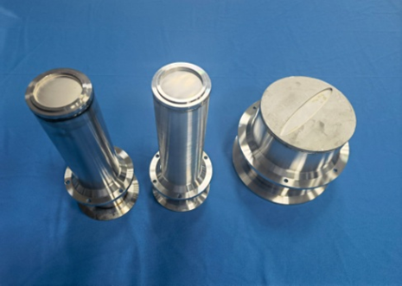
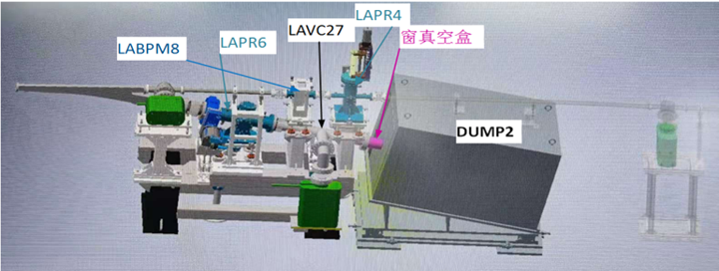
Dump chambers and membrane windows for Linac
The elliptical Ti thin membrane window of 170×10 mm with a thickness of 0.1 mm was welded on the s. s. plate with a diameter of 183 mm and a thickness of 5mm.
membrane windows
Membrane windows
The thickness of Ti window is 0.1mm
Deformation test under vacuum: elliptical window is 0.4mm, circle window is 2.3mm;
ultimate vacuum<5 ×10⁻⁸Pa。
Notes:
材料的选择→加工工艺→样件试制→检漏→变形测量→极限真空测试
对0.1mm厚的钛膜进行电子束焊和钎焊试验；
钛窗真空下变形实验，椭圆窗0.4mm，圆窗2.3mm，打压1MPa未发现有漏；
极限真空小于5 ×10⁻⁸Pa。

Slide 22
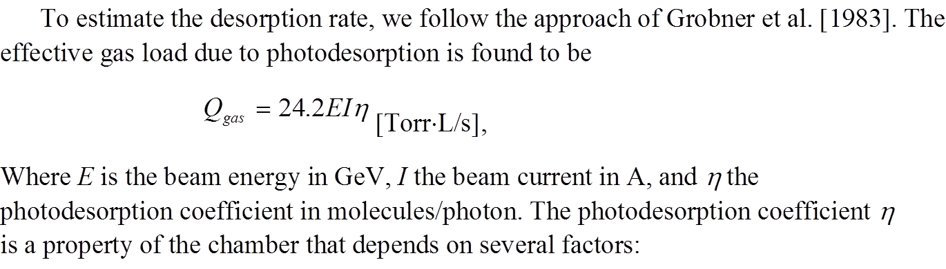
SR power and gas load of damping ring
 | E | I | ρ | Psr | PL | PSD | q _{th} | Q _{gas} | Q _{LSR}
 | Gev | A | m | MW | W/m | molecules/photon | Torr·L/s·cm² | Torr·L/s | Torr·L/s·m
damping ring | 1.1 | 0.024 | 2.87 | 0.00 | 60.12 | 2.00E-06 | 1.28E-06 | 7.09E-08 | 1.1
50MW 下最差真空度--公式计算 2E-6 热放气率按1E-11
 |  | 离子泵间距 | 热放气率 | 每米热气载 | 总长度 | 单位长度 | 总放气量 | 有效抽速 | Pave--总压 | Pmax--总压
 | D/cm | L/cm | TorrL/scm² | TorrL/sm | 流导 L/s |  | TorrL/scm² | S L/s | Torr | Torr
damping | 3 | 200 | 1E-11 | 9.42E-09 | 1.6335 | 3.267 | 8.53E-11 | 15 | 1.9E-08 | 2.3E-08

Slide 23
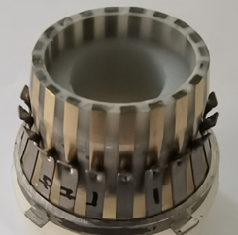
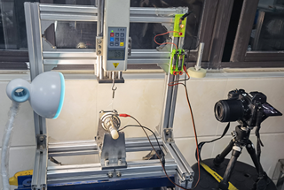
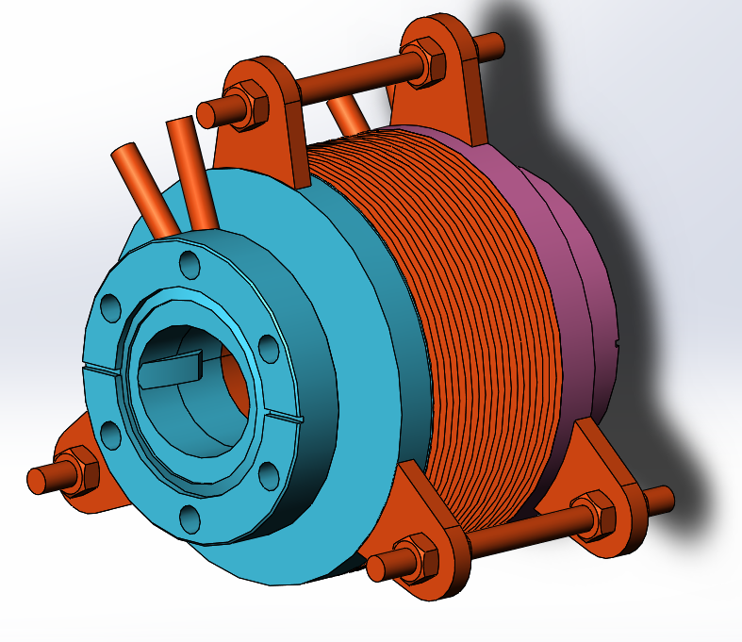
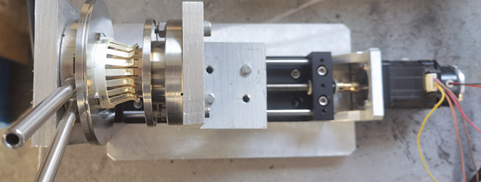
RF shielding bellows of damping ring
Total length | Expansion | Contraction | Ellipse cross section | Contact pressure | Maximum radial offset
70-100mm | 5mm | 10mm | 36mm×30mm | 125±25g | 2mm
Mask is designed on the upstream of RF bellows to absorb the SR
The all RF bellows will be produced by domestic company in China

Slide 24
Thank You

Slide 25
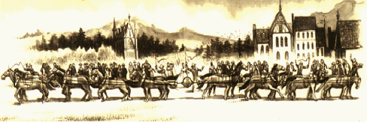
1654年，科学家葛利克做过一个有名的“马拉铜球”的实验，以表明我们周围并非什么也没有，而是充满空气：空气对物体施加压力，以至于16匹马都得十分费力才能把抽空气体的铜球拉开。
但是，真空其实不空。直到今天，科学家甚至不能完全排除某一小范围内的空气。电视机显像管需要高真空才能保证图像清晰，其内部真空度达到几十亿分之一个大气压这样的真空内，1立方厘米大小的空间也有好几百亿个空气分子。在高能加速器上，为防止加速的基本粒子与管道中的空气分子碰撞而损失能量，需要管道保持几亿亿分之一个大气压的“超高真空”；即使在这样的空间，1立方厘米内还有近千个空气分子；即使在高度真空的太空实验室里，每立方厘米的空间也有几个空气分子

Slide 26
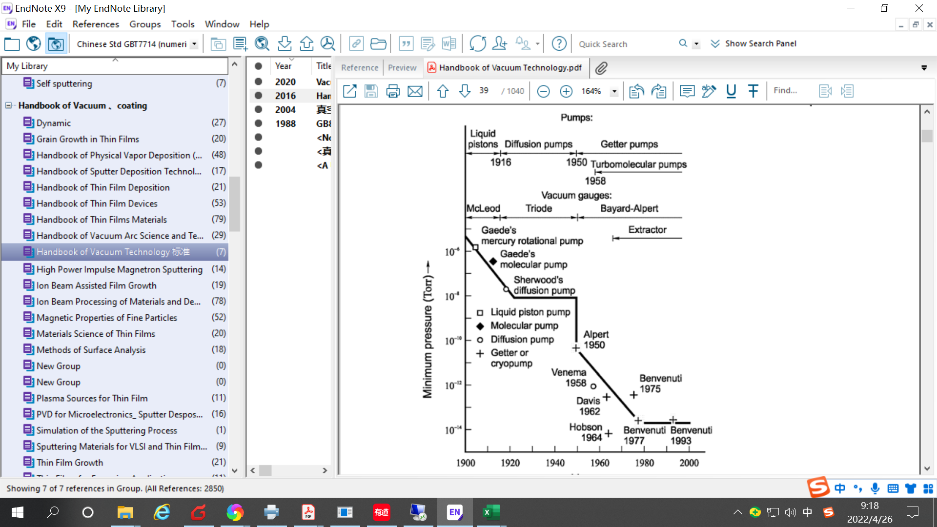
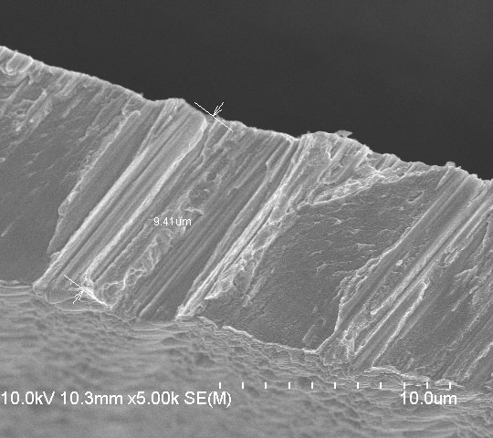
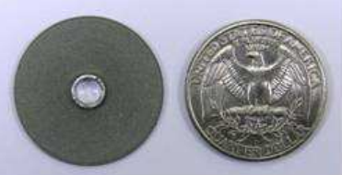
NEG薄膜
(真空盒内壁镀膜)
1um
NEG 块体泵
（泵体）
优点：
体积小，不需要在线供电
Notes:
世界上基本上所有的光源加速器对NEG 都有应用
“ SPS 腔超高真空的获得”。提出了通过非蒸散型吸气剂泵改善BEPC对撞区真空的设计方案，达到预期的降低谱仪本底噪声的目标

Slide 27
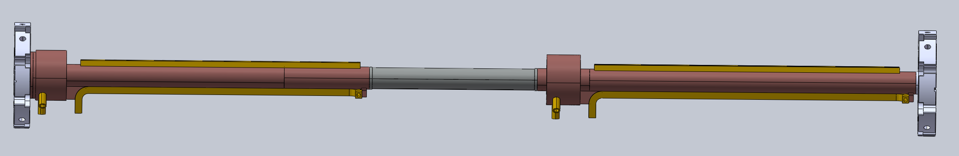
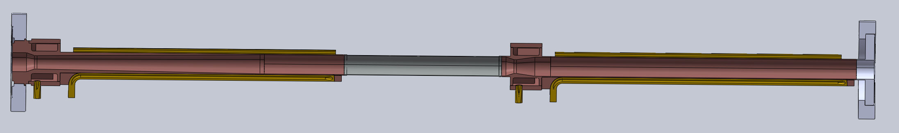
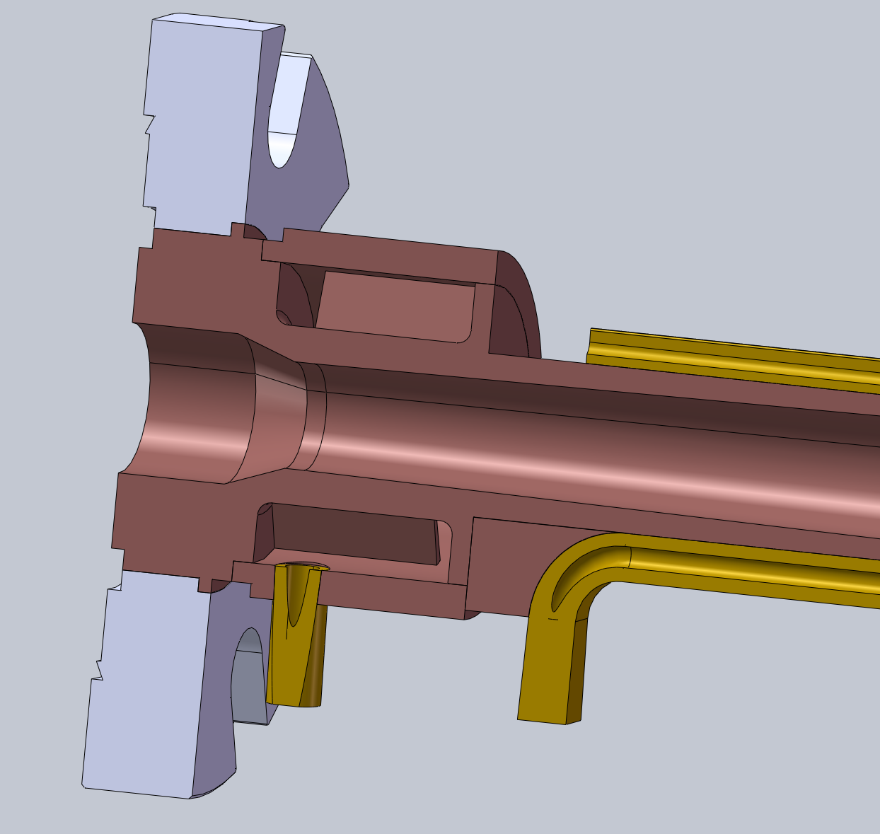
HEPS vacuum chamber
Block
26.5 million CNY of ~1300 m copper vacuum chamber
Unit cost is 20 k CNY

