Slide 1



Status of the CEPC
Yuhui Li
On behalf of the CEPC research team
23. Oct, Nanjing, 2023 international workshop on the high energy Circular Electron Positron Collider (CEPC)

Slide 2
Content
Introduction and reminder
Scientific objectives and key technology issues
Status and maturities of the CEPC technologies
Core team, the host institution and the existing support
International collaboration and influence
Summary

Slide 3
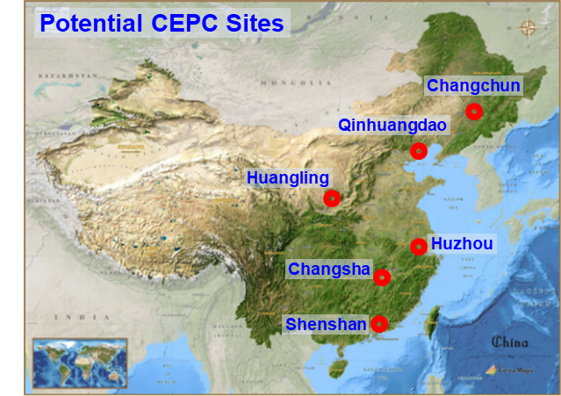
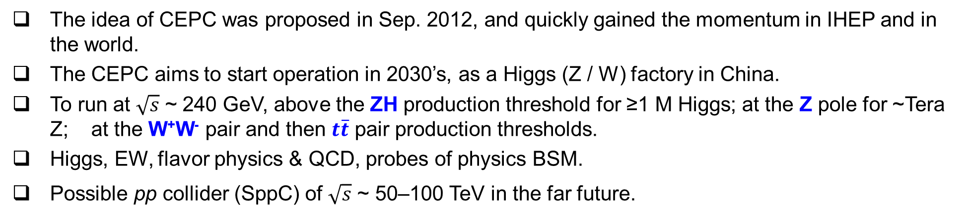

A brief introduction to CEPC
The idea of CEPC was proposed in Sep. 2012, and quickly gained the momentum in IHEP and in the world.
The CEPC aims to start operation in 2030’s, as a Higgs (Z / W) factory in China.
To run at $\sqrt{s}$ ~ 240 GeV, above the ZH production threshold for ≥1 M Higgs; at the Z pole for ~Tera Z; at the W⁺W⁻ pair and then $t\overline{t}$ pair production thresholds.
Higgs, EW, flavor physics & QCD, probes of physics BSM.
Possible pp collider (SppC) of $\sqrt{s}$ ~ 50–100 TeV in the far future.
IP 2
$e^{+}e^{−}$ Higgs (Z) factory
Ring length ~ 100 km
IP 1

Slide 4
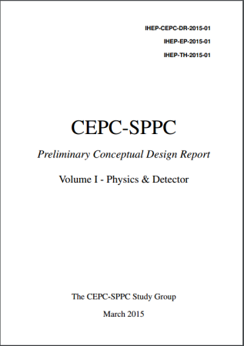
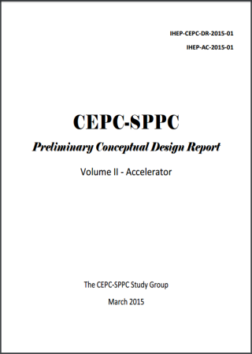
Steps advance and CEPC-CDR
Pre-CDR in 2015
CEPC CDR Released (2018.11)

Slide 5
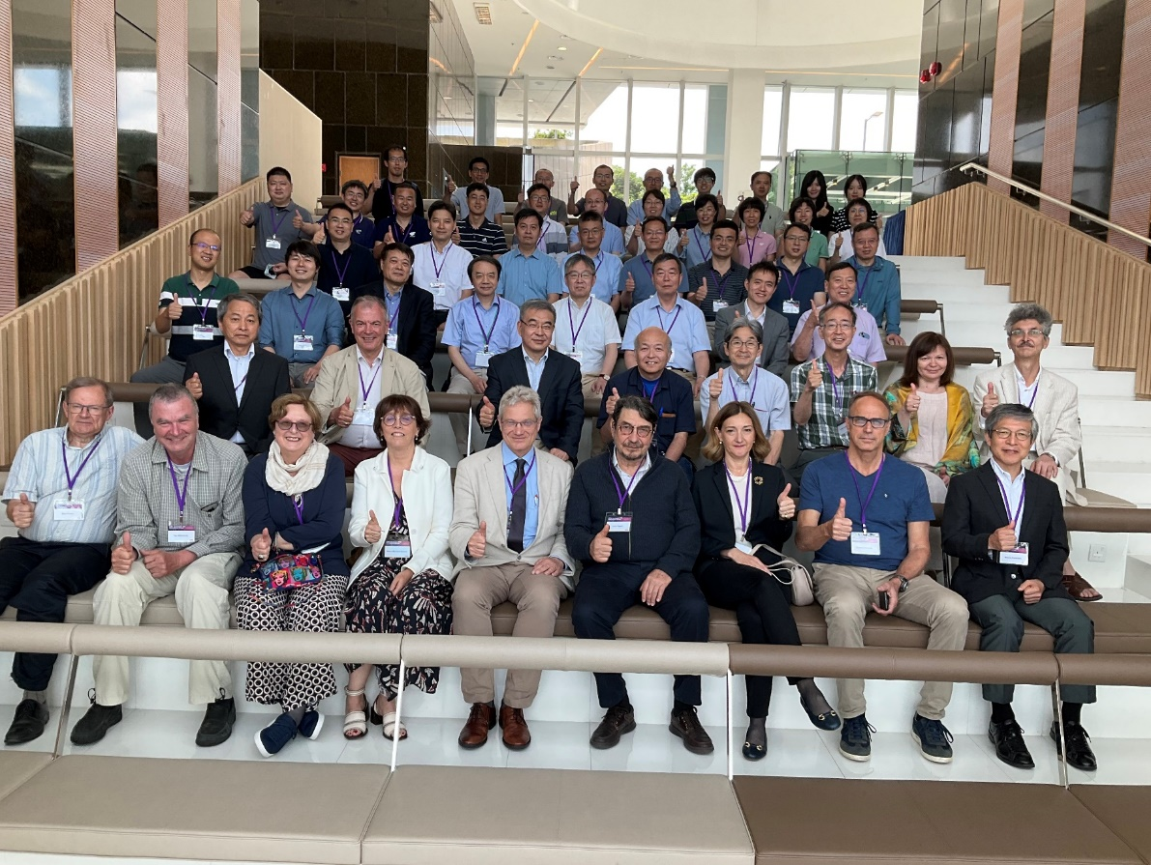
CEPC accelerator technical design report (TDR)
The CEPC Accelerator TDR covers
  The design and the knowledge and progress gained by the CEPC
  The advancement of the technologies the CEPC depends upon, delivered through the comprehensive R&D program, HEPS experience and international contributions and cooperation
  New, innovative ideas and future upgrades to make the CEPC start-of-art as times moves forward
  The costs
Two phases of reviews conducted
Phase-I: This review on the technical aspects of CEPC accelerator June 12-16, HKUST
  Phase-II: Review on the cost aspects
  civil cost review by a domestic committee June 26, 2023
  committee report was presented to an international panel July 17, 2023, online
  cost of accelerator technical system reviewed by an international committee September 11-15, 2023, HKUST
Group photo at the TDR review meeting, Hongkong, June 2023
TDR to be endorsed by the CEPC IAC committee, published in November 2023

Slide 6



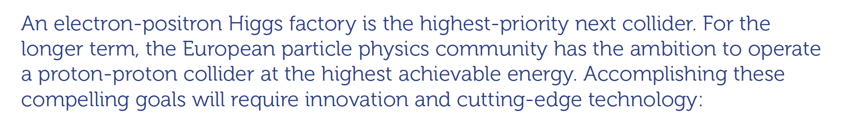
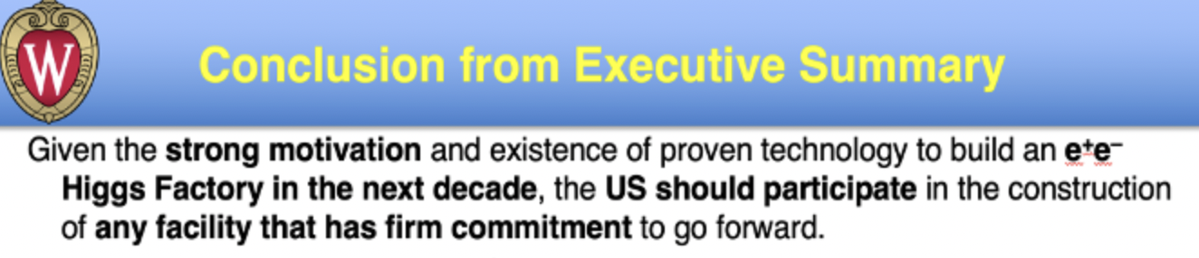


Scientific significance and strategic value
The scientific importance and strategical value of an electron positron Higgs factory is clearly identified.
2013, 2016: the CEPC is the best approach and a major historical opportunity for the national development of accelerator-based high-energy physics program.
2020
In April 2022, the International Committee for Future Accelerators (ICFA) “reconfirmed the international consensus on the importance of a Higgs factory as the highest priority for realizing the scientific goals of particle physics”, and expressed support for the above-mentioned Higgs factory proposals. Recently, the United States also proposed a new linear collider concept based on the cool copper collider (C3) technology [31].

Slide 7
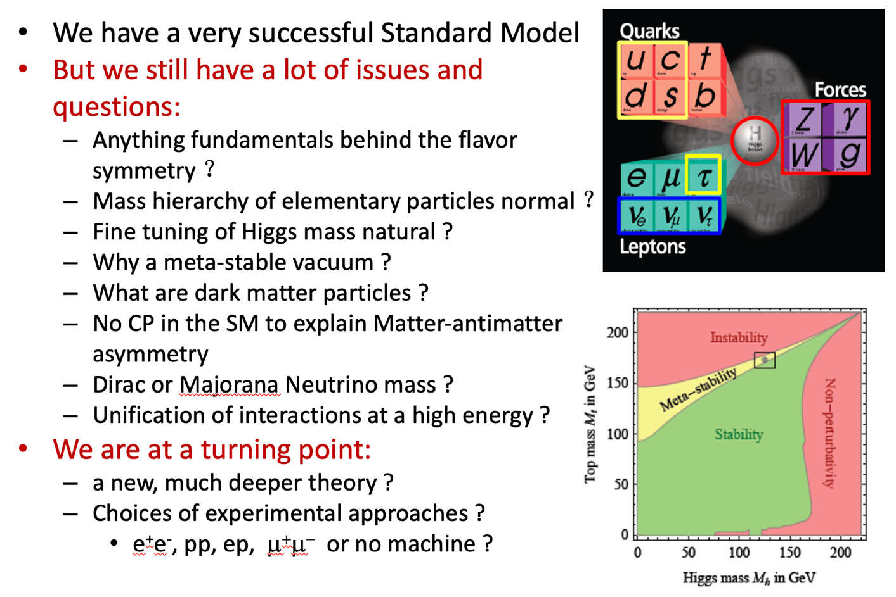
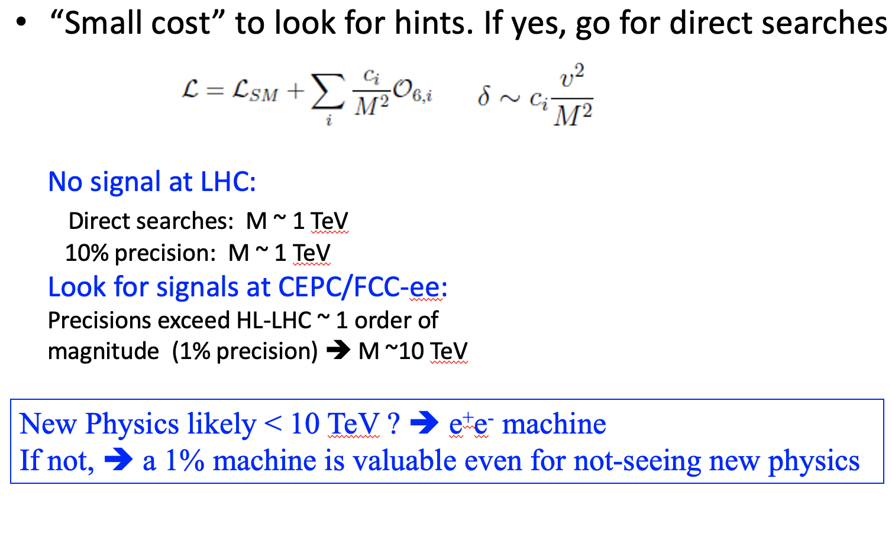
Challenges to the SM and best approaches
Pressing science questions, best addressed by a Higgs Factory (~1% precision)

Slide 8
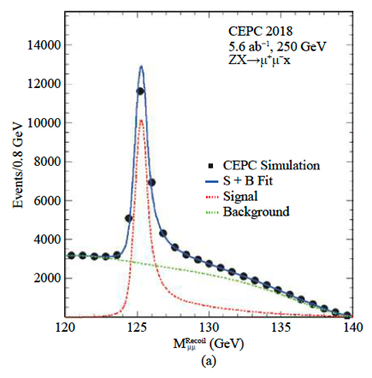
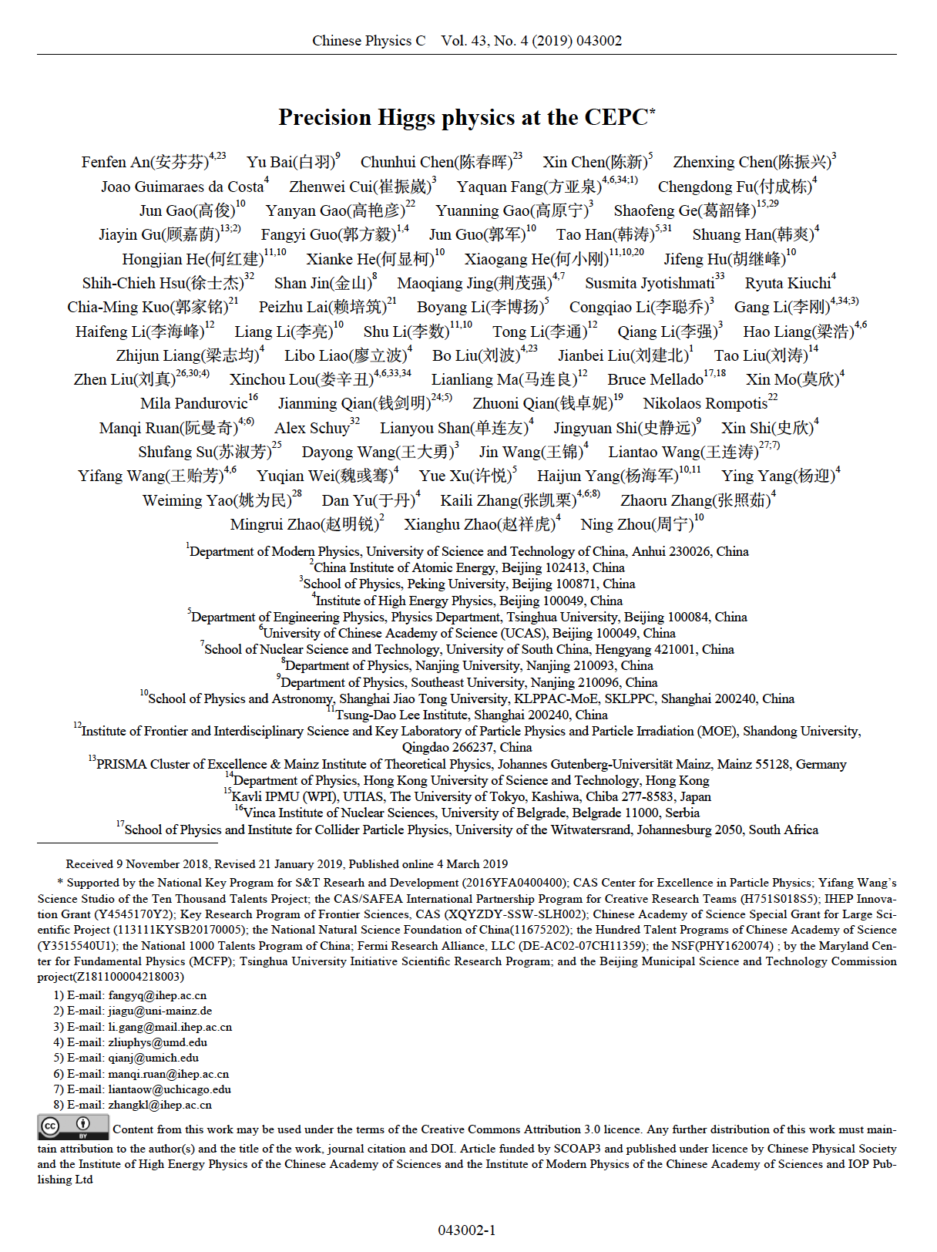
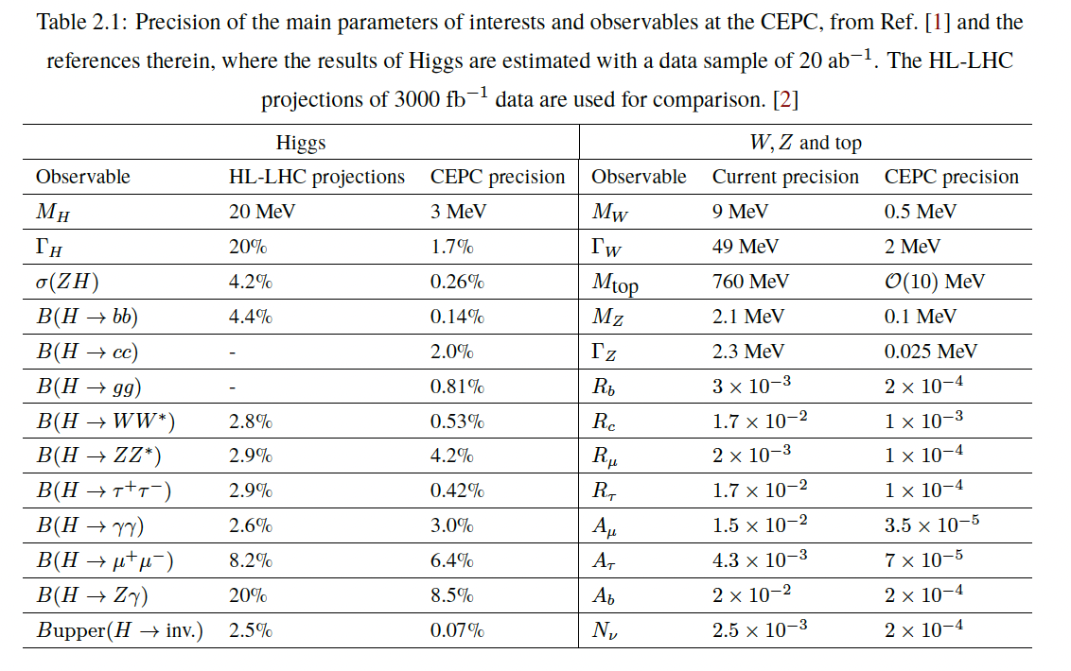
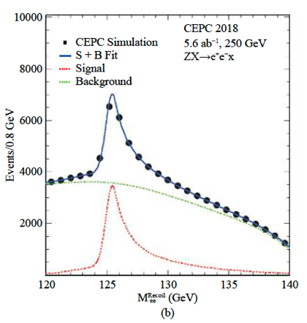
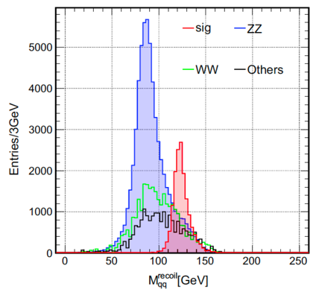
High precision provided by CEPC
CEPC Higgs White Paper
+ o(100) journal/arXiv papers
Scientific Significance quantified by CEPC physics studies, via full simulation/phenomenology studies:
  Higgs: Precisions exceed HL-LHC ~ 1 order of magnitude.
  EW: Precision improved from current limit by 1-2 orders.
  Flavor Physics, sensitive to NP of 10 TeV or even higher.
  Sensitive to varies of NP signal.
  …

Slide 9
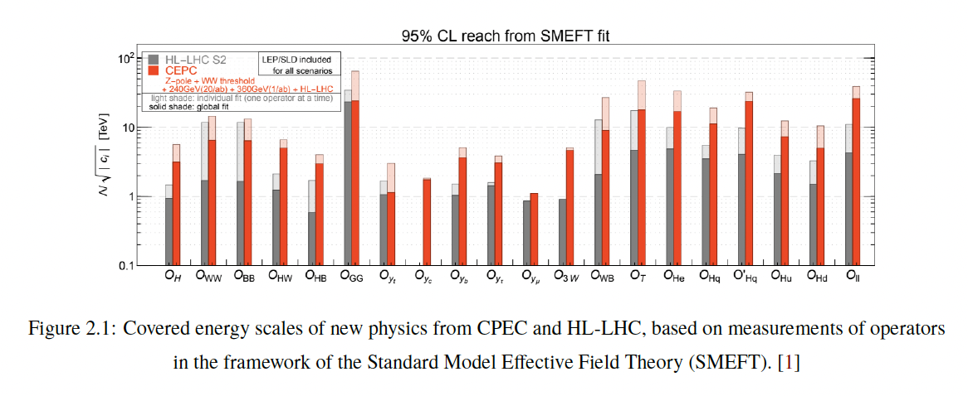
CEPC layout and design essentials
New physics at energy range of ~10 TeV
CEPC targets a major breakthrough in basic research, will greatly expand our understanding of the world.

Slide 10
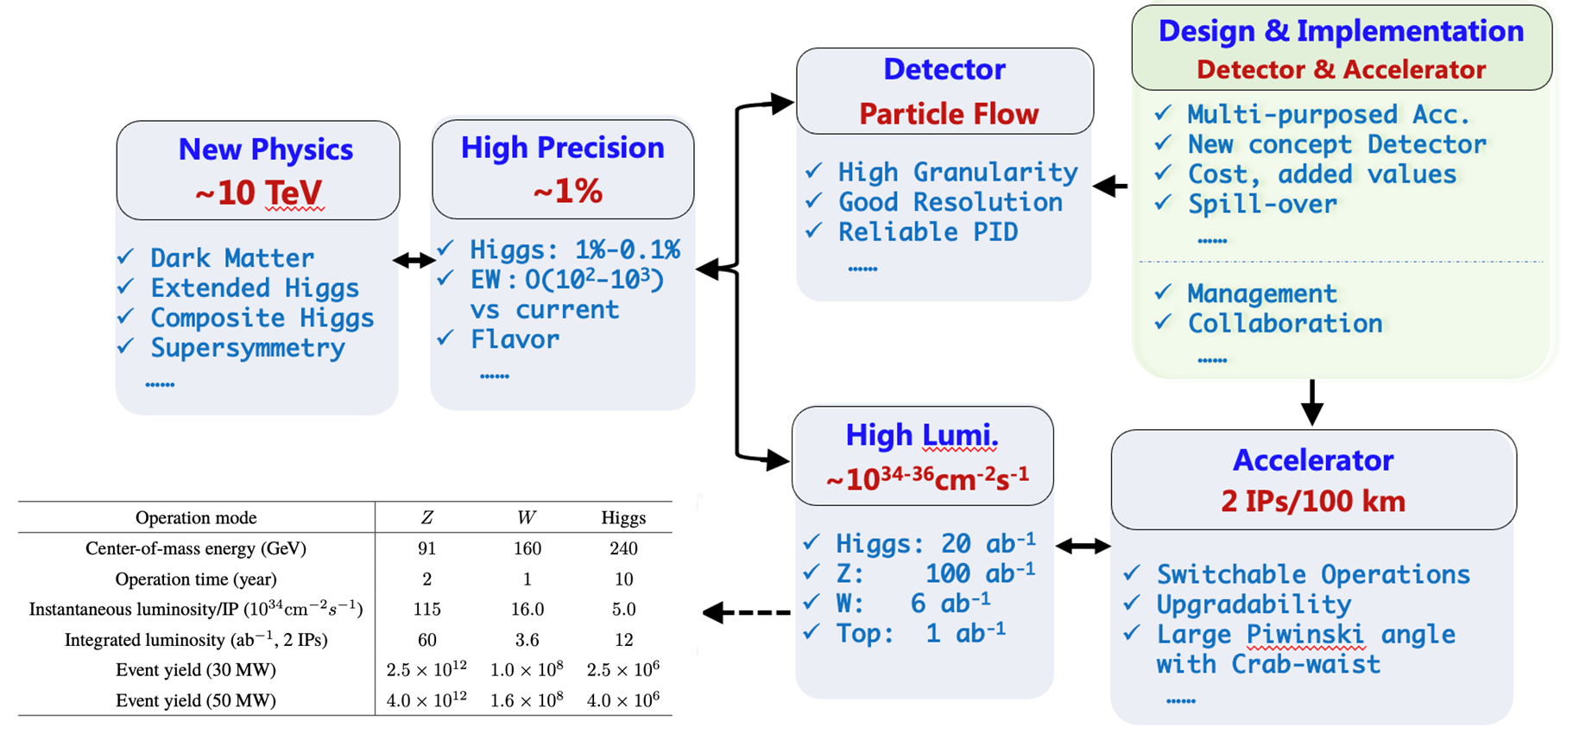
Key scientific issues and technological route

Slide 11
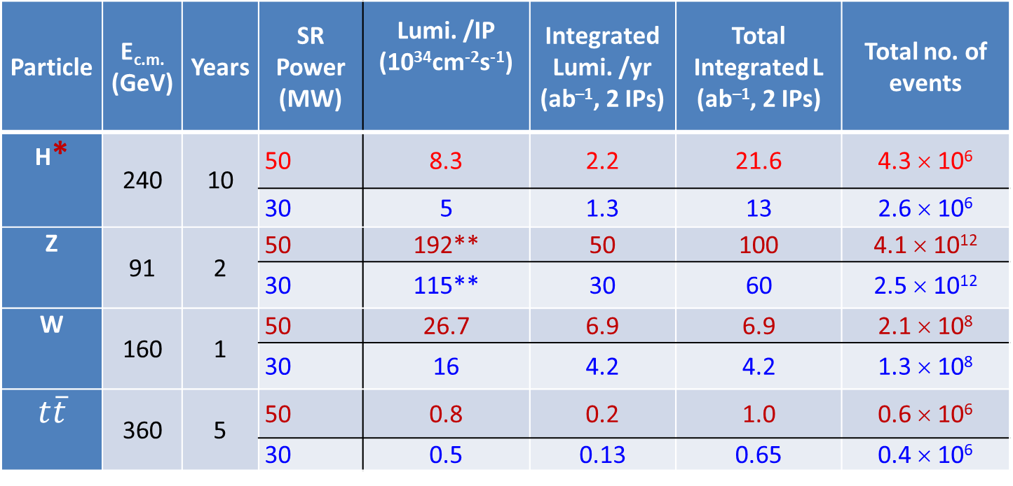
CEPC Operation Plan
Particle | E_{c.m.} (GeV) | Years | SR Power (MW) | Lumi. /IP (10³⁴cm⁻²s⁻¹) | Integrated Lumi. /yr (ab^{–1}, 2 IPs) | Total Integrated L (ab^{–1}, 2 IPs) | Total no. of events
H* | 240 | 10 | 50 | 8.3 | 2.2 | 21.6 | 4.3 × 10⁶
 |  |  | 30 | 5 | 1.3 | 13 | 2.6 × 10⁶
Z | 91 | 2 | 50 | 192** | 50 | 100 | 4.1 × 10¹²
 |  |  | 30 | 115** | 30 | 60 | 2.5 × 10¹²
W | 160 | 1 | 50 | 26.7 | 6.9 | 6.9 | 2.1 × 10⁸
 |  |  | 30 | 16 | 4.2 | 4.2 | 1.3 × 10⁸
$$t\overline{t}$$ | 360 | 5 | 50 | 0.8 | 0.2 | 1.0 | 0.6 × 10⁶
 |  |  | 30 | 0.5 | 0.13 | 0.65 | 0.4 × 10⁶
* Higgs is the top priority. The CEPC will commence its operation with a focus on Higgs.
** Detector solenoid field is 2 Tesla during Z operation, 3Tesla for all other energies.
*** Calculated using 3,600 hours per year for data collection.

Slide 12
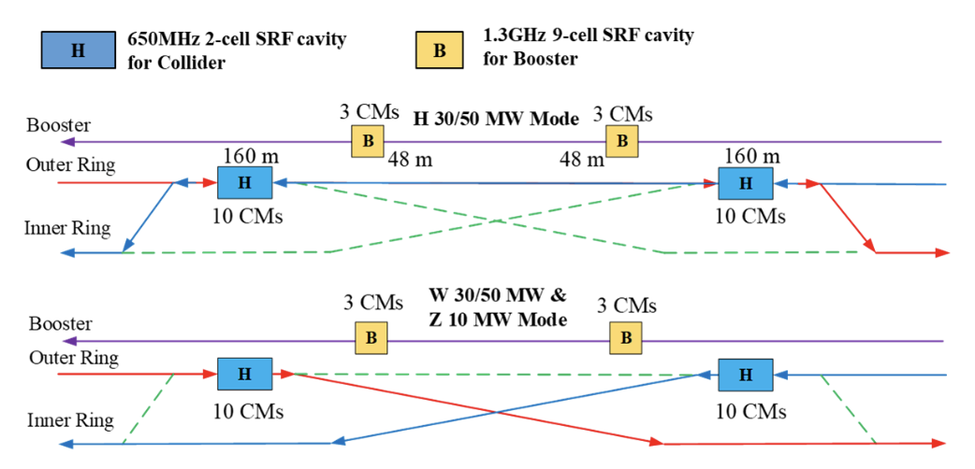
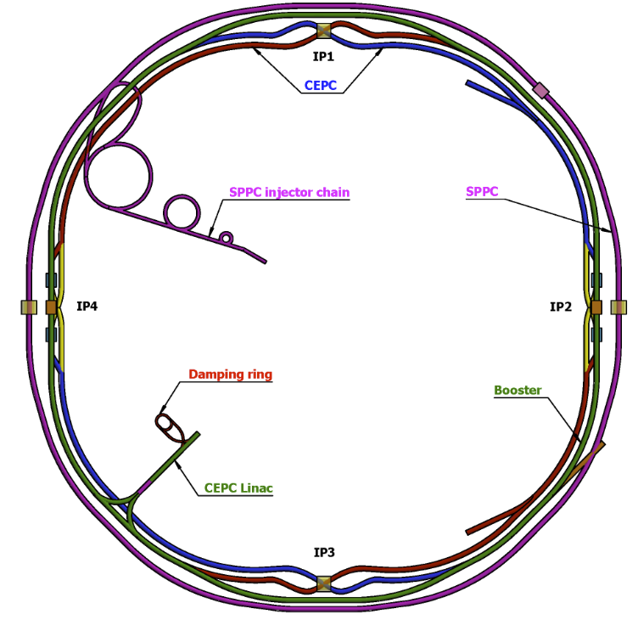
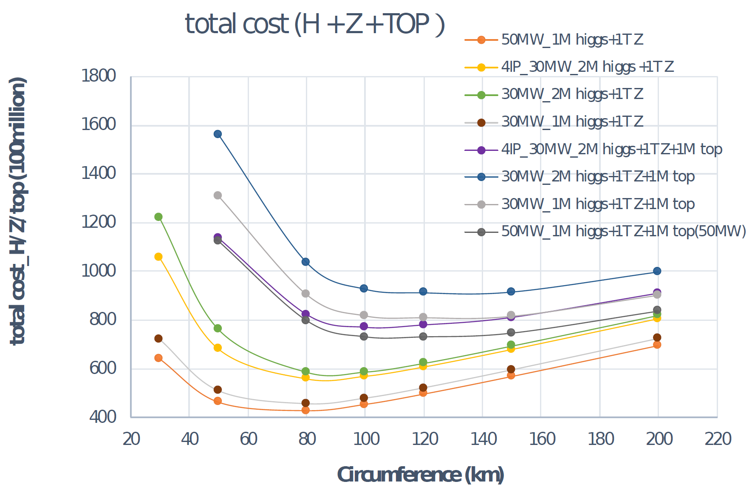
Design of experimental facility
Circular collider: Higher luminosity than a linear collider
100km circumference: Optimal total cost
Shared tunnel: Compatible design for CEPC and SppC
Switchable operation: Higgs, W/Z, top
Accelerator complex comprised of a Linac, a 100 km booster and a collider ring
Switchable operation for Higgs W and Z
Common tunnel for booster/collider & SppC
Baseline: 100 km, 30 MW; Upgradable to 50 MW, High Lumi Z, ttbar

Slide 13
Upgrade capability and added value
SR power per beam upgrade to 50 MW: High Luminosity (8E34 @ 240 GeV)
The center-of-mass energy can increase to 360 GeV: top quark data
Add a super proton-proton collider (SppC) with c.m.s >100 TeV
Expandability: High energy & high flux synchrotron light source provides gamma-ray energy up to 300 MeV, critical for multi-disciplinary science
Boost the developments of multiple technologies:
Fast electronics, mechanics, vacuum, beam, RF acceleration, cryogenic system, novel magnets, high-accuracy power supplies, control systems, big data, automation and intelligence, etc
Upgradable sceanrios to facilate the kick-off of construction
Can be upgraded in several highly valuable ways that further strengthen its discovery power; lifetime spans for decades
CEPC has significant spillover effects on multi-field and multidisciplinary scientific research and applications

Slide 14


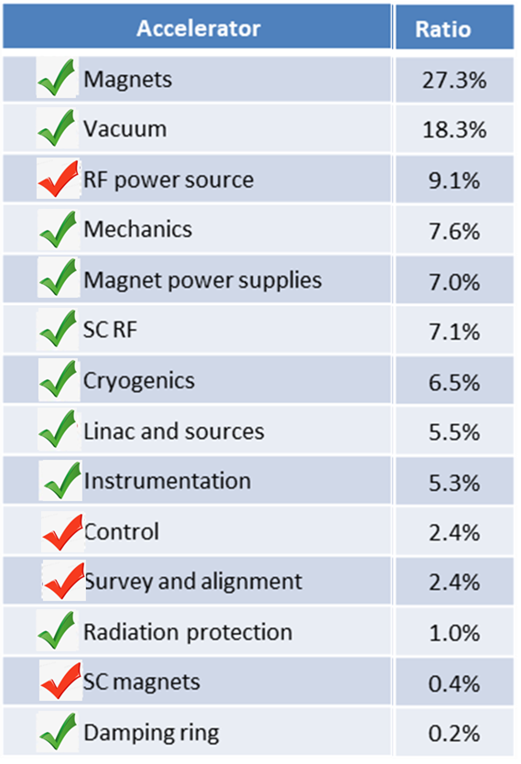
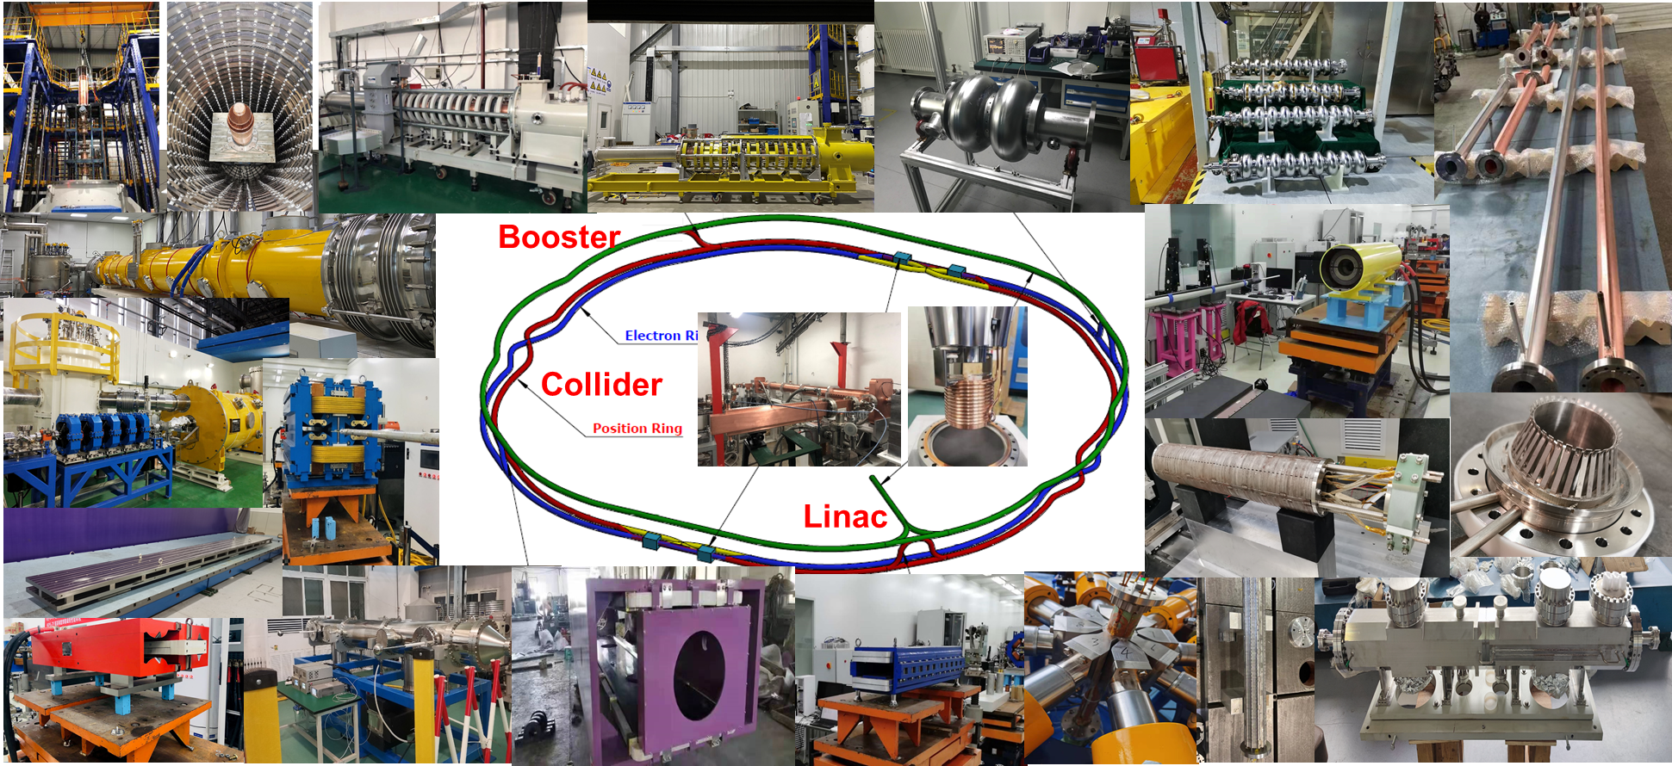
Accelerator R&D
Specification Met
Prototype Manufactured
Fraction
Represented Key Technologies for the CEPC
  Key technology R&D spans all component lists in CEPC CDR

Slide 15
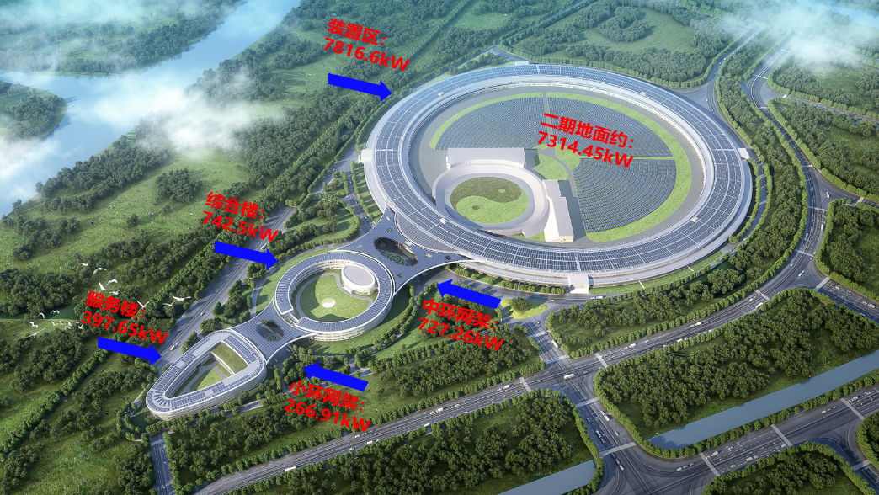
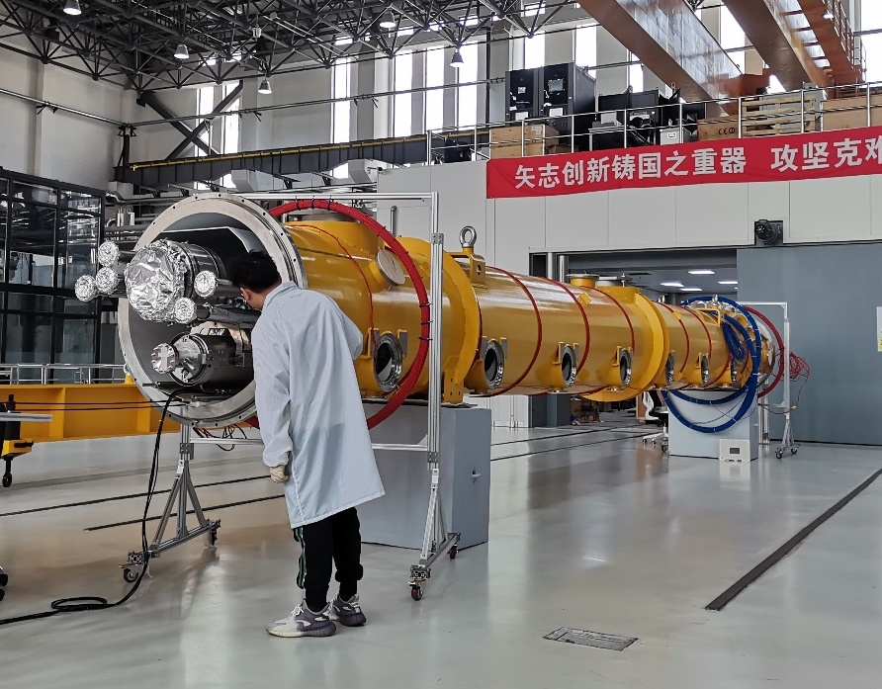
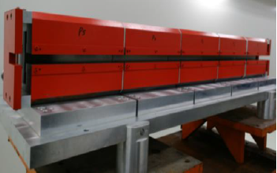
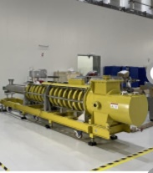
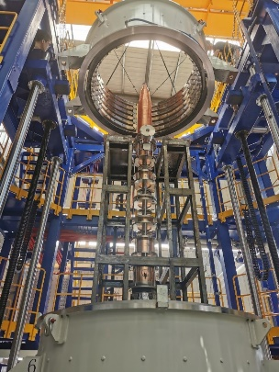
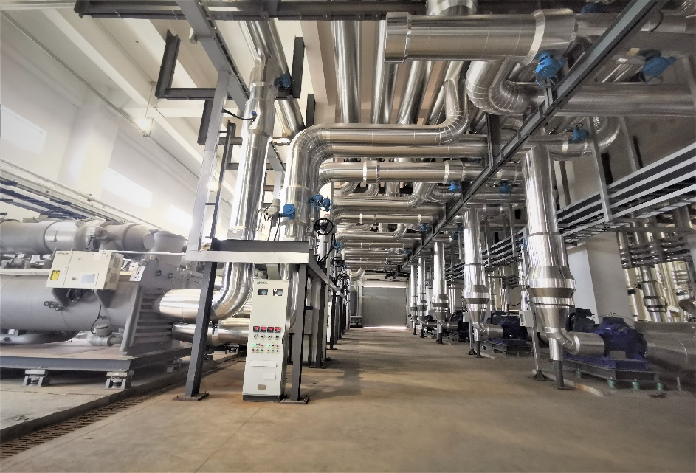
Efforts on green machine
Measures at HEPS
  Solar panel on roof: 10 MW ➔ 10% saving
  Permanent-magnet dipole @ storage ring: 5.6M kWh saving/yr
  Energy recovery from cooling water (13 MW@42ºC) : Exceeds HEPS heating requirement
R&D for CEPC
  High Q SRF cavity: reducing 10MW operation power in a comprehensive evaluation, saving electricity energy about 60M kWh per-year;
  R&D effort for High efficiency & Energy recovery klystron: improve the efficiency from the conventional value (55%) the high efficiency of 80%，CEPC will save 160M kWh electricity per-year;
  Proposal and R&D for “heating-cooling” switchable waste energy recovery system, and increasing the re-use of energy in the cooling water
  R&D and prototypes for dual-aperture magnets with a common coil
Solar panel on the roof of HEPS
High Q SRF module
Permanent magnet
High efficiency klystron
Heat bump application

Slide 16
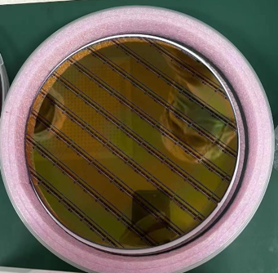
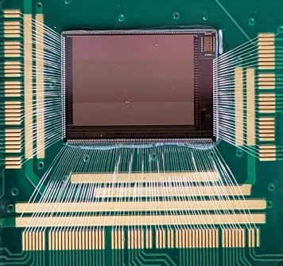
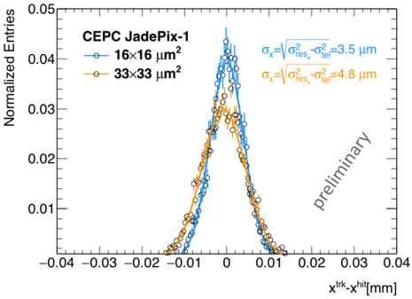
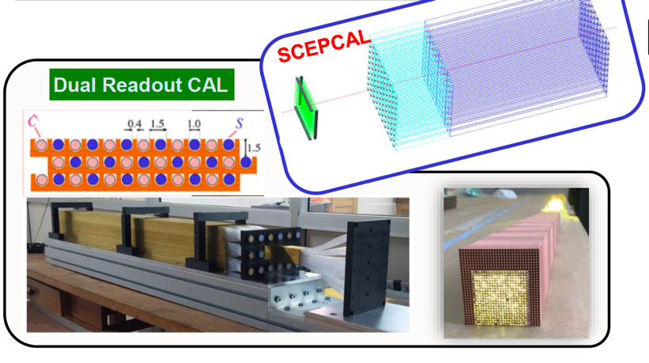

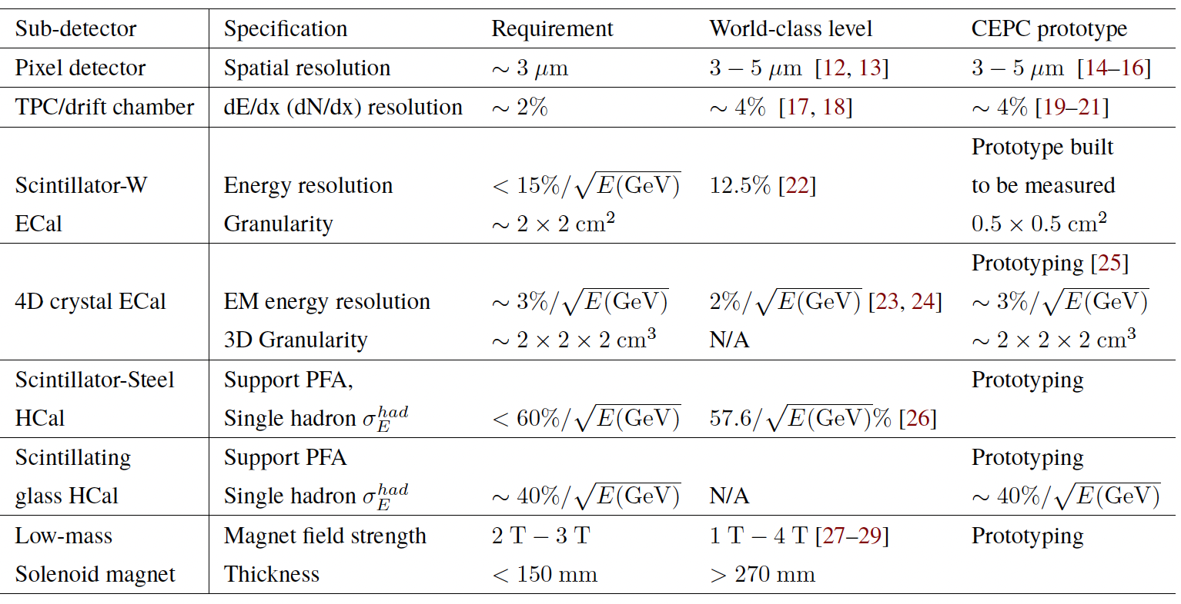


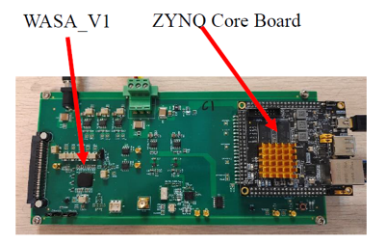
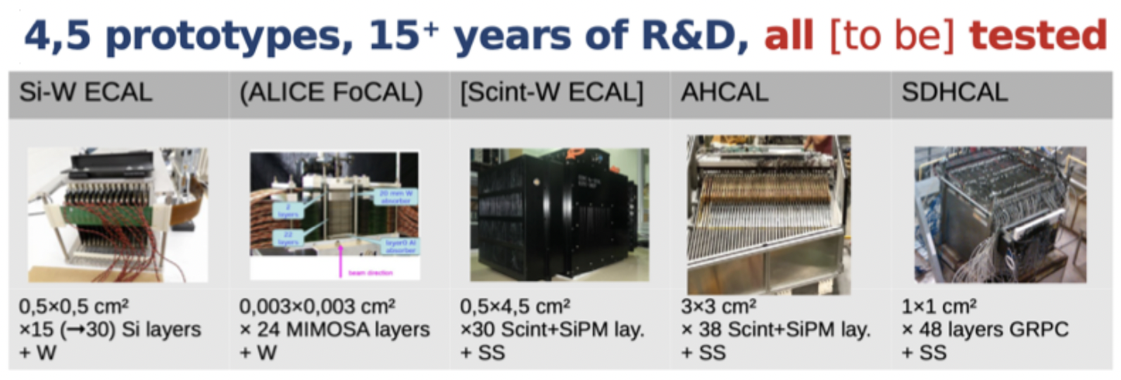
Detector R&D
Lots of R&D benefitted from past experience
  Silicon strip detector: Experience from ATLAS upgrade
  Drift chamber: Lots of Experience from BESIII
  Super-conducting magnet: Experience from BESIII
New R&D on key technology
  Vertex detector
  TPC drift chamber
  PFA calorimeter
Vertex detector R & D ( 3- 5 μm reso.)
TPC prototype
(low power
electronics)
Prototype Manufactured

Slide 17
Project assessment
CAS is planning for the 15th 5-years plan for large science projects, and a steering committee has been established, chaired by the president of CAS
High energy physics, as one of the 8 groups, has been working on this for a year:
  Setting up rules and the standard(based on scientific and technological merits, strategic value and feasibility, R&D status, team and capabilities, etc.), established domestic and international advisory committees
  Collected 15 proposals and selected 9, based on the above-mentioned standard
  Evaluations and ranking by committees after oral presentations by each project
CEPC is ranked No. 1, with the smallest uncertainties, by every committee
A final report will be submitted to CAS for consideration

Slide 18
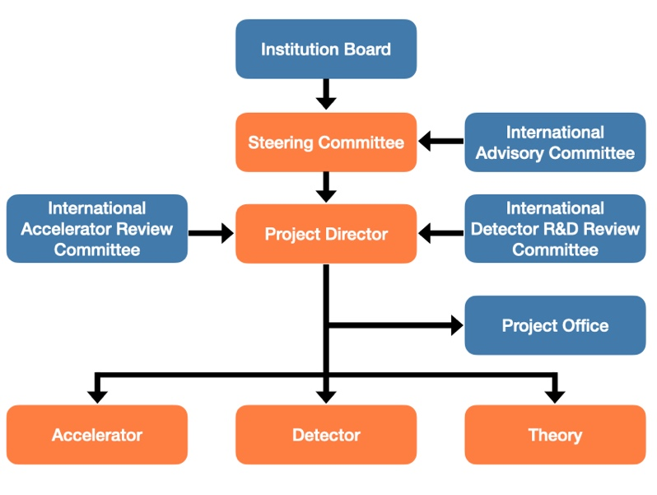
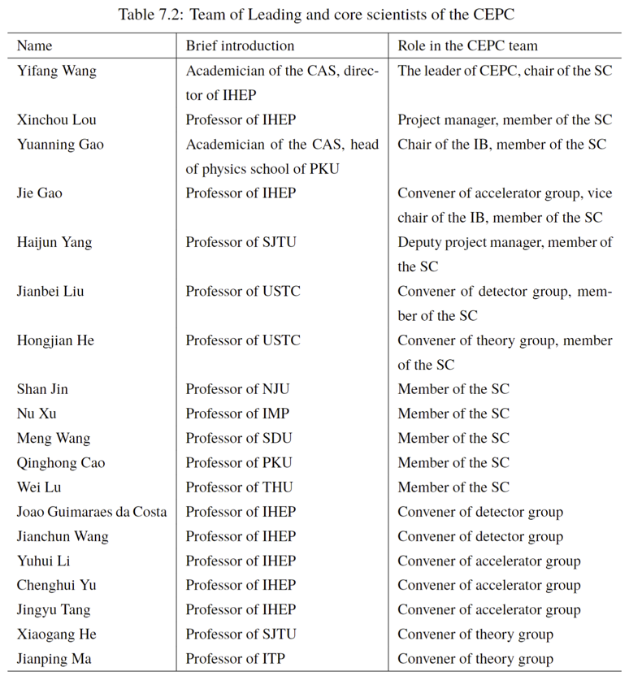
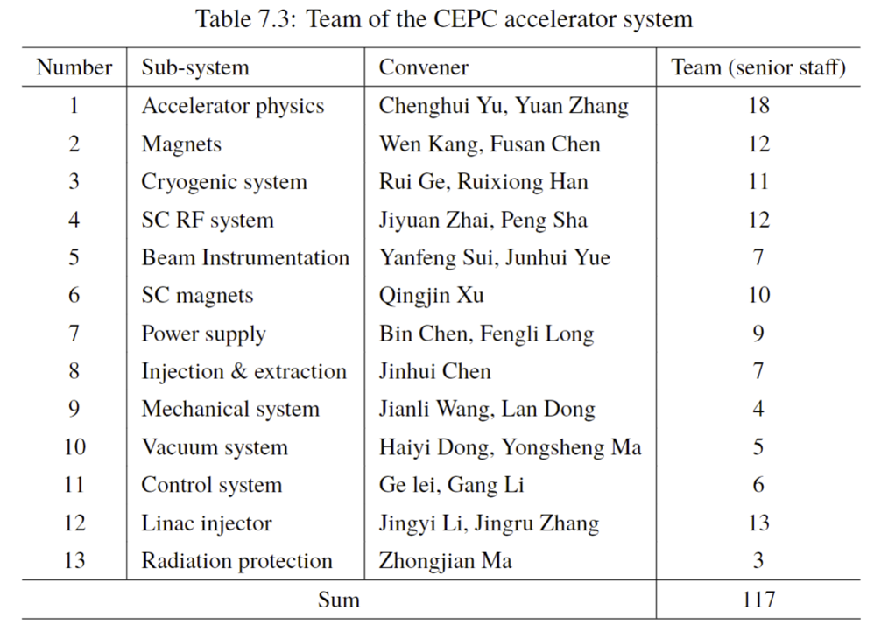
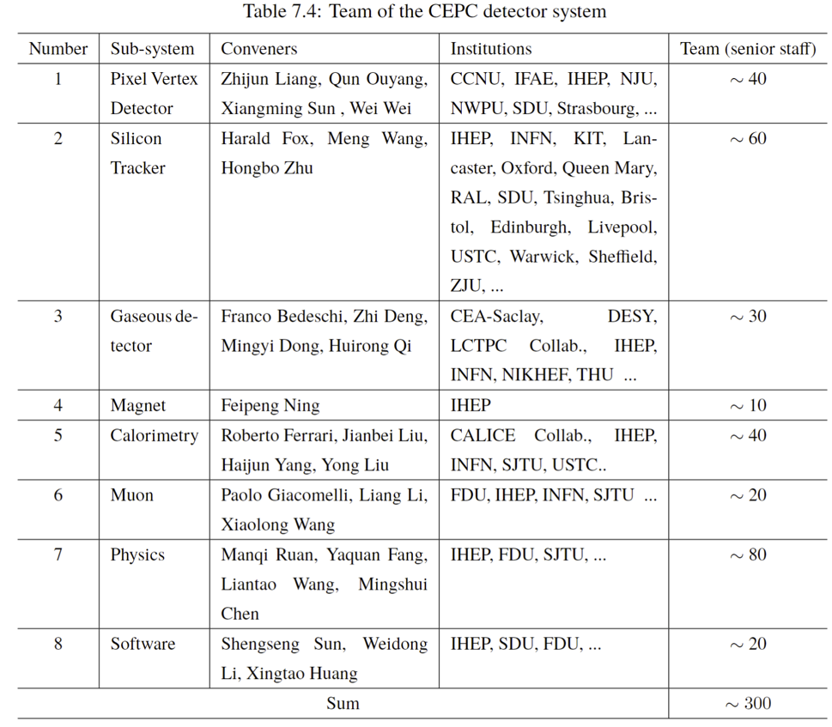
Core team, host institution and existing support
Institution Board: 32 institutes, top universities/institutes in China
Management team: comprehensive management experience at construction projects of BEPCII/CSNS/HEPS, and international projects of BESIII/Daya Bay/JUNO/…
Accelerator team: fully over all disciplines with rich experiences at BEPCII, HEPS…
Physics and Detector team: fully over all disciplines with rich experiences at BESIII, Daya Bay, JUNO, ATLAS, CMS, …
Management team,
world-class leading scientists
117 accelerator + ~300 detector staffs currently, +
~ 400 from BEPC/BESIII/JUNO/HEPS...once CEPC approved

Slide 19
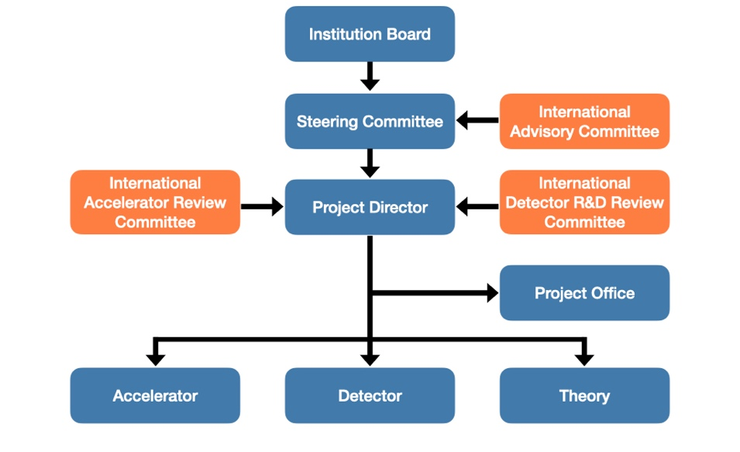
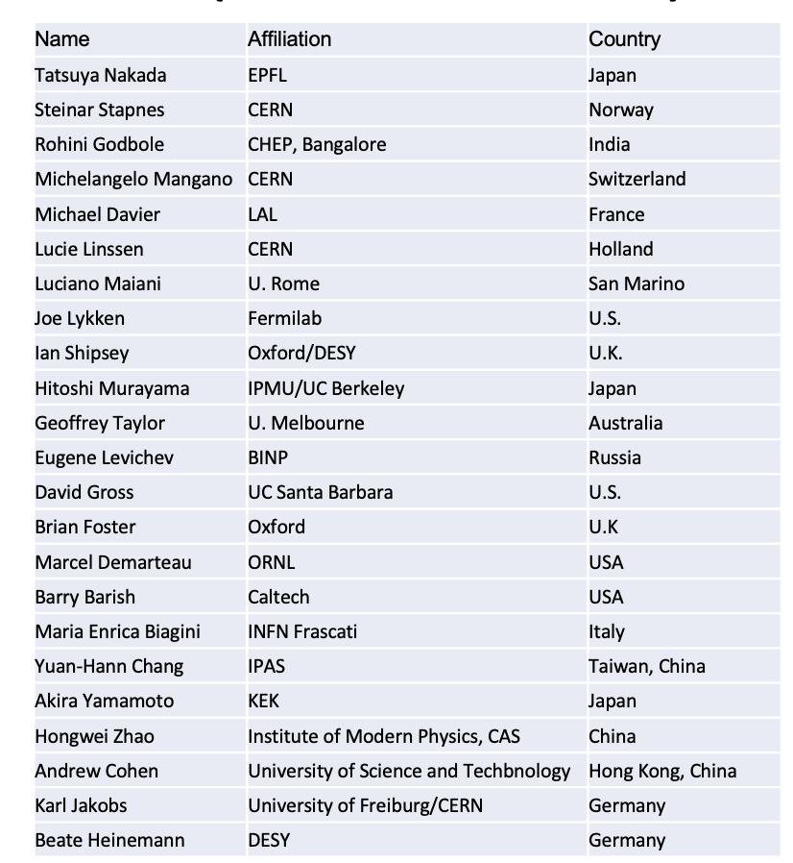
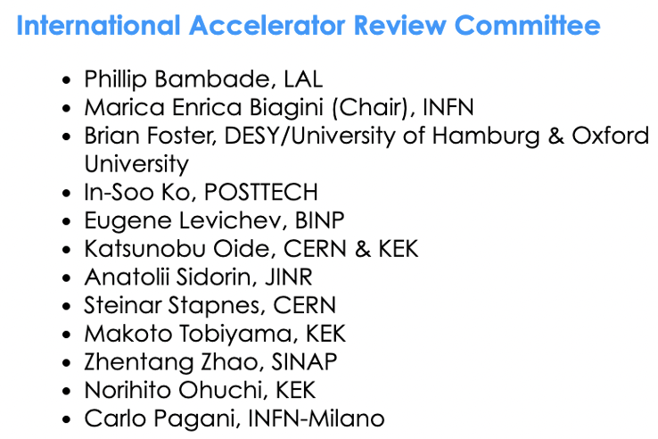
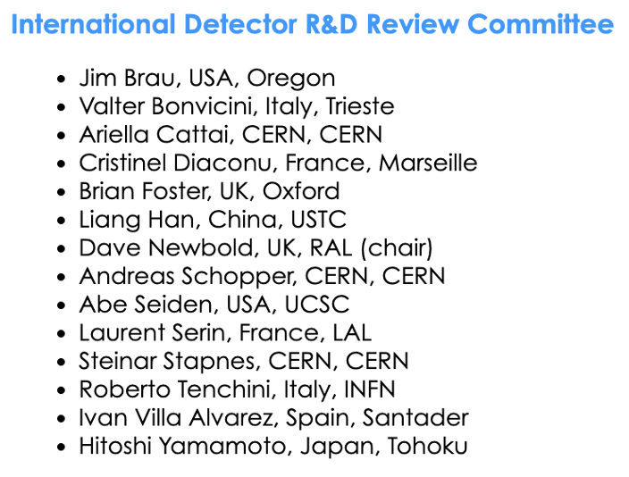
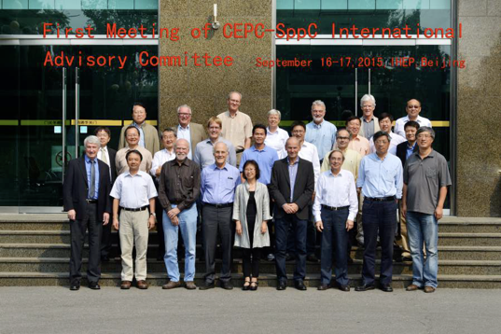
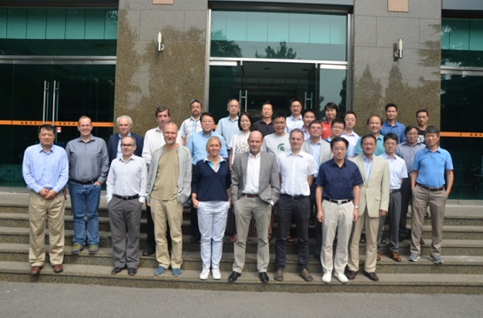
International Committees for CEPC
IAC composed of global renowned scientists and top laboratory or project leaders who have ample experience in project management, planning, and execution of strategies, operating since 2015
IARC & IDRC composed of leading experts of this field, provide guide to the project director

Slide 20
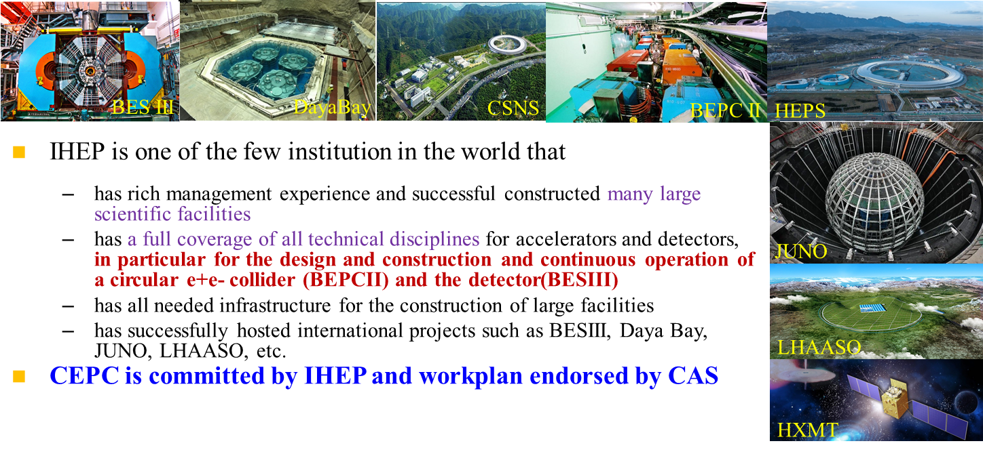
Experiences for large-scaled facilities

Slide 21
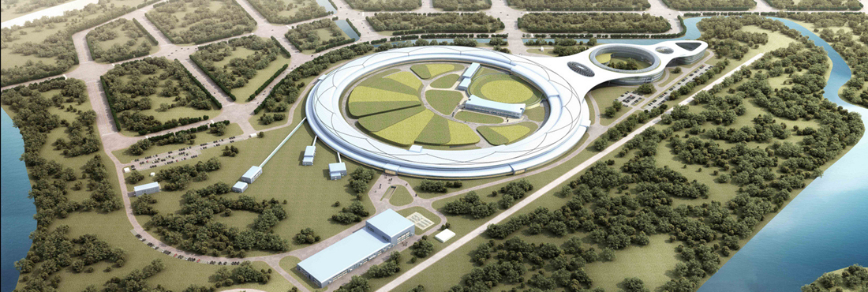
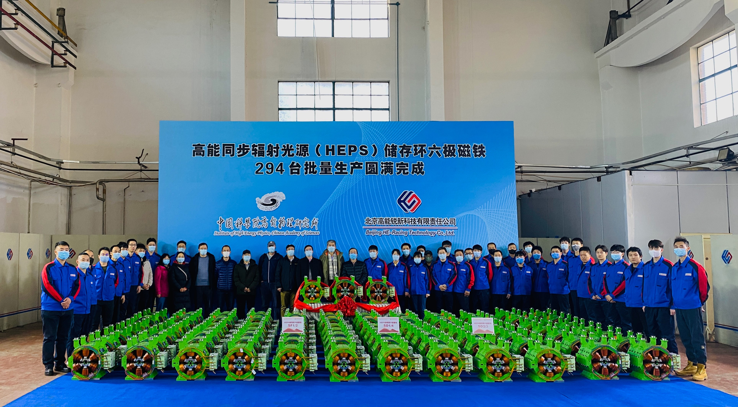
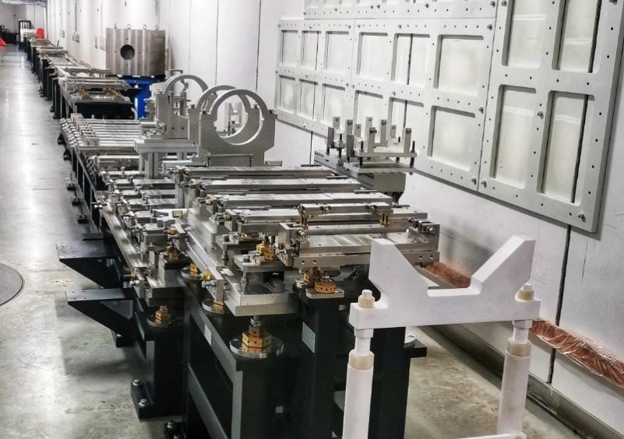
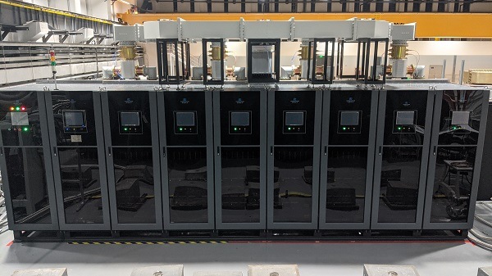


Benefits from HEPS
beam energy 6 GeV, 1.36 km, ≤ 0.06nm·rad, 14 beam lines (Phase I)
Carried out by IHEP, to be completed in 2025,
great training and preparation for CEPC

Slide 22







Platform for key technology R&D
SRF R&D facility
Magnet R&D
Mechanical & alignment
Klystron Test
Beam test hall
SRF test hall
Vacuum assembly & coating
Magnet R&D
Vacuum R&D
Cryogenic System
  Accelerator key technology R&D platform was established:
  ➢ SRF cavity and module ➢ High efficiency Klystron
  ➢ High precision magnet ➢ Mechanics and alignment
  ➢ Vacuum assembly & coating ➢ Beam test facility
Alignment
Beam test lab
Klystron R&D

Slide 23











Site Selection
Changchun
Qinhuangdao
Huangling
Huzhou
Changsha
Shenshan
  Six cities were investigated as potential site for the CEPC;
  Geodetic survey were conducted on all candidate sites
  Qinghuangdao, Changsha and Huzhou are selected for demonstration;

Slide 24



International collaborations
CEPC attracts significant International participation
CEPC CDR Released (2018.11)
Conceptual design report: 1143 authors from 221 institutes ( including 140 International Institutes )
More than 20 MoUs signed and executed
Intensive collaboration on Physics studies
Oversea scientists made substantial contributions to the R&D, especially the detector system
CEPC International Workshop since 2014
EU-US versions of CEPC WS
Annual working month at HKIAS (since 2015)
CEPC workshop in Chicago, 2019

Slide 25



International influence
ESPPU input
Snowmass input
arXiv: 1901.03170
1901.03169
arXiv: 2203.09451
2205.08553
CEPC provides critical input to ESPPU & Snowmass as a major player
Team actively participate International Panel discussions
CEPC attracts intensive international collaboration, ensuring that the CEPC design and technology are among the most advanced in the world. once approved, CEPC is expected to be substantially supported by international community.

Slide 26








Industrial engagement
CIPC, established in 2017, composed of ~ 70 high tech. enterprises, covers Superconducting materials, Superconducting cavities, cryomodules, cryogenics, Klystrons, electronics, power source, vacuum, civil engineering, etc. CIPC actively joins the Key technology R&D and prepares for the mass production for the CEPC construction.
CEPC study group is actively surveying main international suppliers.
CEPC strongly promote these relevant technology development (cost-benefit).

Slide 27

CEPC timeline
TDR (2023), EDR(2026), start of construction (2027-8)
15th FY
16th FY

Slide 28
Summary
CEPC
addresses many most pressing & critical science problems in particle physics;
is part of the worldwide effort to build a leading edge, highly capable next generation accelerator system as a Higgs factory as well as for energy frontier collider
has made strong and systematic progress; design and technologies are reaching maturity;
is completing the TDR for the e⁺e⁻ accelerator and will enter the EDR phase;
has a strong-experienced team, backed by IHEP support and international cooperation, which are keys to bring CEPC to fruition ;
aims schedule following China’s 5-year planning; expects to complete the R&D and the preparation to build the facility and carry out the science program
will offer worldwide HEP community an early Higgs factory

Slide 29

Thank you for your attention

