Slide 1



CEPC as an environmental friendly facility
Rui Ge
Institute of High Energy Physics, CAS
Contributors: Mei Yang, Jiyuan Zhai, Zusheng Zhou, Mei Li, Yuhui Li
The 2023 International Workshop on the High Energy Circular Electron Positron Collider, Oct. 23~27th, Nanjing

Slide 2
Content
Brief introduction
International "green" initiatives for Accelerator
IHEP's "Green" Initiative for Particle Accelerators
Difficulties/challenges and outlook
Summary

Slide 3
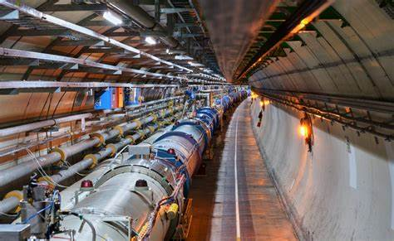
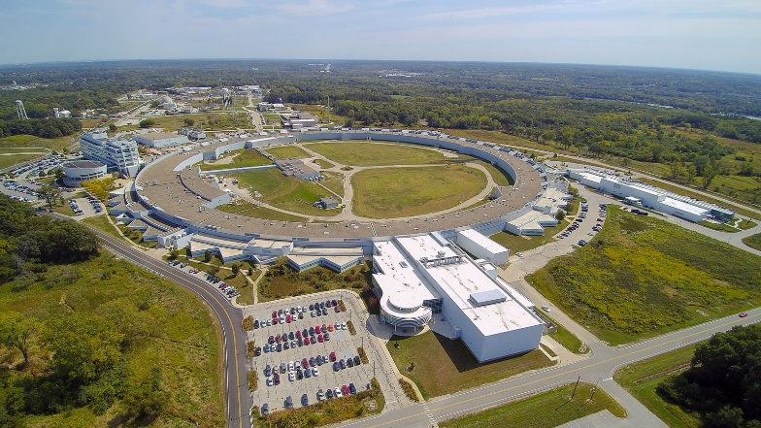
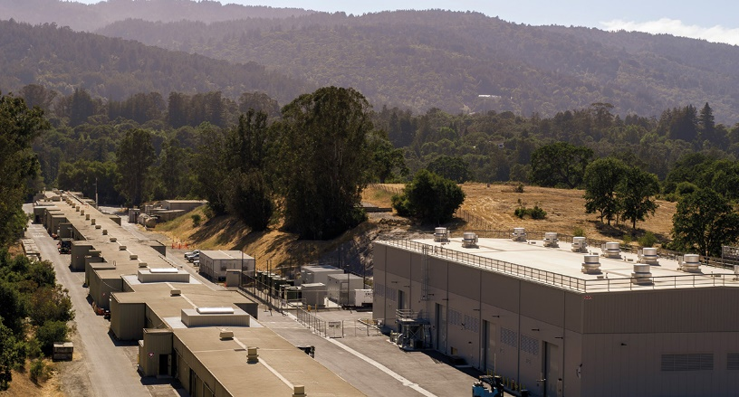

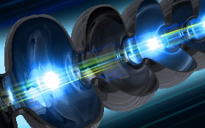
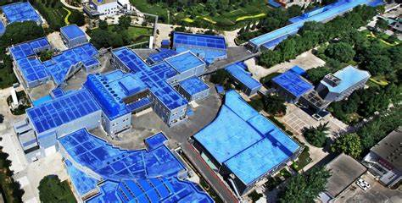
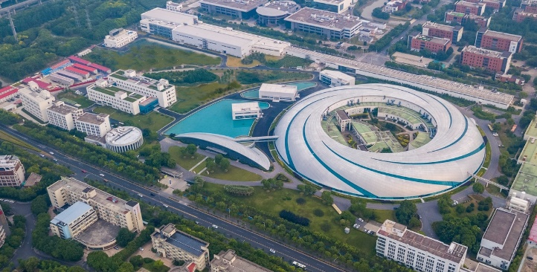
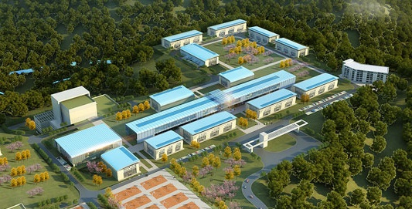
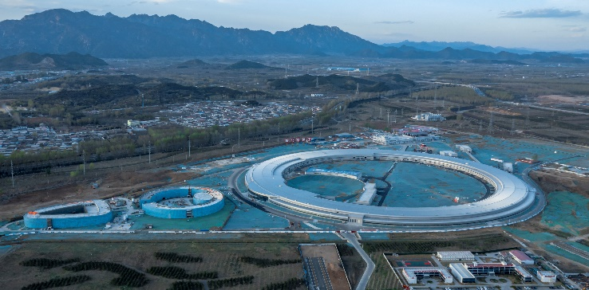
High Energy Physics Accelerator：issues and challenges
China is reducing energy pollution, promoting green accelerator and boosting unit energy GDP (China dual carbon strategy: achieve peak CO2 emissions before 2030 and carbon neutrality before 2060)
Huge energy is needed for modern large colliders such as LHC, ILC, CEPC…
Huge energy means huge cost and huge pollution.
LCLSII 照片
功率 200MW
LHC 照片
功率 200MW
APS 照片
功率 125MW
LHC
Power 200MW
APS
Power 125MW
LCLSII
Power 200MW
Super KEKB
Power 90MW
BEPCII 照片
功率 ？MW
上海光源 照片
功率 ？？W
CiADS 照片
功率 7MW
HEPS
Power 38MW
BEPCII
Power 6.5MW
SSRF
Power 10MW
CiADS
Power 7MW
HEPS 照片
功率 ？MW
Saving power=lower pollution=lower operation cost

Slide 4
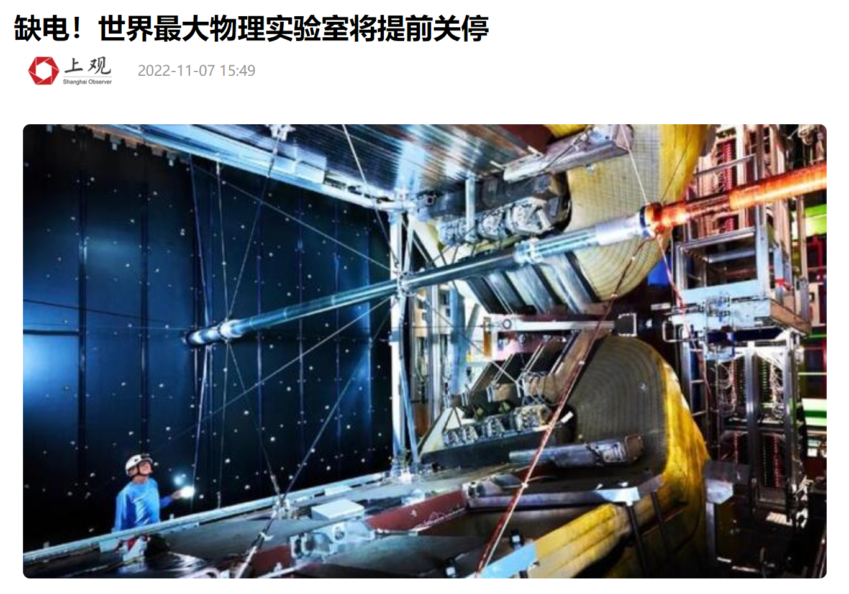
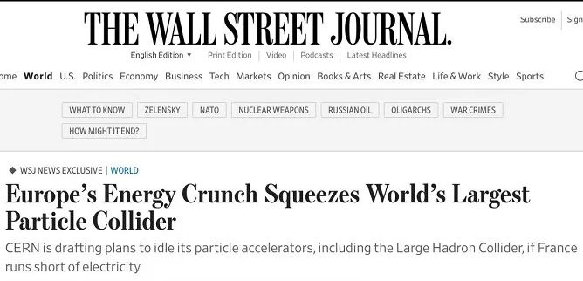
Accelerator facility in energy crisis (examples)
The annual power consumption of CERN's LHC can reach 1300 GWh, which is equivalent to one-third of the city of Geneva in Switzerland.
As the European energy crisis intensifies, closure of some accelerators during peek periods, reducing consumption by 25%.
From Request of the French power company, to further shorten the operating time in 2023 by an additional 20% consumption.

Slide 5
Power consumption estimation of the future high energy accelerator
Accelerator (beam energy, TeV） | Estimated power consumption（MW） | Efficiency of strong power to particle beam flow | Nation
FCC-ee（0.25） | 290 | ~30-40% | Europe
ILC（0.25） | 140 | ~30-40% | Japan
CLIC（0.38） | 110 | ~30-40% | Europe
CEPC（0.25） | 320 | ~30-40% | China
CCC（0.25） | 150 | ~30-40% | America
ILC（3） | 400 |  | Japan
FCC-hh（100） | 560 |  | Europe
SPPC（125） | 400 |  | China
PWFA（3） | 230

Slide 6
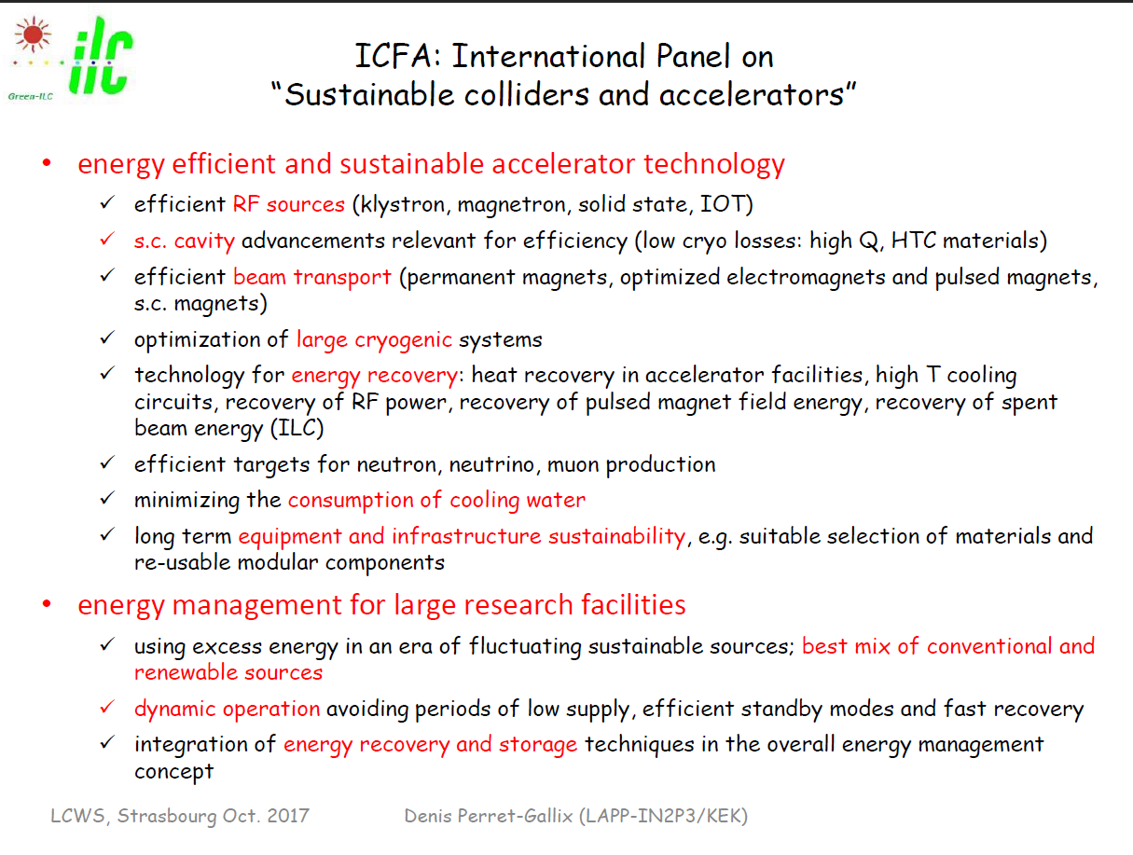

Slide 7
International "green" initiatives for Accelerator
Improvement of integrated management capabilities
Improvement of equipment energy utilization efficiency (klystron, superconducting RF cavities, permanent magnets, superconducting magnets, etc.)
Retrofit of old equipment
New energy utilization
Recycling and utilization of waste energy

Slide 8
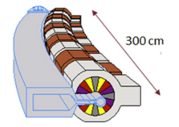

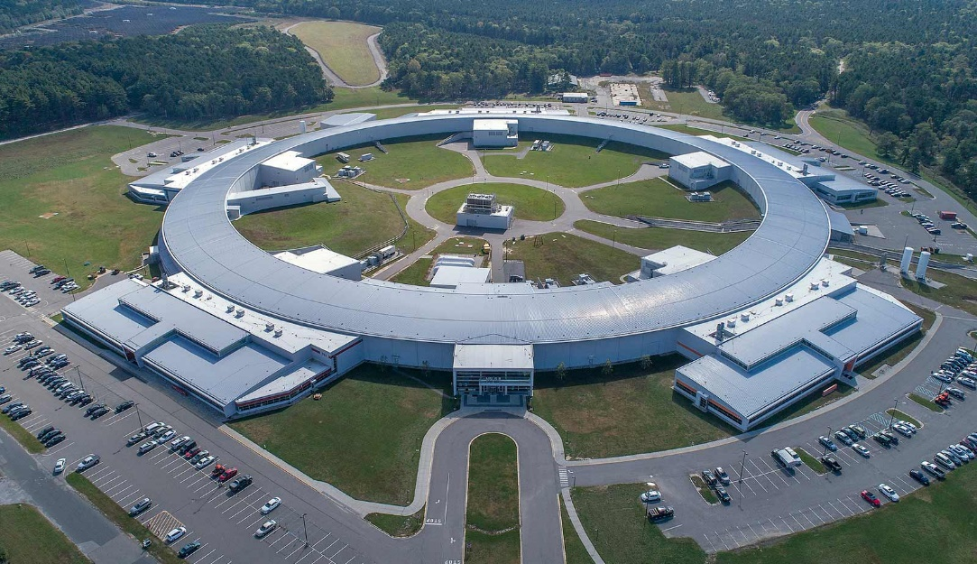
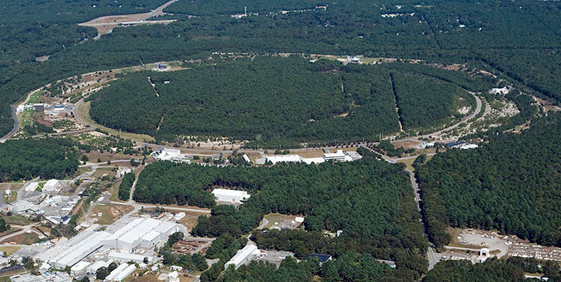
Energy saving initiatives at Accelerator field: BNL
Focus on permanent magnets, common utility technology
NSLSII: Upgraded storage rings to increase the use of permanent magnet.
RHIC (mature machines): multiple upgrades to improve equipment efficiency (maintenance of equipment to improve efficiency and longevity; variable speeding cooling system for general systems); upgraded liquid helium refrigerator to improve efficiency
EIC(planned construction): Improvement of liquid helium refrigerator efficiency; proton cooling in high-fluence electron accelerator with energy recovery (ERL); introduction of heat pump technology to improve waste heat utilization efficiency
NSLSII
RHIC

Slide 9





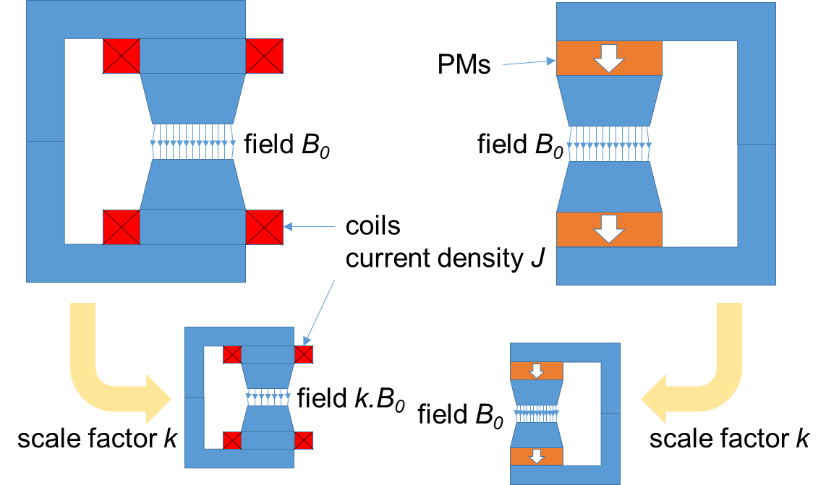











Permanent magnets (PMs) reduce heat consumption
PMs: Pros and Cons
no electricity
no heat dissipation
difficult to tune
no power supplies
handling issues
no power cables
capital cost
no water cooling
no vibration
sintered material
less infrastructure
block tolerances
lower running costs
temperature stability
lower CO₂ emissions
radiation resistance
The ERL Test Accelerator (CBETA) reduces energy consumption by replacing electromagnets with permanent magnets that do not require electricity.
The CBETA accelerator recovers 99.8% of the energy supplied to the main acceleration unit 500 times faster than an accelerated beam without an energy recovery unit.
https://m.thepaper.cn/baijiahao_19675601

Slide 10
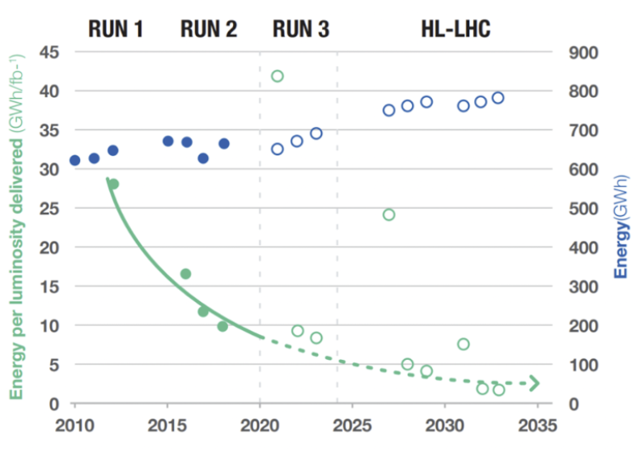
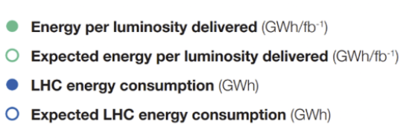
Energy saving initiatives at Accelerator field: CERN
Focus on management and waste heat recovery
Management-side initiatives
Technology-side initiatives
Improvement of the performance of LHC machine, by increasing the collision brightness and reducing the energy consumption/brightness ratio
Utilization development of waste heat from the Research Data Center (Prévessin) for the heating of the surrounding buildings
Recovery of cooling tower heat from the LHC for heating the town of Meyrin, Switzerland.
① Reduction of operating hours from 2022 (approx. 20% reduction); ② Comprehensive energy saving initiatives (turning off street lights, lowering room temperatures, delaying heating)
Apply for and pass energy management certification ISO 50001: ① Improve feasible comprehensive energy management and energy utilization programs; ② Submit energy use plan for 2022-2026 (new energy use manual, new energy procurement process, establish communication program focusing on energy, etc.)
Assessment of the energy-related technology situation in laboratories to confirm the use of standardized technologies.

Slide 11
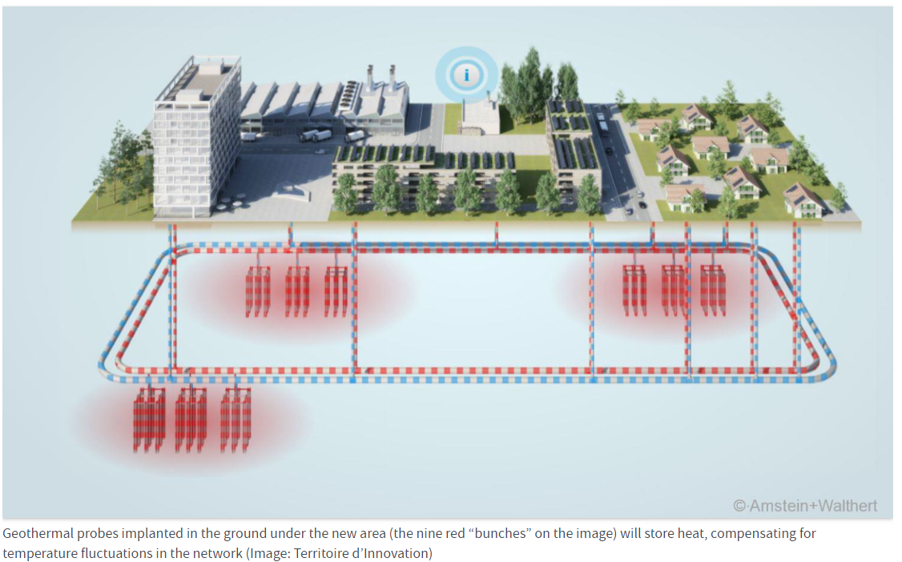
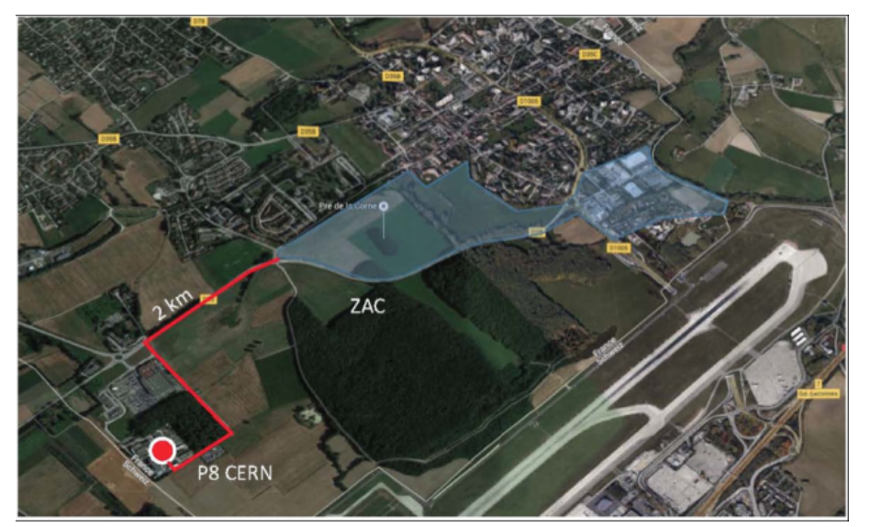
Energy saving initiatives at Accelerator field: CERN
Focus on management and waste heat recovery
July 23, 2019 - CERN signed an agreement with local authorities in France to recycle the thermal energy generated by the LHC 8th site to provide hot water for the heating system of the town of Ferney-Voltaire from 2022 onwards .
(Quoted from: *Globe. 'Part-time' heating for residents, Europe's LHC no longer 'cold', 2019-07-25.)
Up to 8,000 people benefit from having their homes heated at a lower cost and with fewer CO2 emissions.
https://home.cern/news/news/engineering/lhcs-cooling-system-energy-source-cerns-neighbours

Slide 12
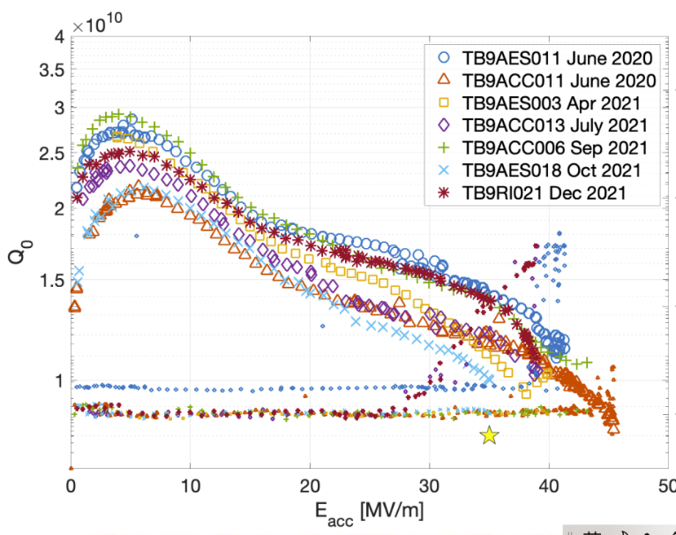
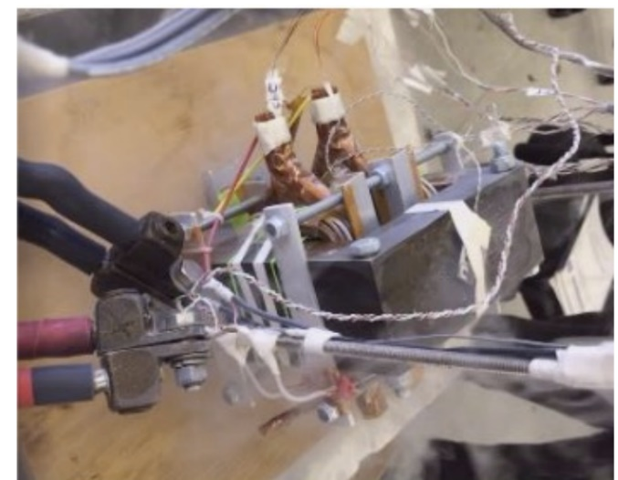
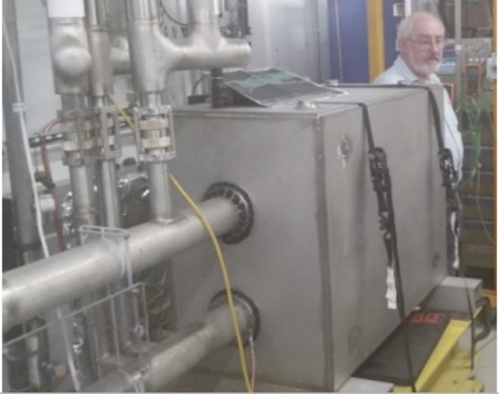
Energy saving initiatives at Accelerator field: FermiLab
Focus on Superconducting Technology
Research on key technology of SRF to improve cavity Q value
Current: $Q_{0}>{1×10}^{10}$ (ILC, LCLS-II, etc)
F$uture: Q_{0}>{3×10}^{10}$ (FCCee, Muon Collider, etc)
R$aising Q_{0} while raising gradient$ $>45GV/m$
High-temperature superconducting high-field magnet technology
High field solenoid coils >30 T
Low cost 0.1T HTS diode iron (for FCCee)
50T superconducting solenoid HTS Magnet (for Muon Collider)
HTS magnets with rapidly changeable magnetic fields
For RCS (rapid cycling synchrotron) and Muon collider
2nd HTS materials (ReBCO etc.) ~1m magnet realizes 300T/s
Plans to realize 1000-3000T/s prototypes

Slide 13
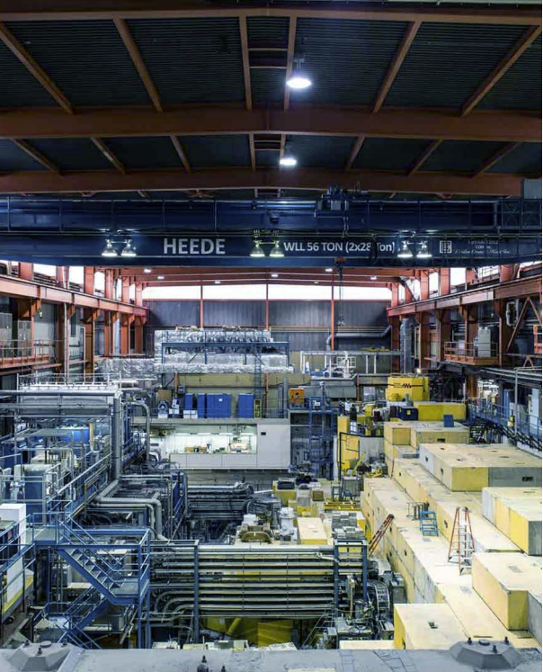
Energy saving initiatives at Accelerator field: TRIUMF(Canada)
Focus on Old Equipment Retrofits
Retrofit the older machines (cyclotron at 500 MeV after 50 years of operation;
ISAC (isotope separation accelerator ) to improve the efficiency of power utilization after 25 years of operation.
New High Efficiency Magnet Power Supplies
TRIUMF Campus: exploring the use of heat pump technology, future utilization of waste heat, serving local universities, etc.
Projects to consider serving sustainable development in the next five-year plan (2025-2030)
Promoting the ADS program in Canada

Slide 14
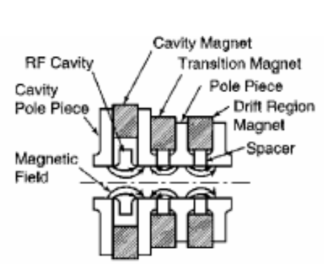
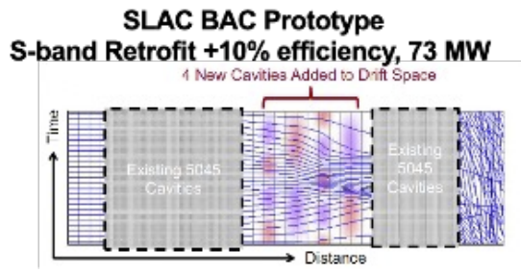
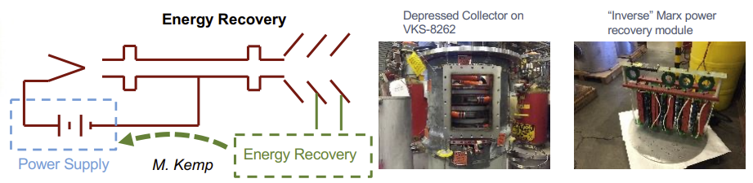
Energy saving initiatives at Accelerator field: SLAC
Focus on Power Source Technology
For pulsed devices, solenoid coils typically consume the most average power
Started manufacturing of Periodic Permanent Magnets (PPM) klystron.
Improvement of efficiency by adopting a new type of cluster design (BAC-Bunching Alignment Collection/COM-Core Oscillation Method)
Collector Pole Energy Recovery Program
Residual energy recovery of the collector pole waste beam

Slide 15
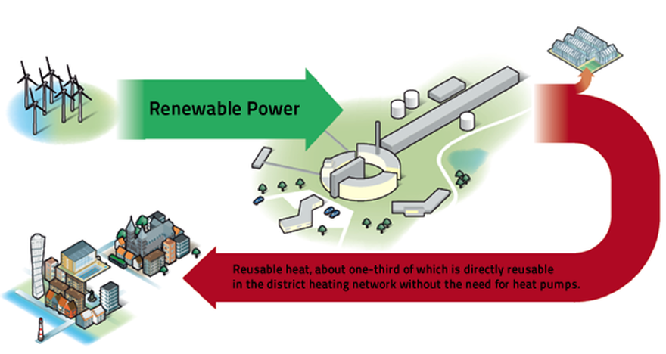
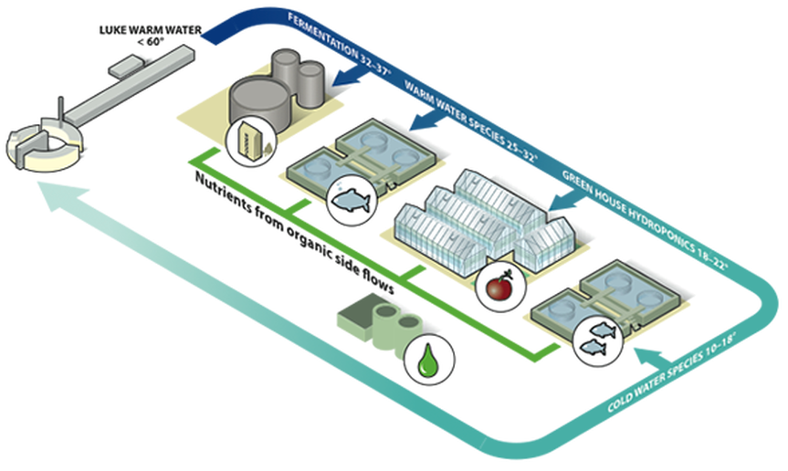
Energy saving initiatives at Accelerator field: ESS
Focus on Integrated Energy Management
Limit annual power consumption to no more than 270 GWh;
Create detailed energy flow profiles, including levels and distribution of different temperatures
Maximize the use of renewable energy sources; ensure that installations are based on new and competitive technologies and that energy use is stable and predictable
Optimizing the recyclability of energy by dividing waste heat into three classes
High temperature waste heat: directly integrated into the local heating system
Low-temperature waste heat: used to heat the buildings in the ESS park.
Medium-temperature waste heat: de-ices bike paths

Slide 16
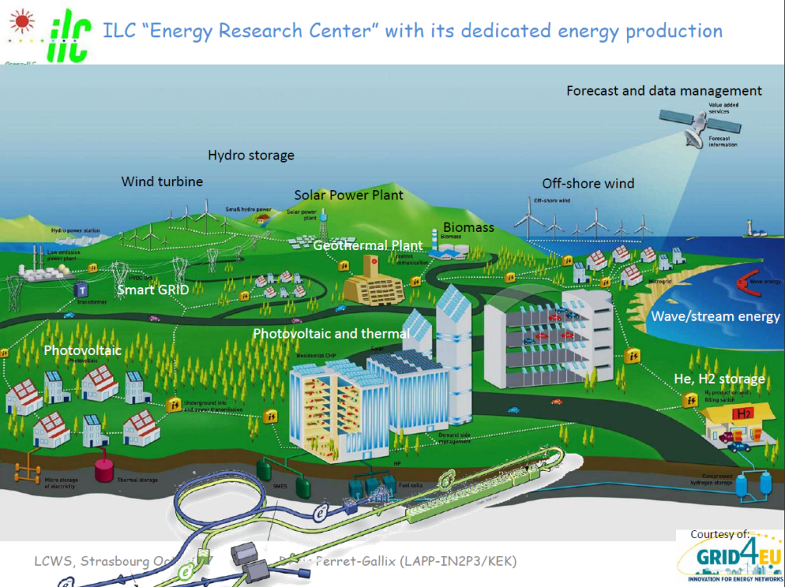
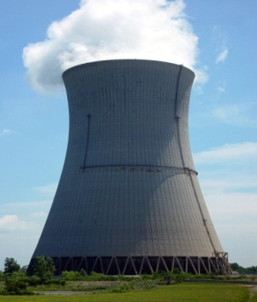
Energy saving initiatives at Accelerator field: ILC
Focus on Renewable energy
ILC : lower running cost, better operational flexibility, environment friendly
Revisiting all ILC components:
Energy Saving: improving efficiency …. 90% lost as heat waste
Operational saving
Energy Recovery and Recycling
Alternative energies:
Renewable energy production, best for ILC and ILC site
Energy Storage (for energy recovery and intermittency)
Distribution and Management: Smart Grid
Energy for: societal needs and world economy,
Basic Research
Synergies: expertise (SC, magnets, beams, computing), photon, neutron factories
Technology innovation
ILC as a test bench: building pilot power plants for ILC

Slide 17
IHEP's "Green" Initiative for Particle Accelerators
Large-scale utilization of solar energy (new energy)
The first large-scale adoption of permanent dipole magnet in China for HEPS facility
Vigorously develop high-efficiency klystron
Vigorously improving the Q value of superconducting high-frequency cavity and SC magets
Recycling of liquid helium in the Institute
Optimization of large cryogenic system
Practical application of waste heat resources

Slide 18
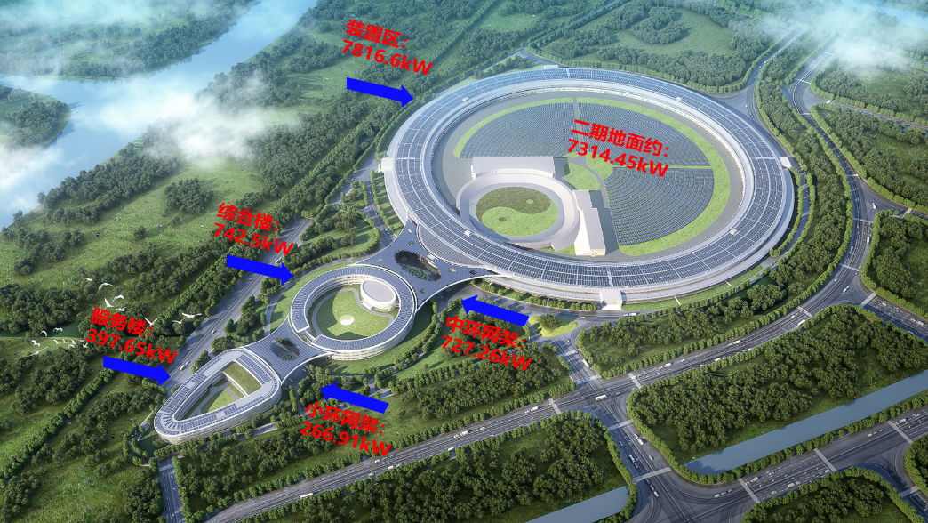
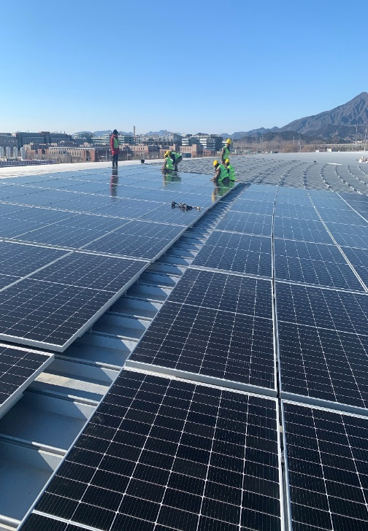
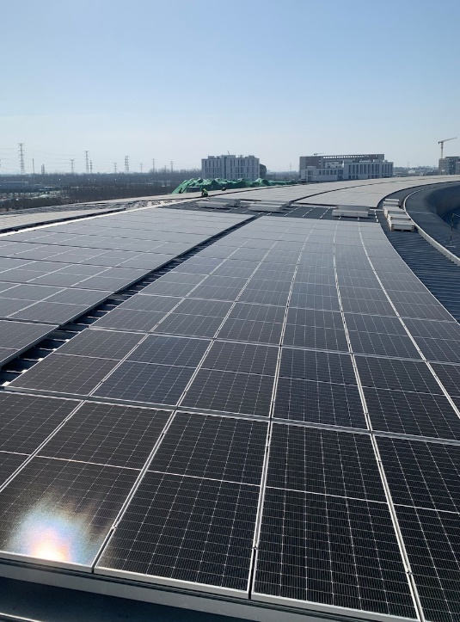
High Energy Photon Source (HEPS) Photovoltaic facilities
HEPS buildings in Huairou are designed and installed with photovoltaic (PV) power generation systems on the roofs to realize the win-win effect of architectural functions and grid-connected power generation, and to create a clean, environmental friendly, intelligent, convenient, and aesthetically pleasing high-tech park.
Adopting 465Wp/550Wp monocrystalline silicon photovoltaic modules, the first phase has a total installed capacity of 9,950.92 kWp. It is expected that the average annual power generation will be 10.30766 million kWh, and the equivalent average annual utilization hours will be 10,035.85h.
The electricity generated by the project is consumed locally.
Phase I is planned to be connected to the grid on 2023.10.30.
The second phase is planned to lay PV modules on the ground inside the storage ring with an installed capacity of 7314.45kWp.
储存环屋顶施工现场
18

Slide 19
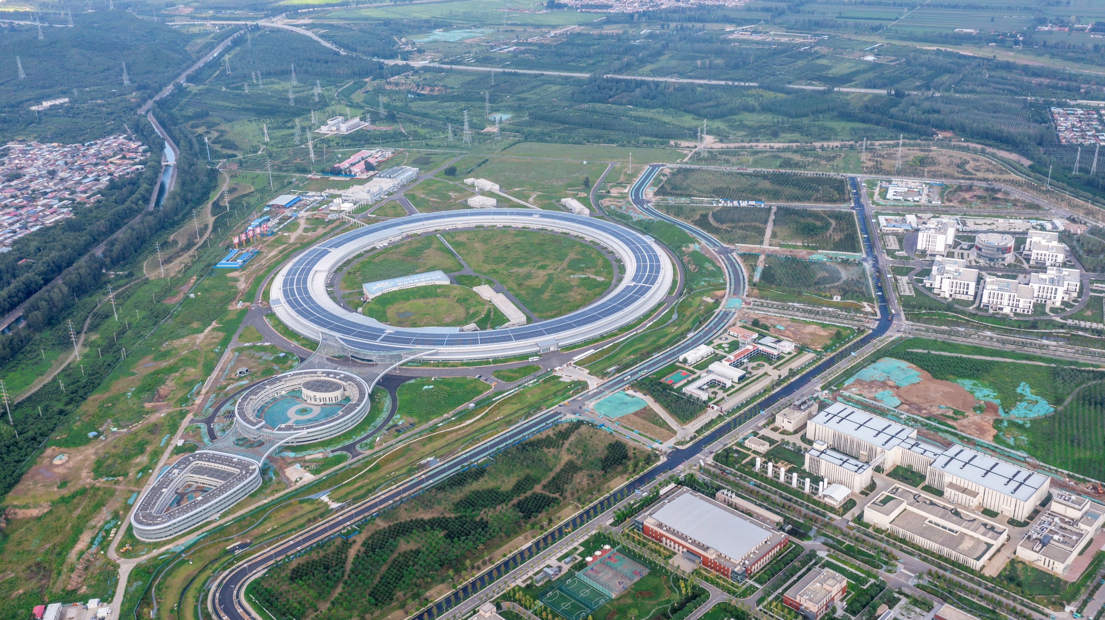
HEPS onsite picture

Slide 20
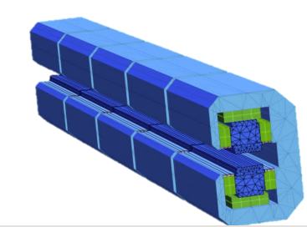
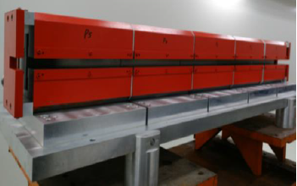
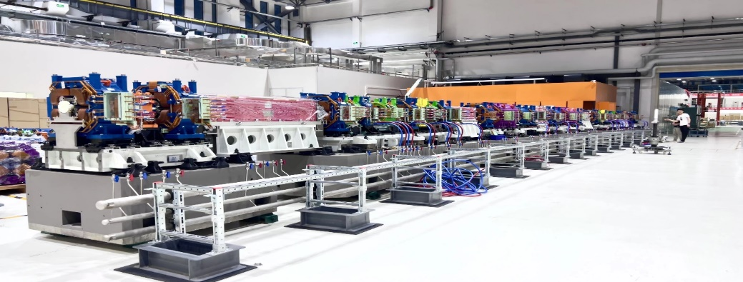
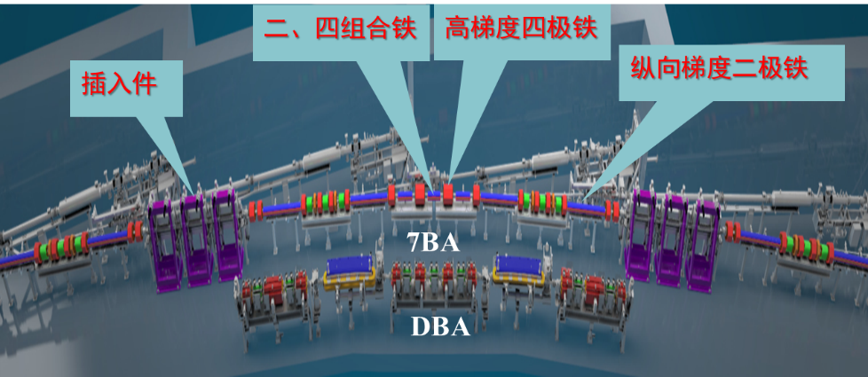
HEPS employs a permanent dipole magnet
Developing new technologies, the dipole magnets are made from pure permanent magnetic materials without consuming electricity during operation, all without affecting the device's performance.
Equivalent single excitation energy consumption of about 1.62kW.
Equivalent cooling, power efficiency additional energy consumption of about 1.3kW
240 magnets in the whole ring
Annual running time of 8000 hours
Annual saving electricity about 5.6 million kWh

Slide 21
Environmental protection and optimization of Magnet design
Magnets provide one of the largest sources of power consumption in modern accelerators. By reducing the power requirements of magnets, more sustainable accelerators can be designed and built.
In CEPC magnet system, large amount magnets are needed. The following aspects are considered to optimize the magnet construction and operation cost.
    Low current density with less power consumption in the power cables.
    Compact magnets with narrow yokes and simple structure
    Dual aperture dipole and quadrupole magnets can save about 50% power consumptions.
    Low field strength dipole magnets, so combined magnets can be used.
    Recycling related to magnet heating is considered.
    Permanent and superconducting magnets are also an option under consideration.

Slide 22
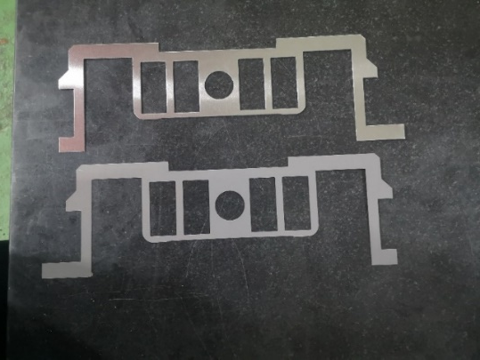
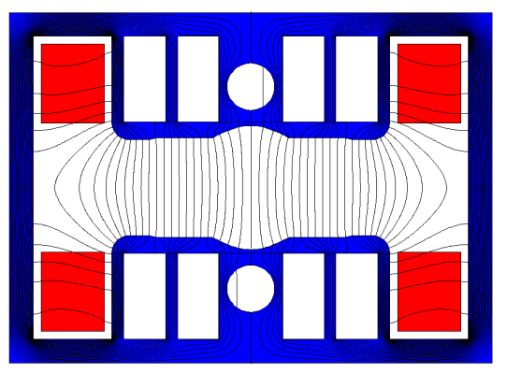
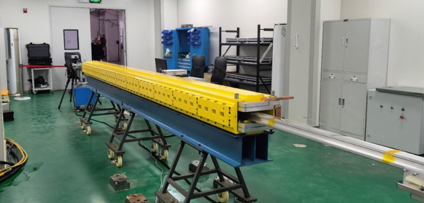
CEPC Booster magnets design
CEPC Booster magnets (19624 sets of magnets cover about 74 km )
  Field ramping with the beam energy ( from 30 GeV to180 GeV) in 10 seconds
  Low field and long dipole magnets: 95 Gs @30 GeV to 564 Gs @180 GeV with a length of 4.7 m.
  Resistant laminated magnets are the first choice.
  Low field dipole magnets with interleaved non-steel/steel laminations, narrow yoke and holes in the pole to reduce the magnet weight
  Aluminum busbar coils for cheap price and low weight ( Vs Copper)
  Combined dipole and sextupole magnets are used to reduce the power consumption of individual sextupole magnets.

Slide 23
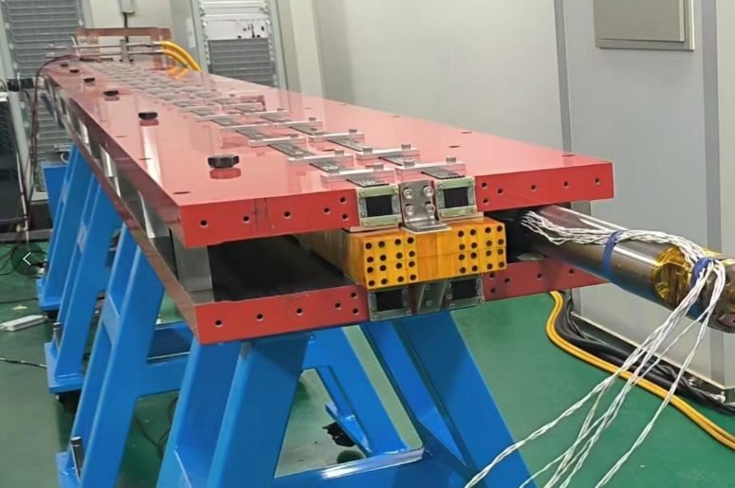
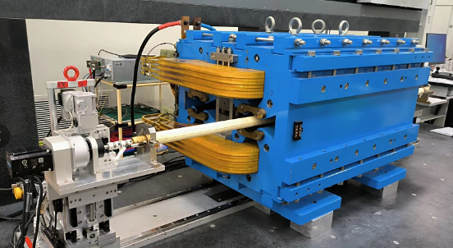
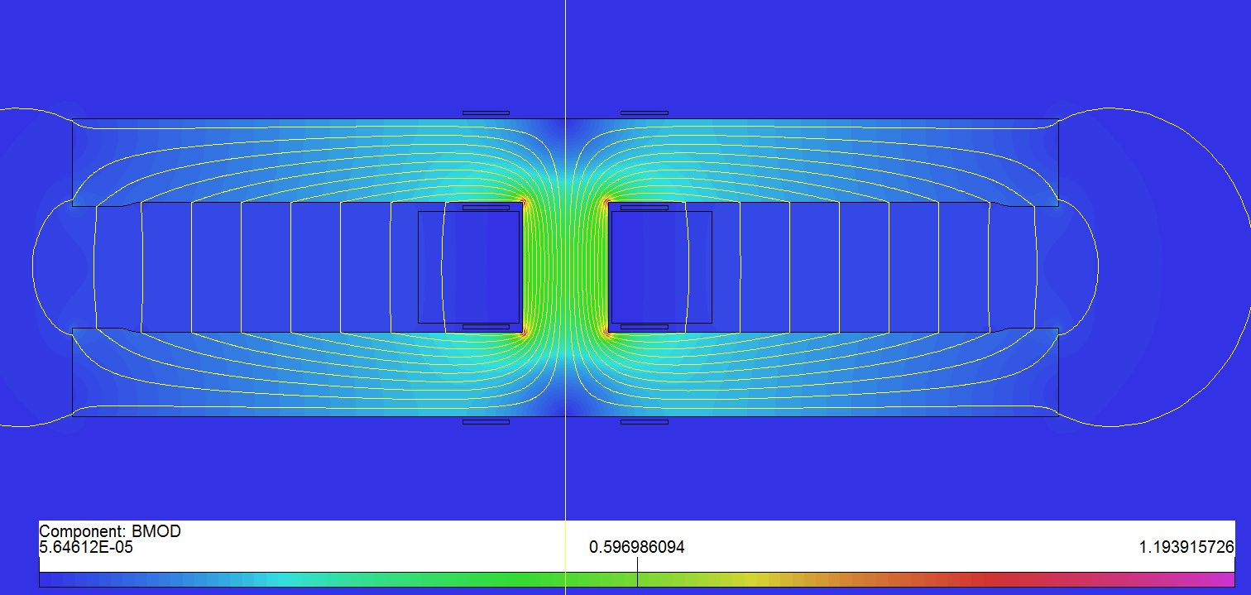
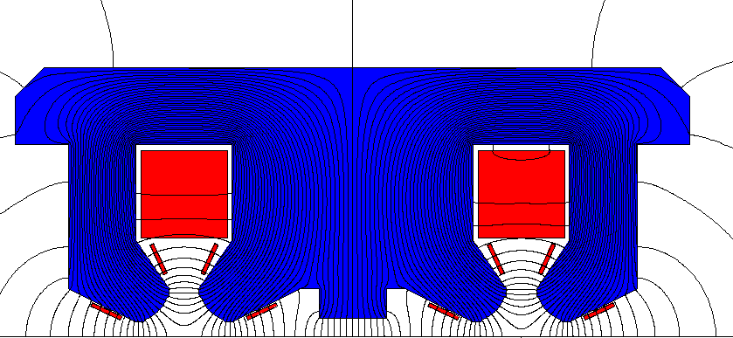
CEPC Collider magnets design
CEPC Collider magnets (17574 sets of magnets cover about 84.67 km)
  DC magnets work at four energies of 45.5, 80, 120 and 180 GeV
  Dual aperture magnets can decrease the number of units to manufacture, test, transport, install, maintain, and save about 50% power consumption.
  Compact magnets with narrow yokes and simple pole shape
  Pure solid iron is used for dual aperture dipole magnet with aluminum excitation bars
  Simple racetrack coil is used for dual aperture quadrupoles.

Slide 24
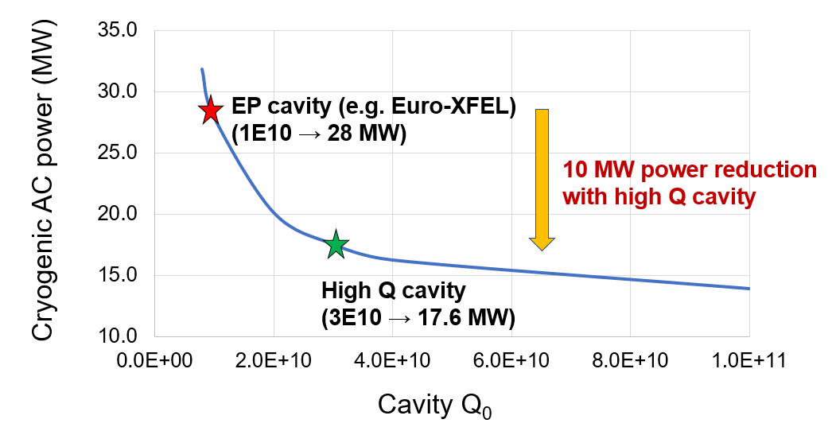
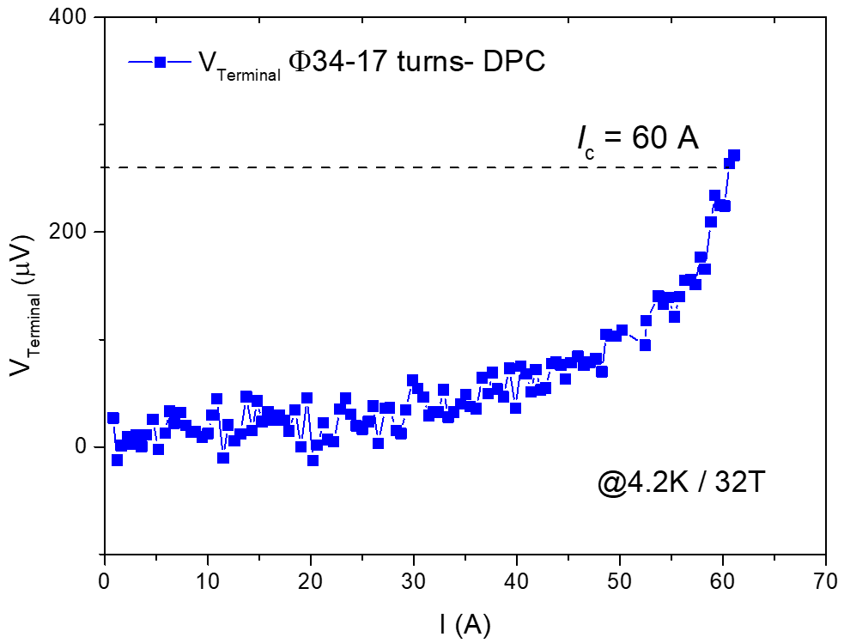
Develop the superconducting technology
CEPC's superconducting high-frequency system (with attached cryogenic system) is the main source of energy consumption. The high Q superconducting cavity can effectively reduce the heat load of the cryogenic system, effectively saving power
High-temperature superconducting (HTS) technology, can dramatically change the technical solutions of accelerator magnets and reduce energy consumption
High-performance superconducting cable is the key technology for superconducting magnets;
High-Q superconducting cavities at IHEP, with a quality factor of ~5e10. Average Q of superconducting cavities at EuXFEL is ~1e10
Chinese scientists pioneered iron-based high-temperature superconductivity technology IBS
  ◈ low cost ◈good stability ◈ flexible winding
High Q cavity for CEPC, comprehensive accounting can reduce the operating power of 10MW, annual power savings of about 60M kWh
50MW Higgs Mode Cryogenic System Power Consumption vs. Q
Performance of IBS solenoids under a 32 T
I_{c} reach 60 A at 4.2 K and 32 T
SC magnet
RF

Slide 25
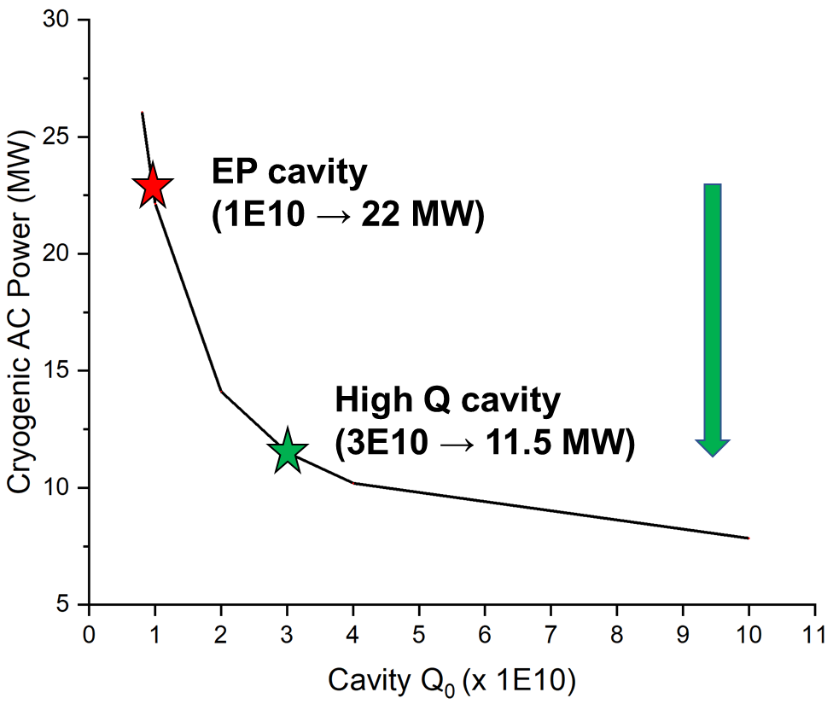
Cryogenic AC Power vs Cavity Q0 of CEPC
CEPC Higgs 30 MW mode:
10 MW cryogenic AC power reduction
with high Q SCRF cavity
For CEPC ttbar collider ring:
2 K dynamic heat load will decrease from 60 kW to 20 kW by increasing Q₀ from 1E10 to 3E10, saving 30 MW electric power.

Slide 26
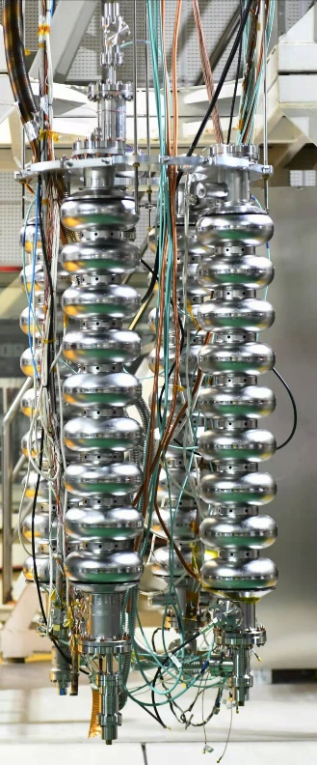
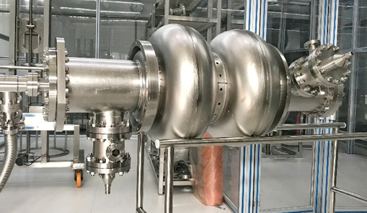







IHEP High Q 650 MHz and 1.3 GHz Cavity
High Q 1.3 GHz 9-cell
650 MHz 2-cell BCP
High Q 650 MHz 1-cell

Slide 27





IHEP Mid-T High Q 1.3 GHz Cryomodule
World’s first 1.3 GHz cryomodule with 8 mid-T (medium-temperature furnace bake) 9-cell cavities.
World’s record Q cavity in the cryomodule. Exceeds CEPC specification.
Parameters | IHEP Mid-T CM Horizontal Test | LCLS-II & HE Spec | CEPC Booster Higgs mode Spec
Avg. usable CW E_{acc} | > 23 MV/m | 2.7×10¹⁰ @ 16 & 20.8 MV/m | 3.0×10¹⁰ @ 21.8 MV/m
Avg. Q₀ @ 21 MV/m | 3.6×10¹⁰ |  | 3.0×10¹⁰

Slide 28




Develop high-efficiency klystron
Efficiency target of 80.5% for the third klystron (multiple injection high efficiency)
Efficiency target of 75% for the second klystron (single injection high efficiency)
First klystron, 62% efficiency, already met the standard
CEPC at 800 RMB/MWh and 6000 hours/year
Save Money
130M RMB
1 year
90 M RMB
Excessive electricity bill, M RMB
High-efficiency prototype klystron efficiency has reached 70.5% @ 630kW, now has been further modified
Efficiency, %
The CEPC can save 160M kWh of electricity per year by increasing the conventional efficiency (55%) of the klystron to a high efficiency of 80%.
28

Slide 29


Optimization of the large cryogenic system
CDR
TDR
Eliminate many small valve boxes;
Process flow looks more easier;
Reduce the cryogenic cost;

Slide 30






Full recovery/recycling of the liquid helium/helium gas
Helium gas is an associated resource of natural gas, which is non-renewable and mainly relies on imports in China. In recent years, due to the international situation, the price fluctuates greatly;
All the devices in IHEP realize all helium gas recovery: the liquid helium recovery and purification system of BEPCII(ADS)/PAPS has been running stably for many years.
Recovery capacity ≥210NM³/h; purification capacity ≥105NM³/h;
Promote the localization of large-scale liquid helium recycling system.
PAPS helium purification
and recycling system
ADS helium purification
and recycling system
BEPCII cryogenic system

Slide 31


HEPS Waste Heat Sources Utilization
Installation the heat recovery condenser
A heat recovery chiller unit is used to recover waste heat typically discharged into the atmosphere through cooling towers. While meeting the cooling load, this system utilizes the byproduct of refrigeration operation, which is waste heat, to produce inexpensive hot water. Simultaneously, it reduces the heat emissions and noise from the cooling tower, thereby mitigating the "heat island effect" in the city.
HEPS (presumably a facility or system) has installed four heat recovery chiller units: 2 * 5500 kW and 2 * 2800 kW. During operation, it can provide a maximum of approximately 13 MW of recovered heat energy at 42°C.
The maximum heat load for HEPS is 10.4MW in winter and 4.1MW in summer. When the system is running, the recovered heat source can fully replace municipal heat sources.
The equipment was installed and commissioned by the end of 2022. Economic benefits analysis:
Initial investment cost: Approximately 2.4 million RMB.
The additional electricity cost for the heat recovery units: Approximately 900,000 RMB.
Savings in municipal heat source costs: 5 million RMB. Savings in vacuum gas boiler costs: 3.67 million RMB.

Slide 32
Difficulties/challenges and outlook
New theory and new scheme
Difficulties/challenges

Slide 33

Energy Saving Measures of IHEP: further develop the Energy Recovery Type klystron
The energy of electrons in the klystron cannot be converted to microwave energy at 100%. In the traditional approach, electrons are directed into the collector electrode, but there is residual energy (approximately over 30% of the total energy), which is entirely wasted.
In the new approach, the collector electrode design has been improved to progressively reduce the voltage of the wasted electrons, further recovering the residual energy and converting it into electrical energy.
Need to resolve many theory design and key technologies difficulties:
Optimization of the beam dynamics of the collector electrode to reduce the axial and radial energy spread.
Design optimization of the multi-stage electrode structure, electrode voltage distribution, and improved heat dissipation performance to achieve maximum efficiency in electron energy recovery.
Exploration of electrode surface coating processes to reduce the secondary electron emission coefficient.

Slide 34



New possible scheme: waste heat recovery technology
Table 1 CEPC circulating cooling water demand parameters table
CEPC Higgs 50MW consumes about 340MW of electric power, which will be up to 2,720 GWh (about 2.7 billion dollars of electricity) per year based on 8,000 hours of operation.
About 82% of the electrical power consumption (282MW) becomes low-grade heat energy (30°C), which is discharged by the cooling water;
By means of heat pump technology, light - heat technology and thermal energy storage, low-grade energy is converted into high-grade energy and energy ladder utilization is enhanced.
 | Ring | Booster | Linac | BTL | IR
冷负荷MW | 245.814 | 12.68 | 18.344 | 0.856 | 4.552
冷水量m³/h | 7045.40 | 363.43 | 525.77 | 36.80 | 195.70
冷却水回水温度℃ | 30~40 | 30~40 | 30~40 | 30~40 | 30~40
Cooling water load：282MW （17MW/unit）;
Winter:
heating to 80℃
Summer: refrigeration to 10℃
Layout of the cooling water circuit in CEPC collider ring

Slide 35
New possible scheme: waste heat recovery technology
As the rapid development of photovoltaic and heat storage technology, Absorption-type Heat pump (AHP) can be served the new possible scheme to recover the waste heat.

Slide 36



As for AHP, What does the solar-transfer-electricity driven efficiency vs. solar-transfer-thermal driven efficiency look?
Electrical heat pump
$$\text{solar} \text{energy}\text{→}\text{electricity}\text{→}\text{EHP} \text{enhance} \text{T}$$
$$\text{15\%∗3=45\%}$$
Absorption heat pump
$$\text{solar} \text{energy}\text{→}\text{heat}\text{→}\text{A}\text{HP} \text{enhance} \text{T}$$
$$\text{50\%∗1.8=90\%}$$
1. 《光伏发电效率技术规范》
Technical Specification for Photovoltaic Power Generation Efficiency
2.《蒸气压缩循环冷水（热泵）机组国家标准GB/T 18430》
National Standard for Vapor Compression Cycle Chilled Water (Heat Pump) Units GB/T 18430
3. 《真空管型太阳能集热器国家标准 GB/T 17581-2021》
National Standard for Vacuum Tube Solar Collectors GB/T 17581-2021
4. 《第一类溴化锂吸收式热泵机组国家标准GBT 34620-2017》
National Standard for Type I Lithium Bromide Absorption Heat Pump Units GBT 34620-2017

Slide 37


Basic working principle of the absorption heat pump
Absorption heat pump technology（AHP）
Using the gas-liquid equilibrium (PVT) characteristic
AHP contains two circle: 1st circle--refrigerant vapor passes from the generator (point 5) through the condenser (point 3), the throttle valve (point 1), the evaporator (point 1'), the absorber (point 2) and then returns to the generator, which is a refrigeration cycle;
2nd circle： Driving circle of the AHP (the power cycle of the heat compressor)–starting from the generator (point 4) through the solution valve (point 8), the absorber (point 2), the solution pump (point 7) and then back to the generator (point 5).
Condenser pressure
Hot water (supply)
generator
condenser
Heat exchanger
Low-grade waste cooling water
evaporator pressure
absorber
evaporator
evaporator temperature
Condenser temperature
generator temperature
b) p-T and h-ξ（ Specific enthalpy and concentration ）diagram
a) Working principle
Absorption-type heat pump

Slide 38




Application difficulties and challenges for AHP technology?
Difficulties analysis applied in accelerator field
01
02
02
1/
2/
Performing multi-physical chemistry coupling modeling and simulation, optimization, and economic analysis of the entire waste heat recovery system is inherently challenging.
Load matching issue and high-efficiency for both cooling and heating aspects still need to be studied.
Carry out research on the coupled heat-flow transport mechanism and its enhancement technology;
Waste heat recovery process may exist model mismatch, heat load fluctuation and heat source instability perturbation.

Slide 39
Summary
The development of environmental friendly, green and sustainable accelerator is a relatively new topic in this field;
The comprehensive development of green accelerator requires a cross-section of management, municipal planning, resource recycling, specialized technology, theoretical innovation and other areas, and it is complex and difficult to coordinate all aspects of integrated consideration;
Further green accelerator development & research works are still going on
……

