Slide 1


Quantum Computing Quantum Machine Learning
Status and Prospects
Hamburg
Zeuthen
Prof. Dr. Kerstin Borras
Deutsches Elektronen-Synchrotron DESY and RWTH Aachen University
DESY Quantum Technology Task Force qt-task-force@desy.de

Slide 2
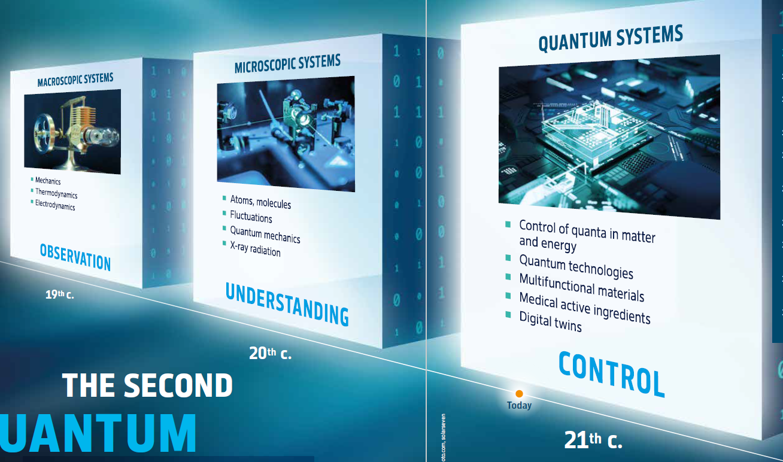
The Second Quantum Revolution is Transforming the World.
Decoding of Matter with novel methods and tools → get ready today !
1st Quantum Revolution:
understand & apply
→ ground-breaking: transistors, lasers etc.
2nd Quantum Revolution:
Identify, control, manipulate individual quanta
→ exploit the potential
Quantum Advantage:
Improvement versus
the best known conventional method
Quantum Technologies: Rethinking of our methods
→ completely different principles
→ pioneering work improves already our classical methods
→ maximizing our achievable scientific and economic success

Slide 3
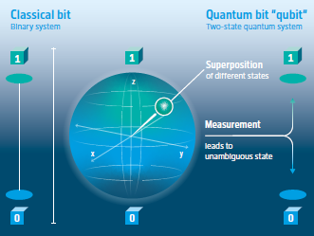
Quantum Computing is part of our Future.
Quantum Computing is opening new windows for our science today.
2nd Quantum Revolution:
manipulate quantum effects in customized systems and materials
→ expands the useable phase space considerably:
one classical bit turns into a whole Bloch sphere
Quantum Advantage:
For a given problem, the improvement in run time for a quantum computer versus
a conventional computer operating the best known conventional algorithm.
→ working on completely different principles than classic technology
superposition, entanglement, randomization
→ potential to solve challenges in Complexity and Big Data
Quantum Computing demands for a rethinking of our methods
→ pioneering work improves already our classical methods
Example: System of n qubits
→ computational basis states of this system are of the form |x₁, x₂, ... x_{n}⟩
→ quantum state is specified by 2^{n} amplitudes
→ n=500 → number is larger than the estimated number of atoms in the Universe!
→ storing all these complex numbers is not possible on any conceivable classical computer.
Exciting times with exponential evolution of novel technologies

Slide 4
Quantum Computing in Particle Physics in Theory and Experiment.
Novel methods and tools for the 100x100 Challenge→ get ready today !

Slide 5
Quantum Computing in Particle Physics in Theory and Experiment.
Novel methods and tools for the 100x100 Challenge→ get ready today !

Slide 6
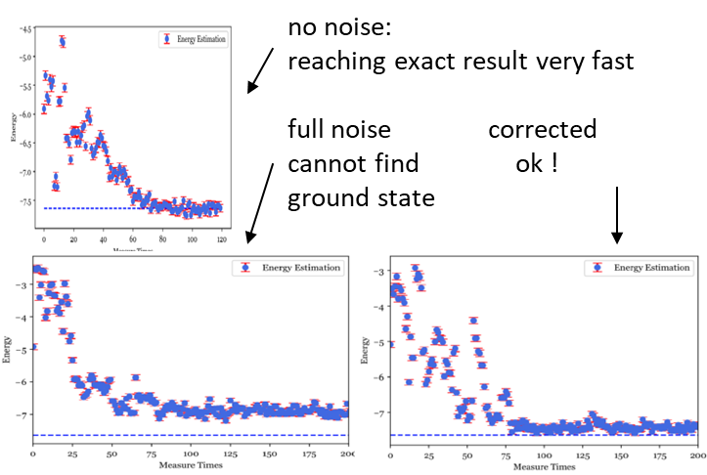
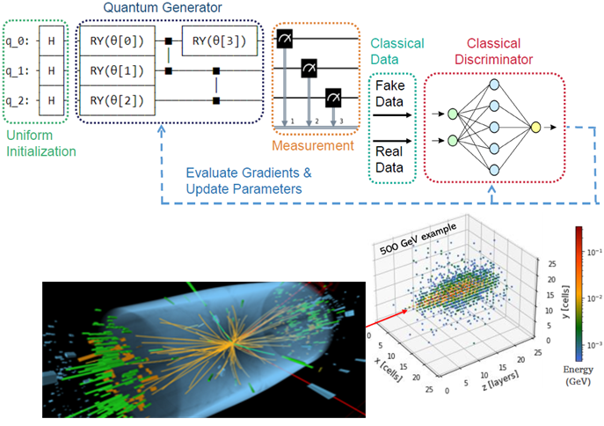
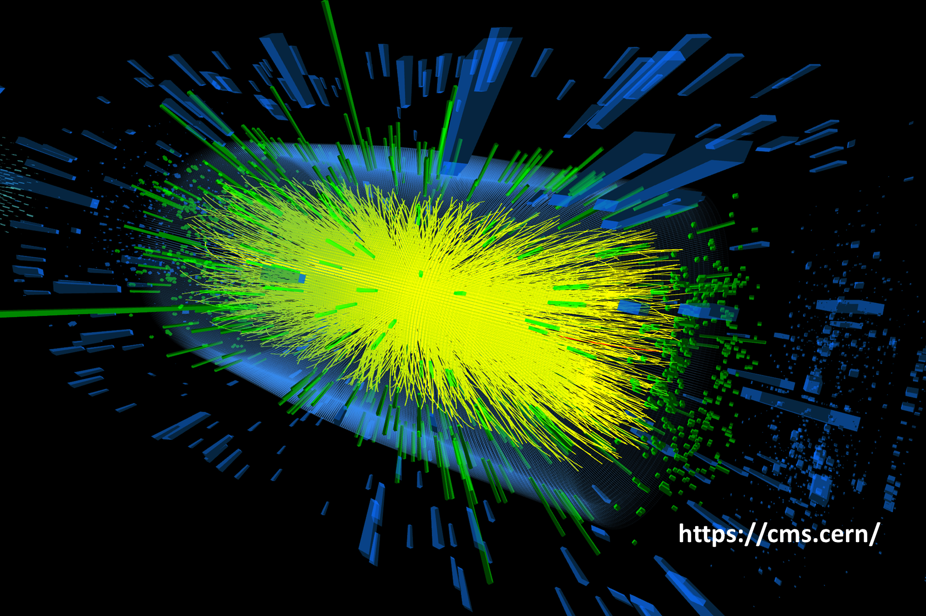
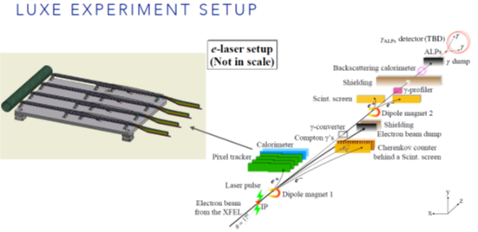
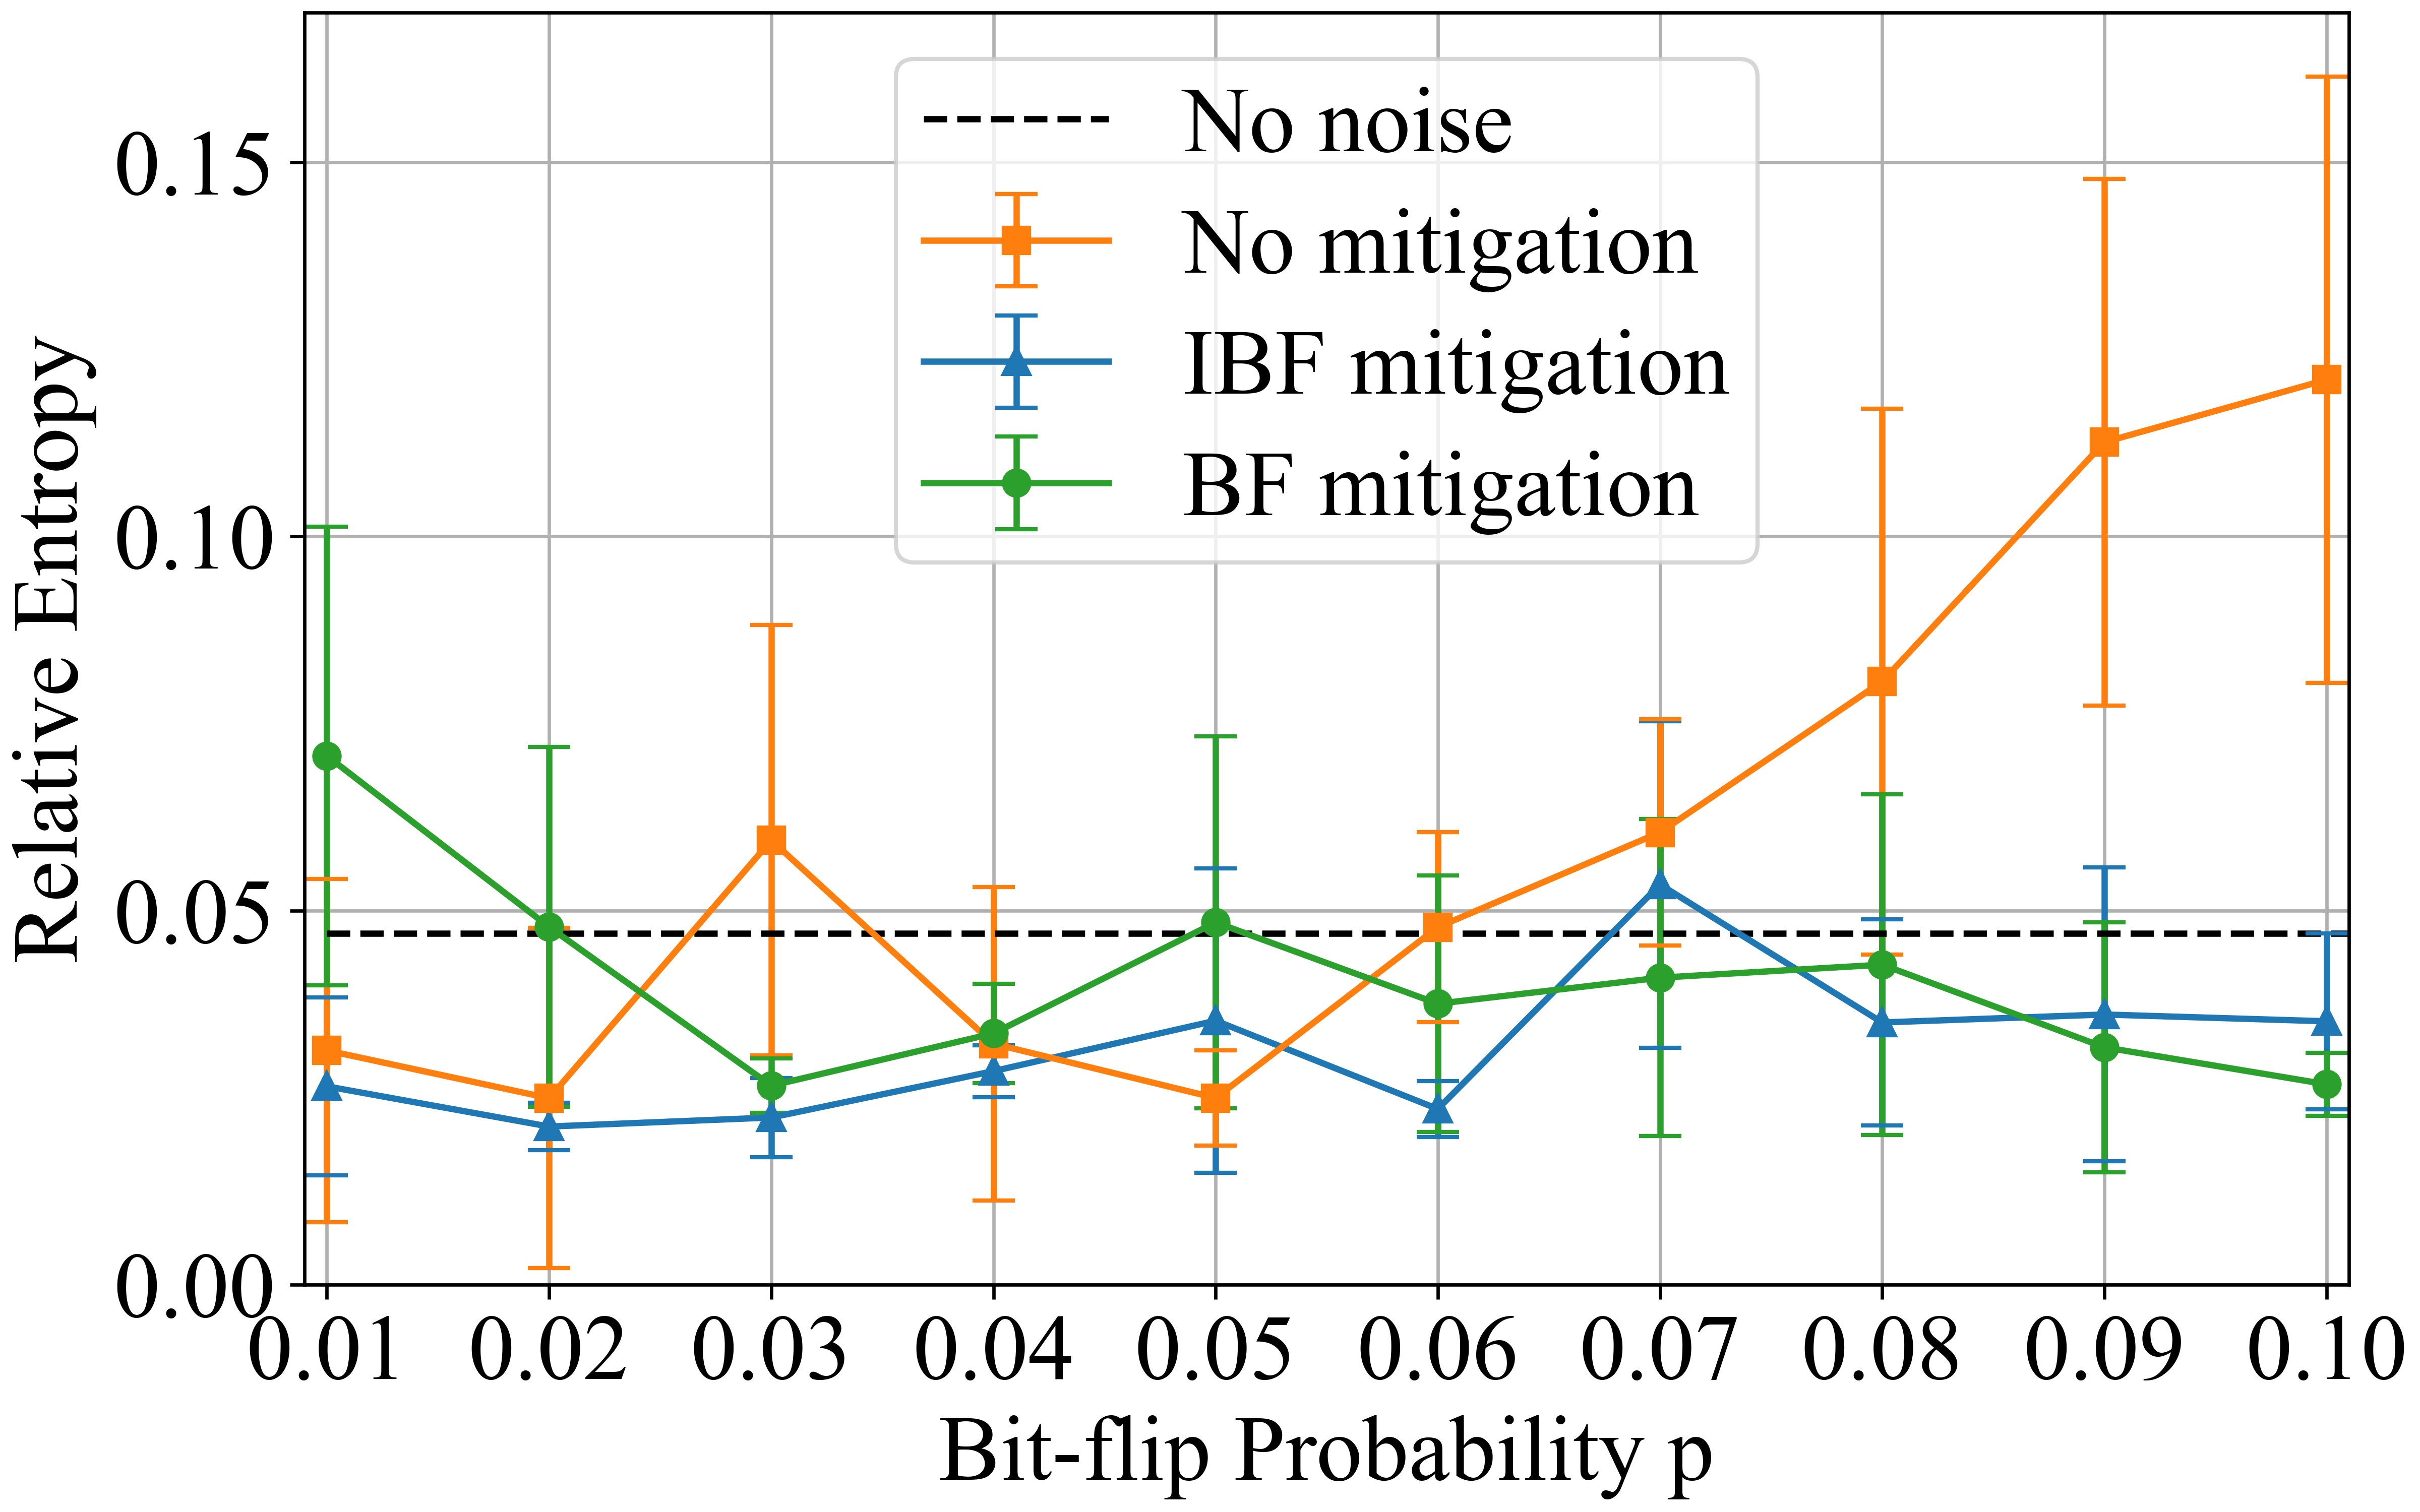
Quantum Computing Activities at DESY
Quantum Computing will be part of our future
Quantum Computers have the potential to solve problems
that cannot be addressed with classical computers
Develop algorithms and methods in Theoretical Particle Physics
Calculations in theory → novel unique results &benchmark novel devices
Applications in particle physics similar to other logistics problems
(optimization of flight gate assignment)
Error mitigation in QC calculations
Optimization of Quantum Gate Circuits (to reduce noise)
Quantum Machine Learning (usually in hybrid mode)
Develop machine learning and tensor network methods for QC
Simulations for detectors at LHC (CERN), IBM
Tracking for LUXE (DESY), IBM
Particle identification at Belle II (KEK, Japan), Annealer
EFT Fits to find New Physics (Annealer)

Slide 7
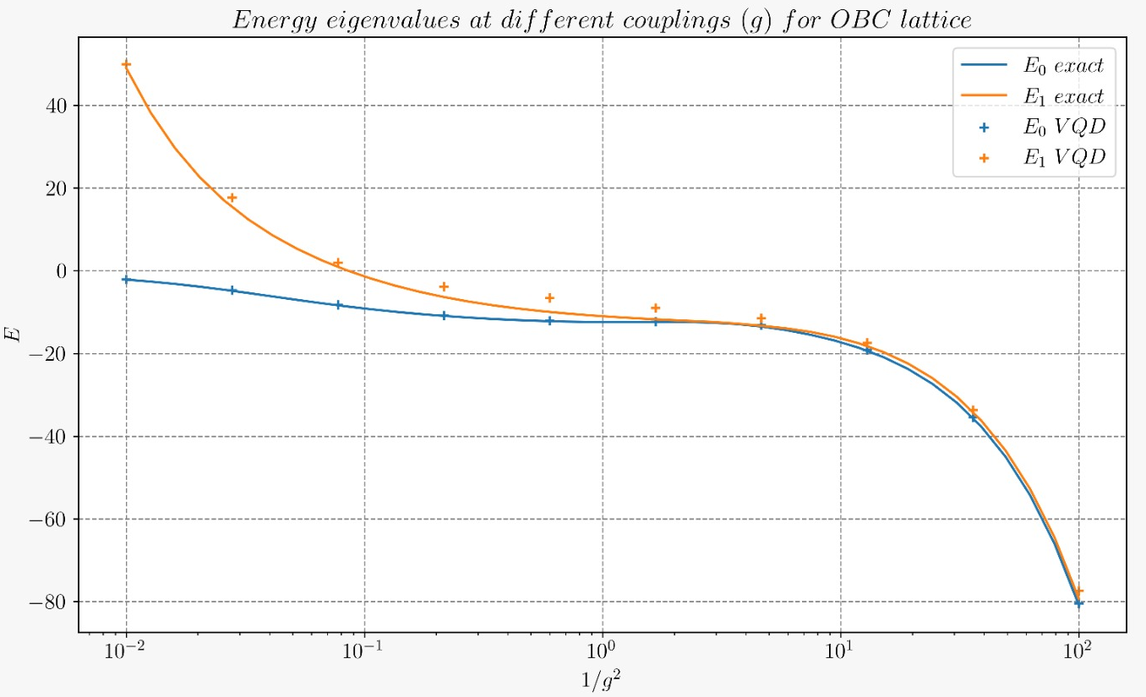
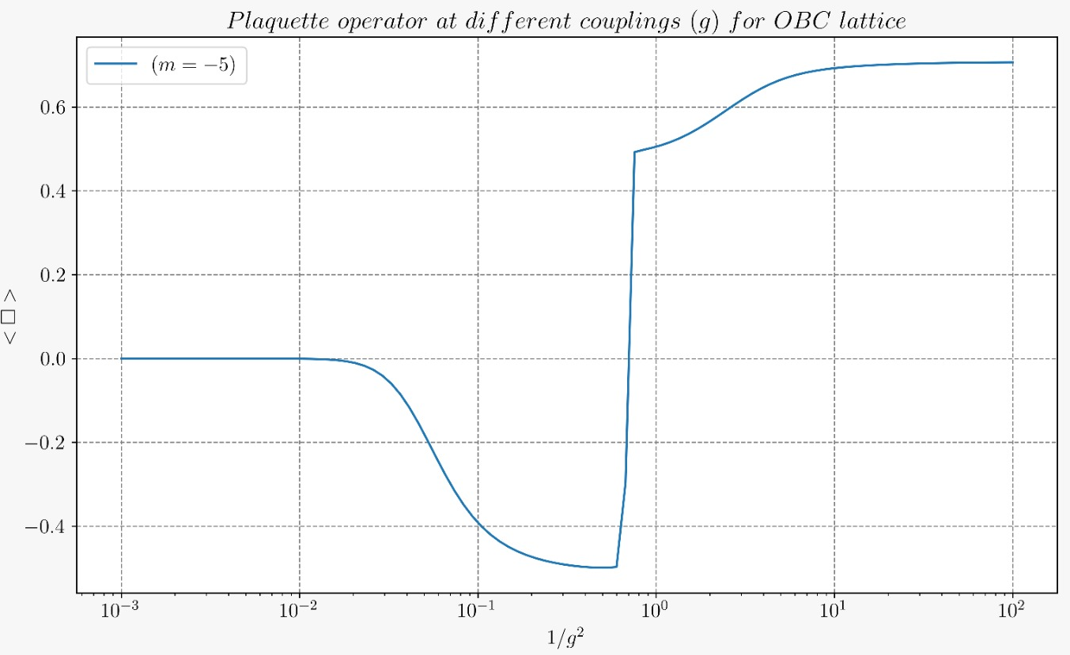
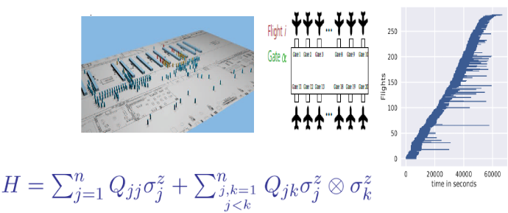
Quantum Computing: From Theory towards Applications
arXiv:2206.12454
From QED in 2+1 dimensions to Flight Gate Assignments
Variational Quantum Simulations (VQS) for QED
Detecting a phase transition
at negative mass
→ not possible with MC methods
Particle Mass
Δ = E₁ – E₀
→ physical quantity
Clemente G. et al, Strategies for the Determination of the Running Coupling of (2+1)-dimensional QED with Quantum Computing, https://arxiv.org/abs/2206.12454
Very similar approach for
Flight Gate Assignment Optimization
find lowest energy ⇔ shortest path
same mathematics for problems in traffic, logistics, aerospace, ...
Theoretical optimization:
Y. Chai, L. Funcke, T. Hartung, S. Kühn, T. Stollenwerk,
P. Stornati, K. Jansen, arXiv:2302.11595
Hardware Runs:
Y. Chai, E. Epifanovsky, K. Jansen, A. Kaushik, S. Kühn, arxiv:2309.09686

Slide 8

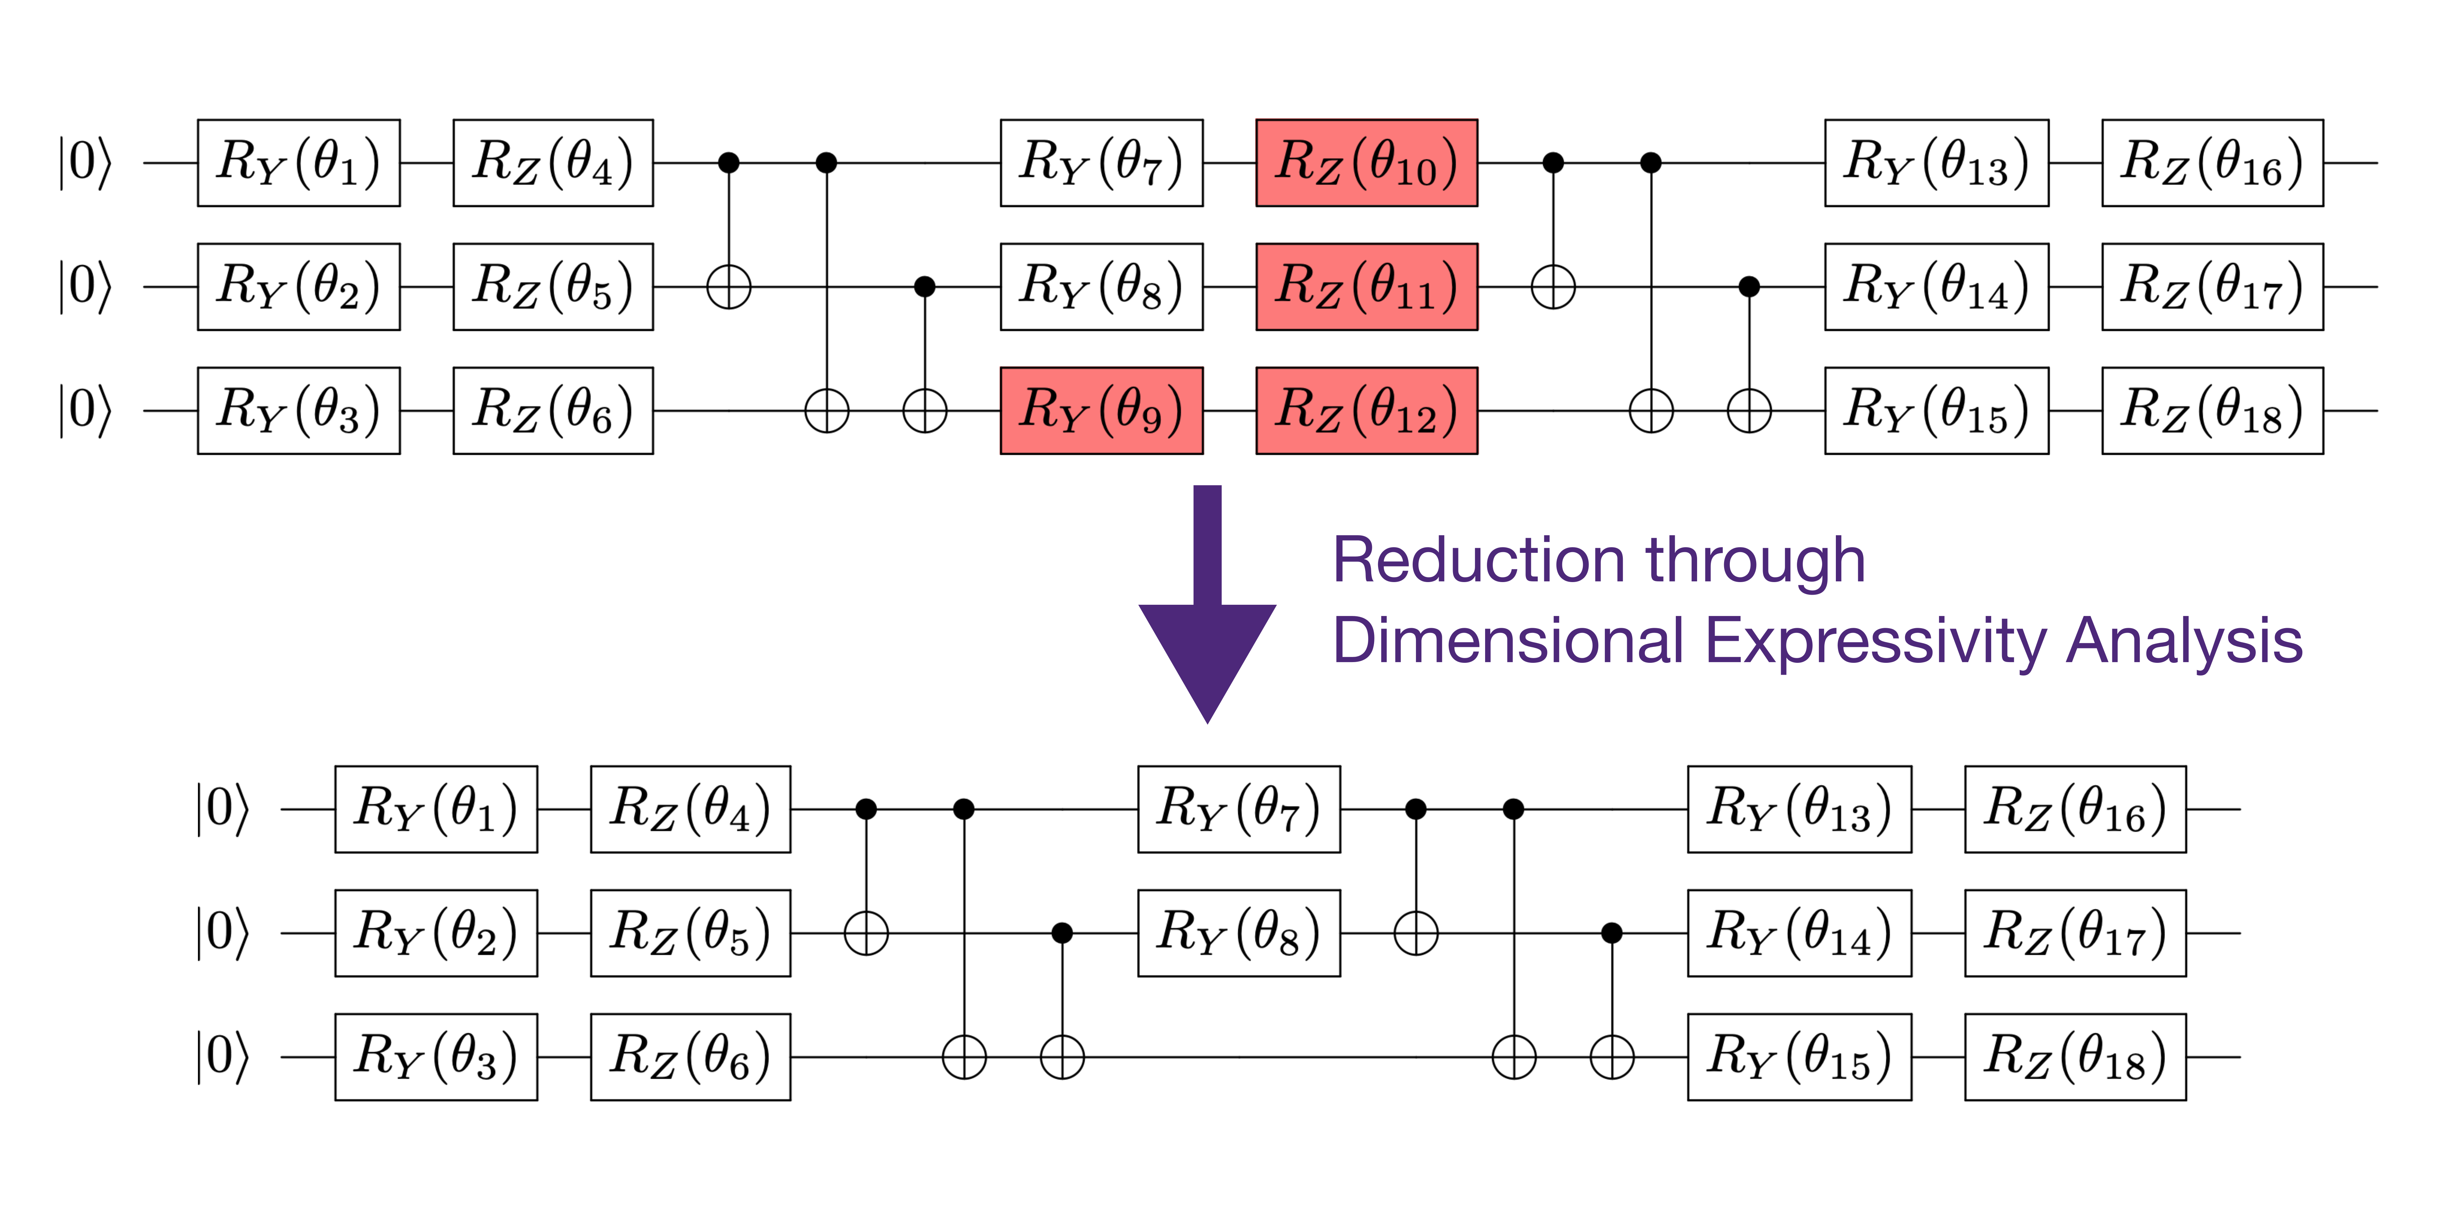
Methods for reliable Quantum Computing Calculations
Increase the Reliability for Quantum Computing Calculations
Example for Error Mitigation in Variational Quantum Simulation VQS
  Model in Condensed Matter Physics:
  1-Dimensional Heisenberg model, very prone to QC errors
  Cured by own developed error mitigation methods
Funcke L. et al, Measurement Error Mitigation in Quantum Computers Through Classical Bit-Flip Correction, arxiv:2007.03663, Phys. Rev. A 105, 062404
Optimize Dimensional Expressivity of a Quantum Gate Circuit
  Gate Operations are erroneus
  Develop methods for Dimensional Expressivity Analysis
  Generate as many/complicated states as possible
  with fewest number of gates
Funcke L. et al, Dimensional Expressivity Analysis of Quantum Circuits
Quantum 5 (2021) 422

Slide 9

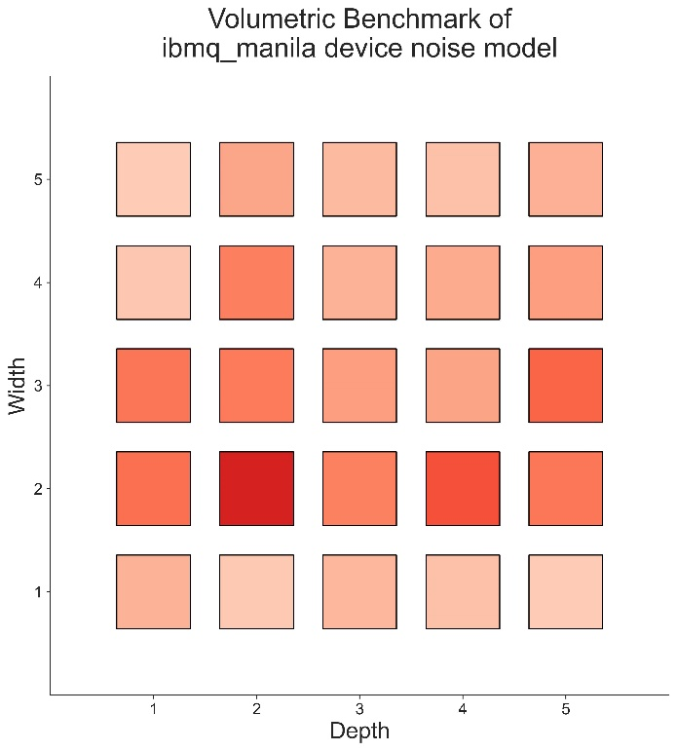
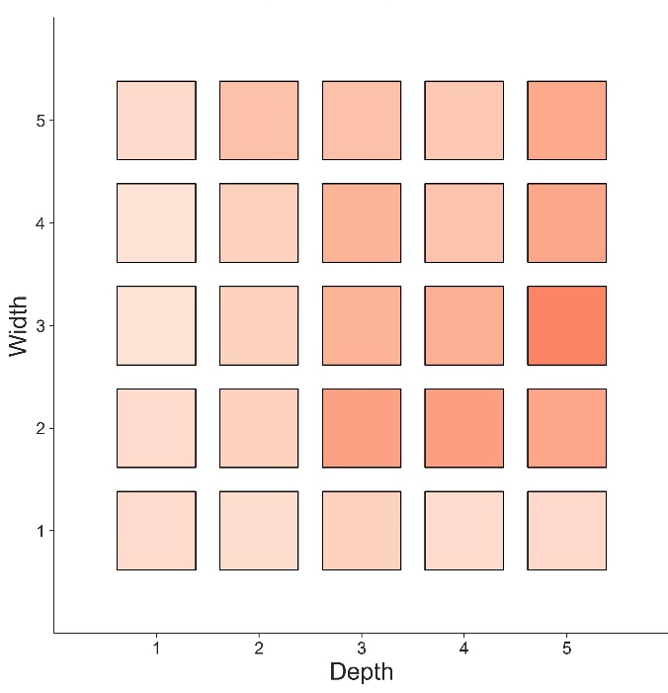


Software engineering for Noise Model Benchmarks
Increase the Reliability for Quantum Computing Calculations
Software Engineering Models for Error Mitigation
  Systematic approach to train error models with Machine Learning and perform benchmarks for quantum computing applications
IBM noise model
# qubits
$$\left\langle Z^{⊗w}\right\rangle$$
Our trained noise model
# qubits
bad
good
Weber, T. et al.
Construction and Benchmarking of Quantum Computing Noise Models.
Submitted to IOP Physica Scripta and https://arxiv.org/abs/2306.08427
# layers

Slide 10
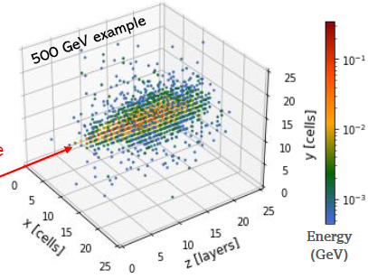
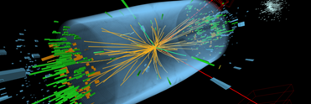
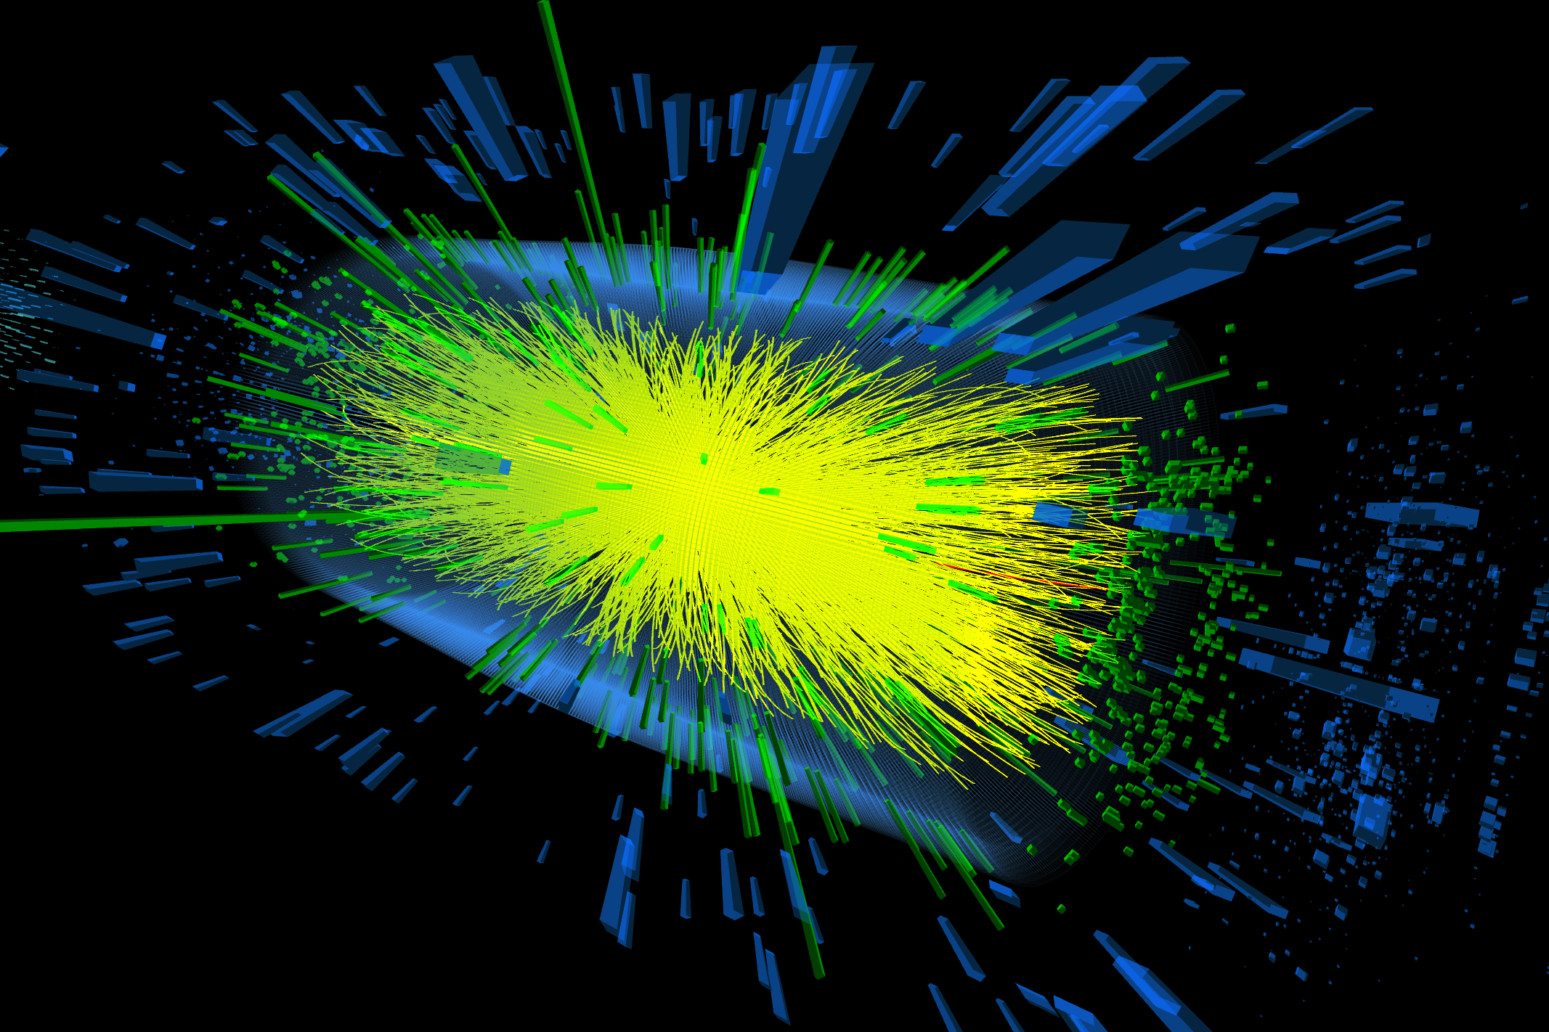


Quantum Machine Learning for Particle Physics
Early examples in Experimental Particle Physics
Quantum Machine Learning lies at the intersection of
Quantum Computing and Machine Learning
High Luminosity LHC (>2029) needs vast amount of simulations with 200 pile-up events,
GRID Computing, Big Data Analysis
LHC (~20 pile-up events)
Develop machine learning and tensor network methods for Quantum Computing
Q-GAN (Quantum Generative Adversarial Network) simulations for detectors
(CERN Openlab with joint BMBF Gentner PhD Student)
LHC (~200 pile-up events)

Slide 11
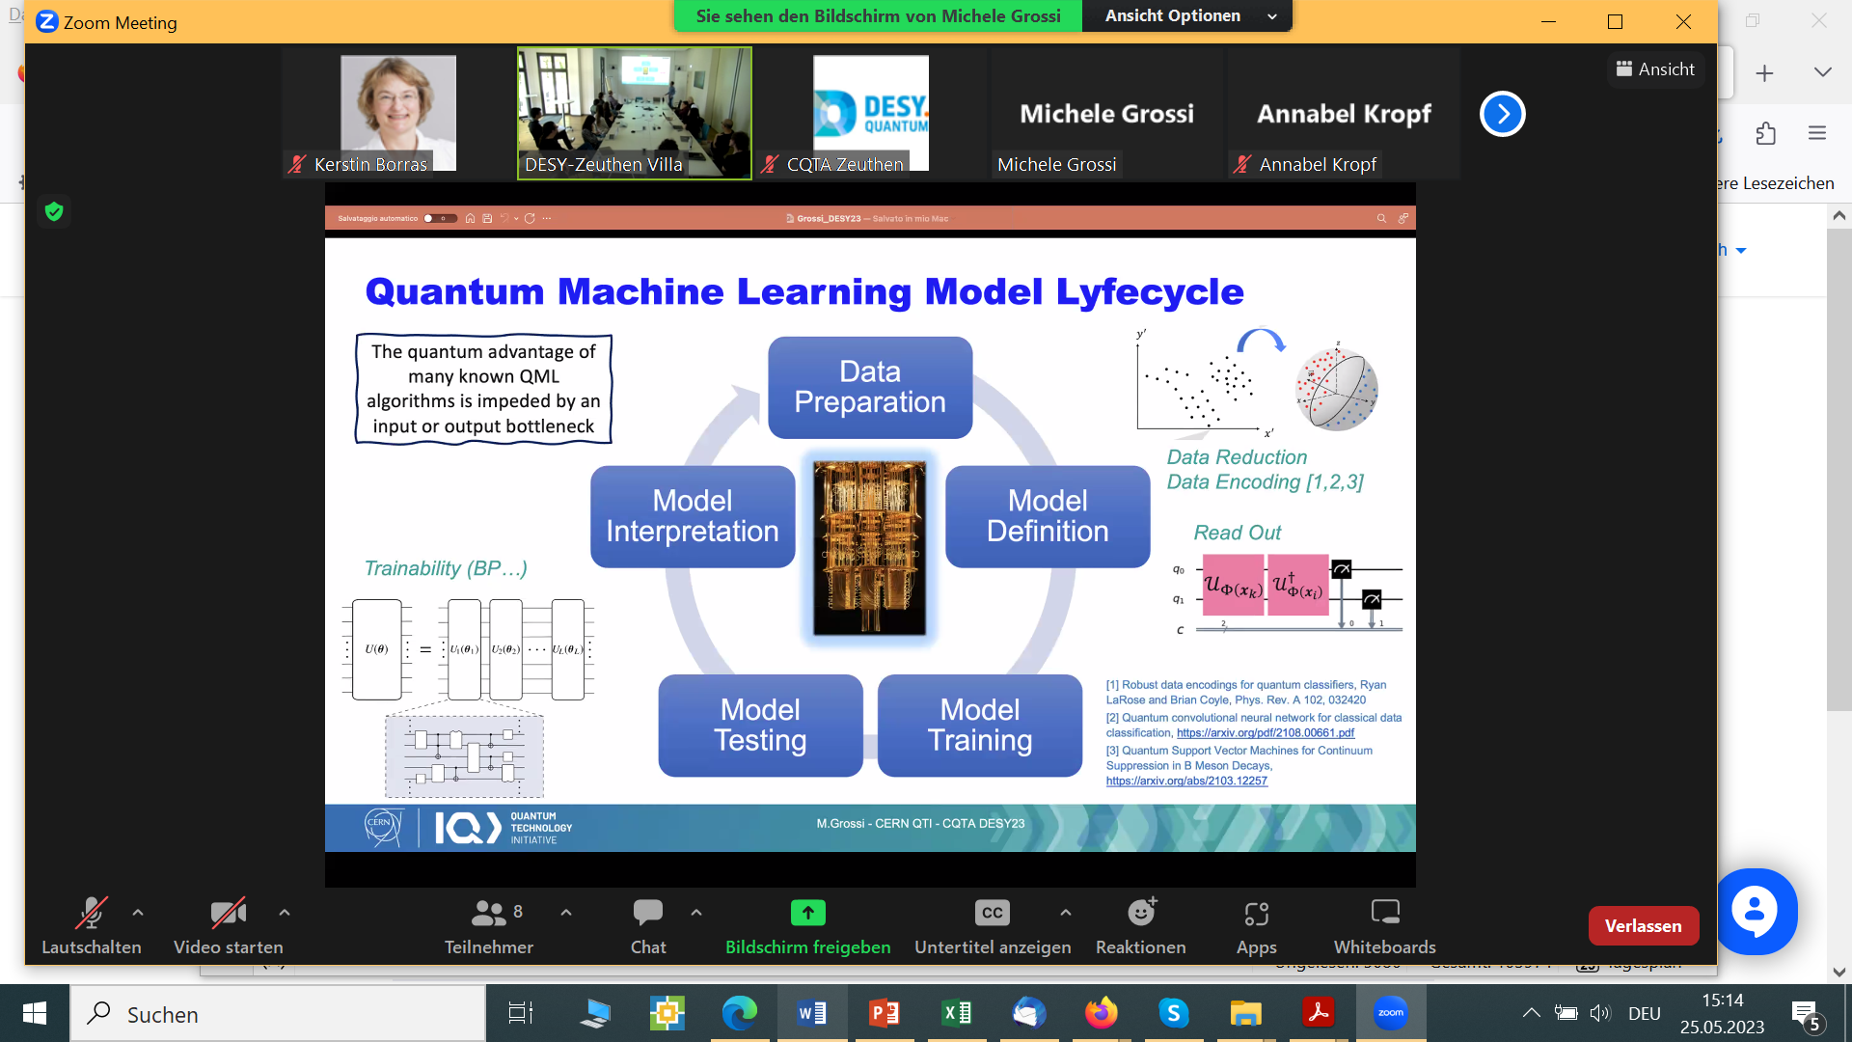
Quantum Machine Learning Model Lifecycle

Slide 12



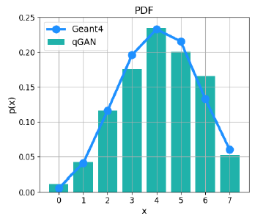
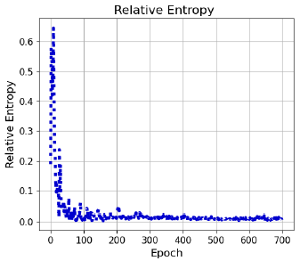
Hybrid Q-GAN in One Dimension
BMBF
NiQ
Down sample 3D shower image → 8 pixels → 3 qubits
Use hybrid approach: quantum + classical
Employ a Qiskit Q-GAN model developed by IBM*
* https://qiskit.org/documentation/machine-learning/tutorials/04_qgans_for_loading_random_distributions.html
Quantum Generative Adversarial Network
8 quantum states:
|000⟩, |001⟩, |010⟩, |011⟩,
|100⟩, |101⟩, |110⟩, |111⟩
Q-GAN simulations in one dimension (with noise)
← readout
noise
full noise
real hardware →

Slide 13
Hybrid Q-GAN in Two Dimensions
BMBF
NiQ
Early examples in Experimental Particle Physics
Down sample → 8x8 pixels → 6 qubits
Adapt Tree Tensor Network
Grant, E., Benedetti, M., Cao, S.et al.
Hierarchical quantum classifiers.
npjQuantum Inf4,65 (2018). https://doi.org/10.1038/s41534-018-0116-9

Slide 14
Full Quantum Angle Generator
→ Correlations & Noise Robustness
BMBF
NiQ
Less parameters for complex data and sufficient accuracy albeit errors
Good Accuracy
Correlations reproduced
Angle Encoding
Best Circuit
Noise in Inference
Noise in Training
Readout + Gate Noise
Gate Noise
Readout Noise
▼ HW Sim M
▲ HW M
▼ HW Sim M
▲ HW C
Rehm, F. et al. Precise Image Generation on Current Noisy Quantum Computing Devices.
IOP Quantum Science and Technology https://doi.org/10.1088/2058-9565/ad0389. / PhD Thesis RWTH Aachen

Slide 15
Quantum Angle Generator: Learning Noise !
BMBF
NiQ
Less parameters for complex data and robustness against noise
Noise in Trainng
Calibration change during training
Noise in training + inference leads to better accuracy.
Quantum Neural Networks can adapt to changing
error enviroment and learn the noise condition
→ robustness against and employing noise !
Rehm, F. et al. Precise Image Generation on Current Noisy Quantum Computing Devices.
IOP Quantum Science and Technology https://doi.org/10.1088/2058-9565/ad0389. / PhD Thesis RWTH Aachen

Slide 16
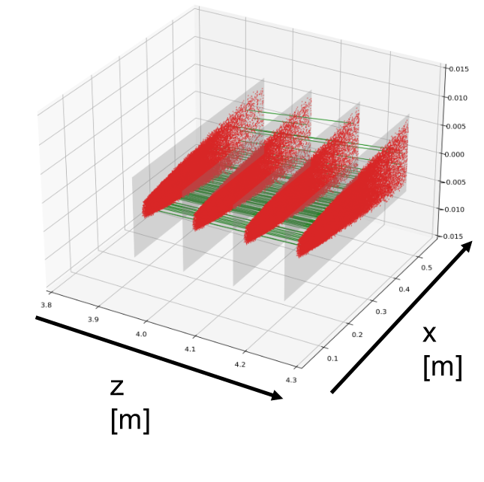
Quantum Computing for Classical Optimization Problems
arXiv:2206.12454
First paper 2109.12636
From Tracking to Logistics
Second paper: Crippa A. et al, Quantum algorithms for charged particle track reconstruction in the LUXE experiment, https://arxiv.org/abs/2304.01690
Tracking at the LUXE Experiment @ DESY
Q-GNN and VQE for
particle tracking
in the LUXE Experiment
(Laser Und XFEL Experiment)
study of the influence of entanglement
Efficiency as a function of the field intensity ξ
Particle tracking
Observe particles through their interaction with detectors
→ Need to single out each particle’s trajectory from a cloud of hits
Flight Gate Assignment
find lowest energy ⇔ shortest path
Same mathematics for problems in traffic, logistics, aerospace, ...

Slide 17
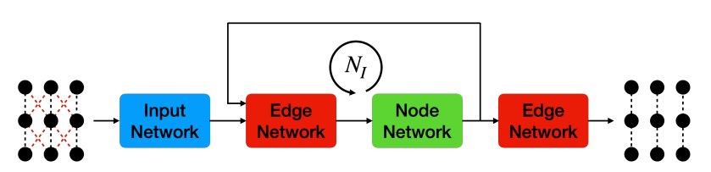
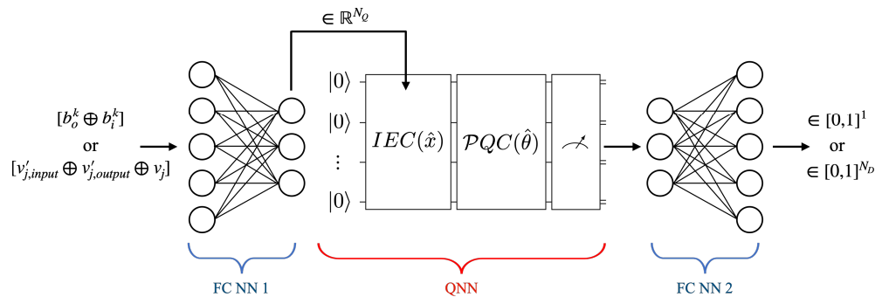
Quantum Graph Neural Network
First paper 2109.12636
Second paper: Crippa A. et al, Quantum algorithms for charged particle track reconstruction in the LUXE experiment, https://arxiv.org/abs/2304.01690
Input network encodes information
(10 hidden features)
Edge and node nets applied 4 times
(as many as the tracker layers)
Retain edges with scores
above fixed threshold
Kerstin Borras | Quantum Computing and Quantum Machine Learning | CEPC 2023 Workshop | 27th October 2023

Slide 18
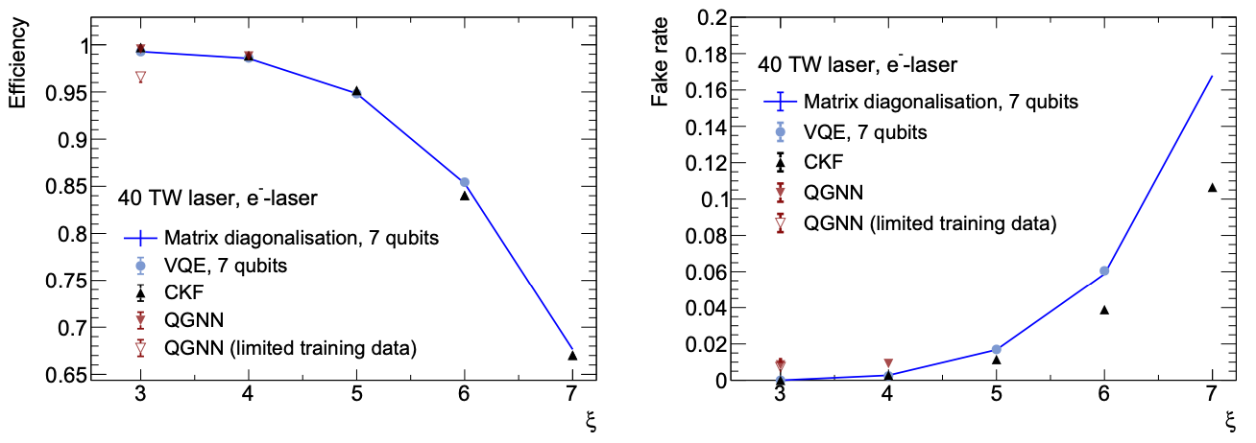
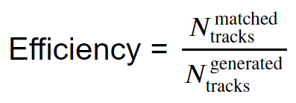
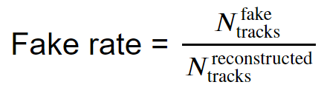
Algorithmic performance
First paper 2109.12636
Second paper: Crippa A. et al, Quantum algorithms for charged particle track reconstruction in the LUXE experiment, https://arxiv.org/abs/2304.01690
Based on ideal classical simulations of quantum circuits
Excellent performance, in line with state-of-the-art classical tracking
→ Quantum algorithms have higher efficiency but ~2x fakes
Not all methods available for each value of 𝜉 (due to computational limitations)
Performed also tests with quantum hardware (ibm_nairobi)
Kerstin Borras | Quantum Computing and Quantum Machine Learning | CEPC 2023 Workshop | 27th October 2023
Notes:
First I would like to present the results for 500 tracks for phase 0 of LUXE.
We can see that the conventional tracking is still some kind of benchmark for us. But we’re coming close to it with the GNN in general and for the quantum approach for xi 4 and 5 in terms of efficiency. For the fake rate the quantum approach with both Eigensolver and VQE ideal simulation shows a significantly higher fake rate than the GNN and the conventional tracking.
When comparing the Eigensolver and VQE it seems that the modelling of our quantum circuit and optimizer is already quite good, as both results only differ by a small amount.
I would like to stress that we’re only at the start of exploring what we can achieve with the quantum approach. We already know that tweaking the parameters of the QUBO has a huge effect on the performance and that’s what we are currently working on.
Also we are restricted by the subQUBO size, which makes us rather find local minima instead of the ground state of the hamiltonian.

Slide 19
Some Key Questions for the Future
Challenges and Opportunities in Quantum Computing
How can we profit from the higher encoding potential
given by qubits?
How can quantum algorithms
enable timing inclusion
(4⁺D-tracking / 5 D-calorimetry?
How can we profit from different entanglements of qubits?
How can we use quantum devices to solve complex fitting problems?
QFitter for measurement combinations
2207.10088
Quantum annealing-based method for fitting EFT coefficients
to experimental measurements
How can we use quantum devices to solve complex problems in theory calculations,
simulation, reconstruction, correlations, anomalies, tomography…
How can we profit from the need to limit I/O by extracting features ?
How can we profit from the unique access to different Quantum Technology Computers?
Kerstin Borras | Quantum Computing and Quantum Machine Learning | CEPC 2023 Workshop | 27th October 2023

Slide 20


Any
Questions ?
Prof. Dr. Kerstin Borras kerstin.borras@desy.de
DESY Quantum Technology Task Force: qt-task-force@desy.de

