Slide 1
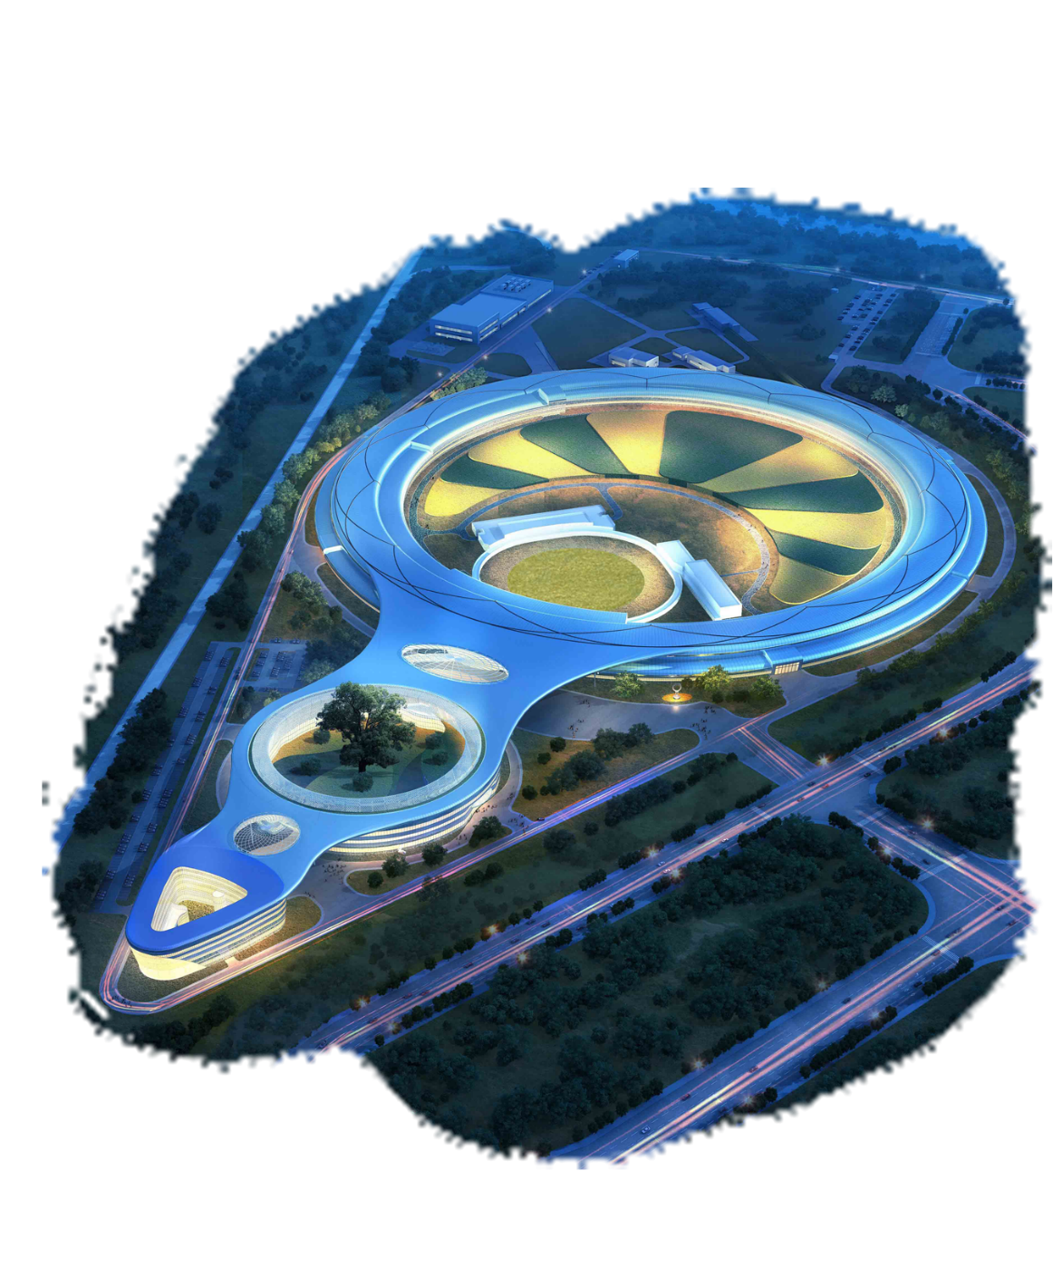
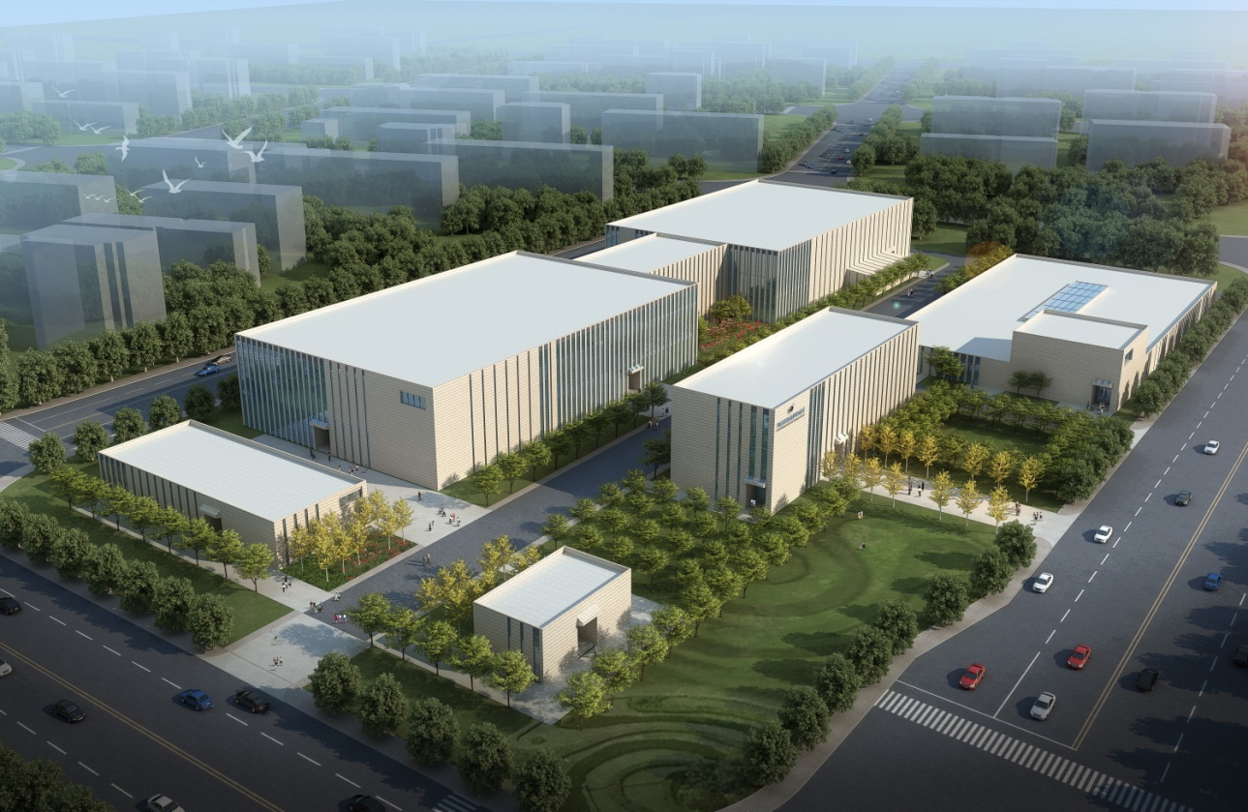
IHEP
The detector requirements for HEPS and what can we get from CEPC
PAPS
HEPS
Li Zhenjie
Institute of High Energy Physics, CAS, China
High Energy Photon Source(HEPS)
2023.10
Thanks for all of the HEPS detector team members.
Notes:
I’m LiZJ, come from IHEP, CAS, China. It’s a pleasure to be here, to talk about the SR detector technique and application.
Thank you for your coming to listen my talk. Today, I will give you a brief introduction about the Development of SR detector in IHEP. If you have any question, please do not hesitated to interrupt me. Any questions will be welcome, I will tell you what I know about.

Slide 2
Content:
A short introduction of High Energy Photon Source (HEPS)
Hybrid pixel array detector development for HEPS
The time-resolved detector- APD
SDD for the energy spectrum measurement
The diamond detector working as a solid ion chamber and XBPM
Summary
Notes:
This report includes six parts. First of all, I’ll give you a short introduction about HEPS project, a new SR facility , will be built in Beijing this year.
Then, I ‘ll show you some results of our detectors. Including HPAD, APD,SDD and diamond detector, our group has developed. Some detectors have came into engineering phase, some detectors are on the way.
The last, the summary will be given for the SR detectors.

Slide 3


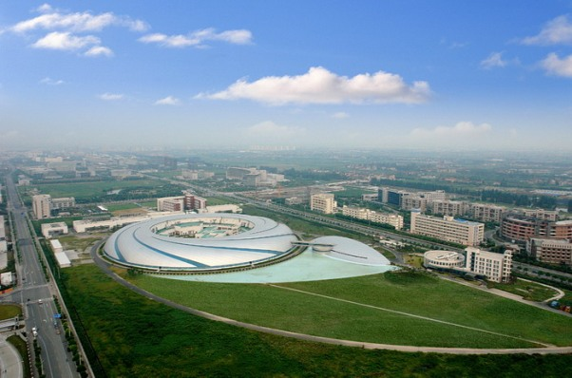
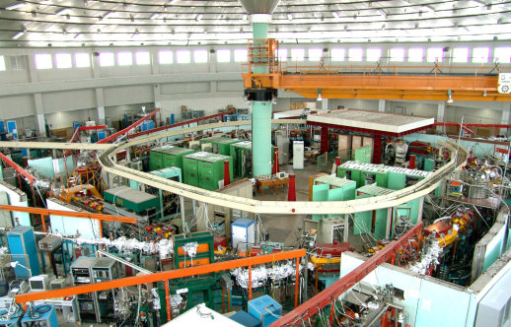
Current status of synchrotron radiation devices in mainland China
Beijing SR-BSRF
Medium Energy
Shanghai SR-SSRF
Medium Energy
Hefei SR-HLS
Low Energy
Beijing SR-BSRF: First Generation
Hefei SR-HLS: Second Generation
Shanghai SR-SSRF: Third Generation, started operation in 2009
Notes:
Current SR light source in china are all in the mid and low energy regions. There are a large gap between the domestic and international science and technology communities in terms of light sources with photon energy higher than 40keV. With the development of the economy and science in china, more and more users need a new light source to do researches. Although the shanghai SR facility started operation in 2009. there are a large number users in and near Beijing, which led to calls for a high energy photon source for multidisciplinary research in northern China.

Slide 4
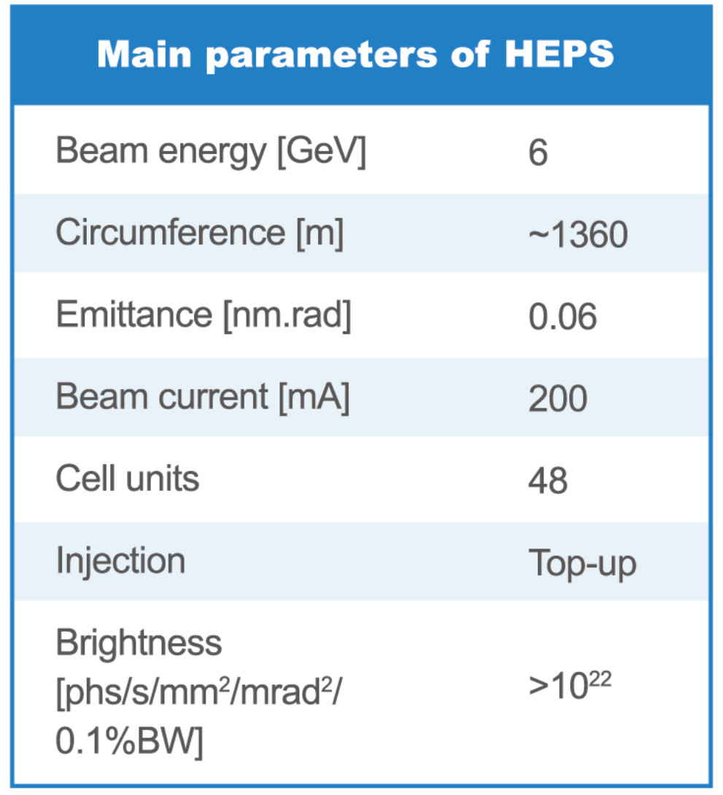
New Generation synchrotron radiation in China:
High Energy Photon Source(HEPS)
Will be started construction in this year (may be on June );
The construction time for this project is about 6.5 years.
HEPS will be the brightest SR X-ray source in the
World when it is completed
Low emittance and high brightness (>10²²)
High photon energy ~300keV
14 beamlines to be constructed, with the capacity
90 beamlines in total
Notes:
Proposed in 2008, the HEPS, an ultra-low emittance ring-based SR light source with a beam energy of 6GeV, was included as one of the large research infrastructure projects in China’s 13th National Five-Year Plan.
The main parameters of HEPS are in the table.

Slide 5
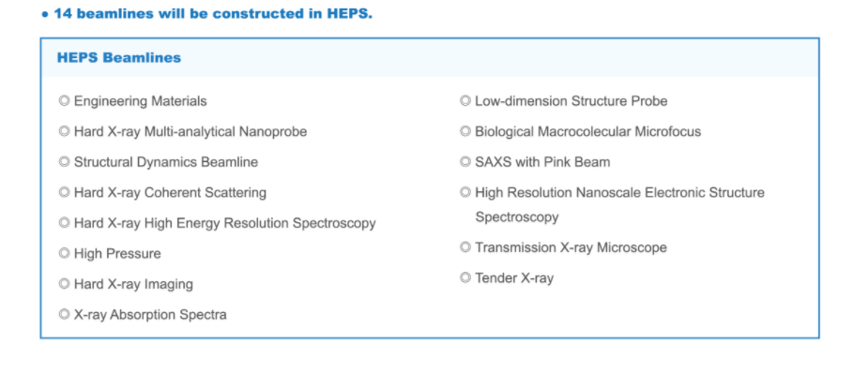

Slide 6



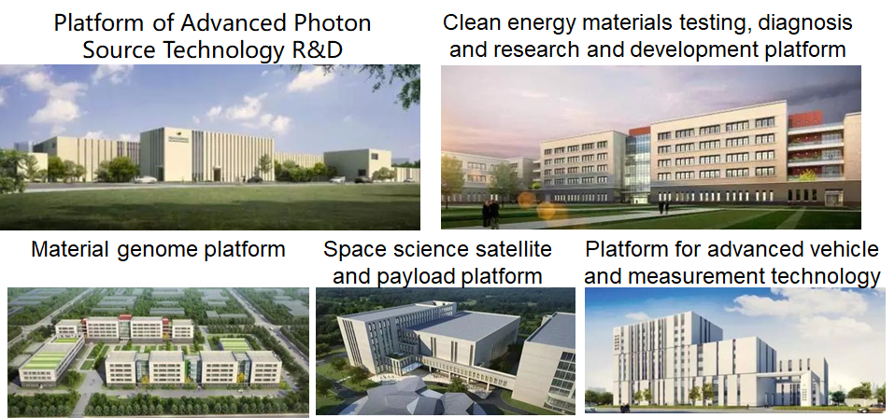
Huairou
50km
appearance design
Downtown
Notes:
HEPS will be built in Huairou District in suburban Beijing, as one of the core facilities in Huairou Science City.
The distance from HEPS to Beijing downtown is about 50km.
In order to solve the key technology of the new SR source, the government have invested a R&D center named Platform of Advanced Photon Source Technology R&D (PAPS). The PAPS have benn done in 2021.
We have built some labs for the detector R&D.
All above is the introduction of HEPS, a new light source in China.

Slide 7
What do we concern about the SR detectors? X-ray detection
Detector efficiency:
Intensity:
Dynamic range: 10^6-10^10cps
Linearity of response
Uniformity of response
stability
Spatial:
Spatial resolution:20um-200um
Spatial distortion
parallax
Energy:
Spectral resolution: 120eV@5.9keV
Energe range:1-300keV
Time:
Frame rate: up to 100kHz
Photon time resolution: 100ps-1ns
Position resolution detector:
Energy resolution detector:
Time resolution detector:
Hybrid pixel array detector
SDD detector
APD detector
…
High energy detector(CZT and GaAs)
Notes:
X-ray detectors are key components of experimental stations. Detector requirements are strongly dependent on the experimental technique and on the specific application setup.
In almost all the SR experiment, what we would like to know about the X-ray are intensity, energy, position, arrival time and the polarization.
So the detector should be record the information of what we like to know.
You know, the detector technology seriously restricts the development of SR. We have the best accelerator, the better X-ray optical system and beamlines. But we do not have the advanced detector to maximize the SR performance.

Slide 8
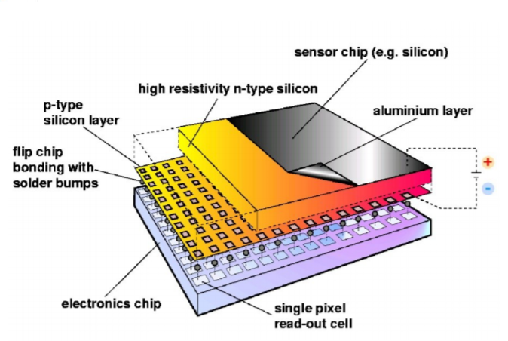
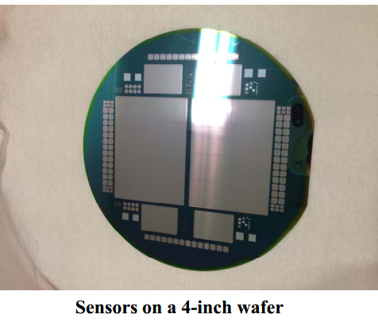
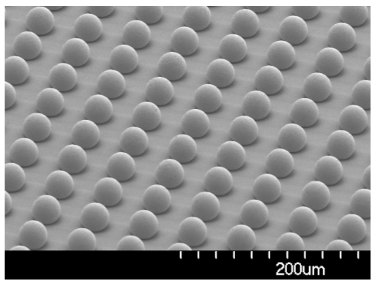
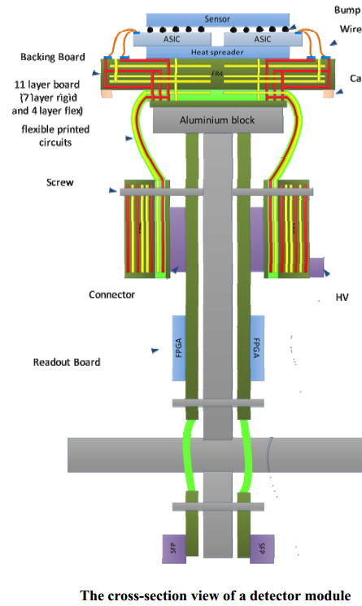
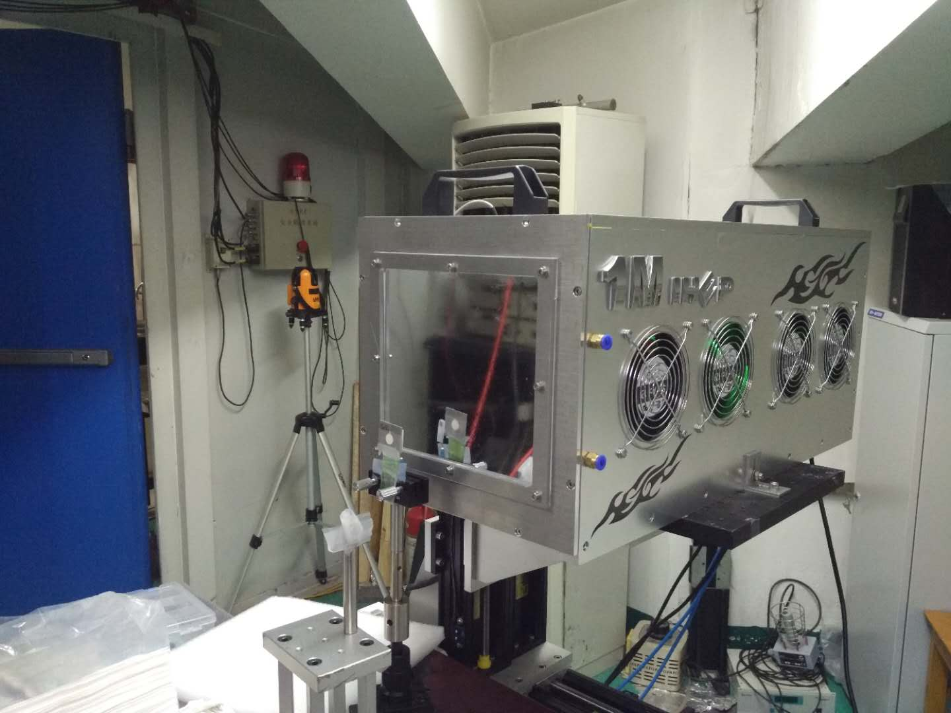
HEPS Detector team work for the synchrotron radiation
HEPS projects
Technologies for assembling
highly integrated detectors
Hybrid pixel array
Detector
SDD
Diamond detector
Time-resolved detector
ASIC Design
Sensor Design
Packaging technology
System electronics
DAQ
Mechanical structure and
Thermal design
What we can do by ourselves
Notes:
In IHEP, the detector group specially for SR application had been set up since 2012. although it is a little late. but Never too old to learn, never too late to turn.
During these years, we have done some researches and developments of the detector.
I’ll show your some results of these detectors we have done now.

Slide 9
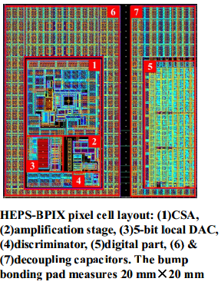
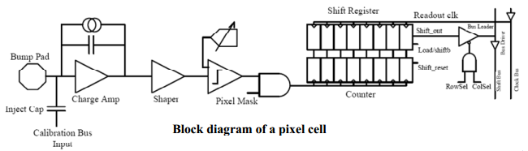
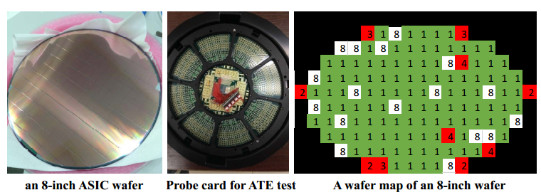
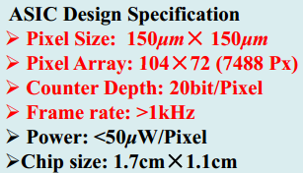
2、Hybrid pixel array detector
A hybrid pixel detector working in the single photon counting mode was designed for the High Energy Photon Source (HEPS) in China.
It is focusing on synchrotron radiation applications: SAXS, Macro Molecule…, with a high frame rate of 1kHz.
The detector module is composed of:
Si-PIN Sensor (300 Sensor (300μm thick ) + Indium Bump Bonding+ HEPS-BPIX readout ASIC

Slide 10
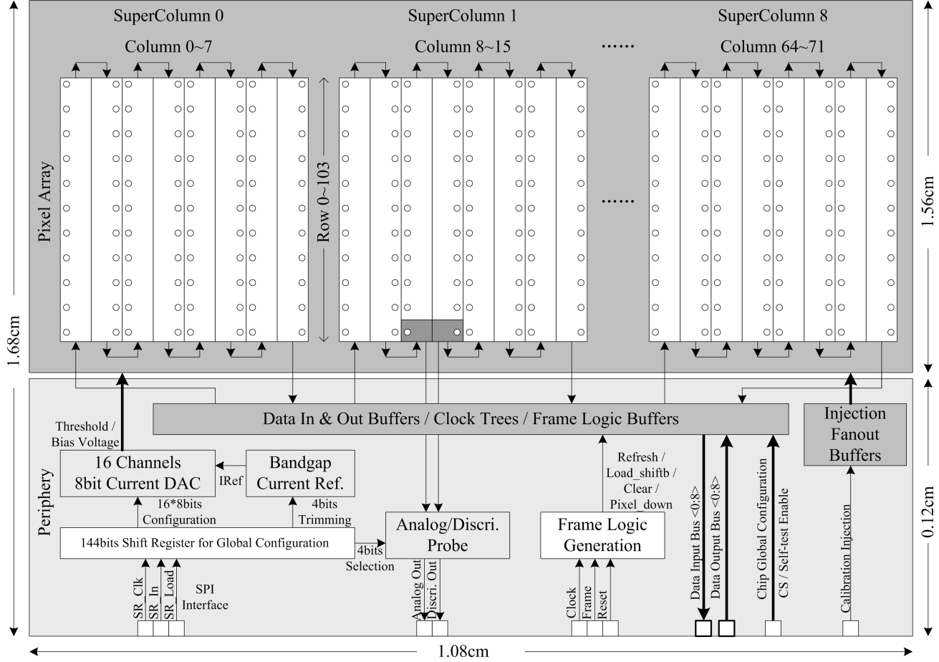
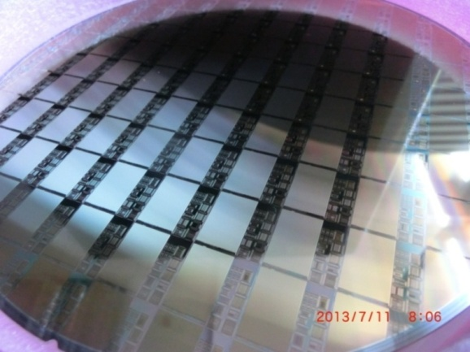
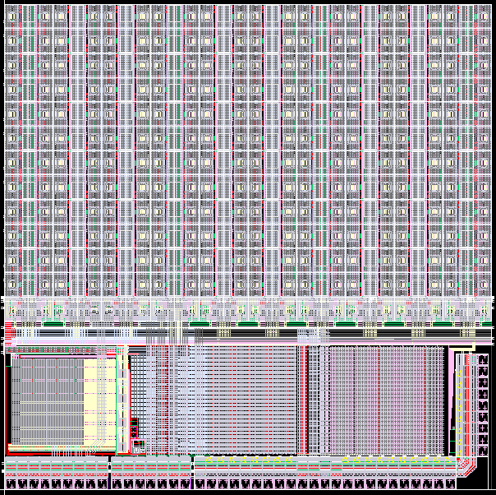
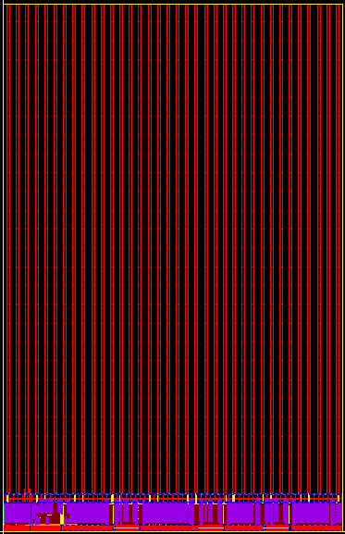
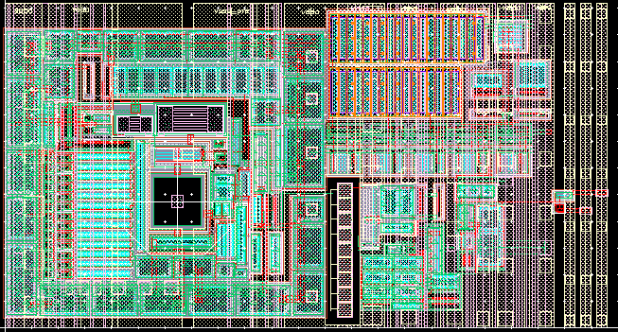
ASIC design
MPW wafer of ASIC
ASIC Design Specification
Pixel size | 150μm×150μm
Pixel array | 104×72
Count depth | 20bit/pixel
Frame rate | >1kHz
Power | <50μW/pixel
Chip size | 1.7cm×1.1cm
ASIC Readout chip structure
Single pixel
12×20pixels
72×104pixels
From Wei Wei

Slide 11
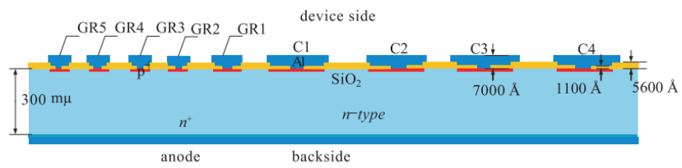
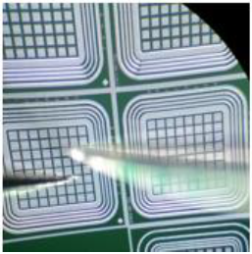
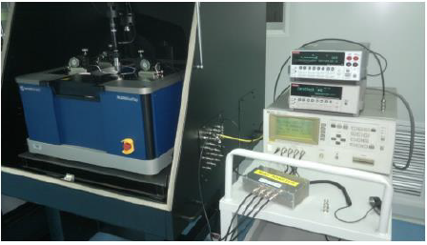
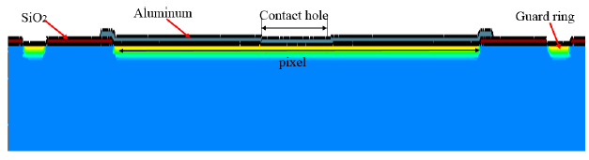
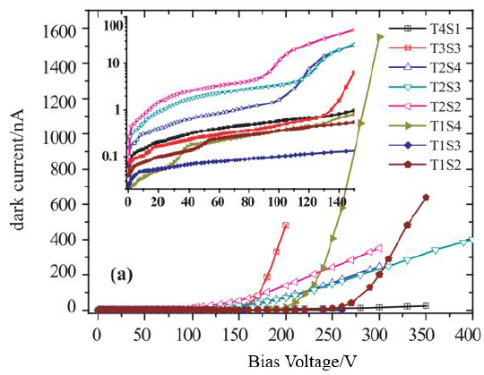
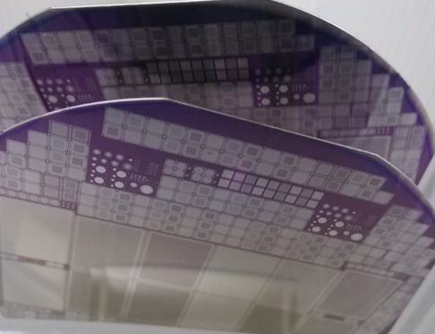
Silicon pixel sensor design
Sensor Design Specification
Pixel size | 150μm×150μm
Pixel array | 208×288
Dark current | <10nA/cm2
Depletion V | 30-50V
Breakdown V | >150V
Thickness | 320μm

Slide 12
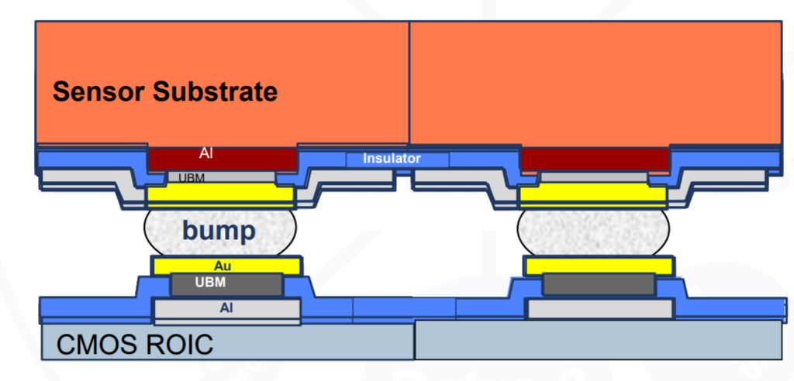
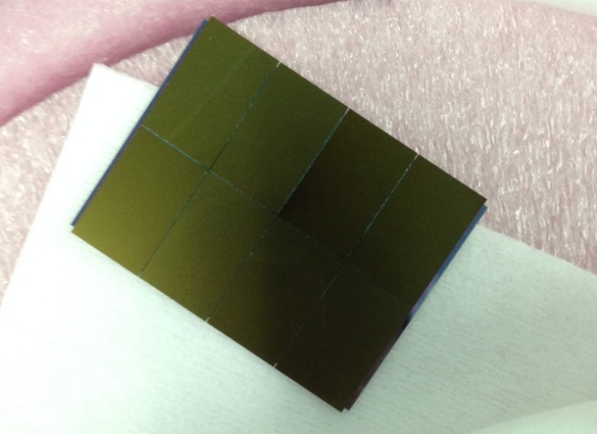
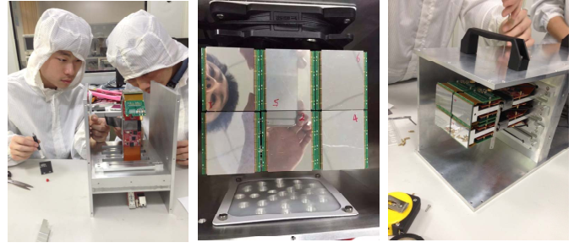
Bump bonding
Detector prototype with 1Mpixels
1 sensor with 8 ASICs

Slide 13
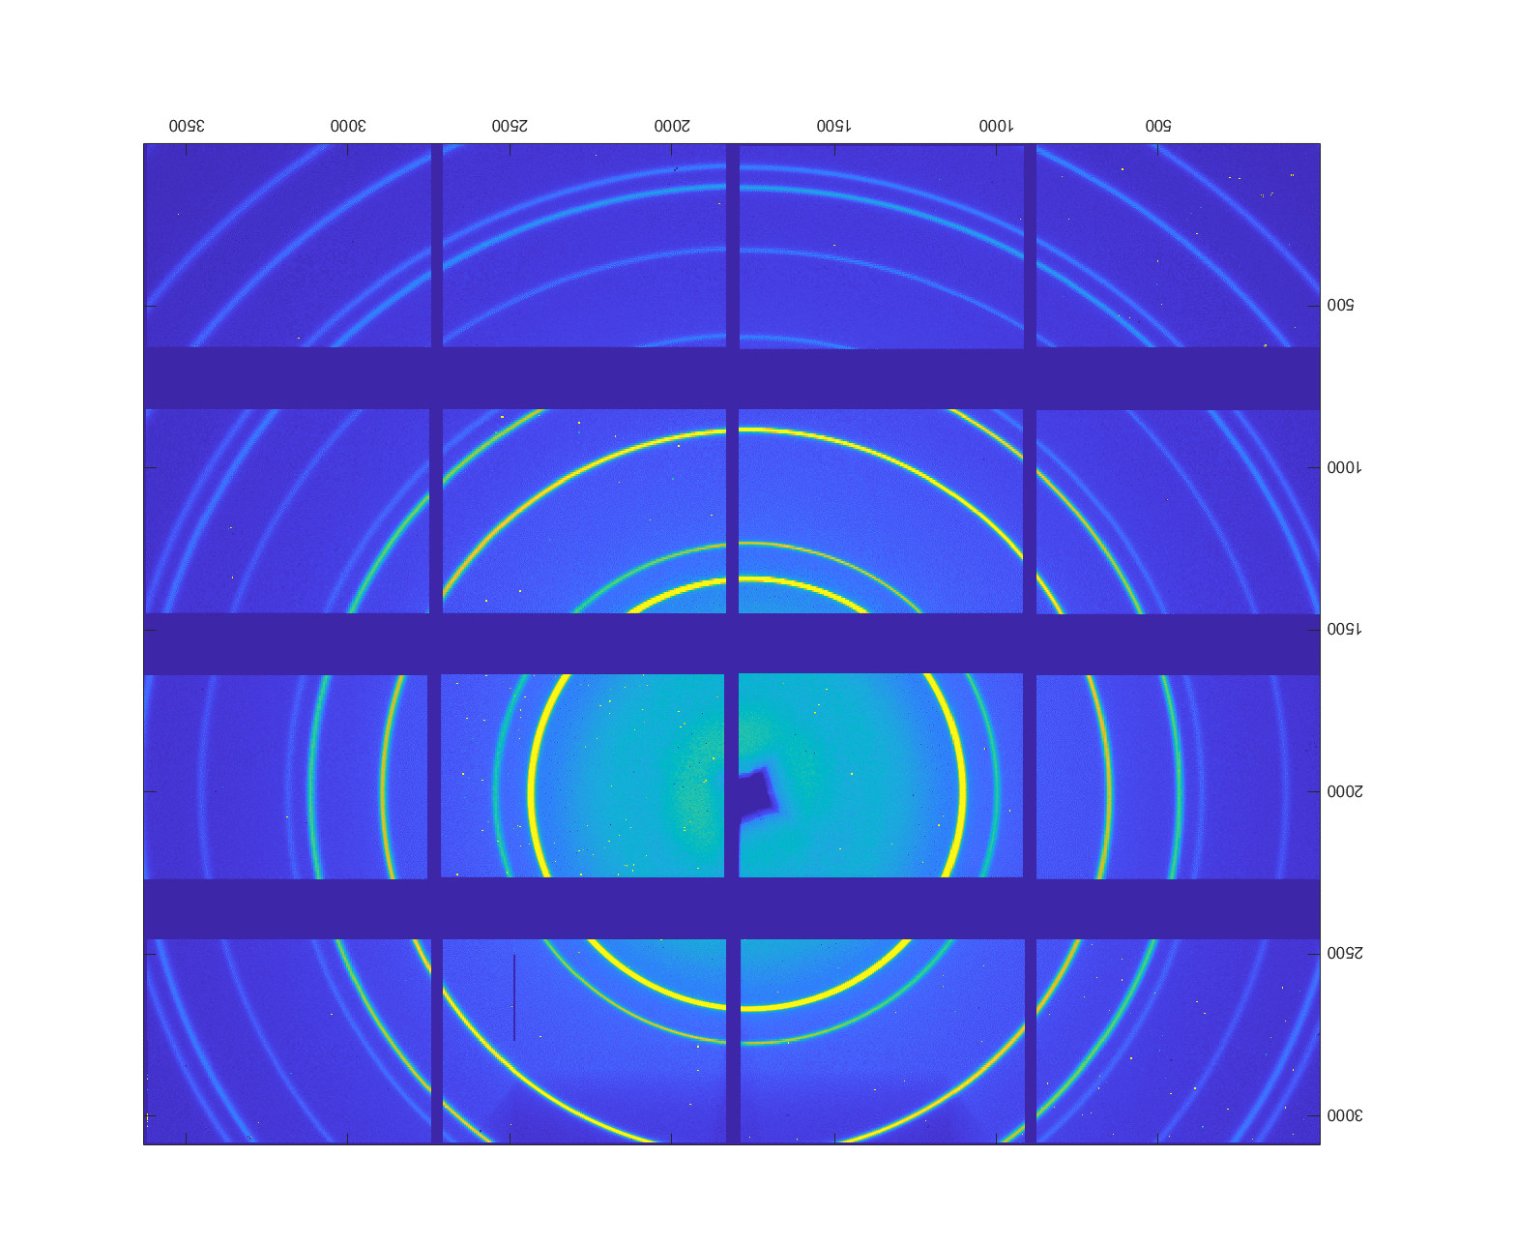
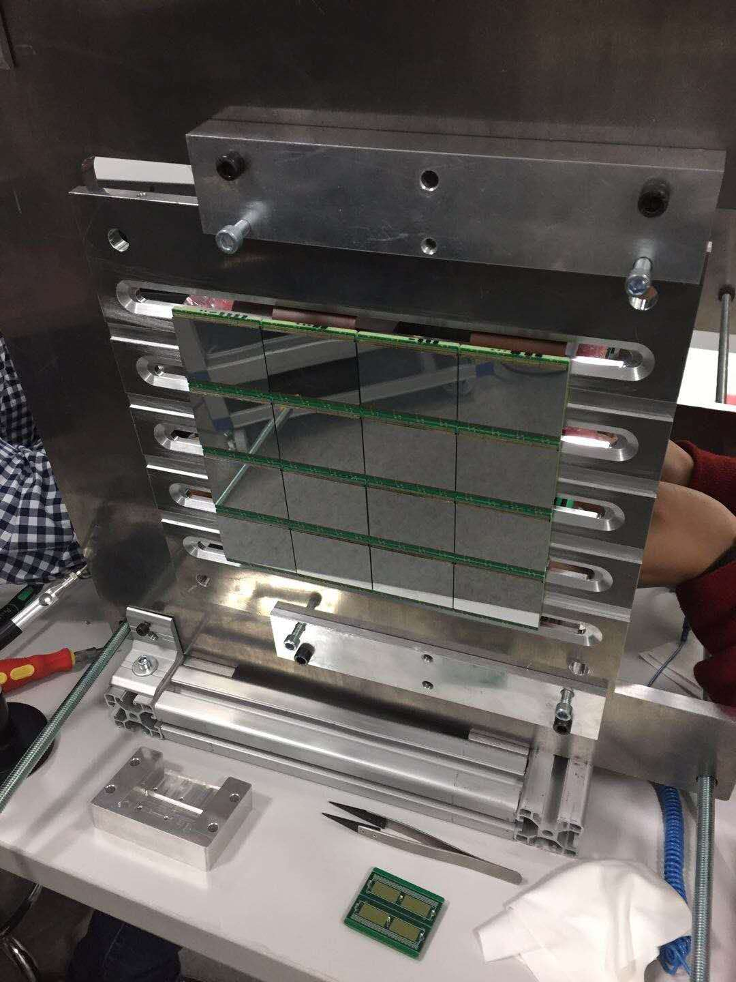
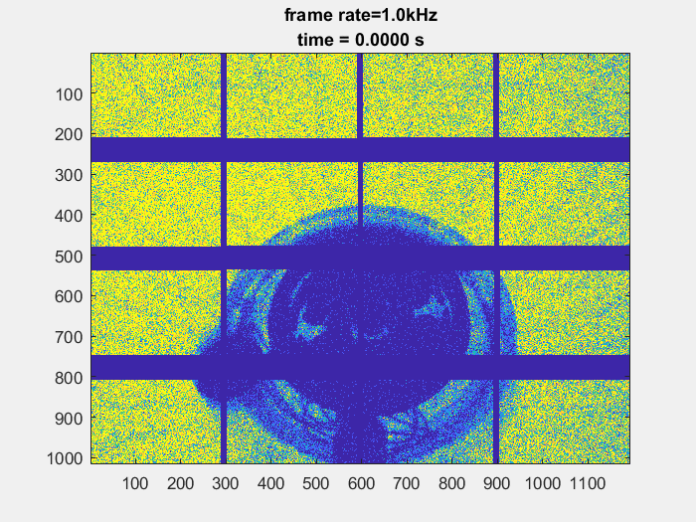
Detector test at BSRF
N=1.7×10⁶
Pixel1
R-square: 0.99
Pixel2
R-square: 0.99
Pixel3
R-square: 0.99
Pixel4
R-square: 0.99
Ln(I_{d})
Counting type pixel
Active area: 12.24cm×17.28cm
Pixel size：150μmx150μm
Frame rates：1 KHz
Dynamic range: 20bits
Energy range: 8－20keV

Slide 14
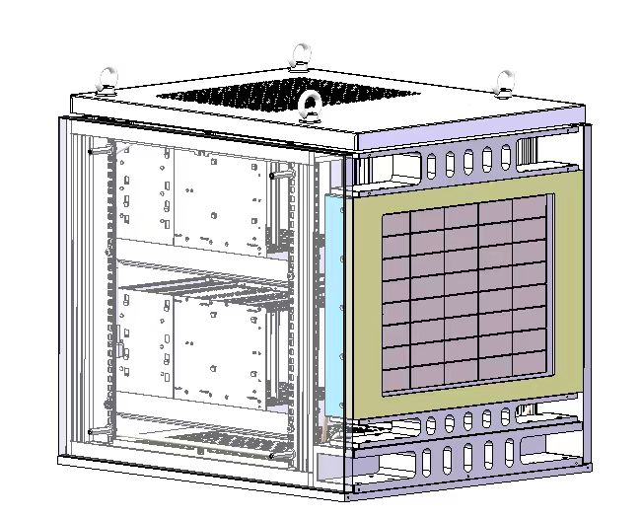
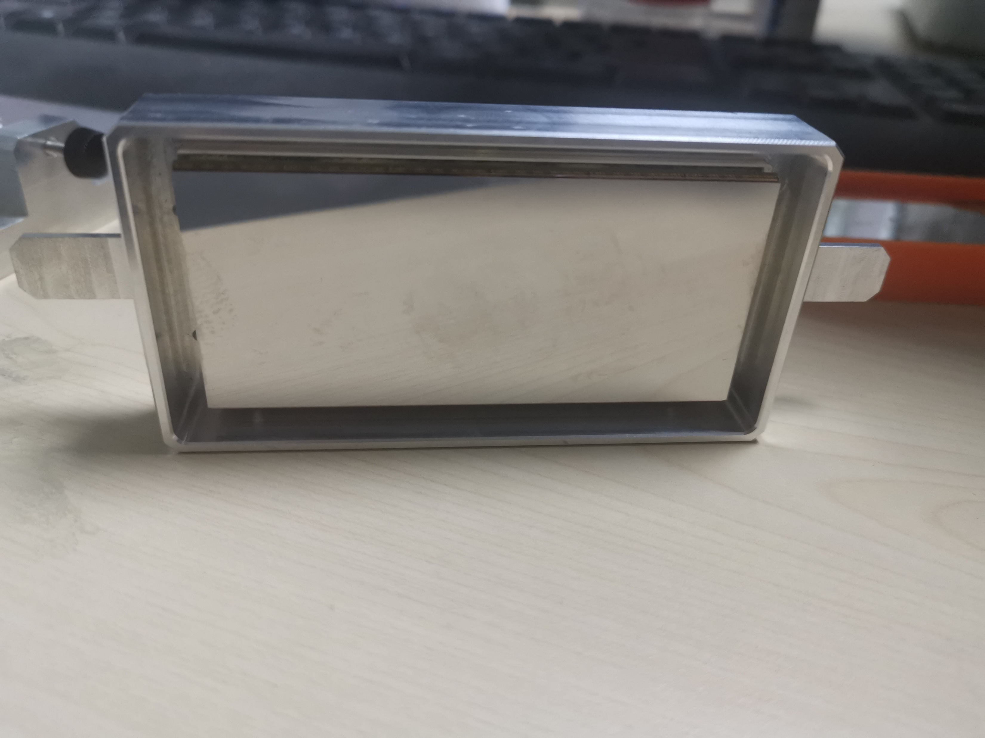
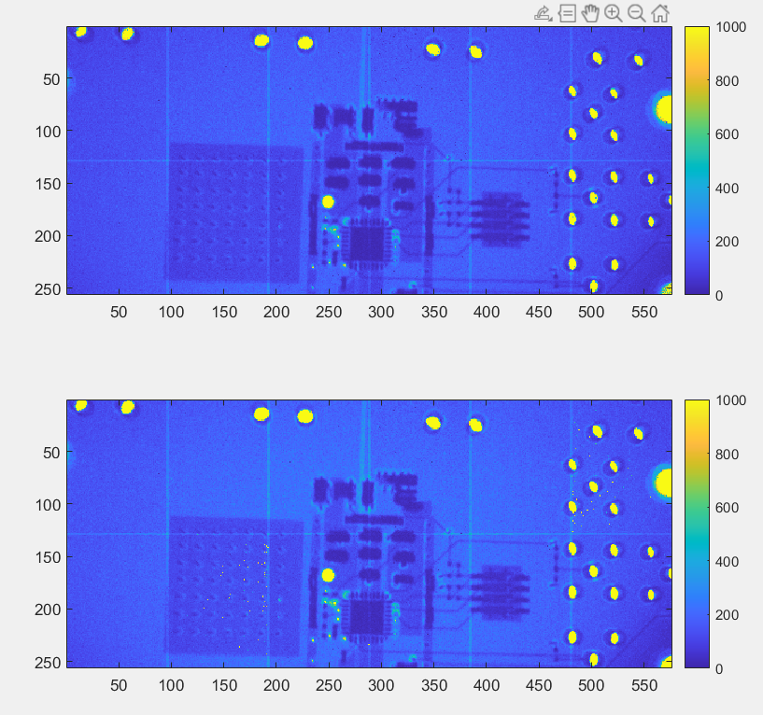
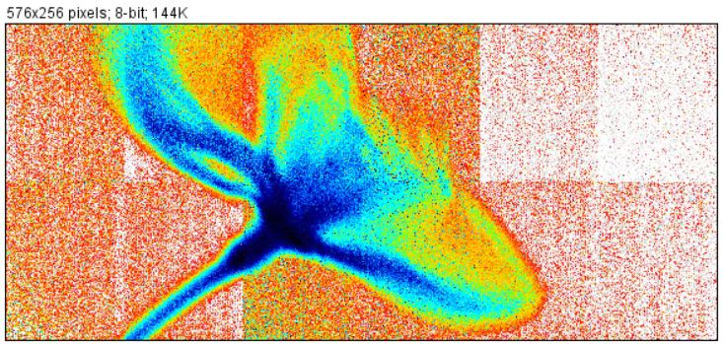
A new generation pixel array detector for HEPS
参数 | V1 | V2-new
Sensor | 320um silicon PIN | 450-500μm
Pixel Size | 150umX150um | 140umX140um
module | 208X288 | 256X576
Count rate | >1Mcps | >1Mcps
Frame Rate | 1kHz | 1KHz
Energy Range | 8-20keV | >6keV
Threshold | 1 | 2
Bad pixel | <1‰ | <1‰
Gap | 1.6mmX5.0mm | 1.2mm×2.8mm
6M Pixel Array Detector for BA beamline
Calibrate and Flat field correction

Slide 15
Problems and Next plan
The gap between the module is a little big, we should decrease the gap size.
Dead areas between modules is a problem. But now
The new generation is OK. The TSV is also a good choice.
2. There are some noise pixels in the module. Temperature control should be
considered.
3. The efficiency based on silicon sensor is small for high energy photon.
Next, we will focus on solving the engineering prototype problem.
Decrease the gap using TSV bonding technology
Using high Z sensor (for example GaAs or CZT sensor)
Thermal design to reduce the temperature of the ASICs and the sensor
Reduce the pixel size to 55um
Very very important: scale and calibration!!

Slide 16
3、Time-resolved detector: APD
Why we need APD detector: linear gain is suitable
Nanosecond or picosecond time resolution
High count rate –up to 10⁸
Low dark count rate-mHz/cm2
There is no commercial product for sale.
We need to design by ourselves.
APD sensor, fast preamplifier, ASIC preamplifier, TDC readout electronics.
Time resolved experiment for the dynamic structure research
More experiments ……
Gain=50-100, suite for the X-ray detection. Not the SiPM and LGAD
Thickness: above 200um, good quantum efficiency.
Notes:
avalanche photon diode

Slide 17
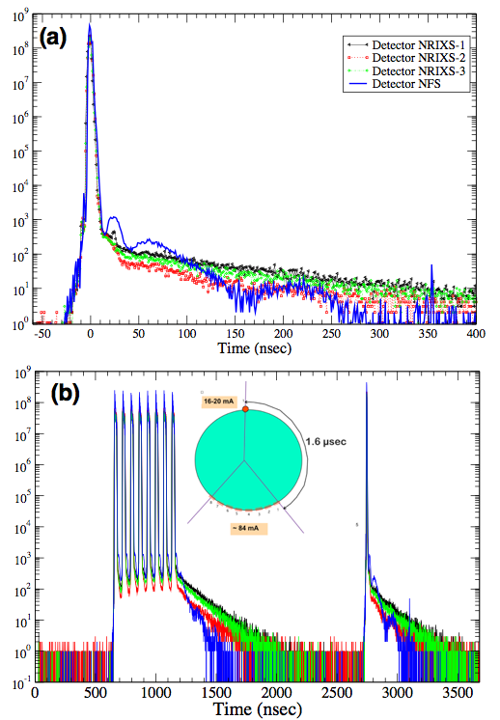
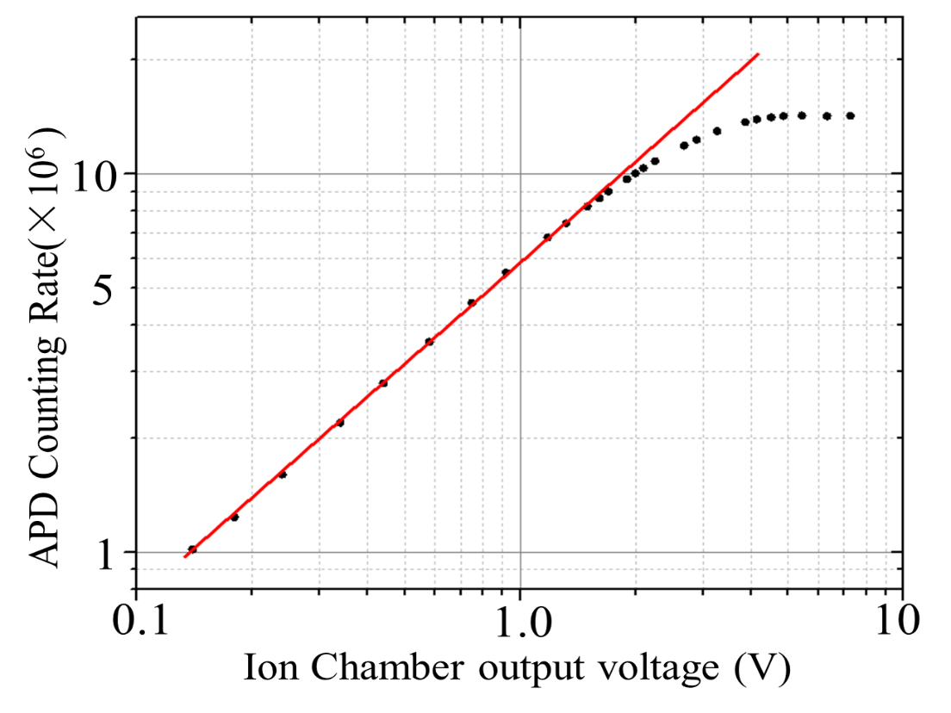
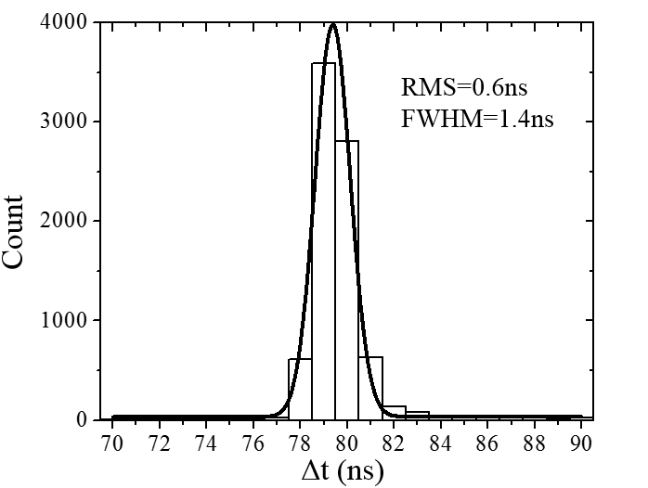
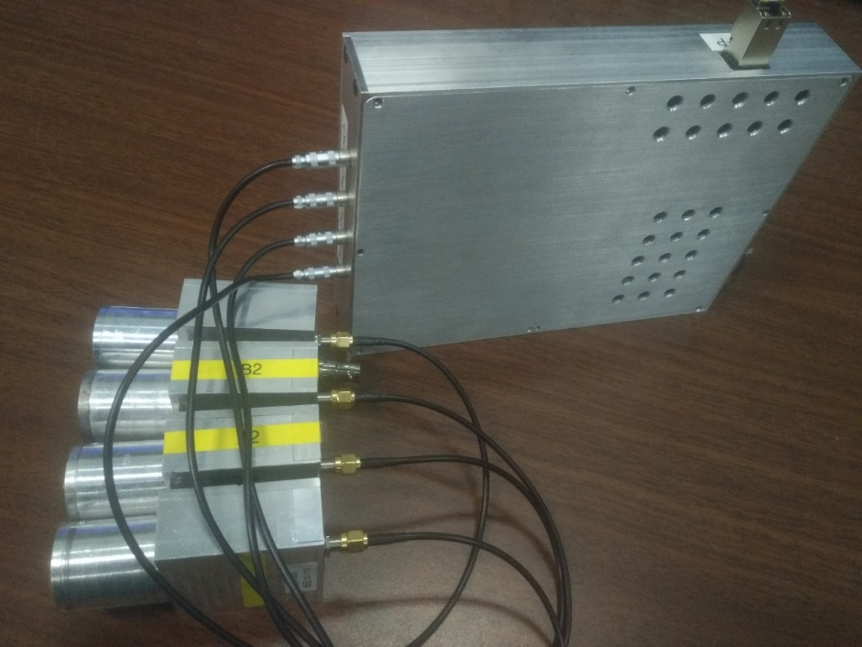
The first prototype APD detector system
Time resolution：1ns
Count rate：>5MHz/CH.
Dark count rate :<0.01Hz
Readout ： GigE
Working mode：single photon detection
APD sensor: 10×10mm2 E&G Canada
Fast preamplifier：design with discrete component
TDC：realized by FPGA using multi-phase method
(a) The first three detectors (NRIXS-1, 2, and3) are measuring the 6.4 keV nuclear-resonant-decay-induced K fluorescence of iron, the last detector is placed in the beam direction after the sample, and measures Mössbauer spectrum in the time domain. (b) Complete bunch structure of the Advanced Photon Source storage ring during the “hybrid fill mode” operations.

Slide 18
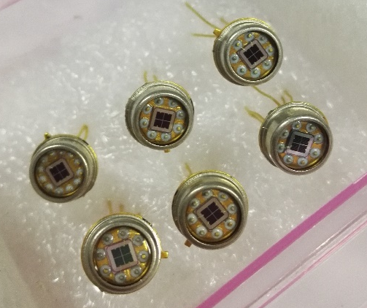
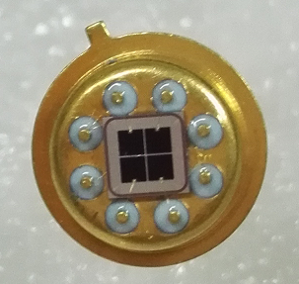
The second prototype APD detector
There are not so many type APD sensor for the X-ray detection.
Hamamatsu Photonics in JAPAN;
E&G in CANADA
……
We design the APD sensor, cooperated with other lab in China. So we can design the APD detector
system more flexible.
two type APD sensor: the thicker APD for high efficiency and modest time resolution
the thinner APD for high time resolution
2×2 array
Pixel size：1mm×1mm
thickness：12um
Basic structure and size of APD

Slide 19
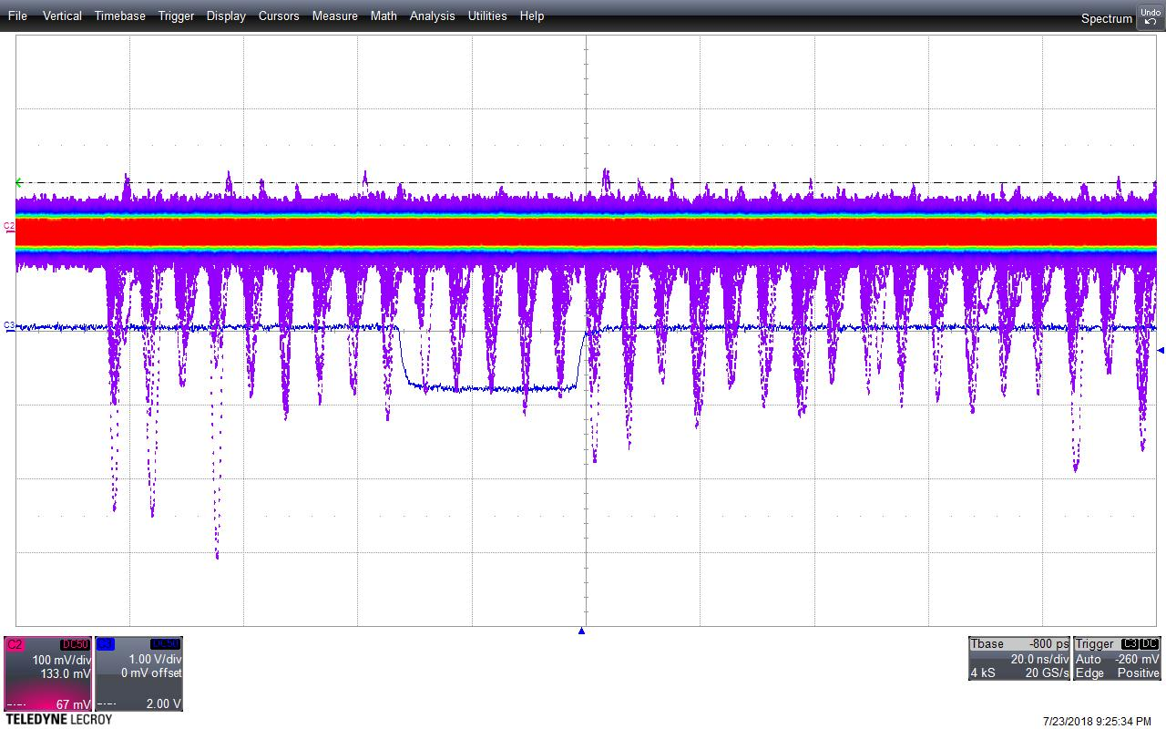
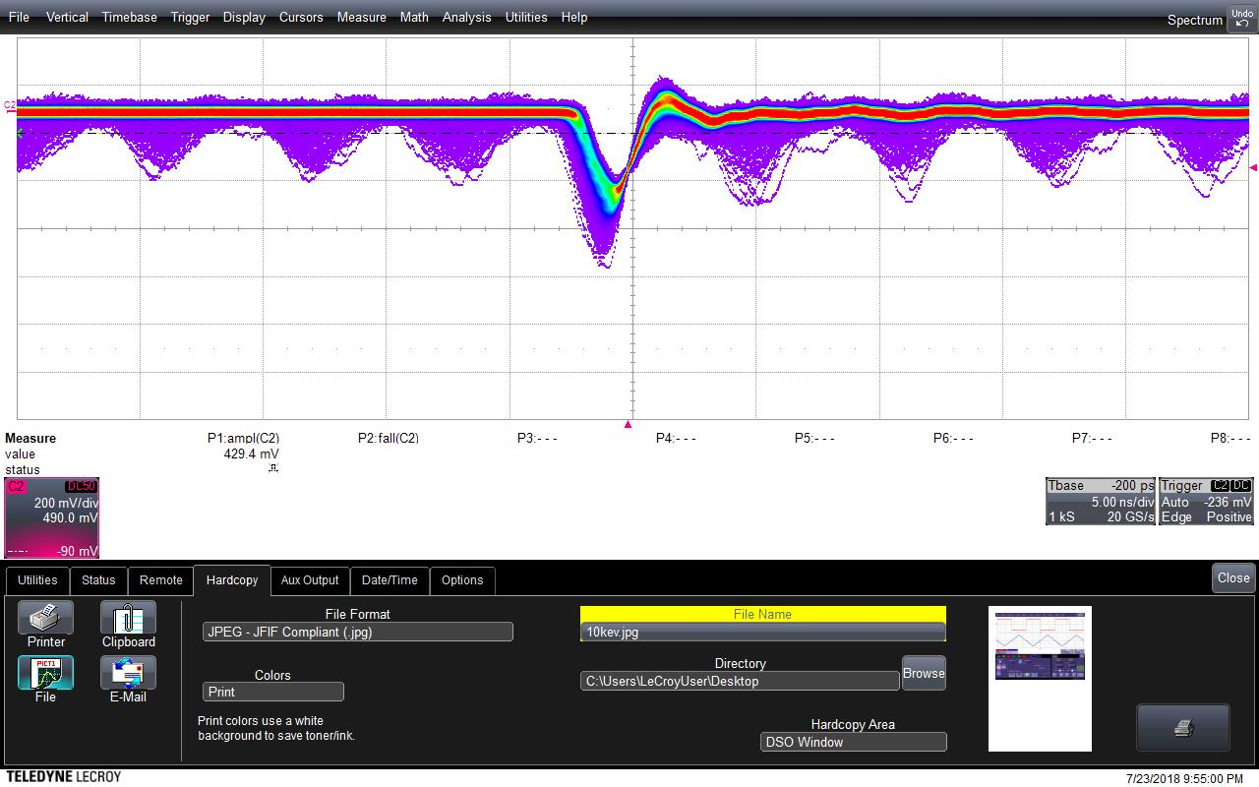
X-ray test at 1W2B BSRF
Full time of the pulse ：~3ns-4ns
Rise time of the pulse：1ns
The amplitude is about 200mV @12keV

Slide 20
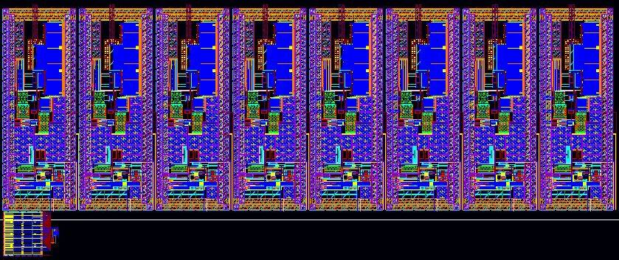
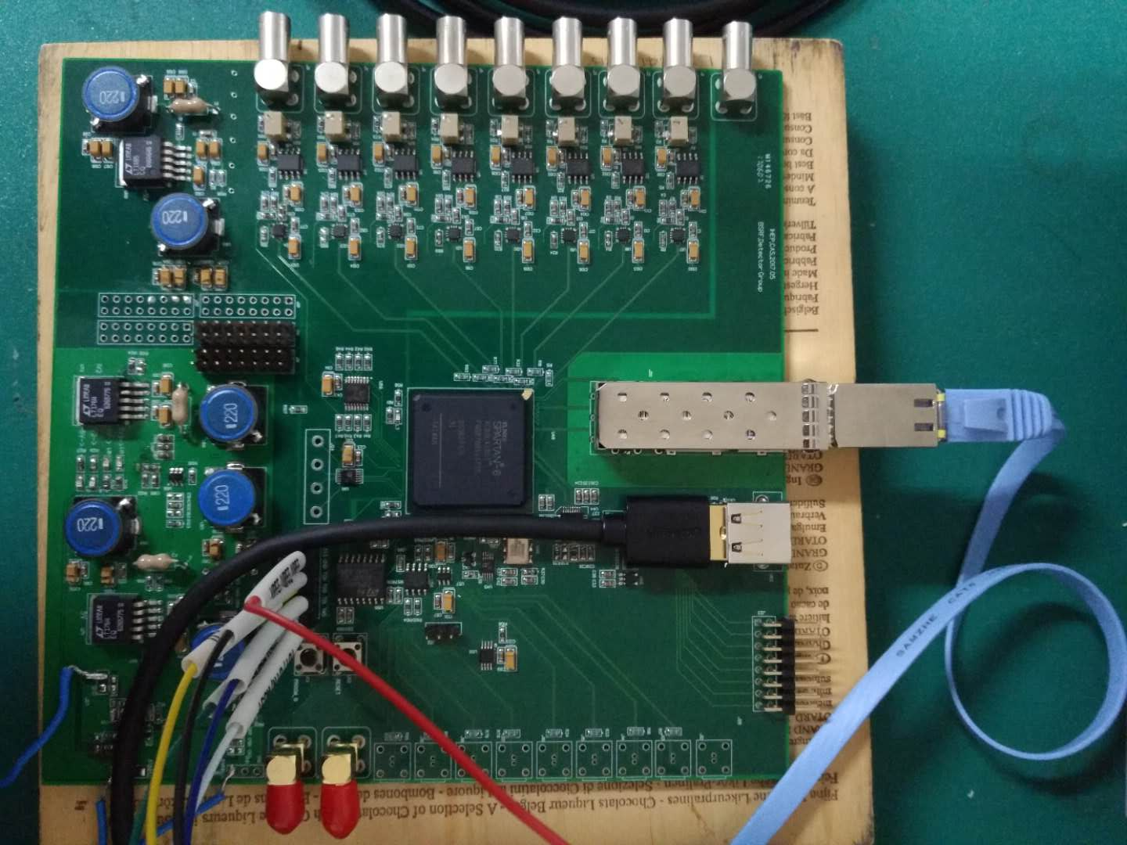
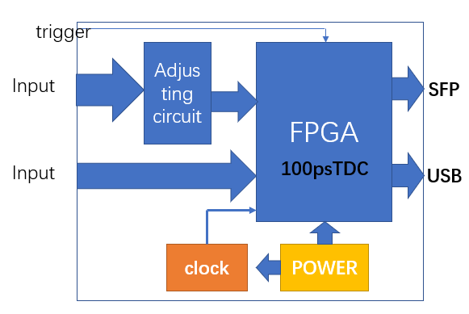
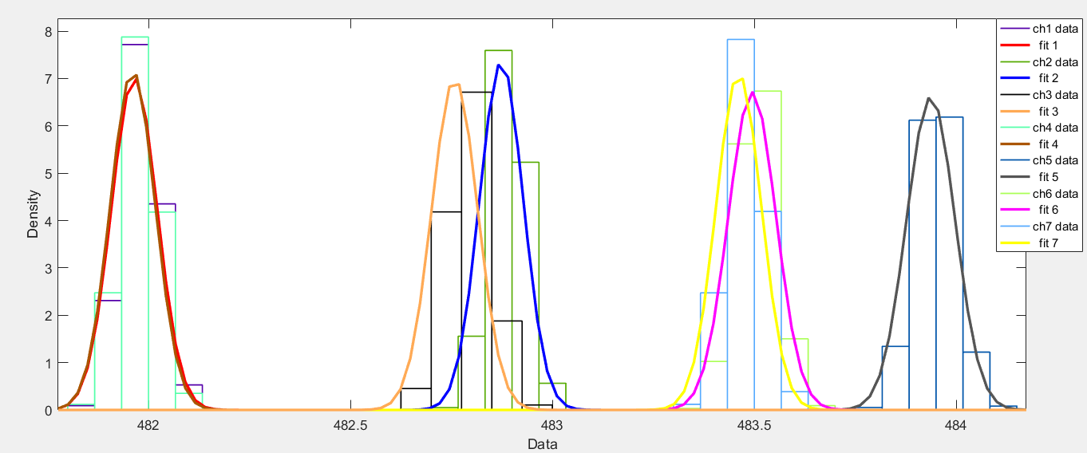
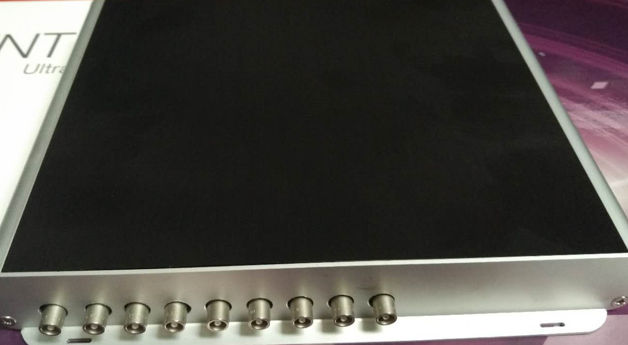
8channels APD readout electronics with 100ps resolution
σ=55ps
FWHM≈120ps
Parameter | Performance
Process | 0.13 μm CMOS
Power consumption | < 5 mW / channel (excluding the output LVDS driver consumption)
Discriminator threshold | ≥ 12 mV (15 fC)
Time resolution (rms) | < 30 ps @ input charge > 75 fC; < 100 ps @ 30 fC ≤ input charge ≤ 75 fC
Input resistence | ~ 45 Ω
TDC and ASIC preamplifier

Slide 21

2X4-channel APD detector
APD detector is not the most popular detectors in SR experiments, but it is indispensable
in some special experiments.
In order to get higher time resolution, higher efficiency, we need to develop new “APD”.
Could the pixel array APD detector be developed in recent year??

Slide 22





4、Silicon Drift Detector
SDD
制冷管
ASIC chip，readout electronics
SDD
High energy resolution 123eV
High count rate 1M/channel
High level of integration
We are developing the array SDD for the energy resolution experiments.
In progress, but have not finished.
Notes:
Silicon driftdetector (SDDs) are the energy dispersive detectors in SR experiments.
A brief introduction about the SDD and diamond detector.

Slide 23





Array SDD detector
The array SDD detector is used for high count rate condition.
One module consists 20 SDD pixels, the pixel radius is 1.5mm.
Sensor ： SDD with 500μm thickness
Resolution：<200eV@5.9keV
Count rate: 1Mcps/pixel
2X10 SDD detector

Slide 24








5、 Diamond Detector for the SR intensity measurement
Process
Physical design of diamond detector
The broadband and high-flux monochromatic beam flux and white beam flux need new detector other than the ion chambers for measurement in case of saturation under high-flux conditions.
a low atomic number resulting in a low absorption cross-section when used as beam position monitor and a high radiation and wide linear range when used as beam intensity measuring.
packaging

Slide 25



X-ray intensity measured by diamond and ion chamber, the data showed the same result of
the experiment. The poly diamond detector could monitor the intensity of the beam light.
X-ray absorption spectrum using
diamond instead of
ion chamber
position scan with X-ray size of 2mm×2mm, σ=0.67um, FWHM=1.58um

Slide 26



Diamond XBPM detector for Beamline
The Diamond XBPM is used for the beam position
monitor.
Thickness: 50μm
Position resolution：200nm-1μm
Current range: 1nA-2mA
Electronic
XBPM
The Diamond XBPM will be used in each
Beamline of HEPS.

Slide 27
Detectors need for the synchrotron radiation
Detector efficiency:
Intensity:
Dynamic range: 10^6-10^10cps
Linearity of response
Uniformity of response
stability
Spatial:
Spatial resolution:20um-200um
Spatial distortion
parallax
Energy:
Spectral resolution: 120eV@5.9keV
Energe range:1-300keV
Time:
Frame rate: up to 100kHz
Photon time resolution: 100ps-1ns
HEPS projects
Technologies for assembling
highly integrated detectors
Hybrid pixel array
Detector
SDD
Diamond detector
Time-resolved detector
ASIC Design
Sensor Design
Packaging technology
System electronics
DAQ
Mechanical structure and
Thermal design
What we can do by ourselves

Slide 28
New ideals and concepts from CEPC
Ideals and technology from High Energy Physics
Application in the X-ray detection, and progress in the SR filed.
Time pixel detector-(timepixel ASIC,medipixel)
New electronics, ASIC
New Sensor
New packaging technique
And so on…
Notes:
There are many ideals of SR detector from the High Energy Physics , we hope working with the CEPC to get the inspiration

Slide 29
Summary
X-ray detector are the key components of experiments stations.
In the recommended source with transformative characteristics the area of scientific investigation opened
up will no longer be limited by the source, but instead by the X-ray detector. –from DOE USA
A detector is always compromise, there is no ideal detector for your expectation.
Understanding your detector is part of understanding your science, be aware of the limitation, then you can
improve your experiments.
The HEPS project is a great challenge, not only for the accelerator but also for the detectors and optics
Cooperation should be taken around the world to speed up the development of the SR detectors.
We hope the CEPC will promote the development of detectors.
Thanks for your attention!

