Slide 1
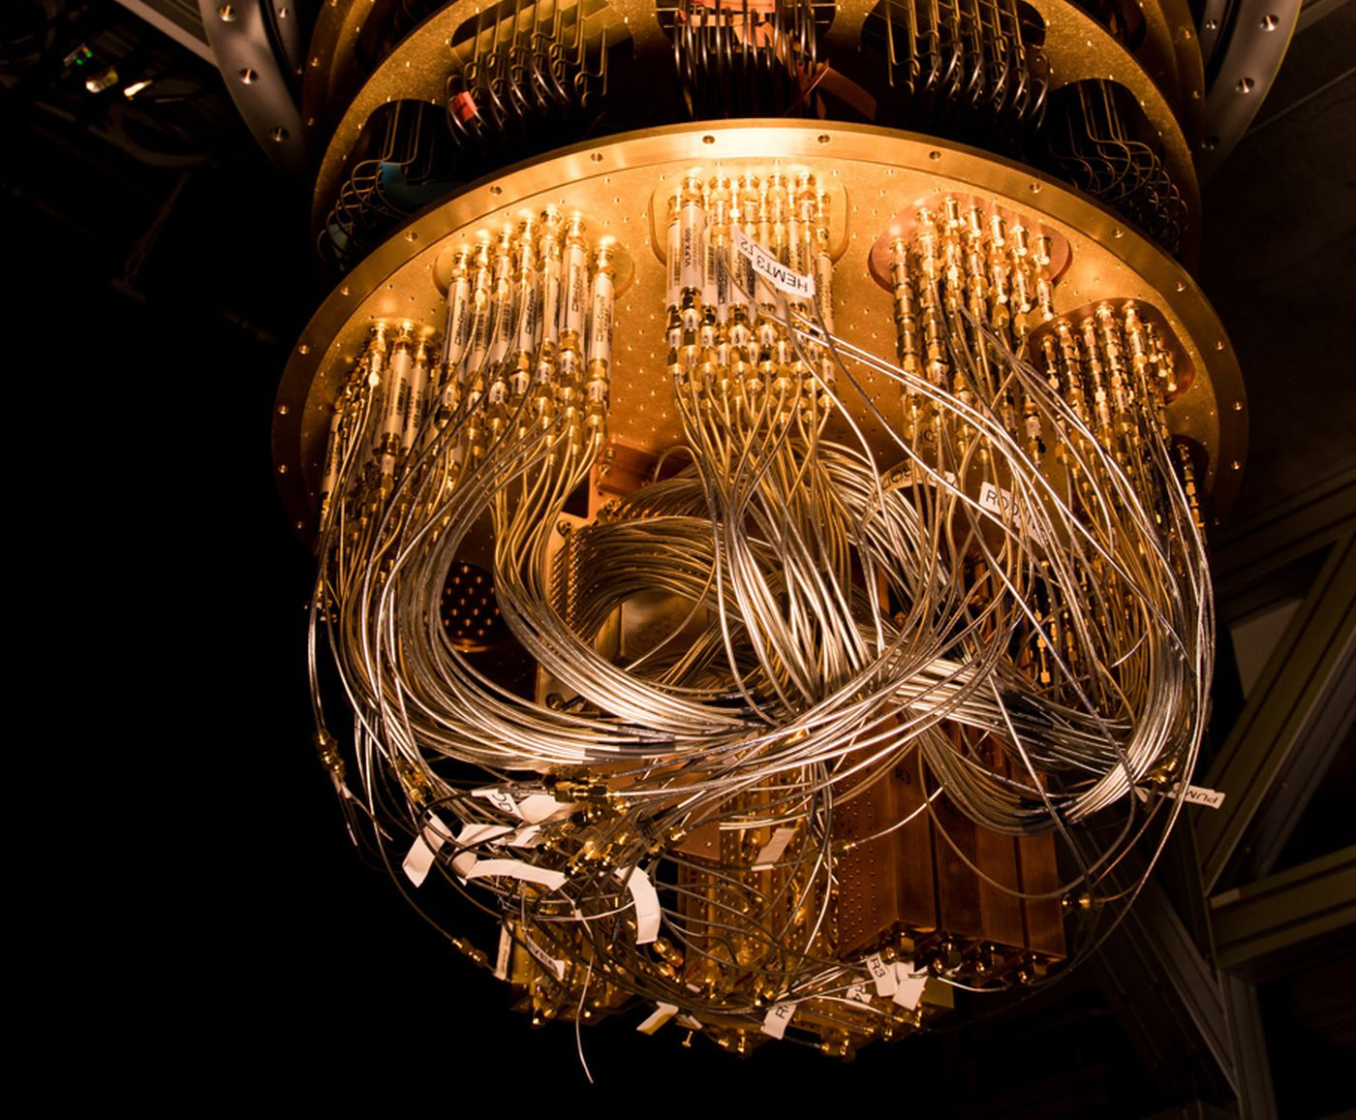
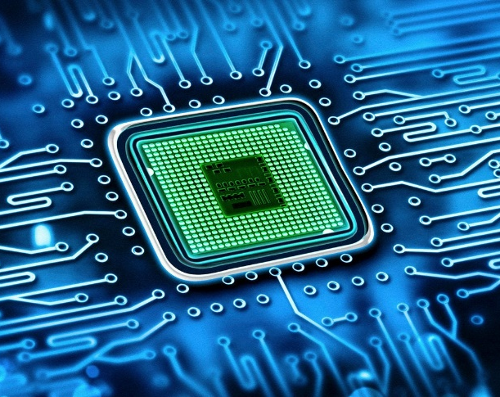
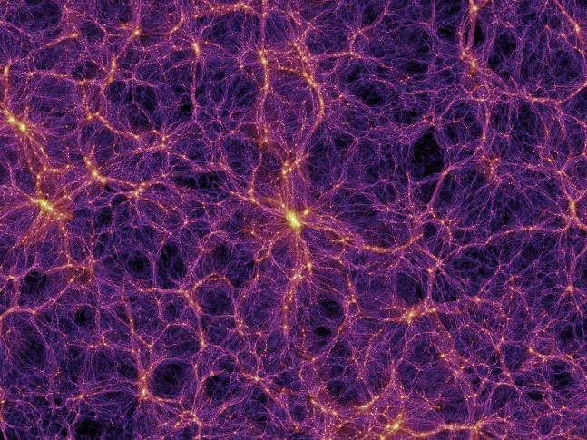
Future Application of Superconducting RF Cavity in Quantum Computing, High-end Chips and other Fields
Jiyuan Zhai (IHEP)
2023 International Workshop on High Energy Circular Electron Positron Collider
October 24, Nanjing, China

Slide 2
Outline
SRF Cavity for EUV Lithography
SRF Cavity for Quantum Computing
SRF Cavity for other Fields

Slide 3
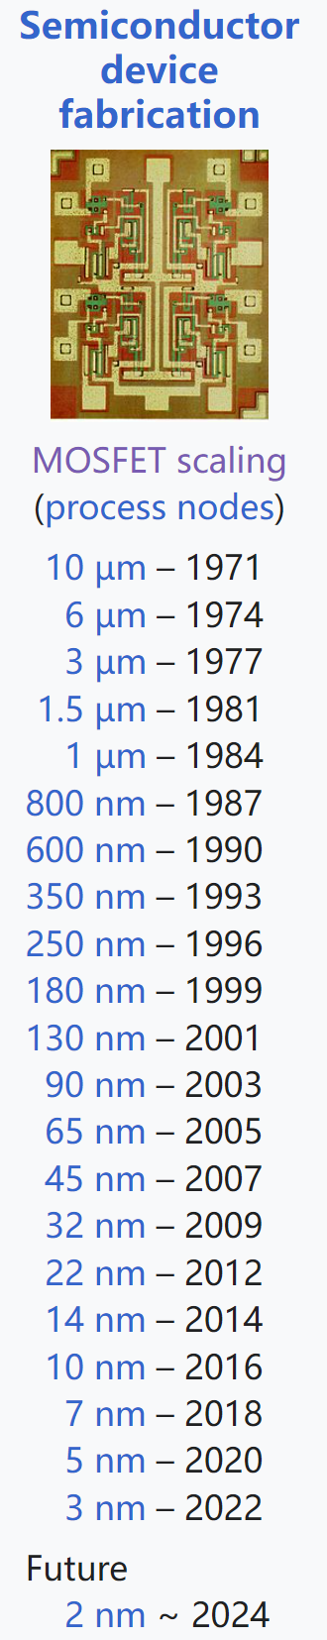
Semiconductor Microchip and Moore’s Law
High-end chips are critical for industry, economy and national security.
Moore's law: the number of transistors in an integrated circuit of a given size doubles about every two years.
  19 billion transistors in a 3 nm chip (300 M transistors / mm²)
  Lithography light with shorter wave length to drive Moore’s law forward
  EUV light source is the bottleneck of < 7 nm high-end chip manufacturing
Market Size | 2017 | 2021
Chipmaking equipment | 44 B$ | 83 B$
Chip | 421 B$ | 571 B$
Consumer electronics | 1883 B$ | 2255 B$
TSMC’s new fab costs 40 B$ (8 CEPC): human’s most expensive factory ever built.
Chip costs ¼ of a smartphone.

Slide 4
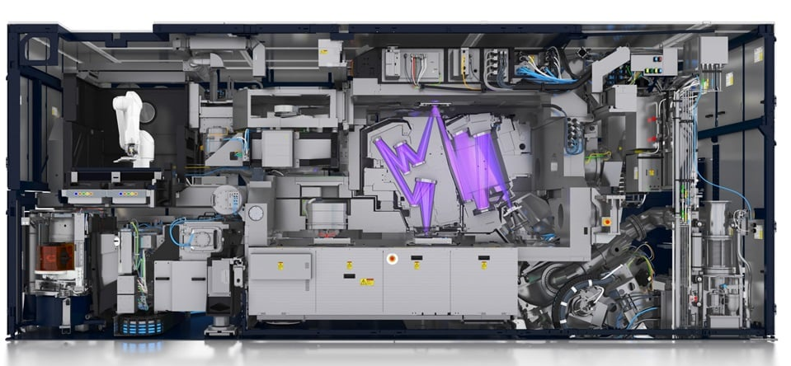
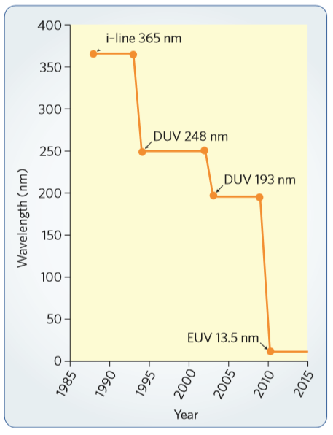
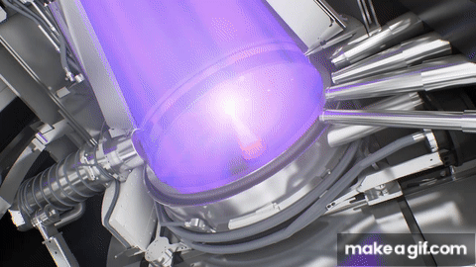
EUV Lithography Light Source
Ideal EUV light source:
  Tin debris contamination of LPP → pure EUV light (with variable polarization for high-NA)
  Stochastic effects at high throughput: 250 W → 1.5 kW for 3 nm node, 2.8 kW for 2 nm
  Upgradable to shorter wavelength for beyond EUV light
  Higher power to have more optics beamlines with one source
  Lower cost and electricity consumption per scanner
13.5 nm is fitted to the reflectivity
of Mo/Si multi-layer mirrors.
High volume manufacturing (HVM) started a few years ago using
a 250 W laser-produced plasma (LPP) source.
ASML sold 26 EUV machines in 2019, ~ 60 in 2023.
180 ton, 200 M$ each.
EUV chip market 1.5 B$ in 2018, 10 B$ in 2026.

Slide 5
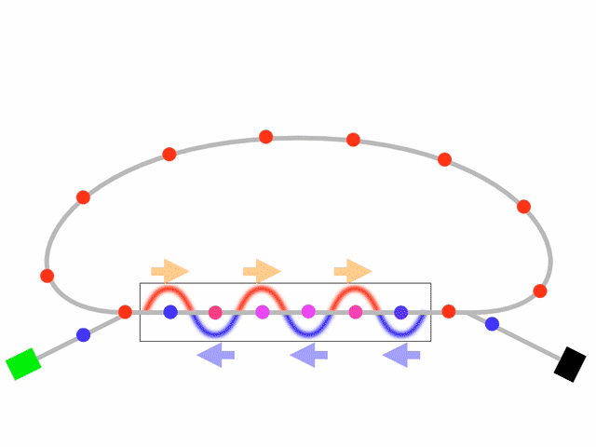
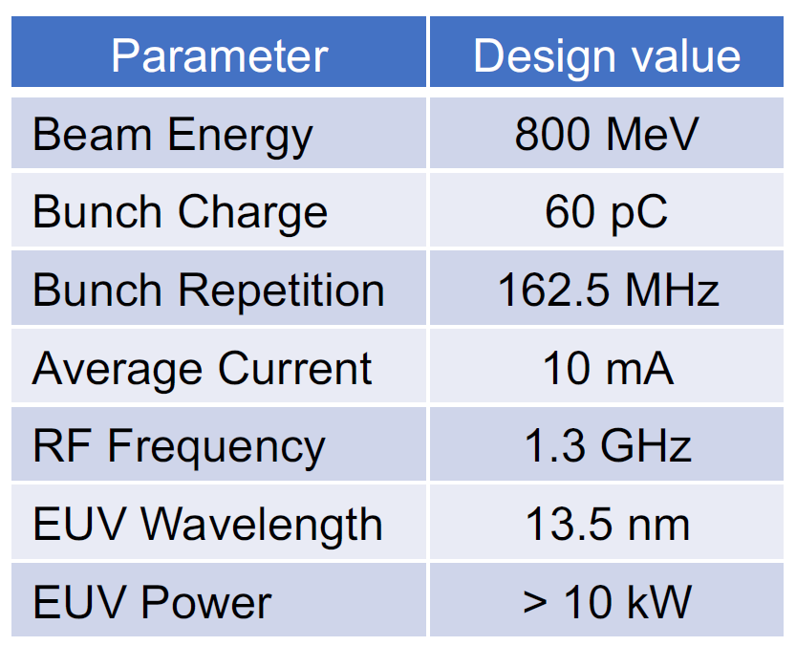
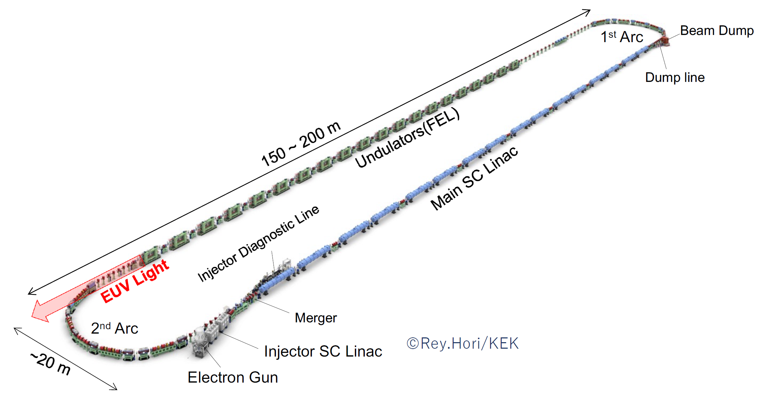
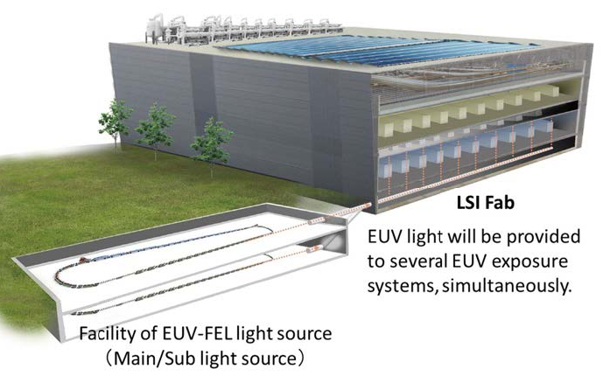
ERL-FEL: Ideal EUV Light Source
Energy recovery linac (ERL) based Free Electron Laser (FEL) for high power EUV lithography (proposed by KEK, Japan)
Many advantages over the current LPP source.

Slide 6
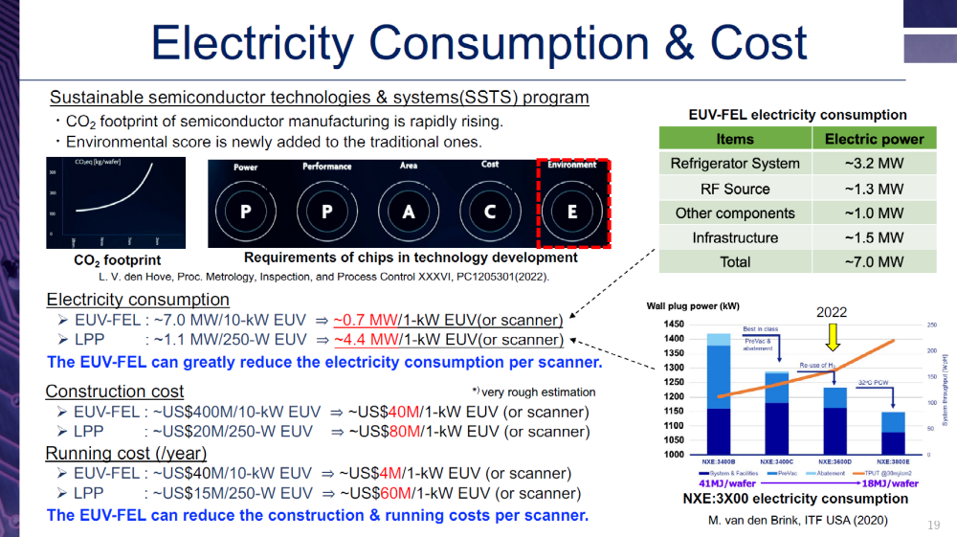
Norio Nakamura. Present state of the EUV-FEL light source for future lithography. 7th EUV-FEL Workshop, 30 January, 2023, KEK

Slide 7
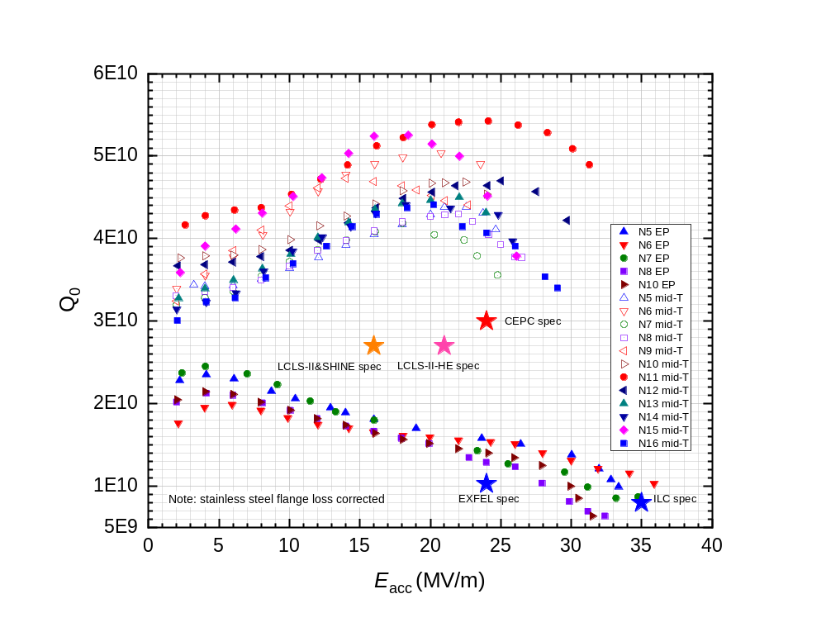
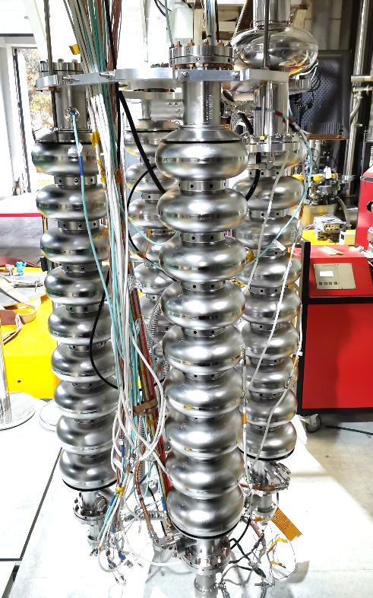
World Leading High Q SRF Cavity for EUV FEL
Superconducting RF cavity as the key component of energy-recovered EUV FEL
RF power: negligible for SRF cavity (to establish intense EM field in the cavity)
Beam power: 99 % recovered by the cavity
Cryogenic power (major electricity consumption): demanding high Q (also reduce capital cost)
IHEP developed a simplified medium temperature furnace baking (mid-T) method for high Q SRF cavities
After the pioneering work of Fermilab (in-situ mid-T bake of assembled cavity) and KEK (normal furnace mid-T bake of unassembled cavity
Applied it for the first time to 1.3 GHz 9-cell cavities in September 2020 and achieved world leading performance.

Slide 8
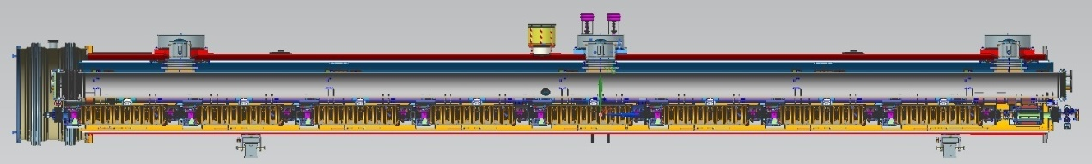
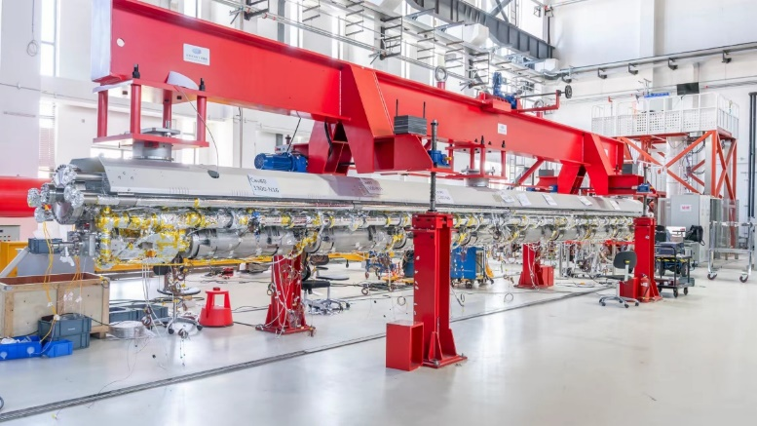
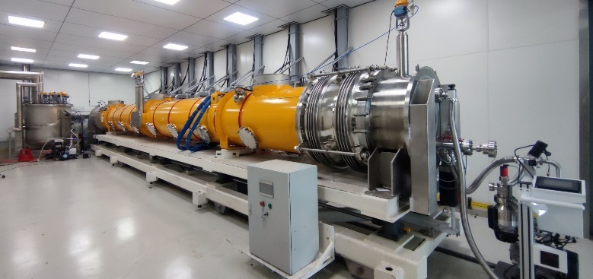
High Q 1.3 GHz Cryomodule for EUV FEL
In June 2023, IHEP’s 1.3 GHz superconducting accelerator cryomodule achieved world’s record high Q: 3.6E10@23 MV/m, module RF voltage 191 MV with dynamic 2 K heat load of only 112 W, and nearly no radiation and very small microphonics.
Only four cryomodules (32 cavities, 50 m) needed for a 800 MeV EUV ERL-FEL. Half linac length and cost of cavity/module/RF power source/cryogenic of KEK (64 cavities, 1E10@12.5 MV/m).
Modify cavity shape for high current; HOM absorbers at 100 K between cavities instead of HOM couplers on beam pipes.
Zhangjiang Lab at Shanghai has started EUV FEL R&D. We believe ERL-FEL the final shape for EUV light source (200 M CNY for main linac SRF and cryogenics with 1.5 MW operation AC power).

Slide 9
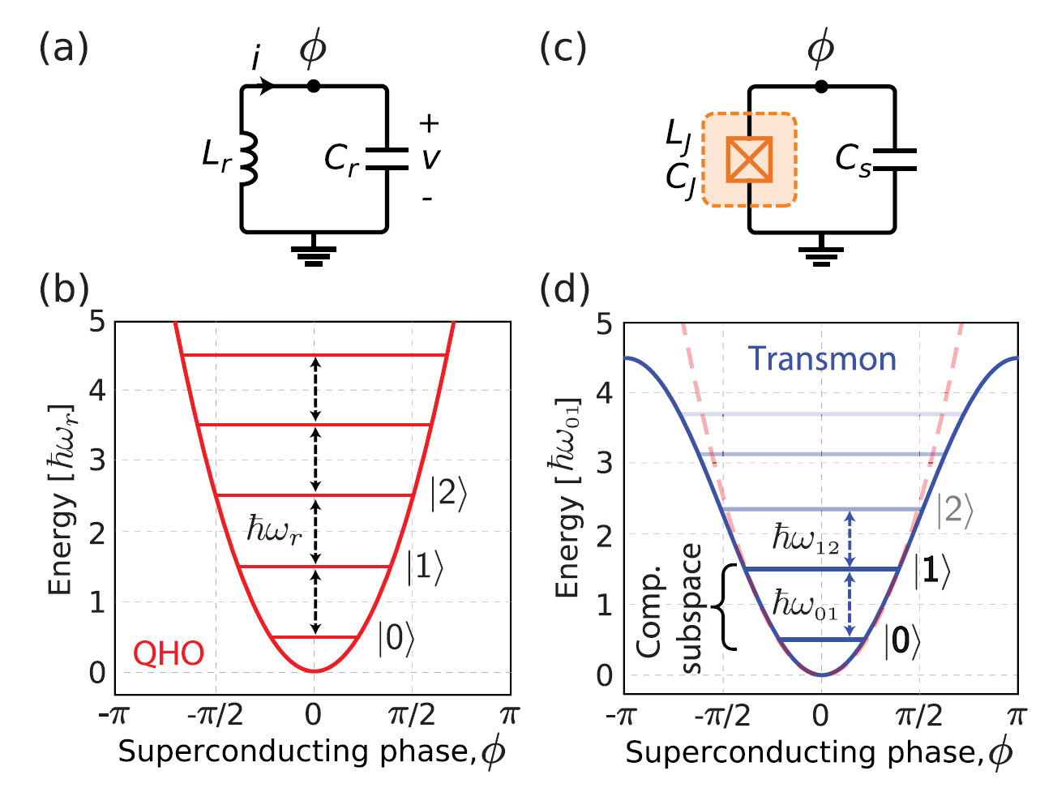
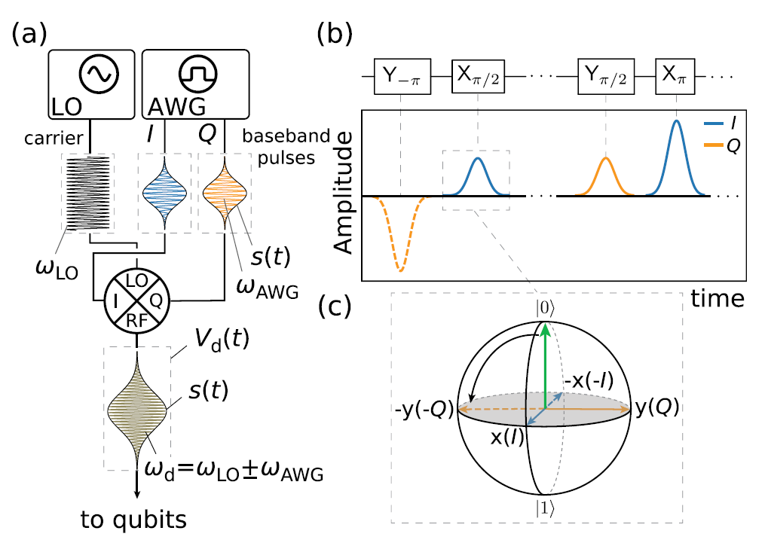
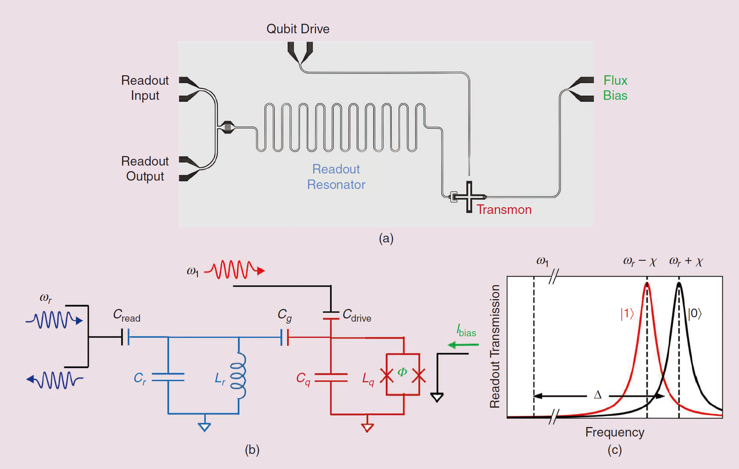
Quantum Computing
n bits can represent only 1 number (state) using classical bit but 2^{n} superpositioned and entangled quantum states using qubits.
Any two-level quantum system can be a quantum bit (qubit).
Superconducting qubit with Josephson junctions as an artificial atom is the most promising physical system for quantum computing.
Operate at extremely low temperature ~ 10 mK (kT << excitation energy)
Use microwave (~ GHz) photons to control (Rabi cycle) and readout (dispersive readout by a resonant cavity) the qubits: Circuit QED.
Qubits decoherence and scaling up are the greatest challenges of quantum computing.

Slide 10
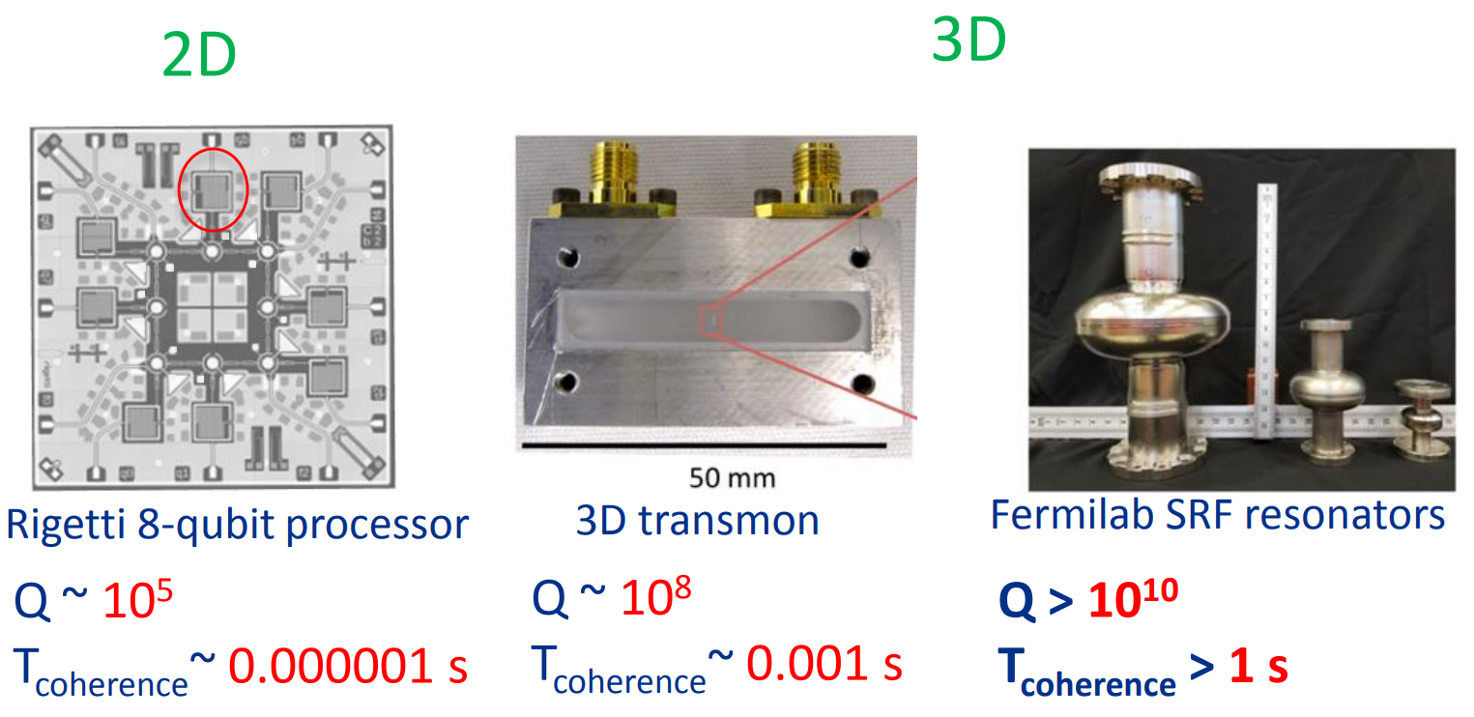
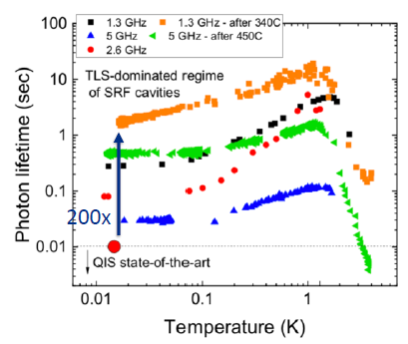
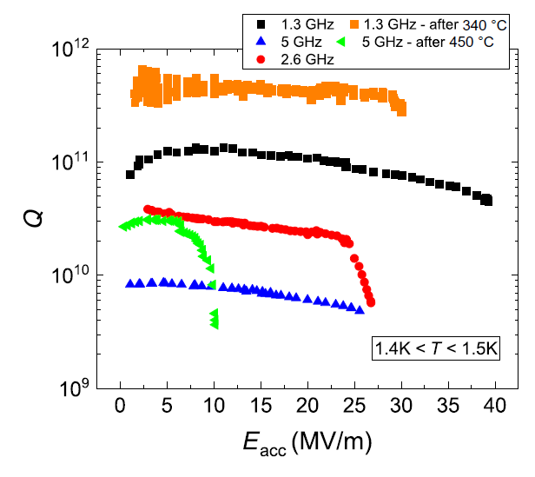
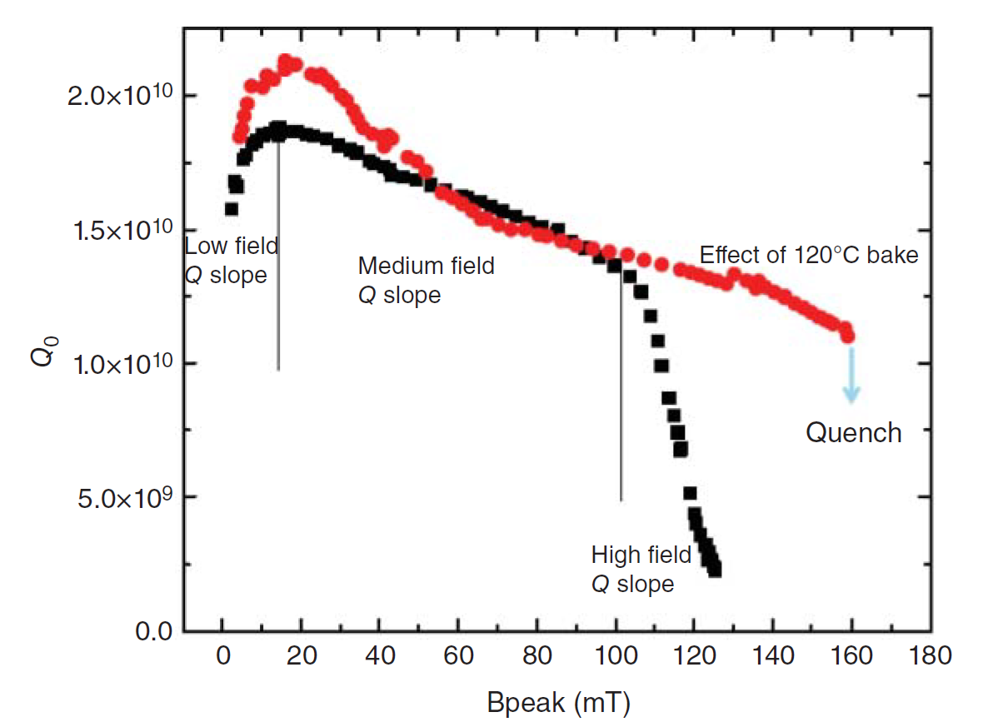
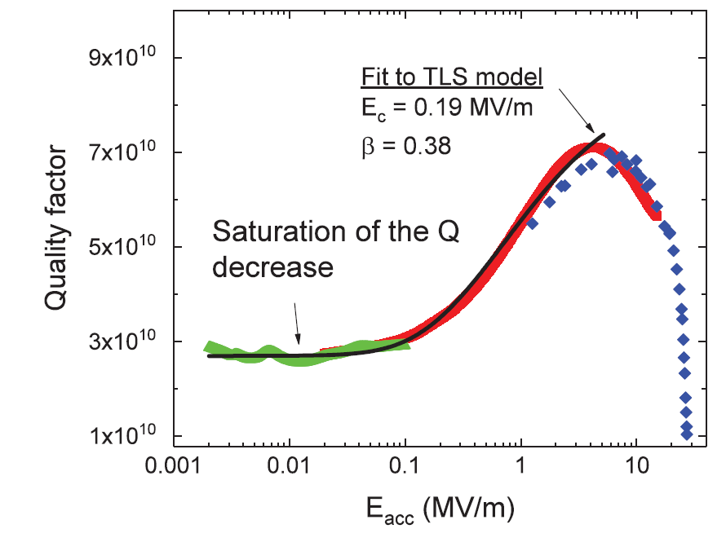
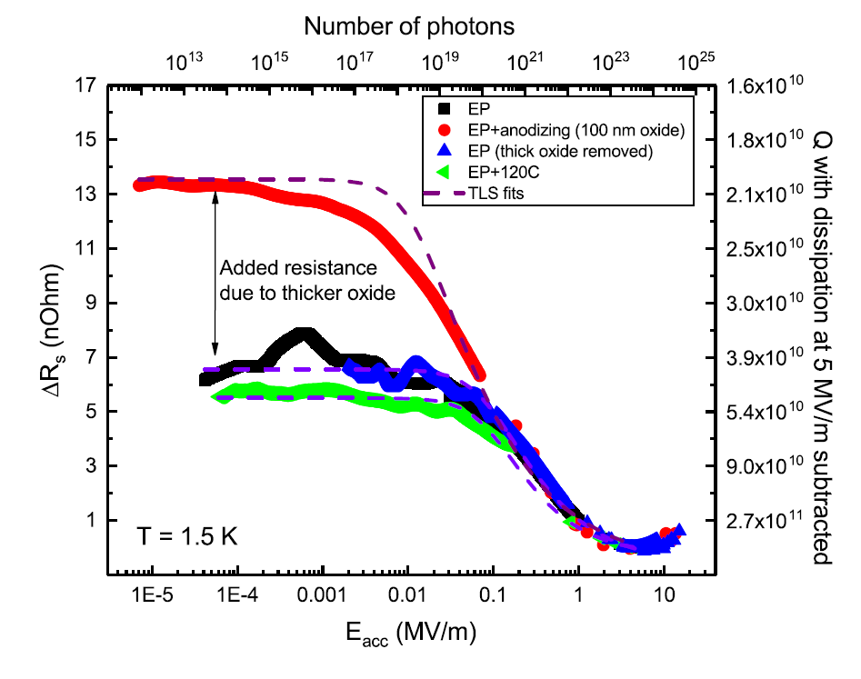
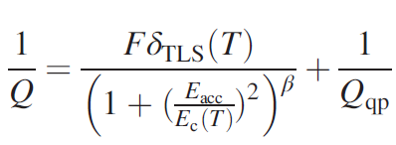
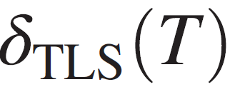

High Q SRF Cavity for Long Coherence Time
Mid-T recipe was initially developed for quantum applications to remove Nb₂O₅ layer, enabling high Q at mK and low photon counts i.e. very low field (instead of high field in accelerator cavity).
Low field Q-slope is due to two-level-system dielectric loss of amorphous Nb₂O₅ layer (T and E_{acc} dependent)
~

Slide 11
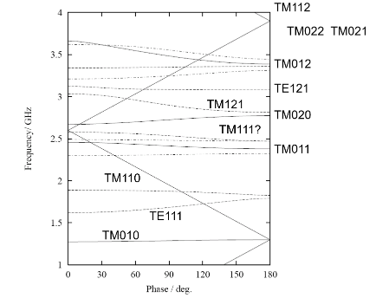
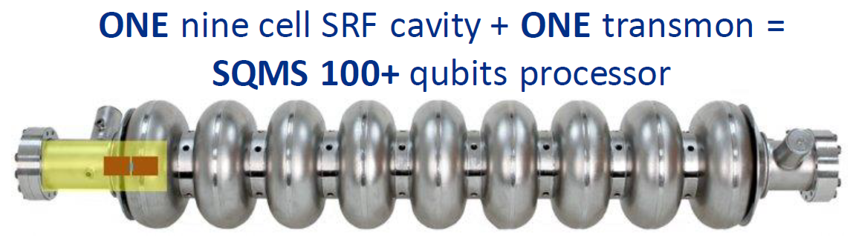
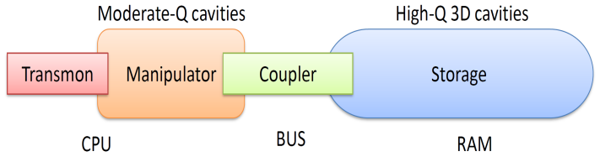
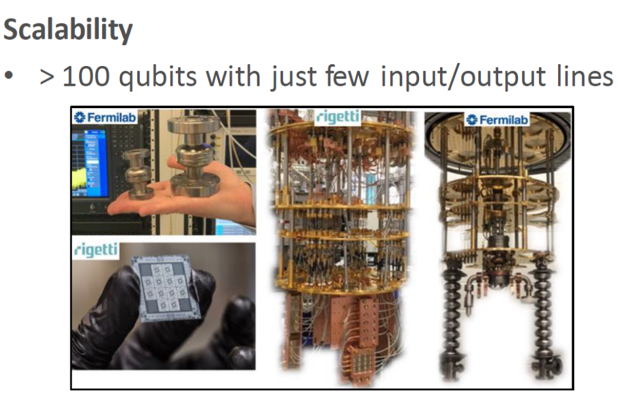
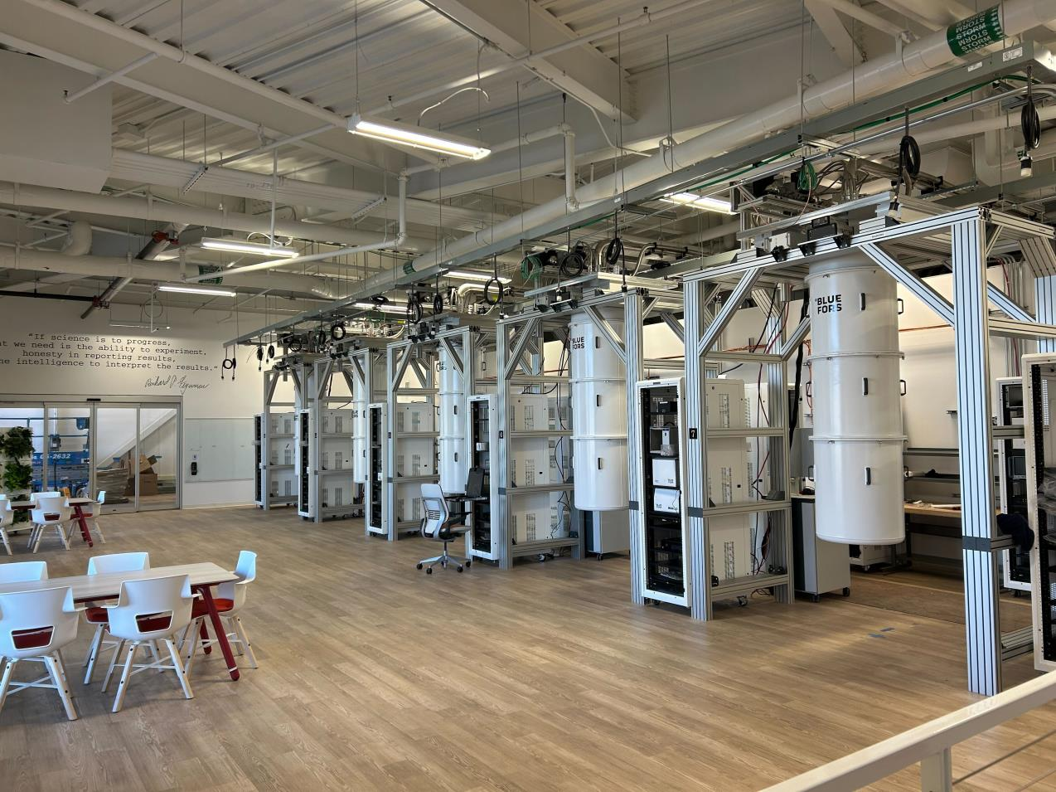
Multi-cell SRF Cavity for Scaling Up
High dimension quantum computing: qudit (2^{n} → d^{n}, d > 2)
All-to-all qubit connectivity. Dramatically reduce the input/output lines.
Dilution refrigerators in FNAL SQMS

Slide 12
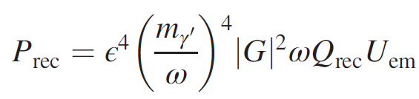
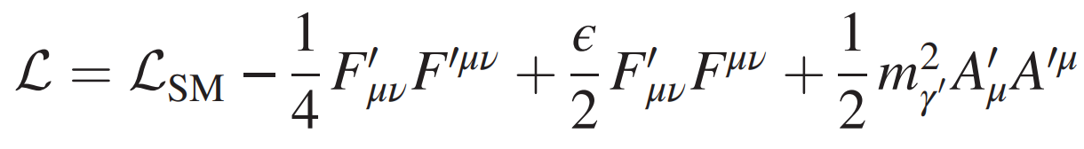
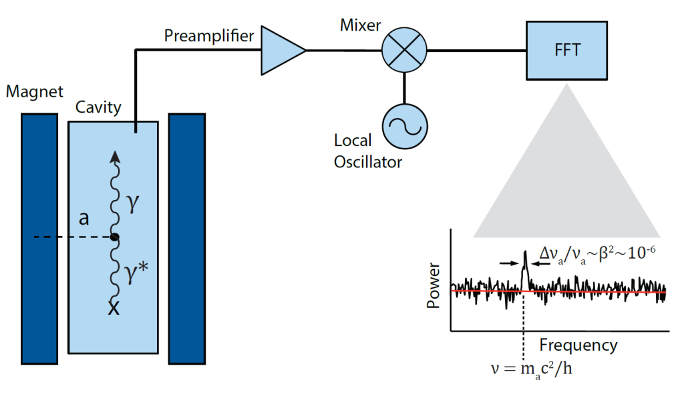
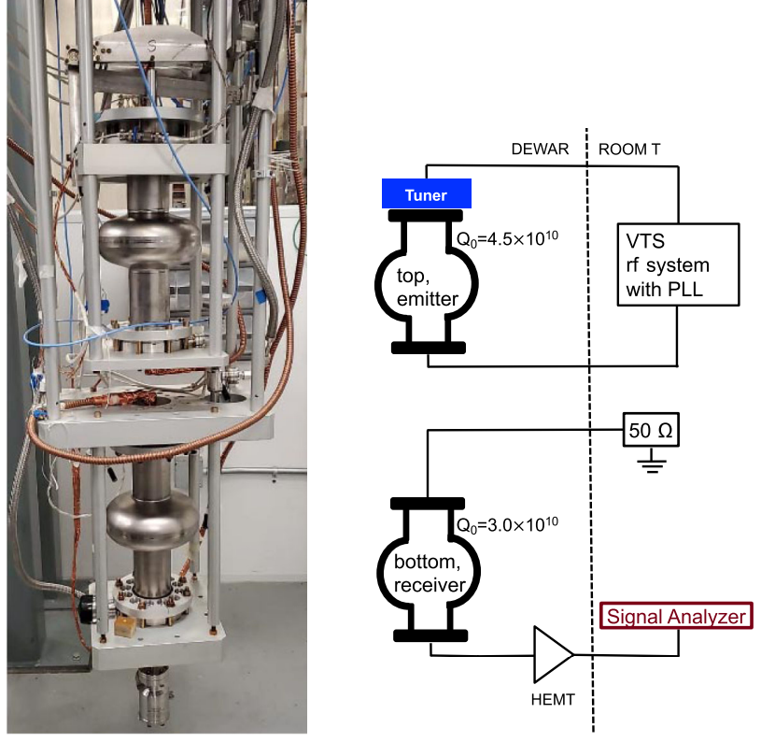
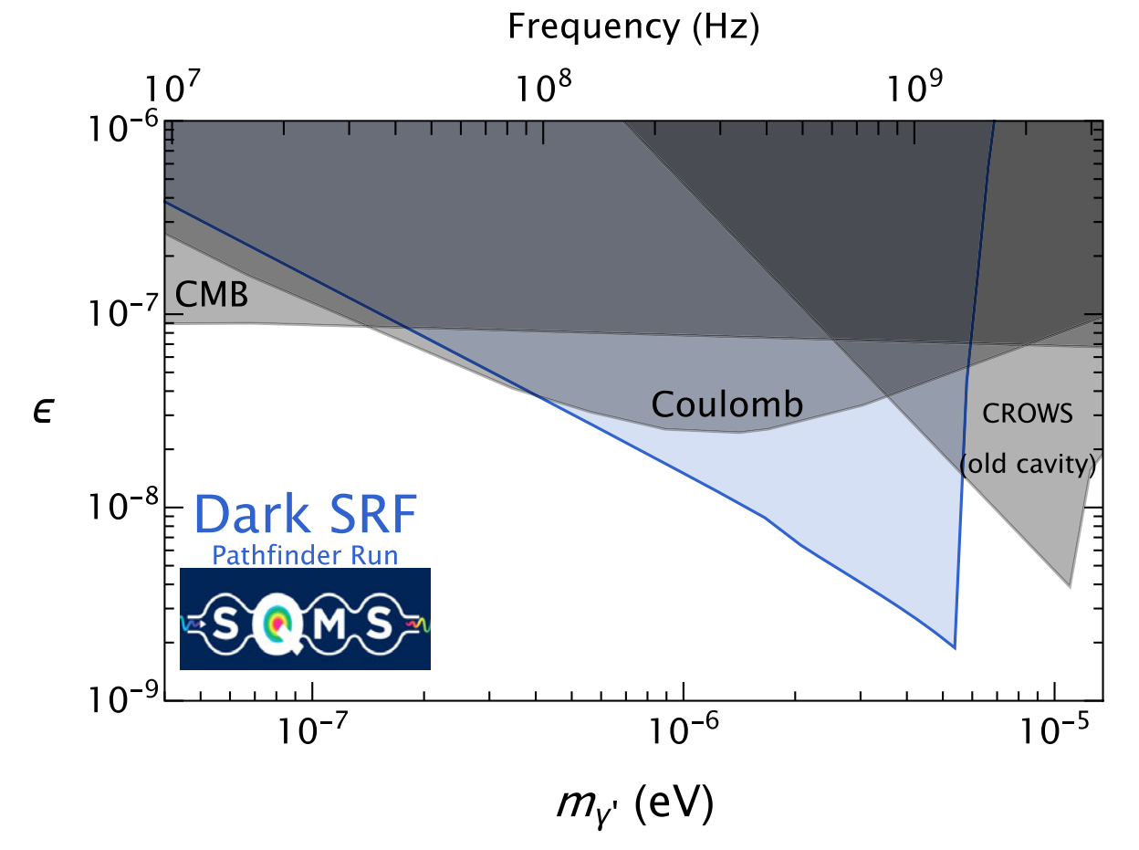
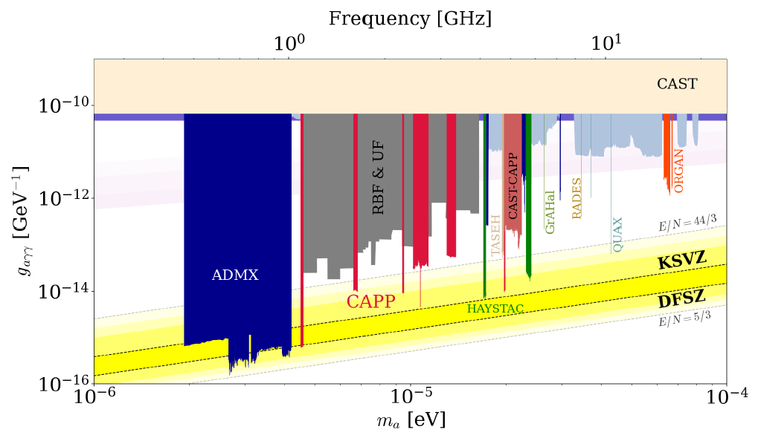
High Q SRF Cavity for Dark Matter Search
Dark Photon Search
Axion Search
~ 10 T
magnetic field
Axion haloscope. High Q cavity to increase sensitivity and scan rate.
SRF cavity material: NbTi (INFN), YBCO, GdBCO, EuBCO+APC (CAPP, IBS), Nb₃Sn (Fermilab)
New exclusion limit for kinetic mixing as small as ε=1.6E-9.
World’s best constraints on dark photons in 2.1E-7 to 5.7E-6 eV range
Fermilab “light-shining-through-wall” (LSW) experiment searching for dark photons using two 1.3 GHz SRF cavities. PRL. 130, 261801 (2023)

Slide 13
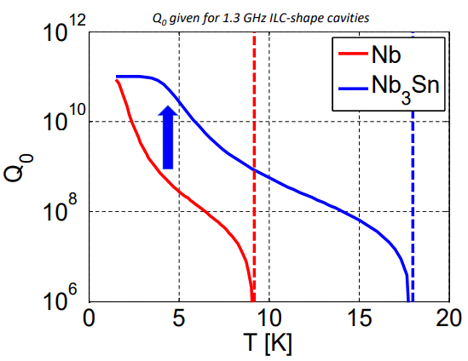
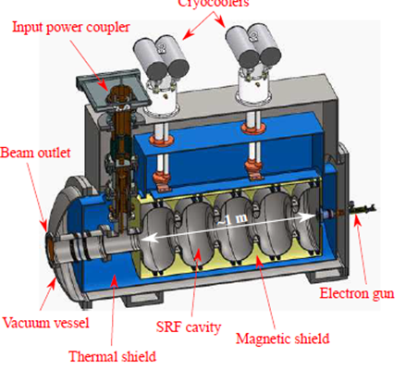
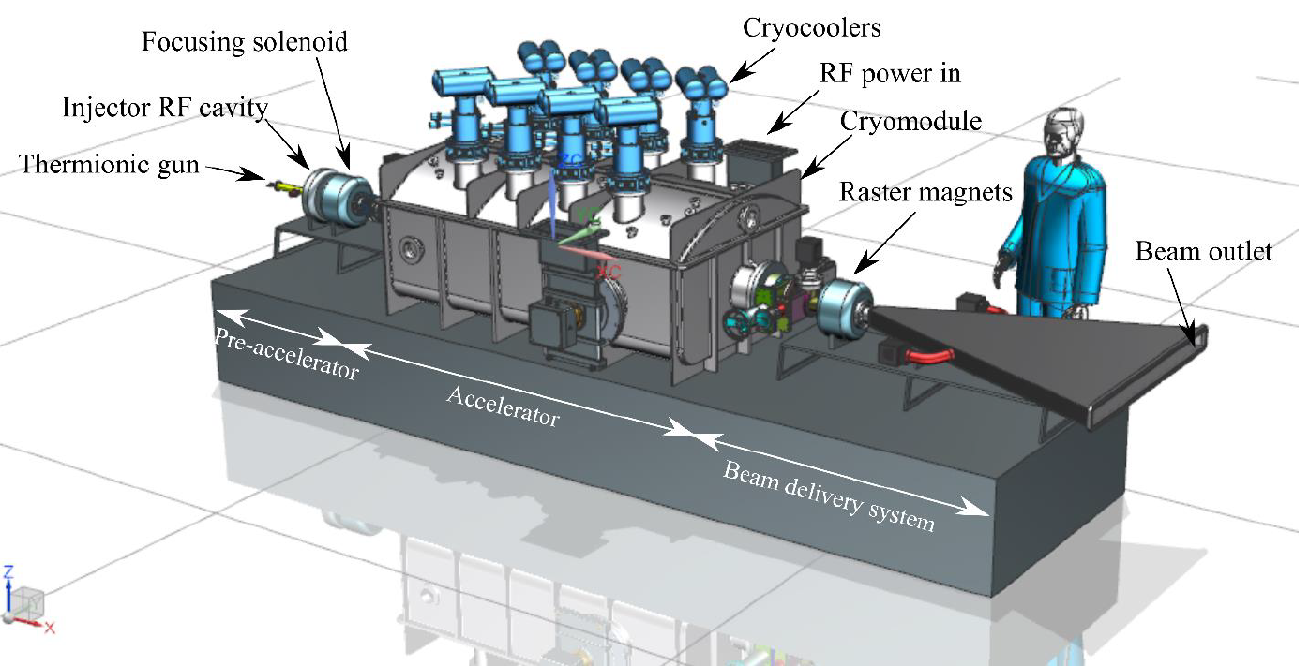
SRF Cavity for Next Generation Industry Accelerator
Nb₃Sn: push performance limit of SRF cavity, high Q at 4.2 K, high gradient
Compact superconducting linac: energy and cost effective, high CW beam power
Huge market (replace normal conducting industry accelerators)
  See Prof. Hao Jiankui’s talk on high Q cavity in Accelerator Session tomorrow morning.
1~50 MeV, 1 MW

Slide 14
Summary
High Q Superconducting RF Cavity Application
at high G: high power ERL-FEL for EUV lithography
at low G: better quantum computer and sensor
at high T: new superconducting industry linac

Slide 15
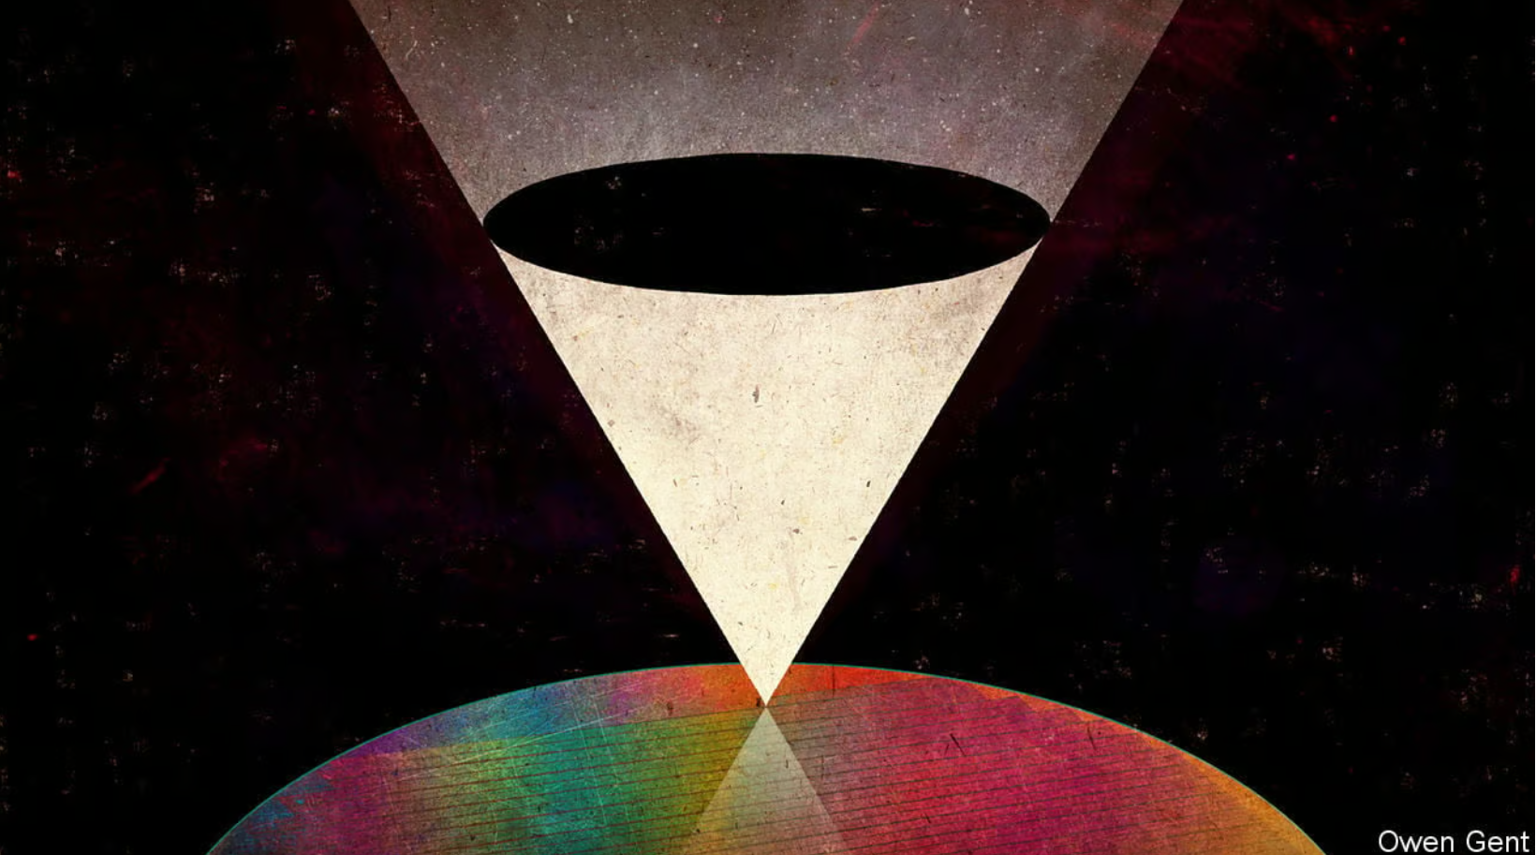
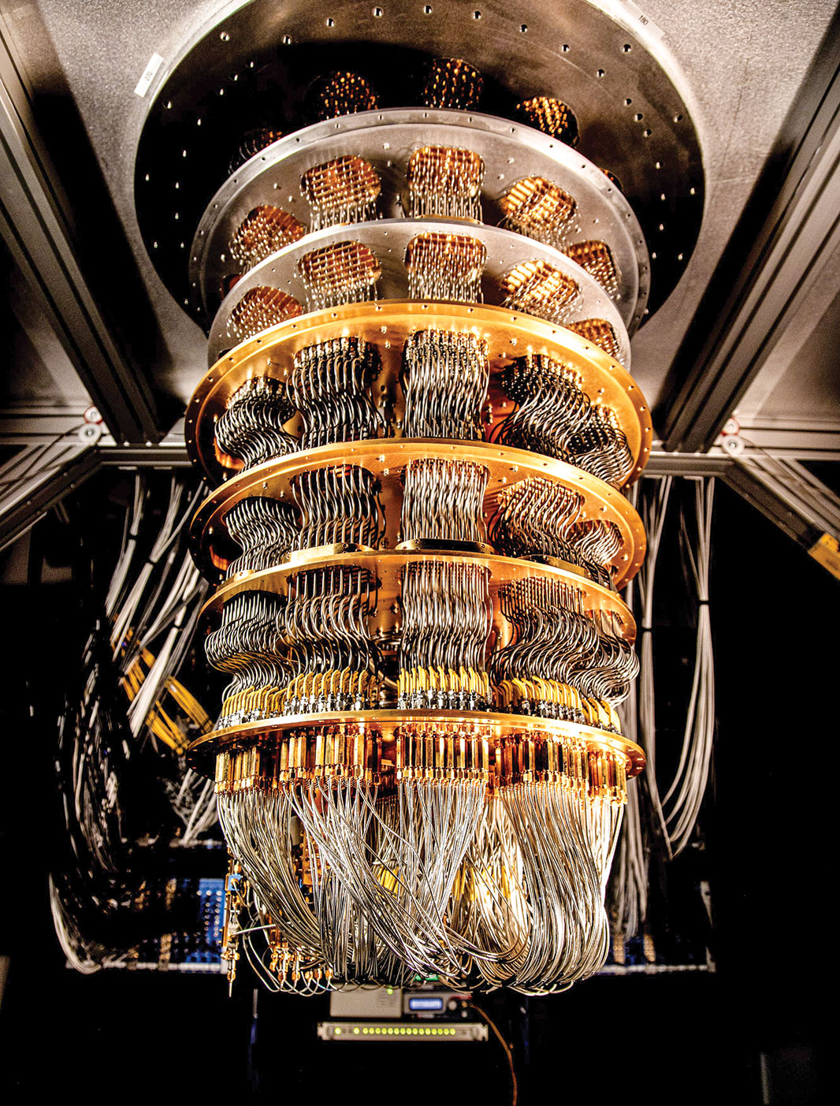
Thank you

Slide 16
Reference
Norio Nakamura, et al. High-power EUV free-electron laser for future lithography. Japanese Journal of Applied Physics 62, SG0809 (2023).
Norio Nakamura. Present state of the EUV-FEL light source for future lithography. 7th EUV-FEL Workshop, 30 January, 2023, KEK, Japan.
Alexander Wu Chao. A new light source SSMB. 23 September 2021, Tsinghua University.
P. Krantz, et al. A quantum engineer's guide to superconducting qubits. Appl. Phys. Rev. 6, 021318 (2019).
T. Roth, et al. The Transmon Qubit for Electromagnetics Engineers: An introduction. IEEE Antennas and Propagation Magazine. Volume: 65, Issue: 2, April 2023.
A. Grassellino. Superconducting Quantum Materials and Systems Center. GGI Summer School. July 27th 2022.
T. Roy. Qudit-based quantum computing with SRF cavities at Fermilab. International Symposium on Lattice Field Theory. 1 August 2023.
A. Romanenko, et al. PRL 119, 264801 (2017)
A. Romanenko, et al. Phys. Rev. Applied. 13, 034032, 2020
Hasan Padamsee. Superconducting Radiofrequency Technology for Accelerators: State of the Art and Emerging Trends. Wiley, 2023.

