Slide 1

WR: a high precise synchronize Ethernet and the applications
Guanghua Gong , Hao Chu, Jianmeng Dong, Yimeng Ye, Hongming Li,
Dept. of Engineering Physics, Tsinghua University
International workshop on the CEPC, Oct.24 2023

Slide 2

Outline
WR introduction
WR @ LHAASO
WR applications
WR standardization
Summary

Slide 3
Outline
WR introduction

Slide 4

WR introduction
  CERN and GSI initiative for control and timing
  Sub-ns synchronization
  Thousands nodes, links to tens km
  Based on well established standards
    Ethernet + PTP + SyncE + DDMTD
  IEEE1588-2019 as high accuracy
Notes:
由于之前时钟同步技术的种种局限，因此发展出基于以太网扩展增强的WR技术。
WR技术实现了频率源广播及亚纳秒时间同步，同时提高了确定、可靠、低延时的数据传输能力。
有望成为下一代网络同步标准PTPv3

Slide 5
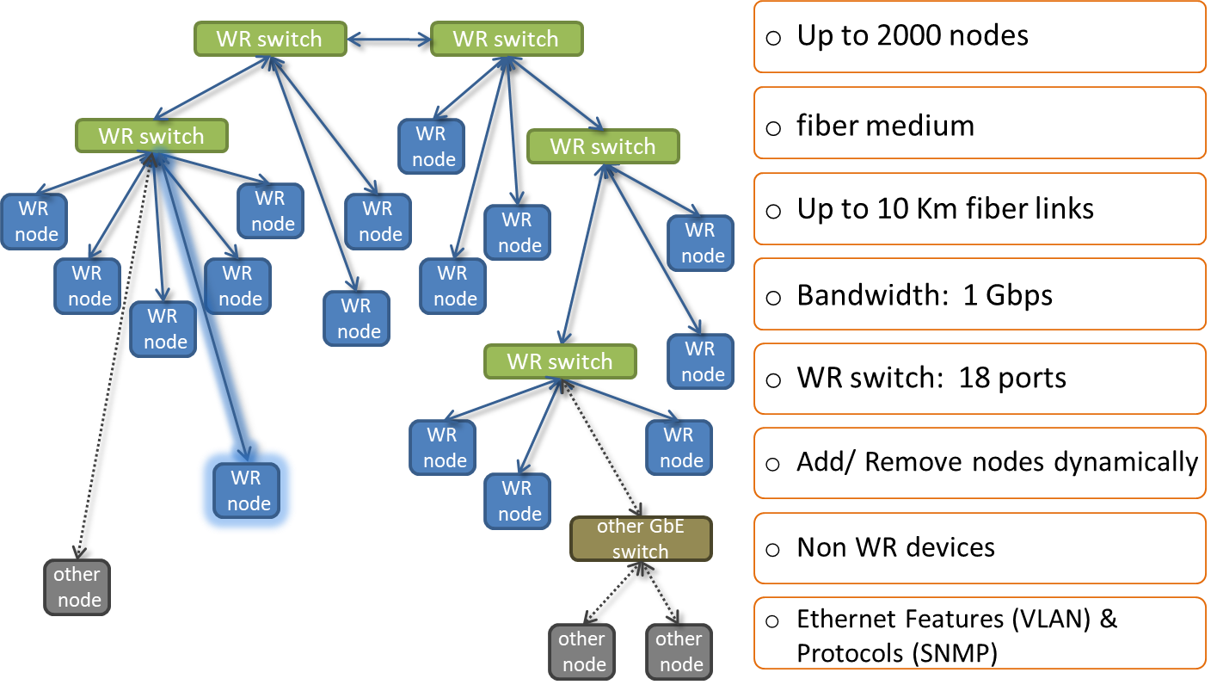
WR introduction

Slide 6
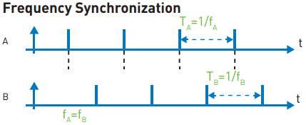
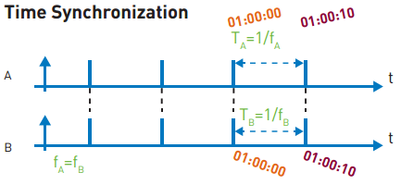


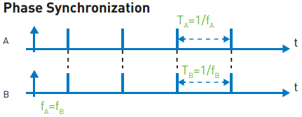
WR technology
Clock Data Recovery
Bi-directional frequency transmission
Sync-E
Improved precision time protocol for time tick synchronization
PTPv2
Digital Dual Mixer Time Difference for phase synchronization
DMTD

Slide 7
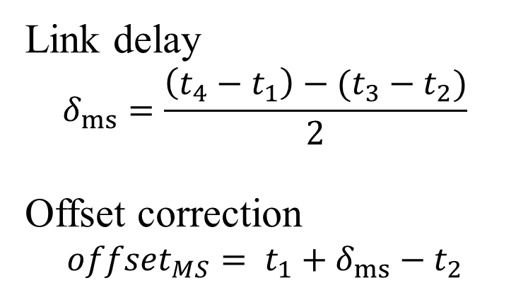
Precise time protocol (IEEE 1588)
PTP as IEEE 1588
Frame based synchronization protocol
Simple calculations
Master
Slave
t₁
Sync. package
t₂
Follow-up
Link delay
$$δ_{ms}=\frac{\left(t_{4}−t_{1}\right)−(t_{3}−t_{2})}{2}$$
Offset correction
$${offset}_{MS}= t_{1}+δ_{ms}−t_{2}$$
t₃
Delay request
t₄
Delay response

Slide 8
From PTP to WR
Devices have free-running oscialtors (±100PPM) that accumulates time drift that requires periodic message exchange
Symmetry medium assumation
Limeted timestanps resolution(8ns for Gigibit ethernet）
Layer 1 syntonisation among all devices
Link delay model to correct link asymmetries
Digital Dual Mixer Time Difference to measure the precise phase difference

Slide 9
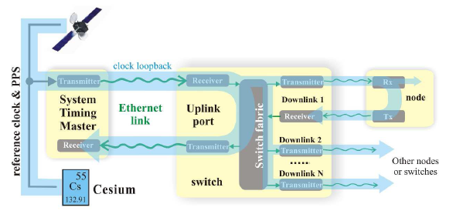
Layer 1 syntonisation
  Clock is encoded in the Ethernet carrier and recovered by the receiver (CDR)
  All network devices use the same physical layer clock
  Clock loopback allows phase detection to enhance precision of timestamps

Slide 10
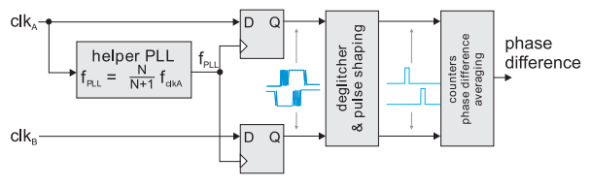
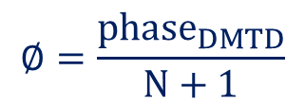
Digital Dual Mixer Time Difference (DDMTD)
Precise phase measurements in FPGA
Performed on both the master and slave sides
$$∅=\frac{{phase}_{DMTD}}{N+1}$$
WR parameters:
  clk_{in} = 62.5 MHz
  clk_{DDMTD} = 62.496185 MHz (N=14)
  clk_{out} = 3.814 kHz
Theoretical resolution of 0.977 ps
Notes:
它实际上就是将被测相位放大了N+1倍，因此也将鉴相器的时间分辨提高了N+1倍

Slide 11
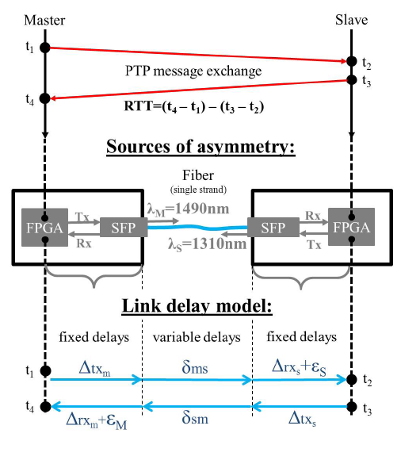

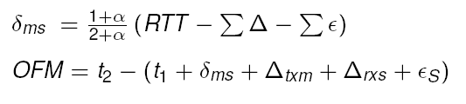
WR link delay model
single fiber with WDM to avoid physical link length difference
Asymmetry sources:
  Variable delays
    Chromatic dispersion in fibers
  Fixed delays：
    PCB trace
    FPGA
    SFP modules
Pre-calibration needed
  Chromatic dispersion calibrated as alpha
  Fixed delay of each node

Slide 12
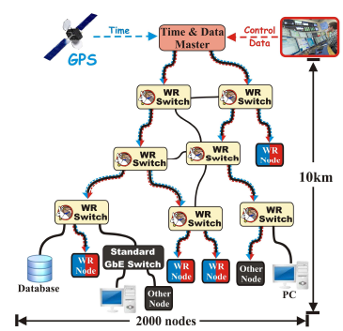
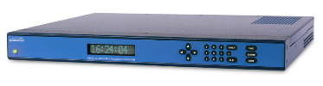
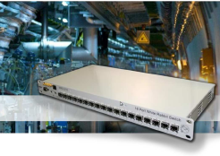
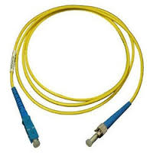
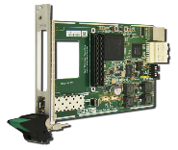
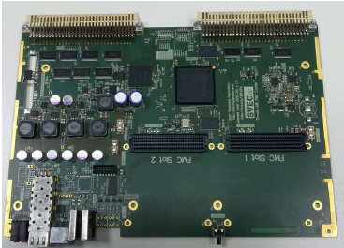
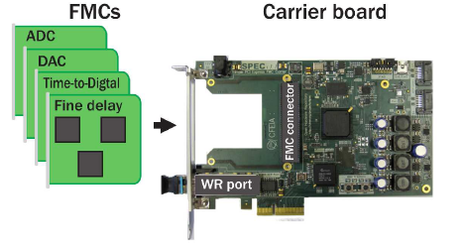
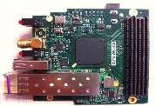
WR network and components
Freq. and Time reference
WR Switch
Optical fibers
WR Nodes

Slide 13
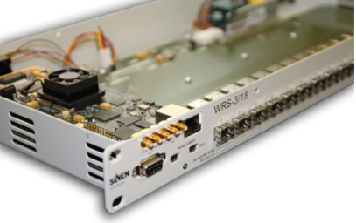
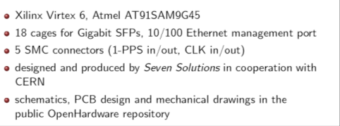
WR Switch

Slide 14
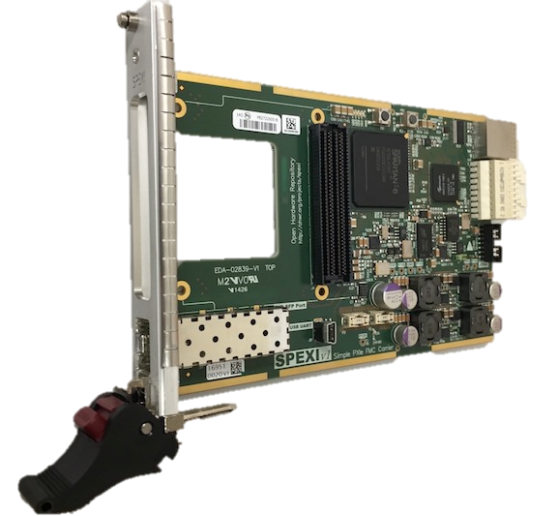
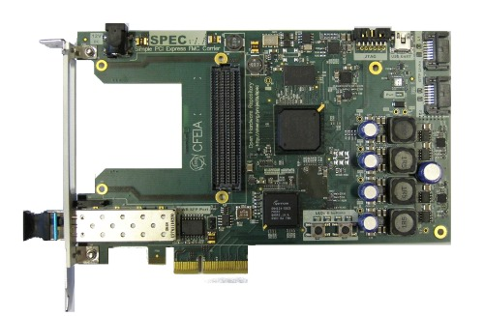
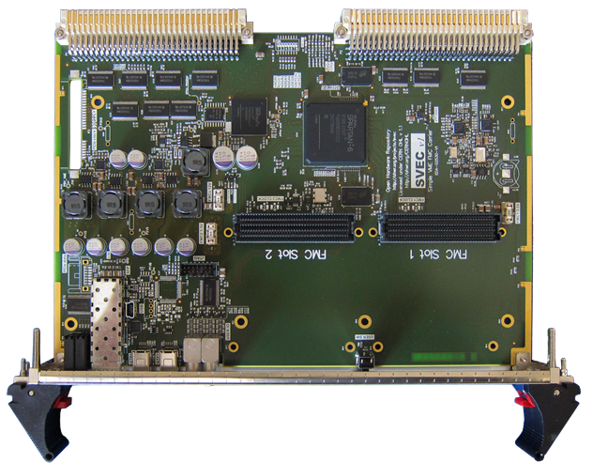
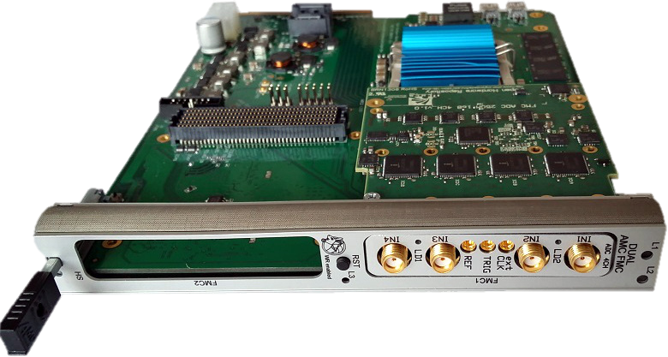
WR node (carrier mode)
PCIe carrier
PXIe Carrier
VME Carrier
AMC Carrier

Slide 15
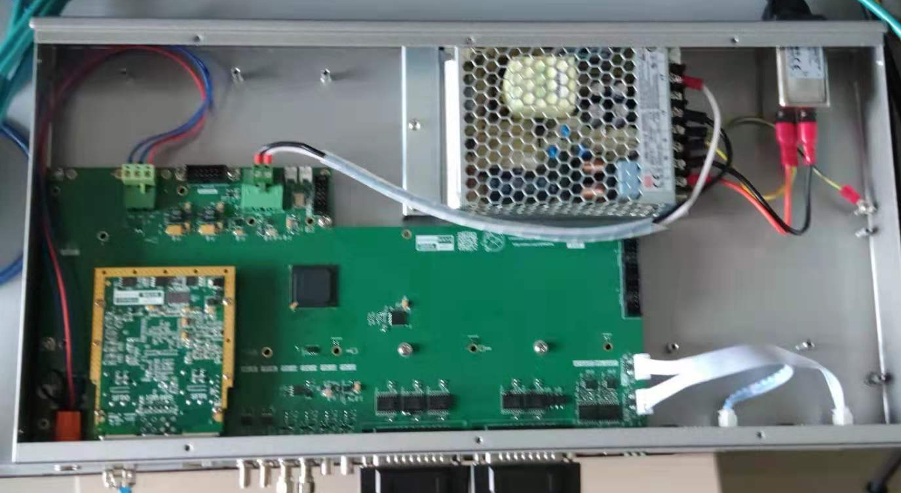
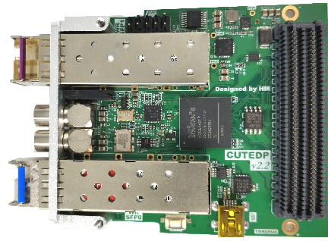
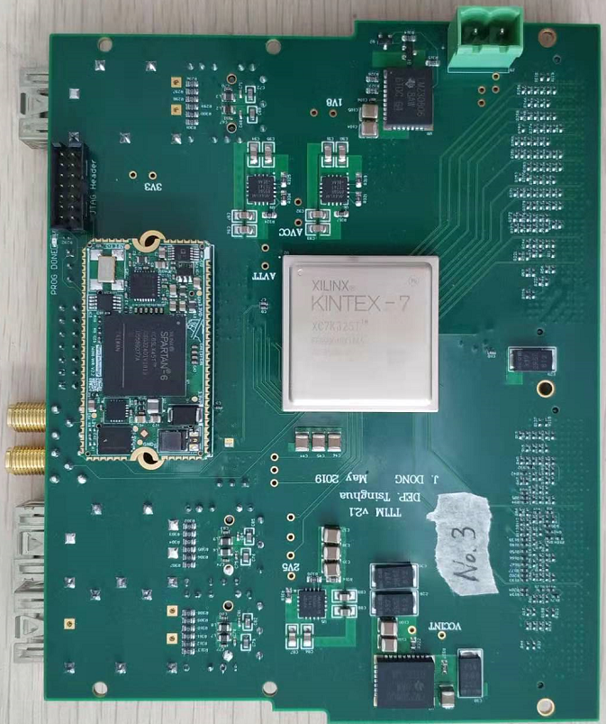
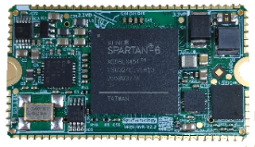
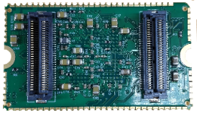
WR node (mezzanine mode)
Cute-WR-A7
Cute-WR-A7 in SHINE time node
Mini-WR
Mini-WR in JUNO timing/trigger devices

Slide 16
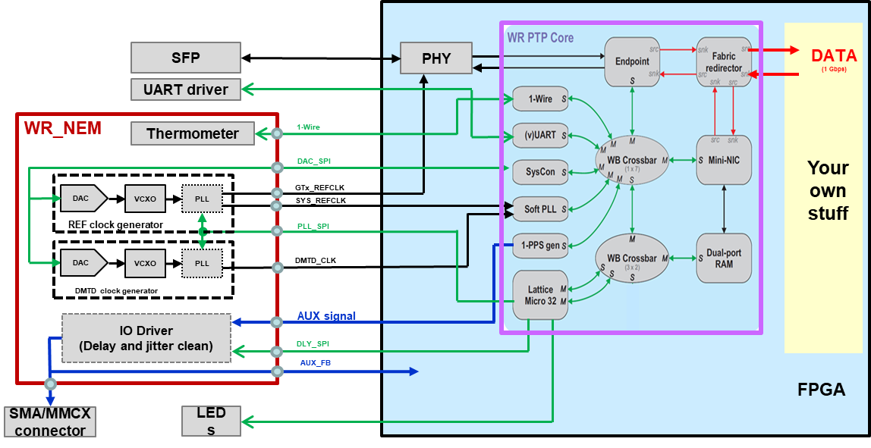
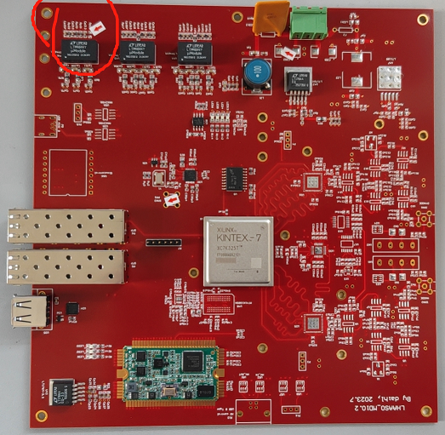
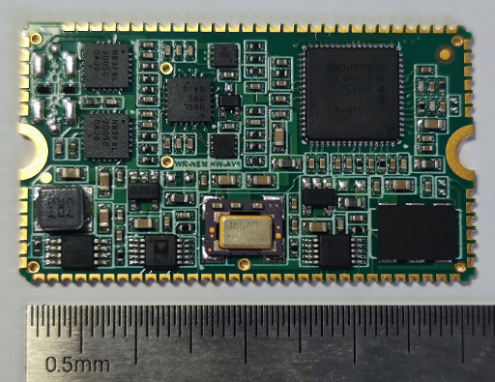
WR node (IP mode)
WR as IP core with external support circuit
WR_NEM in LHAASO MD elec.
WR_NEM: WR external support circuit

Slide 17
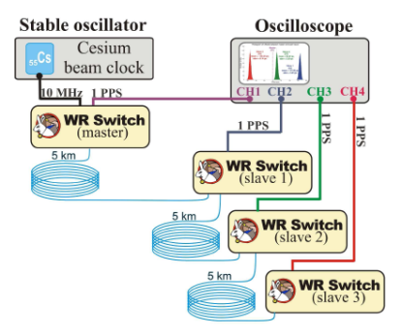
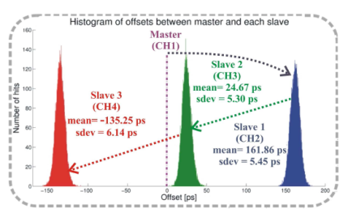
WR performance

Slide 18
Outline
WR @ LHAASO

Slide 19

Large High Altitude Air Shower Observatory
29º21’ 27.6” N, 100º08’19.6” E
4410 m a.s.l.
Full operation since 2021-June.
Chinese National Major Science and Technology Infrastructure
YaDing airport
Notes:
Location: Haizishan(Lakes Mountain), Sichuan Province， 8 km to Daocheng Airport, the world’s highest civilian airport

Slide 20
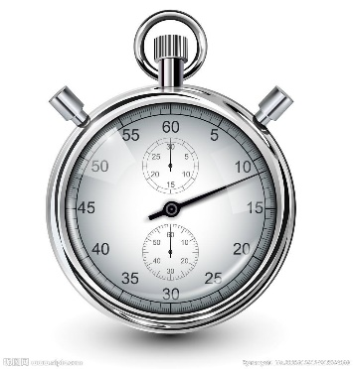
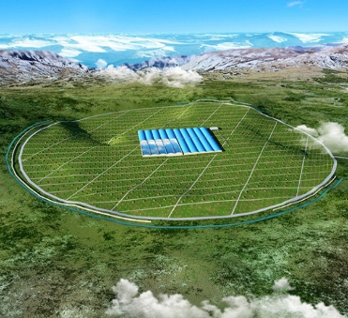

LHAASO timing system
High Precision
Large Scale
High reliability
Accuracy： <500ps
Jitter： <20ps
1.3Km² area
~8000 detectors
4410 a.s.l altitude
wild field deployment
Notes:
LHAASO-KM2A实验需求主要包括以下三点：
大规模探测节点
能量越高的宇宙线探测需要越大的探测面积，KM2A在平方公里地面部署了5195个ED探测器和1171个MD探测器
数千探测器的规模要求节点采用集成技术，单节点成本尽可能低，能实现时钟同步与数据网络复用
2. 高精度时间同步：
阵列式探测器需要全局统一时钟才能完成原始粒子入射径迹重建，为了实现入射角分辨小于0.5度，要求各探测器节点时间测量精度<2ns，时钟全局同步精度<500ps
3. 系统高可靠运行：
大气对粒子衰减严重，为提高探测效率LHAASO选择在高海拔野外区域建设，设备工作环境复杂，温度变化大，在这类工作环境下要求系统：时钟同步可靠性高、阵列的时钟同步标定

Slide 21

Structure
1# Elec_HUT
DAQ SERVER
Ru.OSC
GPS
GM
WRS
Computer Room
WRS-L1
x3
WRS
WRS-L2
x30
WRS
WRS
WRS
WRS
WRS
WRS
~600m
~600m
~600m
WRS
L3 x 450
Detector elec.
X 6800
ADC
FPGA
ADC
FPGA
ADC
FPGA
ADC
FPGA
ADC
FPGA
ADC
FPGA
ADC
FPGA
ADC
FPGA
ADC
FPGA
ADC
FPGA
ADC
FPGA
ADC
FPGA
ADC
FPGA
ADC
FPGA
ADC
FPGA
ADC
FPGA
ADC
FPGA
ADC
FPGA
TDC
ADC
FPGA
ADC
FPGA
TDC
ADC
FPGA
ADC
FPGA
Memory
TDC
Memory
Memory
TDC
Memory
TDC
ADC
FPGA
ADC
FPGA
ADC
FPGA
TDC
ADC
FPGA
Memory
TDC
Memory
TDC
Memory
Memory
TDC
ADC
FPGA
TDC
Memory
TDC
Memory
TDC
Memory
TDC
Memory
TDC
Memory
Memory
TDC
Memory
TDC
Memory
TDC
Memory
TDC
Memory
FMC connector
TDC
Memory
FMC connector
TDC
Memory
FMC connector
TDC
Memory
FMC connector
TDC
Memory
FMC connector
TDC
Memory
FMC connector
TDC
Memory
FMC connector
TDC
Memory
FMC connector
TDC
Memory
FMC connector
TDC
Memory
FMC connector
FMC connector
FMC connector
FMC connector
FMC connector
FMC connector
FMC connector
FMC connector
FMC connector
FMC connector
FMC connector
FMC connector
FMC connector
FMC connector
FMC connector
FMC connector
FMC connector
FMC connector
Distributed in field

Slide 22
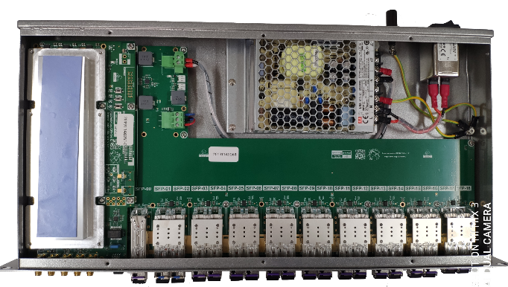
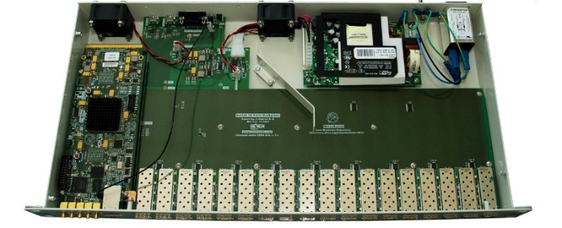
WR Switch improvement
Improved heat dissipation, without FAN
Improved device temp. range to -20 ~ 70
Improved low jitter clock circuit
Improved kernel board placement
Optical Management port for fiber connection
18 WR ports with light guide
Software/Firmware compatible with standard WRS-18
https://www.ohwr.org/projects/wrs-fl-hw/wiki

Slide 23
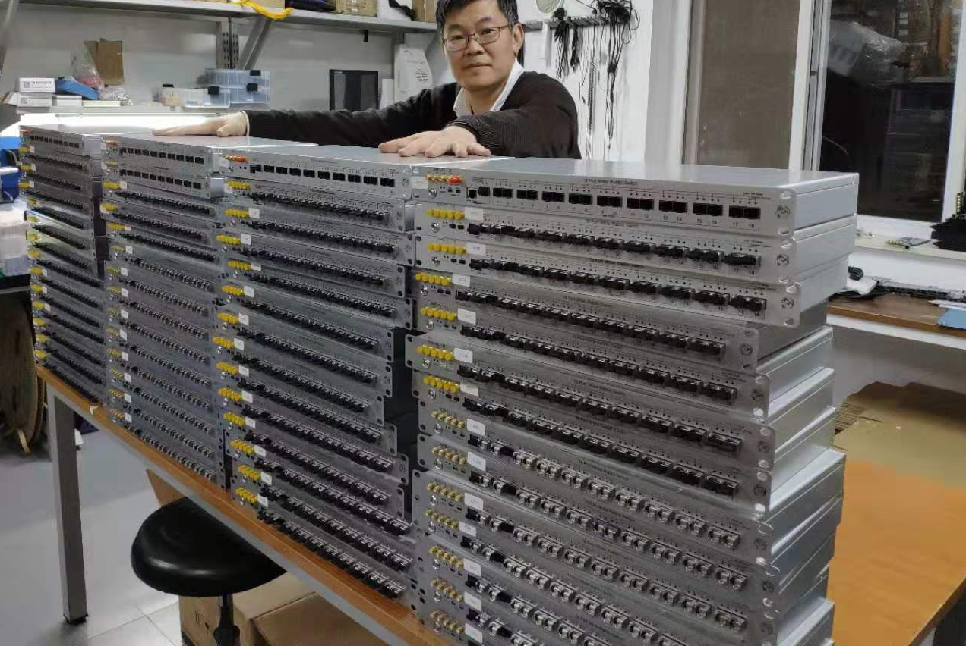
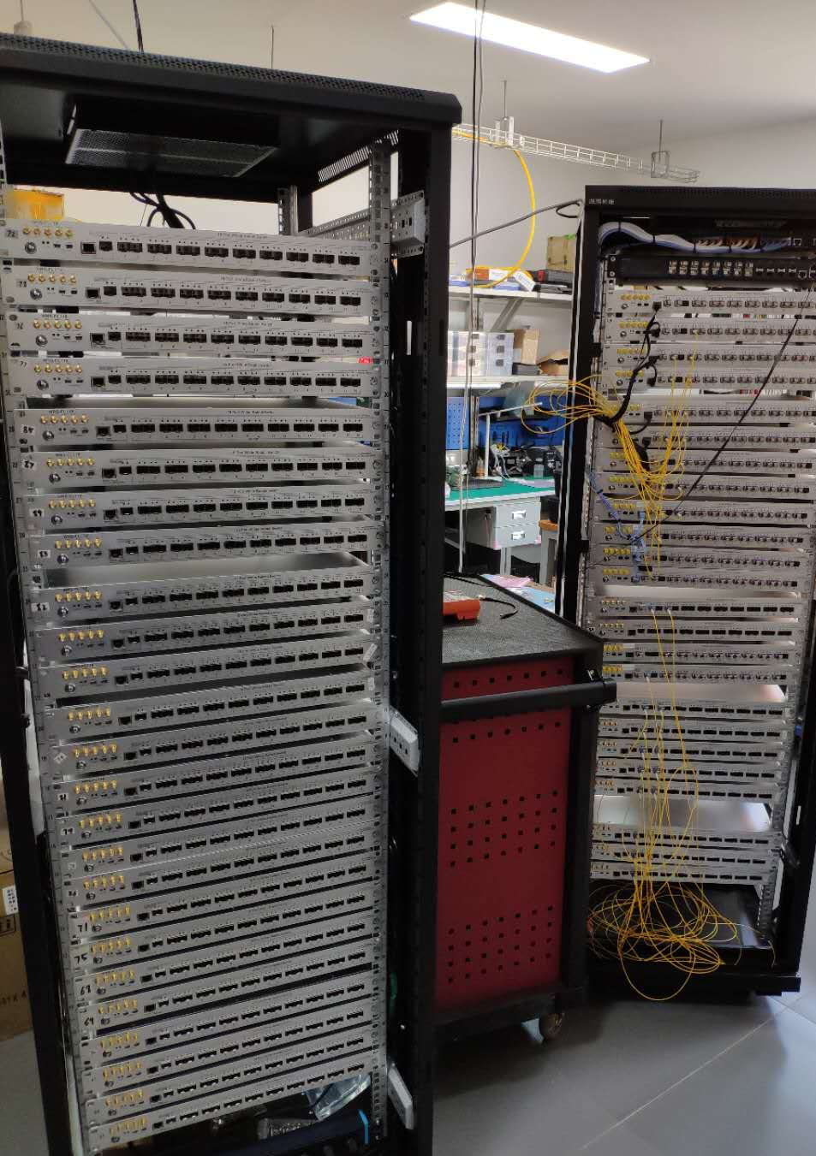
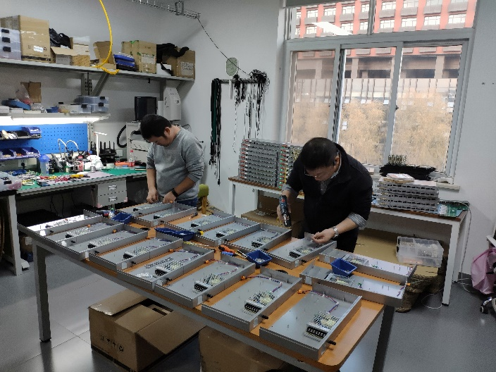
Mass production for LHAASO
550 WRS-FL produced, 500 installed in field

Slide 24
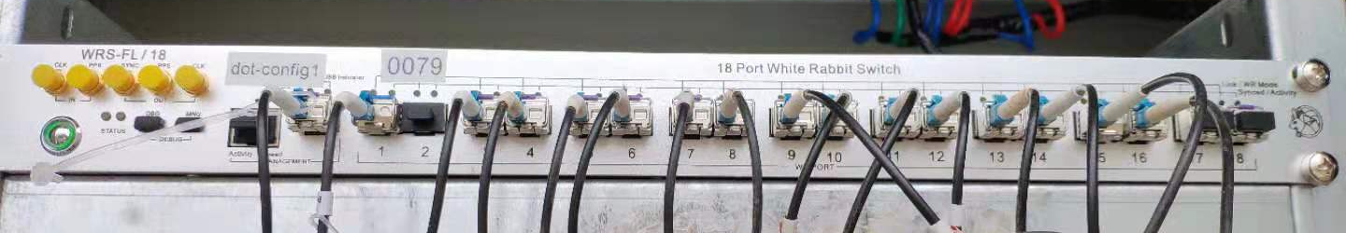
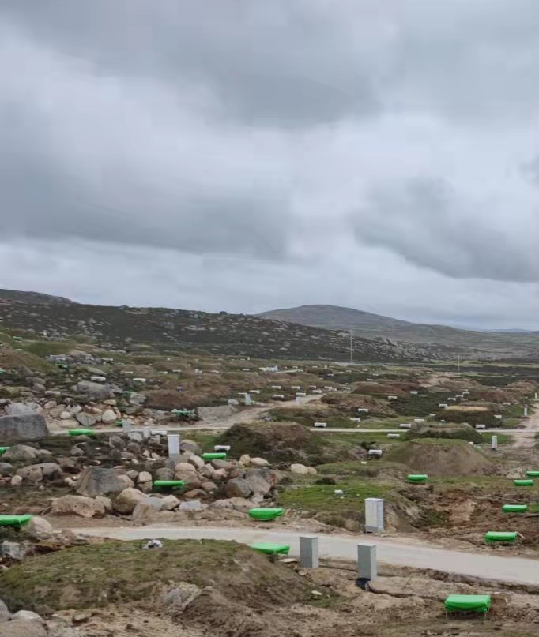
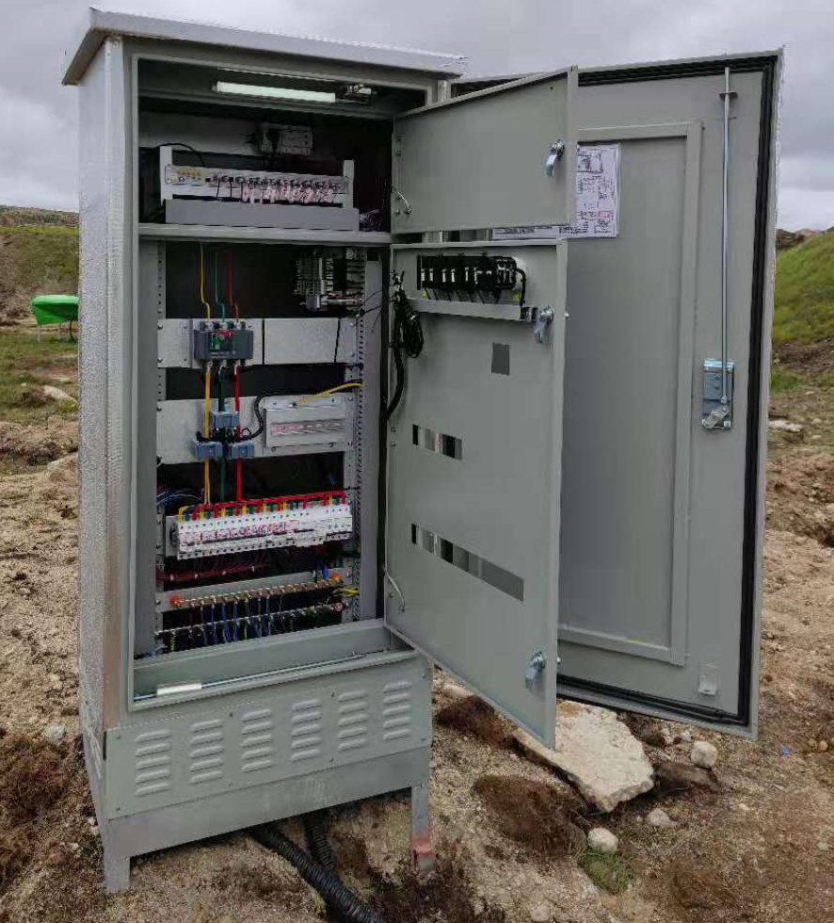
WR deployment
L3 WRS in the rack
WR nodes are embedded inside the detector
photoelectric composite cables used for detector
  220V AC power + 3 fiber (1used, 2 spare)
4-core fiber from L3 WRS to 1#HUT
  1 used for WR Uplink (port1)
  1 used for Management
  2 spare
Detector
(FEE inside)
Outdoor Rack

Slide 25
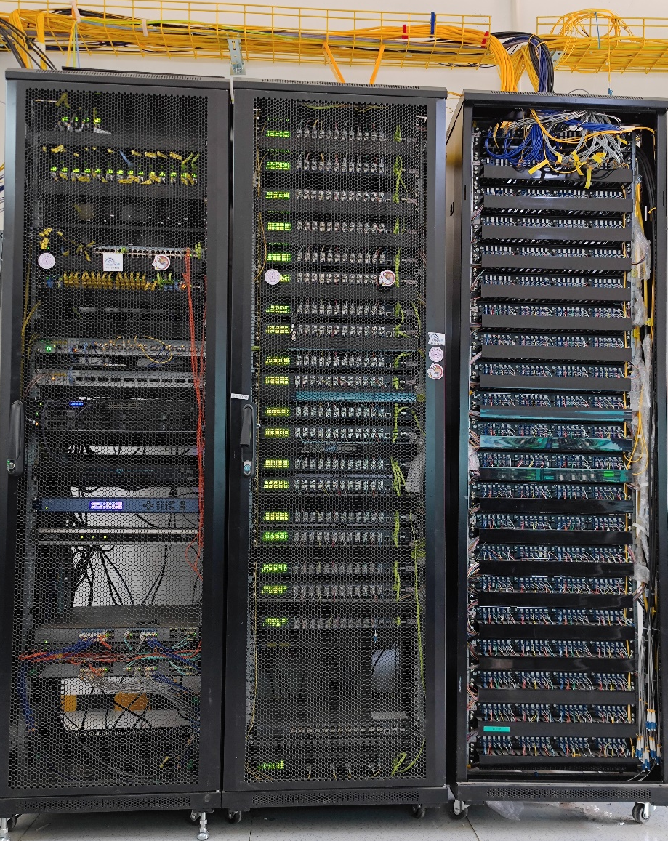
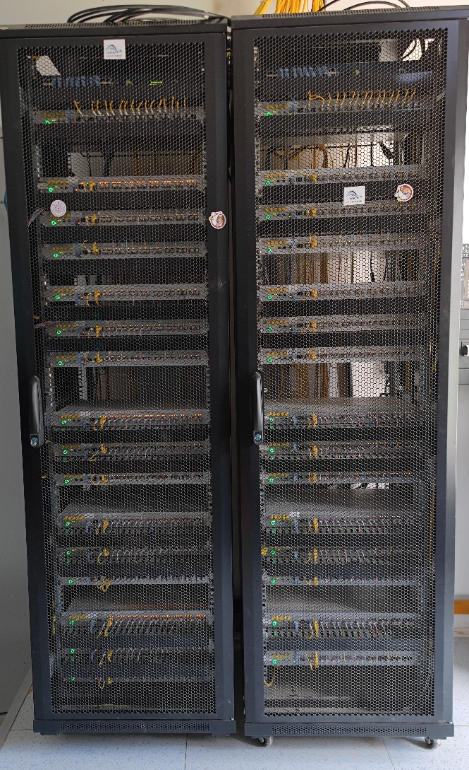
WR in 1#HUT
Cable tray for inter-connection
SYS rack
MNG rack
ODF rack
WRS-A
WRS-B

Slide 26
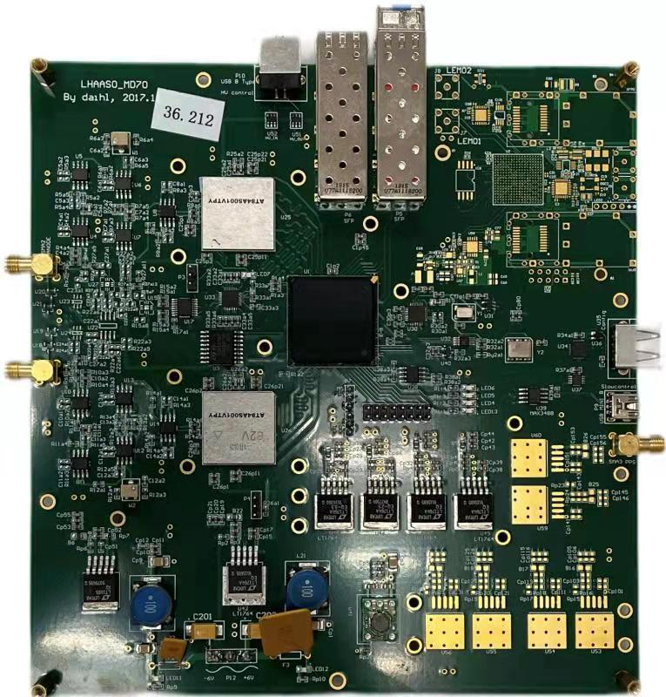
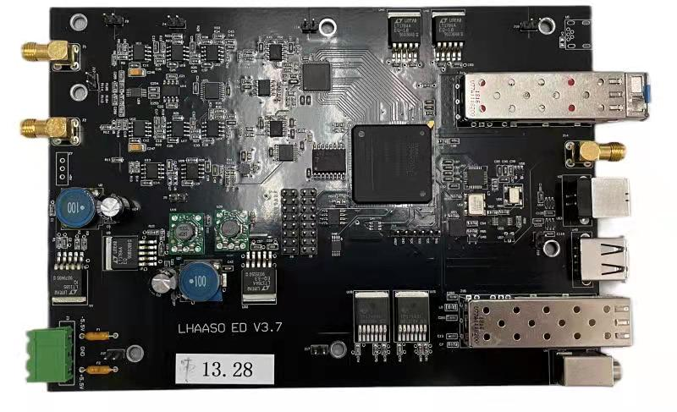
WR integrated in detector FEE
WRPC intergraded inside the detector electronics
  Save the cost for additional connector and FPGA
  Simplify the interface and protocol
  Calibration required when the detector logic changes
  Additional constrains added for the project
WR support circuit
MD electronics
ED electronics

Slide 27
Outline
WR applications

Slide 28

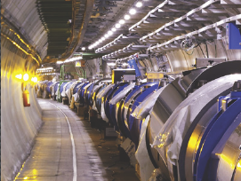
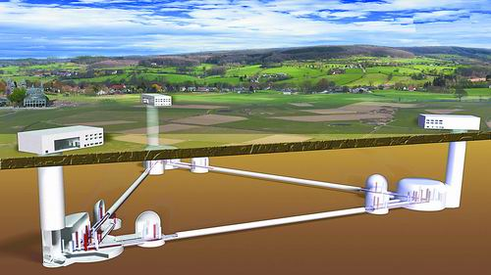



WR applications in HEP
SKA
LHC
Einstein telescope
KM3NET
JUNO
SHINE

Slide 29




WR application in PET instrument
MR-compatible brain PET insert with DOI and TOF capability.
Full digitized front-end
WR based coincidence
CUTE-WR
FEB
DPB
ADB
BMB
PWB

Slide 30
WR potential applications
Science
  Time and frequency, metrology
  Radio astronomy，incoherent scattering radar，VLBI
  Fast trigger and control
Military
  Electronics warfare, beam forming
  Multi-static radar ， synthetic aperture radar
  Adaptive antenna array
Industry
  Distributed base stations, 5G BBU&RRU
  3D mapping, 3D imaging
  Stereo vision，radio positioning
  Power grid synchronization
  Finance, data center, stock exchange
  Time based control and measurement

Slide 31
Outline
WR standardization

Slide 32
IEEE1588 standard revision
New IEEE-1588 standard published in mid-2019
WR became High Accuracy profile of IEEE1588-2019

Slide 33

Q&A
Thank You !

