Slide 1

Pixel Readout Chip Development for the High Energy Photon Source
Wei Wei
Institute of High Energy Physics, CAS
State Key Laboratory of Particle Detection and Electronics
On behalf of the detector design team
2023-10-24

Slide 2
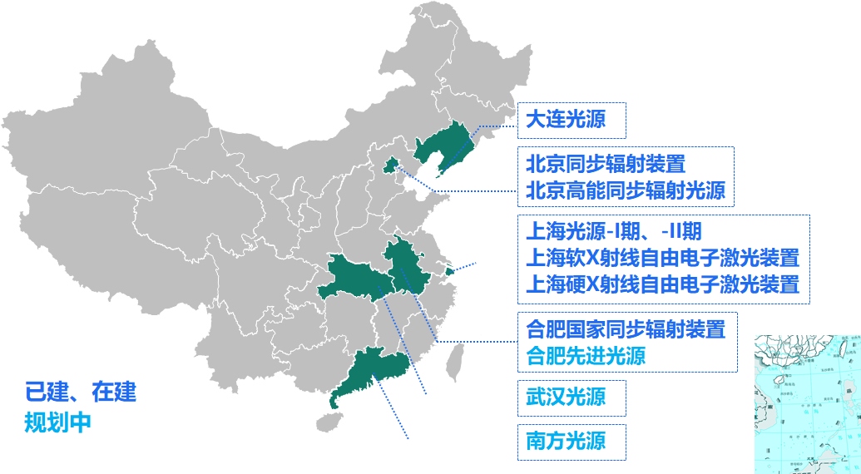
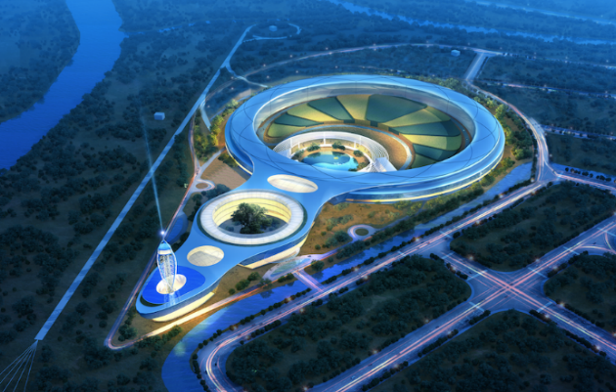
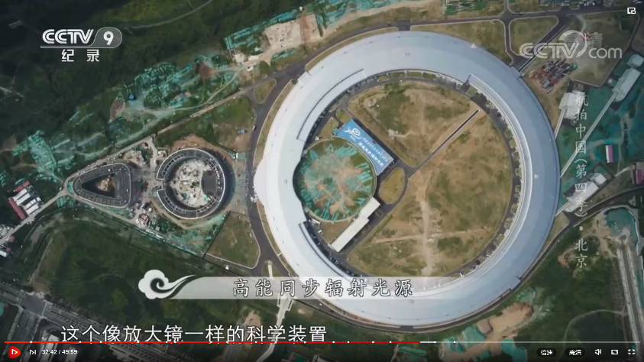
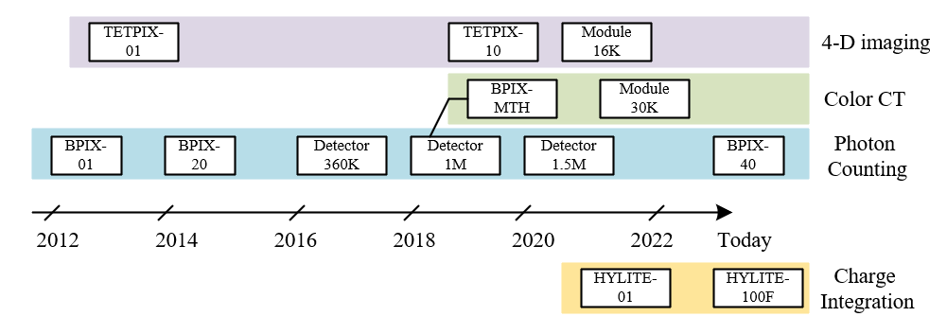
Background & outlook
The photon counting detector for light sources
The charge integration detector for XFEL
Spin-off directions
  Medical imaging on Multi-th
  4-D imaging on TOT

Slide 3
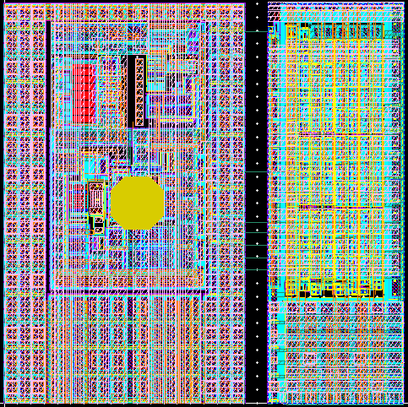
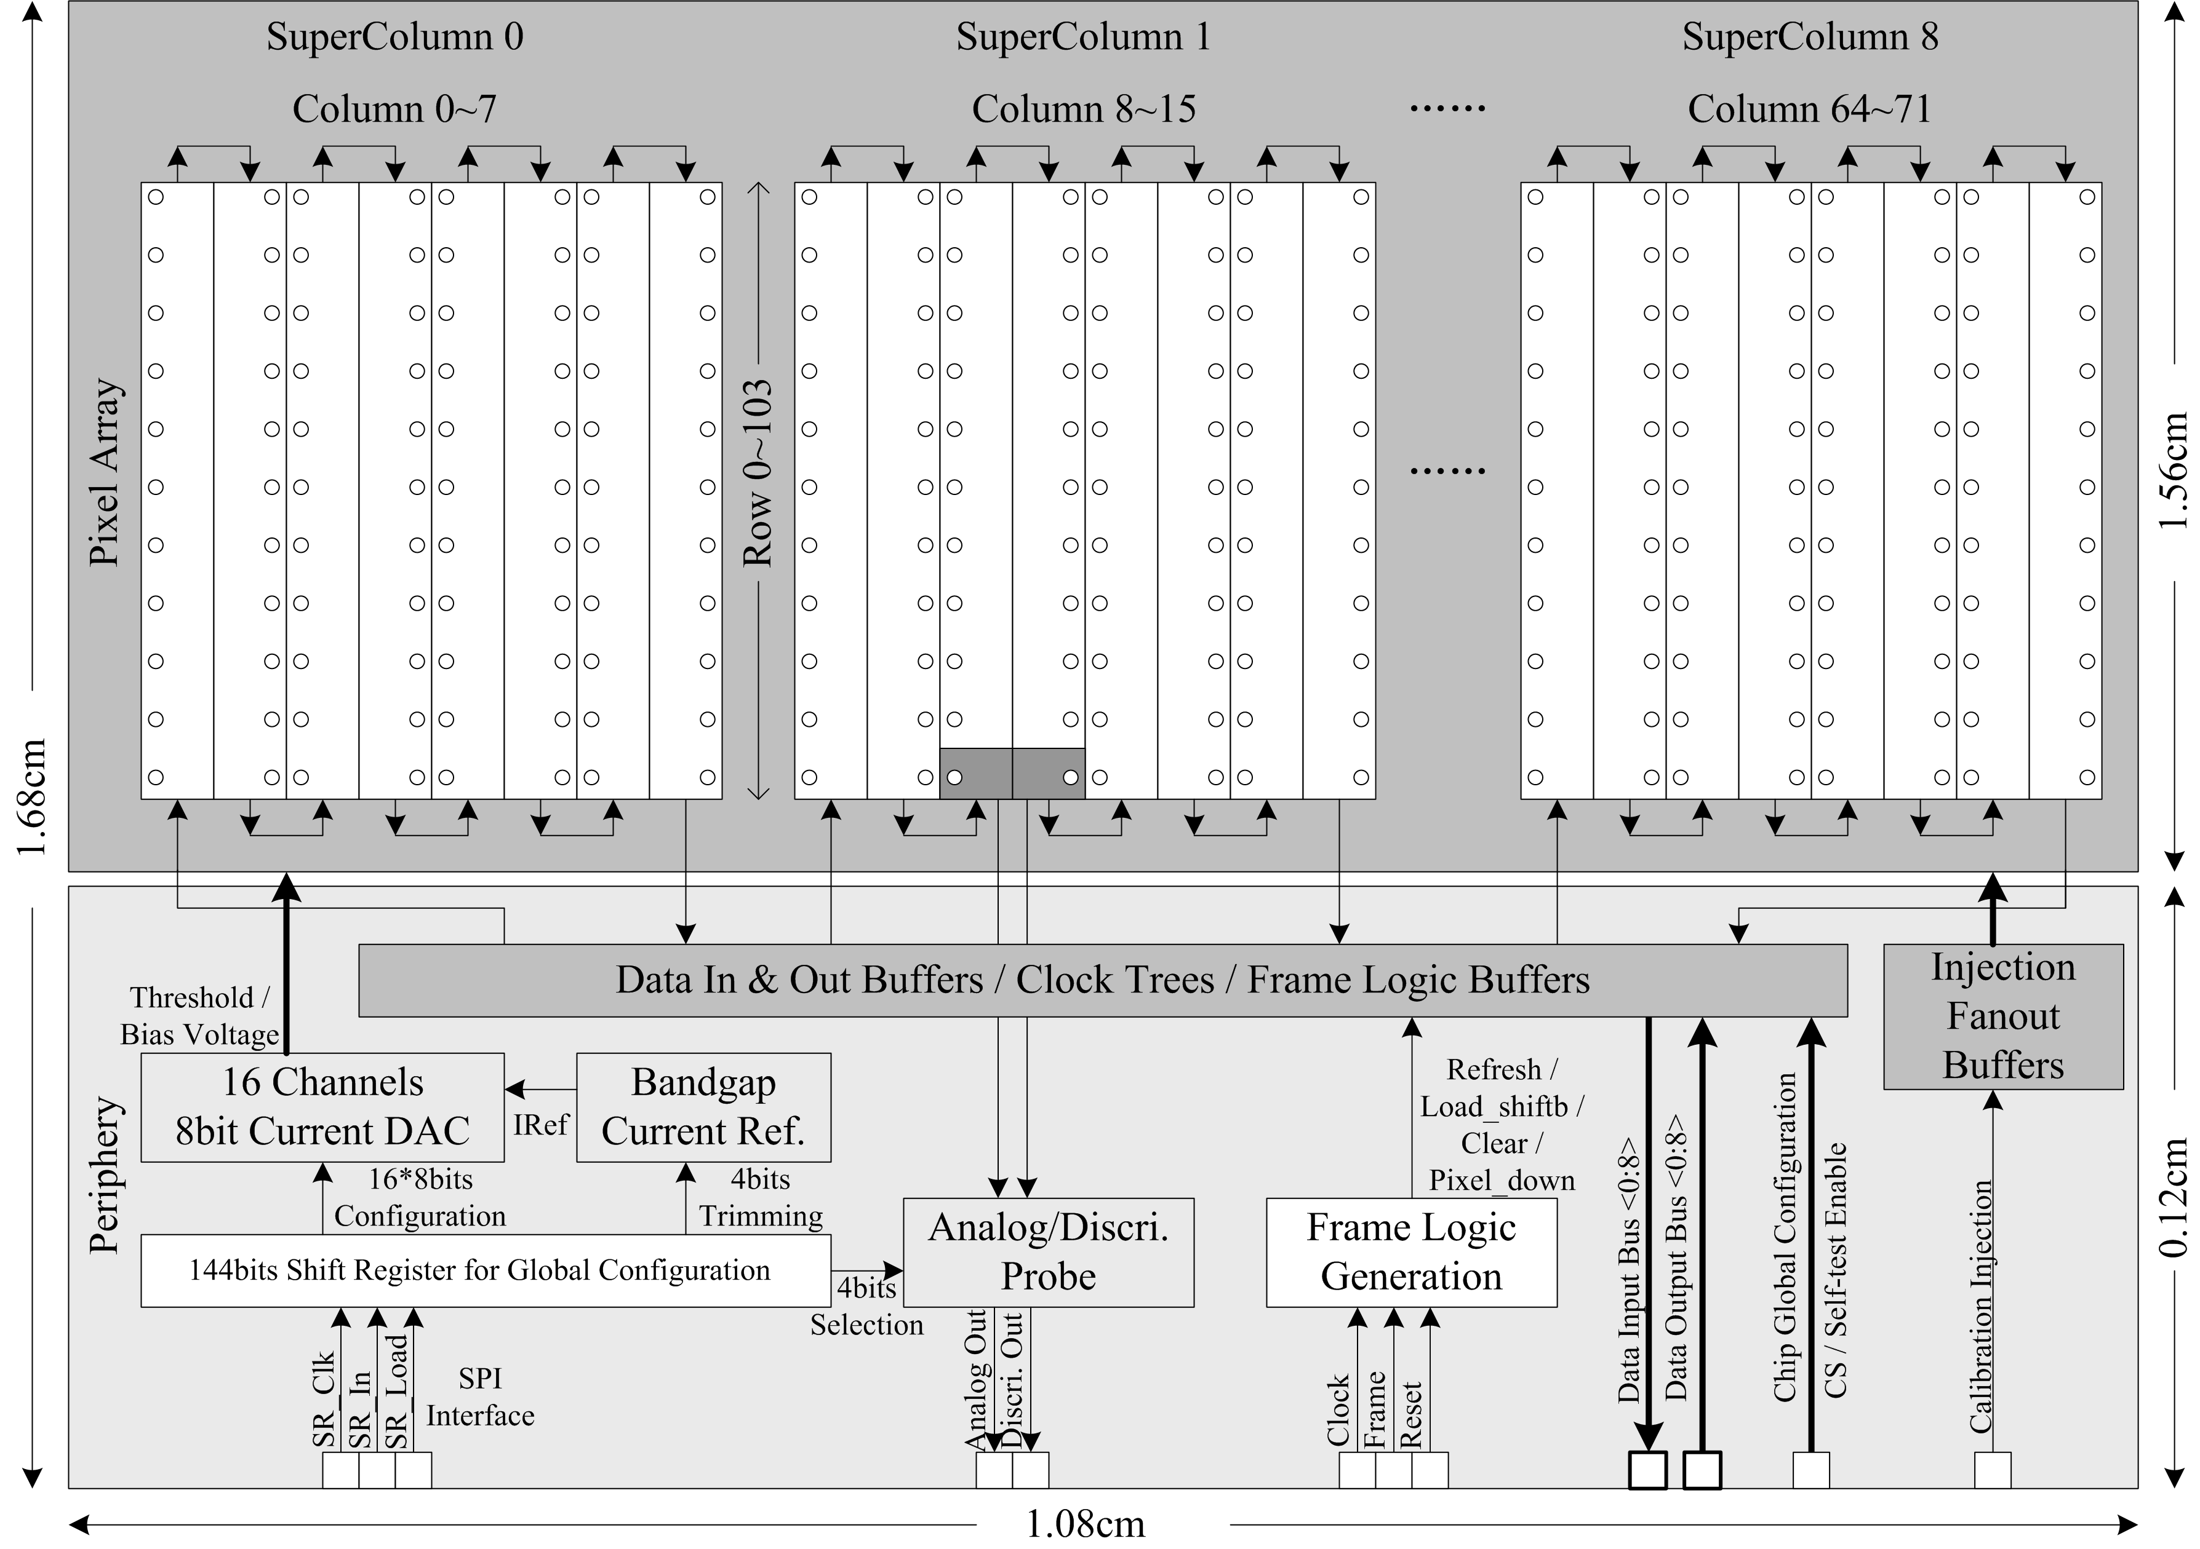
Photon counting detector for the High Energy Photon Source (HEPS)
Specs | Parameters
Sensor | 320um silicon PIN
Pixel size | 150umX150um
Pixels | 104X72
Counting rate | >2Mcps/pixel
Counting Depth | 20bit
Frame rate | 1.2kHz continuous
Energy range | 8-20keV
Threshold | Single threshold
Detector Module | 2X4 chips (208X288 pixels)
Power | 38μW/Pixel
BPIX-20 photon counting chip for HEPS
CMOS 0.13μm, 1P8M
3 MPWs and 1 full mask tapeout
  2012.5 ~ 2014.8
The full chip measures 1.7cm*1.1cm
Layout of a pixel 150μm×150μm

Slide 4
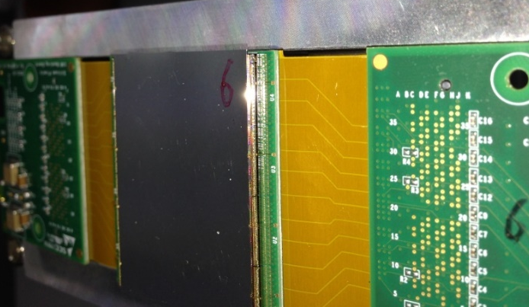
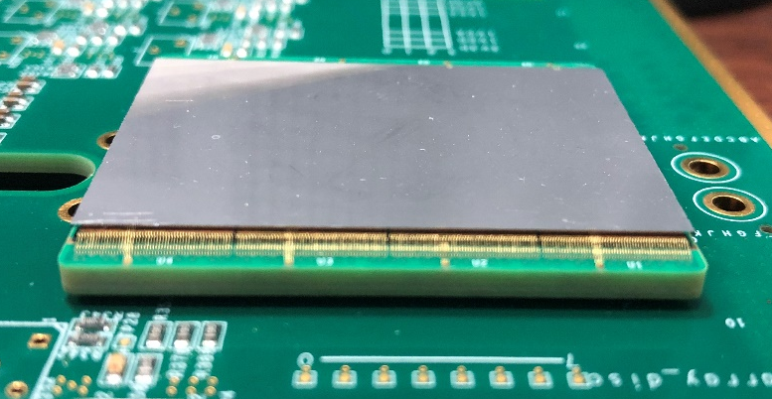
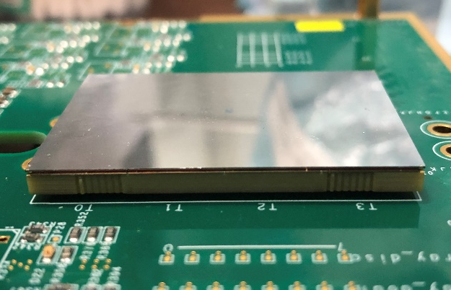
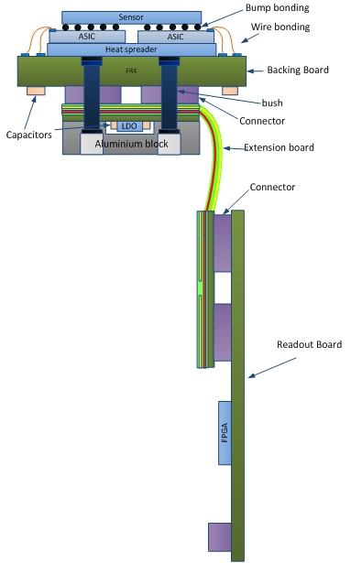
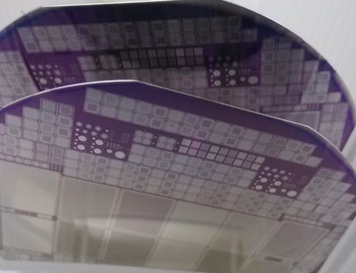
Module assembly evolution
Indium bump bonding module for the 1st prototype
CuSn bump bonding module for the 2nd prototype
Bump bonding + TSV module for the 3rd prototype
Sensor, packaging, system electronics and cooling are all self-developed
Module assembly was evolved in three generation of prototype systems:
  In bump used for the 1st, nice yield but low productivity
    Low temperature in the full product flow was an issue
  CuSn bump for the 2nd, high productivity for mass production, and high temperature compatible
  TSV features added in the 3rd to eliminate the wire bonding, for smaller module assembly gaps
Self-developed Silicon Sensor

Slide 5
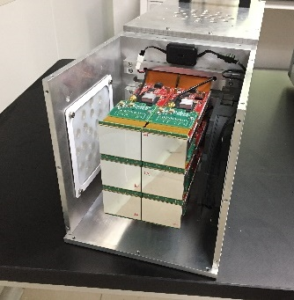
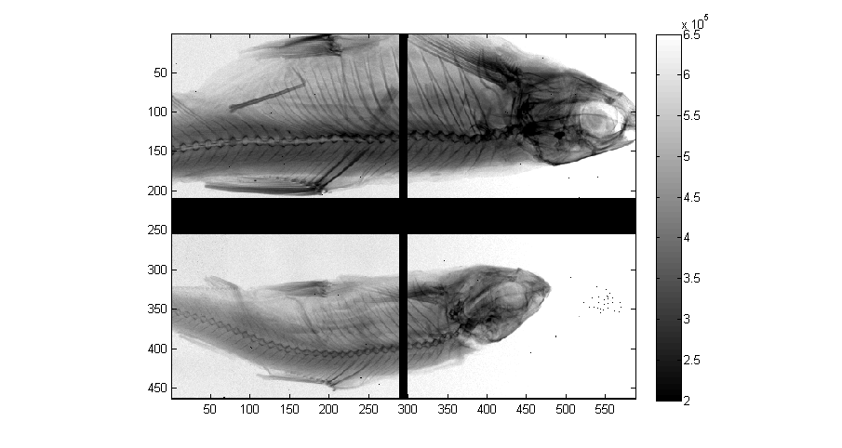
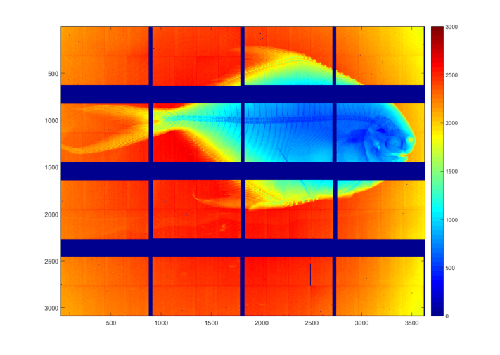
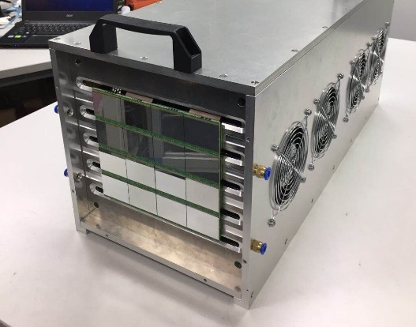
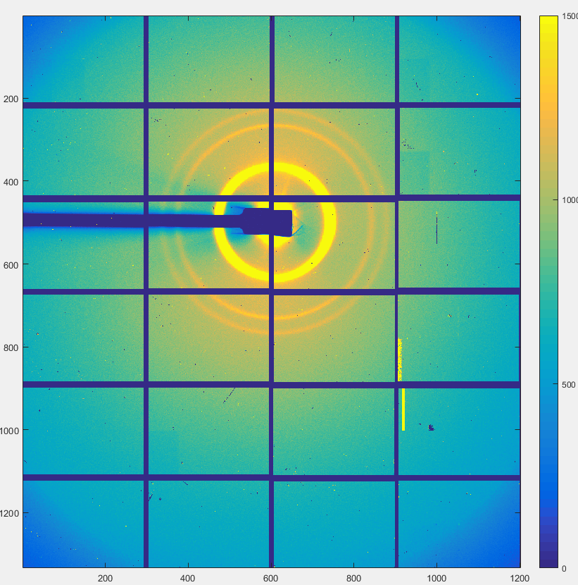
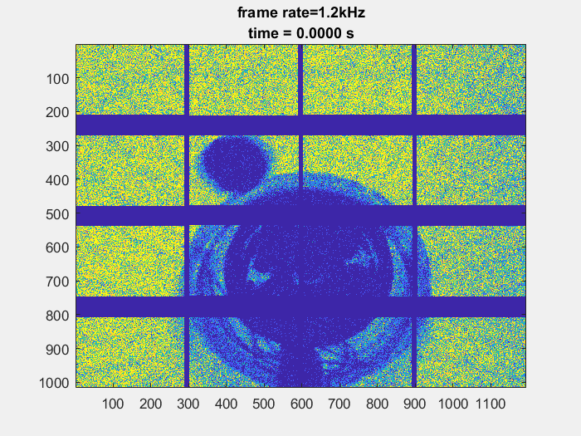
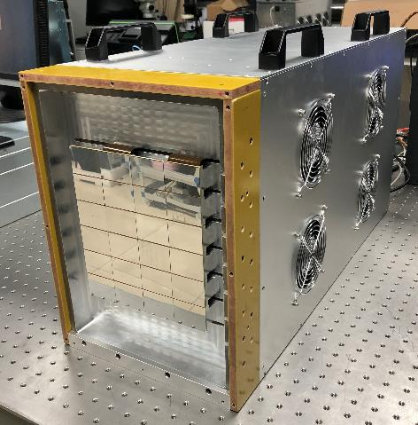
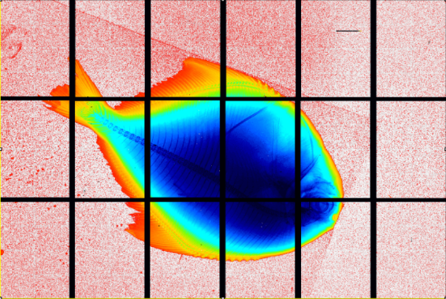
Prototype systems evolution
 | 1st BPIX (2015-2016） | 2nd BPIX (2017-2018) | 3rd BPIX (2019-now)
Modules | 6 | 16 | 24
Pixels | 360K | 1M | 1.5M
Packaging | Wire bonding | Wire bonding | Through Silicon Via (TSV)
Dead zone | 26.3% | 26.3% | 11.8%
Backend Readout | Spartan6 + SFP | Kintex7 + DDR3 + Nano-Pitch I/OTM | Kintex7 + DDR3 + Nano-Pitch I/OTM UltraScale Plus Kintex + NVMe SSD
DAQ interface | 1G Ethernet x12 | 1/10 G Ethernet x4 | 40G Ethernet
Power@1.2kHz | 100W | 370W | ~500W

Slide 6
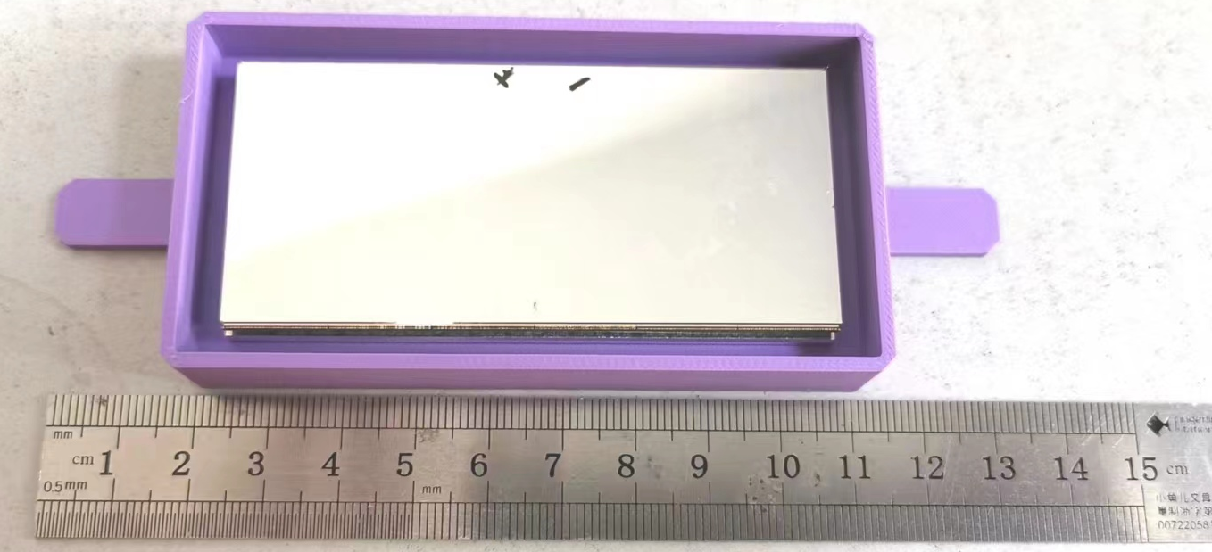
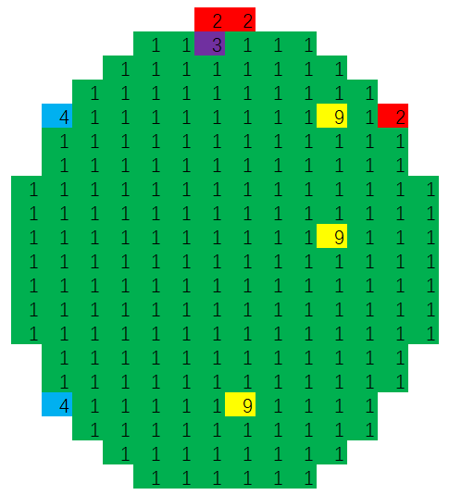
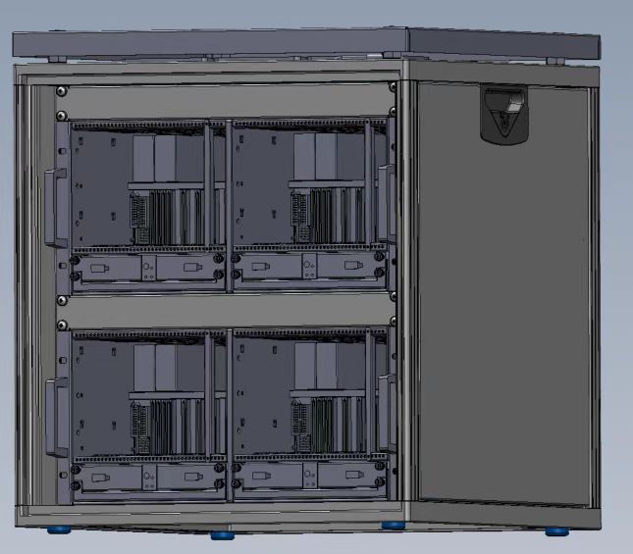
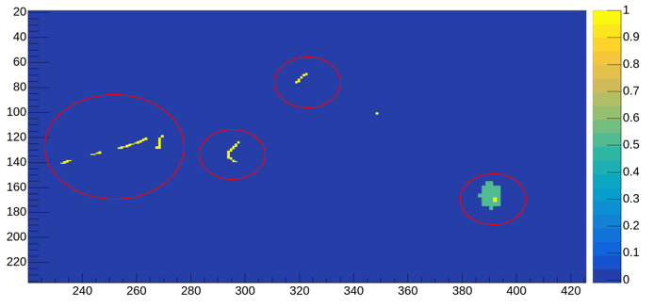
BPIX40: the new upgrade of the pixel chip
Specs | BPIX-20 | BPIX-40
Pixel size | 150μmX150μm | 140μmX140μm
Pixel Array | 104X72 | 128X96
Threshold | 1 | 2
Gain | Fixed | 2 bits tunable
Counting rate | > 2Mcps | > 2Mcps @ Med gain
Frame rate | 1.2kHz | 2kHz
Counting Depth | 20 bit | 14 bit
Detector Module | 2X4 (208X288) | 2X6 (256X576)
Module Gap | 3mm by TSV | 2.7mm by WB
Preliminary
A 6M system will be assembled for the HEPS before 2025
A series of detector different dimension (2M/1M …) also scheduled
yield of a 12-inch wafer
> 95%

Slide 7
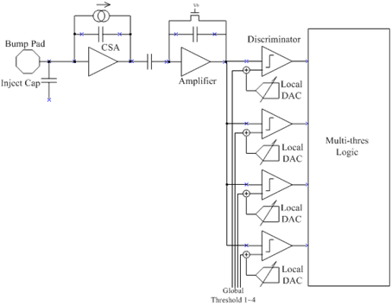
A multi-threshold ver. for high energy X-ray and medical imaging
Specs | Parameters
Sensor | Si / CdTe / CZT / GaAs compatible
Pixel size | 150μmX150μm
Pixel Array | 104 X 72
Threshold | 4
Frame rate | 1.2kHz (continuous readout)
Counting rate | 1×10⁸cps/mm²
Detector Module | 1mm-thick CdTe with 2×2 ASIC (144 ×208)
A variation of BPIX20 with 4 thresholds
Extended to high energy X-ray detection
Spin-off to medical imaging applications (Photon Counting CT)

Slide 8
X-ray imaging of the module
X-ray Imaging at 100kV 200μA

Slide 9
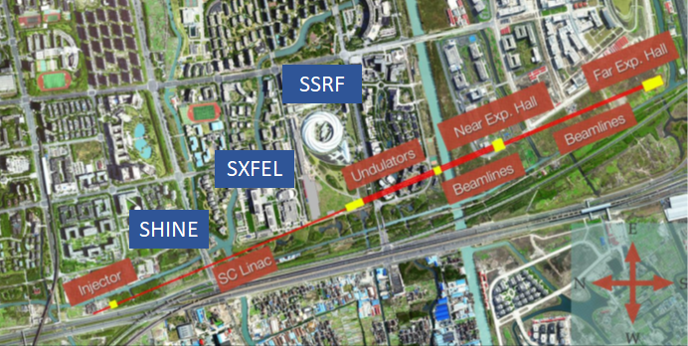
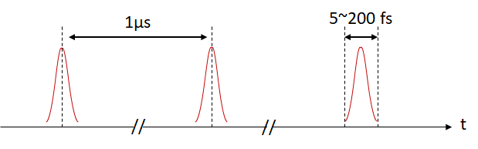
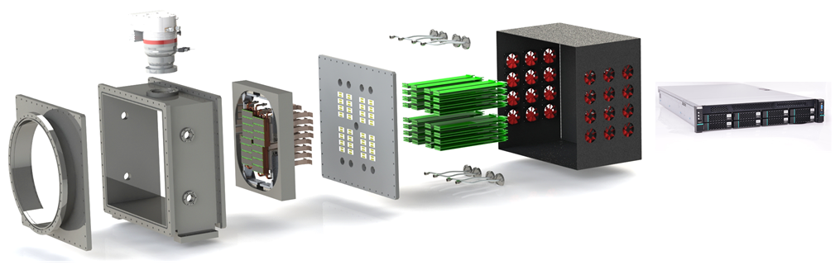
HYLITE for the SHINE beamline
HYLITE (High dYmamic range free electron Laser Imaging deTEctor)
  A charge-integration pixel detector readout chip for SHINE
Specs | Parameters
Sensor | 320um silicon PIN
Pixel size | 100μmX100μm
Pixel Array | 128 X 128
Dynamic range | 1~10000 photons @12 keV
Frame rate | 10kHz (continuous readout)
Detector | A 4M pixel detector in vaccum, quadrant movable
Shanghai HIgh repetition rate XFEL aNd Extreme light facility (SHINE)
Photon Energy: 0.4~25 keV
Pulse Duration: 20~50 fs (5~200 fs)
Repetition Frequency: 10kHz (1MHz)
Peak Brightness: 10³² ~10³³ photons/μm²/rad²/s/0.1%BW

Slide 10
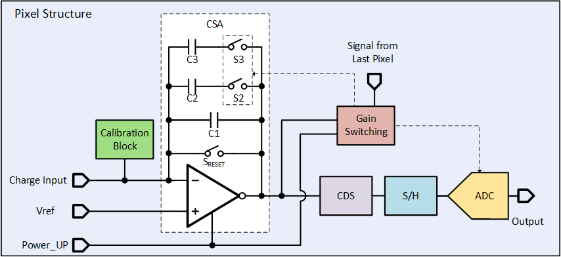
Pixel architecture of HYLITE
Working in Pump-Probe mode, sync-ed with the beamline
Three Gains
  Auto Gain Switching
Three Working Phases
  Analog Phase (less than 1 μs)
  Conversion Phase (20 μs)
  Readout Phase (~70 μs in full size chip)
Power down feature involved
  Total average power: 34 μW/pixel
    Analog：21.96 μW
    Digital：14.76 μW

Slide 11
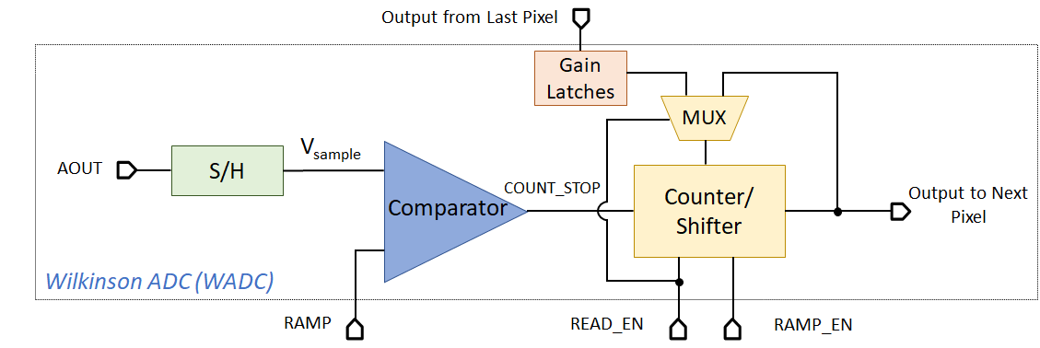
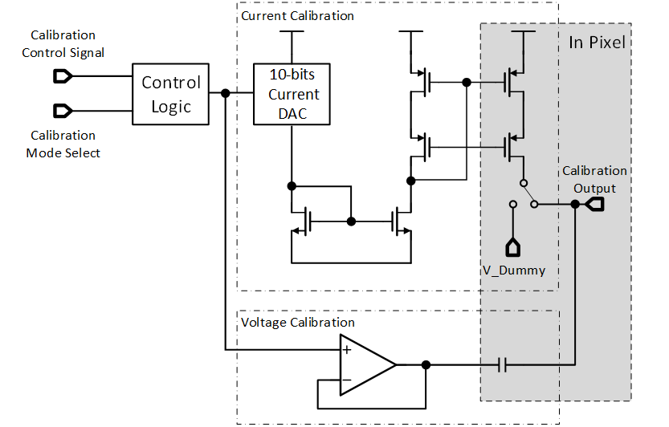
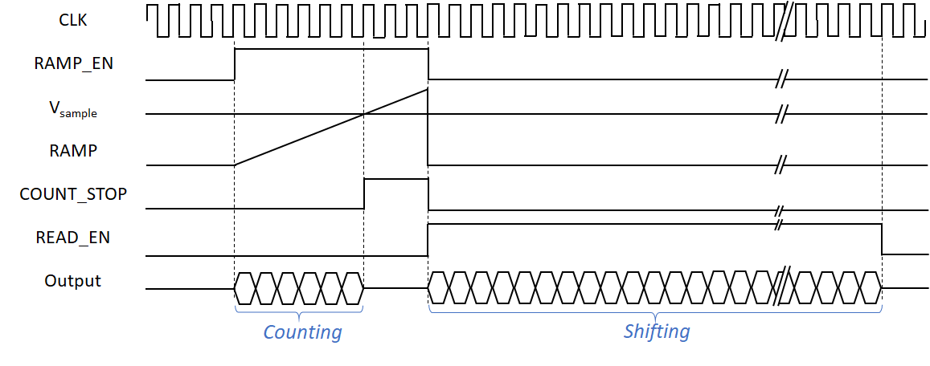
Pixel analog circuit – ADC & calibration
Covers full dynamic range of 10000 photons @12 keV
Voltage Mode by pulse generator
  High linearity for small input
  1~150 photons coverage
Current Mode by variable pulse width
  Full coverage but lose small input
  100 ~10000 photons coverage
A 10-bit Wilkinson ADC in every pixel
Counter of ADC based on LFSR located in pixel, reused as a SR during the readout phase
Only the 62.5MHz count clock and common ramp are fanned out to the matrix

Slide 12
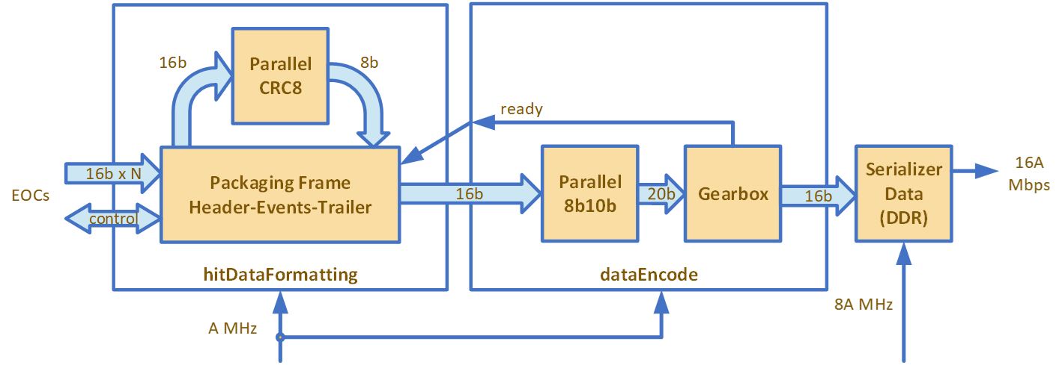
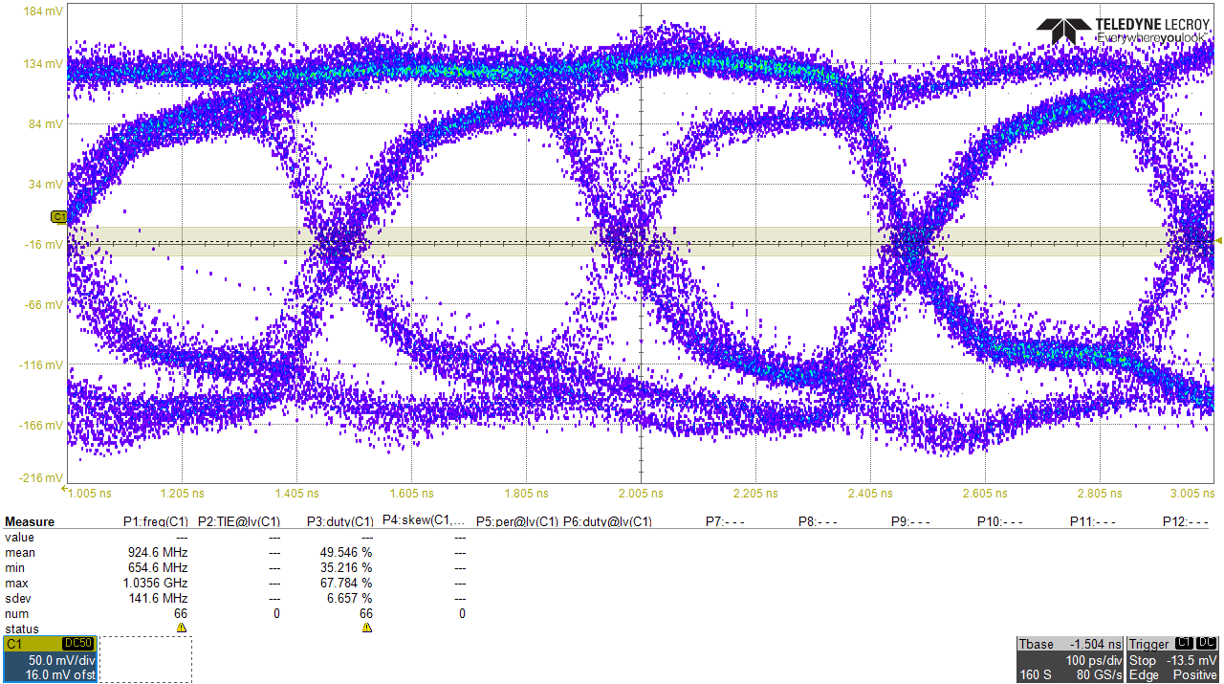
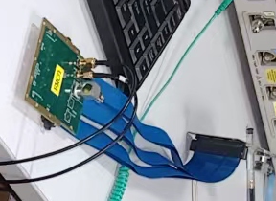
Aurora 8b10b high speed data link
Challenge from the system level
  The detector module will be in vacuum – adding extra cable length to backend
  Typical quadrant movable requirement ask to be longer
Aurora 8b/10b compatible serial link designed
  2 x 2 Gbps DDR link per chip
CML drivability via a 1.6m SAMTEC cable verified till 3.2Gbps per port
The full data rate of a 4M pixel system reaches 625Gbps
Eyediagram after 1.6m transmission
@ 2Gbps

Slide 13
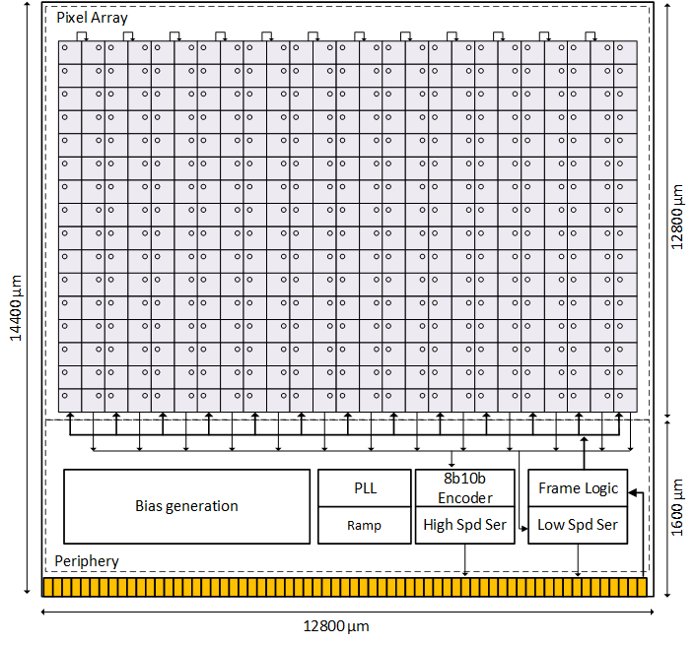
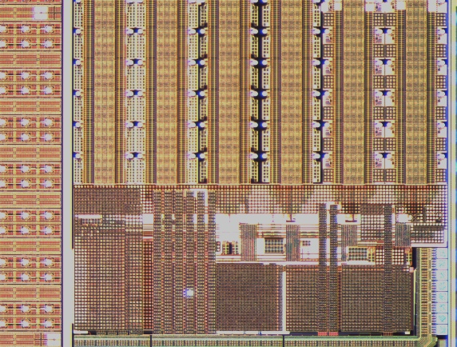
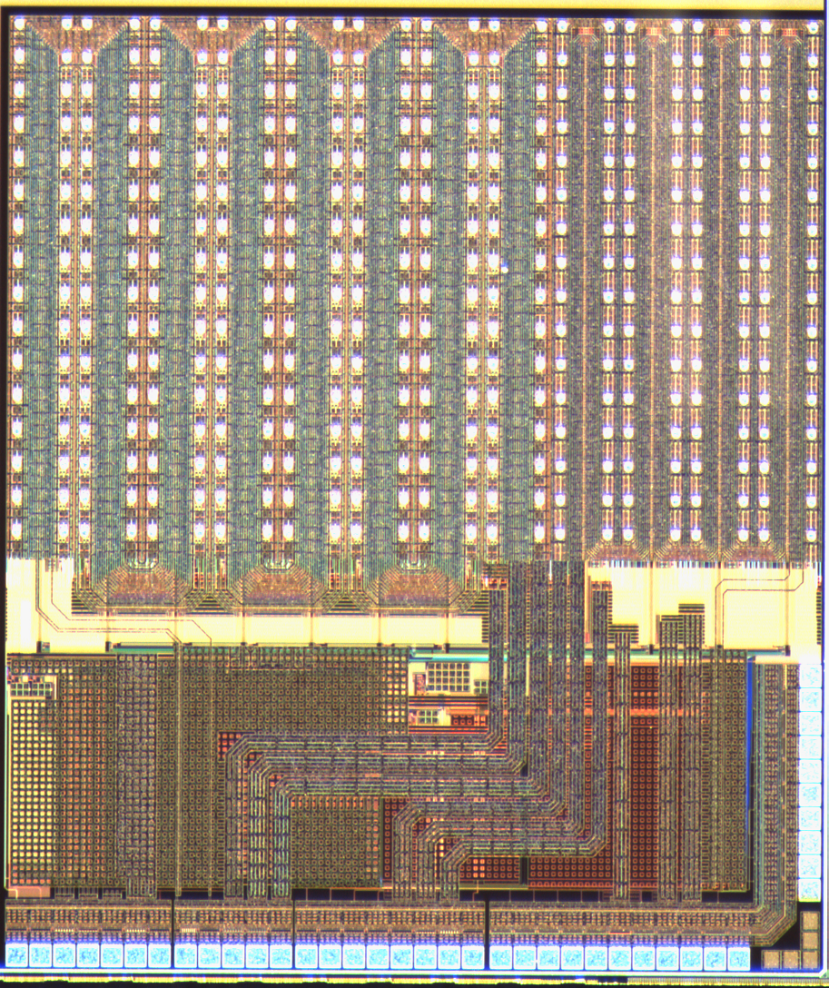
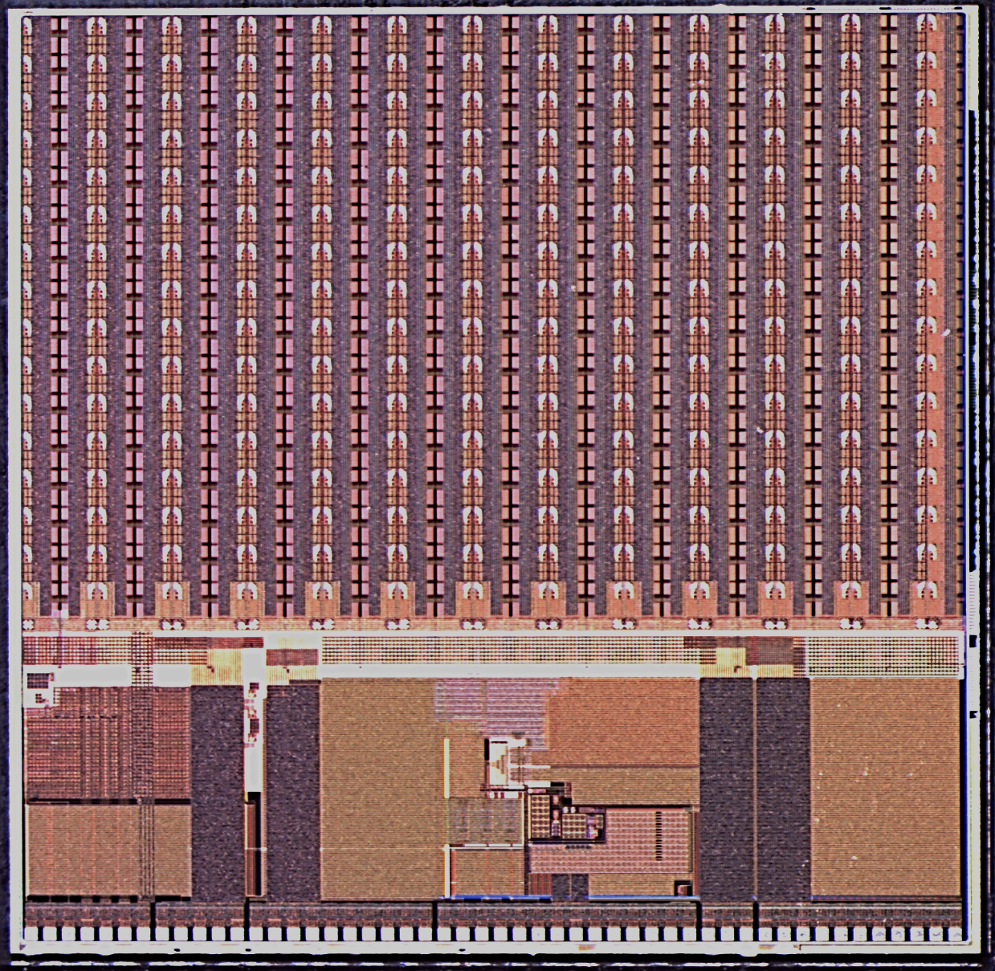
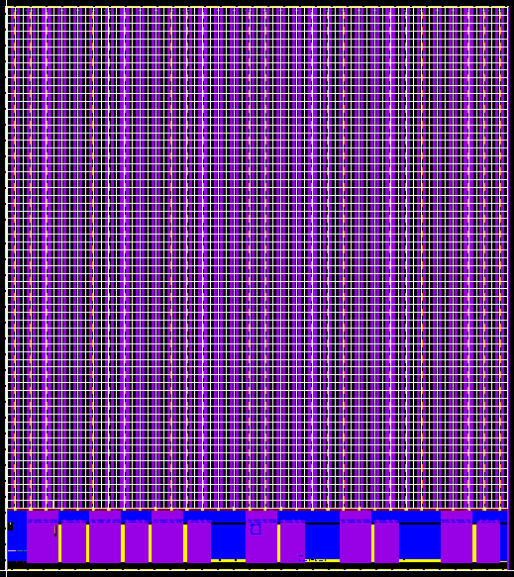
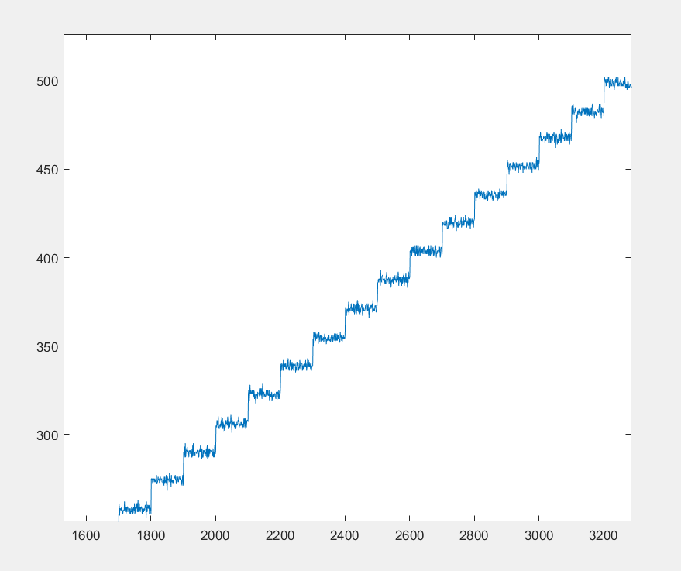
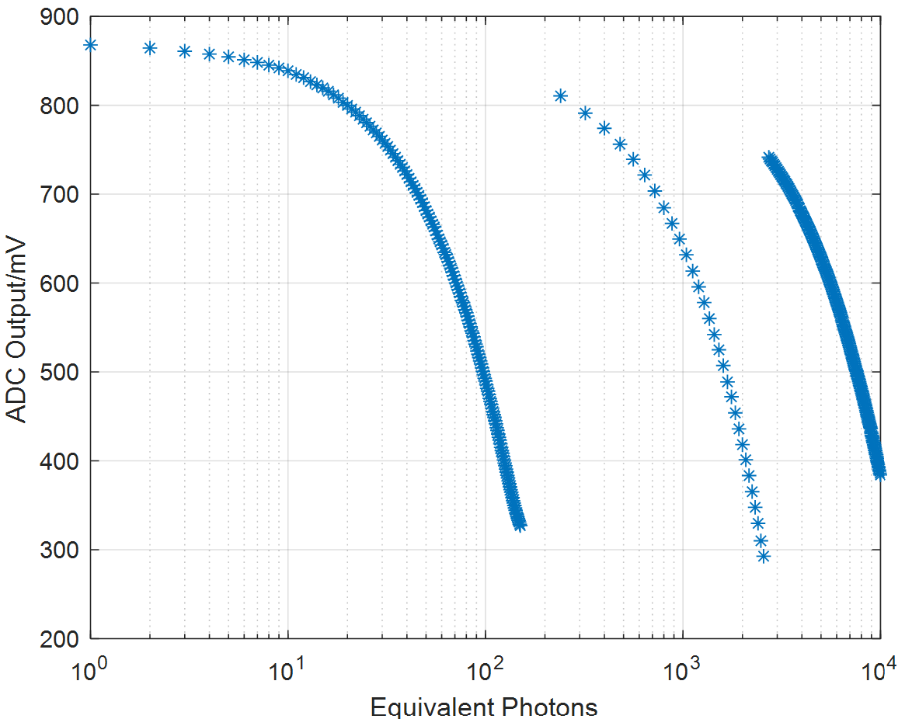
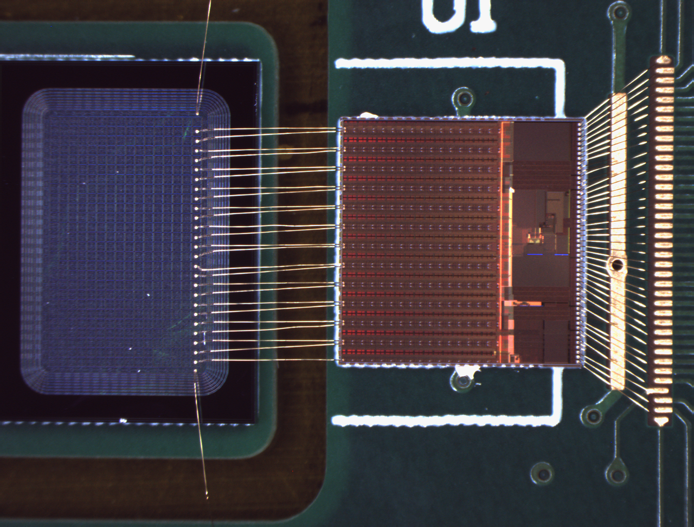
Chip overview
HYLITE0.1
(2020.10)
HYLITE0.2
(2021.4)
HYLITE200S
(2022.2)
HYLITE200F
(Full mask 2023.3)
CMOS 130nm 1P8M
Final full mask tapeout will be submitted in Oct 2023
A detector module will be 2x8 ASIC, measures 2.7cm x 10cm
Single photon S/N@high gain ~9.3
10⁴ dynamic range by self-calibration

Slide 14
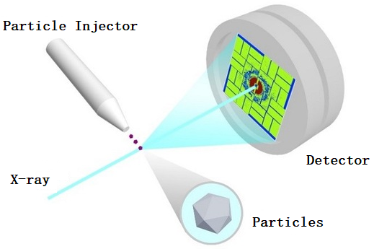
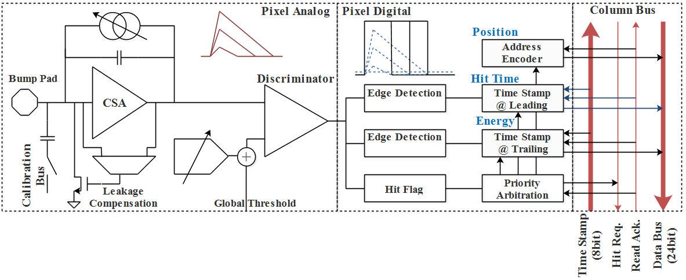
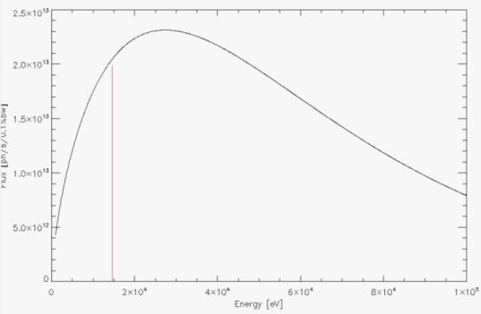
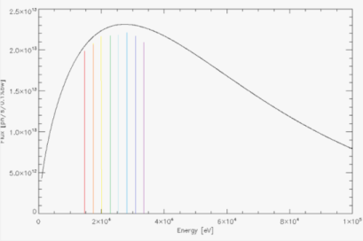
TETPIX for sparsified 4-D imaging
Specs | Parameters
Mode | 4-D detection by TOT (x-y, TOA, Energy)
Pixel size | 150μmX150μm
Pixel Matrix | 64X32
Energy resolution | < 2keV
Time resolution | 20ns
Readout scheme | Event-driven
Counting rate | 2.4kHz/pixel
Date length | 32bits/hit
Prototype Module | 128X128
Time-of-arrival and energy of every photon measured by TOT
New methodology for X-ray and neutron imaging
  Conventional: monochrome light + single photon counting
  New idea: wide band/pink light + 4D imaging
  Greatly improve the efficiency
    Multiple experiments by monochrome → single experiment/ single pulse by pink
Another way to satisfy the dynamic experiment

Slide 15
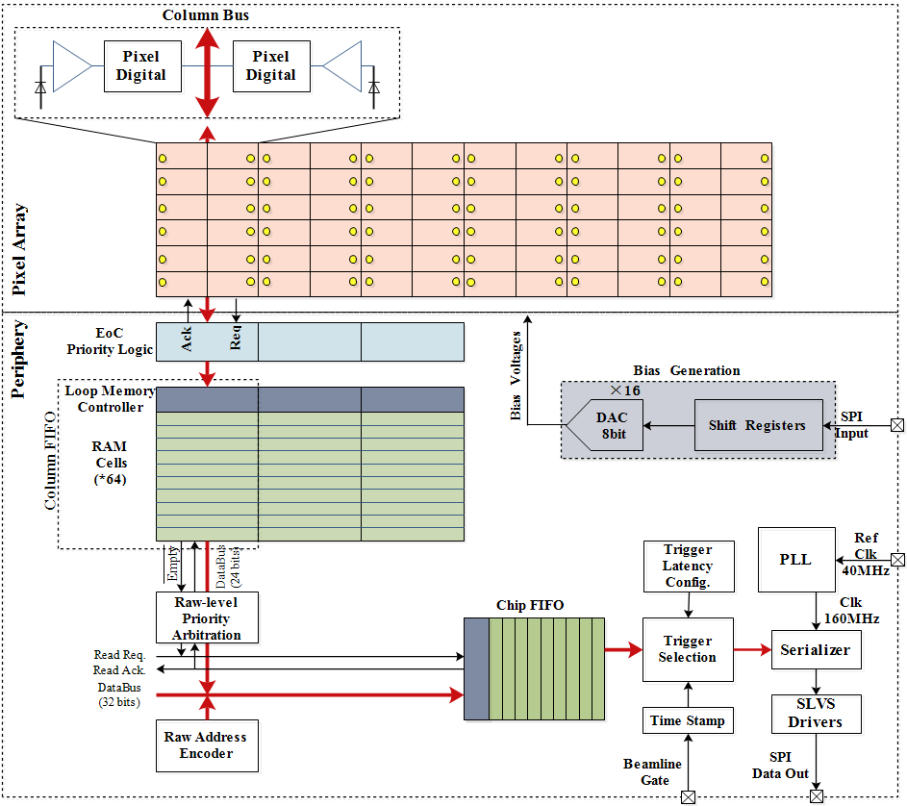
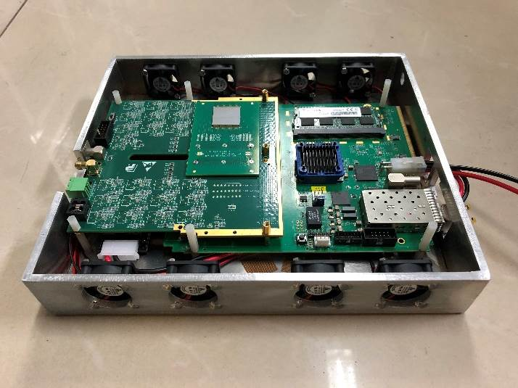
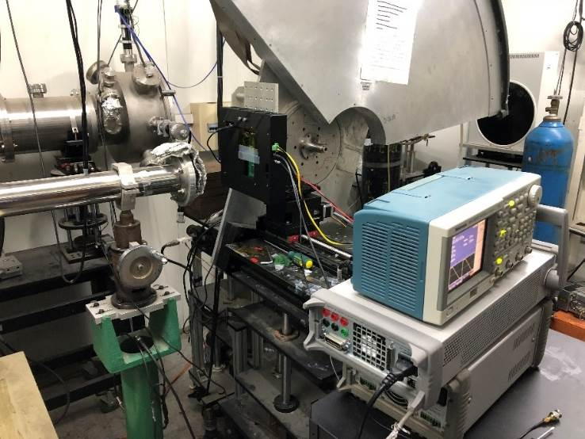
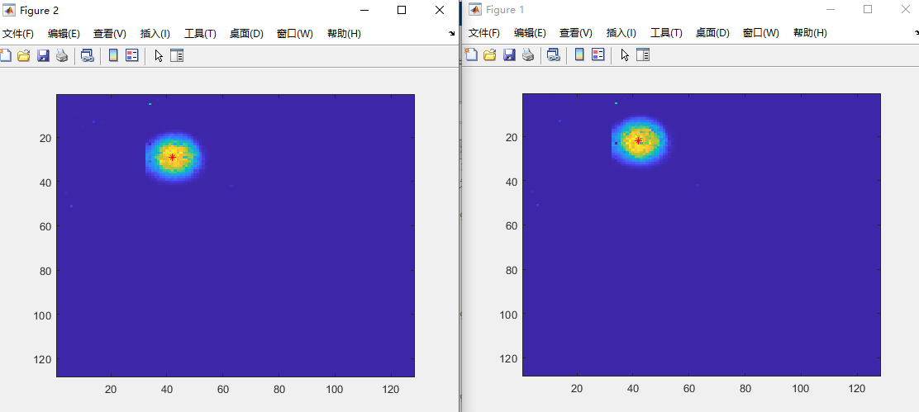
TETPIX for sparsified 4-D imaging
Hits are readout by the column-drain architecture, event-driven readout implemented
  Hits at the same column same time are sequentially readout by priority arbitration logic
    1.5 clk per hit
  Two levels of FIFO were designed for high counting rate
    L1 FIFO: In column level, to de-randomize the hit
    L2 FIFO: Chip level, to match the in/out data rate between the core and interface

Slide 16




Test results of the TETPIX detector

Slide 17


Future development
HEPS Phase I with 14 beamlines in 2025
  BPIX systems are forseen to be equiped with 6M, 2M, 1M, & 150K variants
  Ultra high frame rate detector & high energy variants are in development
The first prototype system for SHINE will also be delivered in 2026
  Frame rate of 10kHz continuous integration as the first milestone
  Will seek more possibility for the rest beamlines
HEPS Phase II, SAPS, and other beamlines of the XFEL are the future goal
  HEPS Phase II is scheduled with 70 beamlines
  SAPS (Southern Advanced Photon Source) beside CSNS (China Spallation Neutron Source) is being discussed but due to be constructed
CSNS & SAPS

Slide 18
Thank you！

Slide 19



HEPS-BPIX Chip Architecture
A BPIX Chip contains：
  104 x 72 pixel array
  Periphery
    16chn 8bit DAC
    Bandgap
    Readout & Control
  Measures 1.7cm*1.1cm
4 MPWs and 1 full mask tapeout in 2 years
  2012.5 ~ 2014.8
Single pixel → 12*20 pixel array → 104*72 full size chip

Slide 20


HYLITE test result：noise
表9 等效输入噪声测试结果
S/N：2.80->9.31
Below the min Poisson noise in each gain stage
 | High/e⁻ | Med/e⁻ | Low/e⁻
HYLITE0.1-C1 | 1259.7(3.3k) | 1.9×10⁴ (4.2×10⁴) | 4.2×10⁴ (2.0×10⁵)
HYLITE0.1-C2 | 1160.3(3.3k) | 9.3×10³ (4.2×10⁴) | 3.1×10⁴ (1.5×10⁵)
HYLITE0.1-C3 | 1127.1(3.3k) | 1.6×10⁴ (4.2×10⁴) | 4.2×10⁴ (1.8×10⁵)
HYLITE200F | 355.9(3.3k) | 4.2×10³ (2.3×10⁴) | 1.8×10⁴ (1.3×10⁵)
ENC after A/D & readout

Slide 21




Bump bonding & TSV features
Wafer after TSV processed, top view with bumps, backside view with RDL
Cross-section view of a TSV connection
TSV with single-layer RDL
Cross-section view of a Bump Bonding +TSV 3D stack
TSV with double-layer RDL

Slide 22




Chip powering
A distributed powering network
  Power group of 2×8 pixels with local LDO
  IR-drop effect of such a large matrix and high power can be eased
    ~125mV vdd drop without LDO, very poor performance
  An extra 15μW/Pixel power was added
    Enough headroom earned
  Total power consumption: 50μW/Pixel
Implemented distributedly in 2×2 100-μm pixel (3 & 4)
Efficiency vs. integration time
Gain gradient suppressed by 68%

