Slide 1
The high-energy and high-brightness γ Synchrotron Radiation (γSR) and applications
The 2023 International Workshop on the High Energy Circular Electron Positron Collider
CEPC γSR working group

Slide 2
Outline
1
Introduction of CEPC
2
The high-energy high brightness γSR
2
3
The applications of the γSR
6

Slide 3
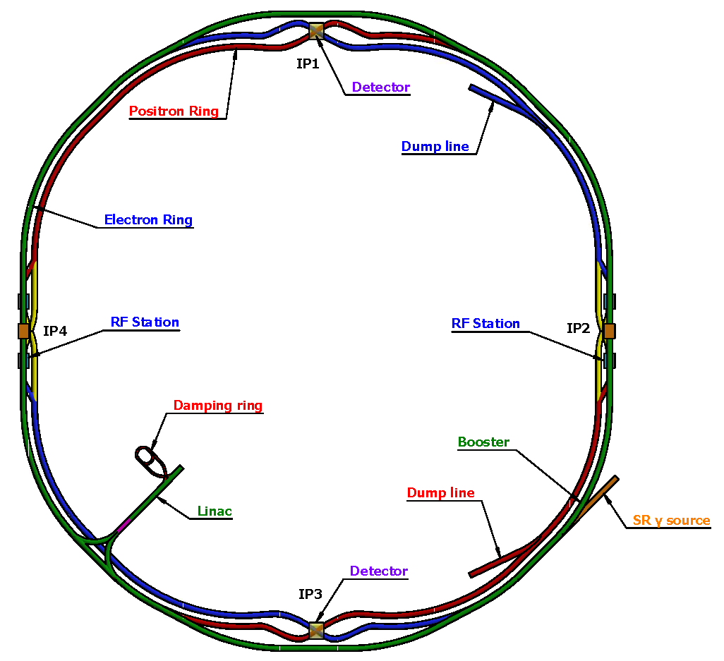
CEPC baselines layout
Wiggler parameters
B (T) | 2
Total length (m) | 0.32
Magnetic period Length (m) | 0.32
Period number | 1
Characteristic gamma energy (MeV) | 19.2
Bending magnet parameters
B (T) | 0.04
Length (m) | 20
Critical energy (keV) | 383
S1+S2:wiggler+ Bending magnet, in the same beam line
Notes:
Considering : radiation power, the baseline layout, the cost and the polarization for Z or W mode. If we add wiggler, it maybe useful for polarization, but increase the radiation power also the cost.

Slide 4
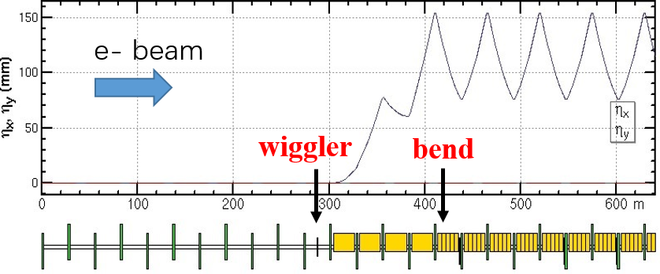
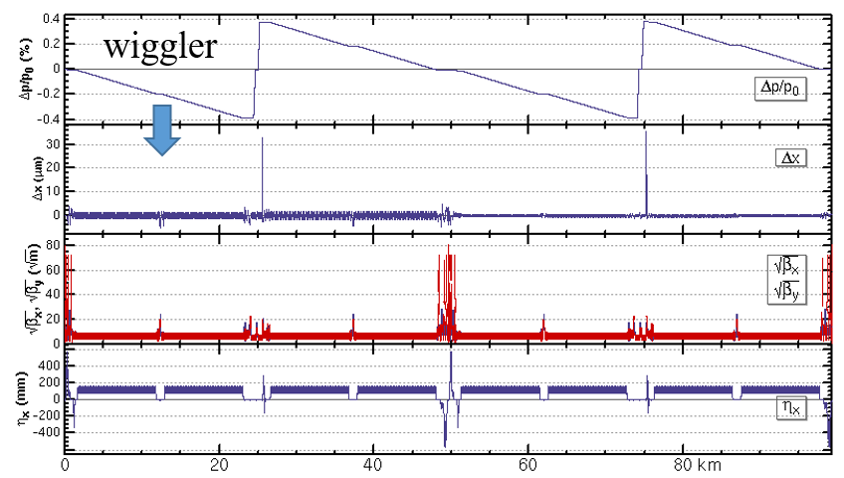
CEPC parameters and lattice
CEPC parameter
Energy (GeV) | 120
Current (mA) | 16.7
Circumference (km) | 100
Bunches | 268
Bunch length (mm) | 4.1
Coupling Constant | 0.2%
Nature Emittance (nm$∙rad$) | 0.64
Energy Spread | 0.17%
Twiss parameter $β_{x}(m)$ | 10
Twiss parameter $β_{y}(m)$ | 10/100
Twiss parameter $η_{x}(m)$ | 0.2
Twiss parameter $η_{y}(m)$ | 0
Twiss parameter $α_{x}(m)$ | 0
Twiss parameter $α_{y}(m)$ | 0
The orbit and optics with wiggler after tapering the magnets strength in the CEPC collider ring at Higgs energy.
Notes:
The bunch number: 0.68us the dynamic imagination, the time resolution
The bunch length:90ps: 2.72mm

Slide 5
Outline
1
Introduction of CEPC
2
The high-energy high brightness γSR
2
3
The applications of the γSR
6

Slide 6
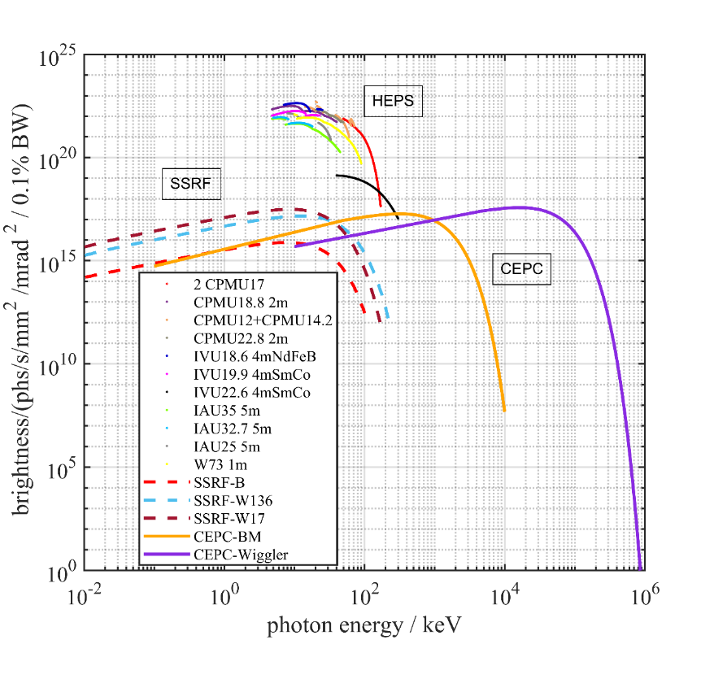
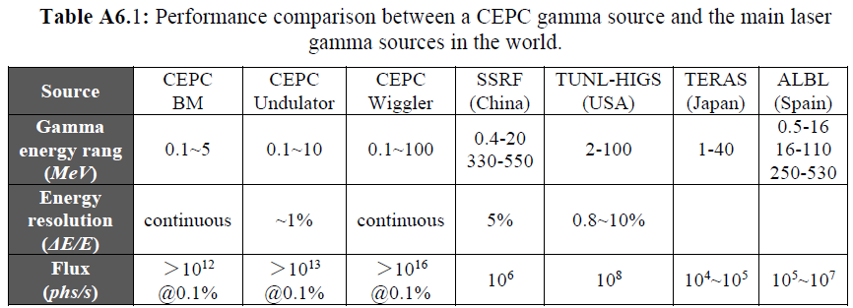
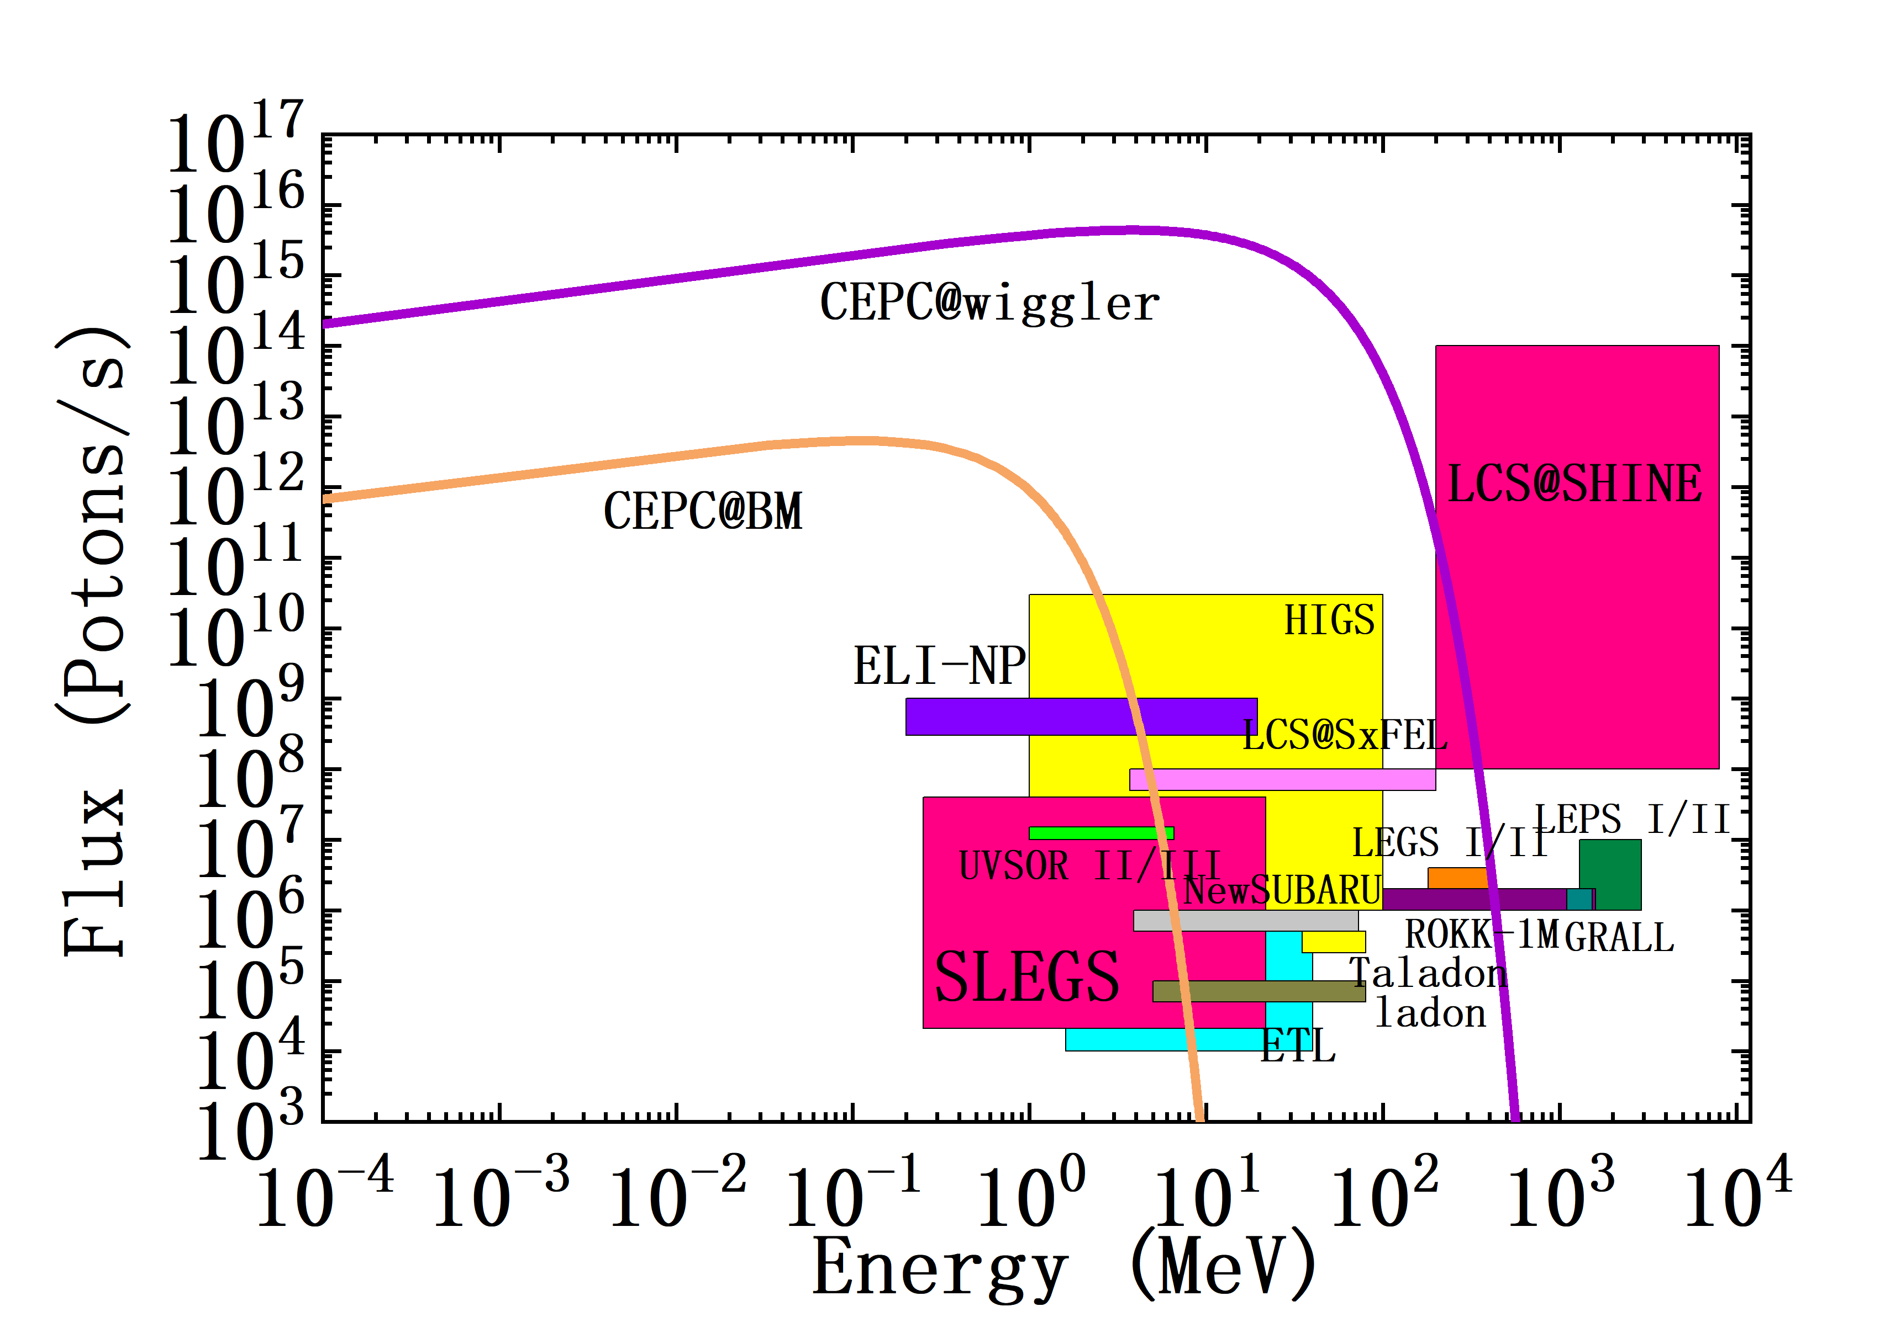
High energy, high brightness synchrotron radiation
Compared with the energy of the exist SR source, the energy of γSR is three orders of magnitude higher.
$${\left.\frac{d^{2}F_{bm}}{dθdψ}\right|}_{ψ=0}=1.327×{10}^{13}E^{2}\left[GeV\right]I\left(A\right)H_{2}(y)$$
$F_{bm}$,flux; I, the curent of the ring, $H_{2}\left(y\right)=y^{2}K_{\frac{2}{3}}^{2}(y/2)$, K, the second Bessel function$y=ε/ε_{c}$, $ε$,the photon energy, $ε_{c}=0.665E^{2}\left[GeV\right]B\left[T\right]=358.2keV.$
Divergence angle: 4.17urad
Beam size: 20um*0.068um-----→6mm at the end of the beamline of 700m
$$>{10}^{14}$$
$$@0.1\%$$
Notes:
IN these calculations, the Increment of the radiation power is not considered. It is a big problem. Another problem: do we need undulator and wiggler together? Maybe, just wiggler Is Ok. The gamma energy from the wiggler can cover that from undulator. Also the spectrum from undulator is not monoenergetic too. The another problem is: there are no so many users of the high energy gamma-ray.

Slide 7
Outline
1
Introduction of CEPC
2
The high-energy high brightness γSR
2
3
The applications of the γSR
6

Slide 8
Applications: lots of things that we didn't dare to imagine before
material
Non-destructive testing of key components in the automotive industry
Online monitoring and quality inspection of products in the steel industry
nucleon
Photon-nuclear physics science
Gamma assisted transmutation
astrophysics
Scale the evolution time of the universe
Determines the waiting point of the nuclear process
Medical
Radioisotope preparation
Dynamical diagnosis of defect evolution
pygmy dipole resonance
Control the sequence of nuclear combustion
flash radiotherapy

Slide 9
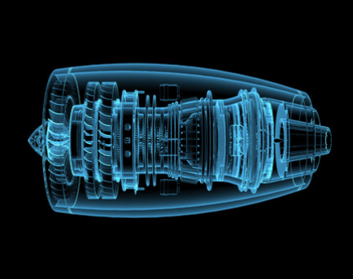
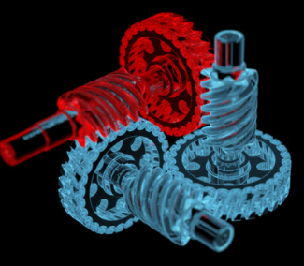
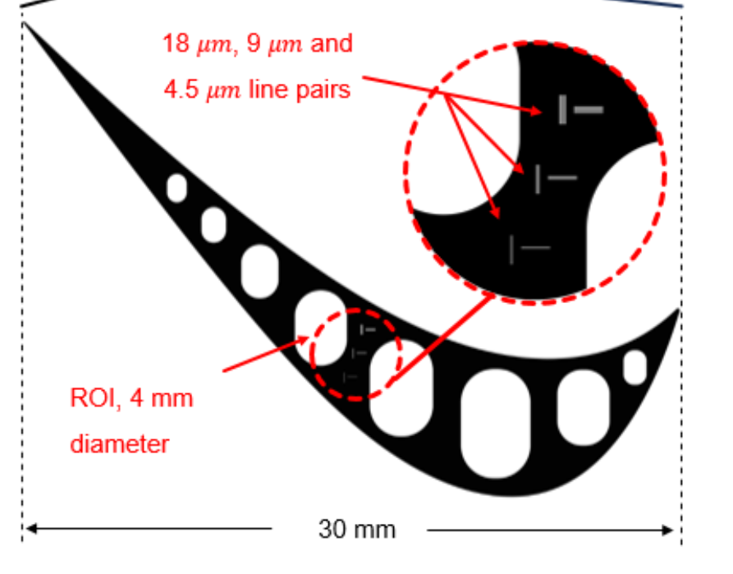
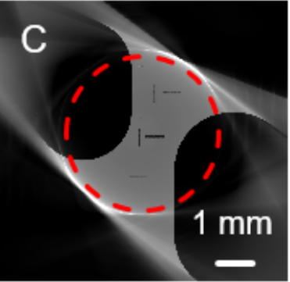
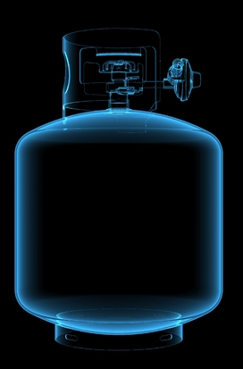
The applications on material: the Integration of Material Technology-Structure-Performance
Processing of heavy metal materials in an in-situ environment
Non-destructive characterization of the internal structure of the workpiece under casting, forging and service conditions
Internal welding problems, defect evolution, grain arrangement and failure analysis of materials
engine
Dynamical diagnosis >1kHz+
large penetration depth+
clear imagination
>$10^{12}$photon/s
$10^{9}$photon----enough for a clear imagination
>1000Hz can satisfy:
Dynamical diagnosis of defect evolution/metal phase change process-droplet solidification/seawater corrosion mechanism
blade
gear
Pressure vessel

Slide 10
The applications on nucleon: γ assistant transmutation
The shortage of ADS idea is the transmutation by using neutrons in the sub-critical system, but meanwhile it produces actinides and long- lived fission products ( LLFPs ).
γ assistant transmutation is quite-valuable, and is an important supplement to neutron transmutation.
(γ,n), (γ,2n), Can increase the average number of fission neutrons!
γ+135Cs → 134Cs、 133Cs; γ+ 133Cs → 132Cs、131Cs
n+133Cs
134Cs
135Cs
136Cs
stable
2.06 y
2.3 My
13.16 d
Notes:
When using neutron transmutation, it will react through cascade neutrons to turn the stable 133Cs into 135Cs!

Slide 11
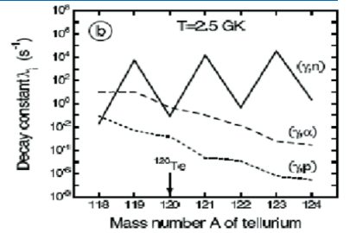
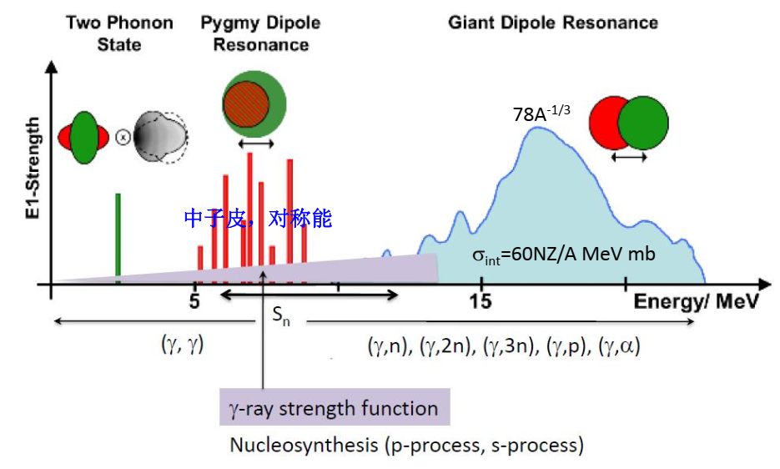
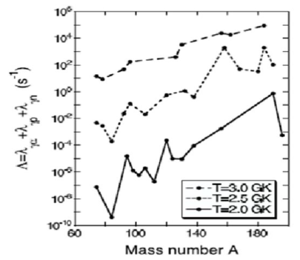
The applications on nucleon: photon-nuclear reactions
(γ, n), (γ, p), (γ, α) are the main photonuclear reaction exit channels
Temperature dependence

Slide 12
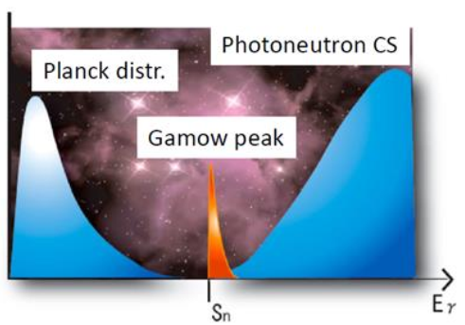
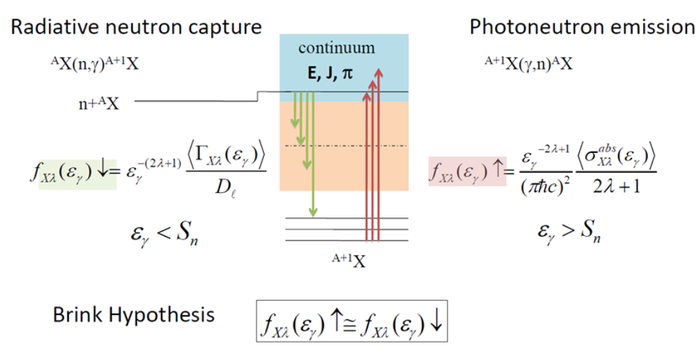
The applications on nucleon and astrophysics: photon-nuclear reactions
The interesting energy range of photon-nuclear reactions:
Gamow peak, Gamow window:

Slide 13
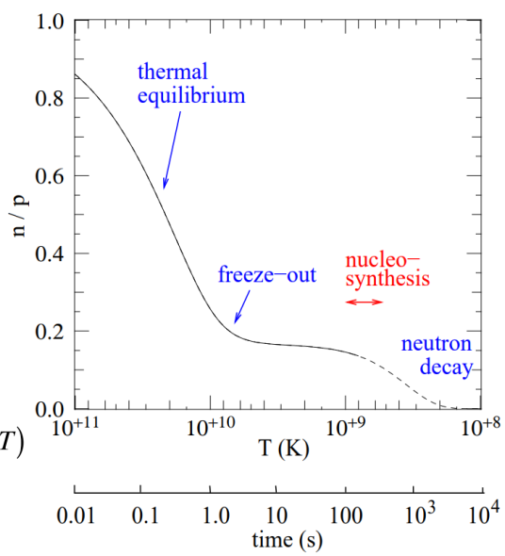
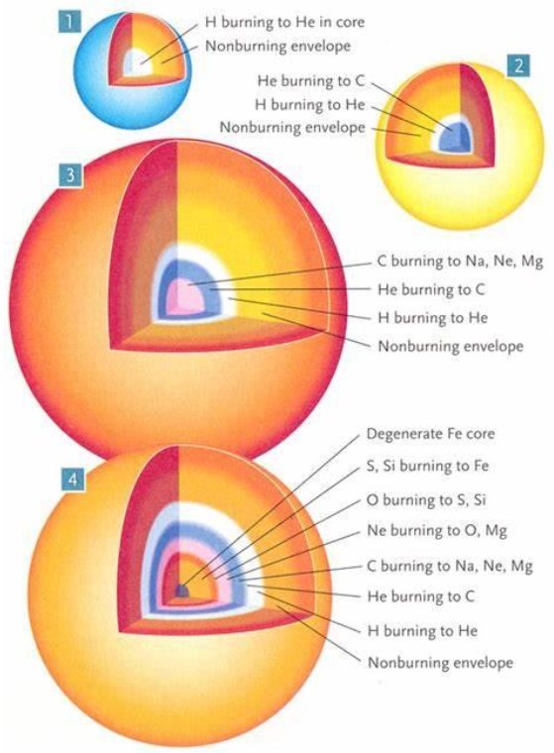
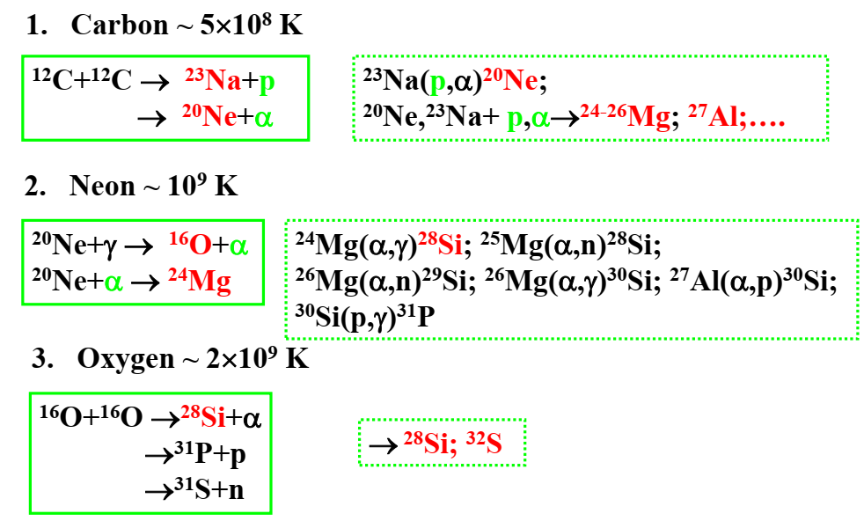
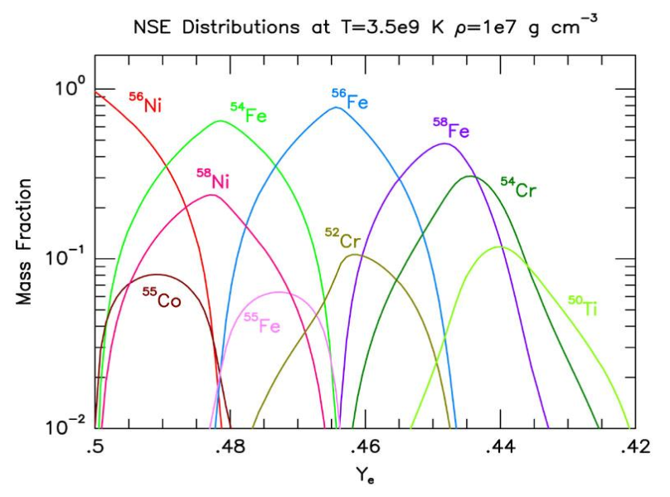
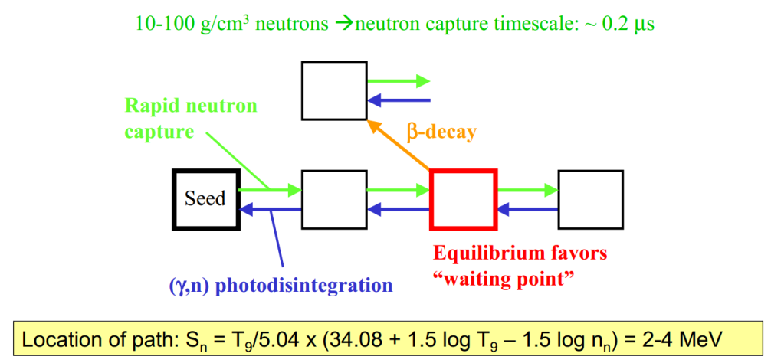
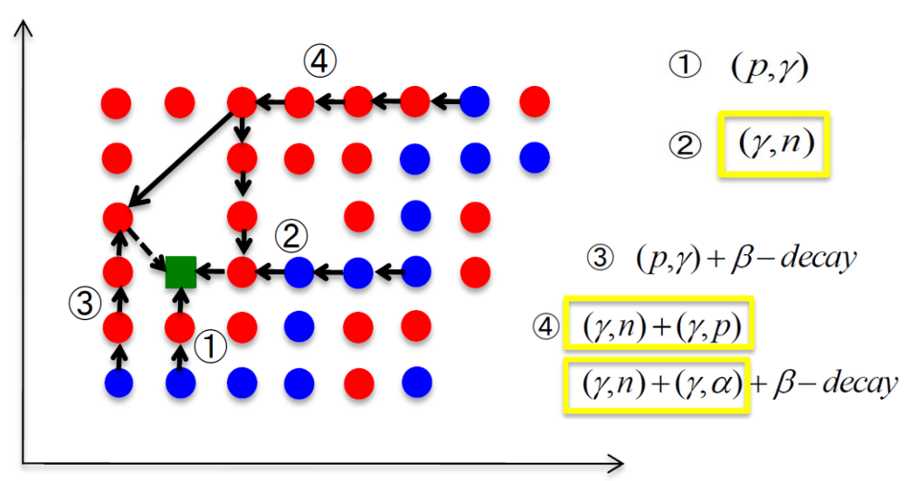
The applications on nucleon and astrophysics: photon-nuclear reactions
Tick the time of the evolution of the universe
Control the sequence of nuclear combustion
Determines the waiting point of the nuclear process
Participate in important nuclear processes (e-process, r-process, p-process)
2H(γ,n)1H determines the time window of the big bang nucleosynthesis
Even A nuclei, magic number nuclei, and short half-life nuclei are candidate waiting point nuclei

Slide 14
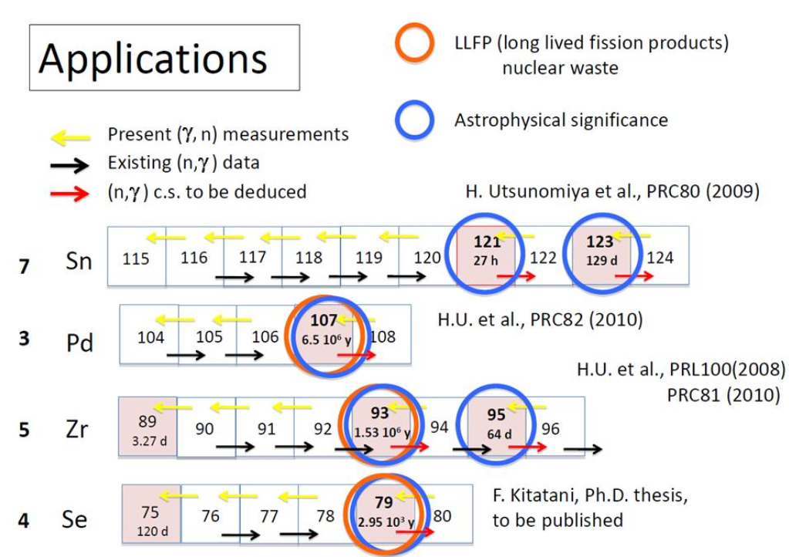
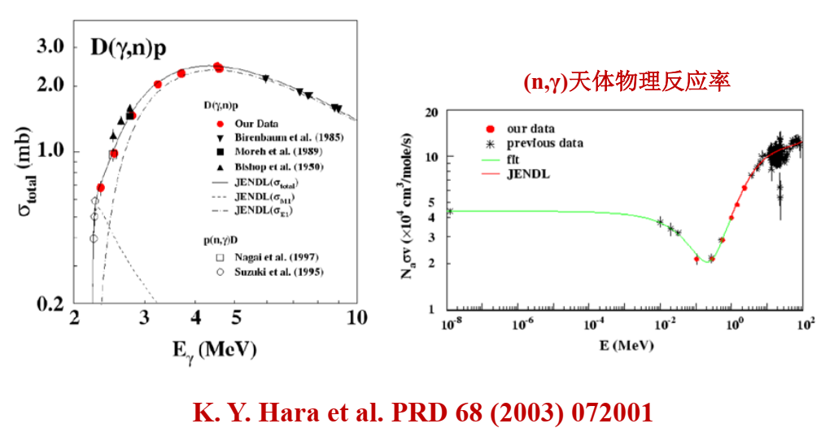
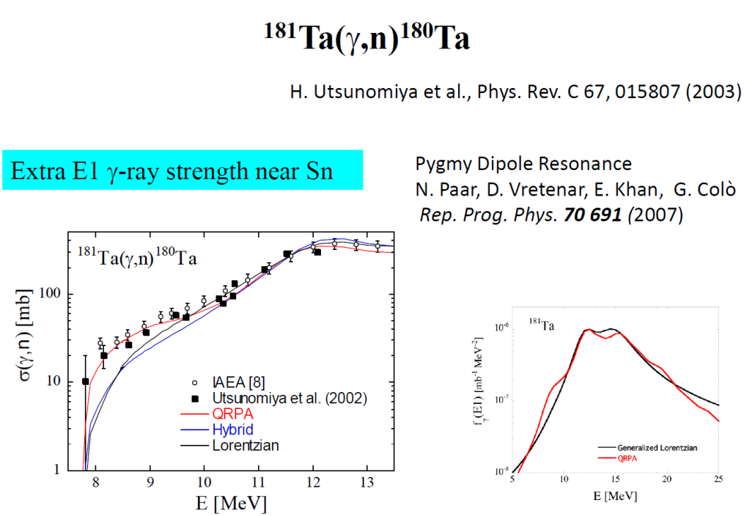
The applications on nucleon and astrophysics: photon-nuclear reactions
D(γ,n)p reactions related to the Big Bang

Slide 15
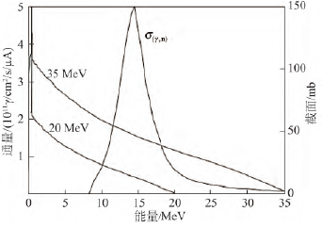
The applications on medical: Radioisotope preparation for SPECT/CT & Flash RT
$10^{14}p/s$ flux can produce: 10000Ci/y Mo99 compared with a linac 1mA per year
SPECT/CT is the first choice for early diagnosis of bone metastases from malignant tumors.
The judgment of the function of thyroid nodules and the differentiation of benign and malignant are of high diagnostic value.
Diagnosis of myocardial ischemia.
（1）¹⁰⁰Mo+γ→⁹⁹Mo+n；
（2）¹⁰⁰Mo+γ→^{99m}Nb+p, ^{99m}Nb（T_{1/2}=15s）→⁹⁹Mo+β；
（3）¹⁰⁰Mo+γ→^{99m}Nb+p, ^{99m}Nb（T_{1/2}=12.6m）→⁹⁹Mo+β；
（4）¹⁰⁰Mo+n→⁹⁹Mo+2n

Slide 16
Thank you very much for
your support and attention!

Slide 17
Comment;
Well-defined;
γSR；
Perspective；
Author list;材料-核物理-核天体物理-医学-CEPC γSR，不同同步辐射源的机构；
大纲-部分的内容；意见-反馈；
国内外专家 大背景写 放进去 写成
不同意见 要修改；
Xin Li对所有人 03:51 PM
15026742530
Jie Pan对所有人 03:52 PM
Wechat ID: lukepun (Jie Pan)

