Slide 1
Plan for development of circular colliders with Crab Waist at BINP
Bogomyagkov, E. Levichev, S. Sinyatkin
Budker Institute of Nuclear Physics
The 2023 International Workshop on the
High Energy Circular Electron Positron Collider

Slide 2
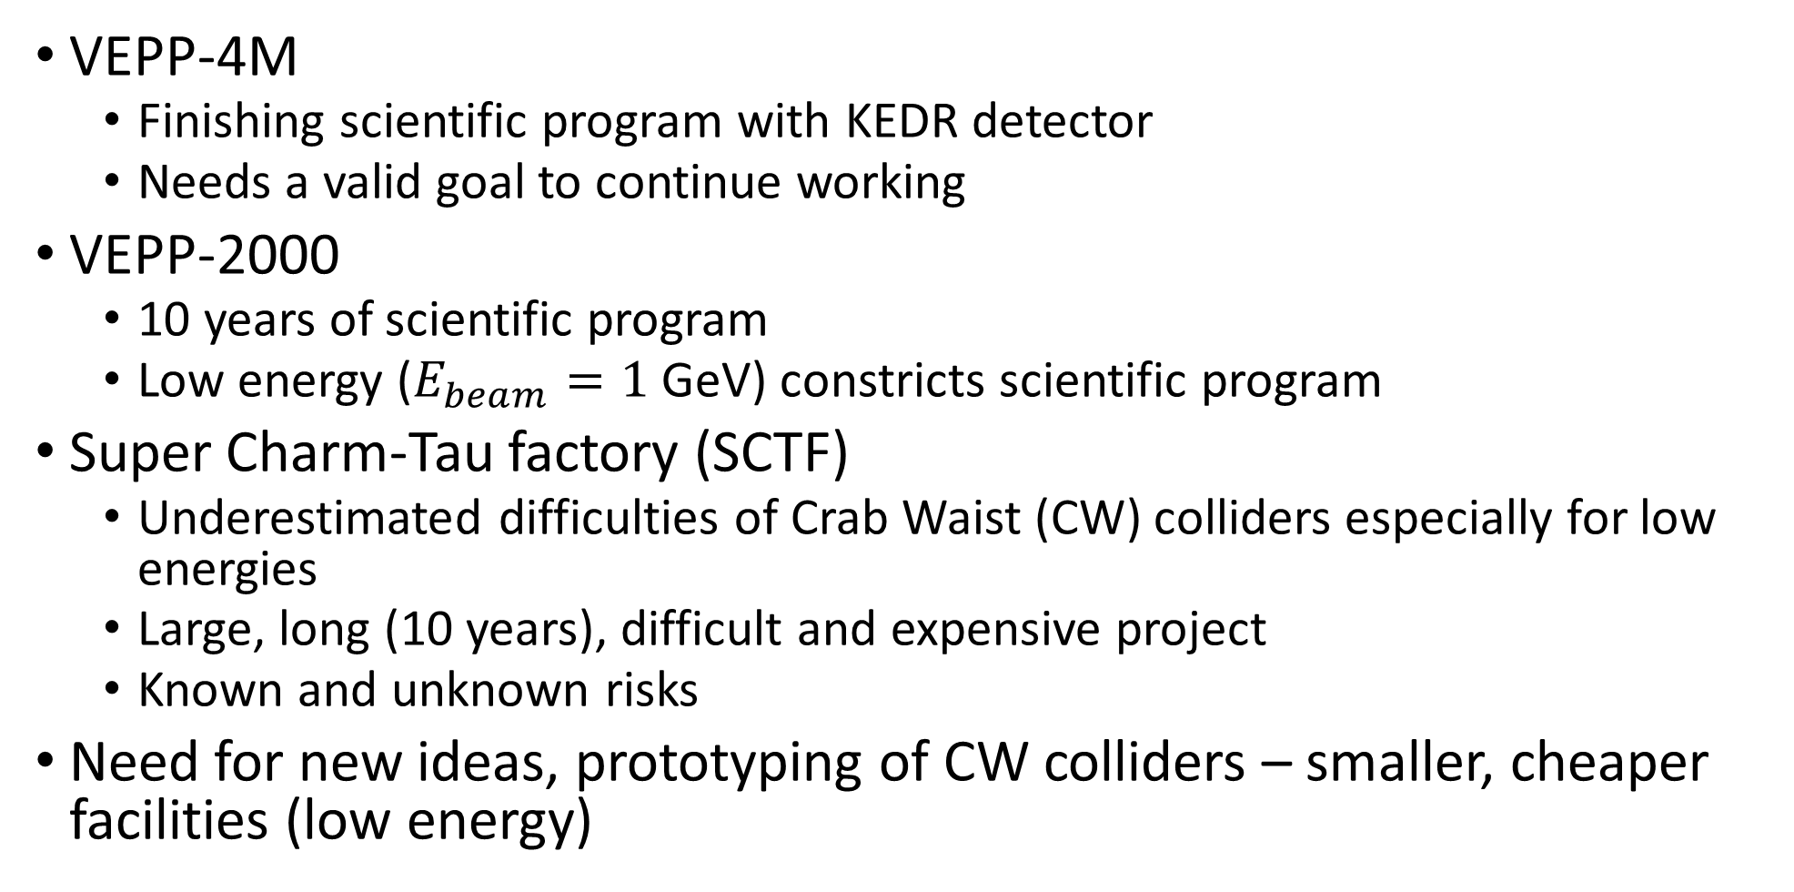
Introduction (initial conditions)
VEPP-4M
  Finishing scientific program with KEDR detector
  Needs a valid goal to continue working
VEPP-2000
  10 years of scientific program
  Low energy ($E_{beam}=1$ GeV) constricts scientific program
Super Charm-Tau factory (SCTF)
  Underestimated difficulties of Crab Waist (CW) colliders especially for low energies
  Large, long (10 years), difficult and expensive project
  Known and unknown risks
Need for new ideas, prototyping of CW colliders – smaller, cheaper facilities (low energy)

Slide 3
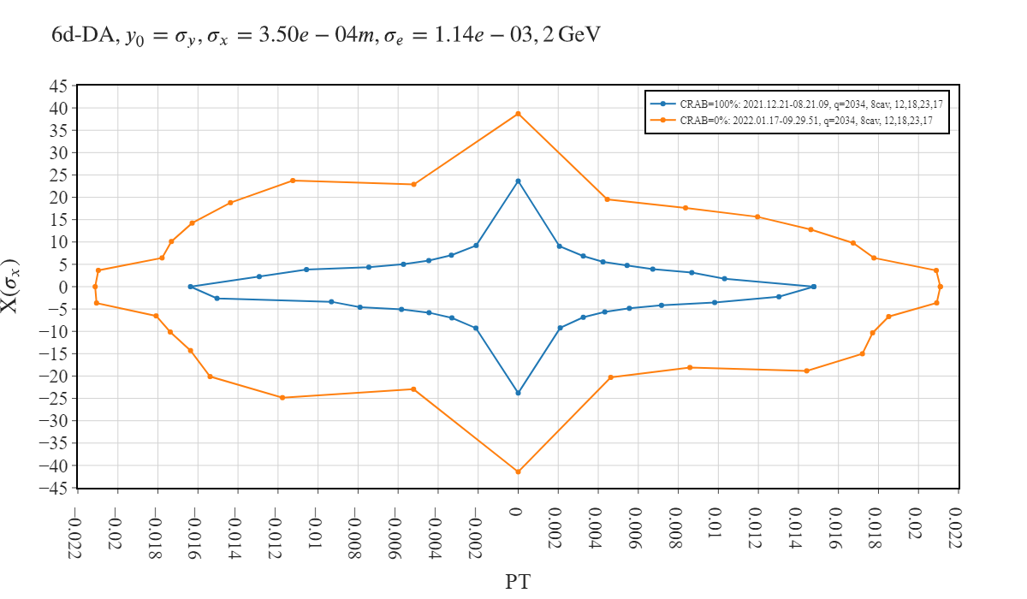
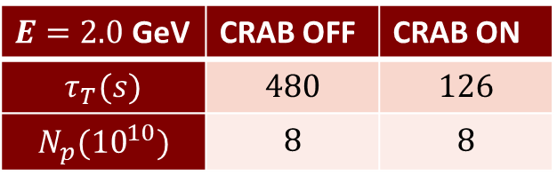

Main problem of CW colliders: SCTF
$E=2.0$ GeV | CRAB OFF | CRAB ON
$$τ_{T}(s)$$ | $$480$$ | $$126$$
$$N_{p}({10}^{10})$$ | $$8$$ | $$8$$
$E=1.5$ GeV | CRAB OFF | CRAB ON
$$τ_{T}(s)$$ | $$280$$ | $$63$$
$$N_{p}({10}^{10})$$ | $$9$$ | $$9$$

Slide 4
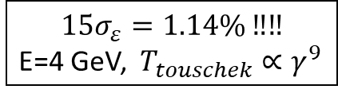
Main problem of CW colliders: SuperKEB
$$15σ_{ε}=1.14\% ‼‼$$
E=4 GeV, $T_{touschek}∝γ^{9}$
K.Oide “Crab waist for SuperKEKB”, 30.01.2020

Slide 5
Challenges of CW
The ultimate goal is SCTF. Risks decrease requires hands-on study of:
Beam-beam effects with large Piwinski angle and CW
Dynamic aperture limitation (Touschek lifetime) by CW sextupoles
Collision parameters dependence on beam energy
Detector background
Final focus quadrupoles and solenoids
Cryostat and vacuum system
Interaction point (IP) vacuum chamber and its cooling
IP vacuum chamber impedance
Beam targeting/separation system at IP
Alignment of FF elements
Detector field influence on mechanical stability and beam dynamics
Particles loss and quenching of FF quadrupoles

Slide 6
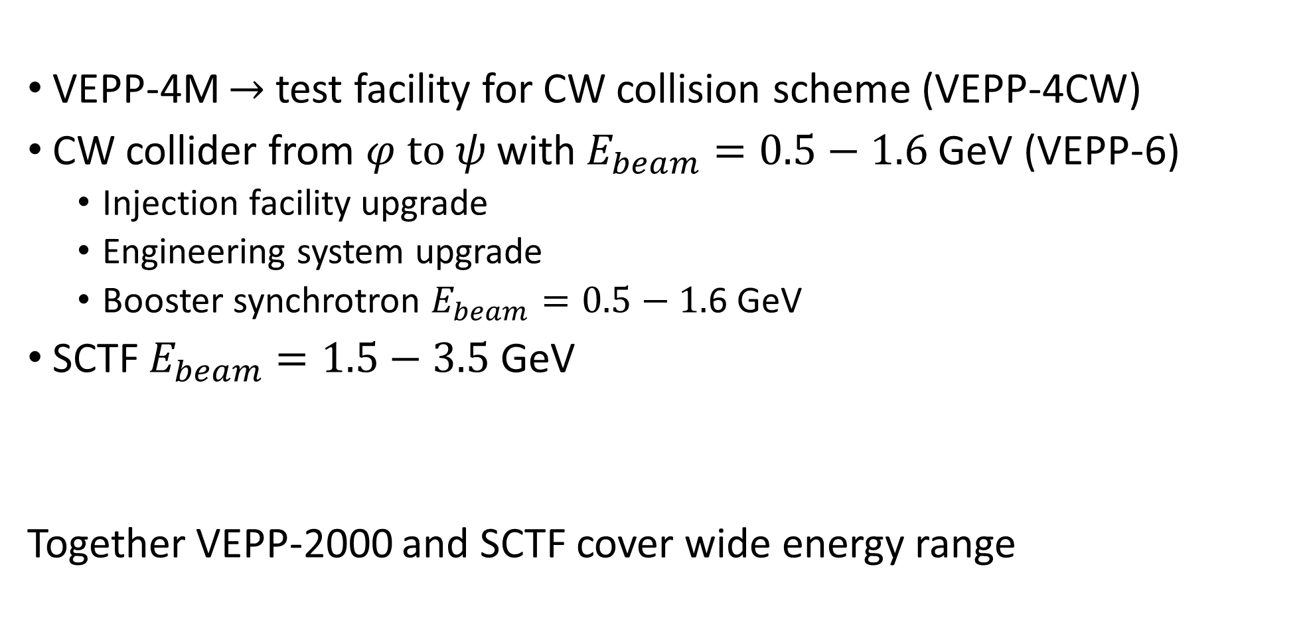
The program of CW development in BINP
VEPP-4M $→$ test facility for CW collision scheme (VEPP-4CW)
CW collider from $φ \text{to} ψ$ with $E_{beam}=0.5−1.6$ GeV (VEPP-6)
  Injection facility upgrade
  Engineering system upgrade
  Booster synchrotron $E_{beam}=0.5−1.$6 GeV
SCTF $E_{beam}=1.5−3.5$ GeV
Together VEPP-2000 and SCTF cover wide energy range

Slide 7
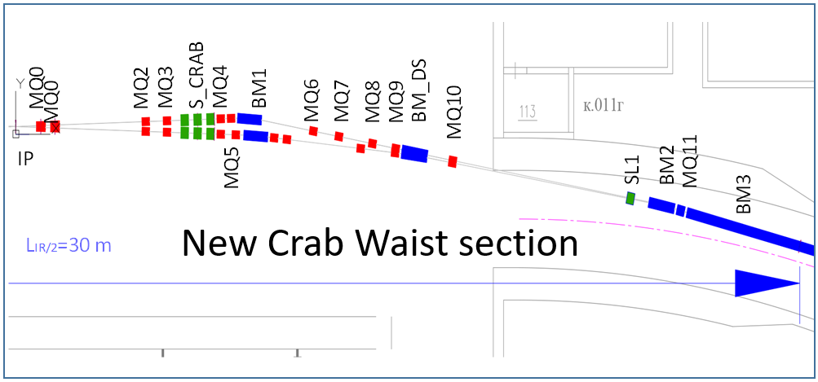
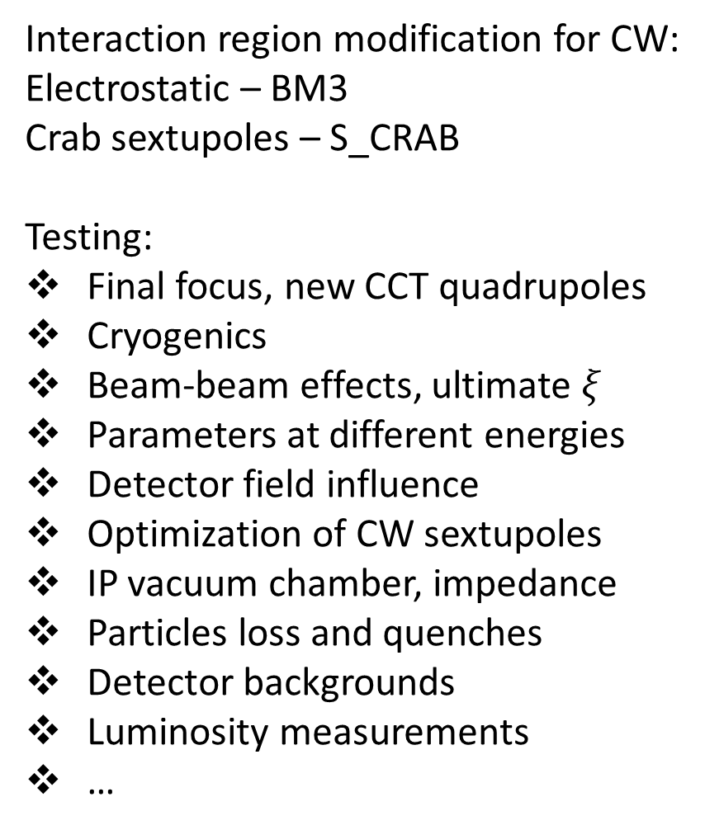
VEPP-4CW ̶̶ “Partial” crab waist
Interaction region modification for CW:
Electrostatic – BM3
Crab sextupoles – S_CRAB
Testing:
Final focus, new CCT quadrupoles
Cryogenics
Beam-beam effects, ultimate $ξ$
Parameters at different energies
Detector field influence
Optimization of CW sextupoles
IP vacuum chamber, impedance
Particles loss and quenches
Detector backgrounds
Luminosity measurements
…
е+
е-
е+
е-
KEDR
Partial CW
VEPP-4M
VEPP-4CW

Slide 8
VEPP-4CW ̶̶ “Partial” crab waist
VEPP-4M
VEPP-4CW
CW sextupoles
IP
IP

Slide 9
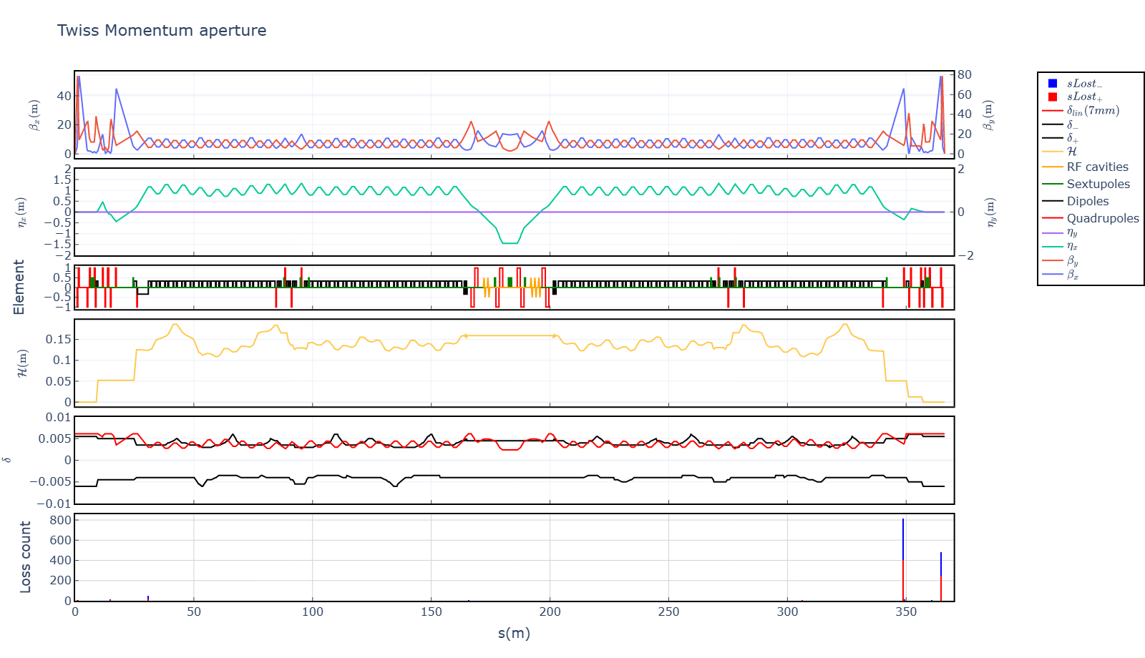
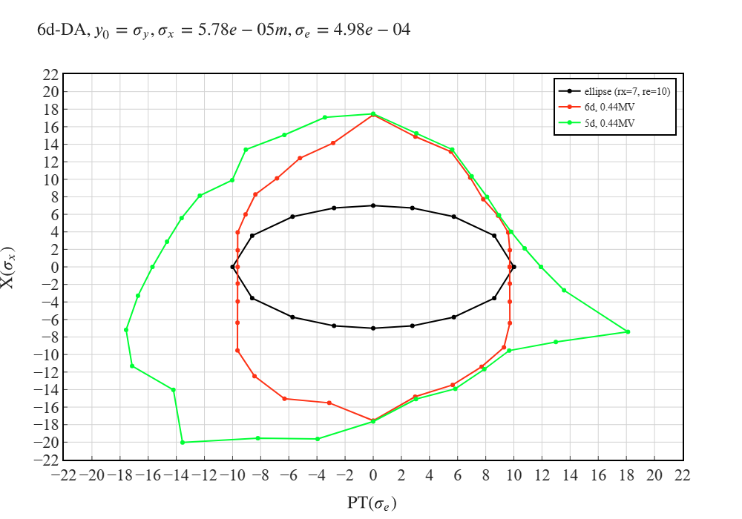
VEPP-4CW ̶̶ “Partial” crab waist
Notes:
Changing beam current or coupling

Slide 10
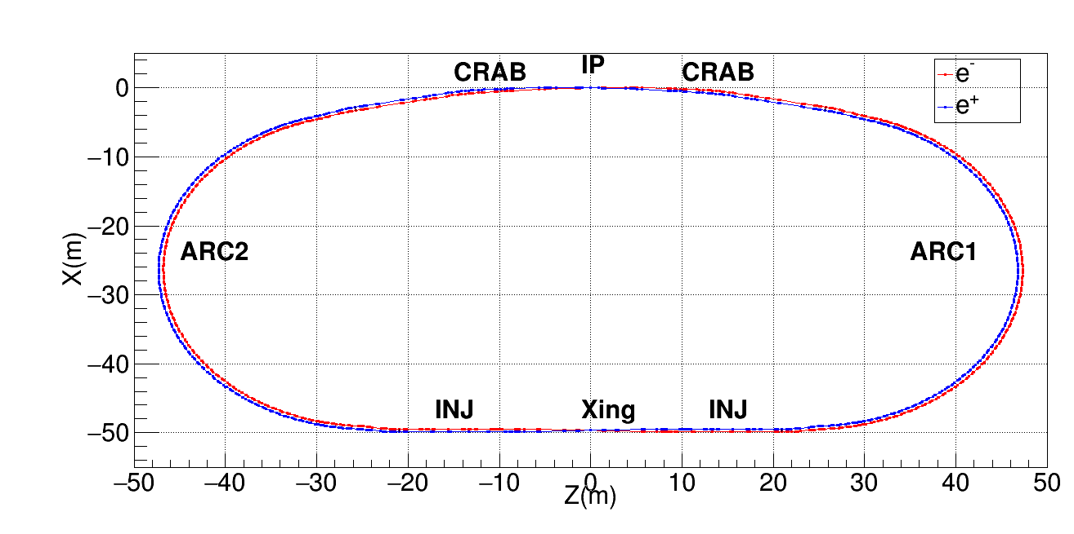
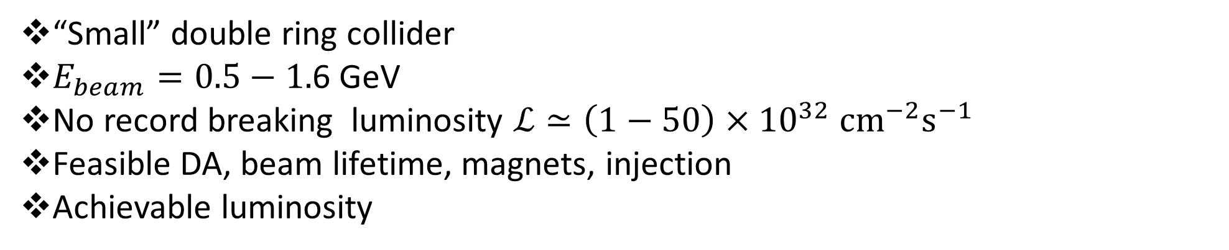
VEPP-6 (from $φ$ to $ψ$)
“Small” double ring collider
$E_{beam}=0.5−1.$6 GeV
No record breaking luminosity $ℒ≃{\left(1−50\right)×10}^{32} {\text{cm}}^{−2}{\text{s}}^{−1}$
Feasible DA, beam lifetime, magnets, injection
Achievable luminosity
Notes:
v.17

Slide 11
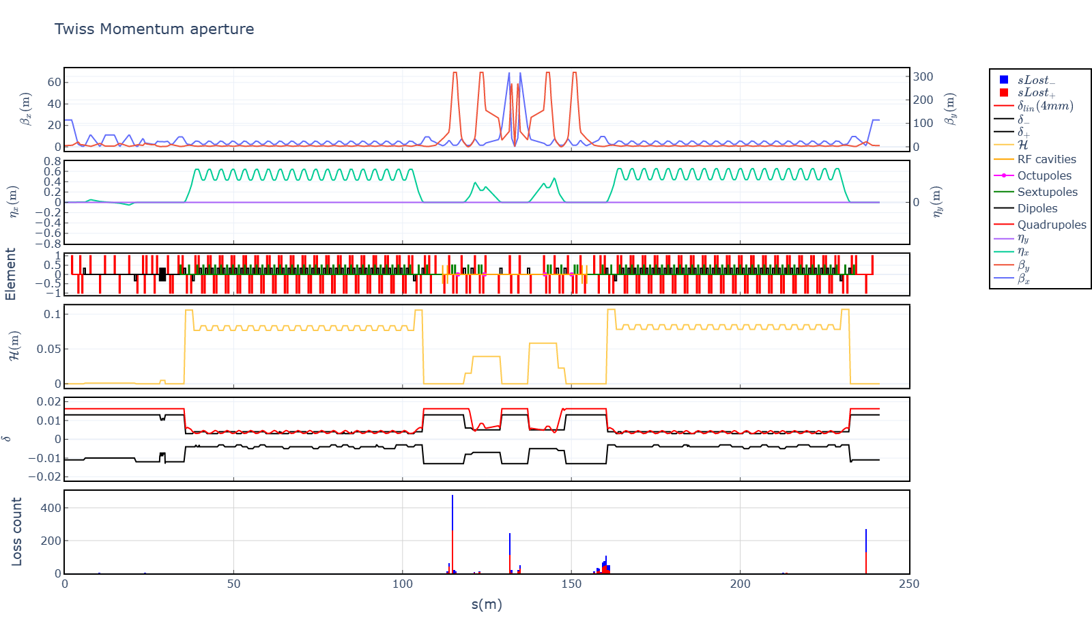
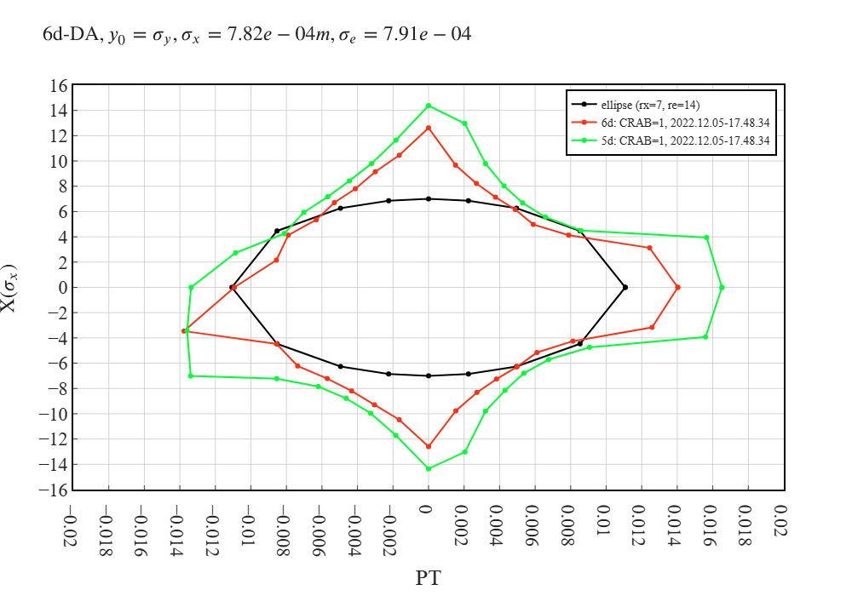
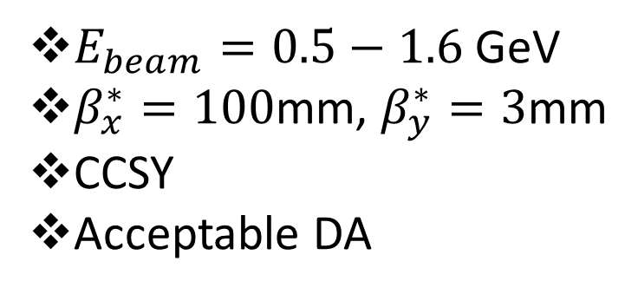
VEPP-6 (from $φ$ to $ψ$)
$E_{beam}=0.5−1.6$ GeV
$β_{x}^{∗}=100$mm, $β_{y}^{∗}=3$mm
CCSY
Acceptable DA
Notes:
v.17

Slide 12
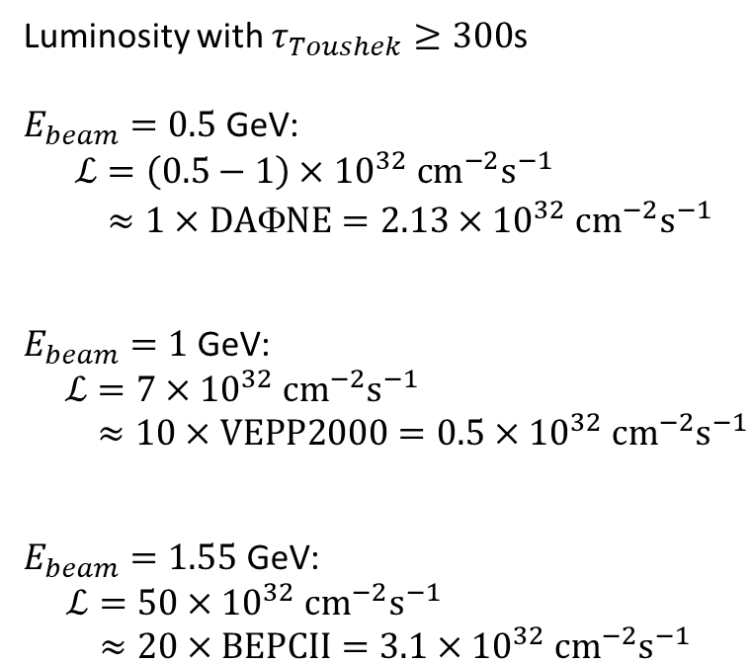
VEPP-6 (from $φ$ to $ψ$)
Luminosity with $τ_{Toushek}≥300$s
$E_{beam}=0.5$ GeV:
$\begin{aligned}ℒ&={\left(0.5−1\right)×10}^{32} {{\text{cm}}^{−2}\text{s}}^{−1} \\ &≈1×\text{DA}\text{Φ}\text{NE}={2.13×10}^{32} {{\text{cm}}^{−2}\text{s}}^{−1}\end{aligned}$
$E_{beam}=1$ GeV:
$\begin{aligned}ℒ&={7×10}^{32} {{\text{cm}}^{−2}\text{s}}^{−1} \\ &≈10×\text{VEPP}\text{2000}={0.5×10}^{32} {{\text{cm}}^{−2}\text{s}}^{−1}\end{aligned}$
$E_{beam}=1.55$ GeV:
$\begin{aligned}ℒ&={50×10}^{32} {{\text{cm}}^{−2}\text{s}}^{−1} \\ &≈20×\text{BEPCII}={3.1×10}^{32} {{\text{cm}}^{−2}\text{s}}^{−1}\end{aligned}$
Notes:
v.17

Slide 13
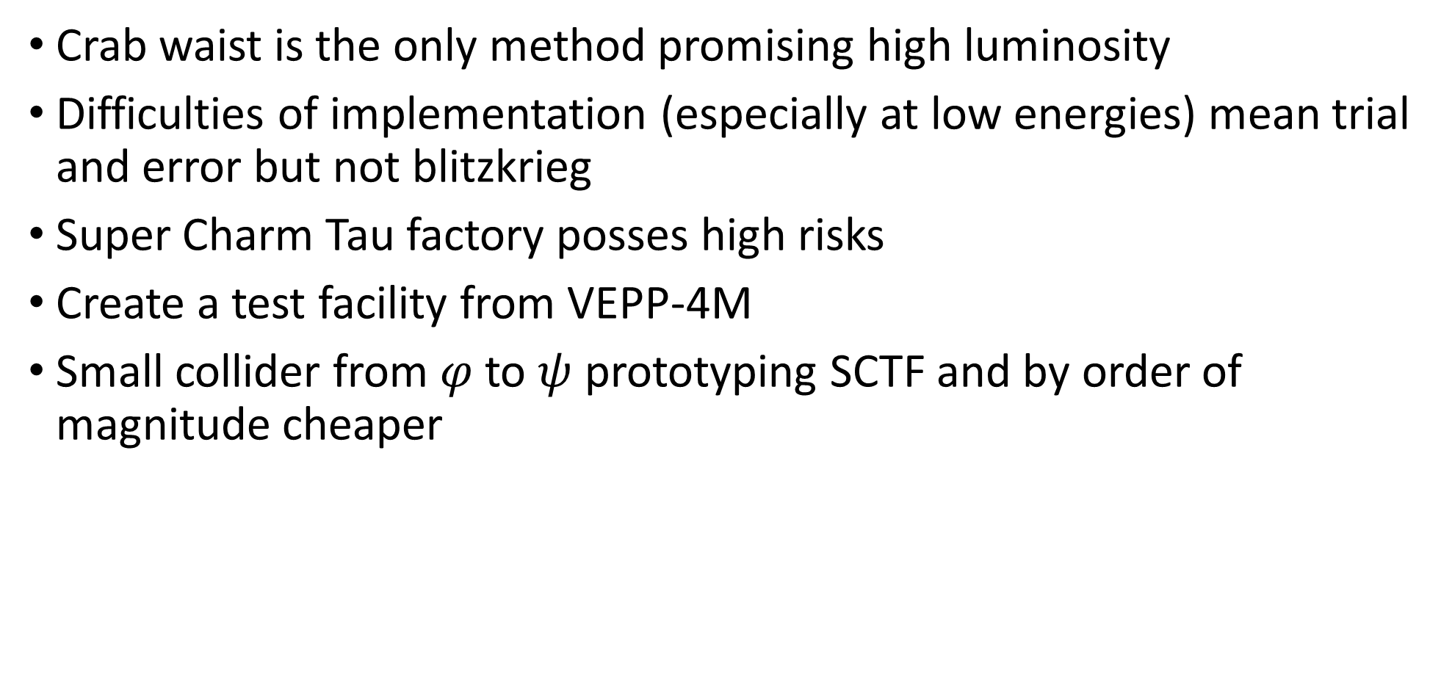
Conclusion
Crab waist is the only method promising high luminosity
Difficulties of implementation (especially at low energies) mean trial and error but not blitzkrieg
Super Charm Tau factory posses high risks
Create a test facility from VEPP-4M
Small collider from $φ$ to $ψ$ prototyping SCTF and by order of magnitude cheaper

