Slide 1


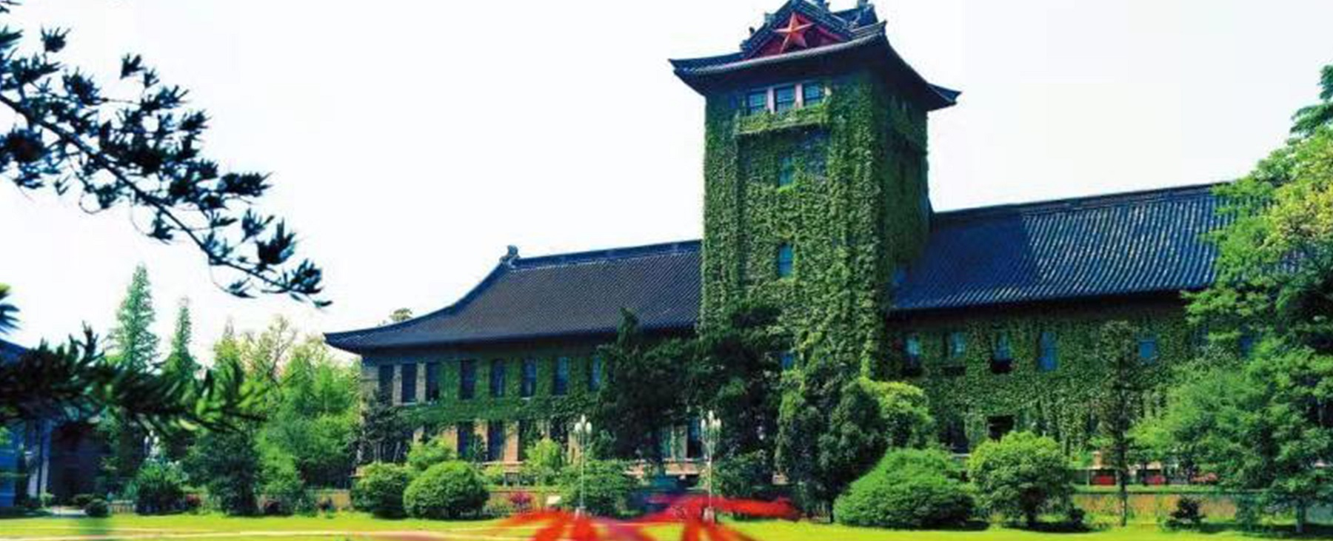

CEPC Booster and Damping Ring
Dou Wang (IHEP)
on behalf of CEPC AP group
23-27. Oct. 2023, Nanjing, The 2023 International Workshop on CEPC.

Slide 2
Content
Design status for CEPC Booster
  Booster design requirements in TDR
  Booster TDR optics (including errors)
  Timing structure & dynamic parameters during ramping
  Summary of Booster TDR parameters
Design status for CEPC positron damping ring
  DR parameters
  DR optics (including errors)
  Particle tracking through the transport lines
Summary

Slide 3
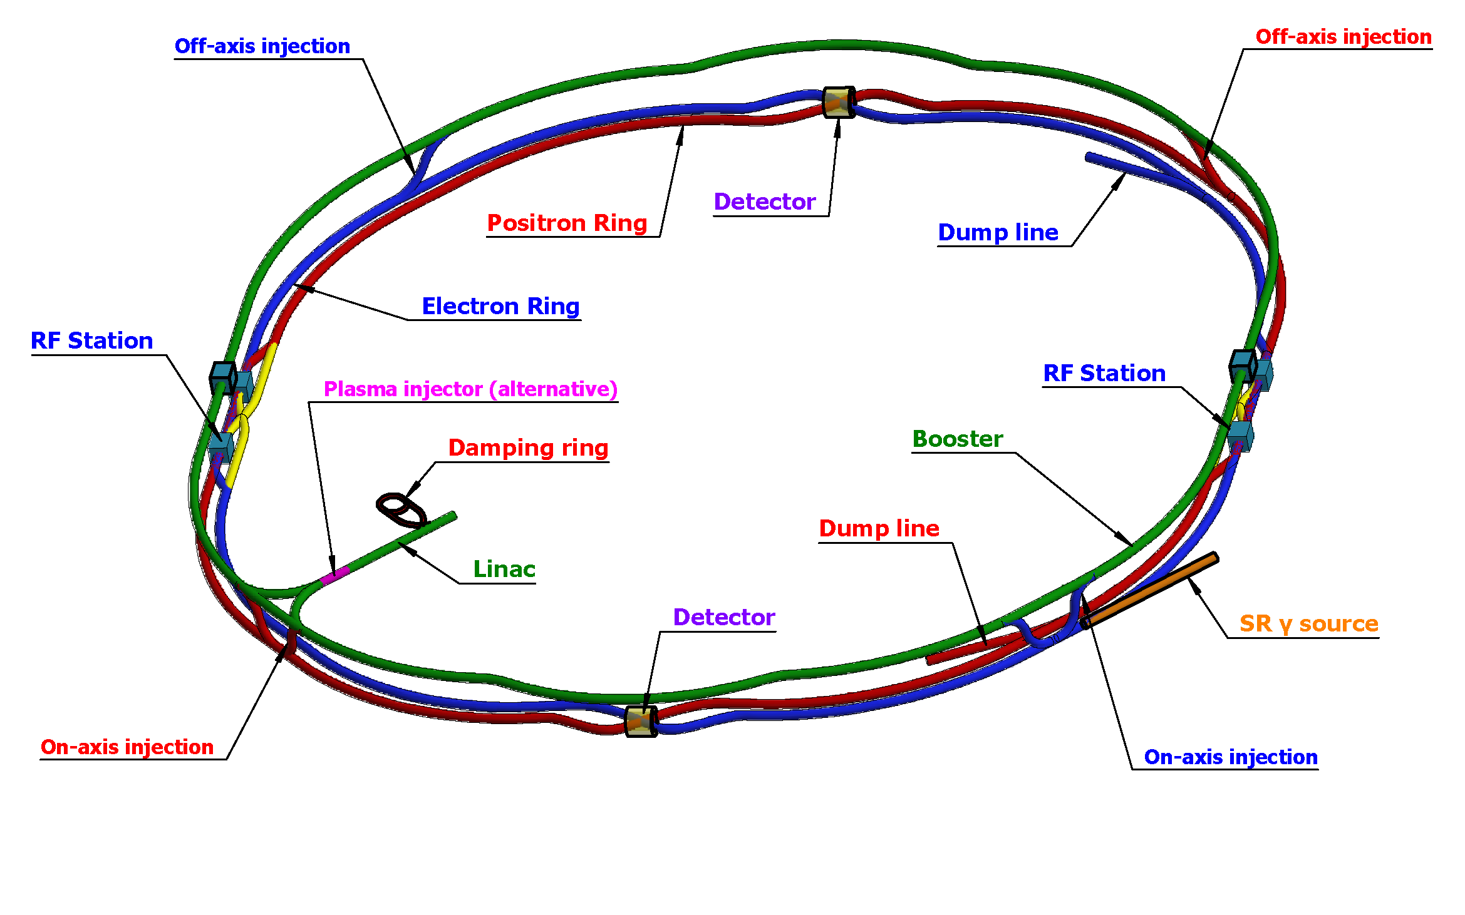
CEPC injector chain
30→180GeV
30GeV
100km
30 GeV linac provides electron and positron beams for booster.
Top up injection for collider ring ~ 3% current decay
Booster is in the same tunnel as collider ring, above the collider ring, bypass in IRs (same circumference).
Budget for transfer efficiency 90%: 95% for booster + 95% for transport lines (inj. to collider).
Beam current threshold in booster is limited by RF system.
Feedback systems (Transverse & longitudinal) are need to damp the instability at low energy.

Slide 4
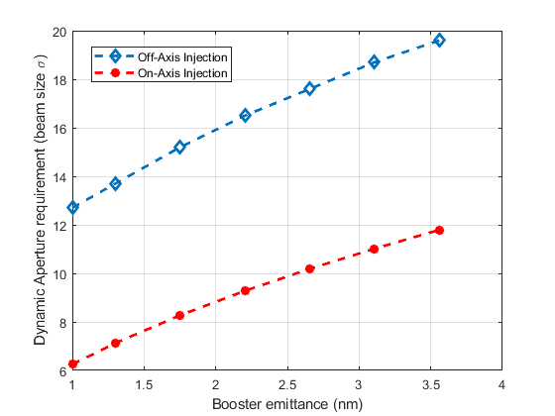
Requirement update after CDR
Collider ring | Higgs (CDR) | Higgs (TDR)
Number of IPs | 2 | 2
Energy (GeV) | 120 | 120
Circumference (km) | 100 | 100
SR loss/turn (GeV) | 1.73 | 1.8
Half crossing angle (mrad) | 16.5
Piwinski angle | 3.48 | 4.88
N_{e}/bunch (10¹⁰) | 15.0 | 13.0
Bunch number | 242 | 268
Beam current (mA) | 17.4 | 16.7
SR power /beam (MW) | 30 | 30
Bending radius (km) | 10.7 | 10.2
Momentum compaction (10⁻⁶) | 11.1 | 7.1
β_{IP} x/y (m) | 0.36/0.0015 | 0.3/0.001
Emittance x/y (nm) | 1.21/0.0024 | 0.64/0.0013
Transverse σ_{IP} (um) | 20.9/0.06 | 14.0/0.036
ξ_{x}/ξ_{y}/IP | 0.018/0.109 | 0.015/0.11
V_{RF} (GV) | 2.17 | 2.20
f _{RF} (MHz) (harmonic) | 650 (216820)
Nature bunch length σ_{z} (mm) | 2.72 | 2.3
Bunch length σ_{z} (mm) | 4.4 | 4.1
Energy spread (%) (SR/BS) | 0.1/0.134 | 0.1/0.17
Energy acceptance requirement (%) | 1.35 | 1.6
Energy acceptance by RF (%) | 2.06 | 2.2
Lifetime due to beamstrahlung (min) | 80 | 40
Lifetime (min) | 25 | 20
F (hour glass) | 0.89 | 0.9
L_{max}/IP (10³⁴cm⁻²s⁻¹) | 2.93 | 5.0
Horizontal DA requirement of collider ring due to injection
X. H. Cui
Booster emittance @120 GeV <1.7nm (3.6nm in CDR)

Slide 5
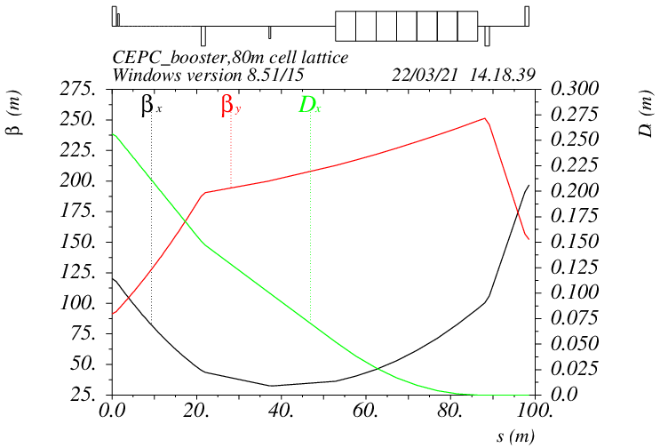
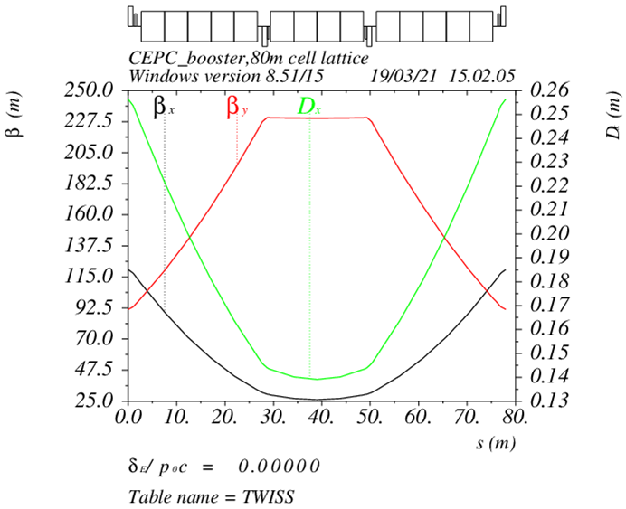
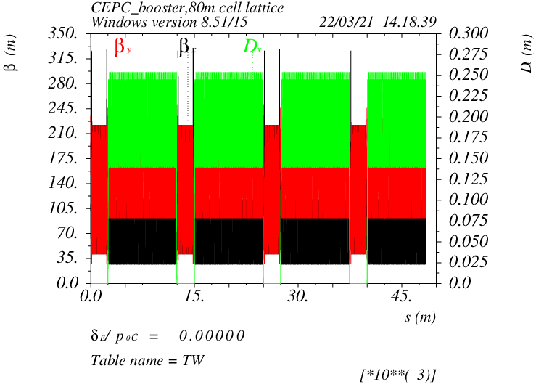
Booster TDR optics
TME like structure (cell length=78m)
Interleave sextupole scheme
Emittance@120GeV=1.26nm
Phase advance/cell: 100° (H) / 28° (V)
D. Wang, C. H. Yu, Y. M. Peng…
Overall idea: uniform distribution for the Q
Combined magnet (B+S) scheme possible
Independent sext. (100) — chromaticity adjustment
Dispersion sup.
Arc cell
Half ring

Slide 6
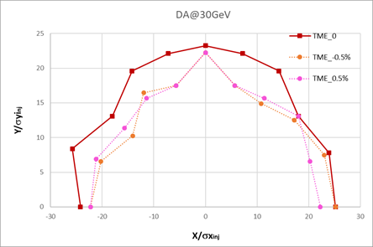
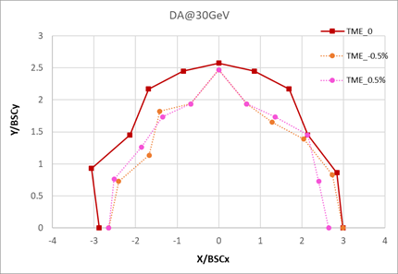
DA results @ 30GeV
Booster energy: 30GeV~180GeV
30GeV: BSC_{xy}=(4σ_{xy}+5mm)*2
Inj. emittance from Linac: 6.5nm
Energy spread from Linac: ≤0.16%

Slide 7
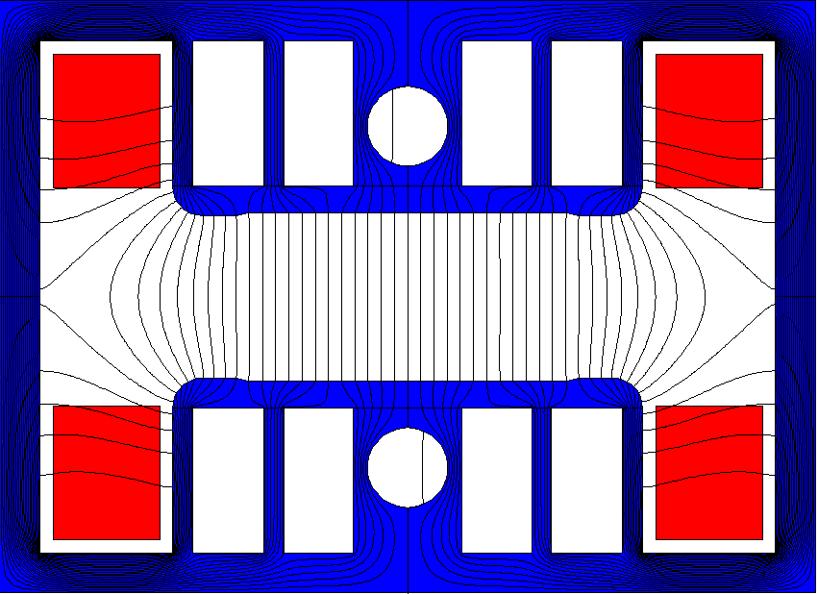
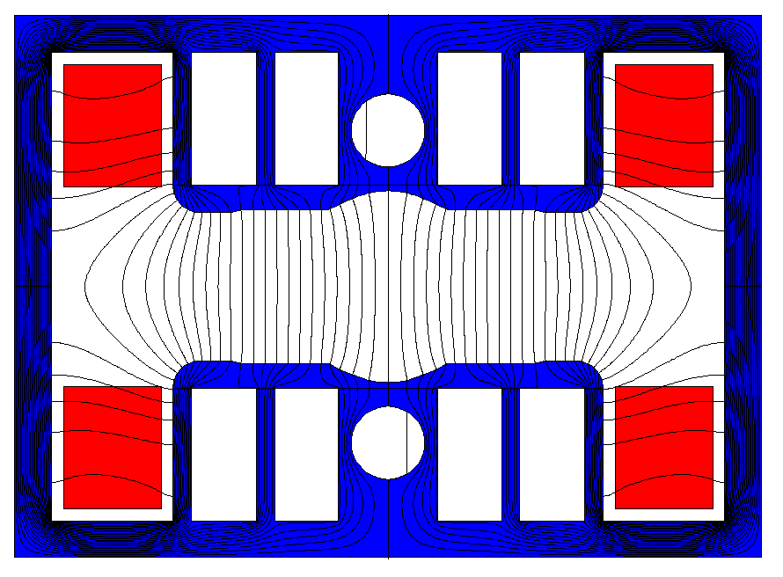
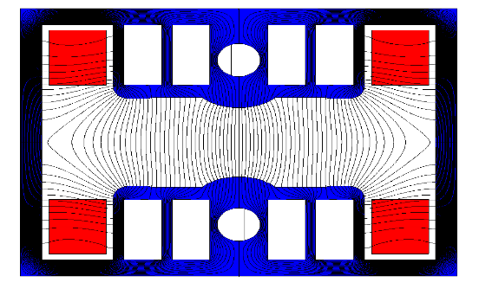
Injection energy change to 30GeV
30GeV injection is adopted for the cost saving in TDR.
The non-oriented steel laminations for the iron dominated dipole magnet can be used at 30GeV.
A cost balance between Linac and booster
Linac parameters at 30GeV
- bunch length= 0.44mm, energy spread= 0.15%, emittance=6.5nm
Magnetic design: the quality of the dipole and sextupole fields meet the physical requirements.

Slide 8
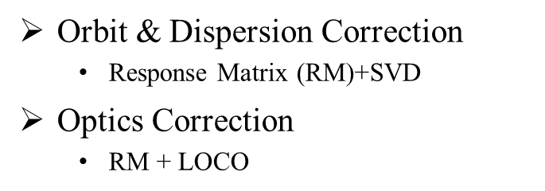
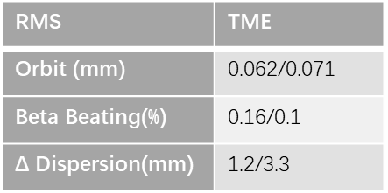
DA results with errors and correction
D. H. Ji
 | Dipole | Quadrupole | Sextupole
Transverse shift X/Y (μm) | 100 | 100 | -
Longitudinal shift Z (μm) | 100 | 150 | -
Tilt about X/Y (mrad) | 0.2 | 0.2 | -
Tilt about Z (mrad) | 0.1 | 0.2 | -
Nominal field | 1e-3 | 2e-4 | 3e-4
 | Accuracy (m) | Tilt (mrad) | Gain | Offset w/ BBA(mm)
BPM(10Hz) | 1e-7 | 10 | 5% | 30e-3
(100 seeds)
(93 seeds)
Include multipole errors
DA track in AT w/o SR
dipole | quadrupole
B1/B0 ≤ 2×10⁻⁴
B2/B0 ≤ 5×10⁻⁴ | B2/B1 ≤ 3×10⁻⁴
B3/B0 ≤ 2×10⁻⁵ | B3/B1 ≤ 2×10⁻⁴
B4/B0 ≤ 8×10⁻⁵ | B4/B1 ≤ 1×10⁻⁴
B5/B0 ≤ 2×10⁻⁵ | B5/B1 ≤ 1×10⁻⁴
B6/B0 ≤ 8×10⁻⁵ | B6/B1 ≤ 5×10⁻⁵
B7/B0 ≤ 2×10⁻⁵ | B7/B1 ≤ 5×10⁻⁵
B8/B0 ≤ 8×10⁻⁵ | B8/B1 ≤ 5×10⁻⁵
B9/B0 ≤ 2×10⁻⁵ | B9/B1 ≤ 5×10⁻⁵
B10/B0 ≤ 8×10⁻⁵ | B10/B1 ≤ 5×10⁻⁵
* refer to the poster B01 on this workshop

Slide 9
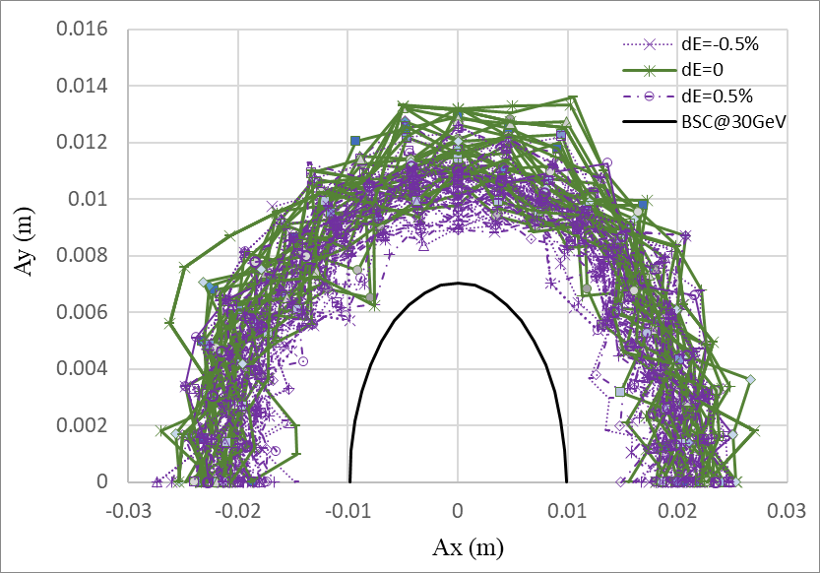
DA@30GeV
Dou Wang, Daheng Ji
On axis injection from Linac to booster
Tracking by SAD (1500 turns)
include errors (w. multipole errors)
Include SR sawtooth orbit (without taper)
Include SR damping & fluctuation
BSC definition (ε_{inj}=6.5nm):
Energy acceptance: 3*δ_{inj} =0.45%

Slide 10
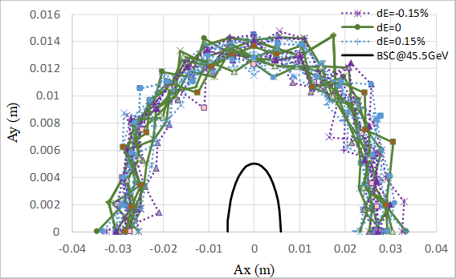
DA@45GeV
Dou Wang, Daheng Ji
Tracking by SAD (1200 turns)
include errors (w. multipole errors)
Include SR sawtooth orbit (without taper)
Include SR damping & fluctuation
Off axis injection from booster to collider
BSC definition (ε_{x}=0.18nm, ε_{y}=ε_{x} *1%):
Energy acceptance: 4*δ =0.15%

Slide 11
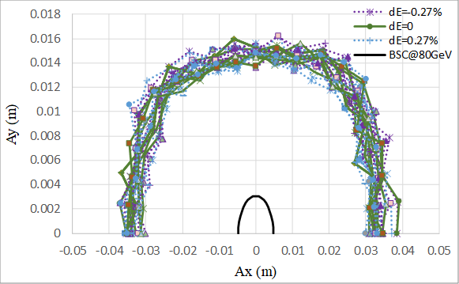
DA@80GeV
Dou Wang, Daheng Ji
Tracking by SAD (500 turns)
include errors (w. multipole errors)
Include SR sawtooth orbit (without taper)
Include SR damping & fluctuation
Off axis injection from booster to collider
BSC definition (ε_{x}=0.56nm, ε_{y}=ε_{x} *1%):
Energy acceptance: 4*δ =0.27%

Slide 12
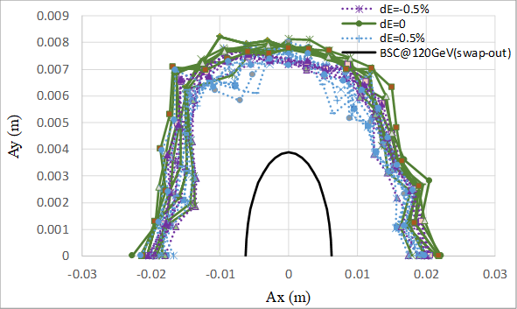
DA@120GeV
Dou Wang, Daheng Ji
Tracking by SAD (250 turns)
include errors (w. multipole errors)
Include SR sawtooth orbit (without taper)
Include SR damping & fluctuation
On axis injection from booster to collider
BSC definition (ε_{x}=1.26nm, ε_{y}=ε_{x} *1%):
Energy acceptance: 5*δ =0.5%

Slide 13
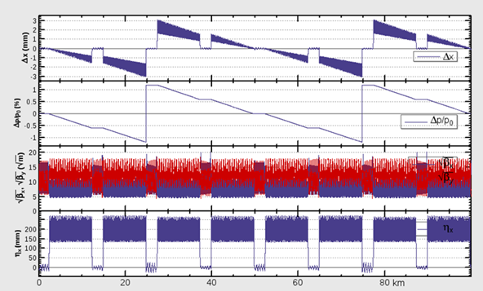
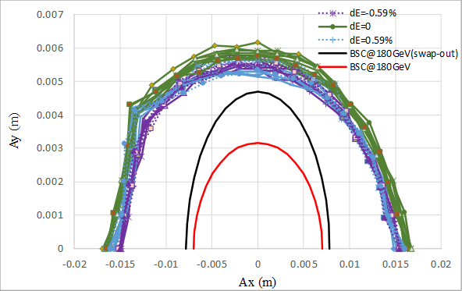
DA@180GeV
Dou Wang, Daheng Ji
Tracking by SAD (150 turns)
include errors (w. multipole errors)
Include SR sawtooth orbit (with taper)
Include SR damping & fluctuation
Keep possibility for on axis injection to collider
BSC definition (ε_{x}=2.84nm, ε_{y}=ε_{x} *1%):
--
--
(On-axis)
(Off-axis)
Energy acceptance: 4*δ =0.59%

Slide 14
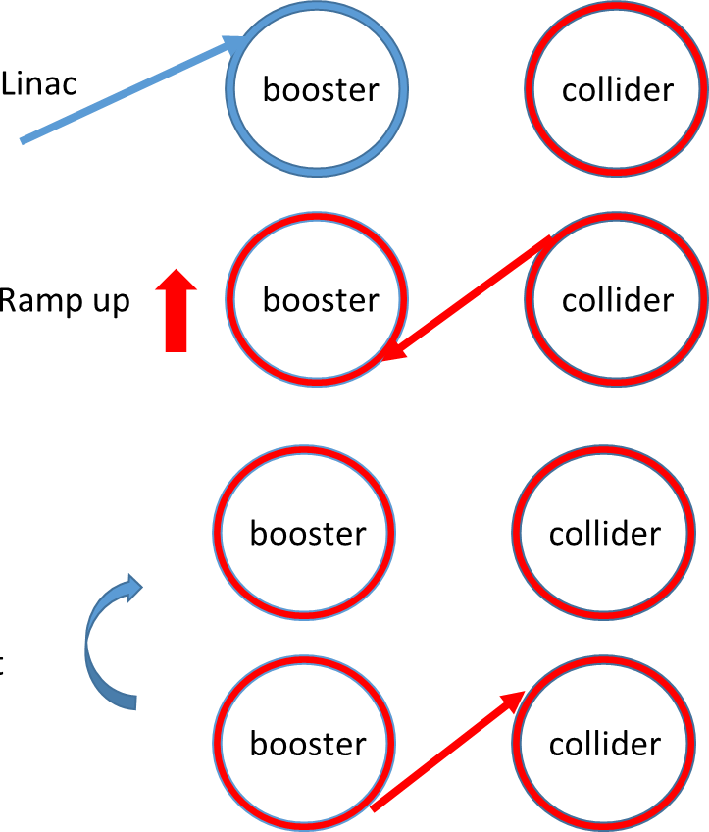

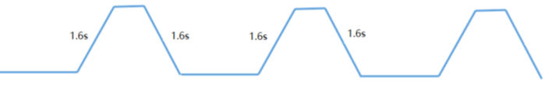
Booster ramping scheme
Dou Wang, Xiaohao Cui
0.035s
On-axis injection @Higgs
tt
7.1s
7.1s
0.35s+7.1s+0.035s+7.1s=14.6s
1 cycles/beam
0.35s
0.27s
4.7s damping
Higgs
4.3s
4.3s
4.3s
4.3s
1 cycles/beam
2.7s
off-axis
2.7s
on-axis
2.7s+4.3s+4.7s+4.3s=16.0s
1.3s
W
2.4s
2.4s
1 cycles/beam
12.97s+2.4s+1.3s+2.4s=19.1s
12.97s
0.05s
Z
1.0s
1.0s
1.0s
(19.9s+1.0s+0.05s+1.0s)*3=65.9s
1.0s
19.9s
19.9s
3 cycles/beam
19.9s

Slide 15
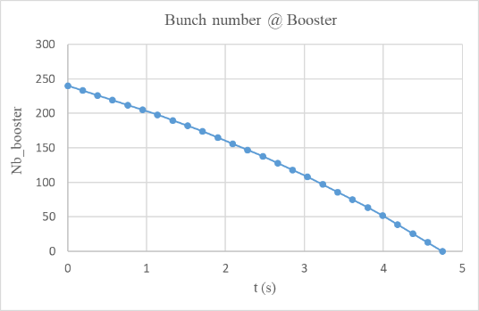
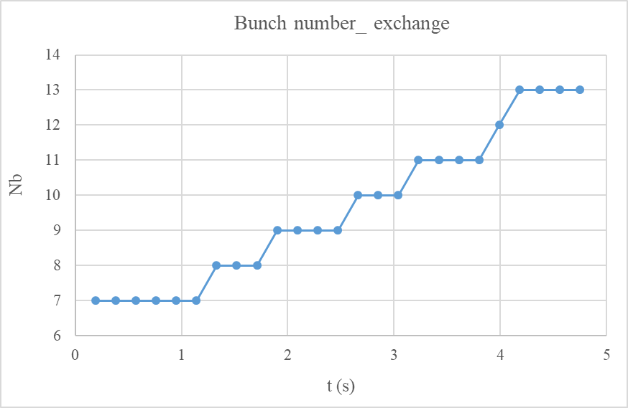
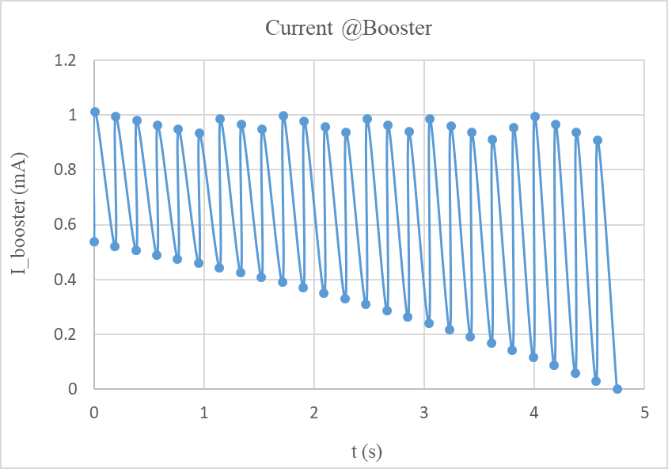
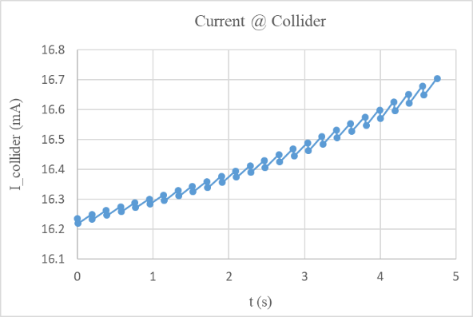
On-axis injection at Higgs energy (30MW)
Swap-out injection
Current threshold in booster: 1mA
Current decay for collider: 3% (top up mode)
4 damping times to merge the bunches in booster

Slide 16
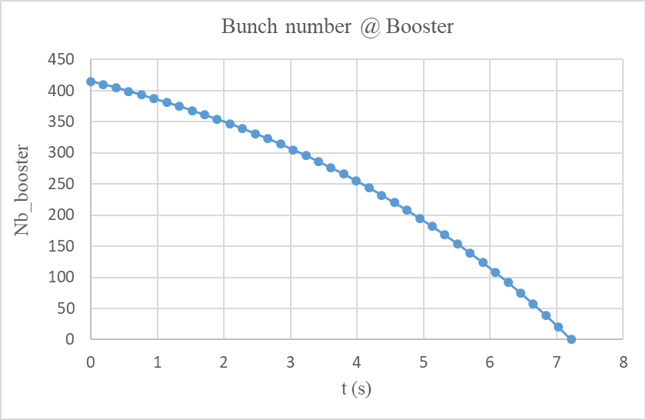
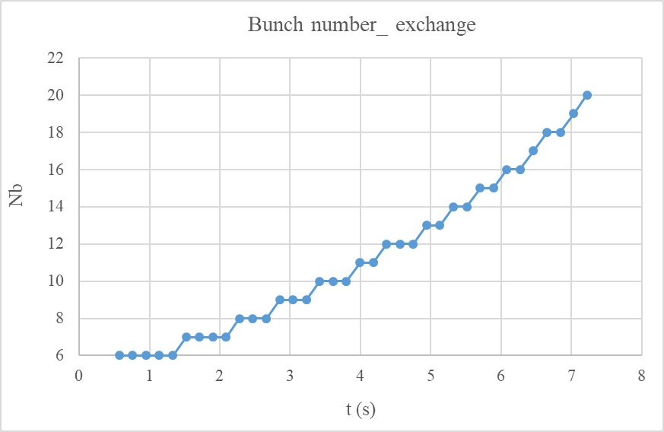
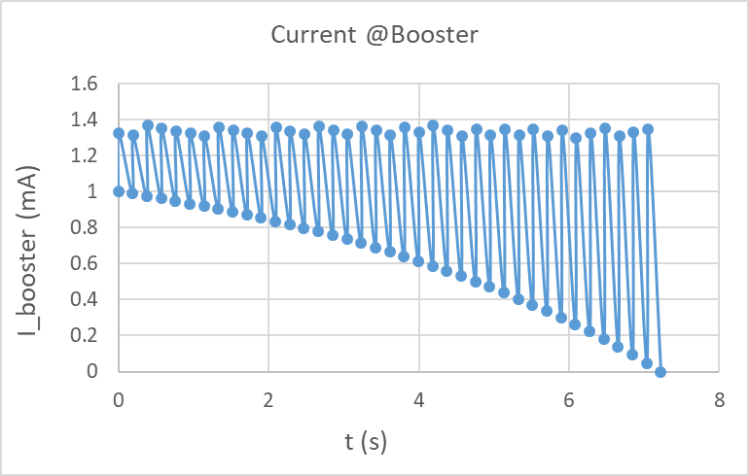
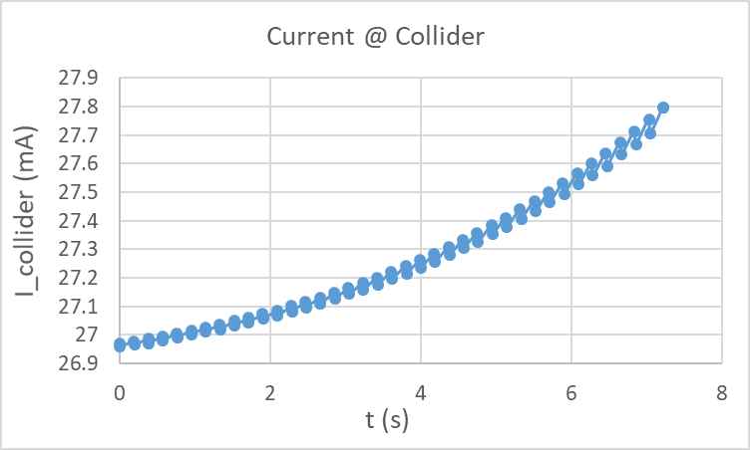
On-axis injection at Higgs energy (50MW upgrade)
Swap-out injection
Current threshold in booster: 1.4 mA
Current decay for collider: 3% (top up mode)
Small upgrade for the RF power source

Slide 17
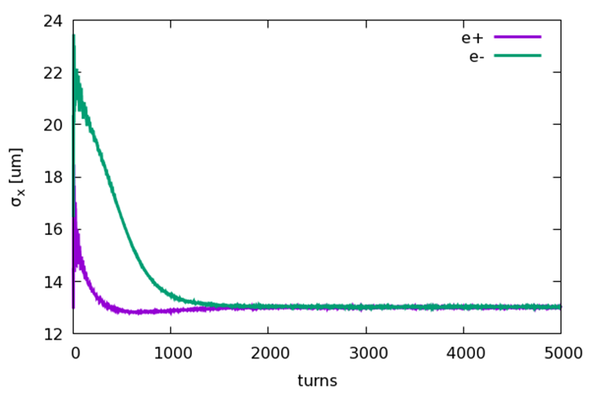
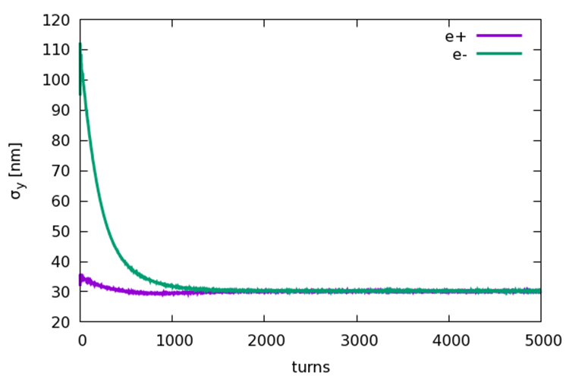
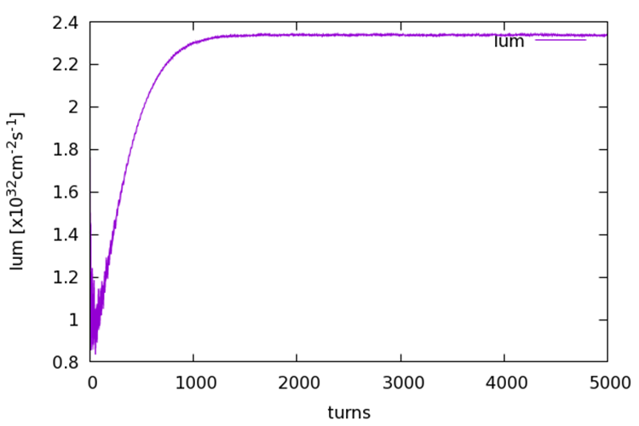
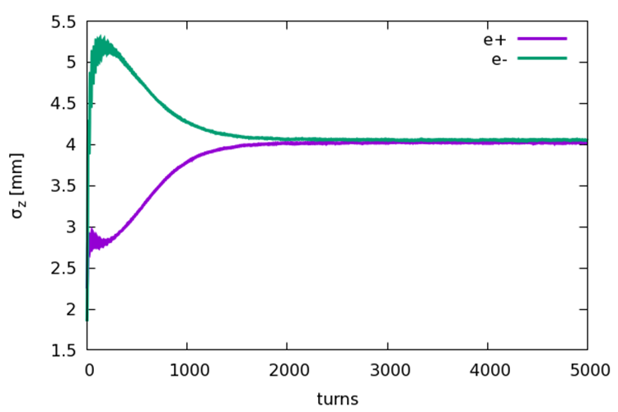
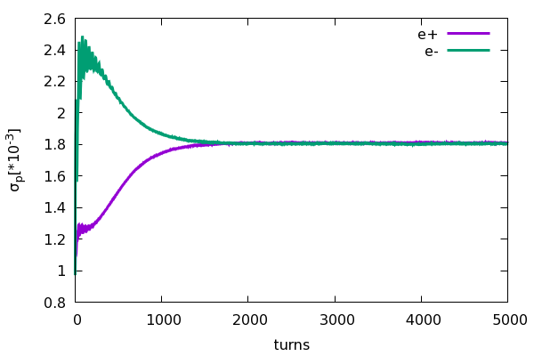
Beam beam instability for on-axis injection
Yuan Zhang
Collision stability check for on-axis injection scheme at 120GeV
e- (Ne=14×10¹⁰)
e+ (Ne=14×10¹⁰)
• Emittance X = 1.26nm
• Energy spread = 0.1%
• Bunch length=1.85mm
• Coupling=1.0%
• Emittance X = 0.64nm
• Energy spread = 0.1%
• Bunch length=2.25mm
• Coupling=0.2%

Slide 18
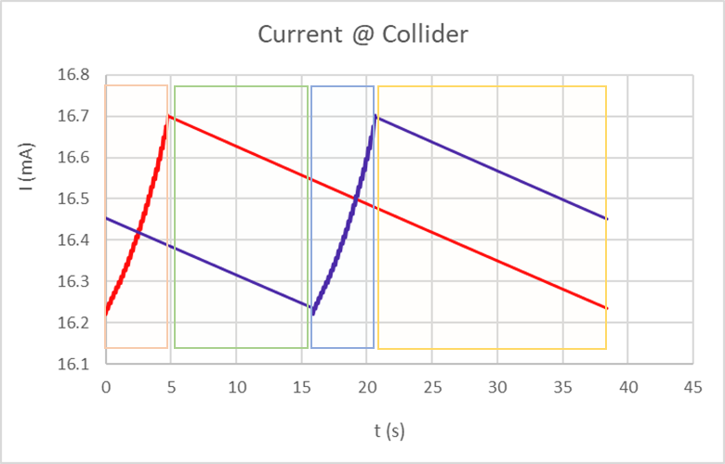
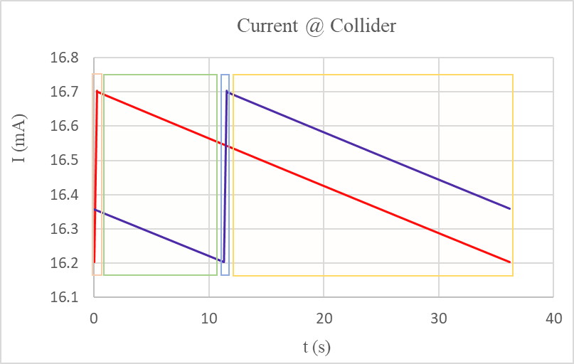
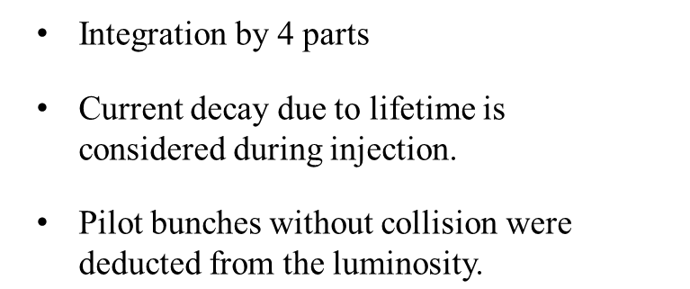
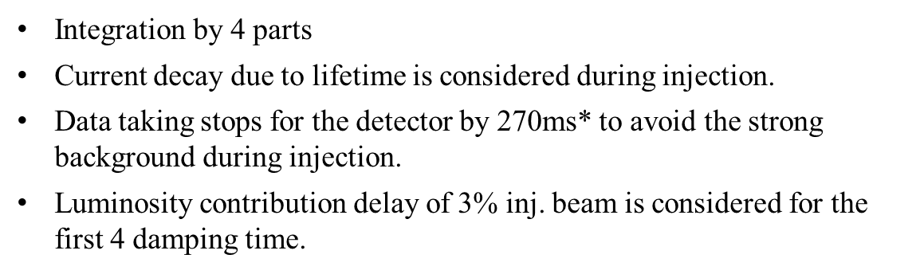
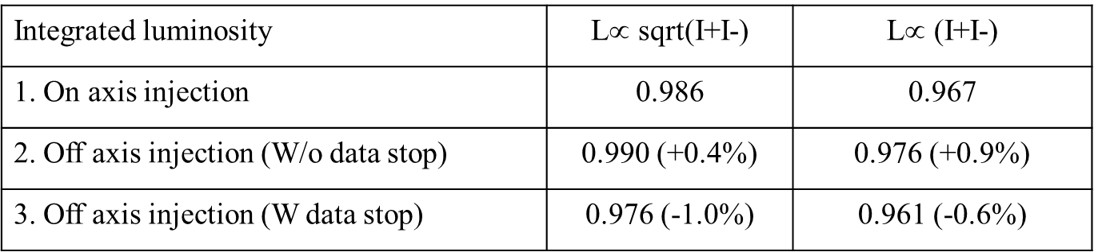
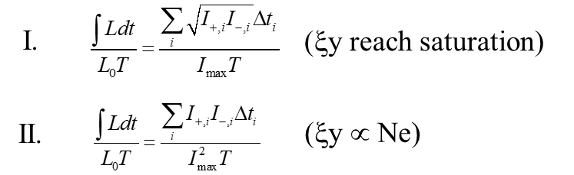
Integrated luminosity @H - on axis inj. Vs. off axis inj.
On-axis
Off-axis
*240ms (injection time) + 30ms (2/3 damping time)

Slide 19
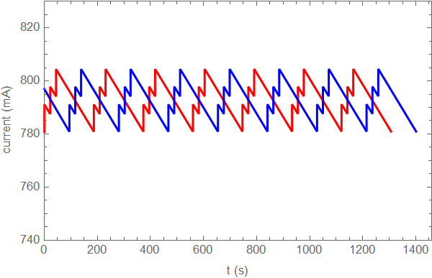
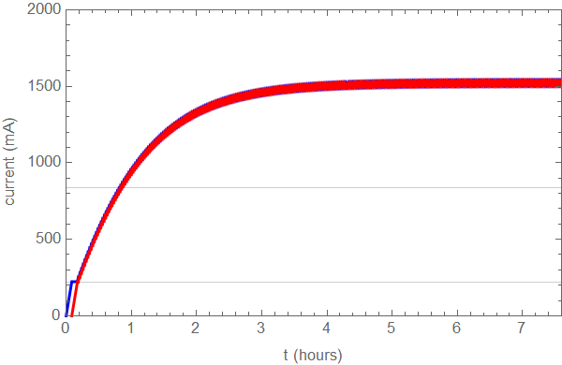
Injection scheme at Z pole
Top-up injection
Full injection
Current drop: 3.0% (804mA in collider)
Booster current = 9.5mA
Train num. @ booster = train num.@collider / 3
Injection speed of Linac: double bunch@100Hz
Train num. @ booster = train num.@collider / 2
Bootstrapping from 220mA (beam-beam stability)
Injection speed of Linac: double bunch@100Hz
Booster threshold: 16mA
0.8h
* D. Wang, et. al., “Problems and considerations about the injection philosophy and timing structure for CEPC”, International Journal of Modern Physics A, 2022.

Slide 20
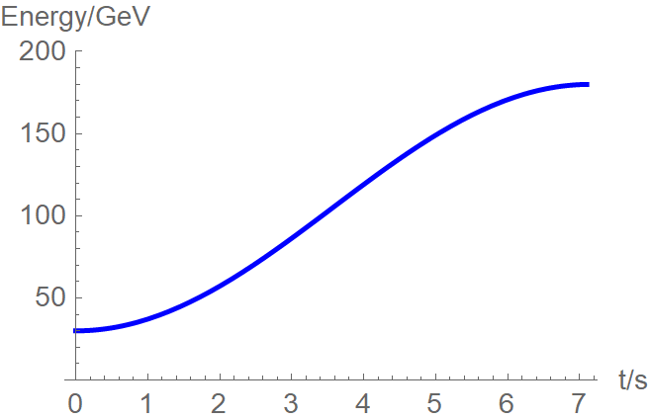
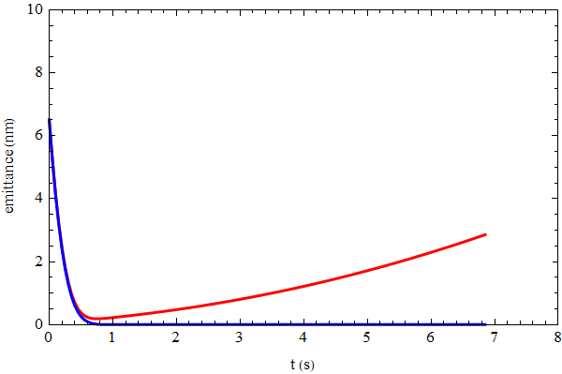
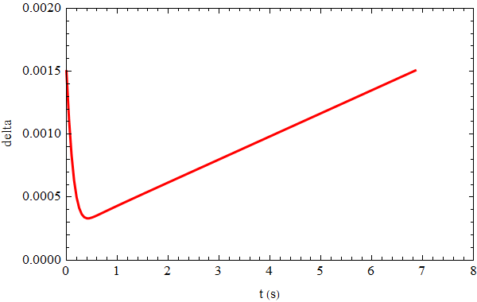
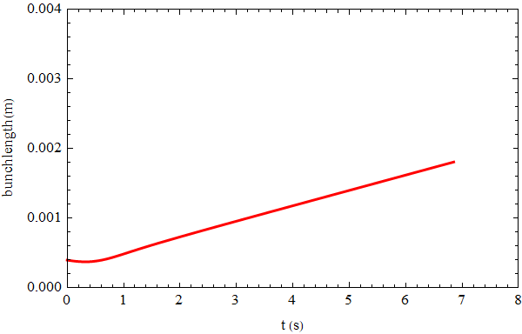
Beam parameter evolution
Injection emittance: 6.5nm @30GeV
Beam parameters reach balance after 45GeV.
emittance
energy
emit_x
emit_y
energy spread
bunch length

Slide 21
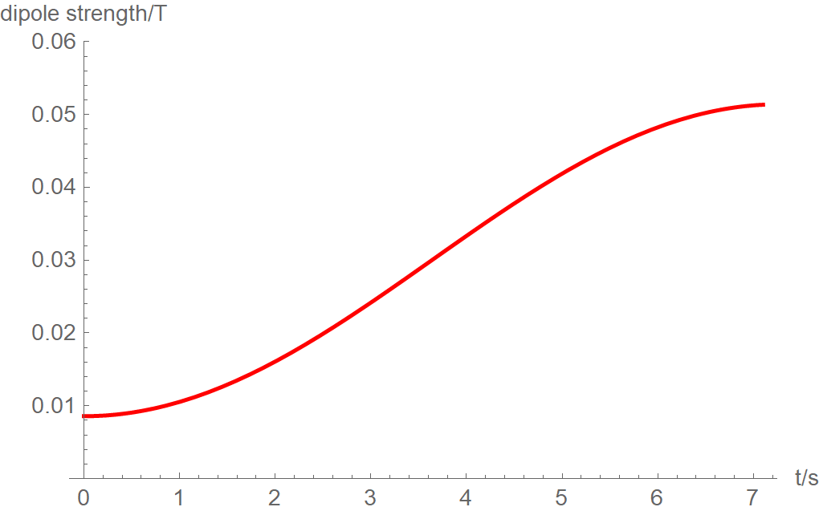
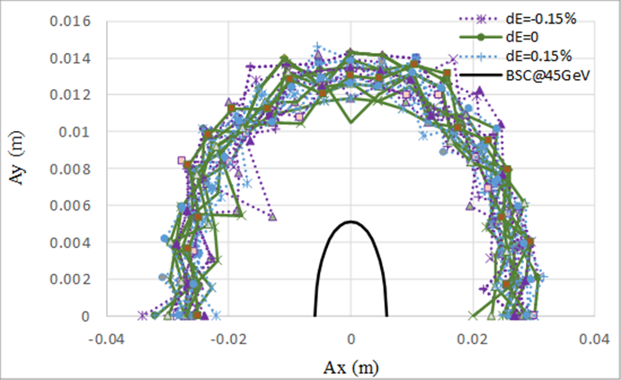
Eddy current effect
Dedicated ramping curve to control the maximum K2.
Al beam pipe (round shape)
Dou Wang, Yuemei Peng, Daheng Ji
- inner diameter: 56mm, thickness: 2mm
Dynamic chromaticity is not corrected.
- Sextupole field is attached to dipole
30 GeV injection weaken the eddy effect
Analytical estimation for eddy effect*
K2 reaches max at 45GeV.
Max K2=0.000029 (m⁻³)
*Yuan Chen et al., Analytical expression development for eddy ﬁeld and the beam dynamics eﬀect on the CEPC booster, IJMPA, Vol. 36, No. 22 (2021) 2142010

Slide 22
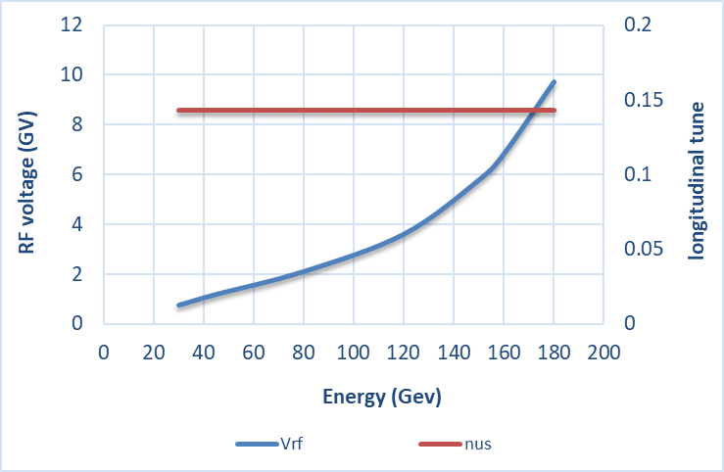
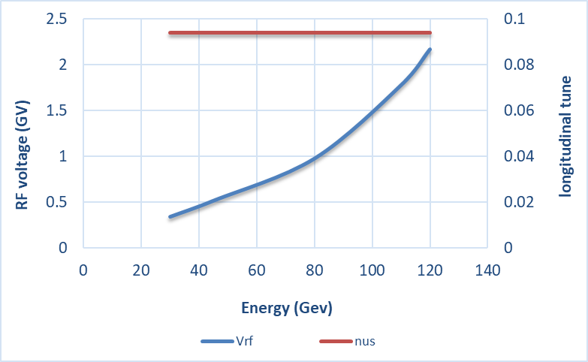

RF ramping curve
D. Wang, J.Y. Zhai
Different RF ramping curve for each energy mode (constant νs )
νs for tt: 0.14
νs for Higgs: 0.094
νs for W & Z: 0.088
tt
Max RF voltage @tt determined by longitudinal quantum lifetime & DA.
η_{RF}: ~ 12 ×δ
VRF (180GeV)=9.8GV
Higgs
W &Z

Slide 23
Booster instability
Y. D. Liu, J. Y. Zhai, D. Yin, Y. F. Sui, J. H. Yue
30GeV: Multi-bunch coupled instability
Growth time
(Z mode)
~ 18ms (transverse)
~ 250ms (longitudinal)
Damping time of feedback
~ 10ms (transverse)
~ 200ms (longitudinal)
120GeV: Single-bunch TMCI instability due to swap-out injection
Threshold of bunch current: 70uA (56mm aluminum chamber )
Maximum bunch current: 62uA

Slide 24






RF beam loading effect @ 30 GeV
T. M. Xin, J. Y. Zhai
Transient beam loading due to half filled ring in Higgs mode.
Assuming a constant detuning and a consistent loaded Q optimized for the top energy in each energy mode.
The longitudinal coupled bunch mode will be effectively managed with the aid of bunch-by-bunch feedback.
However, for Z mode we might need to consider adding more power to meet the requirement.
Higgs
Higgs
Higgs
W
Z
df = -19.4 Hz
df = -216 Hz
df = -752 Hz
Pg = 0.095 MW
Growth rate = 3.7 Hz
Pg = 0.61 MW
Growth rate < 0.01 Hz
Pg = 1.14 MW
Growth rate = 0.88 Hz

Slide 25
Vacuum requirement in booster
D. Wang, Y. S. Ma
 | 30GeV | 45.5GeV | 80GeV | 120GeV | 180GeV
P (ntorr) | 30 | 30 | 30 | 30 | 40
Vacuum lifetime at five energy > 3 hours (include 50MW upgrade)
30 GeV is the most demanding energy from the view of vacuum lifetime.
beam-gas bremsstrahlung @30GeV
beam-gas electron bremsstrahlung @30GeV

Slide 26
Booster TDR parameters
Injection energy: 10GeV → 20GeV → 30GeV
Max energy: 120GeV → 180GeV
Lower emittance ─ new lattice (TME)
Extraction
Injection
*Diameter of beam pipe is 56mm for re-injection with high single bunch current @120GeV.

Slide 27
Content
Design status for CEPC Booster
  Booster design requirements in TDR
  Booster TDR optics (including errors)
  Timing structure & dynamic parameters during ramping
  Summary of Booster TDR parameters
Design status for CEPC positron damping ring
  DR parameters
  DR optics (including errors)
  Particle tracking through the transport lines
Summary

Slide 28
Damping ring design requirement
Dou Wang, Cai Meng
lower emittance collider → lower emittance booster → lower emittance linac
 | CDR | TDR | remark
Energy (GeV) | 1.1 | 1.1
Inj. Emittance (mm⋅mrad) | 2500 | 2500
Ext. emittance (mm⋅mrad) | 530 | <200 | 1) Linac lower emittance: 10nm@30GeV, 2)use C band acc. structure as early as possible
Storage time (ms) | 20 | 20
Damping time (ms) | 15 | <13 | 1) Smaller ext. emittance with same storage time
Circumference (m) | 75 | ~150 | 1) Smaller nature emittance for DR

Slide 29

Damping ring layout (CDR)
Linac repetition: 100Hz
Only for positron beam
Storage time: 20 ms
Emittance (norm.): 2500→ 530 mm.mrad
e +

Slide 30
DR parameters in TDR
Damping with reversed bending magnet
4 (max. 8)-bunch storage, storage time:20 (40) ms
Emittance: 2500→ 166/75 (97/3) mm.mrad
Flexibility for extr. emittance
 | DR V3.0
Energy (Gev) | 1.1
Circumference (m) | 147
Number of trains | 2 (4)
Number of bunches/trian | 2
Total current (mA) | 12.4 (24.8)
Bending radius (m) | 2.87
Dipole strength B₀ (T) | 1.28
U₀ (kev/turn) | 94.6
Damping time x/y/z (ms) | 11.4/11.4/5.7
Phase/cell (degree) | 60/60
Momentum compaction | 0.013
Storage time (ms) | 20 (40)
δ₀ (%) | 0.056
ε₀ (mm.mrad) | 94.4
injection σ_{z} (mm) | 4.4
Extract σ_{z} (mm) | 4.4
ε_{inj} (mm.mrad) | 2500
ε_{ext x/y} (mm.mrad) | 166(97)/75(3)
δ_{inj} /δ_{ext} (%) | 0.18 /0.056
Energy acceptance by RF(%) | 1.8
f_{RF} (MHz) | 650
V_{RF} (MV) | 2.5
Longitudinal tune | 0.0387

Slide 31

DR time structure
Xiaohao Cui, Cai Meng, Gang Li, Ge Lei, Jinhui Chen…
Double bunch (Inj./Ext.: two by two) ⎯ at Z pole
tt/Higgs/W: 100Hz (Inj./Ext.: bunch by bunch)

Slide 32



DR optics
Cell length: 3m
B=1.28T
θ_{r} /θ₀=0.355
Phase/cell: 60°/60°
Interleave sextupole scheme
2 sex. families
Straight
-θ_{r}
B=1.28T
θ₀
Arc

Slide 33

DR DA results
Large trans. acceptance→ inj. efficiency
DA > 5 inj. beam size (ε_{inj}=2500mm.mrad)
Energy acceptance =1.8% (RF)
Phase/cell: 60°/60°

Slide 34


Error study for DR
Orbit correction only
Daheng Ji, Dou Wang
Parameters | Dipole | Quadrupole | Sextupole
Transverse shift X/Y (μm) | 100 | 100 | 100
Longitudinal shift Z (μm) | 100 | 150 | 100
Tilt about X/Y (mrad) | 0.2 | 0.2 | 0.2
Tilt about Z (mrad) | 0.1 | 0.2 | 0.1
Nominal field | 1×10⁻³ | 2×10⁻⁴ | 3×10⁻⁴
Parameters | BPM (10 Hz)
Accuracy (m) | 1×10⁻⁷
Tilt (mrad) | 10
Gain | 5%
Offset after beam based alignment (BBA) (mm) | 30×10⁻³
Dipole | Quadrupole | Sextupoles
B₁ ≤ 2
B₂ ≤ 3 | B₂ ≤ 3
B₃ ≤ 0.2 | B₃ ≤ 2 | B₃ ≤ 10
B₄ ≤ 0.8 | B₄ ≤ 1 | B₄ ≤ 3
B₅ ≤ 0.2 | B₅ ≤ 1 | B₅ ≤ 10
B₆ ≤ 0.8 | B₆ ≤ 0.5 | B₆ ≤ 3
B₇ ≤ 0.2 | B₇ ≤ 0.5 | B₇ ≤ 10
B₈ ≤ 0.8 | B₈ ≤ 0.5 | B₈ ≤ 3
B₉ ≤ 0.2 | B₉ ≤ 0.5 | B₉ ≤ 10
B₁₀ ≤ 0.8 | B₁₀ ≤ 0.5 | B₁₀ ≤ 3
BSC_{x,y}=5σ_{inj_x,y}+5mm
Energy acceptance: 8.3δ_{inj}=1.5%
* refer to the poster B01 on this workshop

Slide 35

Transport lines between DR and Linac
X. H. Cui, D. Wang
Linac→DR | EC
E₀ (Gev) | 1.1
δ₀ (%) | 0.5
σ_{z0} (mm) | 1.5
f_{RF} (MHz) | 2860
V_{RF} (MV) | 16.5
Length of acc. Structure (m) | 1.0
φ_{RF} (degree) | 87
R₅₆ (m) | -0.83
E_{f} (Gev) | 1.1
δ_{f} (%) | 0.18
σ_{zf} (mm) | 4.4
DR→Linac | BC
E₀ (Gev) | 1.1
δ₀ (%) | 0.056
σ_{z0} (mm) | 4.4
f_{RF} (MHz) | 2860
V_{RF} (MV) | 20.6
Length of acc. Structure (m) | 0.76
φ_{RF} (degree) | 89.7
R₅₆ (m) | -0.89
E_{f} (Gev) | 1.1
δ_{f} (%) | 0.55
σ_{zf} (mm) | 0.5

Slide 36




Particle tracking from Linac to DR (before ECS)
Cai Meng
Track by SAD (real distribution)
Inj emittance: ~2500mm.mrad
σ₀ :~1.5mm (RMS)
δ₀ :~0.4% (RMS)

Slide 37




Particle tracking from Linac to DR (after ECS)
Dou Wang, Xiaohao Cui, Cai Meng
Track by SAD (real distribution)
Transporting efficiency: ~95%
σ_{f} :~ 4 mm (RMS)
δ_{f} :~0.18% (RMS)

Slide 38


Particle tracking from DR to Linac
Dou Wang, Xiaohao Cui
Track by SAD (Guass distribution)
Ext. emittance: 166 (H) /75 (V) mm.mrad
σ_{f} :~ 0.5 mm (RMS)
δ_{f} :~0.55% (RMS)
Initial
Final

Slide 39




Alternative design for the DR with polarization
Z. Duan, D. Wang
Produce polarized positron beam for the purpose of energy calibration @ Z & W*.
DR V4.0 | unpolarized e+ | polarized e+
Energy (Gev) | 1.542
Circumference (m) | 145
Number of trains | 2(4)
Number of bunches/trian | 1(2)
Total current (mA) | 12.4
Bending radius (m) | 3.44
Dipole strength B₀ (T) | 1.5
Wiggler strength B₊ (T) | 1.8
Wiggler cell length (m) | 1.5
U₀ (kev/turn) | 190.9
Damping time x/y/z (ms) | 7.77/7.77/3.89
Momentum compaction | 0.015
Storage time | 20 ms | 10 min
δ₀ (%) | 0.072
ε₀ (mm.mrad) | 138
injection σ_{z} (mm) | 6
Extract σ_{z} (mm) | 5.7 | 5.6
ε_{inj} (mm.mrad) | 2500
ε_{ext x/y} (mm.mrad) | 150/15 | 138/14
δ_{inj} /δ_{ext} (%) | 0.18 /0.072
RF acceptance (%) | 1.8
f_{RF} (MHz) | 650
V_{RF} (MV) | 3.95
Longitudinal tune | 0.044
10 min storage → ~20% polarization
arc
Compatible with standard top up operation
Asymmetric wigglers
B₊=1.8T=5 B₋
cell length=1.5m
wiggler
Wiedemann, Particle Accelerator Physics, 4 Edition
* detail in Zhe Duan’ talk on this workshop
16 wigglers

Slide 40
Summary
Booster energy range is modified in TDR. (10GeV/120GeV → 30GeV/180GeV)
Update booster design with smaller emittance in TDR─ support for CEPC high lum. scheme
TME structure with combined magnets (B+S)
Booster parameters update ─ consistent with CEPC TDR parameters at 4 energy
Booster design meets all energy mode requirements of collider (inc. error effects/SR/eddy current).
Damping ring update is also the requirement of higher luminosity goal for TDR.
Circumference: ~150m, energy: 1.1GeV
Reversed bending, extracted emittance=97~166 mm⋅mrad (adjustable)
Damping time: 15ms (CDR) → 11ms (TDR)
DR design meets the requirements of Linac (inc. error effects).

Slide 41
Thanks for your attention!

