Slide 1



CEPC Transport lines and Timing
Speaker: Xiaohao Cui
On Behalf of CEPC AP Group

Slide 2
Introduction
Gun
Linac
30 GeV
Booster Ring
Collider Ring
30 GeV
Damping ring
Injection and extraction from: Linac, damping ring, booster, and collider, and to the dump;
Energy: Higgs (120 GeV), W (80 GeV), Z (45.5 GeV), tt (180 GeV);

Slide 3
Design Parameters / Requirement List
30 MW
 | Higgs | W | Z | tt
Bunch number in collider | 268 | 1297 | 11934 | 35
Bunch charge in collider (ns) | 20.8 | 21.6 | 22.4 | 32
Bunch number in booster | 268 | 1297 | 3978 | 35
Bunch Spacing | 591 ns | 257 ns | 23 ns | 4524 ns
Lifetime (min) | 20 | 55 | 80 | 18

Slide 4
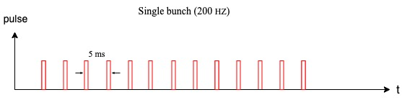
1. Linac
From the electron gun, bunches are generated in 100 Hz.
pulse
10ms
t
For Z mode, more bunches are needed
It can be upgraded to double bunch (100Hz)
200Hz can be an upgrade choice
70ns
100 ms
4

Slide 5
2. Damping Ring
Positron bunches will be injected into a damping ring at 1.1 GeV.
Damping ring circumference | 150 m
Store time of the bunches: | 20 ms
T=0
The bunches are injected into the damping ring with the same frequency as bunches in the Linac;
For double-bunch or 200Hz mode, more bunches will be stored in the damping ring;
Each bunch which cooled for 20 ms will be extracted and re-injected into the linac.
With small changes, the cooling time of the bunches can be increased by holding more bunches in the damping ring.
T=10ms
T=20ms-250ns
T=20 ms
T=30ms-250ns

Slide 6
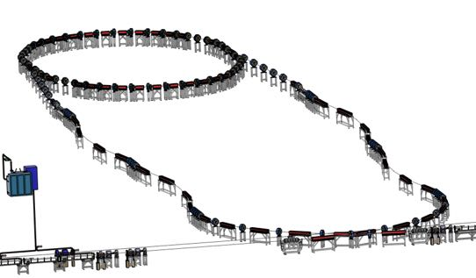
2. Damping Ring
Linac repetition: 100Hz
Energy: 1.1 GeV
Before damping ring, Energy spread of the beam should be reduced in order to match the RF acceptance of the damping ring.
After damping ring, Bunch length of the beam should be reduced to control the energy spread after acceleration.
Geometry of the transport line between Linac and damping ring

Slide 7
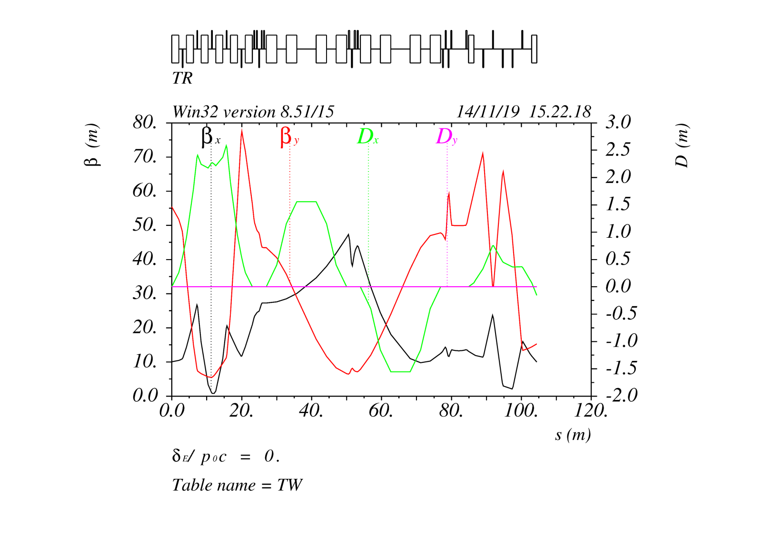
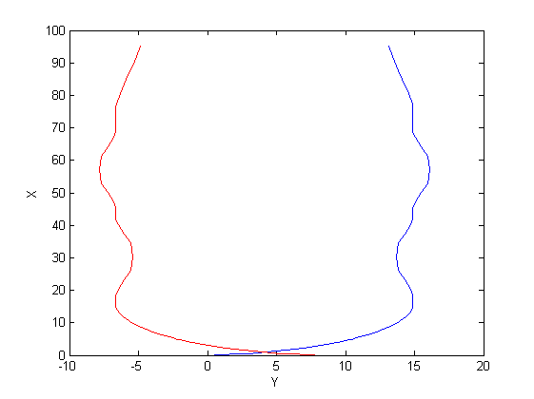
2. Damping Ring
Chicanes for Bunch length control;
Arcs for geometry design;
Matching for injection twiss matching;
Arcs
Chicane
Matching
Lattice and Emittance evolution in the transport line
7

Slide 8
2. Damping Ring
Lattice at injection point/ Extraction point
0.5m
Lambertson
Kicker
Top View:
1.25m
1.25m
0.847m
1m
0.5m
Side View:

Slide 9
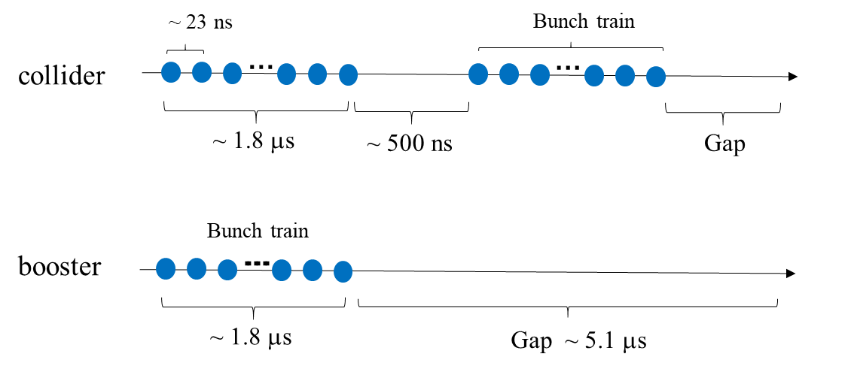
3. Linac to Booster
Energy: 30 GeV
For Higgs, W, Z, tt modes, the bunch pattern is different in the booster.
For Higgs, W and tt modes, the bunch pattern in the booster is the same as that in the collider.
For Z mode, the bunch number in the booster is 1/3 of that in the collider, and bunches are arranged in bunch trains.
There are 78 bunches in a train both for the collider and booster.
There are 153 bunch trains in the collider, and 51 bunch trains in the booster.

Slide 10
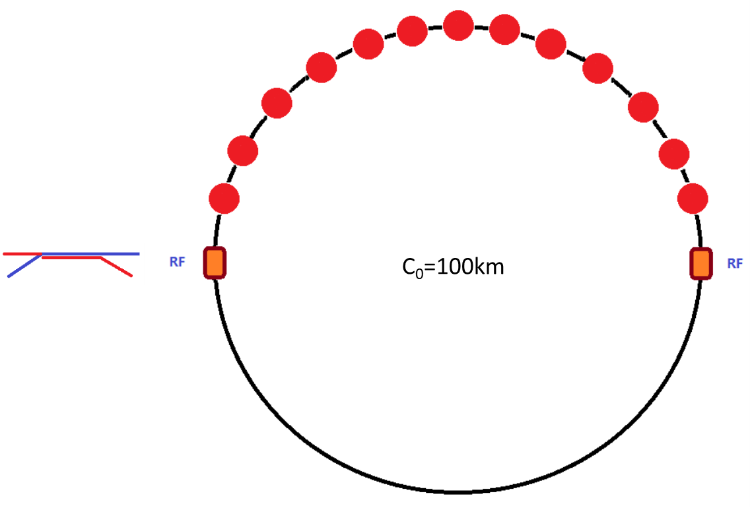
3. Linac to Booster
To share the RF system, for tt and Higgs energy, bunches per beam are in the half ring both for booster and collider.

Slide 11
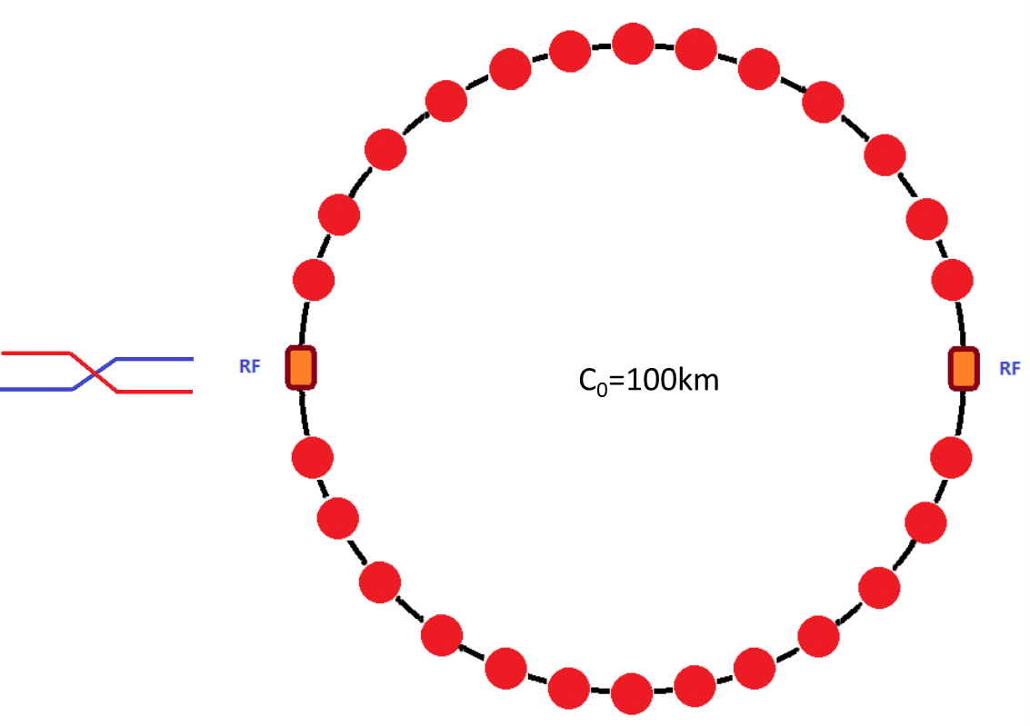
3. Linac to Booster
For W mode, bunches are uniform in the whole ring both for booster and collider.

Slide 12
3. Linac to Booster
bunches per beam are distributed train by train both in booster and collider.
The number of train in the booster is 1/3 of that in the collider.

Slide 13
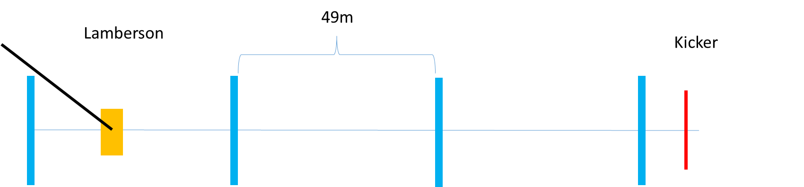
3. Linac to Booster
Injection into the booster is also a standard on-axis injection

Slide 14
3. Linac to Booster
Bunches from the Linac will be in 100 Hz
T_{Linac}=N*Turns+T_{booster}
Booster Ring
T_{Linac}
T_{booster}
For Higgs, W, and tt mode, we inject the bunches one by one, so by changing T_{Linac} slightly, we can fill the booster with any pattern we needed.

Slide 15
4. Extraction from Booster
Energy: 45 GeV, 80 GeV, 120 GeV, 180 GeV
Beam: positron & electron
Extraction for different bunch patterns.
For Z energy, it becomes more complicated due to the large bunch number needed in the collider.
the separation between bunches are only 20~30 ns. Considering the rise time of the kickers, bunches are arranged train by train in the collider for Z energy.
For Higgs, W, tt, the bunches are extracted bunch by bunch;
For Z energy, the bunches are extracted train by train.
15

Slide 16
5. Injection to Collider
Considering the robustness of the design, the injection of the main collider ring is conventional off-axis injection. (Maybe an on-axis injection is needed for Higgs)
For tt, Higgs and W energy, injection into the collider is bunch by bunch; and for Z energy, injection is train by train.
Bunch by bunch
Train by train
Kicker:
1000 Hz
1000 Hz
The kickers rise up, inject one bunch into the collider, and fall down. This process repeated in 1000 Hz, to inject all bunches into the ring.
The kickers rise up, stay there to inject a whole train into the collider, and fall down. This process repeated in 1000 Hz, to inject all bunches into the ring.

Slide 17
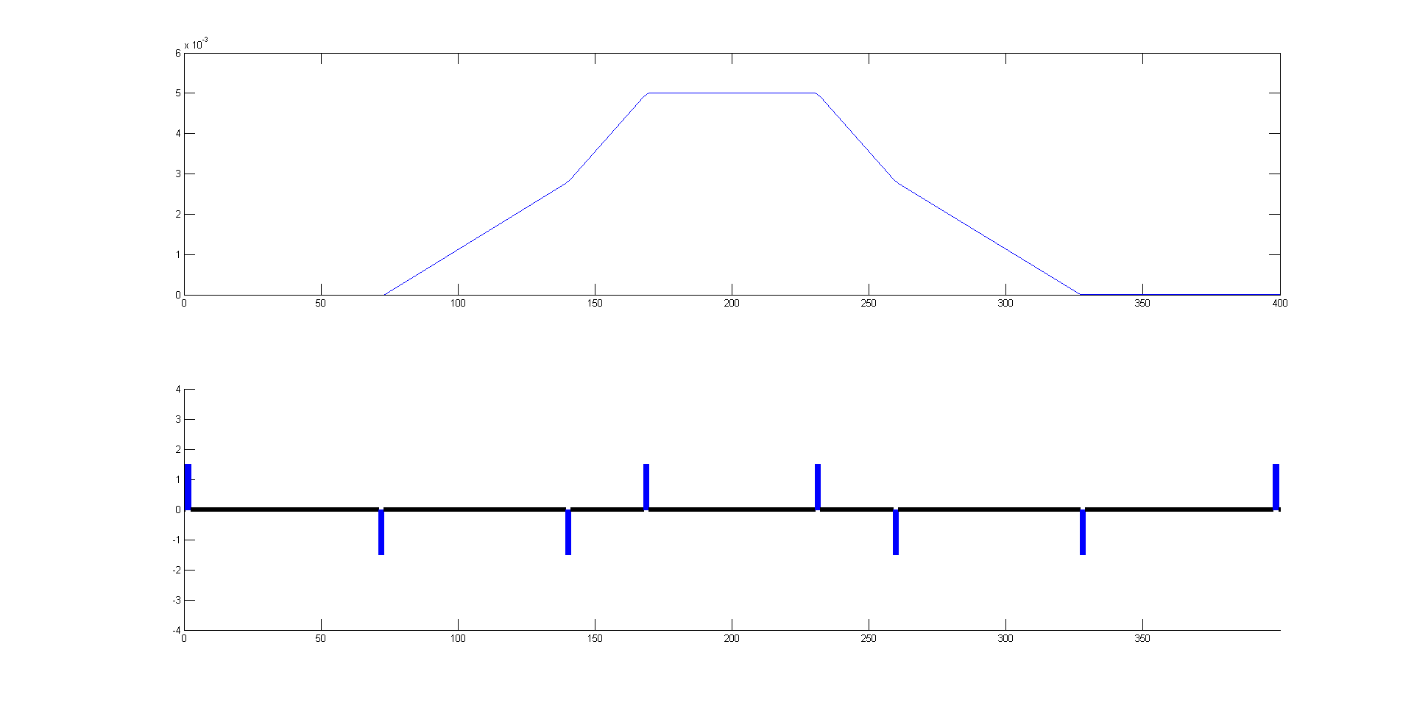
5. Injection to Collider
60m
26m
66m
68m

Slide 18
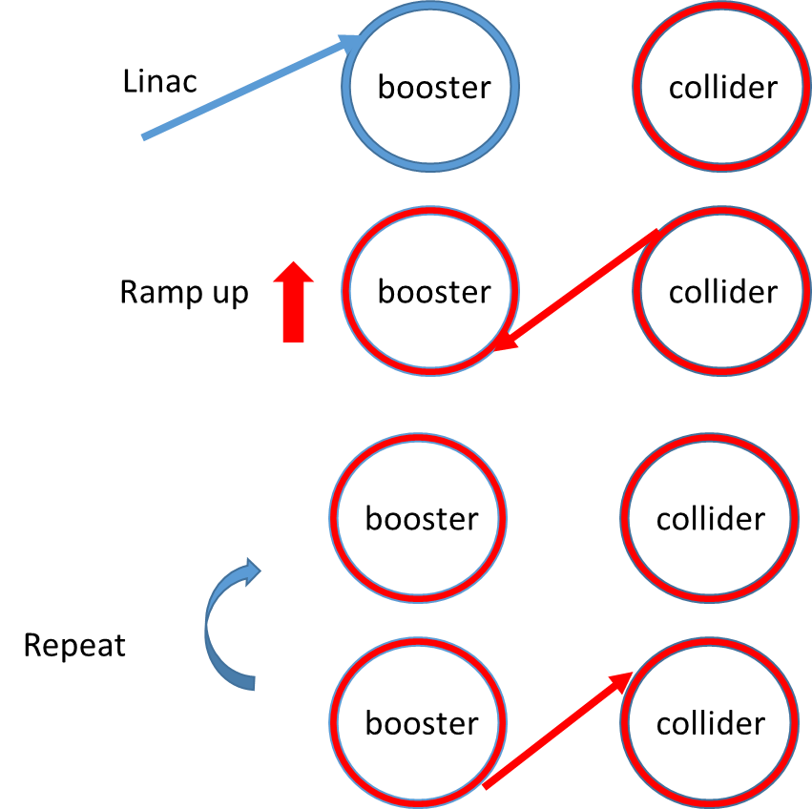
5. Injection to Collider
1. Inject small bunches into the booster.
2. Ramp the booster to high energy and inject several bunches from the collider into the booster.
3. Booster stay at 120 GeV for 4 damping time(200ms), so that the injected large bunches merge with small bunches.
4. Inject the merged large bunches back to the same empty buckets left by the last step.
5. Repeat from last step.

Slide 19
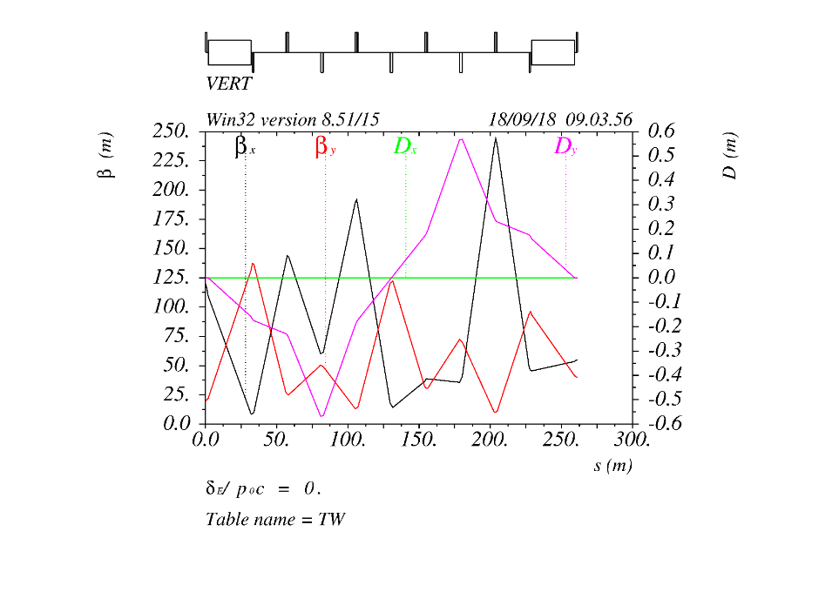
5. Injection to Collider
Twiss for the Transport line

Slide 20
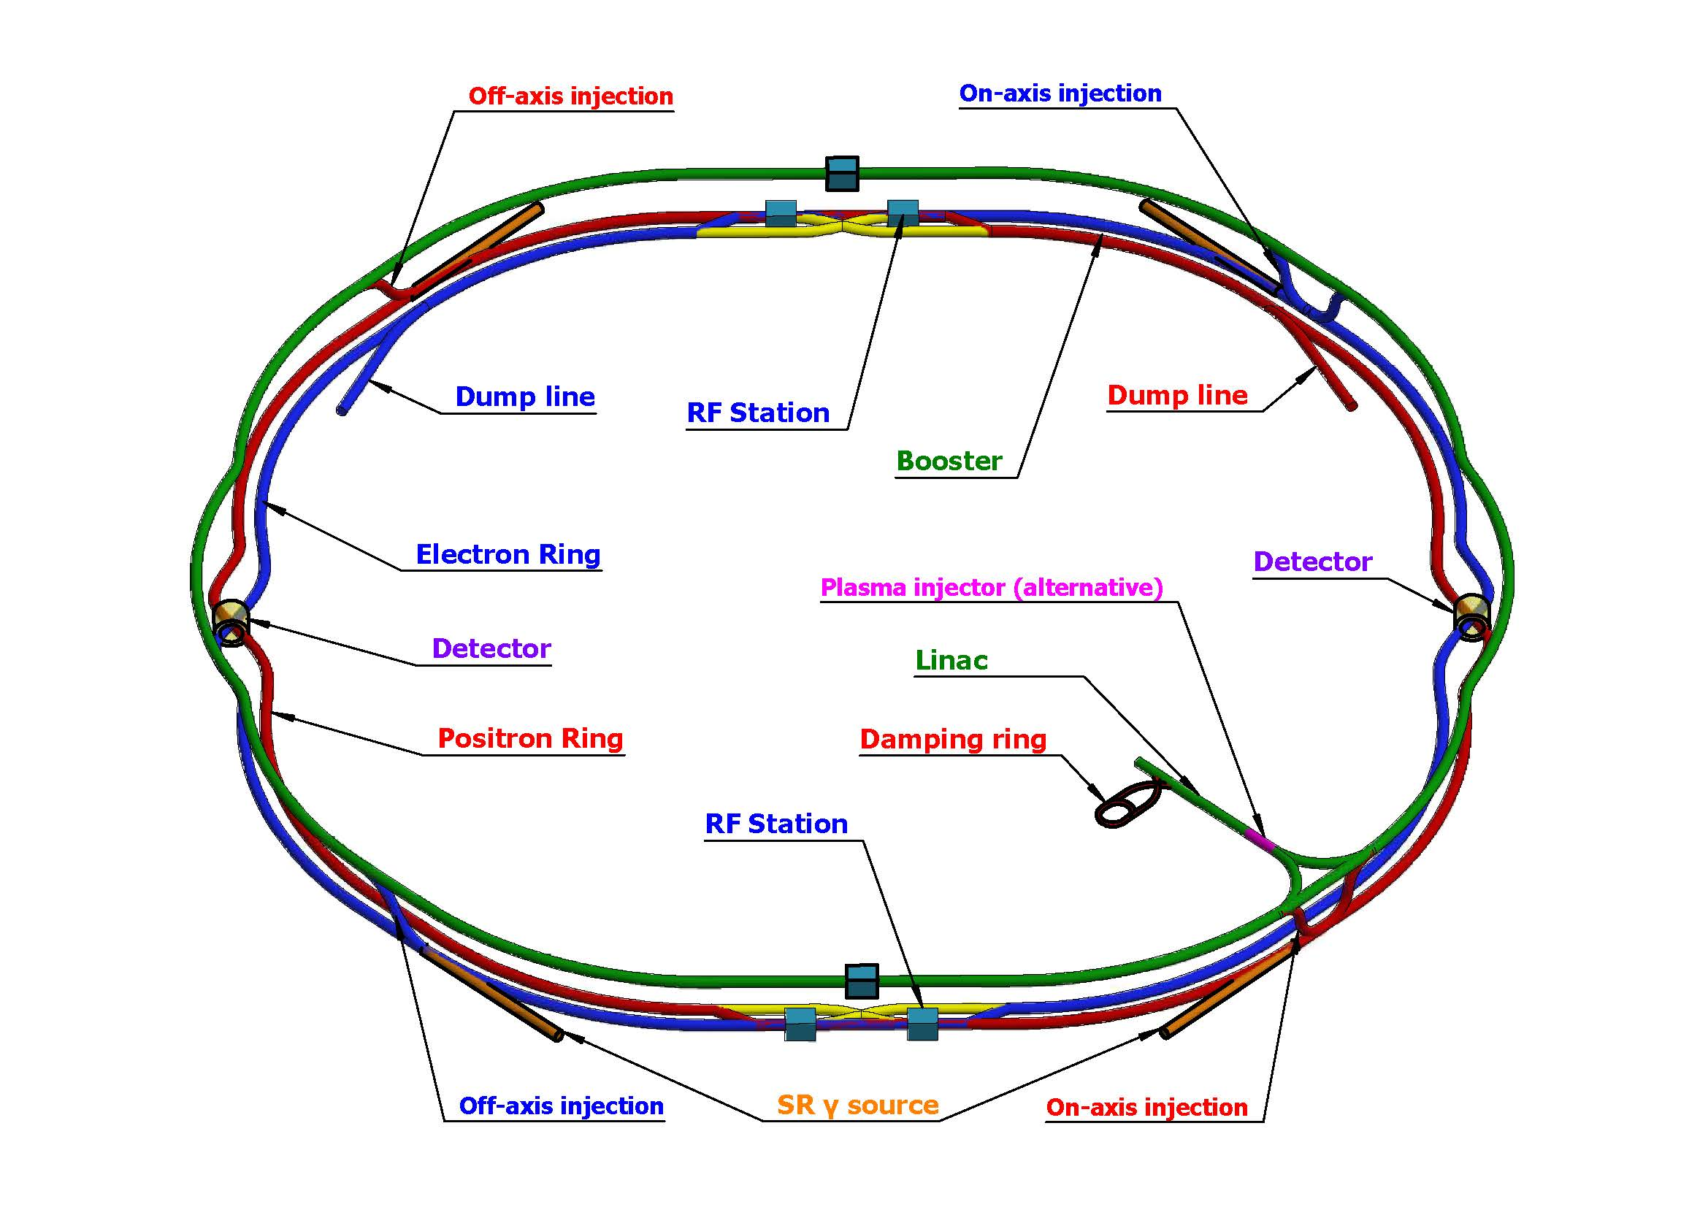
6. Extraction to Dump
For machine and detector protection, added one dump for each collider ring;
Use one kicker and one septum to get the beams into the dump line, so all bunches can be dumped in one turn;
Horizontal and vertical dilution kickers are used to change the position of different bunches at the dump, in order to reduce the beam damage to the dump.

Slide 21
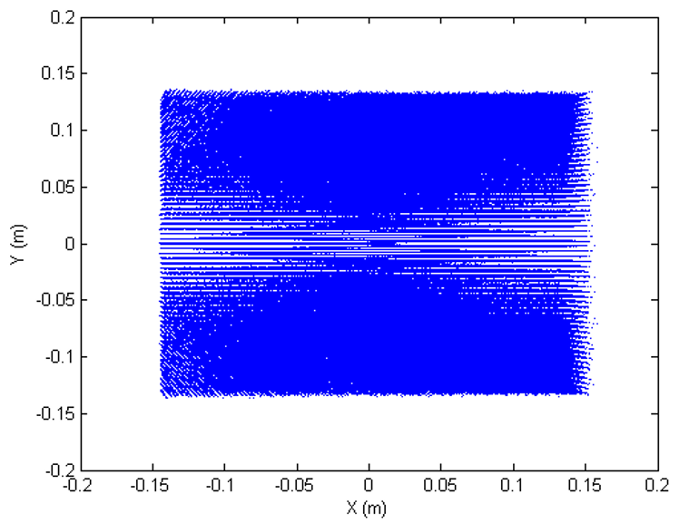
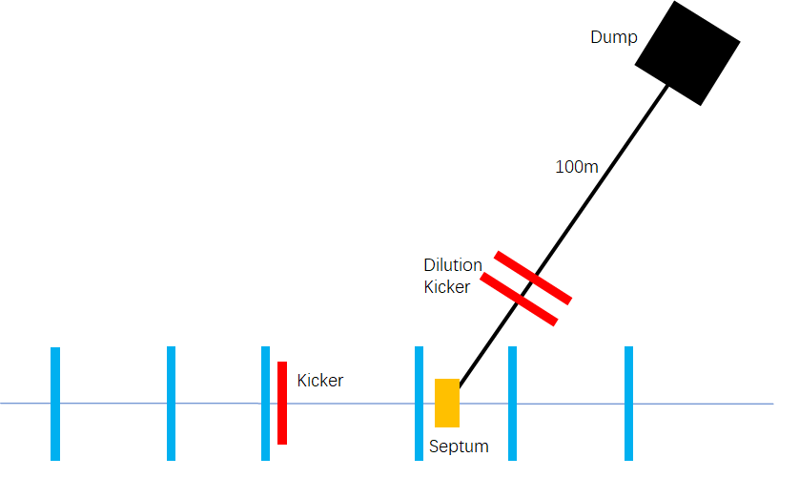
6. Extraction to Dump
Transport line to the dump and particle distributions at the dump

Slide 22
7. Injection time structure
Extract from booster
0.035s
Ramp up
7.1s
Ramp down
7.1s
tt
0.35s+7.1s+0.035s+7.1s ~14.6s
Inject from Linac
0.35s
Extract from booster
0.268s
Ramp up
4.3s
Ramp down
4.3s
Higgs
2.68s+4.3s+0.268s+4.3s ~11.6s
Inject from Linac
2.68s

Slide 23
7. Injection time structure
Extract from booster
1.29s
Ramp up
2.4s
Ramp down
2.4s
W
12.9s+2.4s+1.29s+2.4s ~19.1s
Inject from Linac
12.9s
Extract from booster
0.048s
Ramp up
1.0s
Ramp down
1.0s
Z
Inject from Linac
19.9
(19.9s+1.0s+0.048s+1.0s)*3=65.9s

Slide 24
7. Injection time structure
On-axis injection 5s
Ramp up
4.3s
Ramp down
4.3s
2.4s+4.3s+5.0s+4.3s=16s
Higgs on-axis
Inject from Linac
2.4s

Slide 25
8. To do list for EDR
1. Give an explicit waiting time and restrictions due to the bucket selection for different Energy modes.
2. Injection efficiency optimization with simulation of the whole injection/extraction process including errors.
3. Considerations on the construction of hardwares .

Slide 26
Summary
1. This talk gives a general overview of the timing of CEPC injection process and transport line design.
2. Some challenges and optimization on the design have been explained .
3. Give a to do list aiming at EDR.

Slide 27
Thank You For Your Attention!

