Slide 1



Magnet Power Supply and Electro-magnetic Separator Study Status for CEPC
Bin Chen ( On Behalf of Power Supply Group, IHEP )
23-27. Oct. 2023, Nanjing
The 2023 international workshop on the high energy Circular Electron Positron Collider

Slide 2
Content
Introduction
Magnet Power supply R&D
Electro-magnetic Separator R&D
Summary

Slide 3
Introduction
  Magnet loads of the power supplies for CEPC
    The primary function of the magnet power supply is to provide the necessary excitation current to the magnet.
    Including the Collider ring, the Booster ring, the Transport Line, the Linac and the Damping ring
    Total magnet quantity ：38435
Collider | Dipole |  | Quadrupole |  | Sextupole | Corrector | Magnet quantity
 | D-aperture | S-aperture | D-aperture | S-aperture
 | 3008 | 162 | 3016 | 1116 | 3144 | 7088 | 17534
Booster | Dipole |  | Quadrupole |  | Sextupole | Corrector
 | 14866 |  | 3458 |  | 100 | 1200 | 19624
Linac | Dipole |  | Quadrupole |  | Solenoids | Corrector
 | 15 |  | 364 |  | 37 | 275 | 691
Damping Ring | Dipole |  | Quadrupole |  | Sextupole | Corrector
 | 86 |  | 130 |  | 72 | 60 | 348
Transport Line | Dipole |  | Quadrupole |  | Sextupole | Corrector
 | 64 |  | 120 |  | 0 | 54 | 238
Total | 38435

Slide 4
Introduction
  Requirement of the power supplies for CEPC
    Total Power Supply quantity ：27023
Collider | Dipole |  | Quadrupole |  | Sextupole | Corrector | Trim | SC
 | D-aperture | S-aperture | D-aperture | S-aperture
 | 32 | 38 | 328 | 600 | 1096 | 7088 | 11904 | 88
Booster | Dipole |  | Quadrupole |  | Sextupole | Corrector | Trim
 | 28 |  | 336 |  | 100 | 1200 | 3200
Linac | Dipole |  | Quadrupole |  | Solenoids | Corrector
 | 19 |  | 250 |  | 37 | 277
Damping Ring | Dipole |  | Quadrupole |  | Sextupole | Corrector
 | 8 |  | 104 |  | 2 | 60
Transport Line | Dipole |  | Quadrupole |  | Sextupole | Corrector
 | 26 |  | 148 |  | 0 | 54
Total | 27023

Slide 5
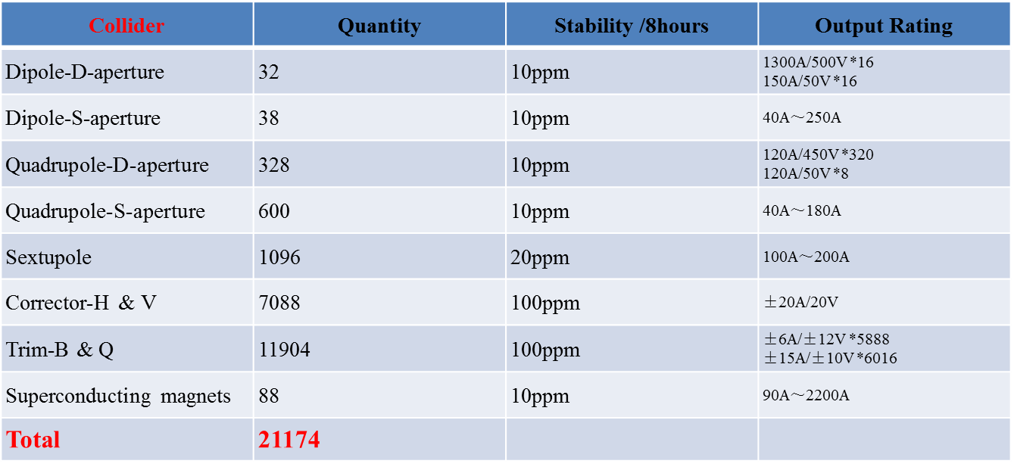
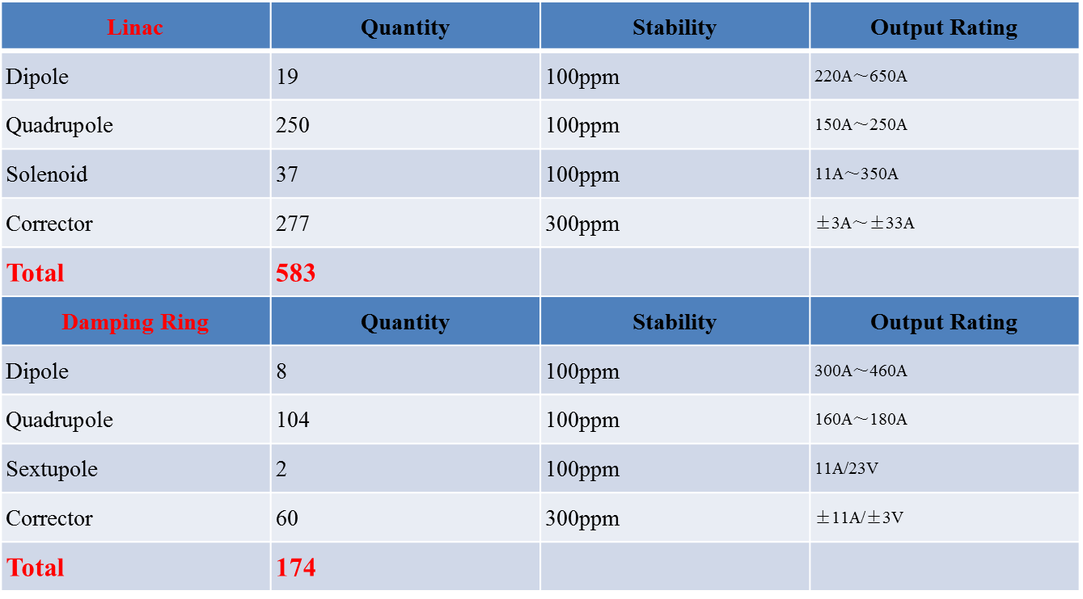
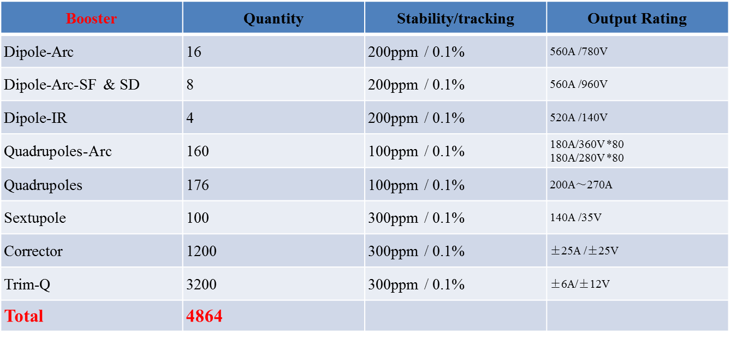
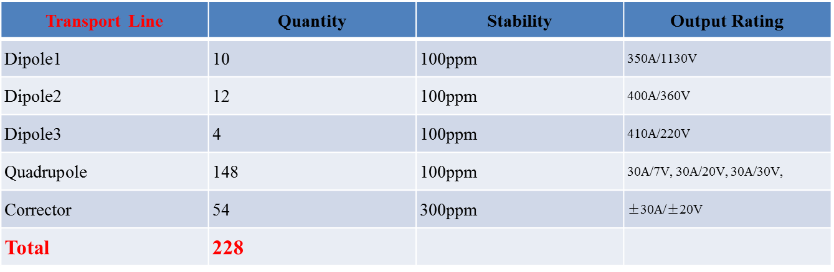
Introduction
  Requirement of the power supplies for CEPC
    Total Power Supply quantity ：27023

Slide 6
Introduction
  Power consumption for CEPC in H mode : 57.65MW
    Magnet power consumption is about 74% of the total loss.
    Cables are copper, cable current density is less than 2A/mm² and cable loss is about 16% of the total loss.
Location | Magnet (MW) | PS (MW) | Cable (MW) | Total (MW)
Collider | 31.22 | 4.22 | 6.72 | 42.16
Booster | 5.18 | 0.85 | 2.43 | 8.46
Transport Line | 4.31 | 0.49 | 0.08 | 4.89
Linac | 1.28 | 0.16 | 0.13 | 1.57
Damping Ring | 0.49 | 0.06 | 0.03 | 0.58
Total | 42.49 | 5.76 | 9.40 | 57.65

Slide 7
Magnet Power supply R&D
  Design Principles of Power Supply System
    Meet the requirement of the accelerator physics design
    Communicate with magnet system to select optimum magnet parameters, and connection modes to reduce power loss
    Decreasing magnet excitation current, but he power supply output voltage rating is limited to 1kV.
    One or two power supplies will be used for the same type of magnets in one arc section ( for main B&Q magnet in Collider and Booster）
    The same type of adjacent magnet as far as possible are connected in series and powered by one power supply
    Switch mode power supply as the main topology, to reduce the volume, improve the efficiency, and easy to achieve digital control
    Adopt modular design to achieve high current and high voltage output for high-power power supply
    Utilize digital control technology for convenient commissioning and maintenance

Slide 8
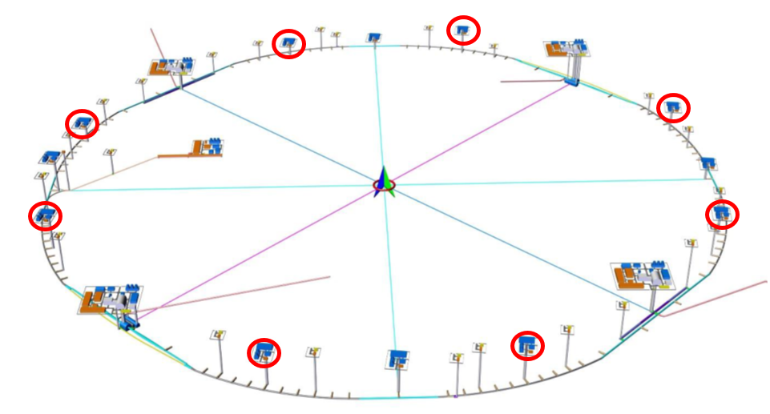
Magnet Power supply R&D
  Design Principles of Power Supply System
    Main power supplies location
    8 equipment halls above ground located close to the access shafts
    96 auxiliary tunnels around the main tunnel below ground
    Installation on the ground is the priority selection
    Reduced space requirements in tunnel
    Easier and more efficient maintenance
    Higher cost & transmission losses on low voltage line

Slide 9
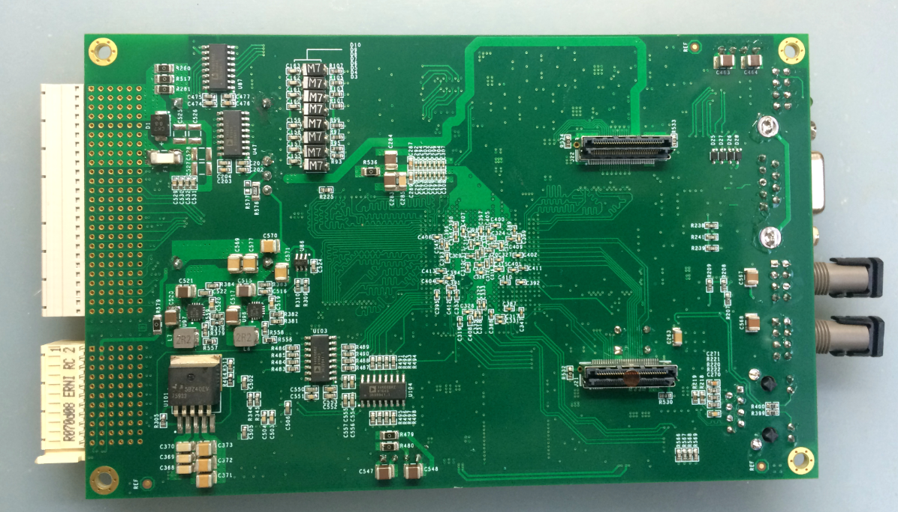
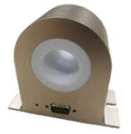
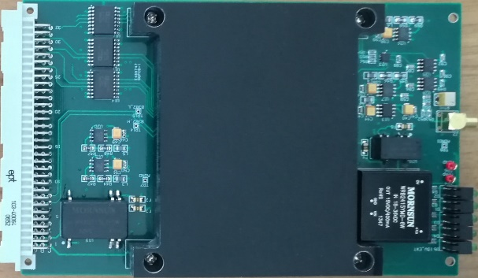
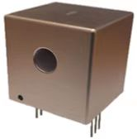
Magnet Power supply R&D
  The digital control power supplies are split in three independent parts
    A power part acting as a voltage source or a current source, which is suitable for industrial design and production
    Current transducers, DCCT（ Commercial Product or Self-design )
    Digital electronics control module, which performs the current regulation, diagnostics, monitoring and local/remote service. It’s standardized for all types of power supply
    Key components that affect the current performance of power supply: DPSCM and DCCT
Functional diagram
DPSCM- Main board and ADC board
Self-design DCCT

Slide 10
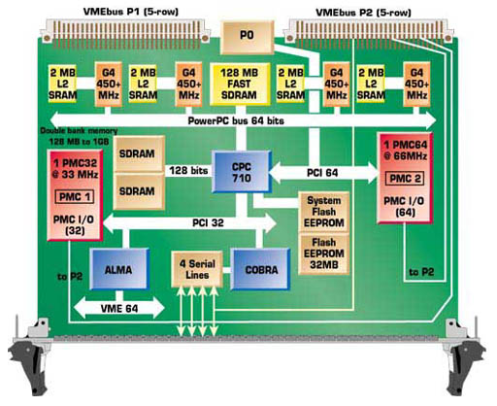
Magnet Power supply R&D
  Digital Power Supply Control Module ( DPSCM )
    SOPC FPGA : System On a Programmable Chip
    All algorithms and peripherals control entirely implemented in one FPGA
I/O
CPU
Flash
I/O
SDRAM
I/O
I/O
I/O
DSP
I/O
FPGA
FPGA
CPU
DSP
Solution: Replace External Devices
with Programmable Logic

Slide 11
Magnet Power supply R&D
  Digital Power Supply Control Module ( DPSCM )
    DPSCM-MB: PID + modern
  control theory
    high precision ADC board
  DPSCM-AD: temp control
    the voltage source
  interfacing board DPSC-DA
    the diagnostic board
    DPSCM_MDA

Slide 12
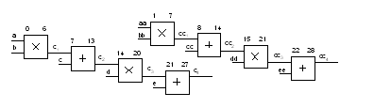
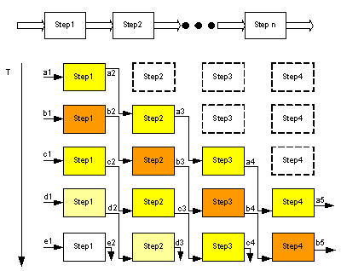
Magnet Power supply R&D
  Digital Power Supply Control Module ( DPSCM )
    Software
Modular time-sharing multiplexing
Pipeline design

Slide 13
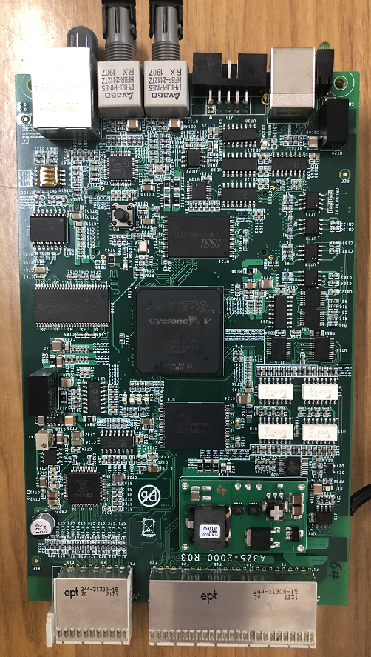
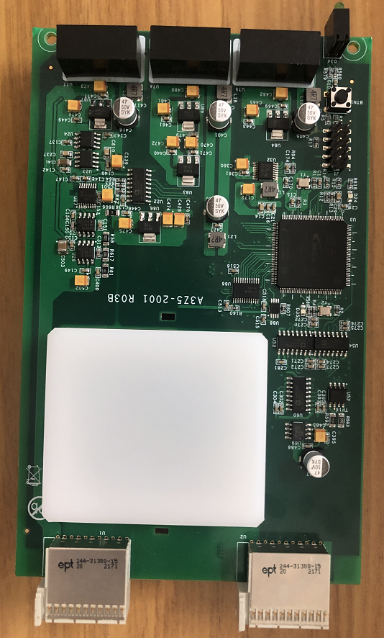
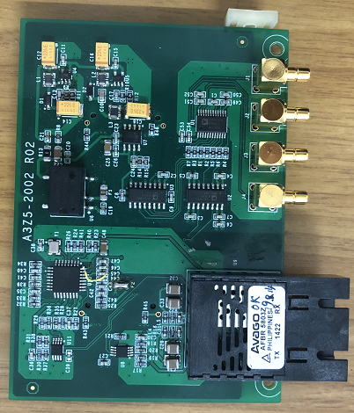
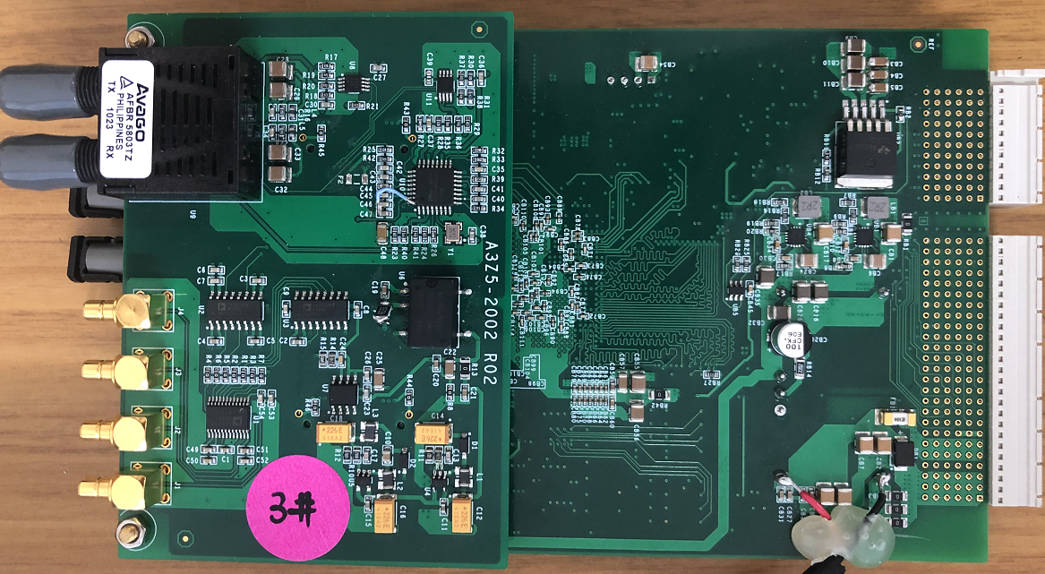
Magnet Power supply R&D
  Digital Power Supply Control Module ( DPSCM )
    Hardware ( used in HEPS )

Slide 14
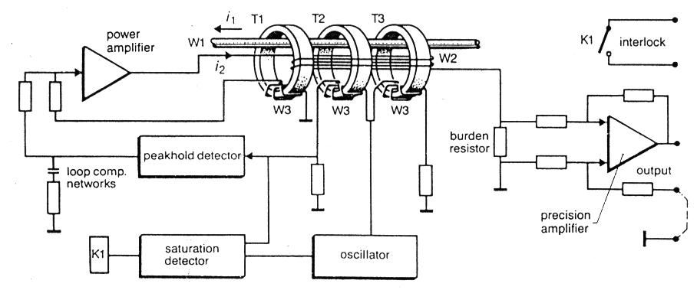
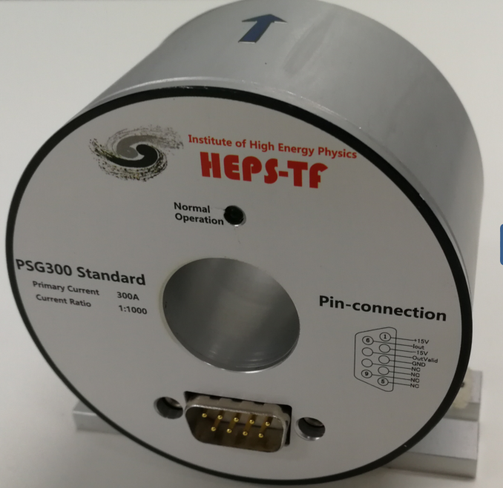
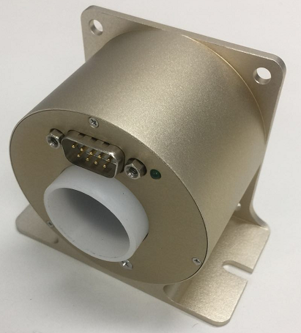
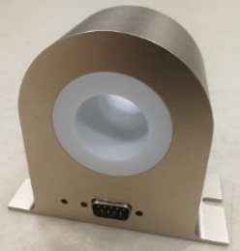
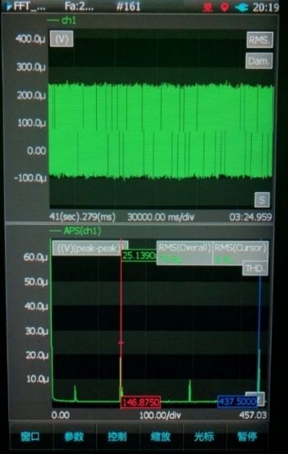
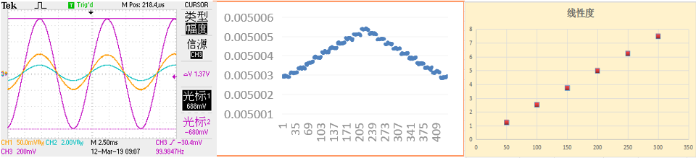
Magnet Power supply R&D
  Current transducers – 300A prototype
    Used at accelerators for magnet current measurement
    High stability, high linearity, high resolution and low temperature drift.
    Capable of performance required for stable, ppm accuracy
    Self-designed 300A and 20A DCCT, based on zero-flux principle.
Reliability, anti-interference, stability have been greatly improved
Version I （HEPS-TF）
Version II
Version III（HEPS）
 | bandwidth (Hz) | Resolution (ppm) | linearity (ppm) | noise (ppm)
Version III | 380 | 0.1 | 1.2 | 1.3
Version III | 350 | 0.15 | 1.2 | 1.5
Version III | 350 | 0.15 | 1.2 | 2
HETIC | 275 | 0.2 | 2.5 | 1
DANYSENSE | 995 | 0.5 | 2 | 1.5
bandwidth
Resolution
linearity
noise

Slide 15
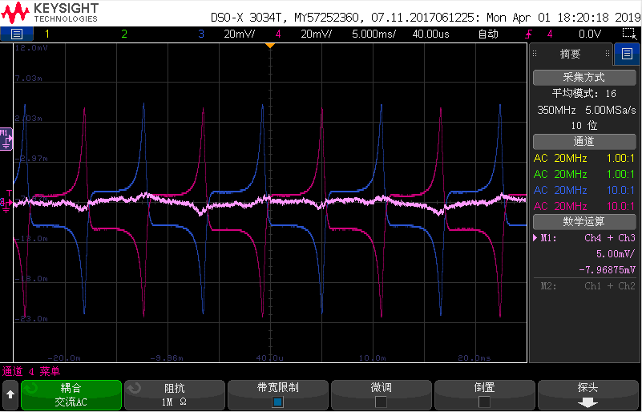
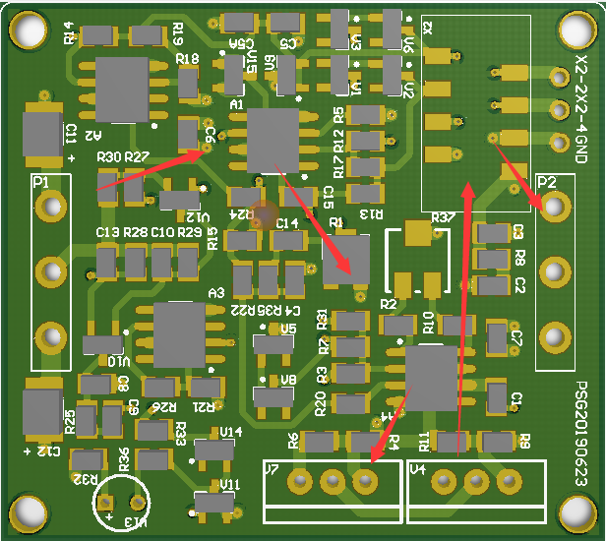
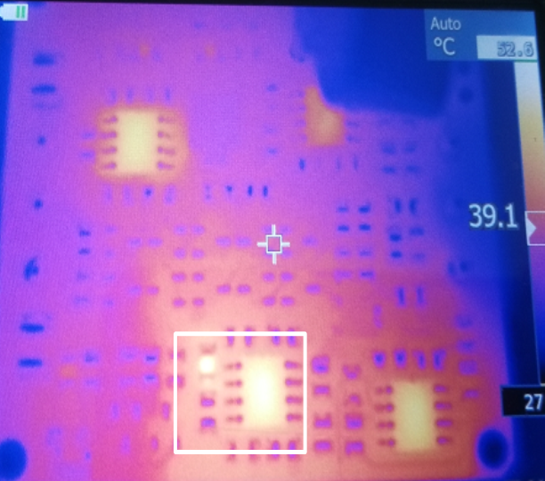
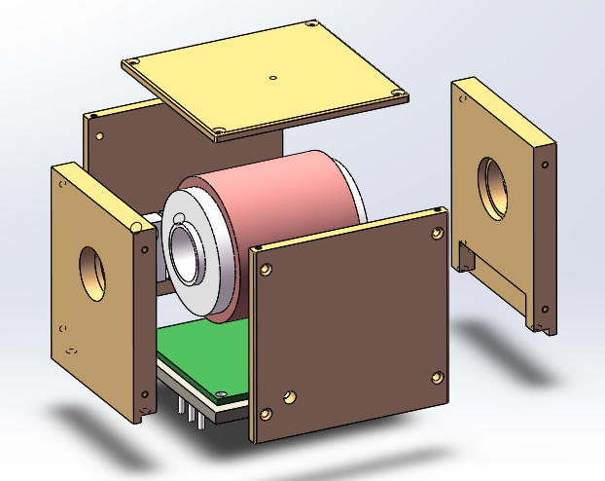
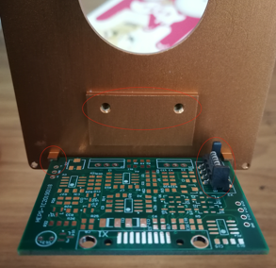
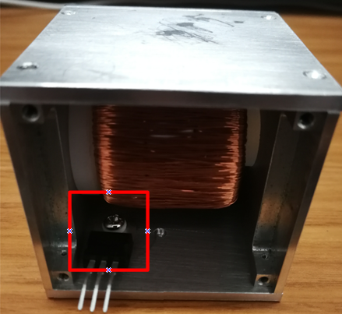
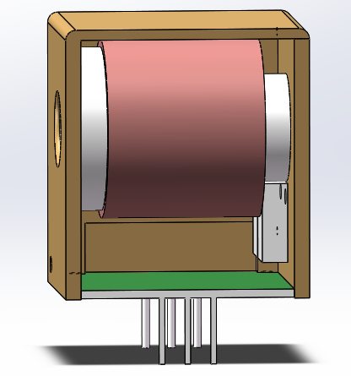
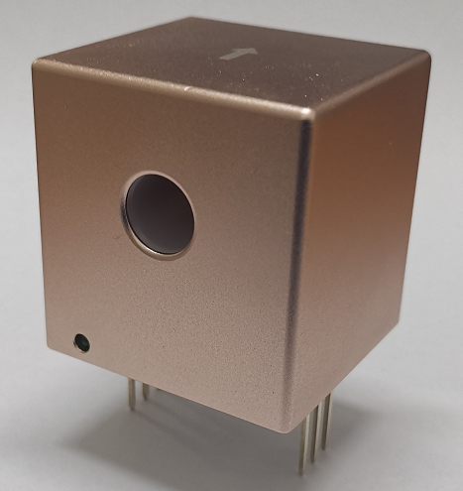
Magnet Power supply R&D
  Current transducers – 20A prototype
    On the basis of the 300A-DCCT: calculation of magnetic circuit parameters, control of circulation noise, structure design.
    20A-DCCT : resolution ≤0.5ppm (10uA), linearity ≤1.5ppm, noise ≤1ppm (maximum noise point)

Slide 16
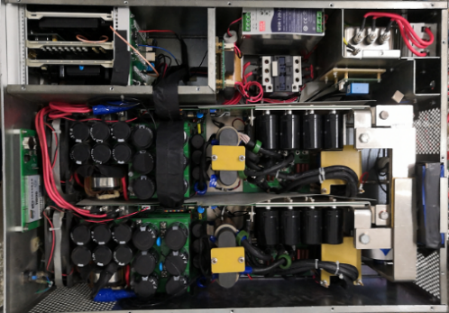
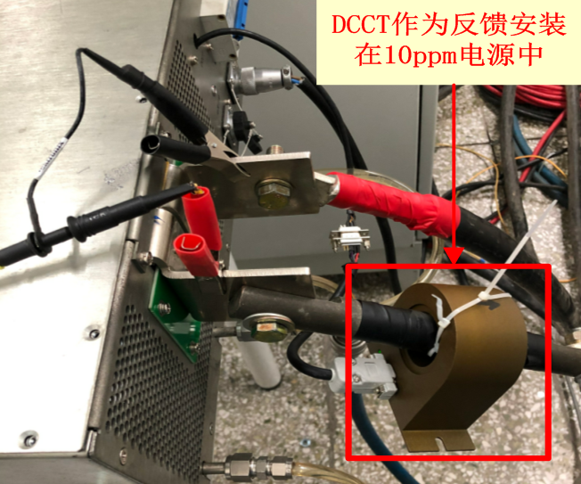
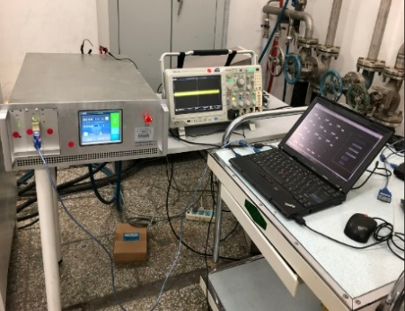
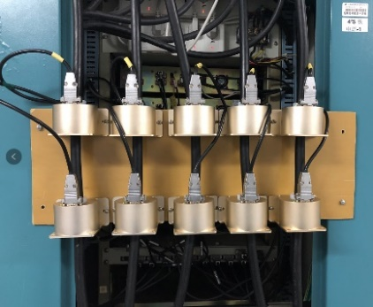
Magnet Power supply R&D
  Current transducers – prototype test
    In order to ensure the reliability and stability of the Self-designed current transducer, long-term performance tests have been carried out in different HEPS power sources
    HEPS high precision power supply, stability is better than 8ppm
Temperature drift effect
Stability 7.912ppm

Slide 17
Magnet Power supply R&D
  High-power power supply - topology ( for main B&Q magnet in Collider）
    Adopt modular design to achieve high current and high voltage output
    Module: three-phase uncontrolled rectifier + H-bridge high-frequency inverter+high-frequency rectifier
PWM
Load
PWM
PWM

Slide 18
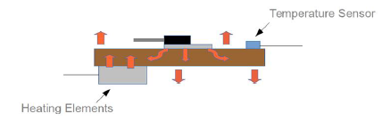
Magnet Power supply R&D
  Power supply – performance improved
    It is recommended to adopt three-loop control structure
    Outer loop: digital current loop, promise current with high precision
    Middle loop: voltage loop, ensuring low voltage ripple
    Inner loop: peak current loop of primary side of high-frequency transformer
    The peak current loop is used to improve the dynamic response of power supply and restrain the fluctuation of the grid
    Improve the stability of output current (to reduce temperature drift )
    Current type DCCT: customized burden resistance by company
    ADC circuit in digital controller equip a temperature control circuit

Slide 19
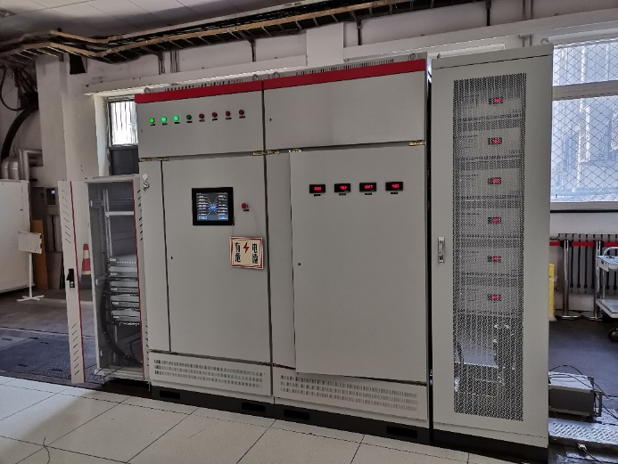
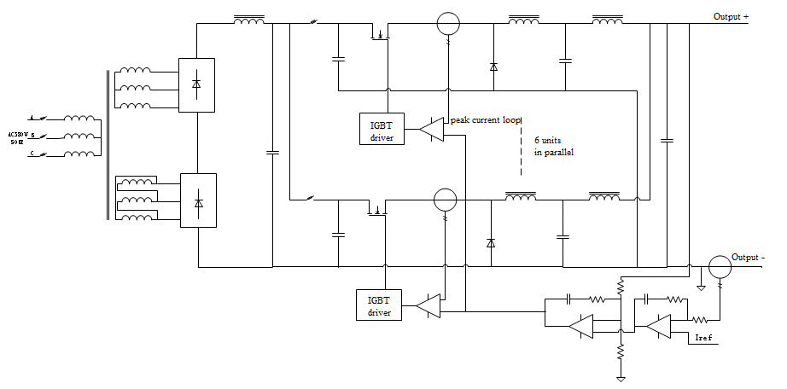
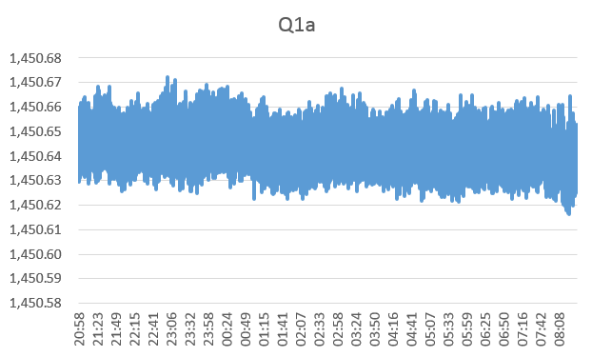
Magnet Power supply R&D
  High-power power supply - prototype
    The front dc source of power supply consists of two 12-phase diode rectifier circuits connected in series to form an equivalent 24 - phase power rectifier circuit. In the output part of the power supply, 6 groups of BUCK circuits are used in parallel to form stable current output
1700A/110V High-power supply for BEPCII

Slide 20
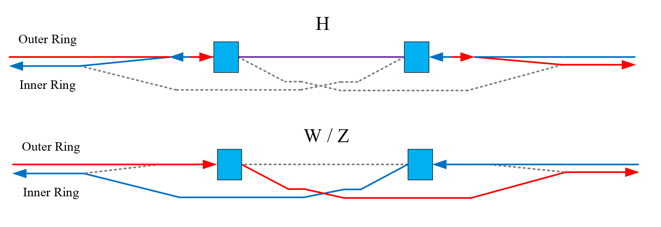
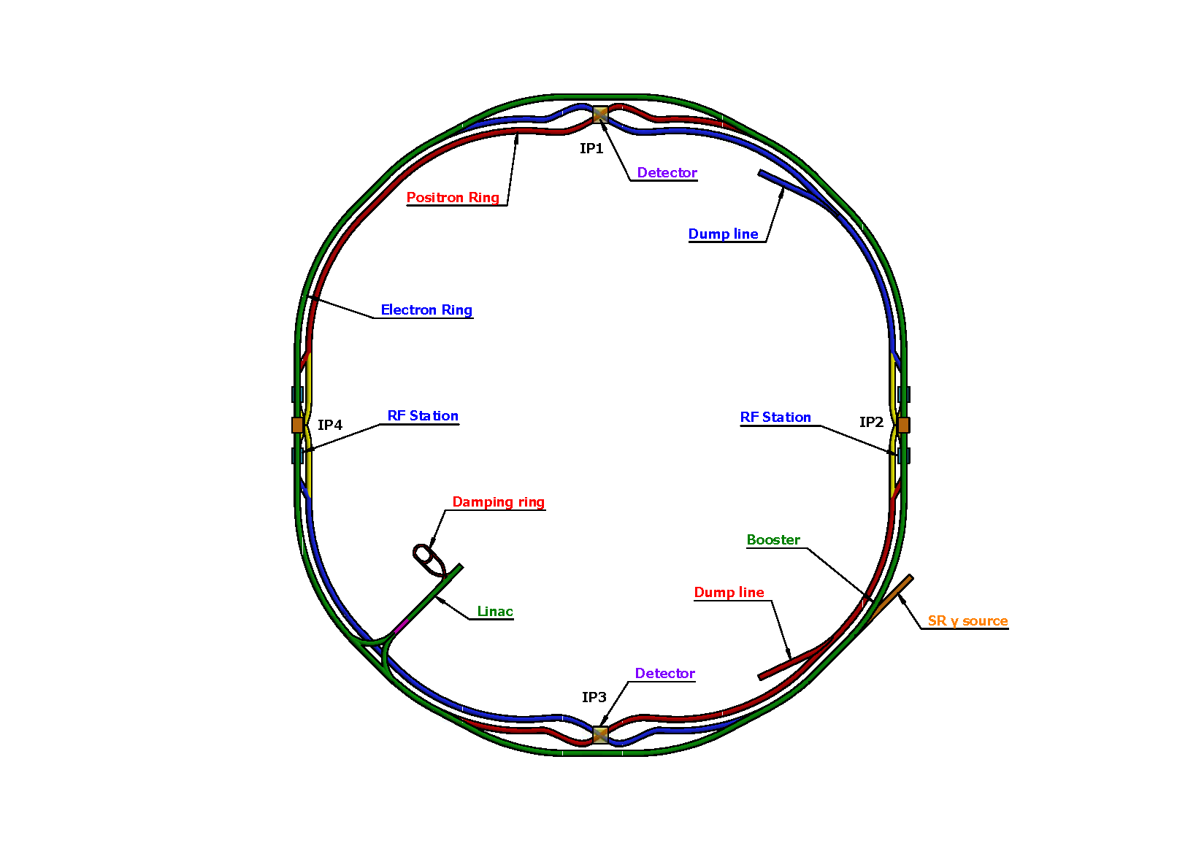
Electro-magnetic Separator R&D
  Introduction
    In the RF region, A set of electrostatic separator combined with dipole magnet (Electro-Magnetic Separator ) are installed downstream of the RF cavities.
    They are used to avoid bending of incoming beam and deflect the outgoing beam in H mode. After the Separators, the positive and negative electron beams of the outer ring passing through the RF cavities are deflected to their respective inner rings.
Layout of RF region
Layout of the CEPC accelerator complex
  Optics of the RF region for Higgs (left), W and Z (right) modes

Slide 21
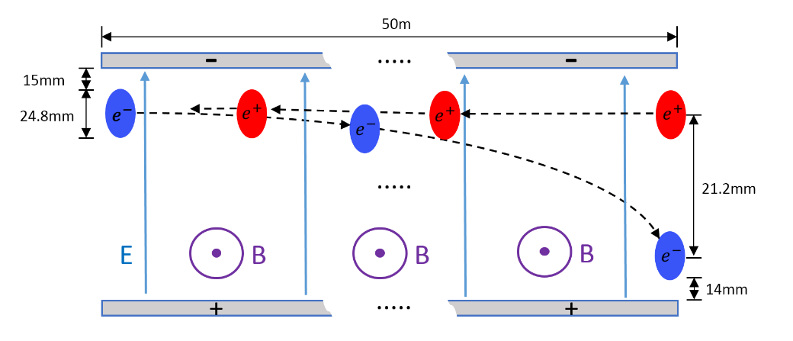
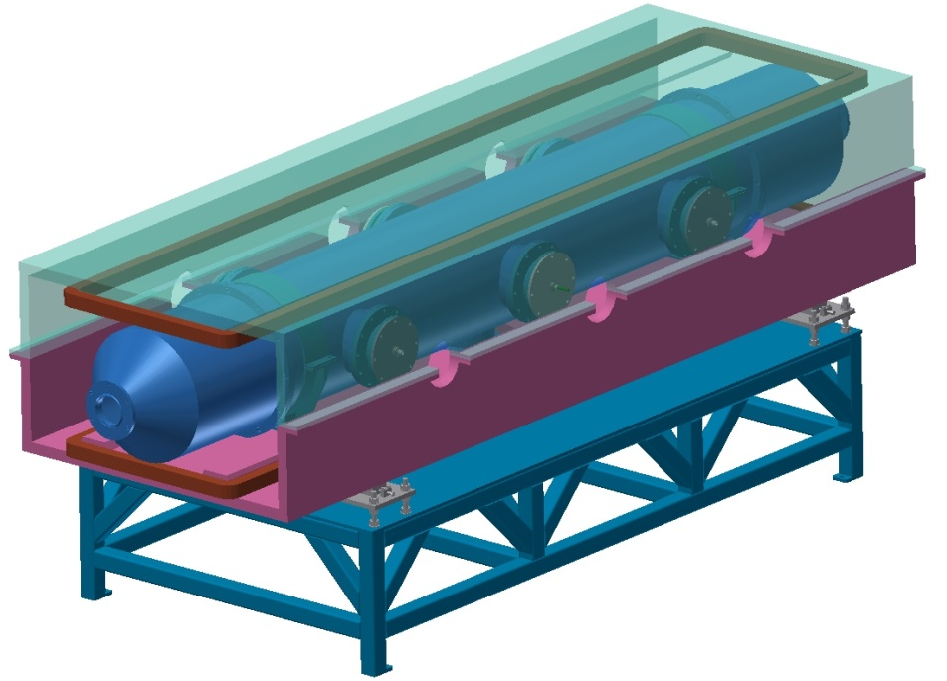
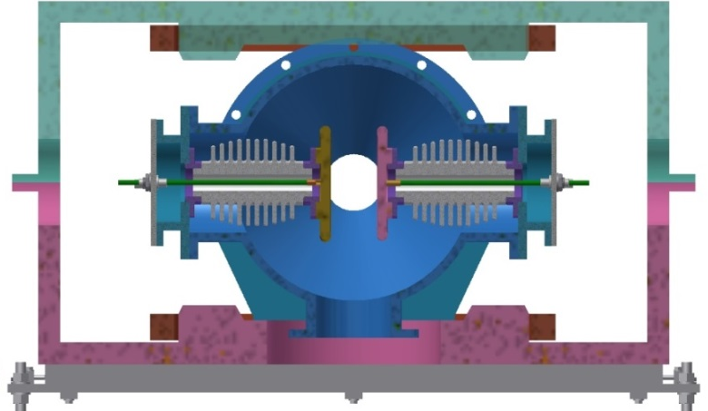
Electro-magnetic Separator R&D
  Introduction
    The Electro-Magnetic Separator is a device consisting of perpendicular electric and magnetic fields.
    One set of Electro-Magnetic Separators including 8 units, total 32 units will be need for CEPC.
 | Filed | Effective Length | Good field region | Stability
Electrostatic separator | 2.0MV/m | 4m | 46mm×11mm | 5×10⁻⁴
Dipole | 66.7Gauss | 4m | 46mm×11mm | 5×10⁻⁴
Schematic of Electrostatic-Magnetic Separator
Metal-ceramic support
High voltage feedthrough
UHV tank
Support
Magnet
Coil
Electrode
  Structure drawing of Electrostatic-Magnetic Separator

Slide 22
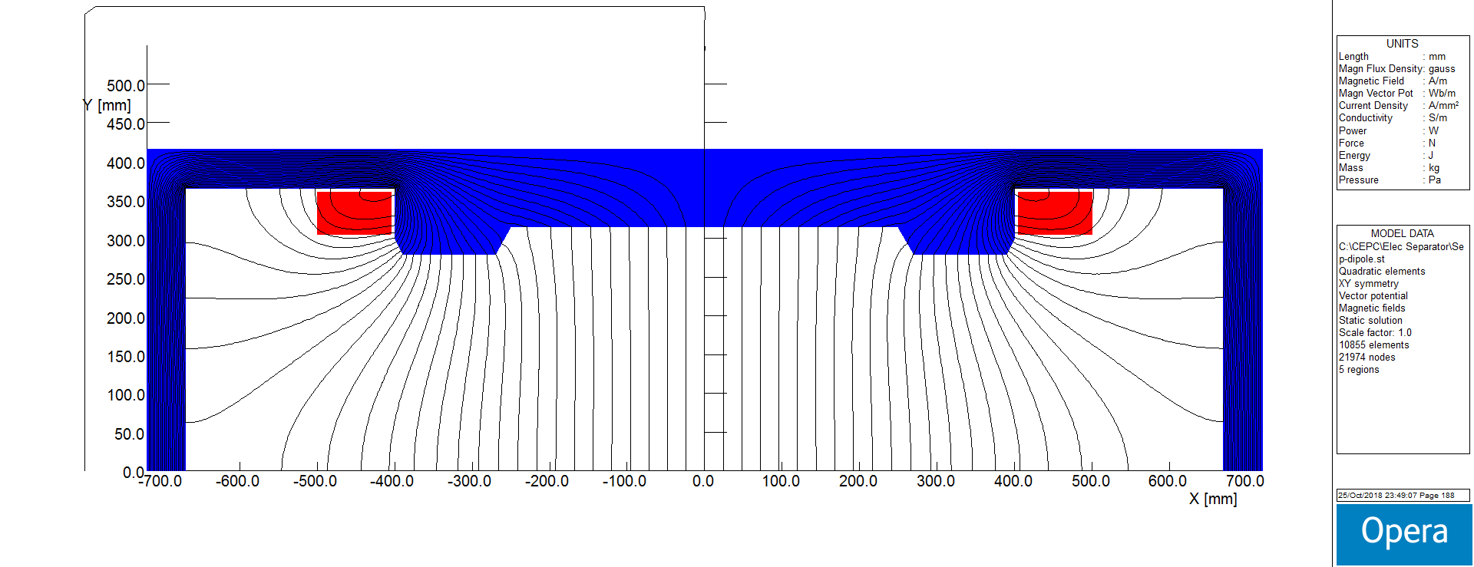
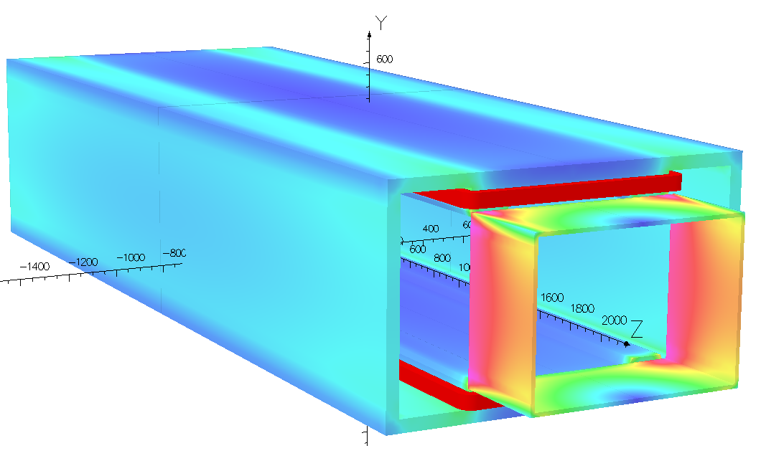
Electro-magnetic Separator R&D
  Design of dipole magnet
    The magnet yoke is H-type, because of the higher field integrals uniformity and installation consideration of the electro-static system.
Magnet Name | ESM
Center field [Guass] | 75.5
Magnet Length [m] | 4.4
Current [A/turn] | 10.8
Turns [H×V] | 12×17
Field Clamp Size [H×V, mm] | 830×610
Field Clamp Wall Thickness [mm] | 10
Field Clamp Number | 2
Coil Number | 2
Conductor Size [H×V, mm] | 3×3
Current Density [A/mm^2] | 1.2
Magnet Resistance [Ω] | 7.82
Magnet Voltage [V] | 84.4
Magnet Power [W] | 660
Magnet Inductance [H] | 2.42
Cooling Method | Air
Yoke Weight [Ton] | 11
Coil Weight [Ton] | 0.328
Magnet Weight [Ton] | 11.328
Field Distribution
Magnetic flux density distribution in 3D Model
Parameters of the magnet

Slide 23
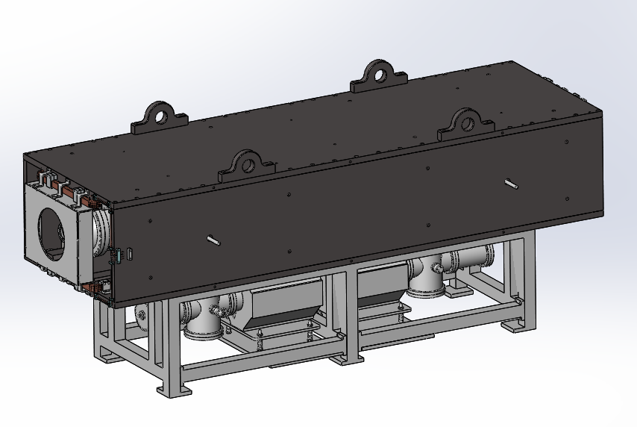
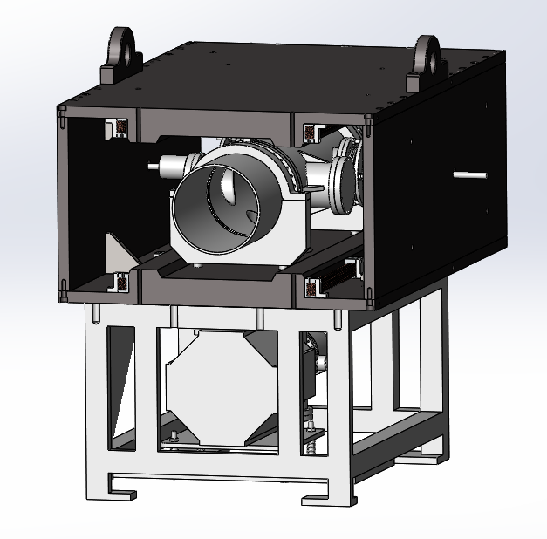
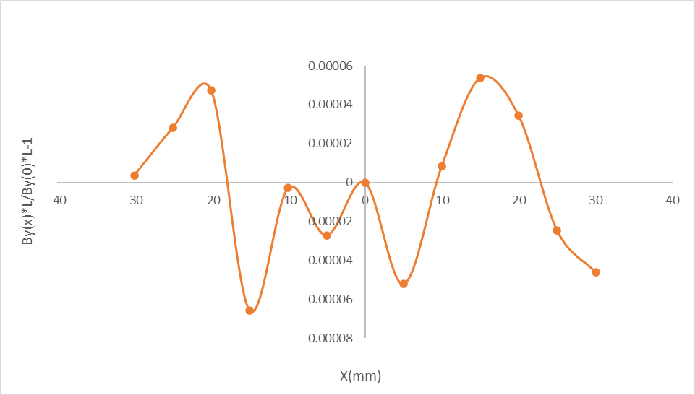
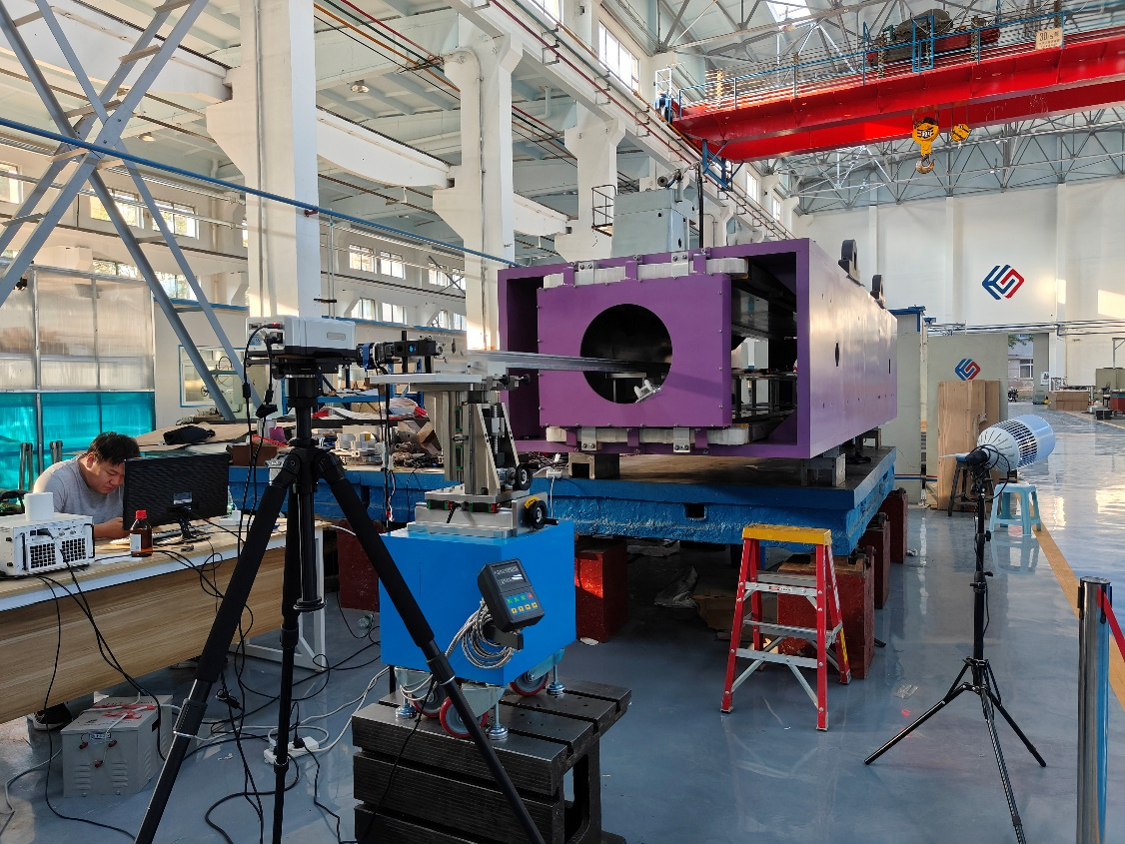
Electro-magnetic Separator R&D
  Design of dipole magnet
    The prototype of the magnet has been developed.
    The field measurement of the prototype have been made.
  integrated magnetic field uniformity

Slide 24
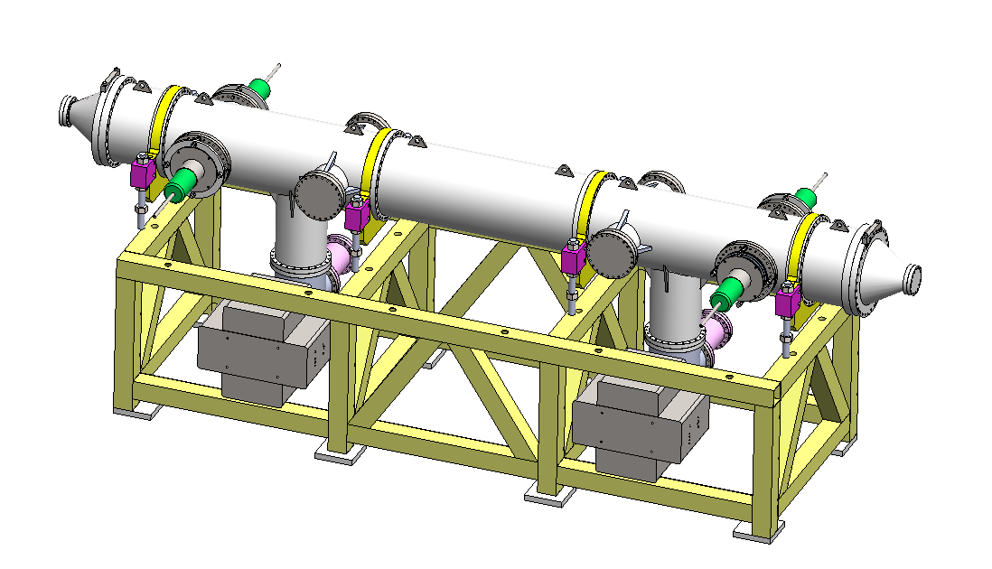
Electro-magnetic Separator R&D
  Design of electrostatic separator
    An electrostatic separator comprise a pair of electrodes, UHV tank, metal-ceramic supports, high voltage feedthrough, High voltage circuit and vacuum system, etc.
Separator length | 4.5m
Inner diameter of separator tank | 380mm
Electrode length | 4.0m
Electrode width | 180mm
Nominal gap | 75mm
Maximum operating field strength | 2MV/m
Maximum operating voltage | ±75kV
Good field region (0.5‰ limit) | 46mm×11mm
Nominal vacuum pressure | 2.7×10⁻⁸ Pa
  Structure drawing of Electrostatic Separator
  Parameters of electrostatic separator

Slide 25





Electro-magnetic Separator R&D
  Design of electrostatic separator
    Electrode ( a pair of metal flat plate )
    Dimension : 4m long and 180mm wide
    Material : Pure Titanium
    Field strength : 2MV/m
    UHV tank
    4.5m long and 38cm inner diameter
Field homogeneity：7.5cm*5cm 0.5‰
Calculated integrated electrical field uniformity ：4.6cm*3cm 0.5‰
Length：400cm
With：18cm
Thickness：2cm
Radius：1.5cm
Density：4.54g/cm³
Weight：≈65kg
18cm
400cm
25cm
400cm
ID：9.5cm
ED：7.5cm
thickness：1cm

Slide 26






Electro-magnetic Separator R&D
  Prototype of electrostatic separator
    The prototype of the electrostatic separator has been developed.
    the prototype of electrostatic separator was commissioning.
    Electrode plate vacuum leak detection and installation.

Slide 27





Electro-magnetic Separator R&D
  Prototype of electrostatic separator
    the prototype of electrostatic separator was commissioning.
    Molecular pump unit for crude pumping.
    Vacuum baking.

Slide 28



Electro-magnetic Separator R&D
  Prototype of electrostatic separator
    the prototype of electrostatic separator was commissioning.
    Arc occurred at the air side of the feedthrough at ±90kV

Slide 29




Electro-magnetic Separator R&D
  Prototype of electrostatic separator
    the prototype of electrostatic separator was commissioning.
    Increase the length of the insulating ceramic column on the atmospheric side.
    Wear a smooth shield on the outside of the feedthrough mounting flange.
    The high voltage is increased to ±118kV.

Slide 30





Electro-magnetic Separator R&D
  Prototype of electrostatic separator
    Test result
    Electric field uniformity (0.5‰) 46×30 mm² (simulation result) ;
    Vacuum degree ≤ 2.6×10⁻⁸Pa ;
    Electric field intensity 3.15MV/m@±118kV .

Slide 31
Summary
  According to the latest physical parameters, about 27,023 power supplies are needed to power the magnets.
  Based on the optimized design, the power demand is estimated.
  The design of the digital controller and current transducer are introduced, the two key components are independently developed and applied in HEPS.
  The design of the High-power power supply is introduced. This type of power supply have been developed on BEPCII.
  The prototype of the magnet has been developed and the field measurement have been made.
  The prototype of the separator has been fabricated and tested. the vacuum and voltage reached the target.

Slide 32
Thank You!

