Slide 1
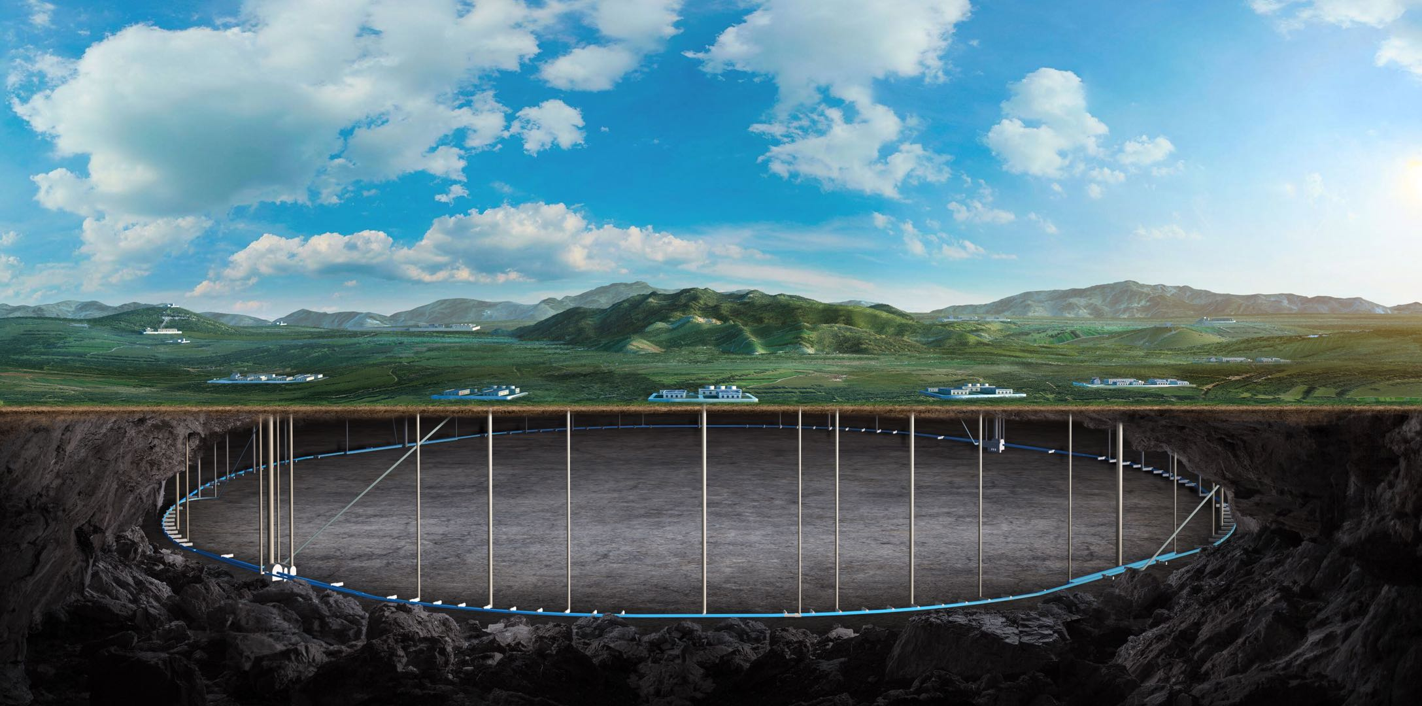
Superconducting quadrupoles design and R&D status for CEPC
Yingshun Zhu
On behalf of CEPC MDI SC magnet system
Oct 23-27. 2023, International workshop on CEPC

Slide 2
Content
Introduction
Design of superconducting quadrupoles in CEPC Interaction Region
R&D status of 0.5m single aperture short model quadrupole
Summary

Slide 3
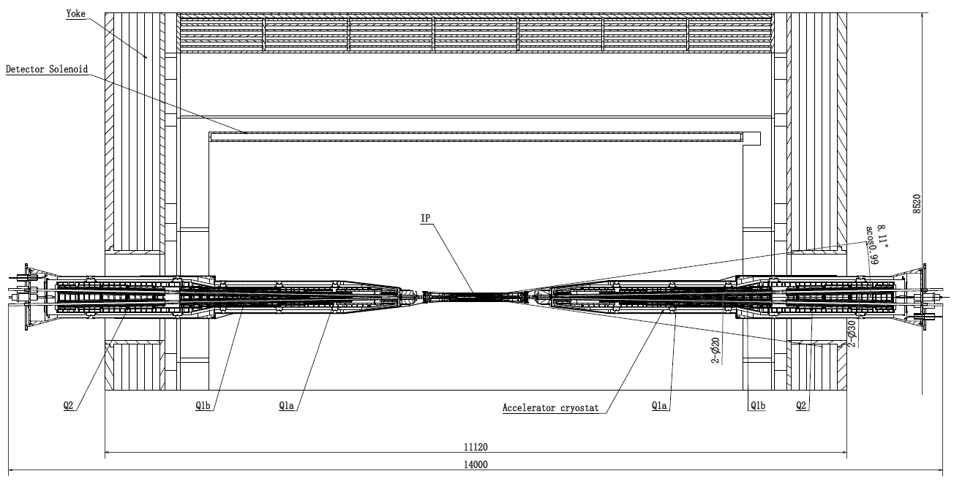
Introduction
CEPC is a Circular Electron Positron Collider with a circumference about 100 km, beam energy up to 120 GeV (Higgs) proposed by IHEP
To greatly squeeze the beam for high luminosity, compact high gradient final focus quadrupole magnets (Q1a, Q1b, Q2) are required on both sides of IP points
TDR requirements of CEPC Final Focus quadrupoles are based on L* of 1.9 m, beam crossing angle of 33 mrad

Slide 4
Introduction
Quadrupole magnets are operated inside the Detector solenoid with a central field of 3.0 T.
To cancel the effect of the detector solenoid field on the beam, anti-solenoids before Quadrupole and outside Quadrupole are needed.
Total field generated by detector solenoid and accelerator anti-solenoid is zero.
Table 1: TDR requirements of Interaction Region quadrupole magnets for Higgs
Magnet | Field gradient (T/m) | Magnetic length (m) | Width of GFR (mm) | Minimal distance between two aperture beam lines (mm)
Q1a | 142.3 | 1.21 | 14.92 | 62.71
Q1b | 85.4 | 1.21 | 18.17 | 105.28
Q2 | 96.7 | 1.5 | 24.48 | 155.11
Field gradient of other modes doesn’t exceeded the one of Higgs mode

Slide 5
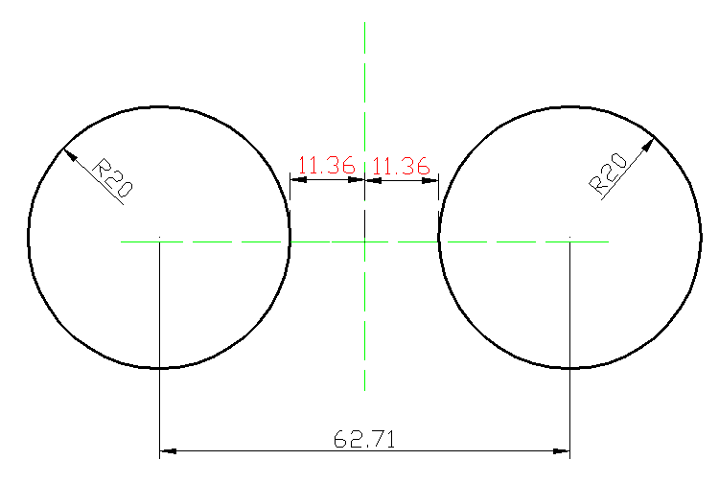
Design of superconducting quadrupoles in CEPC Interaction Region
1 Design of Q1a
Minimal distance between two aperture beam lines: 62.71 mm
Inner radius of beam pipe: 10mm
Leaving space for beam pipe, helium vessel, quadrupole coil inner radius: 20 mm
It is challenging to meet stringent design requirement
1) High field gradient: 142.3T/m
2) Limited radial space
Limited radial space in the magnet middle:
R: [20mm, 31.36mm], only 11.36mm available
3) Magnetic field crosstalk between two apertures
High order field harmonics <5×10⁻⁴
Dipole field: as small as possible

Slide 6
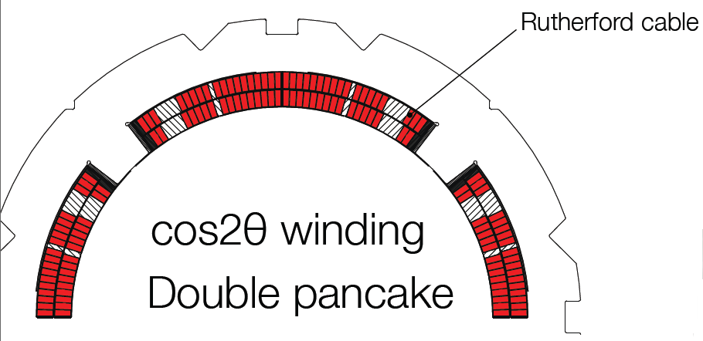
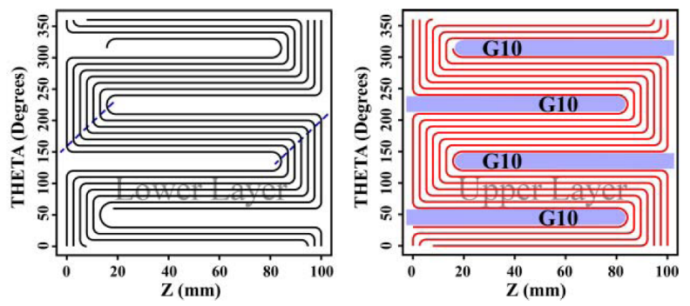
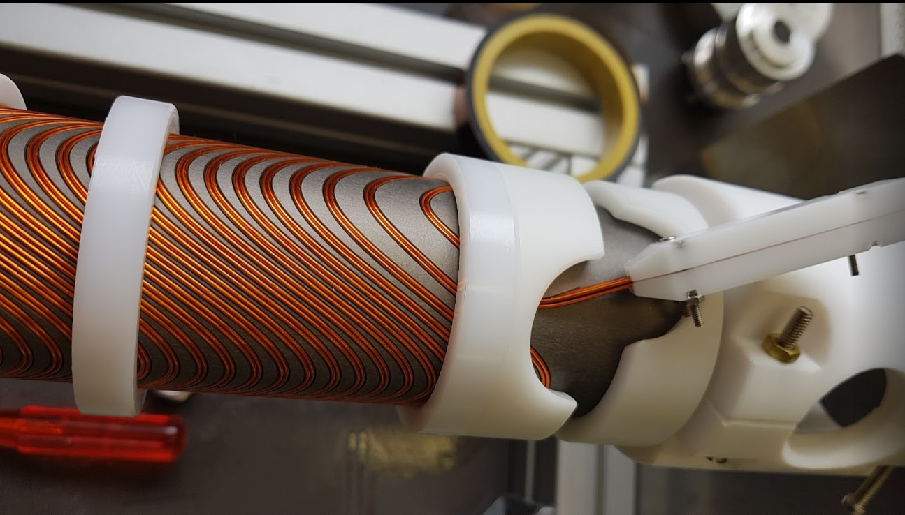
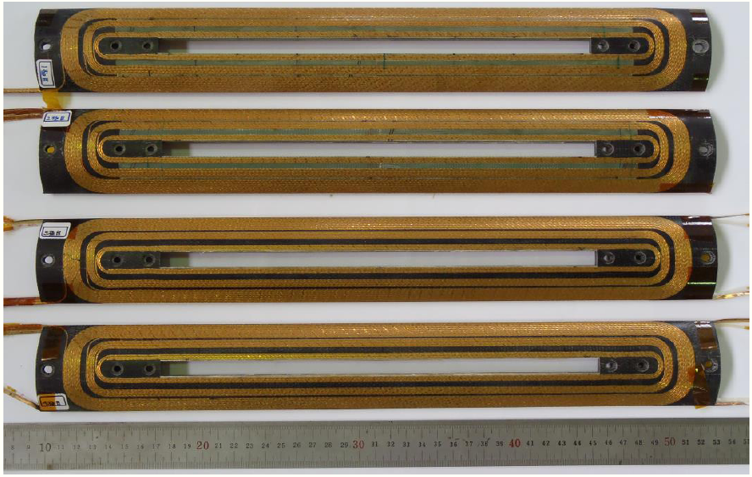
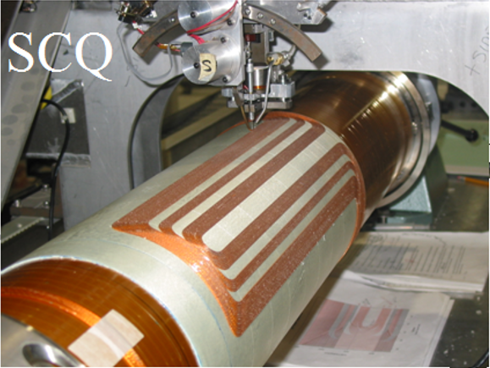
Design of Q1a
Magnetic design of Q1a with 3 kinds of quadrupole coil structures, including cos2θ coil, CCT coil, and Serpentine coil.
Cos2θ coil
(SuperKEKB)
CCT coil
(FCC-ee)
Serpentine coil
(BEPCII)

Slide 7
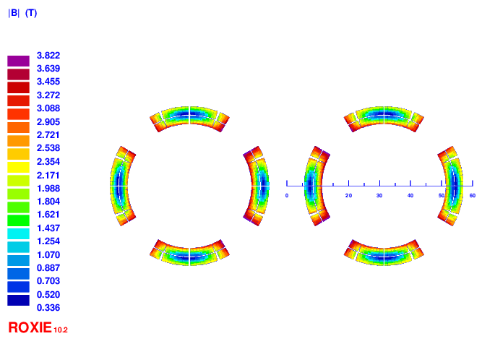
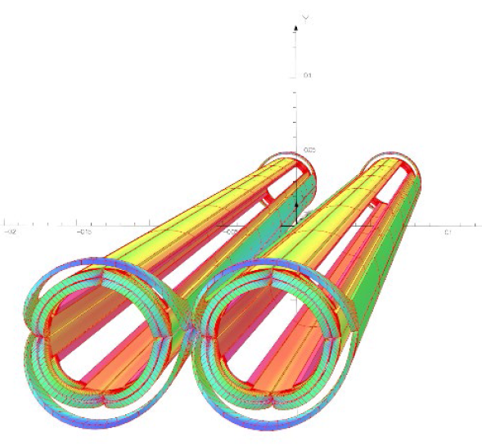
Design of Q1a: Cos2θ option
Option 1: Iron free design
Round 0.5mm strand, HTS Bi-2212 or LTS NbTi
HTS: higher heat load resistant, larger critical current, higher temperature
Two layers cos2θ quadrupole coil using Rutherford, with 10 NbTi strands
Inner diameter of the coil 40mm. Current 2650A
Cable width 2.5mm, 21 turns and four coil blocks in each pole.
Field crosstalk between two apertures introduces a local dipole field >200Gs
(anti-symmetric coil, add corrector coil, etc.)

Slide 8
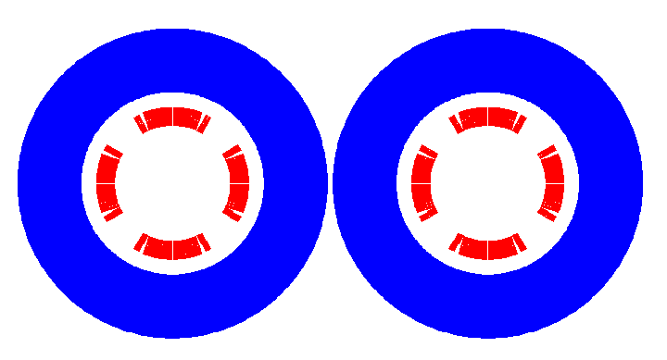
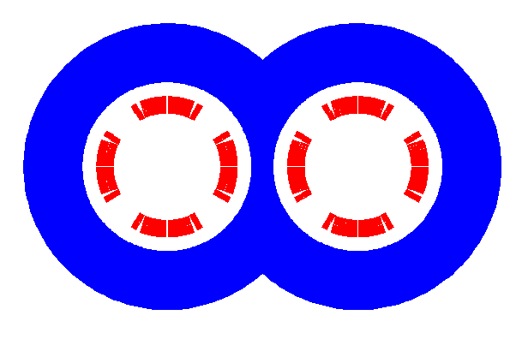
Design of Q1a
Option 2: With iron design
Iron yoke FeCoV with high saturation field is added outside the coil, to
(1) enhance the field gradient (2) reduce the current (3) and shield the field crosstalk
Not enough space to place two single apertures side by side
Compact design: Iron core in the middle part is shared by two apertures
One or two layers corrector coils will be added inside quadrupole coil, using 0.33mm wire

Slide 9
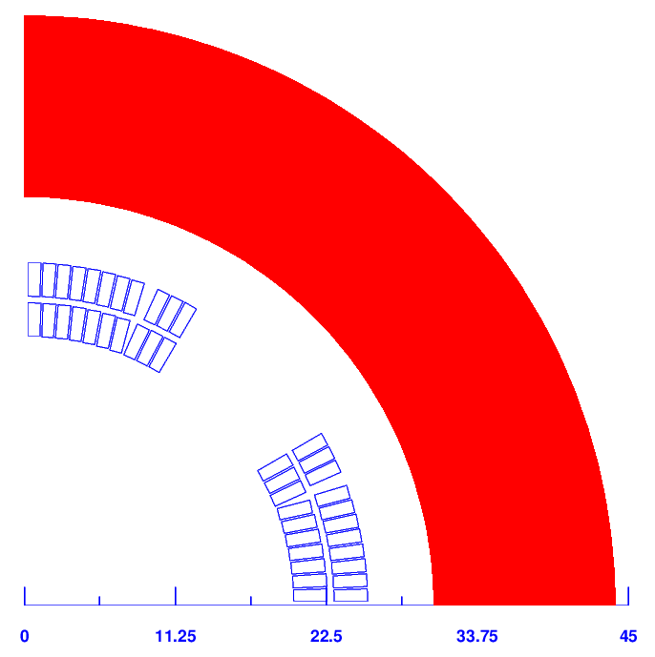
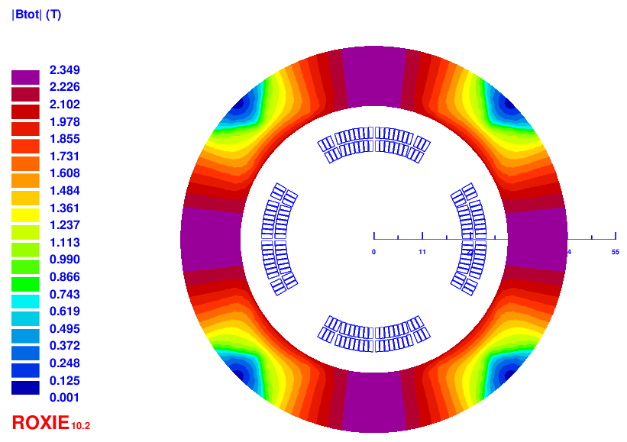
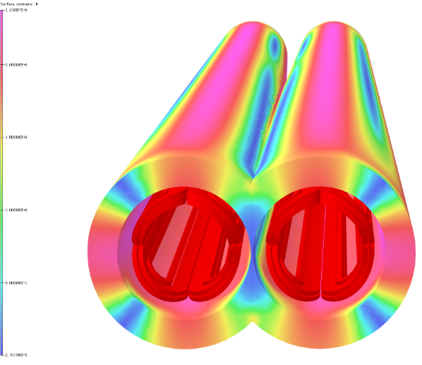
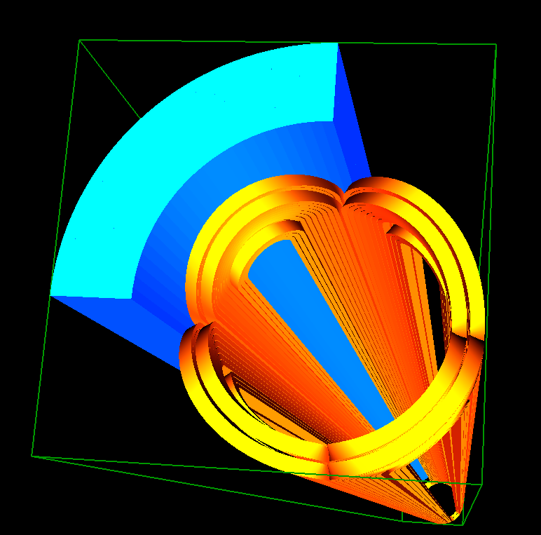
Q1a design with iron
The field harmonics as a result of field crosstalk in each aperture is < 1×10⁻⁴.
Dipole field at each aperture center is smaller than 25 Gs.
Compared with iron-free design, the excitation current is reduced to 2020A@4.2K
Double aperture cos2θ quadrupole with iron yoke shared by two apertures, with crossing angle 33mrad. Meet all requirements.

Slide 10
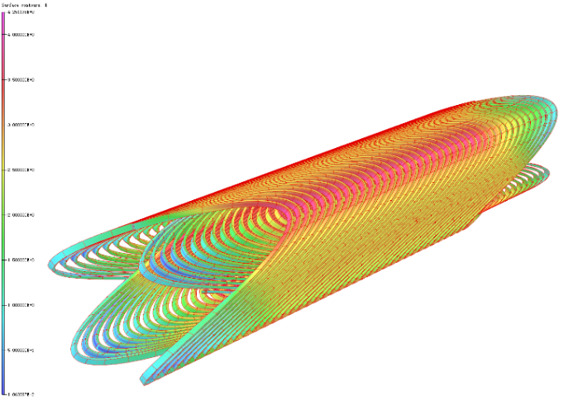
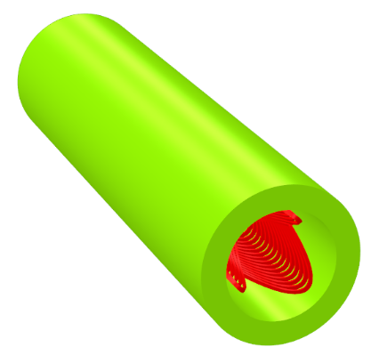
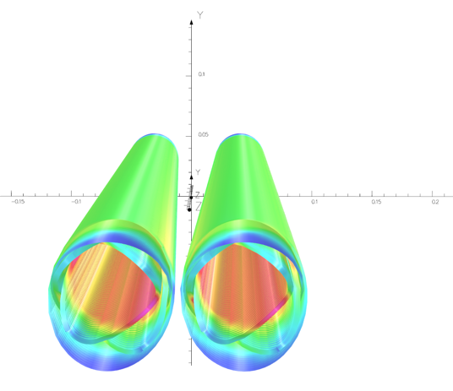
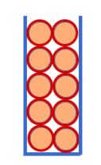
2) CCT option of Q1a
0.5mm round wire, HTS Bi-2212 or LTS NbTi.
Two layers CCT quadrupole coil. The inner radius of the spar is 20mm.
Groove on the spar: 1×2.5mm; 10 wires in a groove.
Conductor canted angle: 16 deg. Excitation current: 324A.
Field gradient is calculated using theoretical formula, and OPERA-3D.
Each integrated multipole field in single aperture is smaller than 1×10⁻⁴.

Slide 11
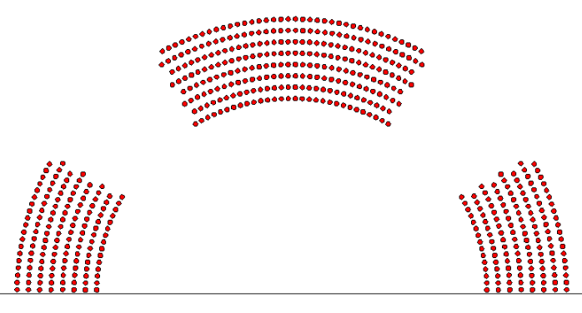
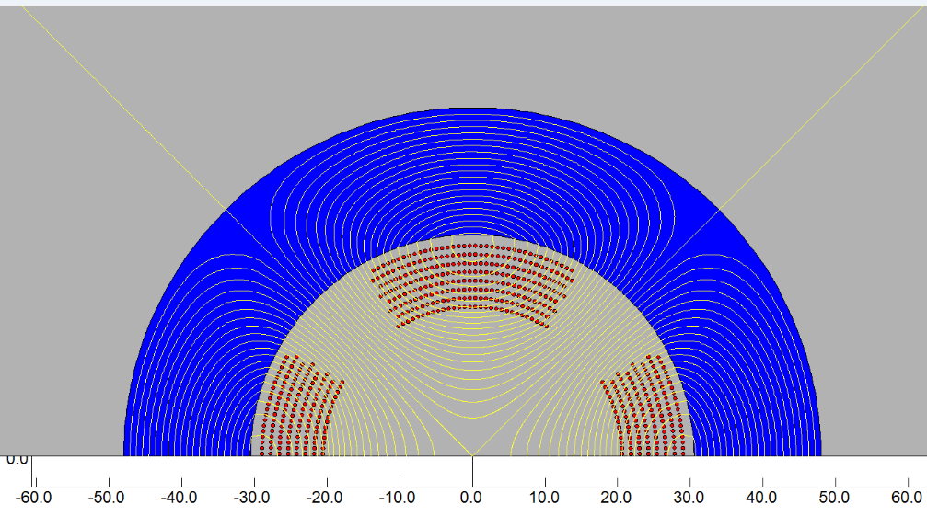
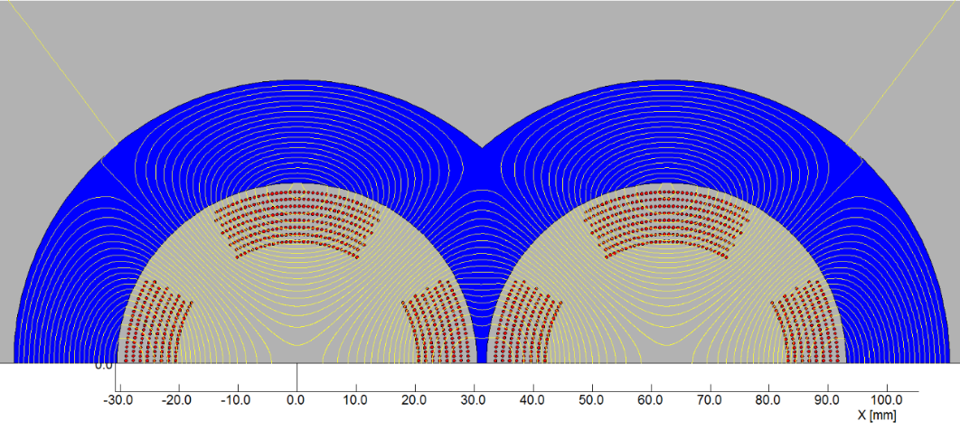
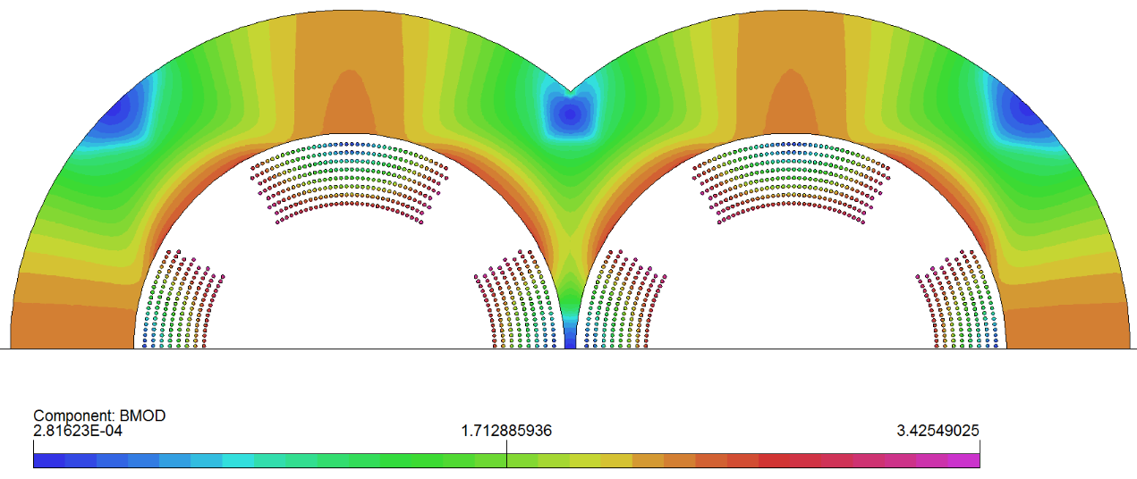
3) Serpentine option of Q1a
0.5mm round wire, HTS Bi-2212 or LTS NbTi.
8 layers Serpentine quadrupole coil. The inner radius of the coil is 20mm.
2D calculation, each multipole field in single aperture is smaller than 1×10⁻⁴.
Excitation current: 334A (with iron)

Slide 12
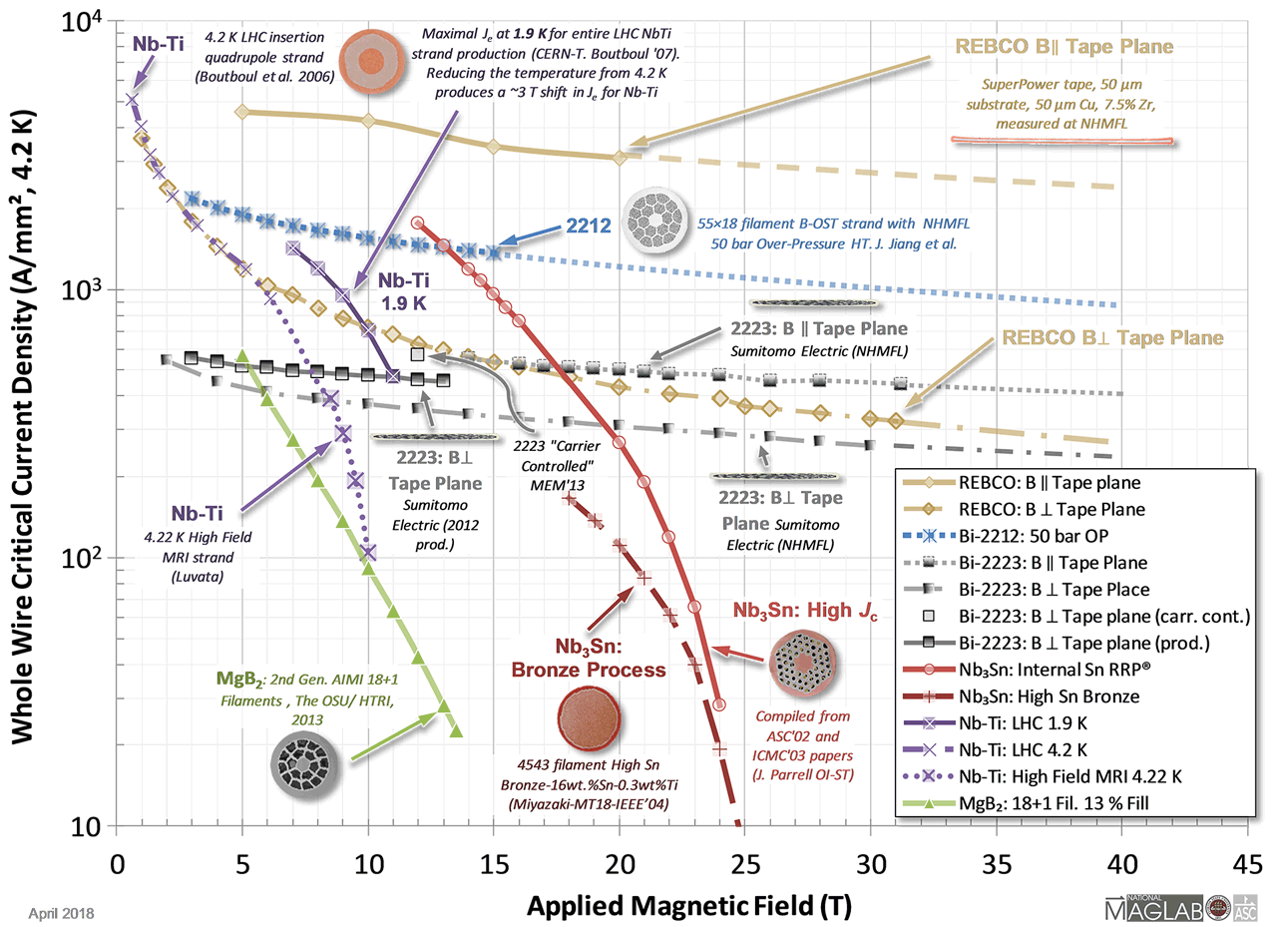
For a fixed field gradient in bore, smaller current density and smaller peak field in coil are advantageous.
From USPAS 2018

Slide 13
Comparison of three design options of Q1a
1) Comparison of three design options of Q1a (142.3T/m, no iron)
2) Comparison of three design options of Q1a (142.3T/m, with iron)
Current is reduced about 24%~30% using iron.
From the comparison, Cos2θ coil has lower peak field and lower current density.
Cos2θ coil with iron as baseline design, CCT and Serpentine coil (iron-free or with iron) as alternative design.
Q1a option | Cos2θ coil | CCT coil | Serpentine coil
Excitation current in strand (A) | 265 | 472.5 | 480
Current density Je on wire (A/mm²) | 1350 | 2406 | 2445
Peak field in coil (T) | 3.6 | 4.3 | 4.2
Q1a option | Cos2θ coil | CCT coil | Serpentine coil
Excitation current in strand (A) | 202 | 324 | 334
Current density Je on wire (A/mm²) | 1029 | 1650 | 1701
Peak field in coil (T) | 3.5 | 3.8 | 3.8

Slide 14
Design parameters of Q1a
Design parameters of the cos2θ Q1a quadrupole magnet with iron yoke
Magnet name | Q1a double aperture
Field gradient (T/m) | 142.4
Magnetic length (mm) | 1211.80
Coil turns per pole | 21
Excitation current (A） | 2020
Coil layers | 2
Conductor (HTS or LTS) | Rutherford Cable, width 2.5 mm, mid thickness 0.93 mm, keystone angle 2.1 deg, 10 strands
Maximum dipole field at aperture center (mT) | 2.5
Stored energy (KJ) | 11.5
Inductance (mH） | 5.64
Peak field in coil (T) | 3.42
Load line @4.2K | 78.8%
Integrated field harmonics | b₆ = -0.61 b₁₀ = -0.24
Coil inner diameter (mm) | 40
Coil outer diameter (mm) | 51.3
Yoke inner diameter (mm) | 61
Yoke outer diameter (mm) | 88
X direction Lorentz force/octant (kN) | 62.33
Y direction Lorentz force/octant (kN) | -58.59
Net weight (kg) | 93

Slide 15
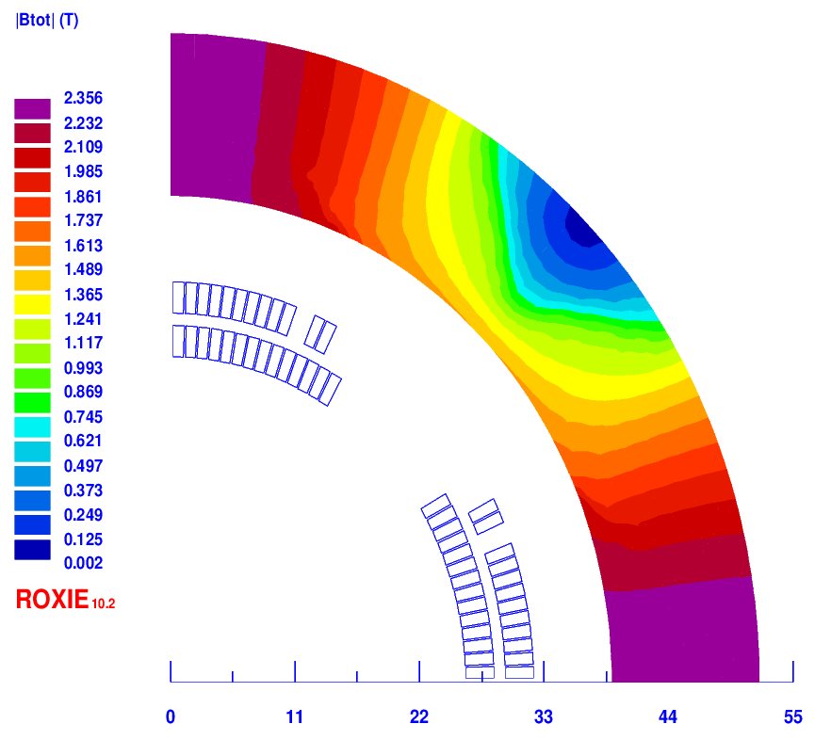
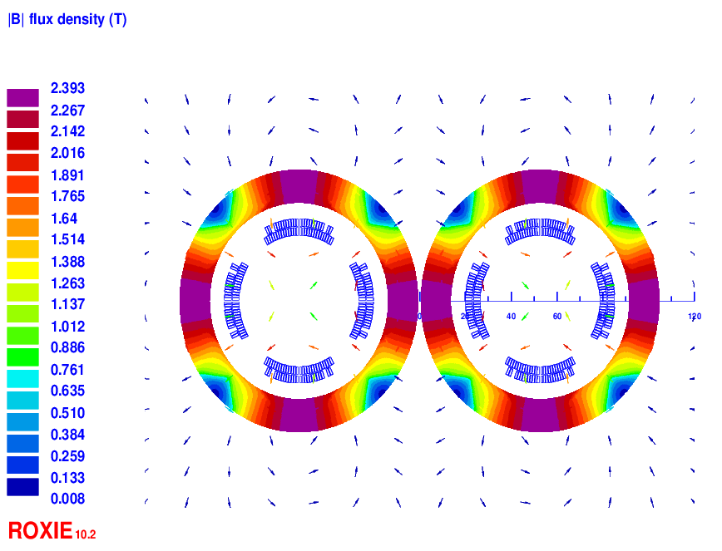
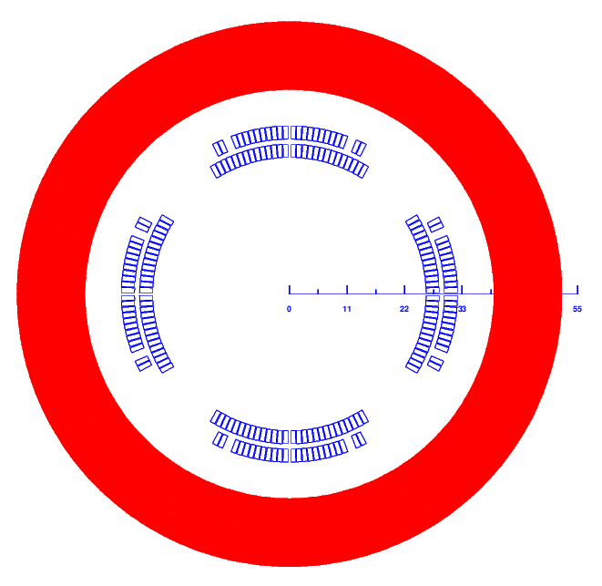
2 Design of Q1b
Baseline design: Cos2θ coil; CCT and Serpentine coil as alternative design
Round 0.5mm strand, HTS Bi-2212 or LTS NbTi
Q1b: two layers cos2θ quadrupole coil using Rutherford cable with iron yoke
The inner radius of the coil is 26 mm.
Cross section is optimized with three coil blocks in two layers.
Width of the cable is 3 mm, 26 turns in each pole.
The excitation current of Q1a is 1590A. Dipole field <30 Gs
Two apertures do not need to share the iron yoke like Q1a.
Two layers corrector coils will be added inside quadrupole coil, using 0.33mm wire.

Slide 16
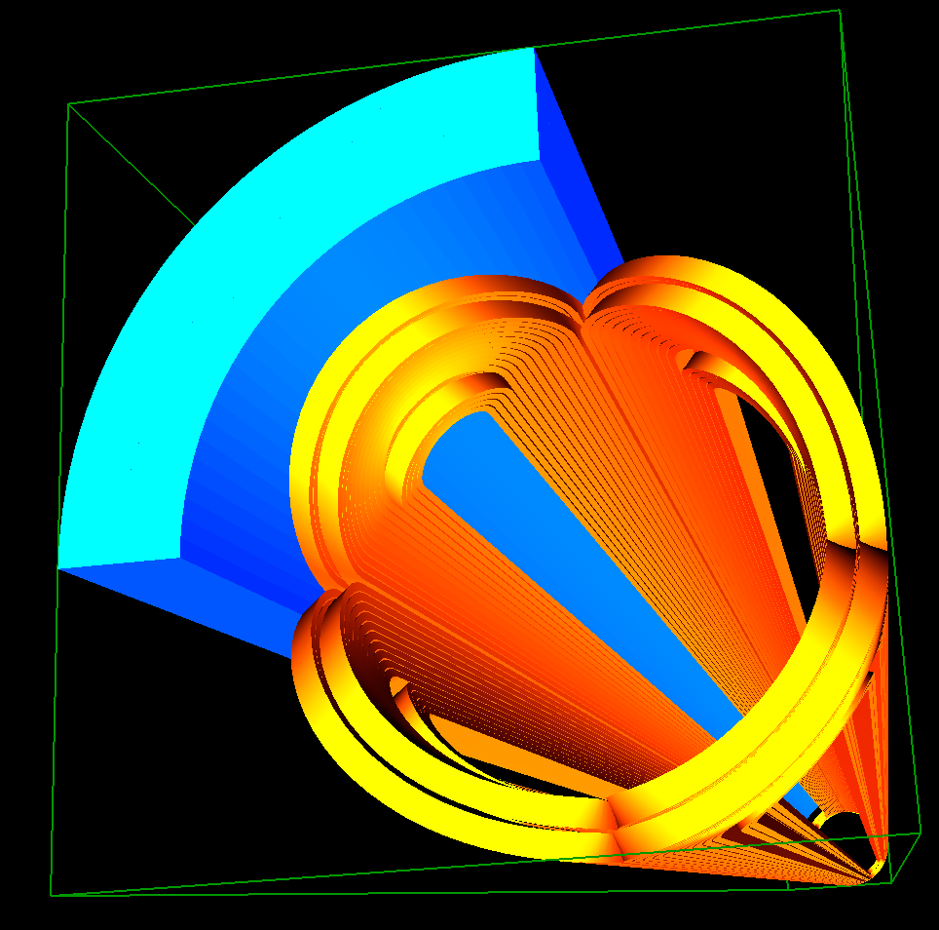
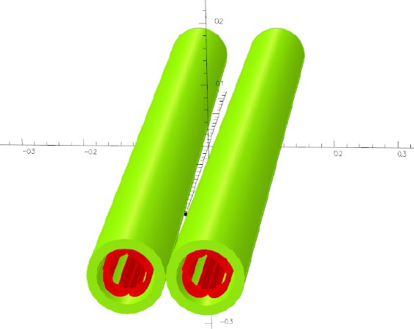
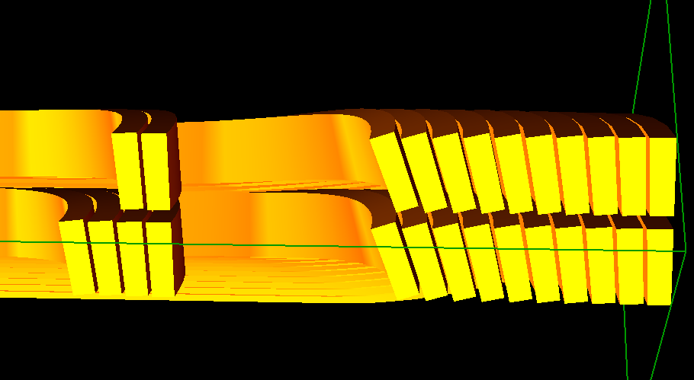
Design of Q1b
3D design of Q1b
3D magnetic field is modeled and analyzed using ROXIE and OPERA.
Coil end detailed shaped is optimized and determined.
Field gradient 85.4T/m, each integrated field harmonics is smaller than 1×10⁻⁴.
The 3D magnetic field performance meets requirement.
Calculation model in 3D

Slide 17
Design parameters of Q1b
Design parameters of the cos2θ Q1b quadrupole magnet with iron yoke
Magnet name | Q1b double aperture
Field gradient (T/m) | 85.5
Magnetic length (mm) | 1211
Coil turns per pole | 26
Excitation current (A） | 1590
Coil layers | 2
Conductor (HTS or LTS) | Rutherford Cable, width 3 mm, mid thickness 0.93 mm, keystone angle 1.9 deg, 12 strands
Maximum dipole field at aperture center (mT) | 2.3
Stored energy (KJ) | 11.0
Inductance (mH） | 8.75
Peak field in coil (T) | 2.7
Load line @4.2K | 56%
Integrated field harmonics | b₆ = 0.25 b₁₀ = -0.14
Coil inner diameter (mm) | 52
Coil outer diameter (mm) | 64.3
Yoke innerdiameter (mm) | 78
Yoke outer diameter (mm) | 103.4
X direction Lorentz force/octant (kN) | 45.86
Y direction Lorentz force/octant (kN) | -44.69
Net weight (kg) | 124

Slide 18
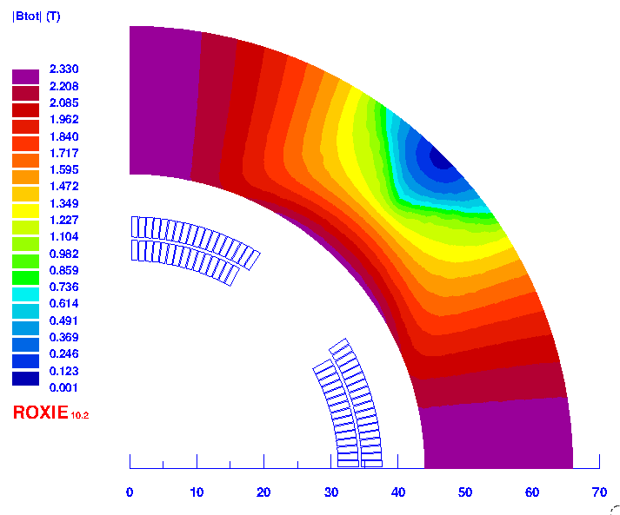
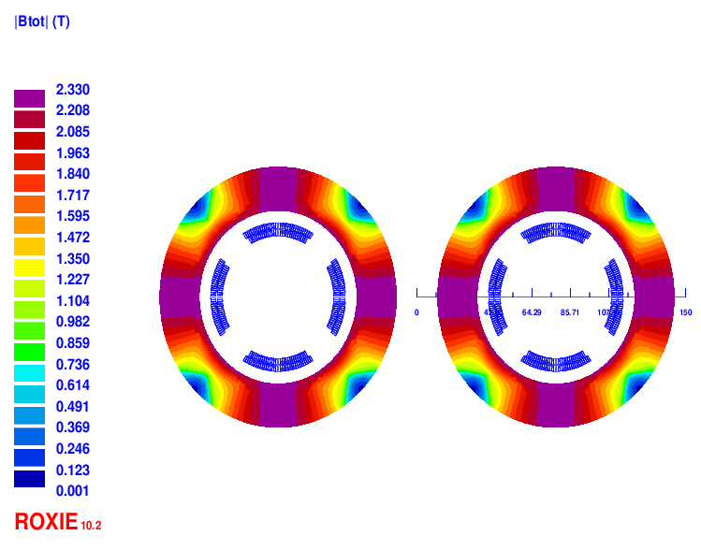
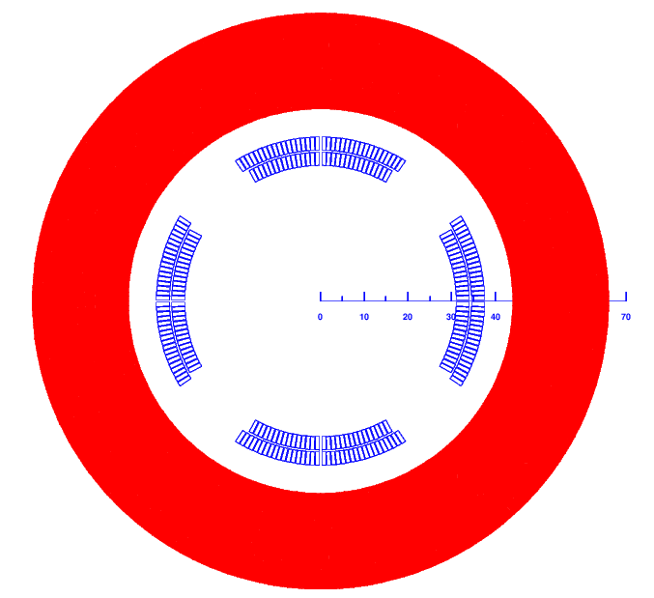
3 Design of Q2
Baseline design: Cos2θ coil; CCT and Serpentine coil as alternative design
Round 0.5mm strand, HTS Bi-2212 or LTS NbTi
Q2: two layers cos2θ quadrupole coil using Rutherford cable with iron yoke.
The inner radius of the coil is 31mm.
Single aperture cross section is optimized with two coil blocks in two layers.
33 turns in each pole. The excitation current is 1925A
Each multipole field in single aperture is smaller than 1×10⁻⁴ in 2D.
Two apertures do not need to share the iron yoke. Dipole field <30 Gs
Two or three layers corrector coils will be added inside quadrupole coil, using 0.33mm wire.

Slide 19
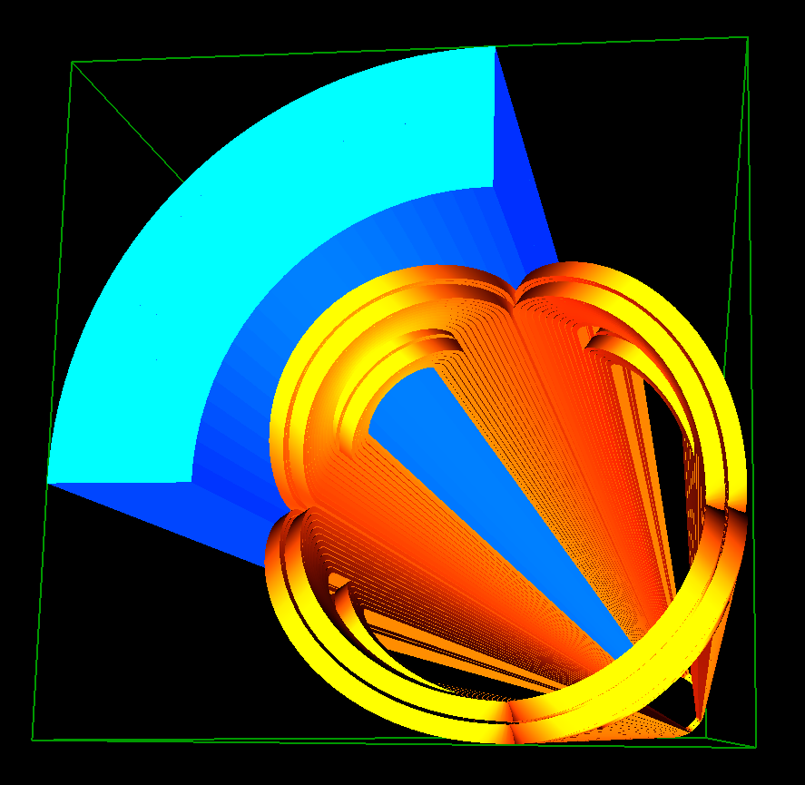
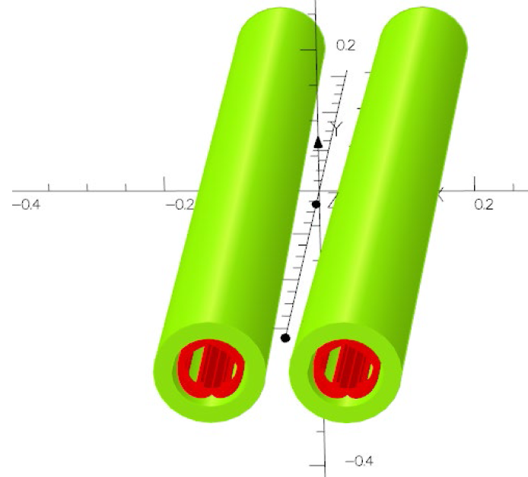
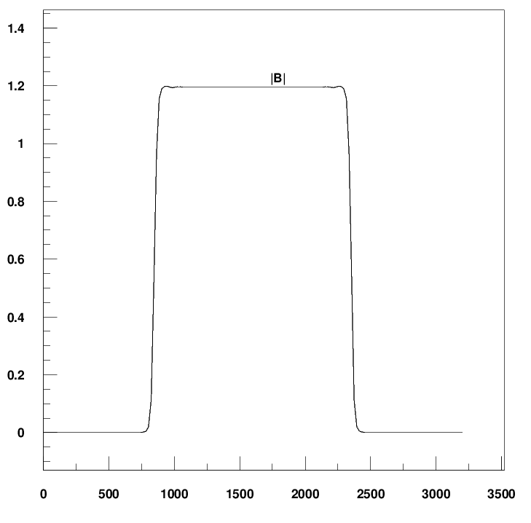
Design of Q2
3D design of Q2
3D magnetic field is modeled and analysed.
Coil end detailed shaped is optimized and determined.
Field gradient 96.7T/m, each integrated field harmonics is smaller than 1×10⁻⁴.
The 3D magnetic field performance meets requirement.
Calculation model in 3D

Slide 20
Design parameters of Q2
Design parameters of the cos2θ Q2 quadrupole magnet with iron yoke
Magnet name | Q2 double aperture
Field gradient (T/m) | 97.7
Magnetic length (mm) | 1502
Coil turns per pole | 33
Excitation current (A） | 1925
Coil layers | 2
Conductor (HTS or LTS) | Rutherford Cable, width 3 mm, mid thickness 0.93 mm, keystone angle 1.9 deg, 12 strands
Maximum dipole field at aperture center (mT) | 2.5
Stored energy (KJ) | 33.2
Inductance (mH） | 18.2
Peak field in coil (T) | 3.7
Load line @4.2K | 72%
Integrated field harmonics | b₆ = -0.52 b₁₀ = -0.49
Coil inner diameter (mm) | 62
Coil outer diameter (mm) | 75.3
Yoke inner diameter (mm) | 88
Yoke outer diameter (mm) | 126.4
X direction Lorentz force/octant (kN) | 126.94
Y direction Lorentz force/octant (kN) | -112.68
Net weight (kg) | 235

Slide 21
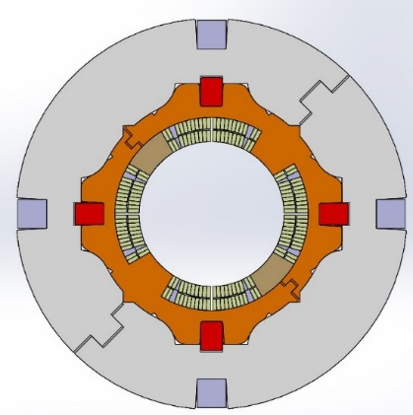
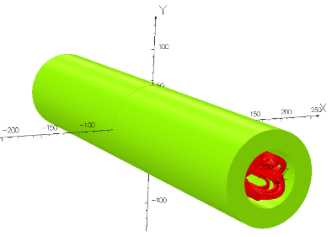
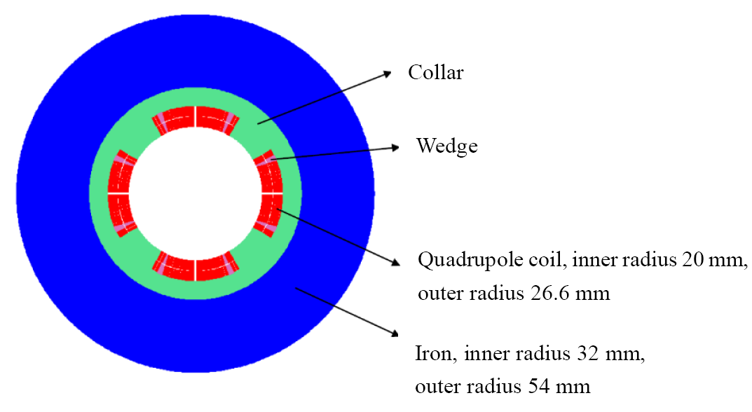
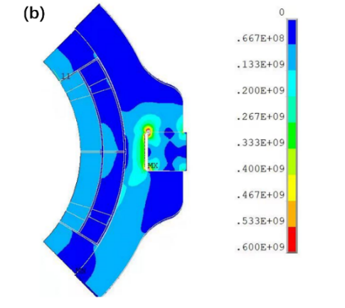
R&D status of 0.5m single aperture short model quadrupole
In R&D, the first step is to study and master main key technologies of superconducting quadrupole magnet, by developing a short LTS model magnet.
NbTi, ∅ 40mm, 142T/m, L= 0.5m, in collaboration with HeFei KEYE Company
Main purpose: verify if high magnetic field gradient can be achieved

Slide 22
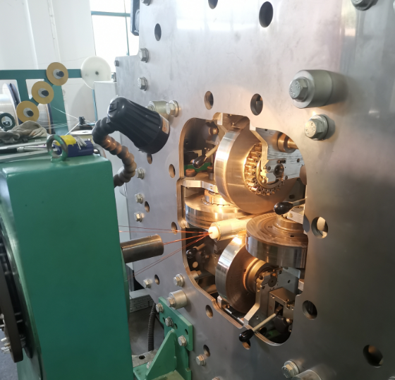
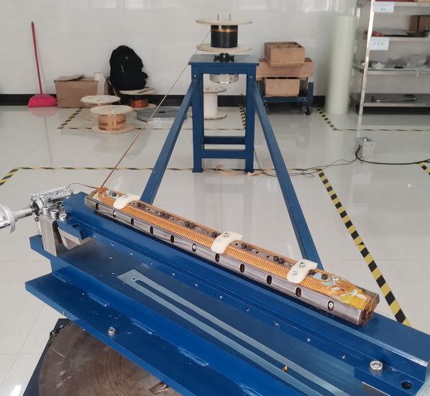
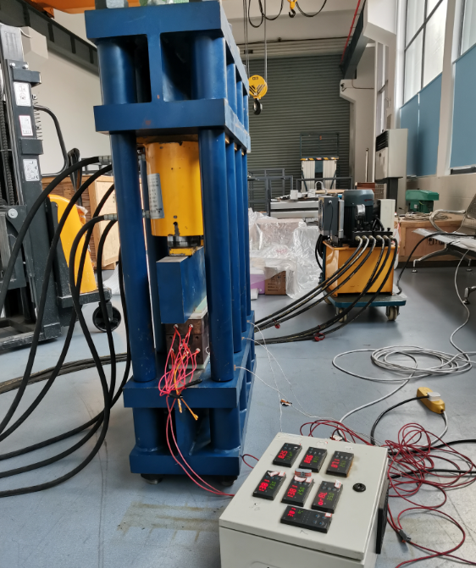
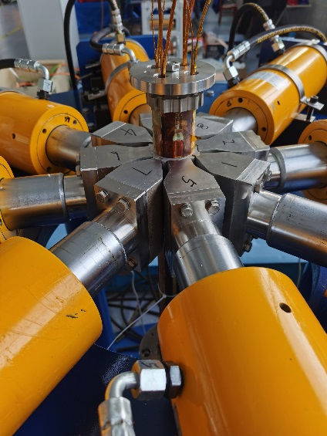
R&D status of 0.5m single aperture short model quadrupole
Manufacture of all hardware is completed.
NbTi Rutherford cable
Winding machine
Coil heating and curing system
Coils assembly system

Slide 23
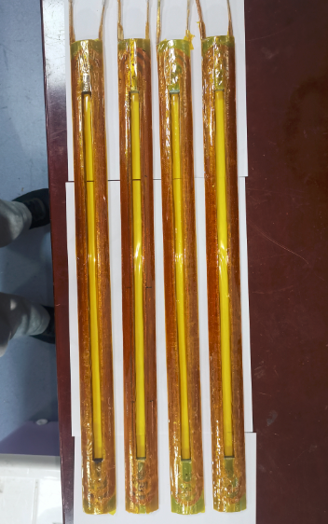
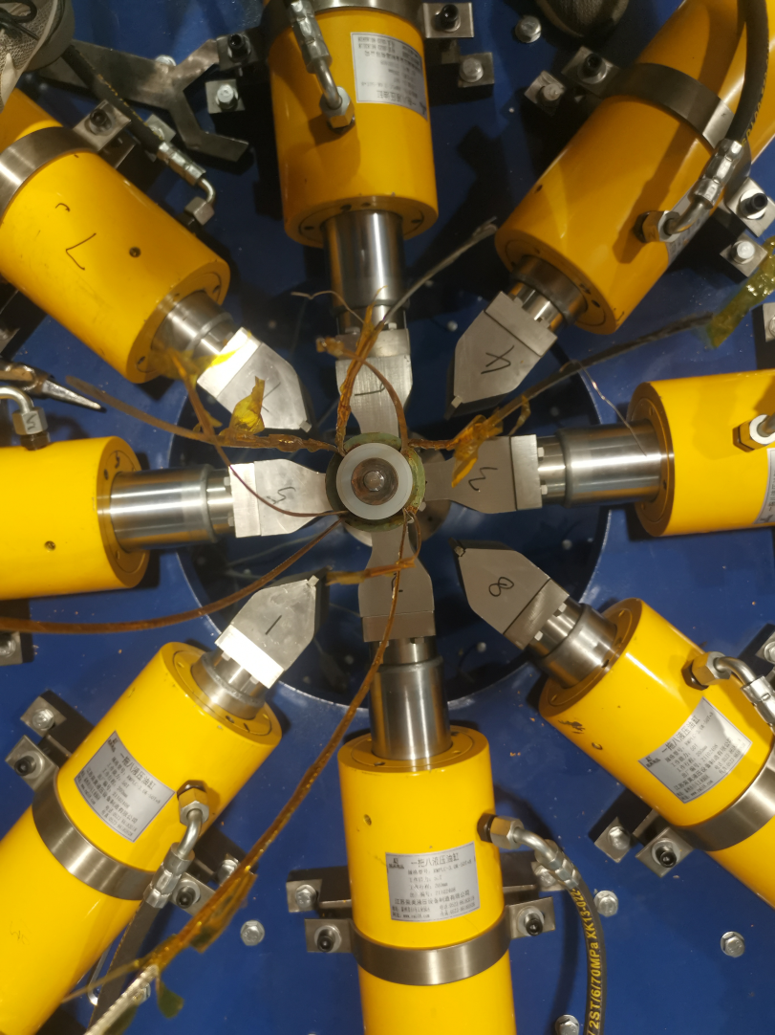
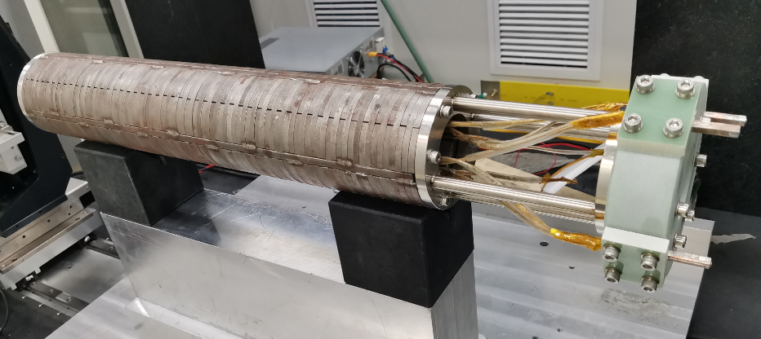
R&D status of 0.5m single aperture short model quadrupole
Many test on the winding and curing of quadrupole coils were performed.
Four SC quadrupole coils have been wound and cured.
Iron yoke has been assembled with the collared-coil.
Coil resistance, ground insulation test, and room temperature field measurement have been performed.
Manufacture of 0.5m short model quadrupole was completed in August 2022.

Slide 24
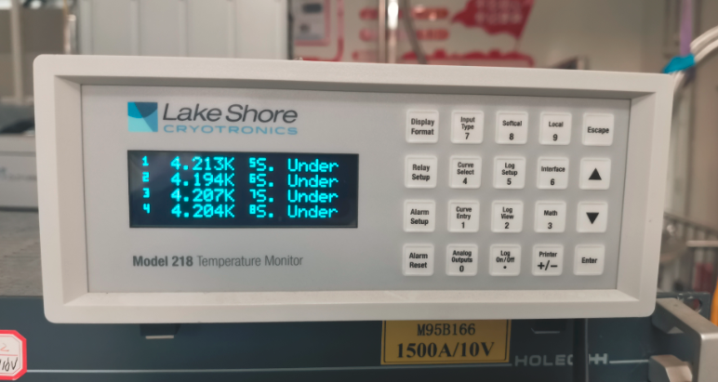
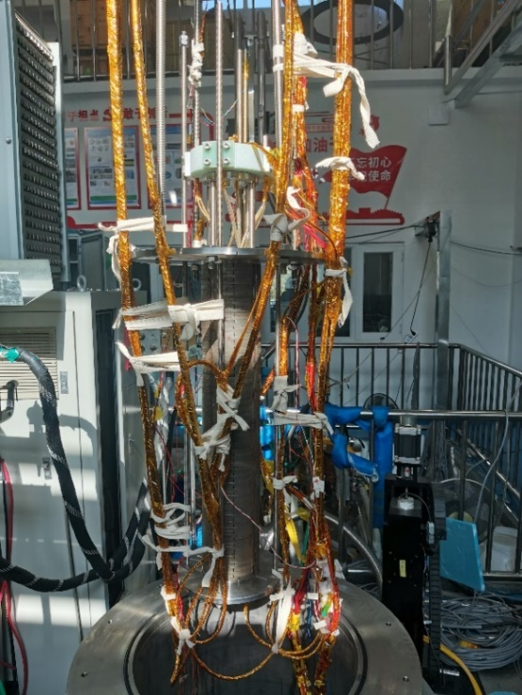
R&D status of 0.5m single aperture short model quadrupole
Cryogenic excitation test at 4.2K in vertical Dewar: to verify whether high field gradient can be achieved. (Nov.10, 2022)
The excitation current successfully reached 2500 A (Max current of leads), and operates stably for 30 minutes.
No quench occurred during the whole excitation process.
Measured inductance about 2mH; consistent with the design value.
The corresponding field gradient at 2500 A exceeds the gradient in the TDR stage (142.3 T/m).

Slide 25
Summary
For CEPC superconducting quadrupole magnets, it is challenging to meet stringent design requirements: 1) field gradient 142T/m
2) limited space 3) field crosstalk between two apertures
HTS and LTS, Iron free and with iron option have been considered.
Three coil types have been studied: Cos2θ coil, CCT coil, Serpentine coil.
Cos2θ coil as baseline design, CCT and Serpentine coil as alternative design.
The designed magnetic performance of superconducting quadrupole meet the requirements.
CEPC 0.5m single aperture short model quadrupole has been developed.
Excitation current successfully reached 2500 A at 4.2K in vertical Dewar.
High field gradient of 142 T/m for CEPC quadrupole can be achieved.

Slide 26
Thanks for your attention!
International workshop on CEPC 2023

