Slide 1



CEPC Cryogenic system
design and R&D
Rui Ge, Mei Li
The 2023 International Workshop on the High Energy Circular Electron Positron Collider, Oct. 23~27th, Nanjing
Notes:
Good afternoon, everyone, This is Mei Li from IHEP, and I am honored to stand here to give you a report “ CEPC Cryogenic system design and R&D” .

Slide 2
Content
CEPC Cryogenic System Brief Introduction
Cryogenic system for the SRF
Cooling Scheme Optimization and Process Calculation
Development of key equipment and technology
Cryogenic system for SC magnets
Summary
Notes:
The outline is including 4 parts: first of all, I will give you a brief introduction of the cryogenic system, Then, the cryogenic system for SRF design. The cooling scheme optimization and process calculation and key equipment and technology R&D are concluded. The third one, is the cryogenic system for SC magnets. Last, a shsort summary.

Slide 3
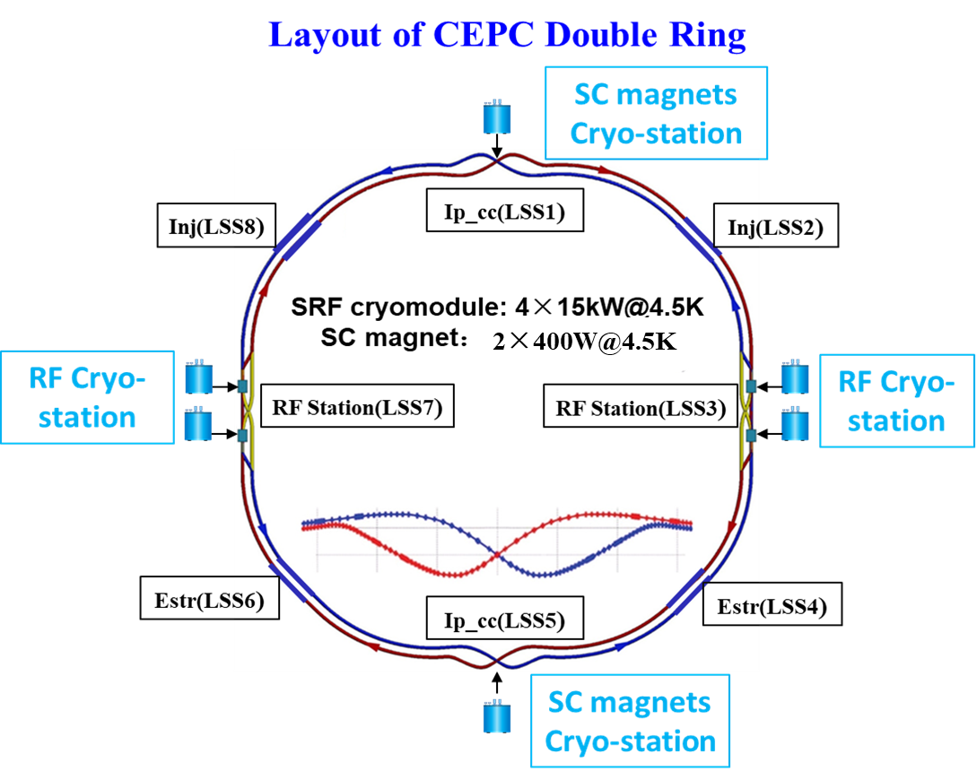
CEPC Cryogenic System Brief Introduction
CEPC is a double-ring collider with electron and positron beams circulated in opposite directions in separated beam pipes.
  Booster ring:
1.3 GHz 9-cell cavities, 96 cavities
12 cryomodules
3 cryomodules/each station
Temperature: 2K
  Collider ring:
650MHz 2-cell cavities, 336 cavities
56 cryomodules
14 cryomodules/each station
Temperature: 2K
  IR magnets:
4 IR magnets,
Temperature: 4.5K
Detectors:
2 detector magnets
Thermosiphon cooling
Notes:
Now, let’s go to the first part: CEPC cryogenic system brief introduction. Please look at this picture. CEPC is a double-ring collider with electron and positron beams circulated in opposite directions in separated beam pipes. RF stations locate at east and west side. For the Booster ring, there are 12 cryomodules for 1.3GHz 9-cell cavities. And for the collider ring, there are 56 cryomodules for 650MHz 2-cell cavities. For the SRF side, there are four cryo-stations with the capacity of 15kW@4.5K for each.
For the SC magnets side, there are total 4 IR magnets working 4K in the MDI. And , the two detectors are installed at two interaction points (IPs), and the detectors presently adopt thermosiphon cooling method.

Slide 4
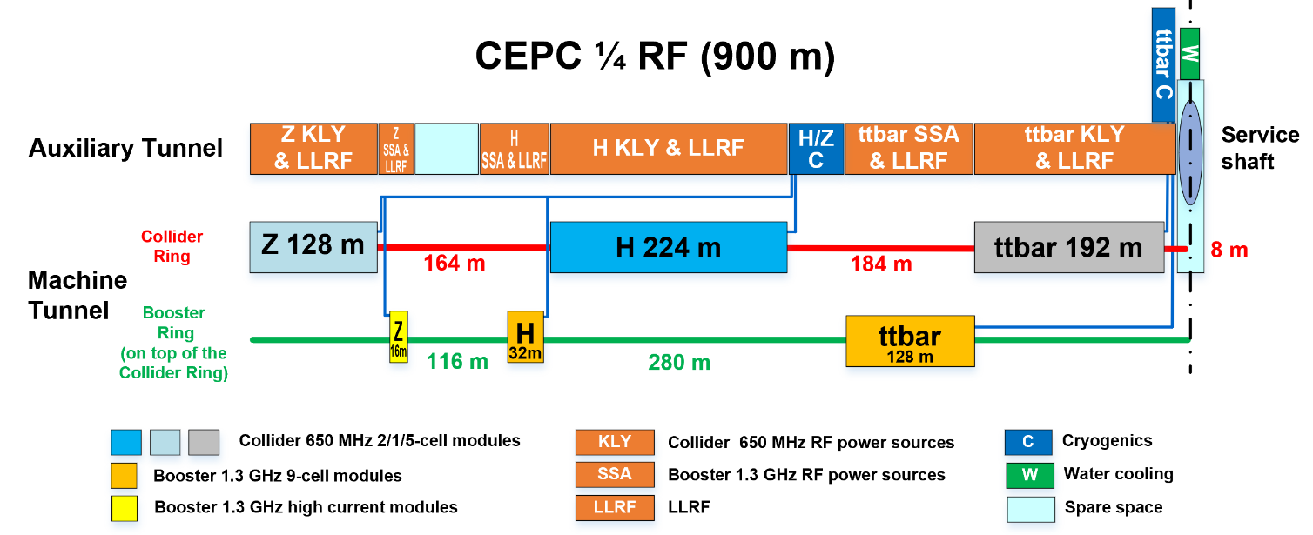
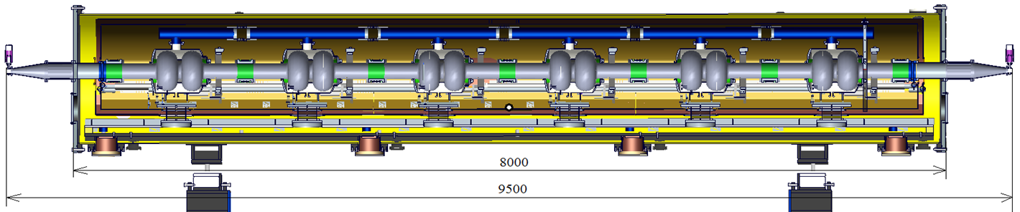
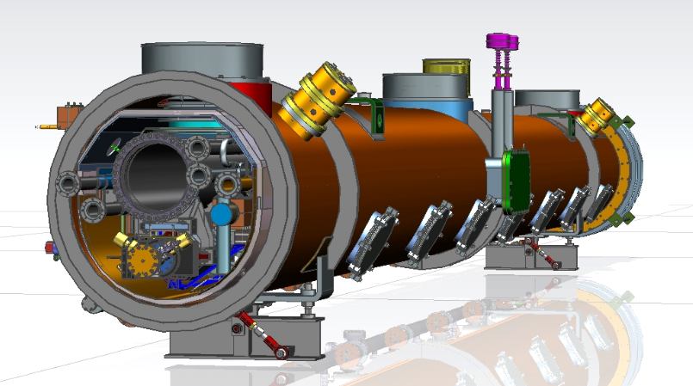
CEPC Cryogenic System Brief Introduction
Cryomodules for Higgs 30 / 50 MW
  30 MW Higgs:
Collider: 192 650 MHz 2-cell cavities in 32 modules (6 HV / CM)
Booster: 96 1.3 GHz 9-cell cavities in 12 modules (8 HV / CM)
  50 MW Higgs:
Collider: add 24 modules, in total 56 650 MHz modules
Booster: 96 1.3 GHz 9-cell cavities in 12 modules (8 HV / CM)
Notes:
The auxiliary tunnel and beam tunnel layout are shown in this diagram. For the Higgs 30 and 50 MW, the cryo-equipment locates in this blue section, and the liquid helium is transferred to the collider ring and booster ring cryomodule through the multiple transfer lines.

Slide 5
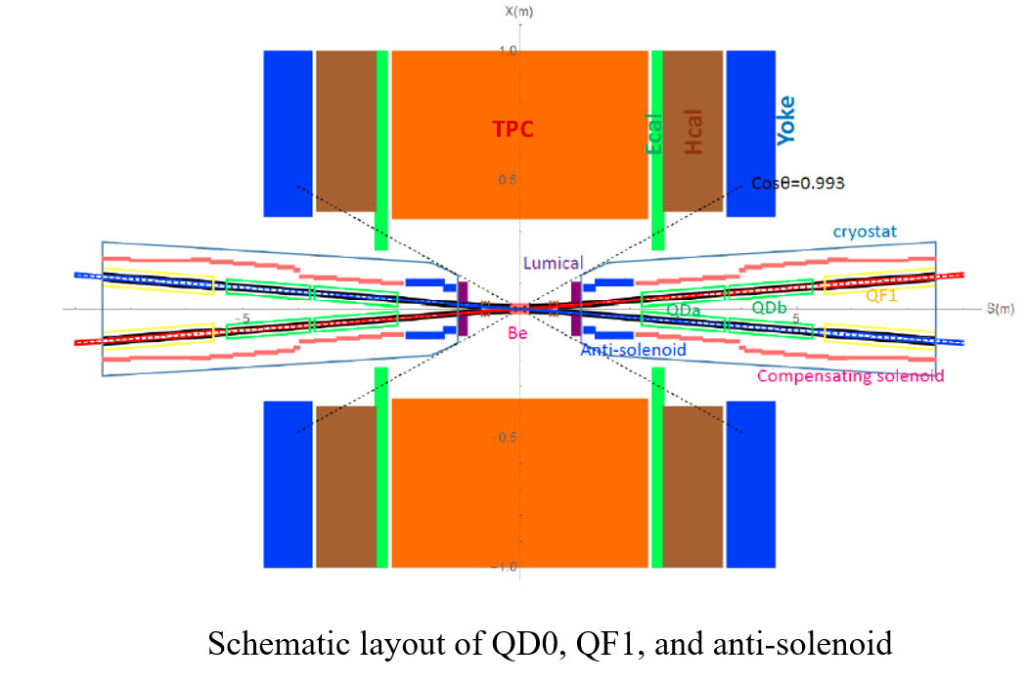
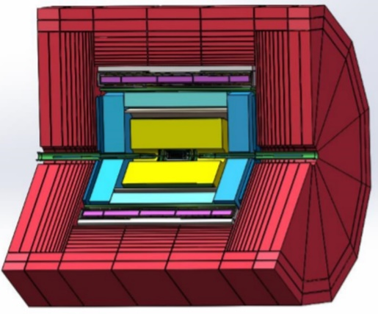
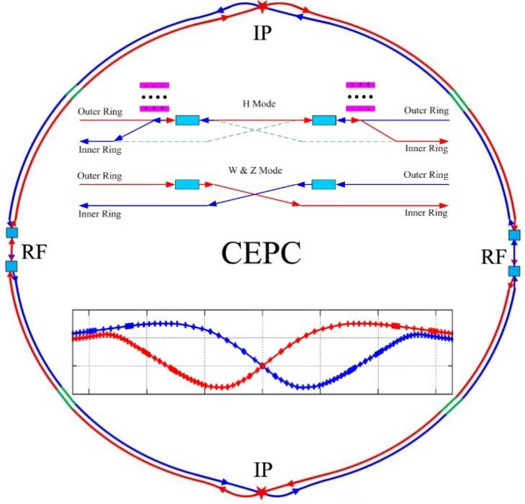
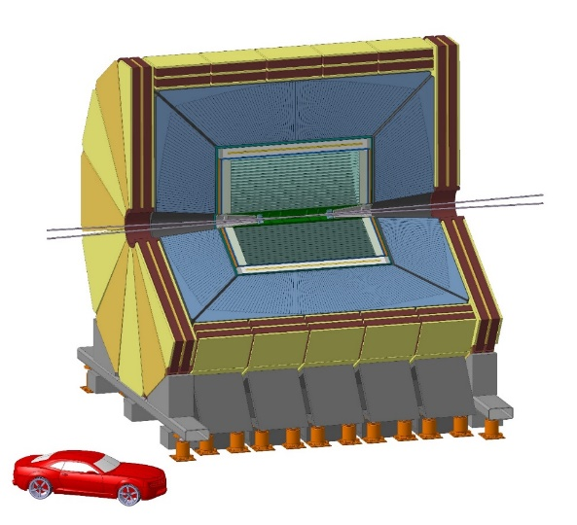
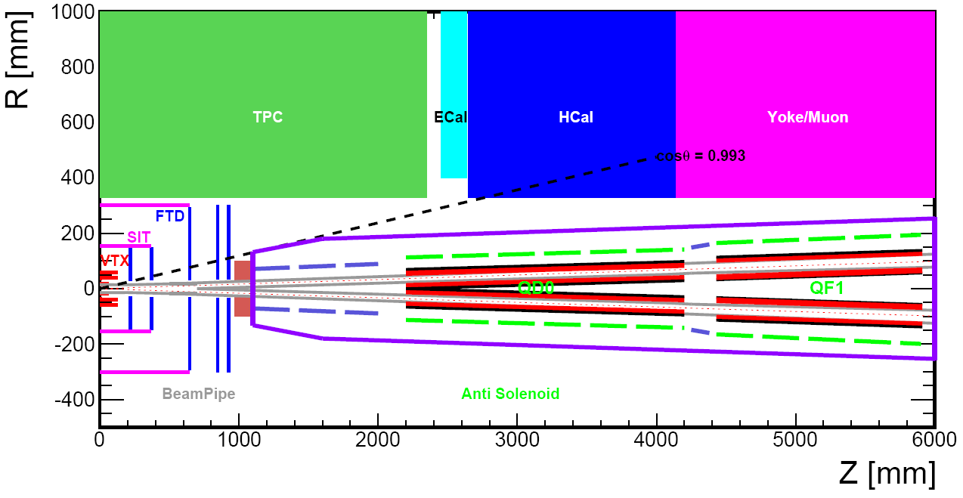
CEPC Cryogenic System Brief Introduction
SC magnets cryogenic system overview
LTS Solenoid
LTS Solenoid ：
Solenoid located outside calorimeter
Inner diameter 7.2 m, length 7.4 m
Central field：3 T
Superconductor：NbTi
Operation temperature：4.2 K
HTS Solenoid
From Zhu Ying-shun
IDEA detector
Zhu Zian，Wang Meifen
HTS Solenoid ：
Solenoid located inside calorimeter/less material
Inner diameter 4 m, length 6 m
Central field：2 T
Superconductor：YBCO
Operation temperature：20 K
Notes:
For the SC magnets side, there are total 4 IR magnets working 4K in the MDI. Besides, the detectors locate at two Ips with two separated schemes., And it’s cooling scheme is designed by Professor Zhu Zian and Wang Meifen. Now this two colleagues have left IHEP, and this section needs to be designed in detail. Therefore, my report mainly introduce the IR magnets cryogenic system.

Slide 6
Content
CEPC Cryogenic System Brief Introduction
Cryogenic system for the SRF
Cooling Scheme Optimization and Process Calculation
Development of key equipment and technology
Cryogenic system for SC magnets
Summary
Notes:
Well, after the brief introduction of the cryogenic system, now let’s go to the second part: The cryogenic system design for the SRF system.

Slide 7
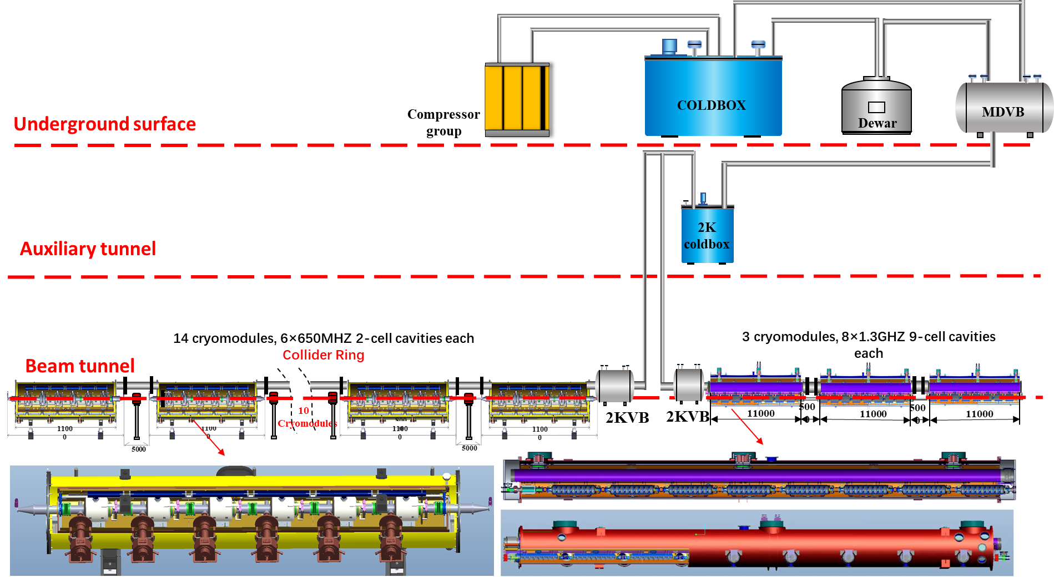
Flow chart of SRF TDR Scheme
To improve the cryogenic system efficiency and reduce the cost, the cooling scheme has been modified, from parallel to series.
In this way, there will not have a lot of small valve boxes in the tunnel, and much expenses and space will be saved.
Notes:
This is the flow chart of the SRF TDR scheme. In the previous conceptional design report, the cooling scheme is parallel for the SRF cryomodules. That means each cryomodule has a separated valve box in the auxiliary tunnel. And the length of main TL is very long.
Later, to improve the cryogenic system efficiency and reduce the cost, the cooling scheme has been modified, from parallel to series. In this way, there will not have a lot of small valve boxes in the tunnel, and we just use two big valve box to replace them. Besides, the length of the TL is much reduced, and the process scheme looks more easier. Most importantly, much expenses and space will be saved.

Slide 8

Higgs 30MW Heat Loads—TDR Scheme
Cavity RF voltage 11.5MV
Higgs Mode 30MW | Unit | Collider |  |  | Booster
 |  | 40-80K | 5-8K | 2K | 40-80K | 5-8K | 2K
Predicted module static heat load | (W/module) | 300 | 60 | 12 | 140 | 20 | 3
Predicted module HOM static heat load | (W/module) | 2.4 | 1.2 | 0.1 | 0 | 0 | 0
Predicted module Input coupler static heat load | (W/module) | 6 | 3 | 0.3 | 16 | 8 | 0.8
Predicted module dynamic heat load (RF) | (W/module) | 0 | 0 | 123.2 | 0 | 0 | 40.9
Predicted module HOM dynamic heat load | (W/module) | 2.9 | 1.4 | 0.2 | 7.1 | 3.6 | 0.6
Predicted module Input coupler dynamic heat load | (W/module) | 90.1 | 22.5 | 3.8 | 208 | 20.8 | 2.6
Module dynamic heat load | W | 44.4 | 23.9 | 127.2 | 215.1 | 24.4 | 44.1
Each Module total heat load | W | 401.4 | 88.1 | 139.6 | 371.1 | 52.4 | 47.9
Cryomodule number | - | 32 | 32 | 32 | 12 | 12 | 12
EVB heat loss | W | 50 | 10 | 5 | 50 | 10 | 5
EVB number | - | 32 | 32 | 32 | 12 | 12 | 12
MDVB heat loss | W | 50 | 30 | 10 | 50 | 30 | 10
MDVB number | - | 4 | 4 | 4 | 4 | 4 | 4
Total cryogenic transfer line length | m | 552 | 552 | 552 | 168 | 168 | 168
cryogenic transfer line heat loss per meter | W/m | 2 | 0.5 | 0.3 | 2 | 0.5 | 0.3
Total cryogenic transfer line heat loss | W | 1104 | 276 | 165.6 | 336 | 84 | 50.4
Total heat load | kW | 15.7488 | 3.5352 | 4.8328 | 5.5892 | 0.9528 | 0.7252
Overall net cryogenic capacity multiplier |  | 1.54 | 1.54 | 1.54 | 1.54 | 1.54 | 1.54
equiv. heat load with multiplier | kW | 2.81 | 4.90 | 36.69 | 1.00 | 1.32 | 5.50
4.5K equiv. heat load with multiplier | kW | 44.39 |  |  | 7.82
Total 4.5K equiv. heat load with multiplier | kW | 52.21
Installed power (COP(219W/1W)) | MW | 9.72 |  |  | 1.71
4×15kW@4.5K refrigerator
Notes:
This table shows the Higgs 30MW heat loads. There are total 32 cryomodules in the collider and 12 cryomodules in the booster. Considering the attached transfer and distribution system, the estimated heat loads at 4K is about 52kWs, and four cryo-plants with the cooling capacity of 15kW for each station.

Slide 9
Higgs 50MW Heat Loads—TDR Scheme
Cavity RF voltage 6.5MV
Higgs Mode 50MW | Unit | Collider |  |  | Booster
 |  | 40-80K | 5-8K | 2K | 40-80K | 5-8K | 2K
Predicted module static heat load | (W/module) | 300 | 60 | 12 | 140 | 20 | 3
Predicted module HOM static heat load | (W/module) | 2.4 | 1.2 | 0.1 | 0 | 0 | 0
Predicted module Input coupler static heat load | (W/module) | 6 | 3 | 0.3 | 16 | 8 | 0.8
Predicted module dynamic heat load (RF) | (W/module) | 0 | 0 | 40.1 | 0 | 0 | 40.9
Predicted module HOM dynamic heat load | (W/module) | 4.8 | 2.4 | 0.4 | 9.6 | 4.8 | 0.8
Predicted module Input coupler dynamic heat load | (W/module) | 85.8 | 21.5 | 3.6 | 256 | 25.6 | 3.2
Module dynamic heat load | W | 90.6 | 23.9 | 44.1 | 265.6 | 30.4 | 44.9
Each Module total heat load | W | 399 | 88.1 | 56.5 | 421.6 | 58.4 | 48.7
Cryomodule number | - | 56 | 56 | 56 | 12 | 12 | 12
EVB heat loss | W | 50 | 10 | 5 | 50 | 10 | 5
EVB number | - | 56 | 56 | 56 | 12 | 12 | 12
MDVB heat loss | W | 50 | 30 | 10 | 50 | 30 | 10
MDVB number | - | 4 | 4 | 4 | 4 | 4 | 4
Total cryogenic transfer line length | m | 936 | 936 | 936 | 168 | 168 | 168
cryogenic transfer line heat loss per meter | W/m | 2 | 0.5 | 0.3 | 2 | 0.5 | 0.3
Total cryogenic transfer line heat loss | W | 1872 | 468 | 280.8 | 336 | 84 | 50.4
Total heat load | kW | 27.216 | 6.0816 | 3.7648 | 6.1952 | 1.0248 | 0.7348
Overall net cryogenic capacity multiplier |  | 1.54 | 1.54 | 1.54 | 1.54 | 1.54 | 1.54
4.5K equiv. heat load with multiplier | kW | 4.85 | 8.43 | 28.58 | 1.10 | 1.42 | 5.58
4.5K equiv. heat load with multiplier | kW | 41.86 |  |  | 8.10
Total 4.5K equiv. heat load with multiplier | kW | 49.96
Installed power (COP(219W/1W)) | MW | 9.17 |  |  | 1.77
4×15kW@4.5K refrigerator
Notes:
And for the Higgs 50MW, the cryomodule numbers increase. There are 56 cryomodules in collider. The cryomodules number have no change in booster. In the mean time, the cavity voltage is reduced to almost one half the value of Higgs 30MW. Therefore, the four individual refrigerators with 15kW still can meet the requirements.

Slide 10
cryogenic system process flow diagram in the SRF system
5K@3bara supercritical helium is subcooled to 4.5K, and then through 2K JT heat exchanger reduced to 2.2K@3bara.
2.2K@3bara helium throttled by JT valve to produce the 2K super fluid helium.
40-80K thermal shield is set to reduce the radiation loss.
5-8K loop to cool down the coupler.
Notes:
5K@3bara supercritical helium subcooled to 4.5K, and then through 2K JT heat exchanger reduced to 2.2K@3bara.
2.2K@3bara helium throttled by JT valve to produce the 2K super fluid helium.
40-80K loop to cool down the cryomodules' thermal shield.
5-8K loop to cool down the coupler.

Slide 11
Booster cryomodules for String
There are two important cryogenic valves in each cryomodule. The JT valve is to produce the 2K superfluid helium, and each cryomodule can achieve separated cooldown process through the cooldown valve.
2.2K@3bara helium supply
Notes:
This is the booster cryomodules for string flowchart. There are two important cryogenic valves in each cryomodule. This is the JT valve to produce the 2K superfluid helium, and each cryomodule can achieve separated cooldown process through this cooldown valve.

Slide 12
Collider cryomodules for String
Notes:
And this is flowchart of the collider cryomodules. The process is similar.

Slide 13
Process calculation
0.15W/m single loop transfer line heat loss
Scheme1
Scheme2
Collider: after modified, Smaller diameter
Notes:
After the process design, we conduct the detailed process calculation. We compared two different cooling schemes, and after the modification, the diameter of the transfer line becomes smaller from DN200 toDN150. And the TL heat load calculation is adopted 0.15W/m.

Slide 14
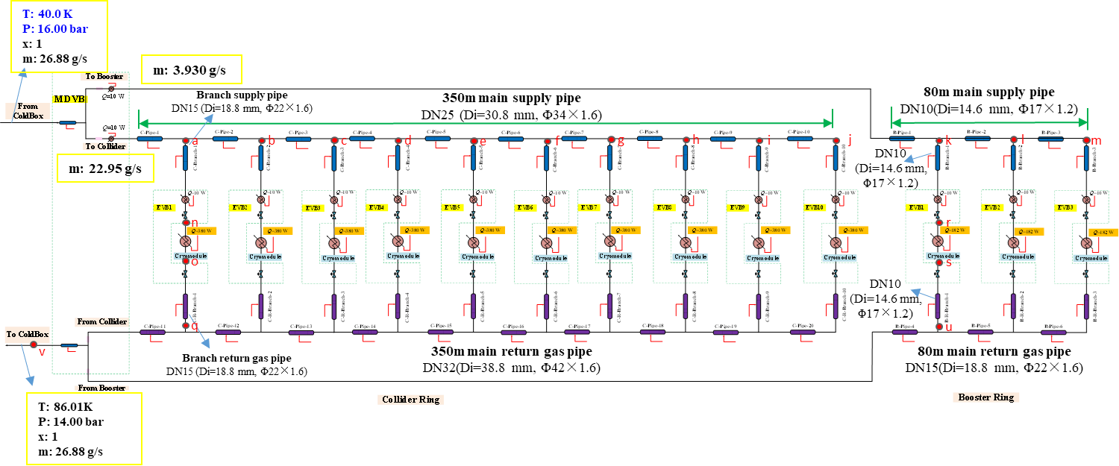
40K~80K TS calculation
Total main supply TL is 430 meters, and the heat loss per meter is 2.0 W.
The mass flow of liquid helium needs to be provided by the refrigerator is no less than 26.88 g/s .
Main supply pipe sizes: collider- Di=30.8 mm, Booster-Di=14.6 mm.
Main return gas pipe sizes: collider- Di=38.8 mm, Booster-Di=18.8 mm.
Branch supply pipe sizes: collider- Di=18.8 mm, Booster-Di=14.6 mm.
Branch return gas pipe sizes: collider- Di=18.8 mm, Booster-Di=14.6 mm.
Notes:
We also conduct the detailed process calculation of the 40K~80K thermal shield calculation. Total main TL length is 430 meters, and the heat loss per meter is 2.0 W.
And the proper sizes of the TL are selected.

Slide 15
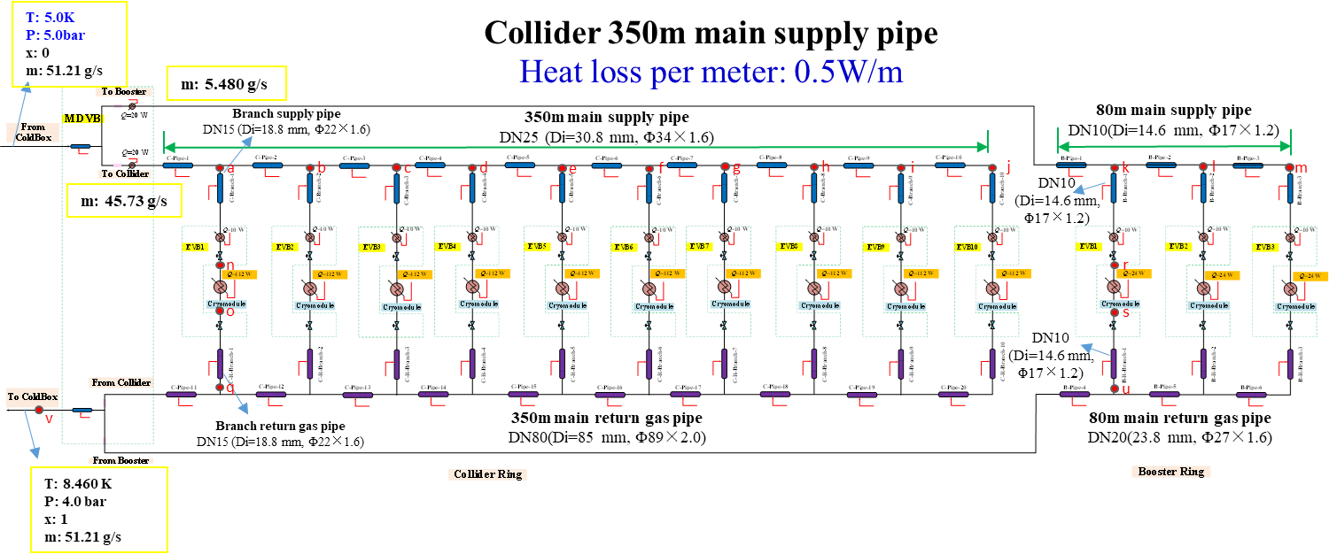
5K~8K TS calculation
Total main supply pipe TL is 430 meters, and the heat loss per meter is 0.5 W.
The mass flow of liquid helium needs to be provided by the refrigerator is no less than 51.21 g/s .
Main supply pipe sizes: collider- Di=30.8 mm, Booster-Di=14.6 mm.
Main return gas pipe sizes: collider- Di=85 mm, Booster-Di=23.8 mm.
Branch supply pipe sizes: collider- Di=18.8 mm, Booster-Di=14.6 mm.
Branch return gas pipe sizes: collider- Di=18.8 mm, Booster-Di=14.6 mm.
Notes:
In the same way, the detailed process calculation for the 5K~8K thermal shield calculation has already be done. And the heat loss per meter is 0.5 W.
And the proper sizes of TL are also selected.

Slide 16
Development of the key equipment and technology
Large refrigerator
1.3GHz cavity cryomodule
650MHz cavity cryomodule
KW JT heat exchanger
Notes:
Next, I will introduce the Development of the key equipment and technology, including :

Slide 17
Key equipment and technology
Large refrigerator
Technical supported by FULL CRYO Company and TIPC, CAS
2.5 kW @4.5K or 500W @2K refrigerator have passed test and will be installed in CIADS campus for the long time running to verify the stability.
The CAS pilot project for the 10 kW @4.5K or 15 kW @4.5K (required for CEPC) has been approved, and it is expected to be developed and fully prepared for CEPC in the next few years.

Slide 18
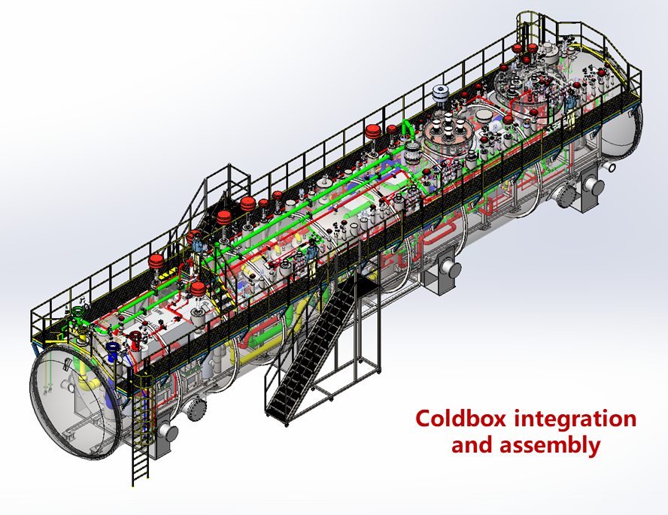
Key equipment and technology
Parameters of the refrigerator
Large refrigerator
Other parameters | Precooled by Turbin expanders | Precooled by liquid nitrogen
The consumption of the Liquid Nitrogen | 0g/s (0L/h) | 428.7g/s(2043L/h)
Gas flow for precooling | 100g/s | 0g/s
Gas flow（g/s） | 1668g/s | 1551g/s
Power Consumption（KW） | 3935.13 | 3721.3
Parameters of the cold compressor
Parameters | The high pressure compressor | The medium pressure compressor | The low pressure compressor
Gas flow (g/s)* | 1668.00 | 862.80 | 230.7
Pressure of the inlet (bara) | 4.05 | 1.05 | 0.40
Pressure of the outlet (bara) | 18.54 | 4.05 | 1.05
Adiabatic efficiency （%） | 85 | 85 | 85
Power consumption (kW) | 2568 | 1155 | 196.3

Slide 19
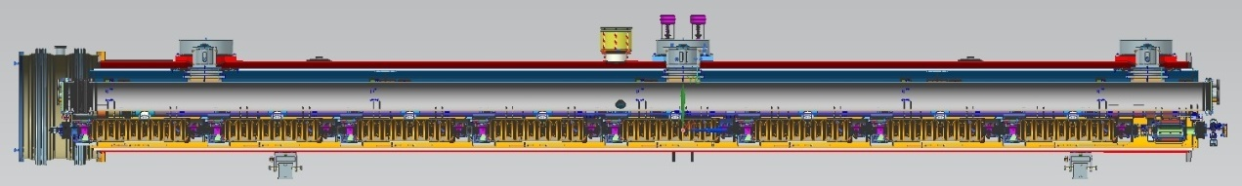
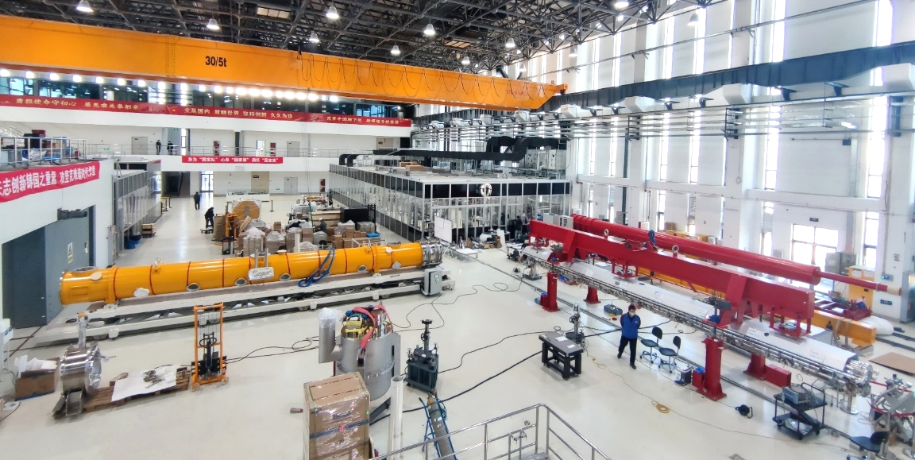
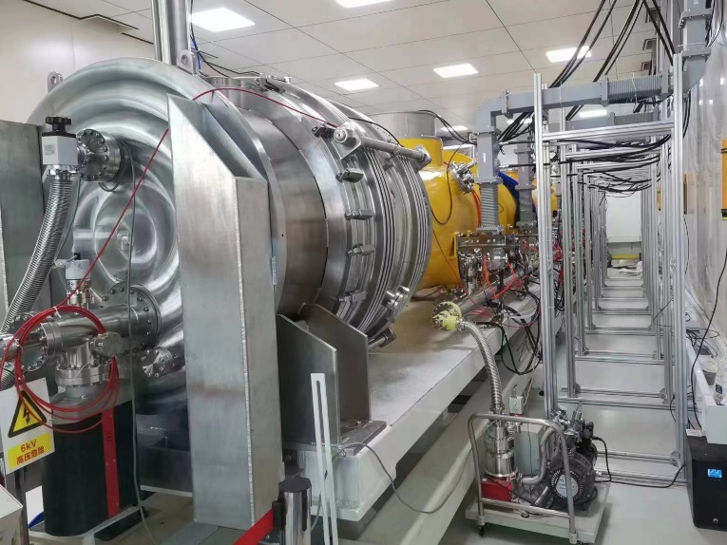
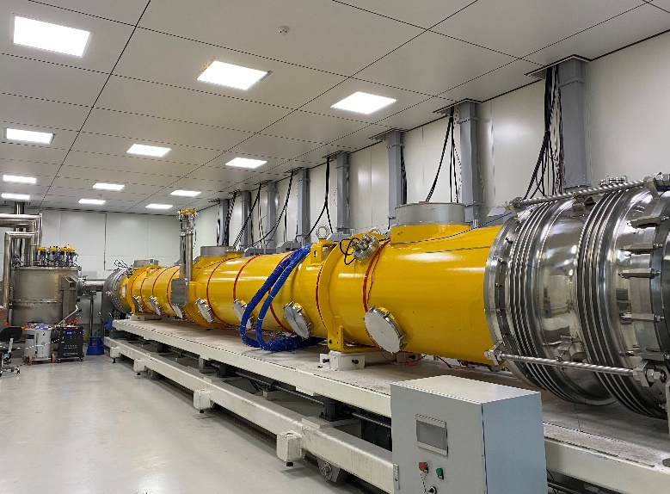

1.3GHz cavity Cryomodule
Notes:
Another key technology is 1.3 GHz cavity cryomodule. The horizontal test has been carried out in PAPS project, and all cryogenic functions, including cooldown, 2K operation, warming up process, have been verified successfully.

Slide 20
1.3GHz cavity Cryomodule
5K helium
2K superfluid helium is produced by the JT valve, and the cavity can be immersed in 2K helium bath. The GHe returns to heat exchanger to recover the cold quantity. And it is heated by the electrical heater, then enter the pump station. Finally, it goes to compressor suction side to complete the whole circle.
2.9bara@2.2K
31mbar@2K
Subcooled 4.5K LHe
2K Valve Box
Feedcap
CRYOMODULE
Endcap
Notes:
The 5K helium from coldbox is supplied to be transferred, in 2K valve box, the helium is subcooled by the saturated liquid helium from DW. And then go to the heat exchanger, the temperature is further lowered, then transferred to cryomodule. 2K superfluid helium is produced by the JT valve, and the cavity can be immersed in the helium bath. The helium vapor gas is collected in gas return pipe, return to heat exchanger to recover the cold quantity. And then is heated by the electrical heater, then enter the pump station. Finally, it goes to compressor suction side to complete the whole circle.

Slide 21
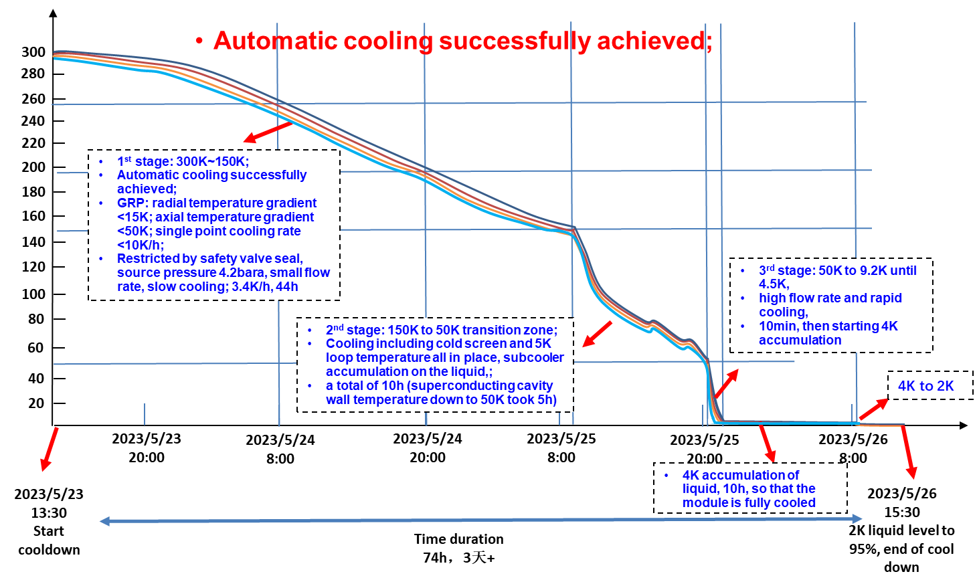
1.3GHz cavity Cryomodule Cooldown
The first stage is from 300K to 150K.
Automatic cooling method was adopted to guarantee the cavity can be cooled smoothly and safely.
Temperature difference in the radial and axial direction should be controlled in the accepted domain.
The second stage is 150K to 50K transition zone;
To increase the cooling speed to prevent "hydrogen poisoning" phenomenon happening.
The third stage : large flow rate fast cooldown.
Established a large temperature gradient to expel magnetic flux, which can improve the cavity performance greatly.
Notes:
The first stage is from 300K to 150K. In this stage, we use the automatic cooling method to guarantee the cavity can be cooled smoothly and safely. And the temperature difference in the radial and axial direction should be controlled in the accepted domain.
The second stage is 150K to 50K transition zone, we need to increase the cooling speed to prevent "hydrogen poisoning" phenomenon happening.
When the temperature reaches 50K, we start the third stage : large flow rate fast cooldown. In this way, it will be established a large temperature gradient to expel magnetic flux, which can improve the cavity performance greatly.
The whole cooldown process is about more 3 days.

Slide 22
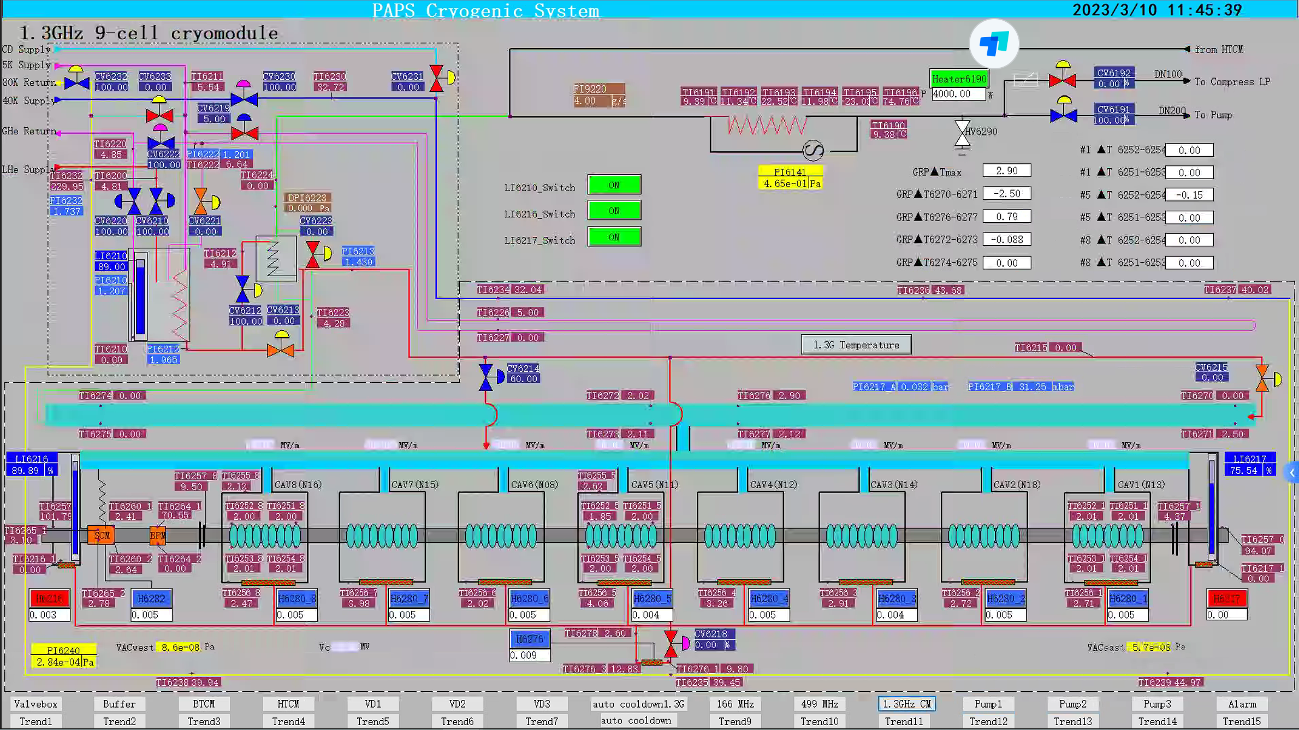
1.3GHz cavity Cryomodule
Notes:
This is the 2K operation control interface. All the temperatures on the cavity surface are all 2K. And Prof. Jiyuan Zhai has already introduced the test results, so I won’t go over this part again.

Slide 23
650MHz cavity Cryomodule
Including six 2-cell 650 MHz superconducting cavities, six high power couplers, six mechanical tuners and two HOM absorbers
Six 2-cell Cavities Cryomodule
Overall length(flange to flange, m) | 8.0
Diameter of Vacuum vessel ,m | 1.3
Beamline height from floor, m | 1.5
Cryo-system working temperature, K | 2
Number of 200-POST | 6
Cryomodule performance |  | Specification
Number of leakage | He →insulation | 0
 | He →beam pipe | 0
 | Insulation →coupler | 0
 | Insulation →beam pipe | 0
 | Coupler →beam pipe | 0
Alignment x/y inside (Cavities) |  | ±0.5mm
Alignment z inside |  | within 2 mm
Coupler antenna design z |  | within 2 mm
Notes:
Ok, the above-mentioned content is the 1.3GHz 9-cell cavity cryomodule, another cryomodule is 650MHz 2-cell cavities cryomodule. This diagram shows the cross section view, Including six 2-cell cavities, high power couplers, mechanical tuners and Higher-Order-Mode (HOM) Absorbers. The total length is about 9.5 meters. These two table shows the parameters.

Slide 24
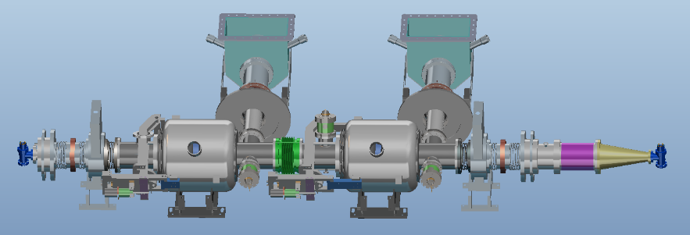
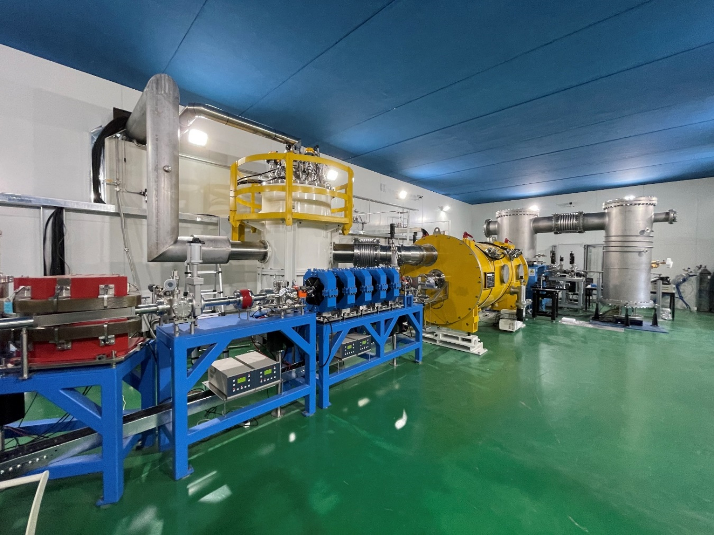
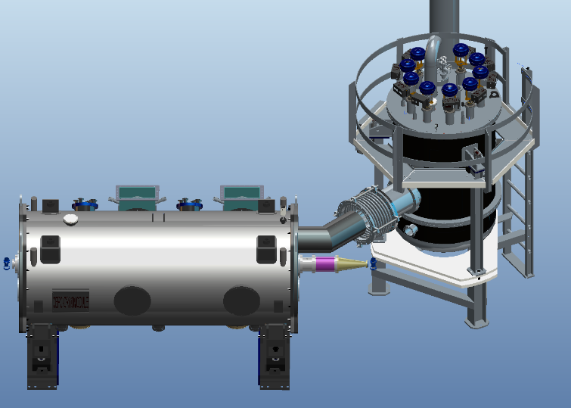
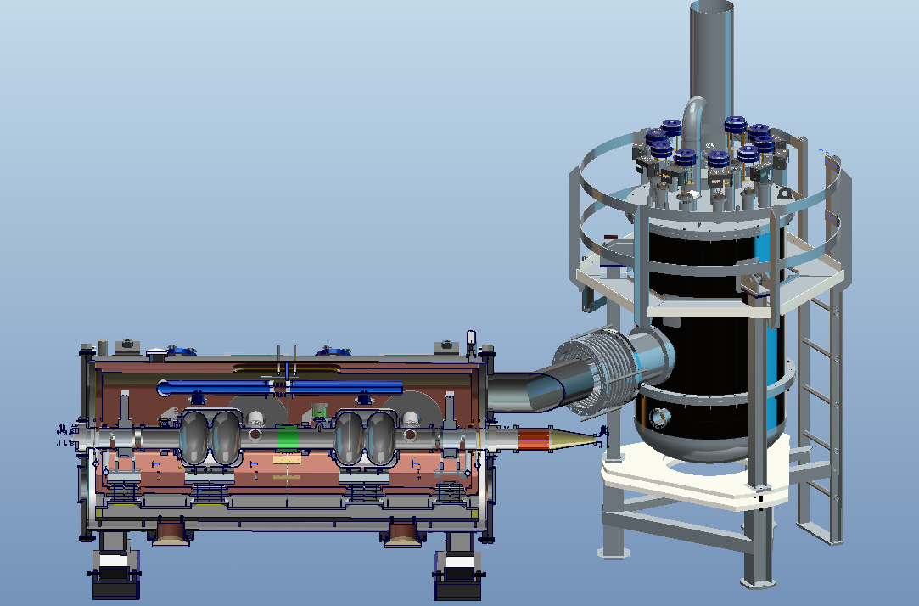
650MHz cavity Cryomodule
Prototype of 650MHz cryomodule with 2* 2cell cavities have been installed in PAPS tunnel and past the cryogenic test in 2021.
Notes:
The prototype cryomodule with two 2-cell 650 MHz superconducting cavities was operated in the PAPS system beam test stand last year, but without beam, just completed the cryogenic test.

Slide 25
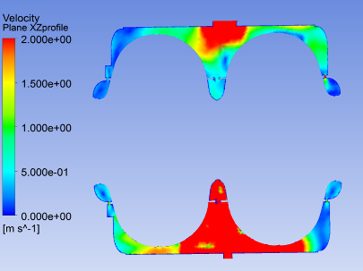
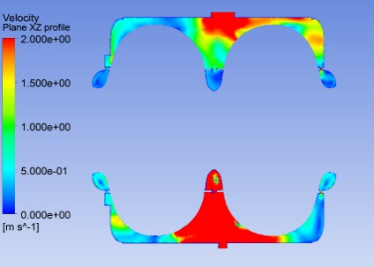
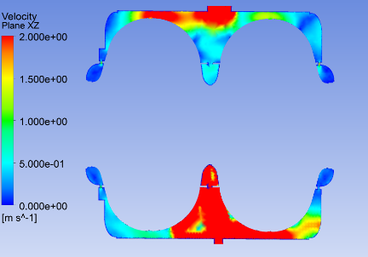
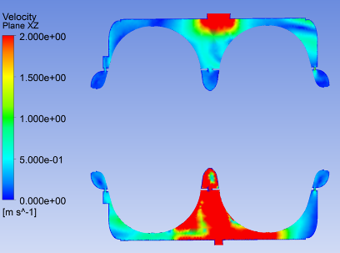
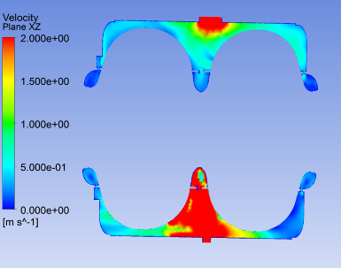
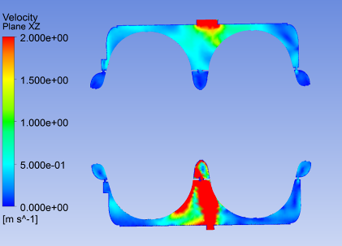
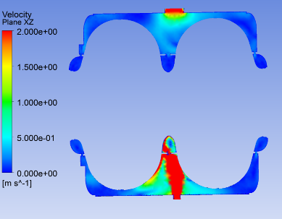
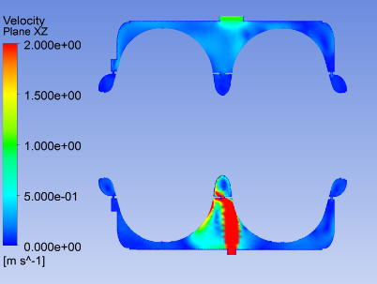
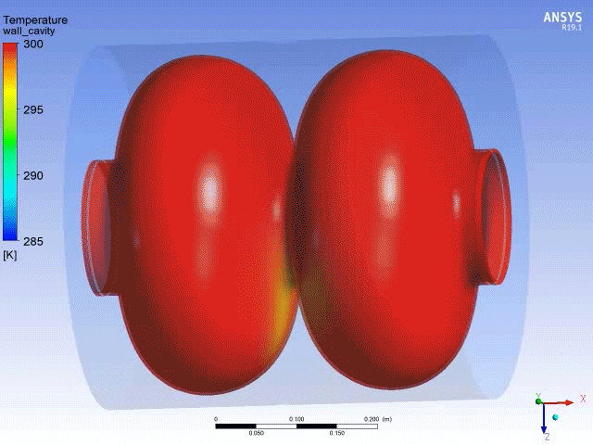
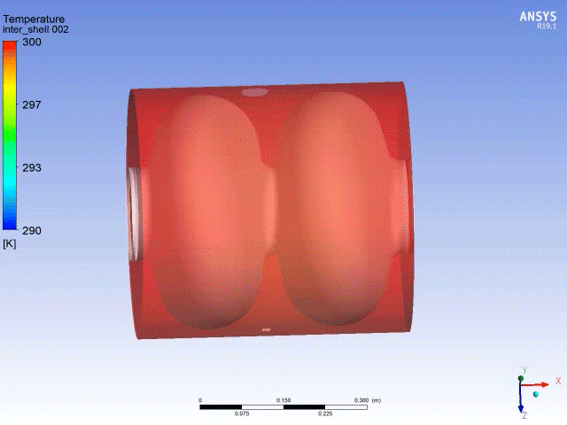
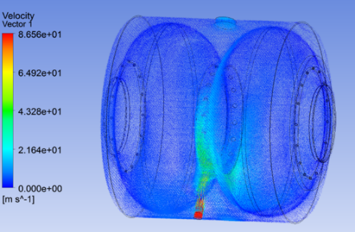

650MHz cavity Cryomodule
The cooling rate of the superconducting cavity needs to be strictly controlled, and a three-dimensional flow field non-stationary numerical simulation of the cooling process of the 650 2-cell superconducting cavity is performed.
A certain simulation basis is laid for the subsequent automatic cooling.
a) 260K b) 220K c) 180K
d) 140K e) 100K f) 60K
g) 40K h) 20K
Non-stationary analysis of superconducting cavity cooling process
Global velocity distribution
Notes:
Also we conducted the heat transfer CFD simulation of the cooldown process. A certain simulation basis is laid for the subsequent automatic cooling

Slide 26
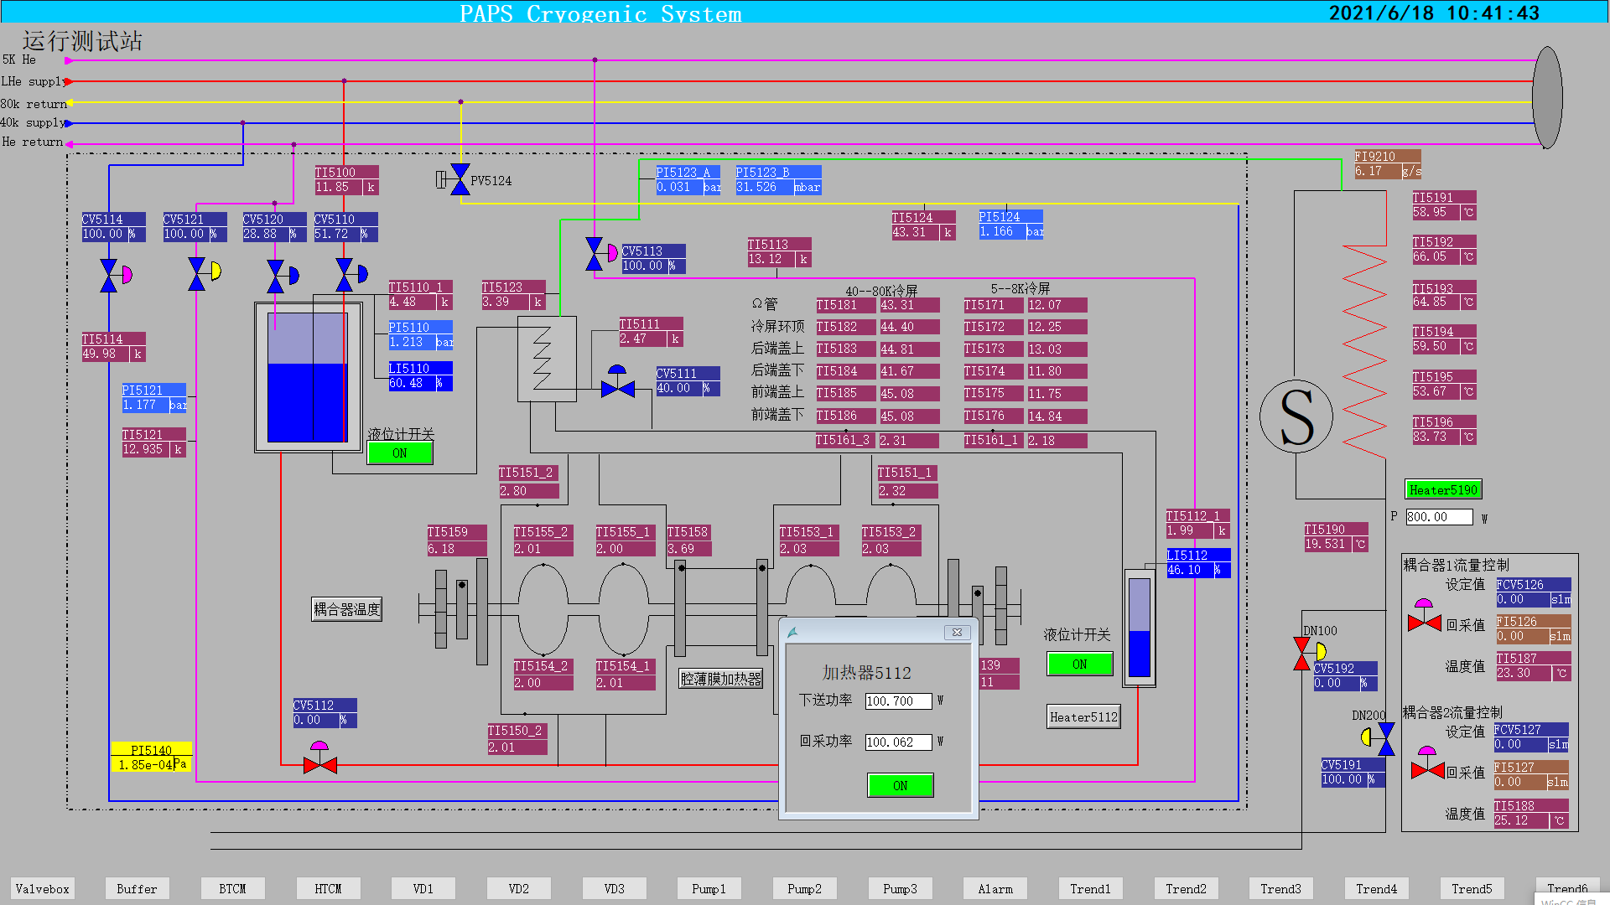
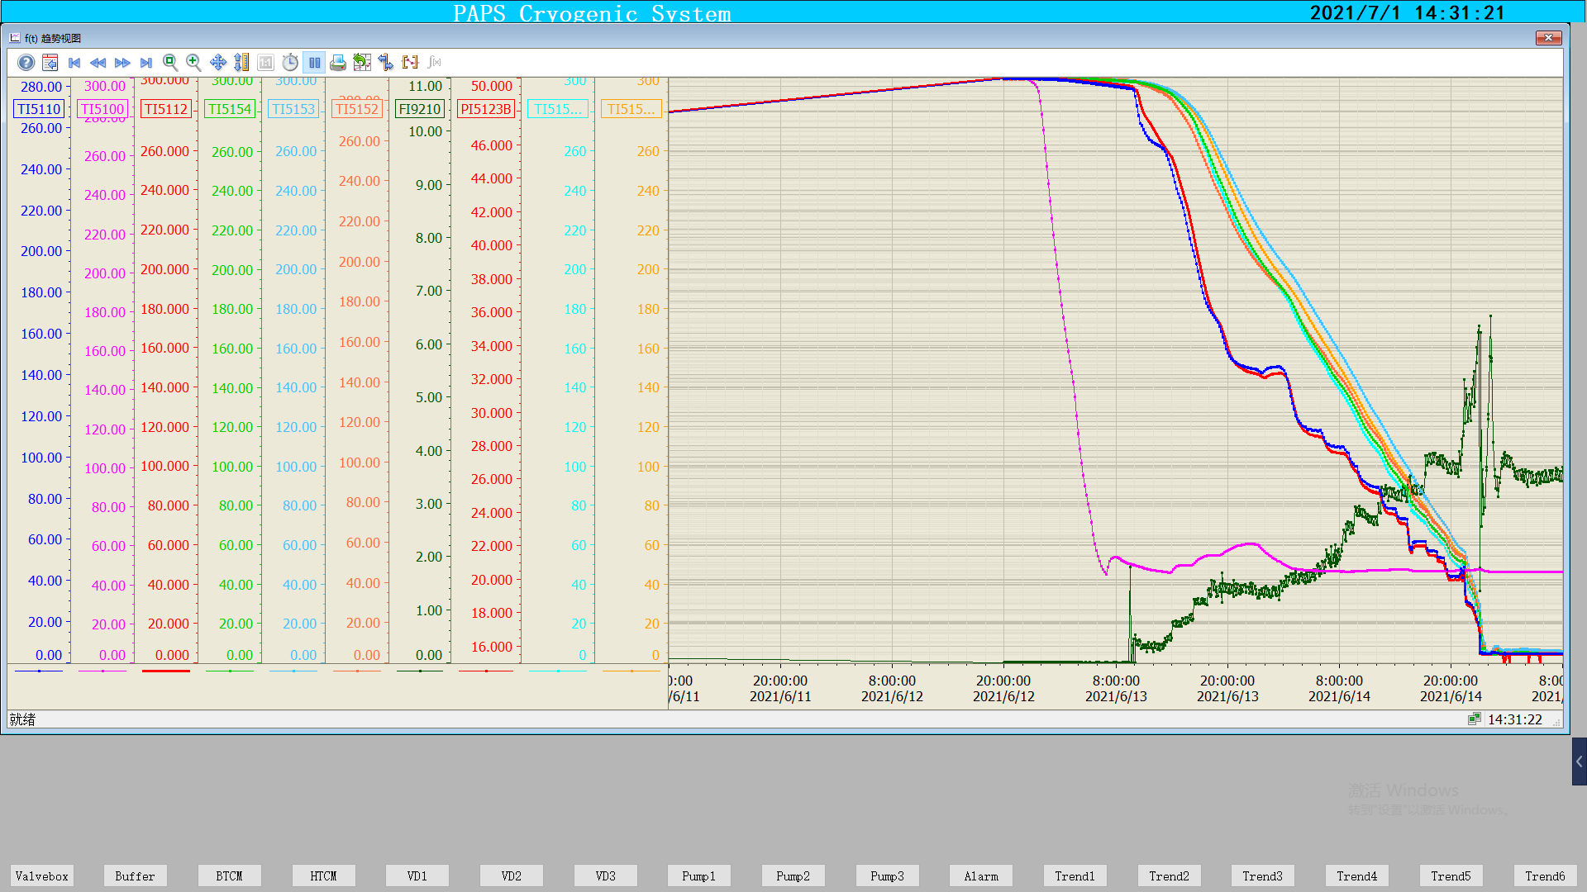
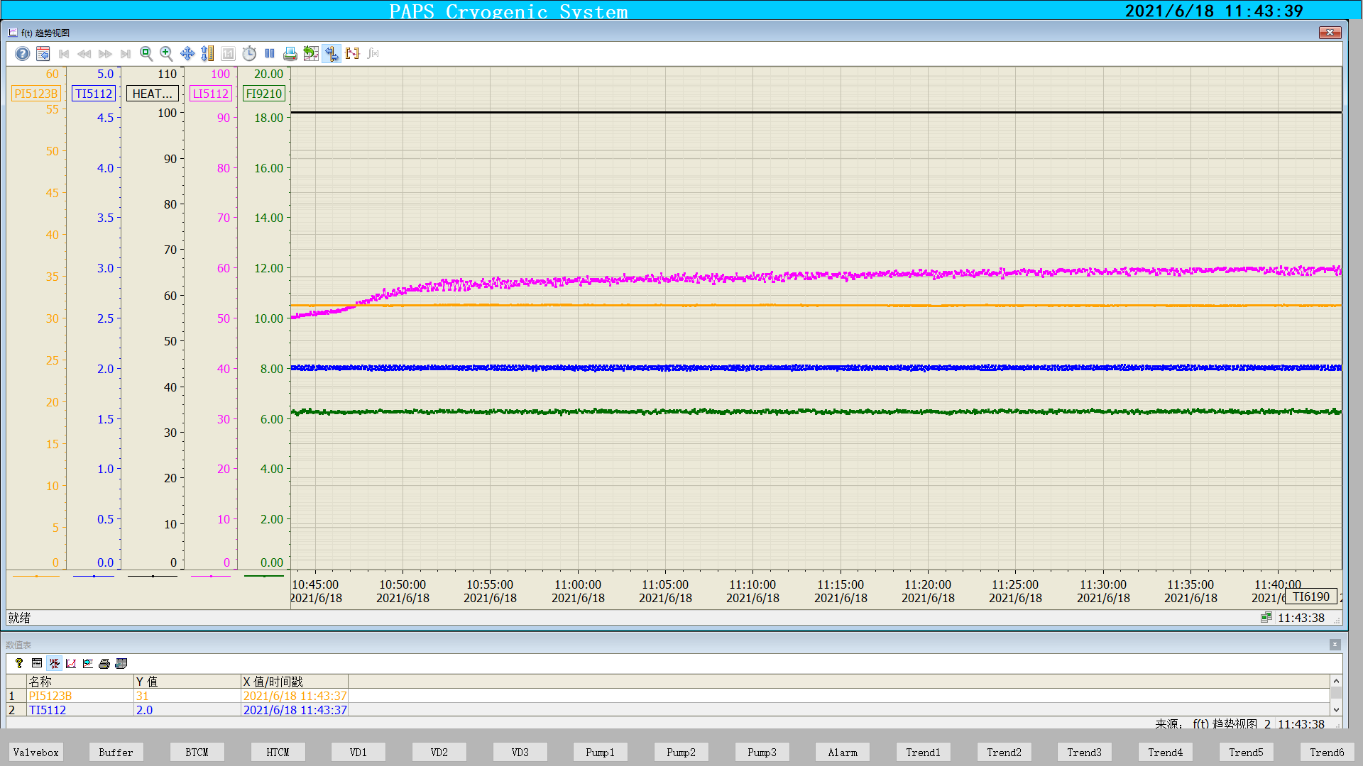
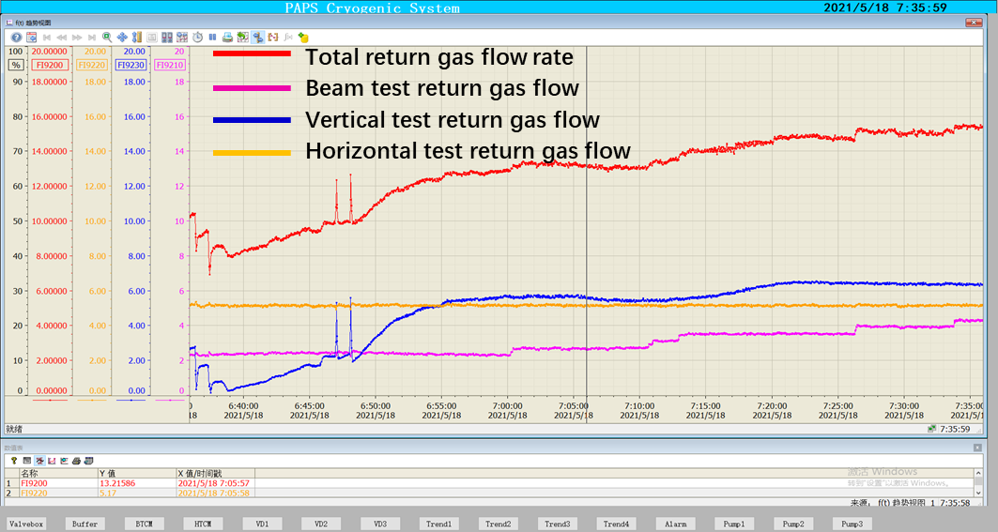
650MHz cavity Cryomodule
BTCM cooldown
BTCM: 100.7W@2K
Level
Temperature
Pressure
Mass flow
Pressure 31mbar±10Pa
Temperature 2K±0.02K
BTCM 2K stable operation
Cryogenic capacity test, 300W@2K return gas flow rate
Notes:
And during the cryogenic test period, the pressure stability and temperature stability at 2K have been verified to meet the requirements . And the whole cooling capacity test is 300W@2K.

Slide 27
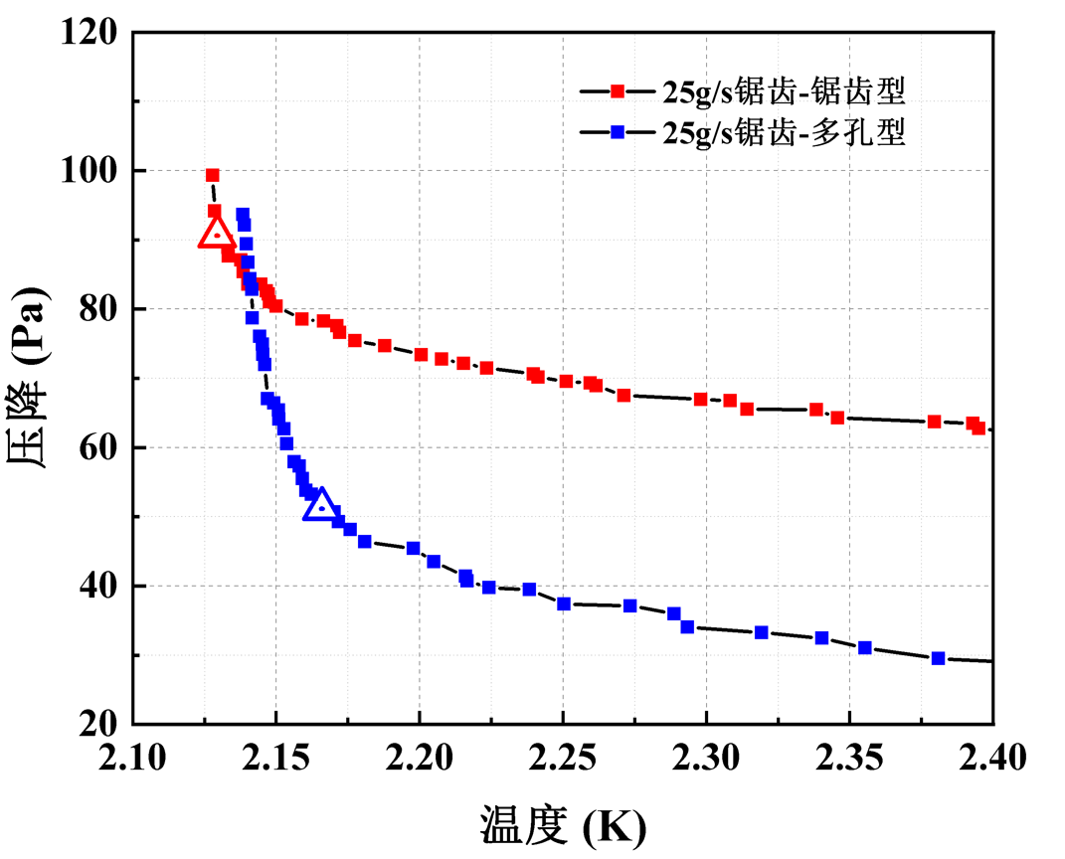
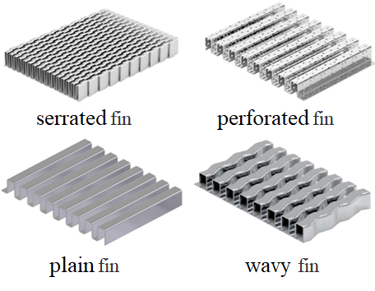
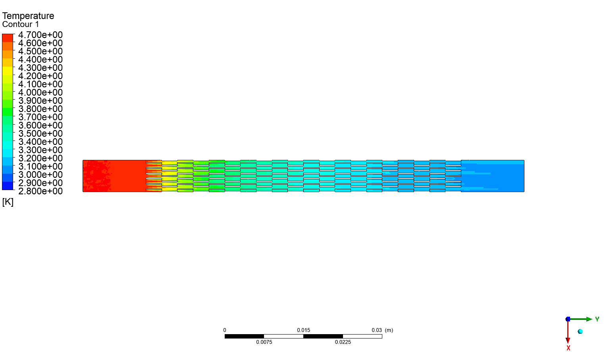
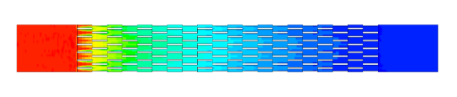
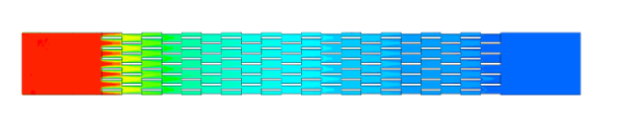
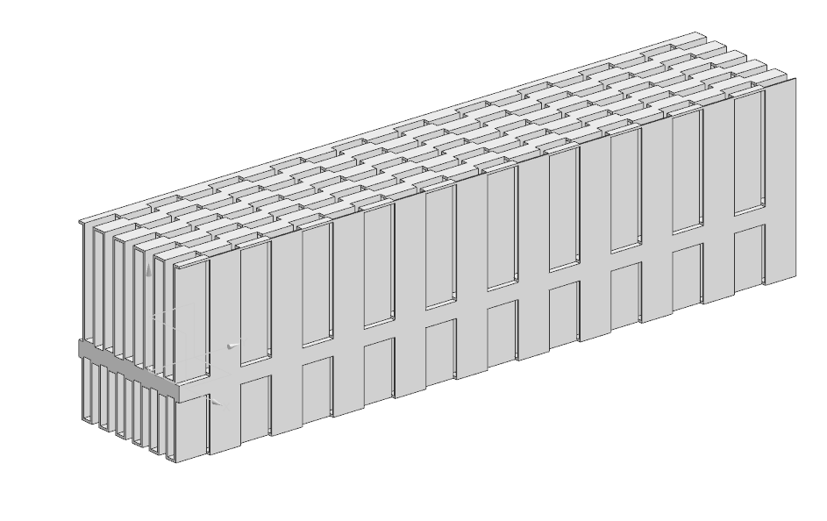
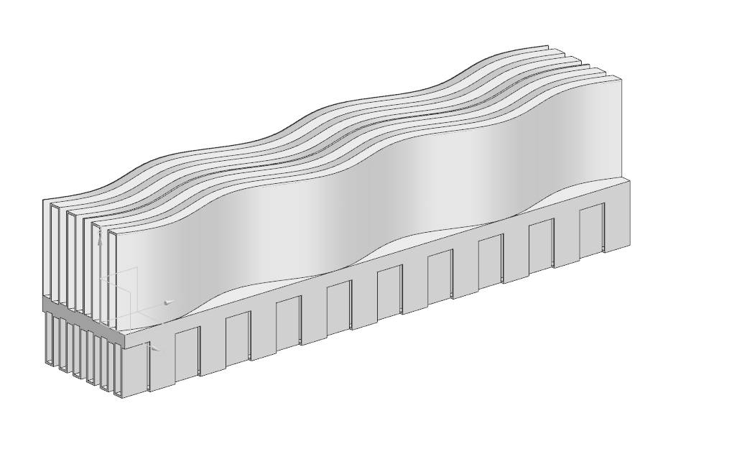
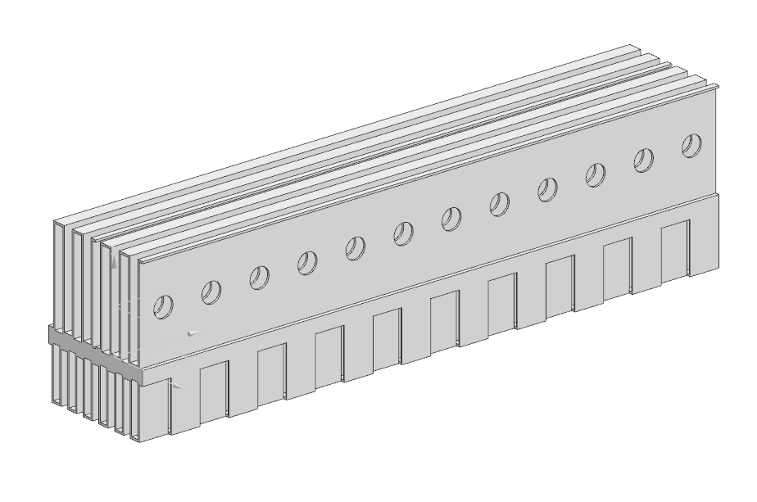

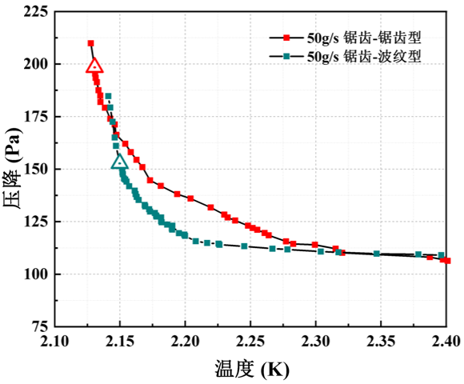
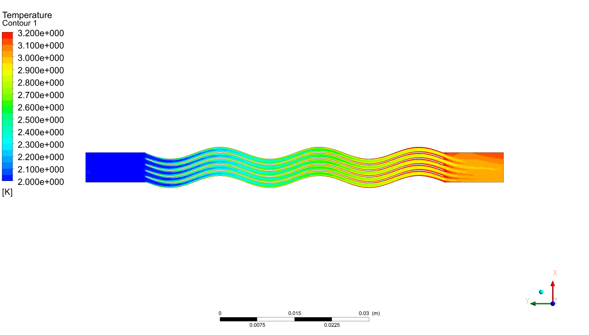
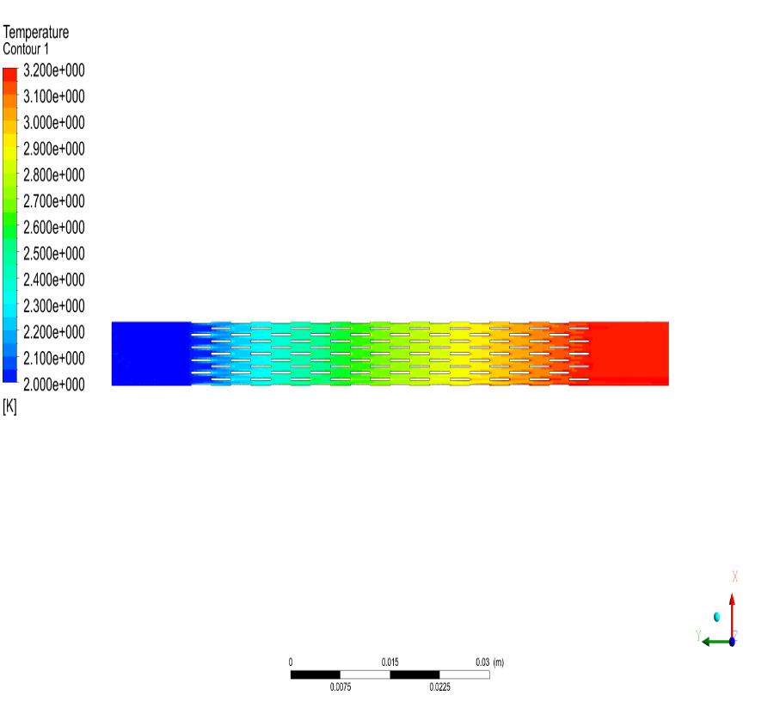
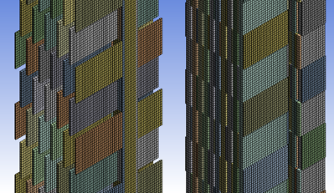




KW JT heat exchanger
JT heat exchanger is an indispensable component in the 2K cryogenic system. According to our experience, it is demonstrated that an efficient HX can increase the liquid helium concentration from 62% to 89% after the JT valve.
For CEPC, there are 4 cryo-stations with the cooling capacity 2kW@2K, so we need 4 JT heat exchanger with the larger mass flow rate.
2022.05-2022.10 Basic Design and Optimization.
NSGA-II Optimization
Designing & Verification
CFD Designing Reslut
Notes:
Next, I will introduce another key technology--the 2K JT HX. JT heat exchanger is an indispensable component in the 2K cryogenic system. According to our experience, it is demonstrated that an efficient HX can increase the liquid helium concentration from 62% to 89% after the JT valve.
For CEPC, there are 4 cryo-stations with the cooling capacity 2kW@2K, so we need 4 JT heat exchanger with the larger mass flow rate. The kilo-watt scale heat exchanger project began in 2022.

Slide 28






KW JT heat exchanger
2022.10-2023.05 Manufacturing and Quality Detection.
Checking Thickness
Before Brazing
Build Up
Leakage Detection
After Product

Slide 29



KW JT heat exchanger
2023.01-2023.06 Cryogenic experiment design and similarity experiment design.
The similarity experiment will hold in 2023.7
and cryogenic experiment will hold in 2023.12
Similarity Experiment Dewar
and Inner structure

Slide 30
Content
CEPC Cryogenic System Brief Introduction
Cryogenic system for the SRF
Cooling Scheme Optimization and Process Calculation
Development of key equipment and technology
Cryogenic system for SC magnets
Summary

Slide 31

Detailed flow chart for the IR Cryostat
In CEPC collider ring IPs, there are four IR SC magnets cryomodules. The primary goal of the cryostat design is to create reliable safe cryogenic system with the possibility of failure-free operation for SC magnets with helium refrigerator.
Compressor
Cold box
Dewar
Main Distribution Valve Box
Helium circulating system 1
Helium circulating system 2
Cryostat 1
IP collision point
Cryostat 2
Notes:
In the both sides of the collision points in the interaction region of CEPC collider ring, there are four IR sc magnets cryomodules. The primary goal of the cryostat design is to create reliable safe cryogenic system with the possibility of failure-free operation for SC magnets with helium refrigerator.

Slide 32
Estimated heat loads for SC IR magnets-updated
 |  | 4.5K |  |  | Thermal Shielding 40~80K
Name | Unit | No. | Heat load for each | Heat load | No. | Heat load for each
IR SC magnet | W | 4 | 30 | 120 | 4 | 30 | 120
Valve Box of IR SC magnet | W | 4 | 30 | 120 | 4 | 30 | 120
Current lead of IR SC magnet | g/s | 4 | 0.8 | 3.2 | \ | \ | \
Main distribution valve box | W | 2 | 50 | 100 | 2 | 70 | 140
Cryogenic transfer-line | W | 100 | 0.3 | 30 | 100 | 1.5 | 150
sum heat load | W |  |  | 370 |  |  | 530
Total heat load @4.5K | W |  |  | 370 |  |  | 61
Total heat load @4.5K including current lead | W |  |  | 370W+3.2g/s |  |  | \
Total heat load @4.5K | W |  |  | 440 |  |  | 57
Coefficient |  |  |  | 1 |  |  | \
Total heat load @4.5K | W |  |  | 440 |  |  | 57
Total equiv. heat load @4.5K | W | 497
Total equiv. heat load @4.5K with multiplier 1.5 | W | 745
2×400W@4.5K refrigerator
Notes:
This sheet gives the estimated heat loads for the SC magnets side. Two individual refrigerators (2 x 400W@4.5K) will be employed.

Slide 33
SC magnets Process calculation
DN25(Di=30.8 mm, Φ34×1.6)
3.0 bar@4.5K subcooled liquid helium
subcooled
DN40(Di=44.8 mm, Φ48×1.6)
0.15W/m
Notes:
Because the requirement for IR sextupole magnets is updated, so the cooling scheme has been changed from superconducting to normal conducting. The cryogenic system for sextupoles can be eliminated. 3.0 bar@4.5K subcooled liquid helium scheme is adopted.

Slide 34


Mechanical structure of IR Cryostat
The structure of the IR SC magnets cryostat has been designed.
The total weight of cryostat is about 2.5 Tones, total length is 6.7m.
Mechanical design, stress analysis and thermal simulation have been finished.
Notes:
Here is for the key equipment for the CEPC magnets side, that is IR magnets cryostat. This is the structure of the cryostat, the total weight of cryostat is about 2.5 Tones, total length is 6.7m. Mechanical design, stress analysis and thermal simulation have been finished.

Slide 35


Thermal dynamics simulation
Research on the flow and heat transfer of helium in the narrow channels.
Choose the appropriate cooling method.
Notes:
We also simulated the temperature field of the vacuum chamber, and the stress analysis.

Slide 36




Thermal shield and supports--temperature field
Thermal shield: inlet 40K cold helium; outlet 70K cold helium. Set the temperature of cold screen coil is 50K
Boundary conditions: T_{INLET}=40K cold helium gas，T_{OUTLET}=70K; Set thermal shield coils temperature is 50K.
Thermal shield cooled by liquid nitrogen， Set thermal shield coils temperature is 77K
Thermal shield cooled by liquid nitrogen. Set thermal shield coils temperature is 77K
Notes:
Besides, we also carry out the simulation of the Thermal shield and supports--temperature field. Here are the simulation pictures.

Slide 37


Stress analysis of helium vessel
Material:316L，E=1.93E11Pa，Poisson’s ratio: 0.27，$[σ_{allow}]$=120.3MPa
Maximum deformation is 0.4mm@P_{IN} 3bar
Maximum stress 118.13MPa@P_{IN}3Bar
Notes:
And simulated the Stress of helium vessel. Maximum deformation is 0.4mm@P_{IN} 3bar.

Slide 38
summary
Previous CDR and TDR works have laid a good foundation for the further design.
For the CEPC cryogenic system TDR design, relevant aspects have been considered , including process scheme, layout, and key equipment design.
For the RF side, series scheme can reduce construction expenses, and has the advantage of low heat loss and easier transfer line construction and flexible maintenance.
For the IR magnets, the preliminary process calculation has been completed. Further detailed design is ongoing.
Several key technologies (JT heat exchanger platform/multi-channel Transfer line test platform/Virtual system establishment and automatic control strategy research) are considered.
Thanks for Your Attention！

