Slide 1



CEPC instrumentation development status
On behalf of beam instrumentation group
Presenter: Jun He
Oct 23-27, 2023, Nanjing, The 2023 international workshop on the high energy CEPC

Slide 2
Content
The design of beam instrumentation in CEPC
  Booster and storage ring beam instrumentation
  Linac and damping ring beam instrumentation
The related R&D of beam instrumentation in IHEP
  Beam position monitor
  Beam loss monitor
  Feedback system
  Tune monitor
  Profile monitor

Slide 3
Requirement List of the SR Beam Instrumentation
Item |  | Method | Parameter | Amounts
Beam position monitor | Closed orbit | Button electrode | Measurement area ：±20mm ×±10mm Resolution：<1 μm Measurement time：< 4 s | 4252
 | Bunch by bunch | Button electrode | Measurement area ：±20mm×±10mm Resolution：<0.1 mm
Bunch current |  | BCM | Measurement range：10mA / per bunch Relatively precision：1/4095 | 2
Average current |  | DCCT | Dynamic measurement range：0.0~1A Linearity：0.1 % Zero drift: <0.05mA | 2
Beam size |  | Double slit interferometer X-ray pin hole | Resolution: 0.2 µm | 4
Bunch length |  | Streak camera Two photon intensity interferometer | Resolution:1ps@10ps | 2
Tune measurement |  | Frequency sweeping method | Resolution:0.001 | 2
 |  | Direct Diode Detection | Resolution:0.001
Beam loss monitor |  | PIN-diode/other type | Dynamic range:120 dB Maximum counting rates≥10 MHz | 5800
Feedback system |  | TFB | Damping time <= 1 ms | 4
 |  | LFB | Damping time <= 65 ms | 4

Slide 4
Requirement List of the Booster Beam Instrumentation
Item | Method | Parameter | Amounts
Beam position monitor | Button electrode | Measurement area：±20 mm×±10 mm Resolution：<20 μm (Turn by turn) | 2408
Bunch current | BCM | Measurement range：10mA/per bunch Relatively precision：1/4095 | 2
Average current | DCCT | Dynamic range：0.0~1A Resolution:50μA@0.6-8mA Linearity：0.1 % Zero drift: <0.05mA | 2
Beam size | Double slit interferometer x ray pin hole | Resolution:0.2 µm | 2
Bunch length | Streak camera Two photon intensity interferometer | Resolution:1 ps | 2
Tune measurement | Frequency sweeping method | Resolution:0.001 | 2
 | DDD | Resolution:0.001
Beam loss monitor | Optical fiber | Space resolution:0.6m | 670
Feedback system | TFB | Damping time<=10ms | 2
Feedback system | LFB | Damping time<=200ms | 4

Slide 5
CEPC BS and SR beam instrumentation design
Beam position monitor
Beam loss monitor
Feedback system (Yue’s report will give more details)
Beam profile monitor
Beam current monitor
Synchrotron radiation based beam diagnostics
Tune measurement
……

Slide 6
Beam position monitor
With one Beam Position Monitor (BPM) near each quadruple, there will be 4252 BPMs in storage ring and 2408 in the booster.
Generally, a design with higher transfer impedance (means more useful signal) ∝r_{b}² has also higher coupling impedance ∝r_{b}⁴. Both the transfer and coupling impedances grow strongly with increase of the button radius. A compromise has to be found to satisfy the two contradicting requirements.
The CEPC beam impedance budget is strict: smaller buttons
Long transmission path → Severe attenuation of useful signals (-6dB/100m @500MHz): bigger buttons
Accelerator tunnel :
Ground, girder, ambient temperature
Auxiliary tunnel :
Radiation resistance, crate
BPM signal
beam
Pick-up
AFE +DFE
long coaxial cable
Read-out electronics

Slide 7
BPM system
1: The key components of BPM detector: Feedthrough with button
    Design, mass manufacturing and testing
2: BPM Read-out electronics developed in house
    Significantly reduce costs
    Free development and addition of new functions

Slide 8
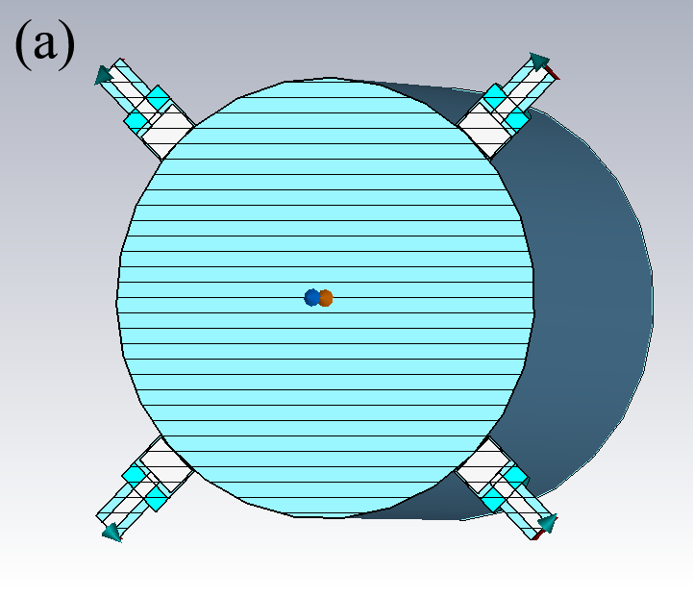
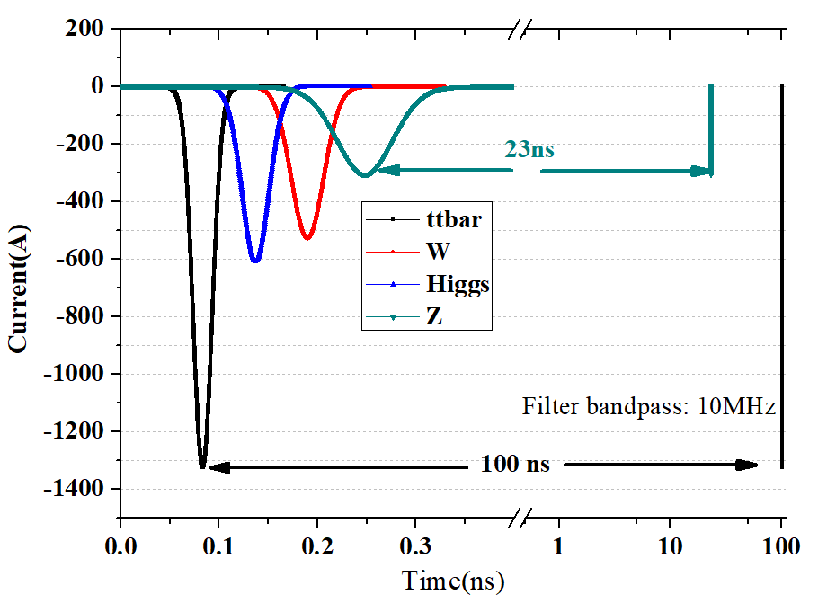
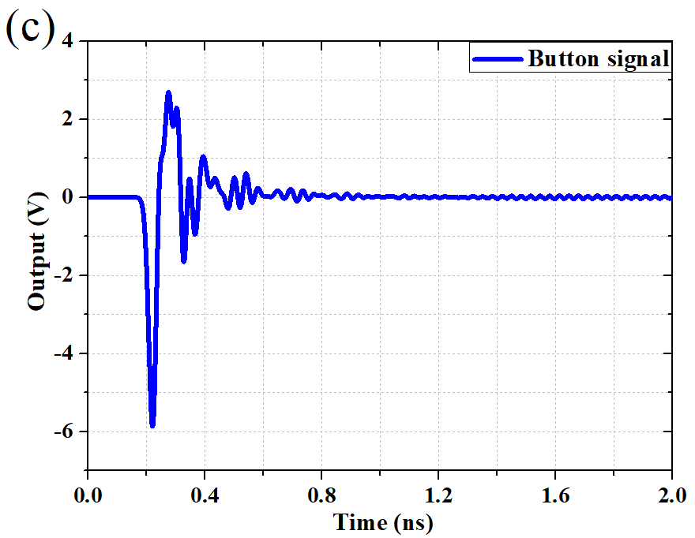
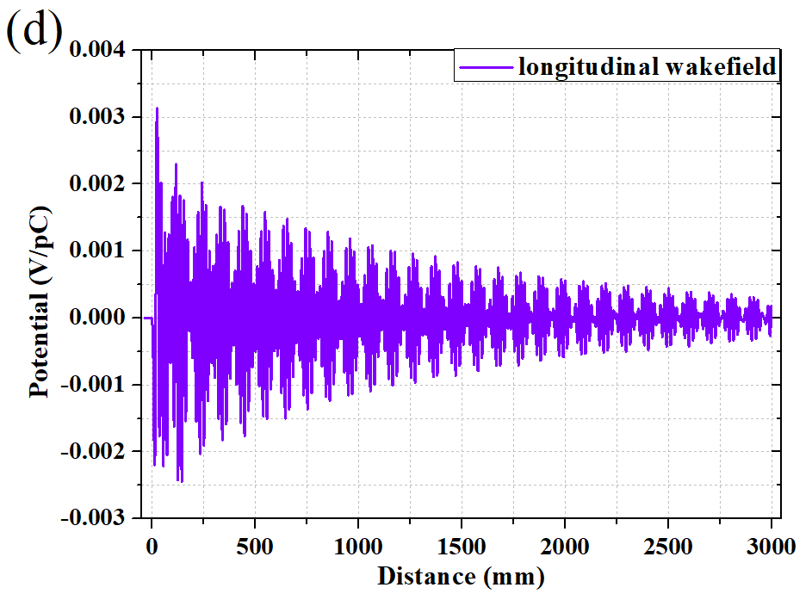
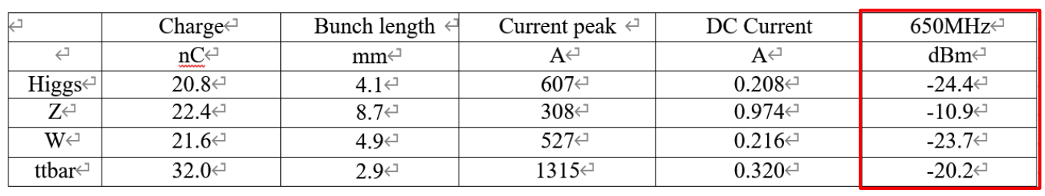
Beam position monitor design
The basic design of the pick-up has been finalized based on CST calculation results
Parameters used for CST simulation and analytical calculations.
Parameters
Bunch | Length | 4.1 mm
 | Charge | 1 nC
Mechanical | r_{b} | 3 mm
 | t_{b} | 4 mm
 | g_{b} | 0.25 mm
 | b | 28 mm
Signal strength before the cable attenuation

Slide 9
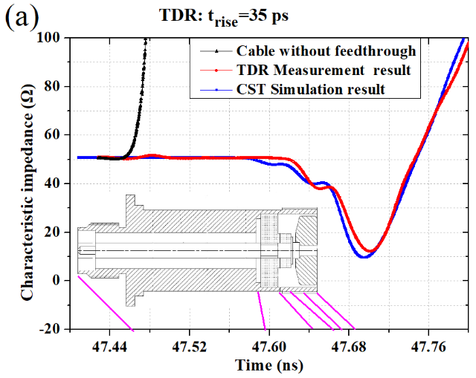
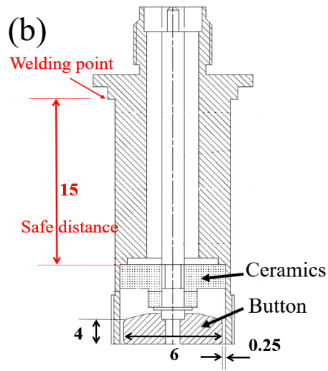
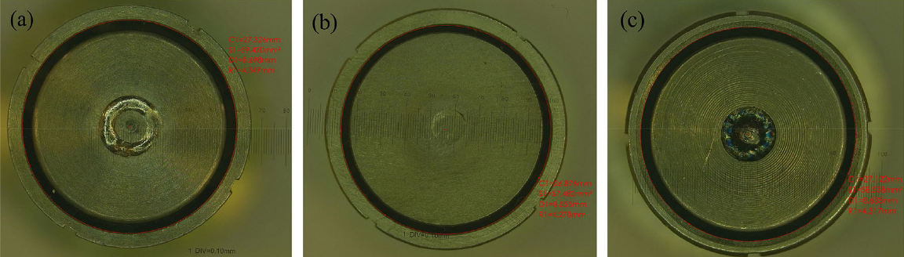
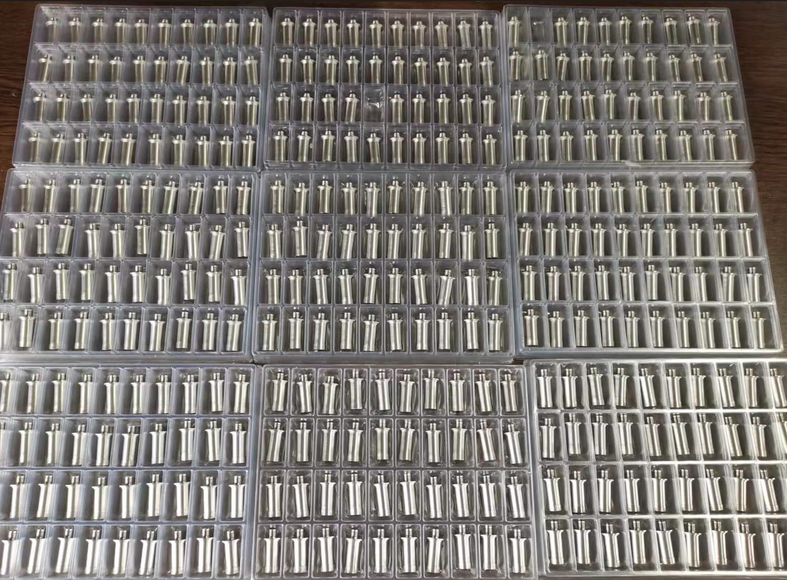
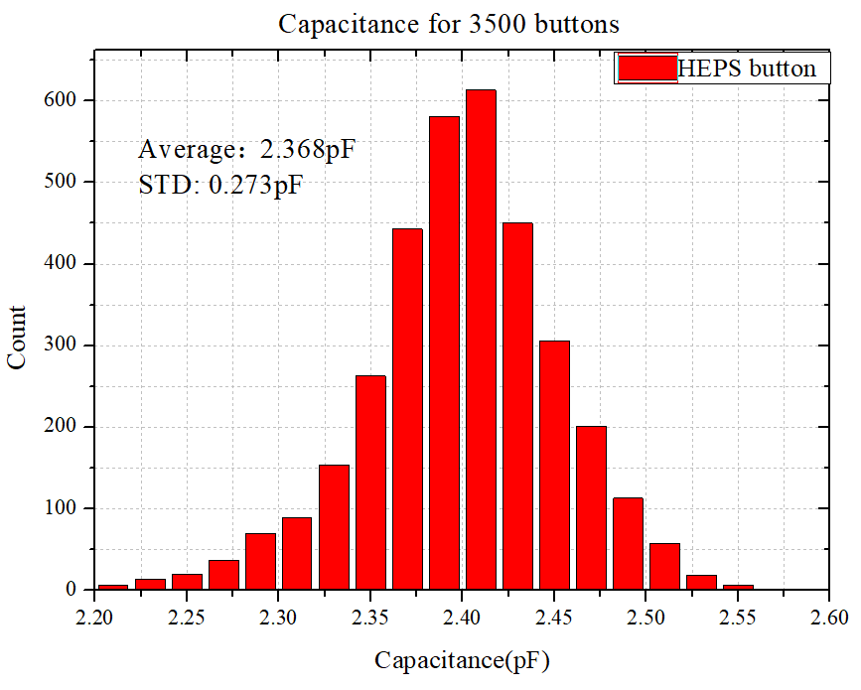
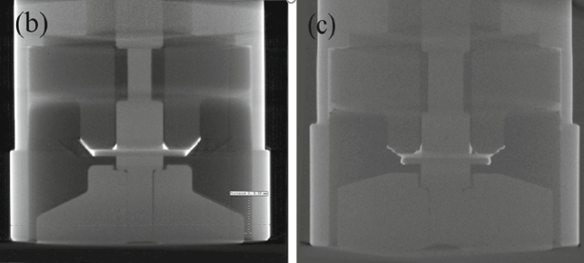
BPM button Pick-up
Optical microscopic imaging show the external structure
TDR results show the characteristic impedance
Capacitance of feedthroughs
Batch consistency test
X-ray tomography results show the inner structure

Slide 10
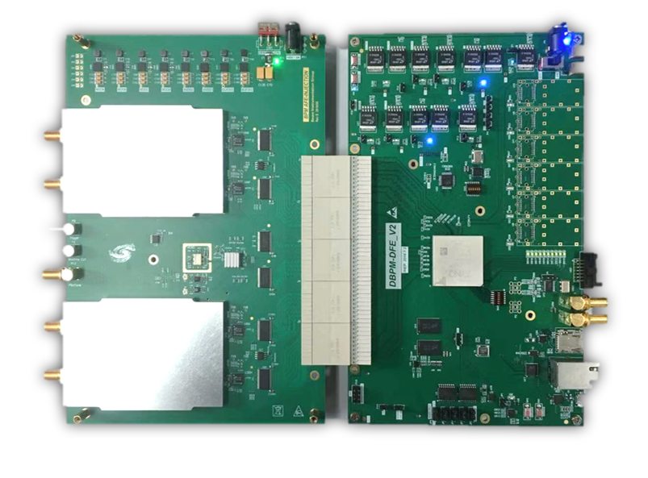
BPM readout electronics
AFE and DFE board
AFE board：RF Processing+ ADCs + Clock + Pilot tone;
DFE board：FPGA(ZYNQ) + DDR3 memory + SFPs + Ethernets;
EPICS IOC：In ZYNQ FPGA, increasing the convenience of the system

Slide 11
BPM readout electronics
Commercial electronics
SA x rms ≈ 114 nm
SA y rms ≈ 110 nm
Electronics made in house
SA x rms ≈ 71 nm
SA y rms ≈ 74 nm
A sub-micron resolution and a performance close to commercial products (I-Tech Liberal)

Slide 12
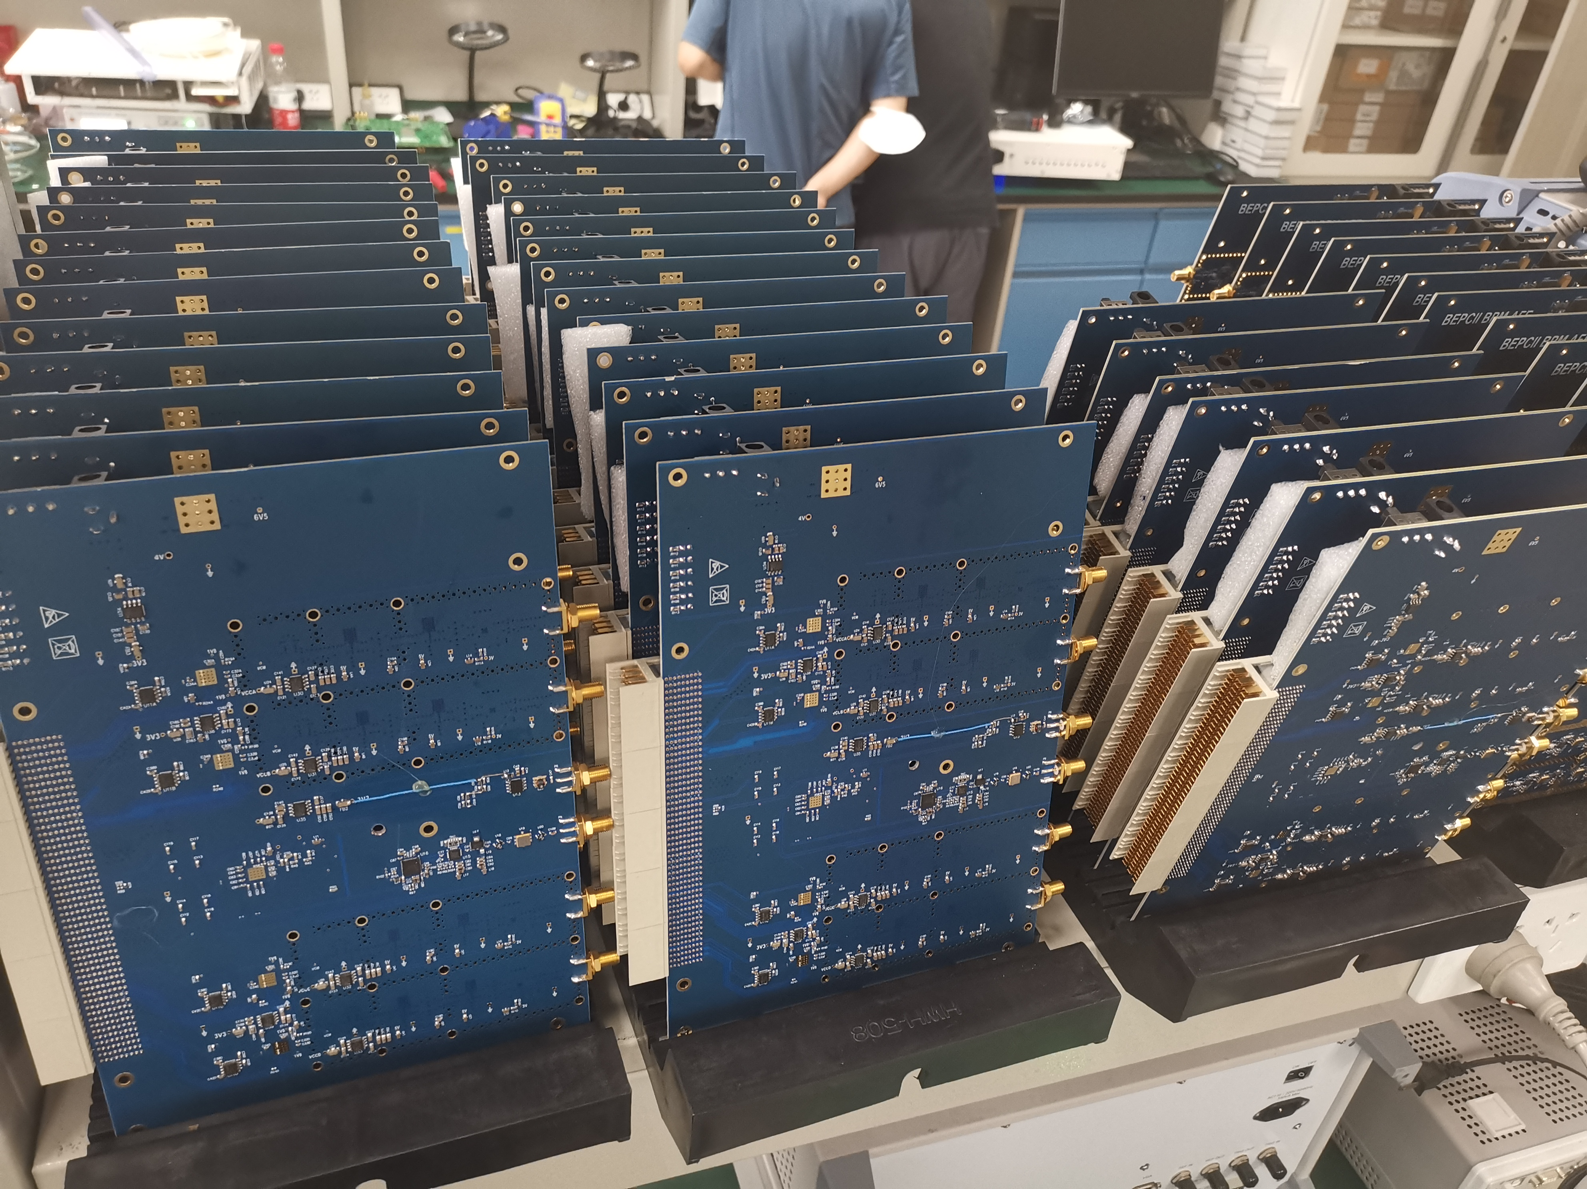
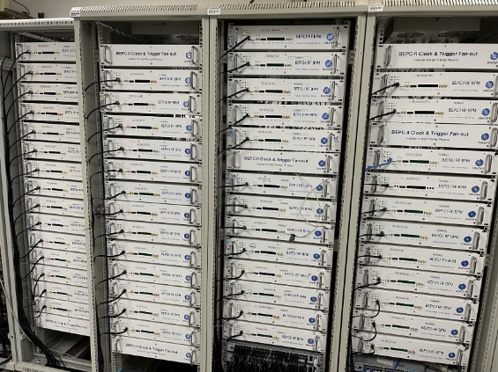
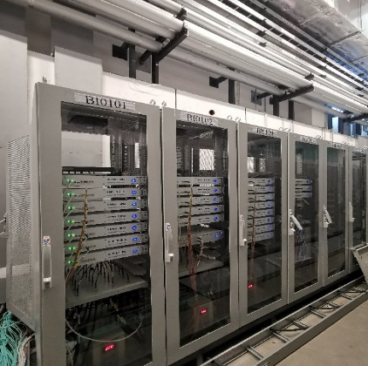
BPM related R&D: readout electronics
110 sets of electronics have been utilized in BEPCII's linac and storage ring
100 sets have been installed in the linac and booster of the HEPS
600 sets will be installed in the HEPS storage ring.

Slide 13
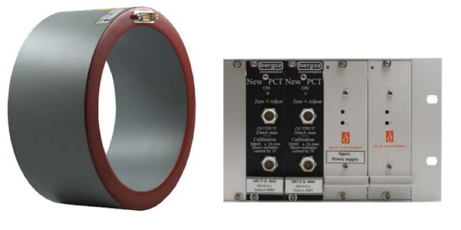
Beam current monitor
Two types of beam current measurement systems are utilized: average beam current and bunch current measurement.
The average current monitor employs Bergoz type DCCT (Direct-current current transformer) sensors, two sets of systems are backup to each other
 | ttbar | Higgs | W | Z
Energy [GeV] | 180 | 120 | 80 | 45.5
Beam current [mA] | 3.3 | 16.7 | 84.1 | 803.5
Bergoz NPCT senor and front-end electronics

Slide 14
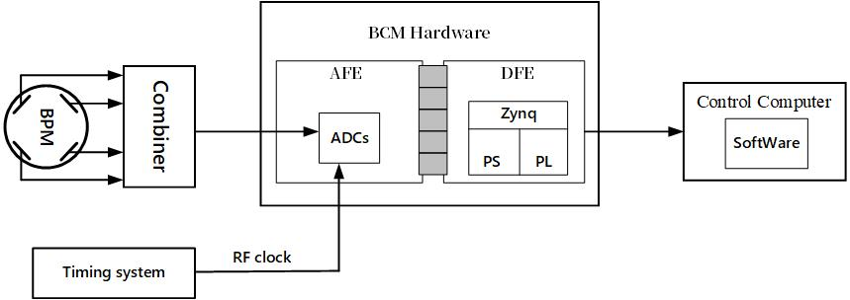
Bunch current monitor
Bunch by bunch readout electronics (BPM sum signal) are used for measuring the bunch current.
A fast ADC sampling BPM sum signal is utilized to measure the bunch current and share the data with the injection control system for bucket selection.
The core part of the AFE is its high-speed ADC. The signal is sampled at a frequency of 650MHz and normalized by the current measure by DCCT.

Slide 15
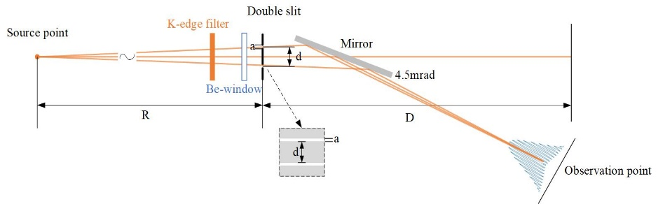
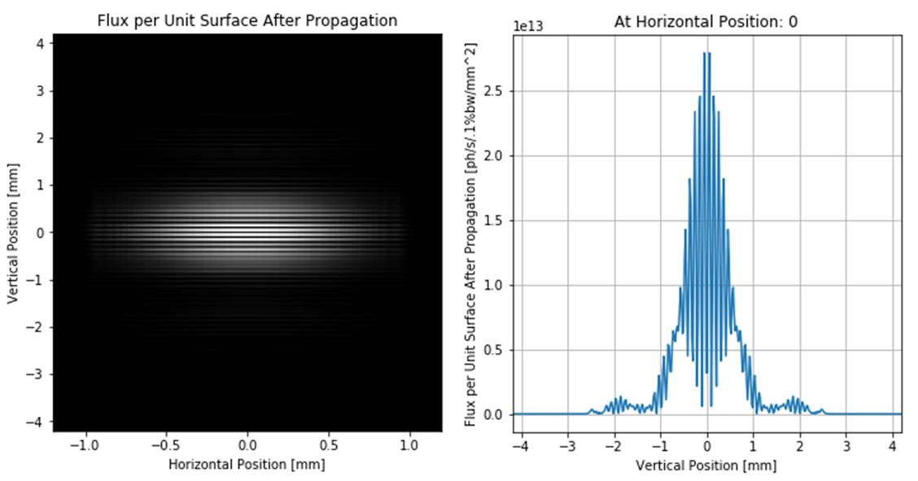
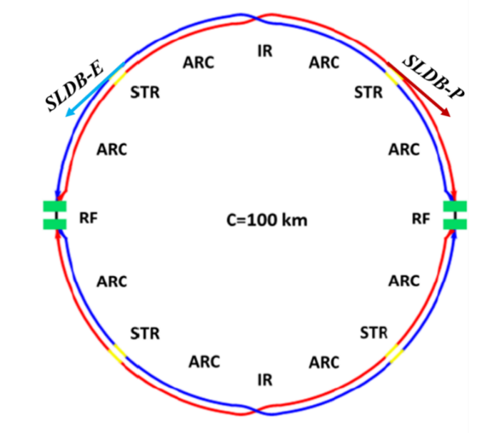
Beam size measurement
X ray energy：12keV
Light spot size：x@ 40µm y@ 5µm
Slits：Distance@d=200 µm Width@ a=8µm
Distance from source to slit: R=100 m
Distance between observation point to slit 75 m
Configuration for double slit X-ray interferometer
Typical interferogram and the intensity distribution curve in vertical direction.
The synchrotron light diagnostic beamlines

Slide 16
Bunch length measurement
 | ttbar | Higgs | W | Z
Energy [GeV] | 180 | 120 | 80 | 45.5
Bunch length (SR/total) [mm] | 2.2/2.9 | 2.3/3.9 | 2.5/4.9 | 2.5/8.7
Bunch by bunch measurement system to monitor the bunch length and its lengthening. Visible SR beam line should be necessary.
Resolution about 1ps (~10% of bunch length), streak camera based on visible light will be used.
Heat deposit onto the SR extraction mirror is not so larger than existing SR machine, so we can use mirror design in SR facilities.(from T. Mitsuhashi )

Slide 17
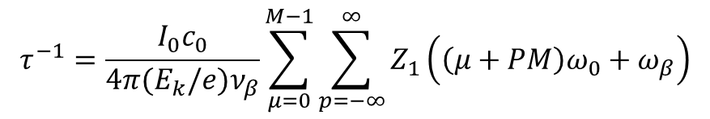
Transverse resistive wall instability – N. Wang
Feedback system
 | 30 MW
Instability growth time [ms] | 1.9 (~6 turns)
Radiation damping [ms] | 850
Bunch by bunch feedback [ms] | 1.0 (~3 turns)
Z mode: E = 45.5 GeV, I = 803.5mA
$$τ^{−1}=\frac{I_{0}c_{0}}{4π(E_{k}/e)ν_{β}}\sum_{μ=0}^{M−1}{\sum_{p=−∞}^{∞}{Z_{1}\left(\left(μ+PM\right)ω_{0}+ω_{β}\right)}}$$
Z mode is the most challenging
Growth of the most challenging mode vs damping factors
Parameter | Higgs | Z
Energy（GeV） | 120 | 45.5
Beta functions at pickup (m) | 250 | 250
Beta function at kicker（m） | 250 | 250
Number of kickers | 4 | 4
Kicker shunt impedance（kΩ） | 140 | 140
Amplitude of oscillation（mm） | 0.2 | 0.2
Damping time（ms） | - | 1.0
Power(w) | - | 2880

Slide 18
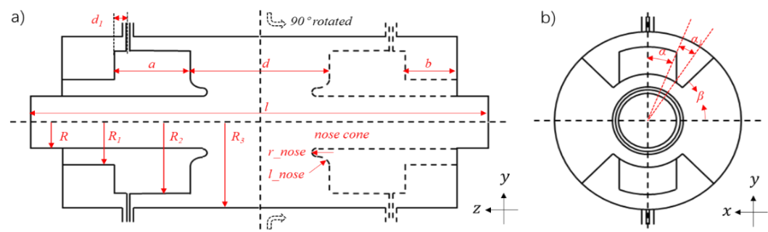
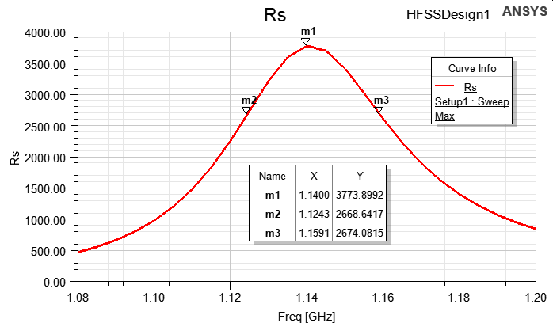
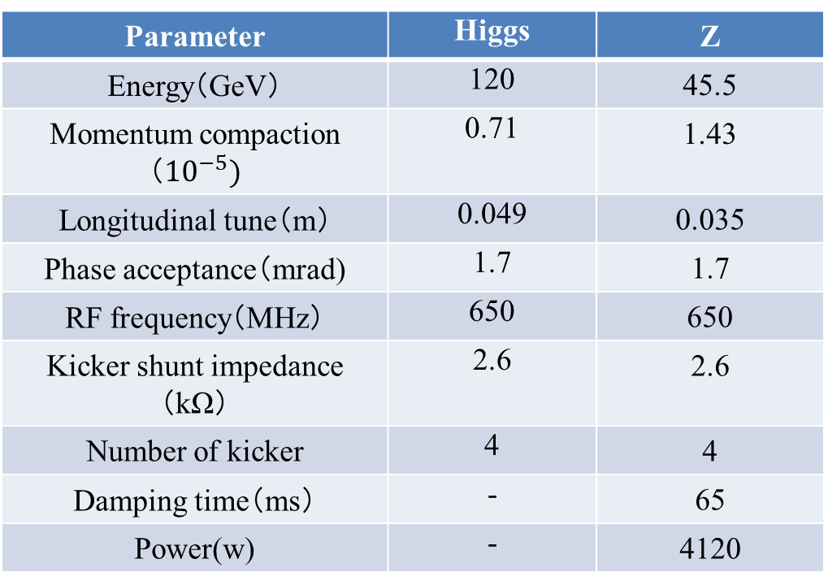
Longitudinal feedback system
The power of longitudinal feedback
Parameter | Higgs | Z
Energy（GeV） | 120 | 45.5
Momentum compaction（${10}^{−5})$ | 0.71 | 1.43
Longitudinal tune（m） | 0.049 | 0.035
Phase acceptance（mrad) | 1.7 | 1.7
RF frequency（MHz） | 650 | 650
Kicker shunt impedance（kΩ） | 2.6 | 2.6
Number of kicker | 4 | 4
Damping time（ms） | - | 65
Power(w) | - | 4120
The schematic of the longitudinal feedback kicker
Parameter | Value | Parameter | Value
Beampipe radius R | 28 mm | Back cavity length | 27.44 mm
Back cavity radius | 56 mm | Cavity length | 303 mm
Ridge radius | 82 mm | Port angle | 15.3 deg
Pillbox cavity radius | 90 mm | Port base angle | 6.7 deg
Cavity gap | 91 mm | Barrier angle | 61 deg
Distance of feedthrough | 5 mm | Nose cone radius | 6 mm
Ridge length | 53.56 mm | Nose cone length | 7 mm
  （More details in the Junhui Yue’s report）
The shunt impedance of the LFB kicker

Slide 19
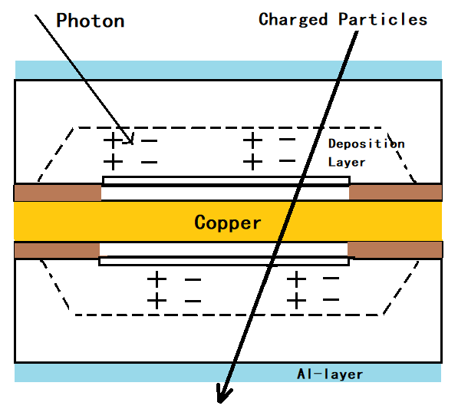
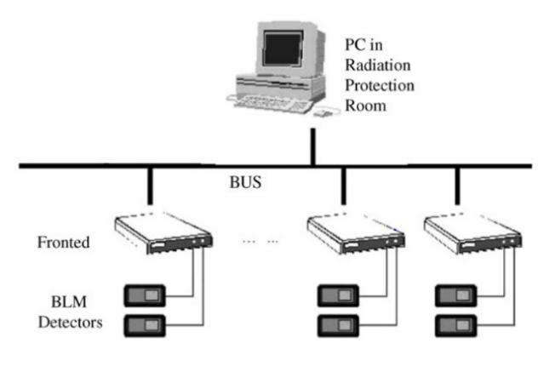
Beam loss monitor
The following important factors are focused for selecting the type of BLM for a specific application in CEPC: intrinsic sensitivity, dynamic range, radiation hardness, response time and sensitivity to synchrotron radiation (SR).
The improved PIN-photodiode in storage ring and the optical Fiber in booster for large range of beam energy
Schematic of PIN photodiode BLM

Slide 20
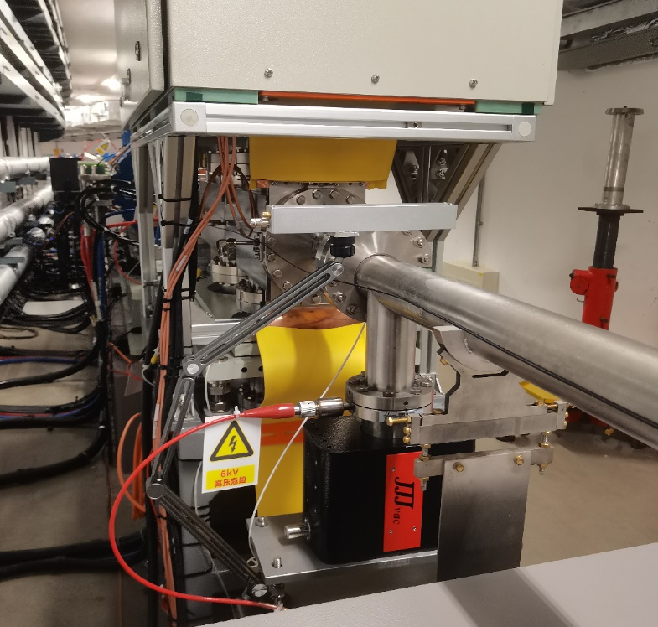
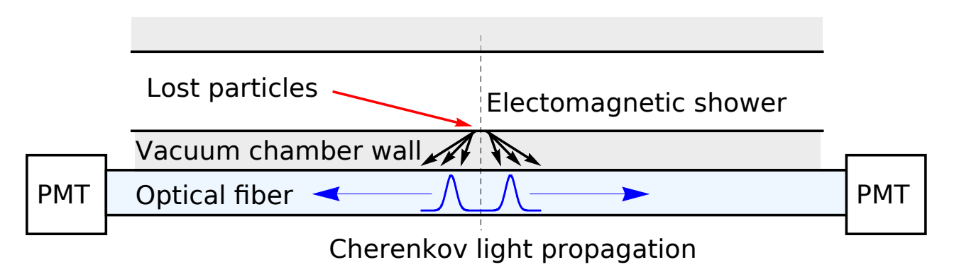
Fiber-based beam loss monitors (FBLM)
A BLM based on the Cherenkov radiation (CR) in optical fiber is distributed and can cover an accelerator structure over long distances.
The CR propagates upstream and downstream along the optical fiber and can be detected with a PMT ends. Timing of the PMT signal gives the location of the beam loss, the signal intensity being proportional to the number of lost particles.
Schematic of FBLM

Slide 21
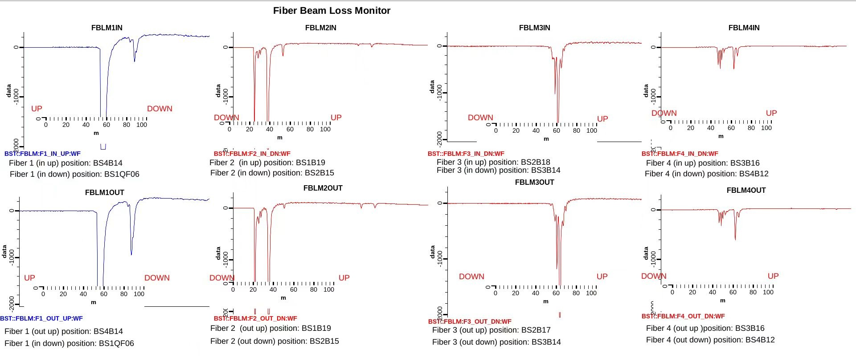
Fiber-based results
Fiber：OFS Company HCP-M0600T, 8×110 m, Circumference 454m, in&out the pipe
Show the location of the beam loss, peaks located BetaX_{max} or Dx_{max}.

Slide 22
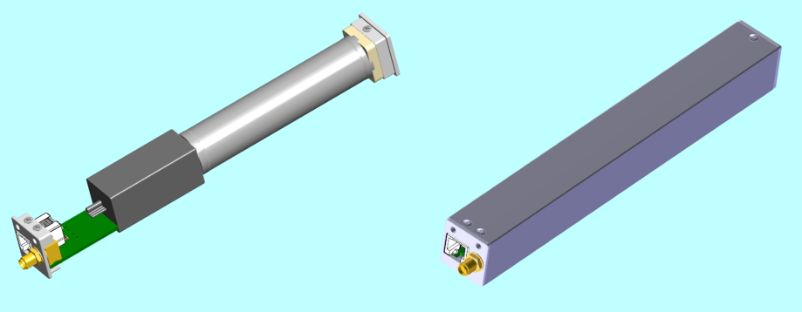
Scintillator-based beam loss monitors (SBLM)
SBLMs, with a plastic scintillator and a photomultiplier (PMT) as their main components. The scintillator chosen is a EJ-200 rod (100 mm length, 22 mm diameter), wrapped in reflective foil to minimize the light losses, which to provide the turn-by-turn loss.
Model of the PMT-scintillator system without and with the metallic casing
First turn commissioning results：3 and 20 turns
SBLMs installed in the HEPS booster

Slide 23
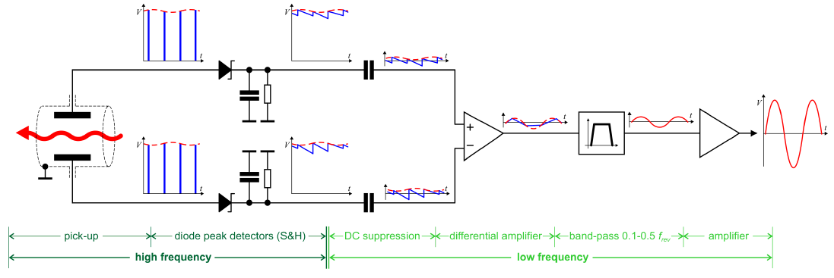
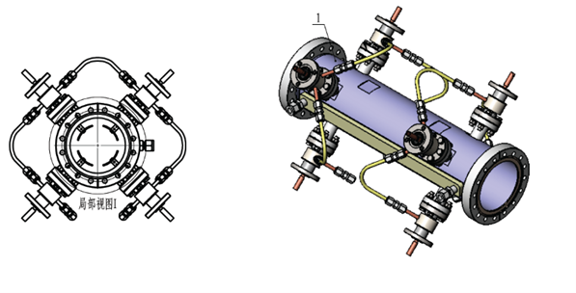
Tune monitor
Frequency sweeping method with gated pulse or FFT analyzing to the data from the digital BPM. Direct Diode Detection (3D) is another choice for the tune monitor
Direct Diode Detection method invented by Marek Gasior will be taken. Sub-micrometer oscillation can be detected.
Courtesy M. Gasior
Pilot bunch exciting method will be used to measure the tune. Changing the phase in BbB feedback filter or kicking the appointed bunch to get the tune.
4 Strip-line kicker

Slide 24
The beam instrumentation in CEPC Linac
 | Item | Method | Parameter | Amounts
Linac | Beam position | Stripline BPM | Resolution ：30um | 150
 | Beam current | ICT | 2.5%@1nC-10nC | 63
 | Beam profile | YAG/OTR | Resolution: 30um | 30
 | Beam emittance | Q+PR | 10% | 3
 | Beam energy & spread | AM+PR | 0.1% | 3
Damping ring | Average current | DCCT | Resolution :50µA@0.1mA-30mA | 1
 | Beam position | Button BPM | Resolution : 20µm @ 5mA TBT | 40
 | Tune measurement | Frequency sweeping | Resolution:0.001 | 1

Slide 25
Linac BPM: Strip-line type
There are 150 stripline BPMs in the Linac and transport lines, which are divided into two groups based on the size of the beam-stay-clear area, a diameter of 30 mm and 20 mm.
To minimize signal reflection, the impedance of the strip electrode was also designed to be 50 Ω. Electromagnetic simulation software CST is utilized to compute the impedance of the stripline.
Mechanical parameters of CEPC stripline BPM
Schematic of strip BPM: (a) Front view (b) Side view

Slide 26
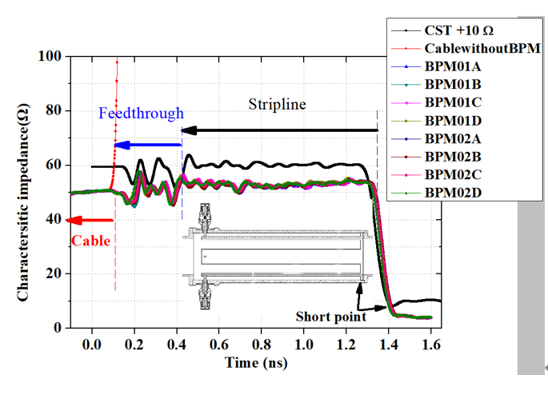
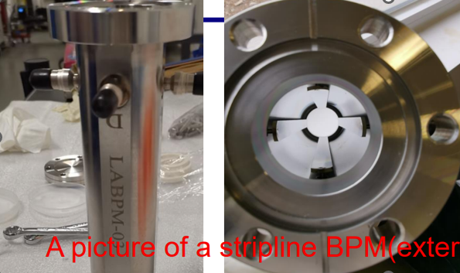
Strip-line type BPM
The average impedances of the strip given by the experiment and CST simulation are 51.5 and 50.3 Ω.
Characteristic impedance of stripline BPM measured by TDR.

Slide 27
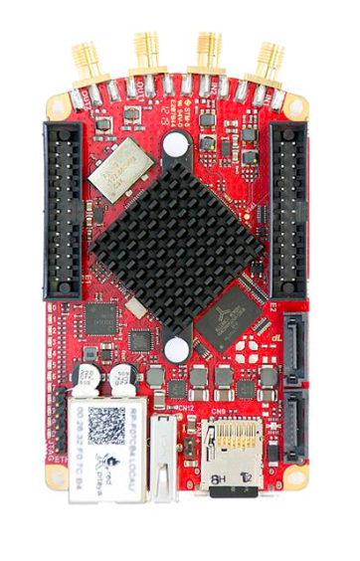
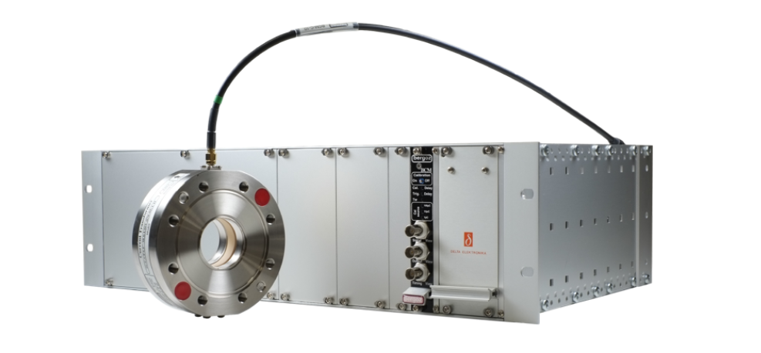
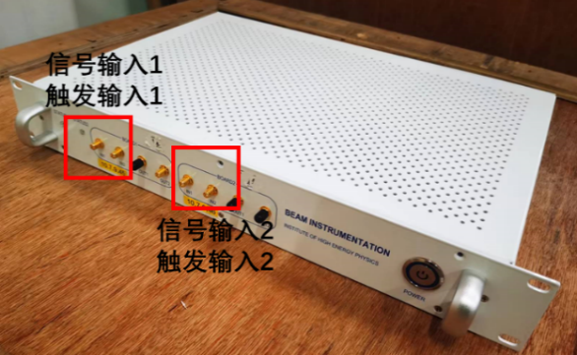
Beam current measurement
The sensitivity of the ICT sensor must take into account the attenuation caused by the transmission cable to ensure accurate measurement results. For this reason, an on-line functional examination and re-calibration can be carried out using the Cali-winding within the sensor.
BCM electronics
A/D
(Local station)
ICT (Tunnel)
Data base

Slide 28
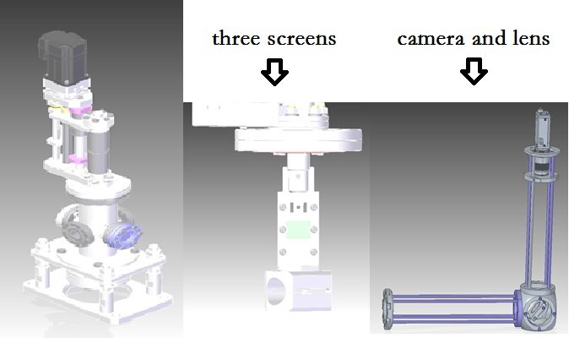
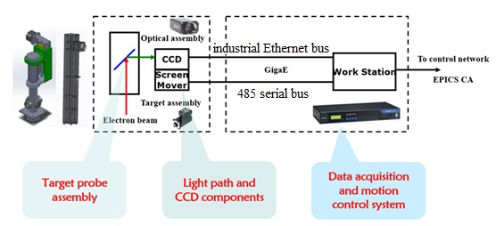
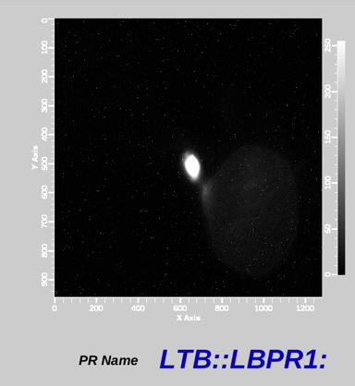
Beam Profile Measurement
The beam profile monitor is designed with three screens. 1. a YAG:Ce crystal screen for low current commissioning, 2. 100 nm aluminum (OTR) for high energy 3. a calibration screen.
The control system software for the beam profile is based on EPICS.
Beam emittance and beam energy & spread measurement are both based beam profile measurement.

Slide 29
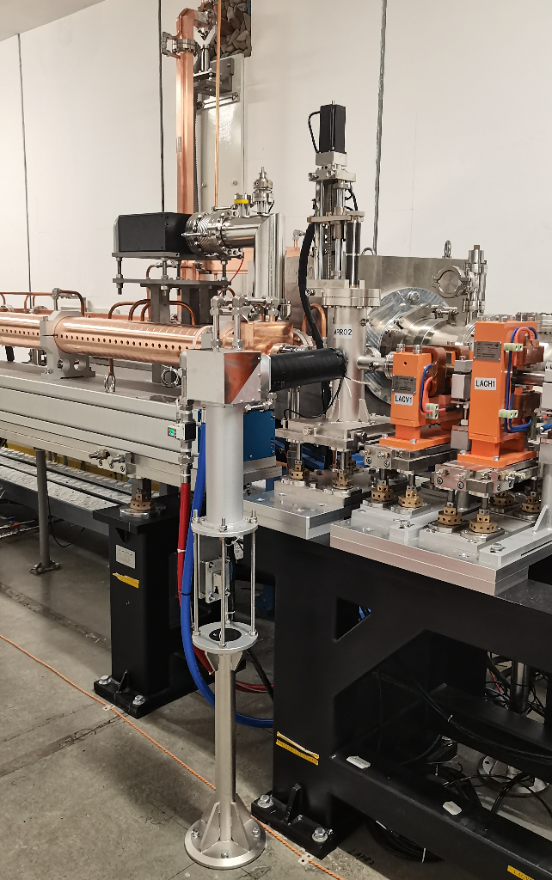
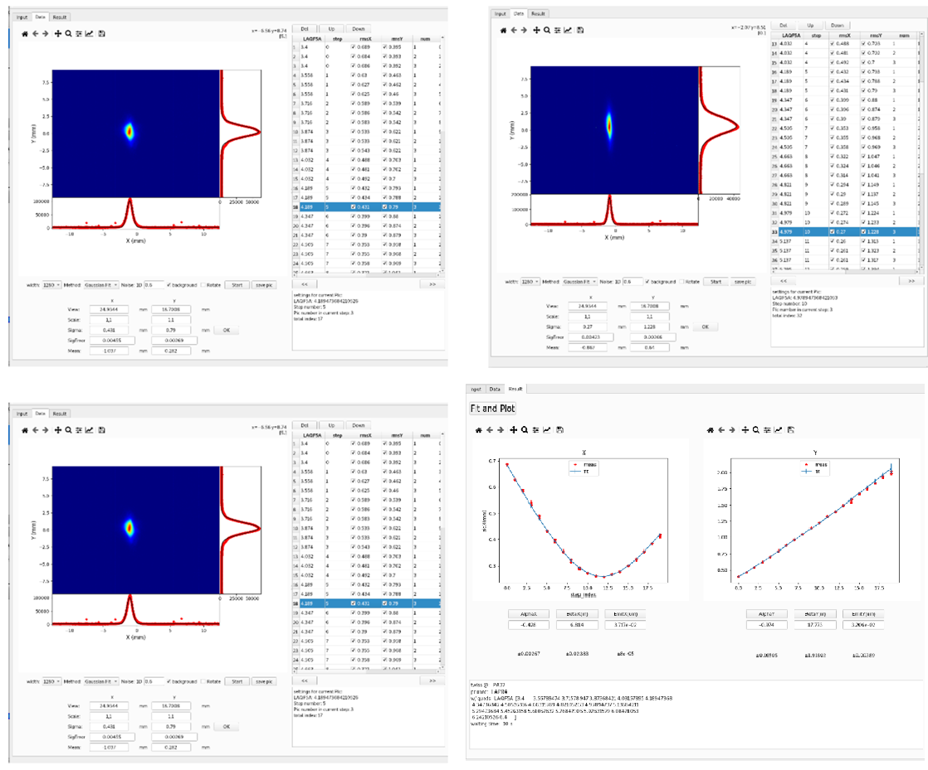
Beam Profile
Emittance measurement results
Screen
Camera
A photo of beam profile monitor

Slide 30
Beam instrumentation related R&D
The R&D activities based on lepton accelerator beam measurement mainly include the following three aspects.
  The design and fabrication of HEPS beam instrumentation
  The maintenance and upgrade of BEPCII beam instrumentation
  The R&D of CEPC beam instrumentation

Slide 31
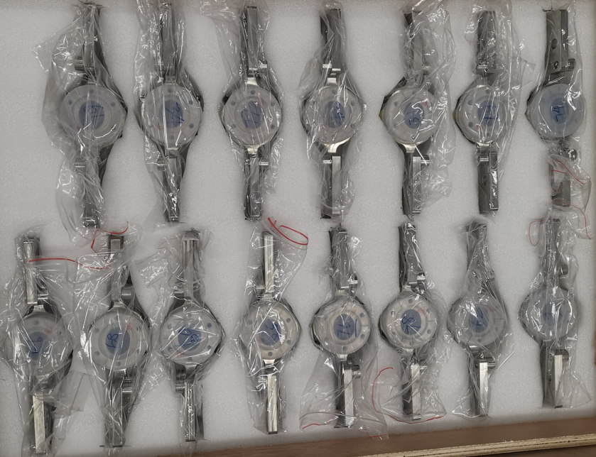
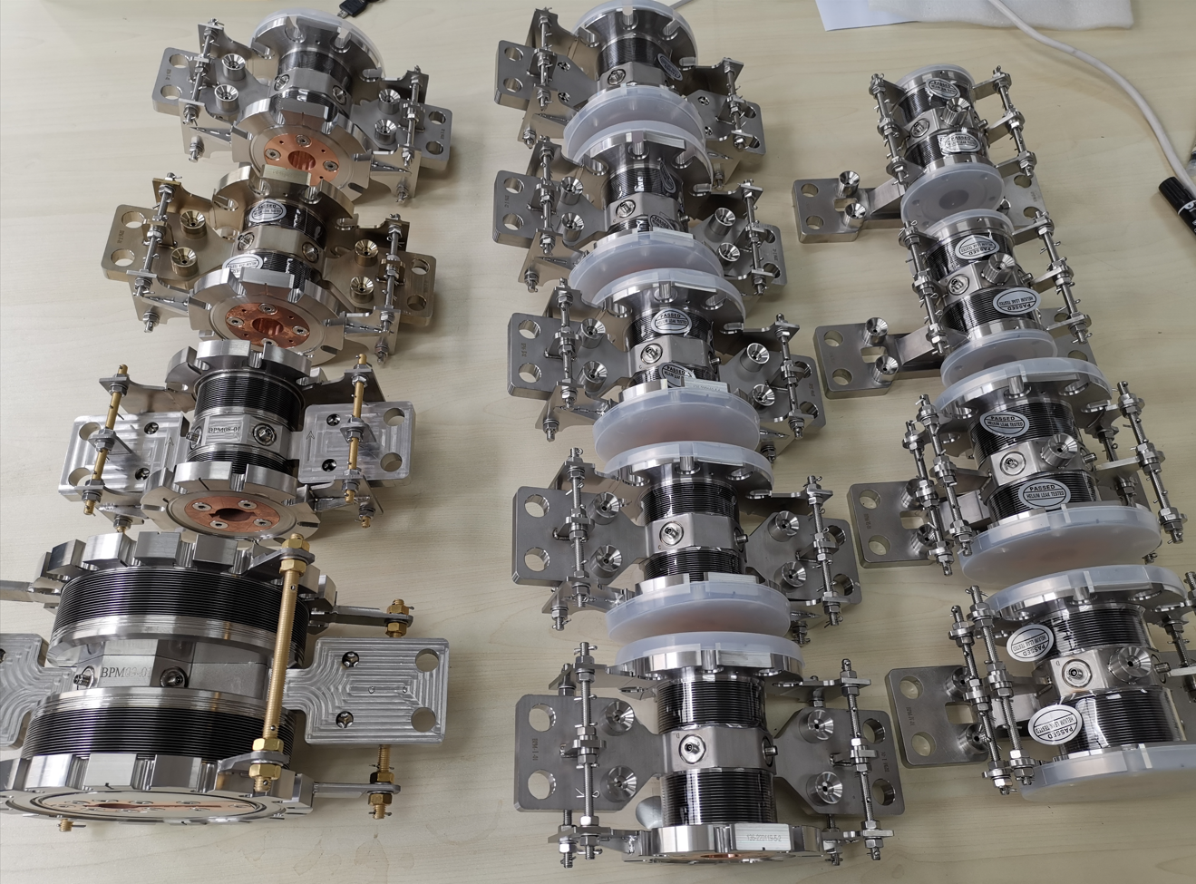
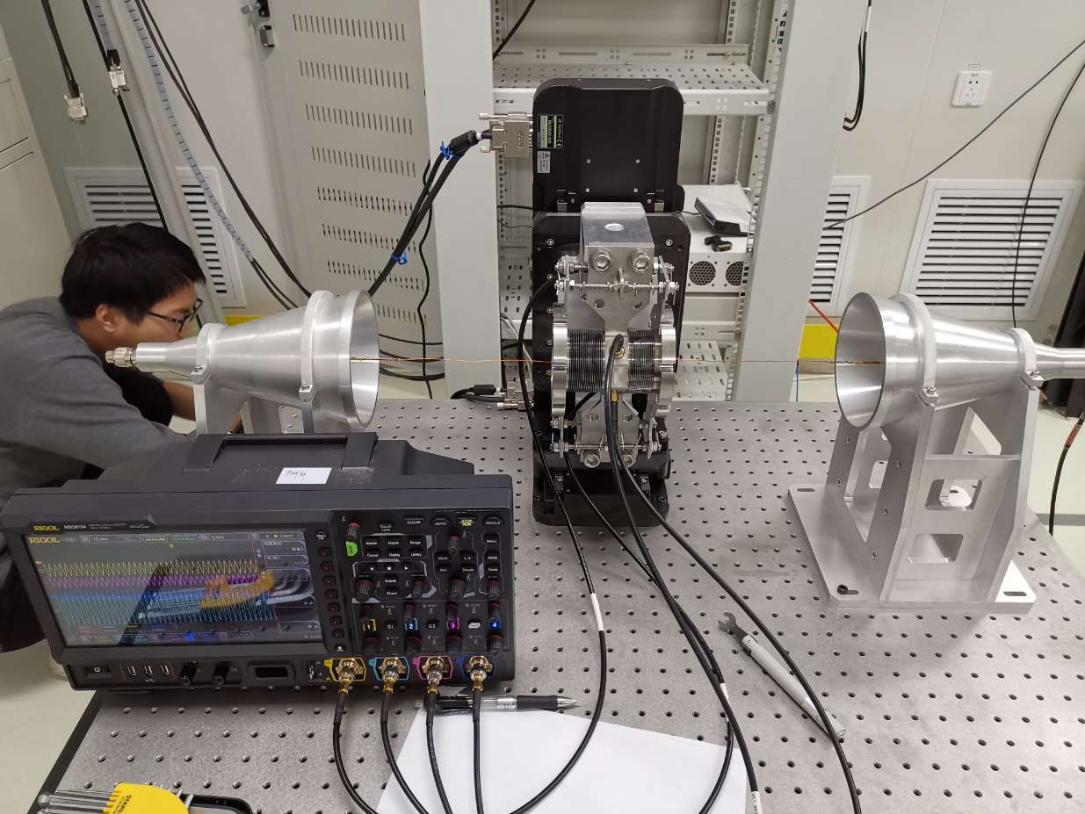
Beam instrumentation related R&D
We have developed button type and strip-line BPM for the HEPS
Goubau line based wire calibration system were set to check BPM’s sensitivity constants
The home-made electronics were used in the HEPS and were proved to be good enough for beam commissioning

Slide 32
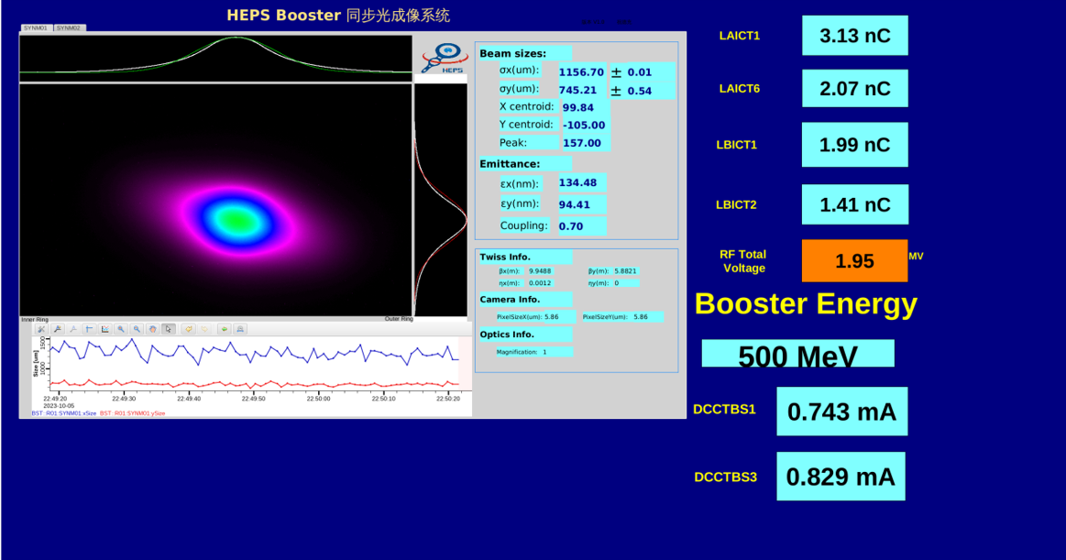
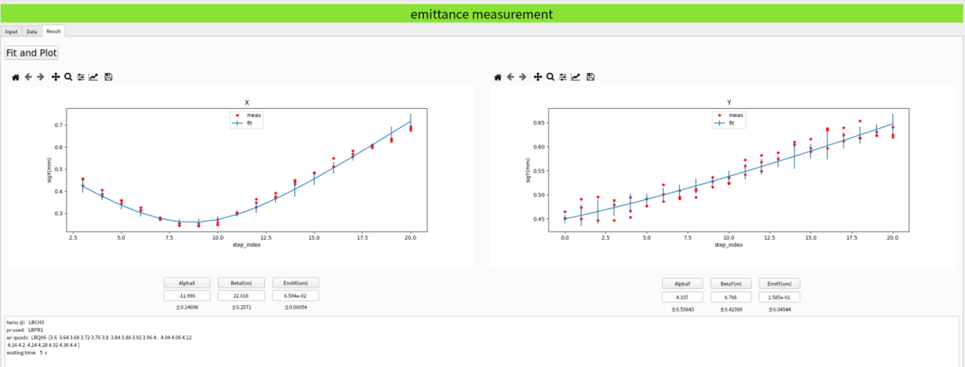
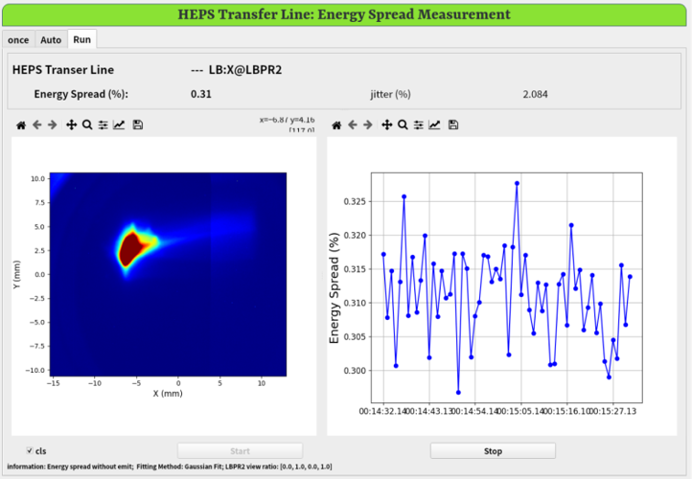
Emittance & energy spread measurement
Emittance measurement system are implemented by changing the focusing strength of the quadrupole.
Enery spread are inferred by the profile of where the dispersion’s contribution is relatively significant.

Slide 33

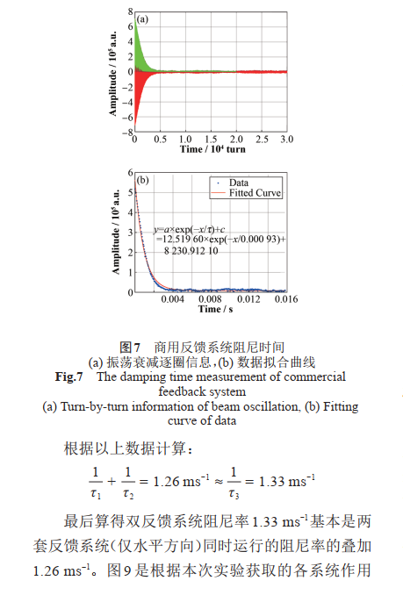
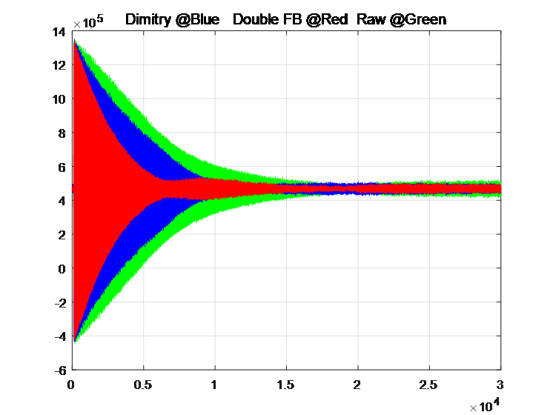
Beam instrumentation related R&D
At BEPCII, the double feedback technique was successfully implemented, the results showed that the damping rate is almost equal to the sum of the two feedback systems. This demonstrates the effectiveness of multi-feedback systems in improving the stability.
The damping time of two TFBs

Slide 34




Beam instrumentation related R&D
Study on feedback system kicker
Shunt impedance Measurement system and results
Resonant strip-line type longitudinal kicker：the shunt impedance is much bigger than ridged waveguide.
Strip-line
Ridged waveguide
Rs max =4734 Ω
Rs effective=3117Ω
f：1.5 ~1.75 GHz
Rs max =707 Ω
Rs effective=559Ω
f：1.0 ~1.25 GHz

Slide 35
Summary
We have reviewed and improved the design report of the system based on the latest parameters
We have understood the measurement requirements of CEPC and conducted extensive research on key technologies.
Through our research and development activities, we have trained our personnel and mastered the necessary technology, which has prepared us for the construction of the project.
Thank you for attention！

Slide 36


Other systems
Vacuum Chamber Displacement Measurement
  Due to heat effects caused by synchrotron radiation and beam loss, the vacuum chamber will be displaced. In order to calibrate the BPMs, the displacement need to be measured.
  The entire system includes Linear Variable Differential Transformer (LVDT), signal processing unit, computer and network.
  Relevant research has been carried out on BEPCII. The displacement detector uses the DL6230 of Micro with dynamic range 500 μ m and accuracy 1 nm.

