Slide 1




Klystrons and RF power sources distributions
Zusheng Zhou
On behalf of CEPC klystron R&D team
The 2023 International Workshop on the High Energy Circular Electron Positron Collider

Slide 2
Content
Klystron
  Design consideration
  R&D Status
    CEPC Collider/650MHz/800kW klystron fabrication
      1st prototype
      2nd (HE klystron) prototype
      3rd (MBK) prototype fabrication progress
    CEPC Linac/5720MHz/80MW & 2860MHz/80MW klystron design
RF power sources distributions
  Collider ring
  Booster ring
  Linac injector/Damping ring

Slide 3
Design consideration for Collider RF sources
Considering klystron lifetime, power redundancy and cost, the 2 cavities will be powered with one CW klystron capable to deliver more than 800 kW.
High voltage DC power supply has multi-operation modes for different klystron type(Single beam and multi-beam klystron).
Distributions of RF power to the cavities, including waveguide, power divider, phase shifter, circulator and load.
Other Auxiliary PS, interlock and controls, LLRF, pre-amplifier are also included in RF power source system.

Slide 4
Design consideration for Collider RF sources
Requirement list:
Klystron | 96 | 650MHz/700kW
PSM Power Supply | 96 | 130kV/16A or 55kV/22A
Circulator | 96 | 650MHz/700kW
Load | 96 | 650MHz/700kW
Phase shift | 96 | 650MHz/700kW
Waveguide | 96 | Power divider/directional coupler
LLRF | 96 | Phase stabilization <0.1 degree, Amplitude stabilization <0.1%
Pre-amplifier | 96 | 650MHz/200W

Slide 5
Design consideration for Collider RF sources
Requirement list:
Klystron | 96 | 650MHz/700kW | Higher efficiency
PSM Power Supply | 96 | 130kV/16A or 55kV/22A | Mature product
Circulator | 96 | 650MHz/700kW | Mature product
Load | 96 | 650MHz/700kW | Mature product
Phase shift | 96 | 650MHz/700kW | Mature product
Waveguide | 96 | Power divider/directional coupler | Mature product
LLRF | 96 | Phase stabilization <0.1 degree, Amplitude stabilization <0.1% | Mature product
Pre-amplifier | 96 | 650MHz/200W | Mature product

Slide 6
Design consideration for Collider RF sources
Cost consumption
CEPC at 800 RMB/MWh and 6000 hours/year
Efficiency impact on operation cost (Only considering operation efficiency of klystrons)
Save Money
84M RMB
1 year
65 M RMB
Excessive electricity bill, M RMB
PAST
1st tube
62%
COMING
2nd tube
75%
Efficiency, %
FUTURE
3rd tube
80%

Slide 7
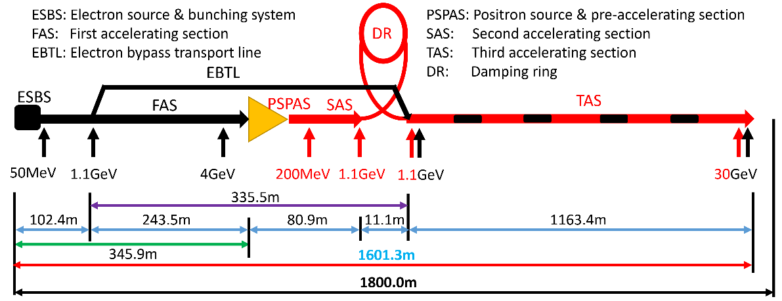
Design consideration for Linac RF sources
The main high power RF sources components are 33 units of 80MW S-band klystron, 236 units of 50MW C-band klystron and related modulators.
Type | QTY | Freq.(MHz) | Structure type
S-band klystron | 33 | 2860 | 1 1-to-1，standard-bunch 3 1-to-2，standard acc. structure. 8 1-to-2，large aperture acc. structure 21 1-to-4, standard acc. structure.
C-band klystron | 236 | 5720 | 1-to-2，standard acc. structure.

Slide 8
Design consideration for Linac RF sources
Requirement list:
S band klystron | 33 | 2860MHz/80MW
Modulator of S band klystron | 33 | 400kV/500A
C band klystron | 236 | 5720MHz/50MW
Modulator of C band klystron | 236 | 350kV/400A

Slide 9
Design consideration for Linac RF sources
Requirement list:
S band klystron | 33 | 2860MHz/80MW | Mature product
Modulator of S band klystron | 33 | 400kV/500A | Mature product
C band klystron | 236 | 5720MHz/50MW | Mature product
Modulator of C band klystron | 236 | 350kV/400A | Mature product

Slide 10
Design consideration for Linac RF sources
Why we do C band and S band 80MW klystron?
  Only C band of 50MW klystron is mature product in the world.
  1 klystron power to 2 accelerator structures (CEPC Linac baseline).
  QTY of C band klystron is very large (236 set).
  S band 80MW with higher efficiency and lower operation voltage.
IF output power of C band klystron is up to 80MW, the number of klystron and accelerator structure will be decreased a lot.

Slide 11
R&D Strategies
650MHz/800kW klystron with higher efficiency design for CEPC Collider.
5720MHz/80MW klystron for CEPC Linac cost decreased.
2860MHz/80MW klystron with higher efficiency design for CEPC Linac.

Slide 12
R&D Status

Slide 13
650MHz klystron R&D strategy and plan
3 or more klystron prototypes
2016 | 2017 | 2018 | 2019 | 2020 | 2021
2022
2023
Prototypes
Step1
1st
Step2
2nd
Step3
3rd
more
Efficiency: 60%
70%
80%

Slide 14
Design scheme
Scheme 1: Traditional way for >60% efficiency
Scheme 2: With high voltage gun (110 kV/9.1 A), low perveance (HE, >75%)
Scheme 3: MBK, 54 kV/20A electron gun (8 beams) (HE, >80%)
Parameter | Scheme1(1st prototype) | Scheme2(2nd) | Scheme3(3rd)
Freq. (MHz) | 650 | 650 | 650
Voltage (kV) | 82 | 110 | 54
Current (A) | 16 | 9.1 | 20(2.5×8)
Beam No. | 1 | 1 | 8
Perveance (µP) | 0.65 | 0.25 | 1.6(0.2×8)
Efficiency (%) | 65 | ~80 | >80
Power(kW) | 800 | 800 | 800(100×8)

Slide 15
1st prototype milestone
Oct. 2017 Design report
May 2018 Mechanical design review
Mar. 2019 Window fabrication
Apr. 2019 Collector brazing
Sep. 2019 Prepressing of electron gun
Oct. 2019 Klystron bake out
Dec. 2019 Delivered to IHEP
Mar. 2020 High power test at IHEP

Slide 16
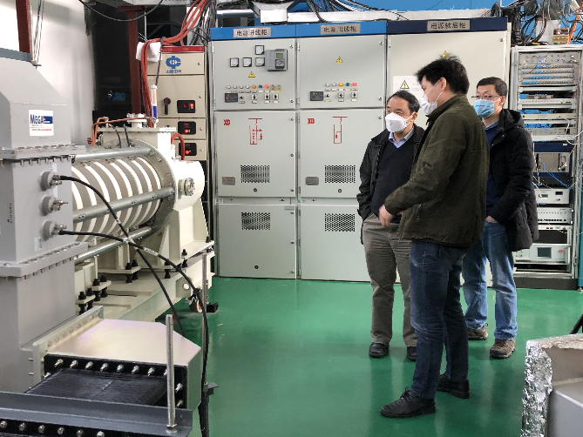
Test results
700kW CW and 800kW pulsed power with 62% efficiency
Parameters | Design | Test
Operating frequency (MHz) | 650 | 650
Beam Voltage (kV) | 81.5 | 80
Beam Perveance (μA/V^{3/2}) | 0.65 | 0.7
Efficiency(%) | 65 | 62
Saturation Gain(dB) | ≥45 | 47
Output power(kW) | 800 | 800
1 dB Bandwidth(MHz) | ≥1 | 1.8

Slide 17
2nd prototype (HE design) milestone
Jan., 2021: Klystron manufacture started
Jul., 2021: Parts fabrication completed
Nov., 2021: Gun processing and klystron baking out
Dec., 2021: Klystron delivered to IHEP
Mar., 2022: Klystron conditioning started
Jul., 2022: CW 630kW with Eff. 70.5% (1st stage high power test)

Slide 18
1st stage test results
Jul.5, 2022
CW power: 630kW
Eff. : 70.5%

Slide 19
3rd prototype (Muti-beam design) milestone
Dec., 2021: Klystron manufacture started
Sep., 2022: MBK waveguide window fabrication completed
Nov., 2022: Experiment cavity cold test
Mar., 2023: Klystron beam tester delivered to IHEP
Oct., 2023: Klystron beam tester conditioning completed

Slide 20
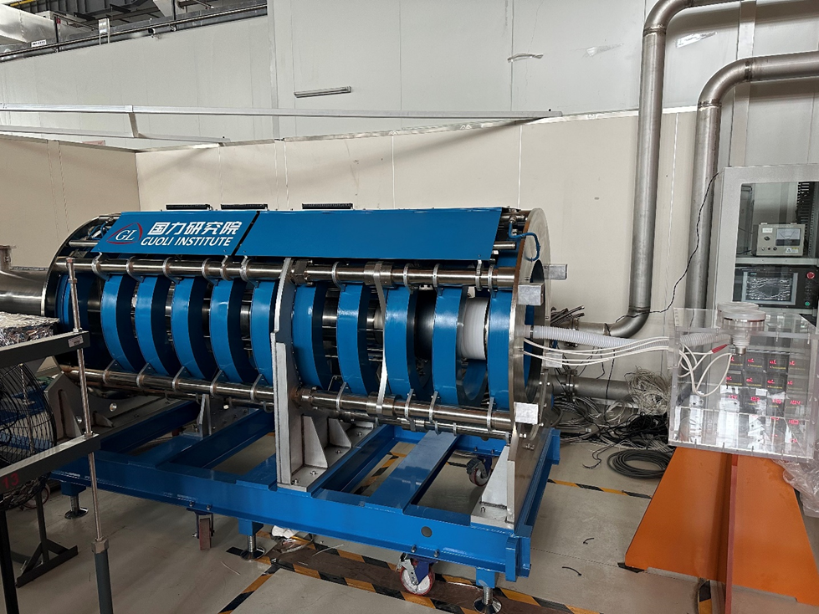
MBK beam tester conditioning
Fabrication of MBK beam tester is completed(including electron gun, collector, focusing coil) and has been delivered to IHEP March of 2023. It has been tested in Platform of Advanced Proton Source(PAPS).

Slide 21
5720MHz klystron design

Slide 22
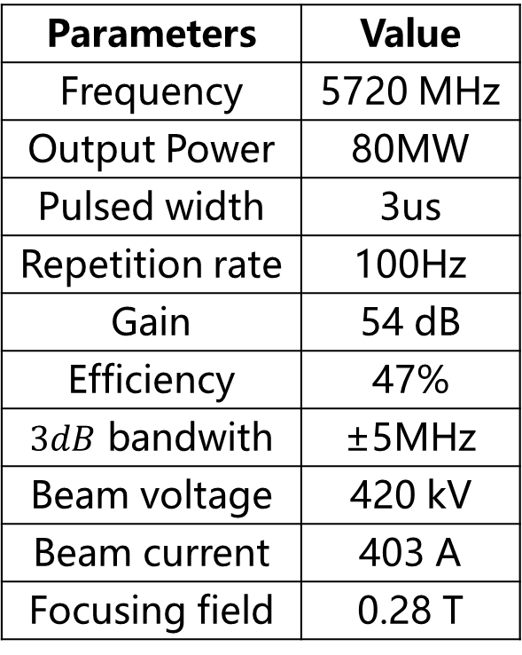
Main parameters
Parameters | Value
Frequency | 5720 MHz
Output Power | 80MW
Pulsed width | 3us
Repetition rate | 100Hz
Gain | 54 dB
Efficiency | 47%
$3dB$ bandwith | ±5MHz
Beam voltage | 420 kV
Beam current | 403 A
Focusing field | 0.28 T

Slide 23
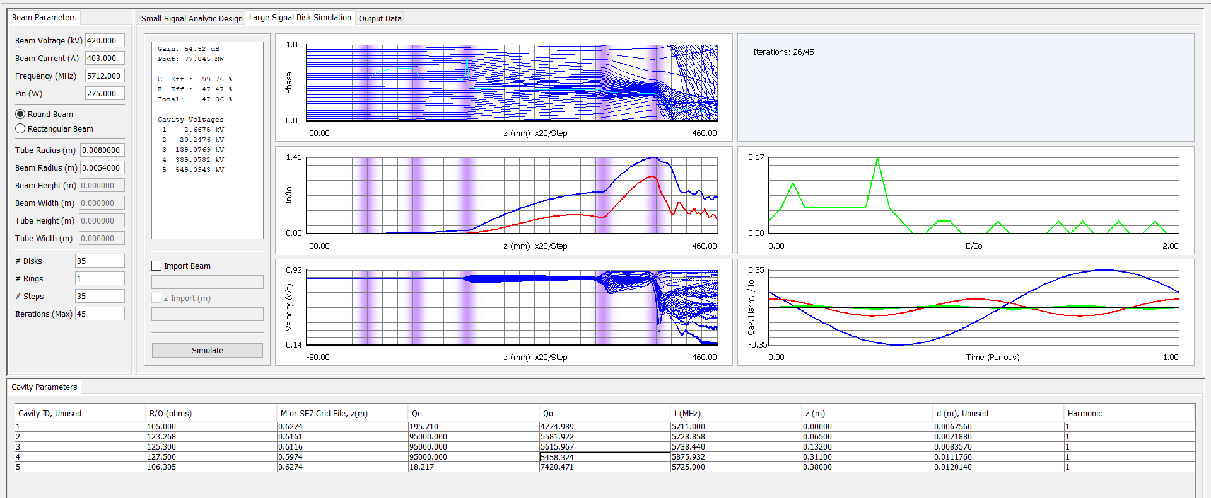
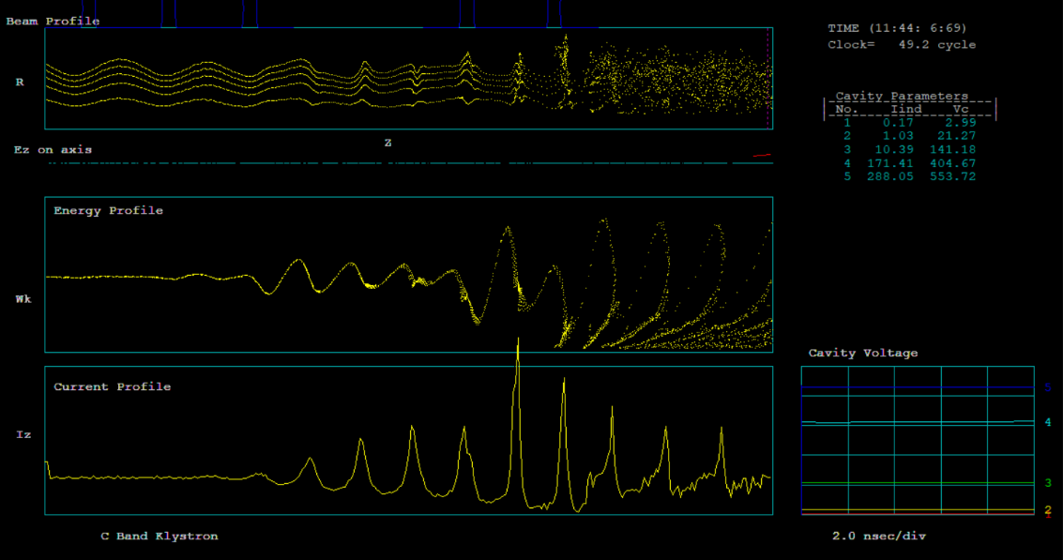
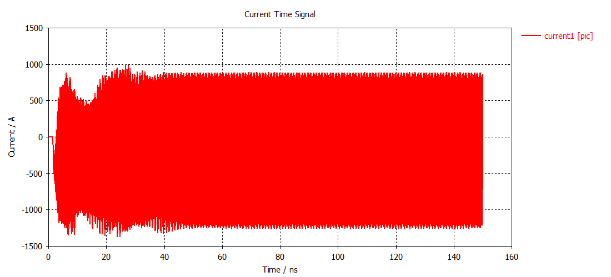
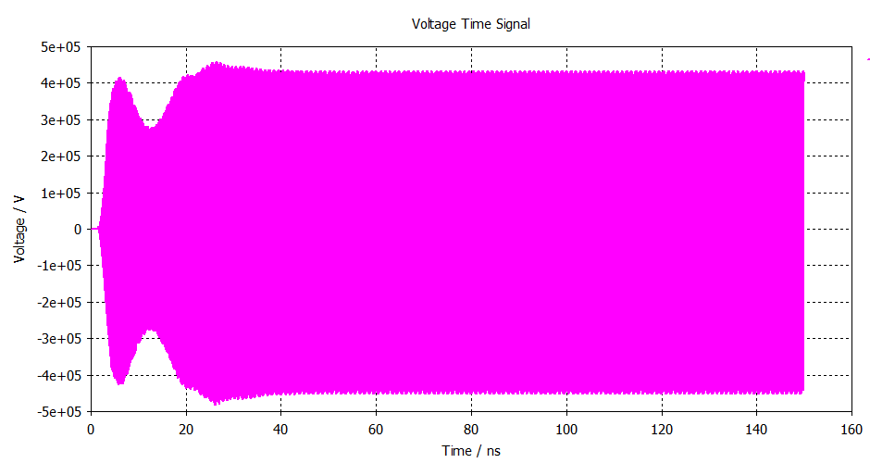
Beam dynamics

Slide 24
2860MHz klystron design

Slide 25
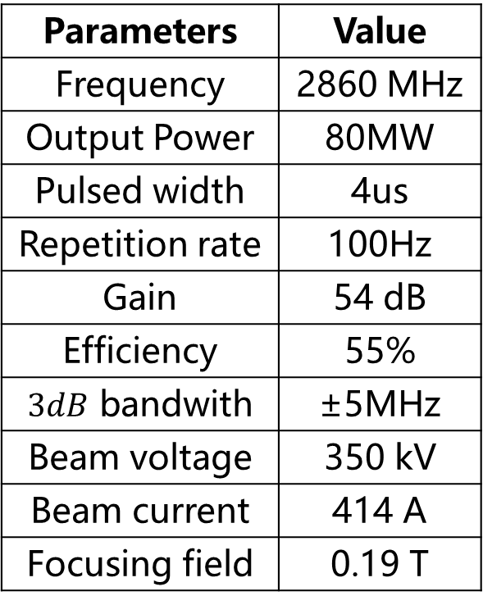
Main parameters
Parameters | Value
Frequency | 2860 MHz
Output Power | 80MW
Pulsed width | 4us
Repetition rate | 100Hz
Gain | 54 dB
Efficiency | 55%
$3dB$ bandwith | ±5MHz
Beam voltage | 350 kV
Beam current | 414 A
Focusing field | 0.19 T

Slide 26
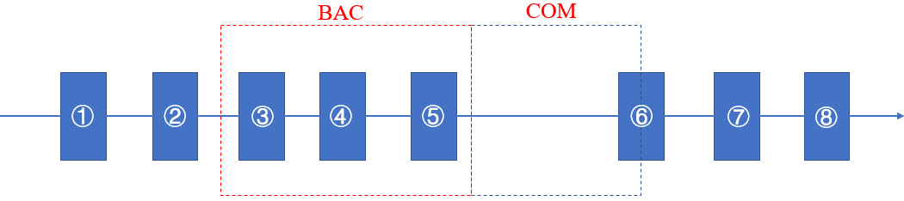
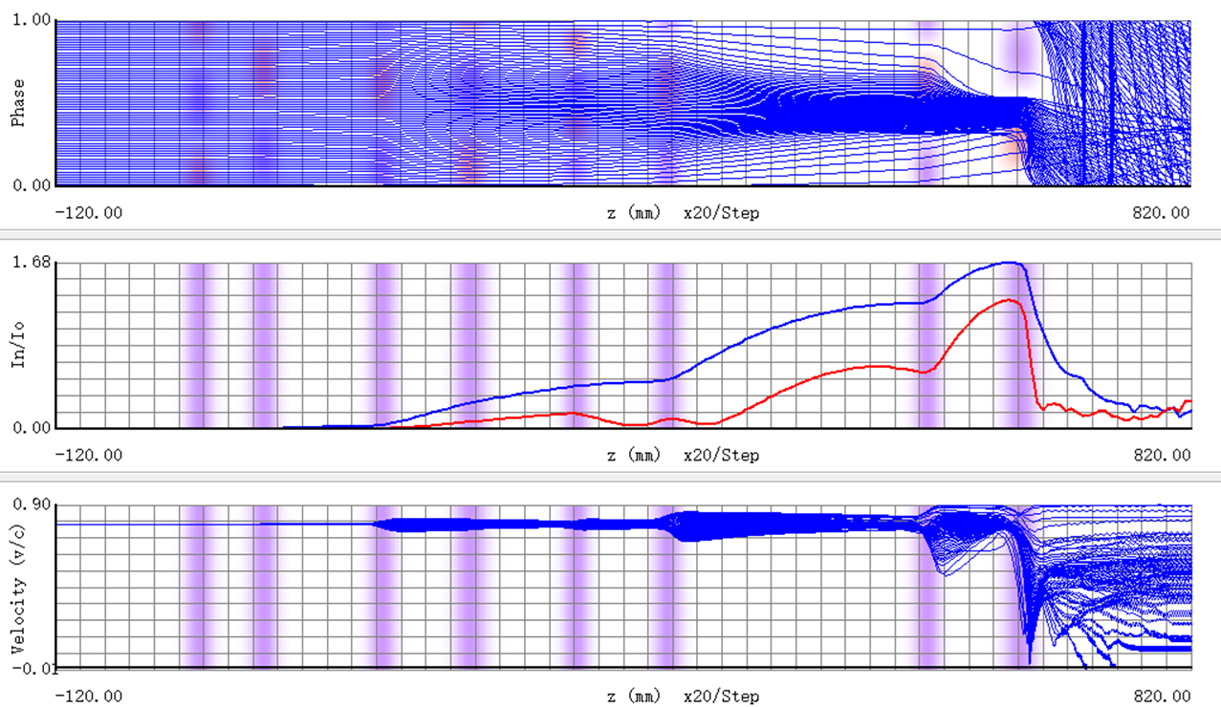
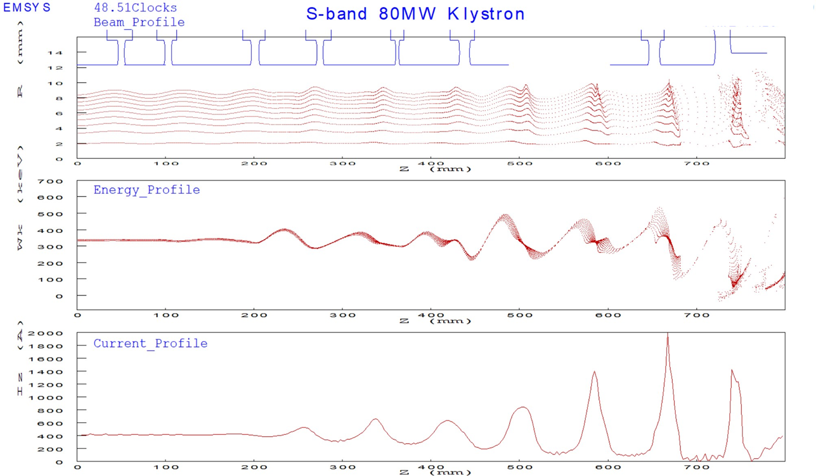
Beam dynamics
8 cavities with BAC and COM method for efficiency improvement.
2-D simulation, the efficiency is 57% and the output power is 83 MW

Slide 27
RF power sources distributions

Slide 28
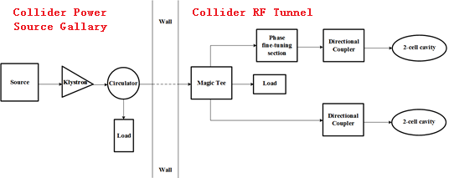
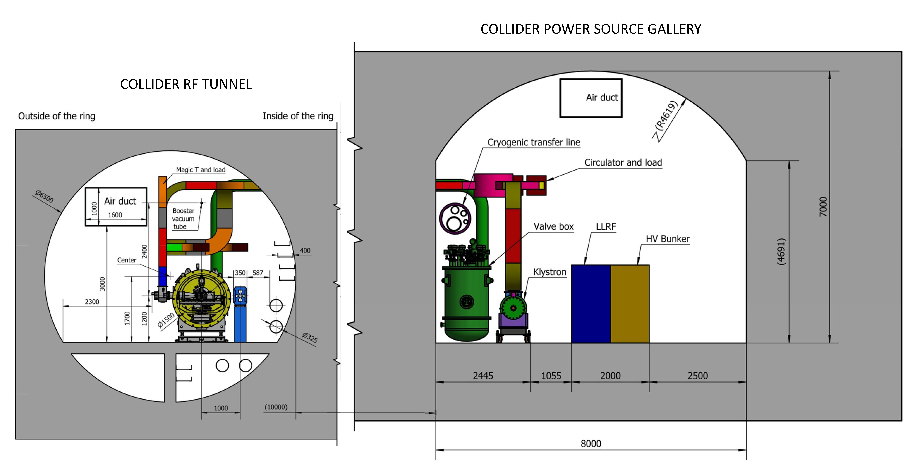
Collider power sources distributions
High voltage power supply are placed on the ground.
For space savings, transmission system in part are placed in RF tunnel.

Slide 29
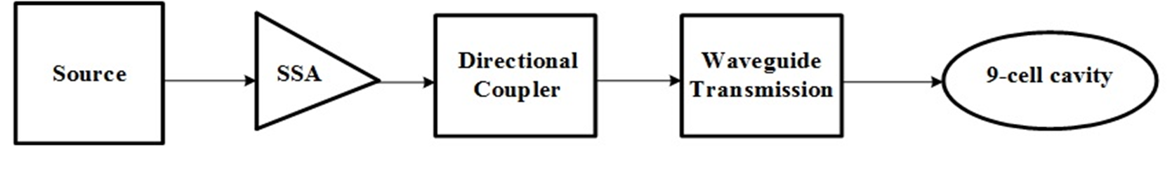
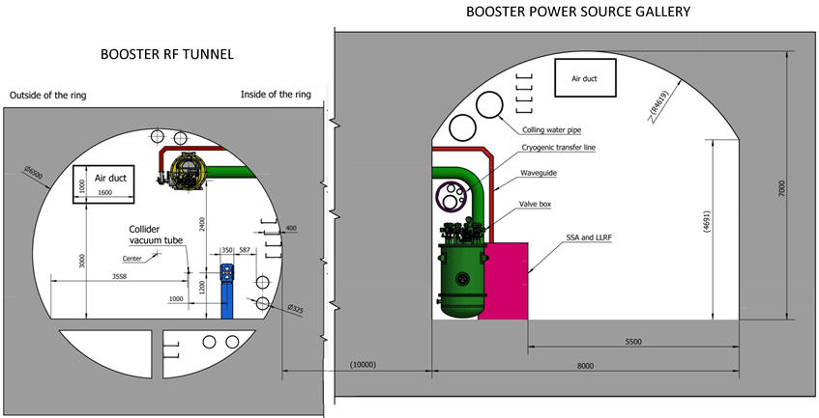
Booster power sources distributions
The Booster RF system consists of 1.3 GHz superconducting RF cavities. There are 12 cryo-modules for Higgs operation, each containing eight 9-cell superconducting cavities.
These cavities need 96 set 25kW power sources.

Slide 30
Damping ring power sources distributions
There are 2 RF stations, RF power is 650MHz/90kW/station.
650MHz/90kW SSA Specifications
Parameters | Values
Frequency | 650MHz
Power | 90 kW
Gain | ≥65 dB
Bandwidth (1dB) | ≥ 1 MHz
Amplitude stability | ≤0.1% RMS
Phase stability | ≤0.1°RMS
Phase Variation | ≤10°
Harmonic | < -30 dBc
Spurious | < -60 dBc

Slide 31
Linac power sources distributions
Type | Structure type
S-band klystron | 1 1-to-1，standard-bunch 3 1-to-2，standard acc. structure. 8 1-to-2，large aperture acc. structure 21 1-to-4, standard acc. structure.
C-band klystron | 1-to-2，standard acc. structure.

Slide 32
Summary
Much higher efficiency and much less power consumption and cost.
650MHz high efficiency klystron will be tested this year.
C band and S band klystron are also being developed with higher power level and higher efficiency.
RF power source distributions are also under consideration.

Slide 33
Thanks for your attention!

