Slide 1



CEPC mechanics system
Haijing Wang
23-27. October, 2023, Nanjing, The 2023 International Workshop on the High Energy Circular Electron Positron Collider

Slide 2
Content
Supports for regular magnets
MDI mechanics
Collimators
Summary

Slide 3
Content
Supports for regular magnets
  Supports in Collider
  Supports in Booster
  Supports in Linac and Damping Ring
MDI mechanics
Moveable Collimators
Summary

Slide 4
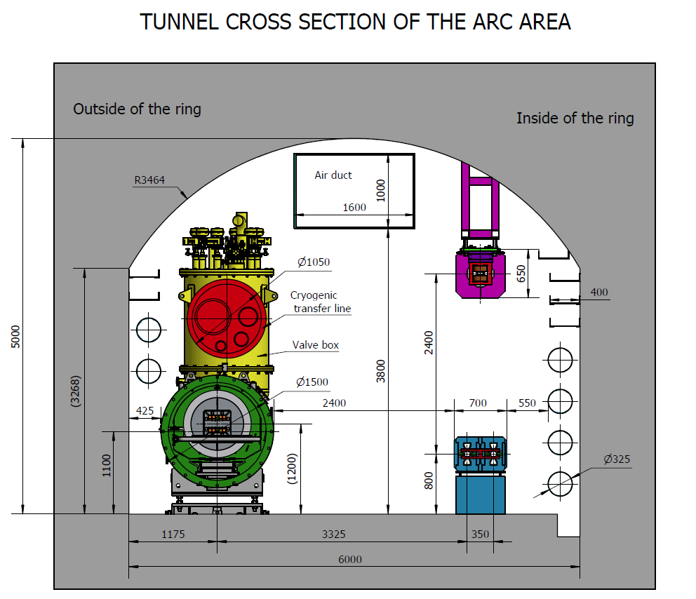
Supports for regular magnets
Over 90% of the 100 km ring is covered by magnets.
Requirements
  Stability with large time constants to avoid creep and fatigue deformation,
  Simple and reliable structures for safe mounting and easy alignment.
  Good vibration performance.
Booster
Collider
Adjustment range and resolution of supports in
Collider, Booster, Linac, Damping ring and transport lines
Direction | Range of adjustment | Direction | Resolution
X | ≥±20 mm | X | ≤10μm
Y | ≥±30 mm | Y | ≤10μm
Z | ≥±20 mm | Z | ≤10μm

Slide 5
Supports for regular magnets
Quantities of magnets and their supports in the collider
Magnet type | Quantity | Magnet length (mm) | Core number per magnet | No. of supports per core
Dipole (13250 magnet cores) | 1024 | 19743 (twin-aperture) | 4 | 4
 | 1920 | 23142(twin-aperture) | 4 | 4
 | 64 | 21700(twin-aperture) | 5 | 4
 | 162 | 28450~93378 (single aperture) | 5~17 | 4
Quadrupole | 3008 | 3000(twin-aperture) | 1 | 3
 | 8 | 1500 (twin-aperture) | 1 | 2
 | 1124 | 500~3500 (single aperture) | 1 | 1~3
Sextupole | 3072 | 1400 | 1 | 3 in common girder
 | 104 | 300~1000 | 1 | 1
Corrector | 7088 | 875 | 1 | 1

Slide 6
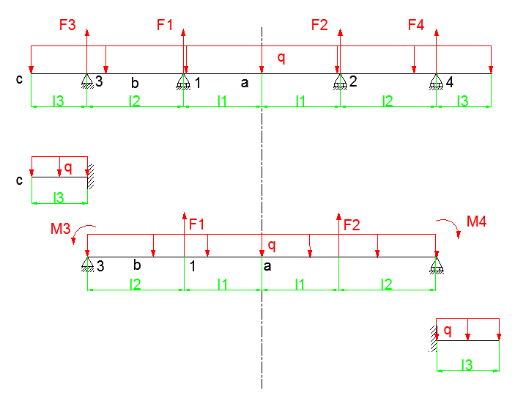
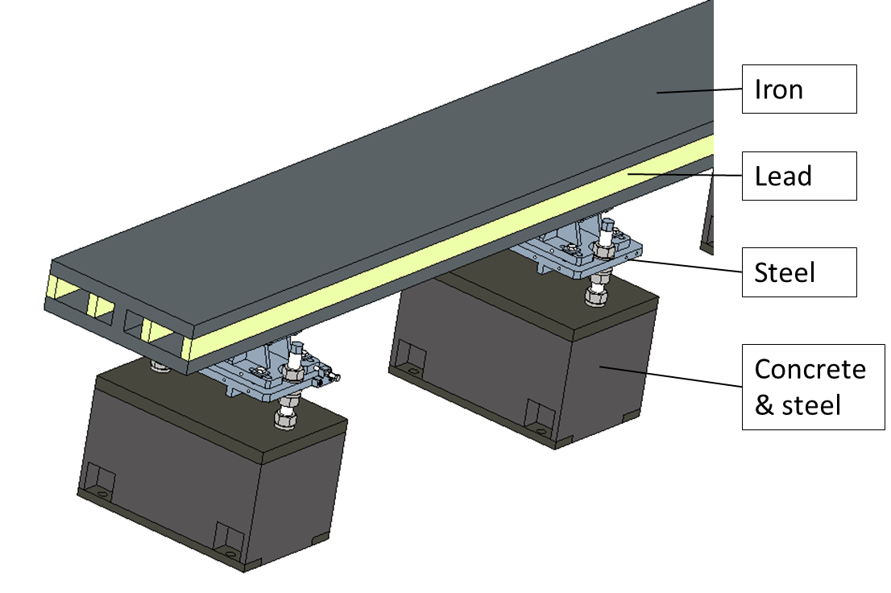
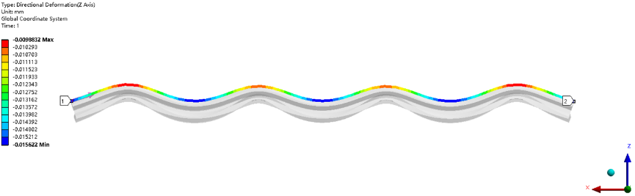
Supports in Collider
Deformation optimization for dipole magnets
  Methods: theoretical derivation & Workbench Response surface
  The maximum uneven deformation of the 5,594 mm long dipole core is 7μm, induced by gravity and support.
Model for analyzing
Number of supports | 3 | 4 | 5
Max. deformation (µm) | 19 | 7 | 5

Slide 7
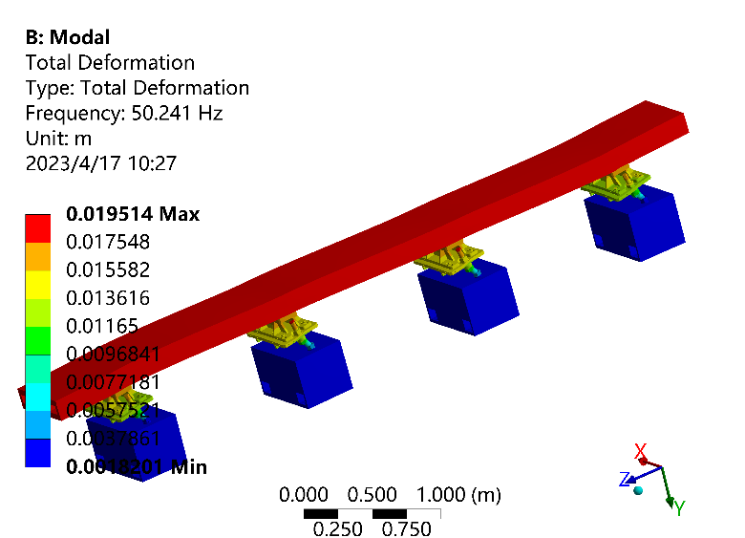
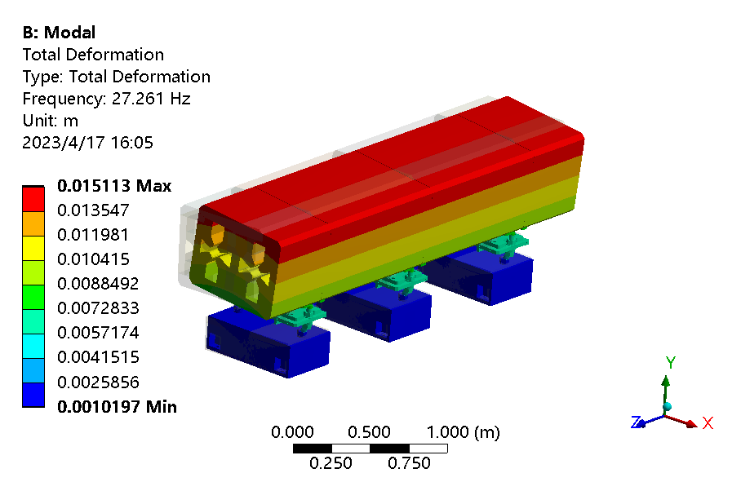
Supports in Collider
Dynamic stability
  Assume the natural frequency of the pedestals is above 150 Hz according to the experience of HEPS.
  The 1st natural frequency is 50.2 Hz for dipole and 27.3 Hz for quadrupole.
No. of order | Frequency (Hz) | Mode
1 | 50.2 | Z translation
2 | 51.3 | X translation
3 | 59.7 | Yaw rotation
4 | 89.0 | Bend in XZ plane
5 | 117.2 | 1st order bend YZ plane
6 | 123.8 | 2nd order bend YZ plane
No. of order | Frequency (Hz) | Mode
1 | 27.3 | X translation
2 | 31.5 | Z translation
3 | 33.2 | Yaw rotation
4 | 65.8 | Pitch rotation
5 | 67.3 | Y translation
6 | 80.4 | Roll rotation

Slide 8
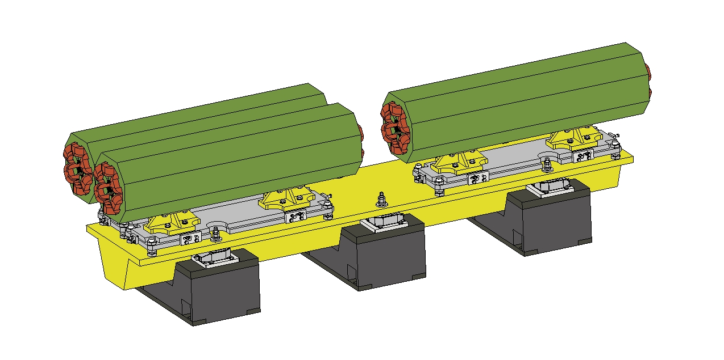
Supports in Collider
Sextupole support
  Common girder for the adjacent three sextupoles.
  Magnet length: 1.4 m; girder length: 3 m.
  Needs pre-alignment.

Slide 9
Supports in Booster
Support structures are similar to those of the Collider, with the exception that its pedestal is made of steel frames attached to the tunnel ceiling.
Quantities of magnets and their supports in the Booster
Magnet type | Quantity | Core length (mm) | No. of supports per core
Dipole | 14226 | 4700 | 4
 | 640 | 2350 | 2
Quadrupole | 2314 | 1000/700 | 2 (common frame)
 | 1144 | 2000 | 2
Corrector | 1200 | 583 | 1

Slide 10
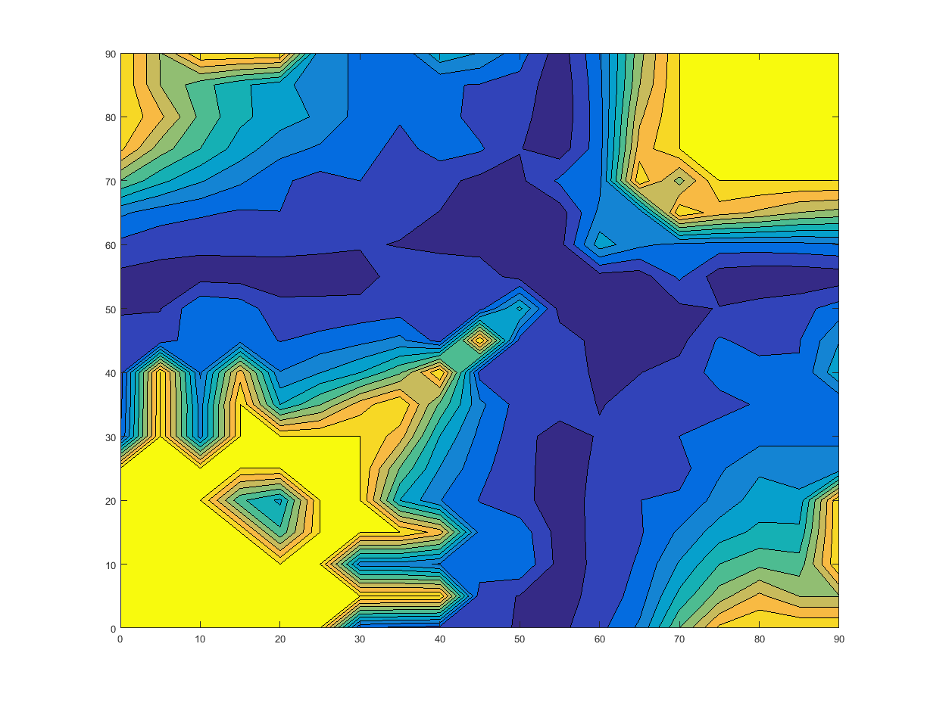
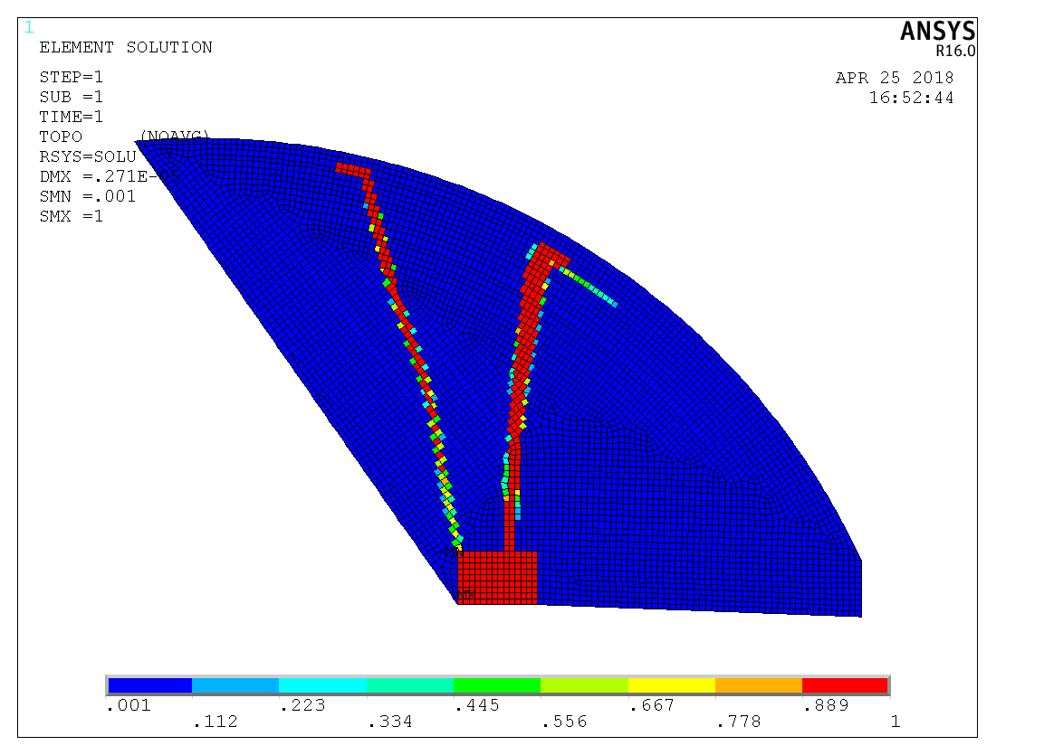
Supports in Booster
Topology optimization
  To design the supporting location in the XY plane.
  Constraint: volume; Objective function: structure compliance.
  Applicable to all types of magnet supports hanged to the ceiling.
  Vertical steel frames with horizontal ribs are adopted to achieve a simple structure and a better appearance.
Tunnel ceiling
Selected elements for support
Angular coordinate of 2nd support point
Magnet
Angular coordinate of 1st support point

Slide 11
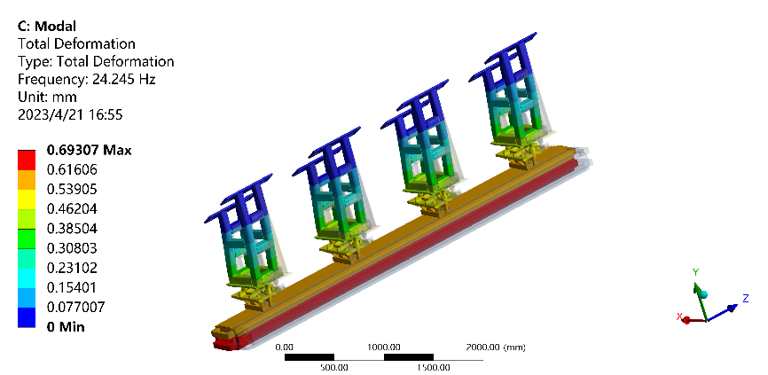
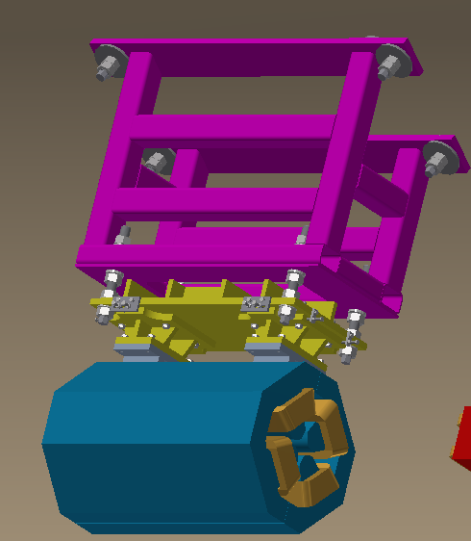
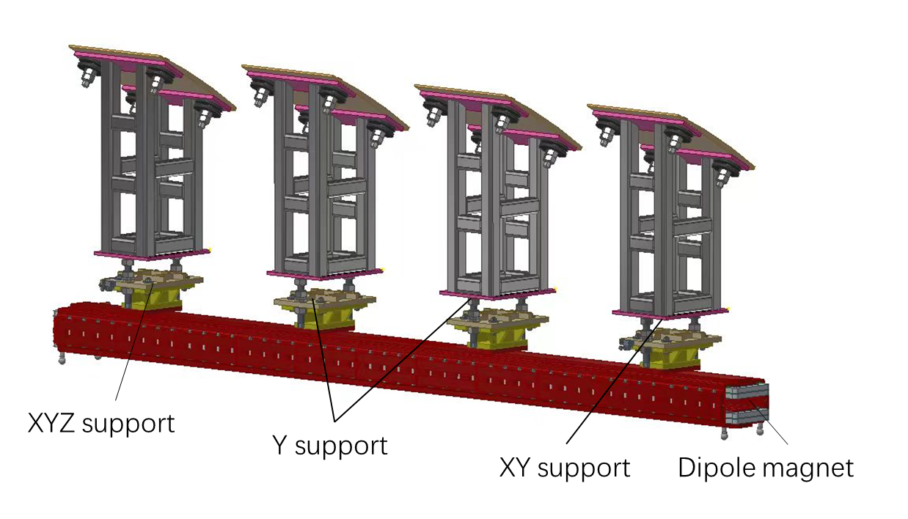
Supports in Booster
Hanged on the ceiling by steel frames
Modal analyses of Booster dipole and support
No. of order | Frequency (Hz) | Mode
1 | 24.2 | X translation
2 | 26.6 | Yaw rotation
3 | 28.9 | Z translation
4 | 79.0 | Bend in XZ plane
5 | 117.4 | Roll rotation
6 | 122.2 | Pitch rotation

Slide 12
Supports in Linac and Damping Ring
Mechanical supports in the Linac
Supports | Quantity (set) | Remarks
Bunching system support | 1 | Supports of subharmonic buncher, buncher, accelerating structure, solenoid and instruments
EBTL support | 2
Positron accelerating structure support | 1 | Supports of positron source, solenoid, accelerating structure and positron acceleration section
Triplet support unit | 104 | Support of the quadruples, correctors and instruments in the triple unit
Dipole support | 19 | Supports of 6 kinds of dipoles
Accelerating structure support | 579 | Supports of S band and C band accelerating structures

Slide 13
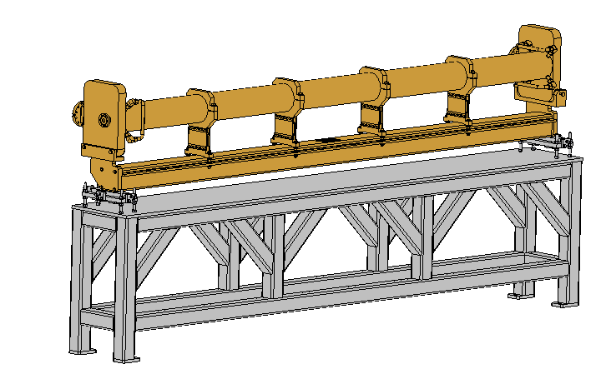
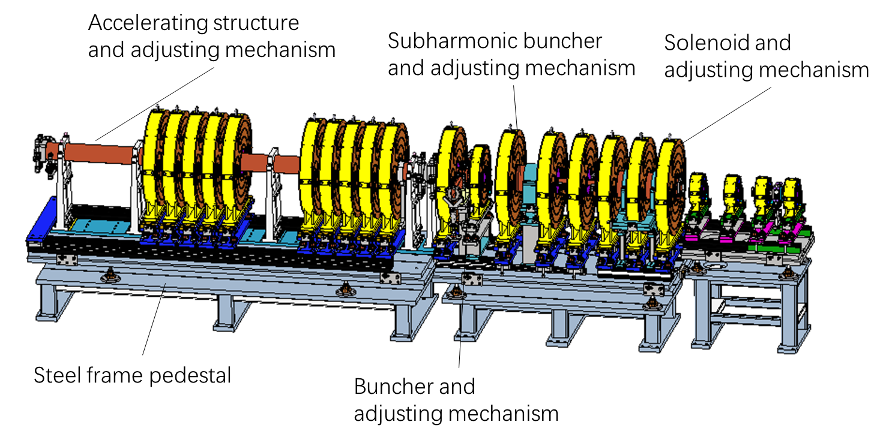
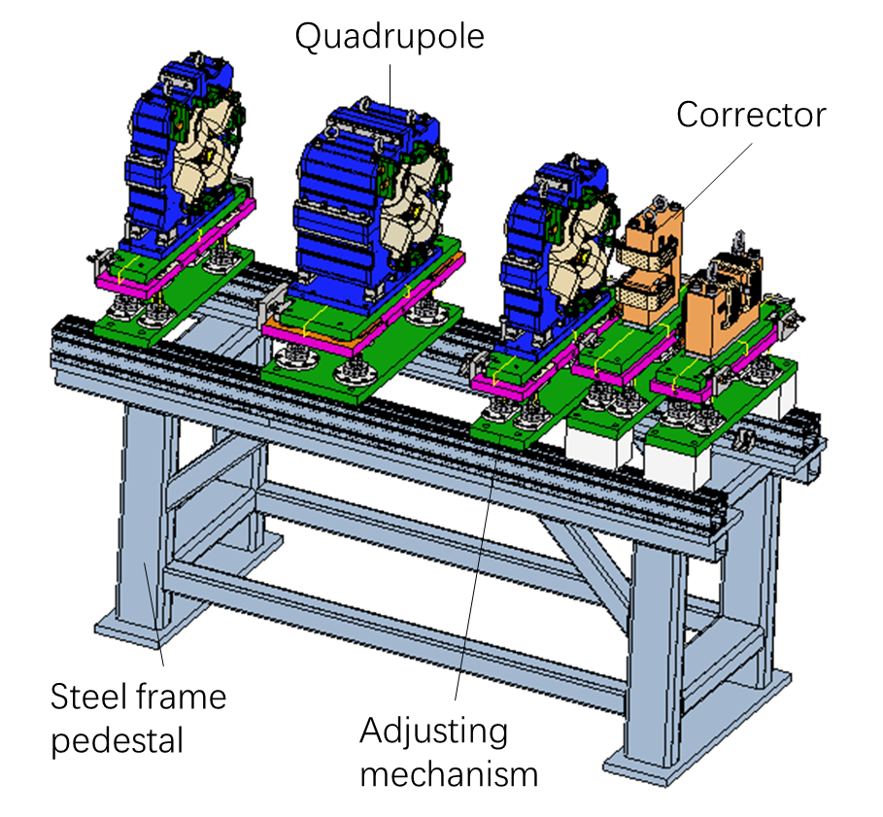
Supports in Linac and Damping Ring
Linac：Similar to the Linac support of HEPS
Accelerating structure support
Bunching system support
Triplet unit support

Slide 14
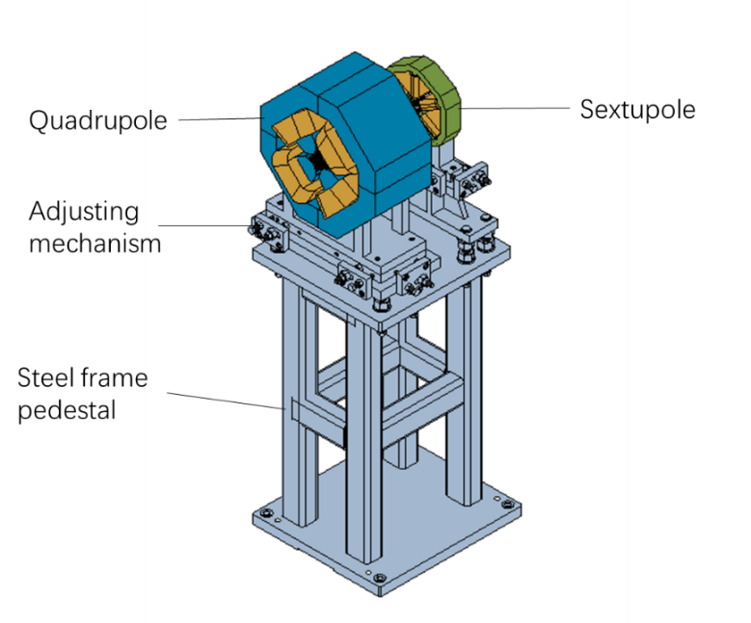
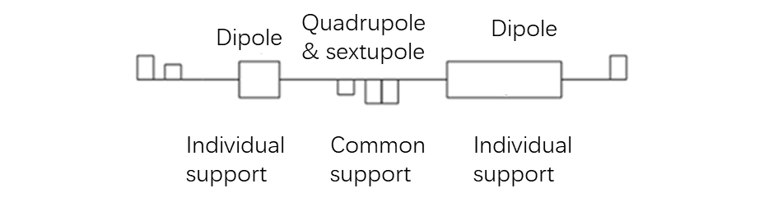
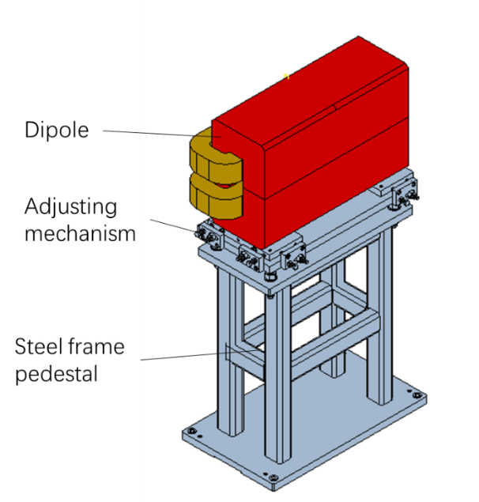
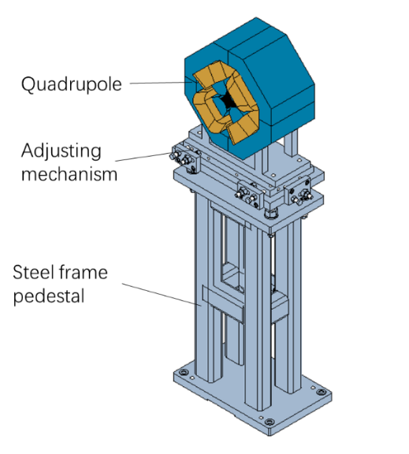
Supports in Linac and Damping Ring
Damping Ring: Similar to the transport line supports of HEPS
Mechanical supports in the Damping Ring
Supports | Quantity (set) | Remarks
Quadrupole & sextuple support | 72 | Common girder for one quadrupole and one sextuple
Quadrupole support | 32 | Supports of 2 kinds of quadrupoles
Dipole support | 80 | Supports of 2 kinds of dipoles
Lambertson support | 2
Kicker support | 2
Support of adjcent quadrupole and sextupole
Individual support of dipole magnet
Individual support of quadrupole magnet

Slide 15
Supports for regular magnets
Future work:
  Number of supports for dipole magnets in Collider and Booster will be checked with the magnet colleagues, the magnetic field quality, stability and cost will be integrated into account.
  A semi-automatic adjusting mechanism will be considered with the alignment colleagues, aiming at much higher alignment efficiency.

Slide 16
Content
Supports for regular magnets
MDI mechanics
  MDI Layouts
  SC magnet support system
  Remote vacuum connector
Collimators
Summary

Slide 17
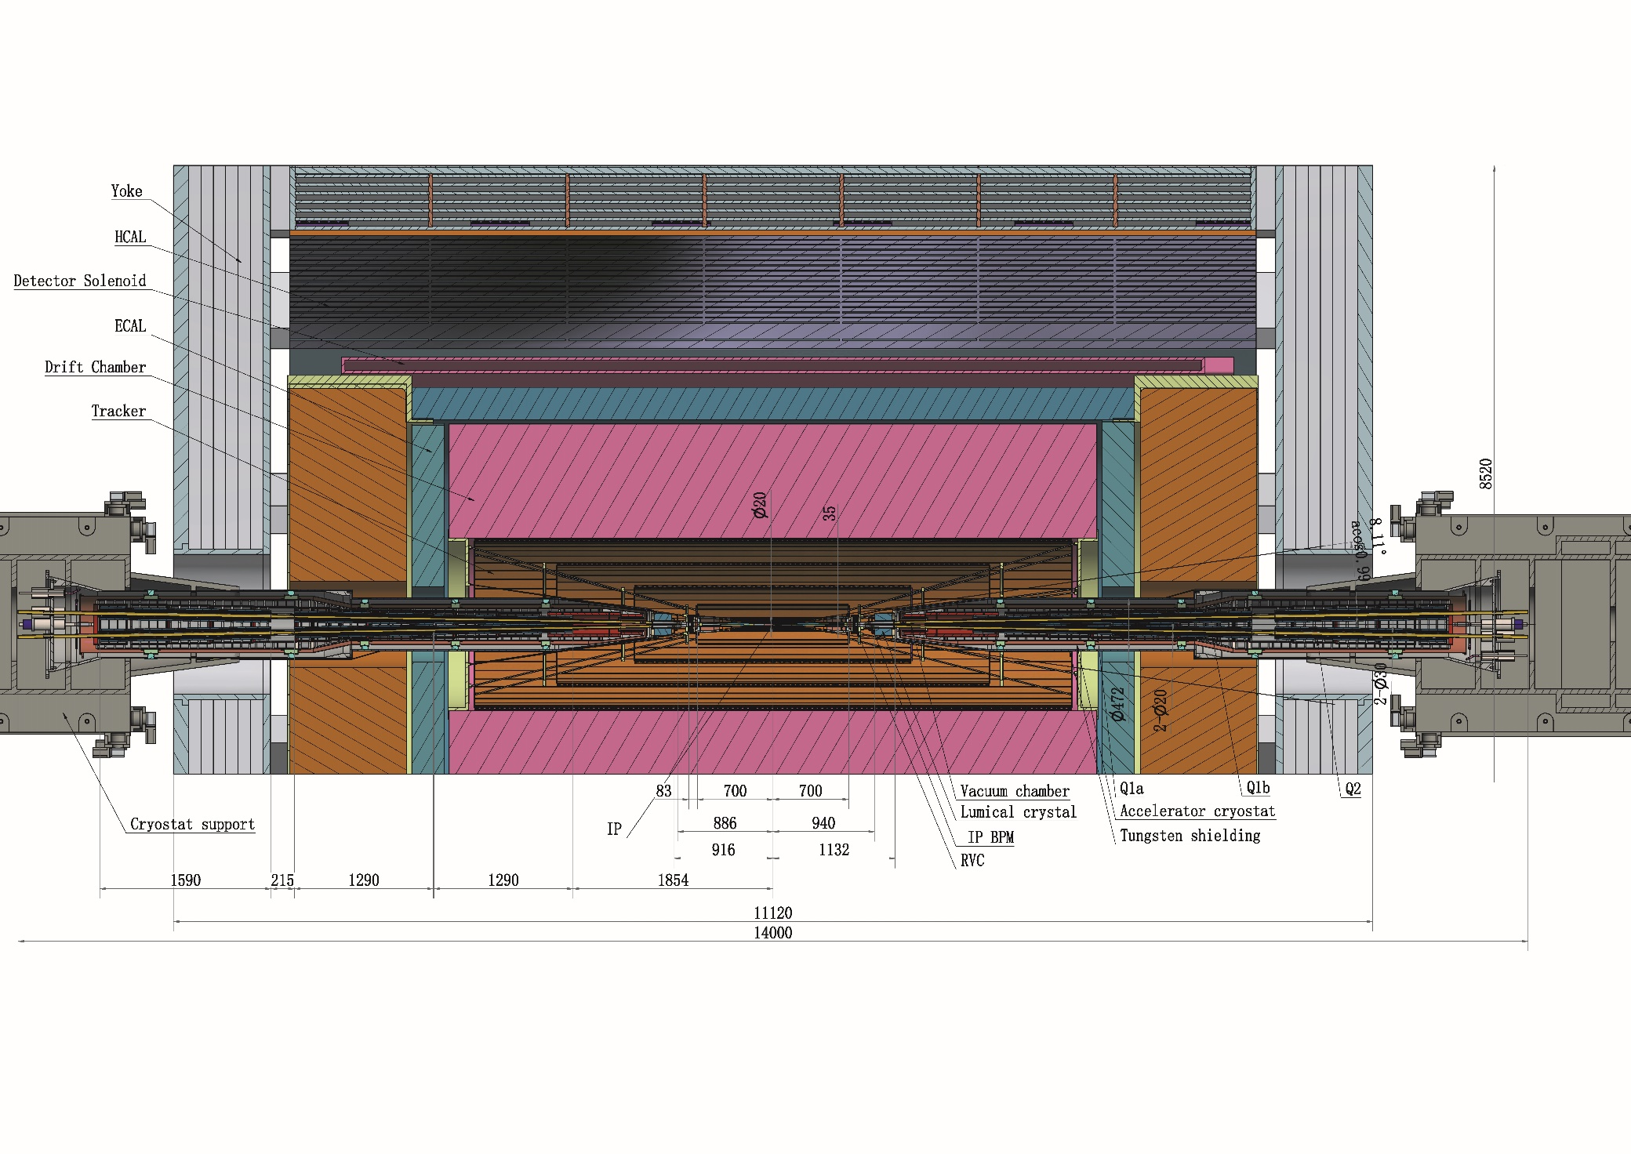
MDI layouts
Detective angle: acos0.99
Detector York length: 9620mm
IP chamber:-700mm~700mm

Slide 18
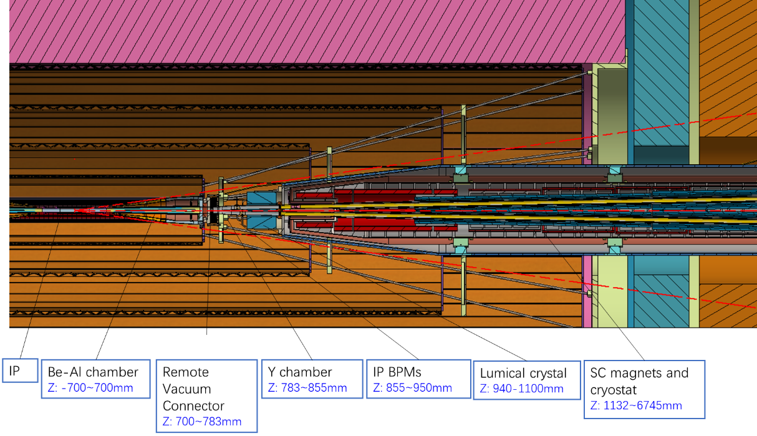
MDI layouts
Distance to detective angle
  IP chamber flange: 5.3mm RVC: 14.9mm (pressure tube) Shielding outside cryostat: 16.5mm

Slide 19
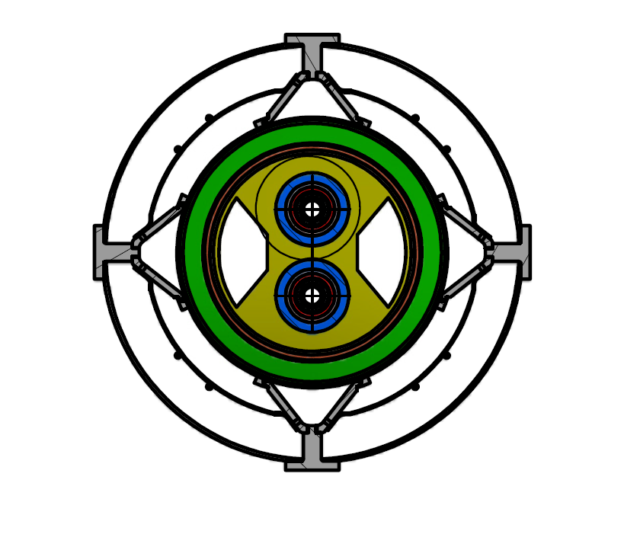
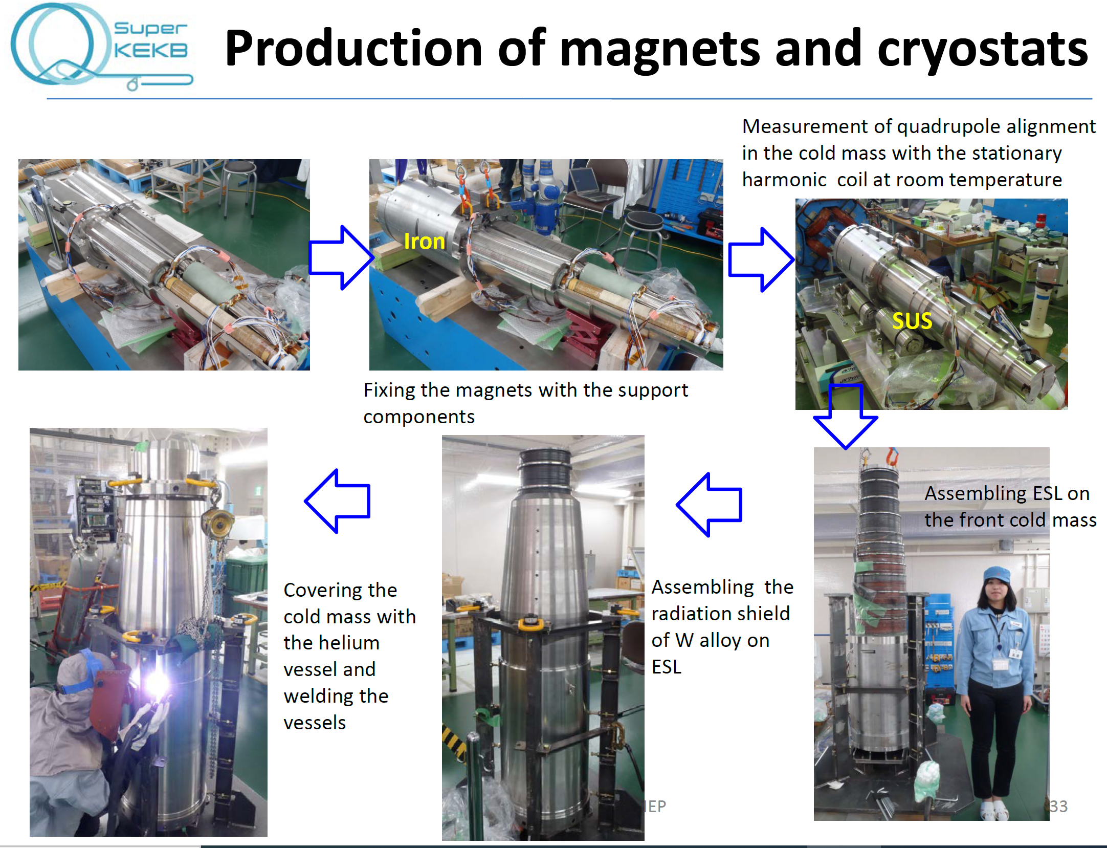
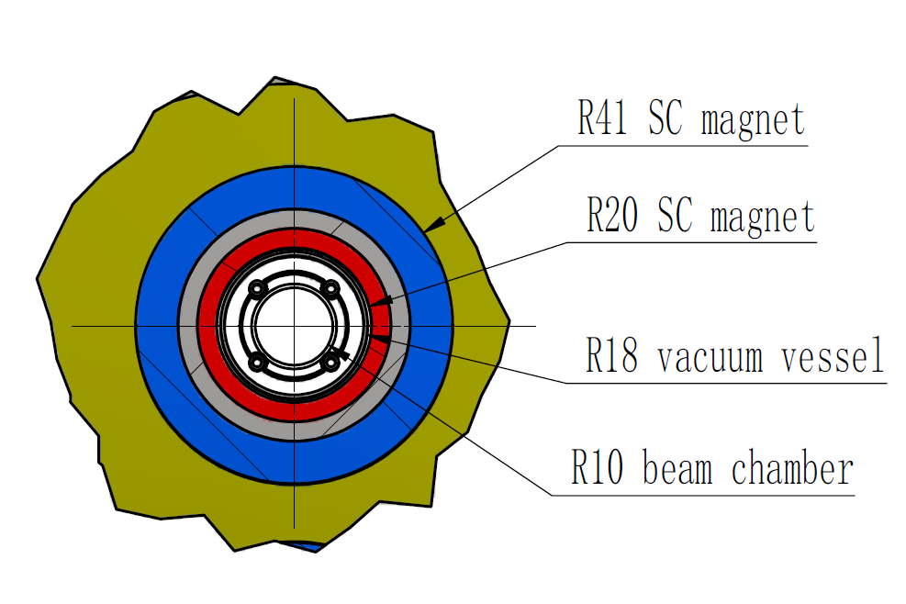
MDI layouts
Cross section at Q1a
SKEKB experience is greatly helpful for the integration
Vacuum vessel
Helium vessel
Anti solenoid
Skeleton supports

Slide 20
MDI Layouts
Assuming the detectors are assembled, and the IP chamber is installed and aligned, the assembly sequence for the accelerator devices in the MDI region proceeds as follows:
  Secure the SC magnets with the supports inside the helium vessel.
  Assemble the helium vessel to the vacuum vessel of the cryostat and perform pre-alignment in the lab.
  Assemble the vacuum chambers inside the cryostat and align them with the cryostat in the lab.
  Assemble the Lumical crystal, Y chamber with IP BPM, and perform alignment in the lab.
  Assemble the cryostat to the cryostat support system on-site, adjusting the cryostat using the adjusting mechanism with alignment, and then attach the RVC.
  Move the cryostat into the detector using the moving mechanism of the cryostat support system to its designated location, connecting the Y chamber with the IP chamber using the RVC.
  Perform the final alignment.

Slide 21
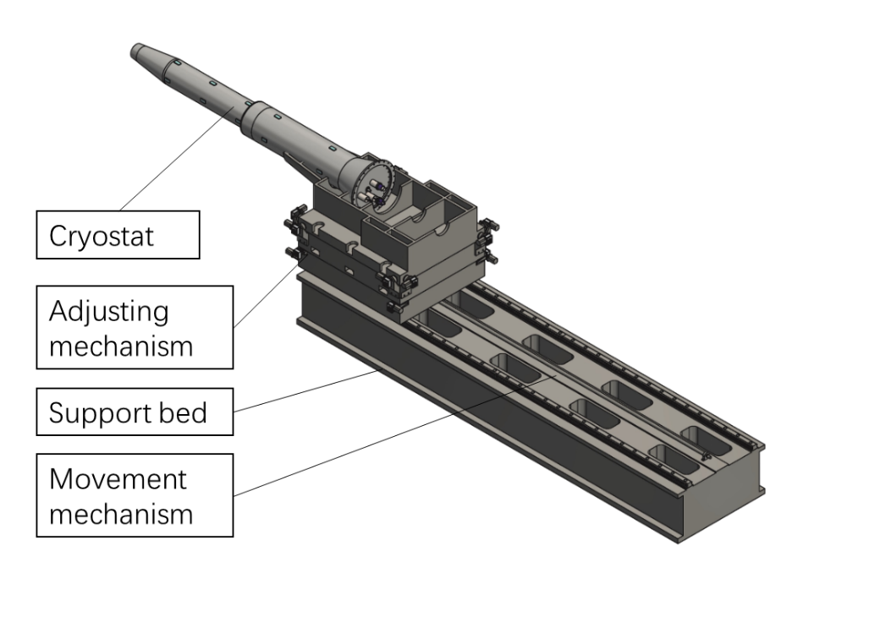
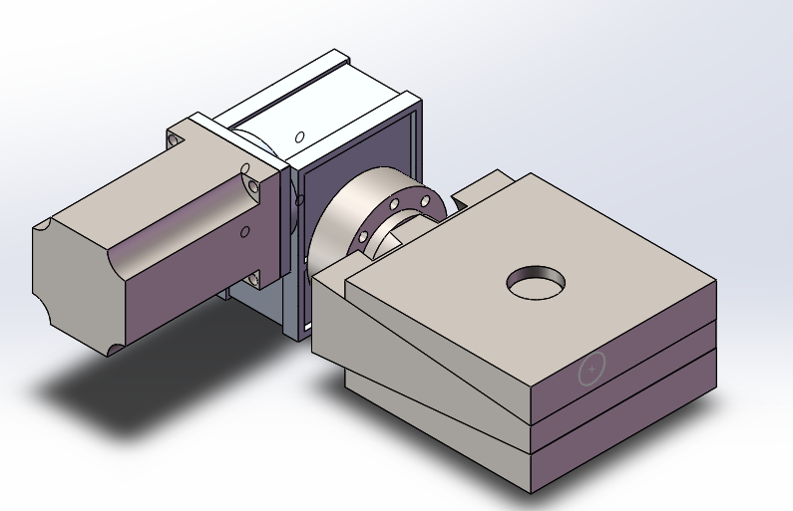
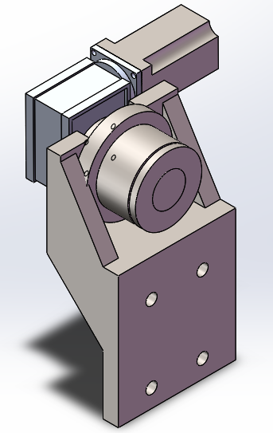
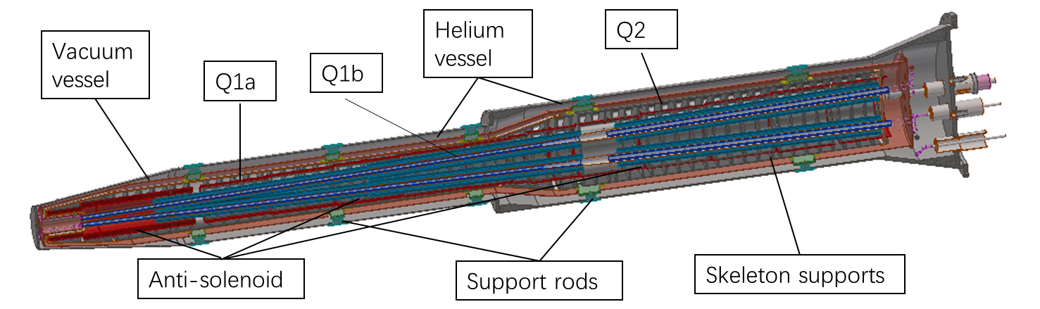
SC magnet support system
Key points
  Stability (static and dynamic)
  Accuracy
  Easy-operating
  Dimensions
Alignment requirements: ≤100 μm.
  High resolution: ≤ 5 μm
  Small uneven deformation
Cryostat length: ~5.6 m

Slide 22

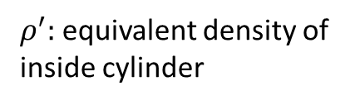
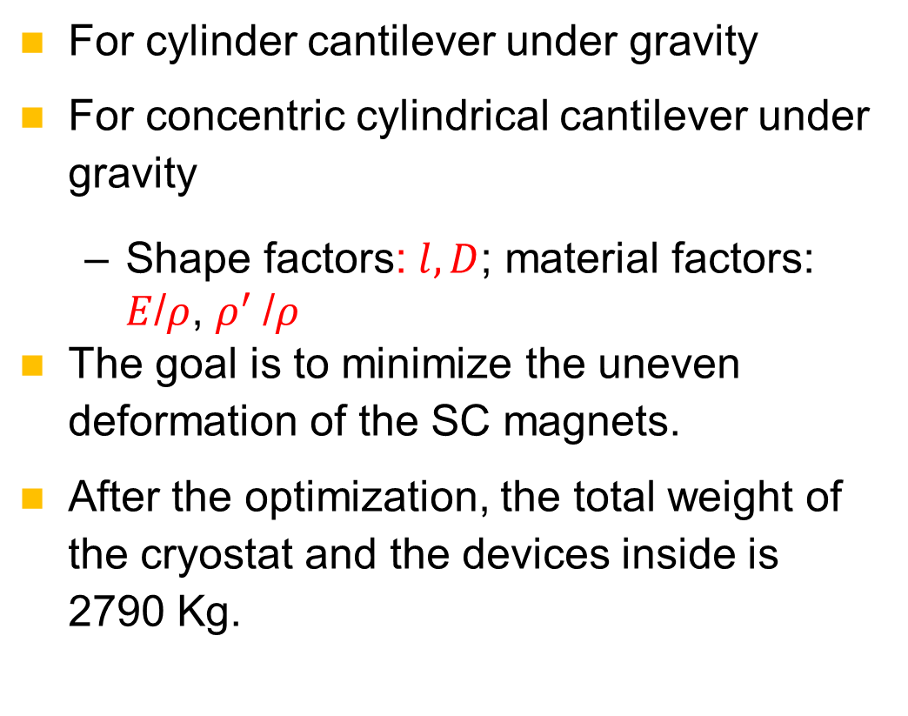
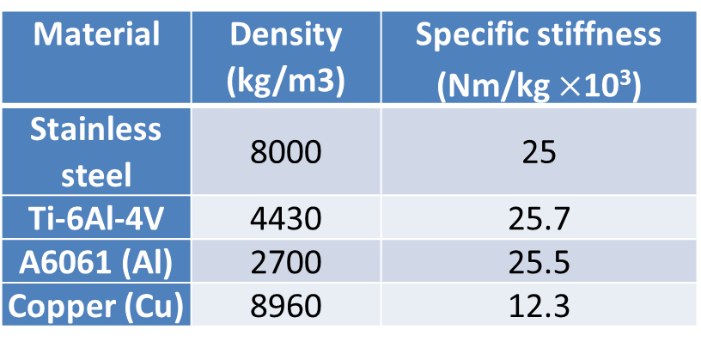

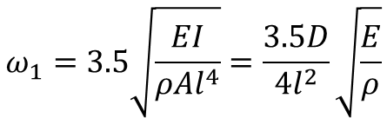
SC magnet support system
$$y_{max}=−\frac{ql^{4}}{8EI}=\frac{l^{4}ρ}{πED^{2}}$$
$$ω_{1}=3.5\sqrt{\frac{EI}{ρAl^{4}}}=\frac{3.5D}{4l^{2}}\sqrt{\frac{E}{ρ}}$$
For cylinder cantilever under gravity
For concentric cylindrical cantilever under gravity
  Shape factors: $l, D$; material factors: $E$/$ρ$, $ρ^{′}$/$ρ$
The goal is to minimize the uneven deformation of the SC magnets.
After the optimization, the total weight of the cryostat and the devices inside is 2790 Kg.
$$y_{max}\sim \frac{ρl^{4}}{32EI}(D^{2}−d^{2}+\frac{ρ^{′}}{ρ}d^{2})$$
$ρ^{′}:$equivalent density of inside cylinder
Material | Density (kg/m3) | Specific stiffness (Nm/kg $×$10³)
Stainless steel | 8000 | 25
Ti-6Al-4V | 4430 | 25.7
A6061 (Al) | 2700 | 25.5
Copper (Cu) | 8960 | 12.3

Slide 23
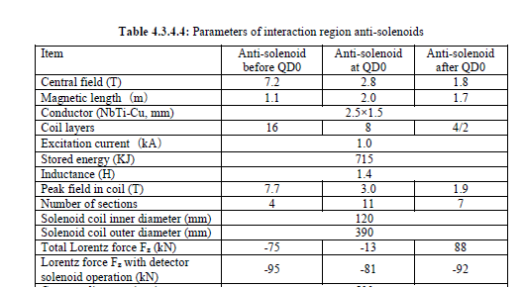
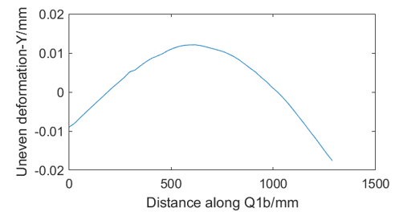
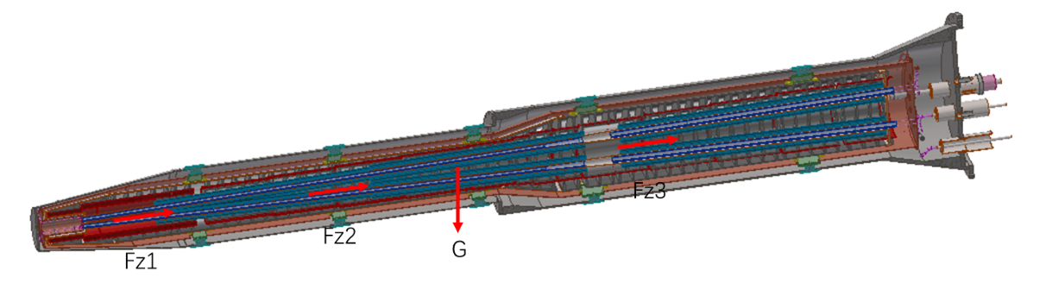
SC magnet support system
Integral FEA
  Loads：gravity, Lorentz force Fz with detector solenoid operation
  Alignment cannot based on the displacement.
  To pre-align the magnet to compensate the absolute displacement.
Temperature | uneven deformation in Y direction (um) |  |  | Displacement in Z direction (mm)
 | Q1a | Q1b | Q2 | Q1a | Q1b | Q2
295K | 5 | 31 | 14 | 0.3 | 0.26 | 0.24
4.2K* | 7 | 30 | 12 | Contract with temperature
  *Thermal expansions are assumed constants for this estimation.

Slide 24
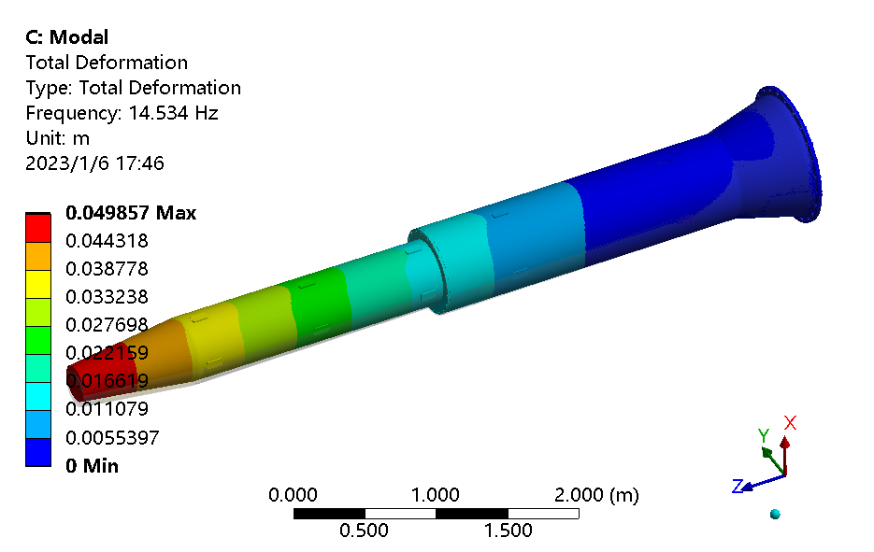
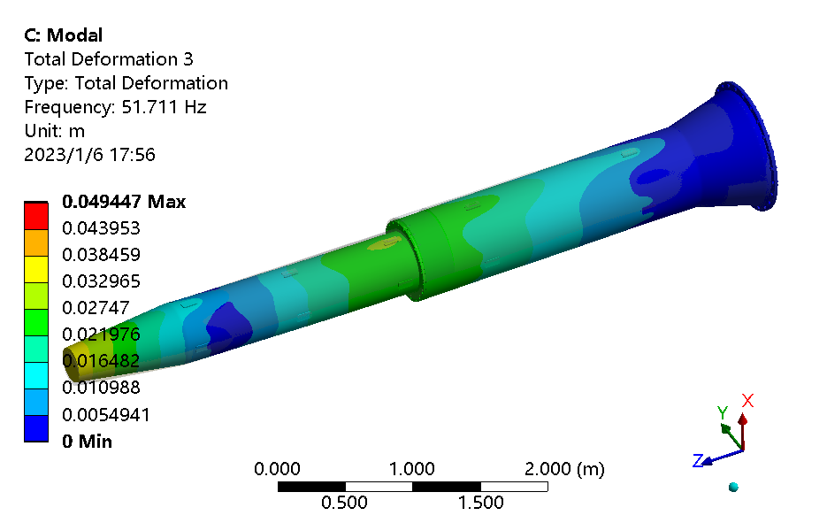
SC magnet support system
Dynamic stability
  Assume the cryostat is fixed at the end.
  The 1st natural frequency is 14.5 Hz.
No. of order | Frequency (Hz) | Mode
1 | 14.5 | Integral vertical sway
2 | 14.9 | Integral horizontal sway
3 | 51.7 | Integral vertical wave
4 | 53.7 | Integral horizontal wave
5 | 89.7 | Vertical wave of helium vessel
6 | 91.4 | Horizon wave of helium vessel

Slide 25
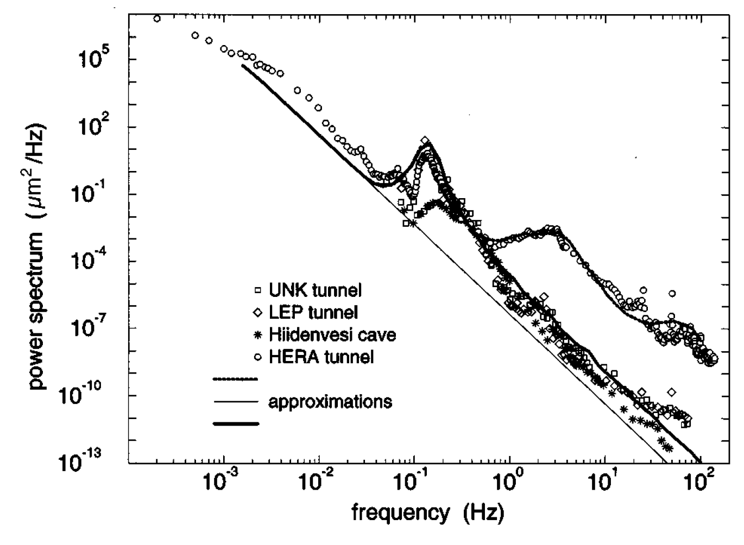
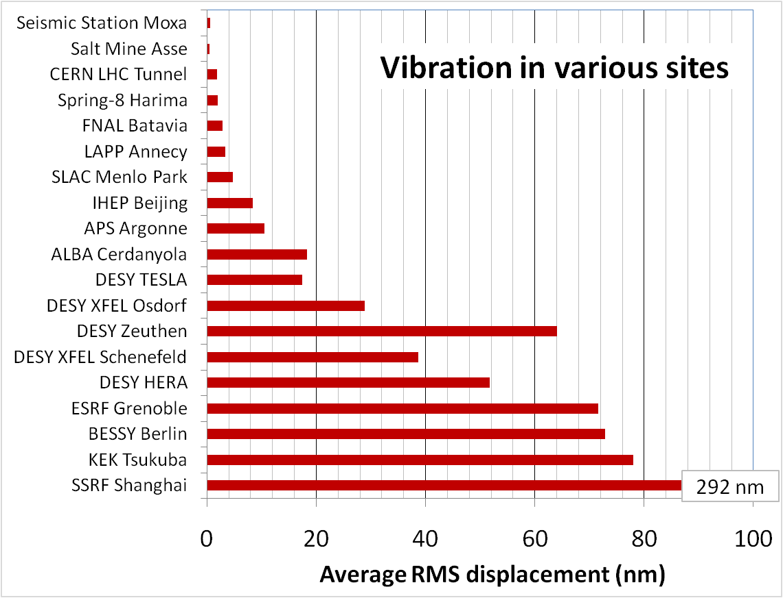
SC magnet support system
Enhancing the natural frequency is an effective method to decrease vibration.
HEPS site
Mechanical dynamic stability (vibration)
  Ground vibration
  Magnet-support assembly
  Damping devices
  Slab and pedestal
Ground vibration decreases with increase in frequency :
  Displacement PSD ~ f⁻⁴
  Spectral displacement ~ f⁻²

Slide 26
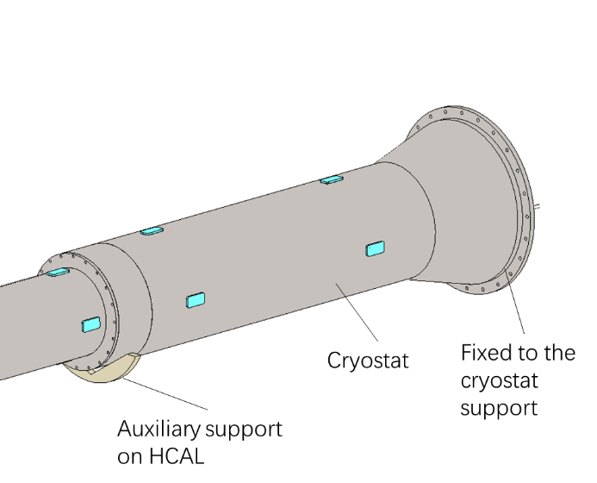
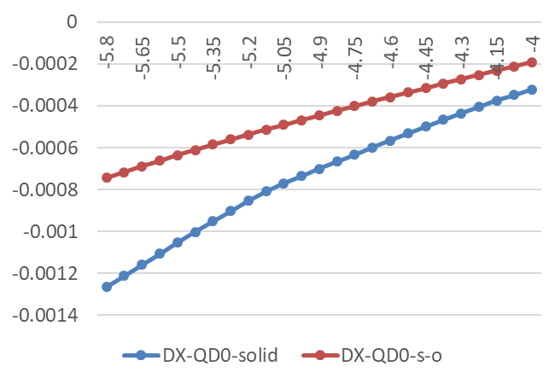
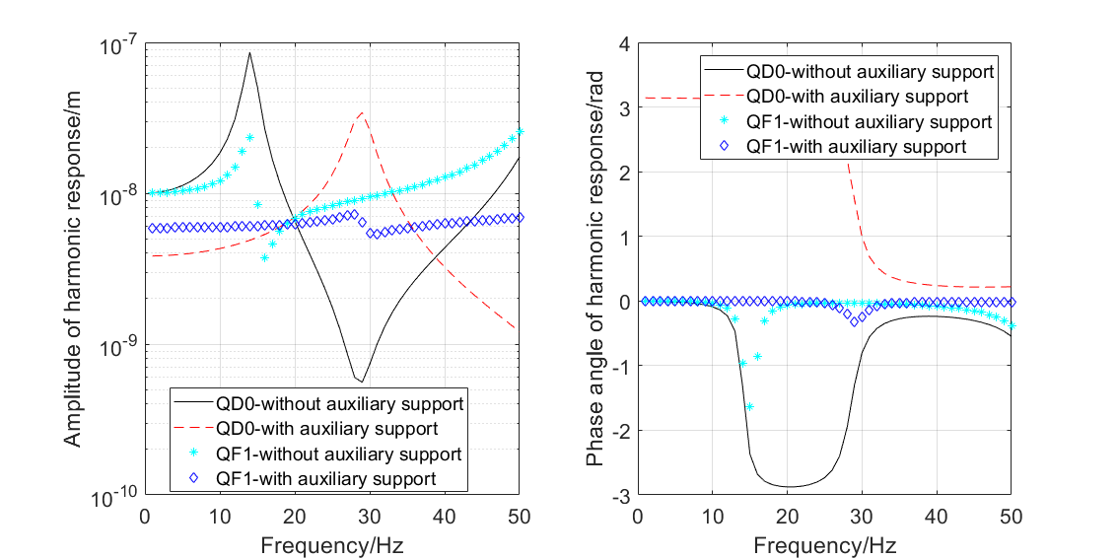
SC magnet support system
Auxiliary support of cryostat
  Auxiliary constraint: V groove, translational in beam direction
  1st natural frequency: 14→29 Hz
  Harmonic response (1-50 Hz) , the response amplitude decreased largely.
  Can decrease the cryostat deformation as well.
Uneven deformation VS support location

Slide 27
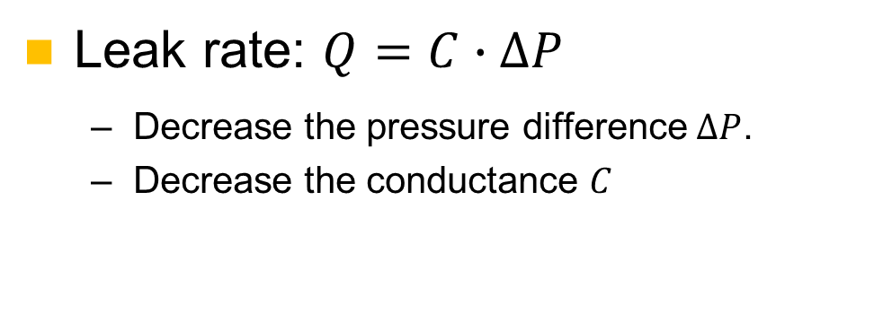
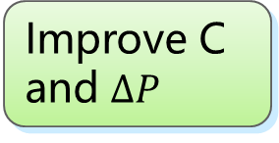
Remote vacuum connector
Used to connect the IP chamber and the vacuum tubes of accelerator.
Leak rate requirement: 2.7 ×10^{–11} Pa·m³/s
Limited operation space
Anti-radiation
High leak rate requirement
Special location
Difficulties
Solutions
Remote connection
All-metal sealing
Improve C and $∆P$
High safety and reliability
Leak rate: $Q=C∙∆P$
  Decrease the pressure difference $∆P$.
  Decrease the conductance $C$

Slide 28
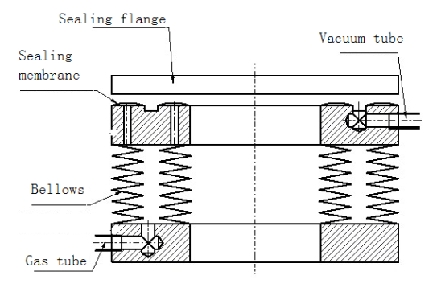
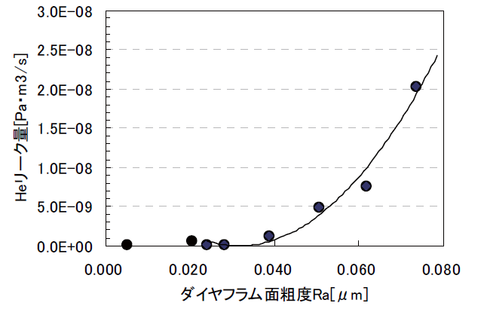
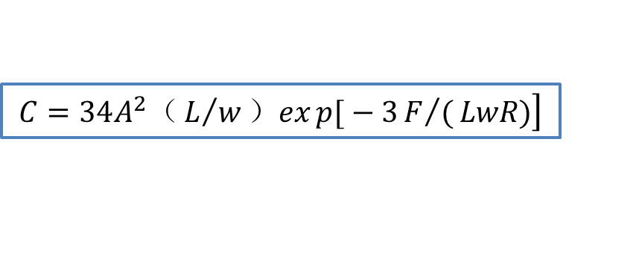
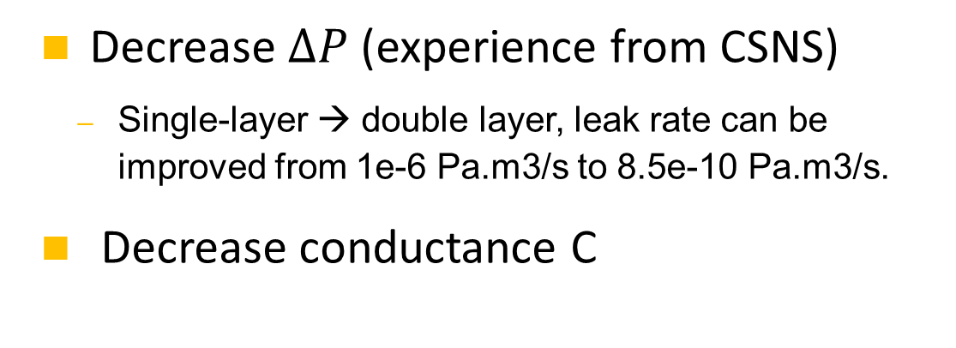
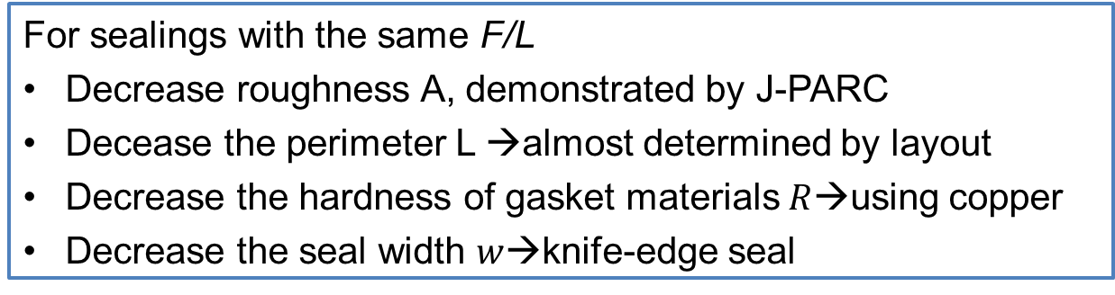
Remote vacuum connector
    Decrease $∆P$ (experience from CSNS)
  Single-layer → double layer, leak rate can be improved from 1e-6 Pa.m3/s to 8.5e-10 Pa.m3/s.
    Decrease conductance C
Inflatable seal
$$\left.C=34A^{2}（L/w）exp{[}−3F/(LwR)\right]$$
  For sealings with the same F/L
  Decrease roughness A, demonstrated by J-PARC
  Decease the perimeter L →almost determined by layout
  Decrease the hardness of gasket materials$R$→using copper
  Decrease the seal width $w$→knife-edge seal
Roughness and conductance, J-PARC

Slide 29
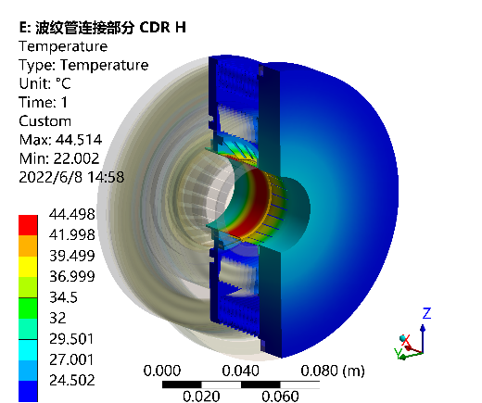


Remote vacuum connector
    Leak rate estimation
  Leak rate obtained in CSNS: 3.9e-10 Pa.m3/s (inner diameter 320mm)
  It is possible to obtain the requirement of 2.7e-11Pa.m3/s (inner dimensions 35-20mm, racetrack)
    Can endure a heat flux of 1 W/cm², the HOM power is acceptable.
temperature
Heat flux

Slide 30
Content
Supports for regular magnets
MDI mechanics
Collimators
Summary

Slide 31
Collimators
CEPC has two kinds of collimators. One is for background decreasing. The other is for machine protection (will begin in EDR).
9 collimators per IP per ring for background decreasing.
name | Position | Distance to IP/m | Beta function/m | Horizontal Dispersion/m | Phase | BSC/2/m | Range of half width allowed/mm
APTX1 | D1I.785 | 44611 | 20.7 | 0.12 | 164.00 | 0.006 | 1~6
APTX2 | D1I.788 | 44680 | 20.7 | 0.12 | 164.25 | 0.006 | 1~6
APTY1 | D1I.791 | 44745 | 105.37 | 0.12 | 165.18 | 0.0036 | 0.156~3.6
APTY2 | D1I.794 | 44817 | 113.83 | 0.12 | 165.43 | 0.0036 | 0.156~3.6
APTX3 | D1O.5 | 1729.66 | 20.7 | 0.06 | 6.85 | 0.00182 | 1~6
APTX4 | D1O.8 | 1798.24 | 20.7 | 0.12 | 7.10 | 0.00182 | 1~6
APTY3 | D1O.10 | 1832.52 | 20.7 | 0.25 | 7.22 | 0.00182 | 0.069~3.3
APTY4 | D1O.14 | 1901.1 | 20.7 | 0.25 | 7.47 | 0.00182 | 0.069~3.3
APTX5 | DMBV01IRU0 | 56.3 | 196.59 | 0 | 362.86 | 0.01178 | 2.9~11.78

Slide 32



Collimators
Horizontal movable collimator for background decreasing
  Inner profile is gradually altered from a circular to a rectangle to minimize impedance.
  Material of vacuum vessel and the jaws is GlidCopAl-15， and SS for flanges.
  Half aperture 4mm for normal operation.
  Open-loop accuracy 10 µm (can be obtained for HEPS).

Slide 33





Collimators
Structure Optimization
  Impedance varies with the offset of the tip.
  About 70% of the synchrotron radiation energy (7.5 kW @ 30MW Higgs) is deposited in the block.

Slide 34




Collimators
Thermal mechanical analyses @30MW Higgs
  Jaw: highest temperature 147 ℃，Maximum von Mises stress89.7 MPa
  Vacuum chamber: highest temperature 124 ℃，Maximum von Mises stress 110.4 MPa

Slide 35

Collimators
For the collimators used for MPS, drawing from the experiences such as SuperKEKB or HEPS, low-Z, high-melting-point carbon-based materials need to be taken into consideration.
We have accumulated relevant experience from the HEPS.
Jointing prototype of copper, graphite and graphene film
2D adjusting mechanism:
X for collimation and Y for fresh surface in case of failure
Jaw of HEPS collimator with copper body and graphite tip

Slide 36


Collimators
We have accumulated relevant experience from the HEPS.
  Shear strength: 38.7 Mpa between graphite and copper
  Copper coating to improve conductivity about one level.
  Endure more than 100 thermal shocks higher than 2000 ℃.
Before/after thermal shock
Microscopic observation of copper-graphite brazing
Copper coating on graphite

Slide 37
Summary
The magnet supports for the majority of magnets in Collider, Booster, Linac and Damping Ring have been designed and analyzed. Other support should have similar structure.
The MDI layout can fulfill the space requirements. The general support structure design and analyses have been done for the SC magnets and cryostat. The adjusting resolution and uneven deformation of magnets can fulfill the alignment requirement. The structure design and leak rate estimation have been done for the remote vacuum connector.
Structure design and analyses have been done for the horizontal movable collimators used for background decreasing. And some copper-graphite jointing experience for MPS collimator has been obtained from HEPS.

Slide 38
Thanks for your attention!

