Slide 1



CEPC application potentials as an advanced photon source
Yuhui Li
23-27. Oct. 2023, Nanjing, CEPC International Workshop 2023

Slide 2
Content
Basic knowledge
CEPC serving as an ultra-high energy γ-ray synchrotron source
  Beam parameters
  Radiation characters
  Impact to the beam and mitigation measures
CEPC potential as an ultra high energy FEL facility
  Tentative schematic plan and beam parameters
  Start-to-end simulation for the electron beams
  FEL parameters optimization and selection

Slide 3
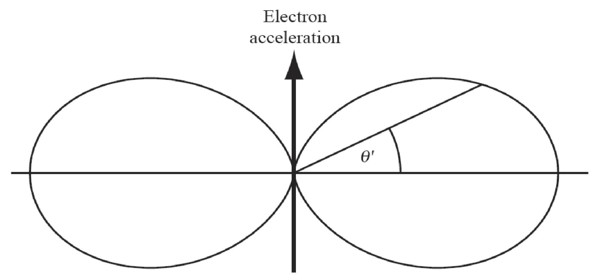
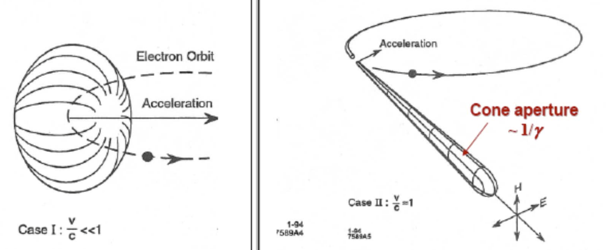
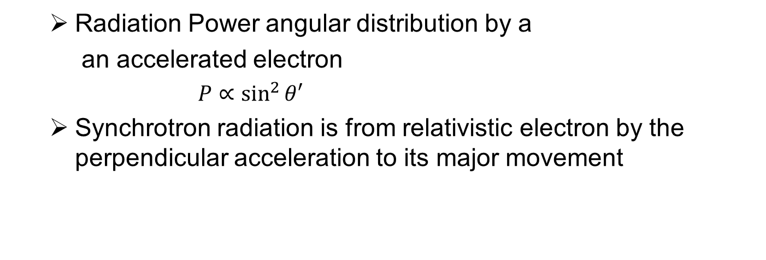
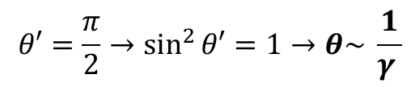
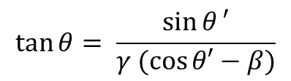
Spontaneous Radiation by relativistic electrons --- angular distribution
  Radiation Power angular distribution by a
  an accelerated electron
  $P∝\sin^{2}{θ′}$
  Synchrotron radiation is from relativistic electron by the perpendicular acceleration to its major movement
  Radiation power angular distribution changes due to the relativistic Doppler effect:
$$\tan{θ= \frac{\sin{θ}′}{γ (\cos{θ′−β})}}$$
$$θ′=\frac{π}{2}→\sin^{2}{θ′}=1→θ\sim \frac{1}{γ }$$
Max. angle:

Slide 4

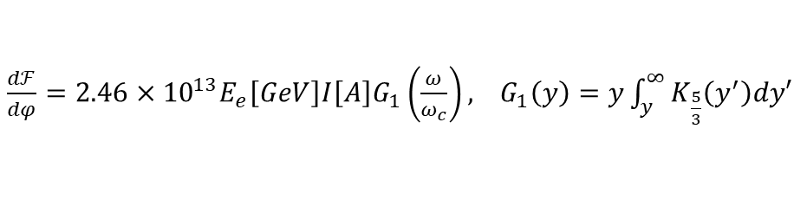
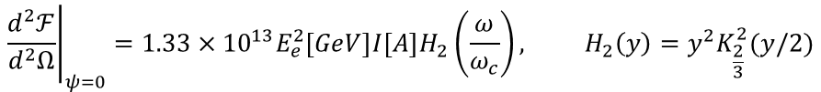
Spectrum of bending magnet & wiggler
    Electric component is an single-cycle oscillation from bending magnet: aperiodic -> continuous spectrum
  Critical Frequency:
$$ω_{c}=\frac{3γ^{3}c}{2ρ}$$
    Radiation distribution in a unit solid angle:
$${\left.\frac{d^{2}ℱ}{d^{2}Ω}\right|}_{ψ=0}=1.33×{10}^{13}E_{e}^{2}\left[GeV\right]I\left[A\right]H_{2}\left(\frac{ω}{ω_{c}}\right), H_{2}\left(y\right)=y^{2}K_{\frac{2}{3}}^{2}(y/2)$$
  Flux angular distribution in a unit bending angle:
$\frac{dℱ}{dφ}=2.46×{10}^{13}E_{e}\left[GeV\right]I\left[A\right]G_{1}\left(\frac{ω}{ω_{c}}\right),$ $G_{1}\left(y\right)=y\int_{y}^{∞}{K_{\frac{5}{3}}\left(y^{′}\right)dy′}$

Slide 5
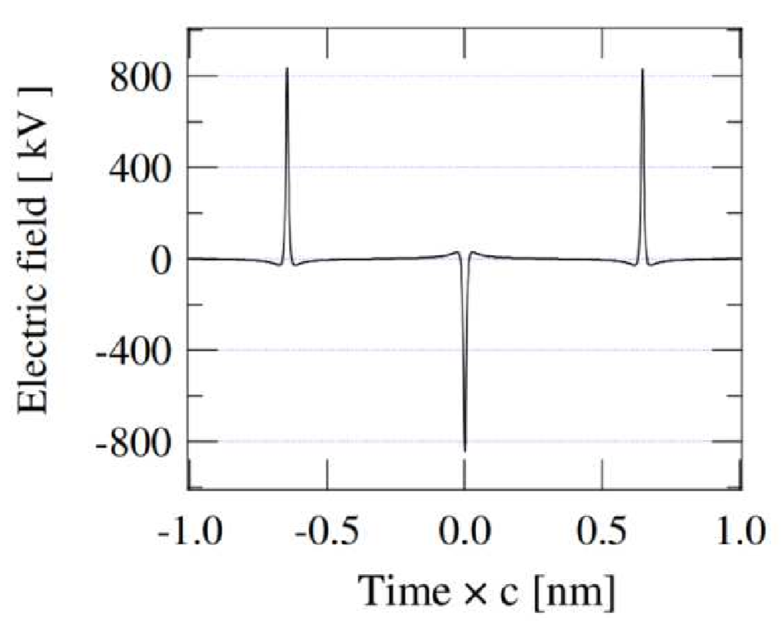
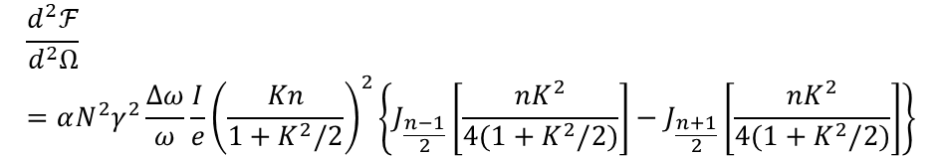
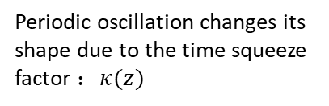
Spectrum of UND Synchrotron Radiation
Undulator radiation is periodic in time domain → fundamental&harmonic radiation
Periodic oscillation changes its shape due to the time squeeze factor $：κ(z)$
Only odd harmonics
Flux density from a planar undulator:
$$\frac{d^{2}ℱ}{d^{2}Ω}=αN^{2}γ^{2}\frac{Δω}{ω}\frac{I}{e}{\left(\frac{Kn}{1+K^{2}/2}\right)}^{2}\left\{J_{\frac{n−1}{2}}\left[\frac{nK^{2}}{4(1+K^{2}/2)}\right]−J_{\frac{n+1}{2}}\left[\frac{nK^{2}}{4(1+K^{2}/2)}\right]\right\}$$

Slide 6
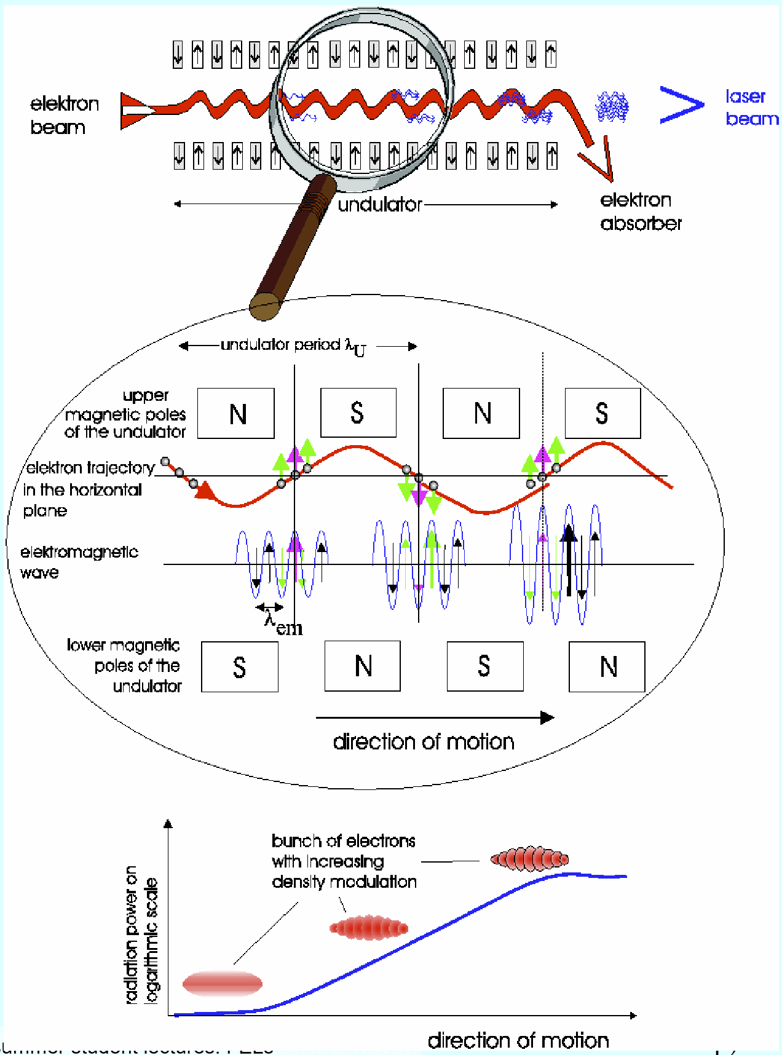
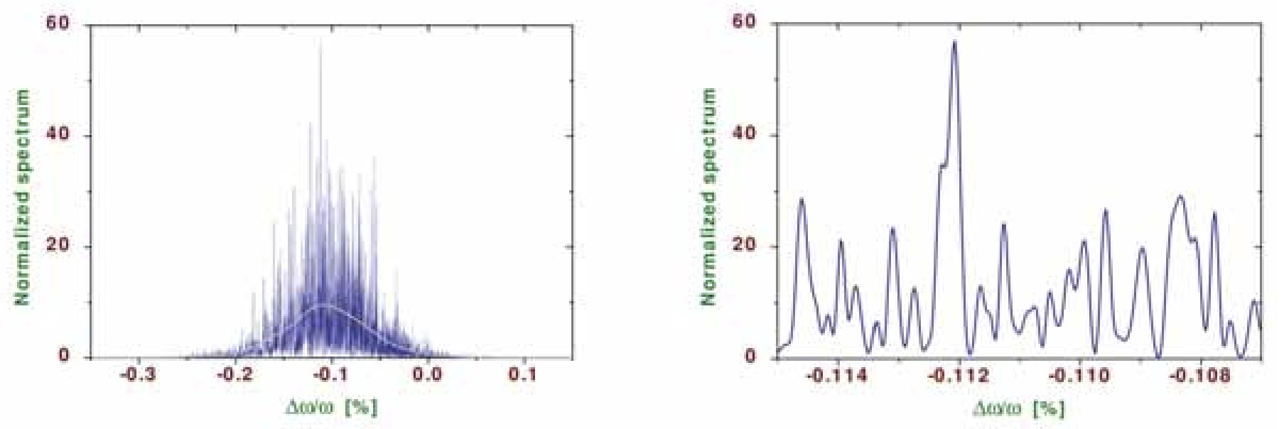


Free Electron Laser --- SASE
What happens if a long enough undulator available? (beam with low emittance & energy spread and with high peak current)
Electron exchange energy with the EM field
$$\overset{⃑}{F}=q\overset{⃑}{E}+q\overset{⃑}{v}×\overset{⃑}{B}$$
Energy exchange rate proportional to the field strength → Exponential gain
Energy modulation with respect to the phase
  density modulation due to R56 of Undulator
  micro bunch in the level of radiation wavelength
  Coherent radiation from different electrons
SASE band width $ρ \sim {10}^{−4}−{10}^{−3}$

Slide 7
CEPC as a gamma-ray SR facility

Slide 8
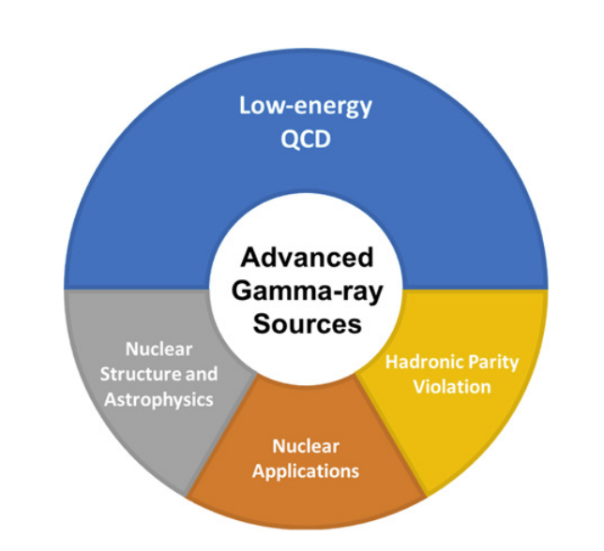
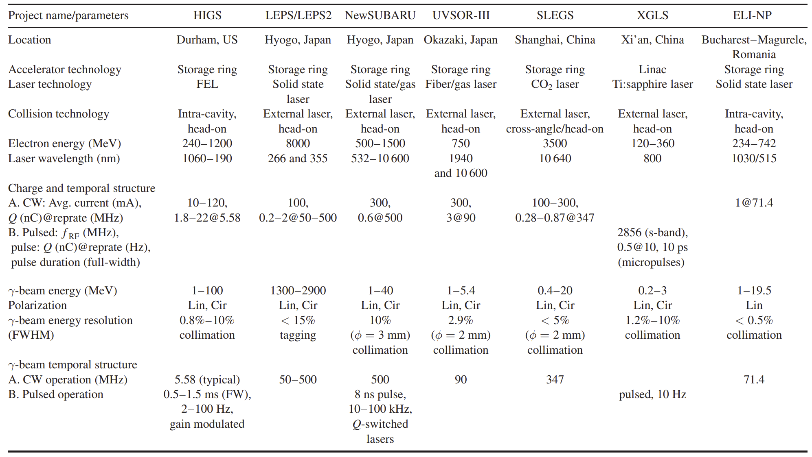
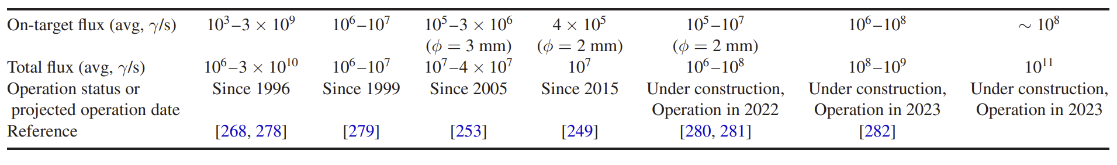
Gamma-ray SR facility: Laser Compton γ-ray sources
medium-energy source with γ-ray beams in the range of 60 and 350 MeV
Low-energy source, below 20 MeV

Slide 9
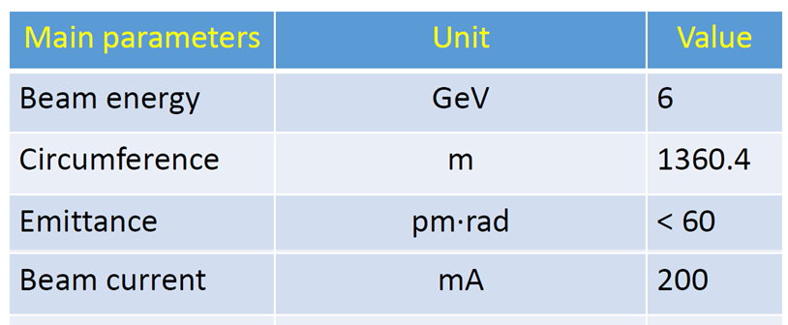
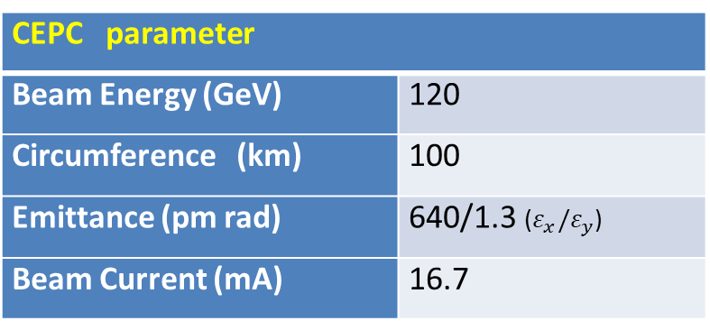
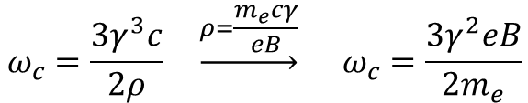
Beam parameters
Beam parameters of CEPC
Beam parameters of HEPS @ Beijing
CEPC parameter
Beam Energy (GeV) | 120
Circumference (km) | 100
Emittance (pm rad) | 640/1.3 ($ε_{x}/ε_{y}$)
Beam Current (mA) | 16.7
Making CEPC a photon source for intensive ultra-high energy gamma-rays
Synchrotron Radiation (SR) critical frequency proportional to energy square and magnet field
In a conventional SR facility, the beam energy stays lower than 10 GeV level, resulting in a maximum photon energy in the level of 100 keV.
Due to the high beam energy, which is approximately 120 GeV, the CEPC SR energy can reach the level of 100 MeV
$$ω_{c}=\frac{3γ^{3}c}{2ρ} \underset{→}{ρ=\frac{m_{e}cγ}{eB}} ω_{c}=\frac{3γ^{2}eB}{2m_{e}}$$

Slide 10
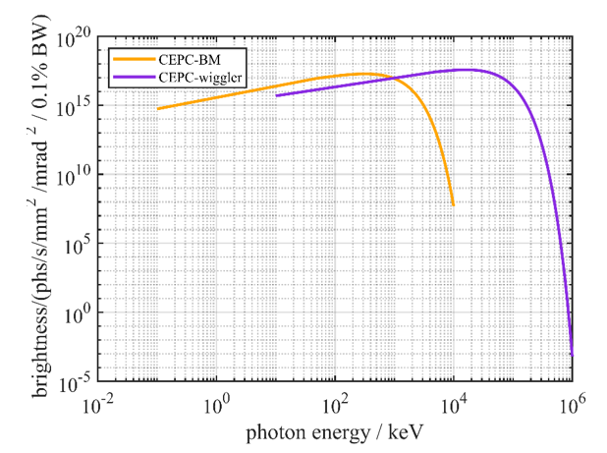

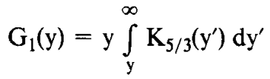

Radiation Spectrum
100 keV
100 MeV
SR sources:
Wiggler parameter
B (T) | 2
Total length (m) | 0.32
Magnetic period Length (m) | 0.32
Period number | 1
K value | 59.7
Critical energy (MeV) | 19.2
Bending magnet
B (T) | 0.04
Length (m) | 20
Critical energy (keV) | 383
Angular Density of Spectral Flux: [Ph/s/mr/0.1%bandwidth]
Bending magnets generate intensive x-ray photon with energy around 100 keV
Wiggler with 2T generates gamma-ray in the level of 100 MeV
$$G_{1}(y)≈\left\{\begin{aligned}{(ω/ω_{c})}^{1/3}\text{,}ω≪ω_{c} \\ \exp\left(−\frac{ω}{ω_{c}}\right),ω≫ω_{c}\end{aligned}\right.$$

Slide 11
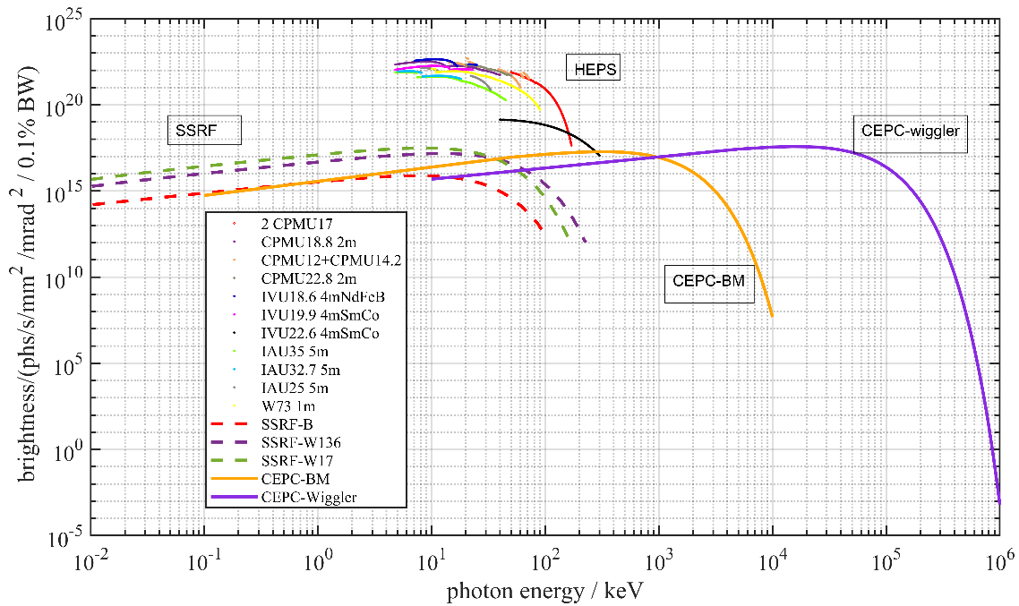
Comparison with other x-ray source
Compare to the SSRF, HEPS in China, CEPC provides much wider energy range, higher intensity, and maximum photon energy

Slide 12
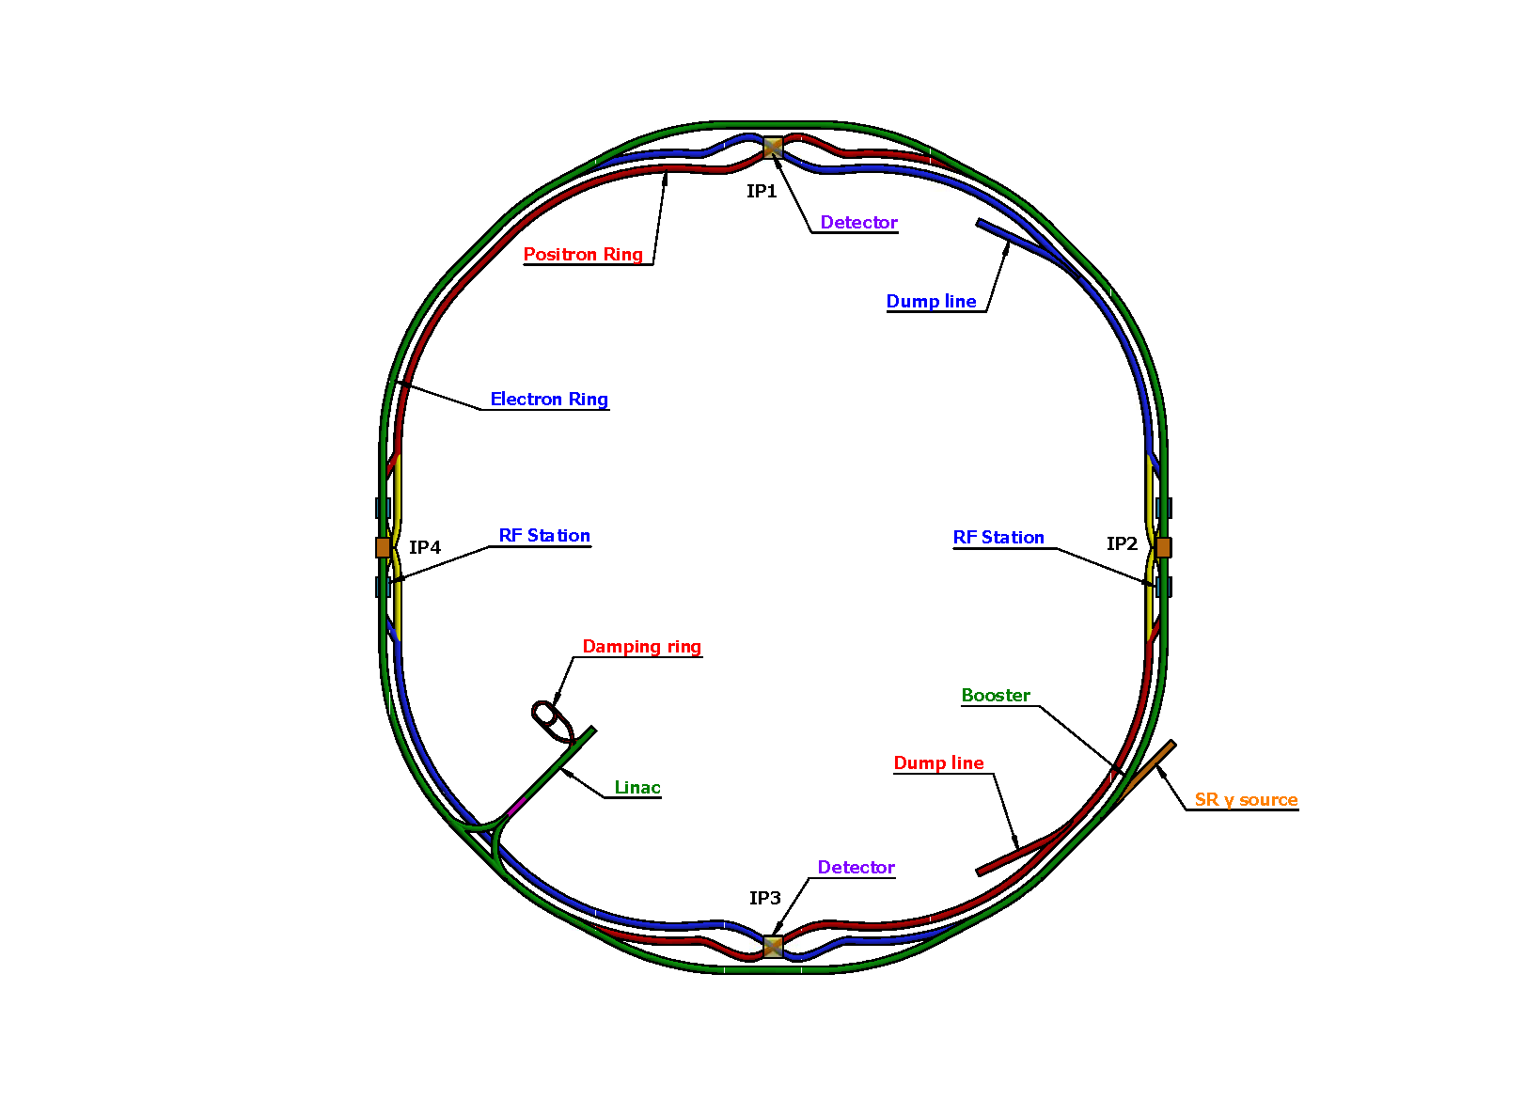
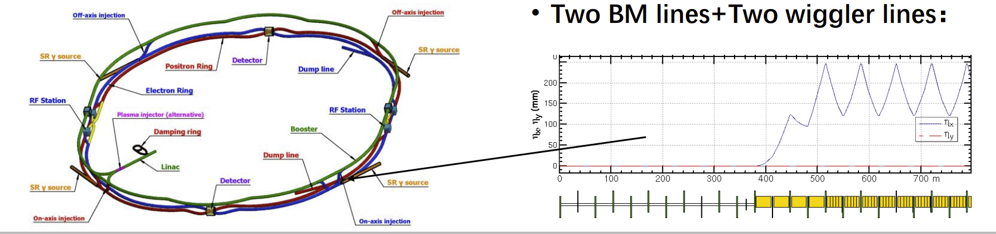

Beam line arrangement and impact to collider
SS4
SS1
SS3
SS2
Since the bending magnets are original ones used in CEPC, they introduce no additional impacts.
The short wiggler is installed in the lattice at the down stream of the on-axis injection region. Switching on the wiggler increases additional 1.3% beam energy loss, which is acceptable according to specific simulations.

Slide 13
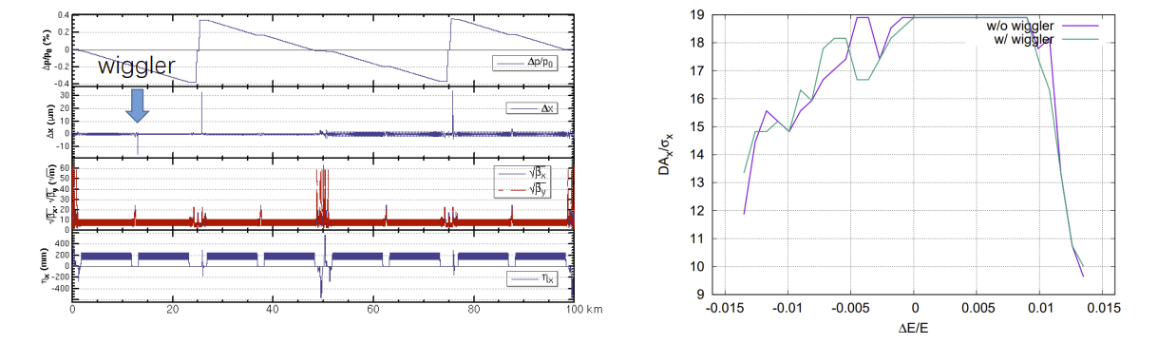
Mitigation measures to the SR effect
The conventional measures to mitigate the beam energy loss due to SR is to taper the bending magnet field.
• The closed orbit distortion is expected to be 15μm at wiggler by applying bending magnet tapering.
• The dynamic aperture w/ and w/o wiggler are almost the same.

Slide 14
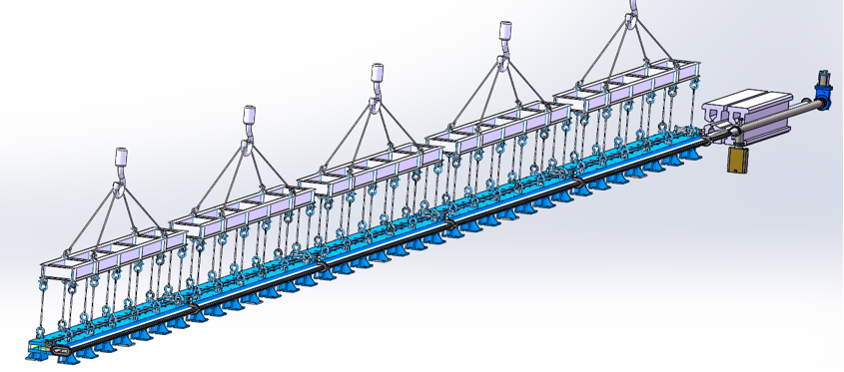
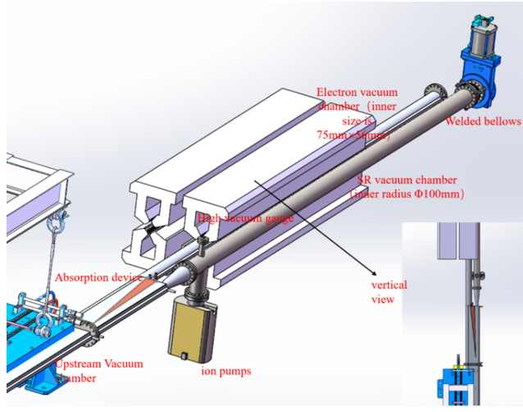
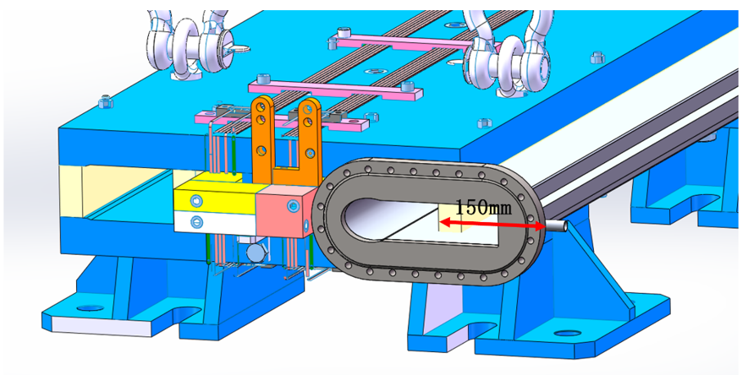
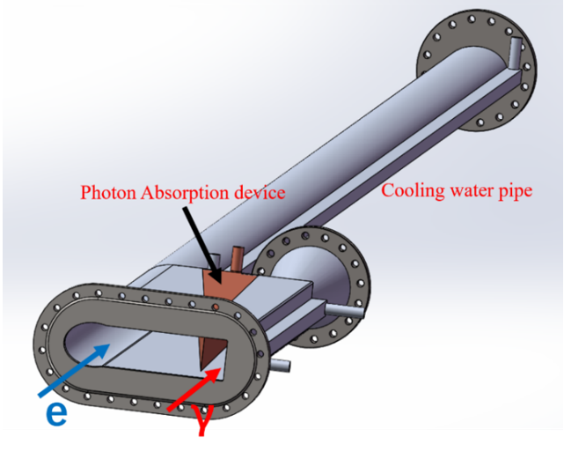
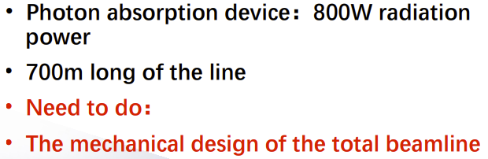
Conceptual design of the vacuum chambers
Dual-aperture dipole and extraction beam pipes

Slide 15
Conclusion to the application as gamma source
Due to the ultra-high beam energy of over 100 GeV, CEPC presents an unique opportunity to generate 100 MeV level intensive gamma-rays using a 2 T wiggler
Compare to other photon sources, CEPC may provide much higher photon energy with intensity
Beam dynamic simulations indicate that the introduced beam energy loss is acceptable
The original bending magnet can generate 100 keV level x-rays, covering a wide range of photon energies
Conceptual design for the vacuum system were made
There are wide-ranging applications waiting to be explored

Slide 16
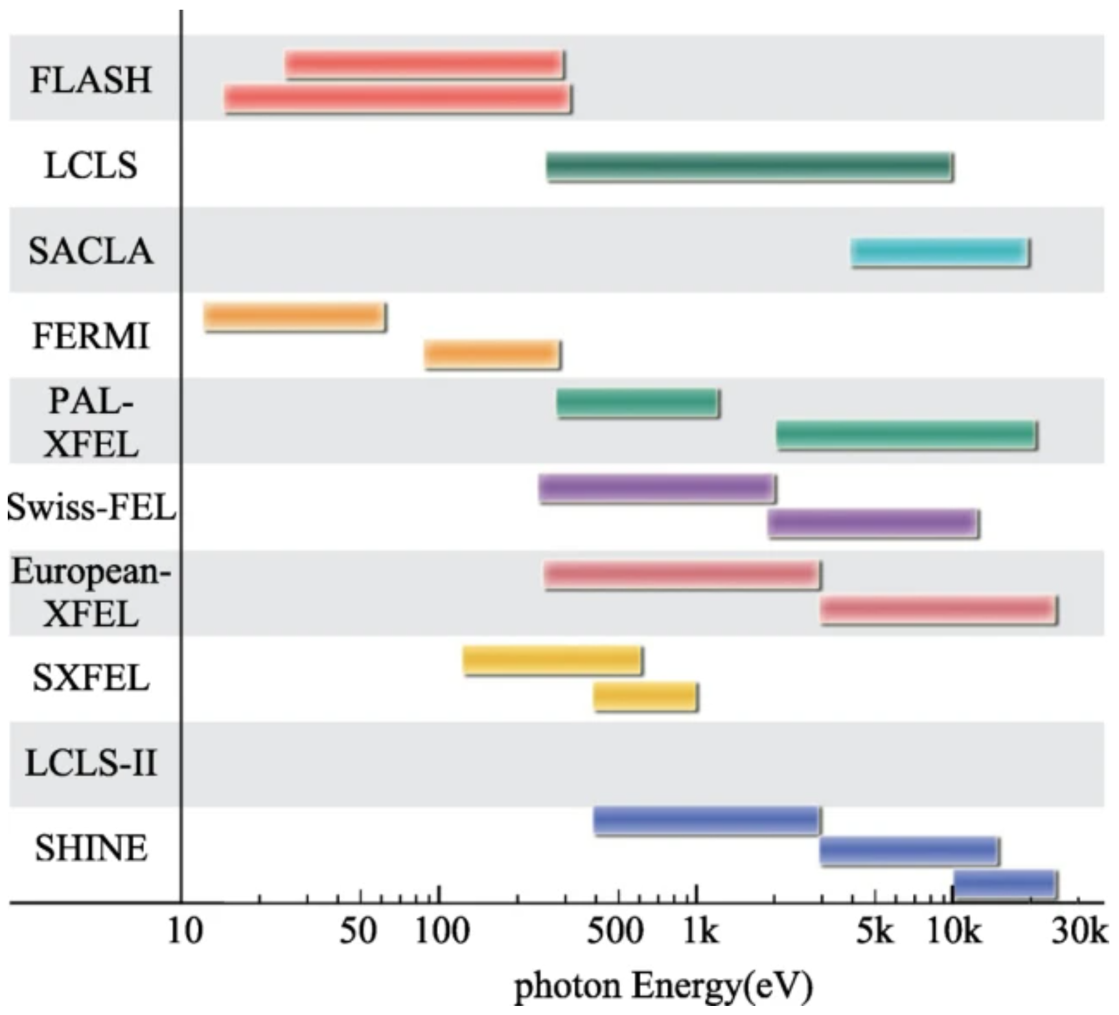
CEPC as a high energy FEL facility

Slide 17
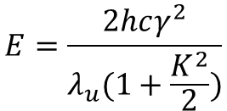
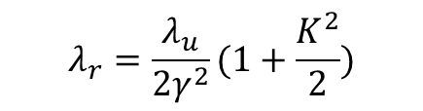
Survey of the hard x-ray FELs in the world
Hard XFEL Facilities | Beam Energy (GeV) | Photon Energy (keV)
European XFEL (Germany) | 17.5 | 0.26- 25
LCLS (USA) | 15 | 0.2-25
PAL-FEL (Korea) | 10 | 0.25-15
SACLA (Japan) | 8.5 | 4-20
SHINE (China, under construction) | 8 | 0.4-25
Swiss FEL (Swiss land) | 6 | 0.25-12
Existing hard x-ray FELs use beam energy less than 20 GeV
As the consequence, the maximum photon energy is lower than 25 keV
In some specialized fields, the current indicators are difficult to meet the requirements. In the study of the dynamic properties of high-Z materials in materials science, there is a high demand for high-flux and high-photon-energy XFELs (photon energy of 50 keV and above).
Ultra-high energy FELs in the level of 100 keV requires beam energy larger than 20 GeV
$$λ_{r}=\frac{λ_{u}}{2γ^{2}}(1+\frac{K^{2}}{2})$$
$$E=\frac{2hcγ^{2}}{λ_{u}(1+\frac{K^{2}}{2})}$$

Slide 18
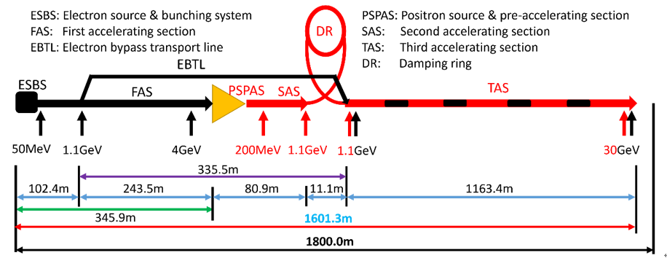
Linac Layout and Potential as a FEL Facility
CEPC Linac is a 30 GeV normal conduction linear accelerator
The C-band accelerator increase the beam energy from 1.1 GeV up to to 30 GeV
It along can generate beam energy over 20 GeV, which is a very good candidate to drive a ultra-high energy x-ray FEL

Slide 19
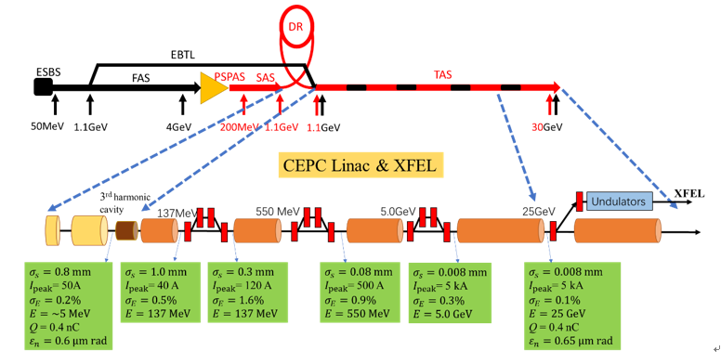
Schematic plan for the XFEL Facility
Additional photon RF gun is needed, adjacent to the damping ring
3 chicanes are induced for bunch compression
Beam energy of 25 GeV is sufficient
An undulator line will be installed parallel to the linac

Slide 20
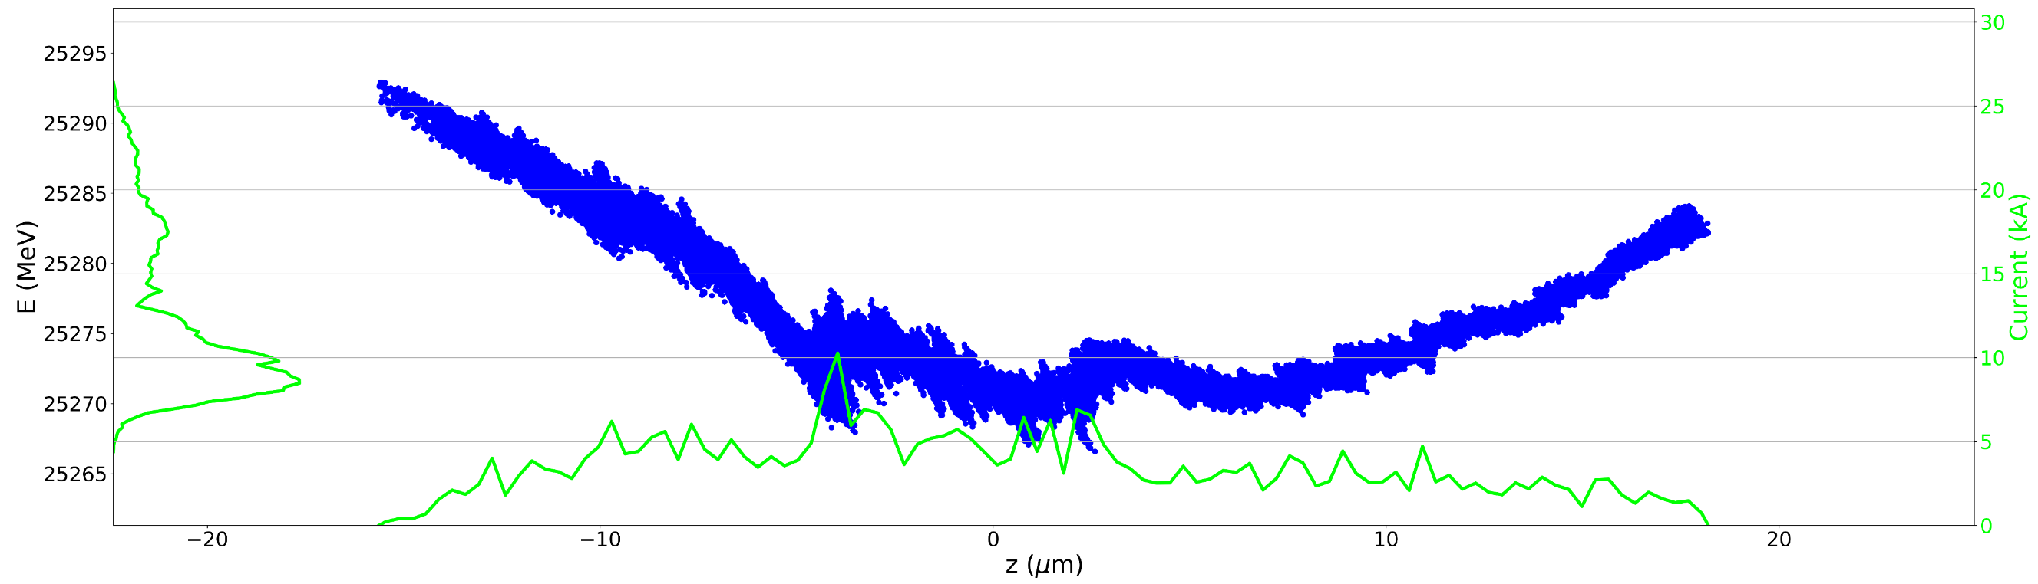
Start-to-end simulations of gun to Linac
Phase space at the accelerator end:
Various effects, including CSR, wakefield, ect., have been accounted;
5kA peak current is available
The energy spreads in the range of 25MeV, slice energy spread is 2MeV

Slide 21
Beam Parameters
 | Value | Unit
Electron energy | 25 | GeV
Bunch charge | 0.4 | nC
Peak current | 5 | kA
Bunch length | 8 | µm
Normalized emittance(slice) | 0.65 | mm mrad
Energy spread (slice) | 2.0 | MeV
Max. Repetition rate | 100 | Hz

Slide 22
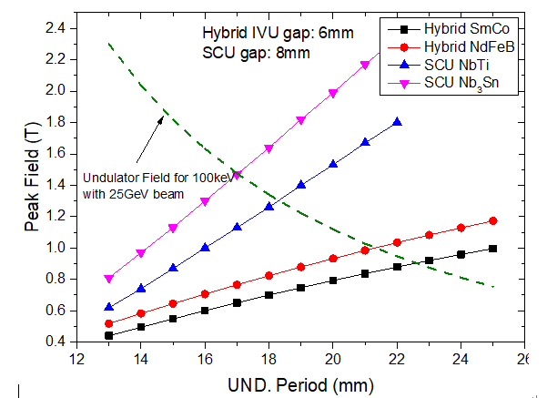

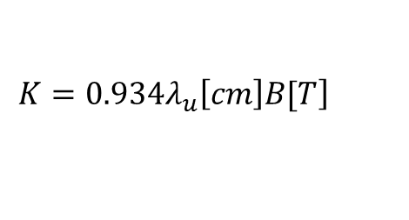
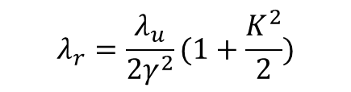
Undulator Parameter Selection
$$λ_{r}=\frac{λ_{u}}{2γ^{2}}(1+\frac{K^{2}}{2})$$
$$\left.K=0.934λ_{u}\left[cm\right]B[T\right]$$
 | Value | Unit
Undulator Period | 25 | mm
Minimum Gap | 6 | mm
Maximum Field | 1.2 | T
Undulator parameter, K | 2.8 | -
Undulator type | IVU, hybrid | -
Magnet material | NbFeB | -
Polarization | Linear
The goal is to generate 100 keV FELs
A certain tunability is need to the lower photon energy region
  48keV ~ 100keV
Performance of different undulators are investigated
$$E(keV)=\frac{1.24}{λ_{r}(nm)}$$

Slide 23
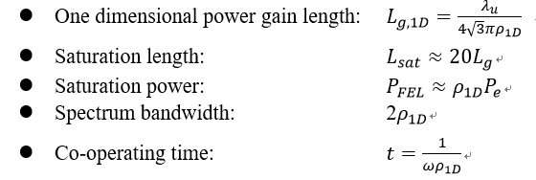
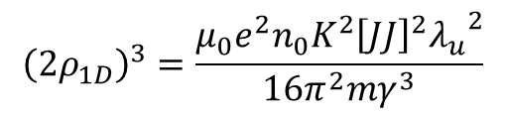

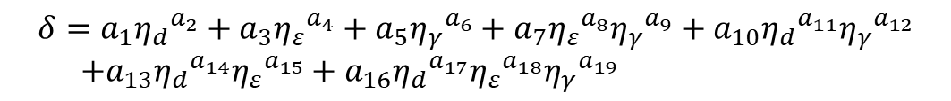
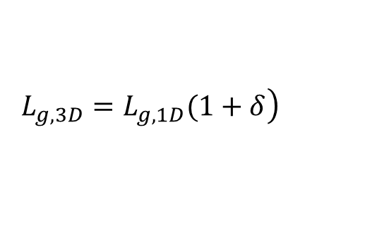
FEL Design Criteria
1-D Pierce Parameter:
$${\left(2ρ_{1D}\right)}^{3}=\frac{μ_{0}e^{2}n_{0}K^{2}{\left[JJ\right]}^{2}{λ_{u}}^{2}}{16π^{2}mγ^{3}}$$
3-D Gain Length:
$$\left.L_{g,3D}=L_{g,1D}(1+δ\right)$$
$$δ=a_{1}{η_{d}}^{a_{2}}+a_{3}{η_{ε}}^{a_{4}}+a_{5}{η_{γ}}^{a_{6}}+a_{7}{η_{ε}}^{a_{8}}{η_{γ}}^{a_{9}}+a_{10}{η_{d}}^{a_{11}}{η_{γ}}^{a_{12}}$$
$+a_{13}{η_{d}}^{a_{14}}{η_{ε}}^{a_{15}}+a_{16}{η_{d}}^{a_{17}}{η_{ε}}^{a_{18}}{η_{γ}}^{a_{19}}$
$η_{d}=\frac{L_{g,1D}}{2k_{r}{σ_{x}}^{2}}$, $η_{ε}=2L_{g}βk_{r}ε$, $η_{γ}=2L_{g}λ_{u}σ_{γ}$
Energy spread, beta-function and beam transverse size are accounted
Ming Xie, NIM A, 445, 59 (2000)

Slide 24
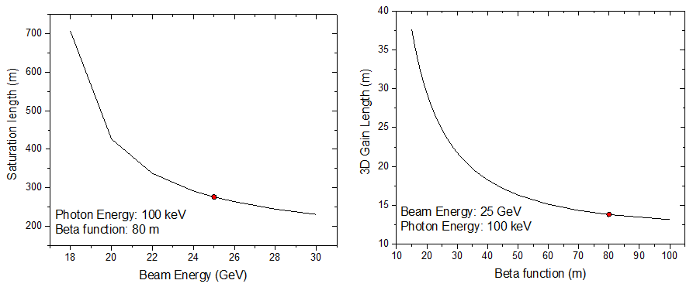
Beam Energy and β Function Investigation
25 GeV beam energy and 80 m beta function is the optimum selection for a reasonable saturation length

Slide 25
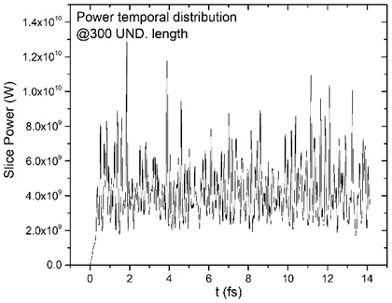
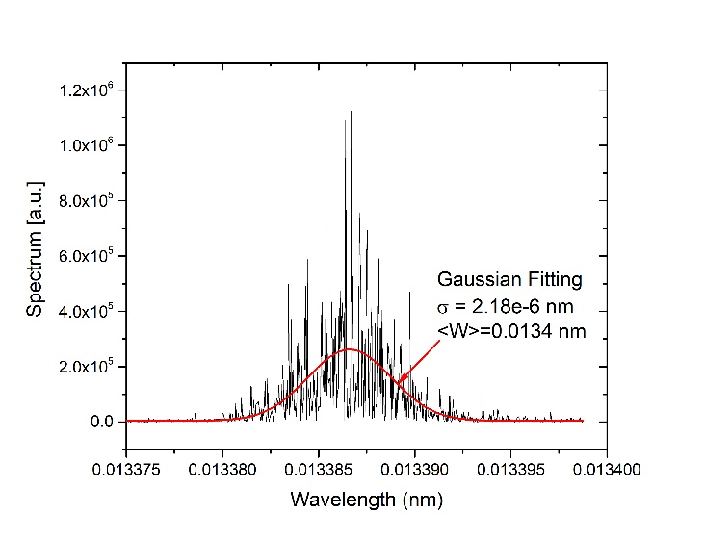
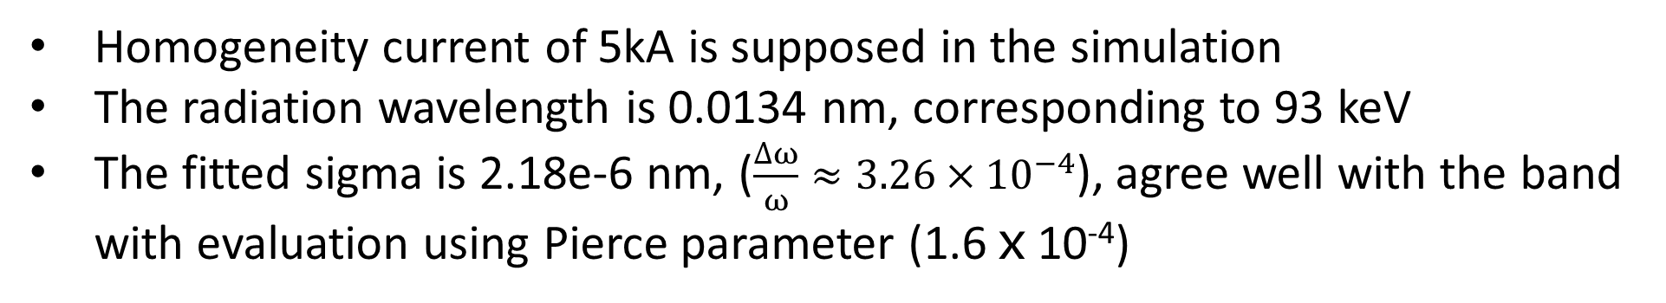
Saturation Spectrum in Time and Frequency Domain
Homogeneity current of 5kA is supposed in the simulation
The radiation wavelength is 0.0134 nm, corresponding to 93 keV
The fitted sigma is 2.18e-6 nm, ($\frac{∆ω}{ω}≈3.26×{10}^{−4}$), agree well with the band with evaluation using Pierce parameter (1.6ⅹ10⁻⁴)
Notes:
1.63e-4

Slide 26
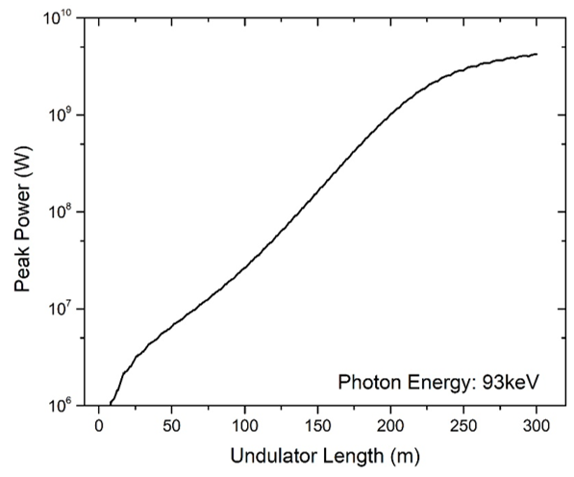
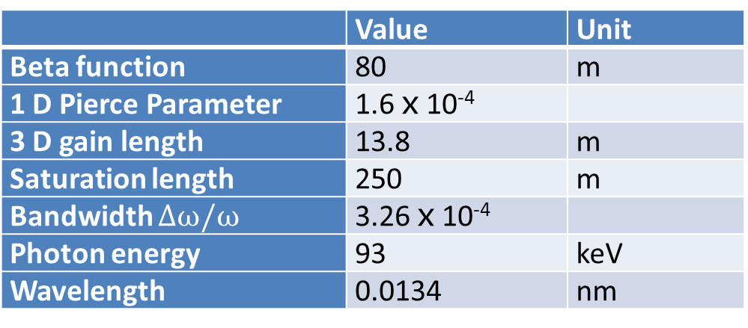
Radiation Gain Curve and FEL Characters
 | Value | Unit
Beta function | 80 | m
1 D Pierce Parameter | 1.6ⅹ10⁻⁴
3 D gain length | 13.8 | m
Saturation length | 250 | m
Bandwidth $∆ω/ω$ | 3.26ⅹ10⁻⁴
Photon energy | 93 | keV
Wavelength | 0.0134 | nm
 | Unit | tt | Higgs | W | Z
Injection interval for collision | s | 32 | 20 | 36 | 71
Linac time for FEL | s | 28 | 14 | 20 | 3
Duty ratio | % | 88 | 70 | 56 | 4

Slide 27
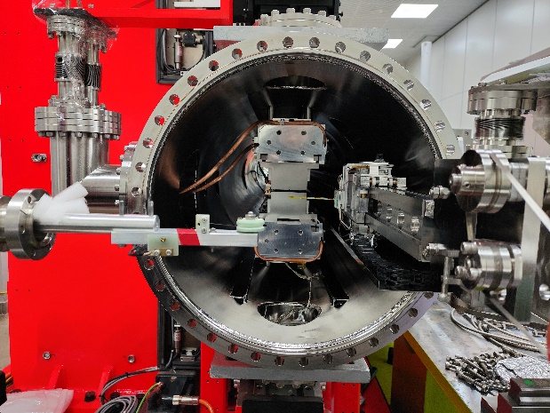

Undulator system R&D
Most of the technologies are conventional and mature
IHEP holds full in-house experiences to most of the related technologies
Undulator is the special technology, which is only used in photon sources
IHEP develop undulators for HEPS, including the required in-vacuum UND
Undulator Tyep | Length [m] | Period [mm] | Performance Gap [mm] | Max. Peak Field [T]
CPMU | 2 | 12.0 | 5.2-7.0 | 0.81
CPMU | 2 | 14.2 | 5.2-9.9 | 1.00
CPMU | 2 | 16.7 | 5.2-10.0 | 1.19
CPMU | 2 | 18.8 | 5.2-13.1 | 1.35
CPMU | 2 | 22.8 | 7.2-16.0 | 1.18
IVU (NdFeB) | 4 | 18.8 | 5.2-13.1 | 1.35
IVU (SmCo) | 4 | 19.9 | 5.2-14.0 | 0.97
IVU (SmCo) | 4 | 22.6 | 5.2-15.2 | 1.10

Slide 28
Conclusion to the application as a FEL facility
CEPC exploits a 30 GeV Linac, which can drive an ultra-high x-ray FEL
Additional photon RF gun is need for small emittance and energy spread
3 chicanes will be installed in Linac for the bunch compression, which results in 5kA peak current
In-vacuum undulator will used to generate 100keV, with a centain wavelength tunability
100 keV SASE-FEL is simulated, corresponding to the analytical evaluation

Slide 29
The End

Slide 30

Gamma-ray focalization

Slide 31

Gamma-Ray Detection

Slide 32

Possible Applications on Metals

Slide 33

Possible Applications on Nucleon
Gamma assistant transmutation:

Slide 34

Possible Applications on Medical

