Slide 1
Studies of Injection Mechanism and Radiation Reaction in Plasma Wakefield Accelerators
Ming Zeng
Institute of High Energy Physics, Chinese Academy of Sciences
CEPC International Workshop
2023.10.26

Slide 2
Contents
Studies of high quality injection in plasma accelerators
Betatron oscillation and radiation reaction in plasma accelerators

Slide 3
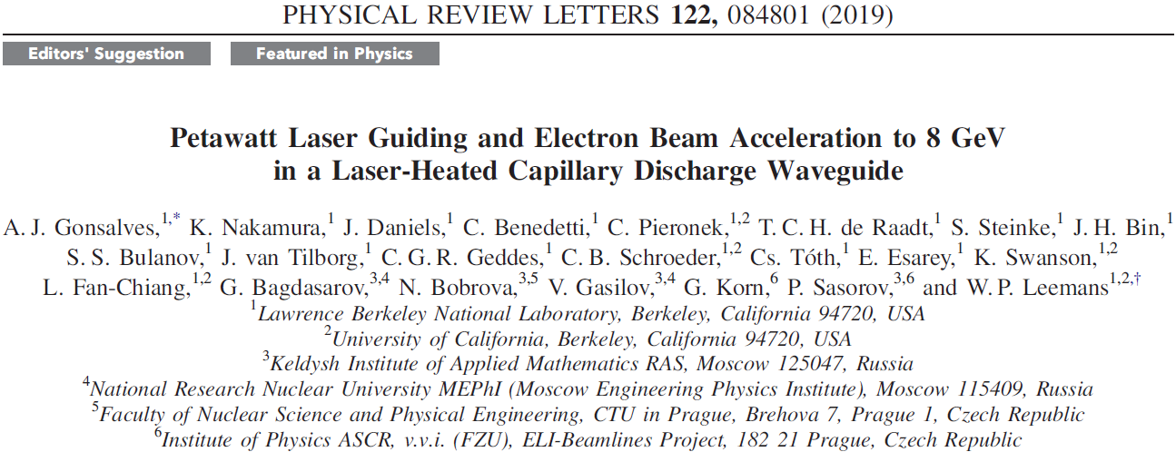
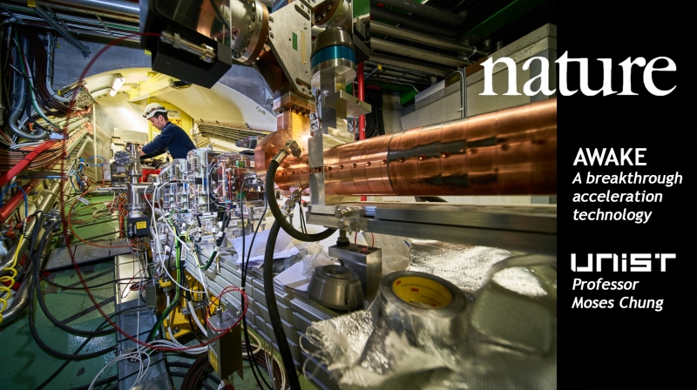
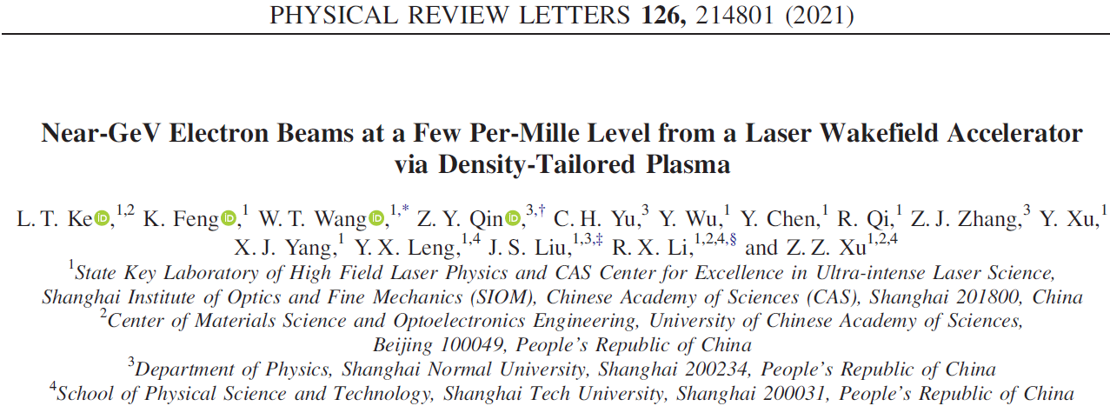
Review of Plasma Acceleration
In 1979, Tajima & Dawson proposed laser-plasma acceleration, which has 1000 higher gradient compared with RF accelerators
In 1985, P. Chen et al. proposed similar acceleration mechanism driven by charged particles
In 2004, three groups obtained mono-energetic beams from laser driven plasma wakefield accelerators (LWFA)
In 2019, LWFA has reached the energy gain of ~8 GeV
In 2021, the low energy spread record has reached ~0.3%
Now, plasma acceleration studies are mainly aiming for real applications

Slide 4
High quality injection: a key issue for the optimization
Optimization of multiple parameters is required in plasma accelerators
Energy spread and charge mainly depend on the injection process
Energy spread and charge are contradictory parameters
Optimized injection mechanism is required to alleviate the contradiction
 | RF accelerators | Plasma accelerators
Acceleration gradient (MeV/m) | 10 ~ 50 | 10³ ~ 10⁵
Maximum energy (GeV) | ~ 6000 | ~ 10
Energy spread | <0.1% | 10% ~ 0.3%
Bunch charge (nC) | 10 | <1
Normalized emittance (mm mrad) | <100 | <10
To be optimized

Slide 5
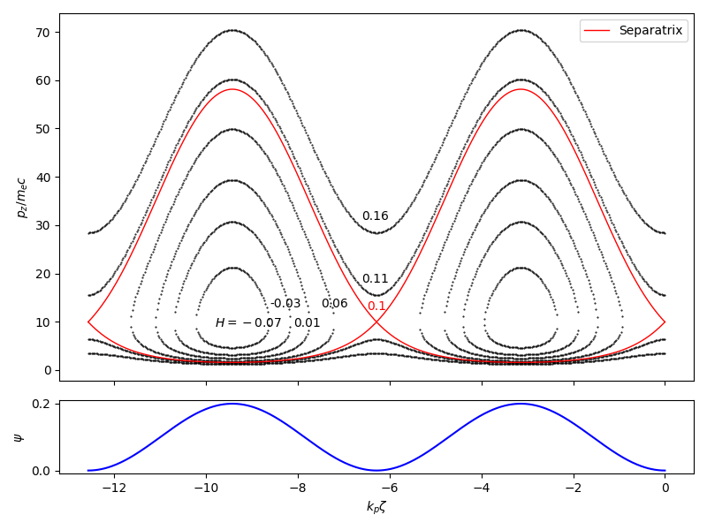
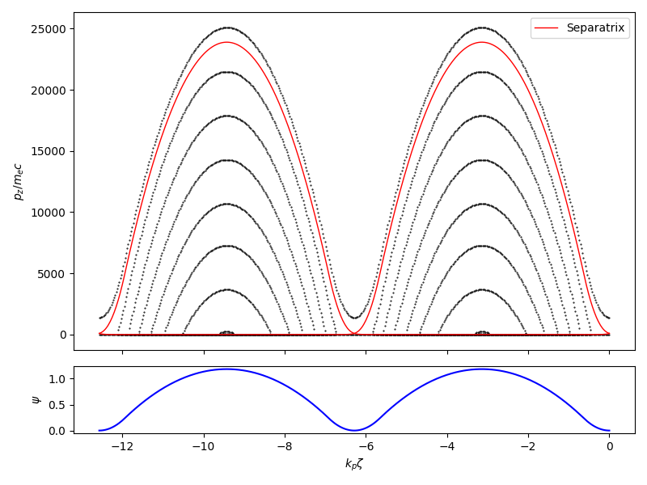
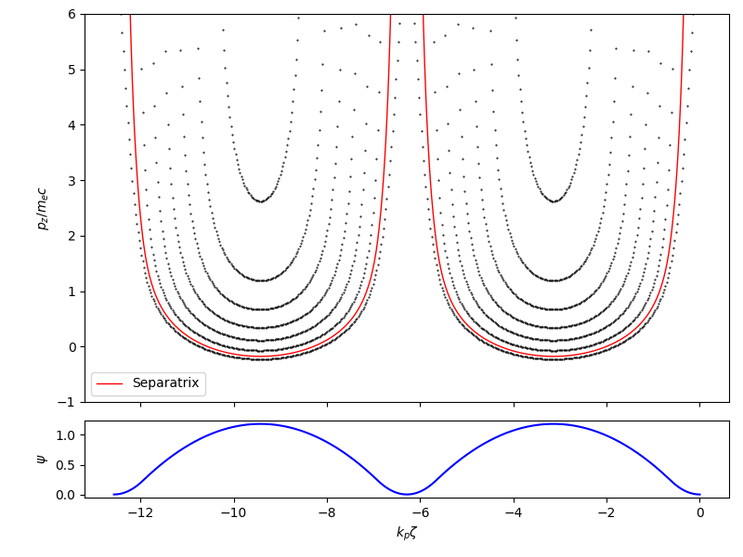
1D injection theory
Constant of motion in wakefield
$$H=γ−v_{φ}p_{z}−ψ=const.$$
where the pseudo-potential is defined as
$$ψ≡φ−v_{φ}A_{z}$$
For 1D cases, $p=p_{z}$, $γ=\sqrt{1+p^{2}}$
The solution is one branch of the hyperbola
$${(H+ψ+v_{φ}p)}^{2}−p^{2}=1$$
with $H+ψ+v_{φ}p>0$
Linear wakefield
Nonlinear wakefield

Slide 6
3D injection theory
The constant of motion is the same, but
Subscript 0 stands for the initial value, and subscript 1 stands for the instant value
When injection occurs, $v_{z1}=v_{φ}$, so that
where $γ_{φ}=1/\sqrt{1−v_{φ}^{2}}$
Use the constant of motion we obtain
where
So the injection can be discriminated by the initial state of the particle and the property of the wakefield
M. Zeng et al., New J. Phys. 22, 123003 (2020)

Slide 7
Main injection categories
Ionization injection
In the wakefield $−Δψ≥1$ exists, so we can release electrons (with 0 initial momentum) in there wakefield where $−Δψ=1$ is satisfied
Optical injection
No need to have $−Δψ≥1$. Use laser colliding or beating to pre-accelerate the electrons so that $γ_{0}−p_{z0}<1$
Injection with reduced phase velocity
Reduce the phase velocity of the wakefield (reduce $γ_{φ}$), so that there can be RHS $≥1$

Slide 8
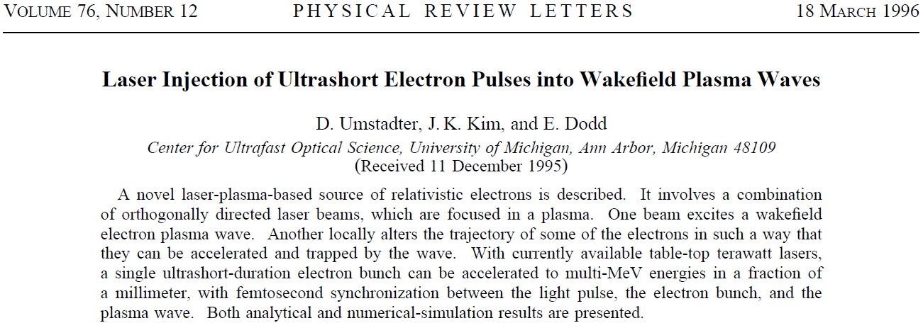
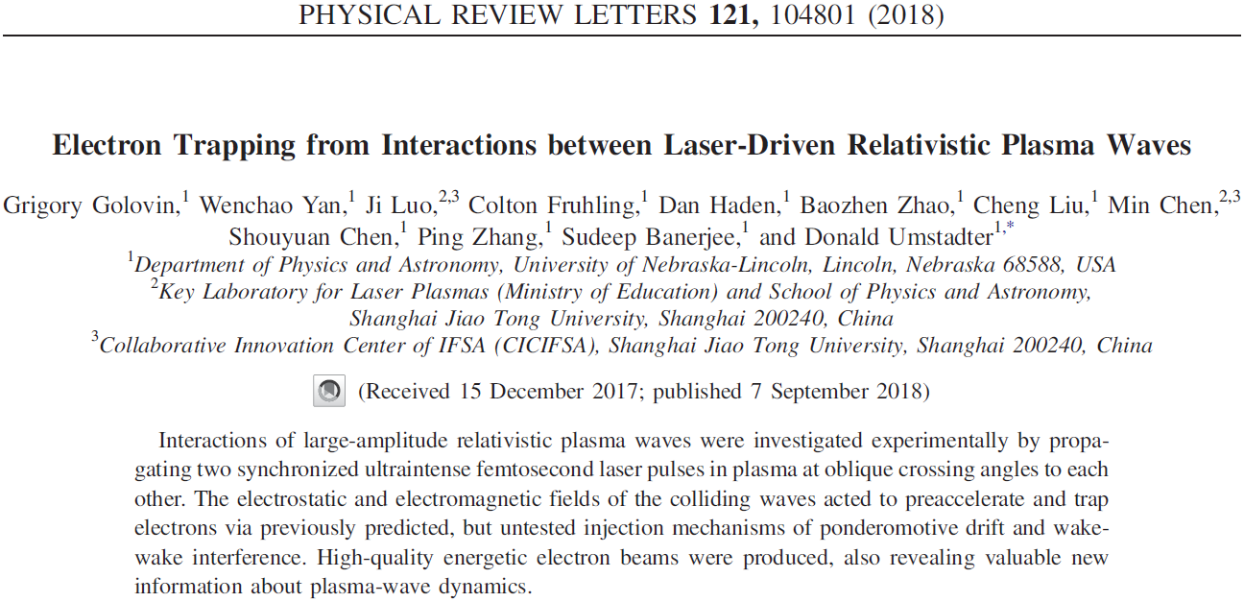
Ponderomotive injections
Pre-accelerate the electrons by a transverse colliding laser pulse
Initially proposed by using a laser from 90° direction
Recently mostly realized by 90° to 180° collision angle (commonly accompanied by other injection mechanisms)

Slide 9
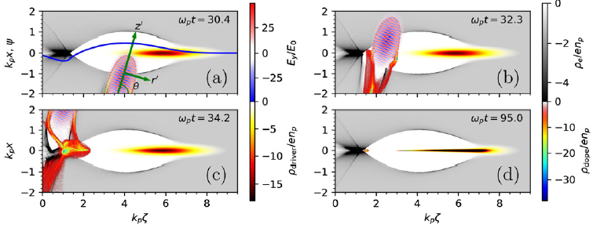
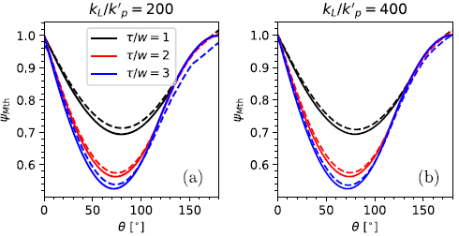
Optimized ponderomotive injection: acute angle collision
An acute angle collision provides more forward momentum
Use high-Z gas to provide electron in the blowout wakefield
Our study shows that the optimal angle is mostly between 70º-80º, and is not significantly depends on the aspect ratio of the laser pulse
With the laser parameter $a_{0}\sim 1$, the injection threshold can already be largely reduced
M. Zeng et al., New J. Phys. 22, 123003 (2020)

Slide 10
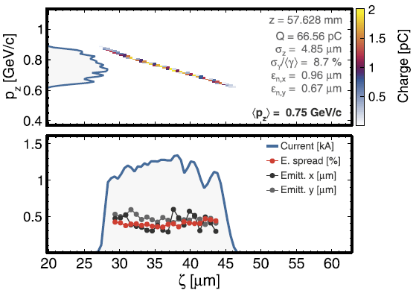
Optimized ponderomotive injection: acute angle collision
Even if the driver is not strong enough, e.g. $−Δψ<1$ with 3 kA beam driver, this scheme can produce high quality injection
The injection threshold is a filter, and only high-quality part of the injected beam remains in the wakefield

Slide 11
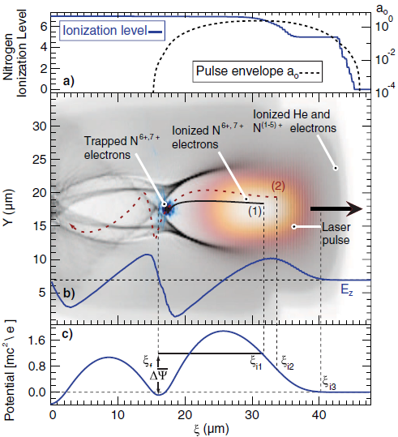
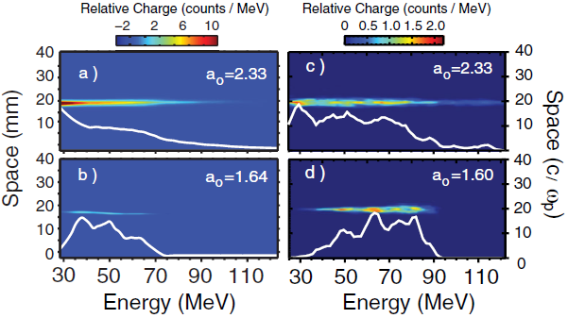
Ionization injection
For strong enough drivers, $−Δψ≥1$ exists
Plasma is doped with high-Z gas element such as N and O, which releases inner-shell electrons inside the wakefield
These electrons are trapped at $−Δψ≈1$
-M. Chen et al., J. Appl. Phys. 99, 056109 (2006);
-C. McGuffey et al., Phys. Rev. Lett. 104, 025004 (2010);
-A. Pak et al., Phys. Rev. Lett. 104, 025003 (2010);
-C. E. Clayton et al., Phys. Rev. Lett. 105, 105003 (2010);
-B. Hiddinget al., Phys. Rev. Lett. 108, 035001 (2012);
-B. B. Pollock et al., Phys. Rev. Lett. 107, 045001 (2011);
-J. S. Liu et al., Phys. Rev. Lett. 107, 035001 (2011).
Pros: easy to see injection, highly reproducible
Cons: continuous injection and continuous energy spectrum
A. Pak et al., Phys. Rev. Lett. 104, 025003 (2010)

Slide 12
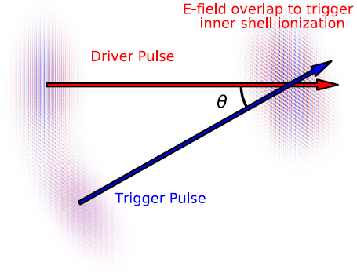
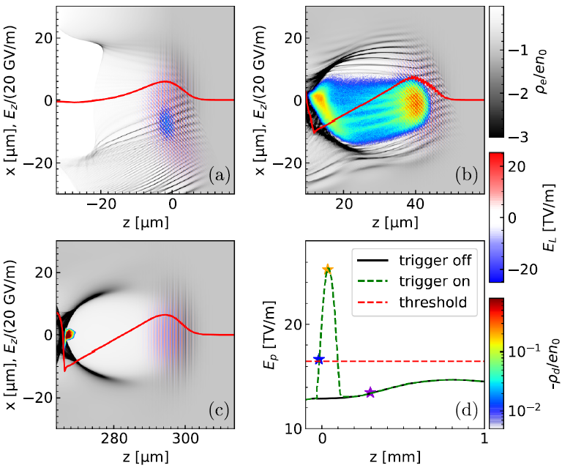
Our recent optimization: Scissor-cross ionization injection
The trigger laser collide with the drive laser with an acute angle
The instant E-field exceeds the ionization threshold when the two lasers overlap
The injection length and beam quality can be controlled by the collision angle
Very small angle (<20º), long injection length, large energy spread and large charge
Moderate angle (~30º), small energy spread and moderate charge
large angle (>60º), large energy spread and large charge, gradually turns to optical injection, and ionization injection is suppressed
40 pC, 1.6% energy spread beam can be produced
Jia Wang, Ming Zeng et al., Plasma Phys. Control. Fusion 64 (2022) 045012

Slide 13
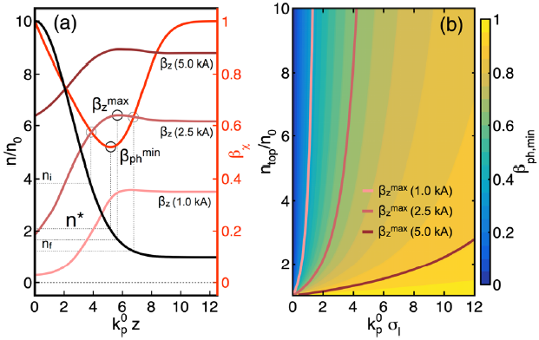
Injection with reduced phase velocity
Phase velocity can be changed commonly by plasma density gradient
-S. Bulanov et al., Phys. Rev. E 58, 5257 (1998);
-A. Buck et al., Phys. Rev. Lett. 110, 185006 (2013);
-W. T. Wang et al., Phys. Rev. Lett. 117, 124801 (2016); -X. L. Xu et al., Phys. Rev. Accel. Beams 20, 111303 (2017);
-A. Martinez de la Ossa et al., Phys. Rev. Accel. Beams 20, 091301 (2017);
-L. T. Ke et al., Phys. Rev. Lett. 126, 214801 (2021);
Also possible by drivers with flying-focus
-F. Li et al., Phys. Rev. Lett. 128, 174803 (2022)
A. Martinez de la Ossa et al., Phys. Rev. Accel. Beams 20, 091301 (2017)

Slide 14
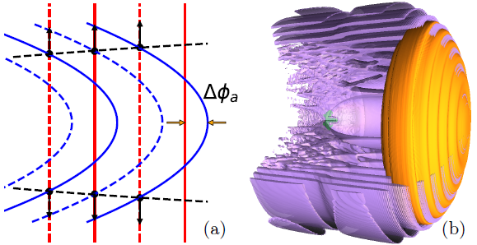
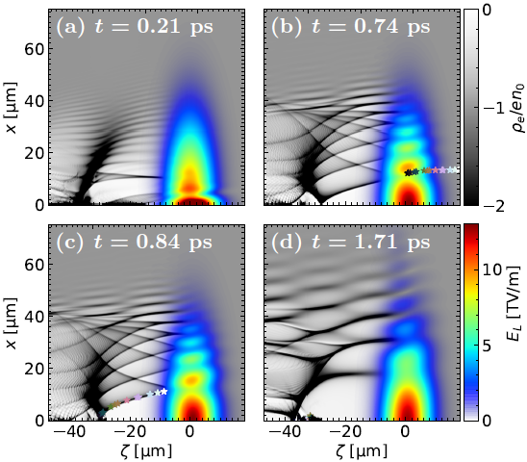
Our scheme: interference by coaxial lasers
Drive laser is relatively loosely focused
Trigger laser is tightly focused and coaxially propagates, forming Onion-like wakefield structure
The inner bubble expands during the propagation because of the defocusing of the trigger laser
The innermost bubble radius is
The innermost bubble length is also elongated, so that the phase velocity is reduced
Jia Wang et al., Matter Radiat. Extremes 7, 054001 (2022)

Slide 15
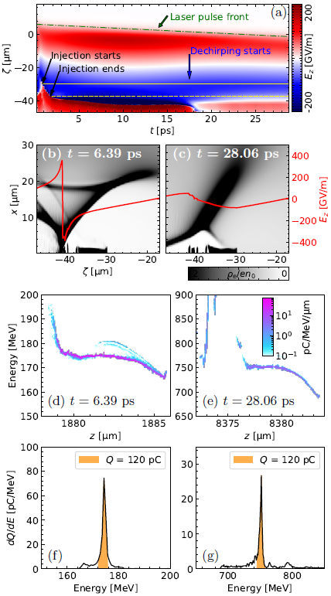
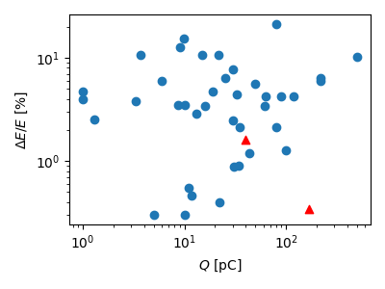
Interference by coaxial lasers
Large charge due to long injection length, but low slice energy spread
After self-dechirping, energy spread of the whole beam is reduced to the same level
A breakthrough of simultaneous optimization of energy spread and charge
A collection of energy spread vs. charge from published results
Jia Wang et al., Matter Radiat. Extremes 7, 054001 (2022)

Slide 16
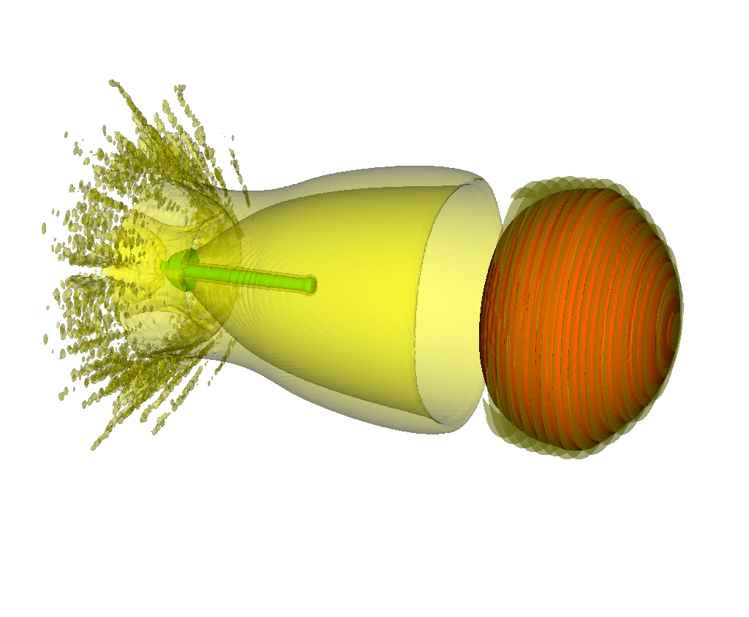
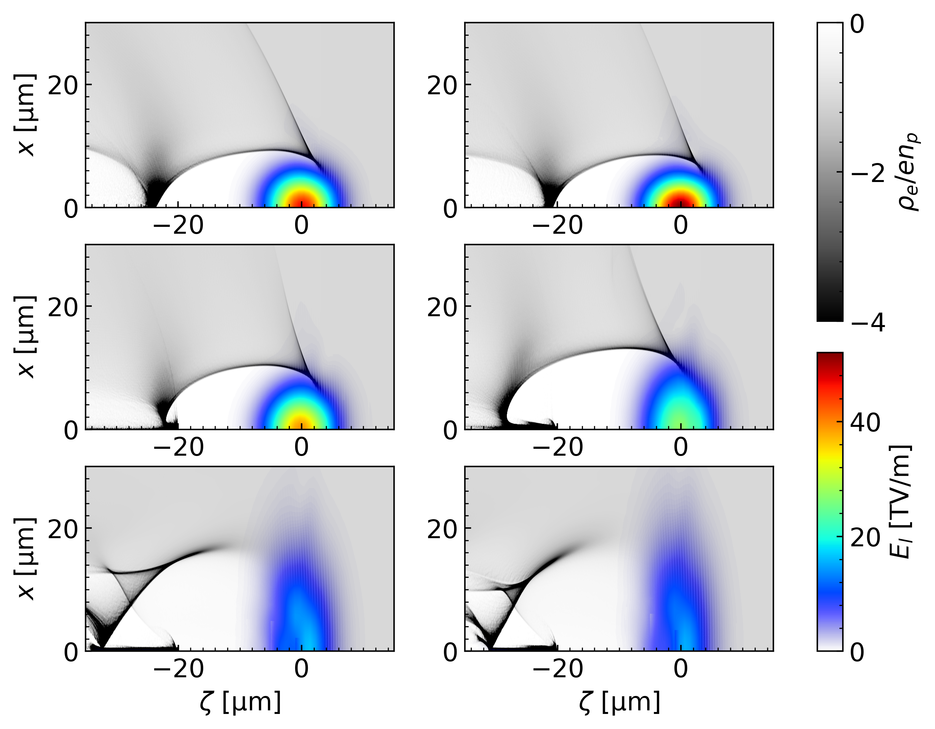
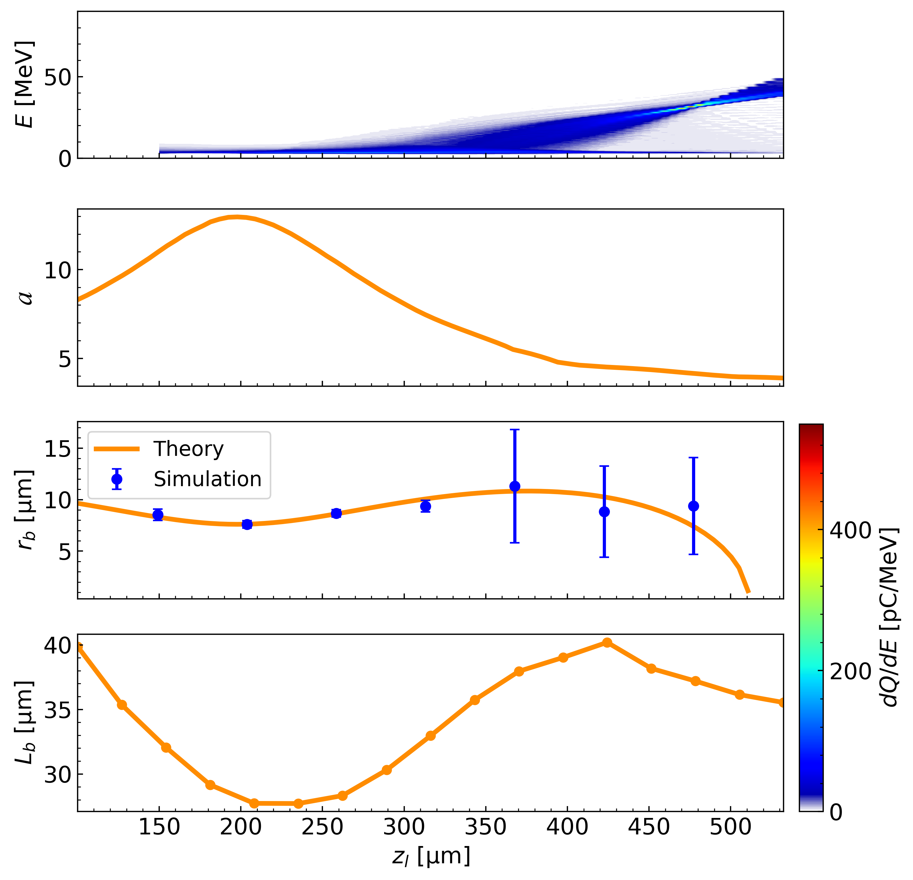
Another scheme: Injection by tightly-focused drive laser
Bubble may also expand during laser defocusing, so that phase velocity decreases
This may be achieved by using tightly-focused drive laser
$$n_{p}=2×{10}^{18}{cm}^{−3}$$
$a_{0}=12, w_{0}=5μm$ (120 TW)

Slide 17
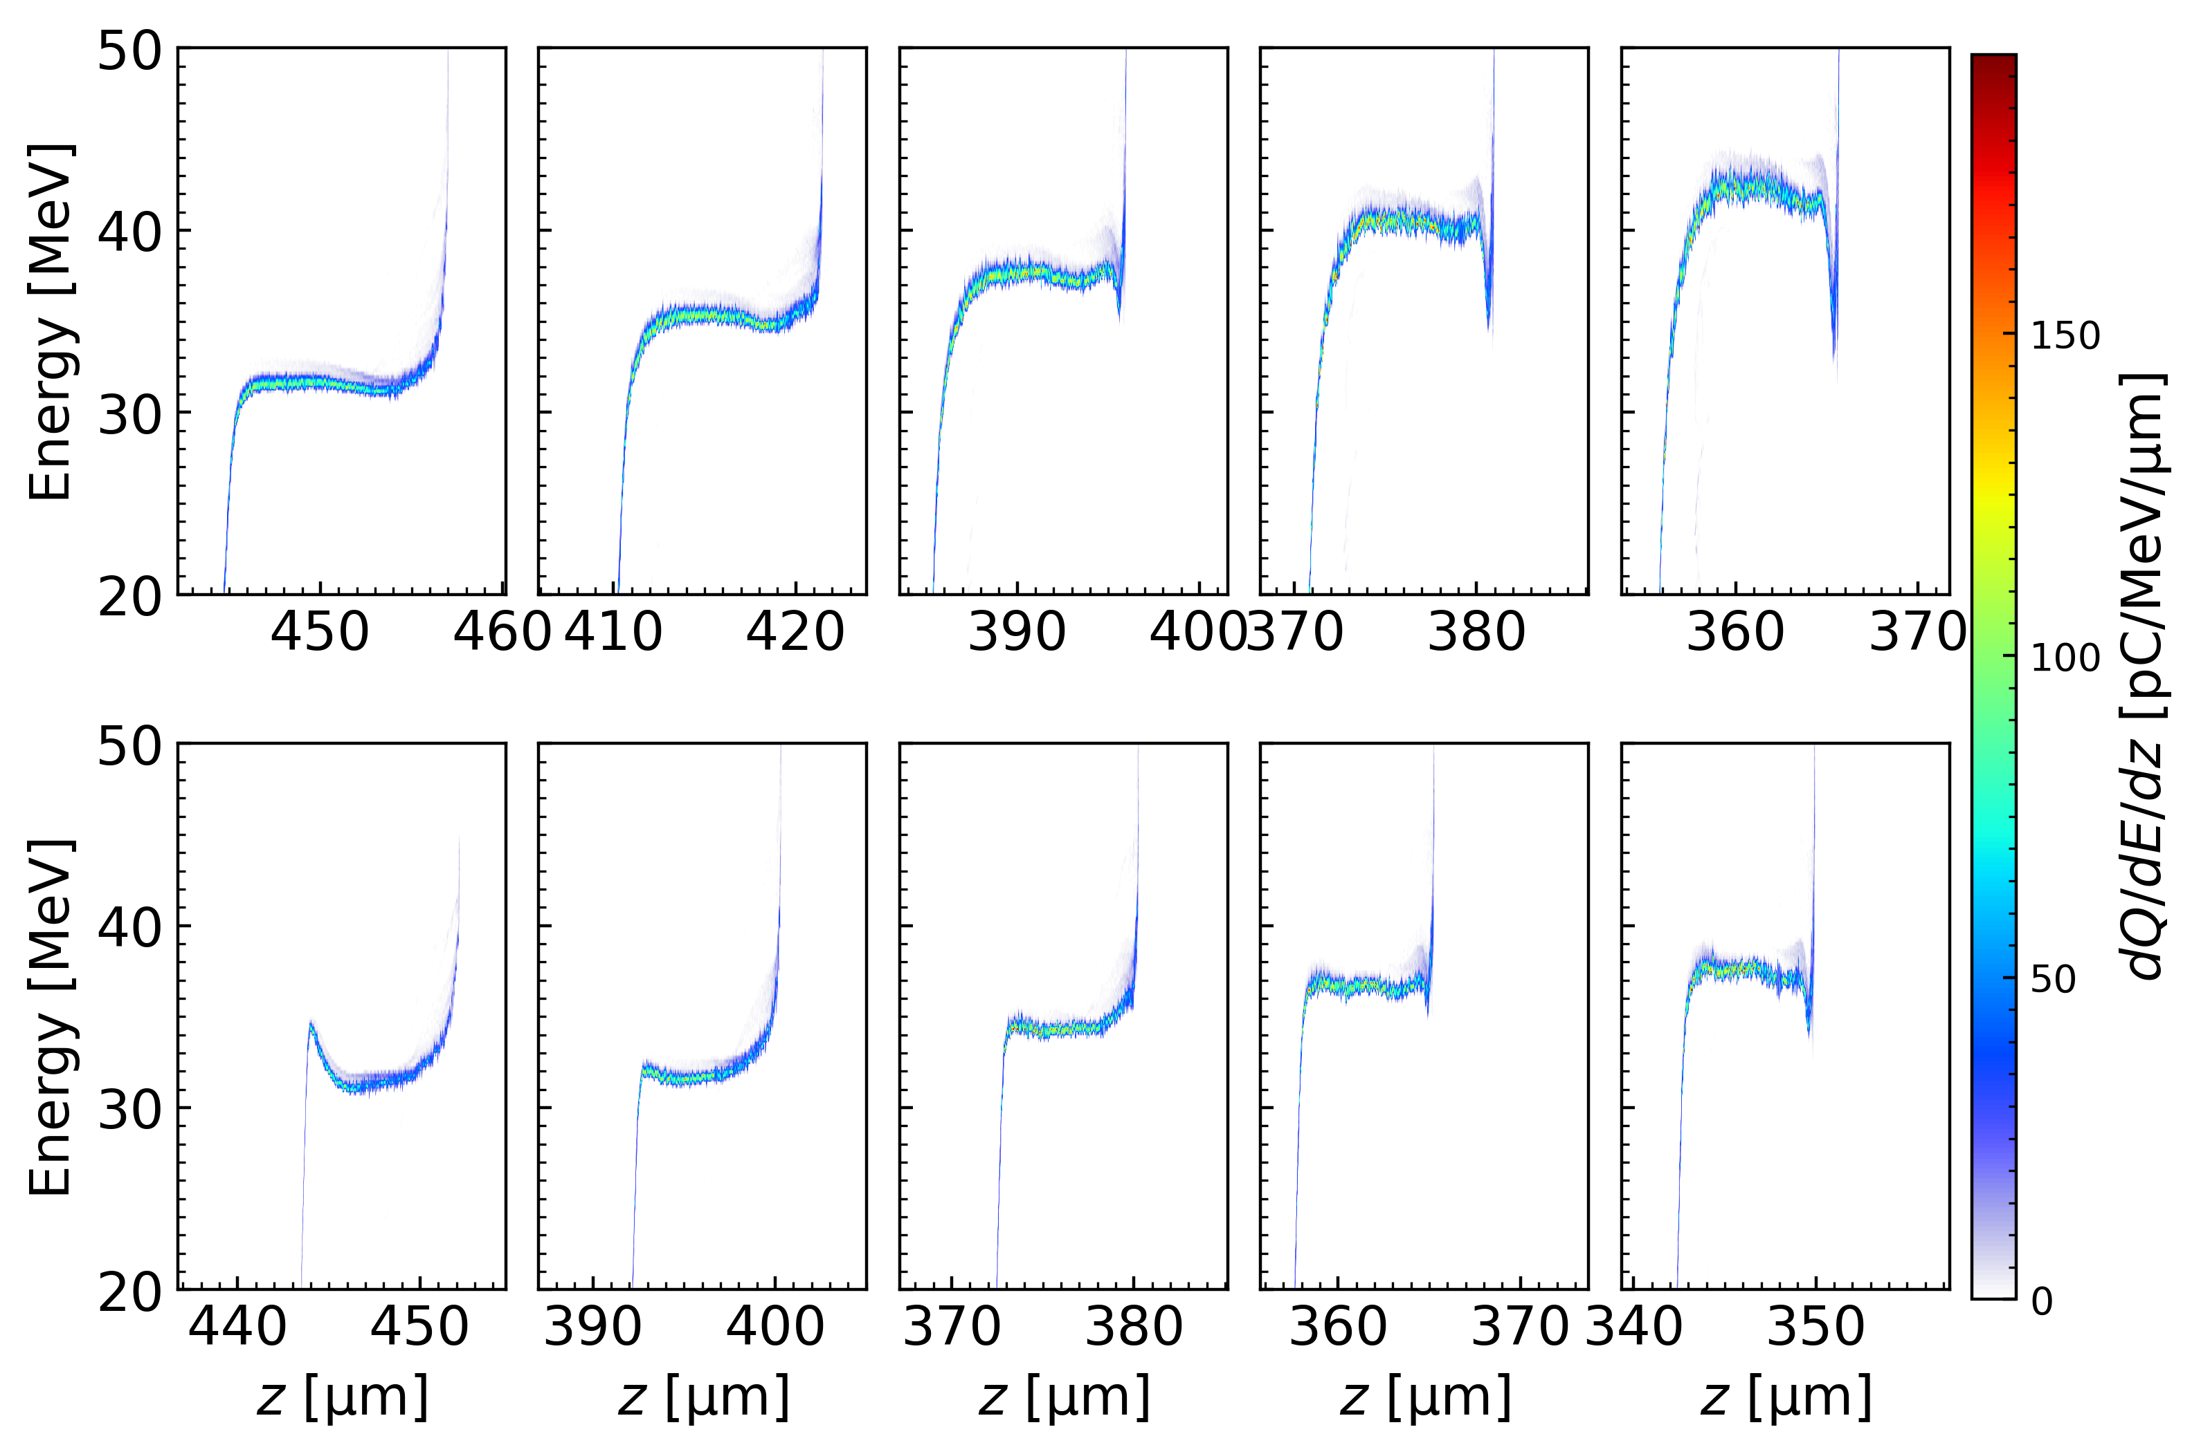
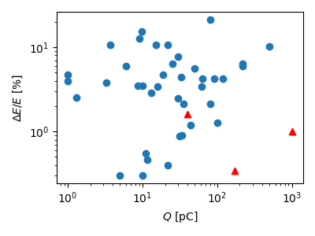
Another scheme: Injection by tightly-focused drive laser
Low energy spread and high charge beam can be obtained
May be tested with very simple experimental configuration
120TW
$$560pC$$
$$720pC$$
$$810pC$$
$$880pC$$
$$940pC$$
RF
60TW
$$280pC$$
$$360pC$$
$$420pC$$
$$480pC$$
$$520pC$$
$$w_{0}=5μm$$
$$n_{p}=2−6×{10}^{18}{cm}^{−3}$$
Jia Wang et al., Phys. Rev. Accel. Beams 26, 091303 (2023)

Slide 18
Contents
Studies of high quality injection in plasma accelerators
Betatron oscillation and radiation reaction in plasma accelerators

Slide 19
Betatron oscillation in plasma accelerators: long-term radiation reaction
The restoring force
$$F_{r}∝−κ^{2}r$$
with the parameter $κ=1/\sqrt{2}$ in blowout regime
The transverse motion of single electron
$$\ddot{x}+\frac{\dot{γ}}{γ}\dot{x}+\frac{κ^{2}}{γ}x=0$$
In the limit $\dot{γ}/γ≪1$, betatron frequency is
$$ω_{β}=\frac{κ}{\sqrt{γ}}$$
Radiation reaction reduces the acceleration, and has transverse cooling effect
There is asymptotic solution with extremely long acceleration and extremely high energy: longitudinal radiation reaction force=acceleration force×2/3
-A. Deng et al., Phys. Rev. ST Accel. Beams 15, 081303 (2012);
-I. Yu. Kostyukov et al., Phys. Rev. ST Accel. Beams 15, 111001 (2012)
How about before reaching asymptotic solution? A important question for large scale plasma accelerator design.

Slide 20
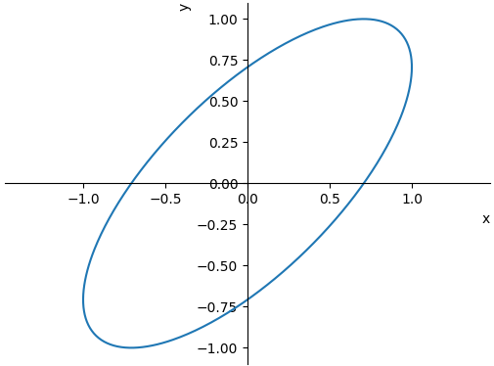
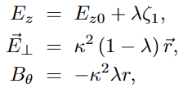
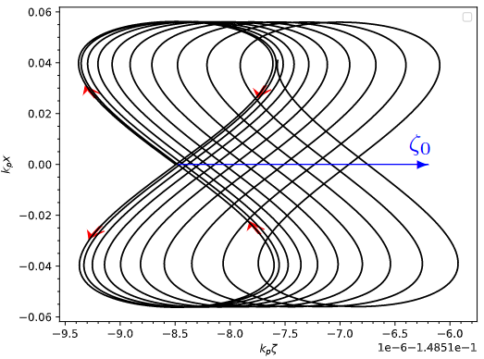
3D betatron oscillation model
In transverse space, electron trajectory is an ellipse in general
Consider the general form of E- and B-field in a blowout wakefield
where $E_{z0}$ is the averaged longitudinal E-field, $ζ_{1}$ is the high-frequency component of the comoving coordinate, $λ$ is the slop of longitudinal E-field
The forces including the radiation reaction are
$$ζ_{1}$$

Slide 21
3D betatron oscillation model
The radiation reaction force in LAD form
The longitudinal oscillations can be expressed by the transverse terms
The equations of motion become

Slide 22
The averaging of the 3D betatron oscillations
We use the same averaging method as in I. Y. Kostyuk et al., PRAB 15, 111001 (2012), and introduce two complex variables
where
$x$, $y$, $β_{x}$, $β_{y}$, $p_{x}$, $p_{y}$ can be expressed by $U$ and $V$, and averaged equations can be obtained
Energy change
Longitudinal phase change
betatron amplitude and phase change

Slide 23
Simplifying the averaged equations
Decompose the complex variables
Introduce new variables (areas in the transverse phase spaces $x$-$p_{x}$ and $y$-$p_{y}$)
Simplified averaged equations are obtained

Slide 24
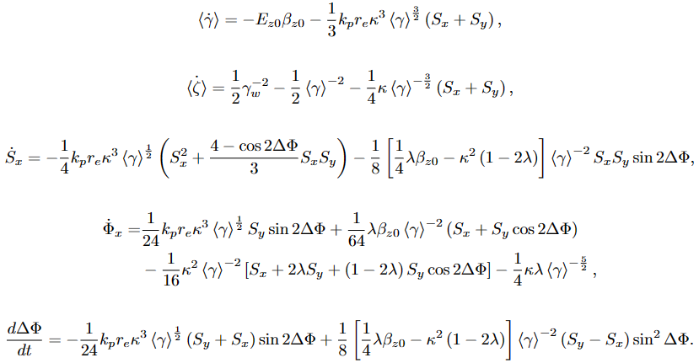
Simplified averaged equations (long-term equations)
Energy change
Longitudinal phase change
Phase space area change
Betatron phase change
Betatron phase difference in $x$ and $y$ directions

Slide 25
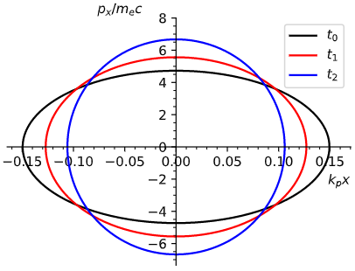
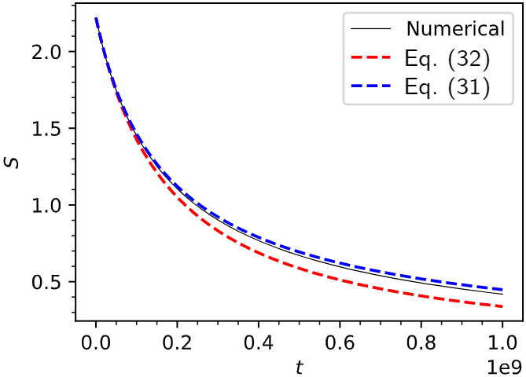
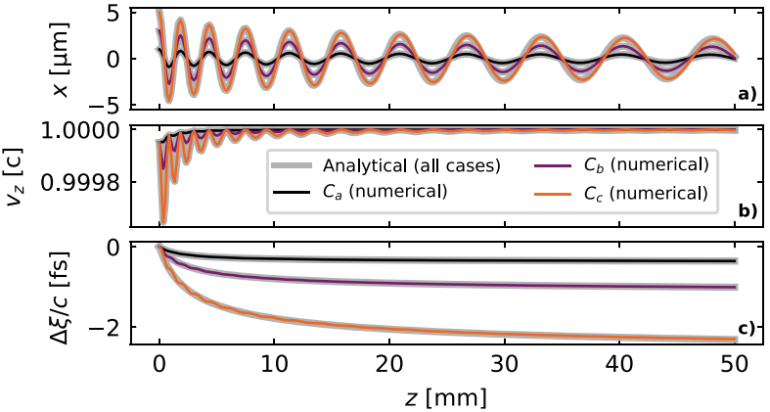
Previously found phenomena
betatron amplitude scale with $γ^{−\frac{1}{4}}$
Longitudinal deceleration due to radiation reaction
P. Michel et al., Phys. Rev. E 74, 026501 (2006)
Transverse cooling
A. Deng et al., Phys. Rev. ST Accel. Beams 15, 081303 (2012)
I. Y. Kostyuk et al., Phys. Rev. ST Accel. Beams 15, 111001 (2012)
M. Zeng and K. Seto, New J. Phys. 23 075008 (2021)
Longitudinal phase drift
A. Ferran Pousa et al., Sci. Rep. 9, 10.1038/s41598-019-53887-8 (2019)
Simplified
Strict

Slide 26
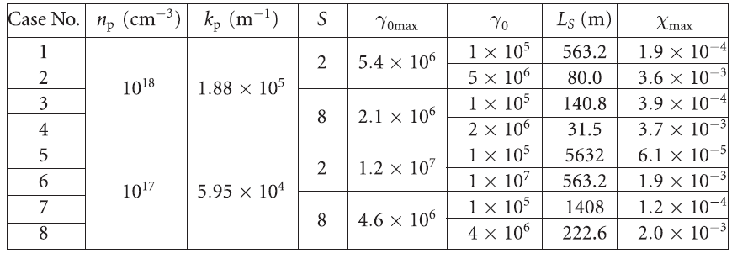
Typical values
Typical values of betatron amplitude damping
M. Zeng and K. Seto, New J. Phys. 23 (2021) 075008

Slide 27
Newly found phenomena
Longitudinal drift:
Electron velocity matches phase velocity
Electron drifts around $E_{z}=0$ position with the frequency
Two regimes:
betatron phase shift dominate regime: $k_{p}r_{e}γ^{\frac{5}{2}}≪1$
betatron radiation reaction dominate regime: $k_{p}r_{e}γ^{\frac{5}{2}}≫1$

Slide 28
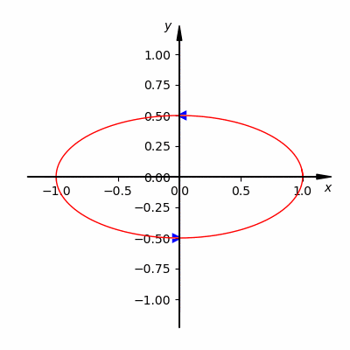
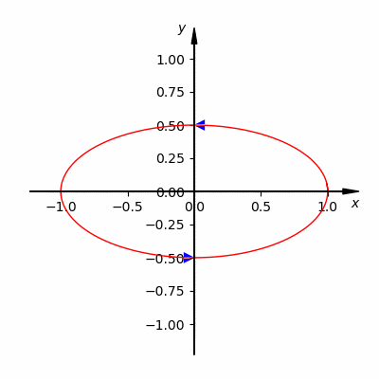
New phenomena
$k_{p}r_{e}γ^{\frac{5}{2}}≪1$, elliptical betatron oscillation has precession
$k_{p}r_{e}γ^{\frac{5}{2}}≫1$, elliptical betatron oscillation approaches linear polarization
Yulong Liu and Ming Zeng, Phys. Rev. Accel. Beams 26, 031301 (2023)

Slide 29
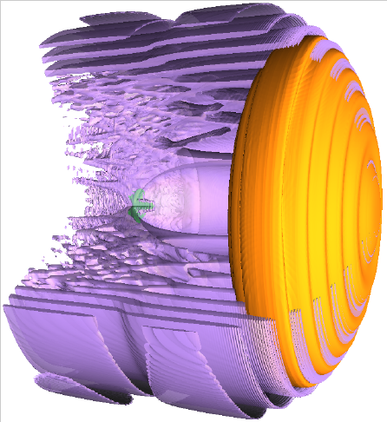
Summary
IHEP is doing several plasma acceleration researches
High-quality injection in plasma accelerators
Ponderomotive assistant ionization injection
Scissor-cross ionization injection
Interference injection by coaxial lasers
Injection by tightly focused drive laser
Betatron oscillation and radiation reaction
3D betatron oscillation model
Averaged equations
Reproduce previous results
Find 3 new phenomena for long-distance plasma accelerators
Longitudinal drift oscillation
Trajectory precession
Polarization linearization
Can be applied to optimization of future large-scale plasma accelerators
RF

