Slide 1
Accelerator Activities at Tsinghua University
Yingchao Du
on the behalf of Accelerator laboratory
dych@tsinghua.edu.cn
Department of engineering physics Tsinghua University
2023-10-27

Slide 2
Outline
Introduction
Highlights of accelerator activities at THU
  Advanced photocathode RF gun developments
  VIGAS: Very compact Inverse Compton GAmma-ray Source

Slide 3
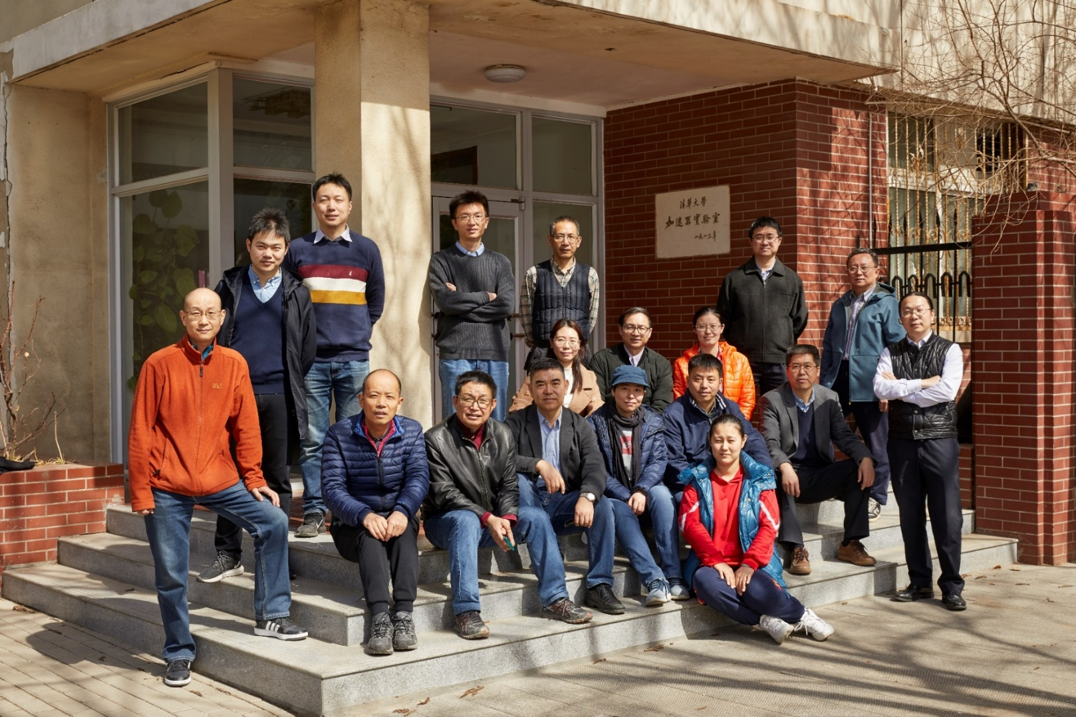
Introduction
Accelerator Laboratory, Department of engineering physics, THU
-17 faculties and more employees
-About 60 graduate students

Slide 4
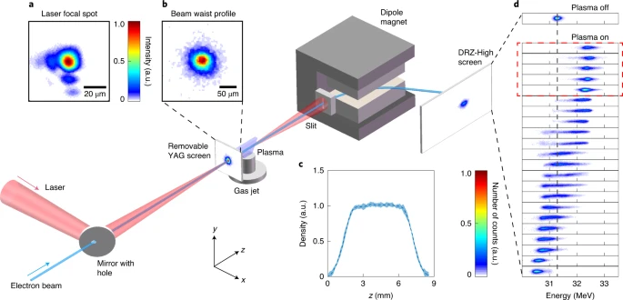
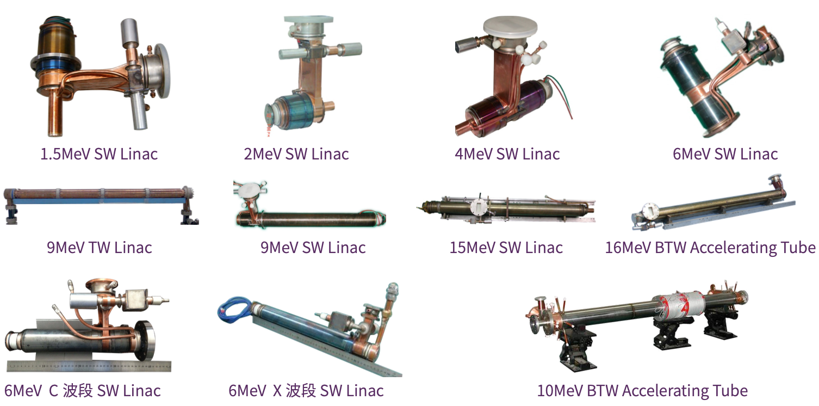
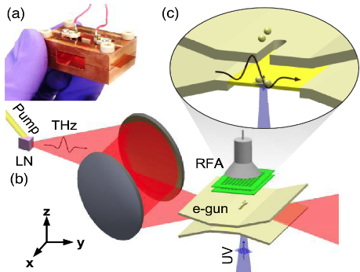

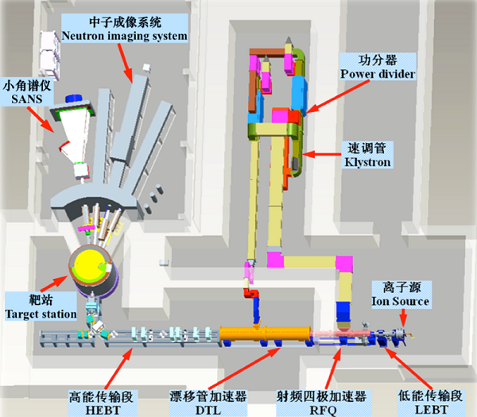
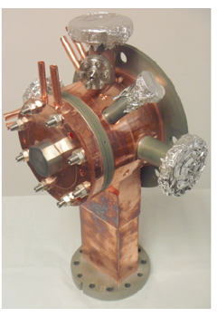
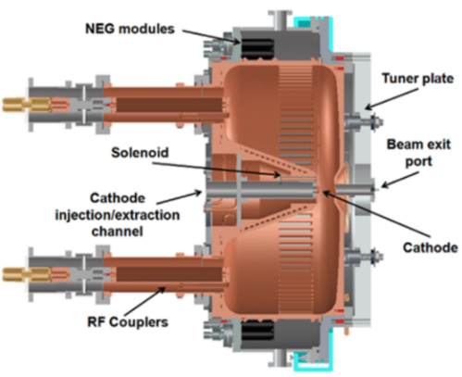
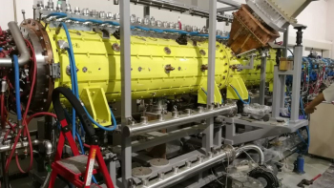
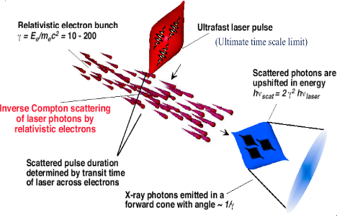
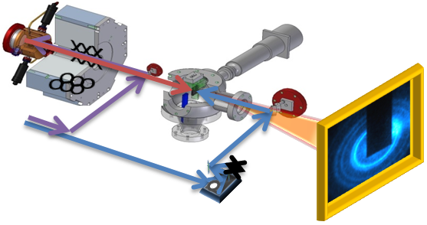
Introduction
Plasma\ THz accelerator
Low Energy Industrial
&Medical Accelerator
Advanced accelerator concept
Accelerator physics and applications
Compact Pulsed Hadron Source (CPHS)
High brightness electron beam and applications

Slide 5
Outline
Introduction
Highlights of the accelerator activities at THU
  Advanced photocathode RF gun developments
  VIGAS: Very compact Inverse Compton GAmma-ray Source

Slide 6
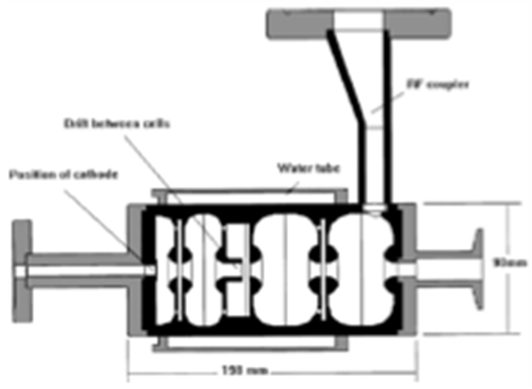
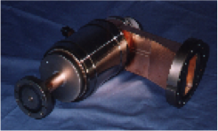
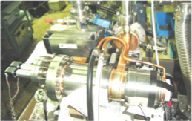
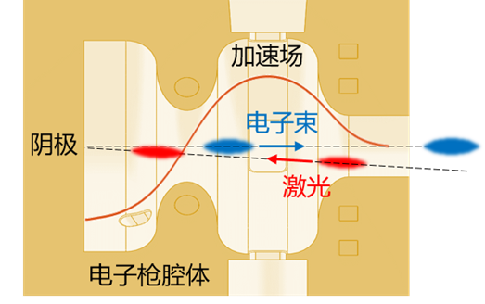
History of gun development at Tsinghua
Thermionic and multi-pactor cathode RF guns (~1990s)
  Large emittance, for industrial applications and long wavelength FEL
S-band Thermionic RF gun for BFEL (1.8 MeV, 809mA, 20mm mrad)
S-band multipactor cathode RF gun (5 MeV, 40mA)
Photocathode RF guns (2001-)
  S-band photocathode RF gun
  C-band photocathode RF gun
  Very high frequency(VHF) continuous wave(CW) photocathode RF gun
  L-band photocathode RF gun
  ……

Slide 7
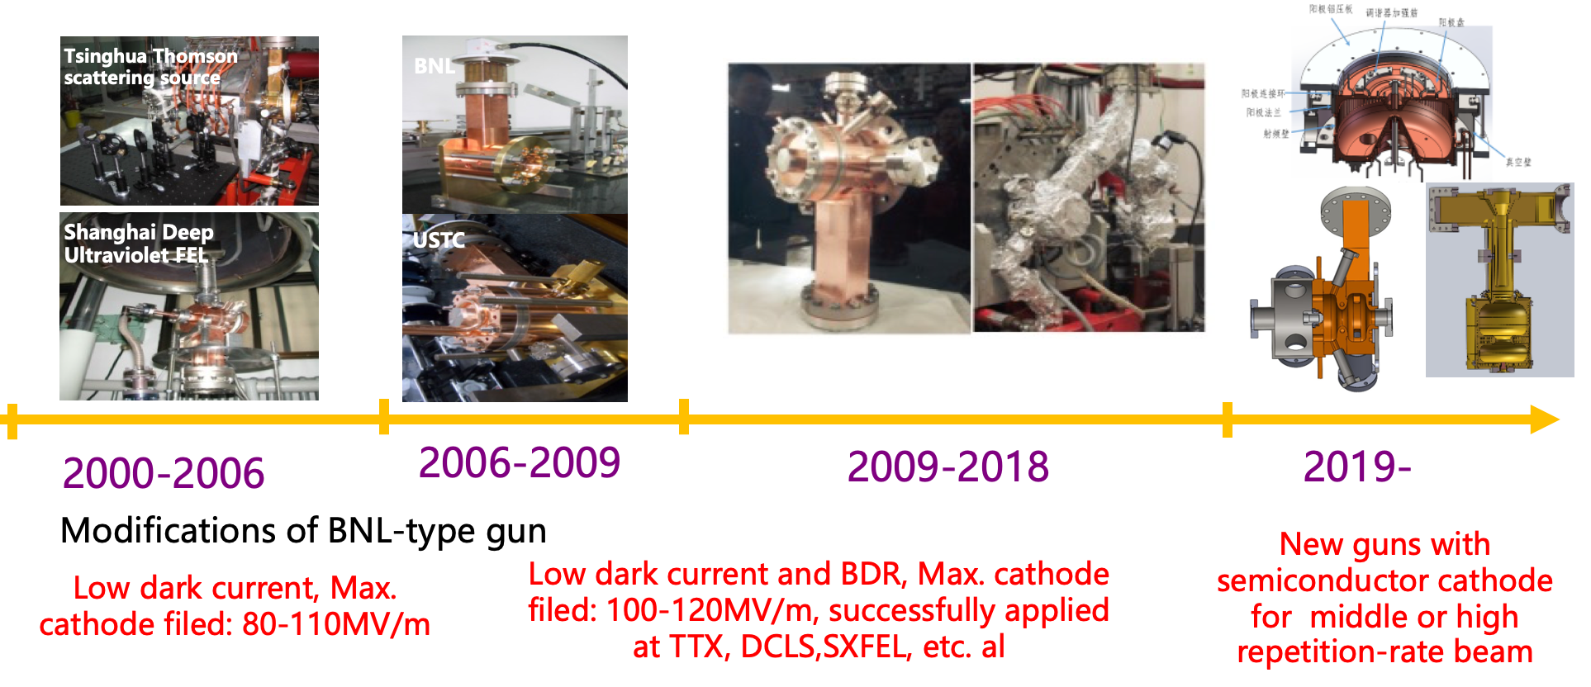
Brief overview of developments of S-band photocathode RF gun at THU
The history of photocathode RF gun study at THU
More than 30 photocathode RF guns were made at THU

Slide 8
Advanced photocathode RF gun developments
Very high frequency(VHF) gun
  CW operation with high vacuum
  High beam repetition to 1MHz
  High cathode gradient to 30MV/m
  Excellent beam source for CW XFEL/CW UED
High vacuum S-band photocathode RF gun
  Extreme high vacuum to 10-9pa
  Testing platform for advanced semiconductor photocathode

Slide 9
Advanced photocathode RF gun developments
Very high frequency(VHF) gun
  CW operation with high vacuum
  High beam repetition to 1MHz
  High cathode gradient to 30MV/m
  Excellent beam source for CW XFEL/CW UED
High vacuum S-band photocathode RF gun
  Extreme high vacuum to 10⁻⁹pa
  Testing platform for advanced semiconductor photocathode

Slide 10
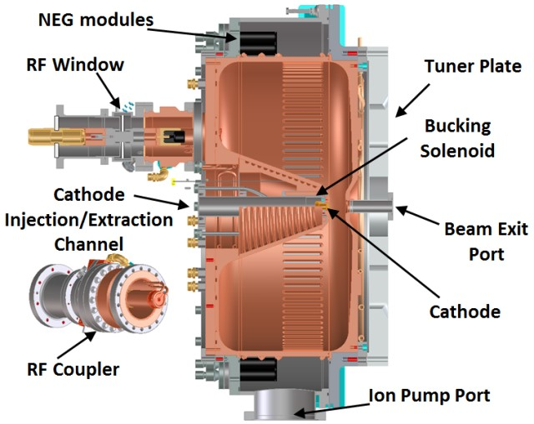
VHF photocathode RF gun
VHF photocathode gun: Baseline for SHINE project
Advantages:
  Normal conducting
  Long wavelength, big size, low temperature increase
  High cathode gradient and cavity voltage
  Good vacuum performance, successfully operated with semiconductor cathode
  Demonstrated for stable CW operation and MHz repetition rate beam generation at LBNL and SLAC
APEX-gun@LBNL

Slide 11
R&D timeline of SHINE VHF gun
2019.3 MOU signed between Tsinghua and SHINE project
2019.12 Finish gun design，start manufacturing
2021.1 Finish the manufacturing of the prototype gun
2021.12 Achieve 30 kW CW operation of the prototype gun
2022.4 Finish the manufacturing of the second gun
2022.8 Achieve 70 kW CW operation of the second gun
2022.8 Generate the first photoelectron beam
2023.1 Beam emittance optimized and achieved good beam performance
2023.4 Delivered to SHINE project and installed in tunnel
2023.9 Vacuum ready in low energy beam line for beam commissioning

Slide 12
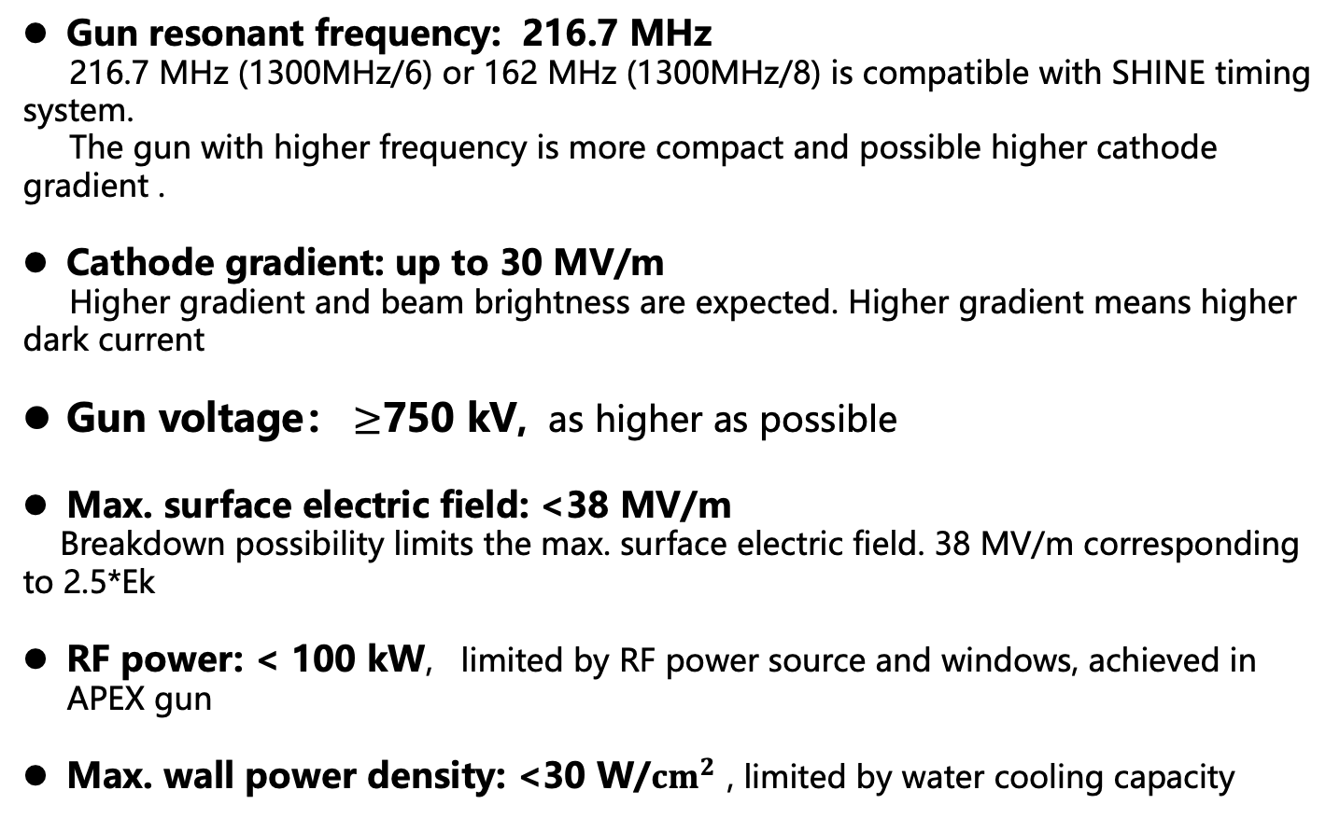
Basic considerations on VHF gun design
Gun resonant frequency: 216.7 MHz
216.7 MHz (1300MHz/6) or 162 MHz (1300MHz/8) is compatible with SHINE timing system.
The gun with higher frequency is more compact and possible higher cathode gradient .
Cathode gradient: up to 30 MV/m
Higher gradient and beam brightness are expected. Higher gradient means higher dark current
Gun voltage： $≥$750 kV, as higher as possible
Max. surface electric field: <38 MV/m
Breakdown possibility limits the max. surface electric field. 38 MV/m corresponding to 2.5*Ek
RF power: < 100 kW, limited by RF power source and windows, achieved in APEX gun
Max. wall power density: <30 W/${cm}^{2}$ , limited by water cooling capacity

Slide 13
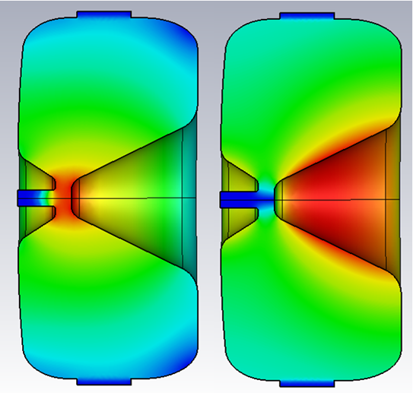
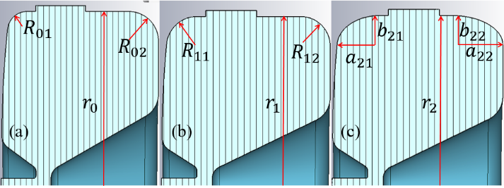
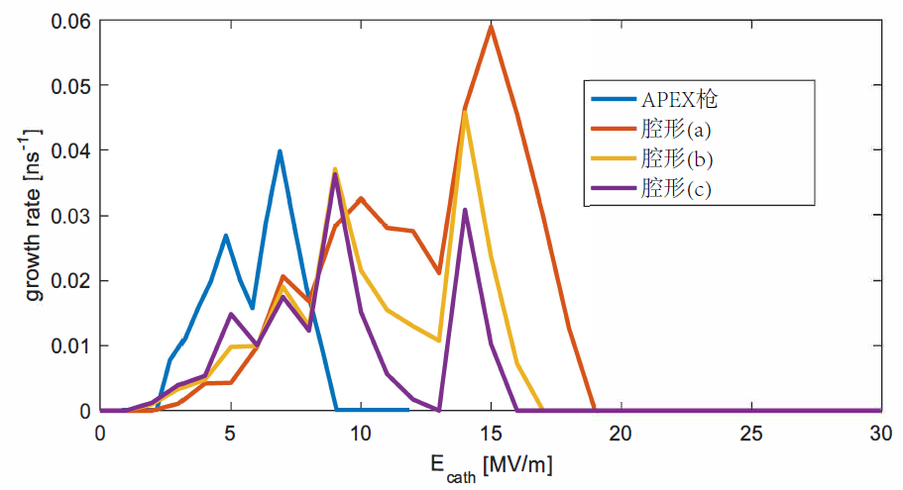
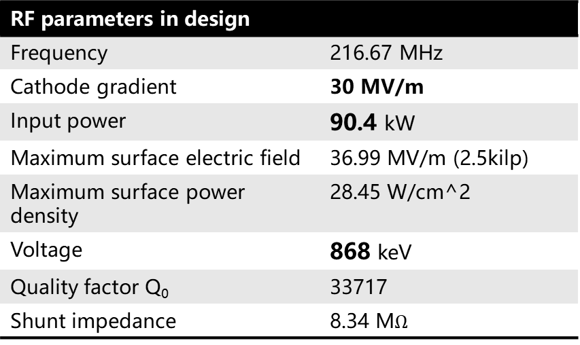
VHF photocathode RF gun
RF parameters in design
Frequency | 216.67 MHz
Cathode gradient | 30 MV/m
Input power | 90.4 kW
Maximum surface electric field | 36.99 MV/m (2.5kilp)
Maximum surface power density | 28.45 W/cm^2
Voltage | 868 keV
Quality factor Q₀ | 33717
Shunt impedance | 8.34 M$Ω$
E field
H field
Gun shape optimization to reduce the multipacting

Slide 14
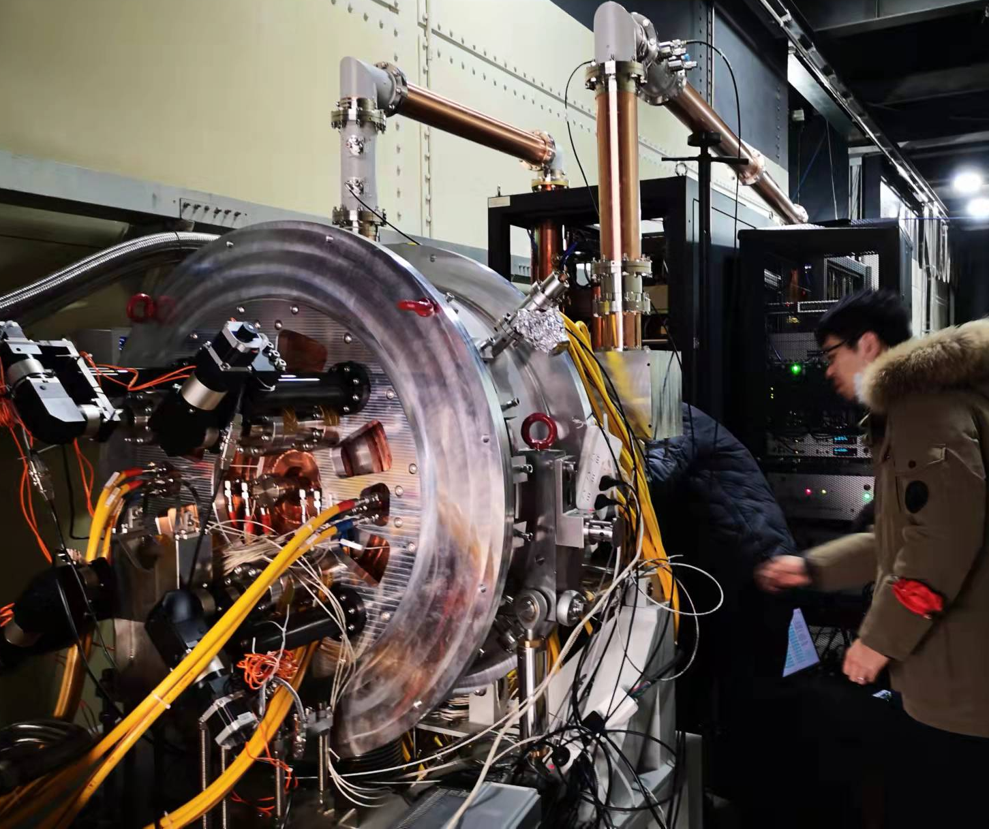
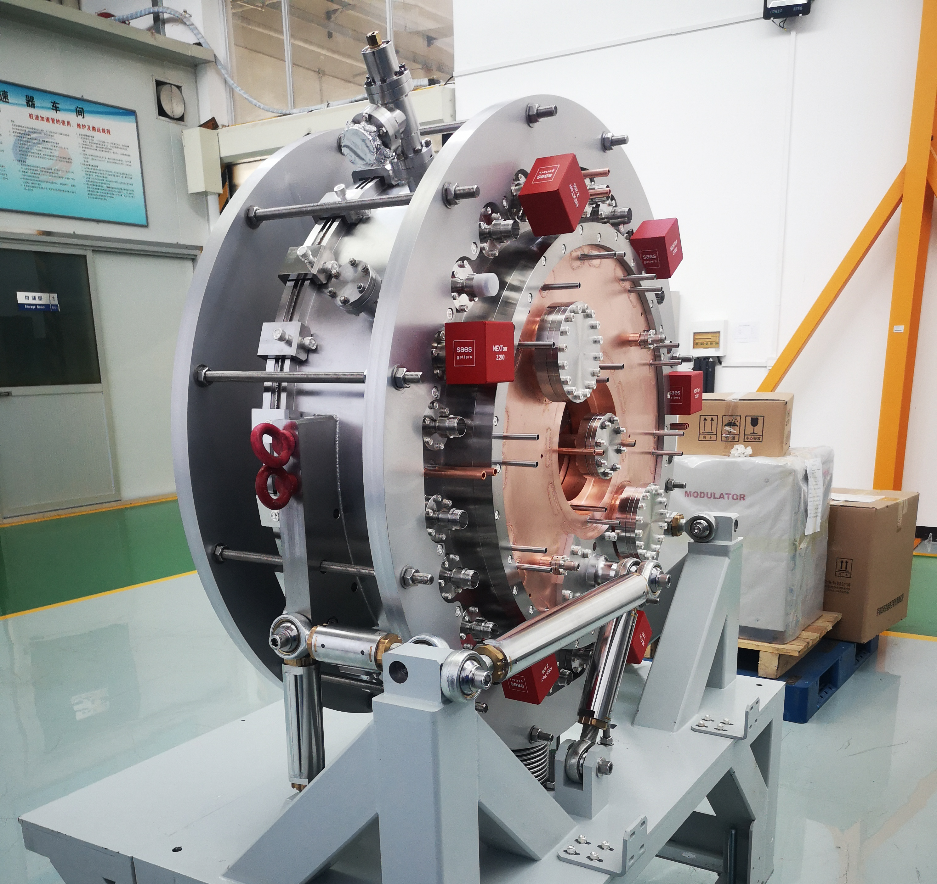
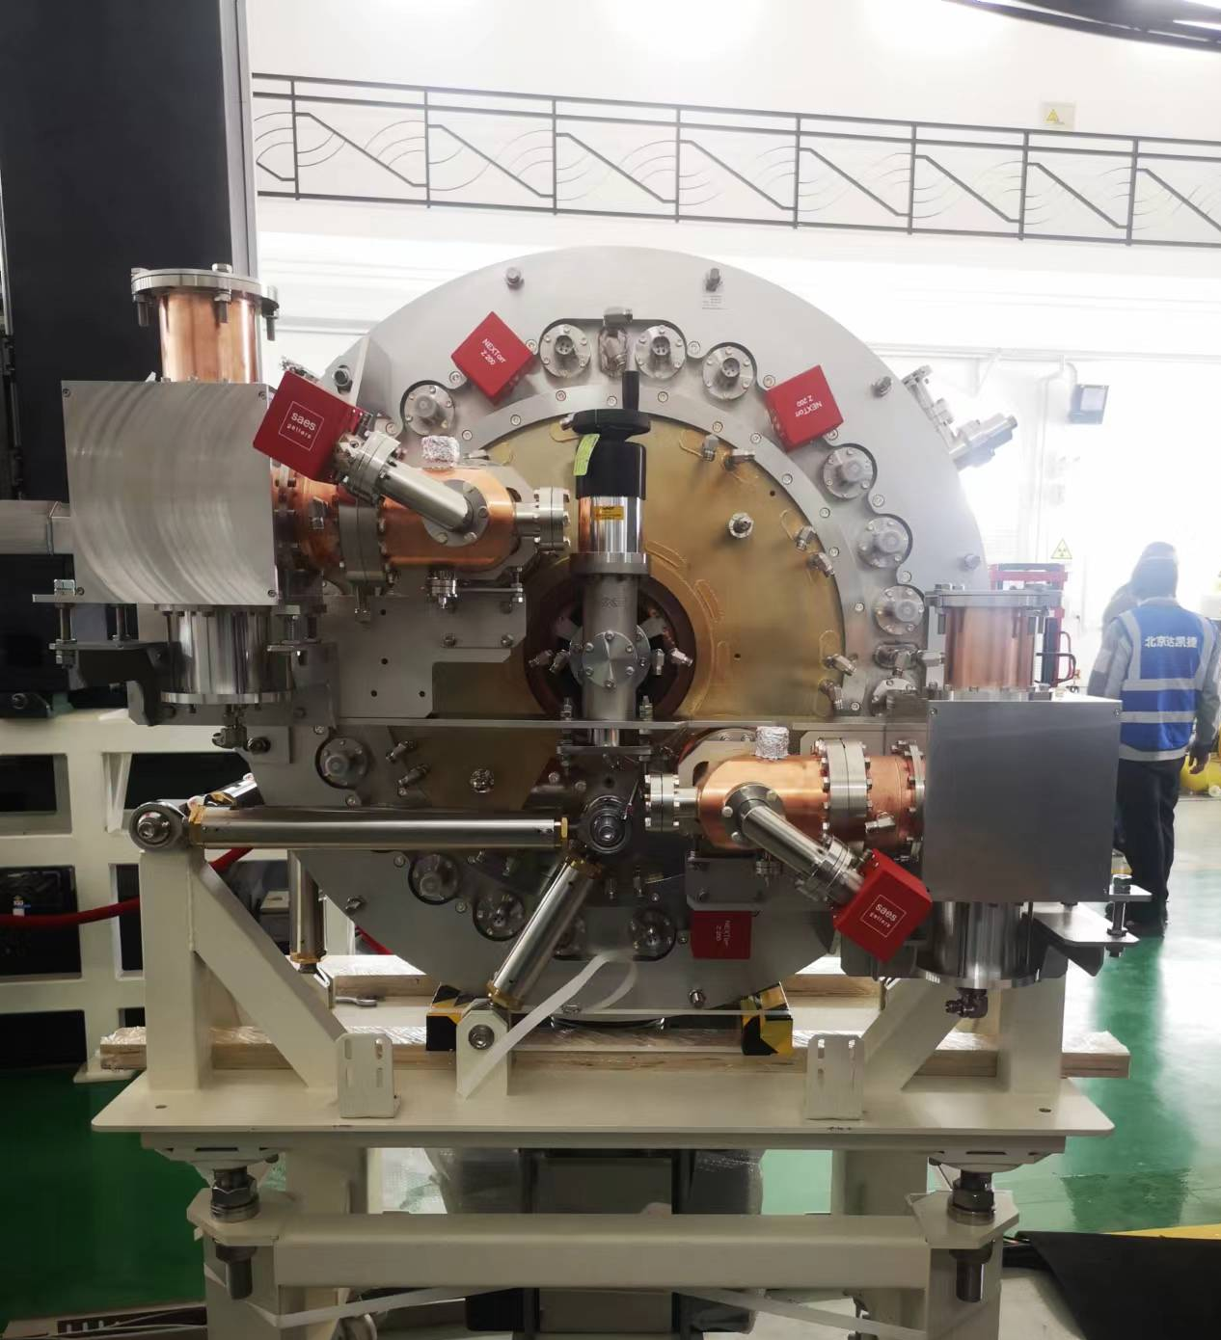
Machining of the VHF gun
3 guns have been made for process testing and beam commissioning
Prototype gun for machining process testing
Gun 2 and 3，>75kW CW stable operation(limited by AC power supply system) with low dark current

Slide 15
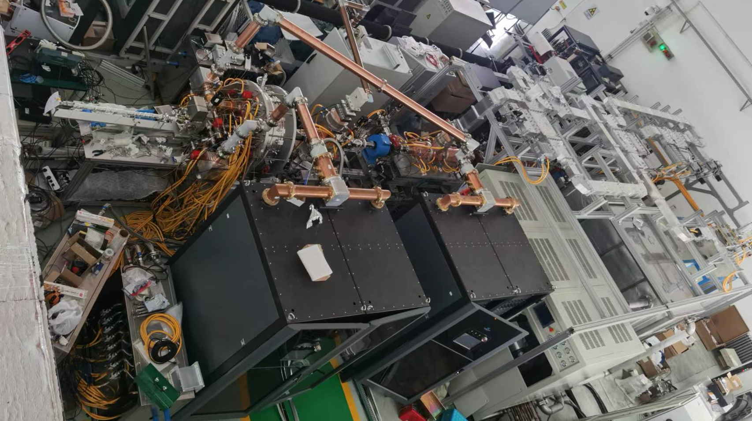
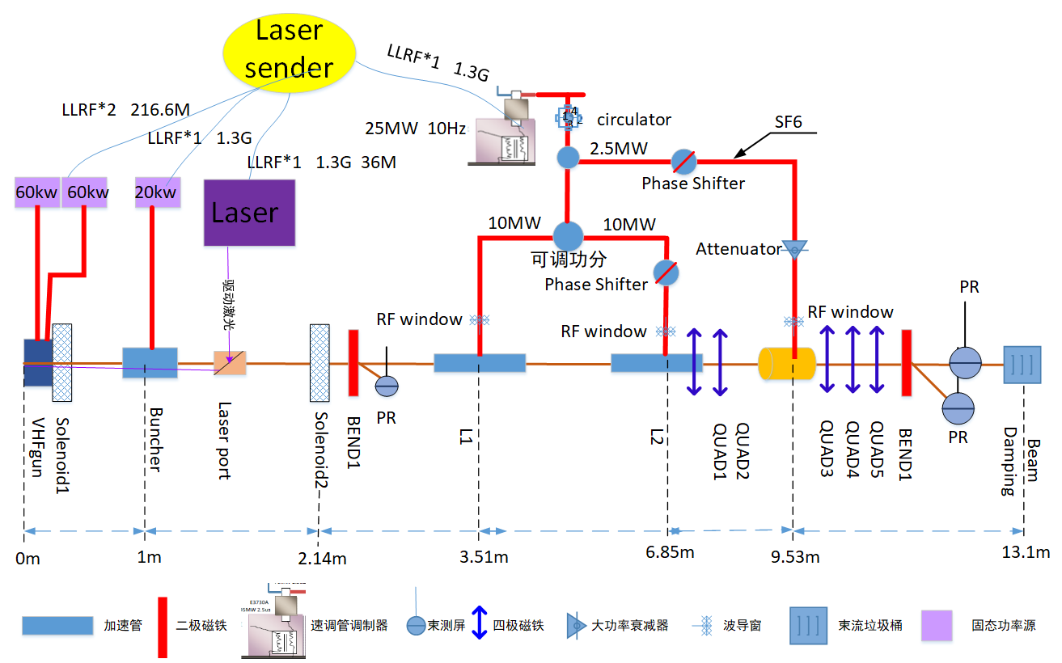
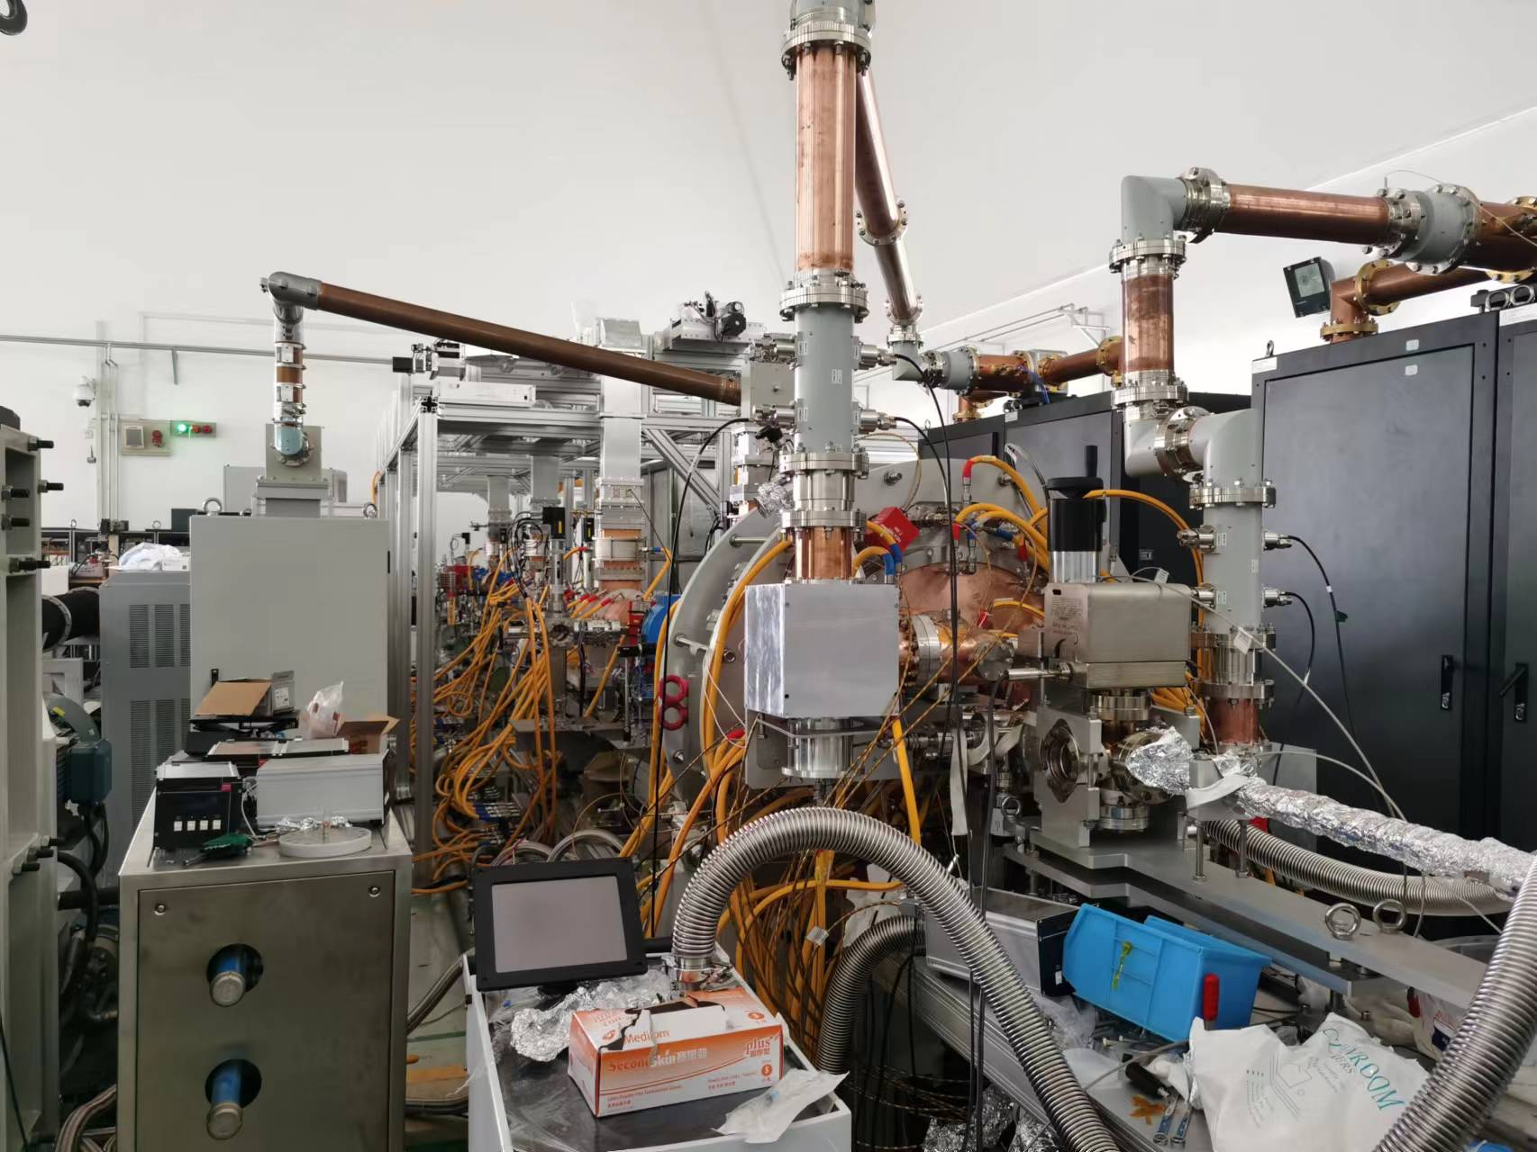
High power testing
30MeV beamline for gun beam testing
One 400kV Buncher powered by 20kW SSA
Two tubes and one deflecting cavity powered by a 20MW klystron operated in pulse mode.

Slide 16
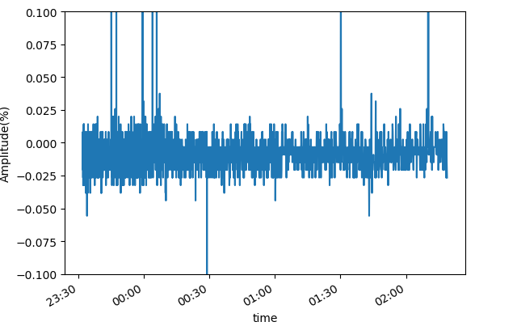
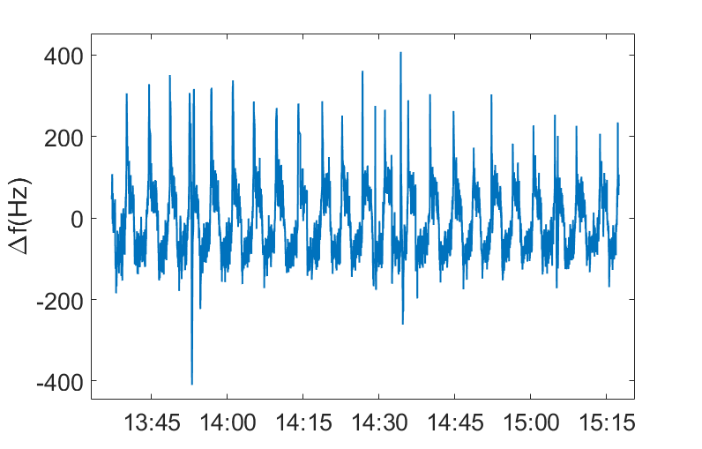
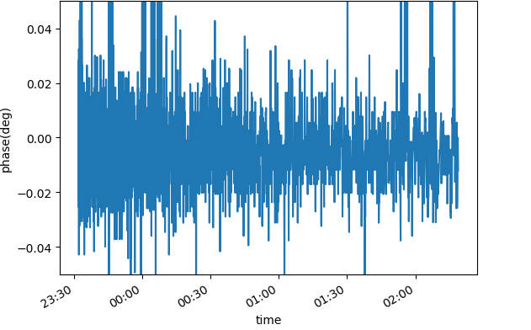


High power testing
After ~20hours RF commissioning, successfully operated in CW mode at 216.667 MHz with ~75 kW input power(limited by power supply system), or ~800kV voltage
Amplitude jitter 1.1$\text{‱}$
$$∆f±300Hz$$
Phase jitter 0.0148 deg
Multipacting is observed with RF power lower than 25kW, which is in consistent with the simulation results.
Good vacuum achieved in testing: ～2.0x10⁻⁸ pa without RF, ~9x10⁻⁸pa with 75kW CW RF power.

Slide 17
High power testing
Dark current
  High dark current in 2nd gun during the first round running, 1-10uA
  Significantly reduced after re-cleaning, less than 10nA with plug in.
  Obvious dark current increasing from 10nA->~400nA during CW operation in about two months. And it also reduced to very low after re-processed.
  Contamination (or dust) from cathode plug or downstream beam pipe？
  In-situ cleaning technologies are necessary for long term running.
dark current w/o plug
Epeak: ~43MV/m
~10uA
dark current with plug
Epeak: ~30MV/m
~1-4uA
dark current and photoelectron
Epeak: ~30MV/m
<10 - 100nA
Photoelectron
Beam (~100pC)
Dark current of the 2nd gun, without(left) or with plug in(mid), and after re-processed

Slide 18
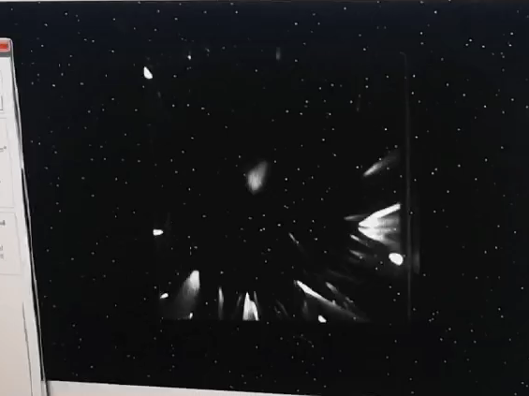
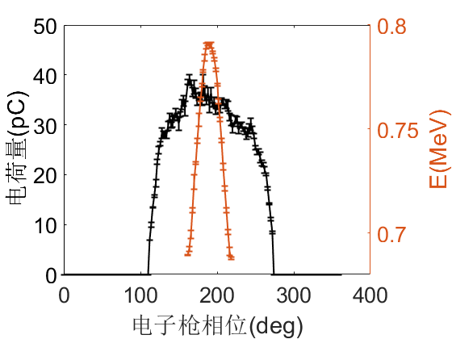
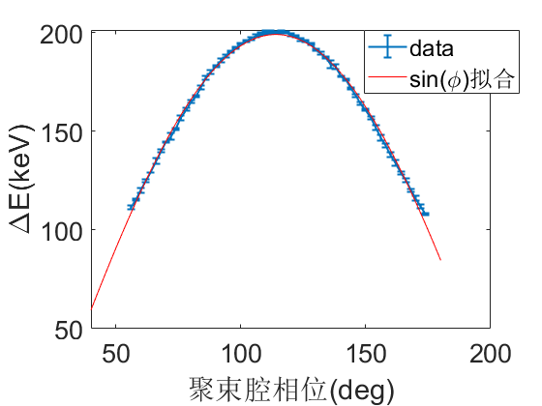
Beam testing
First photoelectron beam generated with Cs₂Te cathode on August 23, 2022.
Bean profile after low energy bend magnet
Gun phase scan(70kW)
First photoelectron beam on 23 August, 2022 , QE: ~1%
Buncher on@~6kW
Deflecting cavity ON

Slide 19
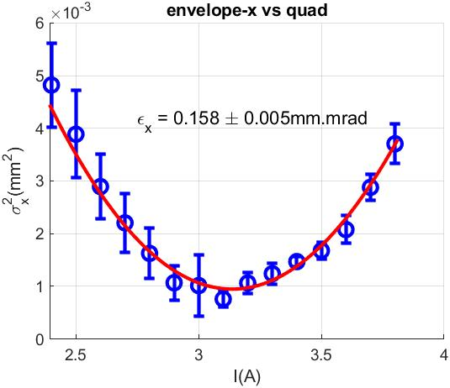
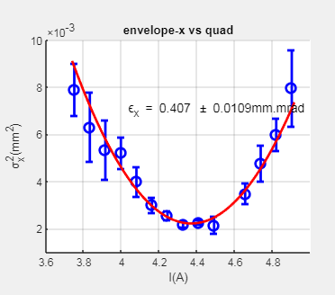
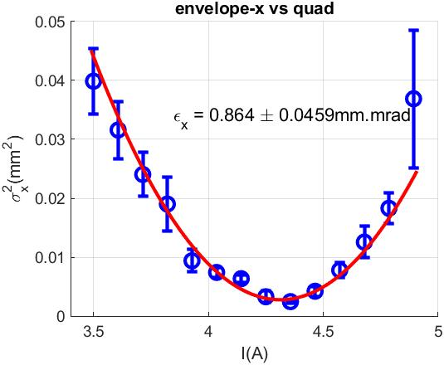
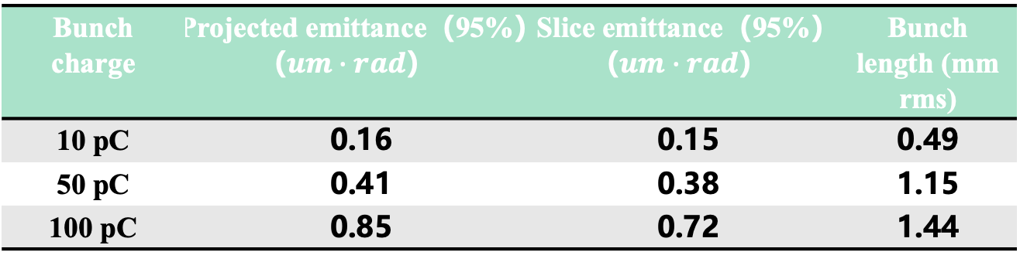
Beam testing
Emittance measurement and optimization(preliminary results )
No-ideal distribution of laser, dipole and quadrupole field in solenoid and RF structures
Bunch charge | Projected emittance（95%）（$um∙rad$） | Slice emittance（95%）（$um∙rad$） | Bunch length (mm rms)
10 pC | 0.16 | 0.15 | 0.49
50 pC | 0.41 | 0.38 | 1.15
100 pC | 0.85 | 0.72 | 1.44
10pC
100pC
50pC

Slide 20
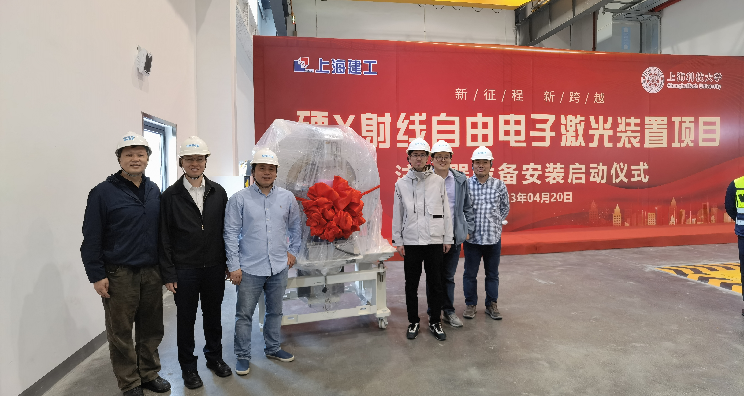
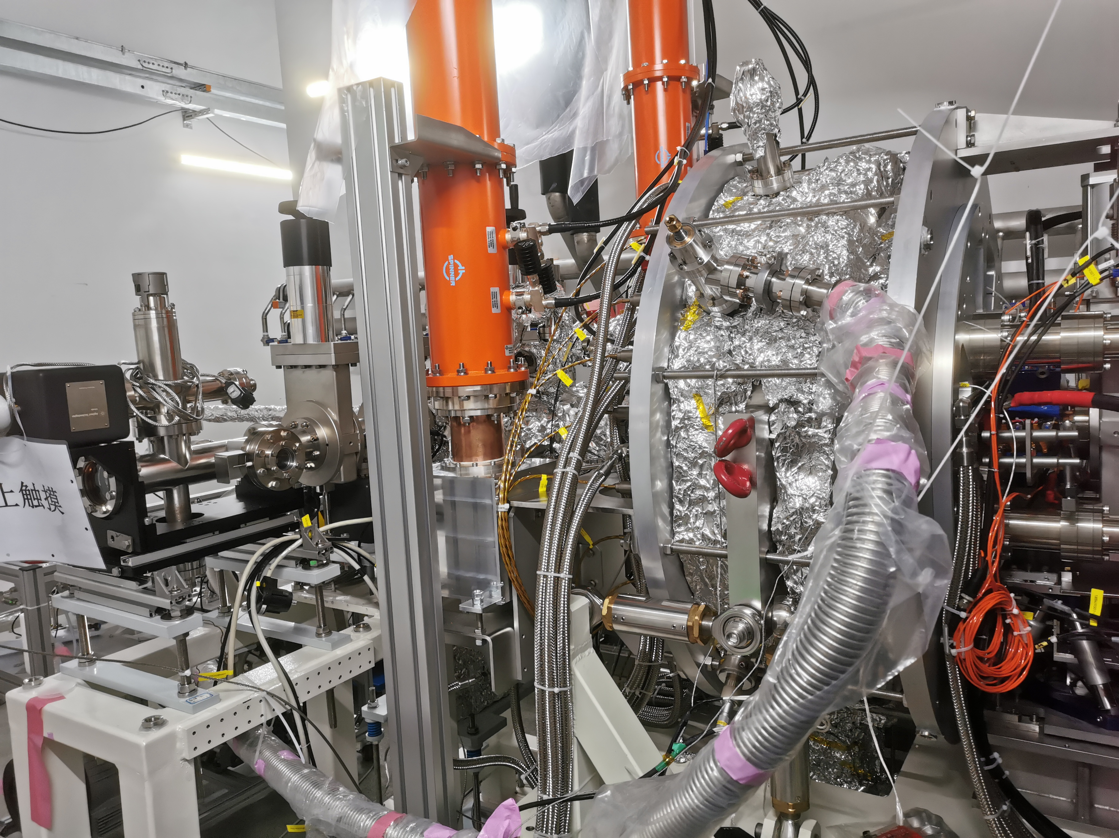
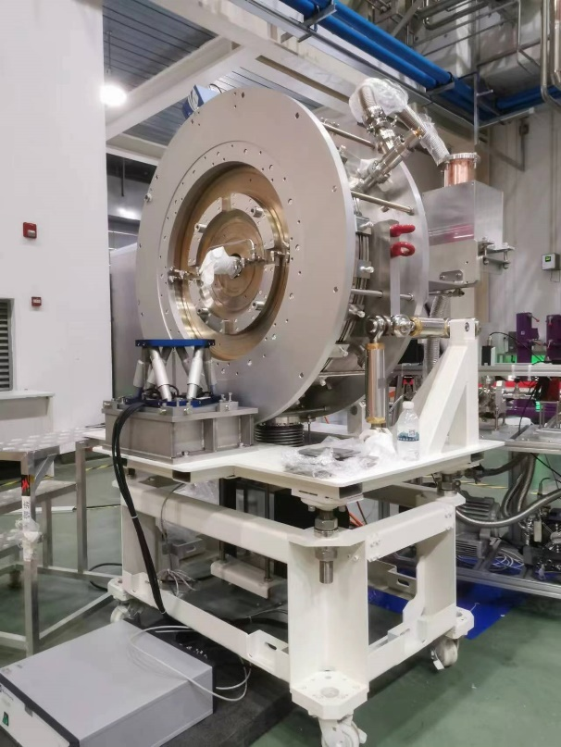
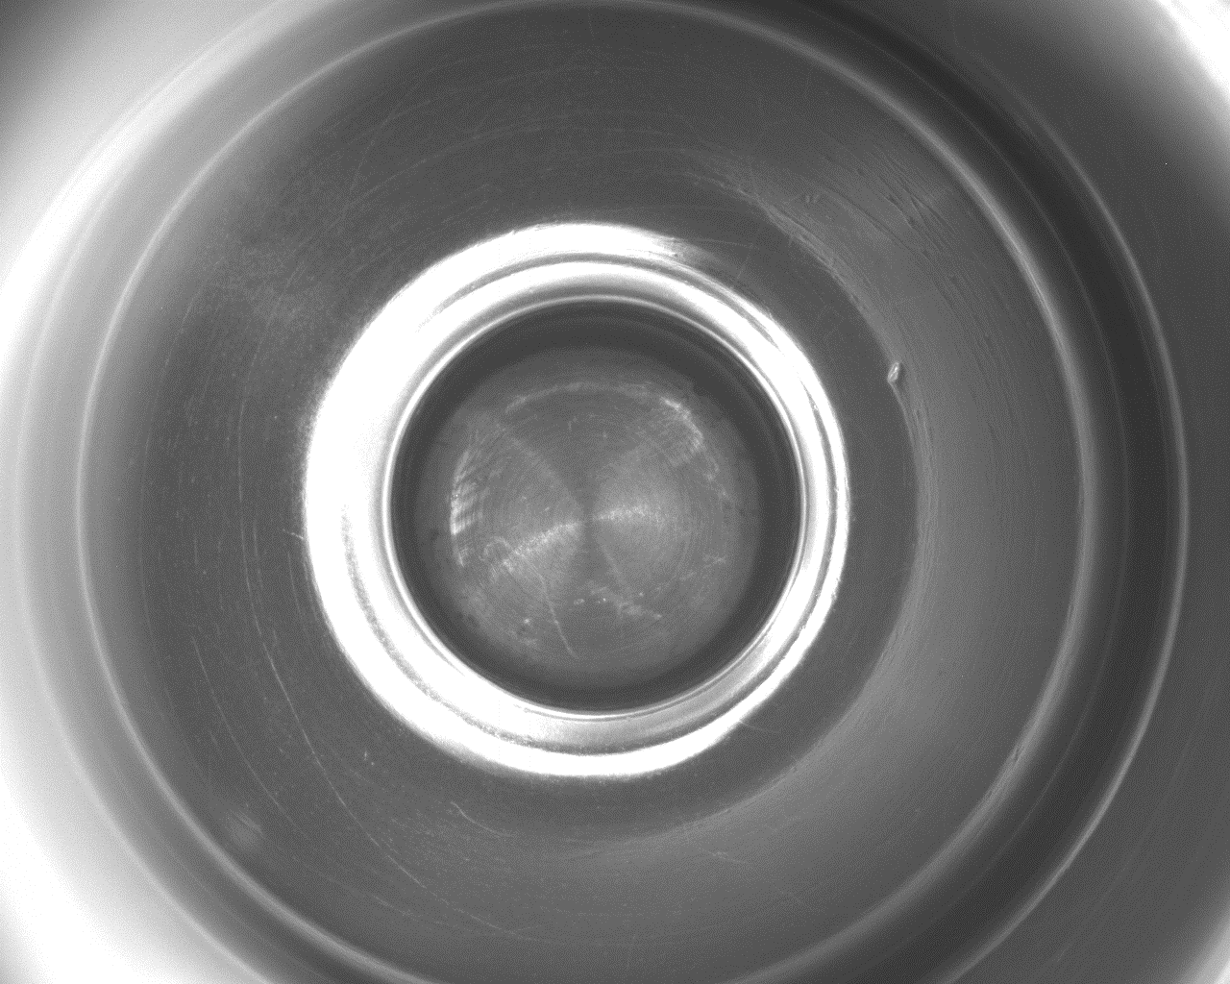
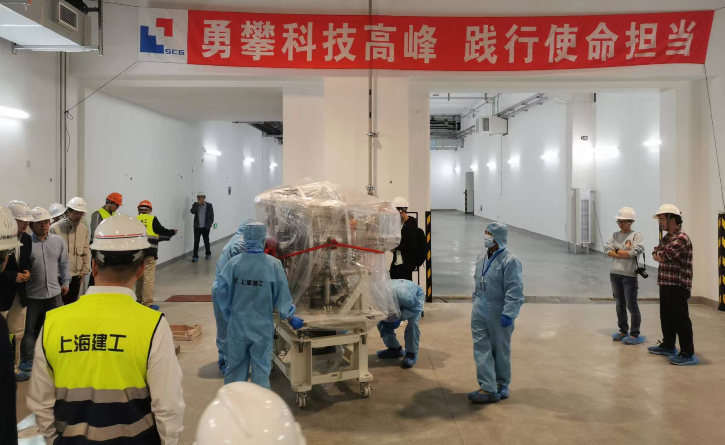
SHINE VHF gun Progress
04.2023 Tsinghua VHF gun delivered to SHINE project and installed as the first beam line component.
08.2023 SHINE injector low energy beamline installed
09.2023 Vacuum ready for beam commissioning(~8x10⁻⁹pa w/o RF)

Slide 21
Advanced photocathode RF gun developments
Very high frequency(VHF) gun
  CW operation with high vacuum
  High beam repetition to 1MHz
  High cathode gradient to 30MV/m
  Excellent beam source for CW XFEL/CW UED
High vacuum S-band photocathode RF gun
  Ultrahigh vacuum to 10⁻⁹pa
  Testing platform for advanced semiconductor photocathode

Slide 22
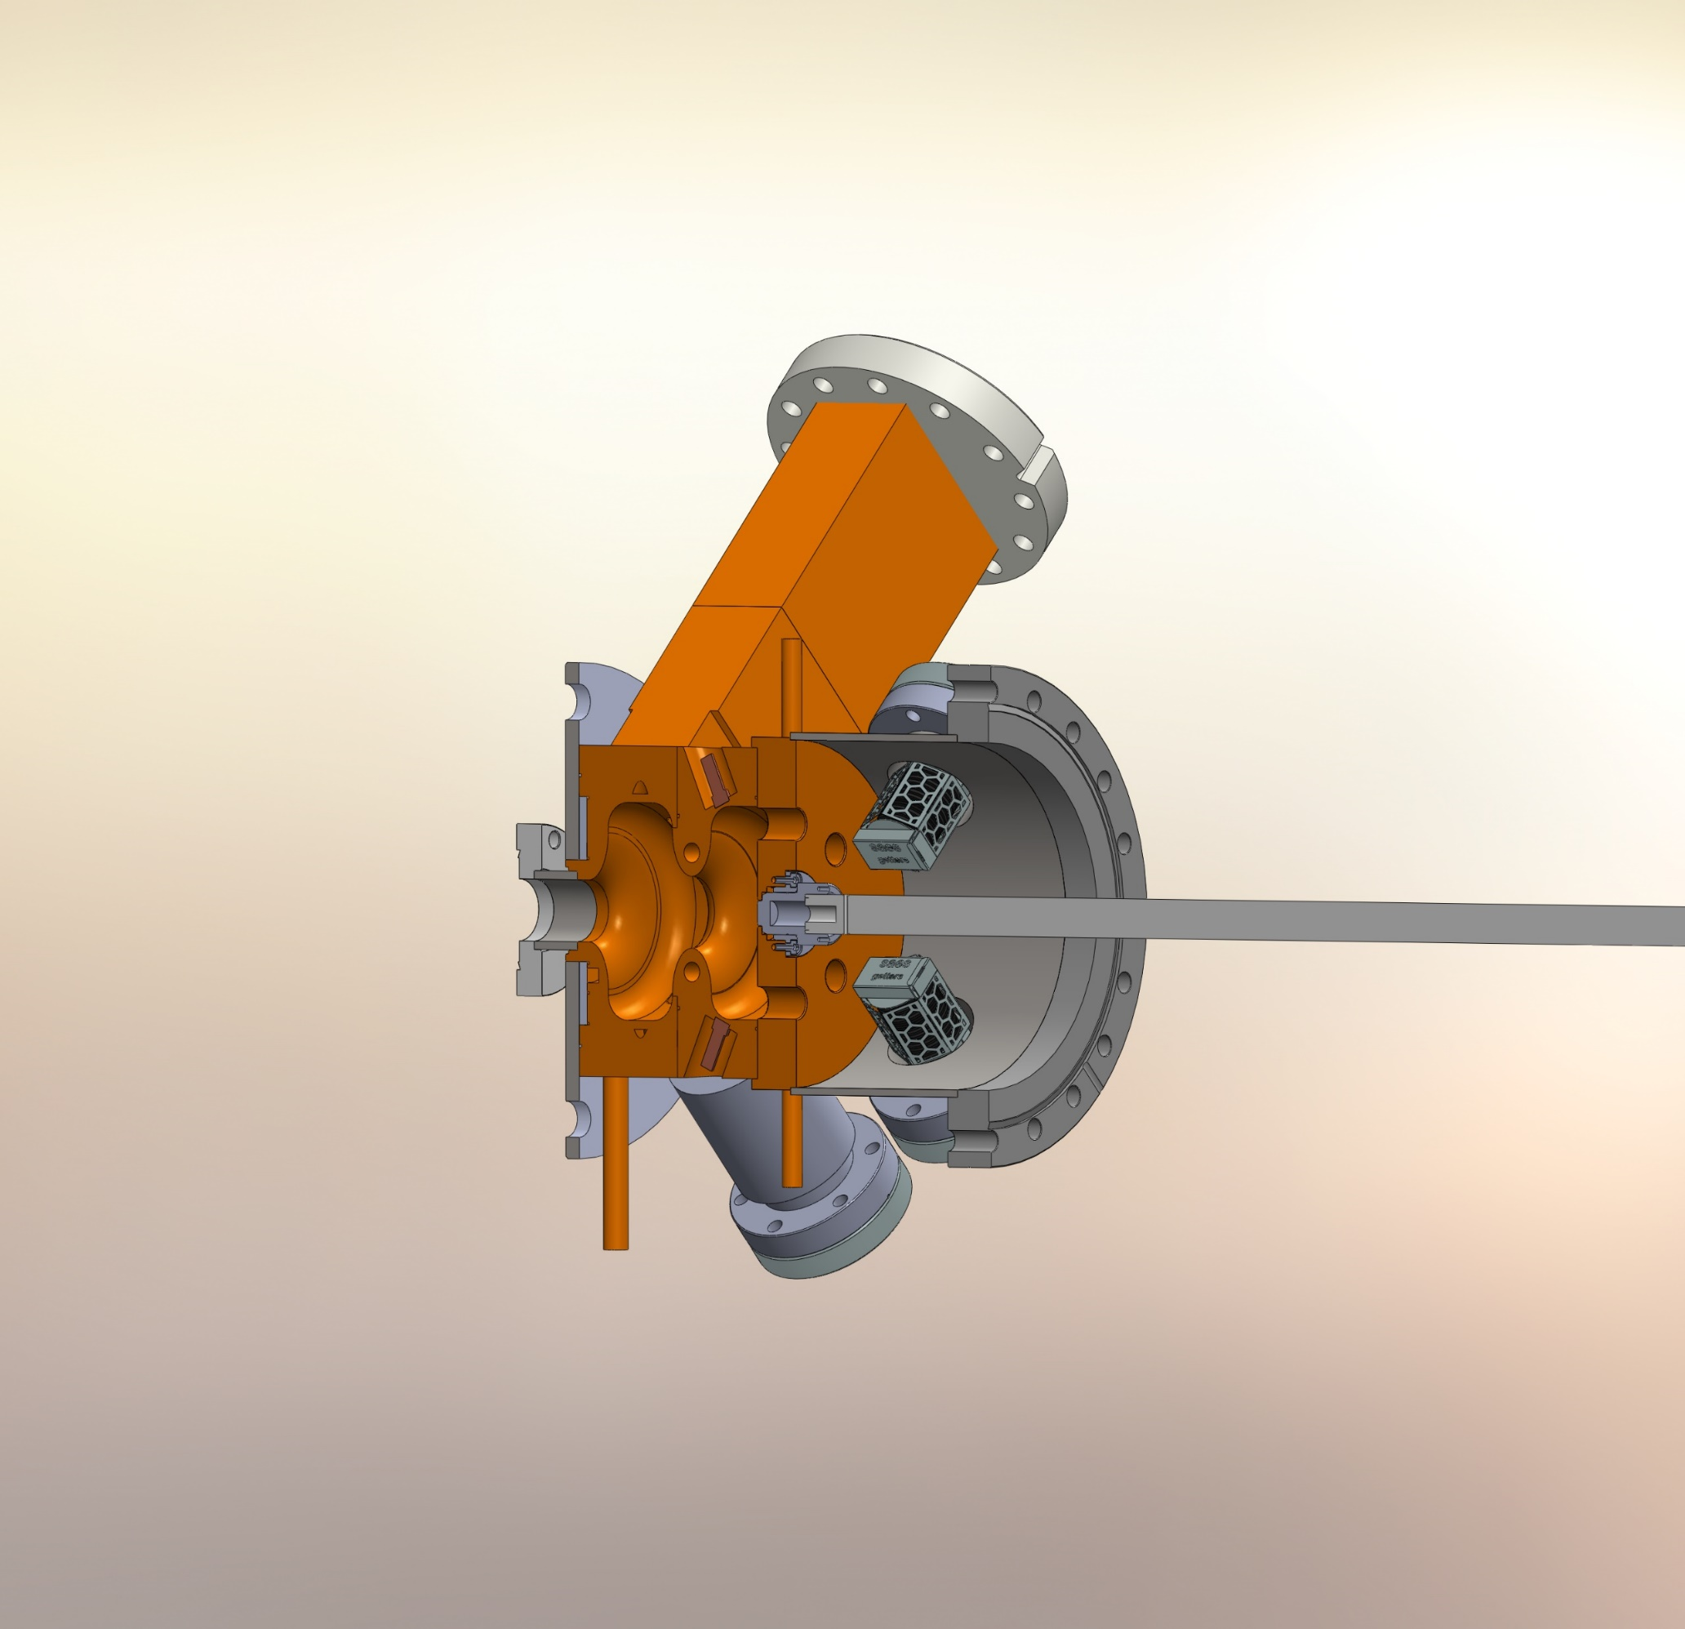
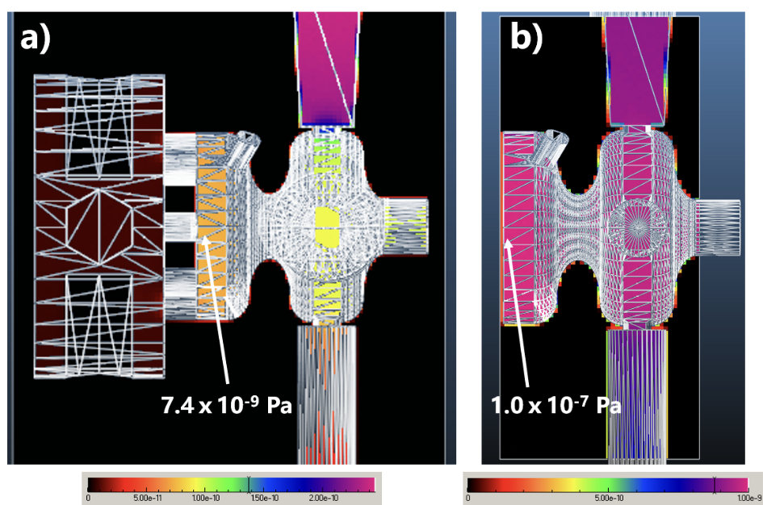
Ultrahigh vacuum gun design
>10 fold improvement in vacuum at cathode surface
P. W. Huang et al., NIMA 1051, 168251 (2023)

Slide 23
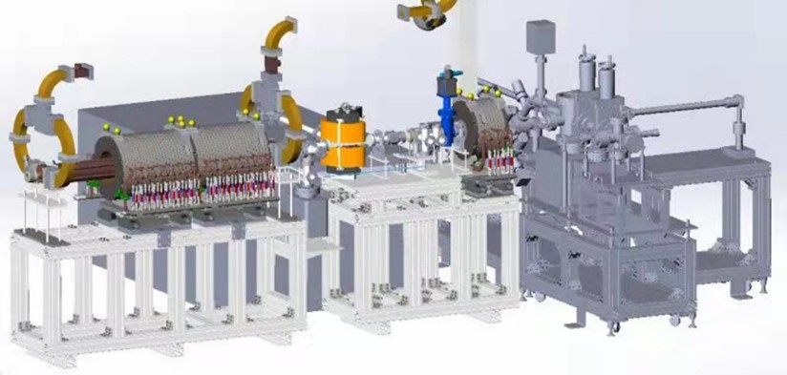
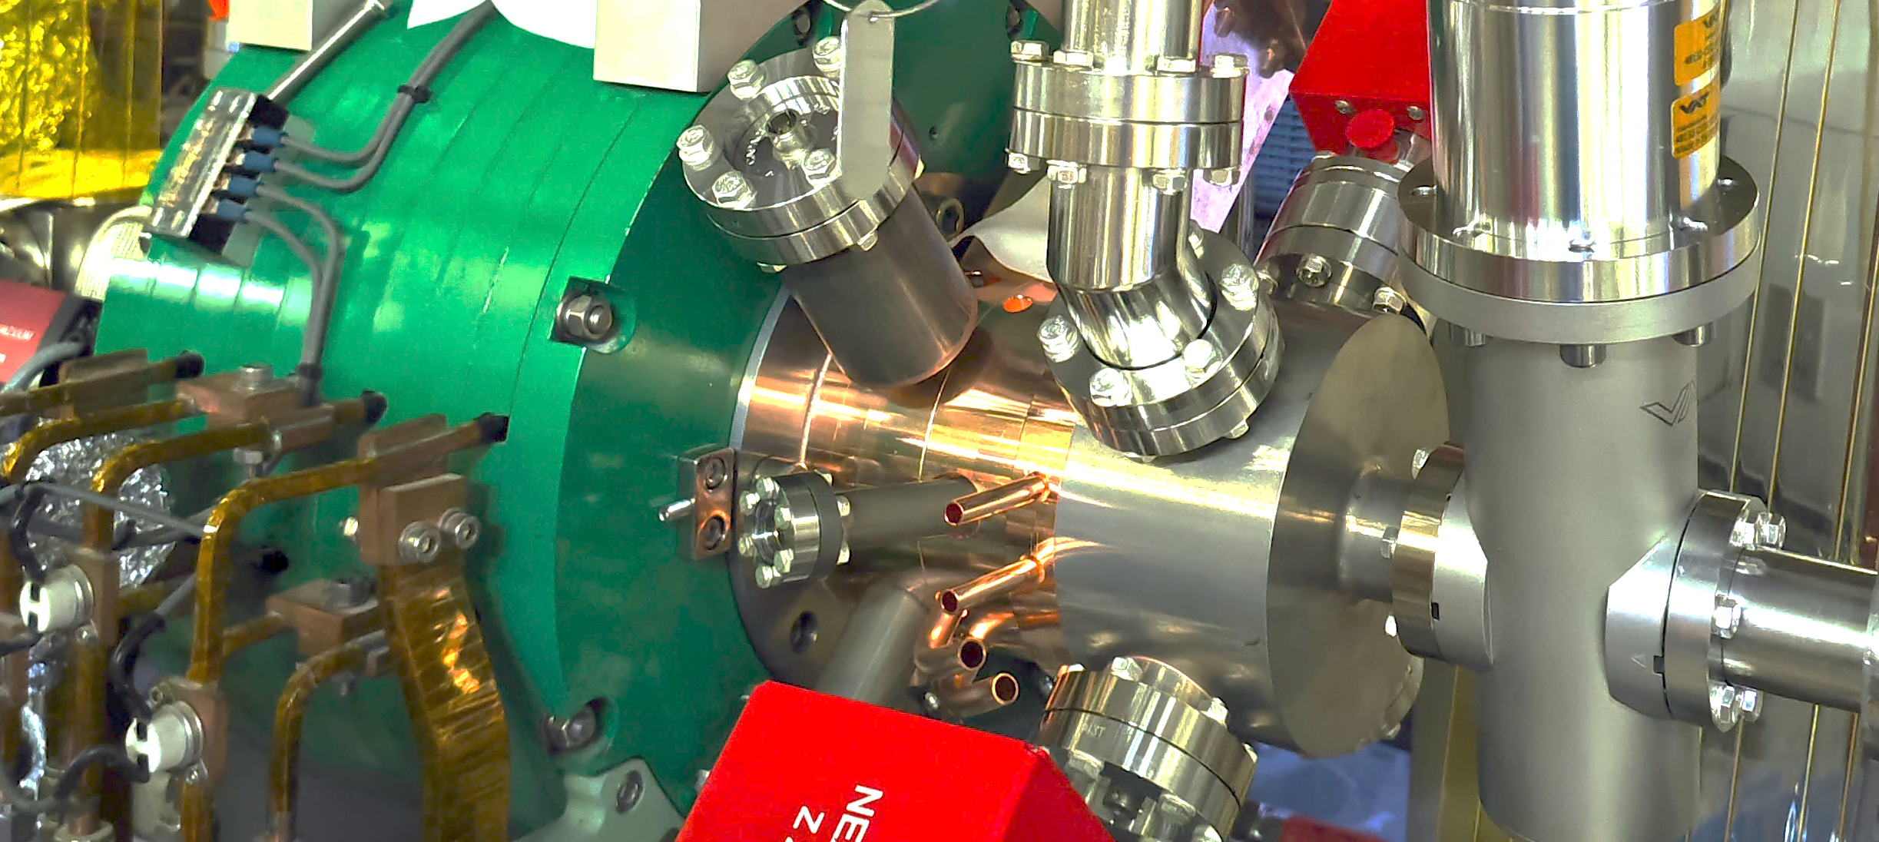
New gun installed
Full cell
Half cell
Vacuum cell
Load-lock

Slide 24
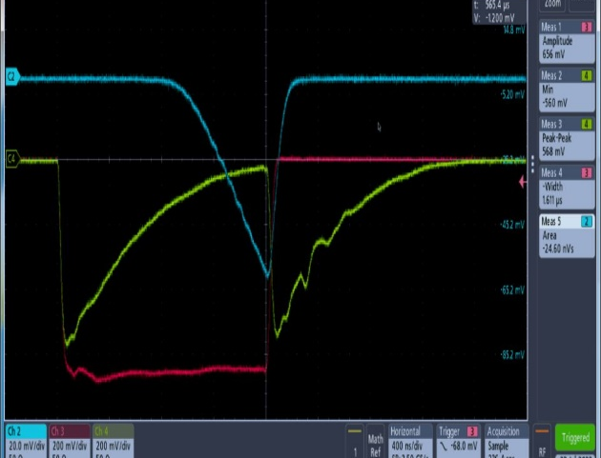
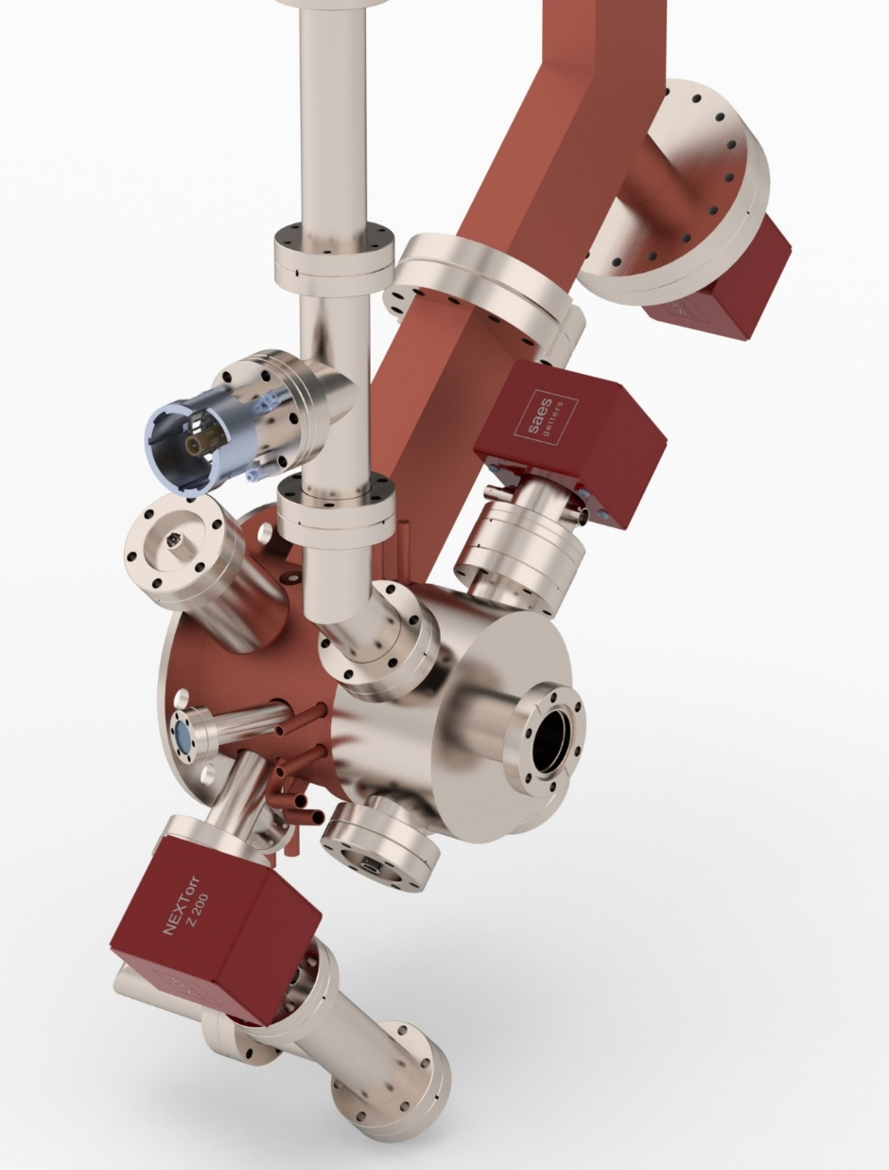
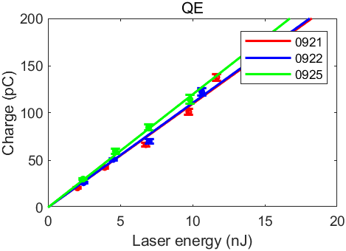
rf conditioning
Base/operation pressure
rf conditioning after 24 hrs
1.5e-8 Pa
5.5e-8 Pa
<2.1e-9 Pa
2.8e-8 Pa
Faraday cup
rf in
rf reflec.
<2.1e-9 Pa
1.4e-8 Pa
Dark current 0.5 nC @ E_{z}～105 MV/m
QE>~5% over a month
<2.1e-9 Pa
<2.1e-9 Pa
Cs₂Te

Slide 25
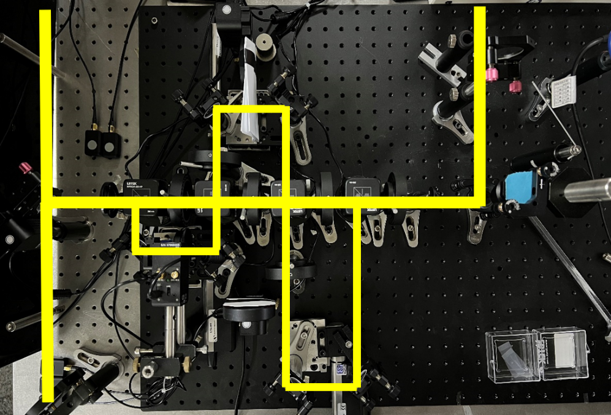




Every rf cycle operation
For several applications, highest possible marco-pulse current is desirable
Need to fill every rf cycle
Laser pulse train generation (stacking or marco-pulse mode laser) and LLRF control
Beam control supported by precise beam characterization
Preliminary data shows QE differences for single versus multiple pulses, more systematic measurement underway
0.35 mm rms

Slide 26
Outline
Introduction
Highlights of accelerator activities at THU
  Advanced photocathode RF gun developments
  VIGAS: Very compact Inverse Compton GAma-ray Source

Slide 27


Inverse Compton scattering X/γ-ray Source
Inverse Compton scattering X/γ-ray source
  Relativistic electron interacted with high power laser
  Highest peak brightness at high photon energy
  Compact and lower cost
高亮度电子束
高功率
脉冲激光
准单能伽马射线

Slide 28



ICS studies at THU

Slide 29



VIGAS: Very Compact ICS Gama-ray source
Funded by NSFC, 2021-2025
The first compact MeV ICS γ-ray source

Slide 30




VIGAS: Very Compact ICS Gama-ray source
Building area ~ 4800m²
Bunker for VIGAS accelerator:
21m $×$ 10 m

Slide 31

S-band photo-injector
X-band high gradient linac
Compact
High performance
Bandwidth：≤1.5%
Photon energy：0.2-4.8MeV
flux：>1.0×10⁸photons/s
Polarization：linear to circular

Slide 32

S-band photoinjector
50 MW power from Canon E3730A feeds for RF gun and S acc
  5dB power splitter
  Phase shifter for S acc phase control
7.5 MW power from Canon E3772A feeds for buncher
Consider RF loss due to waveguides and components:
Power splitter
circulator
Phase shifter
S acc
Power attenuator
 | Transmitted power (MW) | Needed power (MW)
RF-Gun | 11.7 | 7
S acc | 29 | 21
buncher | 6.4 | 3
photoinjector
buncher

Slide 33

X-band modules
Mode converter
Three X-band modules
One klystron for one module
  50 MW, 1.5us
One pulse compressor (SLED I type)
Two X band high gradient structures
  Average gradient >= 80 MV/m
  Energy gain per structure > 50 MeV
  Filling time < 150 ns
Maximum rf loss due to waveguides and rf components from klystron to Xacc is about 0.9dB
Peak power at Xacc input is about 91 MW if power compressor gives gain factor as 4.5
Pulse compressor
Phase shifter
3dB hybrid
RF window
X band high gradient
structure
Rf load

Slide 34





X-band structure: Constant impedance structure VS constant gradient structure
  CI has similar effective shunt impedance with CG when operating with a compressor
  The gradient almost reached 80MV/m with long time RF conditioning(months)
  The breakdown were mostly taken placed at upstream cells.
  The CG design is adopted for quicker conditioning and lower breakdown rate.

Slide 35

Scattering laser system
  Compact and stable laser system from commercial company (Qi-Feng)
参数 | 值
wavelength(nm) | 800 | 400
Bandwidth (nm) | <15 | <8
Pulse energy(J) | >1.5 | >0.8
Pulse length(ps, FWHM) | <10
Bean size at IP(μm, rms) | <10
stability(%, rms) | <1
Pointing jitter(μrad) | <5
Timing jitter(ps) | <0.2

Slide 36
Thank you for your attention!

