Slide 1
SPPC General Study Status
TANG, Jingyu (USTC)
for the SPPC study group
CEPC 2023, Oct. 23-27, 2023
Nanjing, China

Slide 2
Outline
Brief on the main design features
Updating of Accelerator Physics
  Lattice design of the collider rings
  Longitudinal beam dynamics
  Synchrotron radiation
Technical design and R&D
  High-field magnets and R&D
In the frame of CEPC TDR and EDR
Summary

Slide 3
Baseline design at 125 TeV
Since late 2021, we have been working on the scheme of 20-T/125-TeV
  White Paper at Snowmass 2021 [arXiv: 2203.07987, 2022]
CDR study published in:
Frontiers in Physics, 10: 828878 (2022)

Slide 4
SPPC main parameters (TDR)
Parameter | Unit | Value
 |  | PreCDR | CDR | TDR
Circumference | km | 54.4 | 100 | 100
C.M. energy | TeV | 70.6 | 75 | 125
Dipole field | T | 20 | 12 | 20
Injection energy | TeV | 2.1 | 2.1 | 3.2
Number of IPs |  | 2 | 2 | 2
Initial luminosity per IP | cm⁻²s⁻¹ | 1.2e35 | 1.0e35 | 4.3e34
Beta function at collision | m | 0.75 | 0.75 | 0.5
Circulating beam current | A | 1.0 | 0.7 | 0.19
Bunch separation | ns | 25 | 25 | 25
Bunch population |  | 2.0e11 | 1.5e11 | 4.0e10
SR power per beam | MW | 2.1 | 1.1 | 2.2
SR heat load per aperture @arc | W/m | 45 | 13 | 26

Slide 5
Collider Ring - Parameter List

Slide 6
Optional Operation at 75 TeV
The design scheme of CDR with 75 TeV is kept as the optional operation mode of the SPPC project
  Similar to Run-I for LHC, with significantly lower energy
  But the luminosity goal is higher with higher beam current
Parameters | @75 TeV | @125 TeV | Unit
Dipole field | 12 | 20 | T
Initial luminosity per IP | 1.0×10³⁵ | 4.3×10³⁴ | cm⁻²s⁻¹
Annual integrated luminosity | 1.24 | 0.65 | ab⁻¹
Circulating beam current | 0.73 | 0.19 | A
Bunch population | 1.5×10¹¹ | 4×10¹⁰
Normalized emittance | 2.4 | 1.2 | mm-mrad
Stored energy per beam | 9.1 | 4.0 | GJ
SR power per beam | 1.1 | 2.2 | MW
SR heat load at arc per aperture | 12.8 | 26.3 | W/m

Slide 7
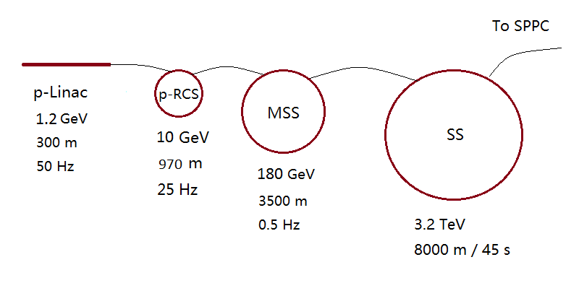
e-p collision and injector chain
CEPC-SPPC e-p parameter design updated to new SPPC baseline design and reported at Snowmass 2021
Injector chain almost unchanged except the energy of the last stage SS increased from 2.1 TeV at CDR to 3.2 TeV
p-Linac: proton superconducting linac
p-RCS: proton rapid cycling synchrotron
MSS: Medium-Stage Synchrotron
SS: Super Synchrotron

Slide 8
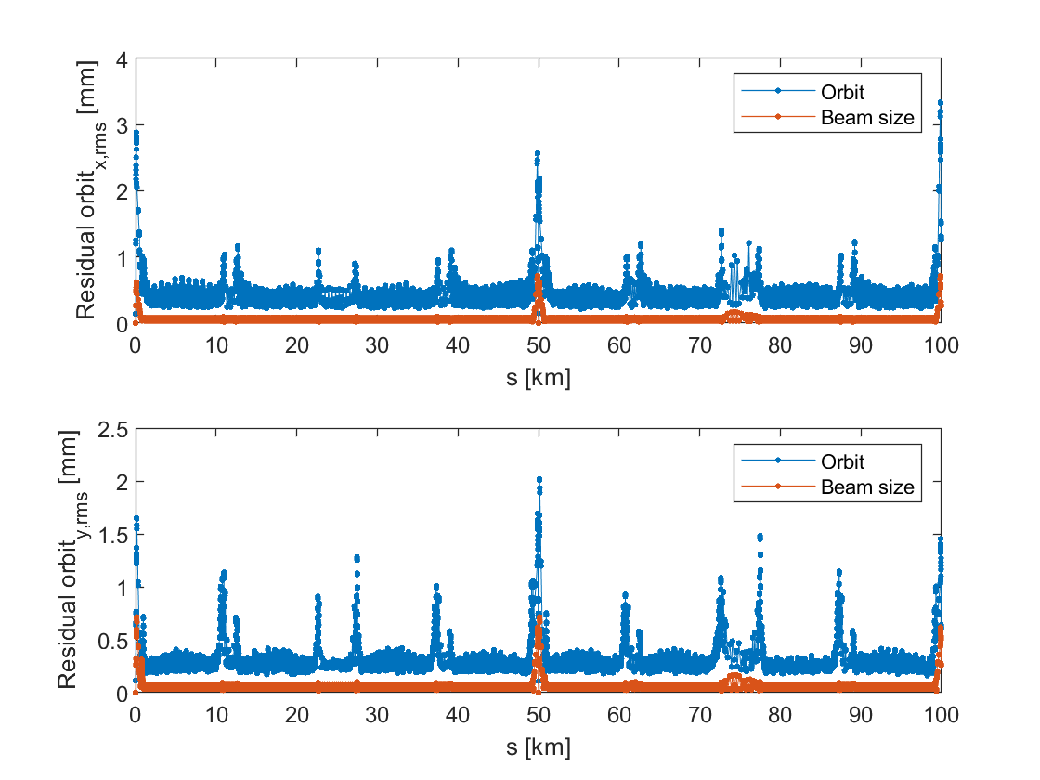
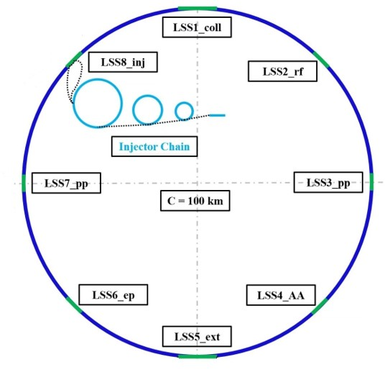
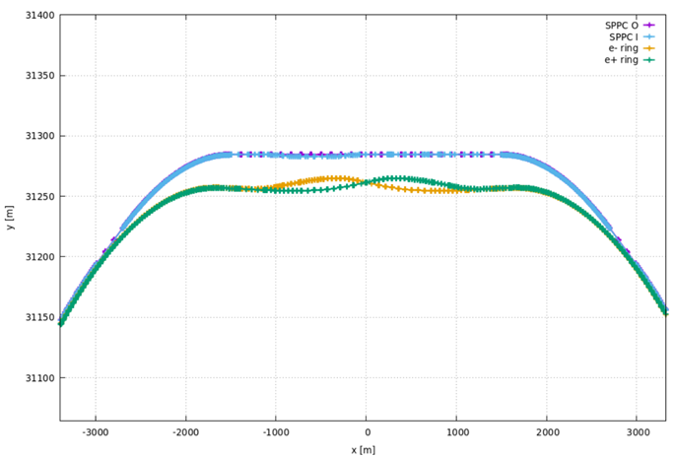
Lattice Design
Xu Haocheng
Wang Yiwei,
See H. Xu’s talk
Orbit correction study @125 TeV
Study on bypass scheme with respect to CEPC

Slide 9
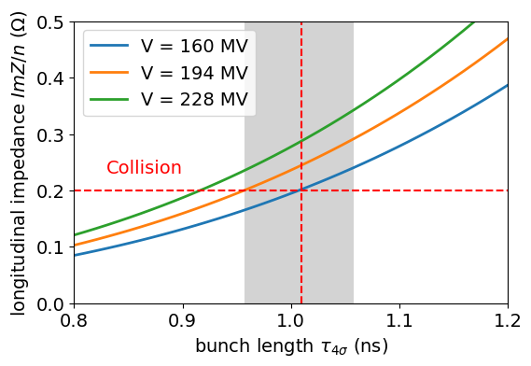
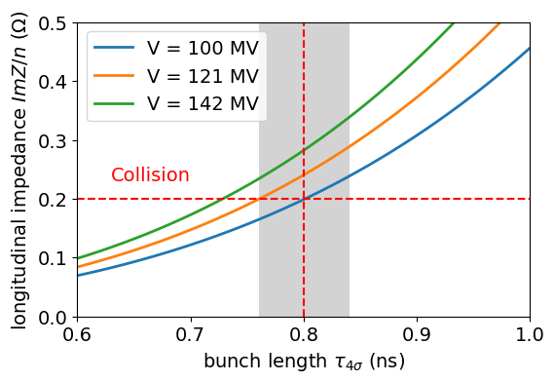
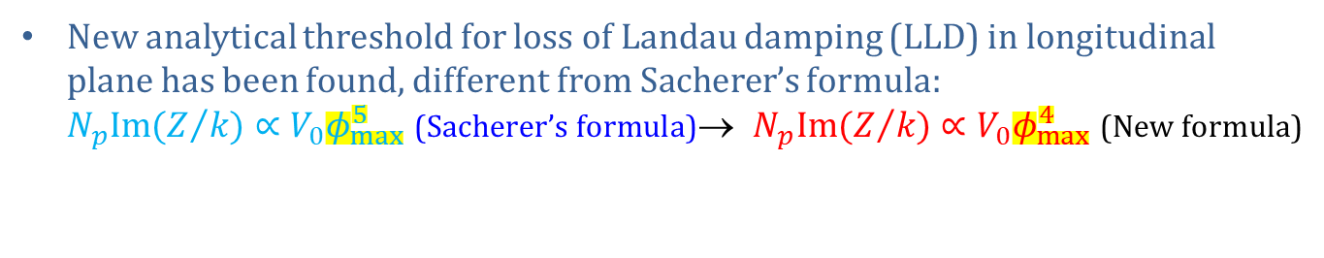


Update on SPPC RF voltage requirement
Zhang Linhao
New analytical threshold for loss of Landau damping (LLD) in longitudinal plane has been found, different from Sacherer’s formula:
$N_{p}Im(Z/k)∝V_{0}φ_{max}^{5}$ (Sacherer’s formula)→ $N_{p}Im(Z/k)∝V_{0}φ_{max}^{4}$ (New formula)
±5% bunch length spread
±5% bunch length spread
CDR: $σ_{z}=7.55 cm, τ_{4σ}=1.01 ns$
TDR: $σ_{z}=6. 0 cm, τ_{4σ}=0.8 ns$
To meet the estimated longitudinal impedance of 0.2 Ω for the objective bunch length with a spread of ±5%, RF voltage at the SPPC collision energy reaches 194 MV for CDR or 121 MV for TDR. (Previous: 40 MV)

Slide 10
Updated RF and beam parameters
Parameter | Unit | Injection (200MHz) | Injection (400MHz) | Collision (400MHz) | Collision (800MHz) | Collision (400+800MHz)
Proton energy | TeV | 3.2 | 3.2 | 62.5 | 62.5 | 62.5
Bunch intensity | 10¹⁰ | 4.0 | 4.0 | 4.0 | 4.0 | 4.0
Longitudinal emittance (4σ) | eVs | 6.0 | 2.9 | 11.9 | 5.5 | 8.2
RF frequency | MHz | 200 | 400 | 400 | 800 | 400+800
RF voltage | MV | 9.8 | 17.6 | 121 | 66 | 41.2
RMS bunch length | cm | 20.0 | 10.0 | 6.0 | 4.0 | 5.5
RMS momentum spread | 10⁻⁴ | 2.24 | 2.15 | 0.76 | 0.53 | 0.57
Synchrotron frequency | Hz | 5.4 | 10.3 | 6.12 | 6.35 | 4.96
Bucket area | eVs | 10.94 | 5.18 | 60.02 | 15.67 | 27.51
Bucket half height | 10⁻⁴ | 5.4 | 5.1 | 3.0 | 1.6 | 1.8
Higher harmonic (800 MHz) or dual harmonic (400 + 800 MHz) RF system can help enhance Landau damping, thus help significantly reduce the required RF voltage

Slide 11

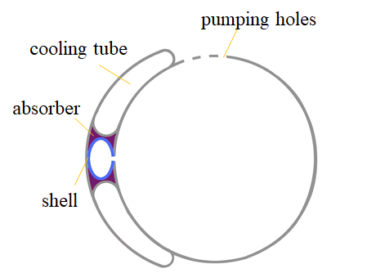
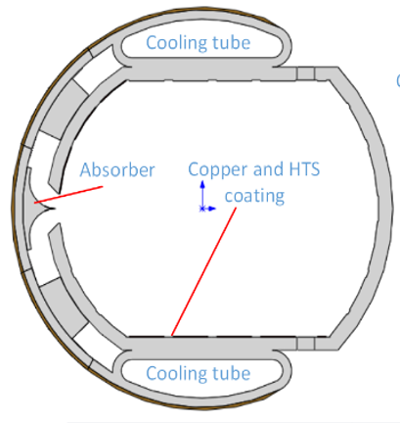
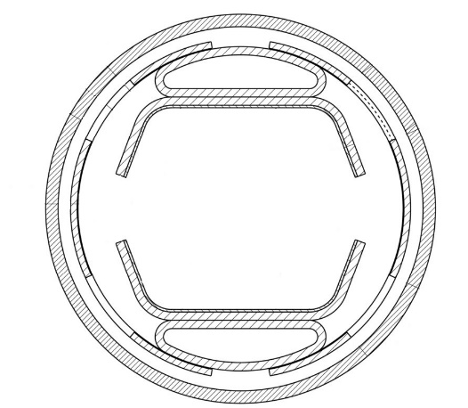
Synchrotron radiation and beam screen
GC Gerardo
With a higher beam energy of 62.5 TeV, the synchrotron radiation becomes more important
  Higher heat load
  Higher critical photon energy
Beam screen scheme revisited
Beam screen at CDR
FCC-hh Beam screen
Beam screen also investigated
Notes:
Bypass问题：采用现在有CEPC Lattice，SPPC尽量绕圈，最高磁场可以适当高一些，如26-30T，或者24T磁场，对撞能量125TeV。哪个优先级高？（Bypass区）给出具体的比较。要给一个Bypass的总长度，而且CEPC土建时预建一段Bypass隧道，以避免SPPC建造时影响全环，需要确定两个隧道分开多大后，可以认为是后建时不影响。新的讨论：尽量达到150TeV能量，两个选择：一是Bypass采用30T，另一是原隧道采用24T。
提供Bypass方案的非共享隧道长度（可以不需要Bypass的直线段：SPPC注入和RF；2个pp对撞区、2个ee对撞区-引出-准直、预留AA对撞区。e-p）。
同步辐射问题：我自己的事。

Slide 12
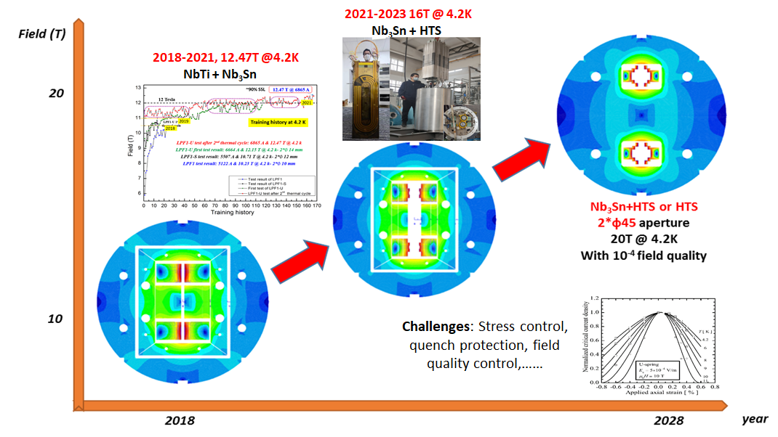
Brief on high-field magnet R&D
Details see talk by Xu Qingjin
R&D efforts on high-field superconducting magnets continue at IHEP
  Long-term efforts to meet the SPPC requirements
  Strong domestic collaboration for the advanced superconductor R&D (HTS & Nb₃Sn)
  Collaboration with CERN on the CCT magnets for HL-LHC
  Significant progresses in different prototypes
  Target at IBS 20 T for SPPC – 125 TeV
Notes:
Bypass问题：采用现在有CEPC Lattice，SPPC尽量绕圈，最高磁场可以适当高一些，如26-30T，或者24T磁场，对撞能量125TeV。哪个优先级高？（Bypass区）给出具体的比较。要给一个Bypass的总长度，而且CEPC土建时预建一段Bypass隧道，以避免SPPC建造时影响全环，需要确定两个隧道分开多大后，可以认为是后建时不影响。新的讨论：尽量达到150TeV能量，两个选择：一是Bypass采用30T，另一是原隧道采用24T。
提供Bypass方案的非共享隧道长度（可以不需要Bypass的直线段：SPPC注入和RF；2个pp对撞区、2个ee对撞区-引出-准直、预留AA对撞区。e-p）。
同步辐射问题：我自己的事。

Slide 13
In the frame of CEPC TDR and EDR
SPPC in TDR
  CEPC TDR draft completed, SPPC as a chapter
SPPC work in the EDR phase from 2023-2025
  Optimization of the SPPC lattice to follow the layout evolution of the CEPC lattice design;
  Study of nonlinear beam dynamics with more-or-less realistic error models;
  Study of the synchrotron radiation effects and beam screen design;
  Conceptual design of the injector accelerators;
  Study of possible bypass schemes for hosting entire CEPC and SPPC colliders including detectors in the same tunnel.
  Further studies on the beam-beam effects and longitudinal dynamics?
  Update design of the beam collimation system?

Slide 14
Summary
SPPC study continued but at a low profile to follow CEPC in the TDR stage, and will continue in the CEPC EDR stage
Some updates on the accelerator physics design: lattice, longitudinal beam dynamics, synchrotron radiation, injector chain accelerators
R&D on high-field superconducting magnets is supported by a domestic research program and collaboration with CERN.
Thank you for your attention!

