Slide 1
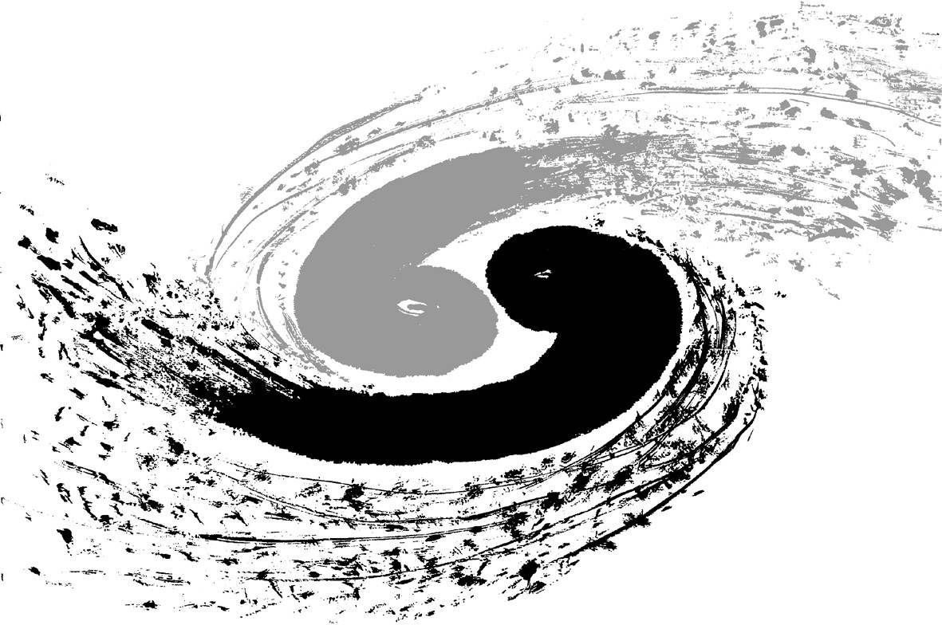
Progress in the mechanical design
of CEPC /MDI detector
Junsong Zhang，Quan Ji ，Shu Chang，Xia Shang, He Longyan

Slide 2
Content:
General introduction
Progress of MDI design
Iron yoke
Superconcuction solenoid
ECAL
Beam pipe
summary

Slide 3
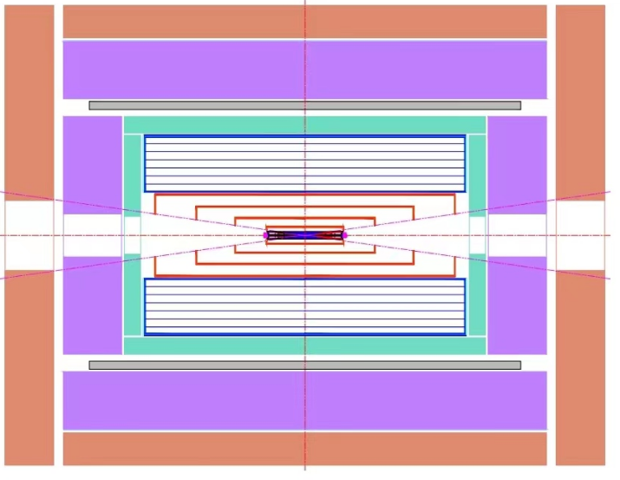
General introduction
iron yoke
end-iron yoke
HCAL
end-iron yoke
superconductiion solenoid
ECAL
Updated design in 2023 :
1) Beam pipe:LumiCal and BPM
2) Yoke:Muon: 7 layers
3）Structure of ECAL
4）Superconducting solenoid: coil support structure
beam pipe
ECAL
superconductiion solenoid
HCAL
iron yoke

Slide 4
Content:
General introduction
Progress of MDI design
Iron yoke
Superconcuction solenoid
ECAL
Beam pipe
summary

Slide 5
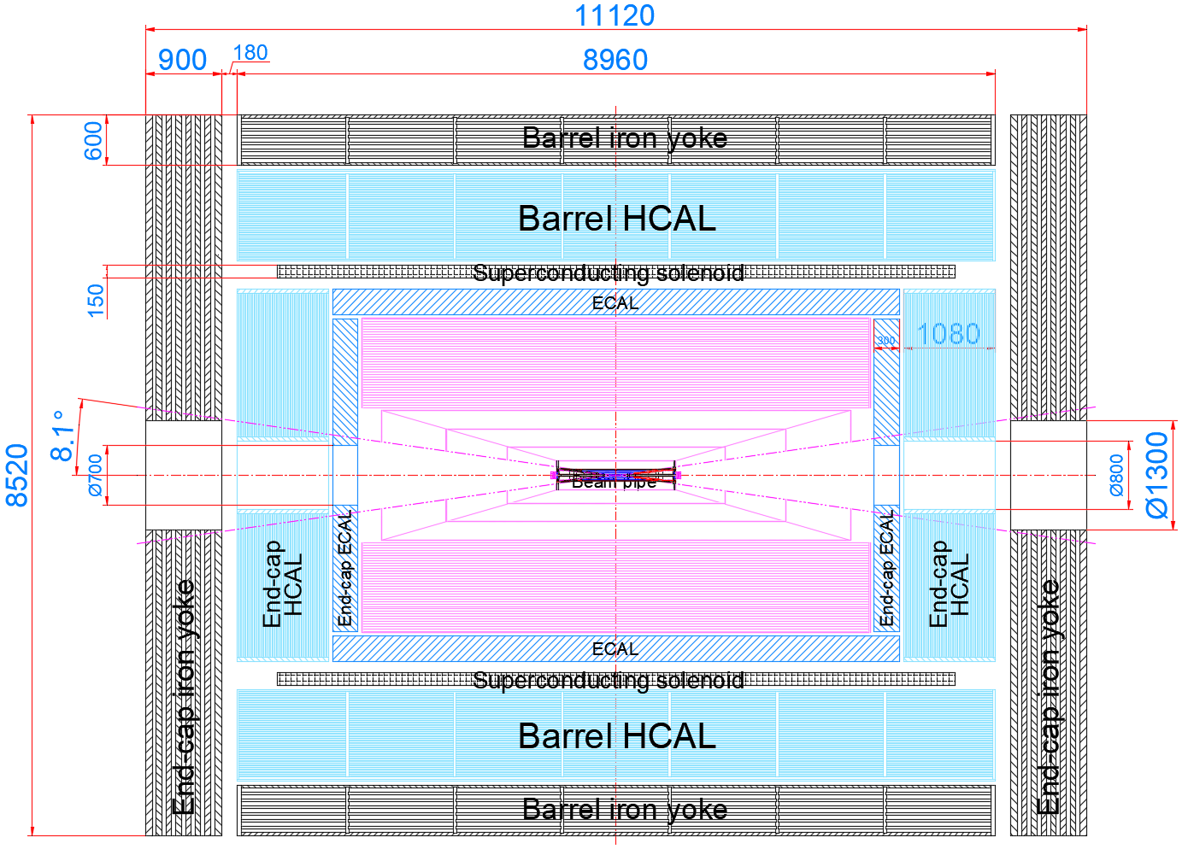
General introduction of yoke
CEPC yoke
height：8.5m
long：11.1m
MDI total weight：3000T
yoke total weight：1000T
Design progress in 2023
added 2 muon detectors
easy to assemble
structure reliability
CEPC MDI profile structure

Slide 6
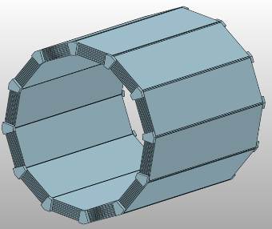
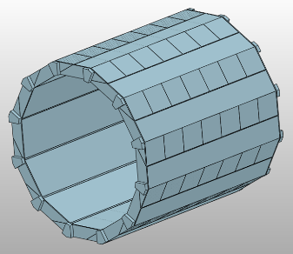
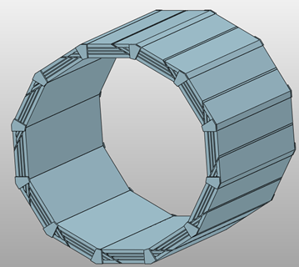
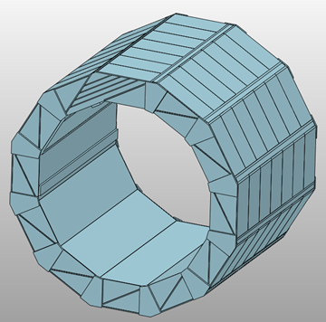
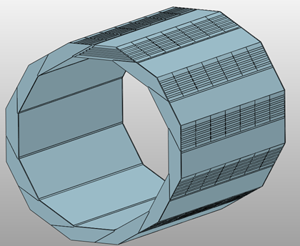
Design process of iron yoke
added muon detector
cost reduction
symmetric type
spiral type
Computational check
2018.12
thickness: 600mm
Muon: 3 layers
height: 9600mm
weight: 920 t
2020.1
thickness: 1460mm
Muon: 4 layers
height: 12120mm
weight: 3180 t
2021.3
thickness: 600mm
Muon: 5 layers
height: 8520mm
weight: 760 t
2023.6
thickness: 600mm
Muon: 7 layers
height: 8520mm
weight: 520 t

Slide 7
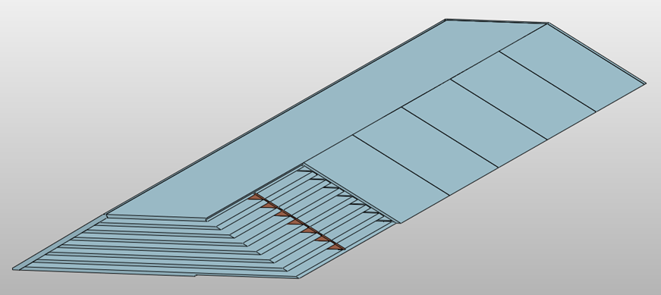
New progress for iron yoke
end-yoke
According to the preliminary verification calculation, the model is adjusted as follows:
end-yoke：Seven-layer muon detector，thickness：900mm；
barrel-yoke：Seven-layer muon detector，thickness：600mm；
symmetry
yoke uint of symmetry style
spiral
yoke uint of spiral style
Objective: To improve the resolution of detector.
Progress: At present, the design model has been modified. The next step is to calculate the deformation of the yoke iron under the action of gravity and magnetic field when the space of seven-layer µon detector is placed.

Slide 8
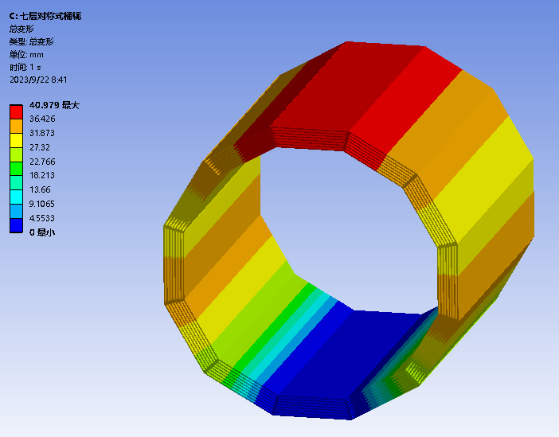
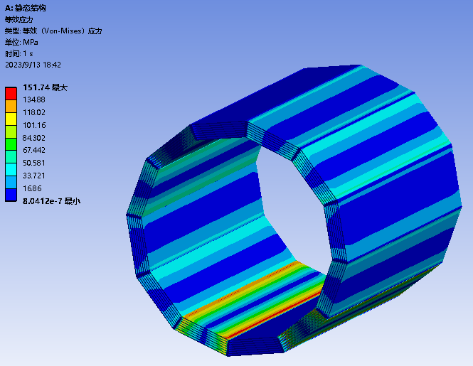
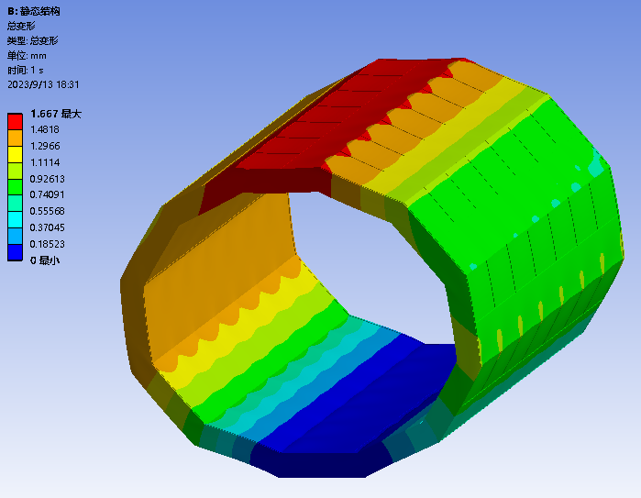
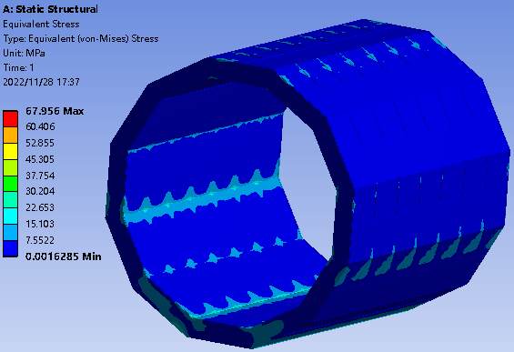
Yoke iron simulation calculation
Result No.1
parameter：
thickness: 600mm
Muon: 7 layers；
materials：T10 ；
loading：560T；
Under the action of gravity, the structural strength of spiral structure is greater than that of symmetrical structure. This is because the spiral structure has some rid plates in the middle of barrel .
symmetry
maximum deformation40.979mm
maximum stress151.74MPa
spiral
maximum deformation1.667mm
maximum stress77.591MPa

Slide 9
Yoke iron simulation calculation
Result No.2
Upper and lower plate: 65mm, layers: 20mm（65+65+20）
Result of self-weight deformation of symmetrical barrel iron yoke
Number of layers | 3 | 5 | 7
deformation | 3.2192 | 7.8251 | 40.979（35+35+30）
 |  |  | 19.161（65+65+20）
 |  |  | 19.322（95+35+20）
When the upper plate and the lower plate thinkness of the yoke uint are added, the stiffness of the yoke iron can be increased. There is same result for spiral structures.

Slide 10
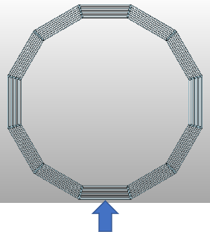
Yoke iron simulation calculation
Result No.3
The number of yoke supports will also affect the stiffness of the yoke. When the number of support of the symmetrical yoke structure is increased to 5, the overall deformation will be greatly reduced.

Slide 11
Content:
General introduction
Progress of MDI design
Iron yoke
Superconcuction solenoid
ECAL
Beam pipe
summary

Slide 12
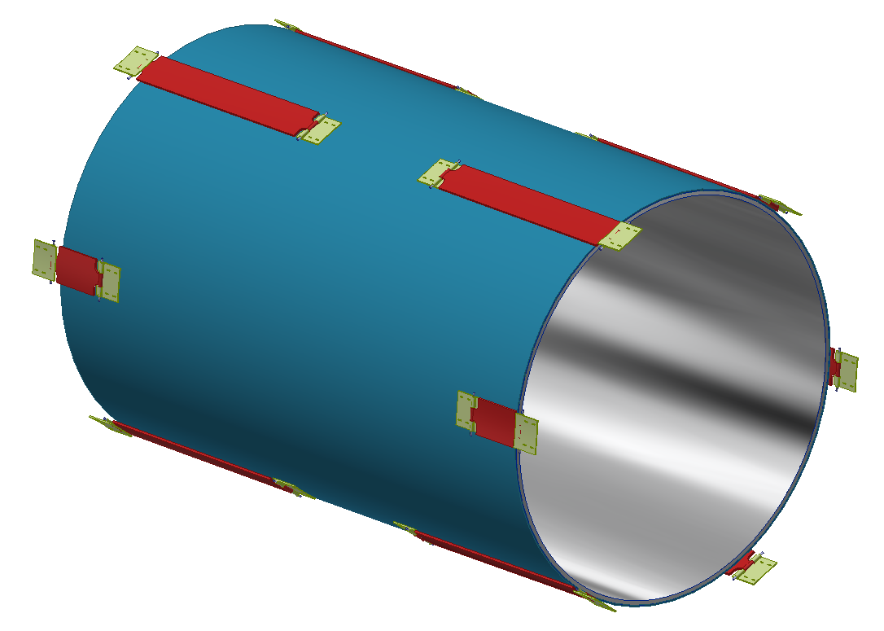
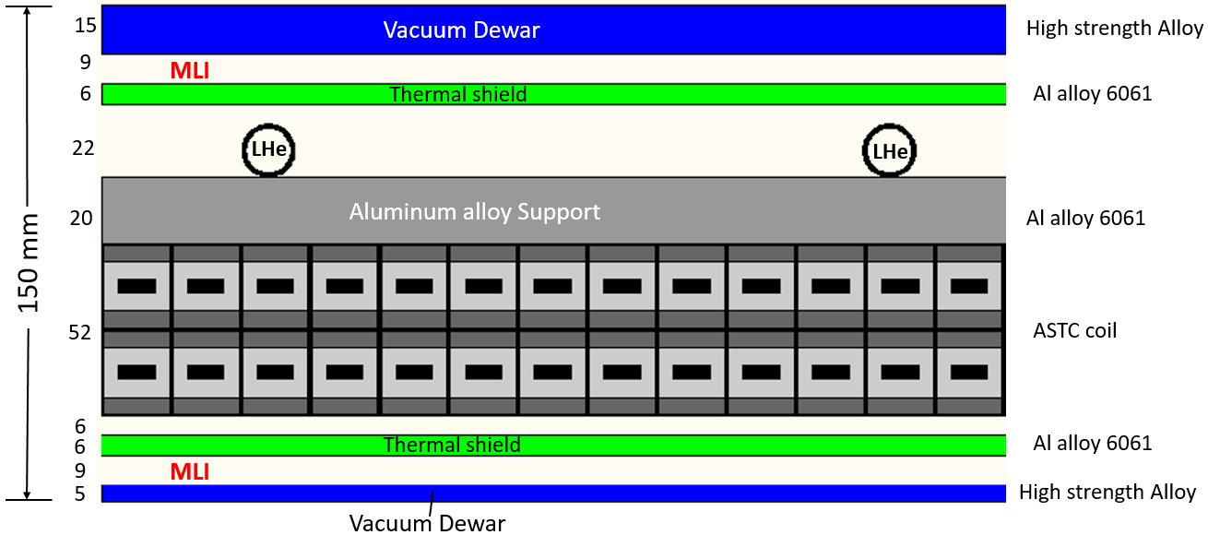
Superconducting solenoid general design
Design of coil hoisting structure。
The design goal is to secure the coil inside the thermostat
coil
The maximum distence from coil to vacuum devar is 37mm. Space is very limited. The distance from the inner surface of the coil to the surface of the vacuum inner dewar is 21mm. The design is difficult.

Slide 13
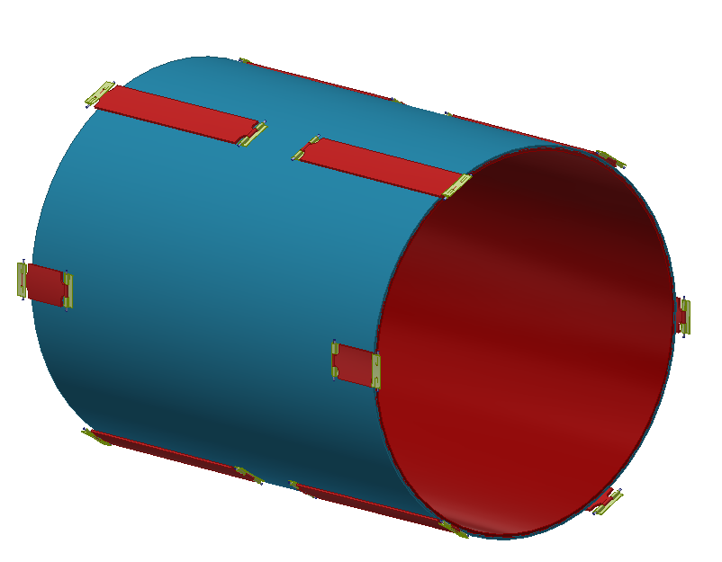
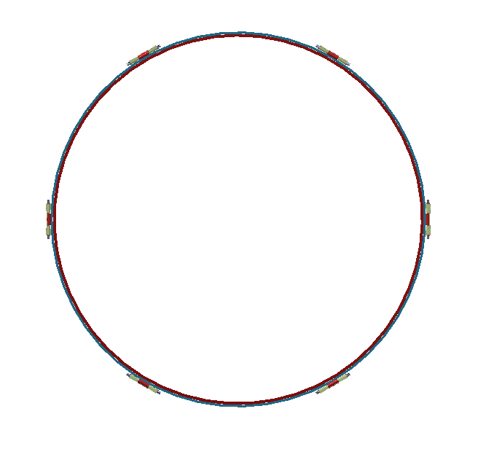
The coil support of the superconduction solenoid design
Axial positioning structure
The superconducting coil fixing scheme adopts two vertical support structures and four axial positioning structures. The vertical support structure carries the overall weight of the coil. One end of the support structure is fixed on the aluminum support barrel and the other end is fixed on the vacuum dewar.
Vertical support structure

Slide 14
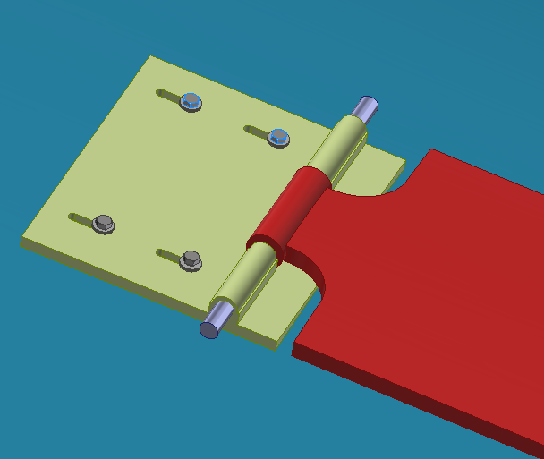
The coil support of the superconduction solenoid design
axis of rotation
belleville spring
link plate
The rotating shaft allows the support structure to adapt to the deformation of the coil at low temperature, and the disc spring and long groove are installed at the position of the mounting hole to achieve the fixation under low temperature deformation.

Slide 15
Content:
General introduction
Progress of MDI design
Iron yoke
Superconcuction solenoid
ECAL
Beam pipe
summary

Slide 16
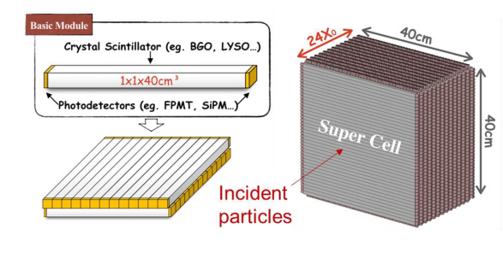
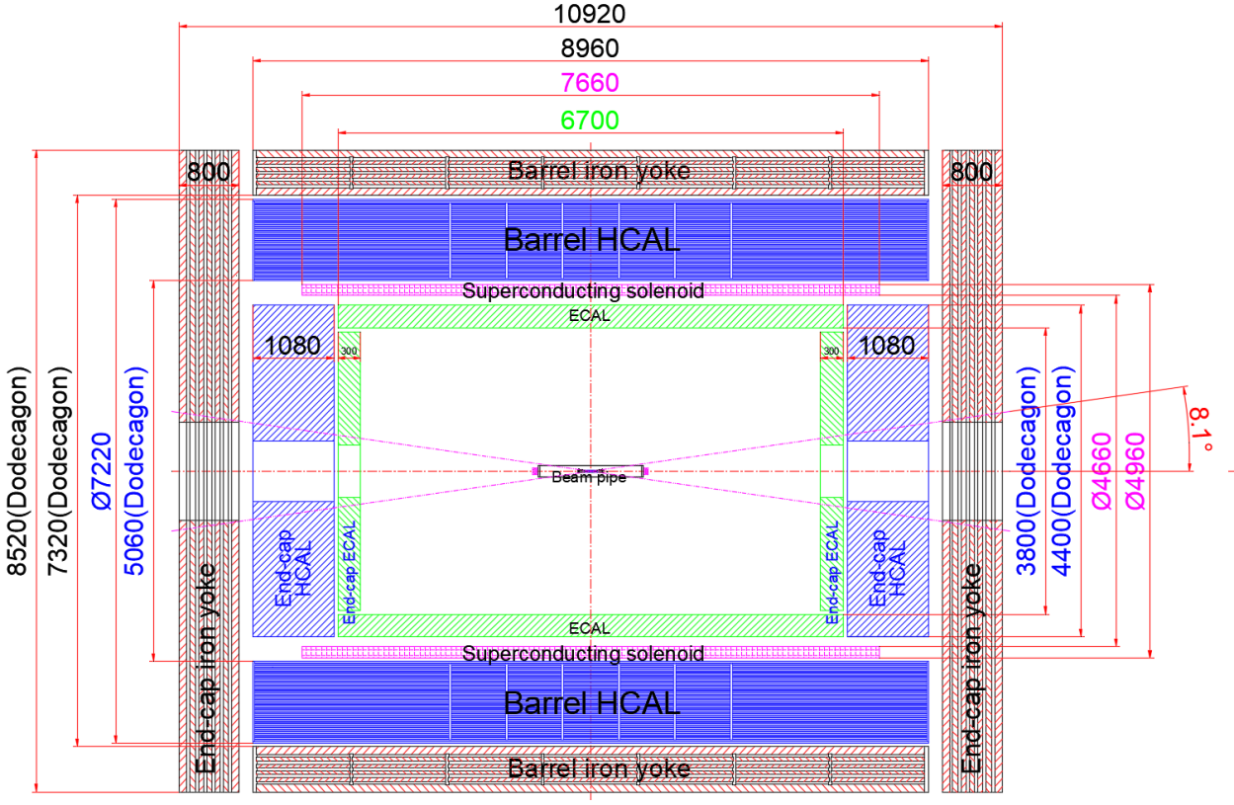
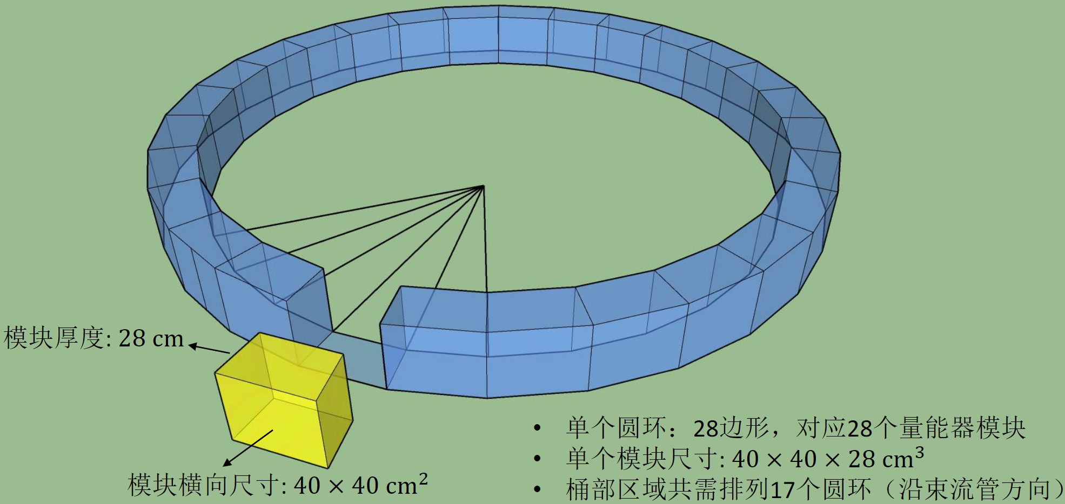
ECAL General design
The composition of detector module：
Horizontal and vertical crystal strips
The detector module are fixed together in radial direction and axial direction.
整体排布示意

Slide 17
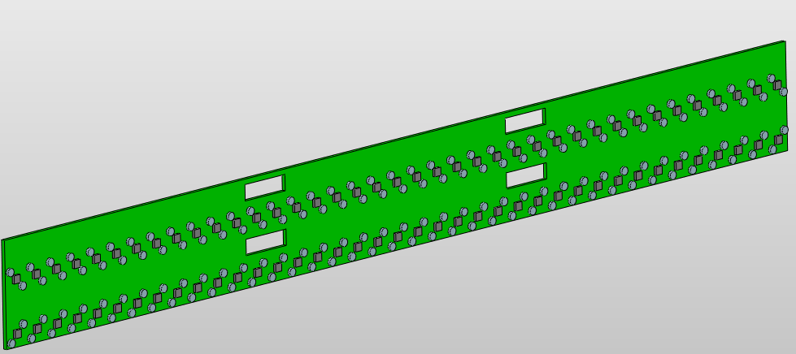
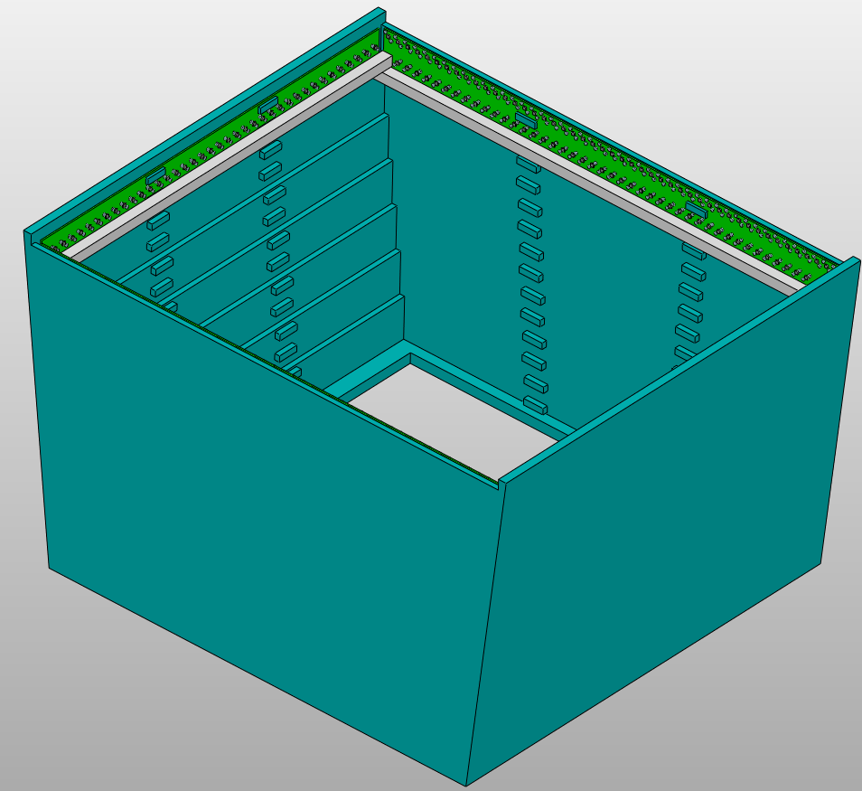
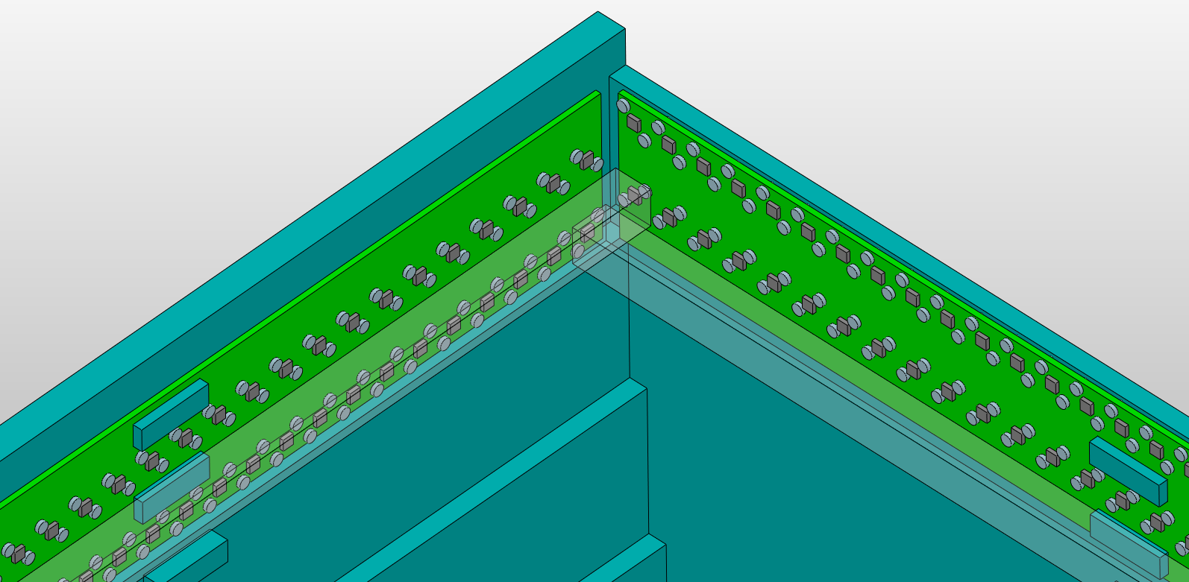
ECAL design
ECAL module
The installation of detector PCB board was increased, and the size of detector module and the number of crystal strips were adjusted accordingly
PCB plate
detector module size
unit hight：28X10=280mm(<300)
unit size(7 group)：413，423，433，443
453，463，473
ECAL longth：373 X 17
Number of crystal every group in one module.
Group 1:37X2 + 41X2 = 156
Group 2:37X2 + 42X2 = 158
Group 3:37X2 + 43X2 = 160
Group 4:37X2 + 44X2 = 162
Group 5:37X2 + 45X2 = 164
Group 6:37X2 + 46X2 = 166
Group 7:37X2 + 47X2 = 168
“有”PCB的结构优化

Slide 18
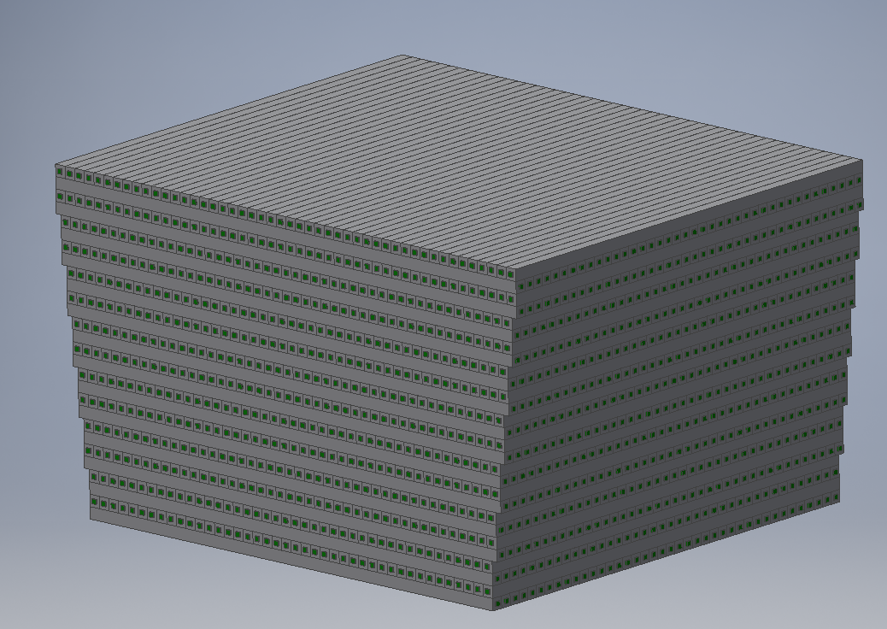
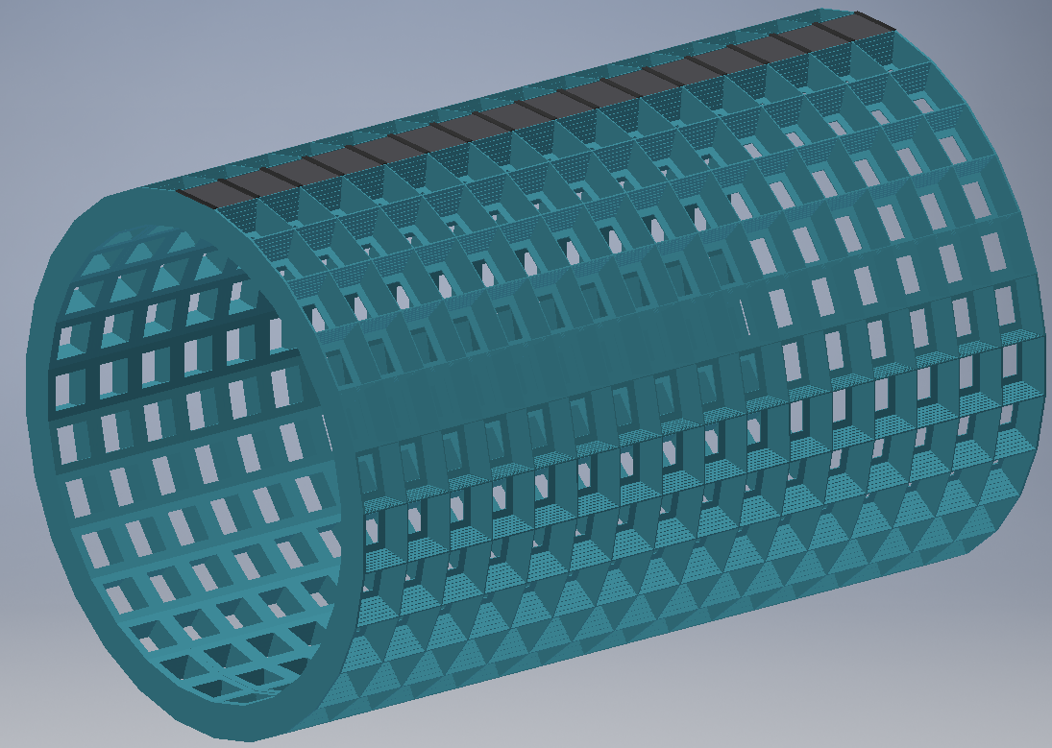
ECAL installation scheme design
Overall honeycomb structure
280mm
400mm
Electromagnetic calorimeter adopts carbon fiber structure processing frame, detector frame structure as shown in the figure.
When installing the detector , install the detector module in the top column, and then rotate the fixed angle to install the next column.
ECAL total weight 180 tons;
There are 476 crystal units;
There are 539784 crystal bars in total.
It will be studied whether the frame structure meets the load-bearing requirements
The manufactury process is very diffcult.
Can aluminum or carbon fiber meet the stiffiness for the honeycomb structure ?

Slide 19
Content:
General introduction
Progress of MDI design
Iron yoke
Superconcuction solenoid
ECAL
Beam pipe
summary

Slide 20
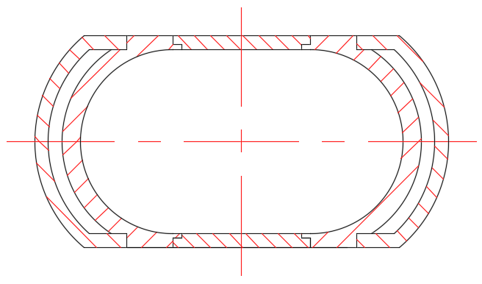
General introduction of beampipe
General drawing
a. The extending Al pipe
b. The central Be pipe
c. Air channel
d. Carbon fiber cylinder
e. Combination flange
BPM
LumiCal
Vertex
LumiCal
BPM
Extending pipe
Both sides : Double
Top and Bottom : Single
Basic Structure:
1) Components : a, b, c, d and e
2) Detectors : BPM, LumiCal and Vertex
Total length : 1400 mm
Updated design :
1) Added detector : BPM
2) Extending pipe : The Extending pipe is designed from conical pipe to runway profile
3) Thermal analysis of Beampipe

Slide 21
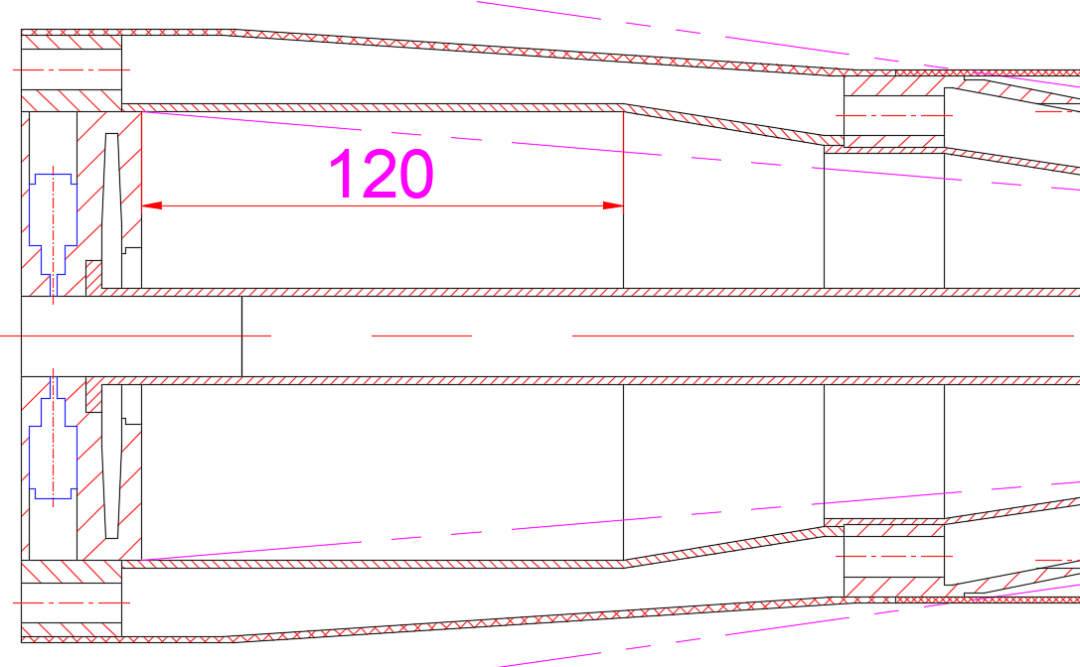
Detailed Structure
Three detectors --- BPM and LumiCal
BPM
1. A 2 or 4 electrode-BPM is installed in
each flange
LumiCal
1. Near the flanges, axial length is 120mm
Installation position
LumiCal
The runway type structure is for greater installation space for the lumical
BPM : 2 or 4 electrodes

Slide 22
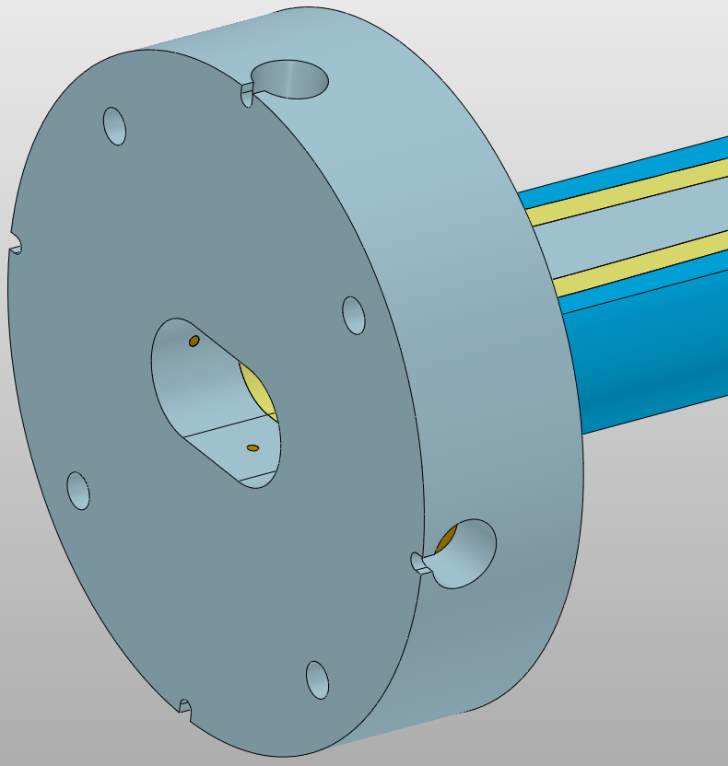
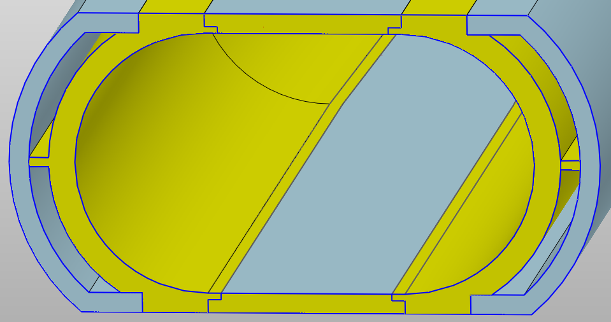
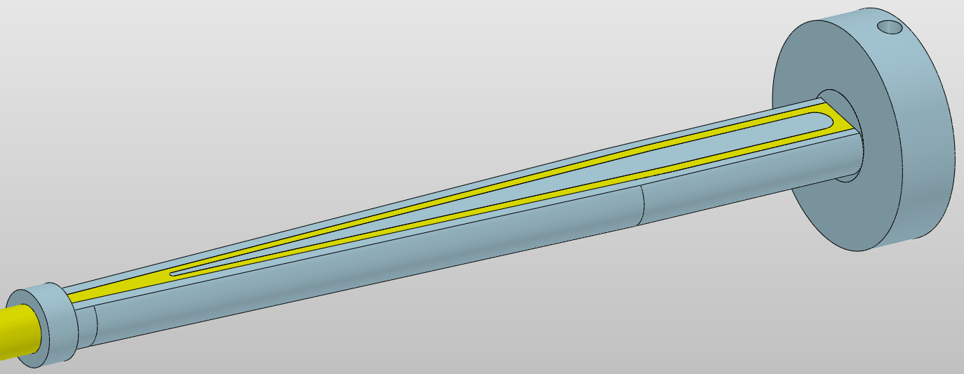
Detailed Structure
The extending Al pipe --- Gradient runway type
Thickness of single layer beryllium sheet : 1.5 mm
Double layer
construction
Double layer
construction
Take away
Take away
HOM heat
HOM heat
Coolant : H₂O
Installation space for LumiCal
Total length : 525 mm
The extending Al pipe

Slide 23
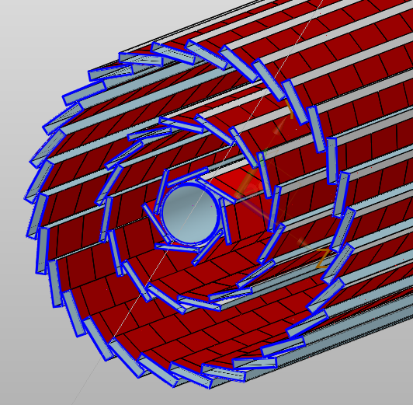
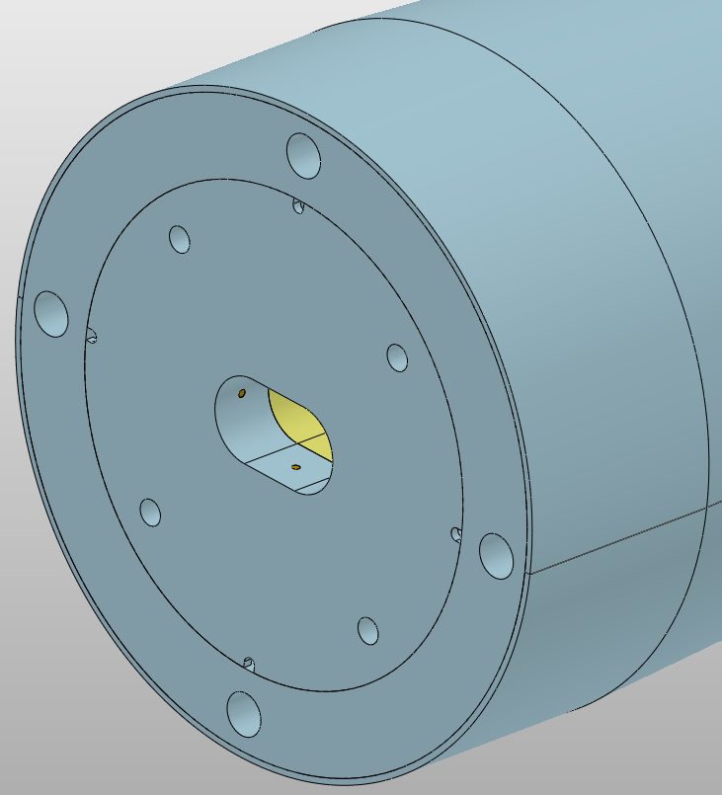
Detailed Structure
Three detectors --- Vertex
The Vertex detector contains only barrel part which
consists of three double layers
Air-cooled inlet
Air-cooled channels and support structures
Air-cooled outlet
Air-cooled inlet
Cooled structure :
Three layer air cooled channel
Air-cooled outlet
Take away
In the next step, we need to calculate the air cooling effect and stability of vertex detector
The heat generated
by chips and electronics
Design requirement
T ≤ 20 °C
△T < 10 °C or 7 °C
Vibration < 1μm (?)
Four inlets , four outlets
Three double layers

Slide 24
Simulation analysis
Thermal analysis --- Beampipe
The design principle is to keep
the outer surface temperature as low as possible
Try to decrease the surface temperature further to meet the requirements of detectors
Outer surface temperature of the beampipe : ≤ 20 °C
For the design of the new beam pipe, it is necessary to carry out temperature check calculation

Slide 25
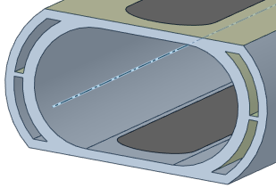
Simulation analysis
Thermal analysis --- Beampipe
Inlet temperature: 16℃
Inlet velocity : 1 m/s
Turbulent
Coolant : H₂O
2 inlet, 2oulet
Inlet temperature: 16℃
Inlet velocity : 0.8 m/s
Laminar
Coolant : Paraffin or H₂O
4 inlet, 4 outlet
Inlet temperature: 16℃
Inlet velocity : 1 m/s
Turbulent
Coolant : H₂O
2 inlet, 2 outlet
Results
Of the overall
We need to study the corrosion of water to beryllium next step.
Highest temperature position(Transition section)
Coolant : paraffin
The temperature of the central pipe meets the design requirements
Coolant : H₂O
T(Max) : 31.1℃
T(Max) : 26.7℃

Slide 26
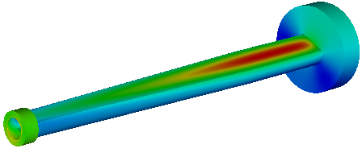
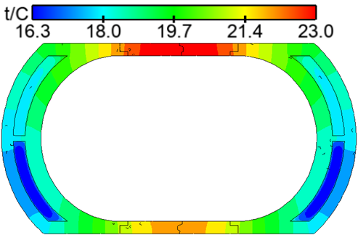
Simulation analysis
Thermal analysis --- Beampipe
Results
Of the extending Al pipe
Outer surface temperature
of the extending Al pipe
Top temperature
Temperature of Be sheet
Bottom temperature
Section temperature distribution(x=585mm)

Slide 27
summary
Iron yoke
Based on the installation of spiral yoke mechanism, the next step is to optimize the design of yoke base, crane and installation station
The structure of superconducting magnet must be calculated and optimized in more detail
For ECAL, the material for the frame structural needs to be studied, and the thickness of the frame structure and the crystal module size need to be optimized
The next step is to perform air-cooling simulation analysis on the vertex detector of the beam pipe, and simulate the vibration generated by air cooling ,and verify the cooling effect ,and study corrosion of water to beryllium.
they will be disigned after the physical requirements are given
Superconducting soleniod
ECAL
Beam pipe
Other detectors

Slide 28
Thanks

