Slide 1
Status of the simulation software in CEPCSW
Tao Lin
(on behalf of the software team)
lintao@ihep.ac.cn
IHEP
CEPC workshop
27 Oct 2023, Nanjing

Slide 2
Outline
Introduction
Simulation framework in CEPCSW
Gaussino-based simulation framework
Parameterized simulation: k4SimDelphes
Summary

Slide 3
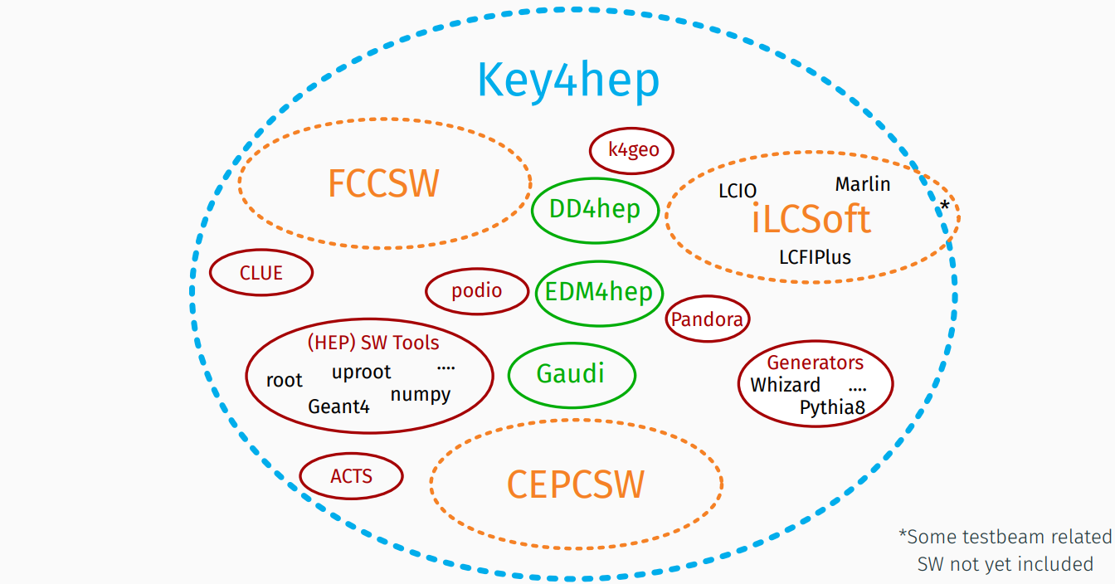
Introduction (1)
New CEPC software (CEPCSW) prototype was proposed at the Oxford workshop in April 2019.
The consensus among CEPC, CLIC, FCC, ILC and other future experiments was reached at the Bologna workshop in June, 2019.
Develop a Common Turnkey Software Stack (Key4hep) for future collider experiments
T.Madlener | Key4hep & EDM4hep
CEPC workshop, Edinburgh

Slide 4
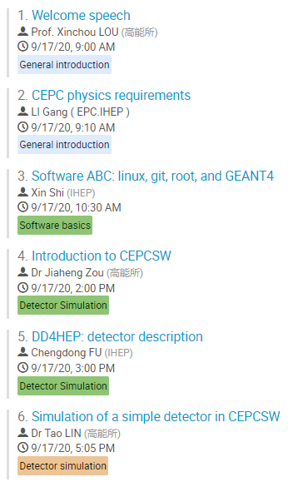
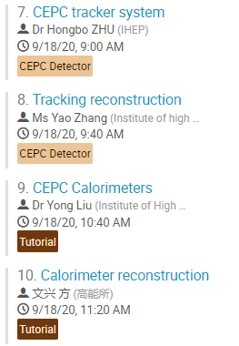
Introduction (2)
As the first application based on Key4hep, following development activities had been initiated.
Development of k4LCIOReader: LCIO to EDM4hep converter
Migration of reconstruction algorithms
Development of simulation framework in CEPCSW
Validation between iLCSoft and CEPCSW.
CEPCSW Tutorial and detector study, IHEP, 17-18 Sept 2020
Covering underlying framework, DD4hep, detector simulation and reconstruction within CEPCSW
https://indico.ihep.ac.cn/event/12341/

Slide 5
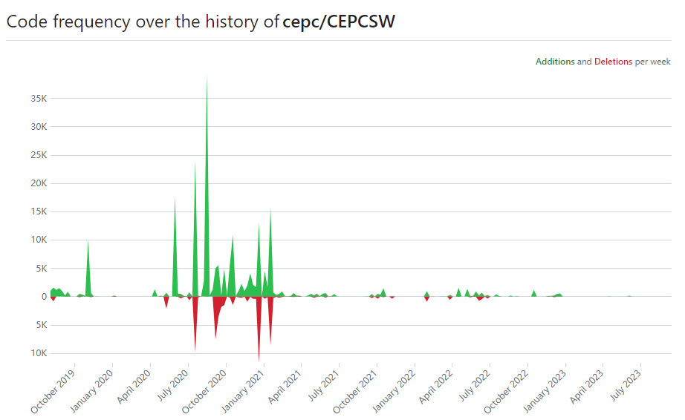
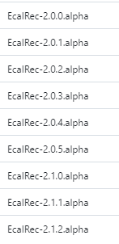
Introduction (3)
Status
For detector design for CDR: code is already included in CEPCSW.
For 4th concept design: some code is not merged into official CEPCSW yet.
Code frequency in official CEPCSW
ECAL software
Official: https://github.com/cepc/CEPCSW
ECAL: https://github.com/qwert2333/CEPCSW
Drift Chamber: https://github.com/myliu-hub/CEPC_Track_Finding
VXD Test beam: https://github.com/ihep-sft-group/CEPCSW-VXDTestbeam

Slide 6
Outline
Introduction
Simulation framework in CEPCSW
Gaussino-based simulation framework
Parameterized simulation: k4SimDelphes
Summary

Slide 7
Simulation framework in CEPCSW (1)
Complete simulation chain with EDM4hep
Physics generator
MCParticle
Detector Simulation based on Geant4
MCParticle (with secondaries), SimTrackerHit, SimCalorimeterHits
Digitization
TrackerHit, CalorimeterHit

Slide 8
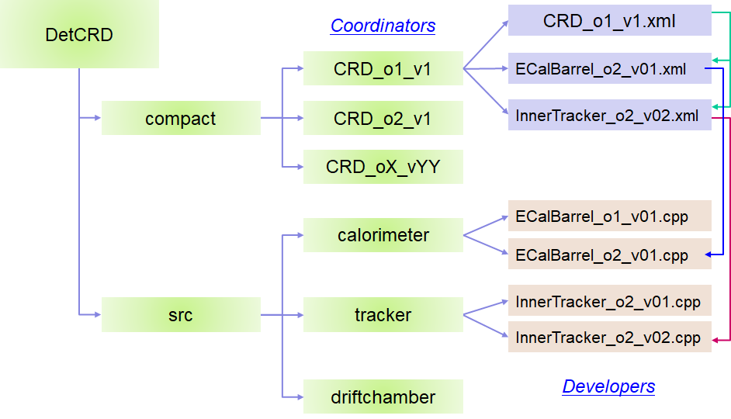
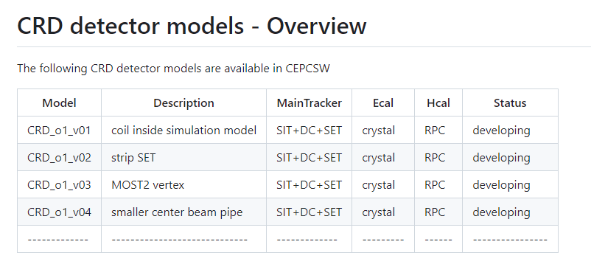
Simulation framework in CEPCSW (2)
Geometry management with DD4hep
Consists of C++ constructors and XML based compact files
https://github.com/cepc/CEPCSW/tree/master/Detector
For the CRD detector models, see README by Chengdong:
https://github.com/cepc/CEPCSW/tree/master/Detector/DetCRD/compact

Slide 9
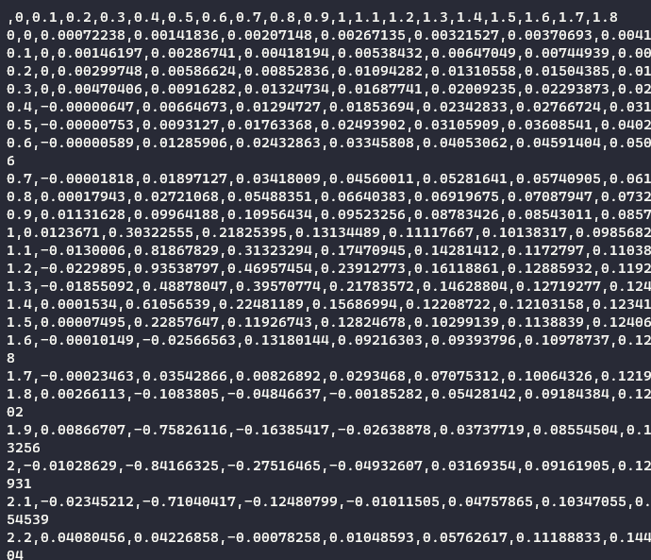
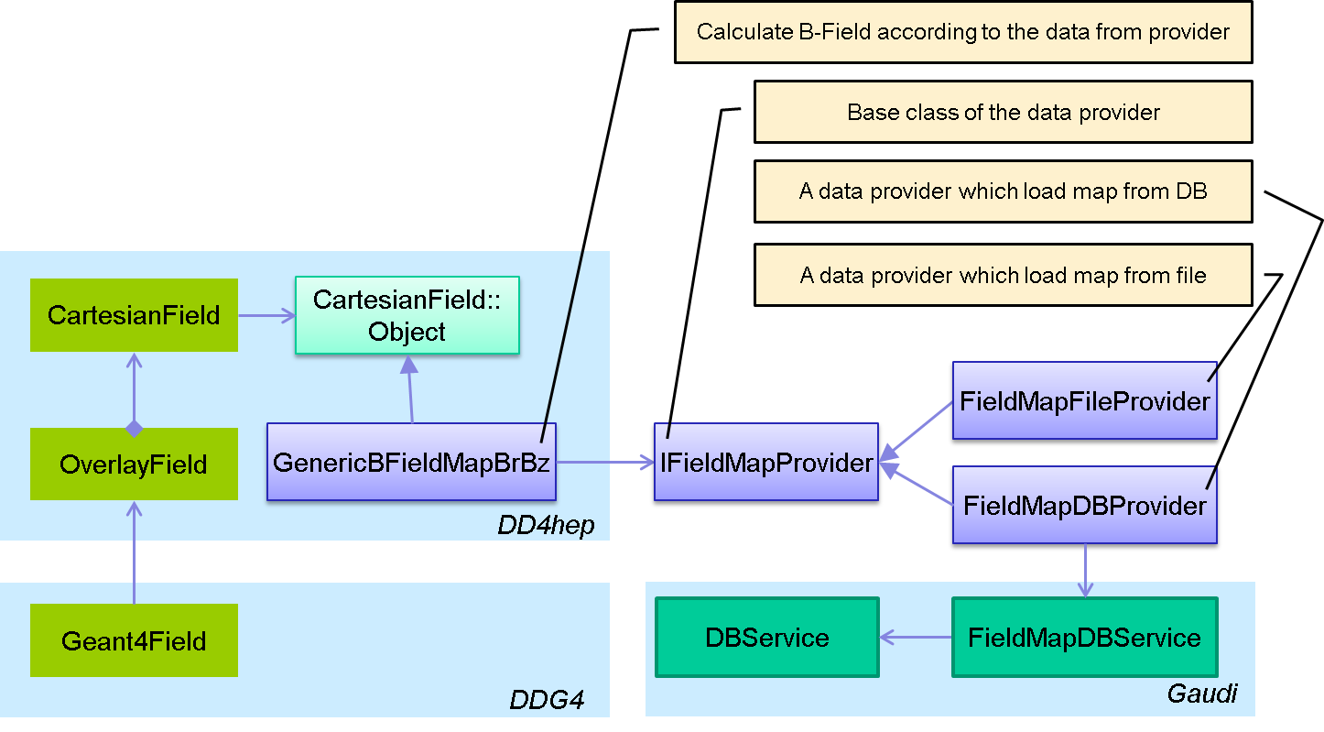
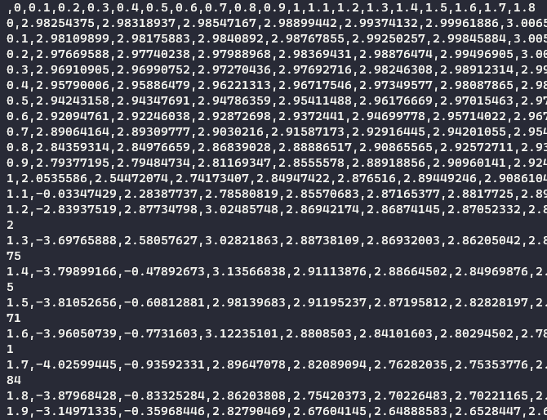
Simulation framework in CEPCSW (3)
Non-uniform magnetic fields
The Br/Bz csv files are provided by magnetic group.

Slide 10
Simulation framework in CEPCSW (4)
Physics generator interface
Physics generators with different formats are integrated, including StdHep, HepEvt, LCIO, HepMC formats.
Particle gun is supported.
Beam background generators, such as Guinea Pig.

Slide 11
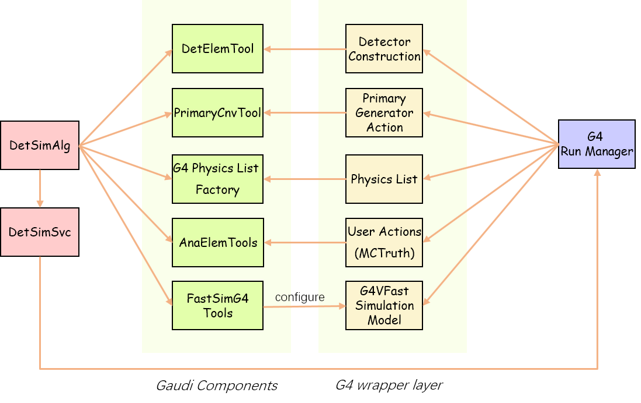
Simulation framework in CEPCSW (5)
Integration with Geant4 and Gaudi
A thin layer is developed to manage corresponding Geant4 objects.

Slide 12
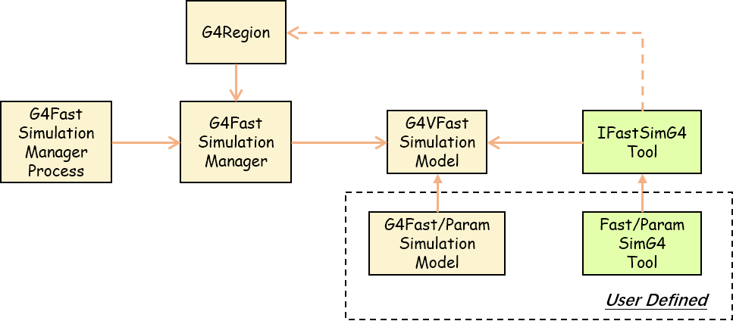
Simulation framework in CEPCSW (6)
Integration with Fast Simulation
Region based: when a particle enter a region, fast simulation will be triggered by Geant4.
Support ML methods via ONNX inference interface.
Example: Fast pulse simulation (MLP) in drift chamber done by Wenxing

Slide 13
Outline
Introduction
Simulation framework in CEPCSW
Gaussino-based simulation framework
Parameterized simulation: k4SimDelphes
Summary

Slide 14
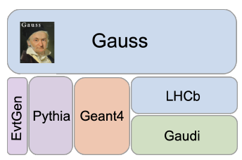
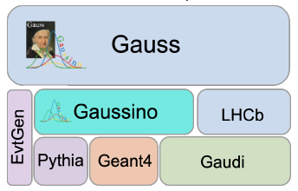
Gaussino-based simulation (1)
CEPC also works together with Key4hep project members and is re-implementing CEPC detector simulation with Gaussino
Evolution of the simulation framework from LHCb
The underlying framework is moving to Gaudi Functional and Gaudi Hive
Better support for multi-threading, machine learning, fast simulation methods
Gauss-on-Gaussino is a new version of LHCb simulation framework
Gaussino is being added to Key4hep by extracting experiment-independent parts from Gauss

Slide 15
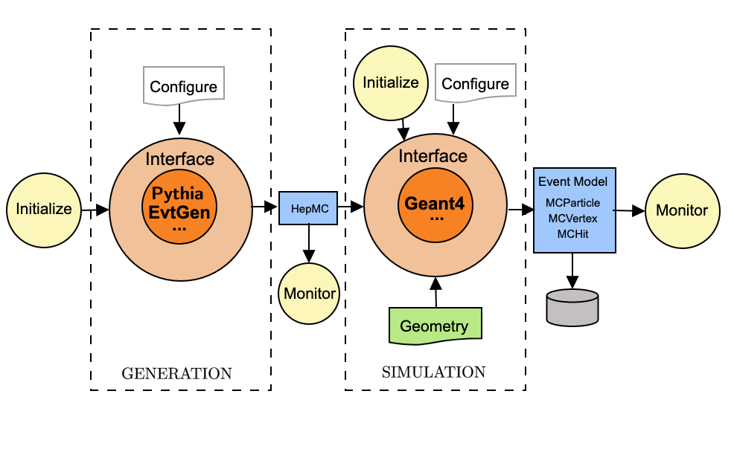
Gaussino-based simulation (2)
Gaussino is a thread-safe simulation framework based on Gaudi Functional and provides interfaces to Pythia and Geant4.
Modular design
Gaudi Functional Algorithms
Gaudi Tools
Four components
Generation of events
The detector simulation
Geometry service
Monitoring & output
Easy to configure by customizing the algorithms, services and tools

Slide 16
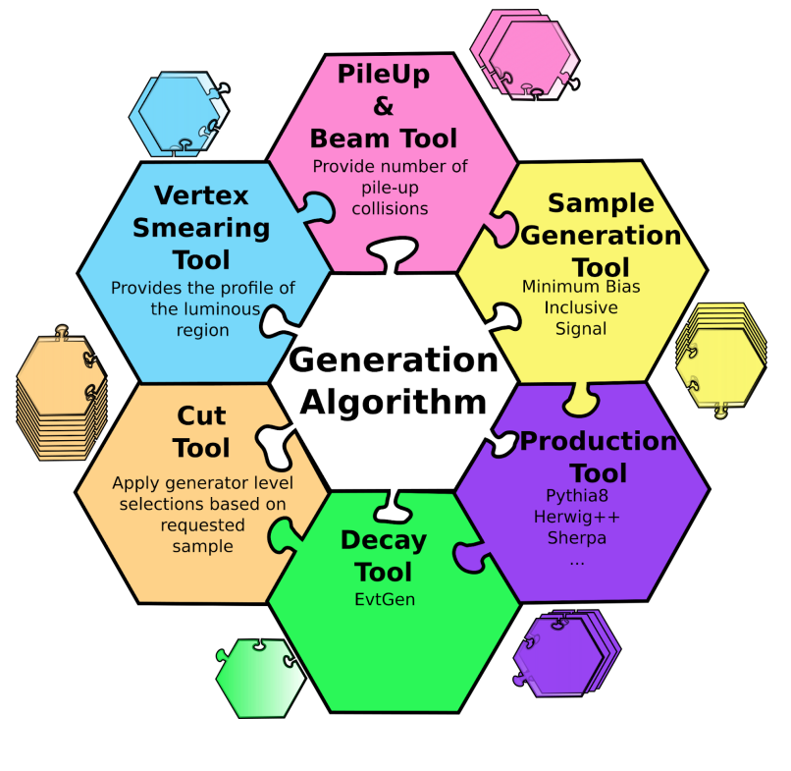
Gaussino-based simulation (3)
Generation algorithms: “Generation” and “ParticleGun”
The input is LHCb GenHeader
The output is HepMC GenEvent
The generation algorithm
It consists of different Gen tools
Thread safety of generators
The particle gun algorithm
N Particles, Particle type, momentum, etc.

Slide 17
Gaussino-based simulation (4)
Detector simulation algorithm: GiGaAlg
The input is HepMC GenEvent
The output is G4Event and MC truths
GiGaMT (Service) is used by GiGaAlg to simulate events with Geant4.
The major interface to Geant4, including Detector Construction, Physics List and User Actions.

Slide 18
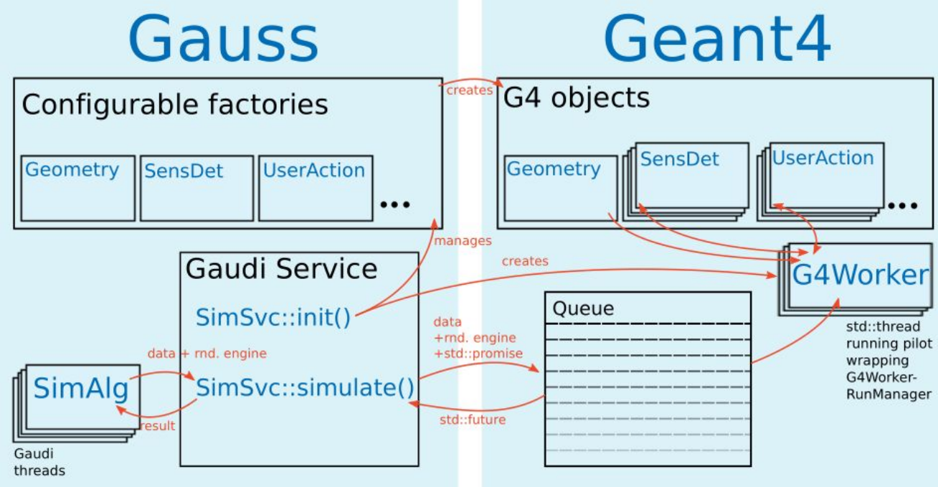
Gaussino-based simulation (5)
Multithreading with Geant4
A queue is used to communicate between Gaussino and Geant4
Sim/GiGaMTCore/include/GiGaMTCoreRun/GiGaWorkerPilot.h

Slide 19
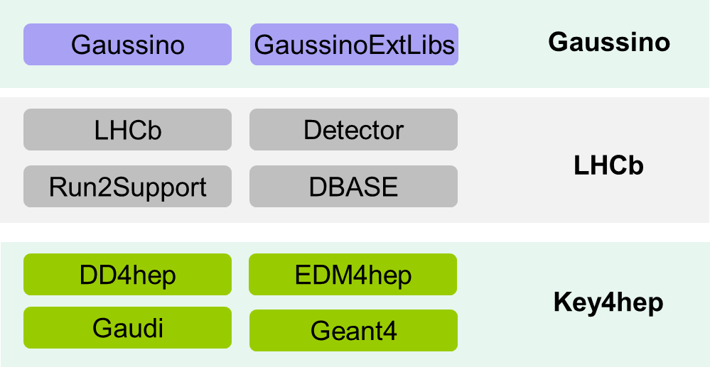
Gaussino-based simulation (6)
Gaussino still depends on LHCb software and can not be used by other experiments directly
Development of CEPC-on-Gaussino was planned with the following three steps
Using the original version having the dependency on the LHCb software
Creating the modified version in which the LHCb dependency is removed
Directly using the Key4hep version (not available at the moment)

Slide 20
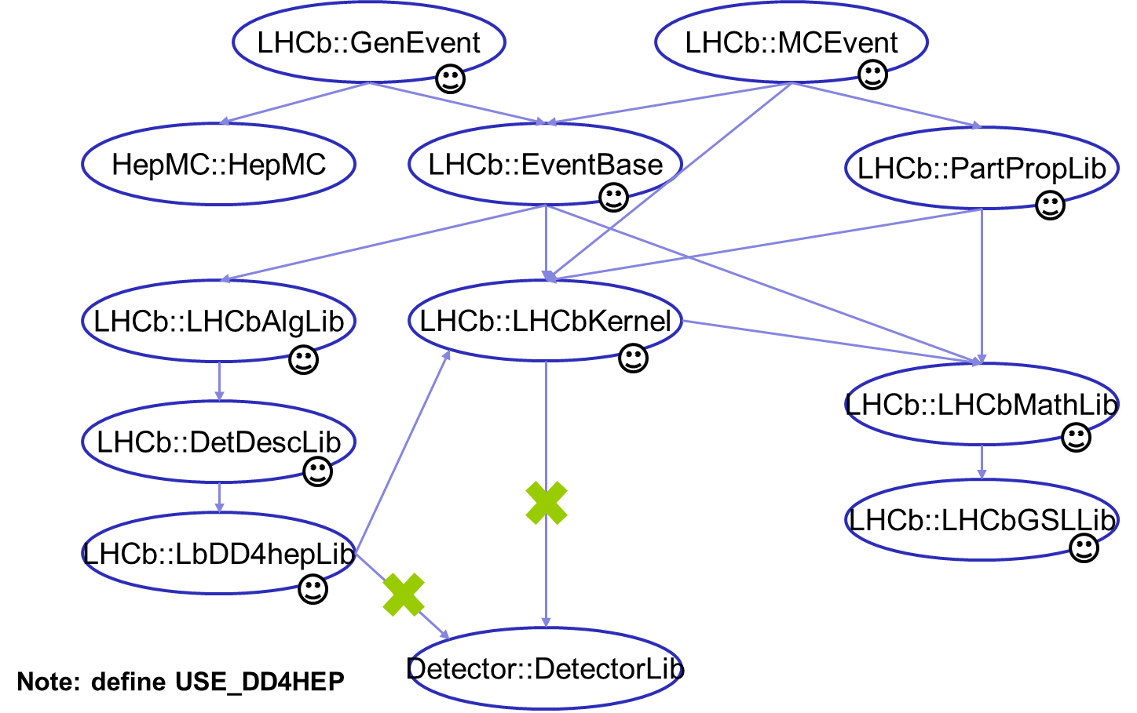
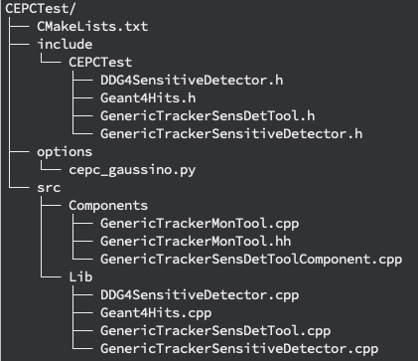
Gaussino-based simulation (7)
CEPC-on-Gaussino :
https://gitlab.cern.ch/talin/build-cepc-on-gaussino
https://gitlab.cern.ch/talin/Gaussino/-/tree/cepc-on-gaussino
Reuse GenEvent and MCEvent from the LHCb project
A minimum number of packages are selected
Non-required dependencies were removed
Implement the simulation of CEPC vertex detector
Use DD4hepCnvSvc as Geometry Service.
Implement G4 Sensitive Detector and Hit object for tracker detector.
Implement a monitor tool to save output.

Slide 21
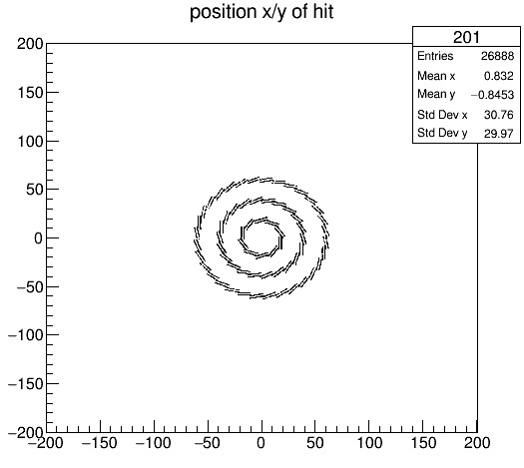
Gaussino-based simulation (8)
Need to take care of the name of the sensitive detector factory.
DD4hep instance needs to know the name to retrieve the DD4hep detector component.
CEPC-on-Gaussino is easy to use
Register the sensitive detector factory and associate it with DD4hep detector name
Register the monitor tool

Slide 22
Outline
Introduction
Simulation framework in CEPCSW
Gaussino-based simulation framework
Parameterized simulation: k4SimDelphes
Summary

Slide 23
k4SimDelphes
Delphes is also integrated into Key4hep.
EDM4hep is one of the supported output formats.
k4SimDelphes offers both standalone executables and the integration with framework.
https://github.com/key4hep/k4SimDelphes
$ DelphesSTDHEP_EDM4HEP \
delphes/cards/delphes_card_CEPC.tcl \
k4SimDelphes/edm4hep_output_config.tcl \
delphes_output_edm4hep.root \
z_ee.hep
Also see Key4hep-doc:
https://key4hep.github.io/key4hep-doc/k4simdelphes/doc/starterkit/k4SimDelphes/Readme.html

Slide 24
Outline
Introduction
Simulation framework in CEPCSW
Gaussino-based simulation framework
Parameterized simulation: k4SimDelphes
Summary

Slide 25
Summary
CEPC simulation software is integrated with Key4hep.
Adopting a common software makes it easy to share between different experiments, such as k4SimDelphes could be used.
A complete simulation chain is available in CEPCSW.
It is already used for detector software development.
Currently migrating to Gaussino-based simulation.
Reuse both GenEvent and MCEvent from LHCb and remove the dependencies.
Implement the CEPC VXD detector simulation.
Next step:
Integrate with the Gaudi functional version of k4FWCore and save the output in EDM4hep.

