Slide 1

Thermal bonding Micromegas and its application in TPC and muon tracker
Zhiyong Zhang
For the USTC MPGD group
State Key Laboratory of Particle Detection and Electronics, China
University of Science and Technology of China

Slide 2
Outline
  Thermal bonding Micromegas
  Method and performance
Readout for TPCs
  Low and high pressure
Muon tracker
  Large detector and muography
Summary

Slide 3
Outline
  Thermal bonding Micromegas
  Method and performance
Readout for TPCs
  Low and high pressure
Muon tracker
  Large detector and muography
Summary
1
Method and resistive anode
2
Detector performance
3
Ultra-low IBF with DMM and TMM

Slide 4
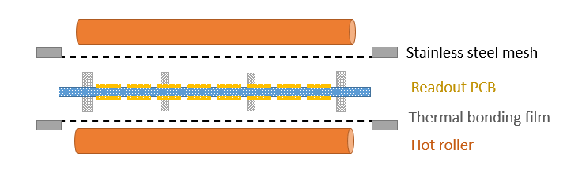
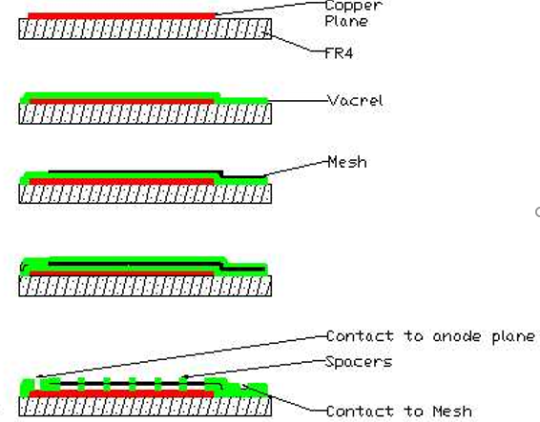
The thermal bonding method
The thermal bonding method provides a concise and etching-free mass-productive process to fabricate Micromegas-like detector.
Micromegas in a Bulk
Thermal bonding processing
No etching, no pollution
➔Easy to handle at lab
Easy to make new structures
Easy to extend to large area
Less than 1% spacer area
➔High efficiency

Slide 5
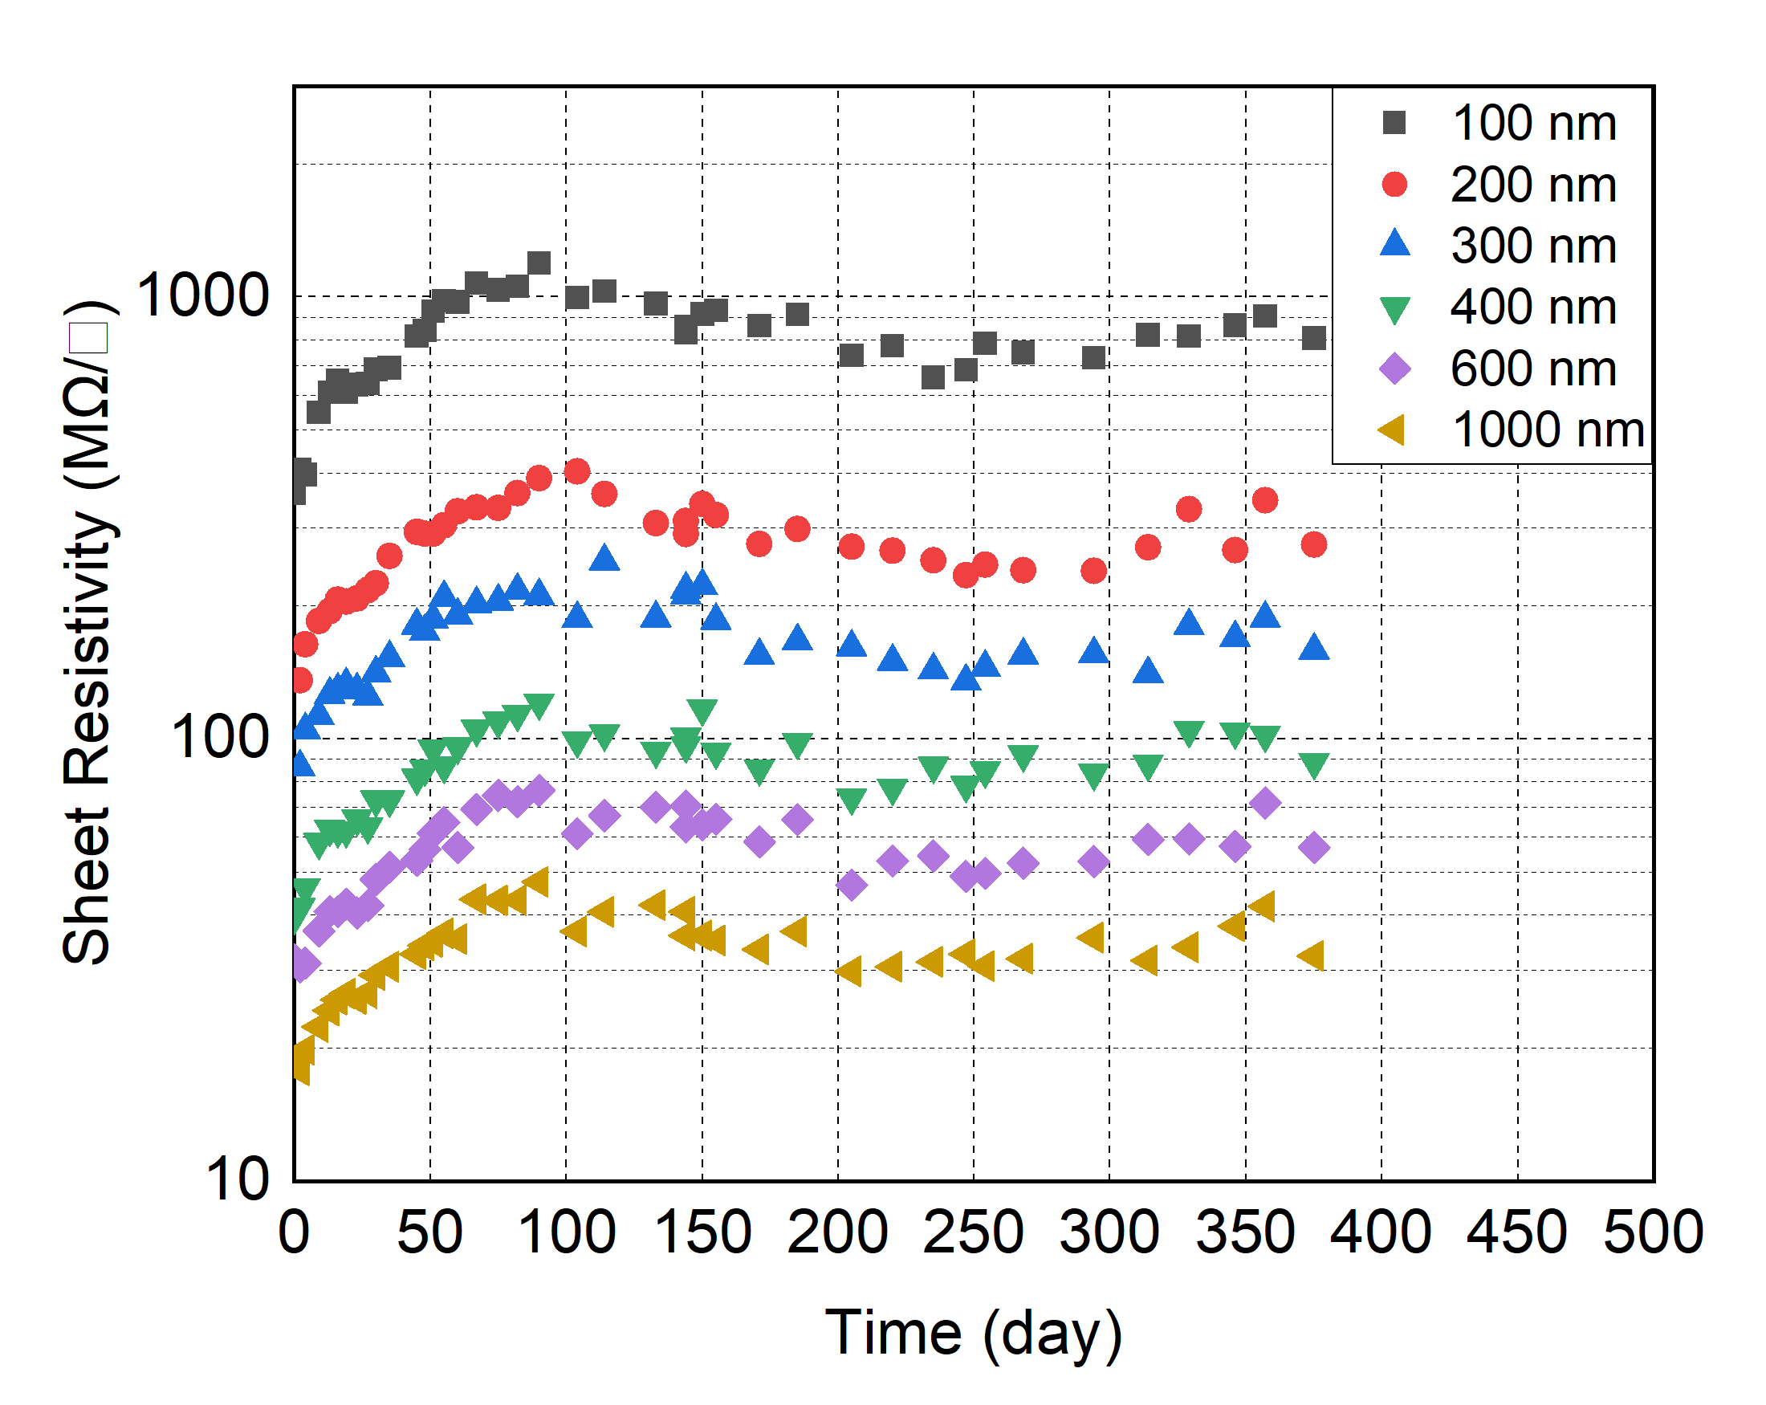
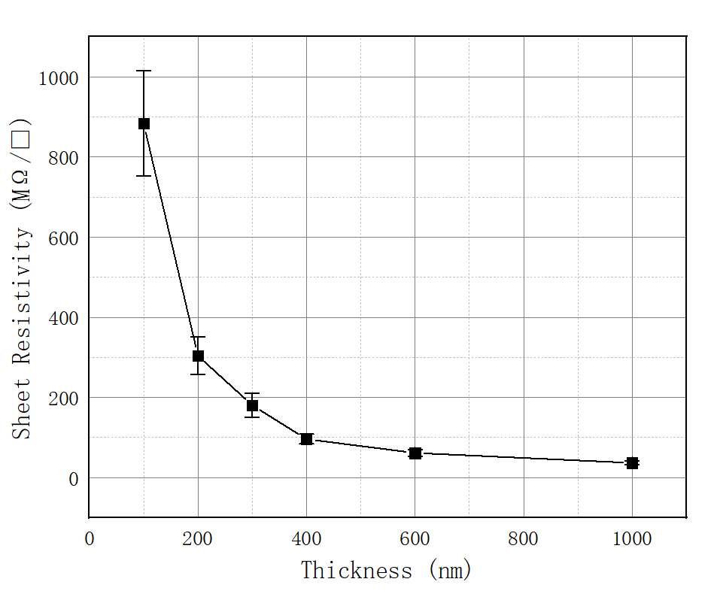
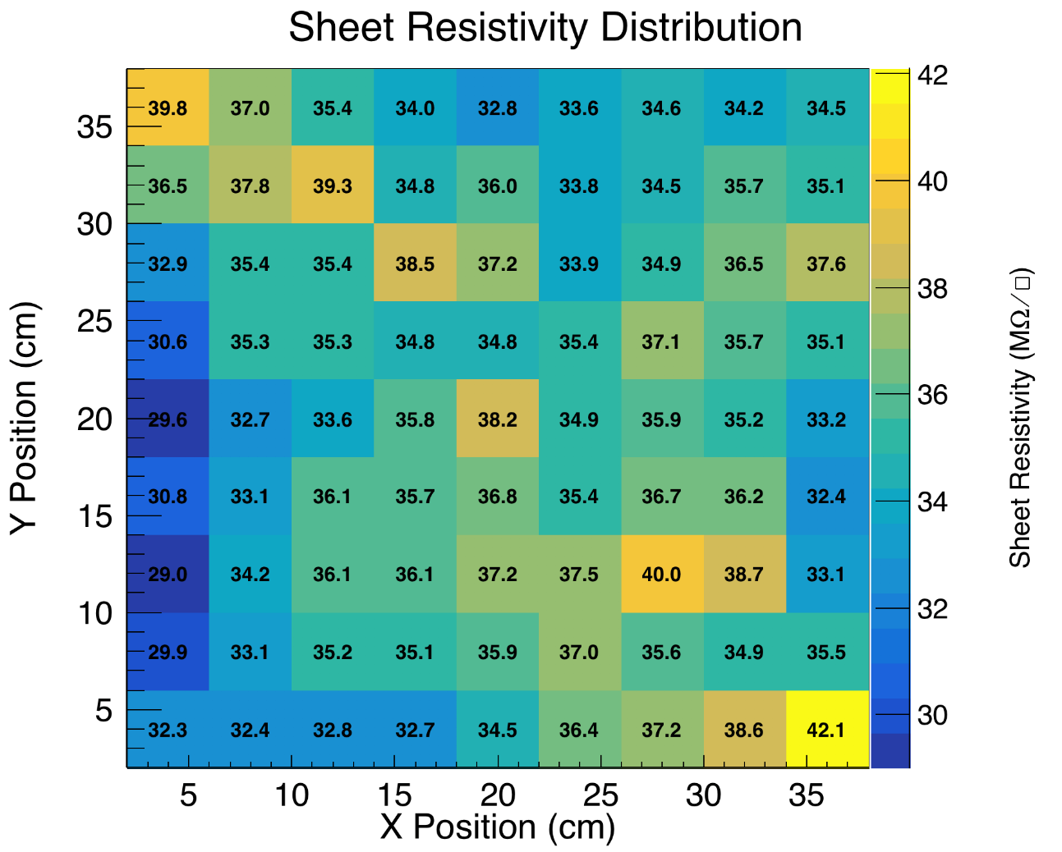
A novel resistive anode using a germanium film
~ m² coating area, 100 nm -1 μm film thickness
Sheet resistivity changes as a function of time for different thicknesses of Ge films
2D sheet resistivity distribution of the Ge film sample with Non-uniformity of RMS/mean =6.7%
Jianxin Feng, Zhiyong Zhang, Jianbei Liu et al., NIM-A 1031 (2022) 166595.

Slide 6
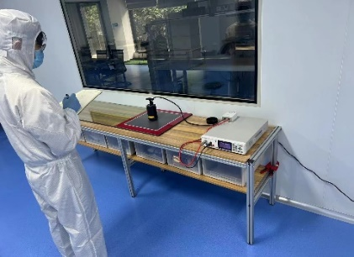
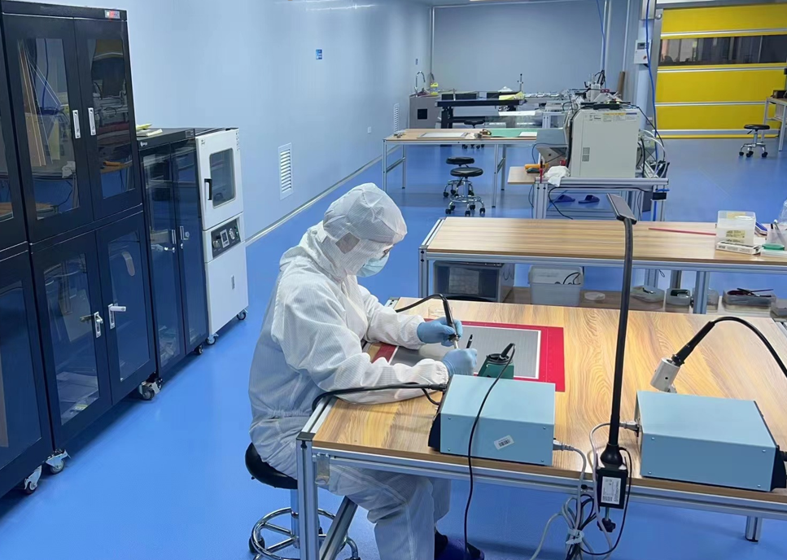
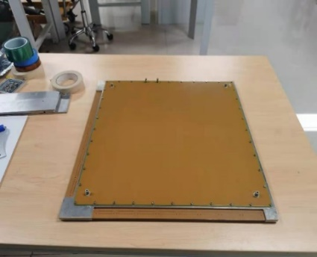
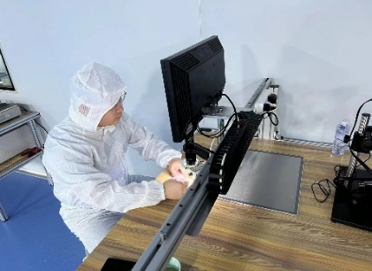
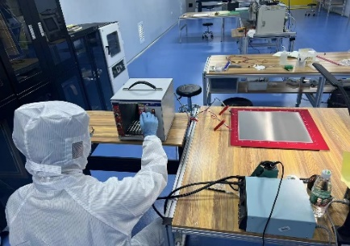
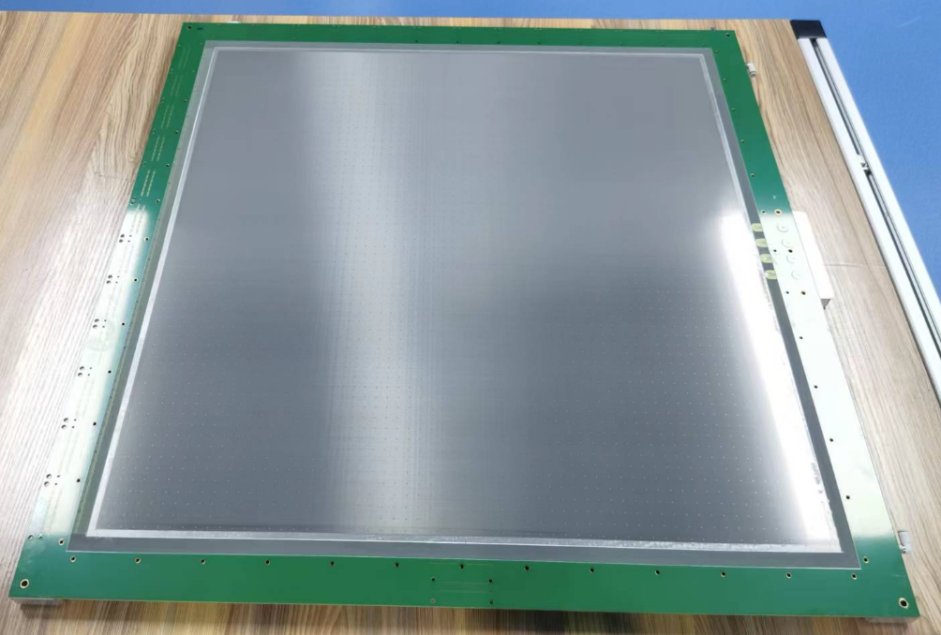
Fabrication site for production
Dedicated site for mass production (540 m² )
Full-developed equipment and fabricating process
M² scale capability
400×400 mm²
600×600 mm²

Slide 7
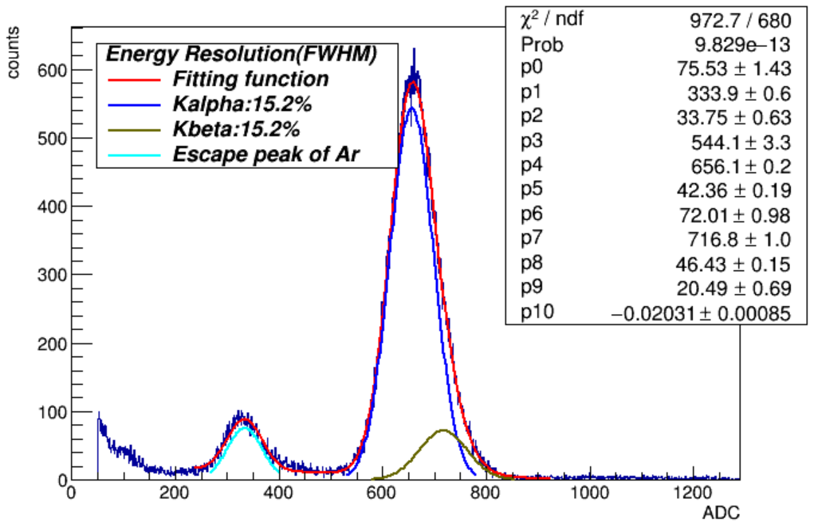
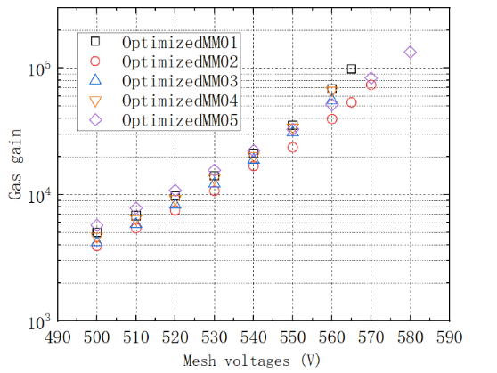
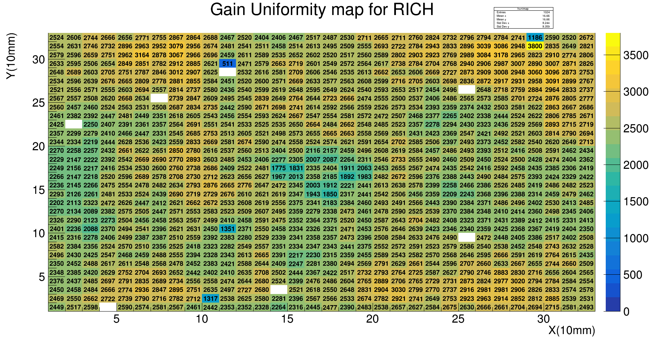
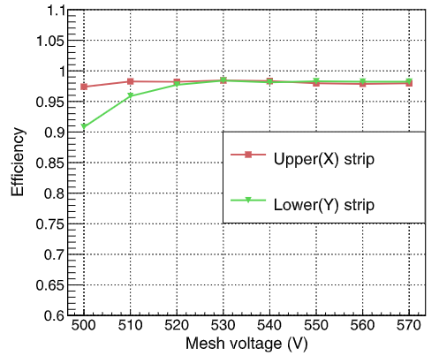
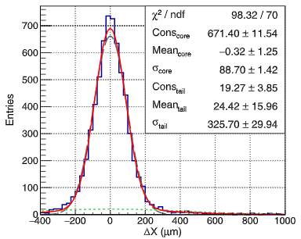
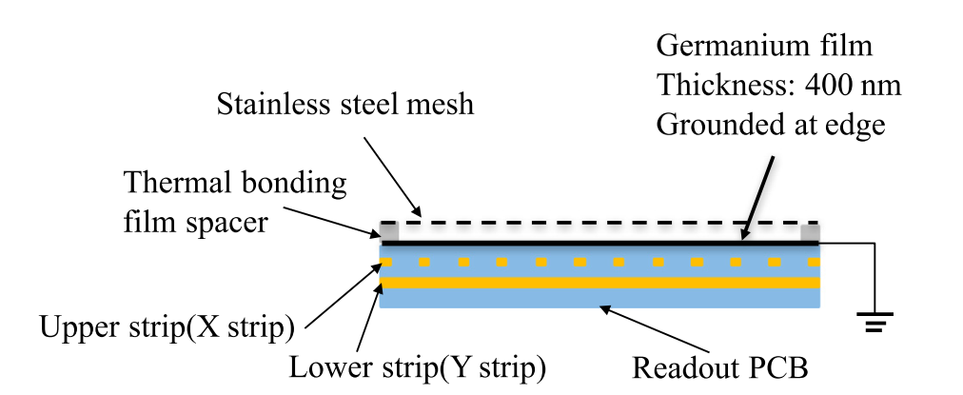
Basic Performance
X-ray test（5.9 keV）
  Gas gain：~10⁵ (Ar+7%CO₂)
  Energy resolution：~15% (FWHM)
  Non-uniformity: ~5% for 30×30 cm²
Electron beam（5GeV）
  Efficiency：>98%
  Spatial resolution：65μm
~10⁵
~15% (FWHM)
ε >98%
RMS/MEAN=~5%
Jianxin Feng, Zhiyong Zhang, Jianbei Liu et al., NIM-A 989 (2021) 164958.
σ_{X}=65 μm

Slide 8

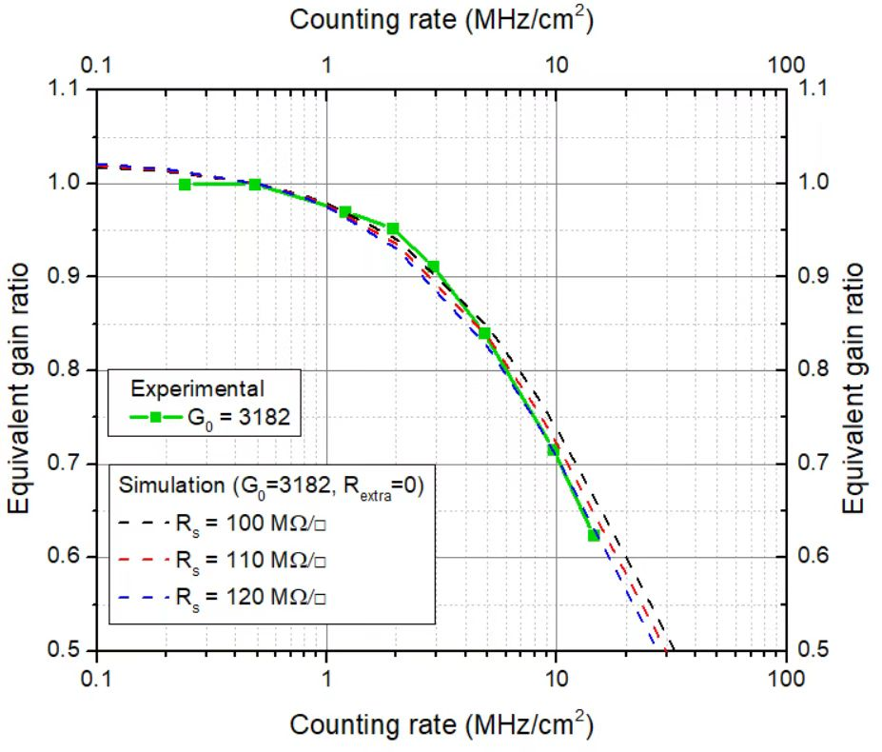
High counting rate
Border grounding
Grid-dot grounding
> MHz/cm²
The counting rate here is for 8 KeV x-rays, the case of MIPs should almost be 10 times higher due to its much lower energy deposition.
Which is successfully used in a high rate neutron detector for BNCT beam monitoring
Zhujun Fang, Zhiyong Zhang*,NIM-A, A 1053 (2023) 168361.

Slide 9
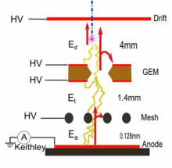
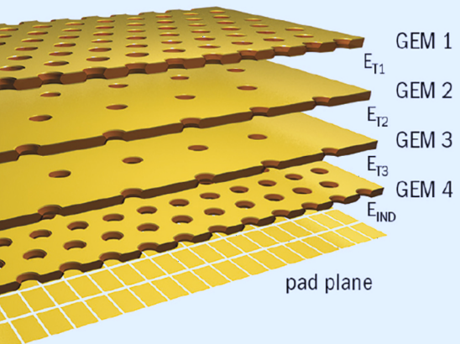
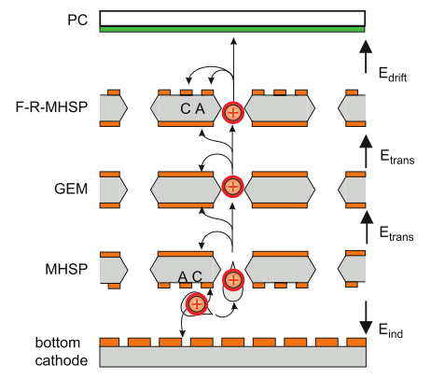
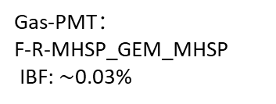
Motivation of low IBF
  High rate TPC
  Gas photon detection
  ALICE upgrade, ILD, CEPC R&D
    To minimize field distortion due to ion space charge
    Continuous readout to keep up with high event rate
    High gain: to be sensitive to single photons
    Very low IBF
UV light：CsI，~mC/cm²
Visible light：Bi-alkali, ~μC/cm² ！
ALICE-TPC
CEPC-TPC
Gas-PMT：
F-R-MHSP_GEM_MHSP
IBF: $\sim$0.03%
A. Lyashenko et al. , NIM A 598(2009) 116-120
Quadruple GEM, IBF < 1%
Gain×IBF<~5，IBF <~ 0.1%

Slide 10

Low IBF with the DMM
DMM: Double Micro-Mesh gaseous structure
Hole-type → mesh-type : to strongly reduce IBF
Double mesh: cascading avalanche for high gain
Drift region
~3-5 mm
PA
~0.2 mm
SA
~0.1 mm
To push IBF down to very low level:
low PA electric field
large PA gap
high mesh density
crossing mesh setting
The product of IBF and gain to < 1 at 2000 gas gain, fulfills the CEPC TPC requirements.
Zhiyong Zhang et al., NIM-A 889 (2018) 78–82
BinbinQi et al., NIM-A 976 (2020) 164282

Slide 11

Ultra-low IBF with the TMM
TMM: Triple Micro-Mesh gaseous structure
One more mesh on the DMM
More stable gain, lower IBF from second avalanche…
Drift region
~3-5 mm
PA
~0.2 mm
SA
~0.2 mm
TA
~0.1 mm
Test with a laser, high gain above 10⁶ for single photon and very low IBF of 3×10⁻⁵ are achieved, which is 10 times better than that of the DMM.

Slide 12
Outline
  Thermal bonding Micromegas
  Method and performance
Readout for TPCs
  Low and high pressure
Muon tracker
  Large detector and muography
Summary
1
  ¹²C(¹²C,α)²⁰Ne reaction experiment
2
  PandaX-III experiment

Slide 13
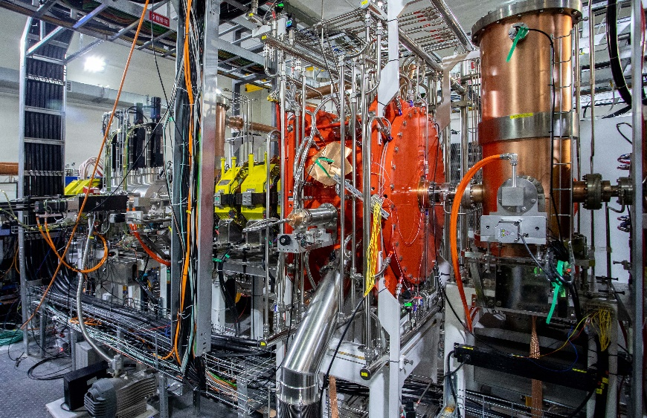
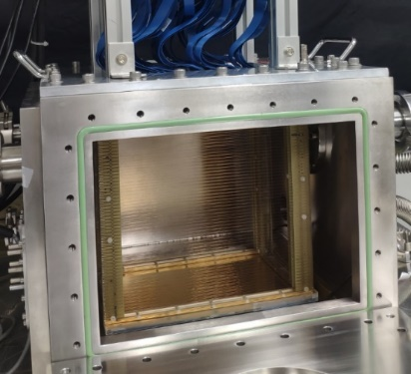
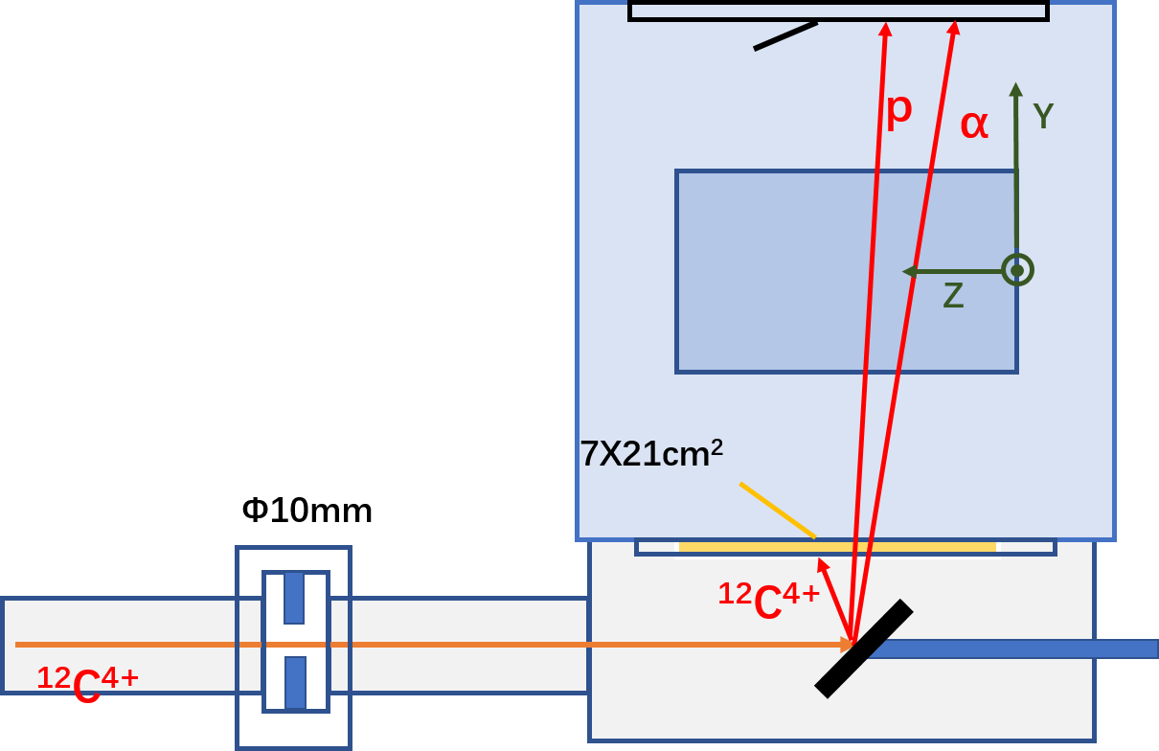
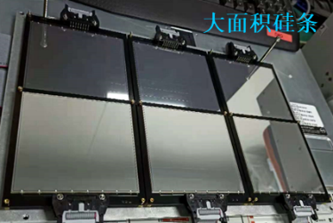
Study of the ¹²C+¹²C fusion reaction
The ¹²C+¹²C fusion reaction is crucial in stellar evolution
  A large uncertainty in the reaction cross section at stellar energies ((E_{c.m.}<3MeV)
  The main products of ¹²C+¹²C are n, p and α
  A TPC technique was developed to measure lower stellar energies with high intensity beam
  LEAF has delivered 50puA, the highest beam intensity ever realized in the carbon fusion experiments
Si wall
TPC
Window
Collimator
Low Energy Accelerator Facility (LEAF)
Target
Courtesy of the nuclear astrophysics group (IMP)

Slide 14
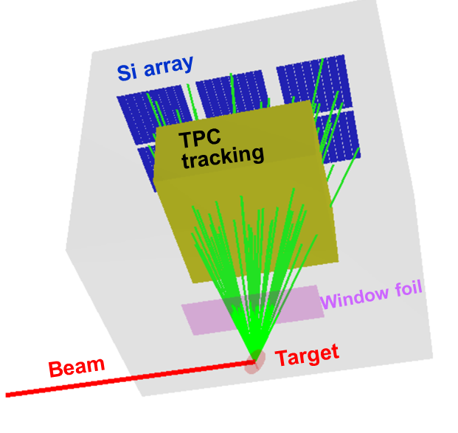
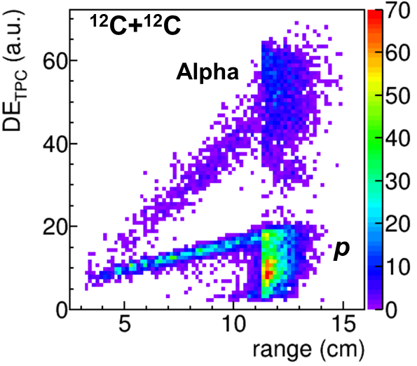
Challenges for TPC detector
Detector challenges
  30-100mbar He based gas
  High gain for proton measurement
  Low event rate ➔long term stability
  High x-ray radiation
  ➔high rate capability, low IBF to reduce the space charge
Solutions
  Simulation to optimize the design for low pressure
  Resistive anode with fast grounding
  DMM to improve the gain and suppress the IBF

Slide 15
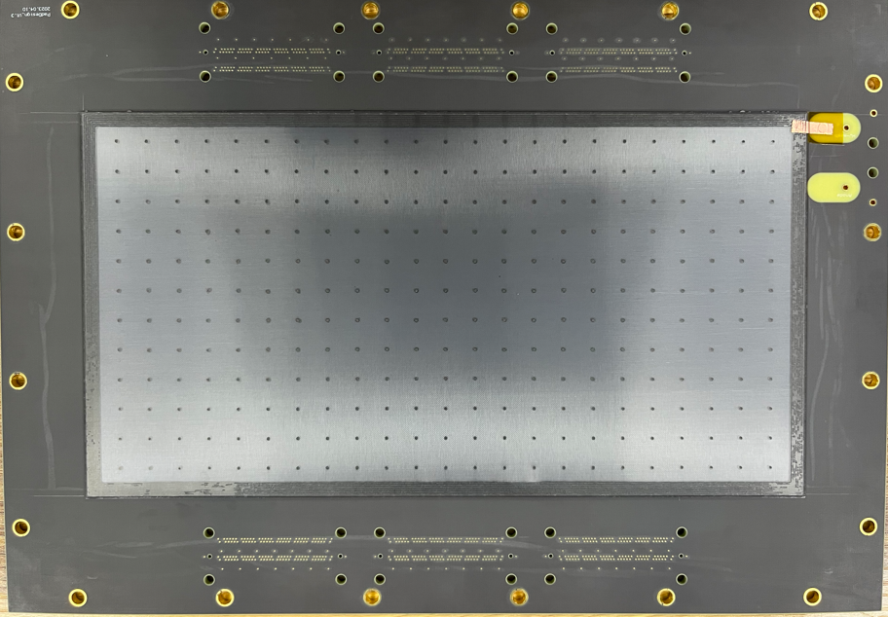
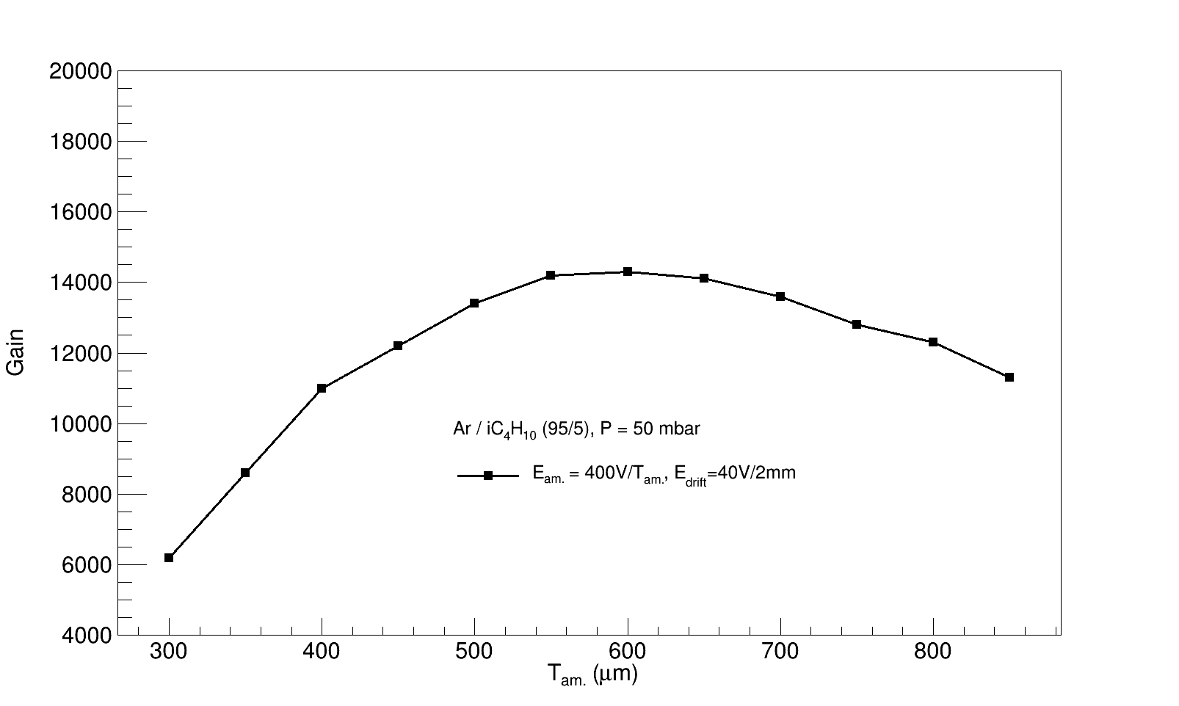
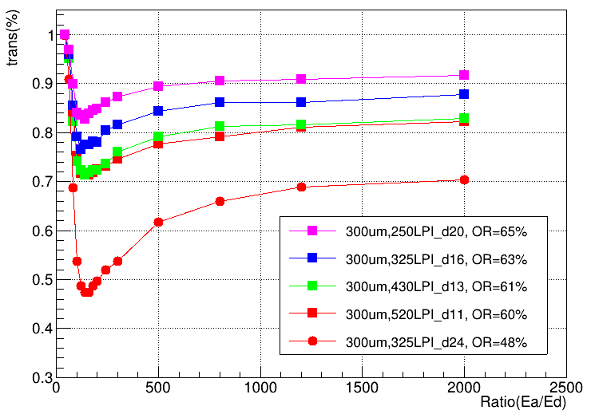
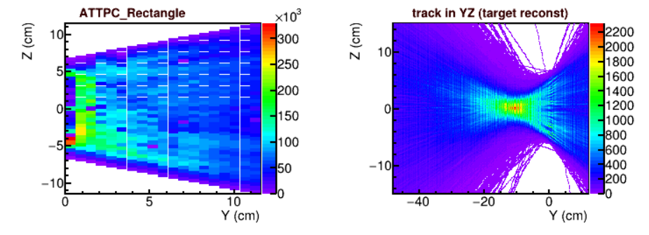
Fabrication and test of the detectors
Garfield simulation
50 mbar He+CO₂
Thermal bonding Micromegas
Gain
Transparency
120 mm × 240 mm
Avalanche gap (μm)
Ea/Ed
Detector design
  500 μm avalanche gap for low pressure
  High opening rate mesh (~63%) for electron collection
  Ge coated anode for high gain and long term stability
  Fast grounding to deal with high X-ray radiation from the target
  DMM are used for high gain and low IBF
Test with carbon beam

Slide 16
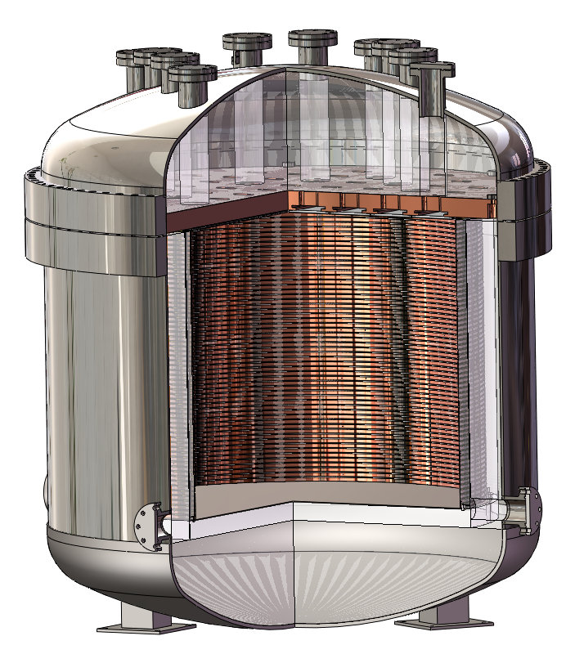
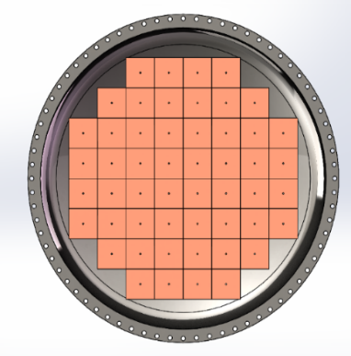
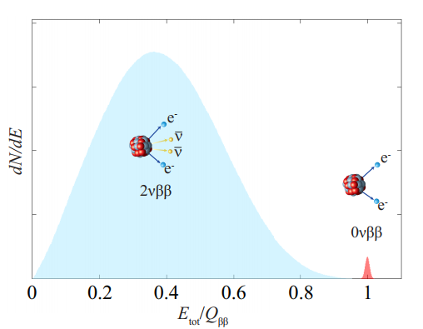
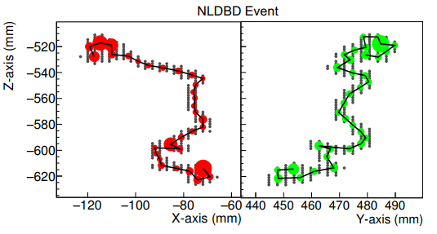
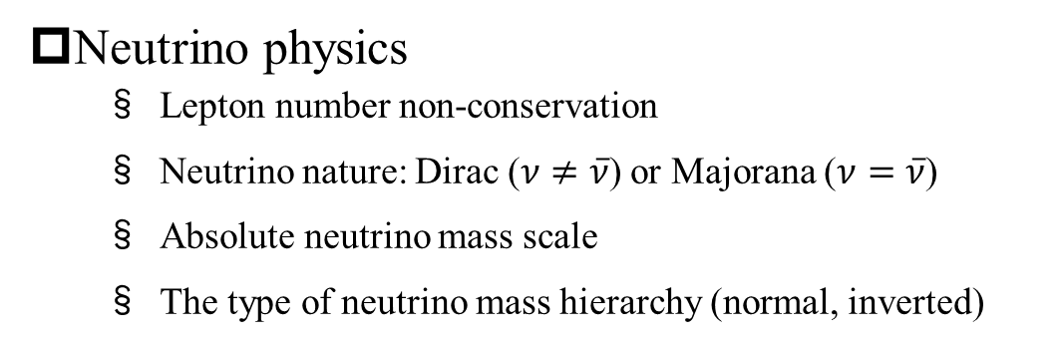
PandaX-III experiment
Neutrino physics
  Lepton number non-conservation
  Neutrino nature: Dirac ($ν≠\overline{ν}$) or Majorana ($ν=\overline{ν}$)
  Absolute neutrino mass scale
  The type of neutrino mass hierarchy (normal, inverted)
Requirements for detector
  Low radioactive background
  Long-term stability at 10 bar Xenon (1%TMA)
  Energy resolution 3% @ 2.458 MeV
  20×20 cm² MMs for charge readout (52)

Slide 17

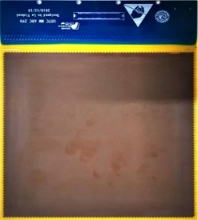

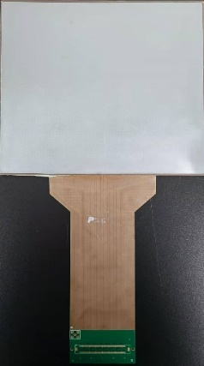
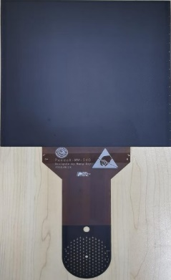
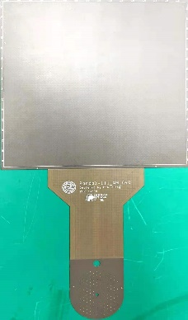
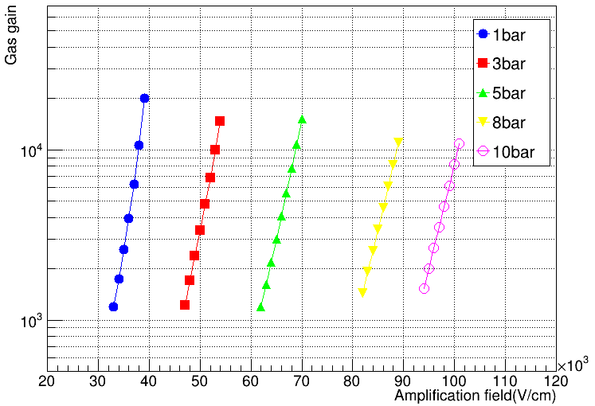
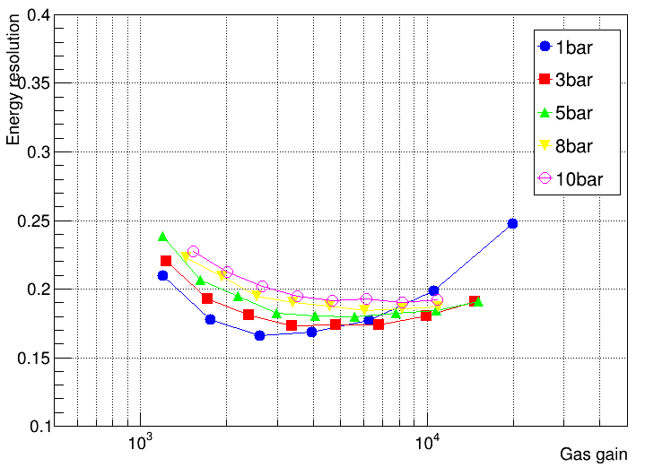
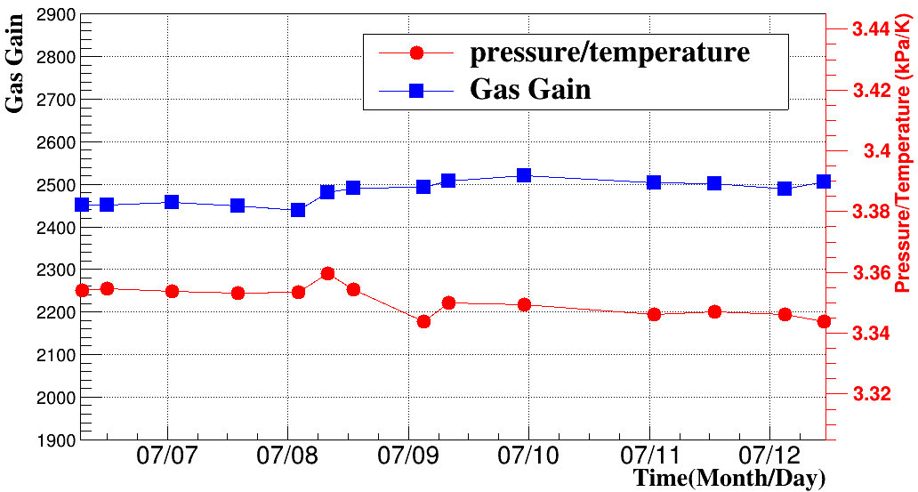
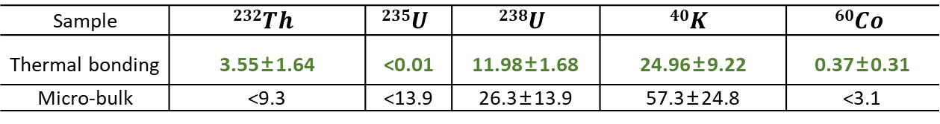
Design and fabrication of the detectors
12/2019
02/2020
04/2020
08/2020
11/2020
06/2021-now
V1
V2
V3
V4
V5
V6
Design for High radiopurity
Stainless steel mesh
Thermal bonding film
Flexible PCB
  Ge anode
  Copper strip
Pure copper substrate
Very low background rate: μBq/cm²
Sample | $$232Th$$ | $$235U$$ | $$238U$$ | $$40K$$ | $$60Co$$
Thermal bonding | 3.55±1.64 | <0.01 | 11.98±1.68 | 24.96±9.22 | 0.37±0.31
Micro-bulk | <9.3 | <13.9 | 26.3±13.9 | 57.3±24.8 | <3.1
>10000 gas gain
<20% (FWHM) energy resolution
>150 hours
Test at 10bar Ar(2.5% Iso) with a 5.9 keV X-ray source

Slide 18
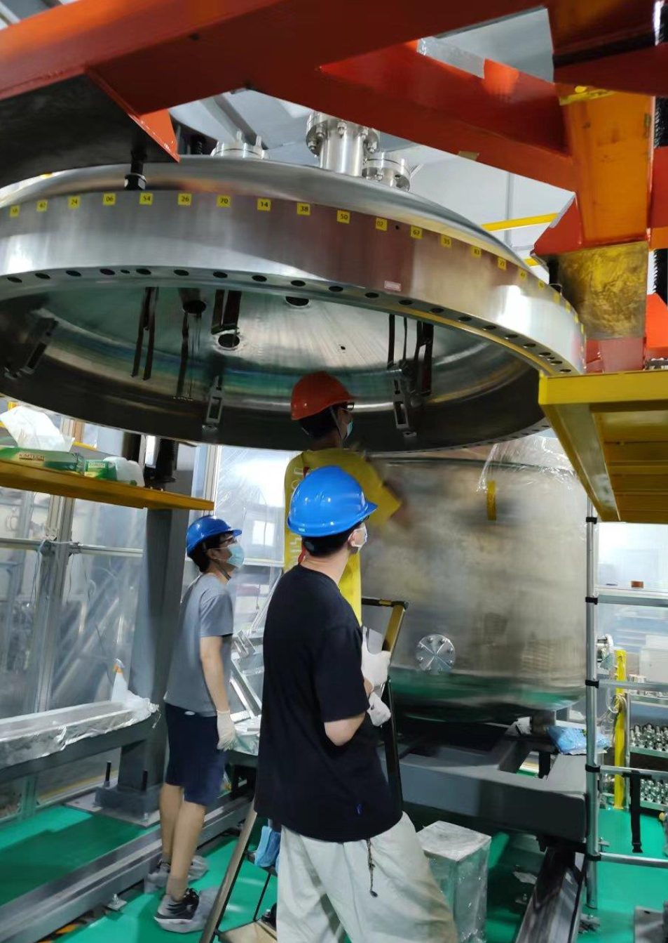
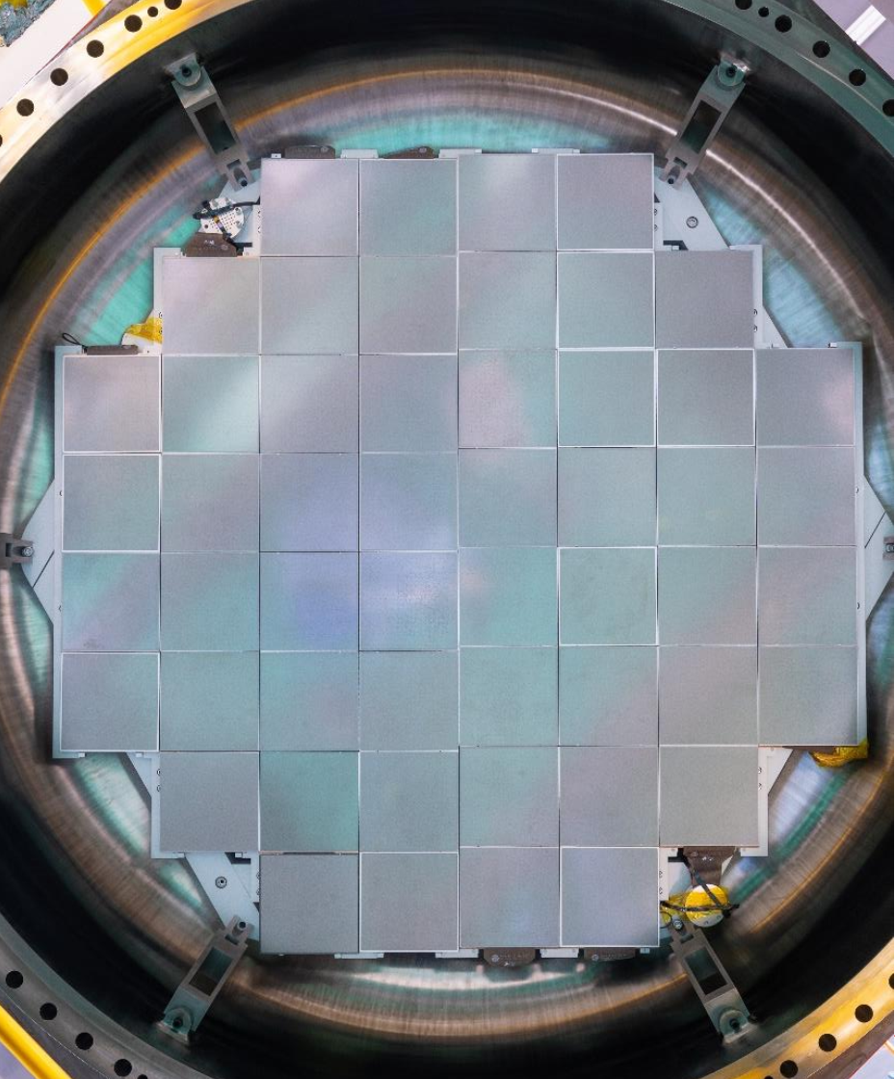
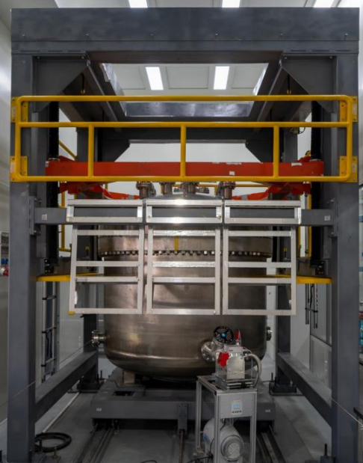
Assembly for 52 detector prototype
Readout plane with 52 Micromegas
Detectors installation completed
There are still some key issues to overcome before the operation of the prototype

Slide 19
Outline
  Thermal bonding Micromegas
  Method and performance
Readout for TPCs
  Low and high pressure
Muon tracker
  Large detector and muography
Summary
1
  Large area muon tracker
2
  Muography

Slide 20
MPGD in collider experiments
 | Vertex | Inner tracker | PID | Hadronic CAL | Muon tracker
ATLAS | GOSSIP/ InGrid |  |  |  | 1200 m² MM
ALICE |  | TPC (130 m² GEM) | VHPMID (CsI THGEM)
CMS |  |  |  | FCAL (GEM,MM) | 1000 m² GEM
CEPC (R&D) |  | TPC(GEM,MM) | RICH(THGEM, MM,DMM) | DHCAL (GEM, THGEM,RPWELL）
Demands for muon tracker
  Large area: ~m²
  high spatial resolution: ~100 μm
  High counting rate: 10 k- 1M Hz/cm²
ATLAS NSW muon detector:
600 -15k Hz/cm² counting rate ~2-3 m² for a single detector, 1280 m² in total
CMS muon spectrometer:
~50 kHz/cm² （ME0）~0.3 m² for a single detector, ~350 m² , ~1000 m² foil，in total

Slide 21
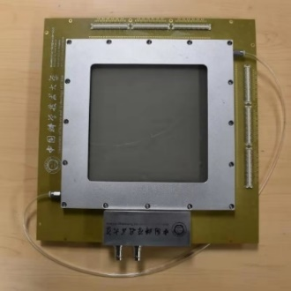
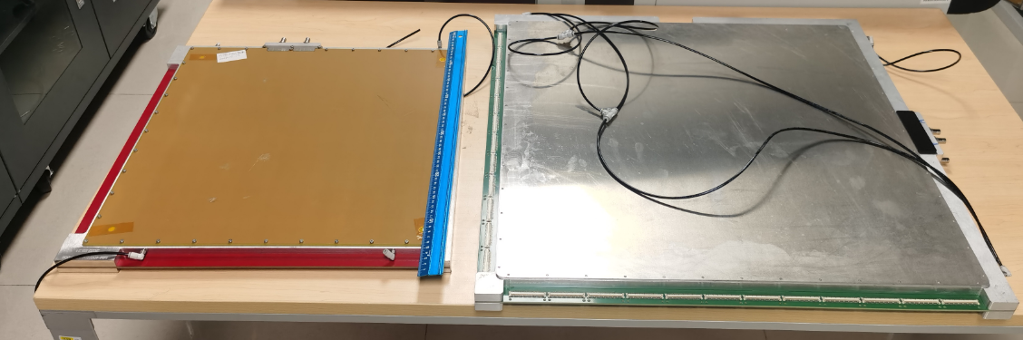


Muon tracker Micromegas
Single side
150×150 mm²
400μm strip pitch
400×400 mm²
600×600 mm²
Back to back
Size | Readout design | Spatial resolution | Efficiency
150×150 | Single side | < 100μm | >95%
400×400 | Single side | ~500μm | ~95%
600×600 | Back to back | ~350μm | ~95%
Larger detectors usually have worse resolution most possibly due to S/N ratio, alignment, PCB bending.
Back to back design can improve the resolution by reduce the PCB bend caused by tension mesh and gas flow
More alignment, correction are needed to improve the results

Slide 22










Muography facilities
μSTC: μ(muon) Scattering tomography & Transmission imaging faCility
Schematic design :
Small prototype:
6 layers of 15×15cm²
~100 μm resolution
2 cm
Larger prototype:
8 layers of 40×40cm²
60×60cm²
~100 μm resolution
Yu Wang, Zhiyong Zhang, Shubin Liu et al., IEEE TNS, vol. 69, no. 1, pp. 78–85, Jan. 2022.

Slide 23





Tomography study with small size prototype
2 cm
4-hour exposure
24-hour exposure
Yu Wang, Zhiyong Zhang, Shubin Liu et al., IEEE Transactions on Nuclear Science, vol. 69, no. 1, pp. 78–85, Jan. 2022.
https://doi.org/10.1109/TNS.2021.3137415.

Slide 24


Radiography of Mt. Dashu
An ancient volcano formed 65 million years ago
Adjacent to the urban area of Hefei city
Altitude of the mountain and facility location is 280m and 60 m respectively
The prototype was set at horizontal angle
Recording muons from both mountain side and the other side (for reference)
Test for duration of ~100 days
The plotted data used: ~15 days

Slide 25
Summary
Thermal bonding method
  High performance Micromegas with large area
  New structures of DMM and TMM for high gain and ultra-low IBF
Readout for TPC
  Low pressure TPC for nuclear physics experiment
  High pressure TPC for rare event searching
Muon tracker
  Large area detector with high spatial resolution
  Facility for muography study
Thank you

Slide 26


High pressure xenon test
Signal of a cosmic muon
One of the key issues is stable operation under high pressure xenon
We have recently made landmark progress:
  Gas 10 bar Xe+1%TMA
  Duration：~10 days
At a gas gain of ~1000

Slide 27




Assembly and test of 7 detector prototypes
1-10 bar Ar+2.5%Iso gas
Using X-ray sources of ⁵⁵Fe, ²⁴¹Am, ¹³⁷Cs
No-signal channels due to the bad connections

