Slide 1
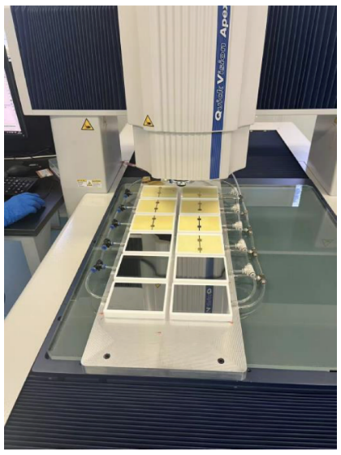
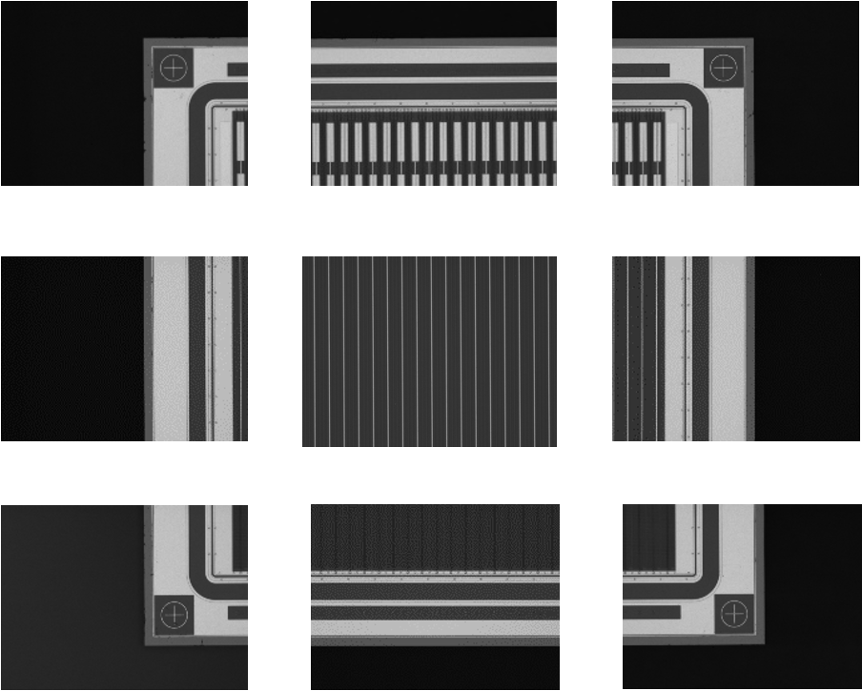
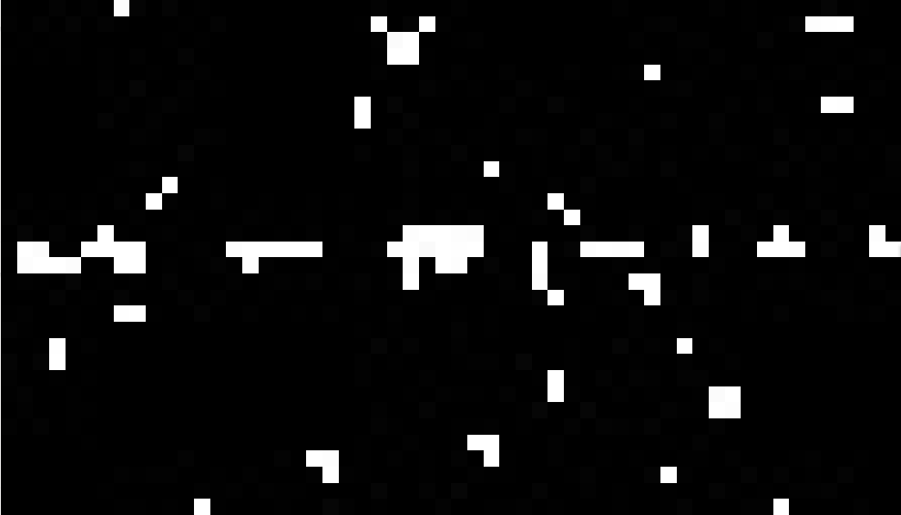
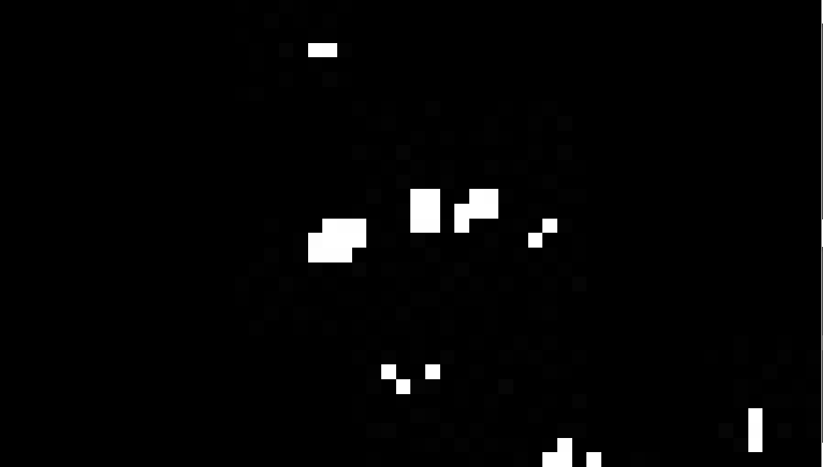
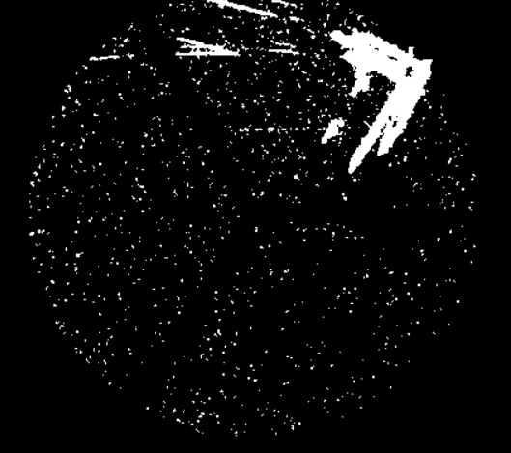
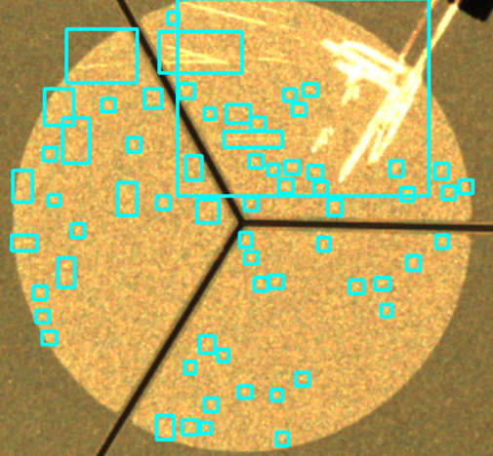
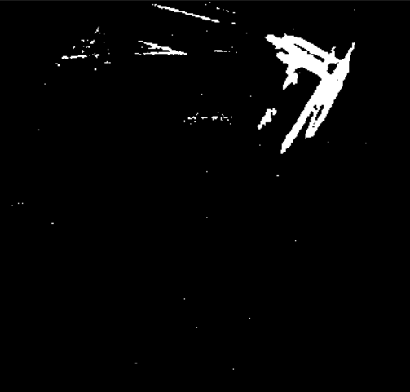
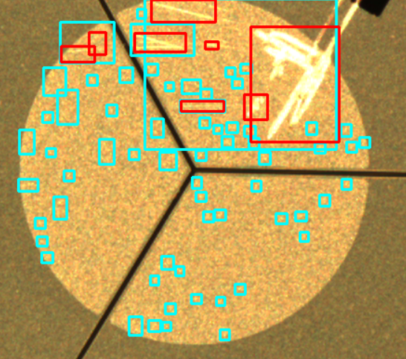
Surface defect detection of silicon sensors
${Shengbo Cao(曹圣博)}^{1}\text{，}{\text{Changcheng} \text{Liu}\text{(}\text{刘长城}\text{)}}^{2}$， ${Hanbing \text{Liu}\text{(}\text{刘}涵兵\text{)}}^{3}$，${\text{Xuhao} \text{Yuan}\text{(}\text{袁煦昊}\text{)}}^{4}\text{，}{Lusen Zhang(张鲁森)}^{4}$
1,3. Jilin University 2. Shandong University 4. Institute of High Energy 5. Hunan University
Introduction
The AMS experiment is a dark matter and antimatter searching experiment mounted on the International Space Station. AMS experiment will be upgraded in 2024 with a new layer of silicon detector layer (L0 detector) which contains ~ 1000 silicon micro-strip sensors. The CMS experiment is a general purpose particle detector at LHC, CMS experiment will be upgraded with a new end-cap high granularity calorimeter (HGCal), which contains ~ 27,000 silicon sensors and will be installed in the next long shut-down of LHC. Silicon sensors in both detectors need to be checked before installation.
These large-scale applications bring about a challenge during the construction process of semiconductor detectors: surface quality inspection.
Why is surface quality inspection necessary?
Surface damage → inadequate detector performance.
Why is surface quality inspection a problem in large-scale production processes?
The need to visually inspect the damage → a large number of images to be analyzed.
How to solve this problem?
Automatically identifying defects on sensors through machine vision methods.
Methodology and Approach
What is the final result obtained?
AMS L0 detector:
The First Step: Taking photos
Automated capturing of SSD surface photos is performed on the Mitutoyo QV-X606 device. Each SSD scan takes ~ 1 hour (>4k photos) and is automatically completed overnight.
Each SSD photo will be divided into 9 categories, and a more detailed defect detection will be performed on each category.
CMS HGCal:
The Second Step: Classification(standard mapping method)
What is the new problem?
Noise handling. Due to severe noise and shallow traces, traditional methods of noise processing have become ineffective.
Select one image as the standard image for each category and subtract it from the image to be processed for classification.
 | color | gray | binary
scratches
noise points
standard image
Test image
Result
Gauss fit threshold
The Third Step: Defect detection
How to solve the problem?
The "two-step screening " method is used. The first judgment is performed to eliminate some noise and determine the region for the second judgment. The second judgment employs multiple criteria to differentiate between noise and traces.
The original OpenCV functions have low accuracy in defect recognition, so we propose a highly accurate "strip-by-strip recognition method".
But high-precision recognition also represents more influencing factors, such as the influence of lighting during photography, regional background grayscale and fine noise.
70 | 70 | 70 | 70 | 70 | 70
68 | 68 | 68 | 68 | 68 | 68
66 | 66 | 66 | 66 | 66 | 66
64 | 64 | 64 | 64 | 64 | 64
62 | 62 | 62 | 62 | 62 | 62
60 | 60 | 60 | 60 | 60 | 60
58 | 58 | 58 | 58 | 58 | 58
56 | 56 | 56 | 56 | 56 | 56
54 | 54 | 54 | 54 | 54 | 54
52 | 52 | 52 | 52 | 52 | 52
50 | 50 | 50 | 50 | 50 | 50
48 | 48 | 48 | 48 | 48 | 48
46 | 46 | 46 | 46 | 46 | 46
44 | 44 | 44 | 44 | 44 | 44
42 | 42 | 42 | 42 | 42 | 42
40 | 40 | 40 | 40 | 40 | 40
38 | 38 | 38 | 38 | 38 | 38
199
198
197
196
195
194
193
192
191
190
189
188
187
194
192
184
183
70
68
66
64
62
60
58
56
54
52
50
48
46
44
42
40
38
What is the final result obtained?
lighting during photography
regional background grayscale
the influence of fine noise
The blue color represents the result after the first screening.
The red color represents the result after the second screening.
The above influencing factors can all lead to inaccurate threshold results.
Using different methods for different situations can yield good results.
Summary and Prospect
Summary:
Our work aims to achieve recognition of surface defects on detectors through machine vision, in order to free up previous human investment in this area. Through the development of machine vision programs, it is now possible to achieve defect detection for AMS and CMS, and it also has good applicability for defect identification on other detectors(such as CEPE).
Prospect:
In the future, machine learning will be introduced to achieve more intelligent and versatile visual detection, while also incorporating detection of more complex areas (containing characters or irregular graphic areas) that cannot be recognized at present. We will also try to develop a fault monitoring program for detector processing and operation in the future.
Contact:
202100101139@mail.sdu.edu.cn
liuhb1121@mails.jlu.edu.cn
caosb1121@mails.jlu.edu.cn
zhanglusen@hnu.edu.cn
The 2023 International Workshop on the High Energy Circular Electron Positron Collider
23-27, October 2023

