Slide 1






国家重点研发计划
R&D and Verification of Key Technologies for a High Energy Circular Electron-Positron Collider
Zhijun Liang for CEPC MOST2 vertex detector team

Slide 2
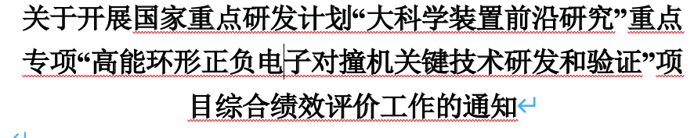
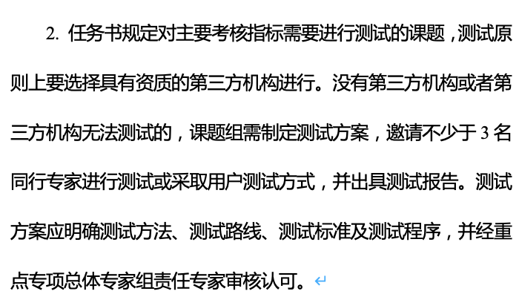
News on MOST2 project
Project timescale （执行期）： up to April 30th ,2023
June 20 –July 21: submission of final reports and review report into MOST2 system
  Reviews on silicon task 2 and reviews on MOST2 project are likely take place in May/June
  Final reports needs to be ready
  Reviews on key parameter (考核指标）
Oct 2023：
  MOST project review and defend

Slide 3
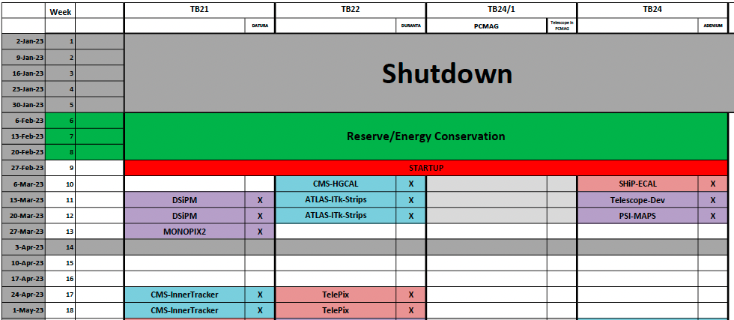
Time line for prototype
  This week: ladder testing and prototype assembly
  Apr 11- Apr 23: Testbeam at DESY(reserved)

Slide 4
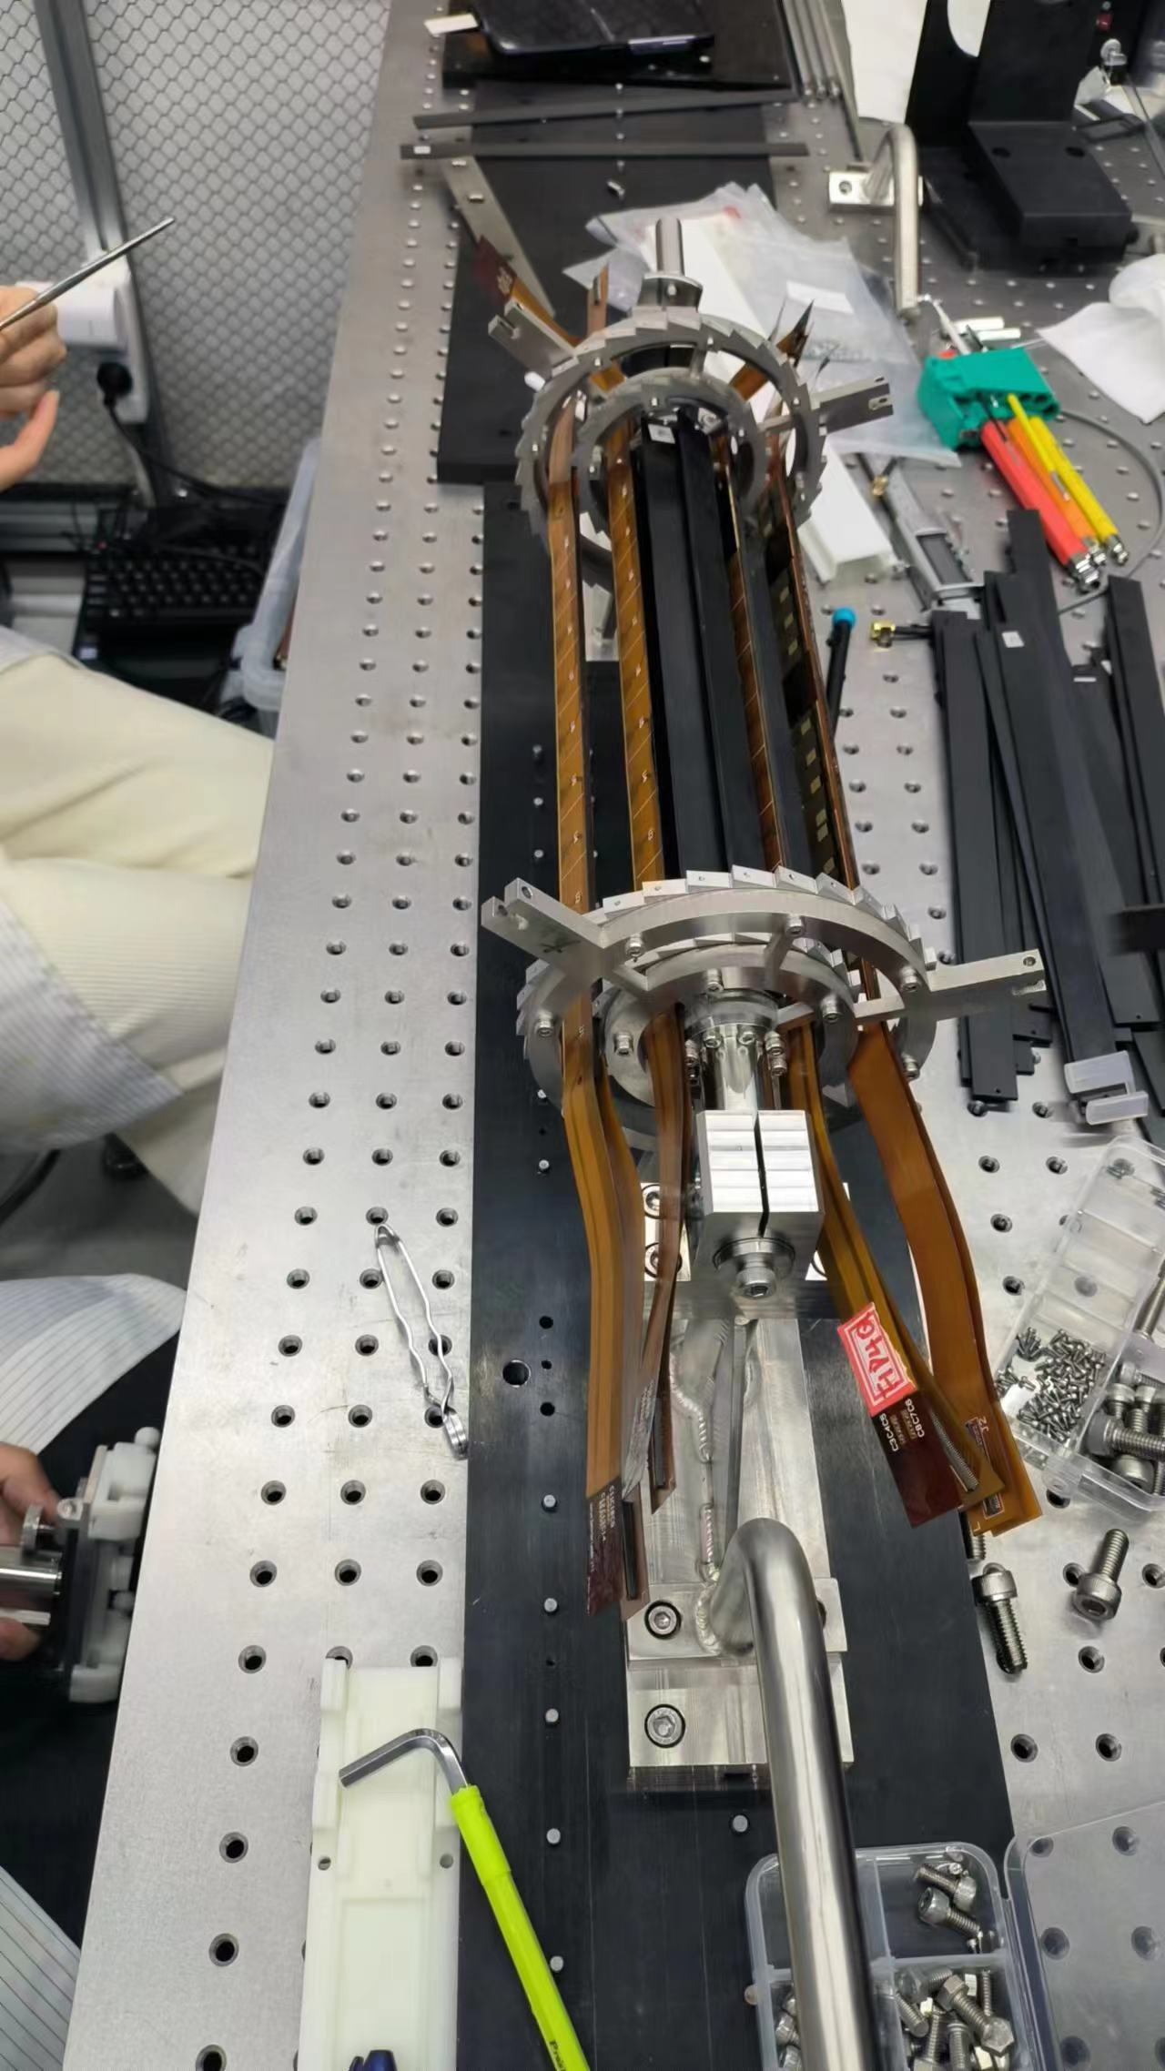
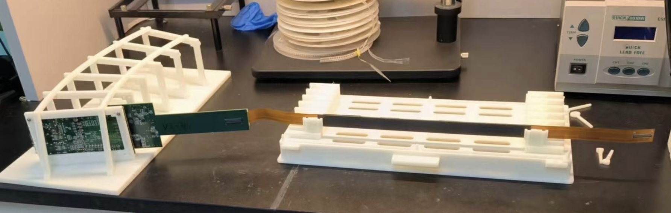
Plan
Focus on assembly and testing ladder
  Goal:
    Aim for 12 double side ladders ( 6 for prototype, 3 for telescope, 3 backup)
    9 ladders ready

Slide 5
Publication plan
Taichu2 Laser test (NIMA): submitted
DESY Test beam 1st paper: submission date: Early March (!!!)
Paper about vertex prototype testbeam : before May 15th (!!!)
  Need to decide on modified process result
Electronics for ladder and prototype (JINST): (should published before Sep 30th )
Paper about the prototype : (should published before Sep )
Paper of TaichuPix3: (should published before Sep 30th ) 30th
Document about irradiation hardness: Before May (!!!)
Final report (结题科技报告）(Before May). (!!!)

Slide 6
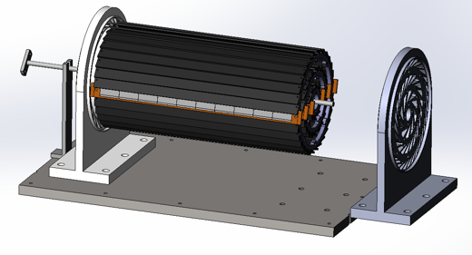
Plan for test beam (Apr 11- Apr 23,2023)
Person power, expertise
  Joao (IHEP, overall)
  Zhijun Liang (IHEP, overall)
  Tianya (IHEP, ASIC)
  Xiaomin WuWei(NWPU, ASIC )?
  Wei Wang(IHEP,ASIC, offline)
  Jia Zhou (IHEP ,DAQ)
  Xinhui Huang (IHEP, mechanism)
  Shuqi Li (IHEP, offline)
  Hao Zeng(IHEP, offline)
  Xuewei Jia(IHEP, offline)
  Yuhang Guo(IHEP, CSNS, testbeam)

Slide 7
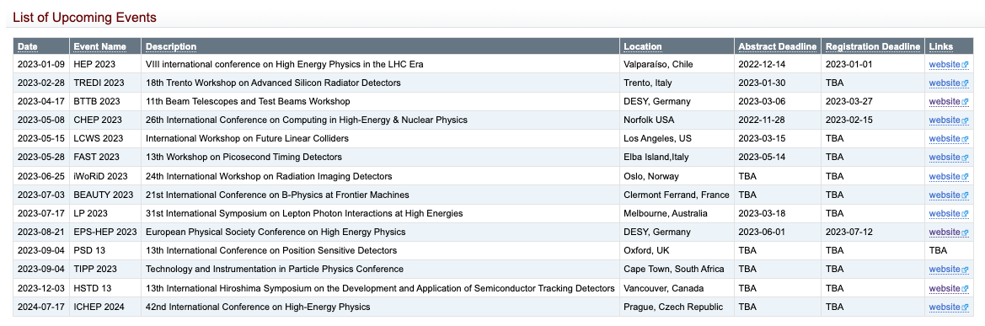
Conference
https://twiki.cern.ch/twiki/bin/view/CLIC/UpcomingConferences

