Slide 1
Plan for DESY 2023
Tianya Wu
wuty@ihep.ac.cn
2023.04.06

Slide 2
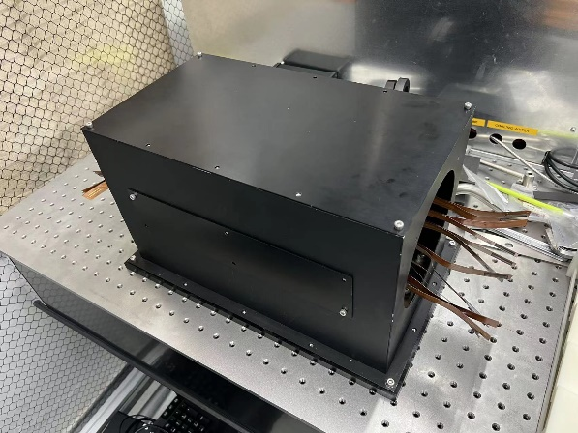
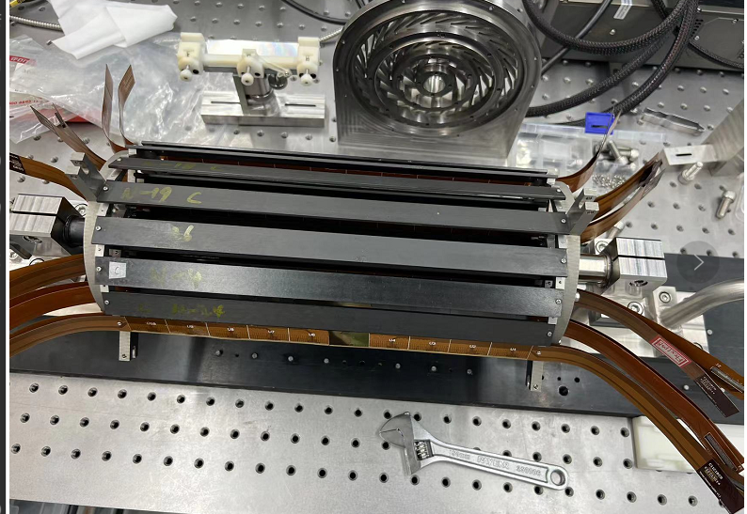
Preparation to DESY
Testbeam: 11-April-2023 to 23-Apri-2023, fly to DESY on 9th April
Prototype：Verified by damage flex or dummy flex, support of interposer and FPGA is under installing
Telescope： Full structure was verified
Firmware：Stable one was verified by ⁹⁰Sr
DAQ：Online hitmap of ladders was done
Cofig masking again
RESET+Cofig masking +Loading DAC
Next step:
1) Replace baseline prototype with good ladders
2) Test more ladders with DAQ to optimize software

Slide 3
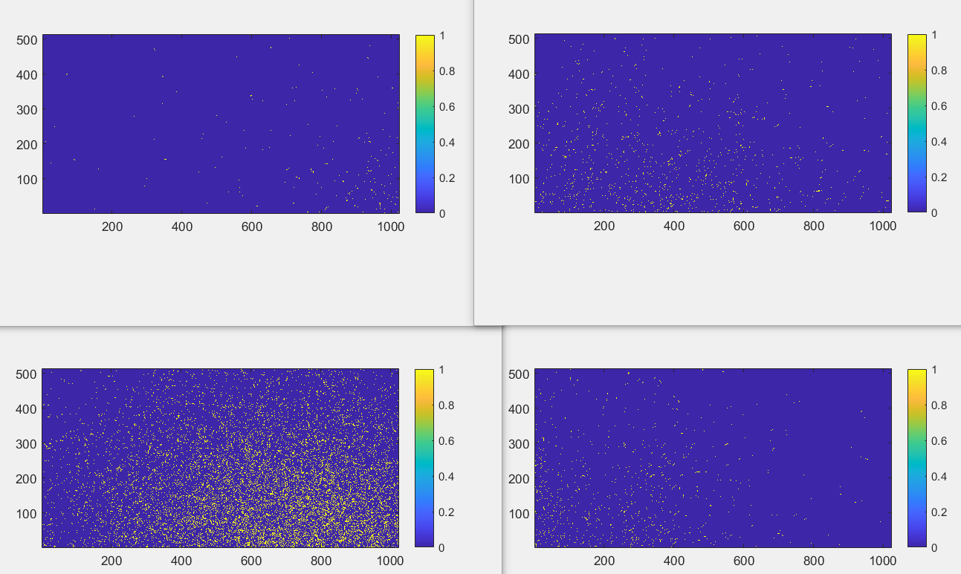
⁹⁰Sr Hitmaps from one ladder
Test with old version FPGA

Slide 4
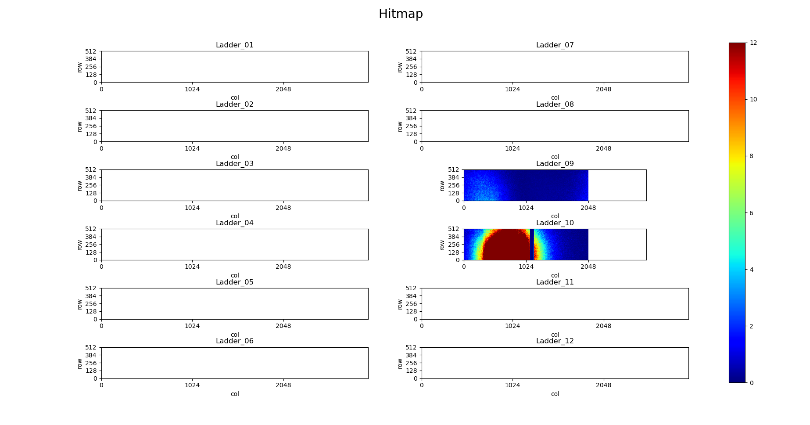
⁹⁰Sr Hitmaps from one ladder
Test with new version FPGA and full architecture

Slide 5
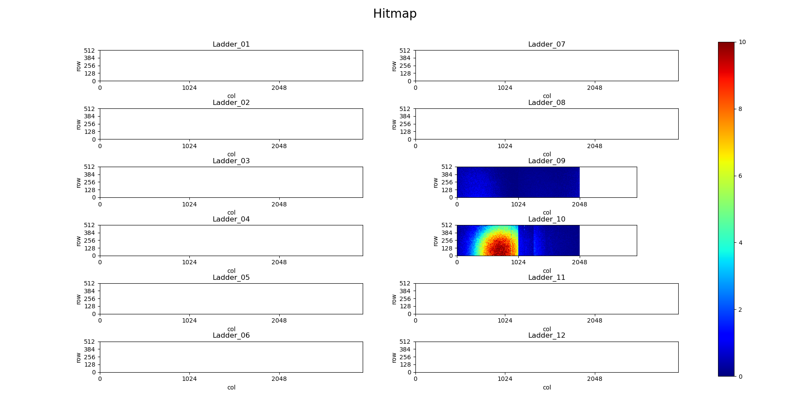
⁹⁰Sr Hitmaps from one ladder
Test with new version FPGA and full architecture

Slide 6
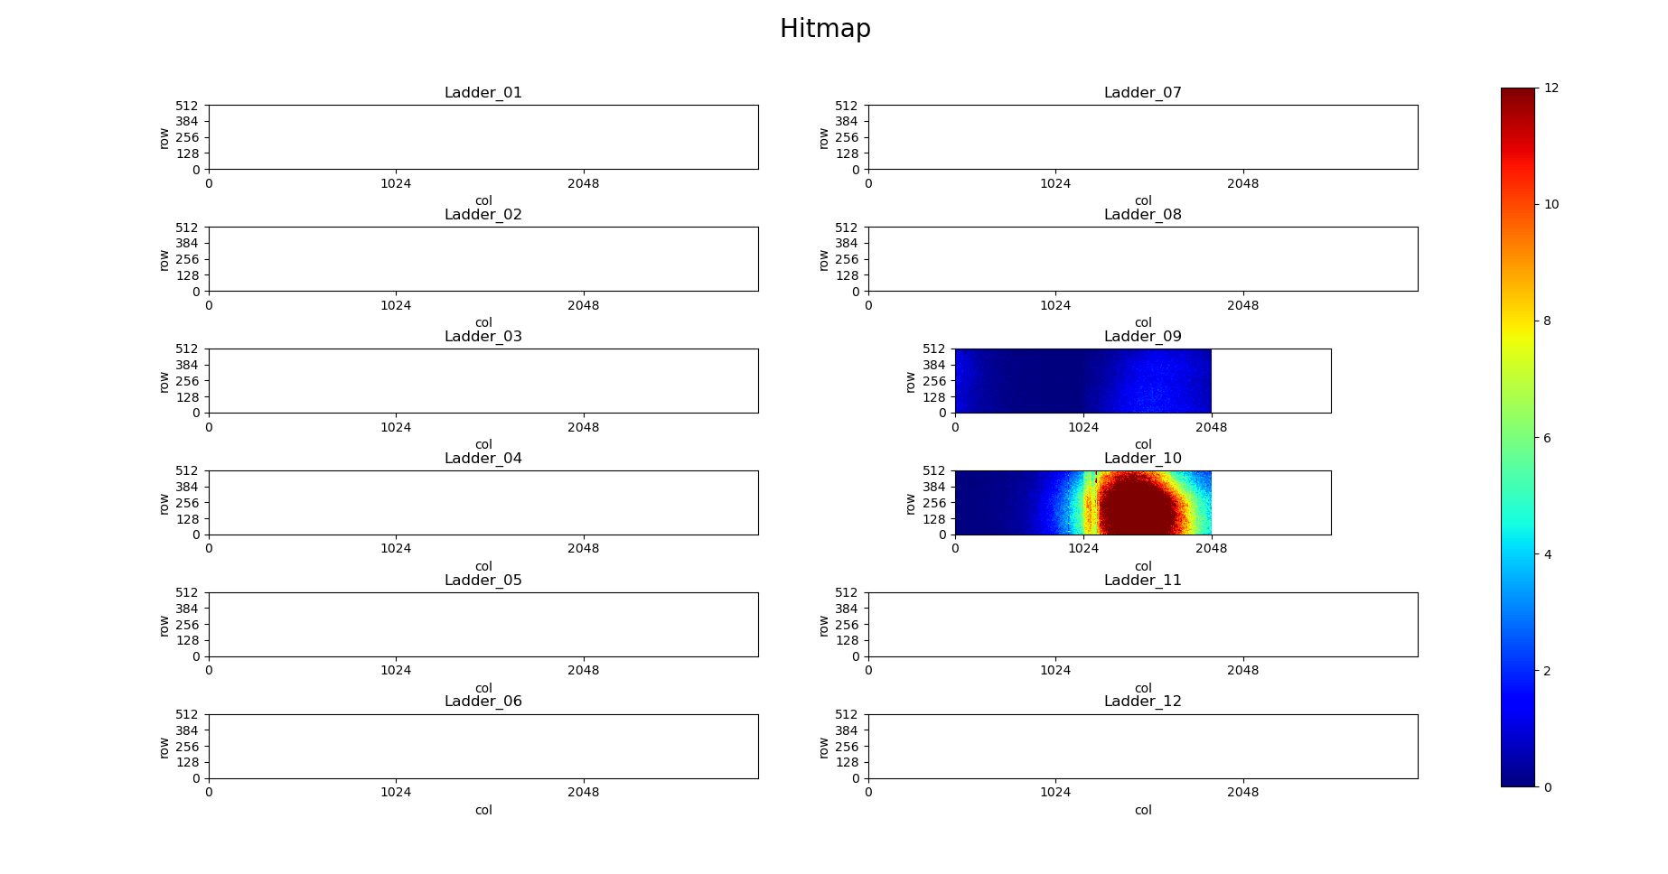
⁹⁰Sr Hitmaps from one ladder
Test with new version FPGA and full architecture

Slide 7
Status of Flexes
Status of flex
8 good ladders are ready, 1 ladders are under installing
5 flexes will do wire-bonding today
6 Wafers are thinning and dicing in company, will be sent today
Cofig masking again
RESET+Cofig masking +Loading DAC
Status | Wafers | Total flex | Damage flex | Flex with one chip work | Flex with 2 chip work | good ladders
Quantity | 1(W8) | 37 | 7 | 5 | 21 | 8
Tagets | - | - | - | - | - | 10

Slide 8
Thanks for your attention!

