Slide 1
TaichuPix-3 test
Ying ZHANG, XiaoXu Zhang
2023-4-6

Slide 2
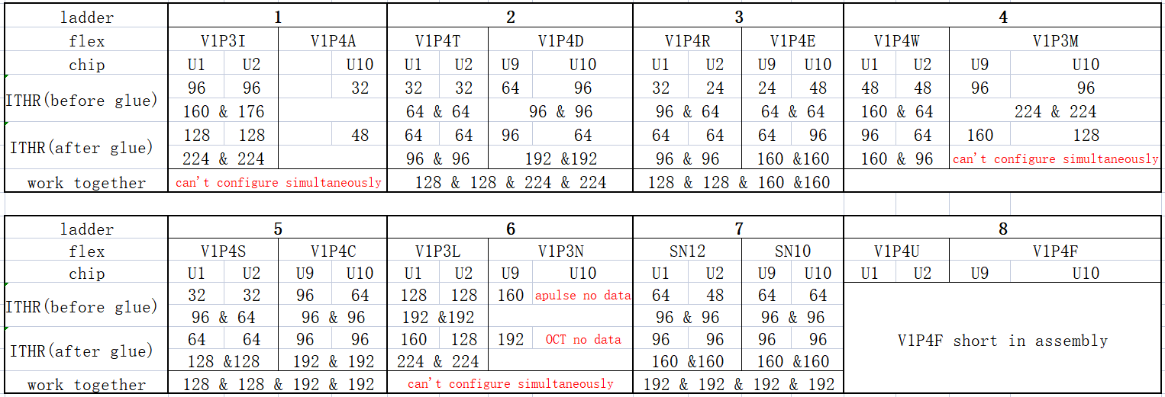
Double-sided ladder（only 4 work normal now）
More chips working together cause crosstalk and more noise.
That means chips must work at larger ITHR.
Some chips can’t configure simultaneously even at ITHR256.

Slide 3
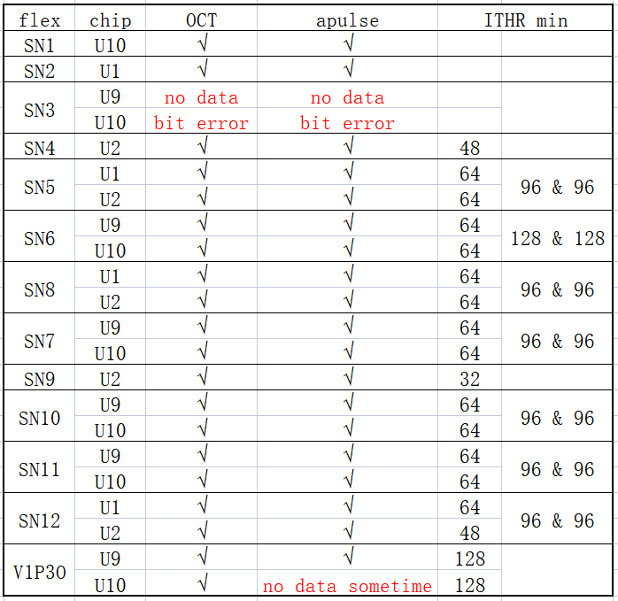
Single-sided ladder（work normal）
3 U1&U2
5 U9&U10
1 U1
1 U2
1 U10

Slide 4
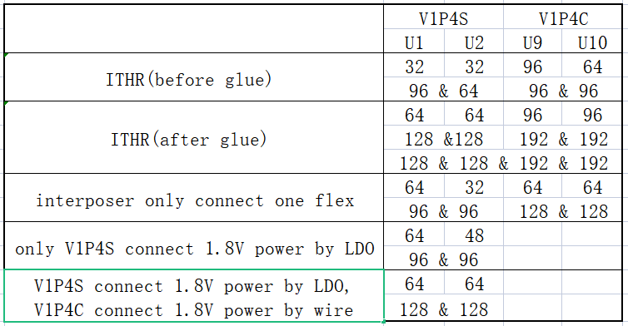
Find reason of crosstalk

