Slide 1
CEPC DC Track Finding
--Mengyao Liu
2023/4/7

Slide 2
Content
Introduction
Process
Result
Summary

Slide 3
Track Finding
Track Seed
Extrpolate track including multiple scattering and non-uniformity of magnetic field
Find and add hit candidates
Select track by quality criteria

Slide 4
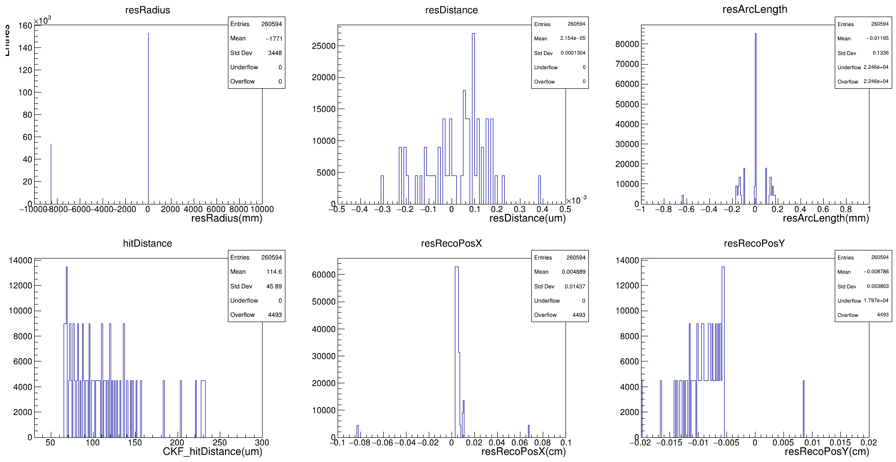
Track Finding
Truth:
resRadius:外推径迹的曲率半径与truth径迹的曲率半径
RecoPos:根据候选单元及外推径迹沿最近方向计算出的最近点
hitDistance:最近点与之间的距离
arclength:径迹到当前击中的弧长
算法内部的计算跟truth是一致的

Slide 5
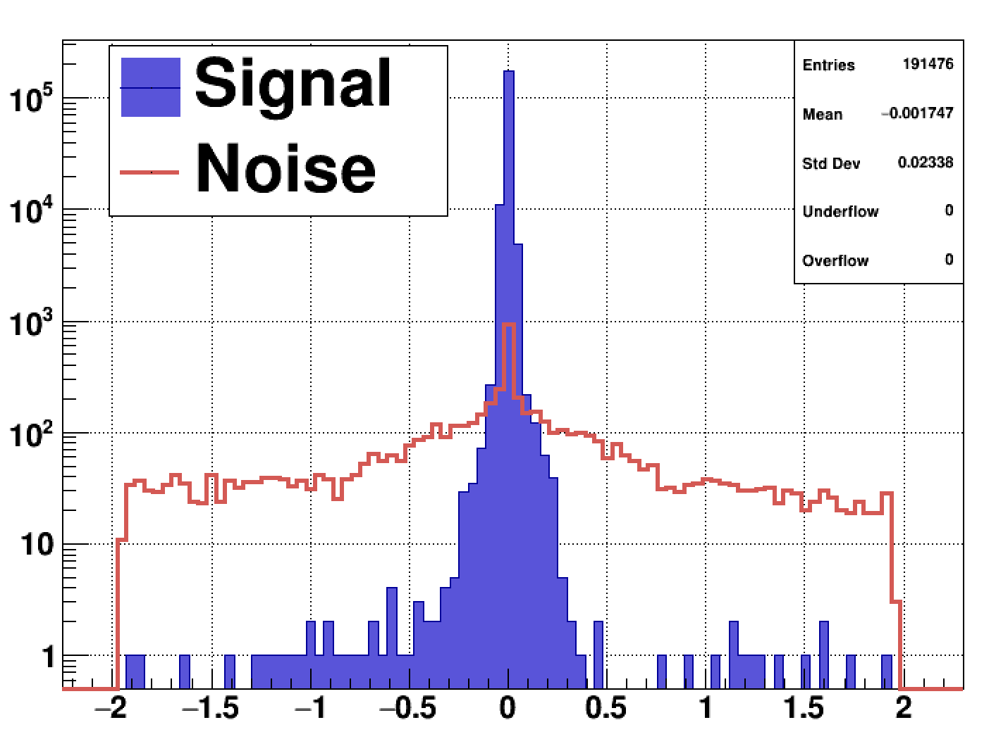
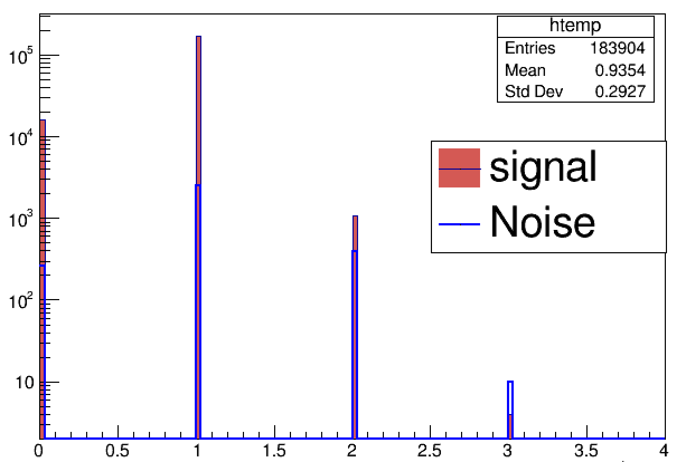
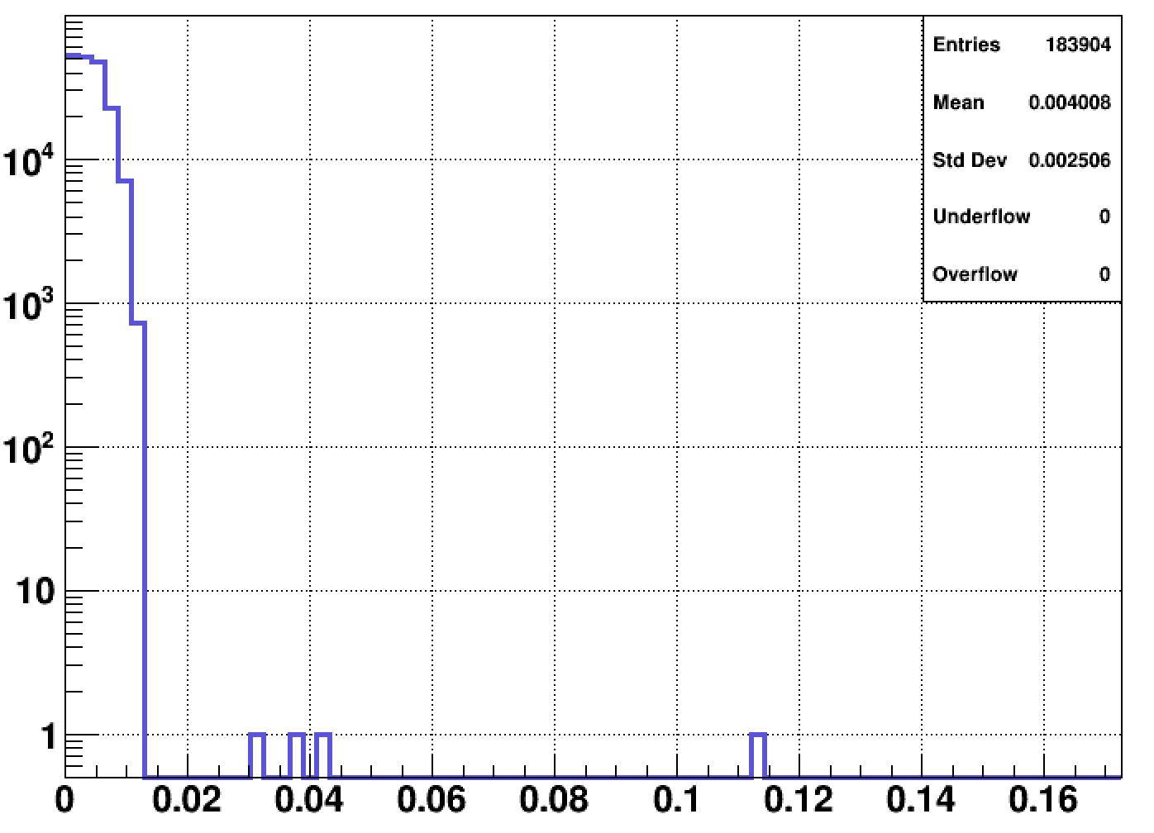
Track Finding
Setting threshold(Noise 20%):
hitDistance:0.5cm
JumpLayerID:1 or 2
deltaPhi: 0.014
hitDistance
JumpLayerID
deltaPhi

Slide 6
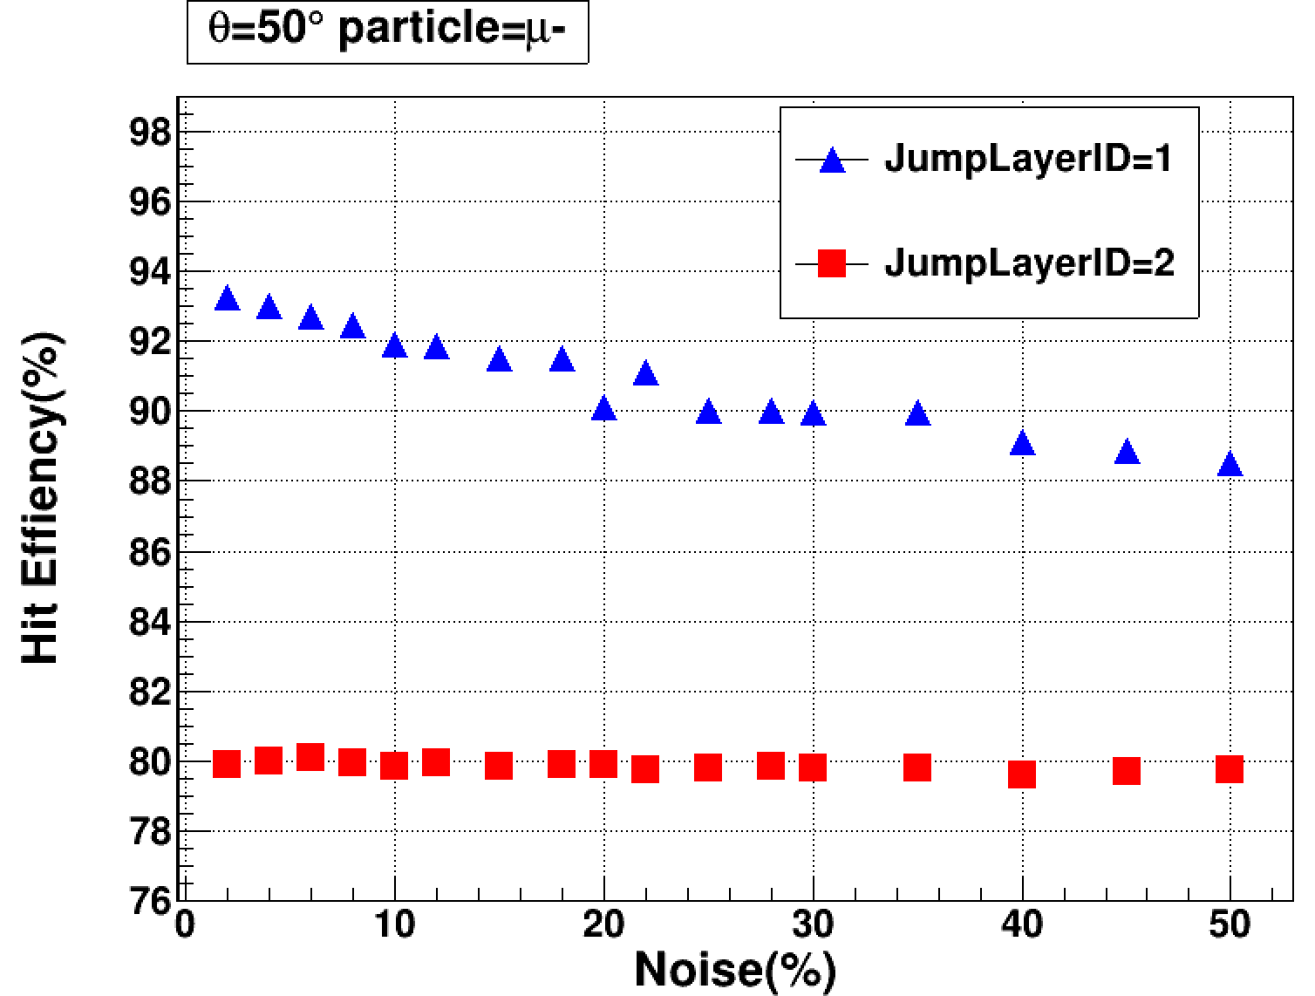
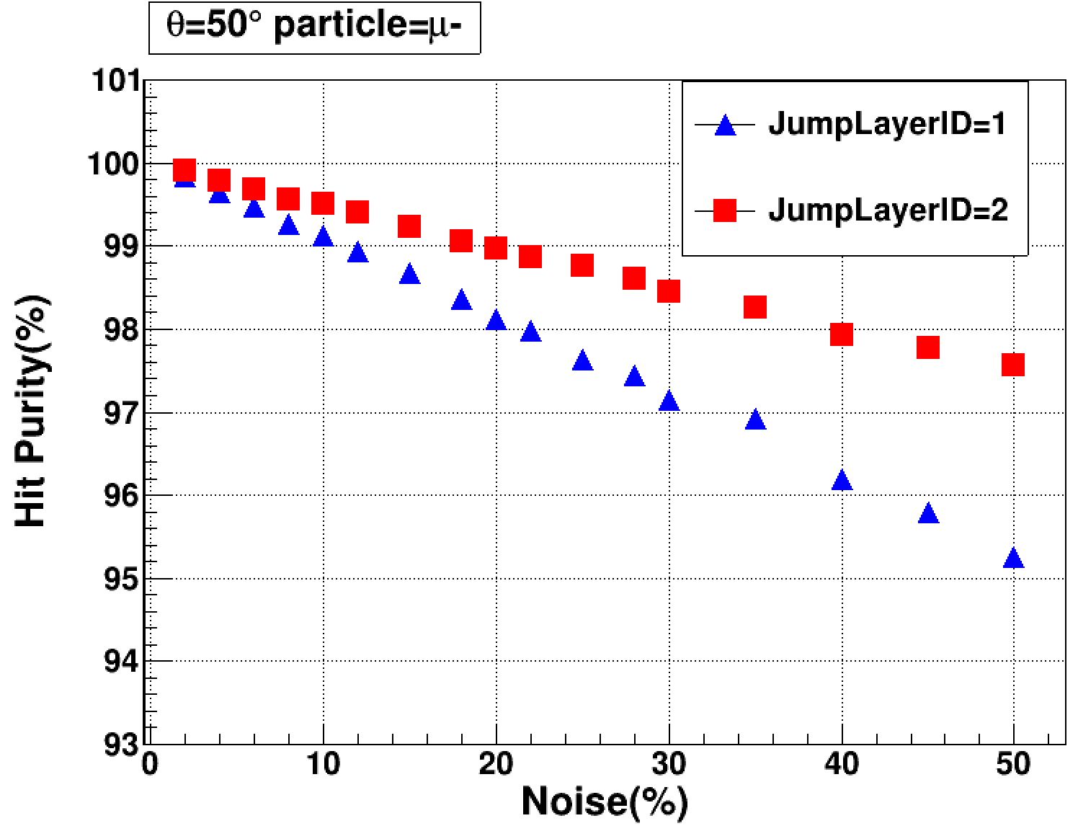
Track Finding
$hit efficiency=N_{foundSignaHit}/N_signalHit$
$hit purity= \frac{N_foundSignalHitOnTrack}{N_foundedHitOnTrack}$
Setting JumpLayerID

Slide 7
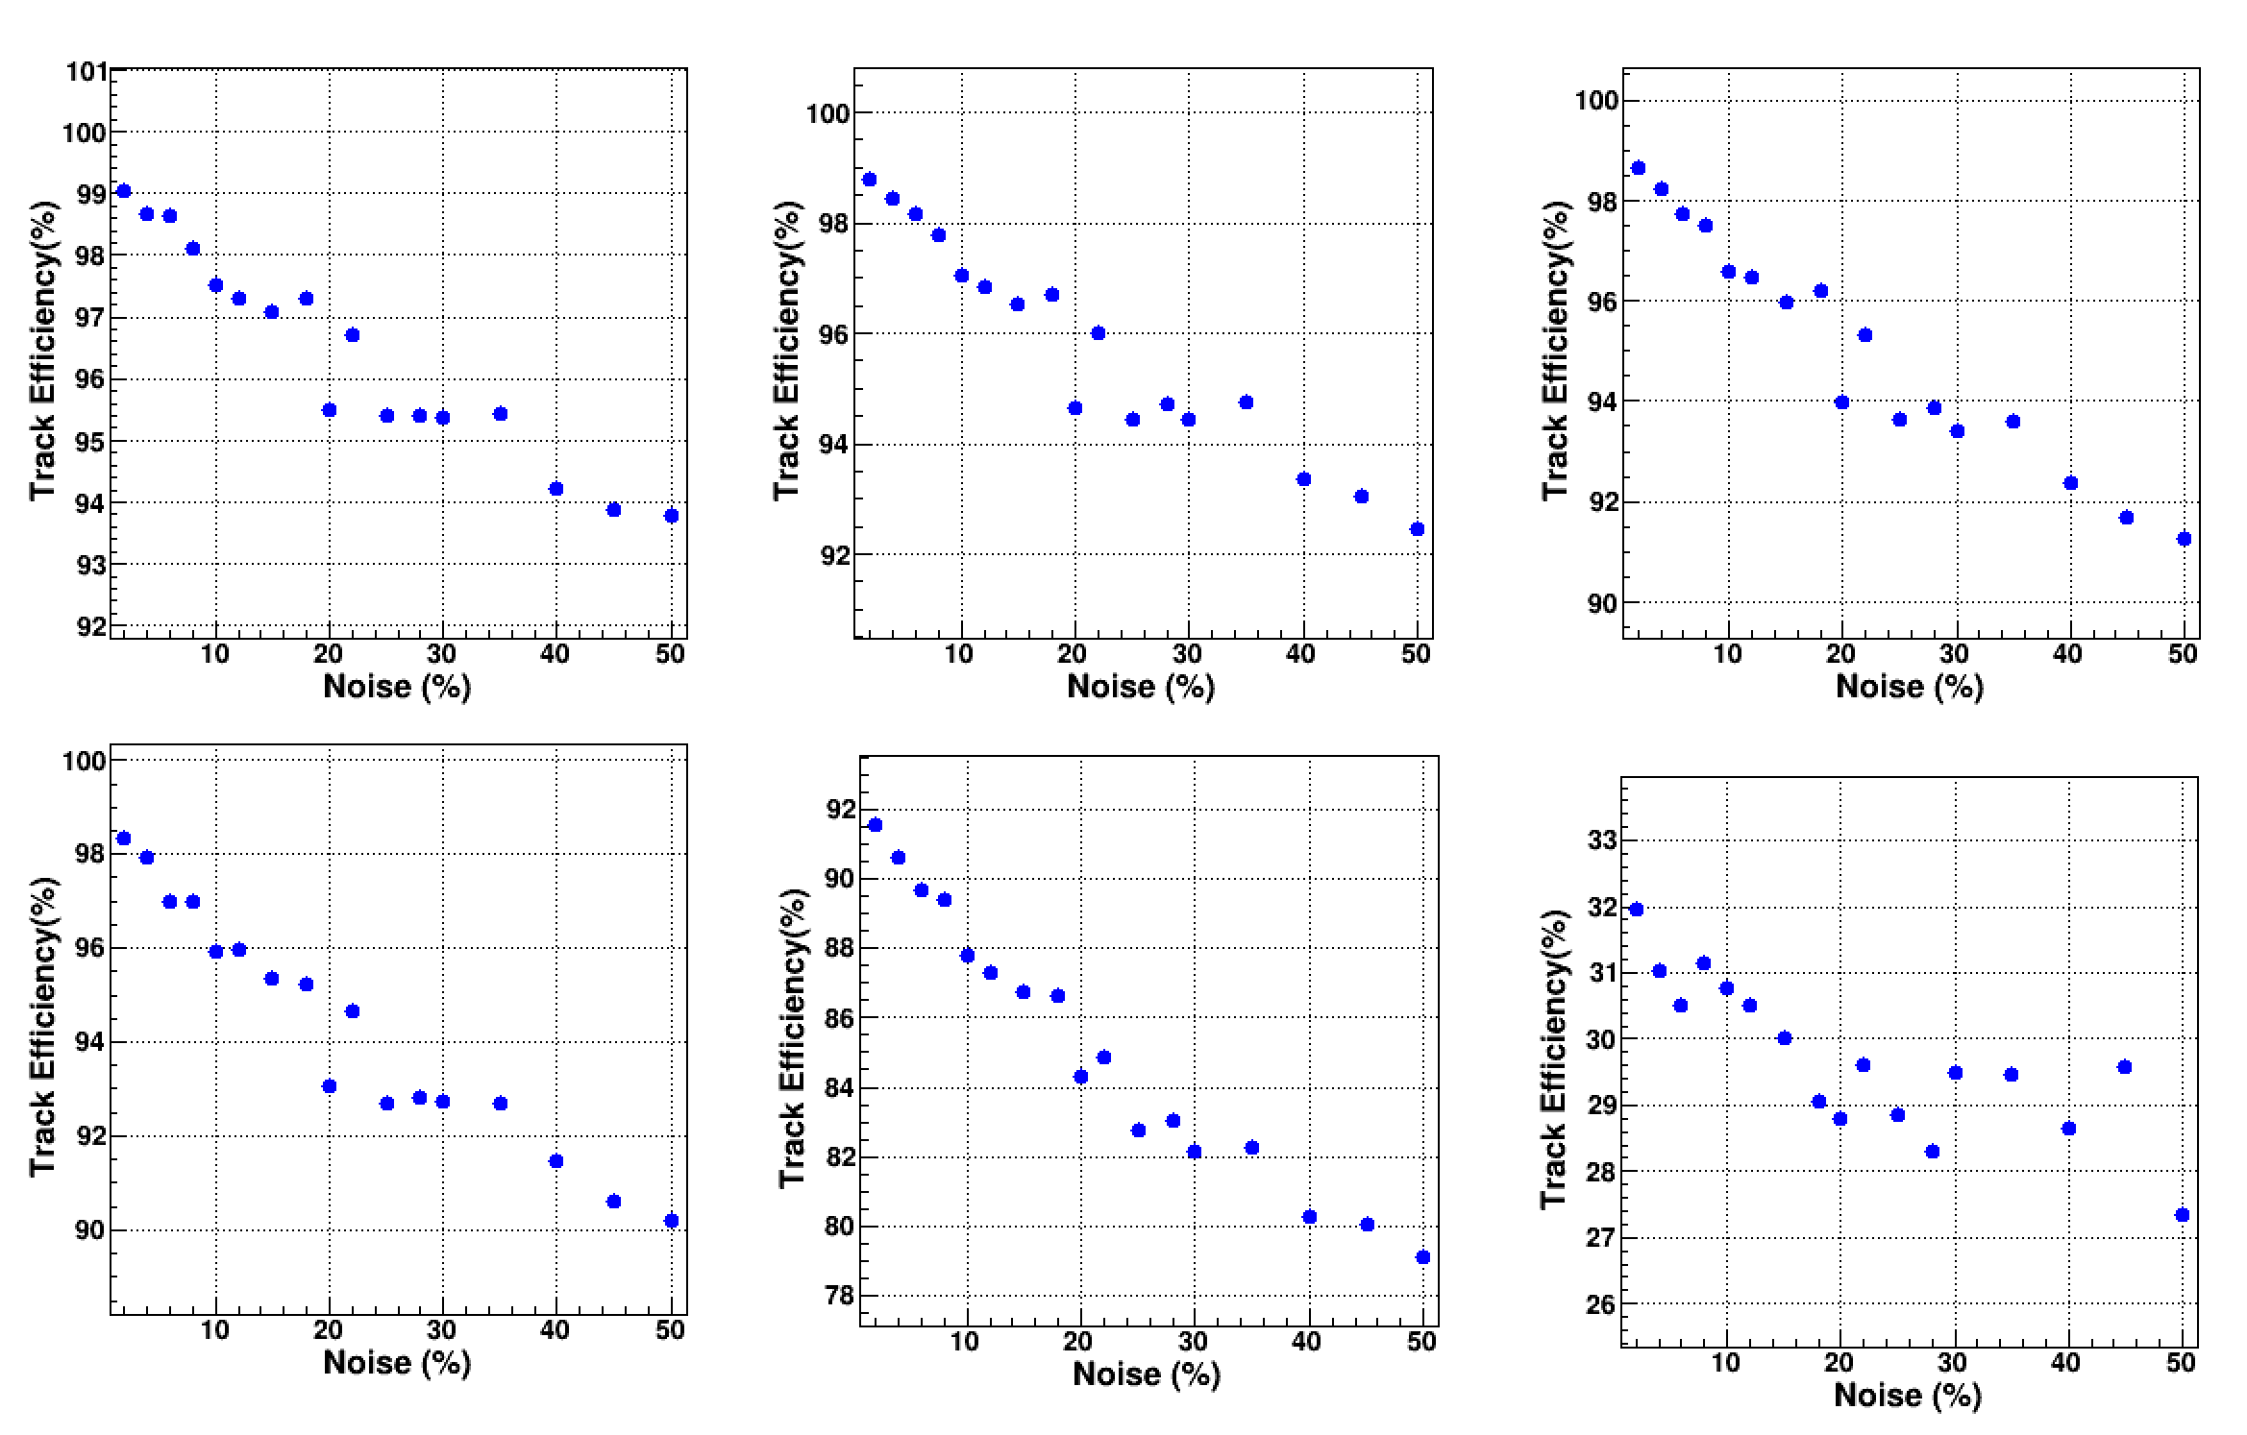
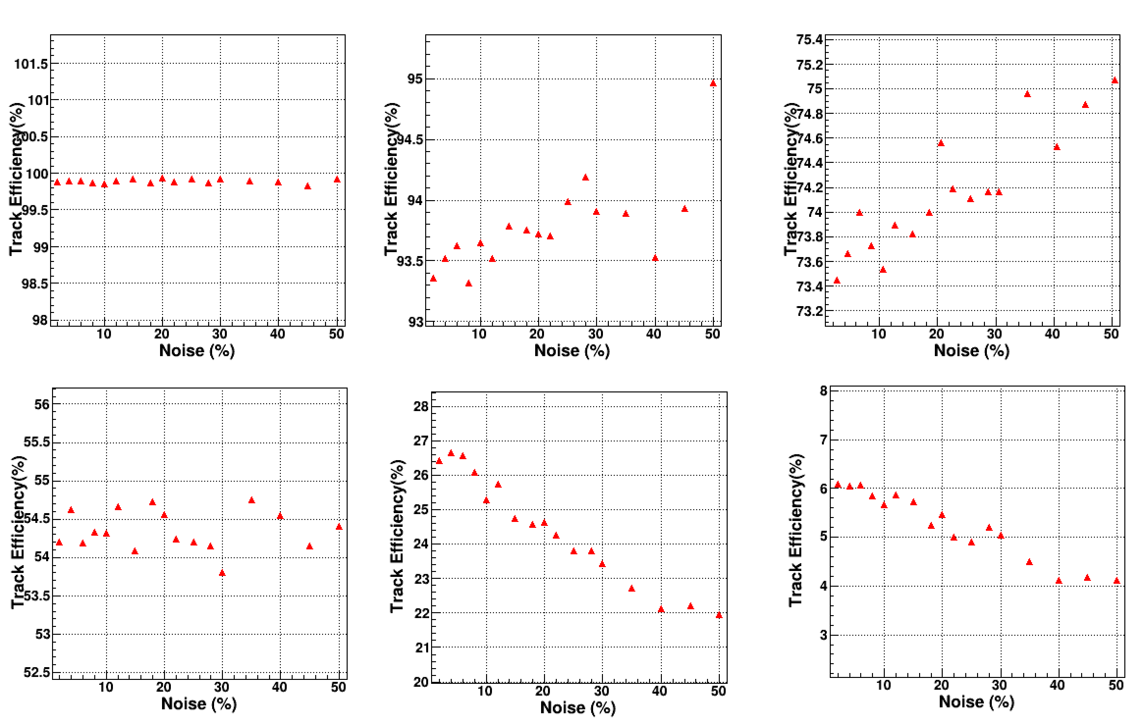
Track Finding
$Track efficiency=$N1/N2
N2: number of McParticle
N1: (N_foundSignalHit/N_signal)>(50%,60%,70%,80%,90%,95%) and
|delta_p|<? And |delta_vertex_position|<?
JumpLayerID = 1
JumpLayerID = 2
>50%
>60%
>70%
>50%
>60%
>70%
>80%
>90%
>95%
>80%
>90%
>95%

