Slide 1
Analytic calculation of multi-loop master integrals for top quark inclusive decay
毕业论文答辩
答辩人：小不点 答辩时间：5.5 指导老师：大不点
Long-Bin Chen
2023-08-14
Based on collaborations with H.T.Li, Z.Li, J.Wang, Y.F.Wang, Q.F. Wu

Slide 2
Top quark is the heaviest and one of the most important elementary particle in the Standard model, it couples to the SM Higgs boson and opens doors to new physics. The properties of top quark need to be studied precisely.
To obtain high order corrections, a crucial step is to calculate Feynman integrals.
Analytic calculation of the high order corrections have many benefits. We can obtain the numerical effect of high order corrections very fast, expand them at any kinematic point, and integrate them to obtain more interesting results.—Y.F. Wang’s talk.
01
毕业论文答辩
Motivation
答辩人：小不点 答辩时间：5.5 指导老师：大不点

Slide 3
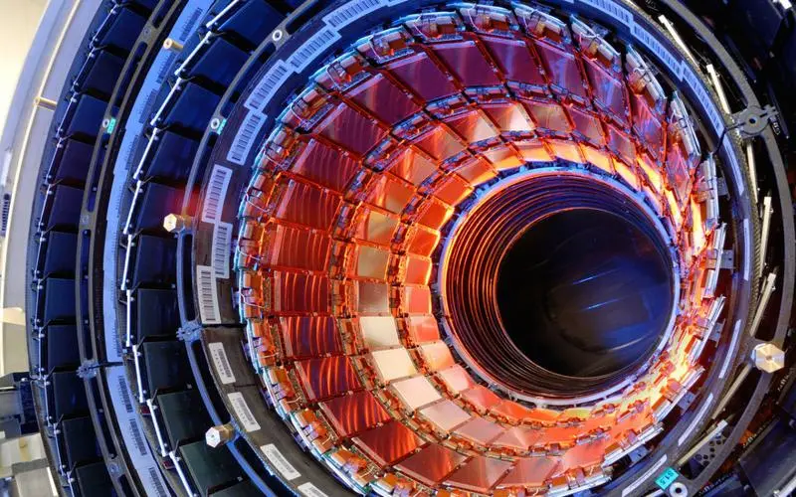
A lot of progress made in multi-loop calculation recent years .
Analytic method: Mostly in method of Differential Equations(DEs)—see L.L.Yang’s talk.
Numerical Evaluation –AMFLOW,FIESTA,pySecDec

Slide 4
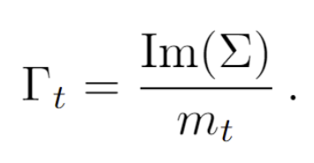
Top quark inclusive decay
02
毕业论文答辩
Leading Order
答辩人：小不点 答辩时间：5.5 指导老师：大不点
陈龙斌

Slide 5
Calculate the imaginary parts of propagator type integrals
1）
Calculation
毕业论文答辩
Calculate the following Integral
答辩人：小不点 答辩时间：5.5 指导老师：大不点

Slide 6
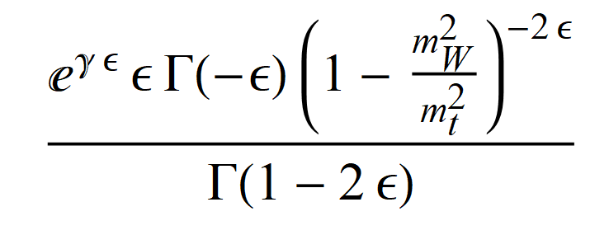
Expansion in $∈$
Calculated by Integrating the Feyman parameters
Analytic Results：

Slide 7
03
毕业论文答辩
Next-to Leading Order
答辩人：小不点 答辩时间：5.5 指导老师：大不点
Jeabek, Kuhn 1989,Czarnecki 1990, Li, Oakes, Yuan 1991
陈龙斌

Slide 8
NLO master Integrals: (“kite integrals”)
毕业论文答辩
答辩人：小不点 答辩时间：5.5 指导老师：大不点

Slide 9
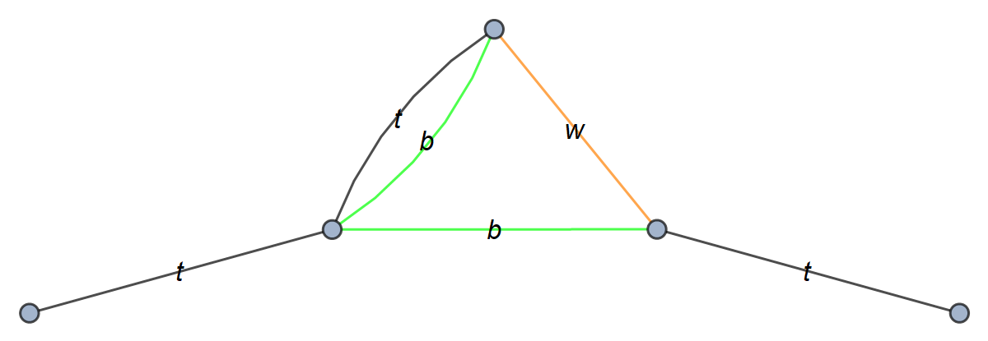
IBP produces four Master Integrals:

Slide 10
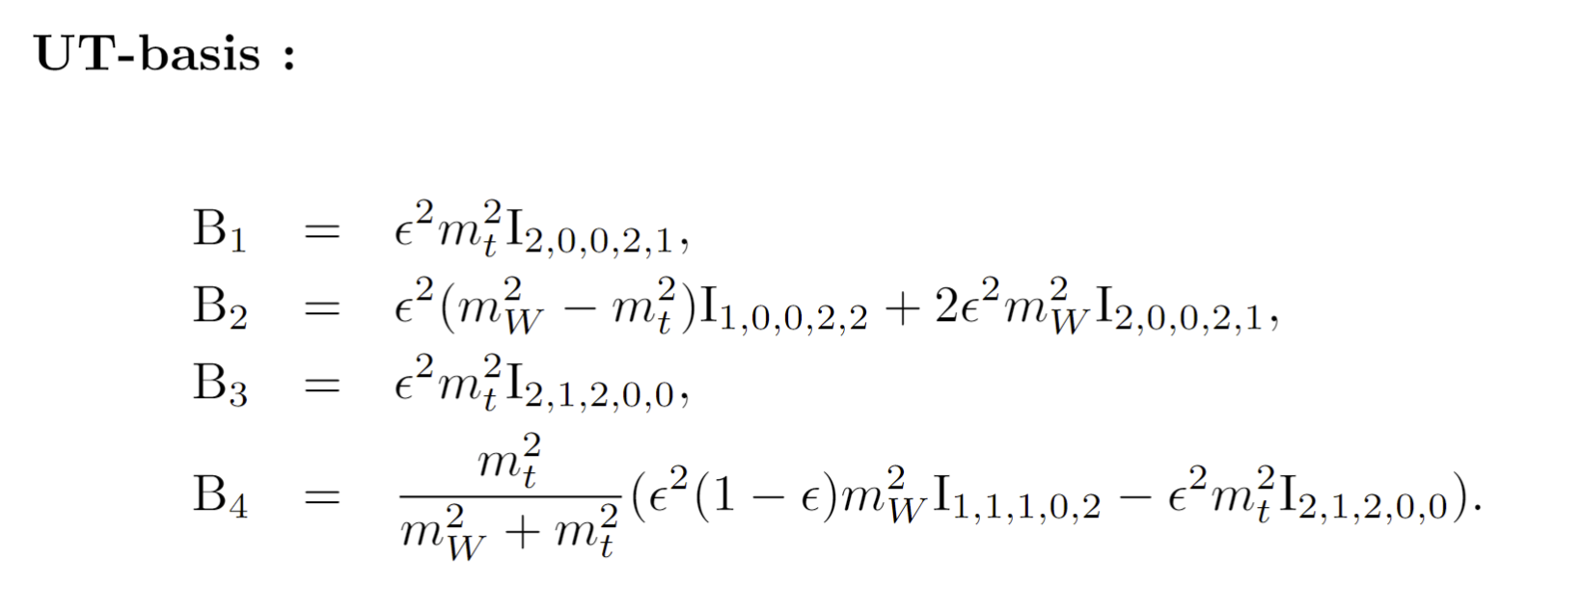
UT basis for NLO
Henn: 1304.1806
Construct UT basis:
CANONICA
1705.06252
DlogBasis
2002.09492
Libra
2012.00279
….

Slide 11
毕业论文答辩
答辩人：小不点 答辩时间：5.5 指导老师：大不点
Knizhnik-Zamolodchik Equation

Slide 12
Chosing alternative basis
Replaced with
More is good
Make the UT basis more simple.

Slide 13
Calculate the UT basis order by order in $∈$ expansion
Integrate Iteratively

Slide 14
Determination of Integration Constants (a more convenient way )
Combing analytic calculation with AMFLOW, PSLQ, C can be obtained in a easier way.
Not Universal

Slide 15
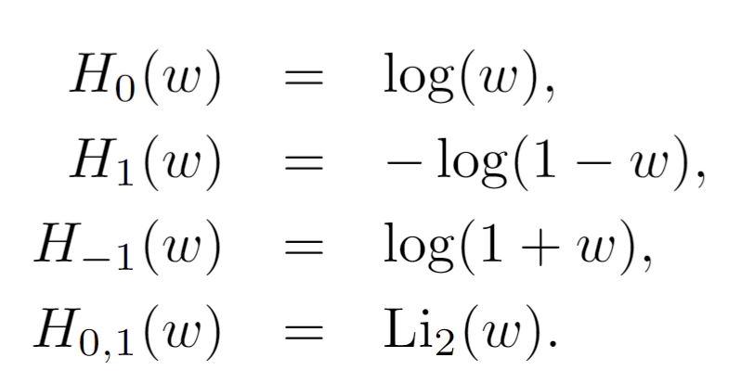
Results of UT basis (Harmonic Polylogarithms hep-ph/9905237):
Evaluation :HPL hep-ph/0507152

Slide 16
04
毕业论文答辩
Next-to-Next-to
Leading Order
答辩人：小不点 答辩时间：5.5 指导老师：大不点
Gao, Li, Zhu, 2013, Brucherseifer, Caola, Melnikov 2013
陈龙斌

Slide 17
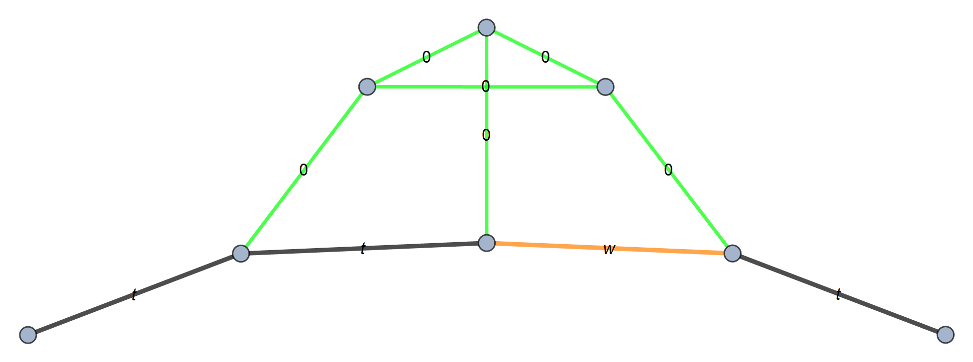
NNLO integral Families
(B)
(A)
(D)
(C)
(E)

Slide 18
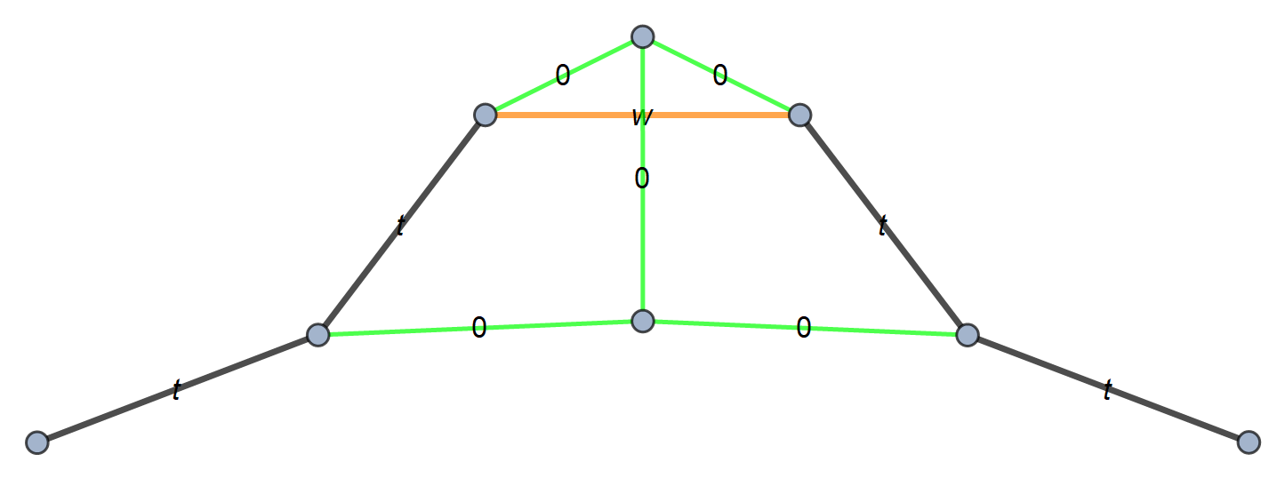
(F)
(G)
(H)
(I)

Slide 19
Cuts

Slide 20
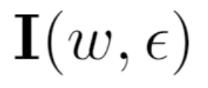
UT basis
DEs
Letters

Slide 21
For different integral families, the letters either appear in
Or in
The analytic results can also be expressed in terms of Harmonic Polylogarithms

Slide 22
Constants of Integration
Boundary conditions
arXiv:hep-ph/0503039
After determination of C, the analytic results can readily be obtained order by order.
The analytic results agree perfectly with numerical results obtained by AMFLOW.

Slide 23
05
Master Integrals for Mixed QED-QCD corrections
毕业论文答辩
答辩人：小不点 答辩时间：5.5 指导老师：大不点
陈龙斌

Slide 24
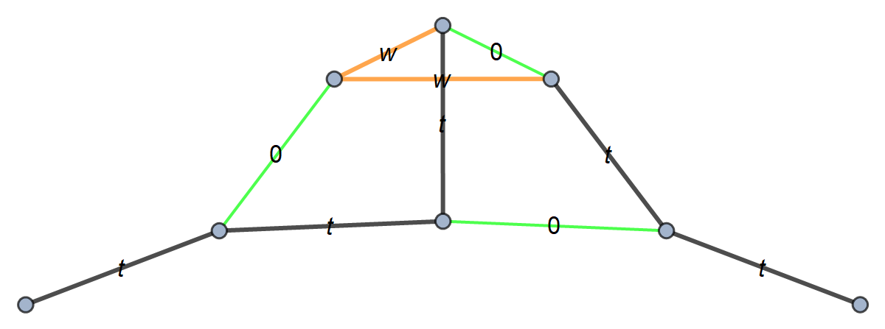
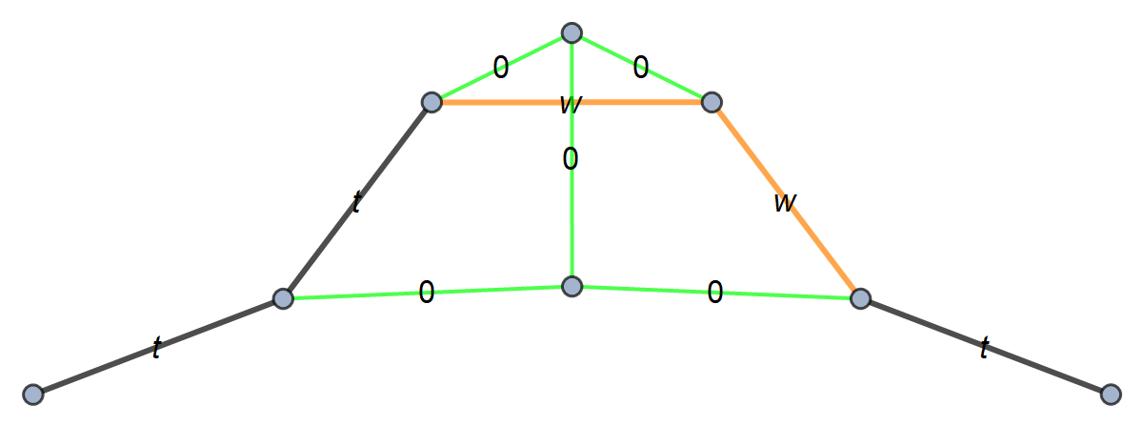
Need additional Integrals besides NNLO QCD corrections
(2)
(1)
(3)
(4)

Slide 25
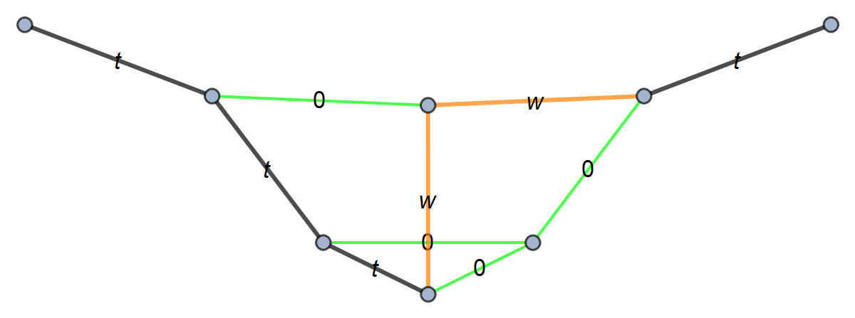
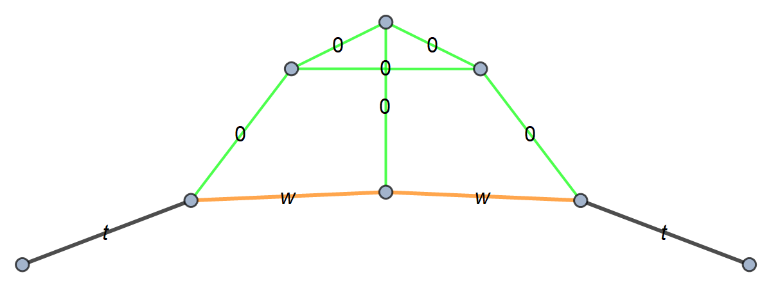
(5)
(6)
(8)
(7)

Slide 26
Cuts

Slide 27
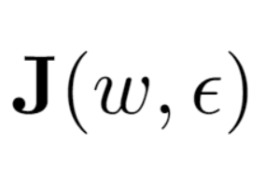
UT basis
DEs
Qi are rational matrices
Constants of Integration
Analytic results expressed in terms of Harmonic Polylogarithms

Slide 28
First look at the evaluation of NNNLO Master Integrals for top quark inclusive decay
06
毕业论文答辩
答辩人：小不点 答辩时间：5.5 指导老师：大不点
陈龙斌

Slide 29
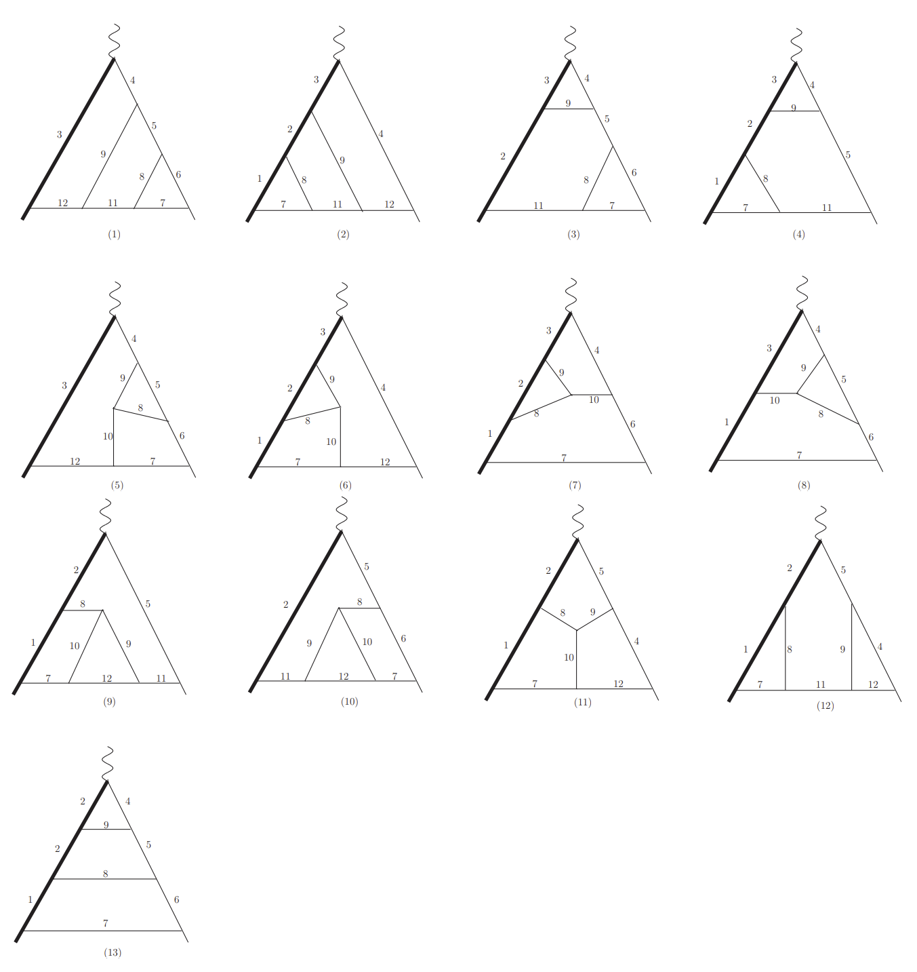
Integrals for Leading color 3-loop heavy-to-light form factors.
毕业论文答辩
L.B.Chen, Jian Wang, Phys.Lett.B 786 (2018) 453-461
答辩人：小不点 答辩时间：5.5 指导老师：大不点

Slide 30
Integral representation for 4-loop Leading Color Contribution
毕业论文答辩
答辩人：小不点 答辩时间：5.5 指导老师：大不点

Slide 31
Two-typical four-loop Feynman integrals for leading color contribution
毕业论文答辩
答辩人：小不点 答辩时间：5.5 指导老师：大不点

Slide 32
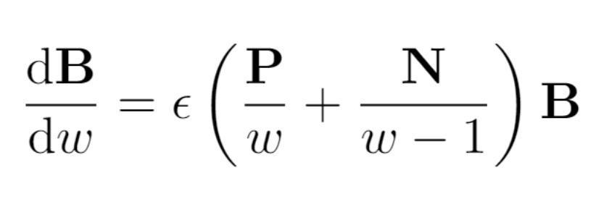
DEs for NNNLO Leading Color
毕业论文答辩
答辩人：小不点 答辩时间：5.5 指导老师：大不点
For any loop, can the letters of leading color(Large Nc limit) integrals still be {w, w-1}?

Slide 33
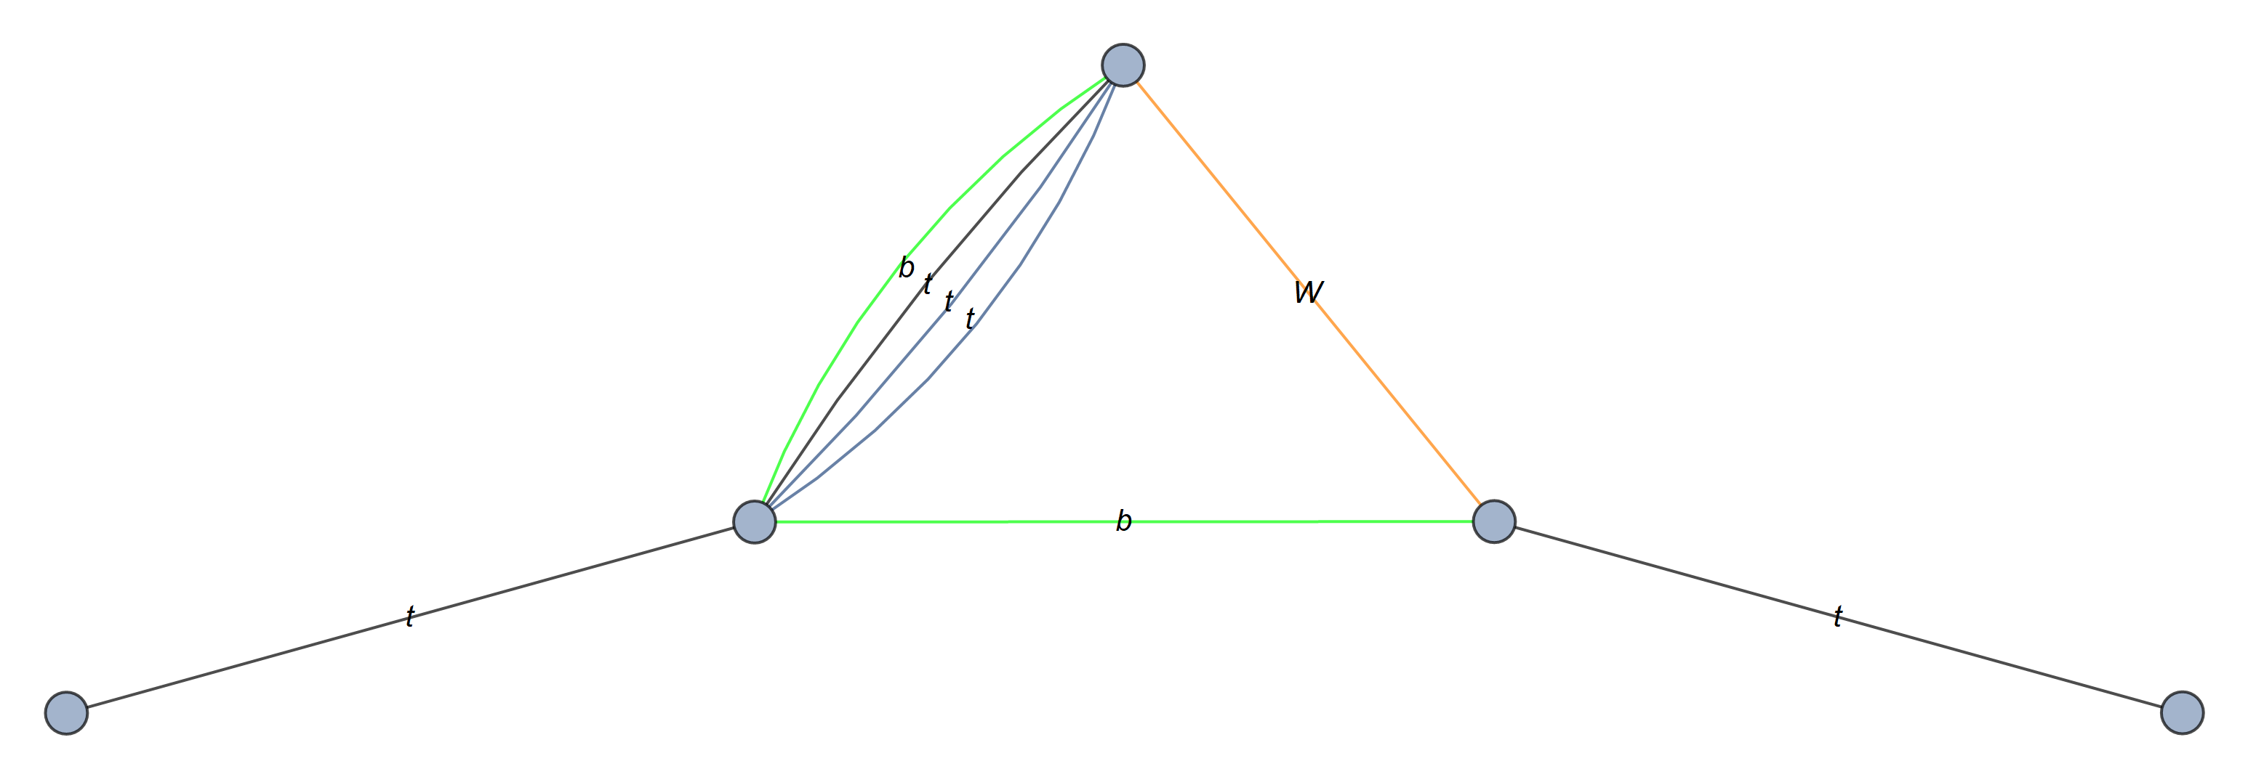
Difficulties on 4-loop integrals analytic calculation
The reductions of 4-loop non-planar integrals are difficulties.
Elliptic functions will appear.
Many Integral Families.
………

Slide 34
OutLook
The master integrals for top quark inclusive decay have been calculated analytically up to 3-loop.
Full NNNLO analytic (even numerically) calculation is still very challenging.
(Too many families, IBP, Elliptic integrals will appear.)
Mixed Electro Weak$⊗$QCD corrections is promising.
Explore analytic differential decay rates and helicity width.
毕业论文答辩
答辩人：小不点 答辩时间：5.5 指导老师：大不点
陈龙斌

Slide 35
毕业论文答辩
Thank You！
答辩人：小不点 答辩时间：5.5 指导老师：大不点

Slide 36
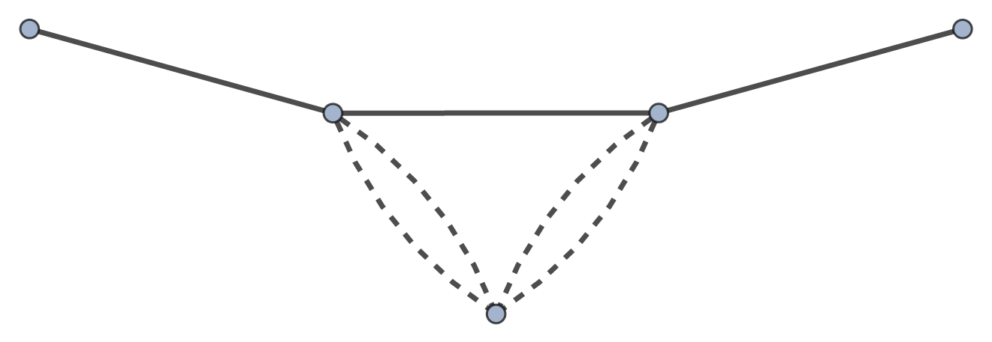
Backup

