Slide 1
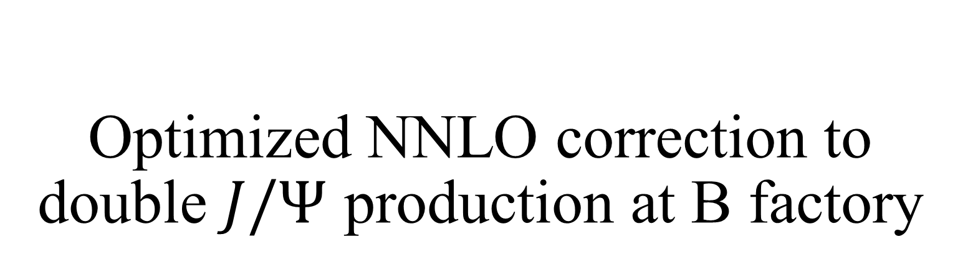
Optimized NNLO correction to double $J/Ψ$ production at B factory
Jichen Pan
Institute of High Energy Physics, Chinese Academy of Sciences
In collaboration with Feng Feng, Yu Jia, Zhewen Mo, Wen-Long Sang, Jia-Yue Zhang
arXiv:2306.11538

Slide 2
Outline
Introduction and Motivation
Improved NRQCD approach
Phenomenological analysis
Non-trivial NRQCD factorization examination
Conclusion

Slide 3
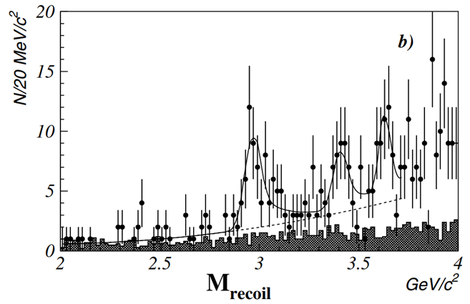
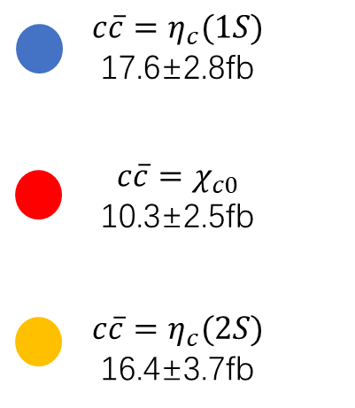
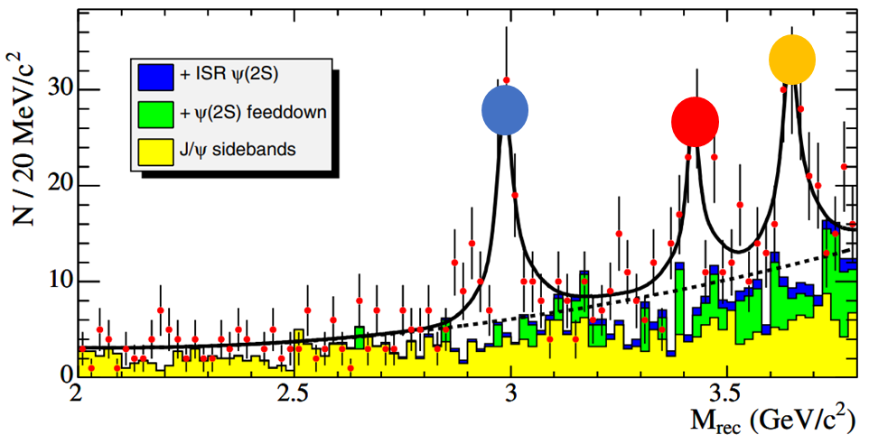

Motivation: Exclusive double hadron production
——C-odd case
For a long time, exclusive double hadron production with odd total C-parity has attracted much attention in $e^{+}e^{−}$ collision experiment.
Belle: K. Abe et al. PRL 89, 142001(2002)
BARBAR: B. Aubert et al. PRD 72, 031101(R) (2005)
Notes:
理论文章citation

Slide 4
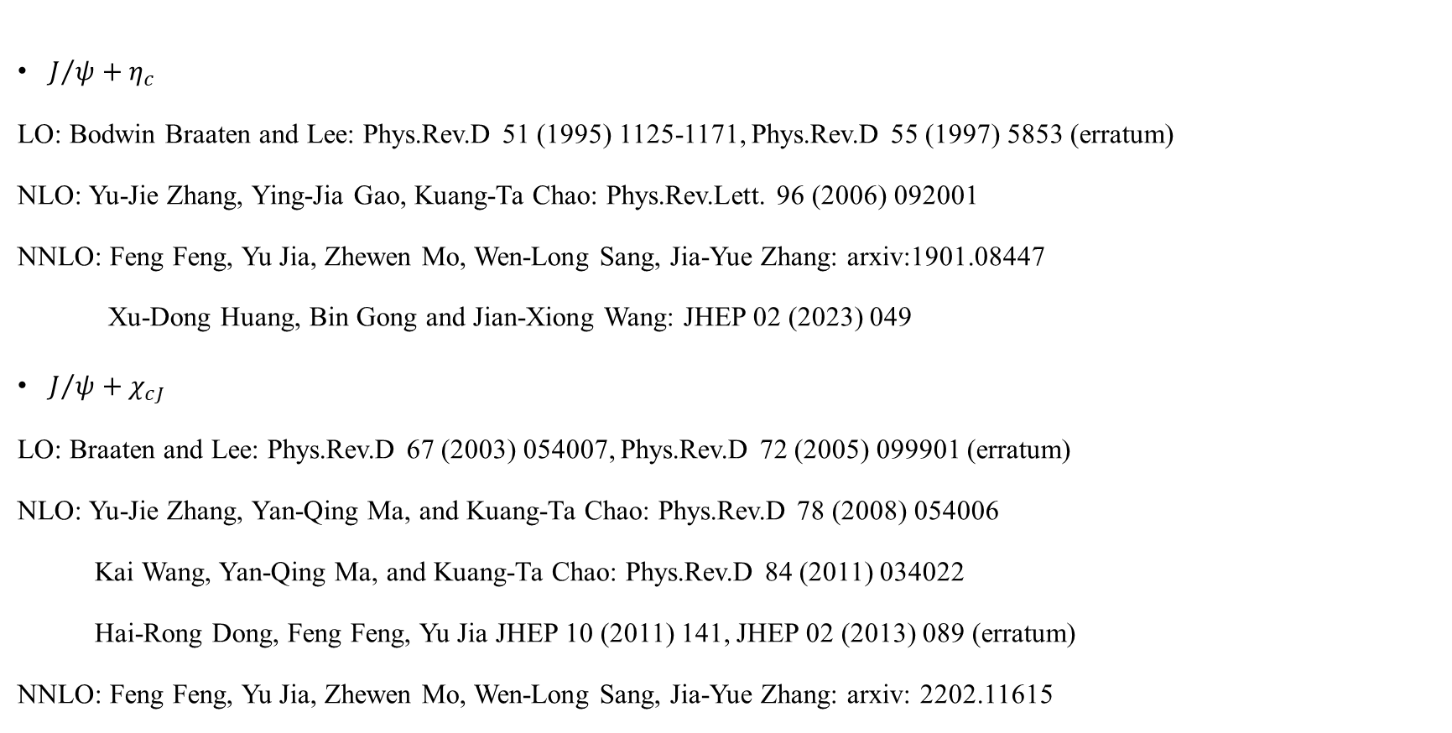
Motivation: Exclusive double hadron production
——C-odd case
$J/ψ+η_{c}$
LO: Bodwin Braaten and Lee: Phys.Rev.D 51 (1995) 1125-1171, Phys.Rev.D 55 (1997) 5853 (erratum)
NLO: Yu-Jie Zhang, Ying-Jia Gao, Kuang-Ta Chao: Phys.Rev.Lett. 96 (2006) 092001
NNLO: Feng Feng, Yu Jia, Zhewen Mo, Wen-Long Sang, Jia-Yue Zhang: arxiv:1901.08447
Xu-Dong Huang, Bin Gong and Jian-Xiong Wang: JHEP 02 (2023) 049
$J/ψ+χ_{cJ}$
LO: Braaten and Lee: Phys.Rev.D 67 (2003) 054007, Phys.Rev.D 72 (2005) 099901 (erratum)
NLO: Yu-Jie Zhang, Yan-Qing Ma, and Kuang-Ta Chao: Phys.Rev.D 78 (2008) 054006
Kai Wang, Yan-Qing Ma, and Kuang-Ta Chao: Phys.Rev.D 84 (2011) 034022
Hai-Rong Dong, Feng Feng, Yu Jia JHEP 10 (2011) 141, JHEP 02 (2013) 089 (erratum)
NNLO: Feng Feng, Yu Jia, Zhewen Mo, Wen-Long Sang, Jia-Yue Zhang: arxiv: 2202.11615
Notes:
理论文章citation

Slide 5
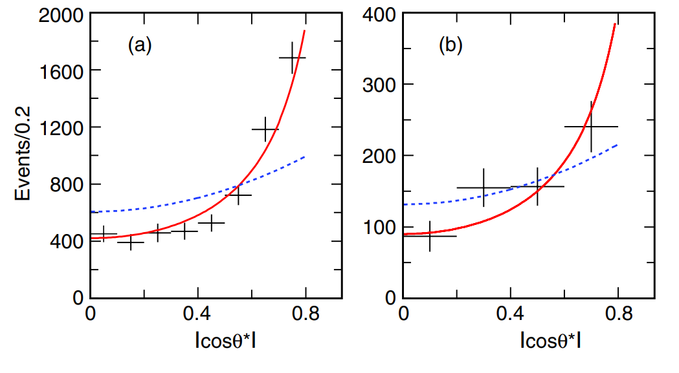
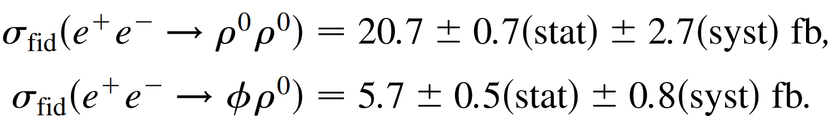

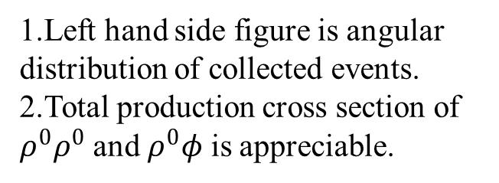
Motivation: Exclusive double hadron production
——C-even case
The first C-even exclusive double hadron production was discovered in BABAR experiment, where $ρ^{0}ρ^{0}$ and $ρ^{0}φ$ is reconstructed from double $π^{+}π^{−}$and $π^{+}π^{−}K^{+}K^{−}$, respectively.
1.Left hand side figure is angular distribution of collected events.
2.Total production cross section of $ρ^{0}ρ^{0}$ and $ρ^{0}φ$ is appreciable.
B. Aubert et al. PRL 97, 112002 (2006)
Notes:
Peskin and experiment

Slide 6
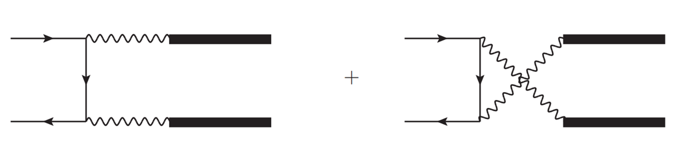
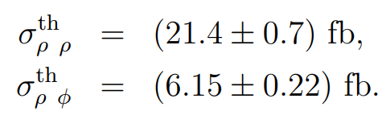
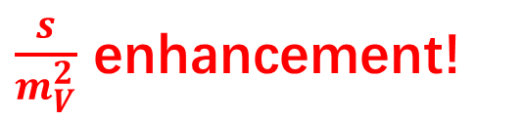
Motivation: Exclusive double hadron production
——C-even case
$\frac{s}{m_{V}^{2}}$ enhancement!
Photon fragmentation diagrams
[1] Davier, Peskin, Snyder hep-ph/0606155
Notes:
Peskin and experiment

Slide 7
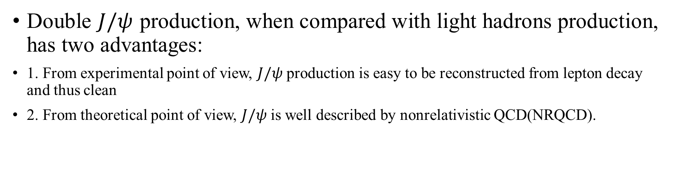
Motivation: Exclusive double hadron production
——C-even case
Double $J/ψ$ production, when compared with light hadrons production, has two advantages:
1. From experimental point of view, $J/ψ$ production is easy to be reconstructed from lepton decay and thus clean
2. From theoretical point of view, $J/ψ$ is well described by nonrelativistic QCD(NRQCD).

Slide 8
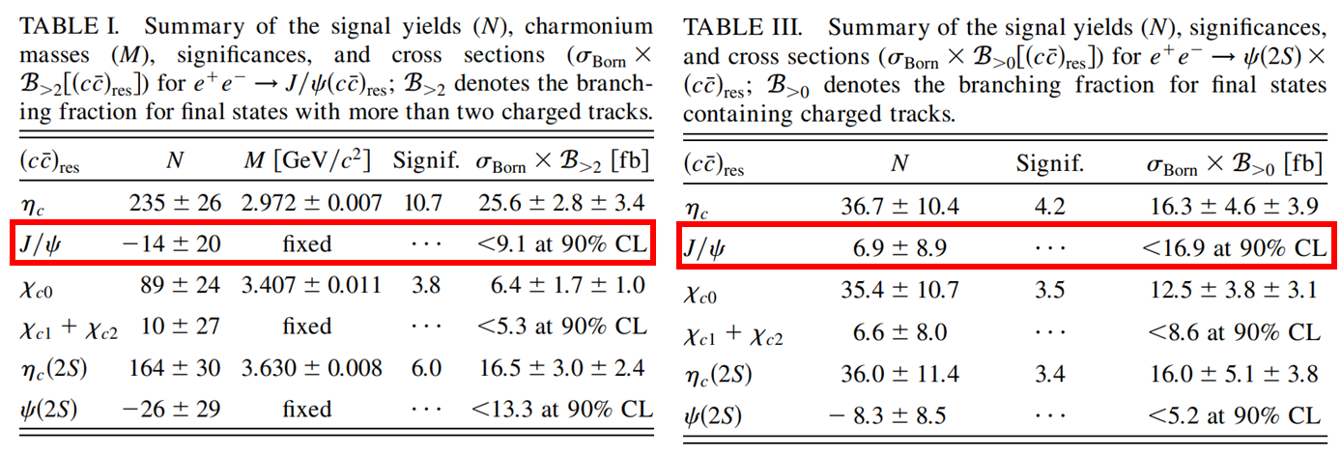

Traditional NRQCD approach
Double $J/ψ$ is not observed ![1]
[1] K. Abe et al. PRD, 70, 071102 (2004)

Slide 9
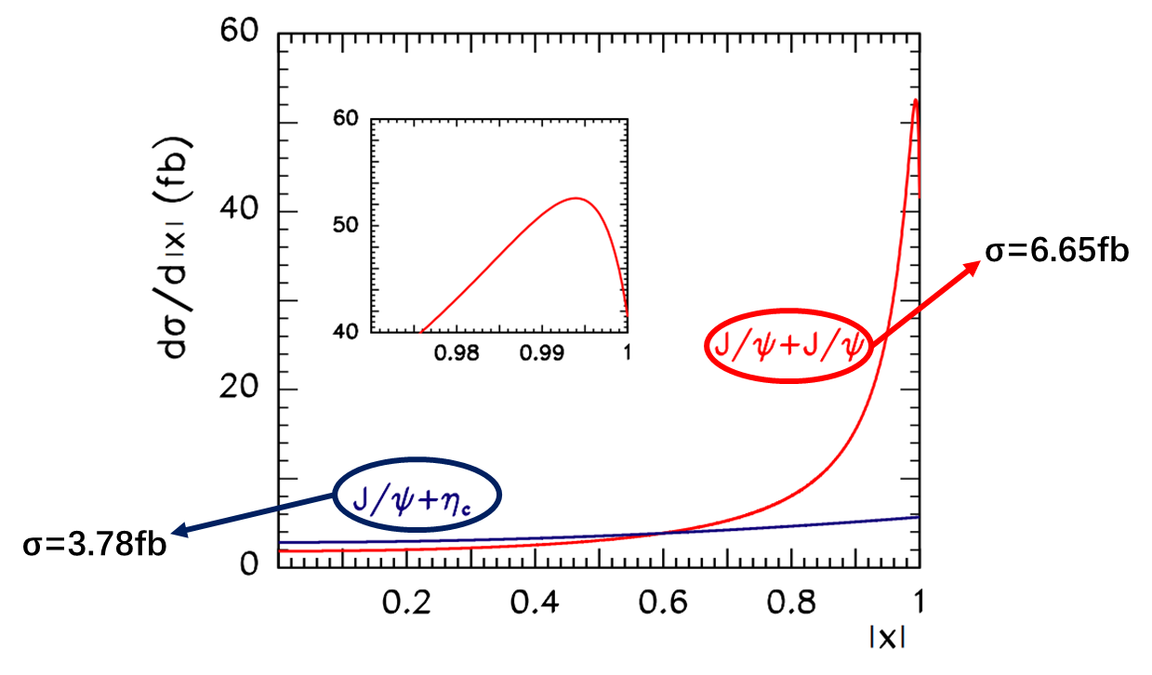
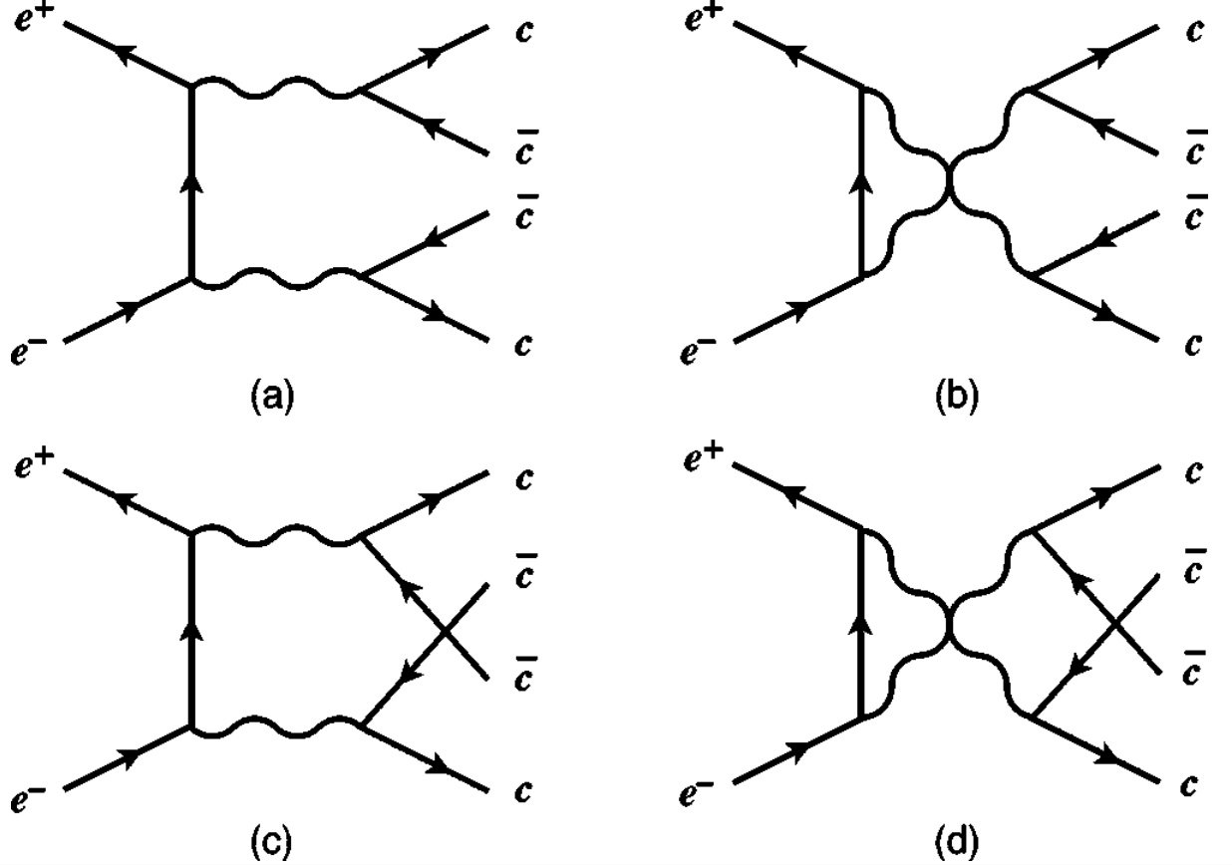
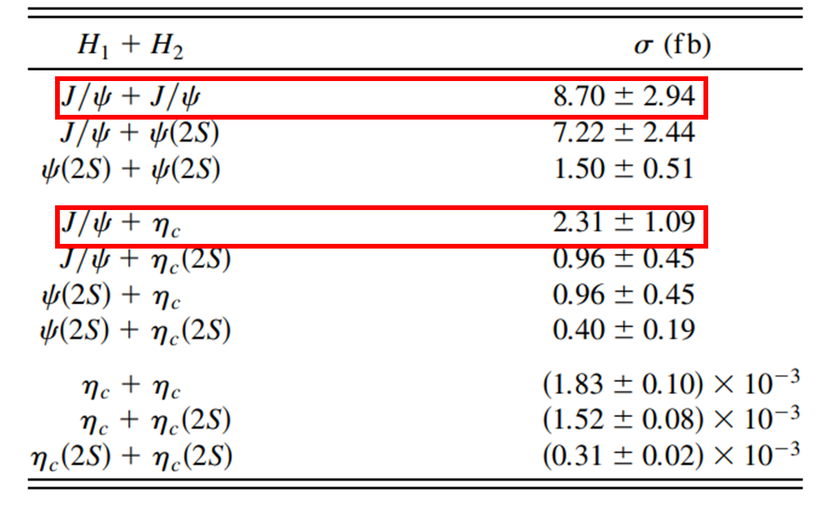
Traditional NRQCD approach: LO
[1] Bodwin, Lee and Braaten PRL, 90, 162001 (2003)
[2] Bodwin, Lee and Braaten PRD, 67, 054023 (2003) PRD, 72, 099904 (2005) (erratum)

Slide 10
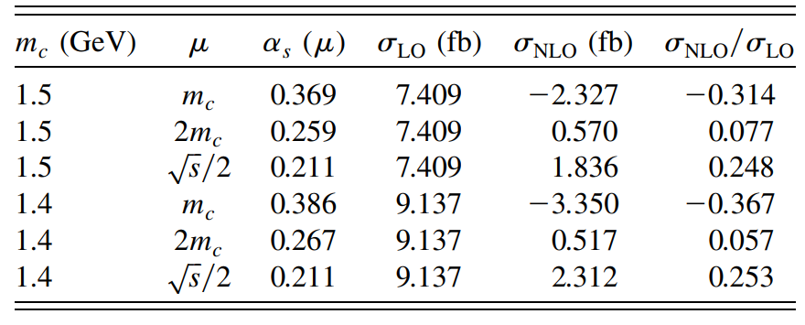
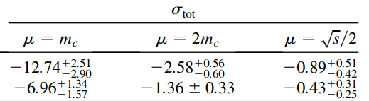
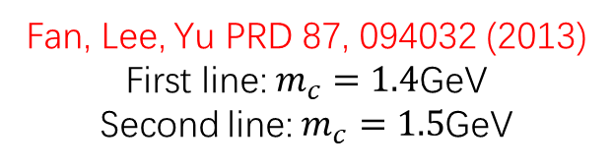
Traditional NRQCD approach: NLO
When researchers take radiative and relativistic correction into consideration, traditional NRQCD shows more defect:
Fan, Lee, Yu PRD 87, 094032 (2013)
First line: $m_{c}=1.4$GeV
Second line: $m_{c}=1.5$GeV
Gong, Wang, PRL 100, 181803 (2008)
1.Sensitive to the input of renormalization scale and charm quark mass
2.Negative total cross section

Slide 11
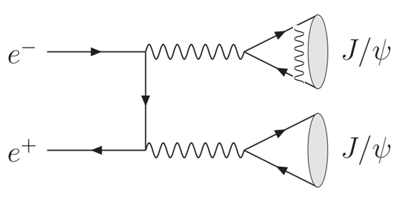

Traditional NRQCD approach: NLO
Negative corrections mainly come from decay constant one loop expansion:
$$\sim {\left(1−2C_{F}\frac{α_{s}}{π}\right)}^{4}\sim 1−8C_{F}\frac{α_{s}}{π}+𝓞\left(α_{s}^{2}\right)\sim 1−0.7$$
Gong, Wang, PRL 100, 181803 (2008)

Slide 12
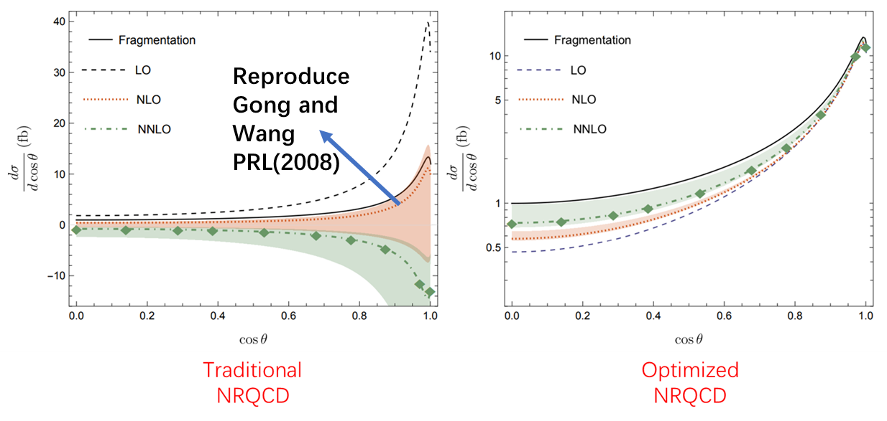
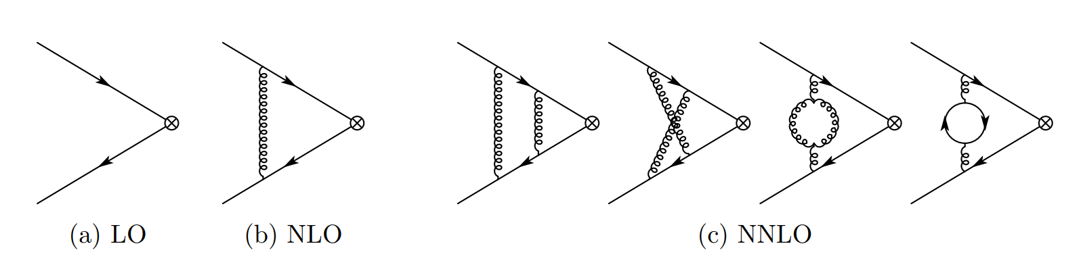
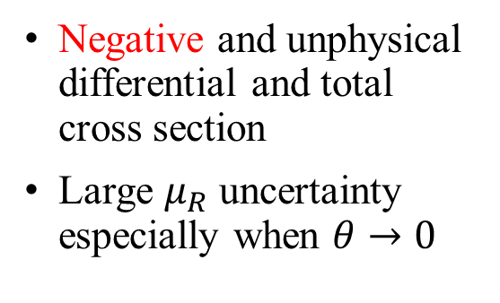
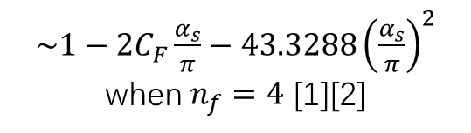
Traditional NRQCD approach: NLO and NNLO
$\sim 1−2C_{F}\frac{α_{s}}{π}−43.3288{\left(\frac{α_{s}}{π}\right)}^{2}$ when $n_{f}=4$ [1][2]
Negative and unphysical differential and total cross section
Large $μ_{R}$ uncertainty especially when $θ→0$
[1] A. Czarnecki and K. Melnikov, PRL. 80, 2531 (1998)
[2] M. Beneke, A. Signer and V. A. Smirnov, PRL. 80, 2535 (1998)
Notes:
NLO gong wang

Slide 13

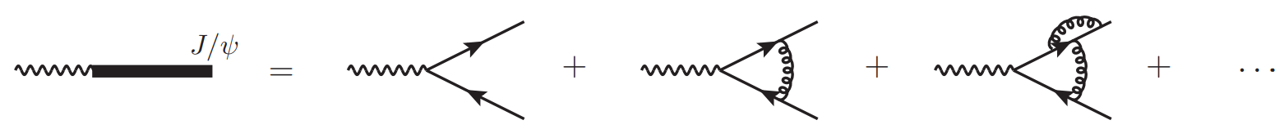
Traditional NRQCD approach: NLO and NNLO
Roughly, negative total cross section emerges in NLO and NNLO may be attributed to inconvergence of perturbative series of decay constant.
Notes:
If we re-sum these diagrams and use decay constant as input directly, not only might the above problem be solved but also we can use physical $J/ψ$ mass in this part so that dependence of charm mass chosen might be weaken.
In history, this method was first utilized to analyze double vector meson production under fragmentation approximation.

Slide 14
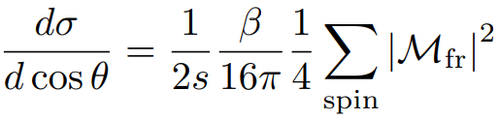

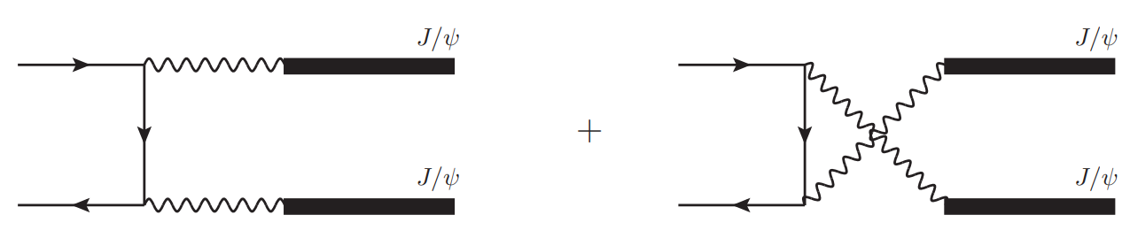
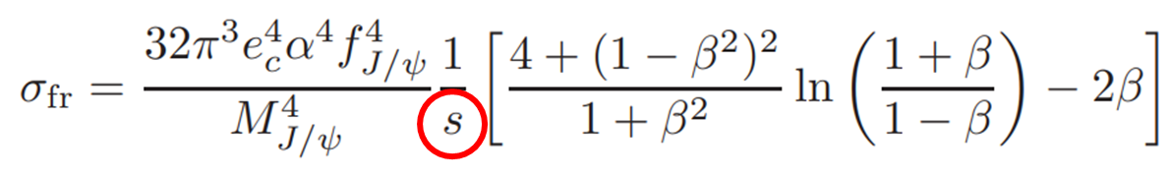
Improved NRQCD approach: Fragmentation approximate
Reproduce results in Davier, Peskin, Snyder hep-ph/0606155 and Bodwin, Lee and Braaten and Yu PRD 74 074014 (2006)
Notes:
earlier

Slide 15

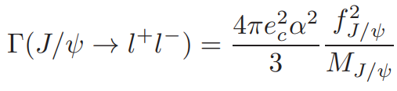




Improved NRQCD approach: Fragmentation approximate
Reproduce results in Davier, Peskin, Snyder hep-ph/0606155 and Bodwin, Lee and Braaten and Yu PRD 74 074014 (2006)
Notes:
earlier

Slide 16
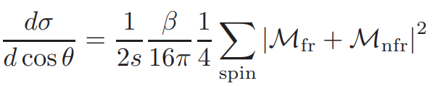
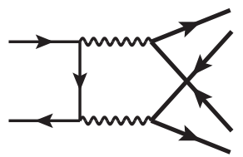

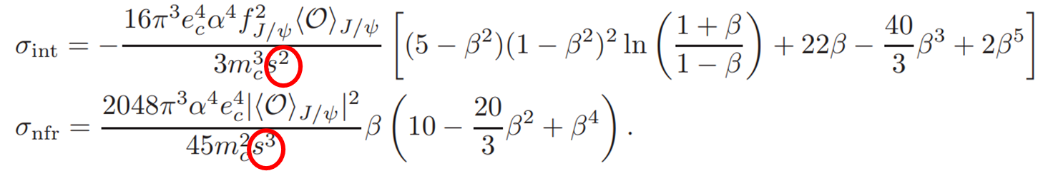
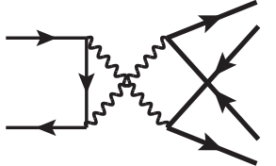
Improved NRQCD approach: LO non-fragmentation correction
Notes:
earlier

Slide 17





Improved NRQCD approach: LO non-fragmentation correction
B-T potential
Bodwin, Lee, Braaten and Yu PRD 74 074014 (2006): 1.69fb
Notes:
earlier

Slide 18
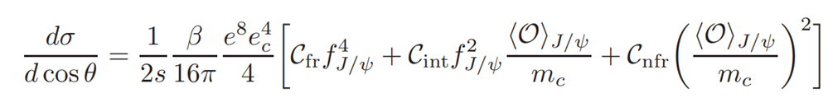
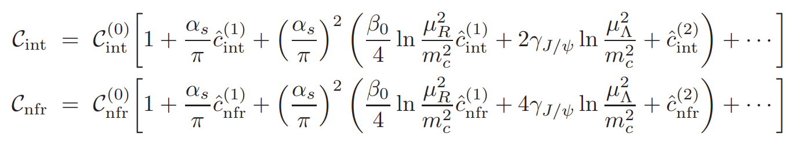
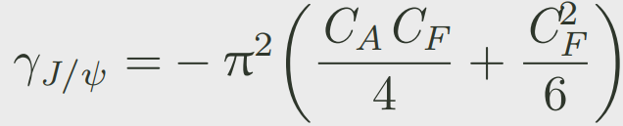
Improved NRQCD approach: NLO and NNLO

Slide 19
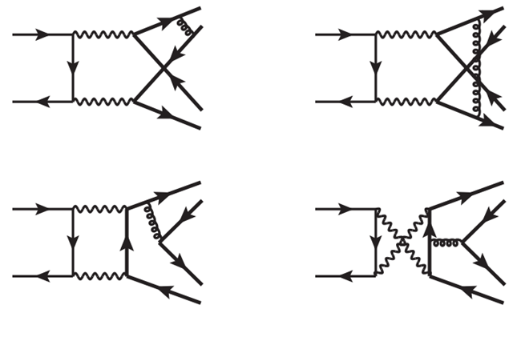
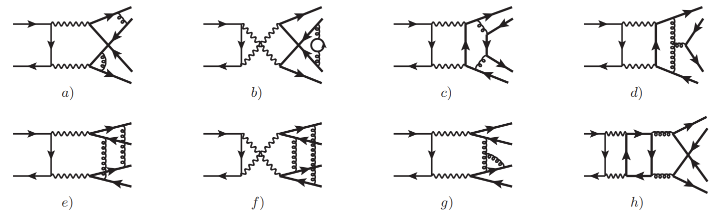

Improved NRQCD approach: NLO and NNLO
Extremely challenging and time-consuming for $2→4$ t(or u) channel diagram!
NLO
NNLO
Qgraf/FeynArts: 24 diagrams
FeynCalc/FormLink + Apart and FIRE: About 30 Master integrals
Qgraf/FeynArts: About 500 diagrams
FeynCalc/FormLink + Apart and FIRE: About 2400 Master integrals

Slide 20
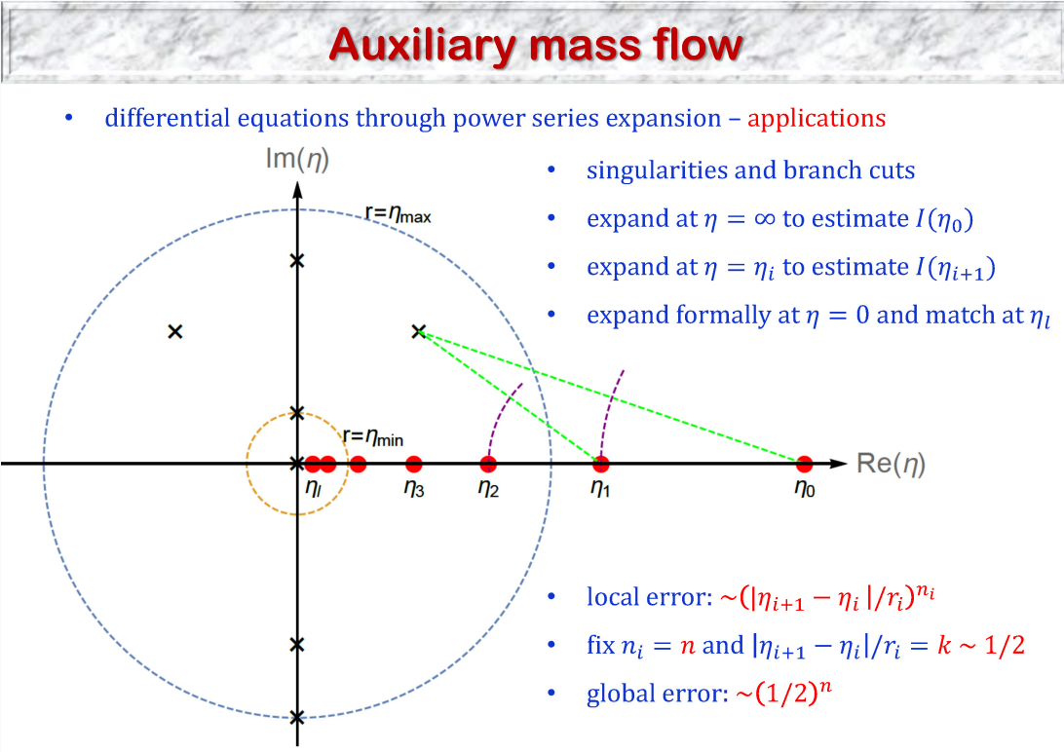
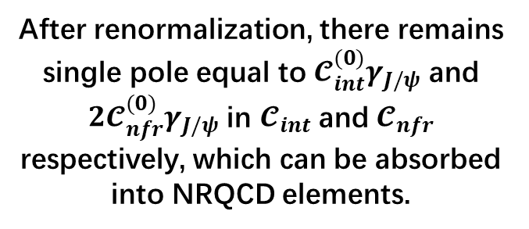
Improved NRQCD approach: NLO and NNLO
To calculate short distance coefficient, we extract hard region of MIs
Compute the MIs with high numerical accuracy by AMFlow
After renormalization, there remains single pole equal to $𝓒_{int}^{(0)}γ_{J/ψ}$ and ${2𝓒}_{nfr}^{(0)}γ_{J/ψ}$ in $𝓒_{int}$ and $𝓒_{nfr}$ respectively, which can be absorbed into NRQCD elements.
[1] Liu, Ma and Wang, Phys. Lett. B 779, 353-357 (2018)
[2] Liu and Ma, Phys. Rev. D 105, no.5, L051503 (2022)
[3] Liu and Ma, Phys. Rev. Lett. 129, no.22, 222001 (2022)
[4] Liu and Ma, Comput. Phys. Commun. 283, 108565 (2023)
Notes:
Challenging 2 to 4. choose costheta

Slide 21
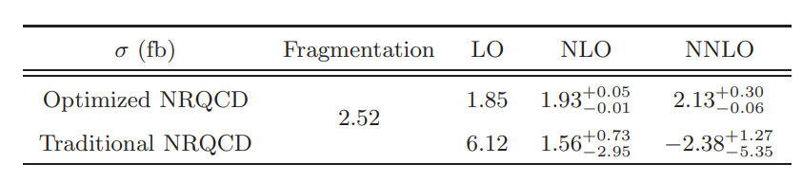
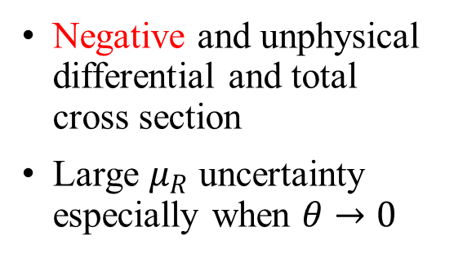
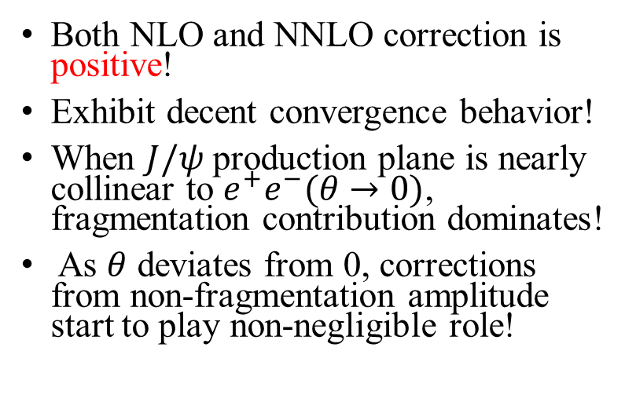
Phenomenological analysis-Differential cross section
Negative and unphysical differential and total cross section
Large $μ_{R}$ uncertainty especially when $θ→0$
Both NLO and NNLO correction is positive!
Exhibit decent convergence behavior!
When $J/ψ$ production plane is nearly collinear to $e^{+}e^{−}(θ→0)$, fragmentation contribution dominates!
As $θ$ deviates from 0, corrections from non-fragmentation amplitude start to play non-negligible role!
Notes:
NLO gong wang

Slide 22
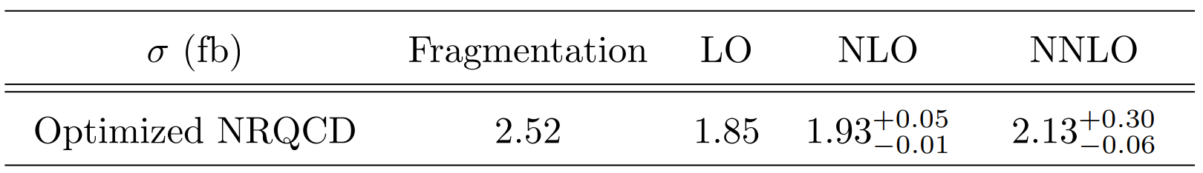

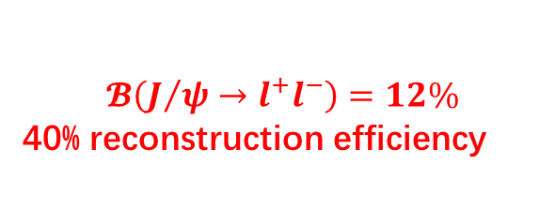

Phenomenological analysis-Total cross section
Belle and the Belle 2 experiments: 1500 fb⁻¹ data accumulated now
$σ_{NNLO}={2.13}_{−0.06}^{+0.30}$fb
Designed 50 ab⁻¹ integrated luminosity at Belle 2 and our predictions make this observation probable!
3105~3645 double $J/ψ$ events
$$𝓑\left(J/ψ→l^{+}l^{−}\right)=12\%$$
40% reconstruction efficiency
18~21 events

Slide 23
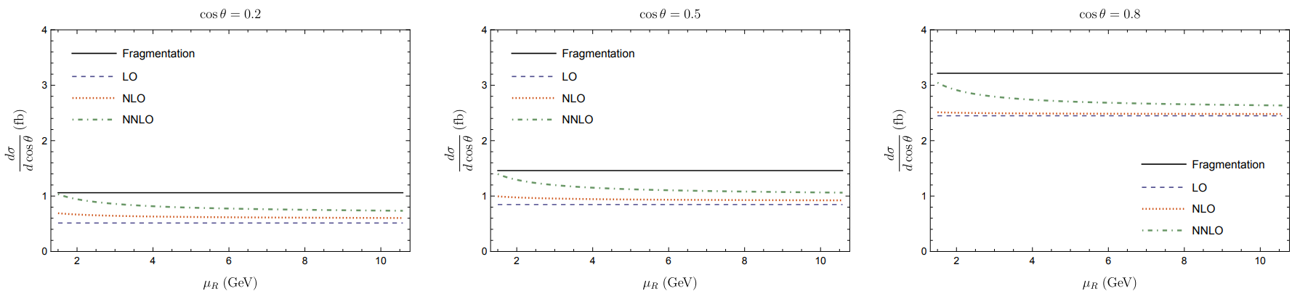

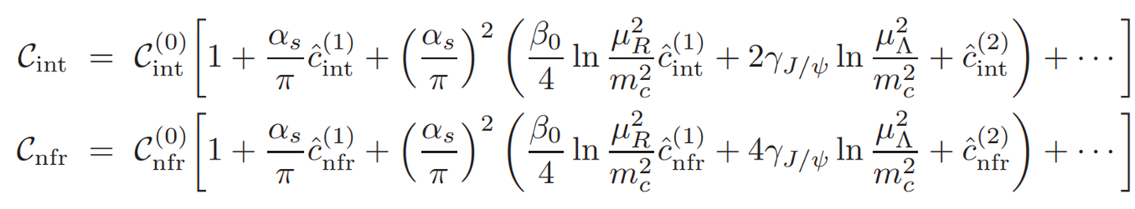
Phenomenological analysis-$μ_{R}$ dependence
Independent of Renormalization scale!
Both NLO and NNLO correction is not sensitive to renormalization scale!

Slide 24





Non-trivial NRQCD factorization examination
When $cosθ≠0$
There are 18 potential factorization invalid diagram!
Begin at $\frac{1}{ε^{3}}$ !
Two of the three comes from the region where photon radiated from electron is collinear and soft (similar to Sudakov double pole)
Another pole comes from the remaining soft gluon
The 18 diagrams are obtained by dressing the fragmentation diagram with two gluon exchanges between double $J/ψ$.
If there were remaining poles after summing, these poles couldn’t be absorbed into LDME and NRQCD factorization would be invalid!
We have take $\frac{t}{m_{c}^{2}}=−1$ as an example to check that when we sum these 18 diagram, the poles vanish.
Notes:
NRQCD factorization why IR pole is dangerous

Slide 25



Non-trivial NRQCD factorization examination
When $cosθ=0$
There are 18 potential factorization invalid diagram!
Begin at $\frac{1}{ε^{2}}$ !
6 diagrams share the same double pole.
Other 12 diagrams’ double pole have an extra −1/2 factor.
When 18 diagrams sum up, not only double poles cancel with each other, Single pole also vanishes
P denotes the magnitude of $J/ψ$ momentum

Slide 26

Conclusion
By virtue of divergence expansion series of decay constant, traditional NRQCD approach gives negative and unstable NNLO prediction of differential and total production section of double $J/ψ$.
Both NLO and NNLO correction is positive and exhibit a reasonable convergence pattern. The total cross section is finally determined at ${2.13}_{−0.06}^{+0.30}$ fb where $\sqrt{s}=10.58$GeV.
NRQCD factorization is confirmed at NNLO exclusive double $J/ψ$ production process!
With the projected integrated luminosity of 50 ab⁻¹ the prospect to observe this exclusive process at Belle 2 experiment appears to be bright!!

Slide 27
Thank you for your attention!

Slide 28


Before Improved NRQCD approach
$\frac{m_{c}^{2}}{s}$ suppressed!
Notes:
分类

Slide 29





Before Improved NRQCD approach
Dominate NNLO correction!
Gluon exchanges inside a single $J/ψ$ don’t change kinetic counting in LO
In the language of method of region, hard gluon exchange between double $J/ψ$ will change virtuality of photon from $1/m_{c}^{2}$ to $1/s$—— suppressed by kinetic factor!
For soft gluon exchange as we will show, they cancel each other up to order $𝒪(α_{s}^{2}v^{0})$
Tip: Single gluon exchange between double $J/ψ$ is not allowed for color singlet constrain.
Notes:
scaling

Slide 30



Before Improved NRQCD approach
Dominate NNLO correction!
This NNLO correction is the same as the corresponding one of $J/ψ$ decay constant:
[1] A. Czarnecki and K. Melnikov, PRL. 80, 2531 (1998)
[2] M. Beneke, A. Signer and V. A. Smirnov, PRL. 80, 2535 (1998)
when $n_{f}=4$ [1][2]
Notes:
Three loop

Slide 31





Phenomenological analysis-Differential cross section
A more detailed numerical table shows that the square of non-fragmentation amplitude is not significant
Exactly speaking, it is interference term that plays some notable role as $θ$ deviates from 0.

