Slide 1
Ncount and dE/dx Comparison in different Sampling rate and Angle
Shuaiyi Liu, Yaxin Shen, Guang Zhao, Linghui Wu, Mingyi Dong

Slide 2
Context
Ncount and Comparison in different angle
Ncount and Comparison in different sampling rate
dE/dx Comparison in different sampling rate
Dependency on $t_{F}$(First Cluster Time) and correction

Slide 3
Dataset List
0°:
Sampling rate = 1G: Run 52, 10000Events
Sampling rate = 1.5G: Run12 + 13, 60000Events
Sampling rate = 2G: Run11, 10000Events
30°:
Sampling rate = 2G: Run49 +51, 10000Events

Slide 4
Dataset List
45°:
Sampling rate = 1G: Run7, 10000Events
Sampling rate = 1.5G: Run 16 + 17 + 18, 65000Events
Sampling rate = 2G: Run10, 10000Events
60°:
Sampling rate = 2G: Run47, 10000Events

Slide 5
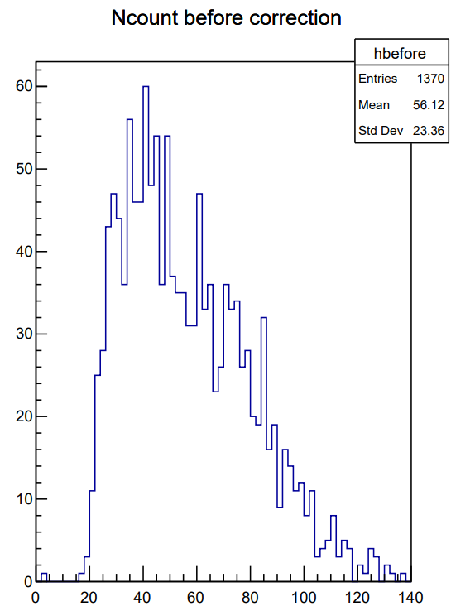
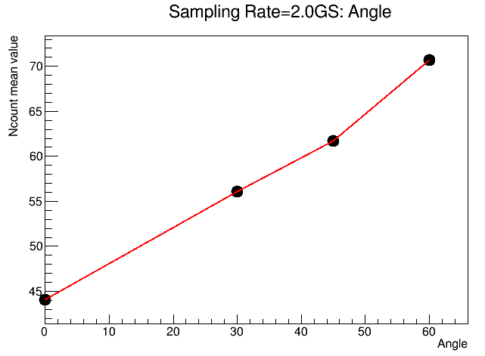
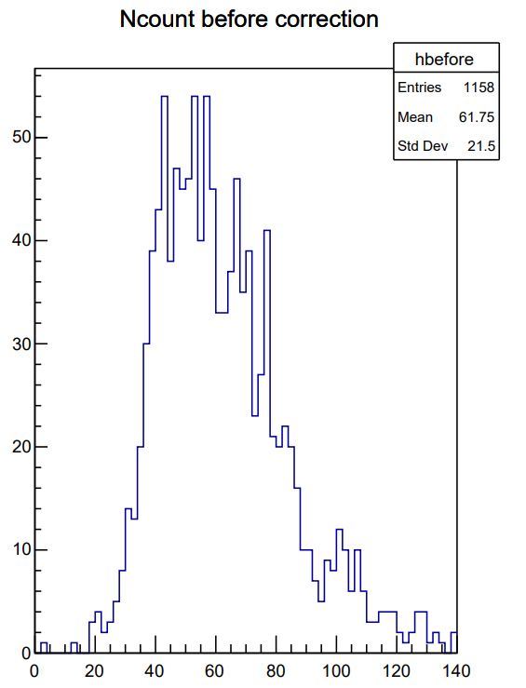
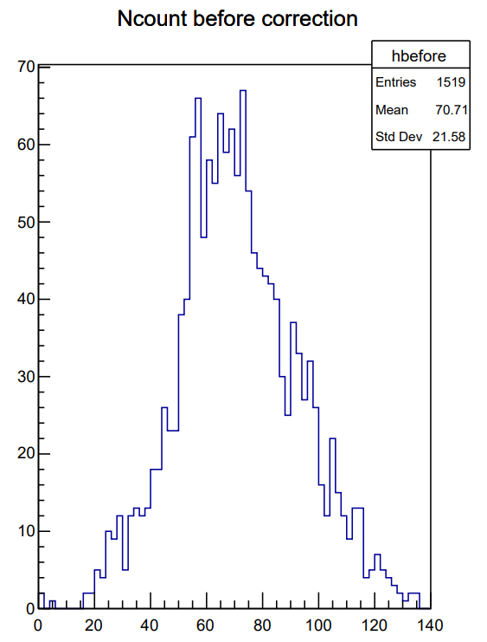
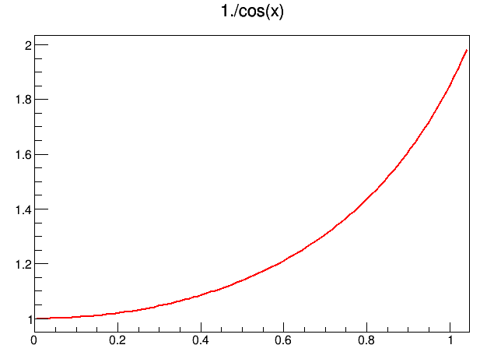
Ncount Comparison in different angles Sampling Rate = 2.0G
0°
30°
Ncount Increasing with Angle like 1/cos(x)
45°
60°
Rad/(0~pi/3)

Slide 6
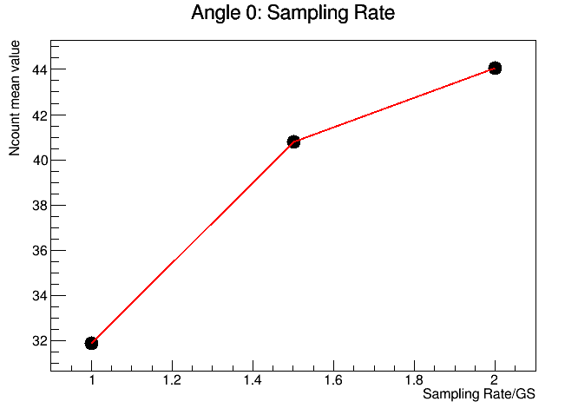
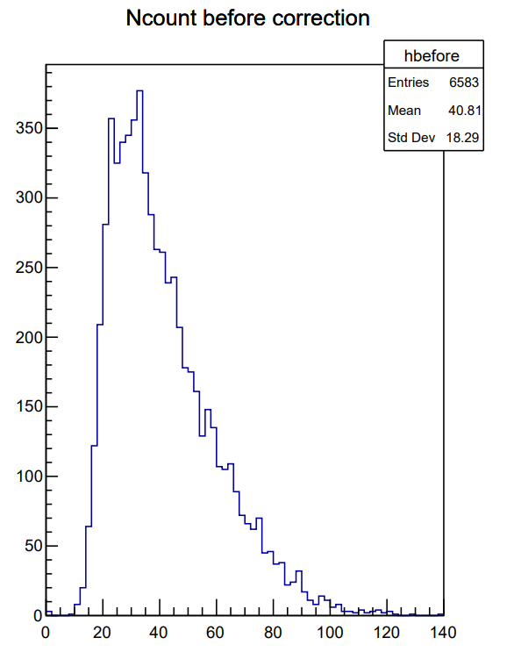
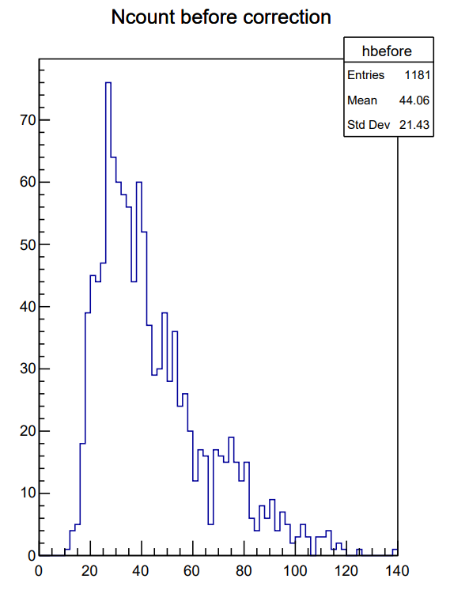
Ncount Comparison in Different Sampling Rates: 0°
Ncount distribution in different sampling rate
1.0G
1.5G
2G
Ncount increasing with Sampling rate

Slide 7
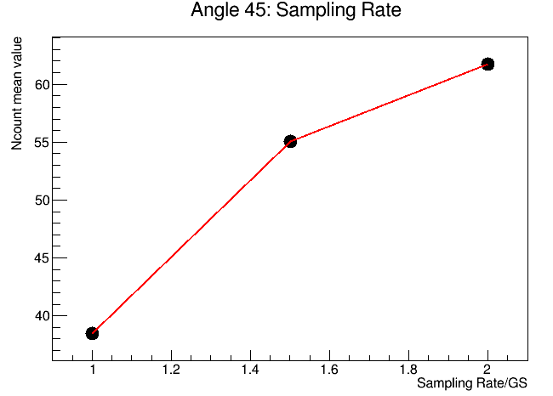
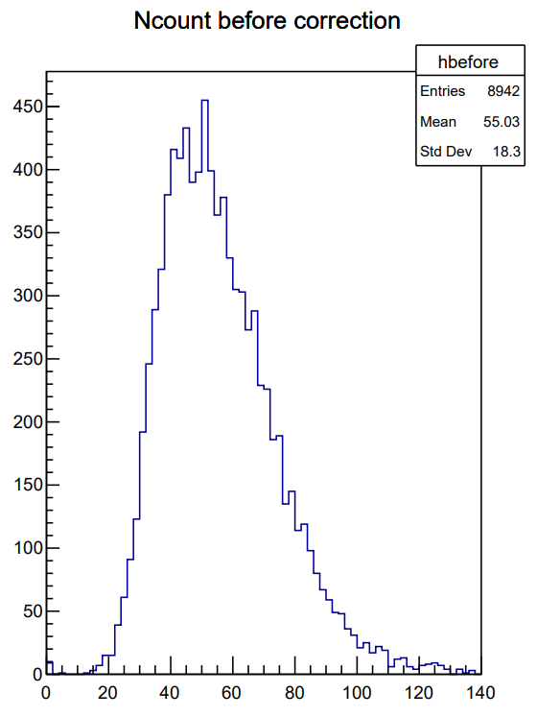
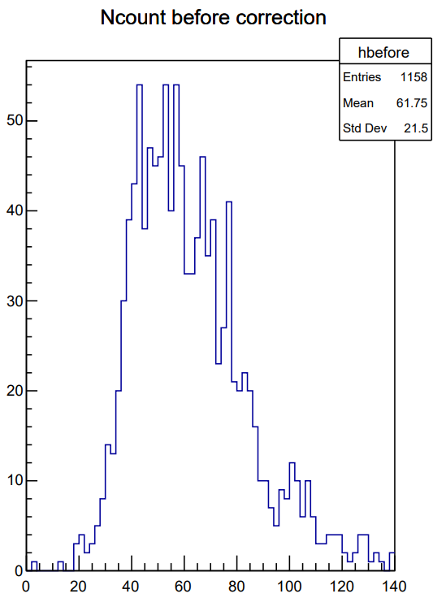
Ncount Comparison in Different Sampling Rates: 45°
Ncount distribution in different sampling rate
1.0G
1.5G
2G
Ncount increasing with Sampling rate

Slide 8
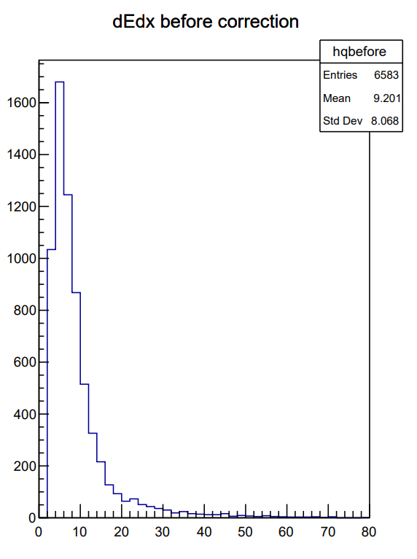
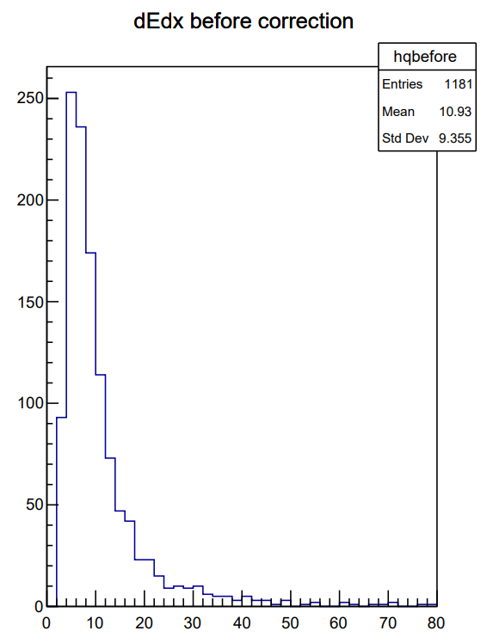
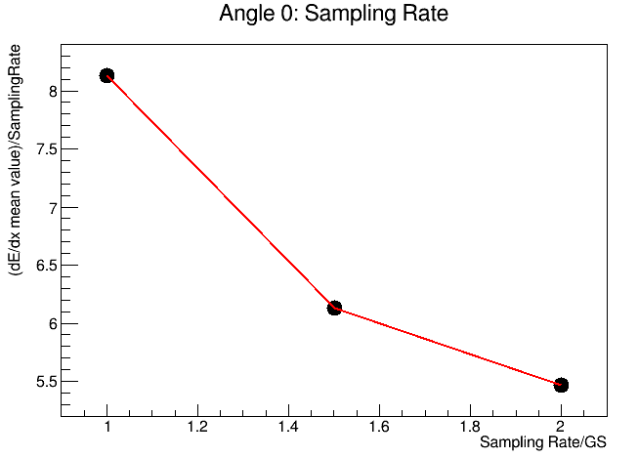
dE/dx Comparison in Different Sampling Rates: 0°
In the right plot, dE/dx is caculated by:
dE/dx=$\sum{(a[i]∗tbin)}$,
(or dE/dx=$\frac{\sum{a\left[i\right]}}{Sampling rate}$)
a means the amplitude of i-th bin,
tbin means the time of one bin
In the dE/dx distribution plots, dE/dx is caculated by:
dE/dx=$\sum{a[i]}$, a means the amplitude of i-th bin
1.0G
1.5G
2G
dE/dx decreasing with Sampling rate
Unexpected decreasing, need to ask question

Slide 9
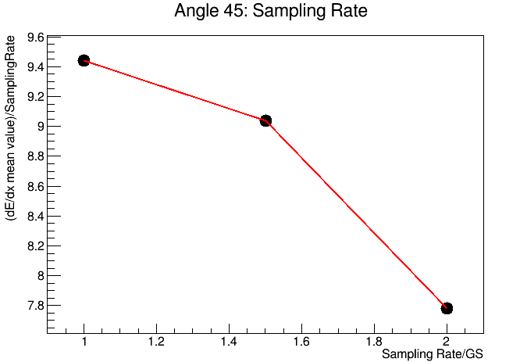
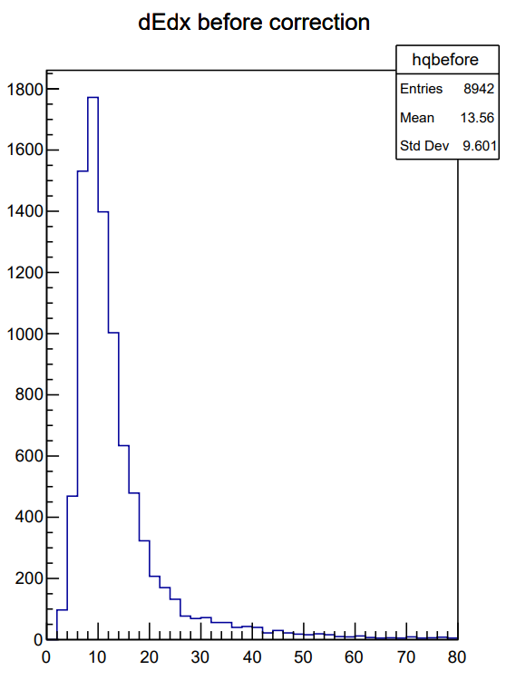
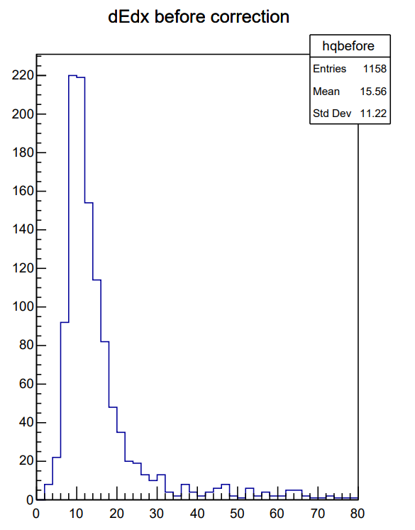
dE/dx Comparison in Different Sampling Rates: 45°
In the right plot, dE/dx is caculated by:
dE/dx=$\sum{(a[i]∗tbin)}$,
(or dE/dx=$\frac{\sum{a\left[i\right]}}{Sampling rate}$)
a means the amplitude of i-th bin,
tbin means the time of one bin
In the dE/dx distribution plots, dE/dx is caculated by:
dE/dx=$\sum{a[i]}$, a means the amplitude of i-th bin
1.0G
1.5G
2G
dE/dx decreasing with Sampling rate
Unexpected decreasing, need to ask question

Slide 10
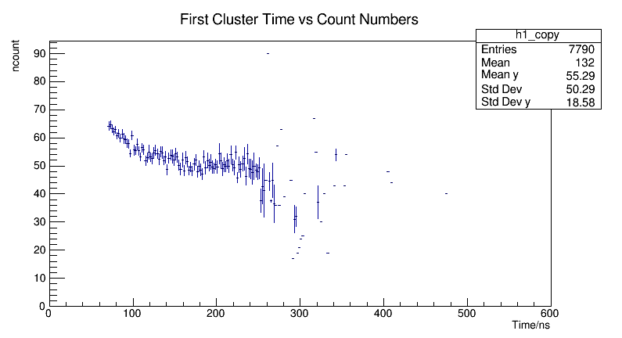
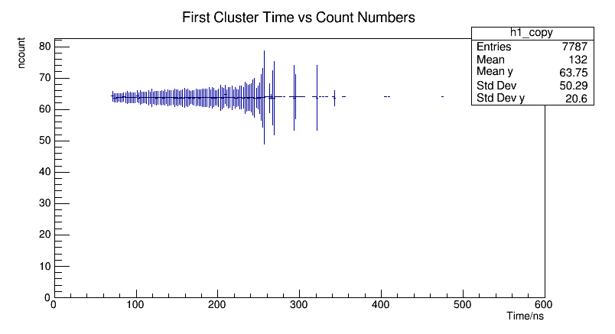
Dependency on $t_{F}$(First Cluster Time) and correction
Run16+17+18, 65000 events, Sampling rate 1.5G, 45°
Correct ncount to ncount($t_{0}$)

Slide 11
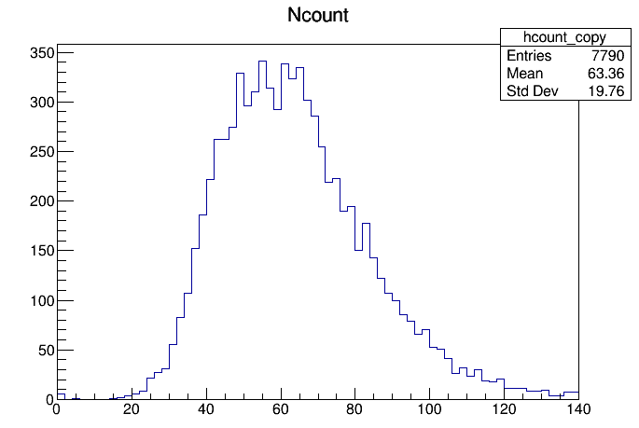
Ncount Comparison ($t_{F}$ Correction)
Before correction
18.3/55.18=33.16%
After correction
19.76/63.36=31.19%

Slide 12
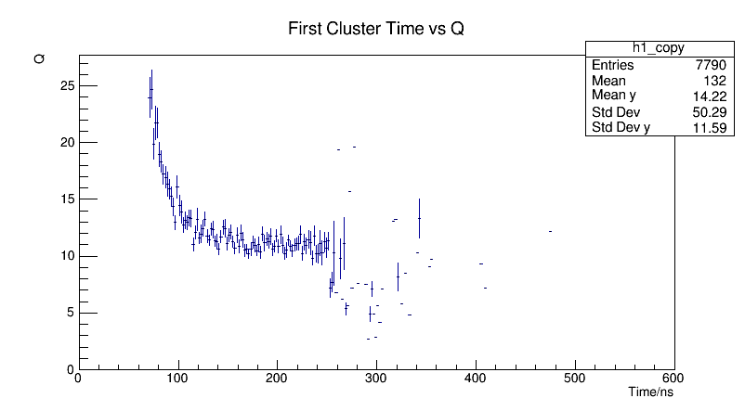
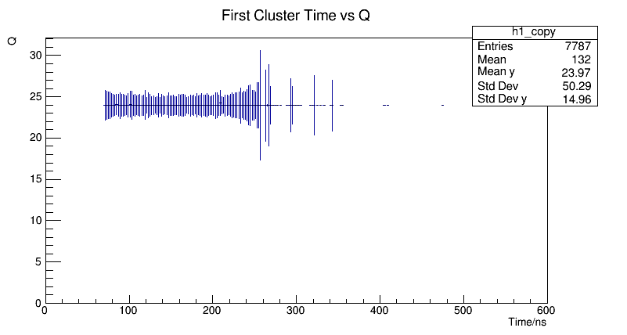
dE/dx Correction Dependency on $t_{F}$
Q’s unit is not converted
45° Run16+17+18
Correct dE/dx to dE/dx($t_{0}$)

Slide 13
dE/dx Correction 45° Run16+17+18
9.713/13.79=70.44%
12.22/23.06=52.99%

Slide 14
Summary
Ncount and dE/dx Comparison in different situation:
Same angle, different sampling rates: Ncount increasing with sampling
Same sampling rate, different: Ncount increasing with angle
Correction on the dependency of $t_{F}$ to dN/dx and dE/dx
Angle = 45°, Sampling Rate=1.5GS, 65000Events
Resolution is improved
Next
Clustring in dN/dx analysis

Slide 15
Backup

Slide 16
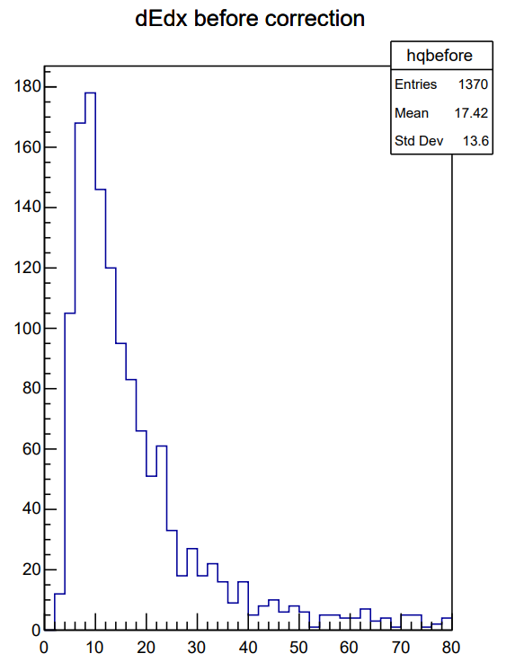
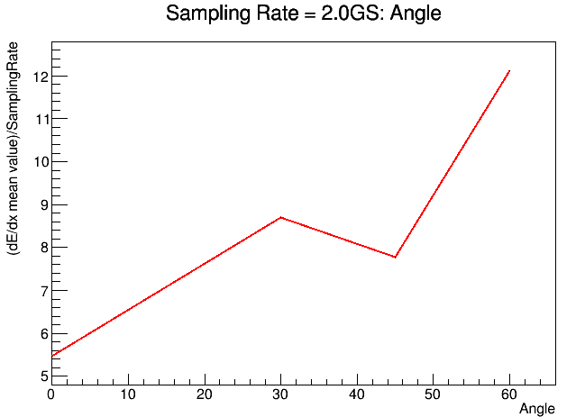
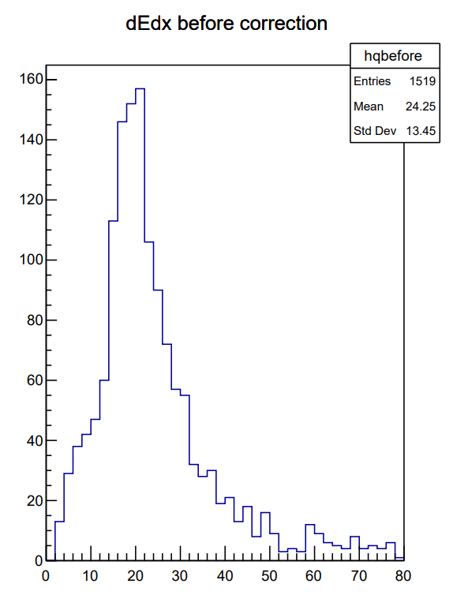
dE/dx Comparison in different angles Sampling Rate = 2.0G
0°
30°
45°
60°

Slide 17
1/cos(x) (0°~60°)
Rad/(0~pi/3)

Slide 18
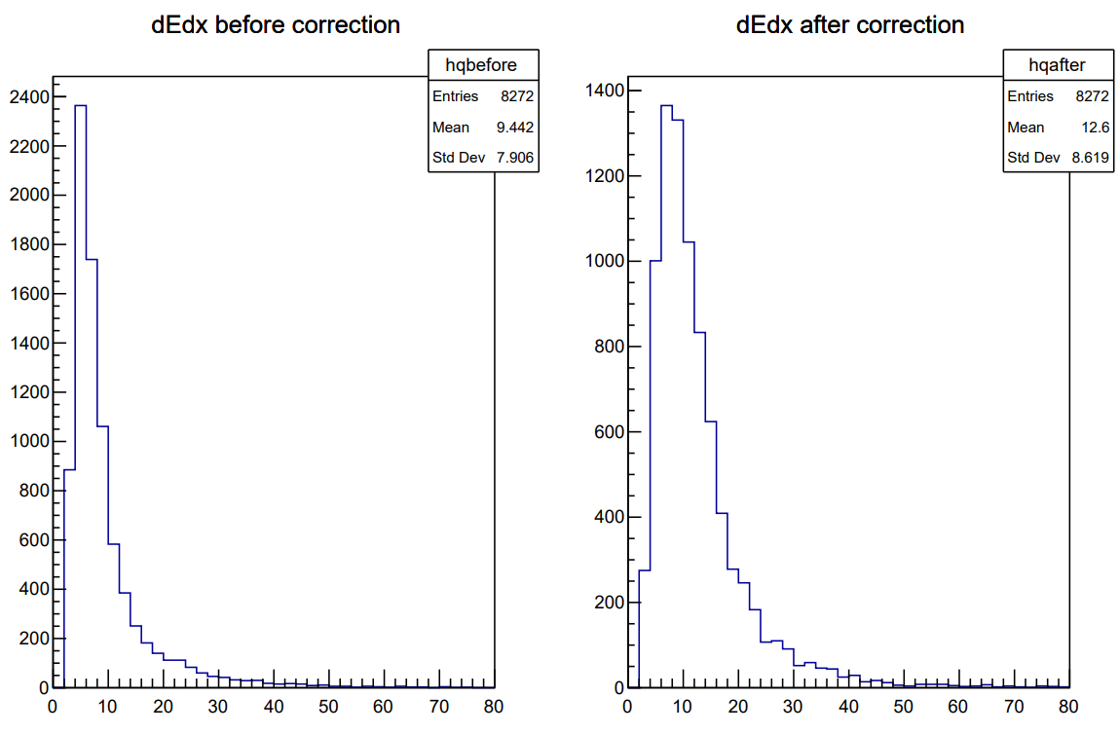
Correction Result: 45° Sampling rate =1G

Slide 19
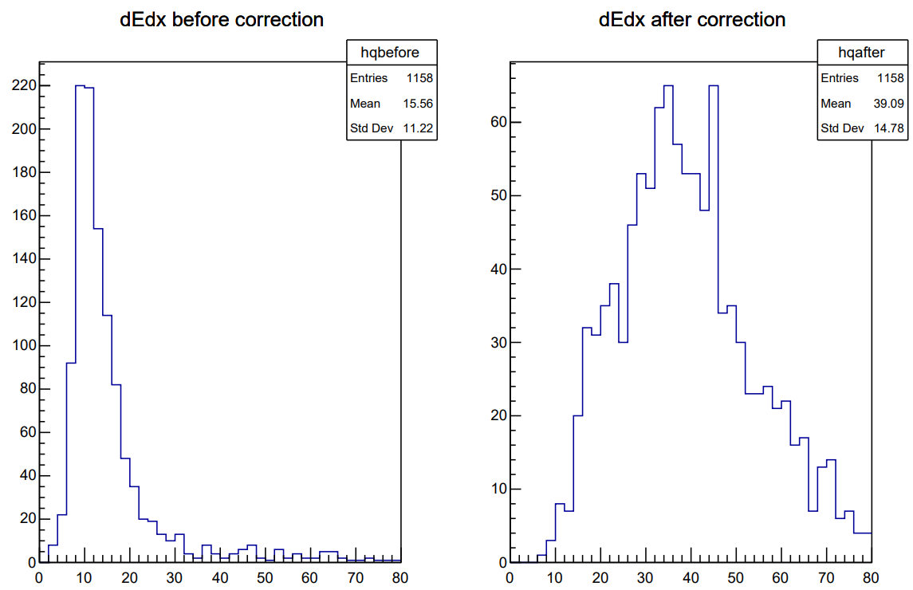
Correction Result: 45° Sampling rate =2G

Slide 20
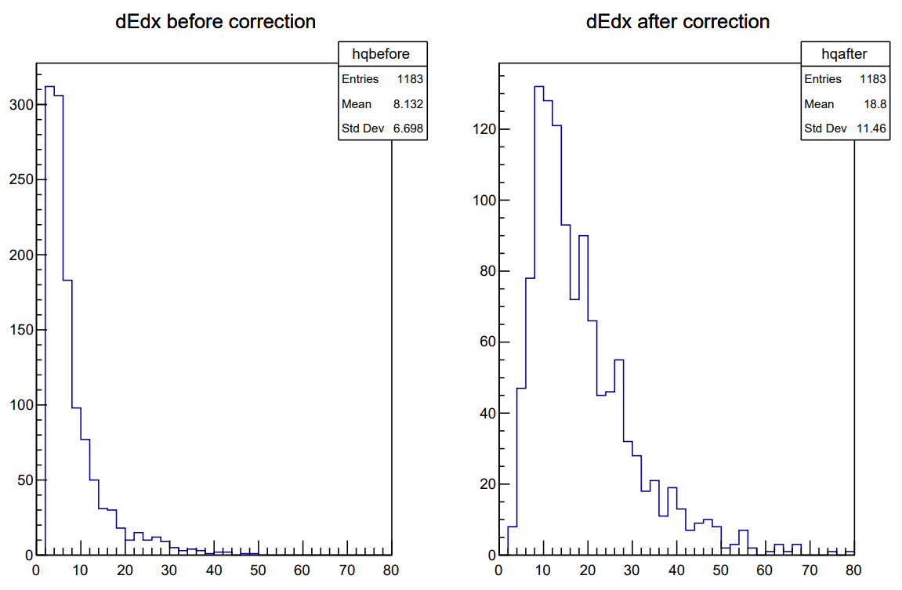
Correction Result: 0° Sampling rate =1G

Slide 21
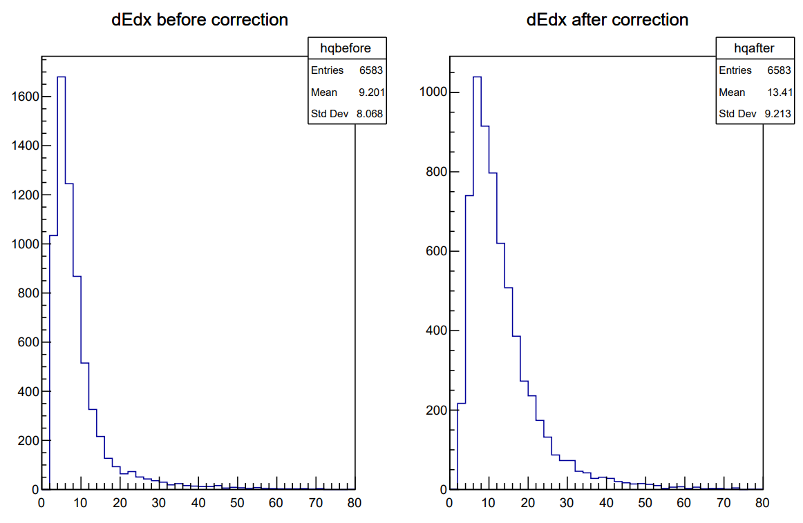
Correction Result: 0° Sampling rate =1.5G

Slide 22
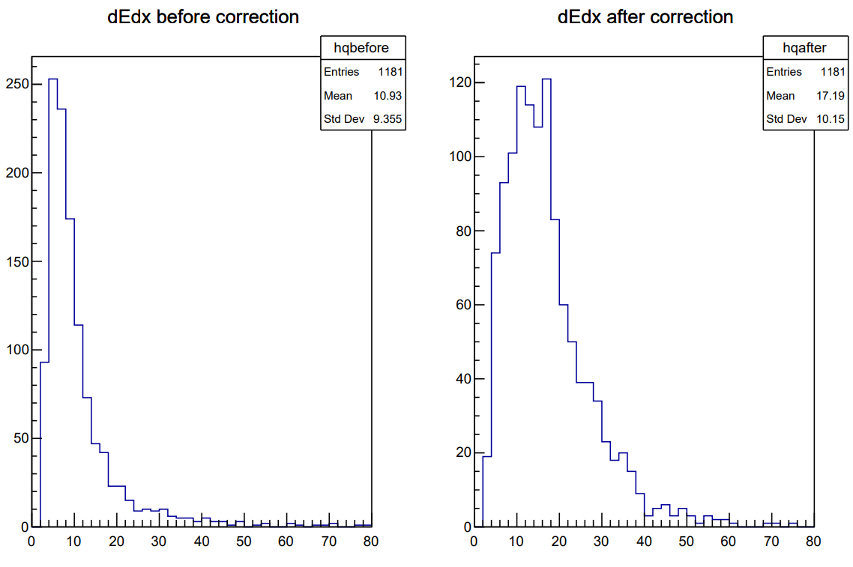
Correction Result: 0° Sampling rate =2G

Slide 23
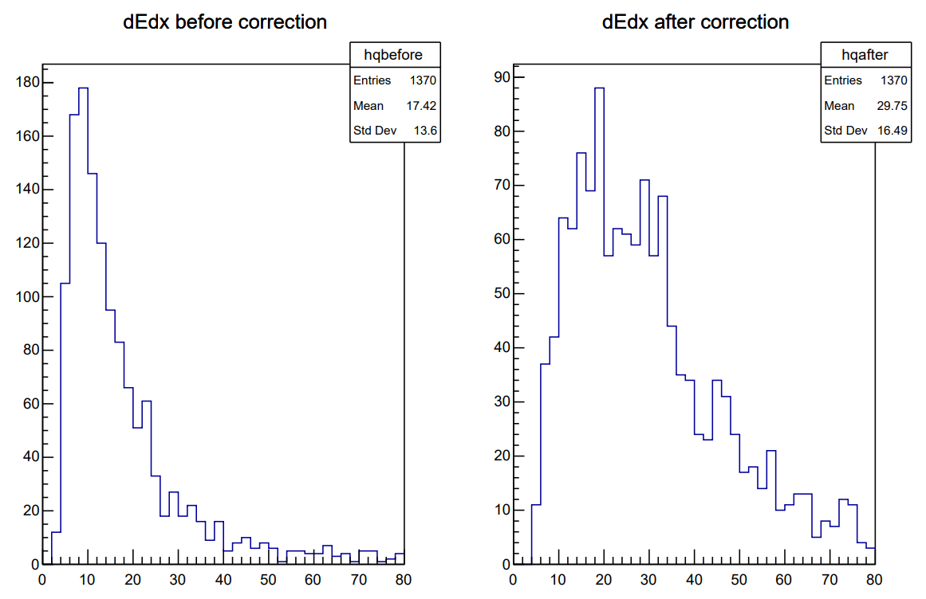
Correction Result: 30° Sampling rate =2G

Slide 24
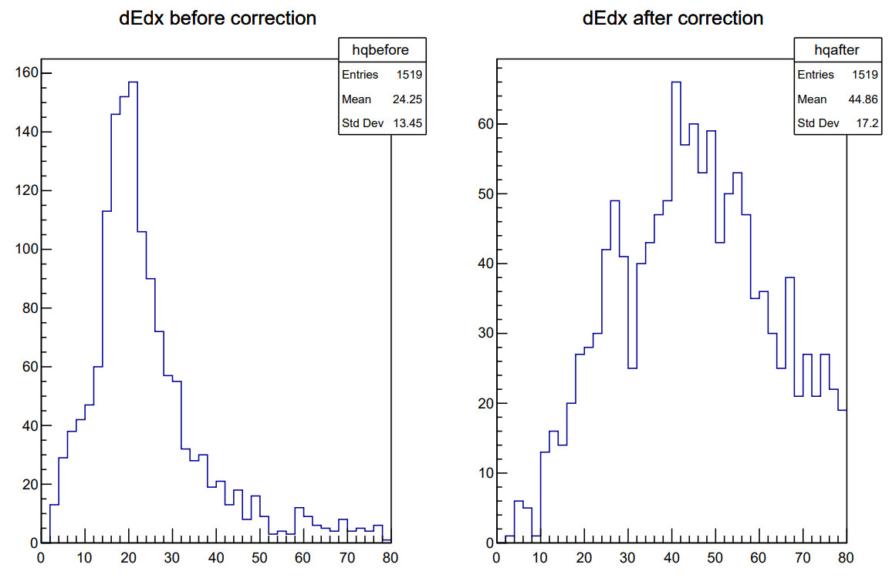
Correction Result: 60° Sampling rate =2G

Slide 25
Correction Result: 30° Sampling rate =1G
T0 is not obvious
Not Corrected

Slide 26
Correction Result: 60° Sampling rate =1G
T0 is not obvious
Not Corrected

Slide 27
Backup Summary
Correction on the dependency of $t_{F}$ to dN/dx, and compared to same correction on dE/dx
Almost all 90/10 data is used
4 different angles, 3 different sampling rate
Resolution is improved after correction
Data of 30°/60°, sampling rate =1.0G have no obvious T0, not corrected now

Slide 28
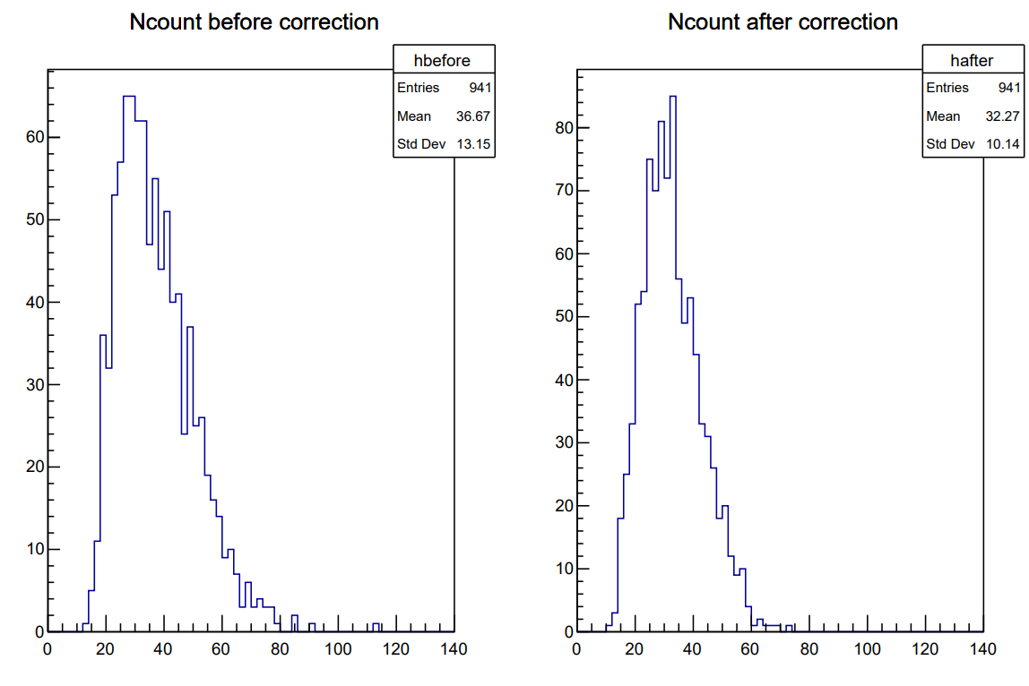
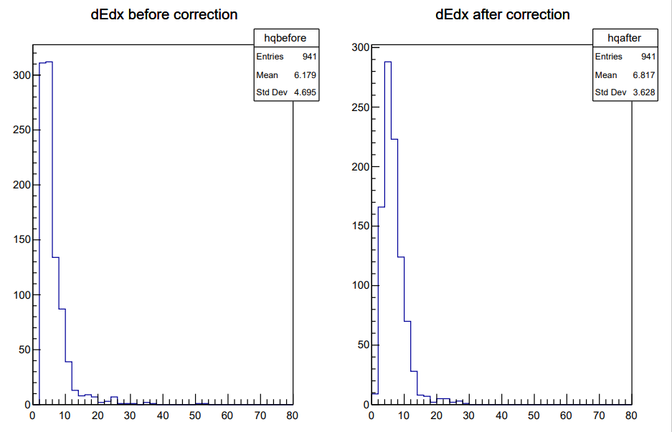
Force Correction of Data of 30°, sampling rate =1.0G
Set T0=128.0

Slide 29
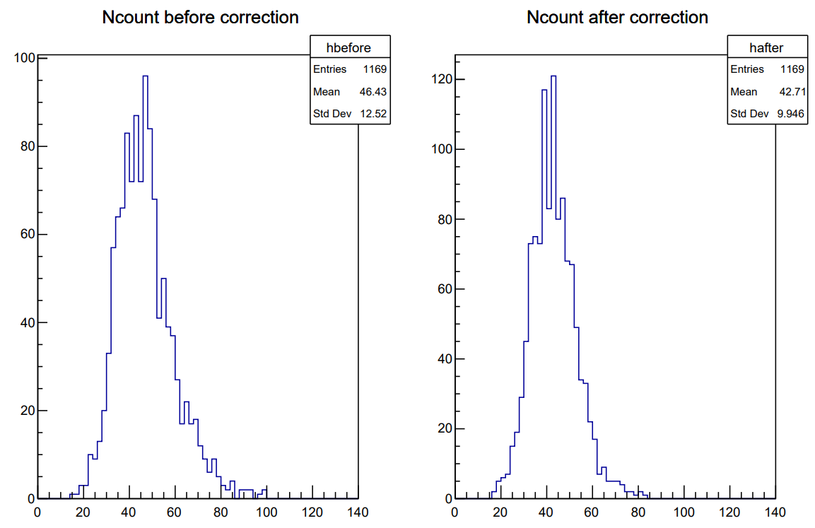
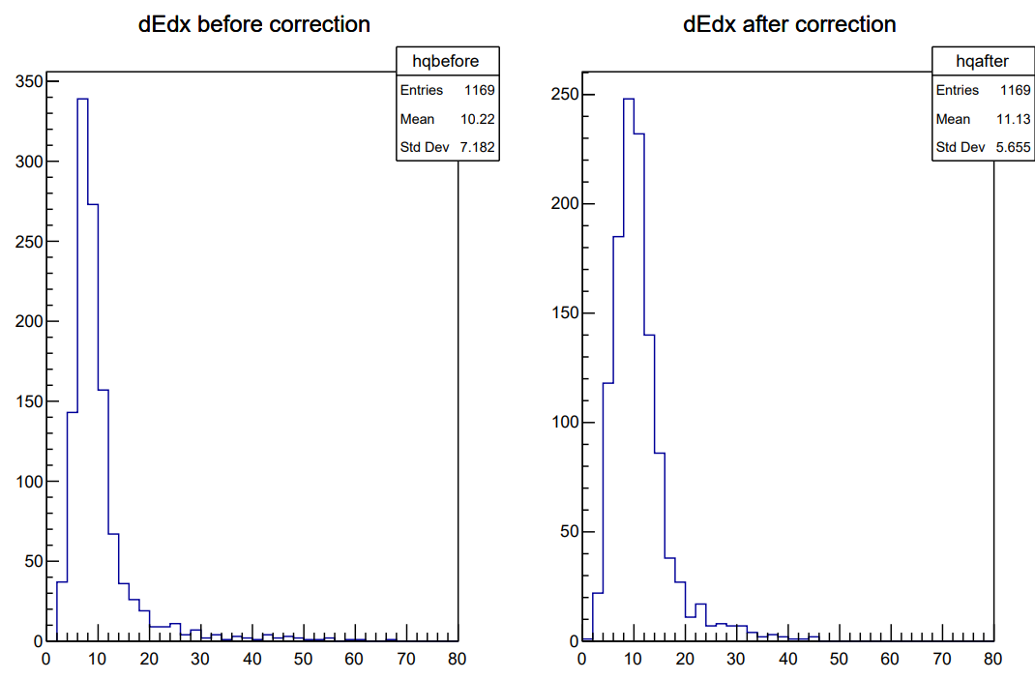
Force Correction of Data of 60°, sampling rate =1.0G
Set T0=128.0

