Slide 1
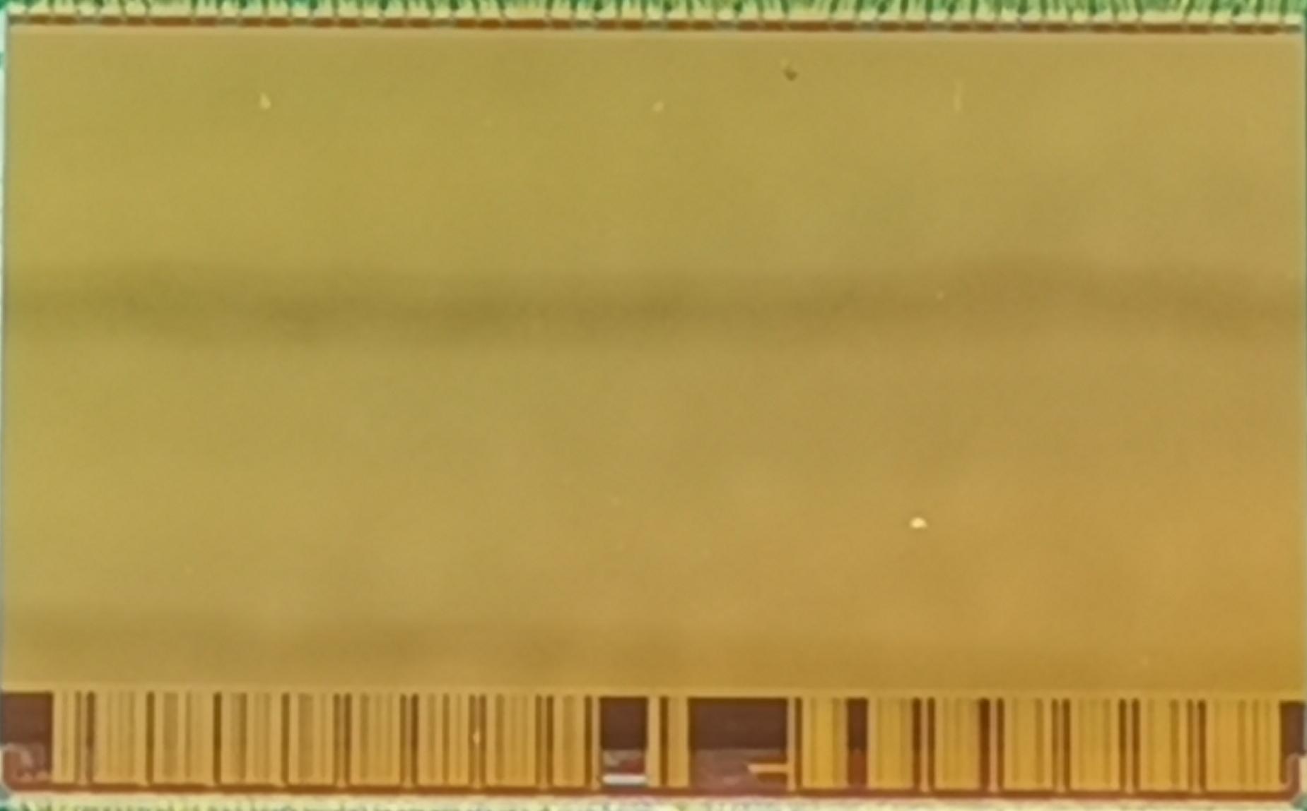
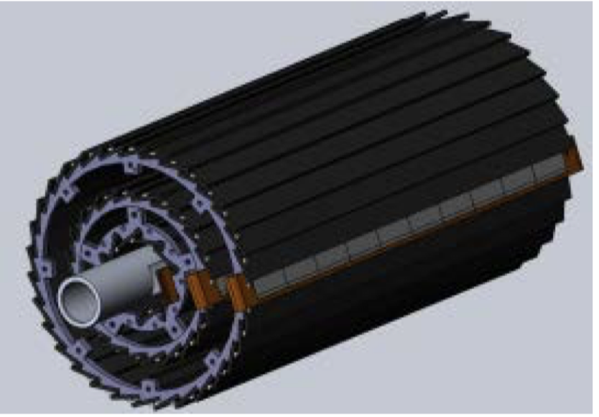
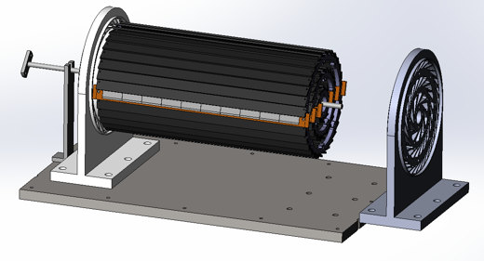
Overview of MOST2 vertex detector R&D
Can break down into sub-tasks
CMOS Pixel Sensor chip R&D
Detector layout optimization, ladder and vertex detector support structure R&D
Detector assembly
Data acquisition system R&D
CMOS pixel sensor prototyping
Full size vertex detector prototype
Detector module (ladder) prototyping
TaichuPix-3
Beam test to verify its spatial resolution
Double sided ladder
10 sensors/ladder side, read out from both ends
Electron beam

Slide 2
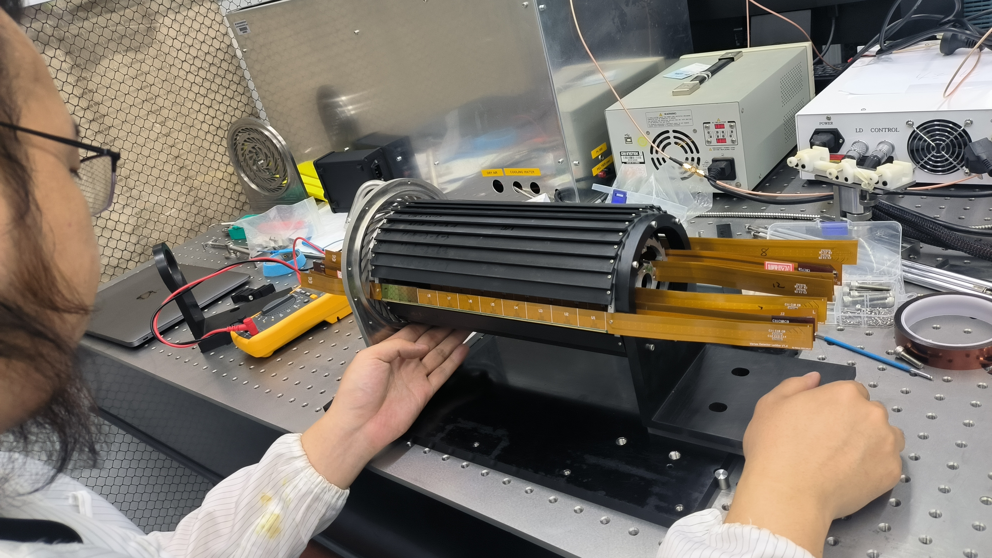
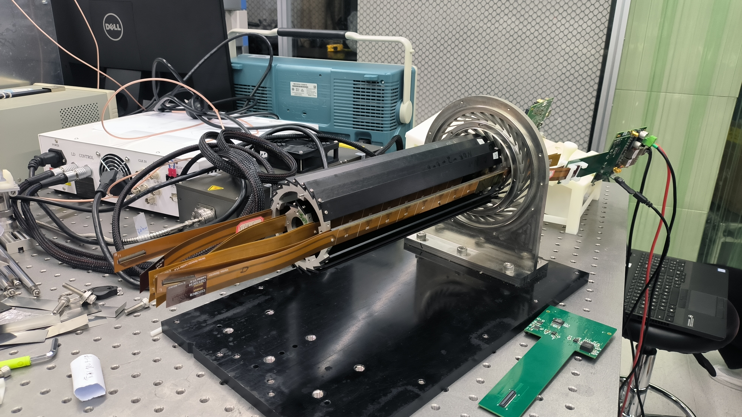
Prototype assembly

Slide 3
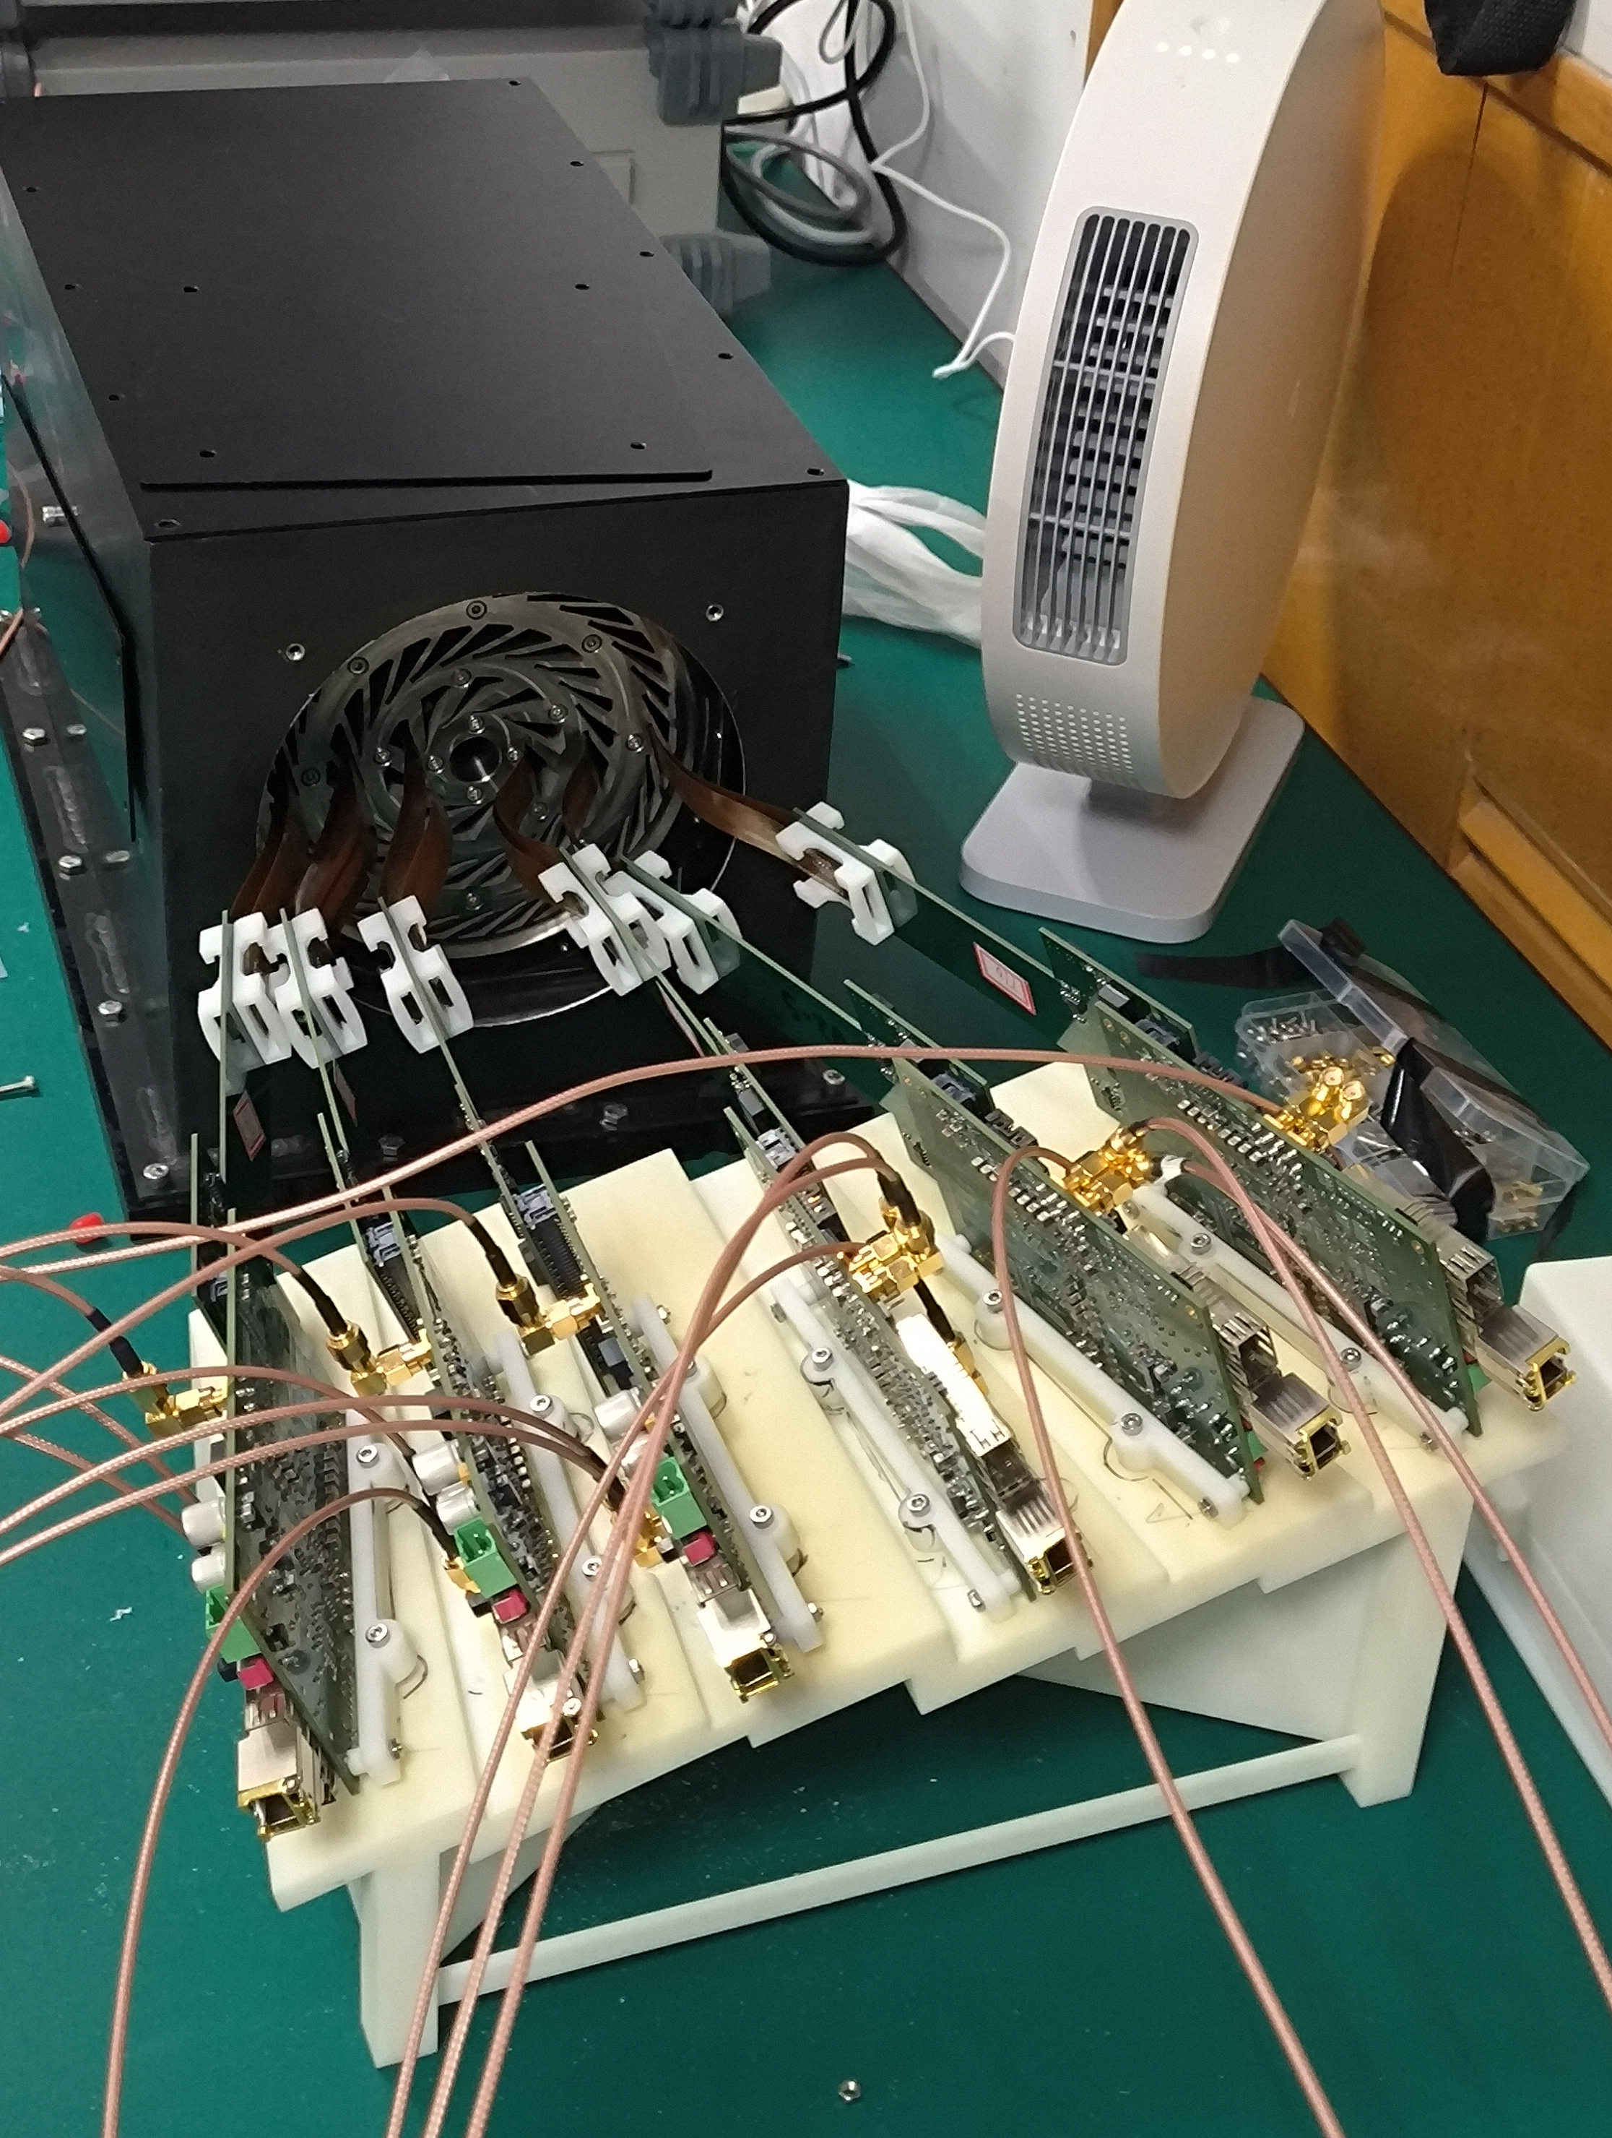
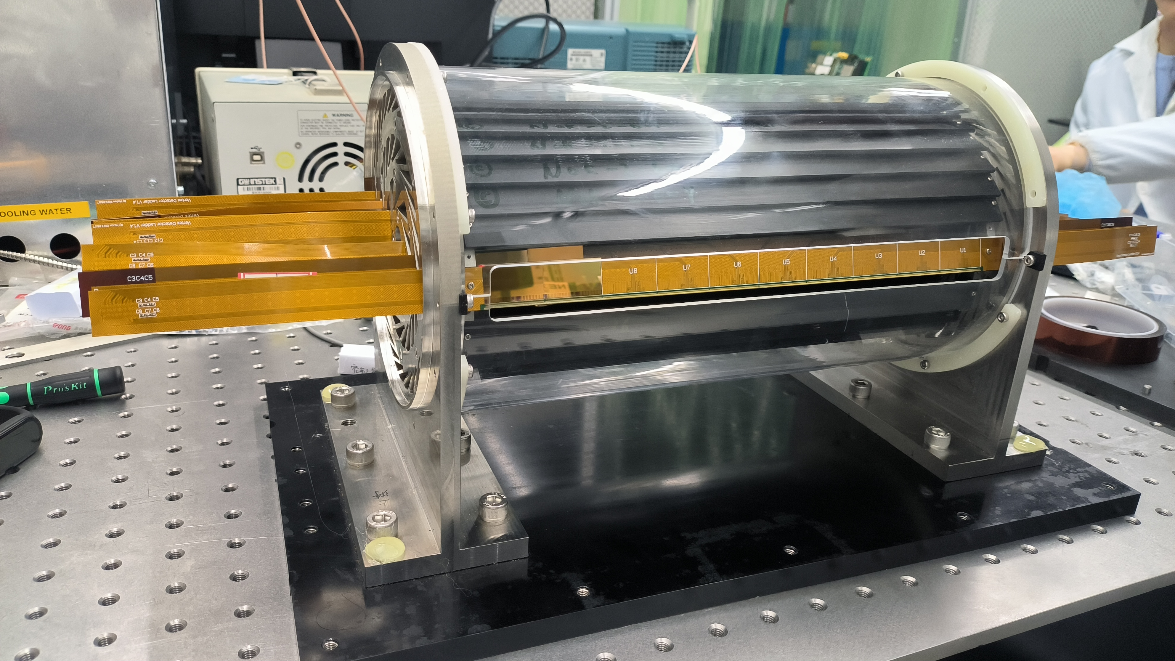
Prototype assembly and test@IHEP
D f

Slide 4
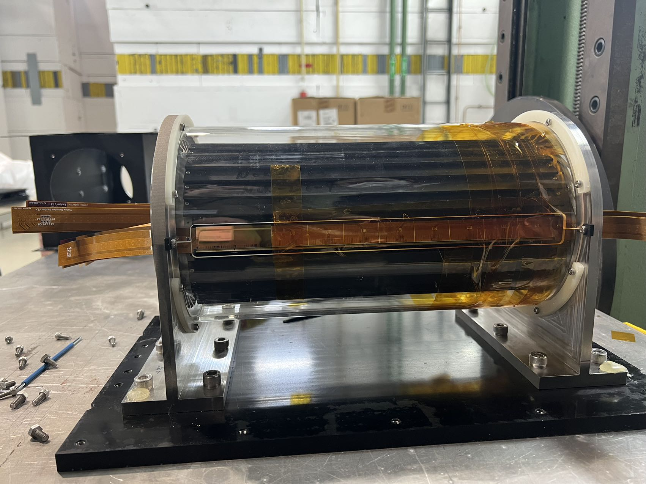
Prototype assembly@ DESY
D f

Slide 5
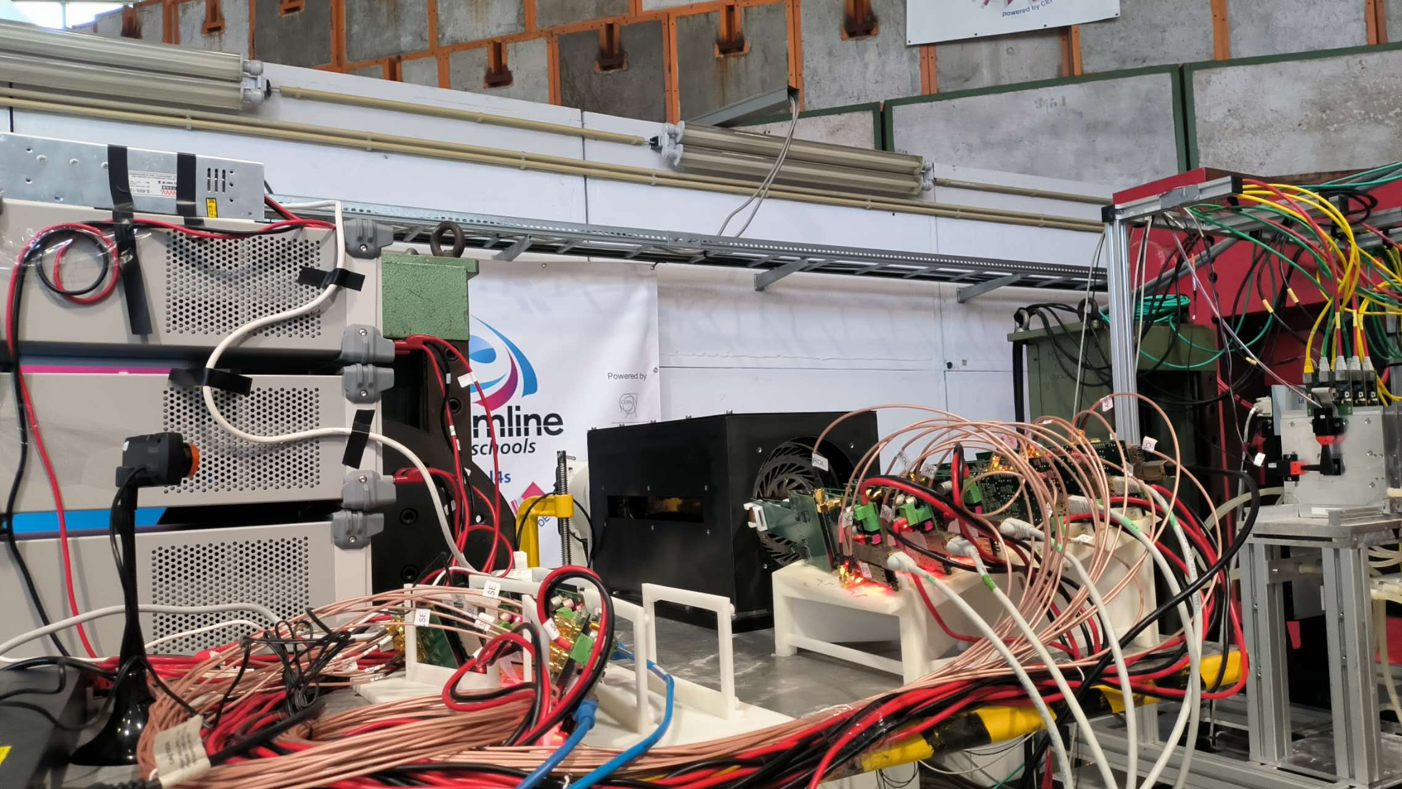
Prototype assembly @DESY
D f

Slide 6
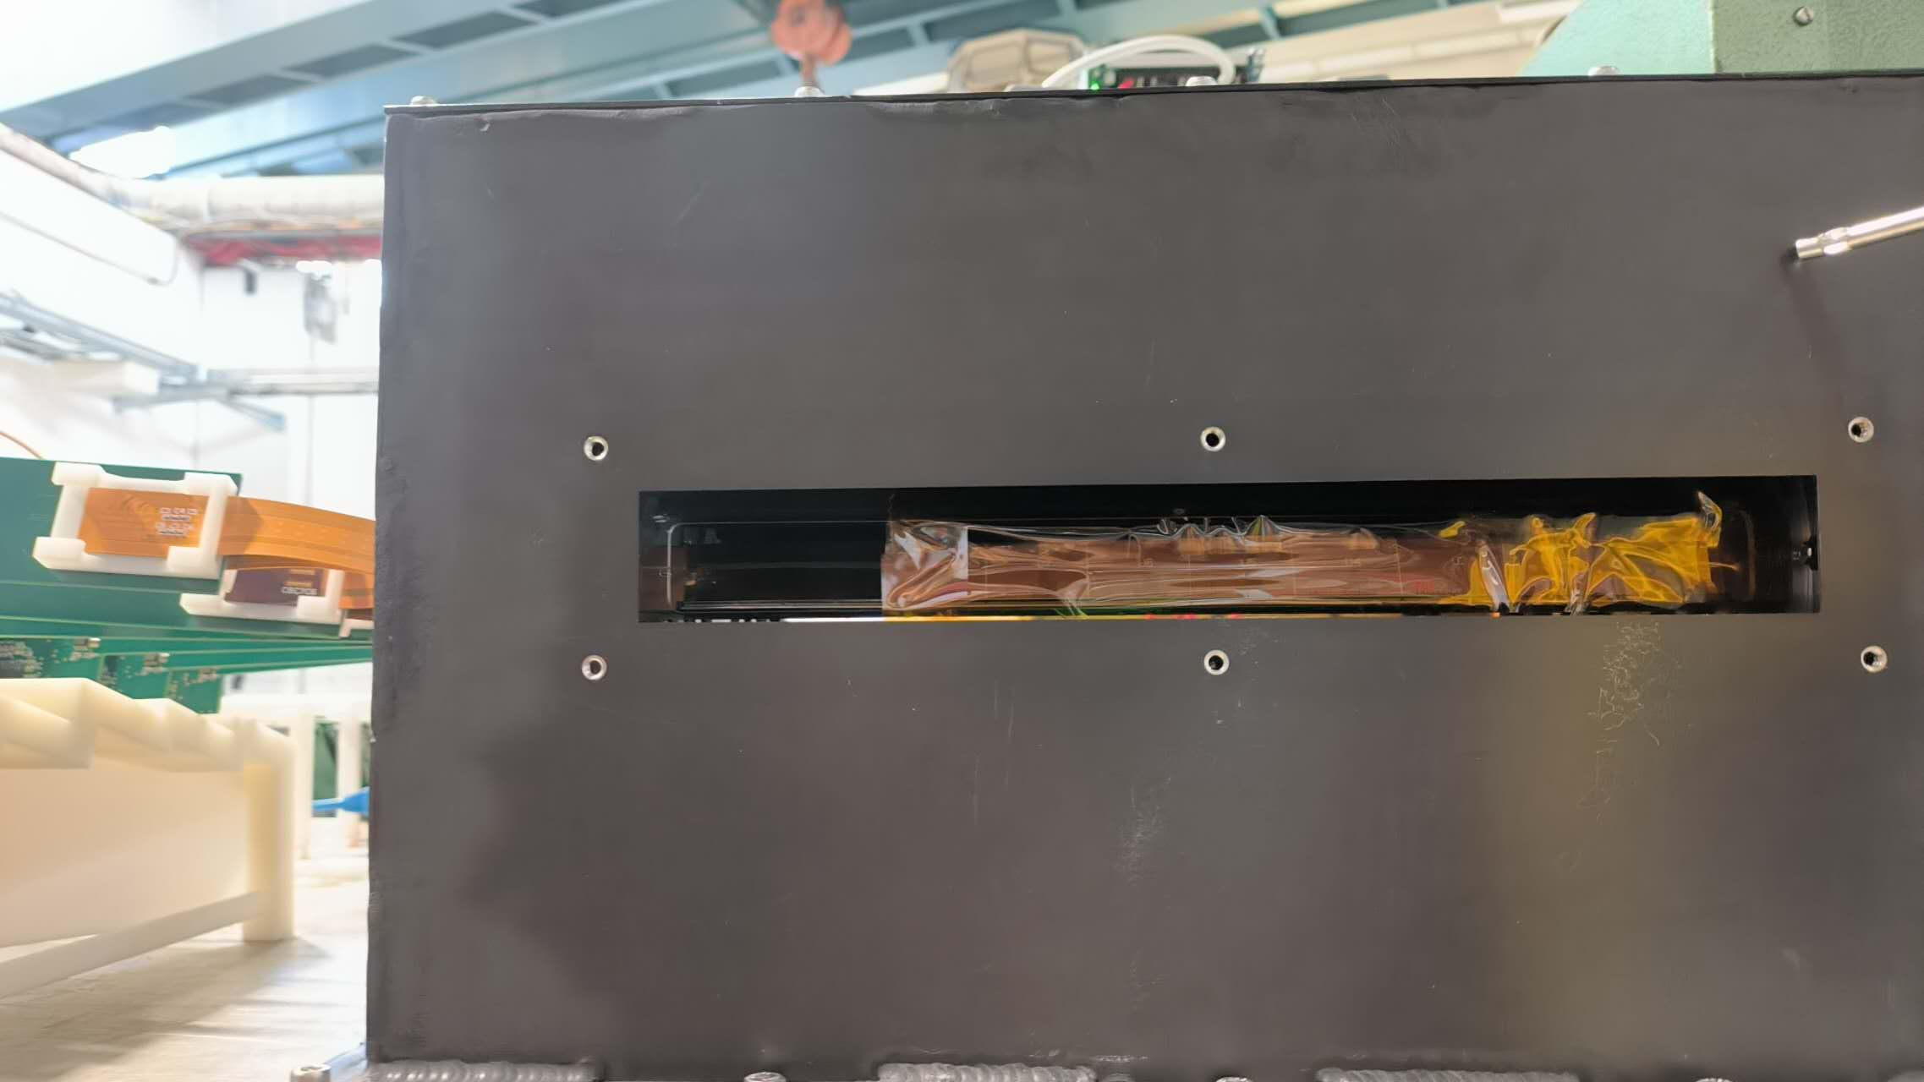
Prototype assembly @DESY

Slide 7
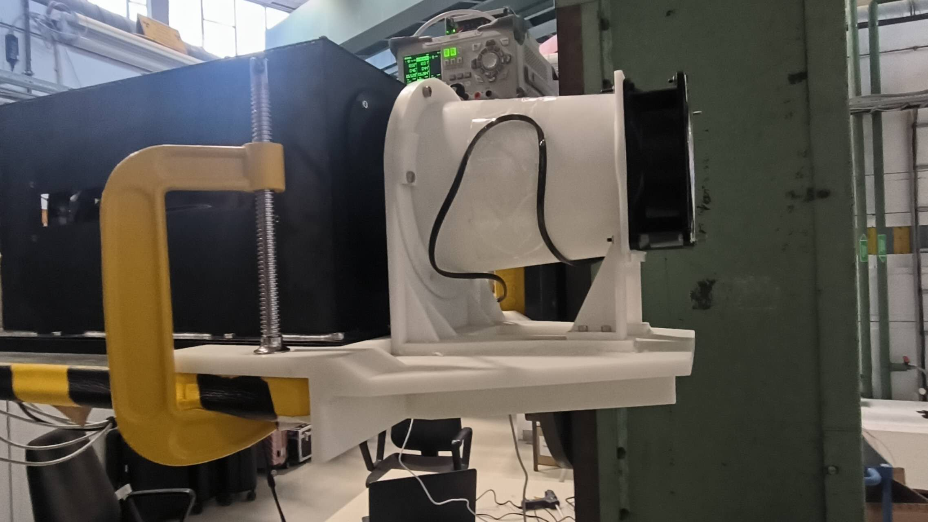
Prototype assembly @DESY

