Slide 1



Instrument Upgrade, Installation and Operation at ISIS
By John Crawford
Notes:
The abstract pattern can be removed or repositioned if required. Be careful to ‘Send to Back’ so that it does not obscure any important information.

Slide 2
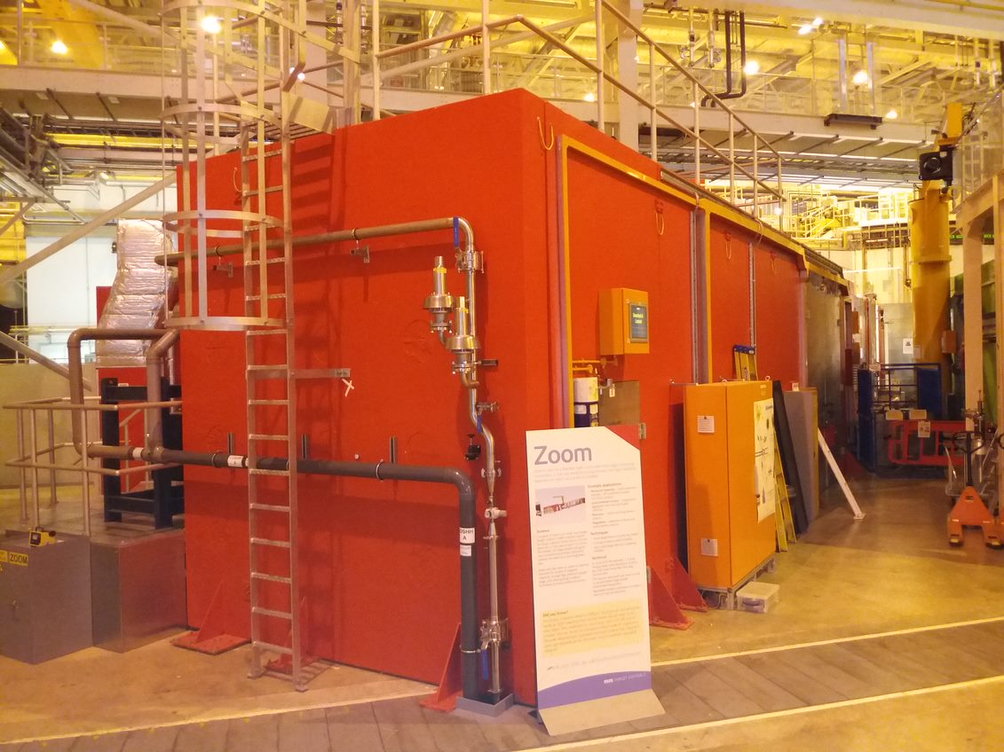
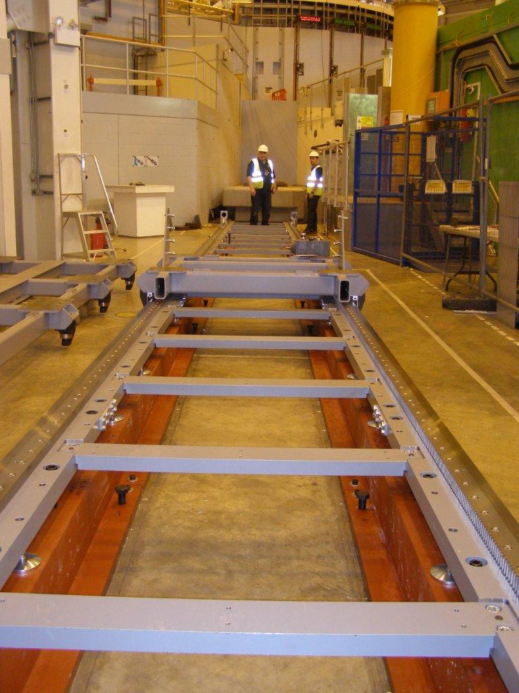
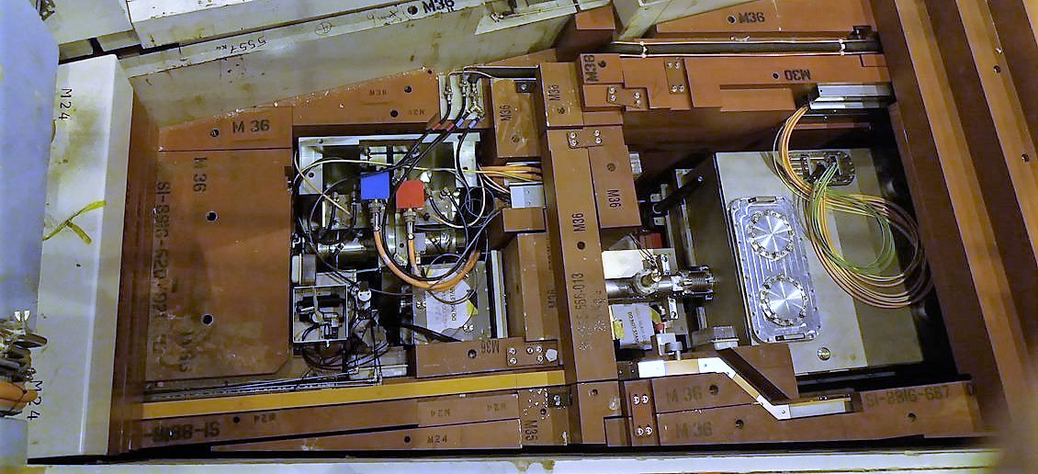
The Objectives
Planning, preparation and integration.
              During the Design Phase
              Understanding Integration
              Installation preparation
              Safety and waste management
              Installation
              Communication
              Finding solutions when things go wrong
              Managing change
      Continual improvement
      Operation
      Handover to Scientists
      Commissioning and maintenance
      Continuous Improvement

Slide 3
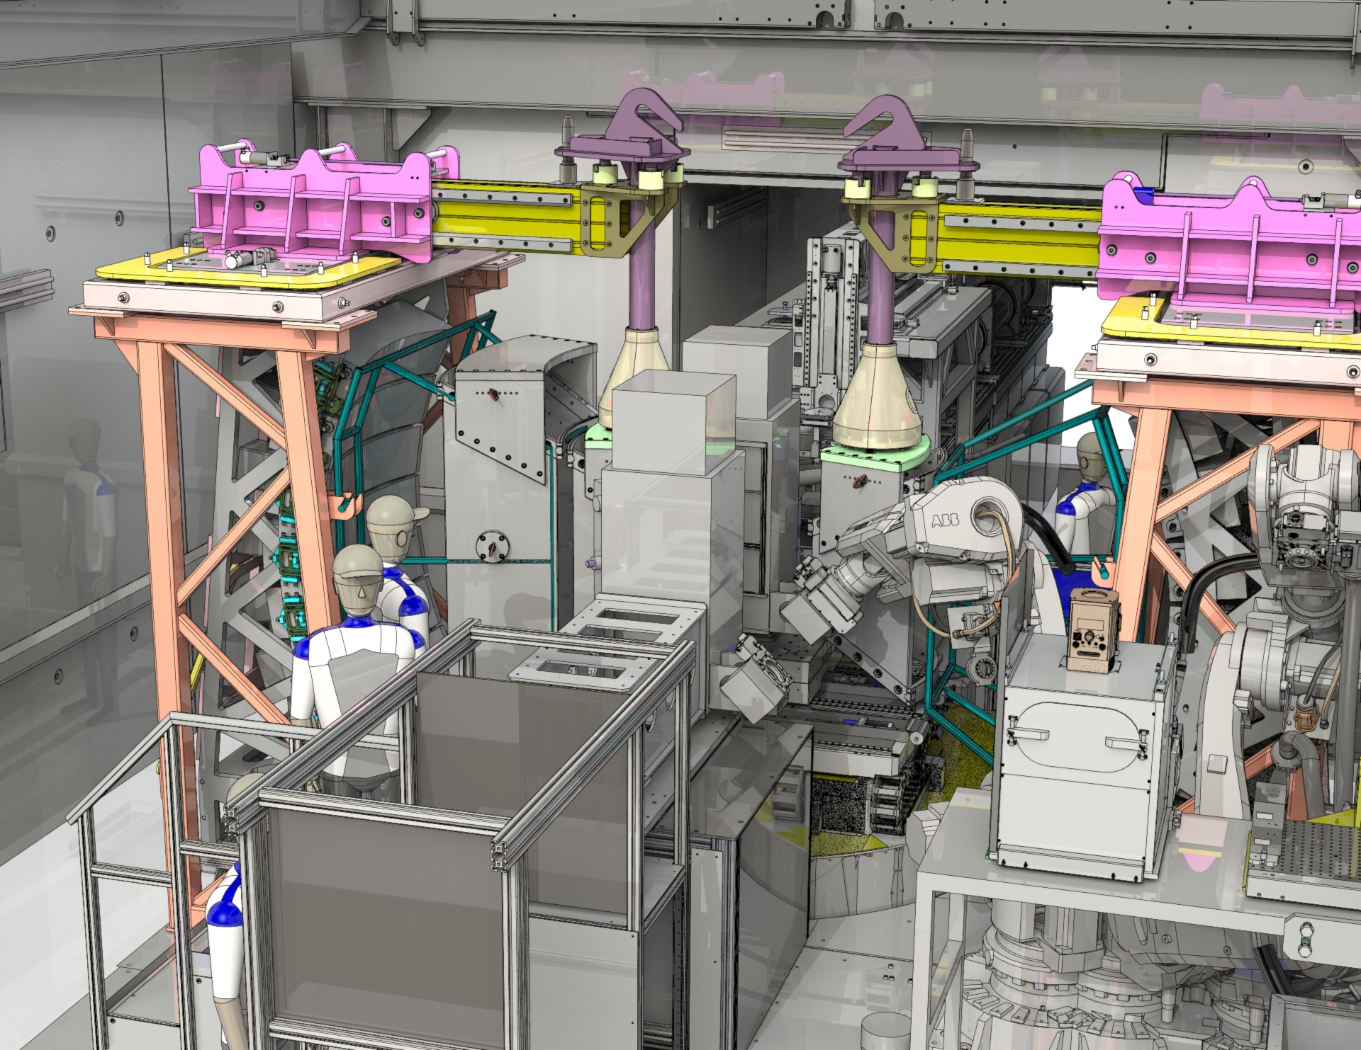
Planning, preparation and integration
During the design Phase
Input into design reviews both CDR and PDR
Identify installation challenges and find solutions
Identify stakeholders for the installation
Pre-build plan. Identify a safe space for components and pre-build activities
Installation plan. Break it down into bite size packages
Resource plan. Who, when and who much??
Waste plan.
Installation area and plan for the build
The Design Phase
IMAT Collimation and Detector Upgrade

Slide 4
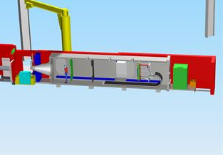
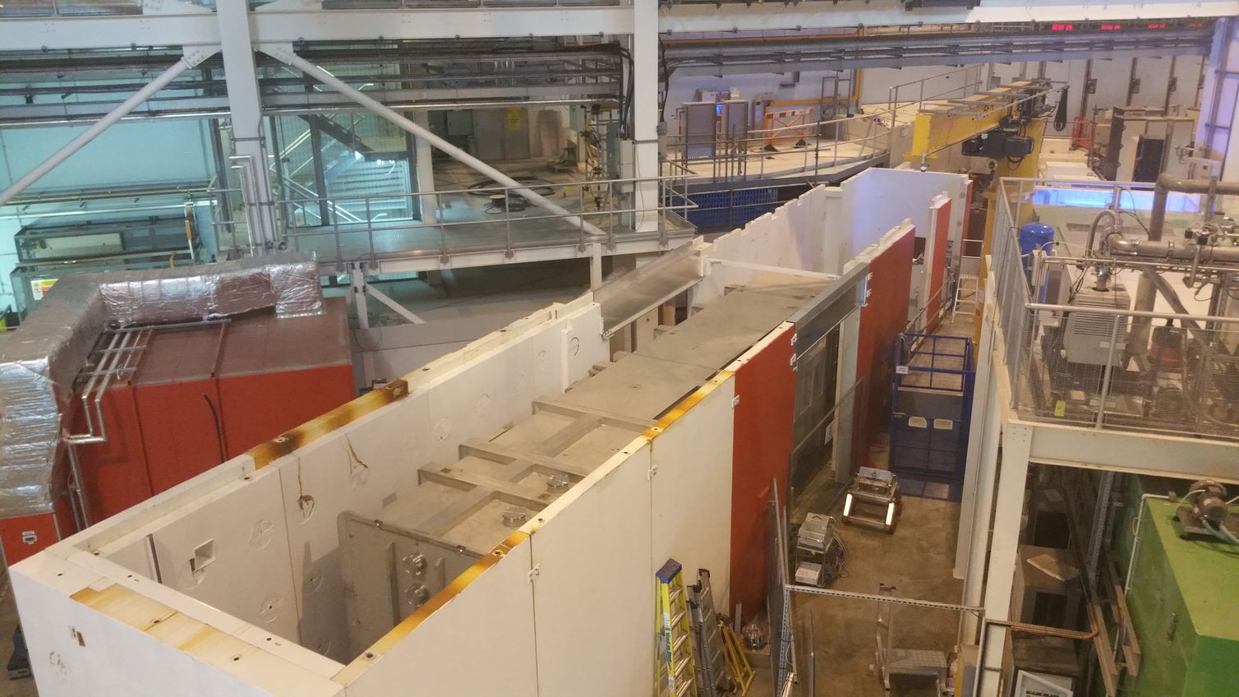


Understanding integration
Design
Integration
Installation
A plan or drawing produced to show the look and function or workings of a building, garment, or other object before it is made.
Mixing things or people together that were formerly separated
The process of combining two or more things to create a whole
To form, coordinate, or blend into a functioning or unified whole.
The act of putting furniture, a machine, or a piece of equipment into position and making it ready to use
Understand and communicate the project goals and deliverables
Interprets the overall project plan and creates the installation plan alongside designers and technicians
Identifies all project stakeholders and gets a buy in to the plan.
Feeds the resource plan
Interprets and communicates technical information
Tracks changes to the design during the installation
Keeps a solutions focus when facing installation difficulties
Interprets the plan and identifies work packages
Creates a task breakdown
Communicates with all involved
Looks after the day-to-day project activities
Ensures quality and compliance
Ensures installation safety
Records and communicates changes
Keeps the plan on track
Functionality. Fulfils the requirements laid out in the science case
Specifications – dimensions, tolerances, precision etc.
Safety – by design RA
Reliability, manufacturability
Provides technical information.

Slide 5
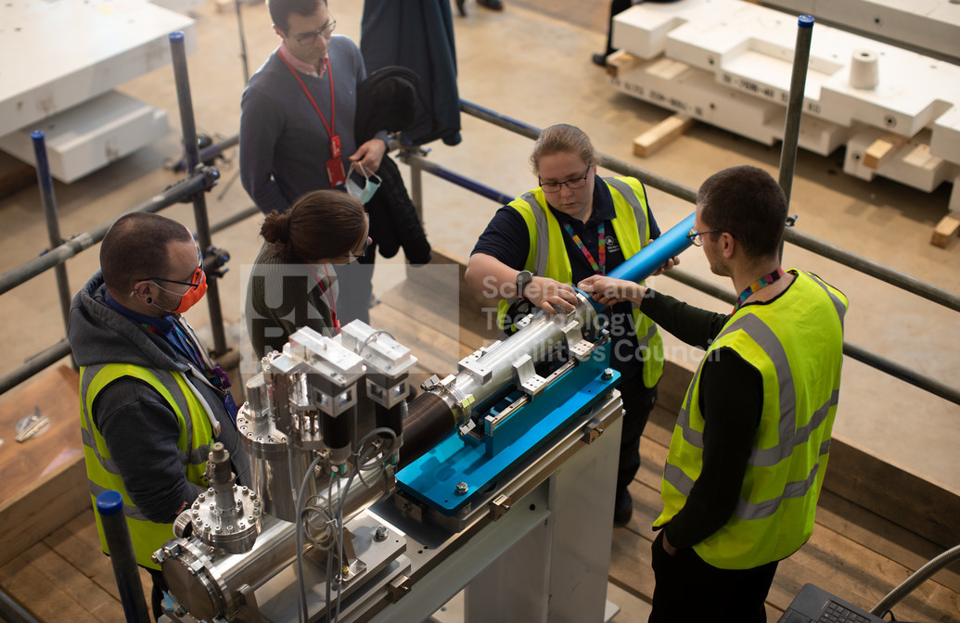
Installation Preparation
The benefits of pre-building all or part of an instrument
Generates information for the installation and assembly sequence
Generates valuable information for producing RAMS
Continuous improvement of methodology
Allows for off-line commissioning – especially motion control and generating alignment data.
Gives the installation technicians time to generate assembly data and fault find delivered components.
Gives designers and technicians the opportunity to work together on the functionality of the systems to be installed
Pre-building will feed your project plan

Slide 6
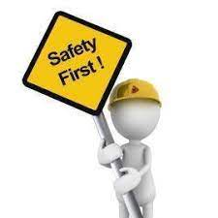
Installation & Operational Safety
Installation Safety
CDM – Construction, Design and Management (regs 2015)
Keep all ISIS users and staff safe during the construction phase.
Create a Construction Phase Plan
Define the boundaries of the work area
Create the waste plan
Identify project stakeholders and their responsibilities
Risk and method statements for the construction phase
Produce site rules
Create the communication plan
Operational Safety
Safety of neighbouring Instruments during Construction
Keep all ISIS users and staff safe during the construction phase.
Known as “business as usual”
Follow operational risk assessments and safe working practices
Stakeholder engagement and communication on progress
Ensure the impact of construction activities on operating Instruments
Looking after visiting users' safety
Integration between Construction and Operation

Slide 7
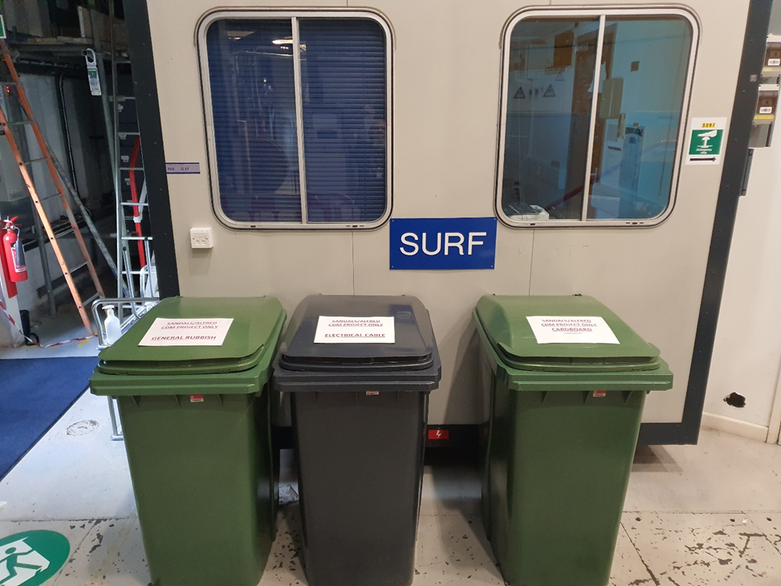
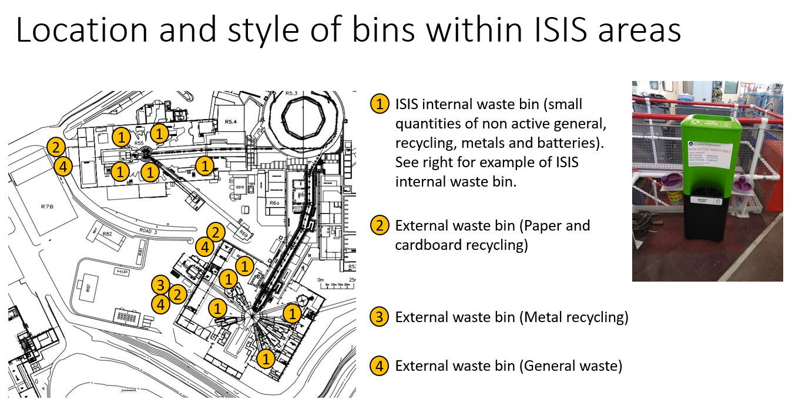
Waste planning
We generate a plan that identifies what we will keep as spares and what's for disposal.
Make sure responsibilities are understood be all stakeholders.
Working clean improves efficiency and helps manage the end phase of a project.
A weekly housekeeping and safety tour helps manage expectations and prevent bad habits forming.
Keep your project environmentally friendly.
Tidying up part of the work
Specialist disposal of Non-active waste
Non active specialist waste such as WEEE waste or hazardous waste need to be disposed of via a specialist route.
Contact the Waste Disposal Officer for disposal of hazardous waste (SHE code 31). See SHE appointments directory (The SHE directory) which is linked to from here: https://staff.stfc.ac.uk/she/Pages/SHEDirectory.aspx
Contacts for other specialist waste such as WEEE waste or other specialist types of waste for advice and to arrange collection can be found here: https://staff.she.stfc.ac.uk/Pages/Staff/Waste-disposal-and-recycling-contact-points.aspx

Slide 8
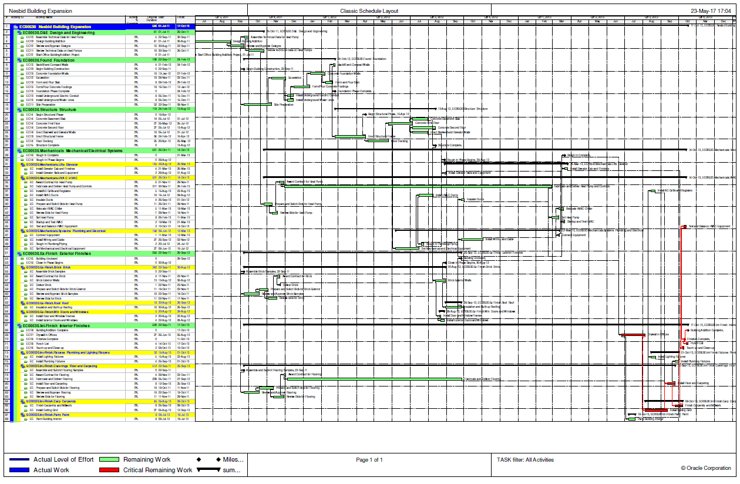
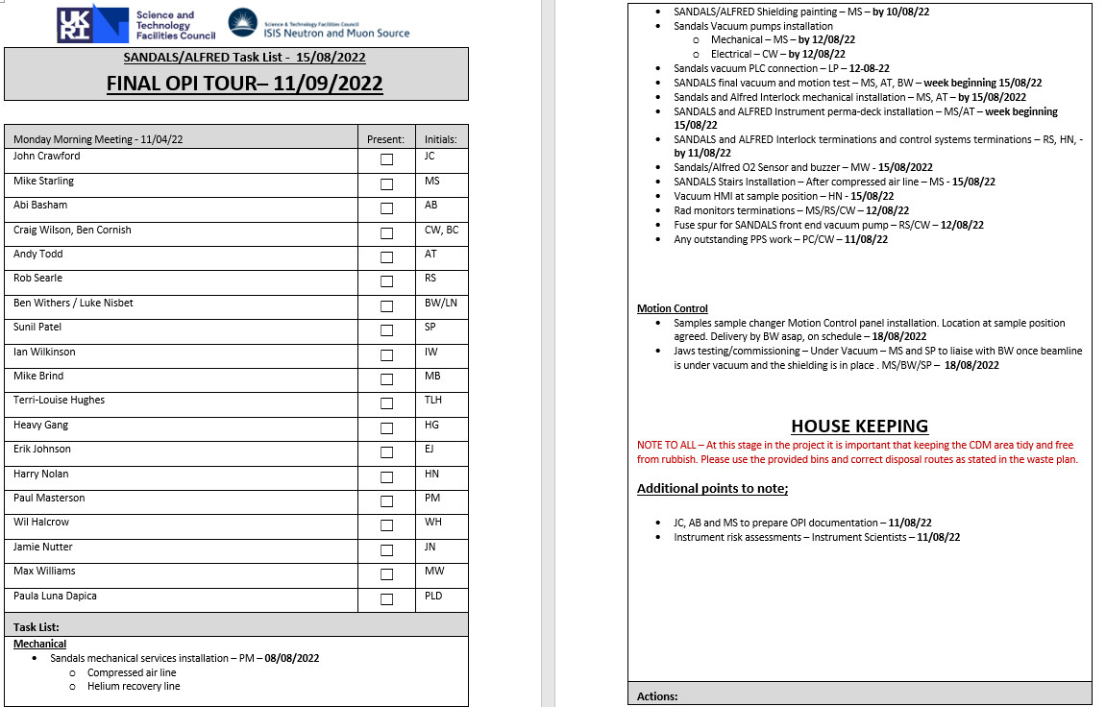
Installation & Communication
The key to successful project is communication – so here’s my top tips……..
Listening is more important the anything else
Adapt your communications to suit the occasion or person (emails/phone/zoom/face to face/text/teams/SharePoint). Never assume your message has been read, understood or received.
If there is a lot to talk about, do it in person. Take notes and seek clarification afterwards to avoid misunderstandings
Be kind, be polite, be inclusive and treating everyone with respect.
At the start of an installation create a 1-month look ahead work plan and a weekly plan

Slide 9
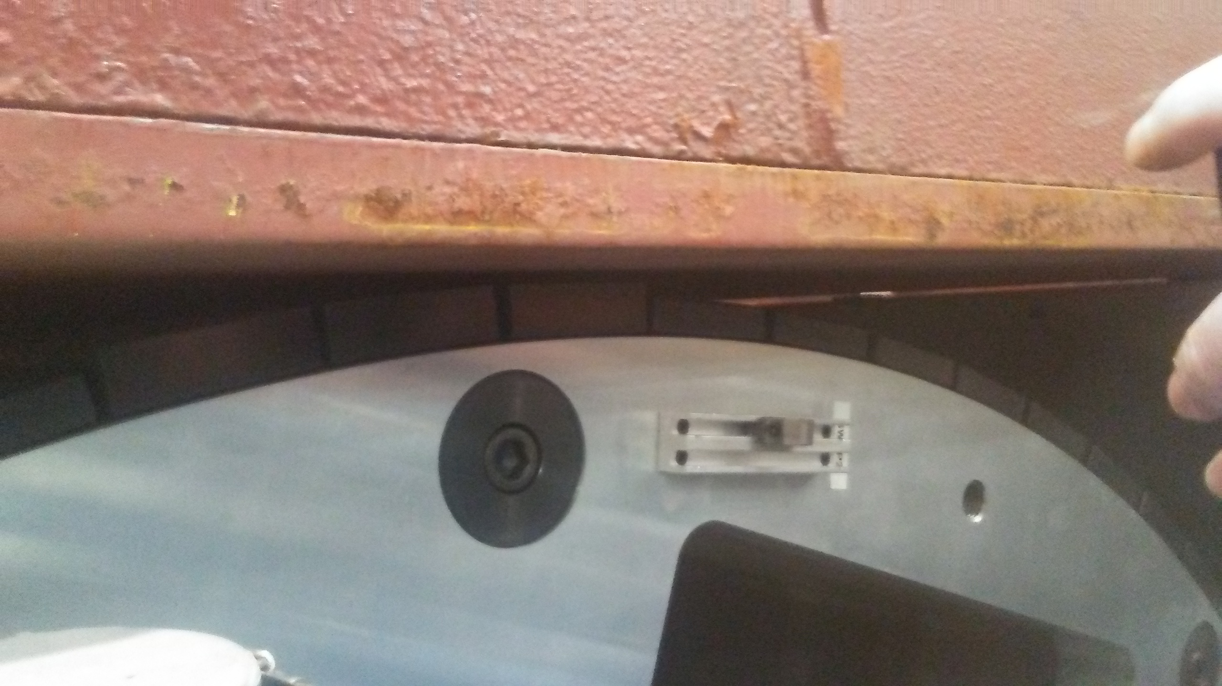
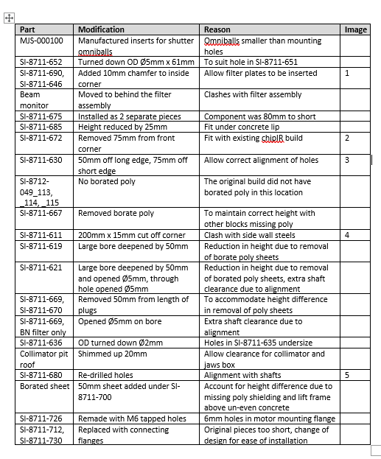
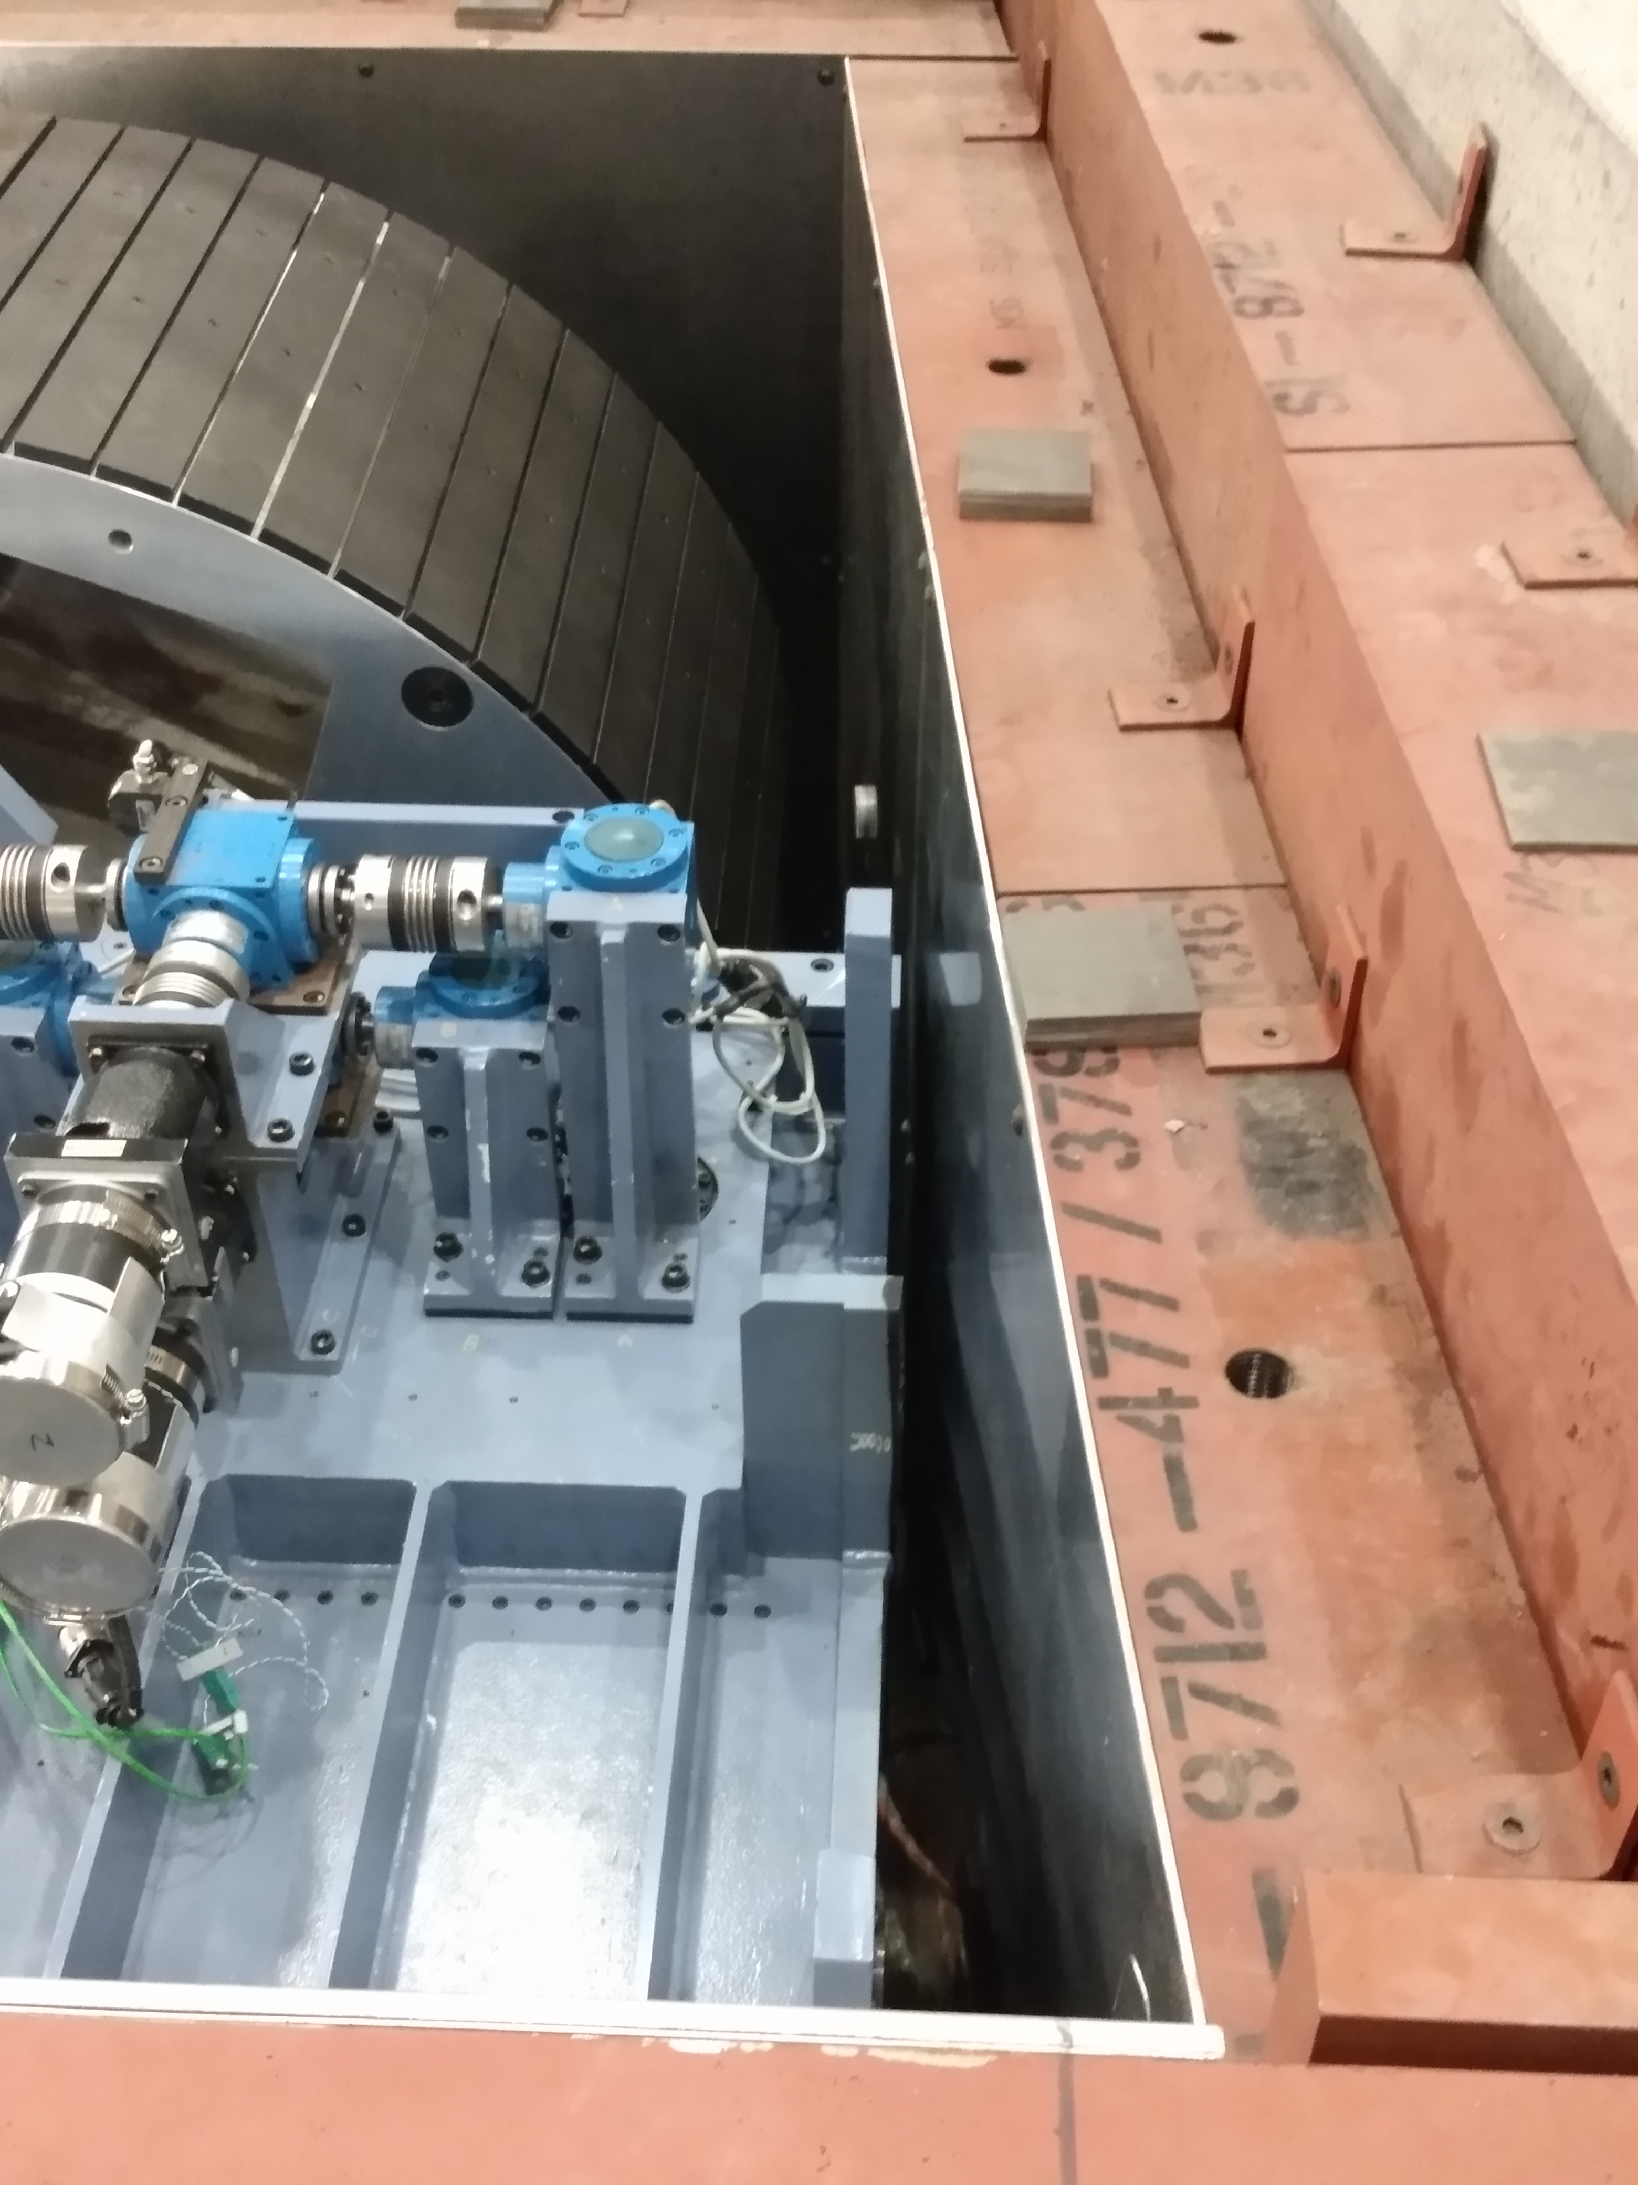
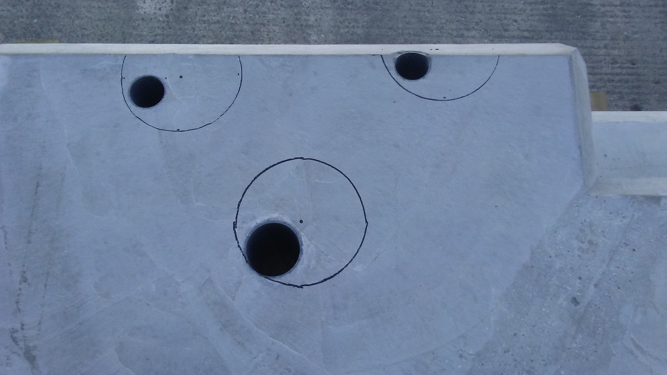
Finding solutions when things go wrong
Example CHIPIR Intermediate shutter and collimation project

Slide 10
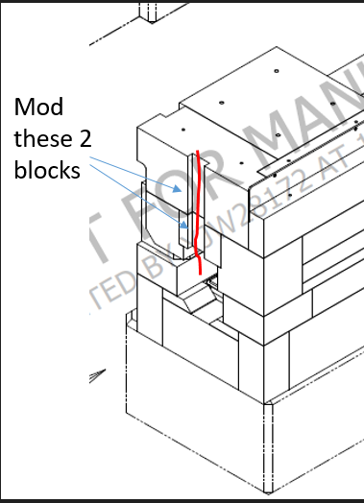
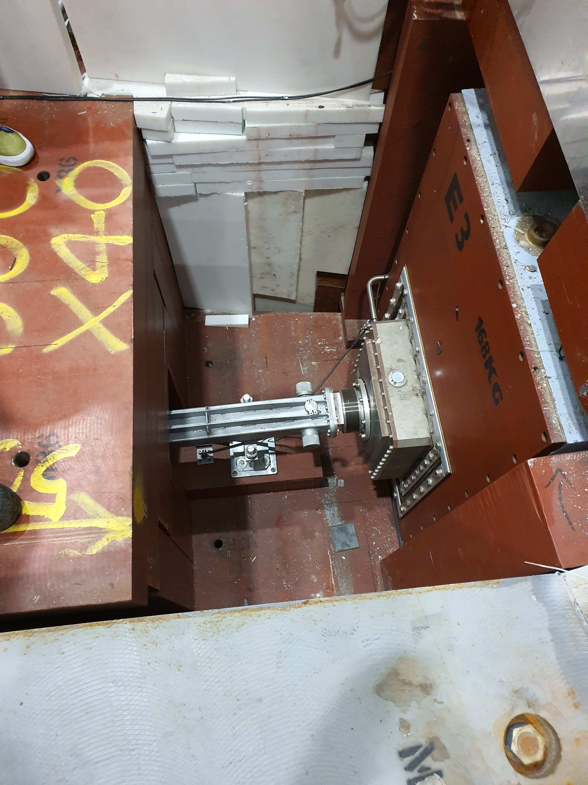
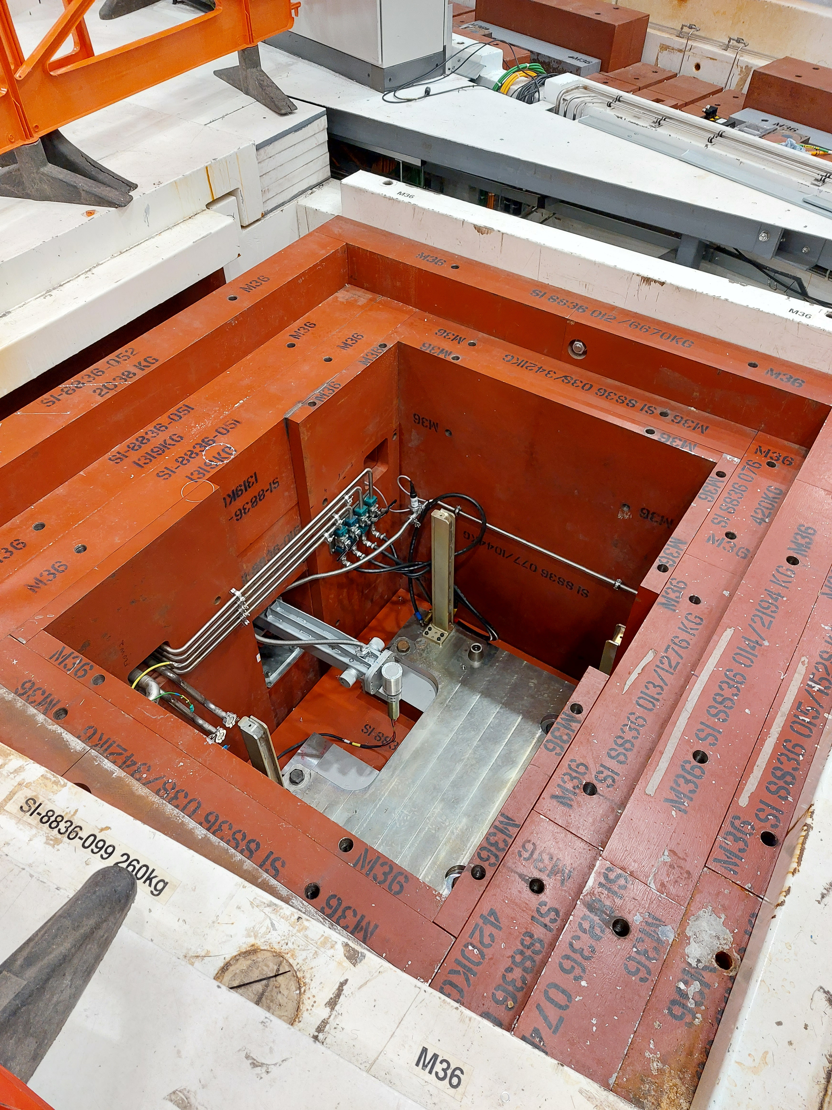
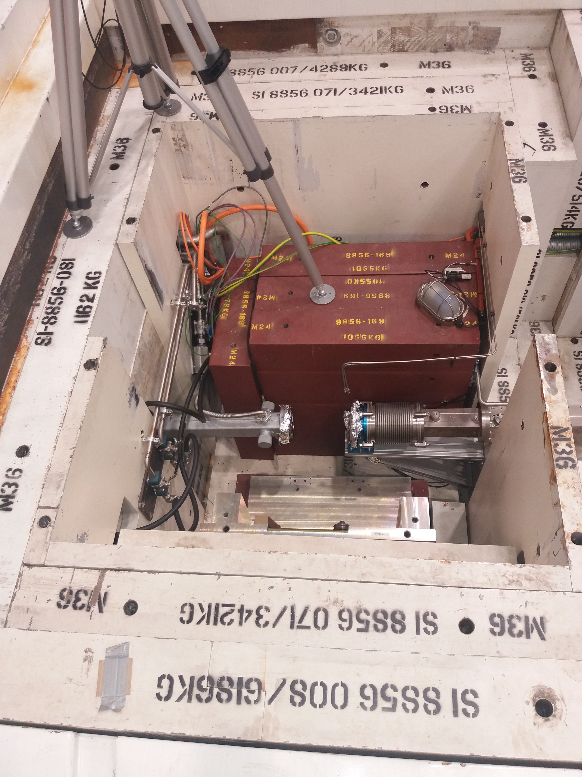
Things Change
All the planning in the world won’t prevent things changing……….
Here’s some examples ☺
Polref and Offspec guide re-alignment
Sandals shielding mods for additional vacuum services

Slide 11
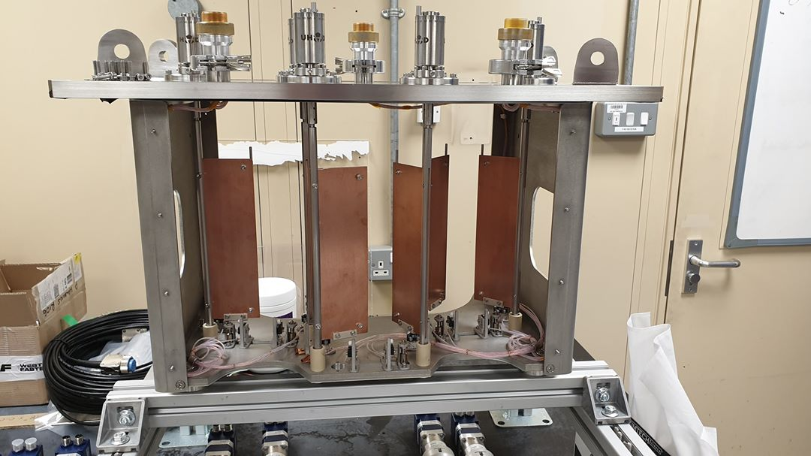
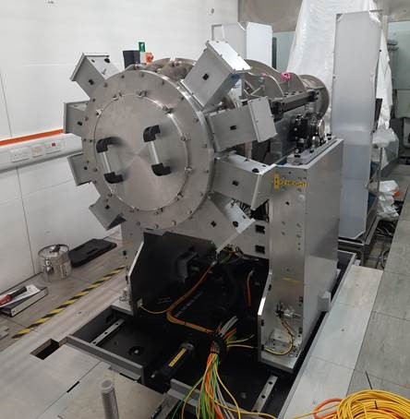
Continuous Improvement
The commitment to continuous improvement and optimal performance requires that we confront the imperfections that get in the way.
Be objective
Describe what happened in objective terms, and then focus on improvements.
Honest and open 360°feedback
Ask for openness
Negative criticism is something positive – it means the beginning of something better
It is normal to be averse to it
Whether averse to it or not, it is necessary for positive change
Documentation for the Future
Document both success and failure
Record methodology
Make recommendations
Feed your findings into future projects
Technical information
CONTINUOUS IMPROVEMENT
Focus on the future
The aim is be better in the future not to assign blame for the past!

Slide 12
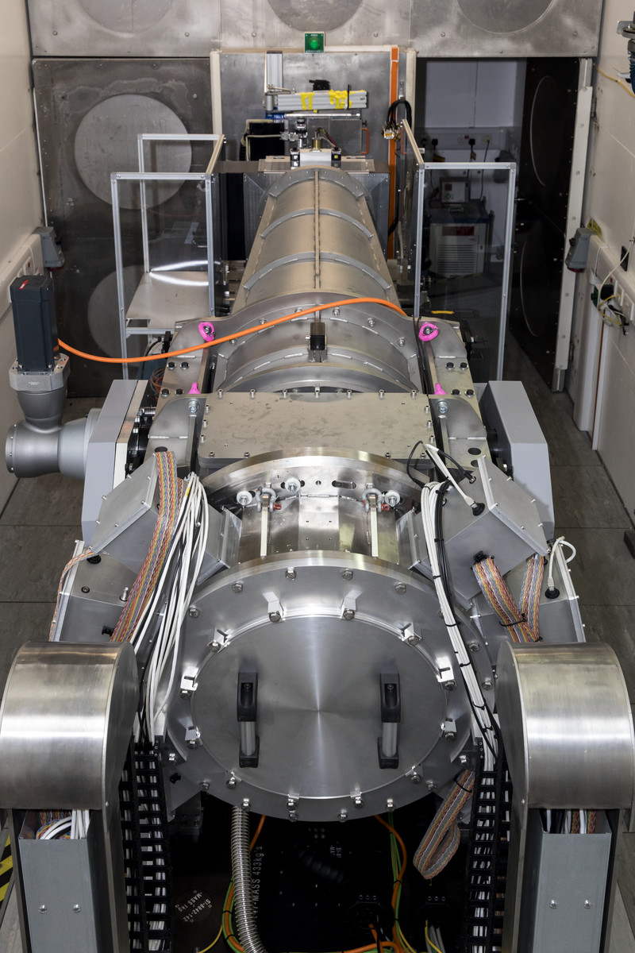
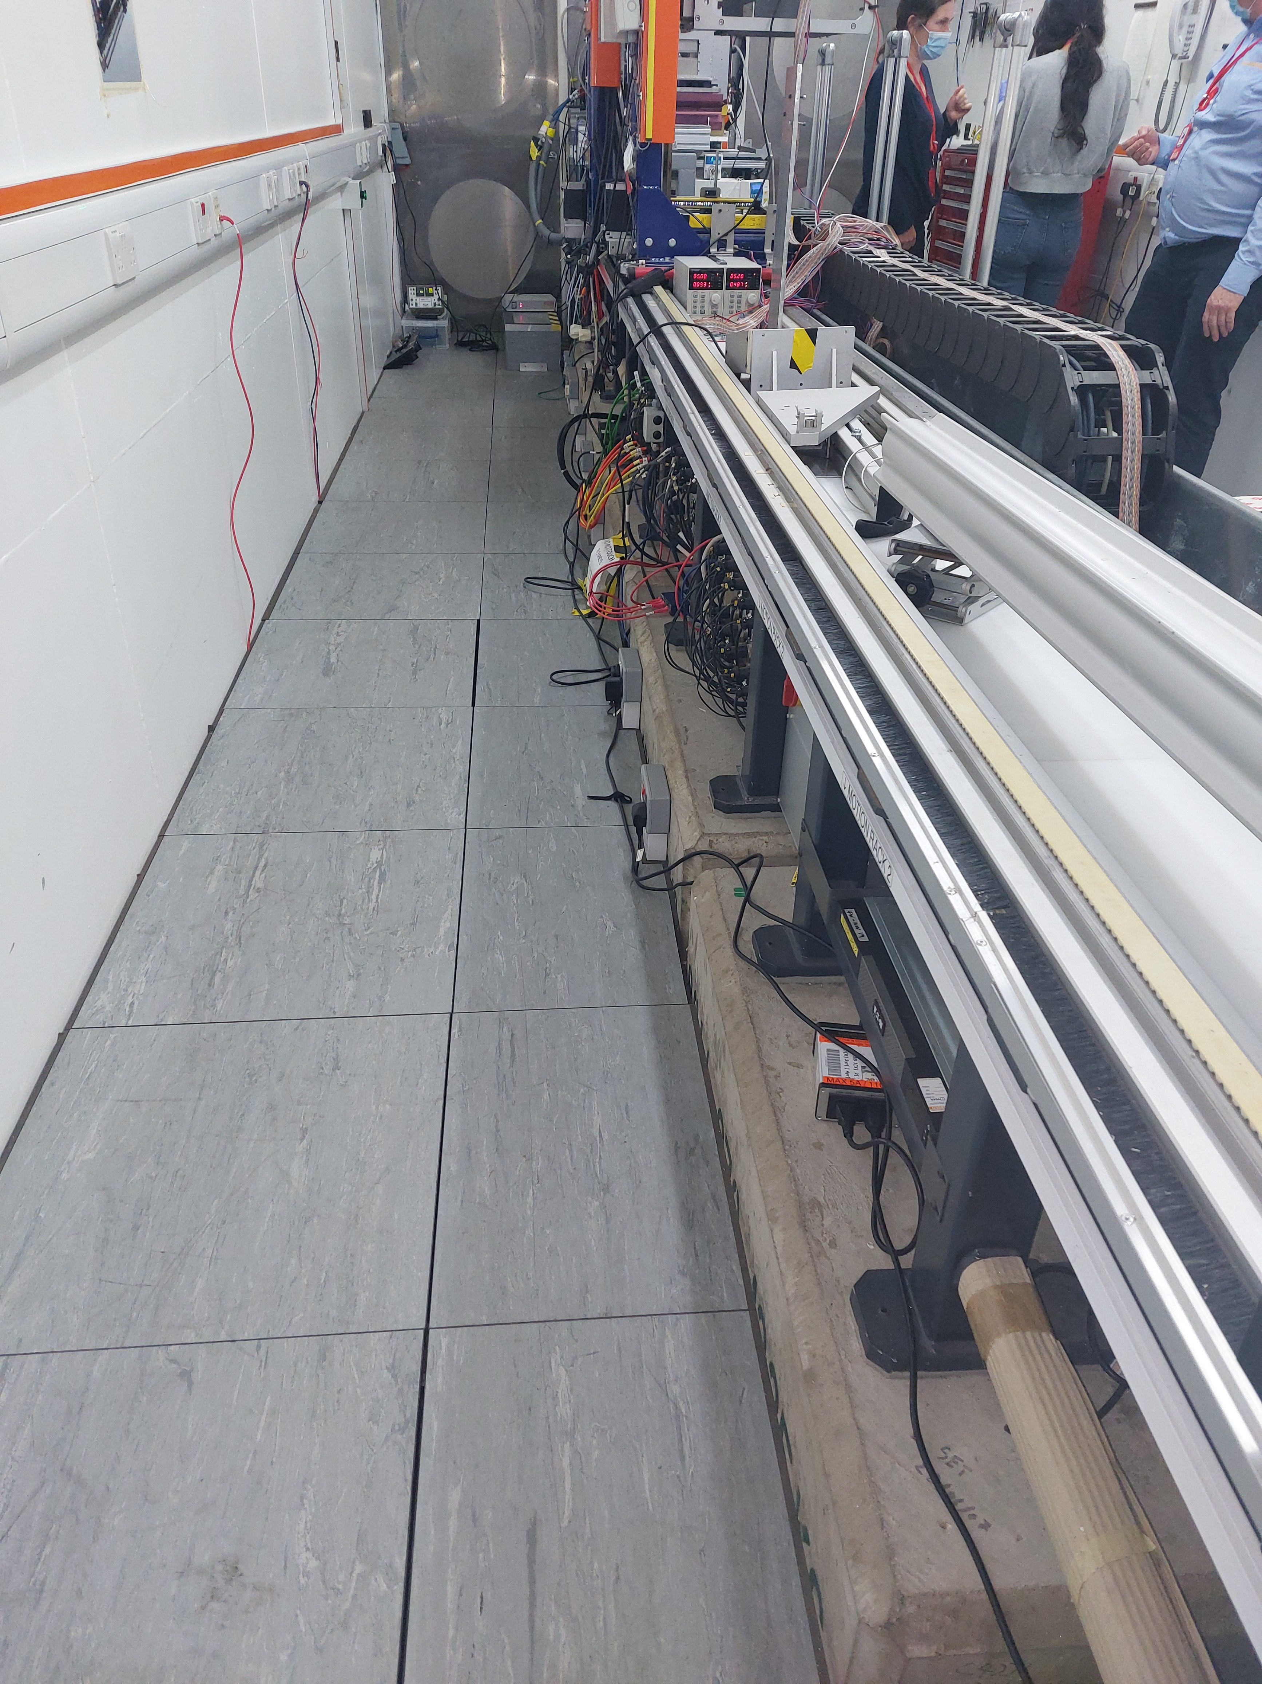
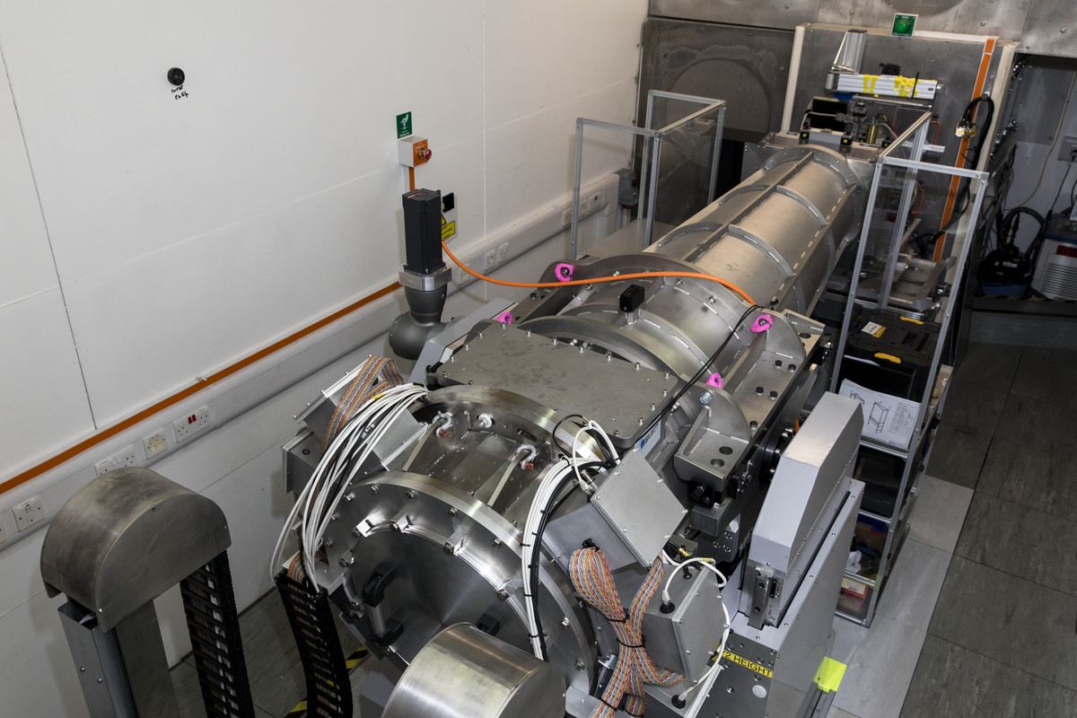
Handover to Instrument Scientists
Safety for Operations
Safety tours and actions
Safety system commissioning
Is the upgrade built as designed?
Motion control safety and commissioning
Complete any safety actions
Agree a radiation survey plan
Key stakeholder sign off – at ISIS we call this OPI

Slide 13
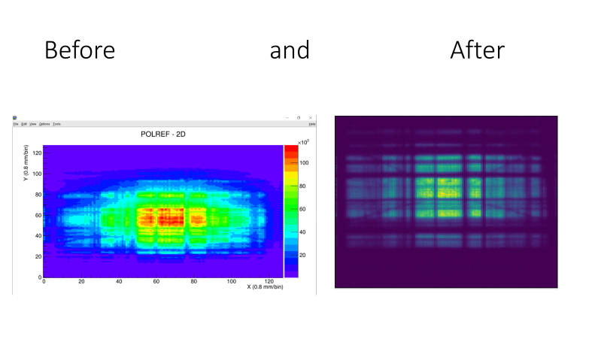
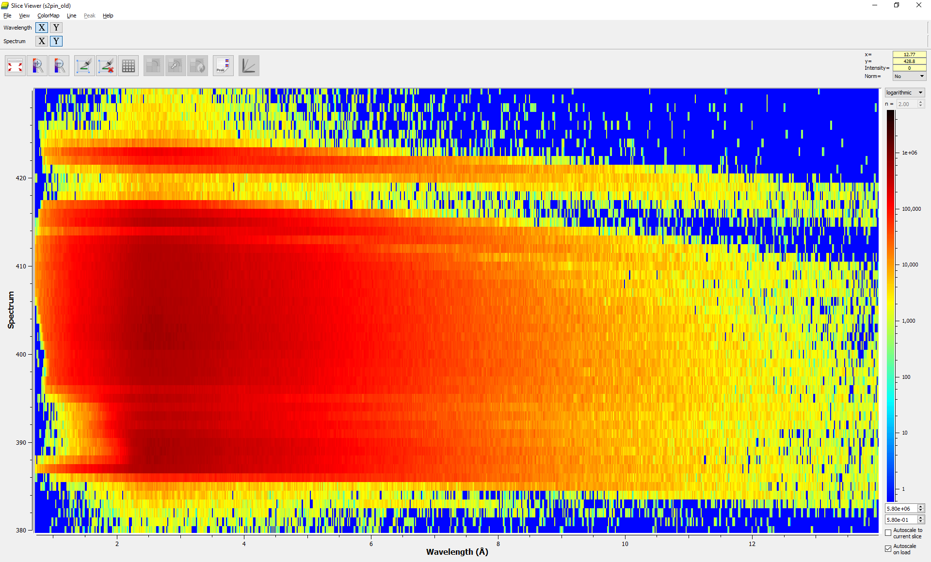
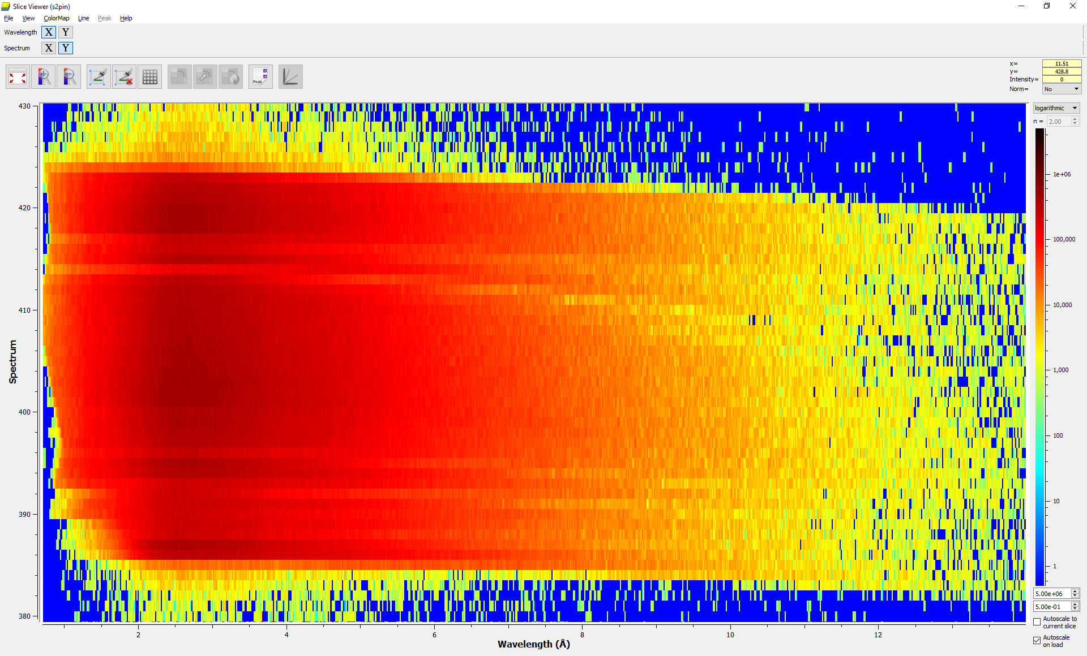
Upgrade Commissioning
OFFSPEC
POLREF
Before
After

Slide 14

Maintenance and Future Operation
Create the Instrument technical file
This will future proof the Instrument Operation and performance. It should contain;
Overview of the Instrument and upgrade
Technical drawings and CAD models (location of and reference numbers)
Neutron transport systems – Shutter, collimation, guide etc.
Defining Components – Jaws, monitors, choppers.
Shielding – Materials, interlocks
Services
Equipment lifecycle – Assembly, manufacture and testing
Installation and commissioning
Maintenance of all systems
Safety systems
Radiation survey results
Spares strategy

Slide 15


Thank you for listening, time for questions!
Notes:
The abstract pattern can be removed or repositioned if required. Be careful to ‘Send to Back’ so that it does not obscure any important information.

