Slide 1
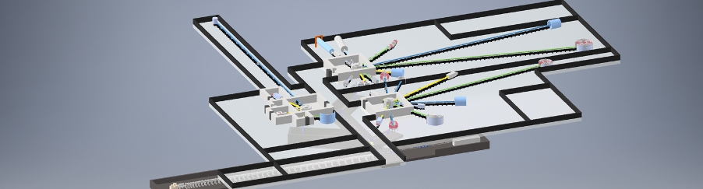
An Instrumentation suite for the HBS
UCANS 10, Budapest
Okt 16, 2023 I Jörg Voigt
Notes:
Alle Vorträge mit derselben Titelfolie; Nur der Untertitel (also Volume 1, 2, 3, 4) und Namen der AutorInnen wird geändert

Slide 2
HBS project
Published summer 2023, https://hbs.fz-juelich.de/
Notes:
2

Slide 3
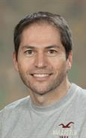
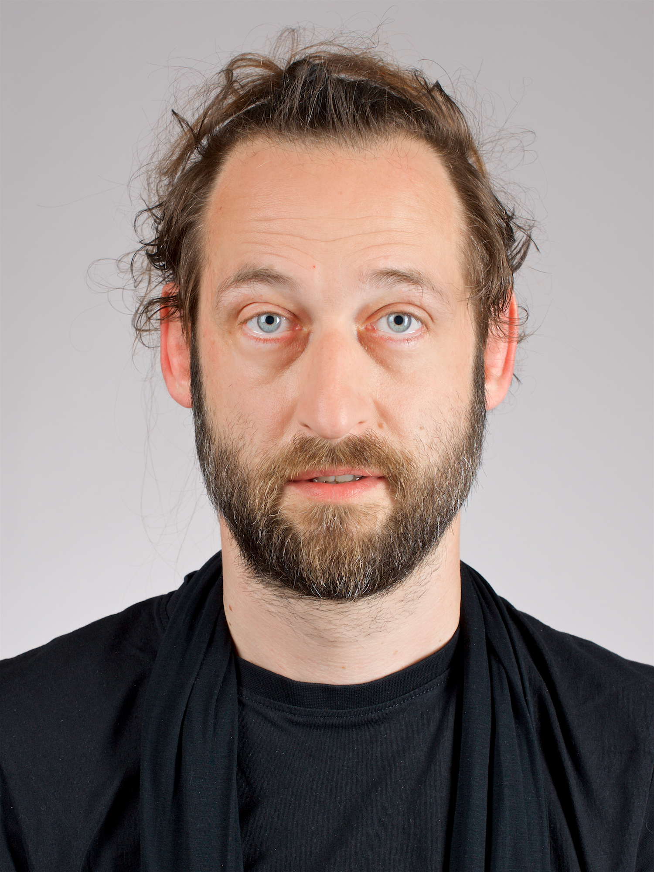
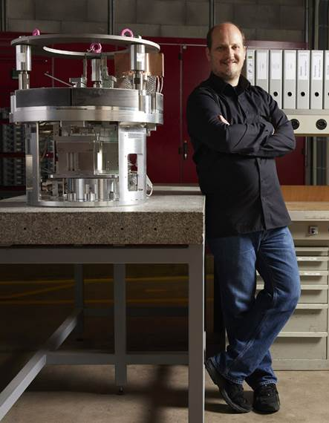


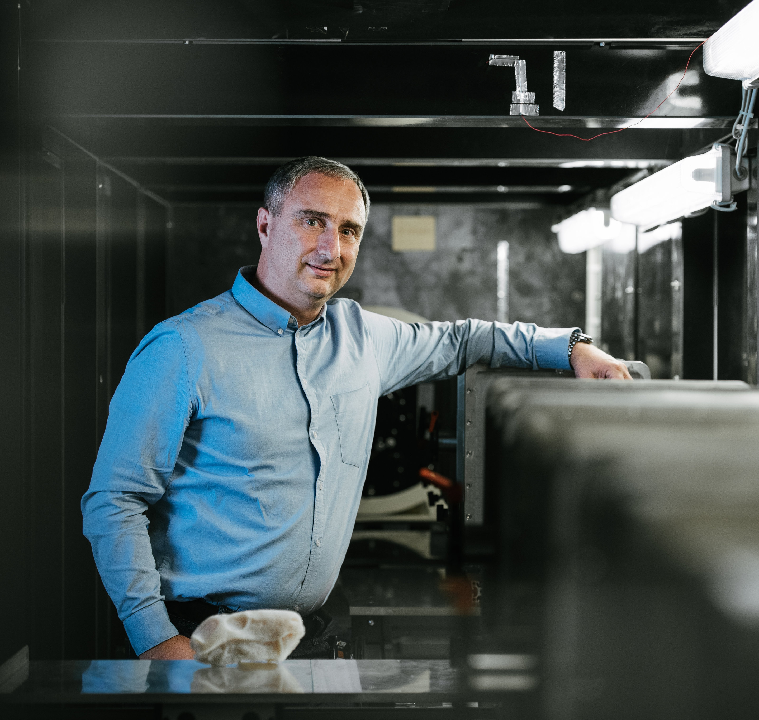

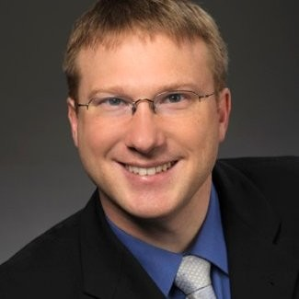
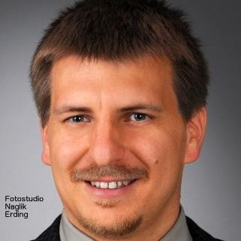
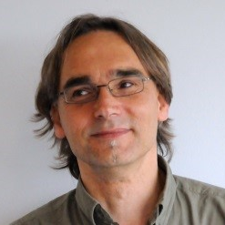
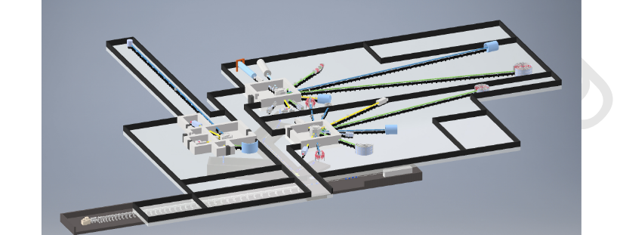

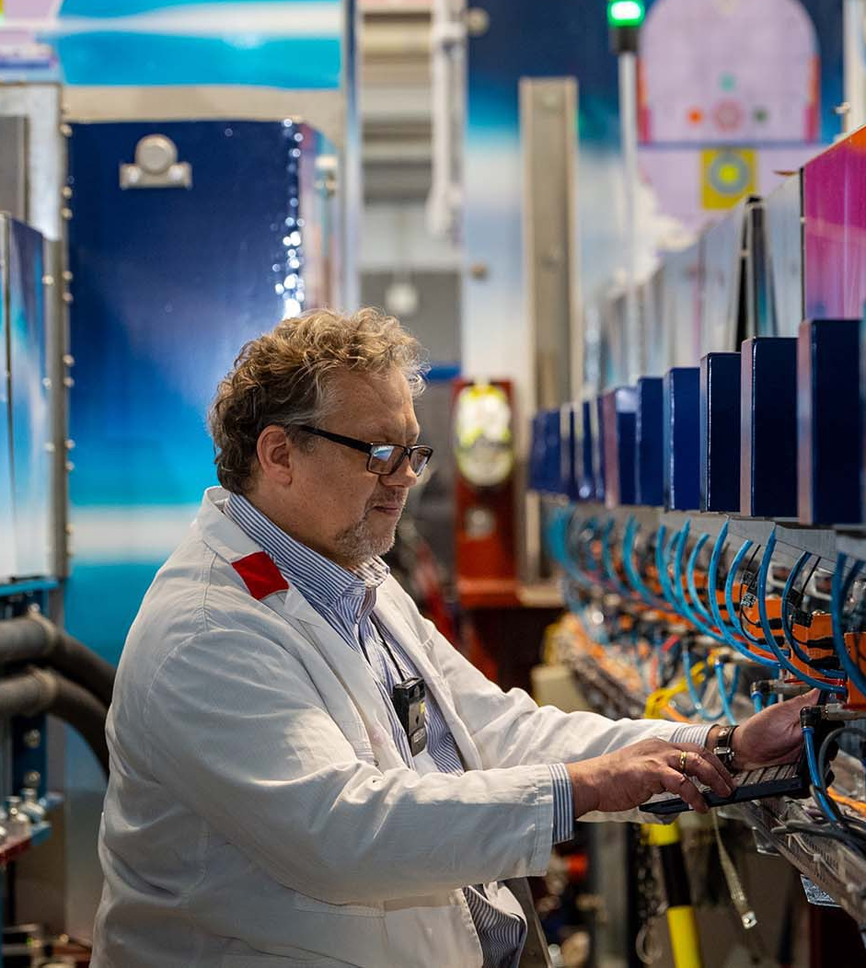
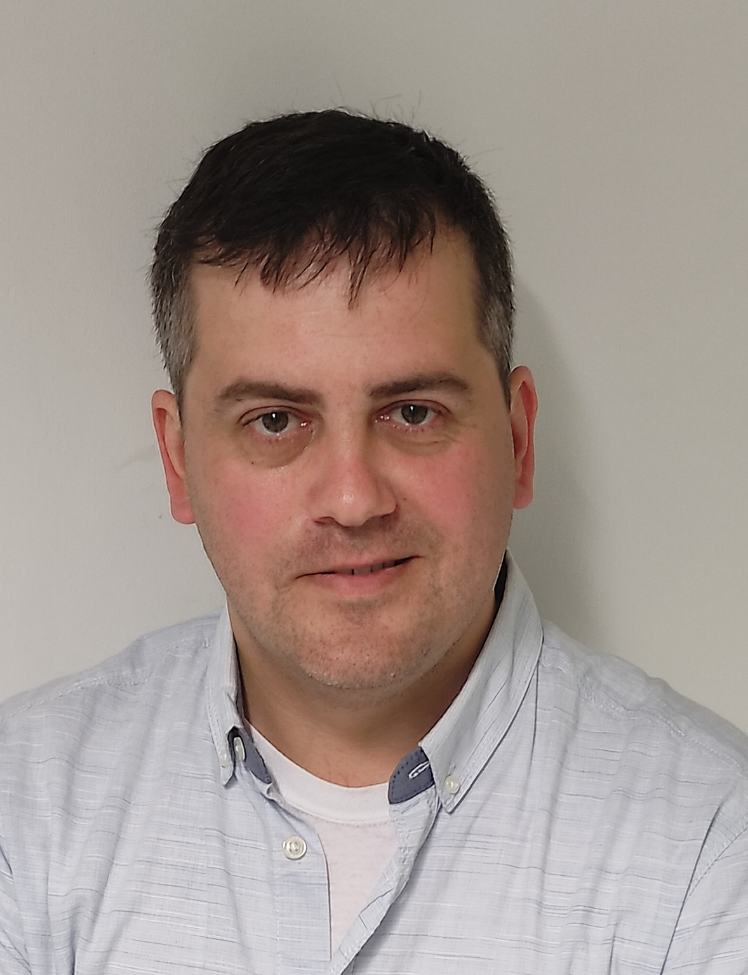
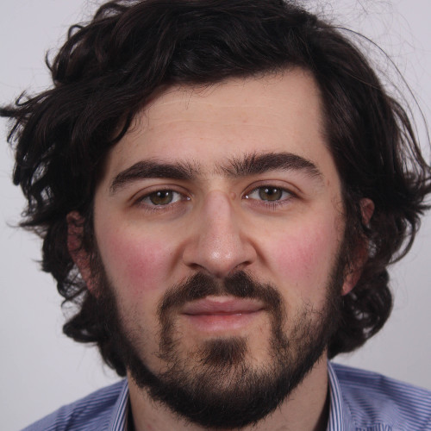
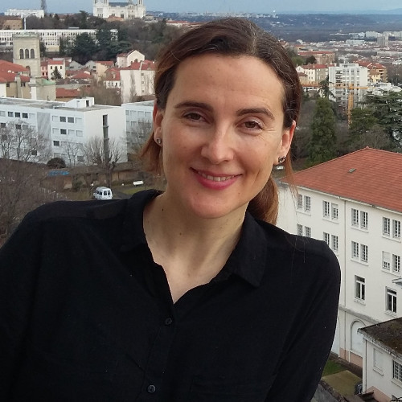
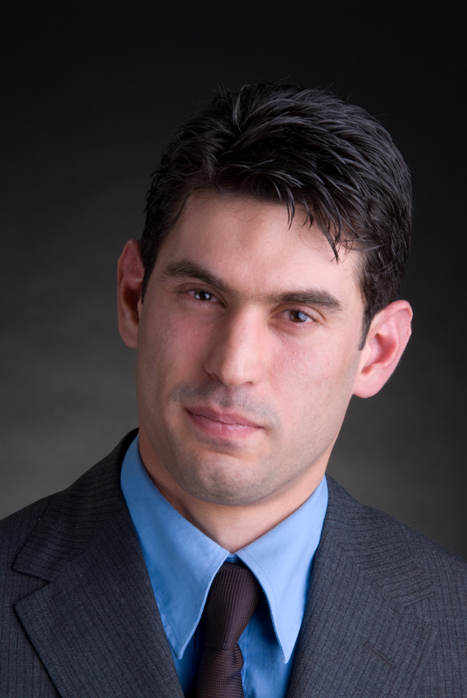
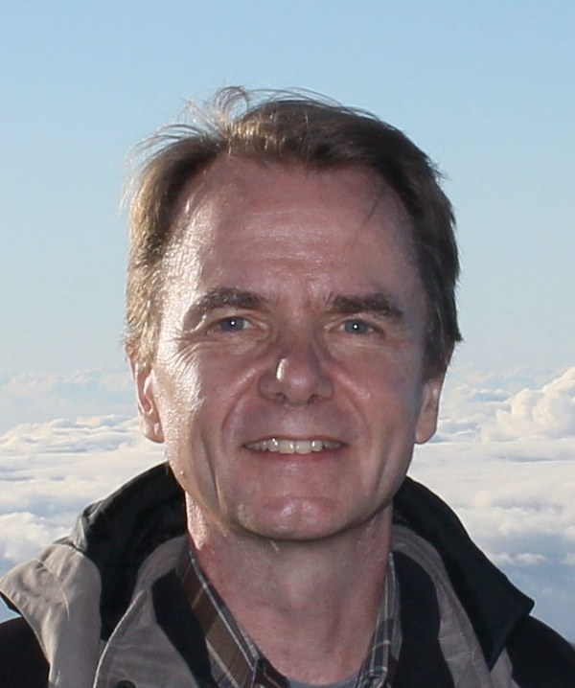
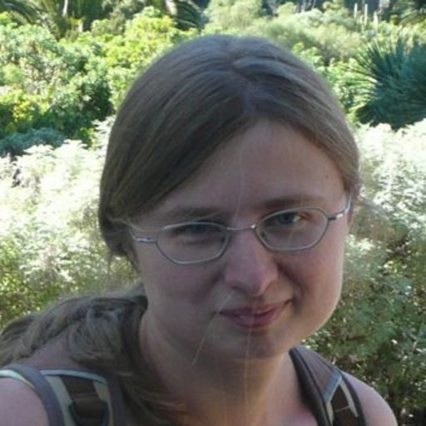
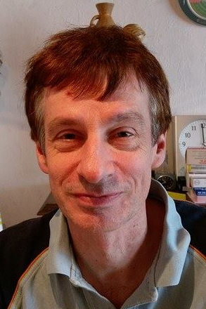
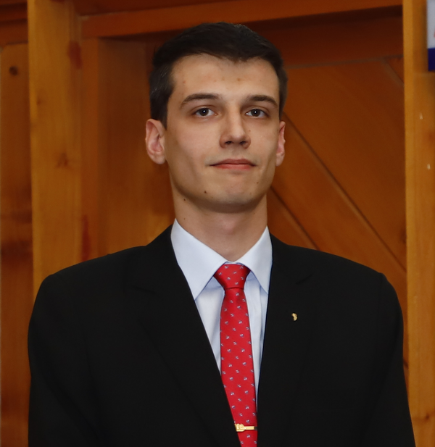
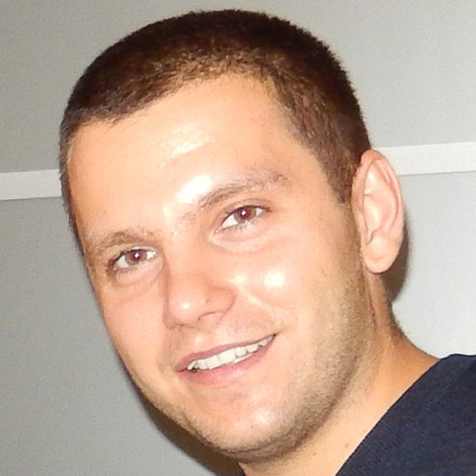
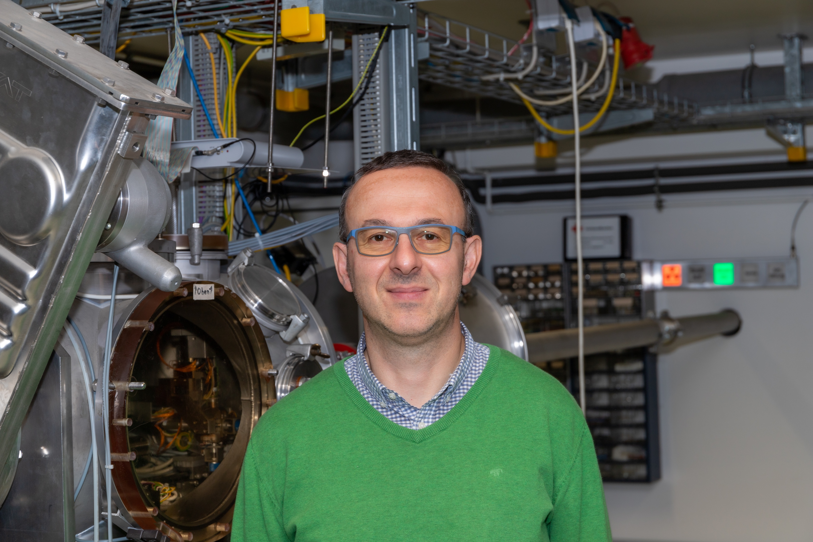
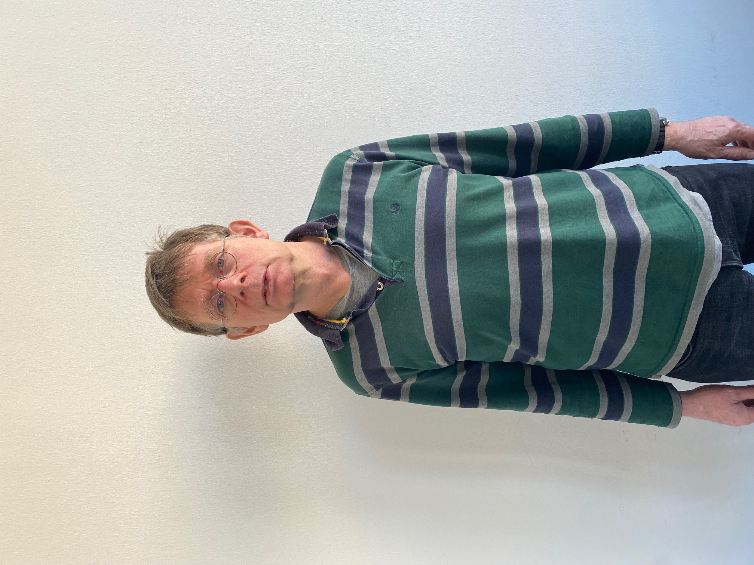
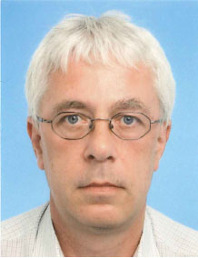

Slide 4











Accelerator Based Neutron Sources
From CANS* to HiCANS**
(*Compact Accelerator based Neutron Source , ** High-Current Accelerator based Neutron Source)
0.01 kW | 0.1 kW | 1 kW | 10 kW | 100 kW
0.001-0.01 mA | 0.01-1 mA | 0.5-5 mA | 1-20 mA | 50-100 mA
~10¹¹ n/s | ~10¹² n/s | ~10¹³ n/s | ~10¹⁴ n/s | ~10¹⁵ n/s
10 Mio EUR 500 Mio EUR
Running CANS facilities:
LENS, Indiana University (USA)
HUNS, Hokaido University (Japan)
RANS, RIKEN (Japan)
NUANS, Nagoya University (Japan)
CPHS, Tsinghua University (China)
IREN, JINR Dubna (Russia)
HiCANS projects:
HBS, JCNS (Germany)
SONATE, CEA LLB (France)
ARGITU, ESS Bilbao (Spain)
LENOS, INFN LNL (Italy)
SARAF, SOREQ (Israel)

Slide 5
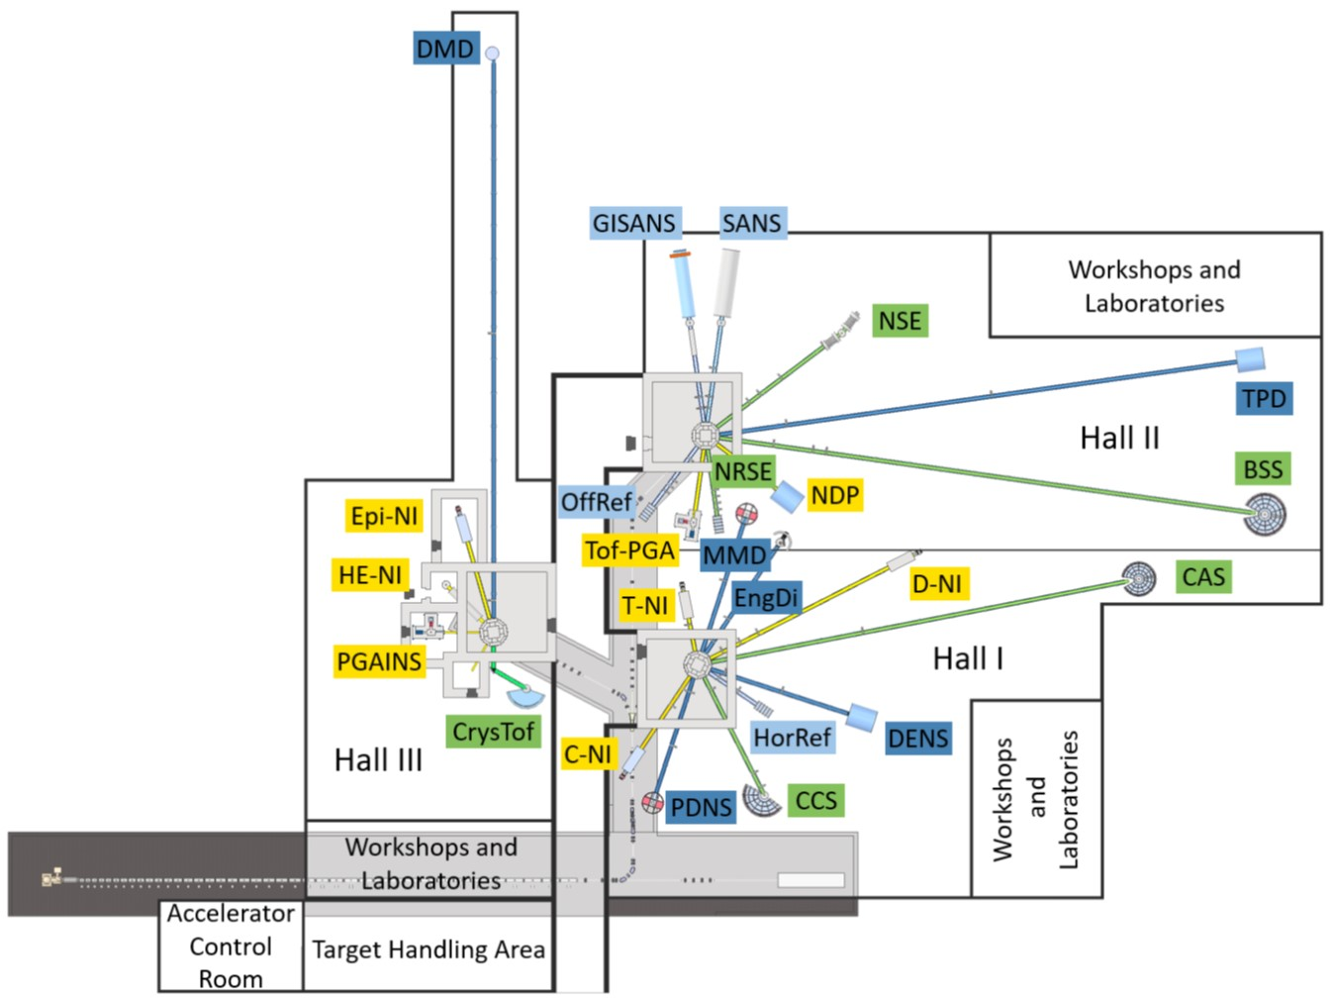
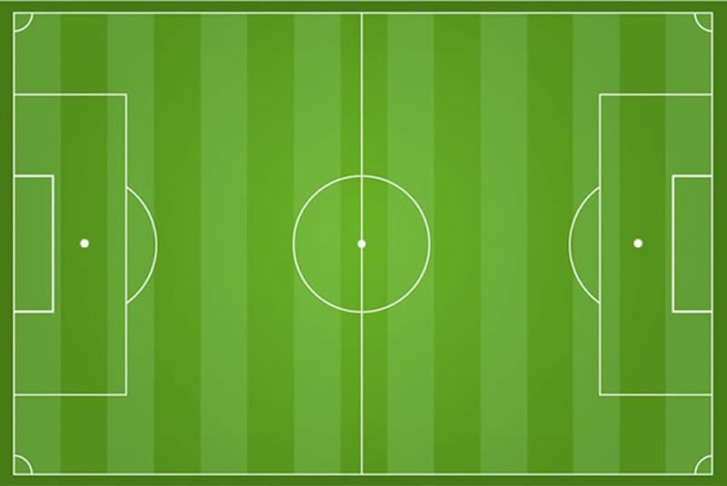
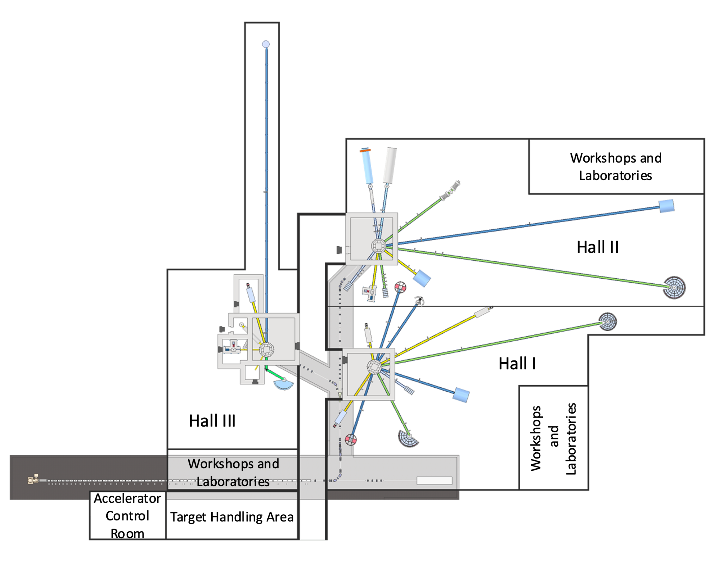
Optimization from Source to detector
HBS: A High Current Accelerator-driven Neutron Source (HiCANS)
Optimal pulse length
Medium pulse→ good resolution w/o chopper
Optimal frequency
Pulse pattern for novel high energy applications
Optimal spectrum
Fast and resonance neutrons
Low frequency→ wide band & pulse shaping
High frequency→ Narrow band
→ ideal secondary time frame
Cold neutrons deep from para lH₂
Long pulse→ low resolution & pulse shaping
Thermal neutrons
Notes:
Multi target facility: Uncompromised properties for specific application
Weak source strength: Adapt, exchange or add target station with reasonable effort

Slide 6
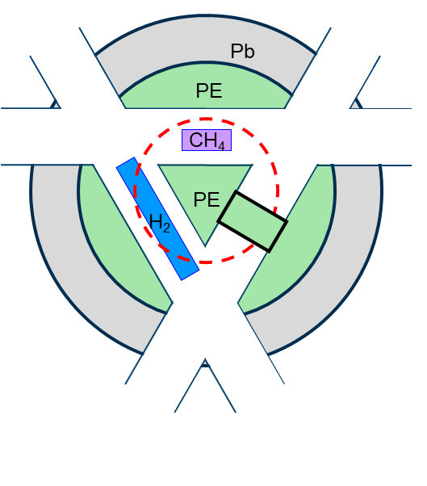
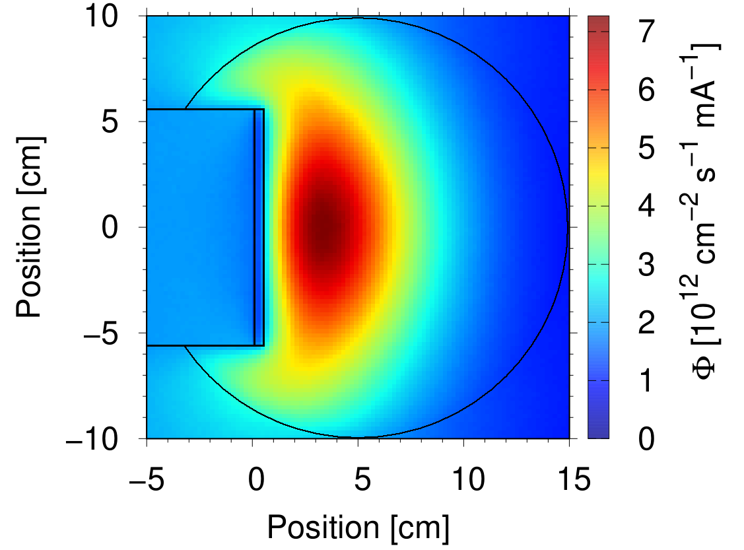
Still compact: The target-moderator-reflector unit
Target-Moderator-Reflector Unit
Thermal neutron cloud in PE moderator
Confinement is crucial
Top view
Side view
Reflector
Target
Ta
Moderators
Compact TMR design + high current accelerator:
Efficient coupling of neutron production and moderation
Confined thermal neutron cloud
High neutron thermal peak flux
Good coupling of cryogenic moderators
→ High Brilliance
6/37
Notes:
Wedge shaped target within moderator
Cold “finger moderator”
Direct coupled neutron optics

Slide 7
Different pulses for different applications
96 Hz 24 Hz
1.6%
τ_{proton} : 167 µs
τ_{neutron}: 252 µs
τ_{proton} : 667 µs
τ_{neutron}: 665 µs
Consequence:
An instrument of 4 times the length installed on the 24 Hz station has the same bandwidth and about 33% less wavelength uncertainty compared to one on the 96 Hz station
Sufficient ToF-resolution
Medium bandwidth
FOM: Mean Brightness / pulse width
Low ToF-resolution or pulse shaping
Broad bandwidth
FOM: Pulse Brightness

Slide 8
Moderator contribution to resolution vs. Bandwidth
Long pulse source
  Low resolution
  SANS & Reflectometry
  N(R )SE methods
  High resolution
  Pulse shaping instruments
Short(er) pulse source
  Modest resolution
  Single Xtal diffraction
  Diffuse scattering
  1 Å < ∆λ < 4 Å
  Focusing specific dynamic range

Slide 9
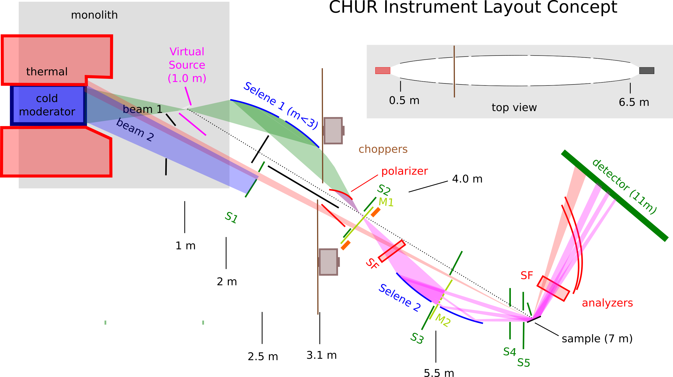
Multi Beam Reflectometer
From small samples to GISANS

Slide 10
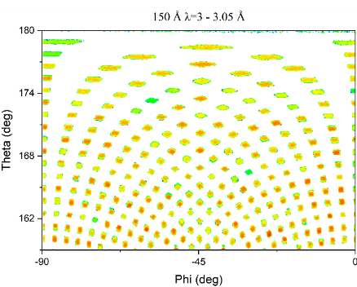
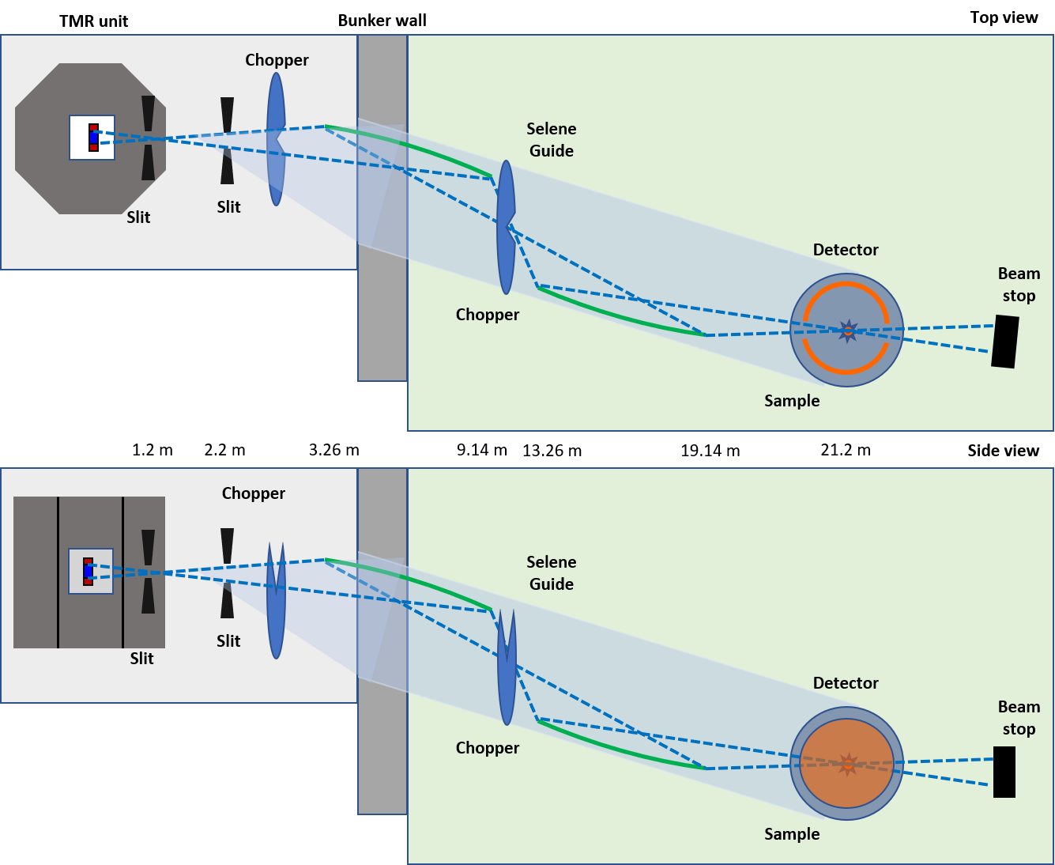
Instruments for tiny samples
Novel neutron optics to illuminate sub mm samples
Macro-molecular diffractometer
Perfect illumination of virtual source
E.g. 2 Å < λ < 4 Å, δλ = 0.05 Å
Flux ≈ MaNDI@SNS (relaxed ToF-resolution)
Notes:
Small samples → extract small beams
Needs a bright cold neutron source

Slide 11
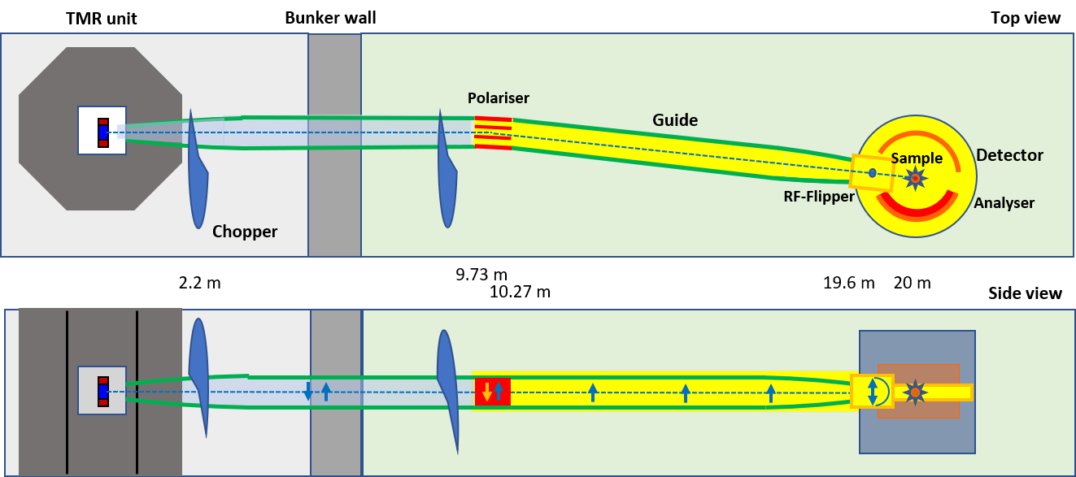
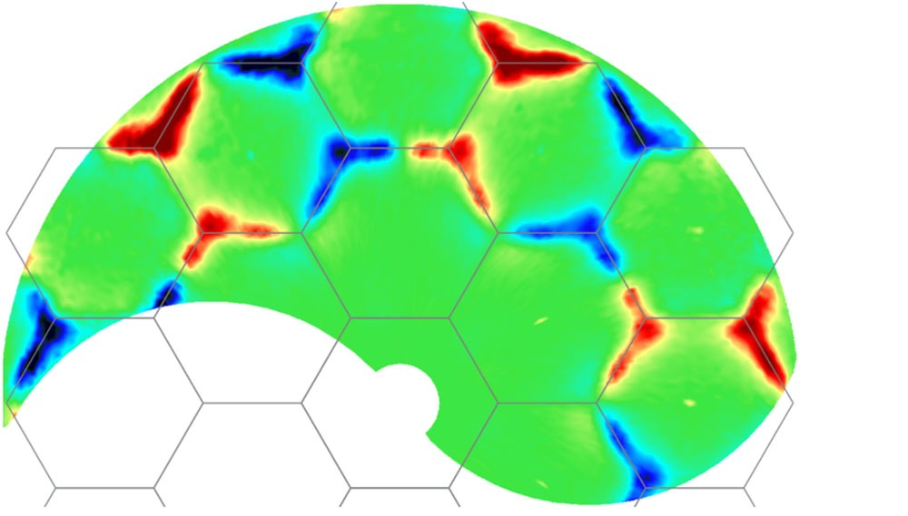
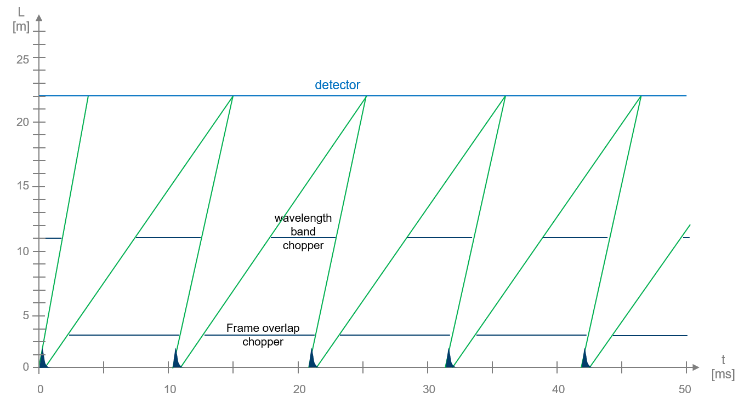
Polarized diffuse neutron scattering (PDNS)
  Diffuse (magnetic) scattering
  H₂ moderator
  96 Hz target station
  21 m length (moderator to detector)
  Polarization and avoidance of direct line of sight by mirror stack
  Detector range: 120° in 2° - 160°
  Bandwidth: 2.0 Å, standard: 2.0 – 4.0 Å
  Wavelength range: 2.0 – 6.0 Å
  Wavelength resolution: 1.2% – 2.4% (θ > 30°)
  Estimated flux (polarized): 5·10⁷ n/(cm²s)
W. Schweika et al.
PRX May 2022
Frustrated
Magnetism
DNS

Slide 12
Crystal analyzer spectrometer
Narrow bandwidth for focused view in reciprocal space
Skyrmion Excitations
Full pulse
∆λ = 0.7 Å
2º x 2º collimation
→ 10⁸ n/cm²/s
Weber et al. Science 375 (2022)
Crystal analyzer Spectrometers
  The TAS successor
  10⁸ n/cm²/s within Δλ = 0.7Å
Notes:
Indespensible tool to study order or disorder and excitation of spins
spectral range below 6 Å essential
natural bandwidth and resolution at high frequency target

Slide 13
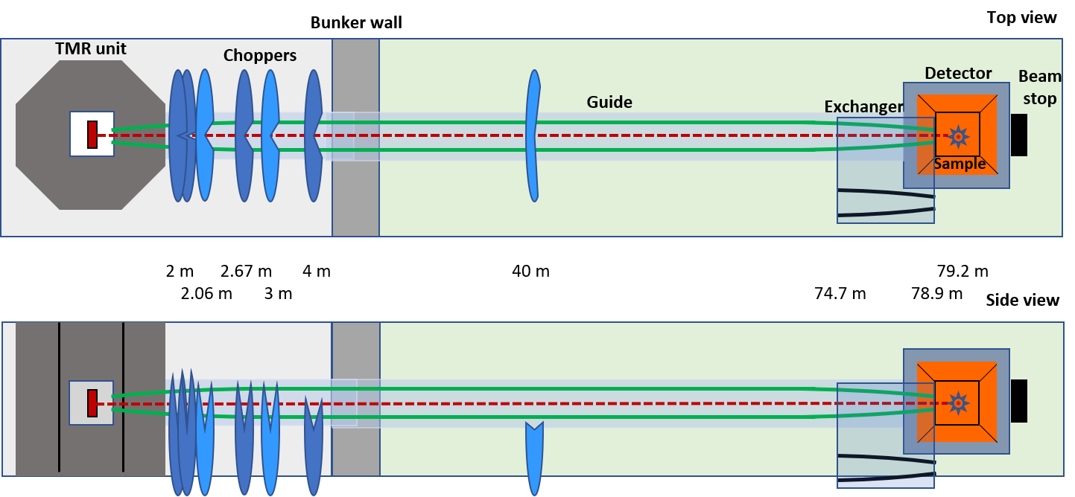
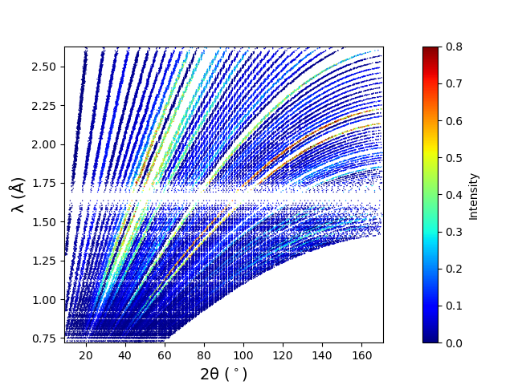
Thermal powder diffractometer (TPD)
Narrow λ resolution: Pulse shaping + wavelength frame multiplication (WFM)
  Powder diffraction on novel materials
  Thermal moderator
  Low frequency (24 Hz, 667 µs)
  80 m total length, 2 frames
  Detector range: 7° - 175°
  Bandwidth: 2.06 Å, standard: 0.62 – 2.68 Å
  d-range : 0.22 – 7.1 Å
  High-Resolution option (100 µs pulse)
    Resolution: 0.11 – 0.82% (θ>90°)
    Estimated sample flux: 5.5·10⁵ n/(cm²s)
  High-Intensity option (667 µs pulse)
    Resolution: 2.2 – 4.7% (θ>90°)
    Estimated flux at sample: 1.6·10⁸ n/(cm²s)

Slide 14
Crystof
Monochromator + Multiplexing → Flux ~ TOPAS @FRM2

Slide 15
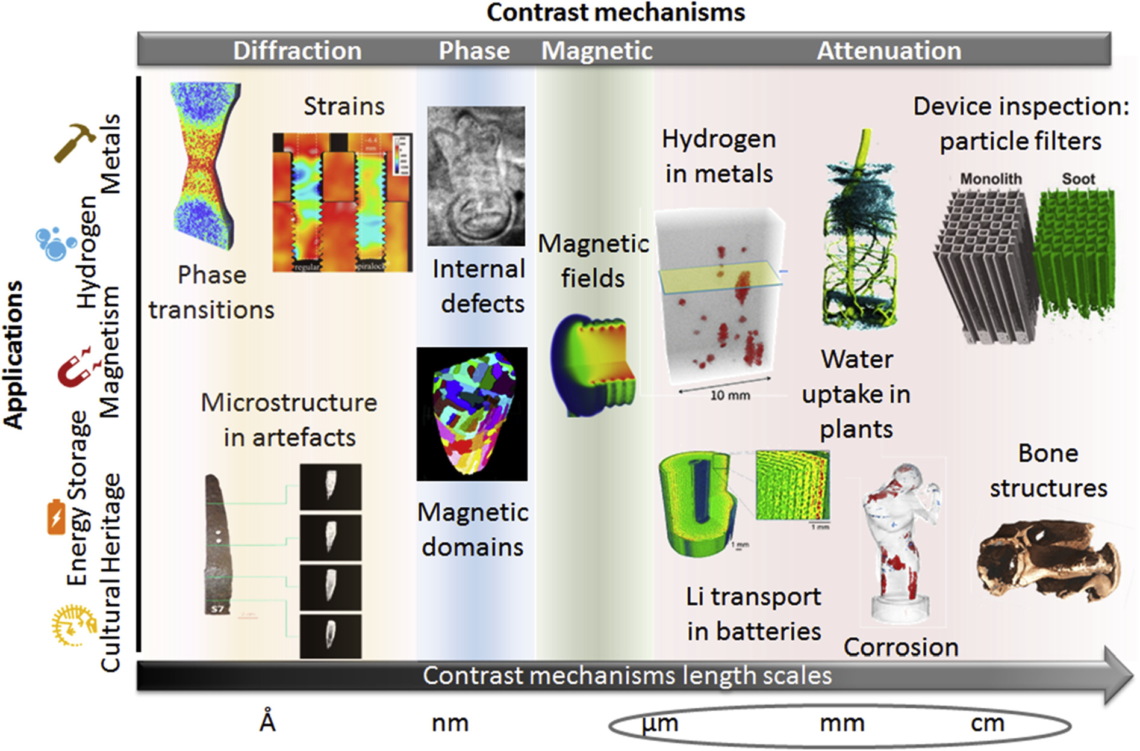
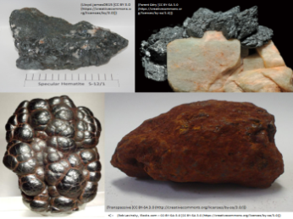
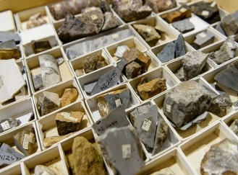
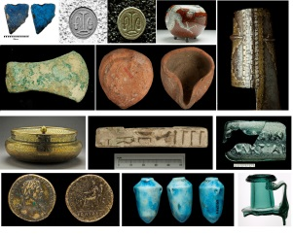
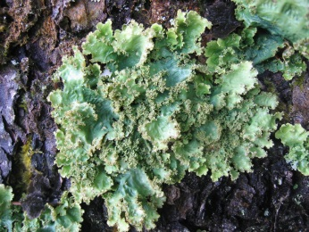
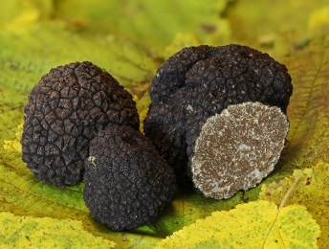

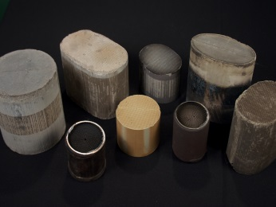
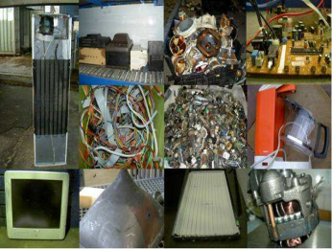
Neutron Imaging & Analytics
Environment
Energy materials
Geology
Hydrogen storage
Cultural heritage
Magnetic materials
Archeology
Car, aviation,
building industry
Paleontology
N. Kardjilov et al., Materials today 21, 652 ff (2018)
Notes:
Emerging field of applications
Potential to raise new users from industry and arts
Explore specimen deep below the surface non-destructively

Slide 16
Neutron imaging and Analytics
ToF-PGNAA (1 meV - 100 eV)
Target station 24 Hz
ToF analysis adds information about element distribution
PGAINS (10 keV - 10MeV)
Target station Epi
Cold NI
Bragg-edge imaging
Dark-field imaging
Polarized neutron imaging
Thermal NI
Bragg-edge imaging
Dark-field imaging
Polarized neutron imaging Real-time radioscopy
Resonance NI
Special pulse pattern for Tof analysis
Fast NI
Large and dense objects
Notes:
Exploit full range of the neutron spectrum
Use the tof analysis to extract more information

Slide 17
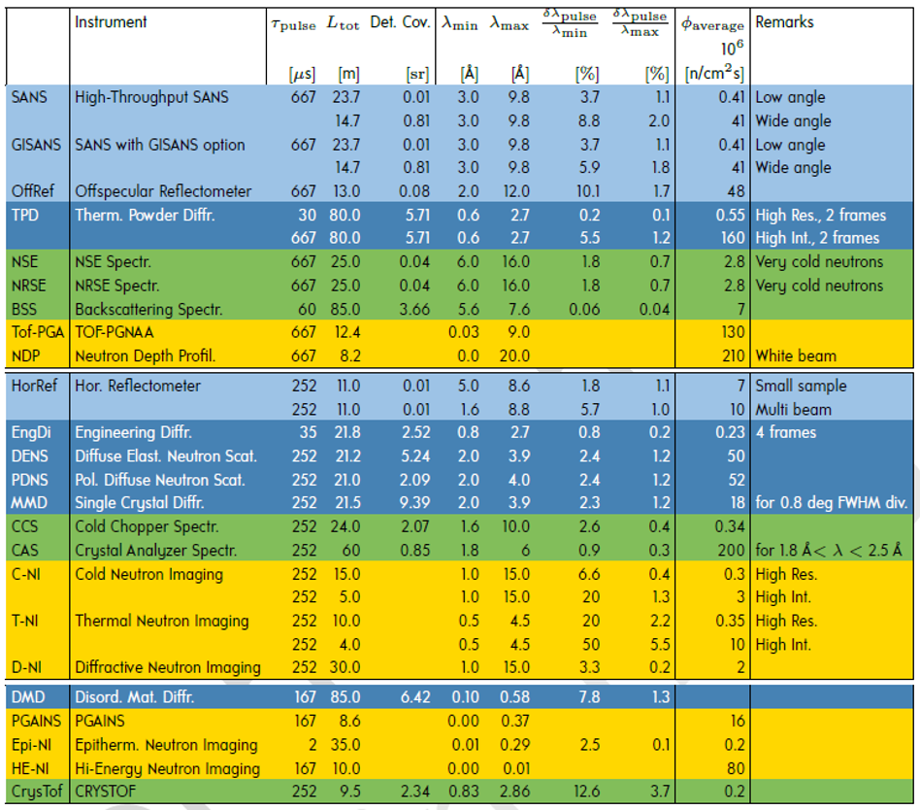
Large structure Instruments
Diffractometers
Spectrometers
Imaging and Analytics

Slide 18

Conclusion
HBS can cover the full range of neutron scattering applications
Excellent performance of dedicated instruments
Intense small beams
Low Background
ToF enhanced imaging and analytics instruments
New opportunities for science, industry and arts
Flexibility: Lean design to adapt to new challenges and develop new ideas

Slide 19
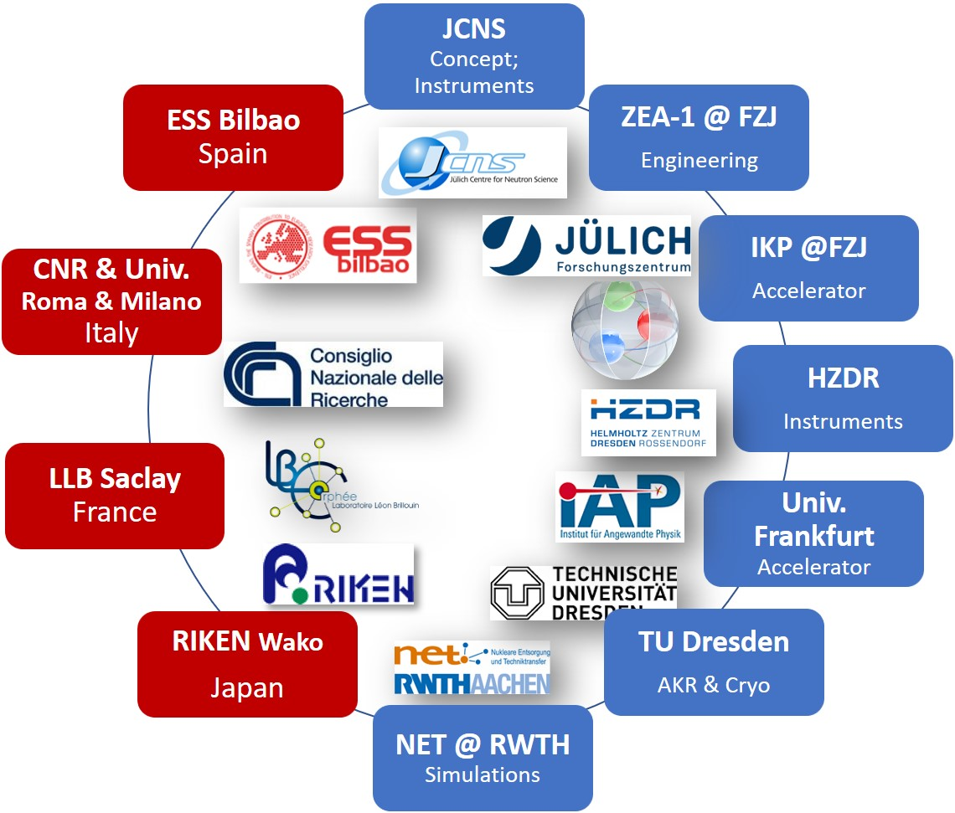



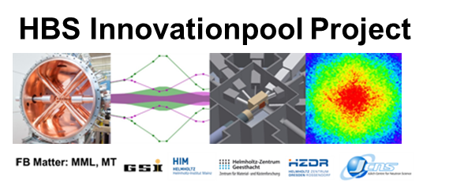



HBS Team
J. Baggemann
Th. Brückel
T. Claudio-Weber
T. Cronert (†)
Q. Ding
P.-E. Doege
T. Gutberlet
J. Li
K. Lieutenant
Z. Ma
E. Mauerhofer
N. Ophoven
U. Rücker
N. Schmidt
A. Schwab
E. Vezhlev
J. Voigt
P. Zakalek
- Core group:
design, verification,
instrumentation
ZEA-1:
Y. Bessler
R. Hanslik
R. Achten
F. Löchte
M. Strothmann
- Engineering
IKP-4:
O. Felden
R. Gebel
A. Lehrach
M. Rimmler
R. Similon
- Nuclear physics
INM-5:
B. Neumaier
- Radio isotopes
S. Böhm
J.P. Dabruck
R. Nabbi
- Nuclear simul.
C. Lange
T. Langnickel
Ch.Haberstroh
M. Klaus
S. Eisenhut
- AKR-2, liquid H₂
H. Podlech
O. Meusel
- Accelerator
W. Barth
- Accelerator
/ HIM
Notes:
19

Slide 20


Accelerator system
From compact to large scale facility
CANS (RANS):
Hi-CANS (HBS):
Average power: 700 W
Energy: 7 MeV
Peak current: 0.1 mA
Particle Type: Proton
Length: < 10 m
Average power: 3 x 100 kW
Energy: 70 MeV
Peak current: 100 mA
Particle Type: Proton
Length: 70 m

Slide 21
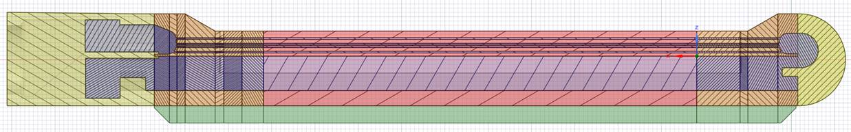
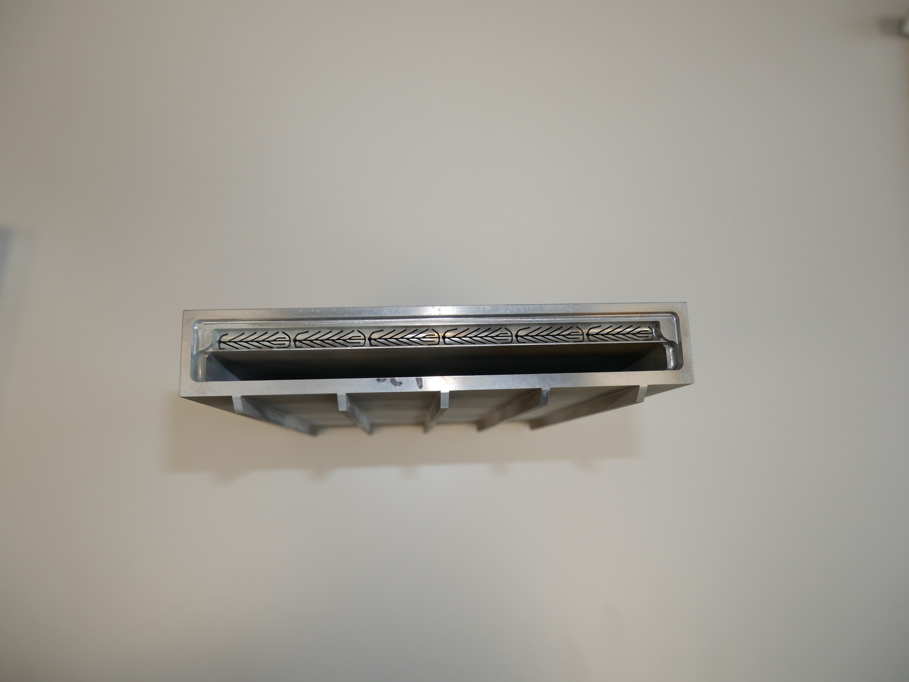

Still compact: The target
70 MeV Protons
Neutron production
Irradiation area
High neutron yield
High blistering threshold
Compact design allowing efficient feeding of moderators
Save operation at 100 kW
at 100 cm² (1kW/cm²)
Water coolant
Reliable
Neutron yield of 10¹⁵ n/s
Coolant
inlet
10 x 10 cm²
outlet
0.35 mm microchannels
Water beamstop
< 2 cm
Tantalum target with microchannel design

Slide 22
Low Resolution, very wide Band
SANS, Reflectometry and Spin Echo spectrometers

Slide 23
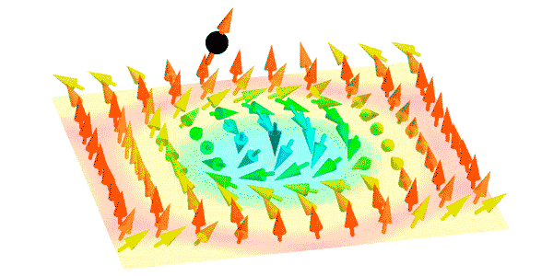
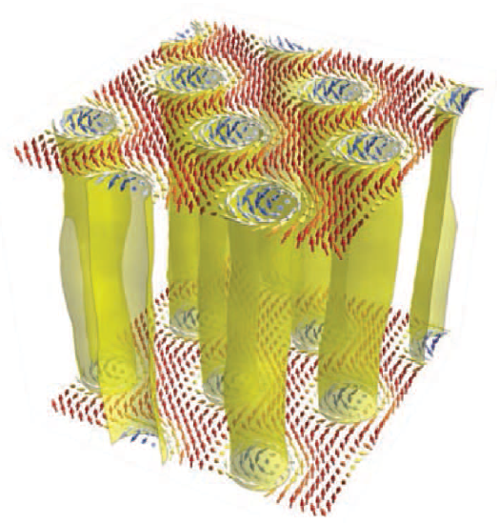











SANS Suite to cover nm to µm STructures
C
C
1Å
10Å
100Å
1000Å
1µ m
10µ m
Q
1Å⁻¹
0.1Å⁻¹
0.01Å⁻¹
0.001Å⁻¹
10⁻⁴Å⁻¹
10⁻⁵Å⁻¹
SANS
VSANS
SESANS

Slide 24
Modest resolution, wide Band

Slide 25

Instruments for tiny samples
Novel neutron optics to illuminate sub mm samples
Only “good neutrons” leave target
Low Background
Little beamline shielding
Flexible and adaptable
Notes:
Small samples → extract small beams
Needs a bright cold neutron source

Slide 26

Indispensable tool for magnetism
Weber et al. Science 375 (2022)
Narrow bandwidth to concentrate the intensity
W. Schweika et al.
PRX May 2022
Frustrated
Magnetism
Skyrmion
Excitations
DNS
Single Crystal diffraction
  Diffuse scattering
  Extreme Environments
  Polarized Flux ≈ 5 x DNS@MLZ
Crystal analyzer Spectrometers
  The TAS successor
  10⁸ n/cm²/s within Δλ = 0.7Å
Notes:
Indespensible tool to study order or disorder and excitation of spins
spectral range below 6 Å essential
natural bandwidth and resolution at high frequency target

Slide 27
Narrow resolution → narrow band

Slide 28
Very Narrow resolution + Wide Band
Pulse shaping at the long pulse source
N(R)SE
CrysTof
Powder Diffraction
&
Backscattering

Slide 29
Near Backscattering spectrometer
~ 5 µeV resolution & Polarization Analysis
Using the FARO principle:
Small sample + PSD + focusing analyzer
→ Large acceptance + good resolution
Large dynamic range
to access long relaxation times

Slide 30
ToF enhanced imaging & Analytics
Cold & thermal Imaging, PGNAA

Slide 31
Adapted Target Stations crucial
Large structure Instruments
Diffractometers
Spectrometers
Imaging and Analytics

