Slide 1
TS2 Horn Pre-Moderator
Henry Russell
ISIS Neutron & Muon Source
Target Operations Group
October 2023
Notes:
The abstract pattern can be removed or repositioned if required. Be careful to ‘Send to Back’ so that it does not obscure any important information.

Slide 2
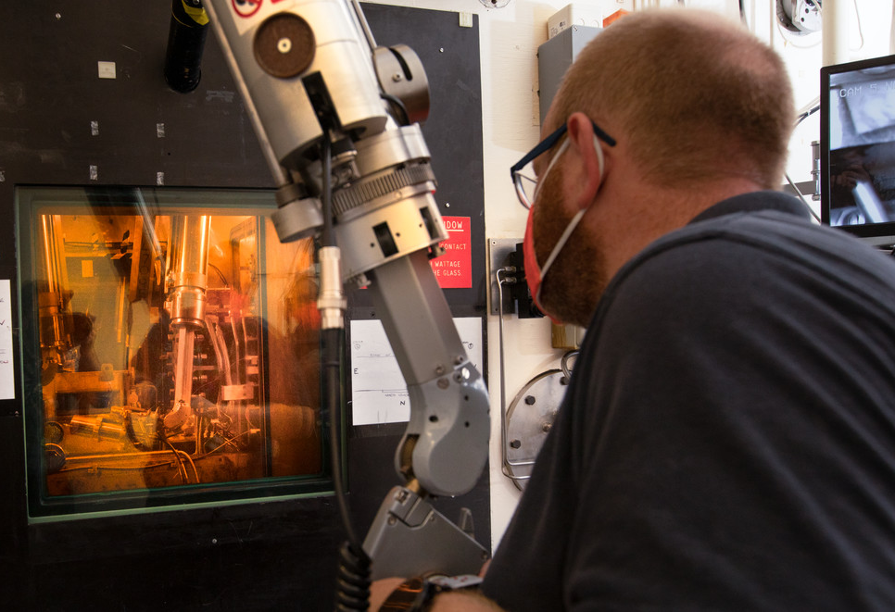
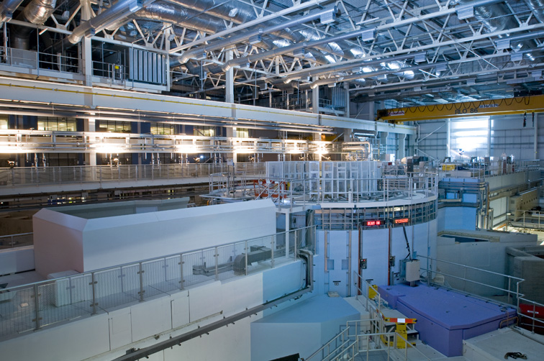
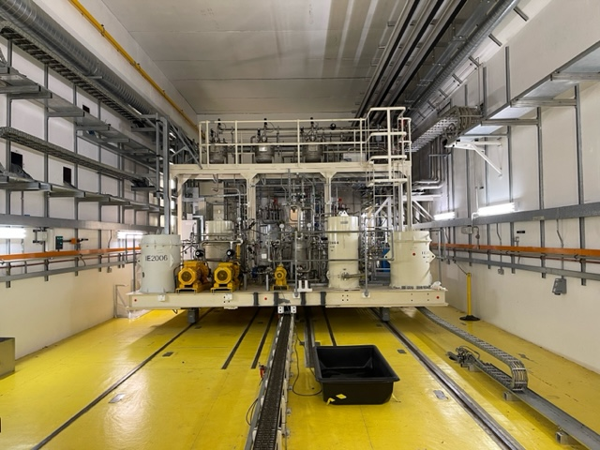
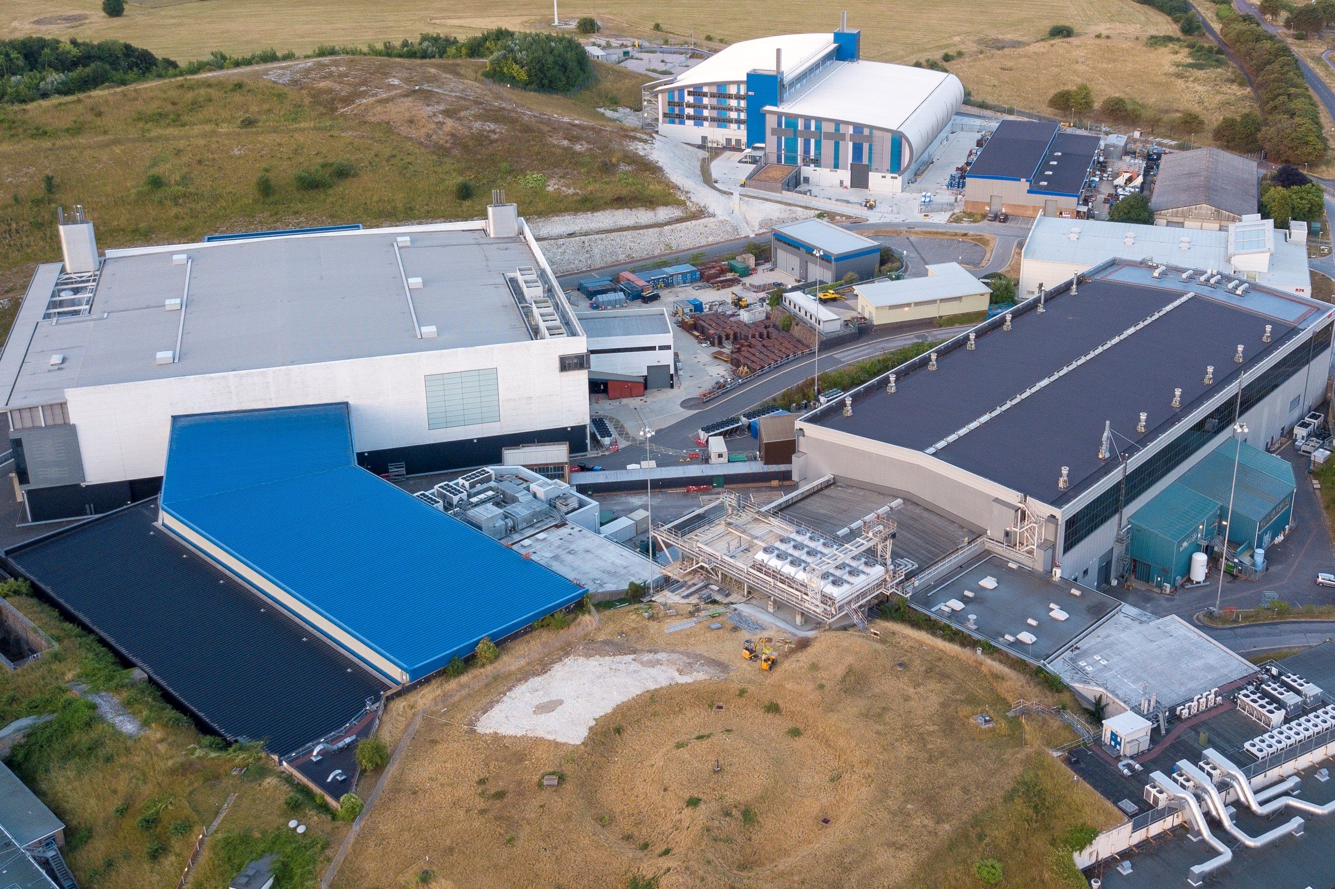
Target Operations Group
Operate, maintain, repair and upgrade all mechanical target systems:
Targets
Moderators
Cryogenics
Gas
Vacuum
Cooling
Ventilation
Notes:
-Intro
-Towards the end of last user run
-Increased moisture in Void Vessel
-Light Water Header tank level decreasing
-Once shutdown pulled trolley back and saw water under reflector

Slide 3
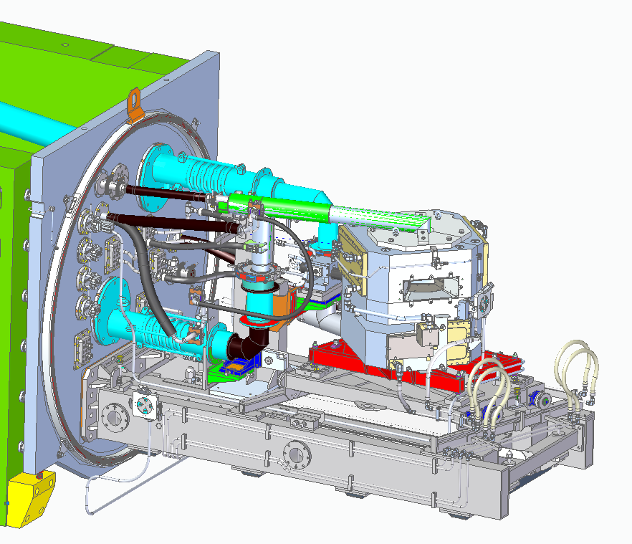
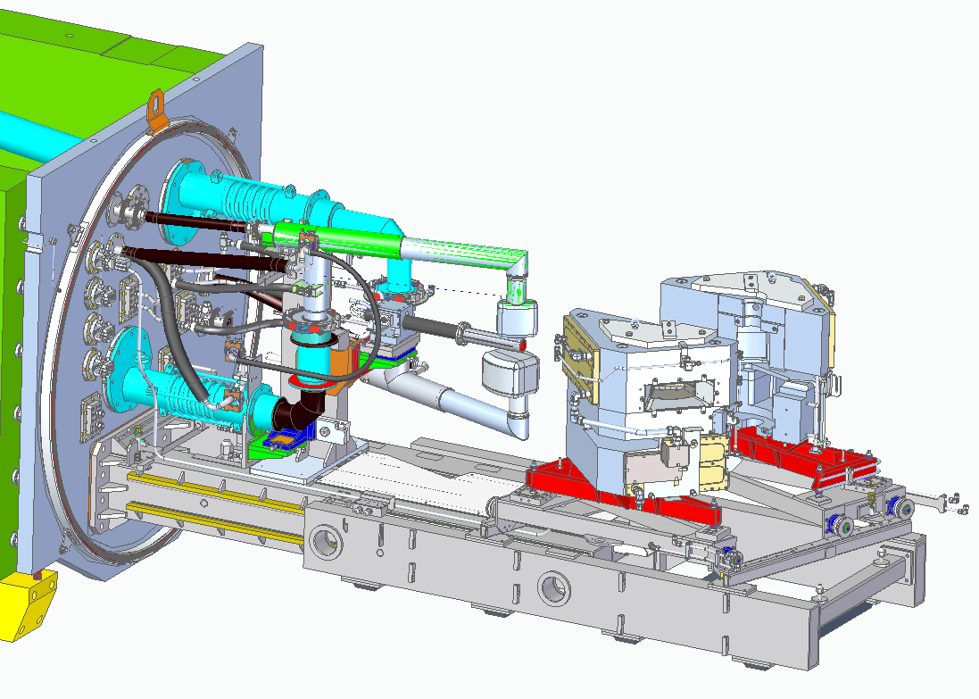
TRaM
DECOUPLED SOLID CH4
MODERATOR
TARGET
WEST REFLECTOR
VOID VESSEL DOOR & SEAL
COUPLED LIQUID H2
MODERATOR
EAST REFLECTOR
Notes:
-Intro
-Towards the end of last user run
-Increased moisture in Void Vessel
-Light Water Header tank level decreasing
-Once shutdown pulled trolley back and saw water under reflector

Slide 4
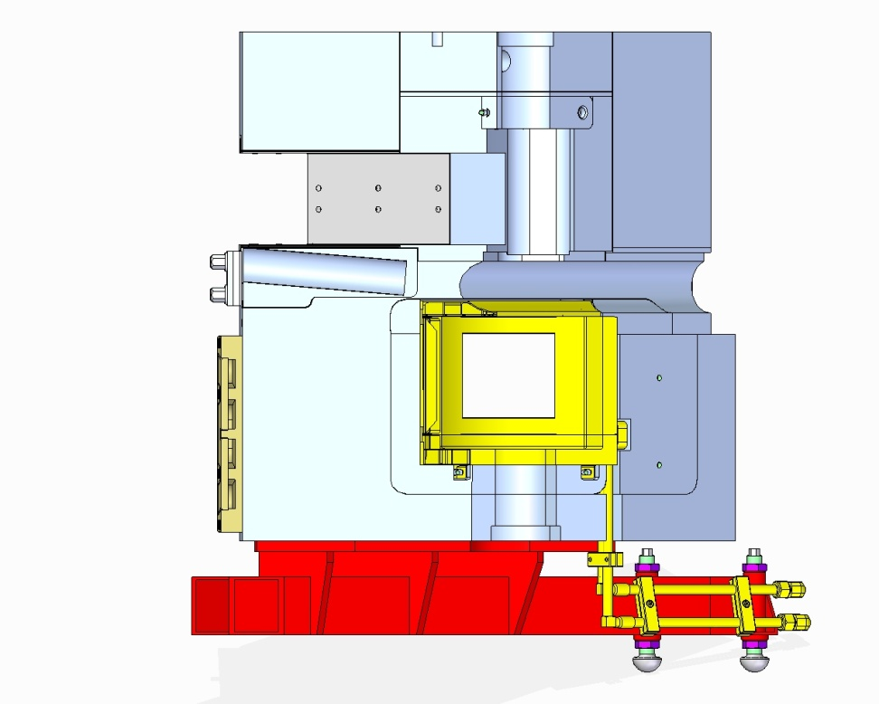
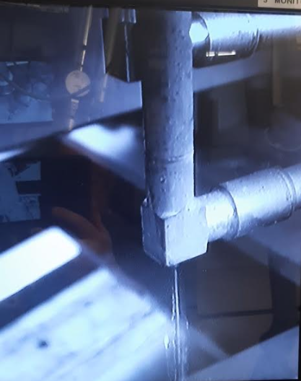
Leak investigation
HORN MODERATOR
DRIP OBSERVED
Notes:
-Split reflector
-No view through windows or fixed cameras
-Used flying lead to inspect leak
-Oxidisation on reflector
-Water tracking down flow/return lines
- We knew we’d have to change the Horn Moderator

Slide 5
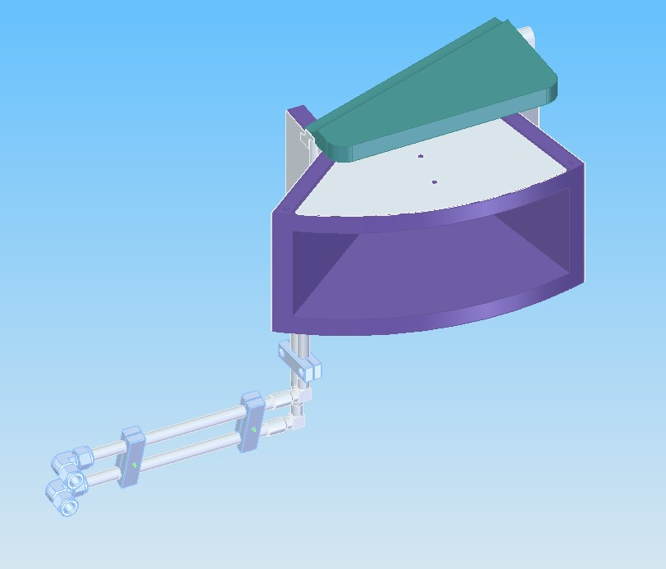
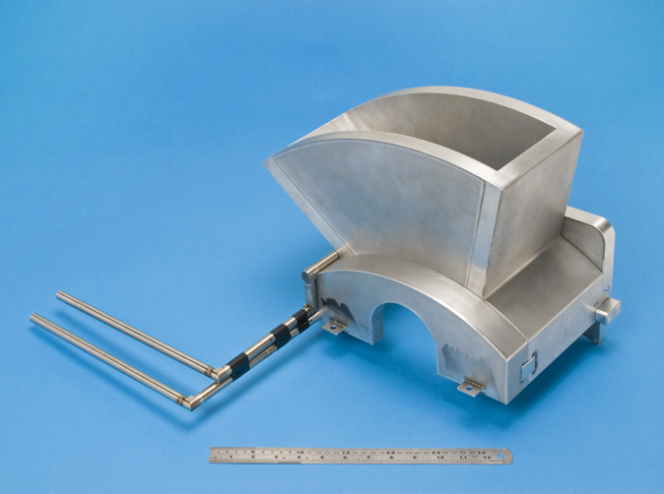
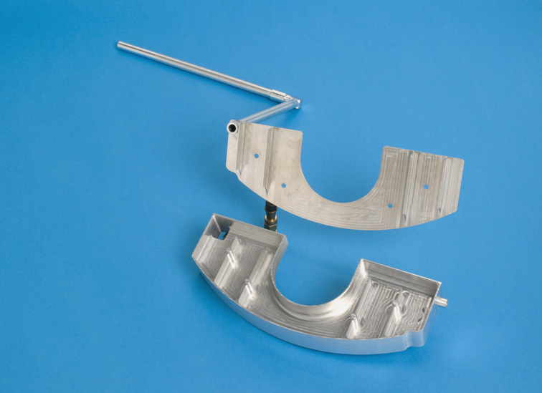
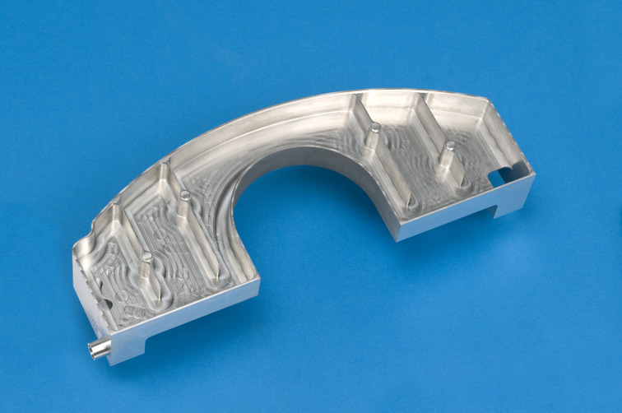
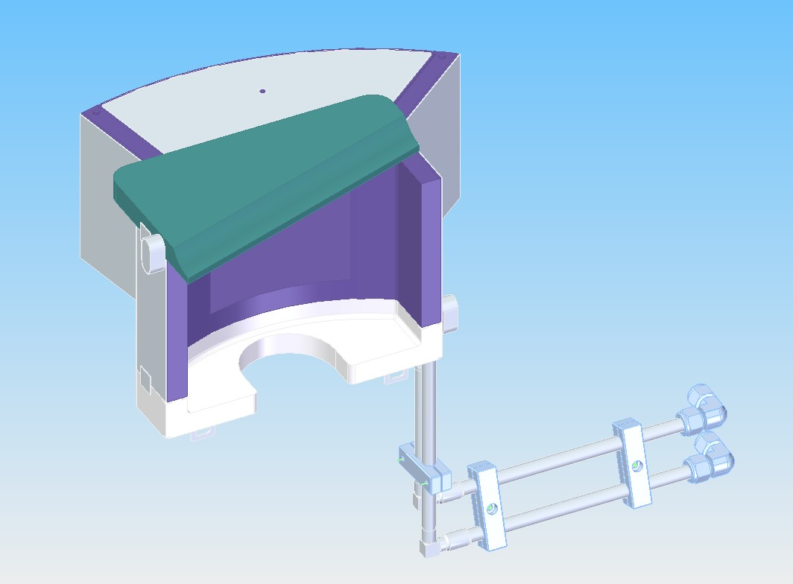
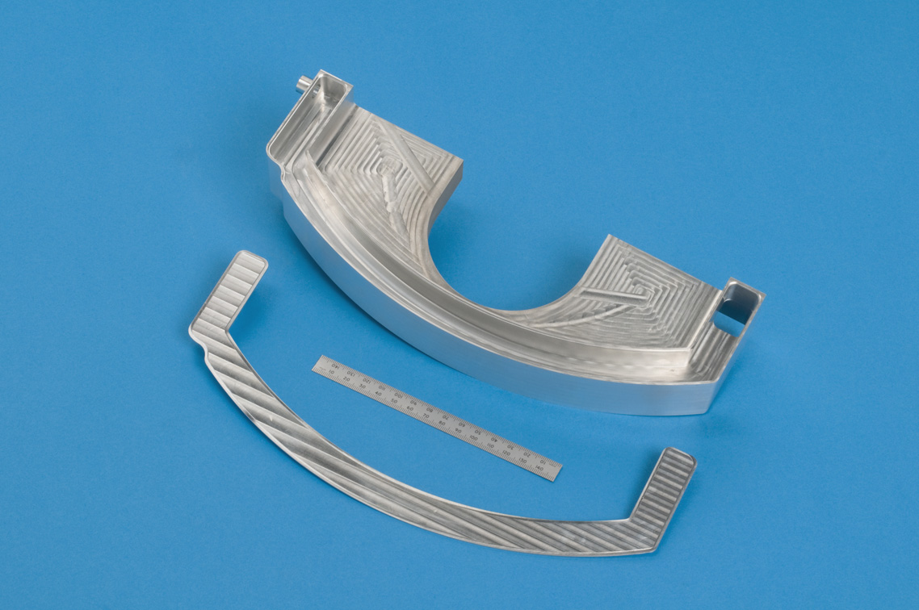
Horn Pre-Moderator
Notes:
-Intro Horn moderator
-Mid assembly shots give an idea of complexity and how delicate it is
-Thin walled – 1.5mm aluminium

Slide 6
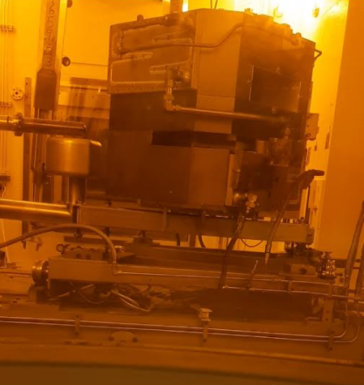
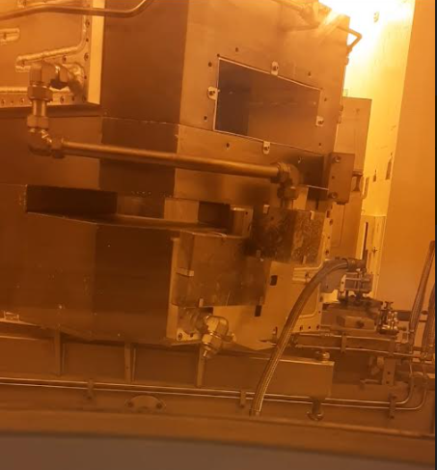
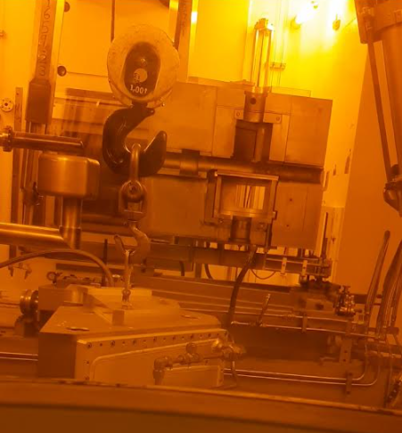
Reflector removal
Notes:
-In order to remove existing unit we had to remove East reflector half
-Had to drain system, however the holding tank in South Tunnel was full
-Liaised with HP, Waste team, RPAs to arrange safe disposal route for water.
-Once drained flexis were removed and capped
-Fasteners removed and unit craned onto East cell floor.

Slide 7
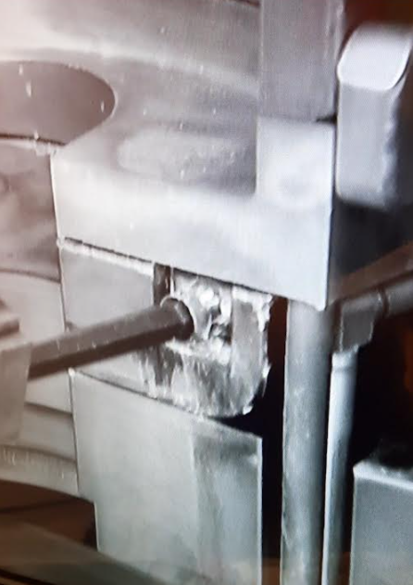
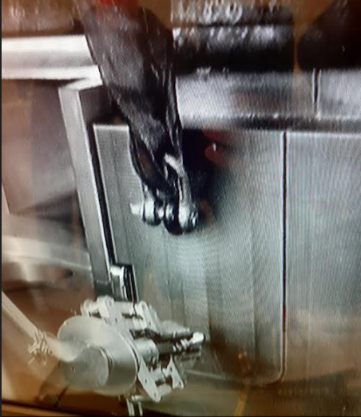
Existing Horn Mod. Removal
Notes:
-Moderator removal was fairly straightforward
-Berillium wedge a little awkward to lift
-had to make up some bespoke tooling for some of the fasteners
-Needed to release some clamps to allow enough flex in the pipes to extract.

Slide 8
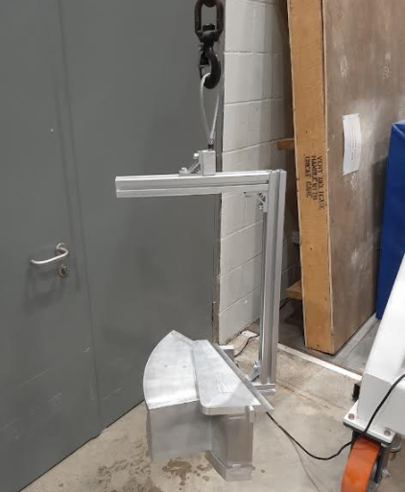
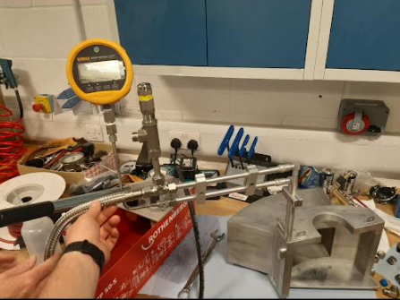
Preparation of new Horn Mod.
Notes:
-Once the old unit was removed we began prepping the new one for installation
-Pressure tested and checked for leaks as although it was new had been in storage for a number of years
-Made up a lifting bracket so it would hang level on the crane
-Minimise need to use the manips in the cell to reduce risk of damage to the unit
-Trial run on the mockup in the rear of R80 to work out method before committing to the cell

Slide 9
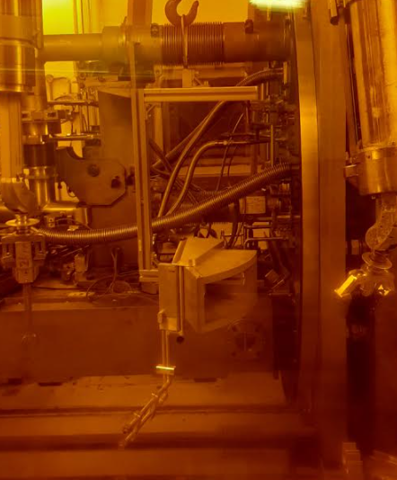
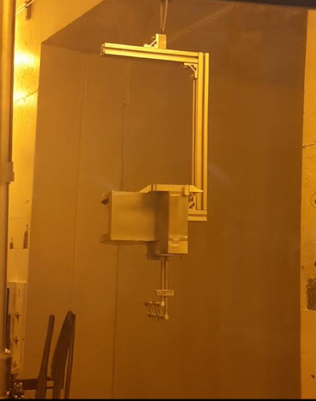
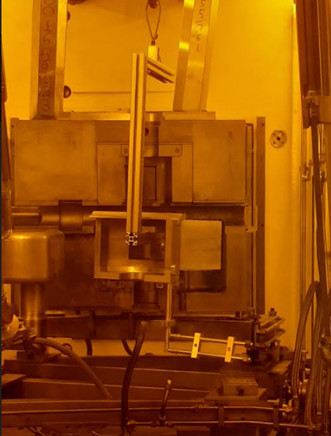
Installation of new Horn Mod.
Notes:
-Installation was pretty painless
-Placed on the transport platform at the rear of the trolley and sent in
-Picked up on the west side, trolley driven back
-Flown around the front of reflector and installed
-minimal manipulation required from arms

Slide 10
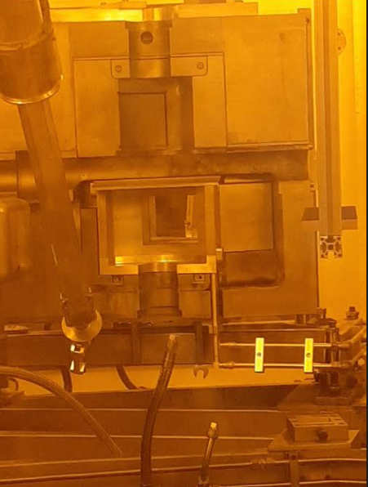
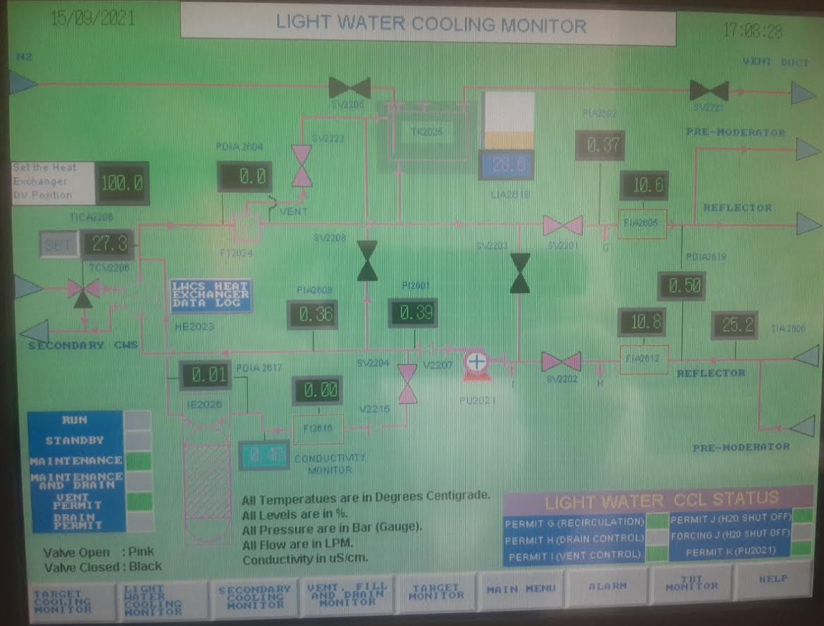
Installation of new Horn Mod.
Notes:
-Fasteners and fittings tightened
-System flooded and bled
-Circulated water around the system and checked for leaks
-Reinstalled East reflector half and once again filled with water and leak checked

Slide 11
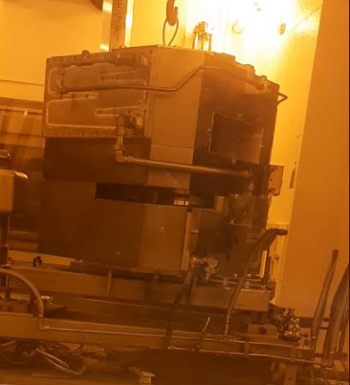
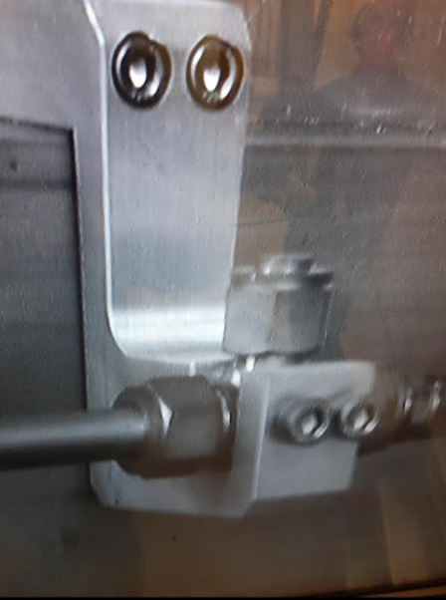
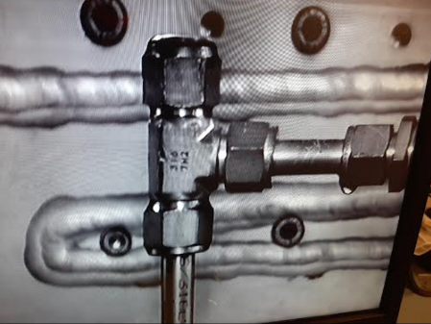
Problems encountered
Notes:
-Although the leak was successfully resolved there were some difficulties and learning opportunities
-Lifting eye on the reflector – arms at virtually full forward and boom extension
-minimal views
-Talk nicely to the design team about a soloution!
-High level bleeds also high on the reflector – one has bracket to assist with bracing
-Once shutdown pressure allows we’d like to revisit the leaking Horn mod.
-Had to get the trolley forward to vent the croft so were under pressure to finish reinstallation
-Discussion with Les about testing the unit on crane near windo by either plumbing into LWCS, running auxillary pump or using compressed air/leak detector spray

Slide 12
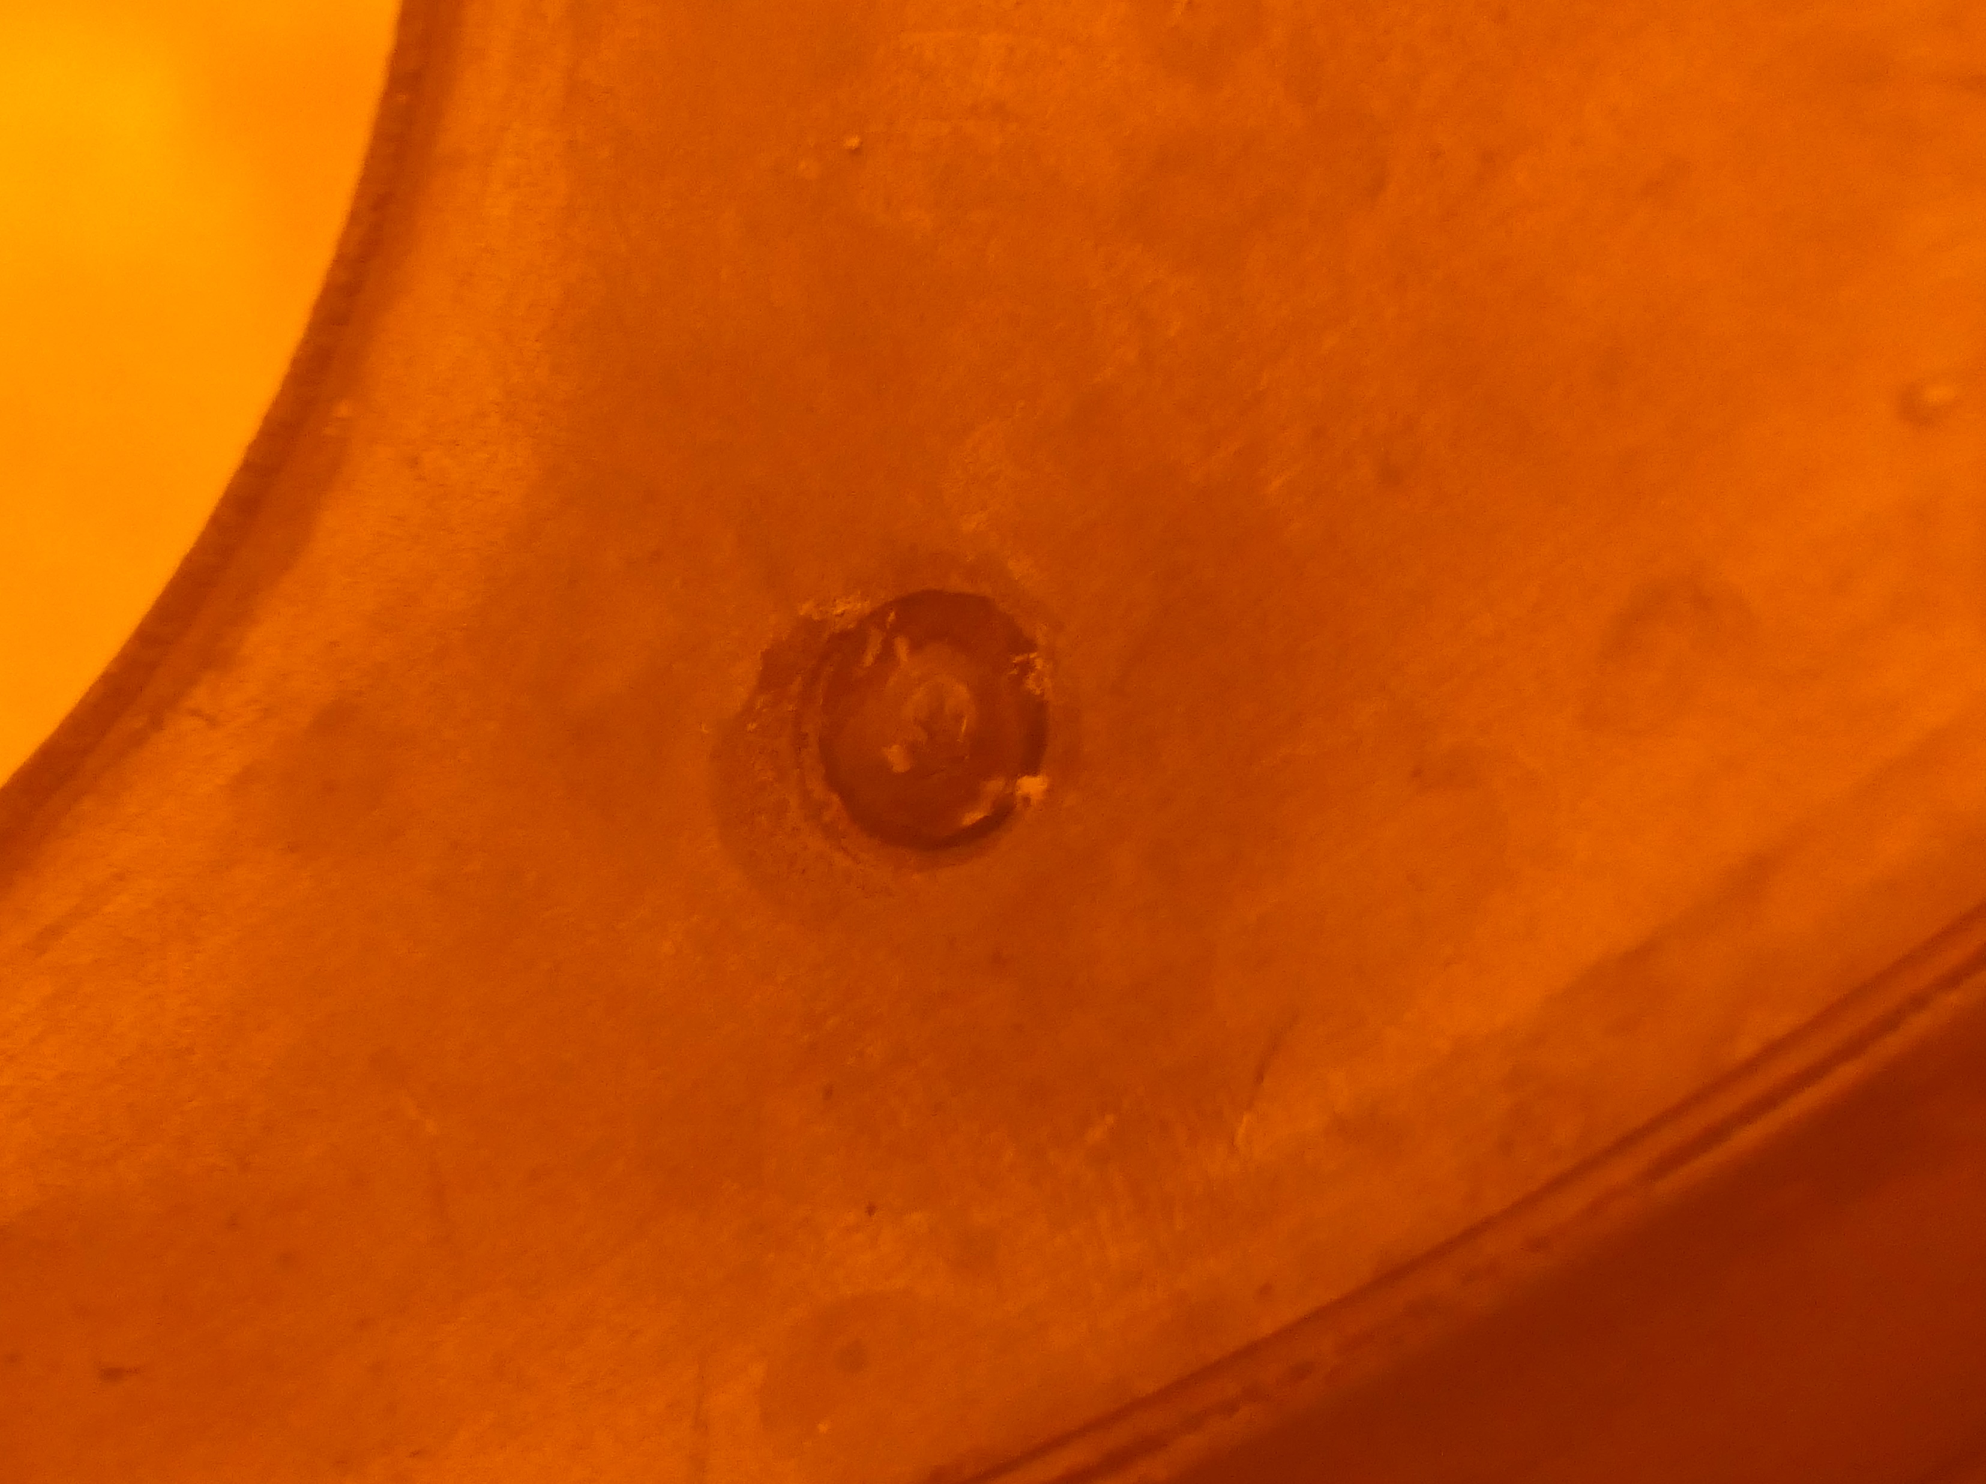
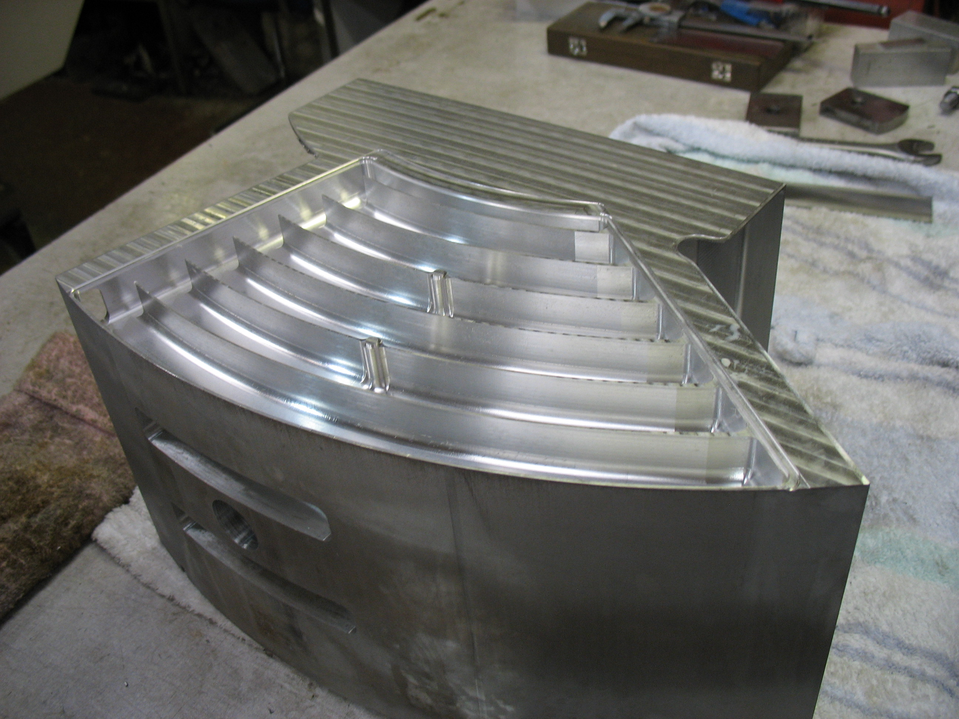
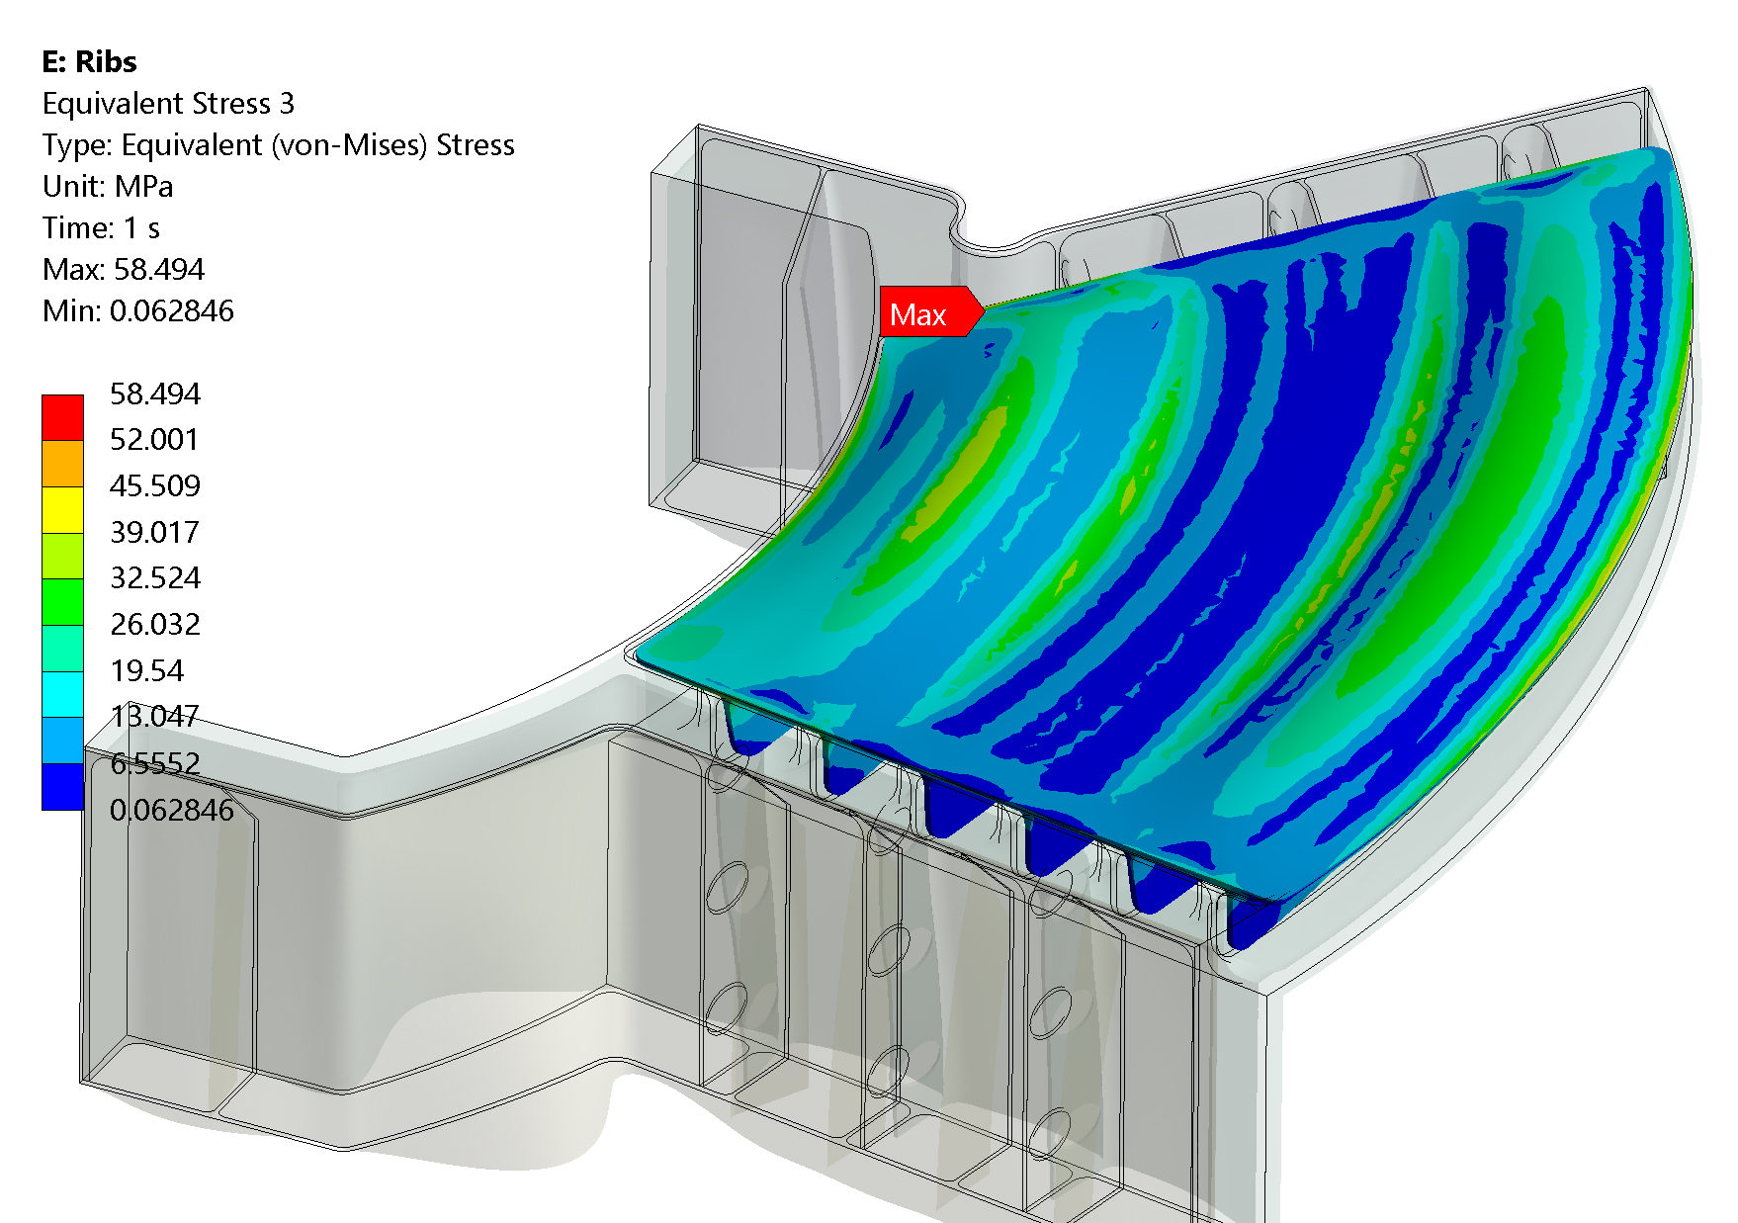
Future development
Notes:
-Although the leak was successfully resolved there were some difficulties and learning opportunities
-Lifting eye on the reflector – arms at virtually full forward and boom extension
-minimal views
-Talk nicely to the design team about a soloution!
-High level bleeds also high on the reflector – one has bracket to assist with bracing
-Once shutdown pressure allows we’d like to revisit the leaking Horn mod.
-Had to get the trolley forward to vent the croft so were under pressure to finish reinstallation
-Discussion with Les about testing the unit on crane near windo by either plumbing into LWCS, running auxillary pump or using compressed air/leak detector spray

Slide 13
Thank you
Any questions?
Notes:
The abstract pattern can be removed or repositioned if required. Be careful to ‘Send to Back’ so that it does not obscure any important information.

