Slide 1
Status of Track Finding for CEPC Drift Chamber
Mengyao Liu²
Yao Zhang¹, Wenxing Fang¹, Tao Lin¹,
Weidong Li¹, Xingtao Huang²,Ye Yuan^{1,} Xueyao Zhang²,Chendong Fu¹
1. IHEP
2. Shandong University
2023-04-18

Slide 2
Outline
Motivation
Simulation
Track Finding
Summary

Slide 3
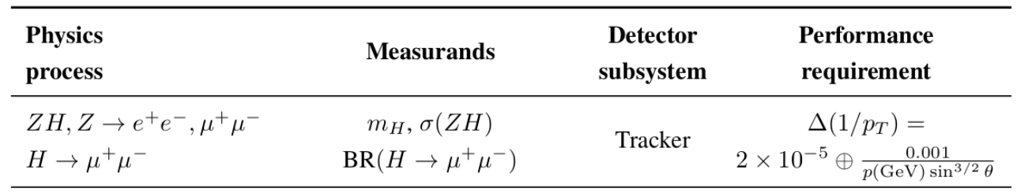
Drift Chamber(DC) Software
Drift chamber is the key detector in the 4th conceptual detector design to provide PID
  Good PID ability (2σ π/K separation at P < ~ 20 GeV/c)
  Precise momentum measurement (eff. ~100%, σp<=0.1%)
Motivation of DC software project
  Development of simulation and reconstruction for DC
  Support the detector design, optimization and performance study
  Support physics sensitivity study
Requirements for DC software
  Modular design and friendly interfaces
  Easily integrated with common tools (ACTS, Genfit etc.)
  Reuse existing algorithms from other experiments
  Application of advanced technic (ML) to simulation and reconstruction
Manpower
  IHEP: Yao Zhang, Tao Lin, Wenxing Fang, Chengdong Fu, Ye Yuan, Weidong Li
  SDU: Mengyao Liu, Xueyao Zhang, Xingtao Huang
A PID drift chamber
Requirements of The CEPC tracker

Slide 4
DC software
The drift chamber software has been developed from scratch
CEPCSW
  Gaudi based framework
  External libraries and tools
Geometry and field map
  DD4hep
  Non-uniform magnetic field: done
Data model
  EDM4hep and FWCore
  dN/dx event model: done
Drift chamber
  DC simulation: done
  DC digitization: done
  Waveform simulation: in progress
  Waveform reconstruction: in progress
  Track fitting with measurement: done
  Track finding: in progress
  dN/dx reconstruction: in progress
  Multi track reconstruction: done
  Performance check: done
DC simulation
Garfield++&& ML
Geometry & field (DD4hep)
data model (EDM4hep & DC EDM)
DC digitization
Waveform
simulation
Genfit
DC track
reconstruction
Waveform
reconstruction
Track & track length in cell: X
N of ionization
dN/dx reconstruction
Drift chamber simulation and reconstruction flow

Slide 5
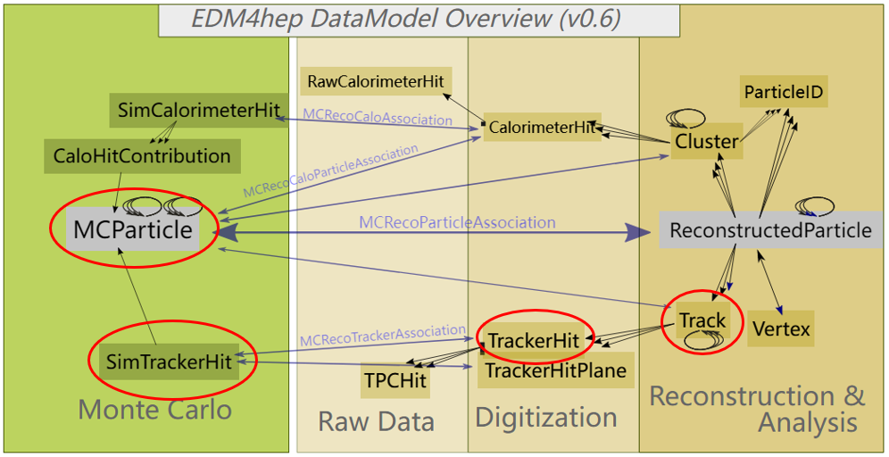
Event Data Model
DC implements the data model following the EDM4hep (commonly used by ILC, FCC, CEPC, CLIC, …)
For drift chamber track simulation and reconstruction: MCParticle, SimTrackerHit, TrackHit, Track

Slide 6
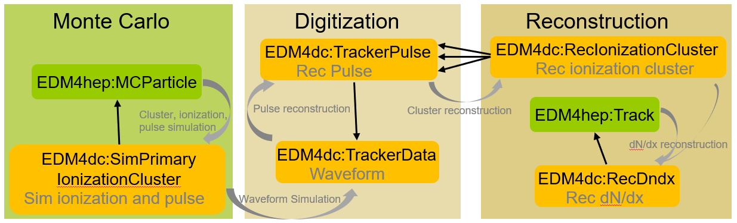
EDM4hep Extension
Extending the EDM4hep:
  To facilitate dN/dx study: simulation and reconstruction
  The extended EDMs are general and can be used both for the drift chamber and the TPC
  Have been merged into EDM4hep

Slide 7
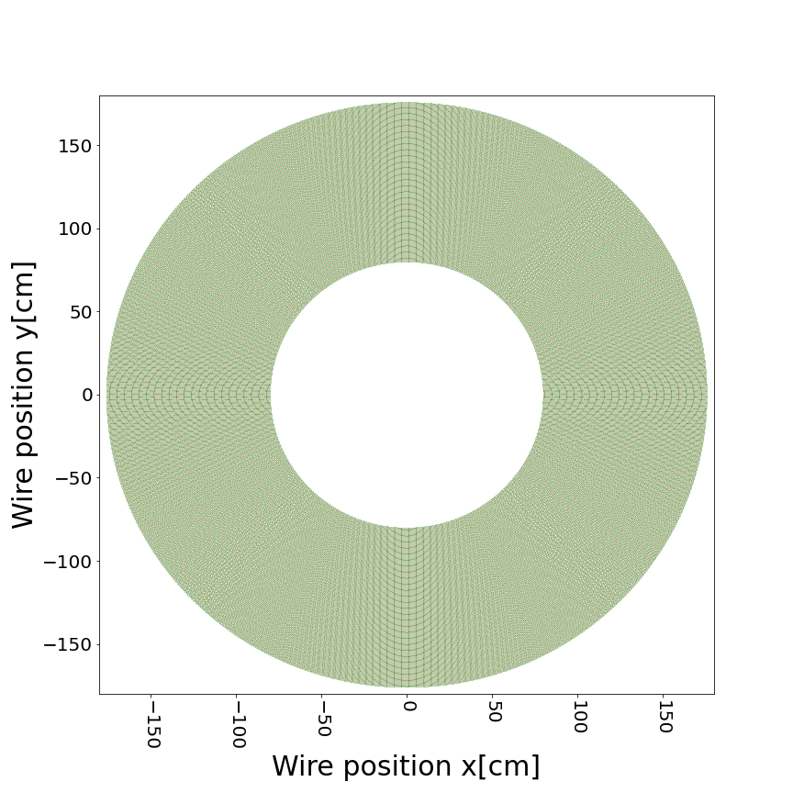
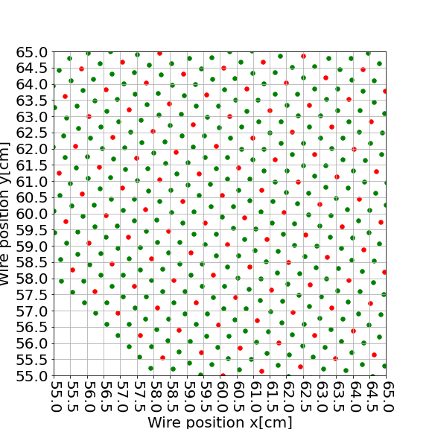
Drift Chamber Parameters in CEPCSW
The baseline configuration of DC in CEPCSW
Half length | 2980 mm
Inner and outer radius | 800mm to 1800 mm
# of Layers | 100/55
Cell size | ~10mmx10mm/18mmx18mm
Gas | He:iC₄H₁₀=90:10
Single cell resolution | 0.11 mm
Sense to field wire ratio | 1:3
Total # of sense wire | 81631/24931
Stereo angle | 1.64~3.64 deg
Sense wire | Gold plated Tungsten φ=0.02mm
Field wire | Silver plated Aluminum φ=0.04mm
Walls | Carbon fiber 0.2 mm(inner) and 2.8 mm(outer)
Cell structure

Slide 8
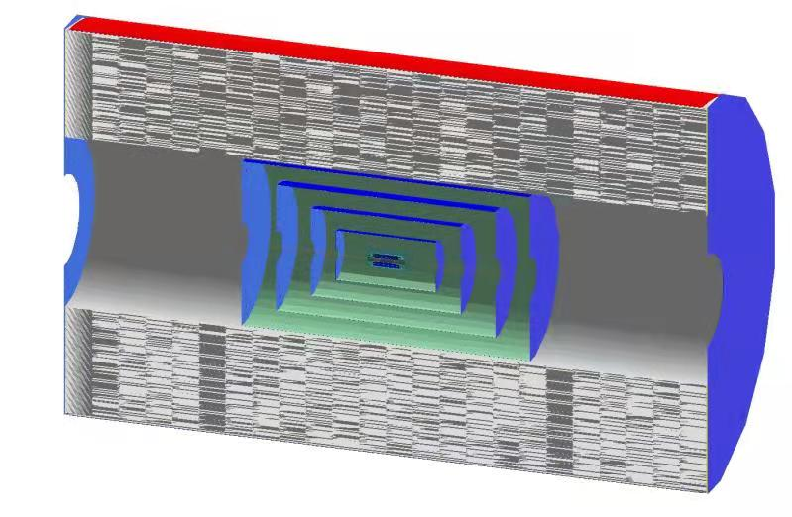
Silicon detectors Parameters in CEPCSW
Silicon tracker | Number of layer | Radius(mm) | σ_{U} (μm) | σ_{V}(μm)
VXD | 3 double layers | 16-58 | 2.8/6/4/4/4/4 | 2.8/6/4/4/4/4
SIT | 4 layers | 230-770 | 7.2 | 86
SOT(SET) | 1 layer | 1815 | 7.2 | 86
CRD tracker o1 v01

Slide 9
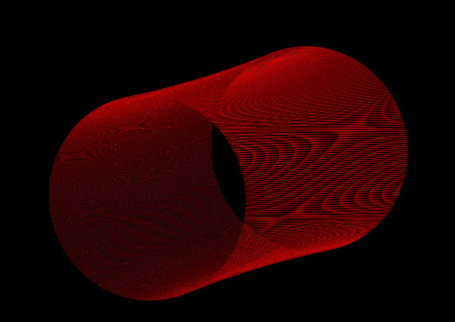

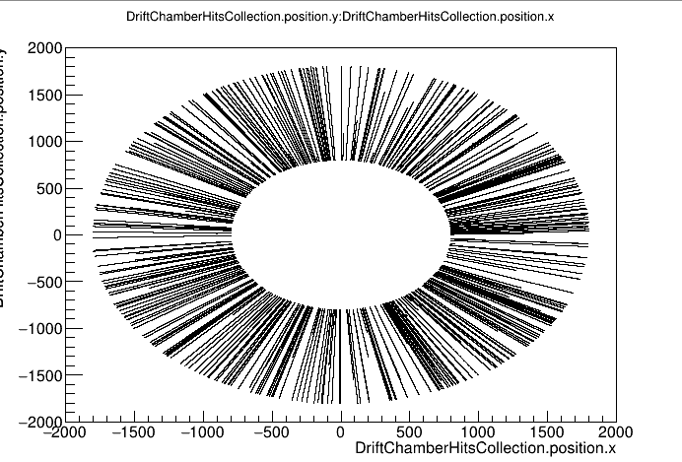
DC Simulation
Following the common scheme for detector description
  XML based compact files for drift chamber detector description
    CRD: Detector/DetCRD/compact/CRD_oX_vYY/CRD_o1_vYY.xml
  Geometry parameters can be flexibly configured
Cell partitioning with segmentation
  Consistent between simulation and reconstruction
Simple digitization
  Constant drift velocity: V_{drift}=40μm/ns & fixed spatial resolution: σ=110um
One stereo layer of drift chamber
Hitmap of MC hits in DC
Software Development for the Drift Chamber, Yao Z.

Slide 10
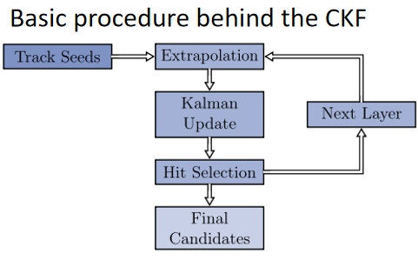
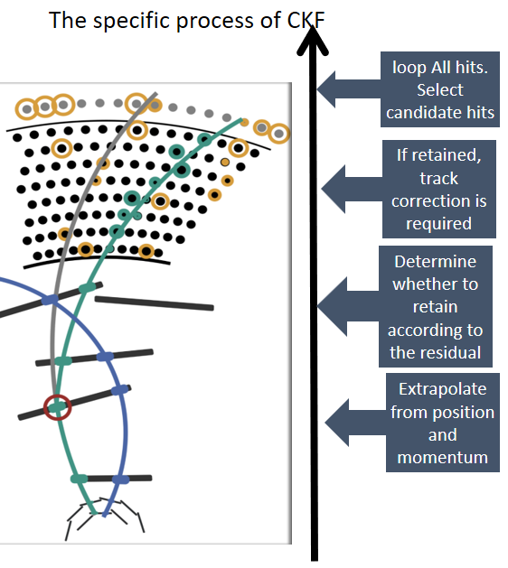
Track Finding--- CKF
    CKF(Combinatorial Kalman Filter):
    Track finding using CKF in Drift hamber
      Purpose: Select hits belonging to this track through the existing track seed
      Methods: The reconstructed SiTrack is selected as seed to select DC hits belonging to the same track
  A tracking concept that combines track finding and track fitting in a search-tree-based algorithm.
  Used by many high energy physics experiments
  Can give precise results

Slide 11
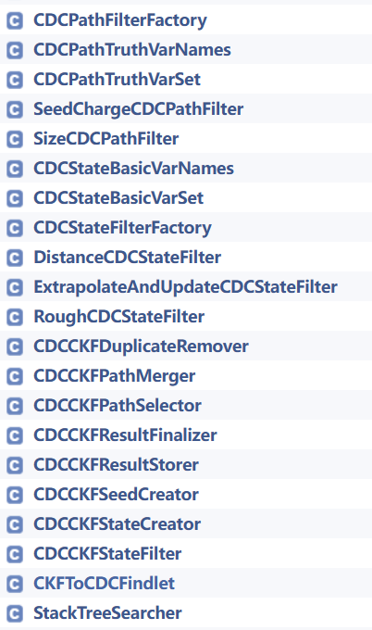
Track Finding---CKFFinding
Based on the track finding algorithm of Belle II
(https://github.com/belle2/basf2)
  CKFToCDCFindlet(main algorithm)
  CDCCKFSeedCreator,CDCCKFStateCreator...
Integration with CEPCSW
  Field
  Geometry
  Data io

Slide 12
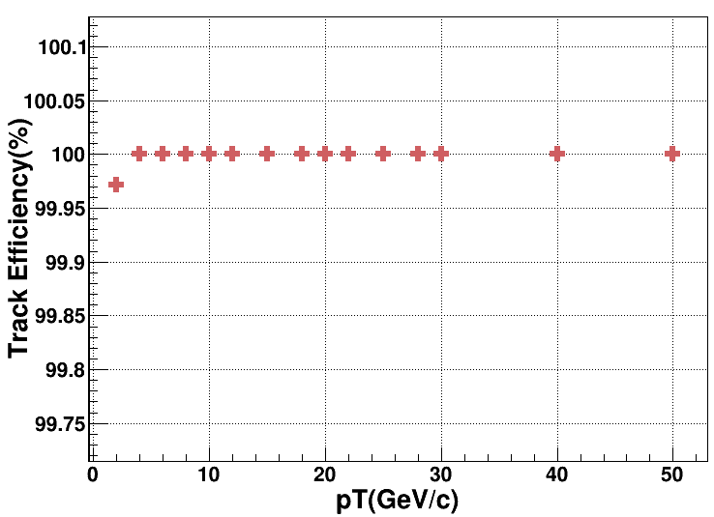
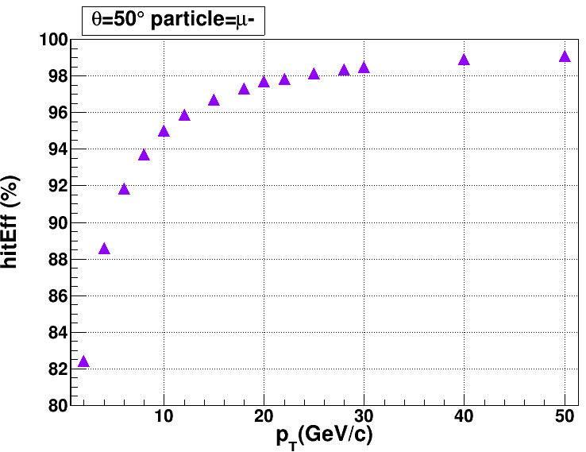
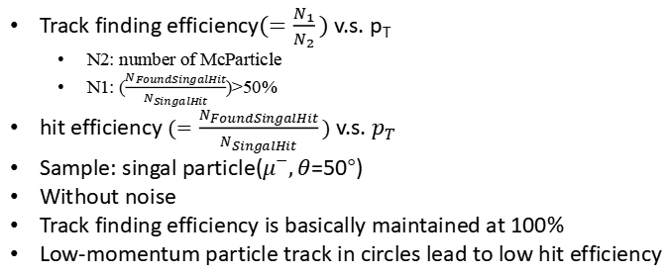
TrackFinding Performance
$Track finding efficiency(=\frac{N_{1}}{N_{2}})$ v.s. $p_{T}$
  N2: number of McParticle
  N1: ($\frac{N_{FoundSingalHit}}{N_{SingalHit}}$)>50%
$hit efficiency (=\frac{N_{FoundSingalHit}}{N_{SingalHit}})$v.s. $p_{T}$
Sample: singal particle($μ^{−},θ$=50°)
Without noise
Track finding efficiency is basically maintained at 100%
Low-momentum particle track in circles lead to low hit efficiency

Slide 13
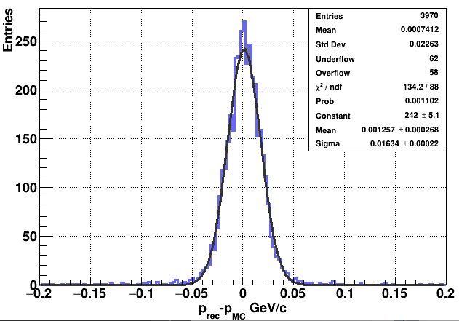
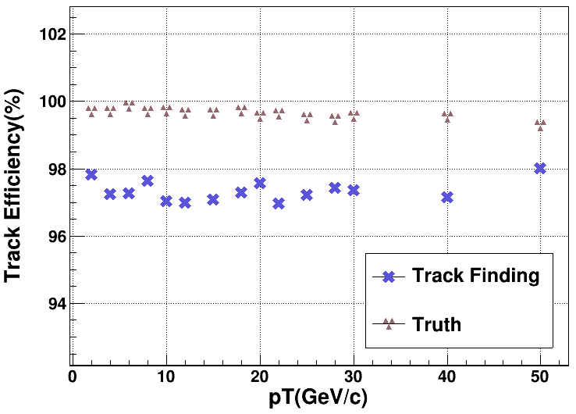
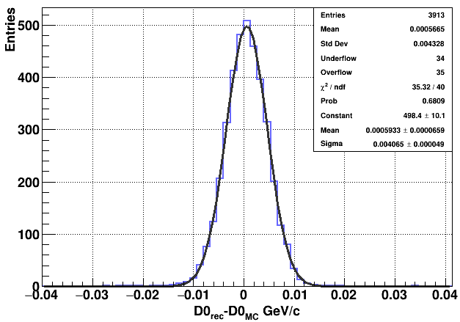
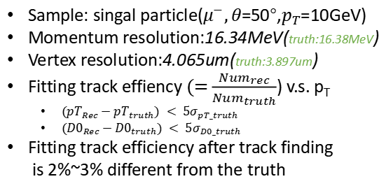
TrackFinding Performance
Sample: singal particle($μ^{−},θ$=50°,$p_{T}$=10GeV)
Momentum resolution:16.34MeV(truth:16.38MeV)
Vertex resolution:4.065um(truth:3.897um)
$Fitting track effiency (=$ $\frac{{Num}_{rec}}{{Num}_{truth}}$) v.s. $p_{T}$
  $({pT}_{Rec}−{pT}_{truth}) < 5σ_{pT_truth}$
  $({D0}_{Rec}−{D0}_{truth}) < 5σ_{D0_truth}$
Fitting track efficiency after track finding
is 2%~3% different from the truth

Slide 14
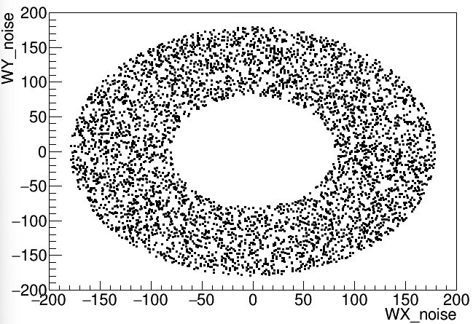
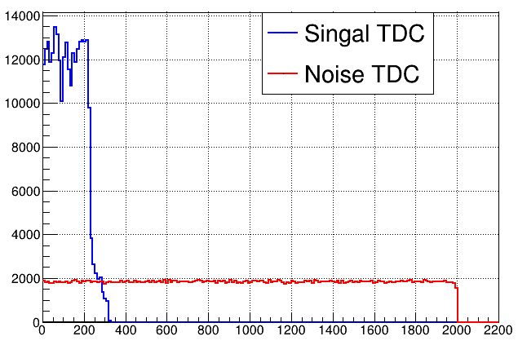
Noise Distribution
Noise level: 20%
  uniform,random
Singal + Noise TDC
  Noise time:0~2000ns
The position of the noise on the XY plane
time(ns)

Slide 15
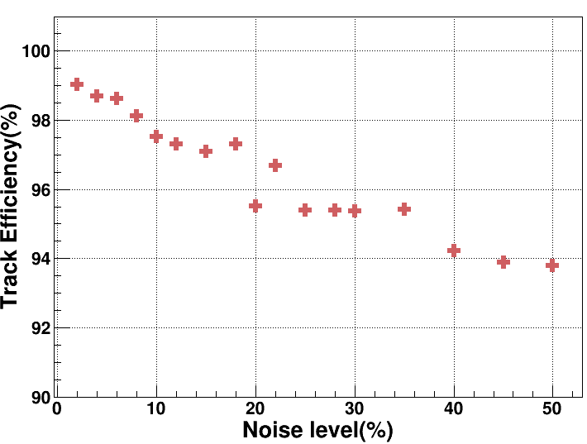
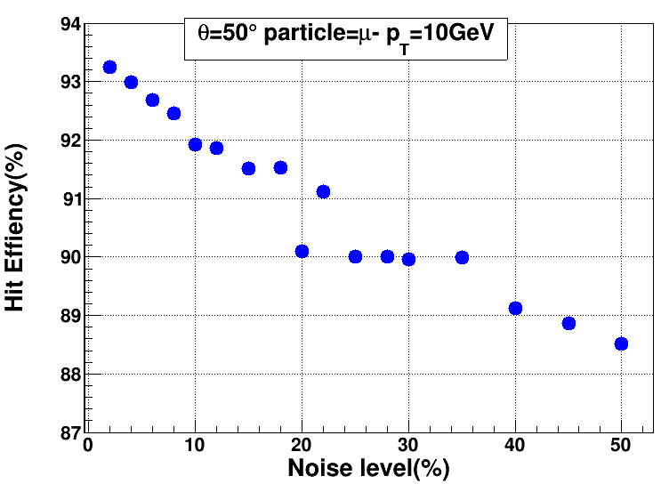
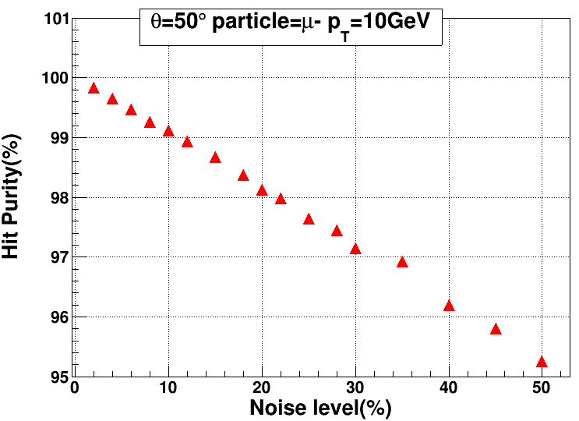
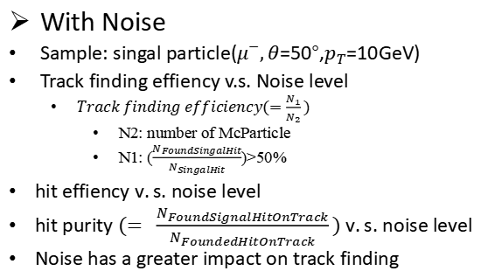
TrackFinding Performance
With Noise
Sample: singal particle($μ^{−},θ$=50°,$p_{T}$=10GeV)
Track finding effiency v.s. Noise level
  $Track finding efficiency(=\frac{N_{1}}{N_{2}})$
    N2: number of McParticle
    N1: ($\frac{N_{FoundSingalHit}}{N_{SingalHit}}$)>50%
$hit effiency v.s. noise level$
$hit purity (= \frac{N_{FoundSignalHitOnTrack}}{N_{FoundedHitOnTrack}}) v.s. noise level$
Noise has a greater impact on track finding

Slide 16
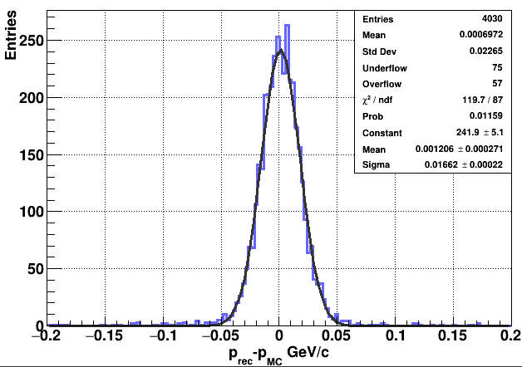
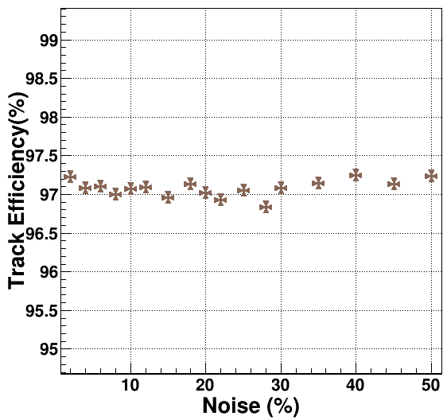
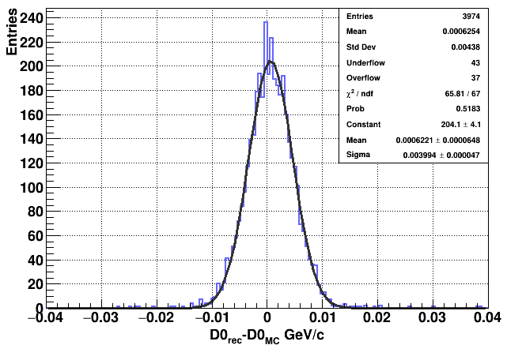
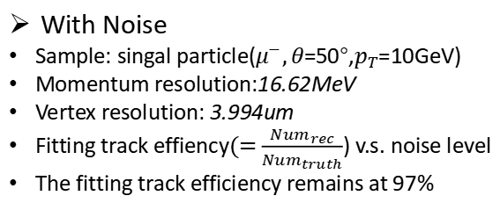
TrackFinding Performance
With Noise
Sample: singal particle($μ^{−},θ$=50°,$p_{T}$=10GeV)
Momentum resolution:16.62MeV
Vertex resolution: 3.994um
$Fitting track effiency(=$ $\frac{{Num}_{rec}}{{Num}_{truth}}$) v.s. noise level
The fitting track efficiency remains at 97%

Slide 17
Summary
The integration of track finding algorithm and CEPCSW has been completed
Geometry and field is available in tracking algorithm
Causes of lower hit efficiency:
  curling tracks
  Not suitable cuts
Future plan
  Optimizing the Track Finding Algorithm
  Optimize tracking cuts
  Improve track efficiency and purity
Thank you!

