Slide 1
工作进展
--刘梦瑶

Slide 2
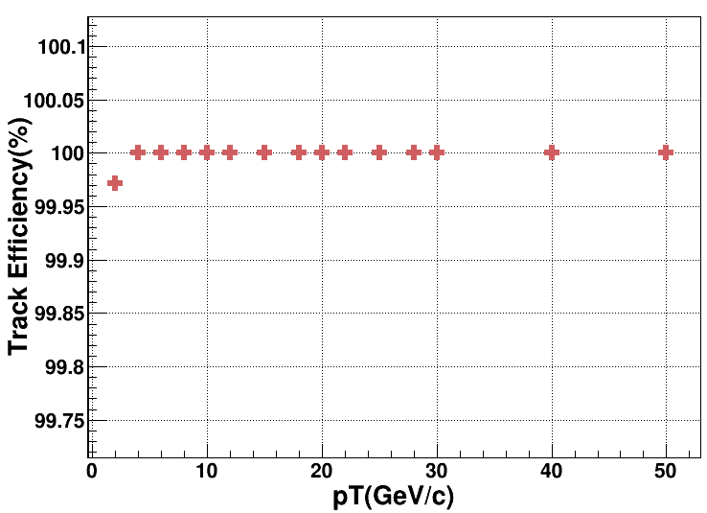
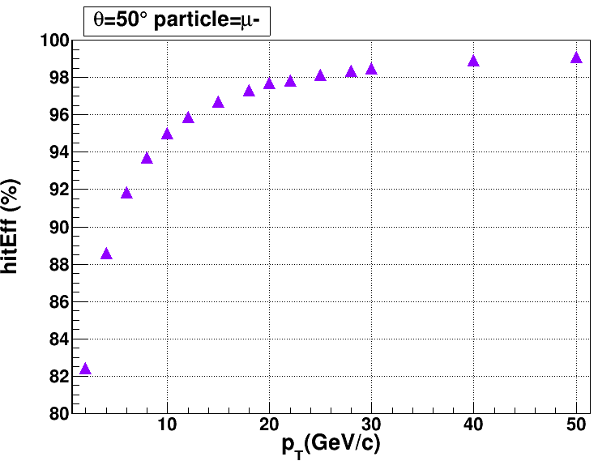
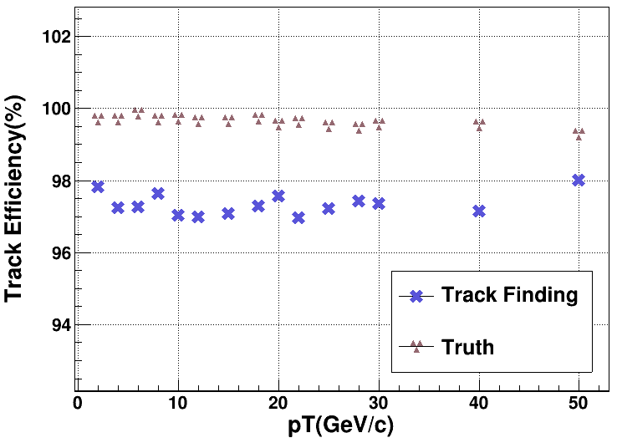
$Track finding efficiency(=\frac{N_{1}}{N_{2}})$
N2: number of McParticle
N1: ($\frac{N_{FoundSingalHit}}{N_{SingalHit}}$)>50%
$hit efficiency (=\frac{N_{FoundSingalHit}}{N_{SingalHit}})$
$Fitting track effiency (=$ $\frac{{Num}_{rec}}{{Num}_{truth}}$) v.s. $p_{T}$
$({pT}_{Rec}−{pT}_{truth}) < 5σ_{pT_truth}$
$({D0}_{Rec}−{D0}_{truth}) < 5σ_{D0_truth}$
样本: 单粒子($μ^{−},θ$=50°)
直丝
无噪声
动量小于10GeV时，击中效率小于95%
寻迹之后的径迹拟合效率比使用truth track差3%

Slide 3
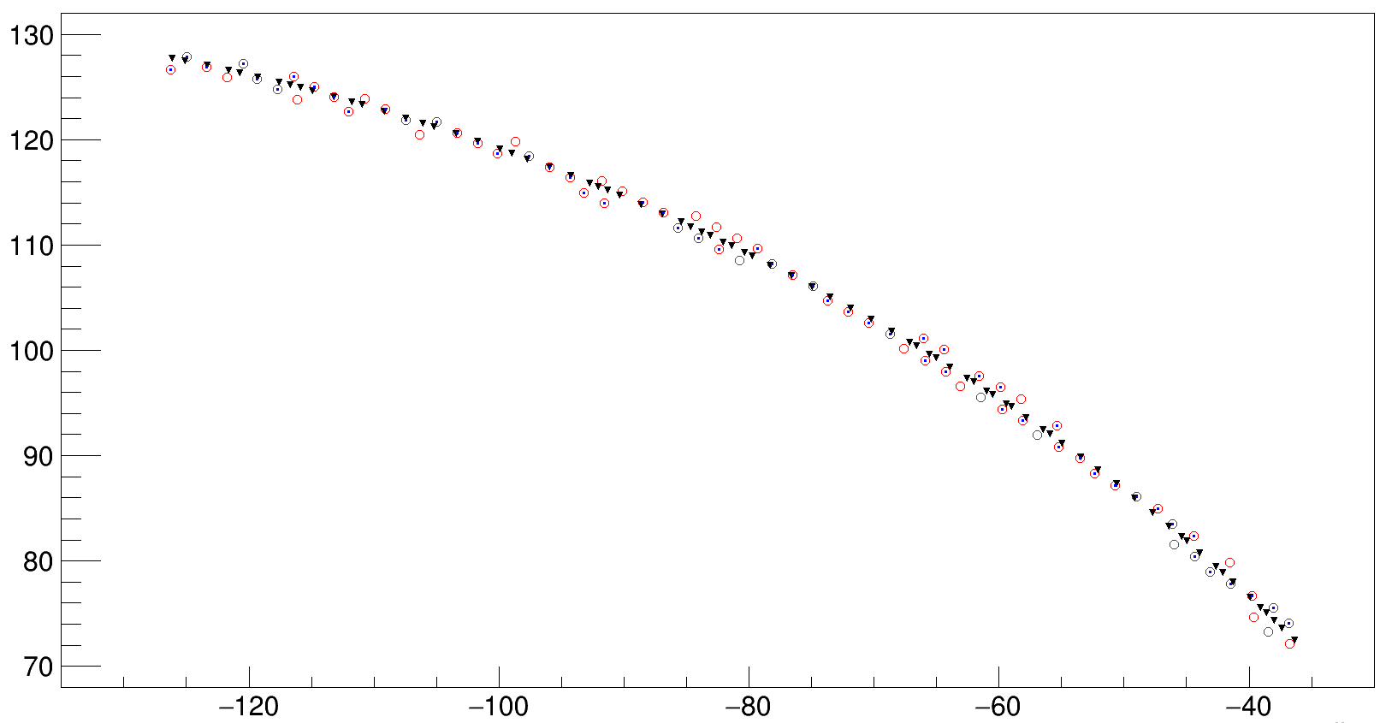
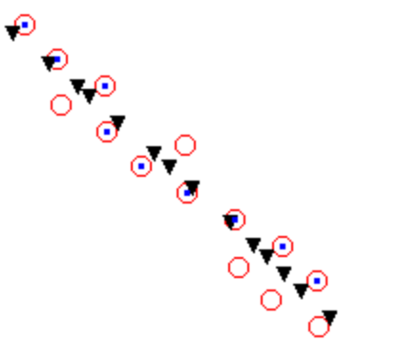
单独事例：2GeV，mu-，$hit efficiency$ = 73.07692%
扔掉原本属于这条径迹上的击中 ➯ JumpLayerID
▲ hitPosition
■ foundhitPosition
O wirePosition
seed

