Slide 1
Polarization simulations for CEPC CDR booster ChenTao

Slide 2
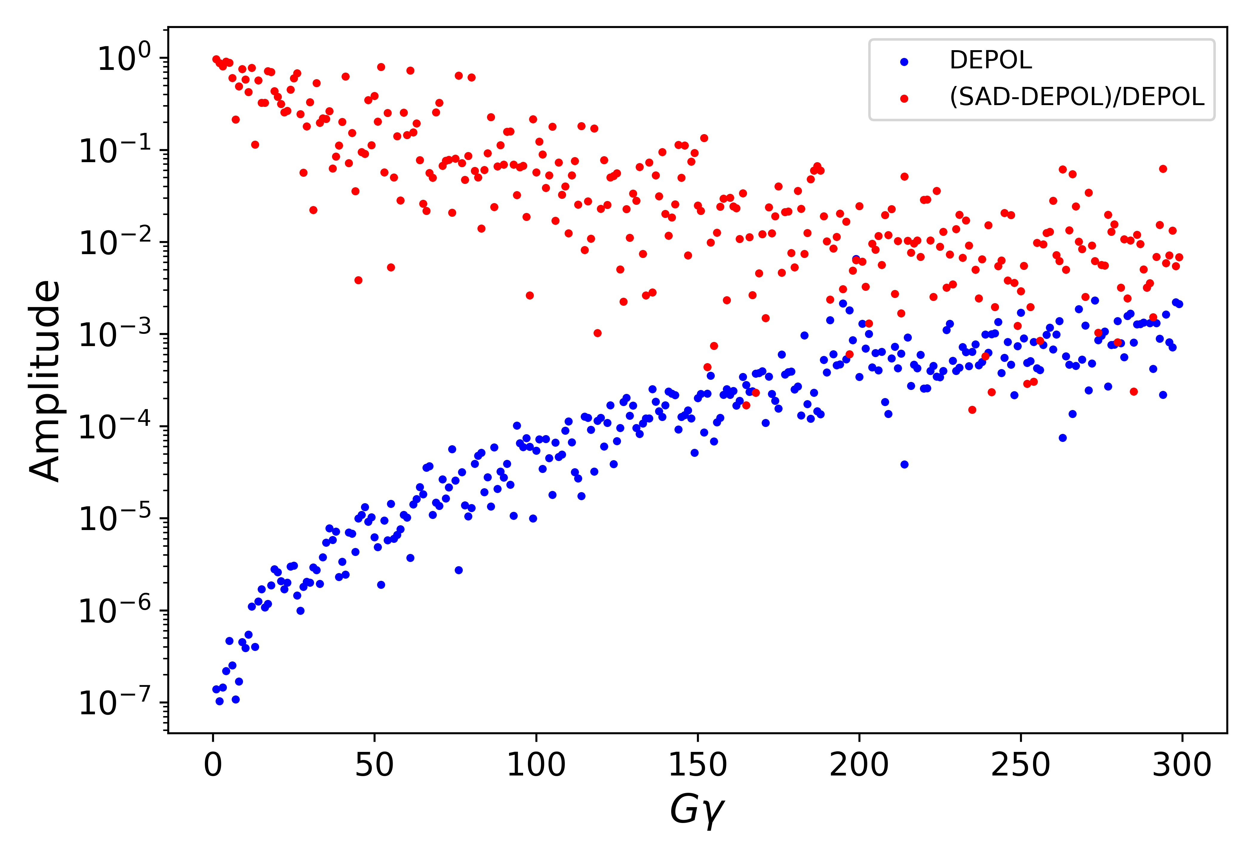
Imperfection resonance
CDR lattice
更新了imperfection resonance计算程序
G$γ$稍大的区域计算结果与SAD近似方法相差不大

Slide 3
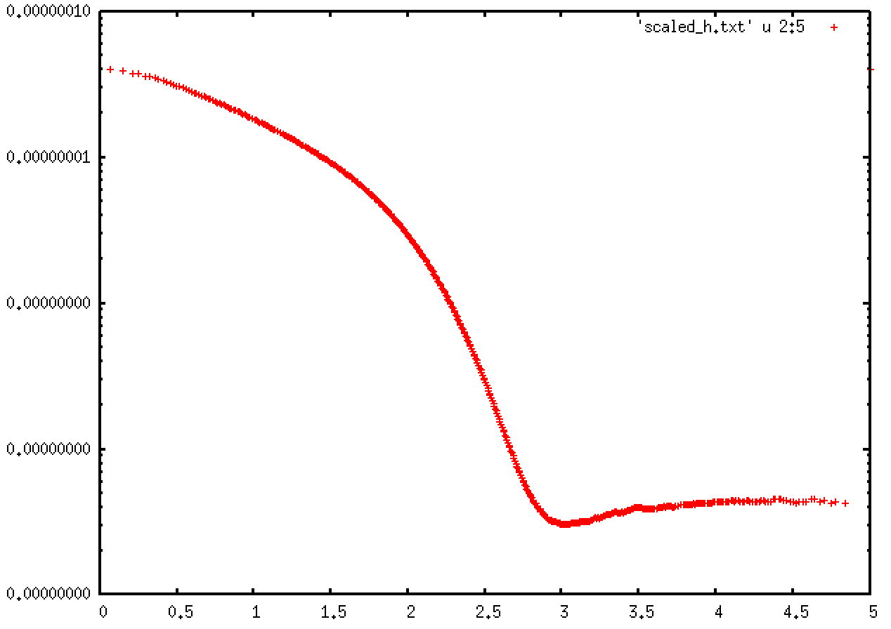
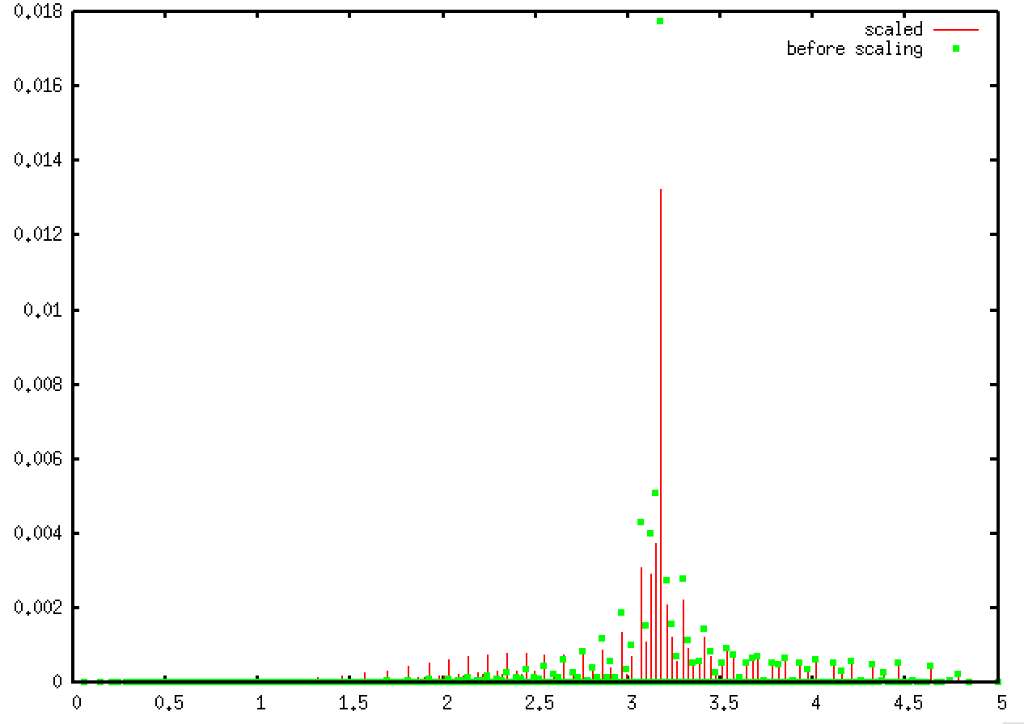
Intrinsic resonance
发射度演化曲线
Strength of intrinsic resonance
44pm

Slide 4
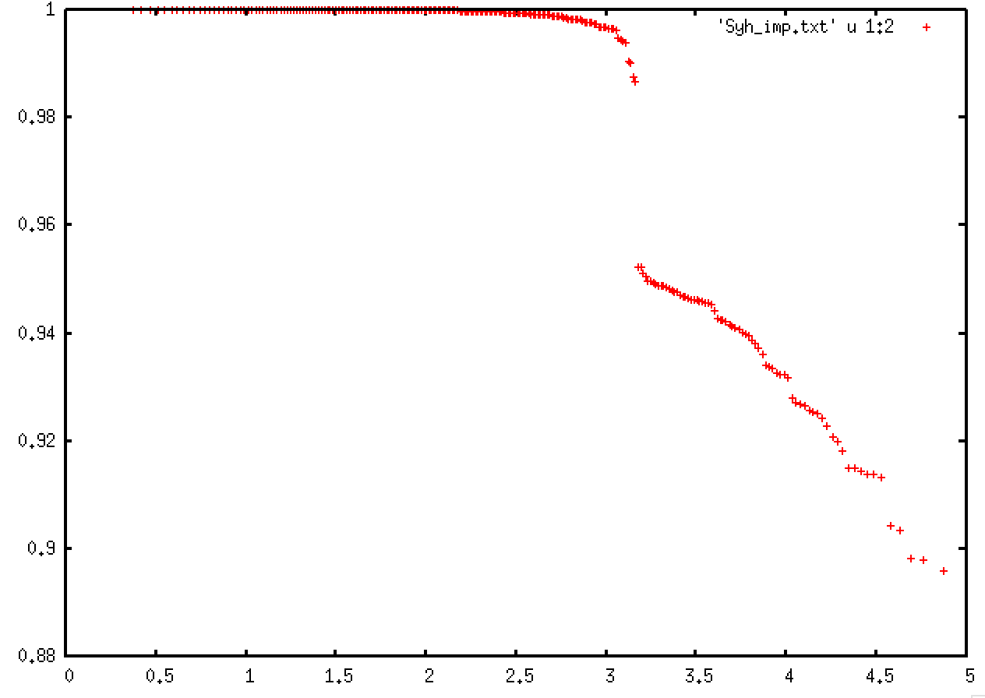
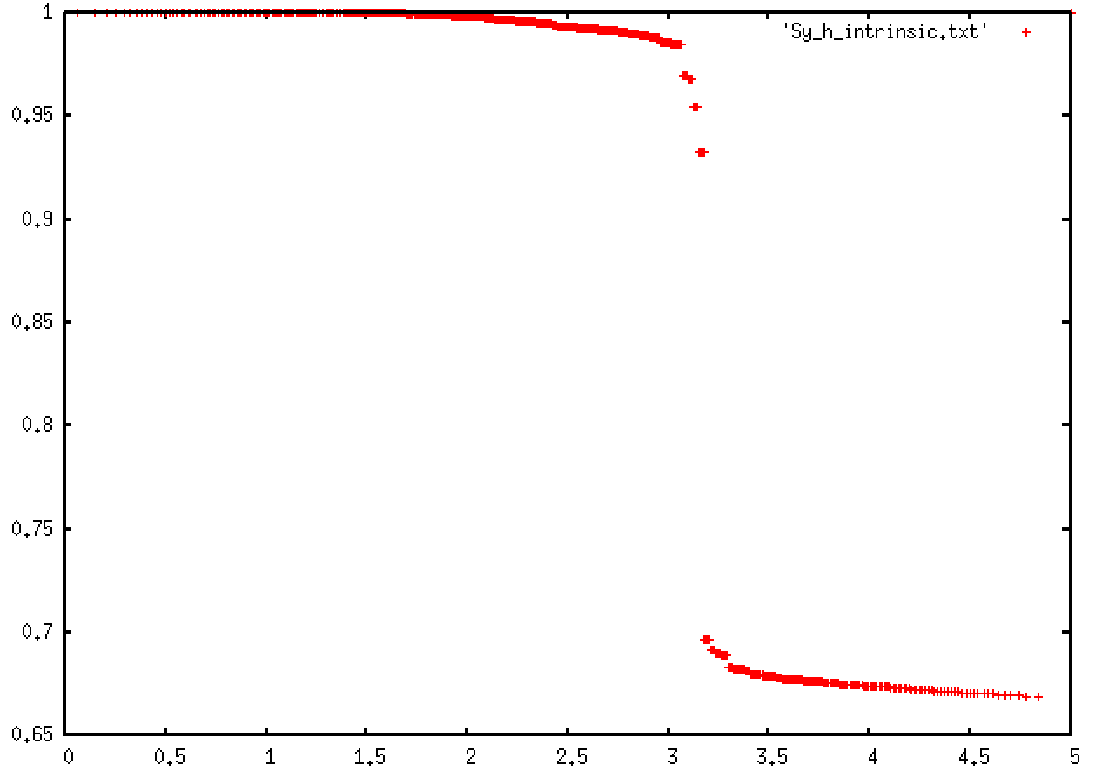
Estimation results
Loss by imperfection resonance
Loss by intrinsic resonance

Slide 5
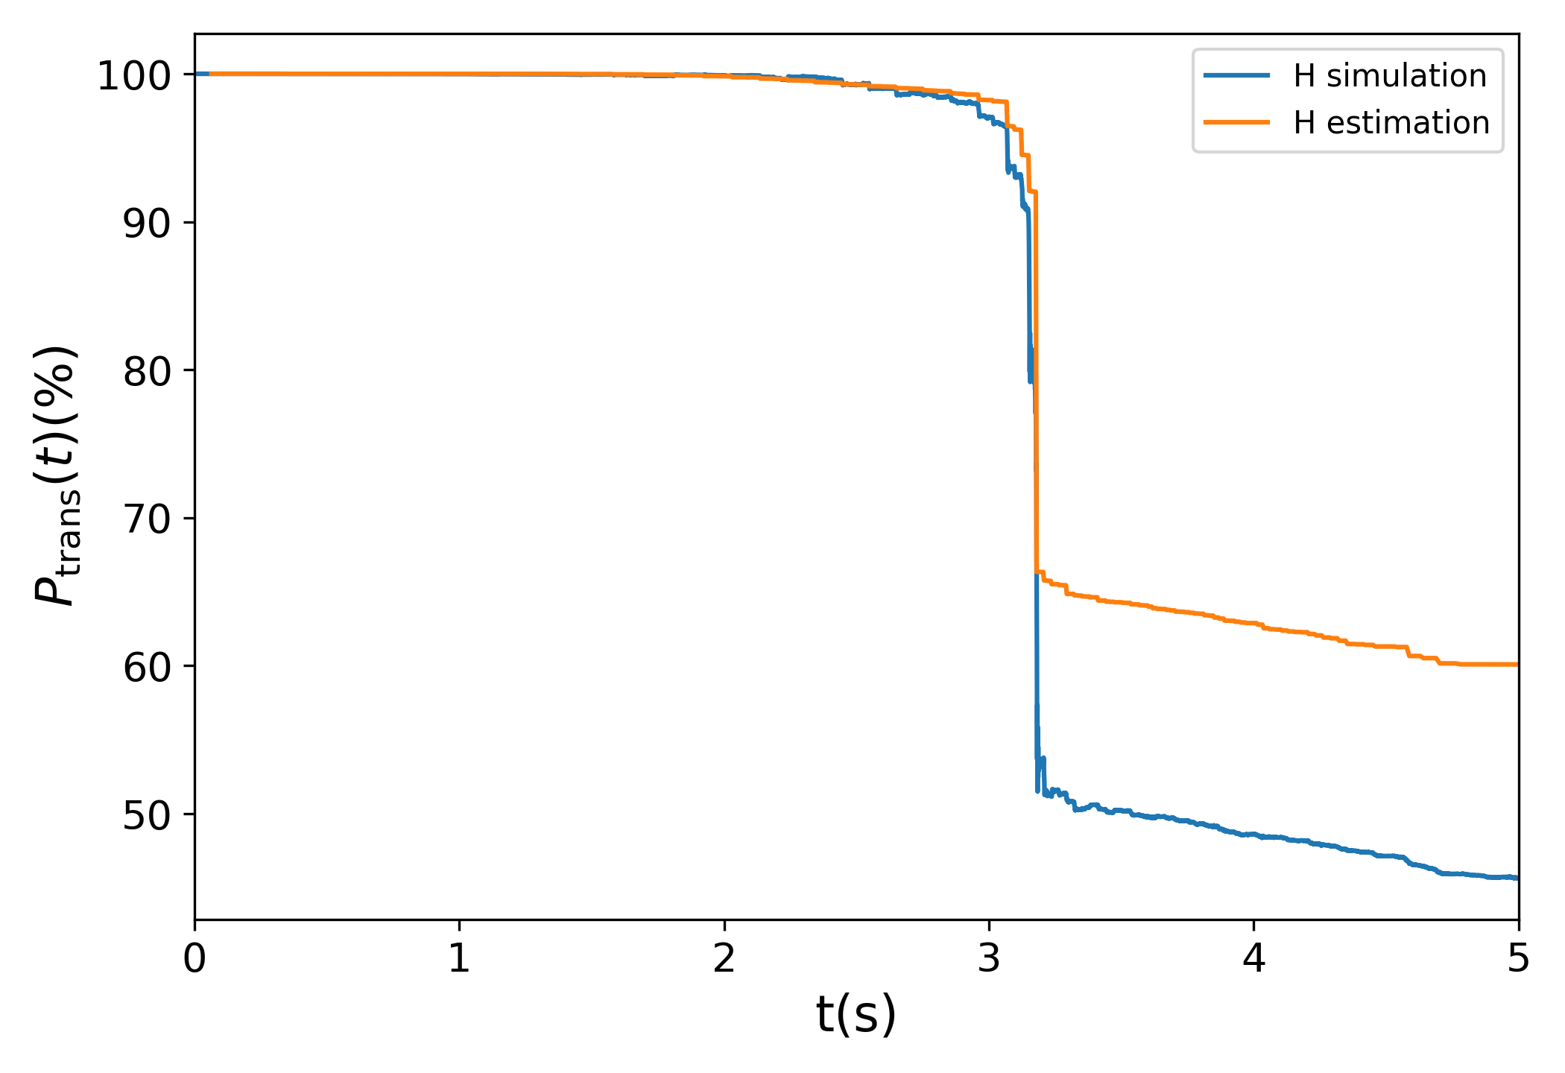
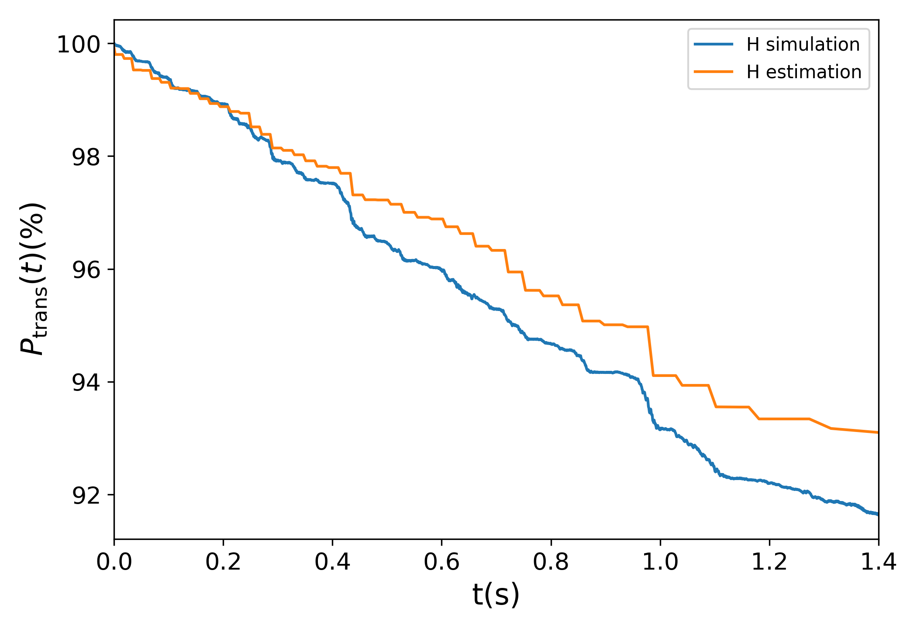
Simulation results
模拟与估计结果比较
峰值（199）附近差距较大
峰值以后，100-120GeV升能过程中退极化较小，且估计值与模拟结果差距也较小
0.663
0.601
$∆=$0.062
0.512
0.456
$∆=$0.056
K=199.21 intrinsic resonance
DEPOL 计算结果： epsilon=0.01775 （10pimmmrad）
BMAD计算：$ξ=\text{3.27671}e3 ，$共振强度$ε=\sqrt{J}∗ξ=0.0176781$

Slide 6
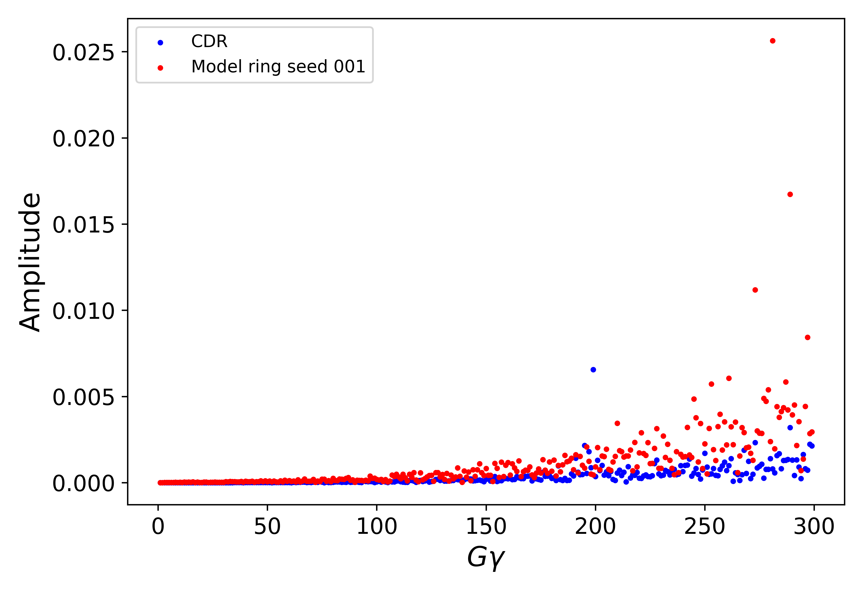
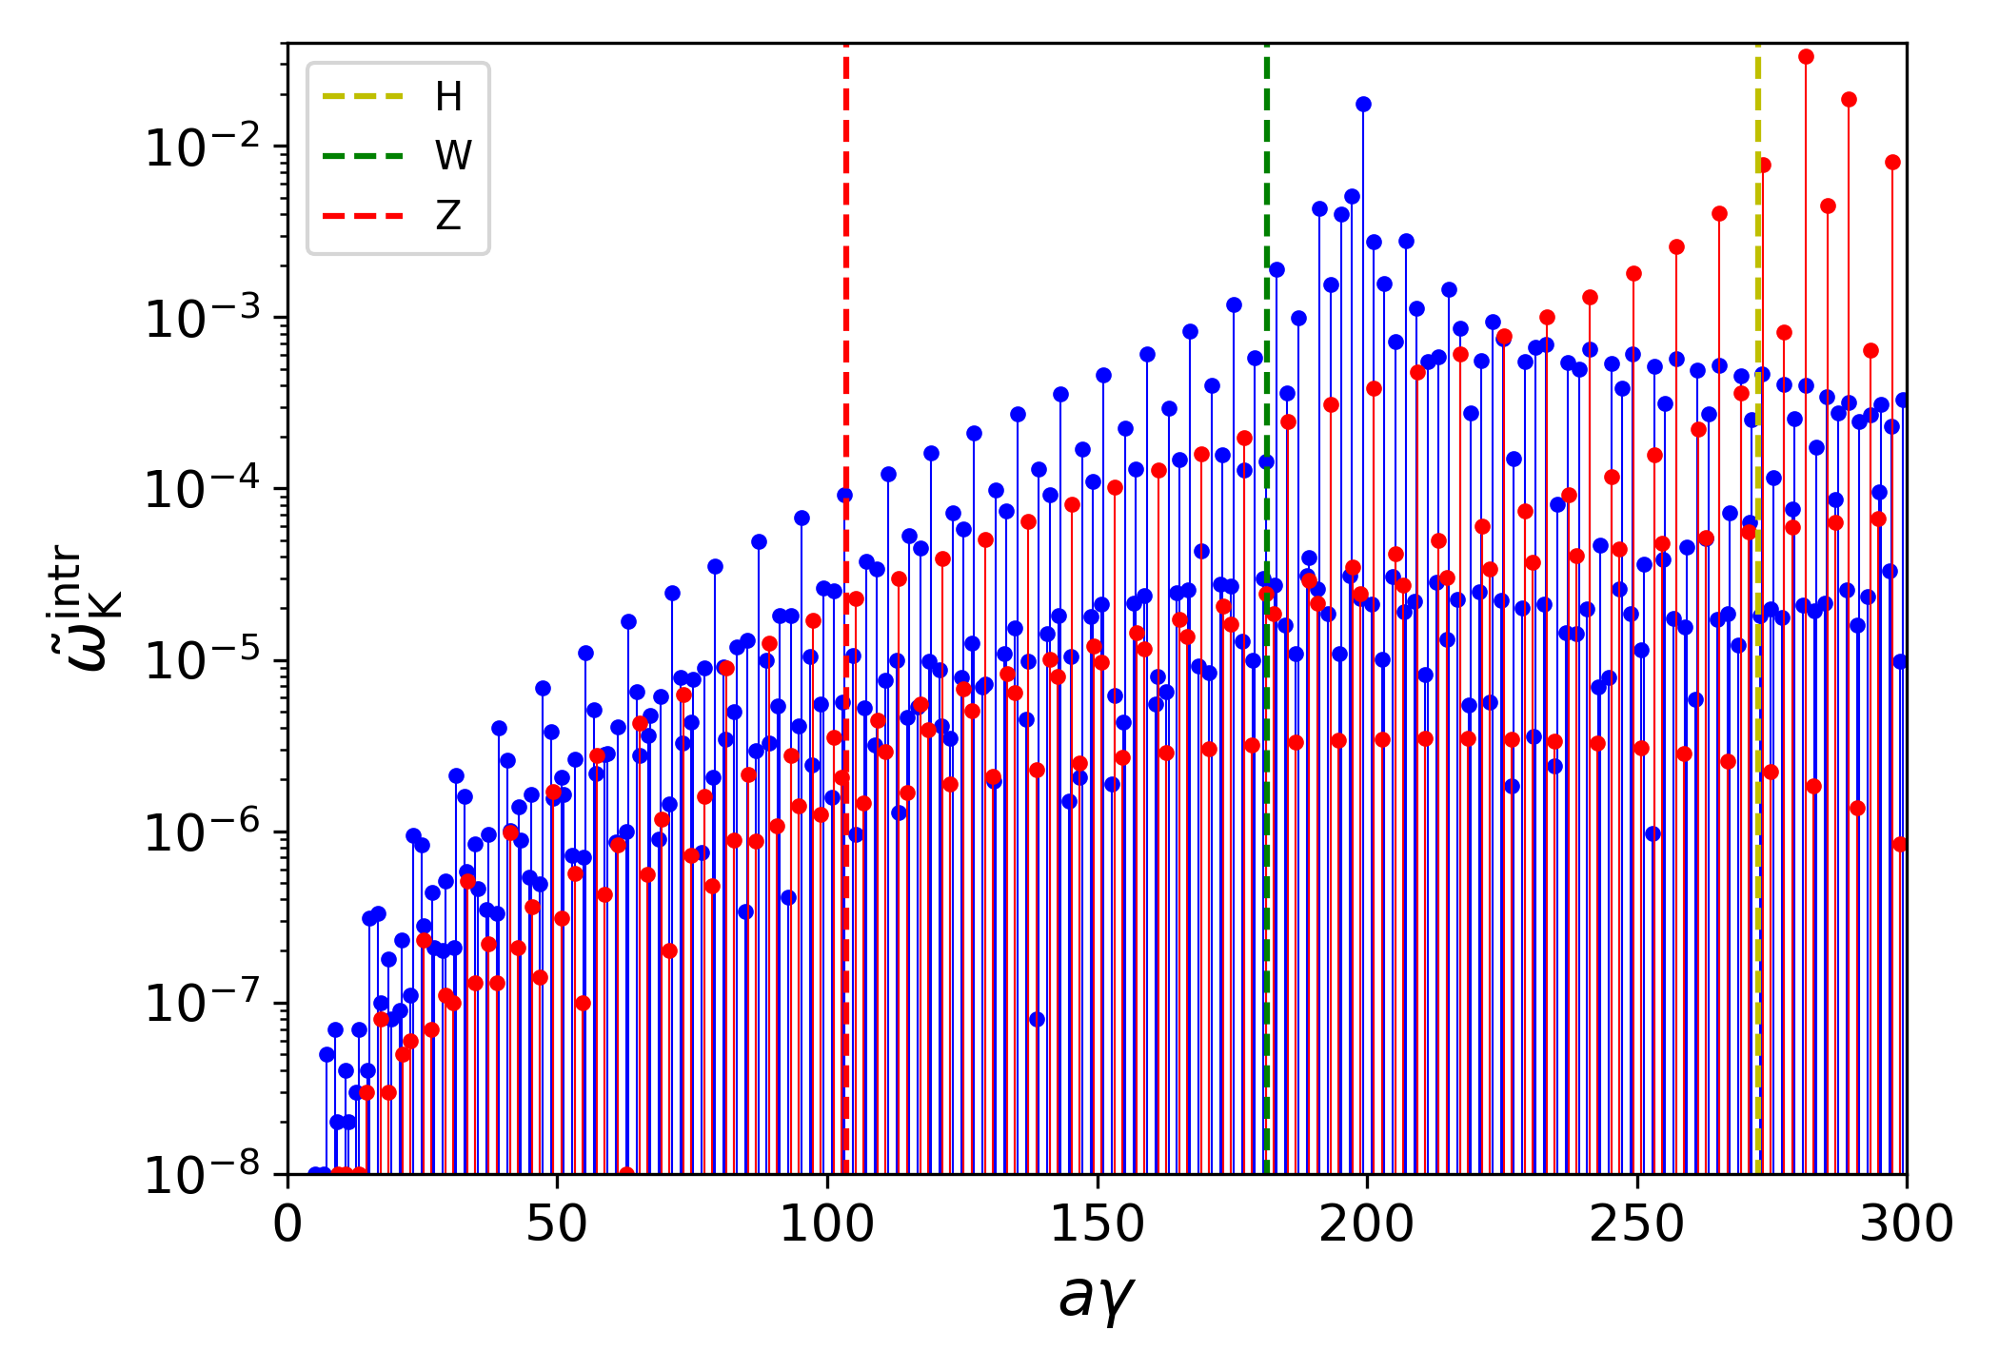
Compare of resonance strength
Seed 001 ,均方根闭轨=97微米，CDR为103微米

Slide 7
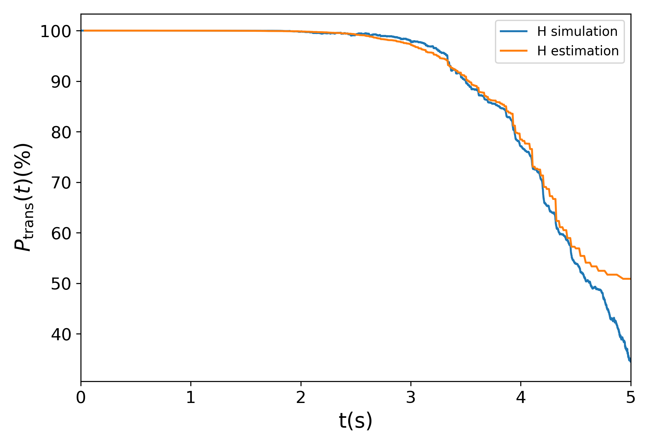
Compare of CDR and model ring
模拟与估计结果均是在共振较强位置相差较大
CDR lattice
Model ring seed 001

