Slide 1
Schwinger-Keldysh holography: two examples
Yanyan Bu（卜严严）
Harbin Institute of Technology

Slide 2
Motivations
For a finite temperature holographic model
how to “derive” effective description on the boundary, rather than “match” some well-known effective models or theories?
lessons from holographic studies: universal things
how to systematically capture both dissipations and fluctuations?
fluid-gravity is very powerful in addressing dissipations, transports, constitutive relations …
ingoing (or regular) conditions on the horizon
dissipation on the boundary

Slide 3
Plan
SK contour and gravity dual
SK theory for nonlinear Brownian motion
Holographic Ginzburg-Landau effective action
What to do with the nonlinear SK action?
Summary and Outlook

Slide 4
SK contour and gravity dual
references
A. Kamenev, Field Theory of Non-Equilibrium Systems, Cam. Univ. Press, 2023
C. P. Herzog, D. T. Son, Schwinger-Keldysh propagators from AdS/CFT correspondence, JHEP 03 (2003) 046
B. van Rees, K. Skenderis, Real-time gauge/gravity duality: Prescription, Renormalization and Examples, JHEP 05 (2009) 085
P. Glorioso, M. Crossley, H. Liu, A prescription for holographic Schwinger-Keldysh contour in non-equilibrium systems, 1812.08785

Slide 5
For a quantum many-body system
Hamiltonian:
$$H(t)$$
initial state:
$$ρ_{0}=ρ(t_{i}=−∞)$$
Von Neumann eqn:
$$∂_{t}\hat{ρ}(t)=−i[\hat{H}\left(t\right),\hat{ρ}(t)]$$
Observable
$\left\langle O\right\rangle \left(t\right)=Tr\left\{\hat{O}\hat{ρ}\left(t\right)\right\}$/ $Tr\hat{ρ}\left(t\right)$

Slide 6
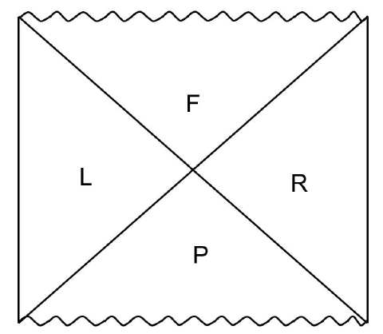
Herzog-Son approach 2002
usual calculations done in either L or R quadrant : $r∈[r_{h},∞)$
For the SK construction, we need to properly “glue” both solutions in L and R
Convinced the “ingoing” prescription for retarded 2pt function within AdS/CFT

Slide 7
van Rees-Skenderis approach 2008
$$t_{i}$$
$$t_{f}$$
SK contour embedded into a mixed-signature AdS black brane
$$β$$

Slide 8
van Rees-Skenderis approach 2008
Lorentzian AdS BH
$$t_{i}$$
$$t_{f}$$
SK contour embedded into a mixed-signature AdS black brane
Euclidean AdS BH
Lorentzian AdS BH
$$β$$

Slide 9
van Rees-Skenderis approach 2008
Lorentzian AdS BH
$$t_{i}$$
$$t_{f}$$
SK contour embedded into a mixed-signature AdS black brane
Euclidean AdS BH
Lorentzian AdS BH
$$β$$
piecewise solutions for bulk fields, to be glued at three time slices
$$t_{1}=t_{f},t_{2}=t_{f}$$
subscripts 1 or 2: upper or lower branch;
$τ$ for imaginary time
$$t_{1}=t_{i}, τ=β$$
$$t_{2}=t_{i}, τ=0$$

Slide 10
Glorioso-Crossley-Liu approach 2018
$$ds^{2}=2dvdr−r^{2}f\left(r\right)dv^{2}+r^{2}d{\vec{x}}^{2}, f\left(r\right)=1−r_{h}^{4}/r^{4}$$
thermal state: $r_{h}=constant$
bulk dynamics on the complexified $r$-contour
non-equilibrium initial state: $r_{h}=r_{h}(x^{α})$

Slide 11
SK theory for nonlinear Brownian motion
Medium
integrate out
Medium d.o.f.
Langevin theory for
$$M_{kin}\ddot{q}+η_{0}\dot{q}=χ(t)$$
FDT
$$\left\langle χ\left(t\right)\right\rangle =0, \left\langle χ\left(t\right)χ\left(t^{′}\right)\right\rangle =ξ_{0}δ(t−t′)$$
systematic generalizations: non-Gaussianity, breaking of spatially rotational symmetry, presence of E&B, etc?

Slide 12
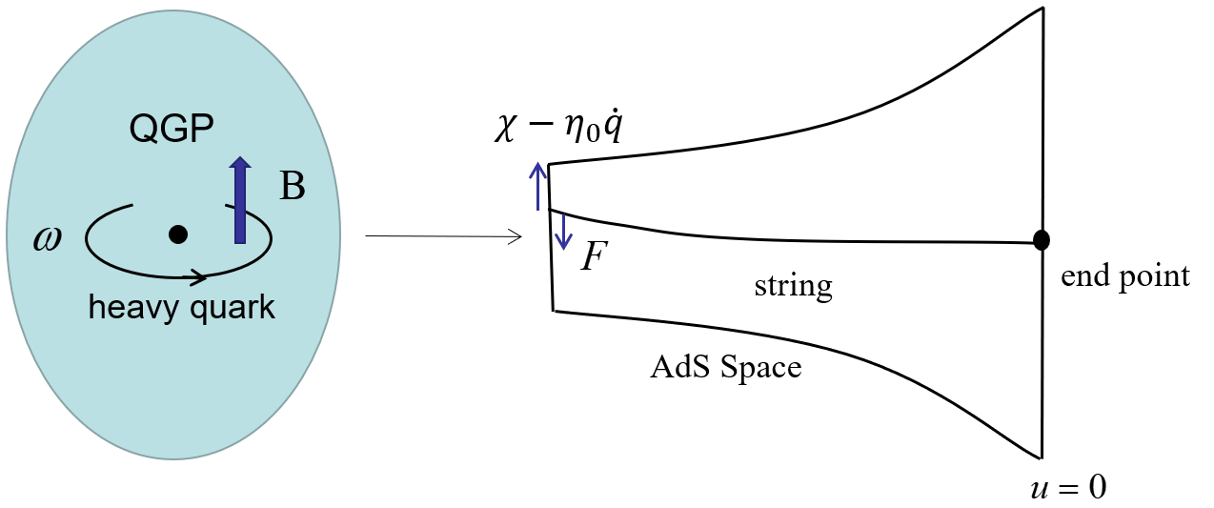
References:
B. Chakrabarty, et al., Nonlinear Langevin dynamics via holography, JHEP 01 (2020) 165
Y. Bu, B. Zhang, Schwinger-Keldysh effective action for a relativistic Brownian particle in the AdS/CFT correspondence, Phys. Rev. D 104 (2021) 8, 086002
Y. Bu, B. Zhang, J. Zhang, Nonlinear effective dynamics of a Brownian particle in magnetized plasma, Phys. Rev. D 106 (2022) 8, 086014

Slide 13
Magnetized Plasma
Magnetic brane in AdS5
$B/T^{2}≪1$: perturbative analytic solution
$B/T^{2}$ generic: numerical solution
for more details, see
Y. Bu, S. Lin, Magneto-vortical effect in strongly coupled plasma, Eur. Phys. J. C 80 (2020) 5, 401

Slide 14
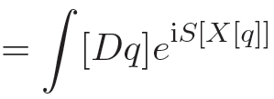
boundary SK action and open string dynamics
$$S=S_{NG}+S_{bdy}$$
$X$: embedding profiles of open string in AdS

Slide 15
static gauge
$$σ^{a}=\left(u,t\right), { X}^{i,z}=X^{i,z}(u,t)$$
geometry on world-sheet of open string
The following story will be similar to that of a probe massless scalar in AdS black brane
anisotropy
high nonlinearity

Slide 17
dynamical variables of boundary theory are encoded in boundary conditions of $X^{i,z}$
The goal is to obtain $S_{eff}\left[q\right]$ up to $𝒪(q^{4})$, it is thus sufficient to obtain linearized string profile $X_{\left(1\right)}^{i,z}$
The original task solving linearized EOMs for open string on the holographic contour

Slide 18
take transverse mode $X^{i}$ as an illustration
“gluing”
the gluing conditions at $u=1+ε$?

Slide 19
the first gluing condition
the second gluing condition
piecewise solutions on the entire contour
gluing

Slide 20
time-reversal (T -)symmetry in the bulk
We resort to Poincare patch
ingoing EF
compact expression on entire contour
transparent T-symmetry guarantees KMS symmetry on the boundary

Slide 21
The “integration constants” $c,h$ will be determined by two AdS boundary conditions
boundary action is obtained by implementing contour integral

Slide 22
Generically, it’s hard to compute $S_{NG}^{(4)}$
To order $𝒪(q^{3}∂_{t}q)$, we obtain $S_{NG}^{(4)}$ via residue theorem
Only horizon values of metric functions will be relevant!
Holography not only predicts the form of SK action for the boundary theory, but also gives values for various coefficients in the SK action.
Holography is insightful in understanding symmetries of formulating boundary SK theory (skipped here)

Slide 23
Results
Keldysh basis
colored noise

Slide 24
FDT at quadratic level
drag coefficients in terms of metric functions

Slide 25
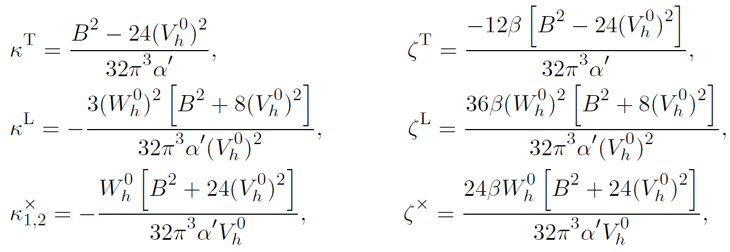
are horizon values of the metric functions $V, W$
KMS relations

Slide 26
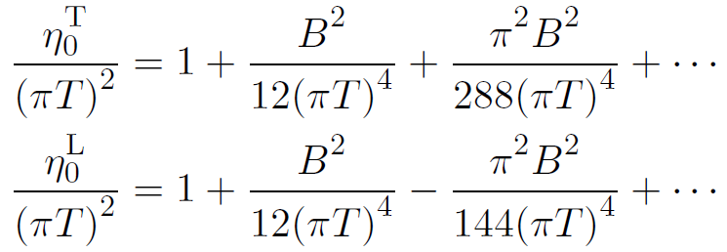
When
For generic $B/T^{2}$

Slide 27
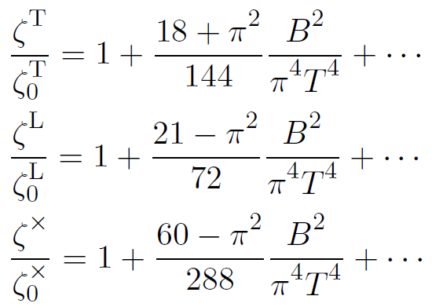
When
The $B=0$ results agree with those of “B. Chakrabarty, et al. JHEP 01 (2020) 165”, up to an overall sign

Slide 28
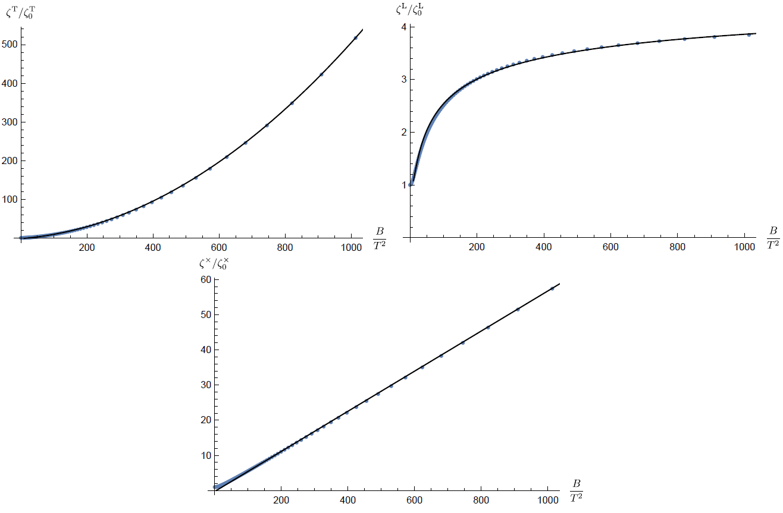
For generic $B/T^{2}$

Slide 29
Holographic Ginzburg-Landau effective action
A second order phase transition
$$T_{c}$$
$$T$$
Effective description near the critical point, $T=T_{c}$
$${F\left[Δ\right]→S}_{eff}[Δ]$$
References:
Y. Bu, F. Mitsutoshi, S. Lin, Ginzburg-Landau effective action for a fluctuating holographic superconductor, JHEP 05 (2021) 187
L. Yin, D. Hou, H-c. Ren, Ginzburg-Landau theory of a holographic superconductor, Phys.Rev.D 91 (2015) 2, 026003

Slide 30
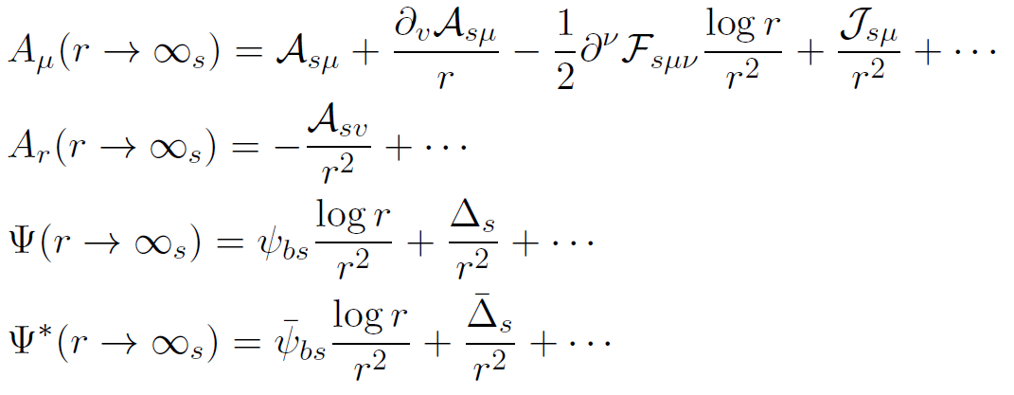
C. P. Herzog, An Analytic Holographic Superconductor, Phys. Rev. D 81 (2010) 126009
analytical solutions become possible
boundary analysis and dynamical variables
time-dynamics only

Slide 31
triple expansion
nonlinear PDEs
decoupled linear ODEs

Slide 32
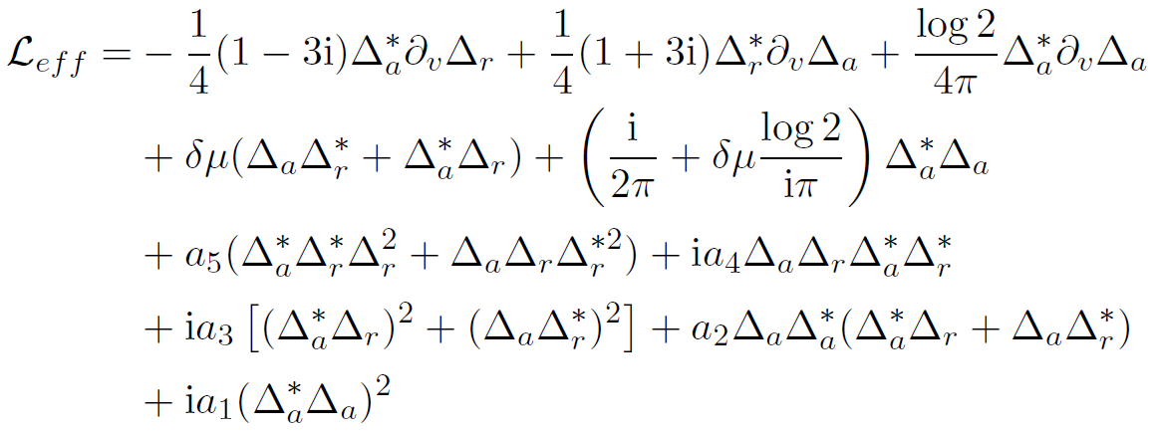
are known numerically
The first two lines and the $a_{5}$-term will produce the following eqn of “model A”
$F[Δ_{r}]$ is the Ginzburg-Landau free energy

Slide 33
bring in multiplicative noise in the Langevin eqn
are of the same structure as the non-Gaussian terms in the story of “nonlinear Brownian motion”
they bring in non-Gaussian noises
The fact that the coefficients are complex do not break any basic rules.

Slide 34
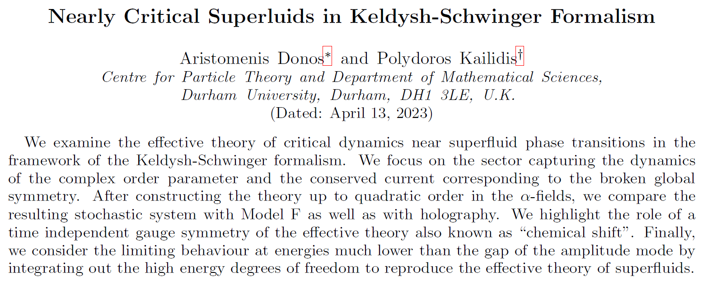
What about the inclusion of charge diffusive mode?
Limited to Gaussian noises
MSR action of “model F”

Slide 35
What to do with the nonlinear SK action?
S. Lin, Y. Bu, C. Lei, Non-Gaussianity from Nonlinear Effective Field Theory, 2301.06703
For illustration, we use Brownian motion e.g. and take $B=0$
diagrammatic approach to correlation functions
for e.g.,
What about stochastic formulations of the SK theory?

Slide 36
generalized Langevin eqn
?
this works well for
multiple non-Gaussian noises

Slide 37
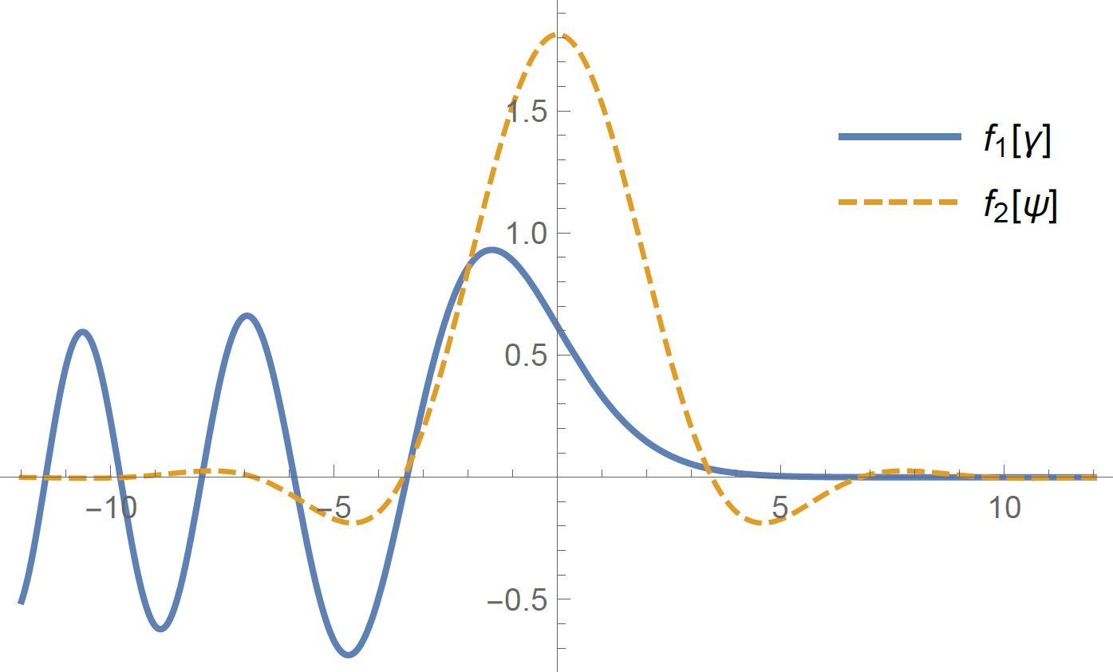
noise weights are not positive-definite!
Indeed, region with negative weight MUST be present, in order to be consistent with $\left\langle γ^{2}\right\rangle =\left\langle ψ^{2}\right\rangle =0$

Slide 38
generalized Fokker-Planck eqn
the probability of finding the system to be with $\left({q_{r}\left(t\right), \dot{q}}_{r}\left(t\right)\right)=\left(q,v\right)$ at time $t$
$$M_{kin}=1$$

Slide 39
Lagrangian formulation
Hamiltonian formulation
canonical conjugate pairs
“quantization”
more efficient in numeric simulations

Slide 40
Summary and Outlook
The holographic SK contour approach works well for deriving nonlinear SK effective action for boundary theory: Brownian motion, and Ginzburg-Landau effective action
Holographic calculations give values for all the coefficients in the boundary SK action
Two stochastic formulations of nonlinear SK action: generalized Langevin vs. generalized FP eqns
Holographic derivation of SK EFT for slow modes: conserved densities and explicit/spontaneous breaking of global symmetries

Slide 41
Thanks for your attention!

