Slide 1
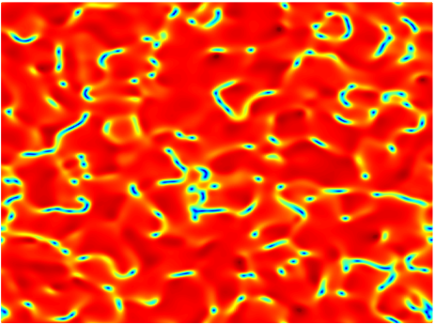
Universality of Phase Transition Dynamics and Holography
曾化碧 扬州大学
PHYSICAL REVIEW LETTERS 130, 060402 (2023)
PHYSICAL REVIEW D 102, 126005 (2020)
JHEP 03 (2021) 136
arXiv:2110.07969 [cond-mat.stat-mech]
e-Print: 2302.11597 [hep-th]

Slide 2
* A short introduction to non-equilibrium AdS/CMT
* Review of equilibrium phase transition critical exponents in holography
* Topological defects formation in phase transition dynamics：Kibble-Zurek mechanism(KZM)
* Experiments beyond KZM：fast quench and finite size
* New universal scaling law beyond KZM and numerical verification
* Summary and outlooks

Slide 3

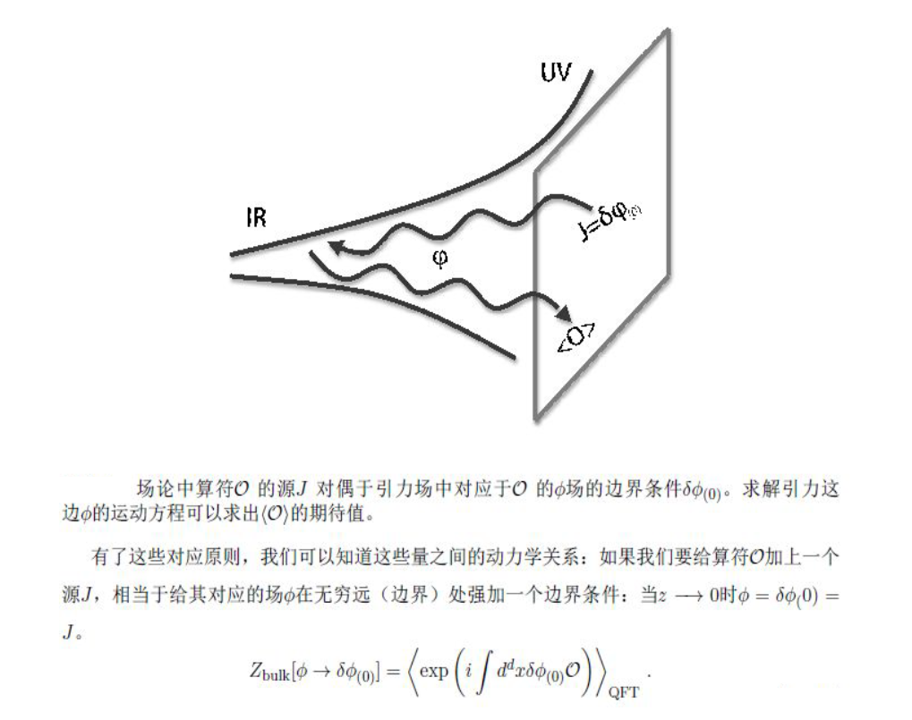
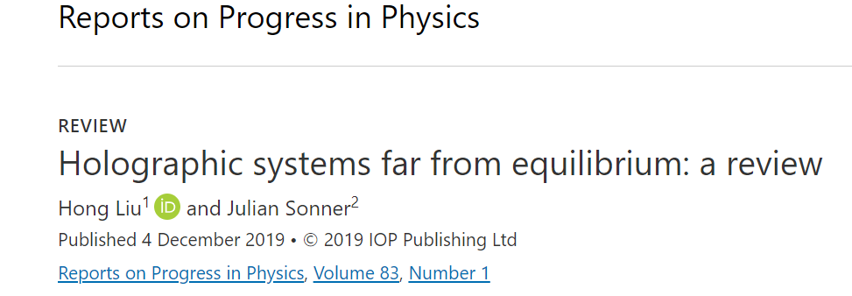
Time dependent AdS/CMT（Bottom-up）
Solve the dynamical equation of motion in the bulk to obtain the information of the boundary theory
dynamics

Slide 4
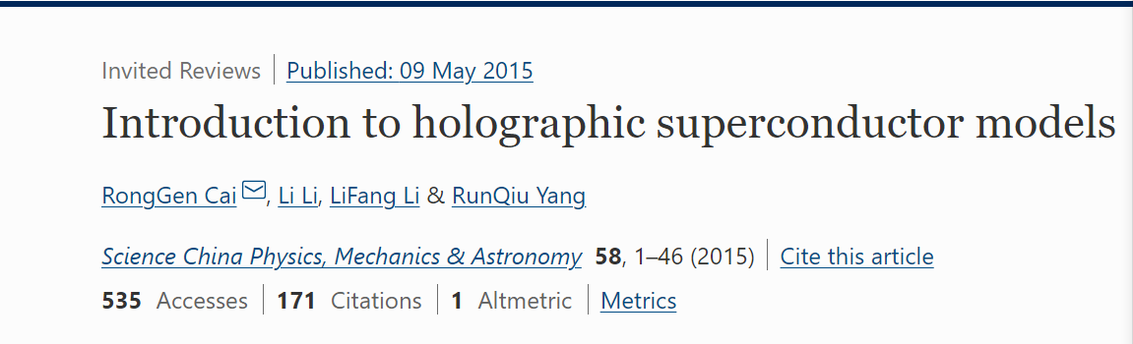
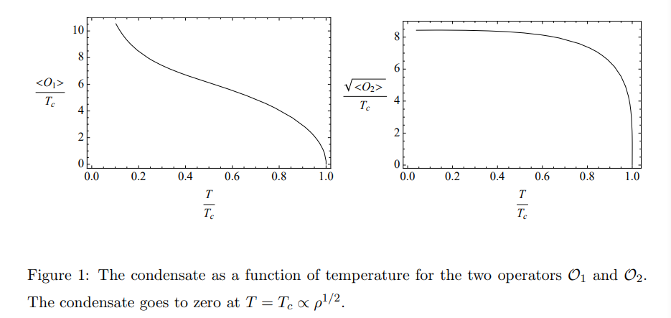
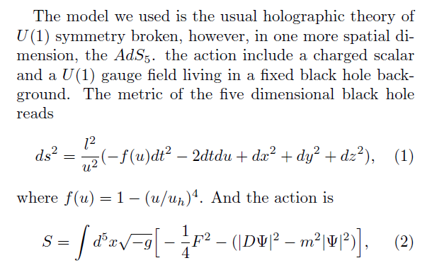
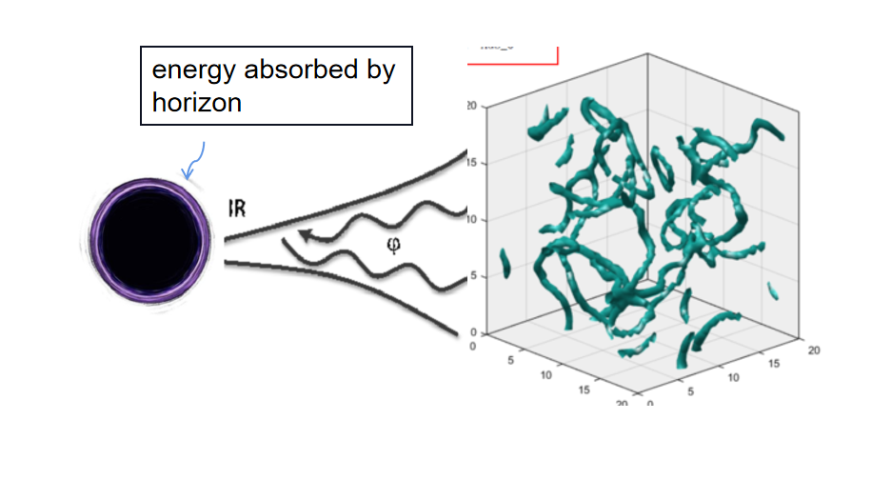
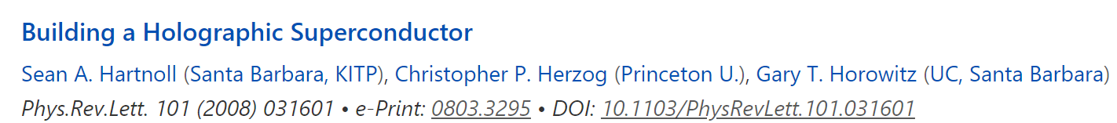
One example in the probe limit
Dynamics of holoraphic superfluid/superconductor

Slide 5
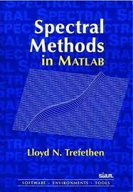
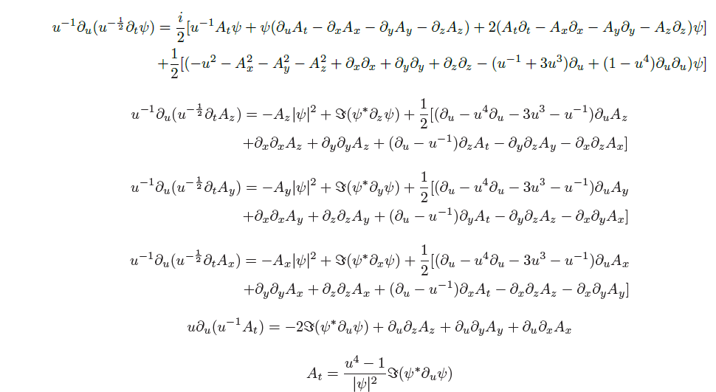
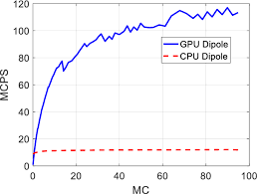
Numerical scheme
t（Runge-Kutta）, x,y,z（Fourier or Chebyshev）, u（Chebyshev）
Use GPU to save time

Slide 6
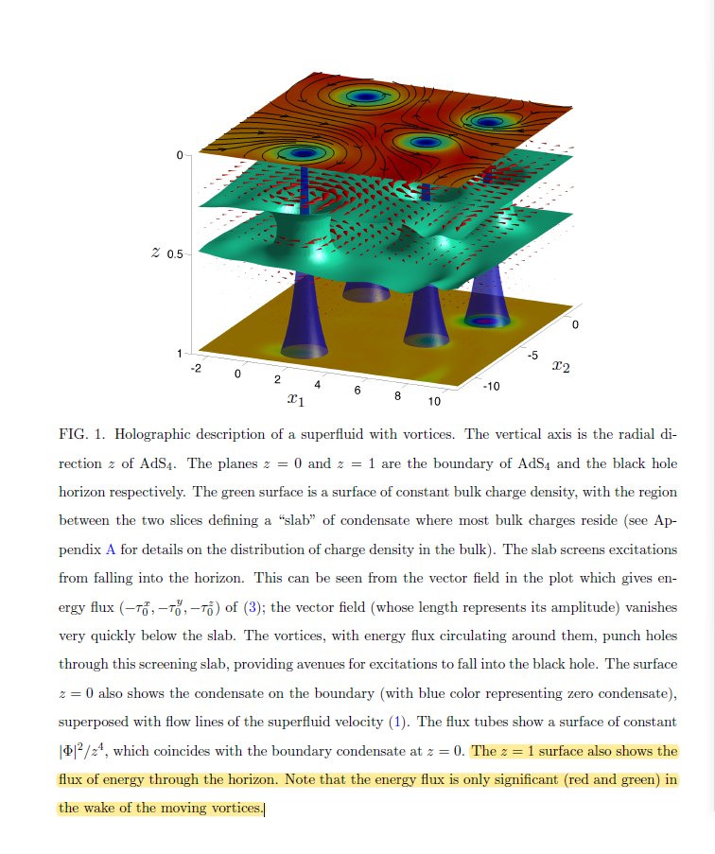
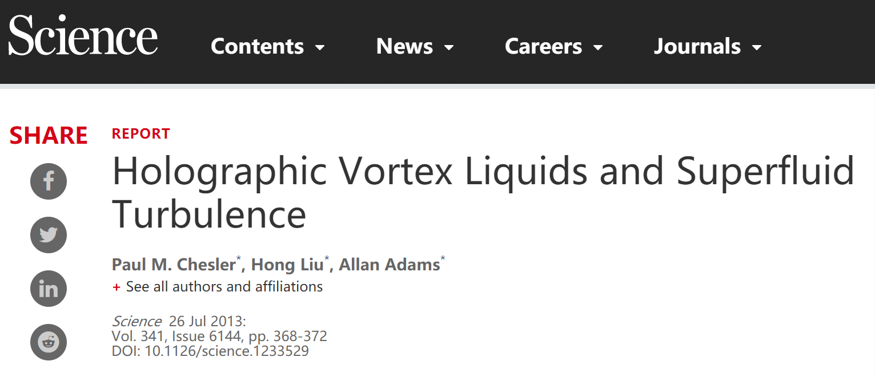
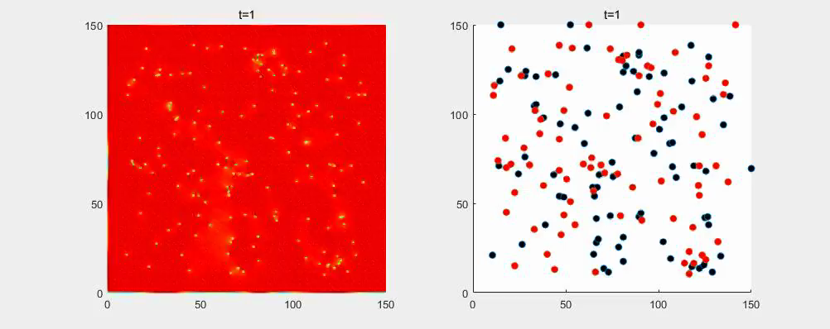
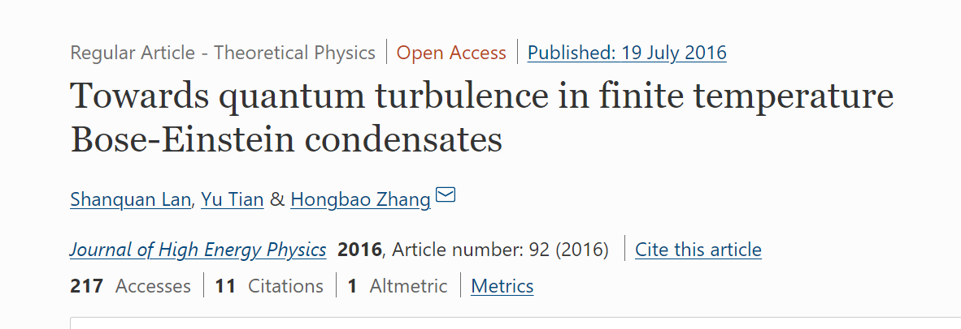
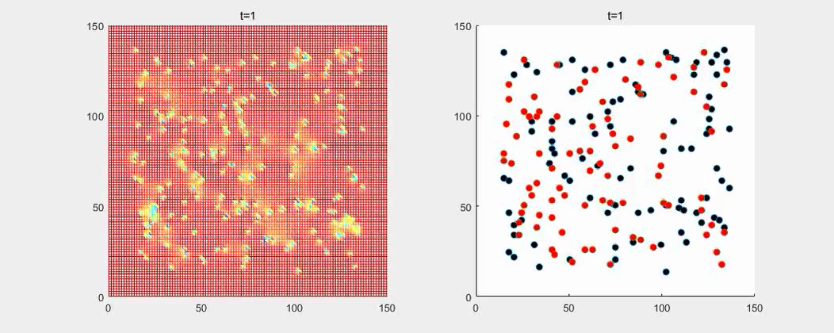
One example：holograhic quantum turbulence
RN 黑洞背景（T~0），work in progress

Slide 7
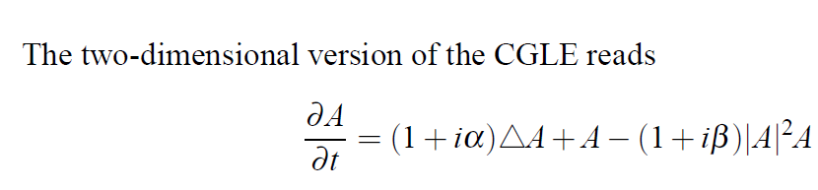
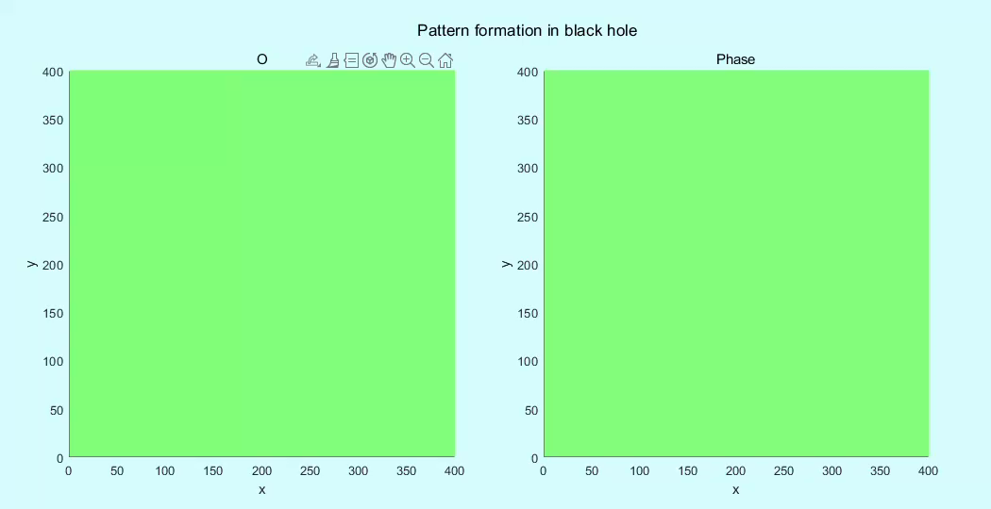
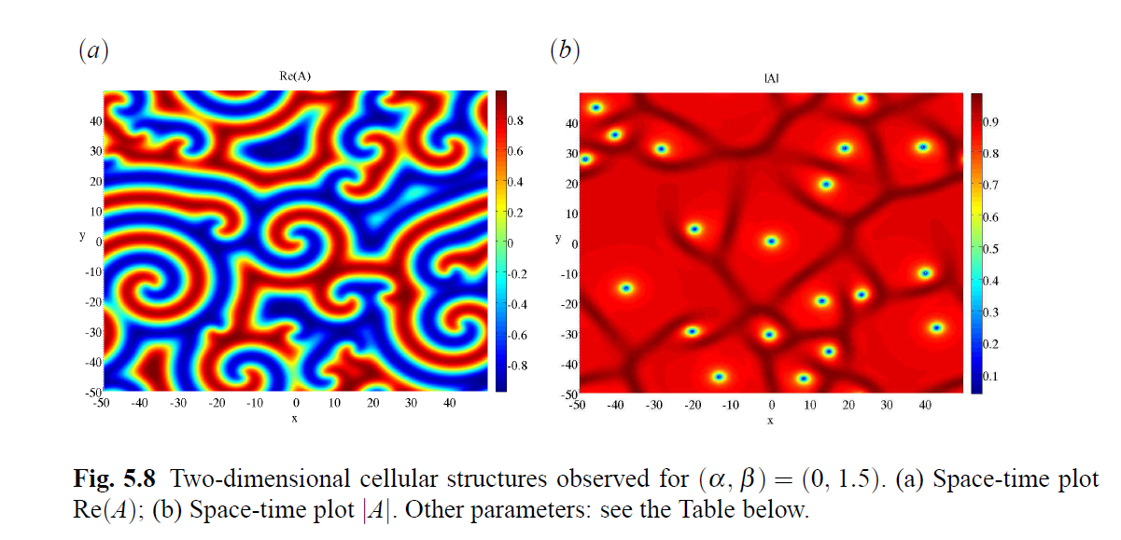
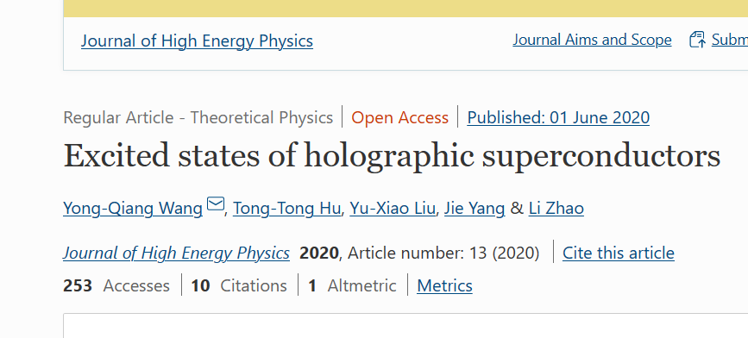
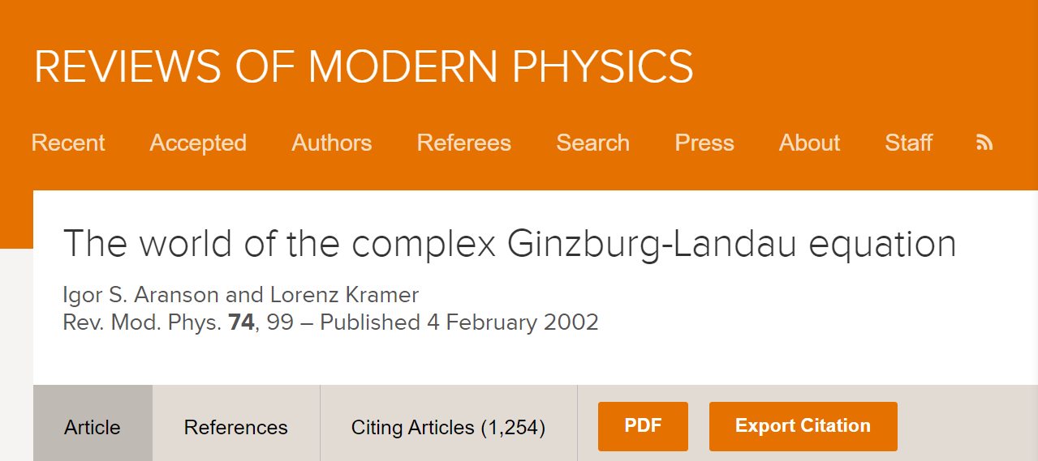
Another example：Pattern formation（work in progress）
Spiral wave solution of complex scalar field in AdS_4
More complex than G-L

Slide 8
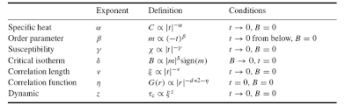
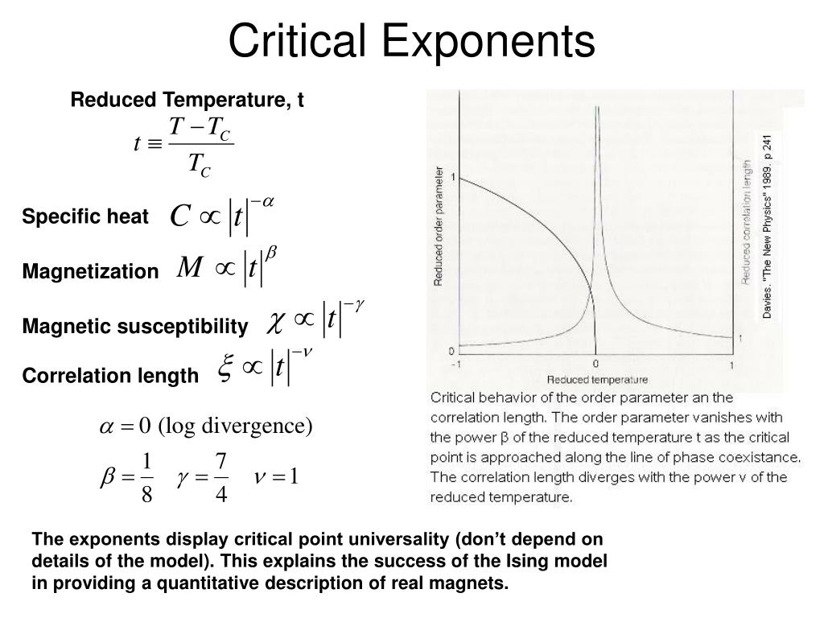
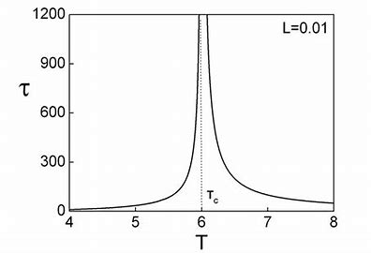
Universality of continuous phase transition
温度缓慢变化
发散的弛豫时间

Slide 9



Critical exponents of holographic superfluid/superconductor:
match G-L theory

Slide 10
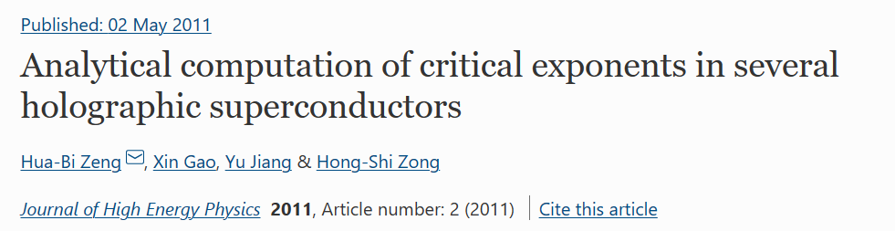
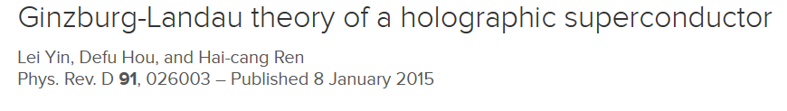
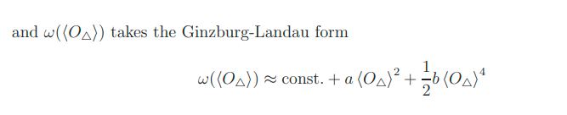
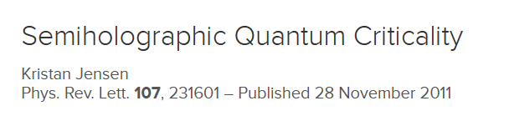

Near T_c, the effective theory of superconductor is a G-L theory
More than G-L theory
locally quantum critical

Slide 11
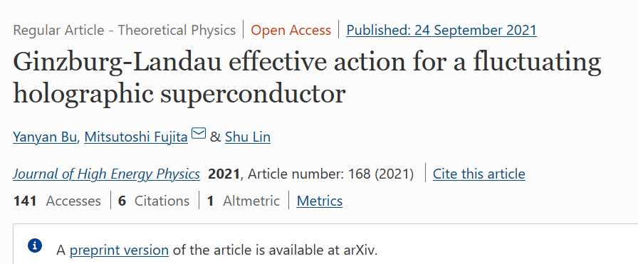
Non-equilibrium holographic superconductor near T_c: Time dependent G-L theory
An semi-holographic version for the dynamical case?

Slide 12
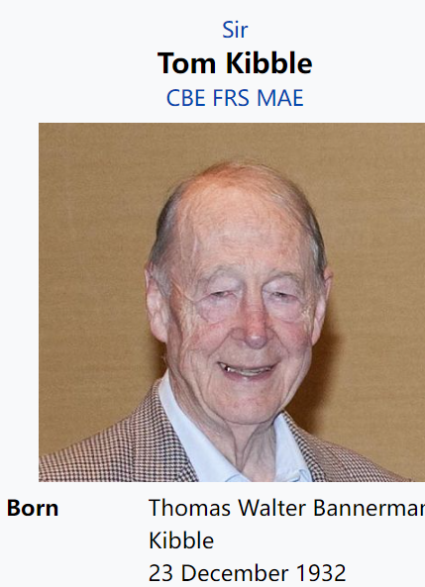
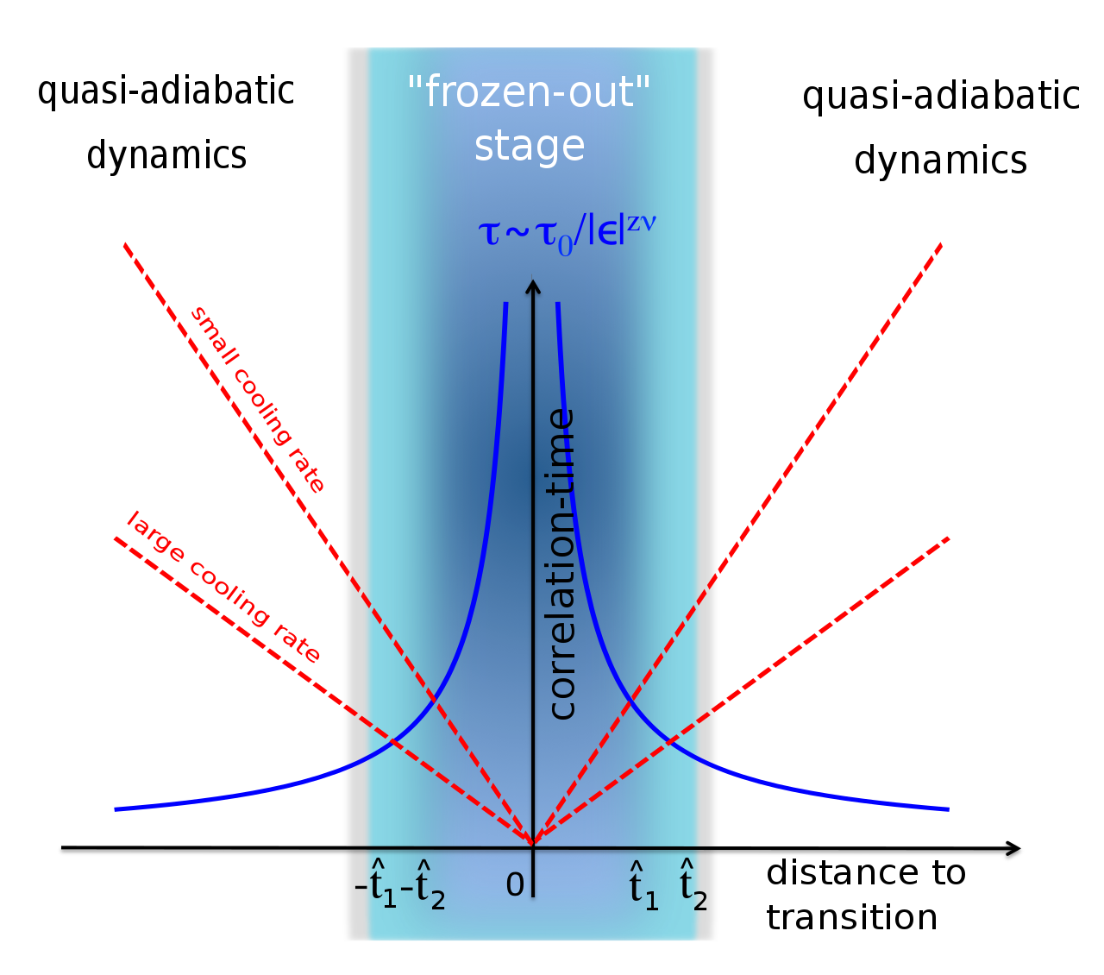
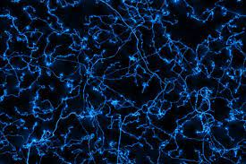
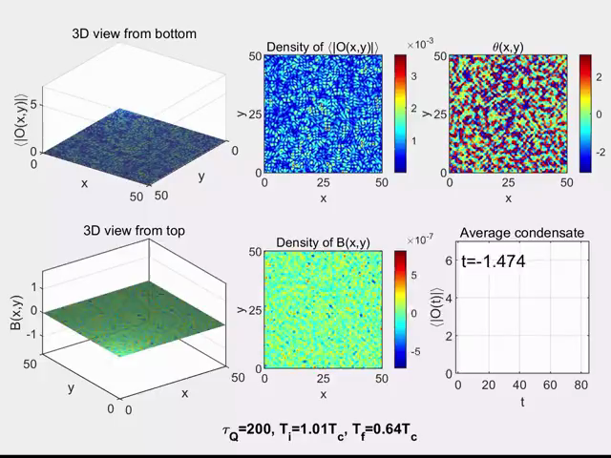
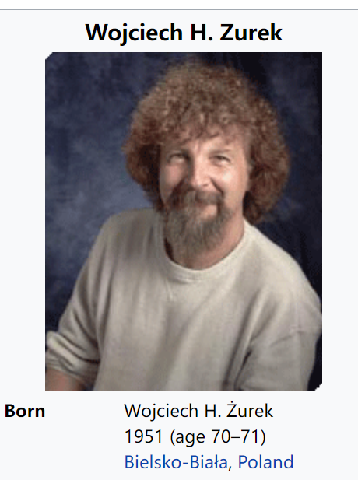
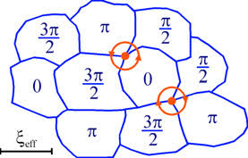
Kibble-Zurek mechanism
温度
critical slowing down
Cosmic string
临界温度
时间
Cosmic string
以可观的速度通过临界点

Slide 13
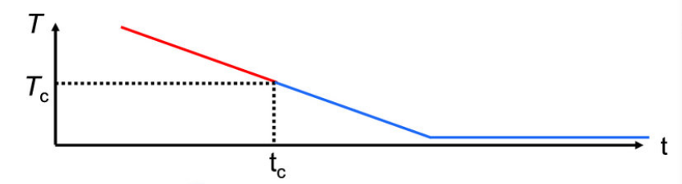
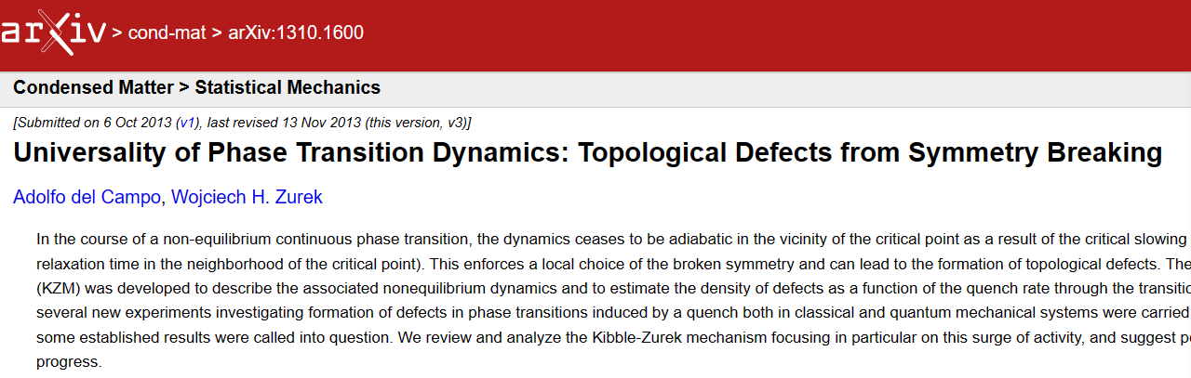
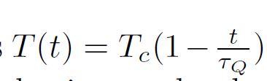
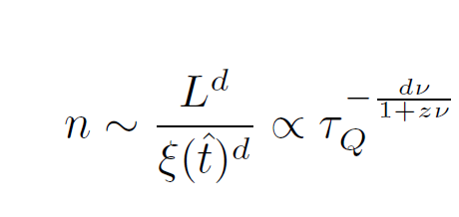
Kibble-Zurek mechanism
Zurek 把拓扑缺陷密度与临界指数（一个是时间特征尺度，一个是空间特征尺度）关联起来，尽管看起来过程具有非线性与空间非均匀性质,但Zurek找到了一种普适规律。

Slide 14
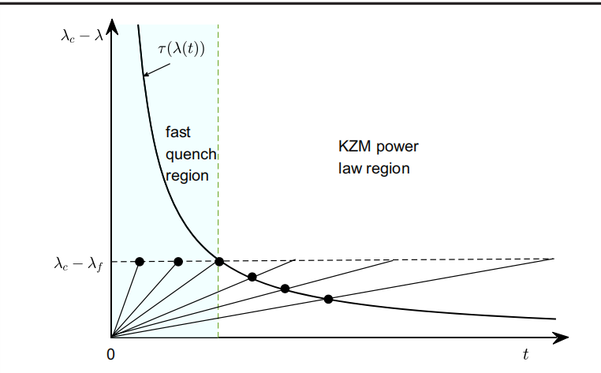


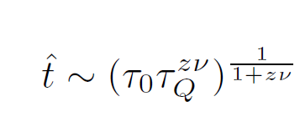
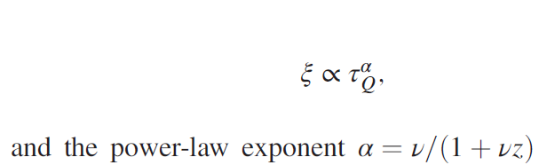
Derivation of Kibble-Zurek scaling
系统何时分块？以什么特征尺度进行分块？
弛豫时间
系统分块的时间
系统开始演化的时间：
L >> \xi(具体多大？)
分块的数量：
n ~ L^d,
多次统计结果
与末尾温度无关

Slide 15
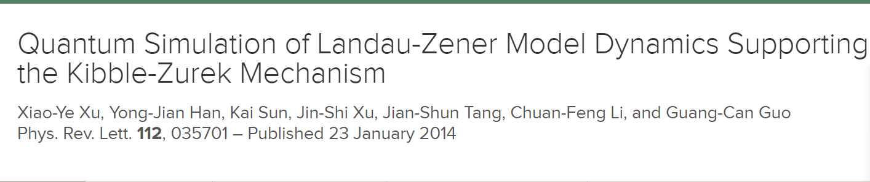
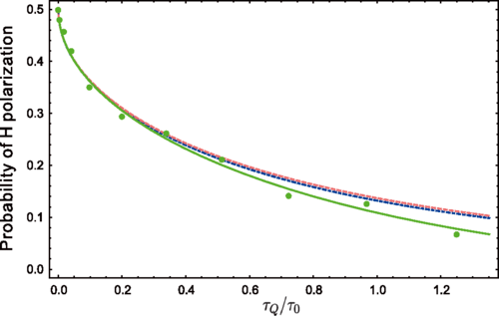
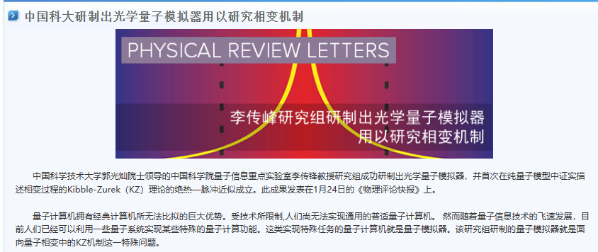
Experimental verification

Slide 16
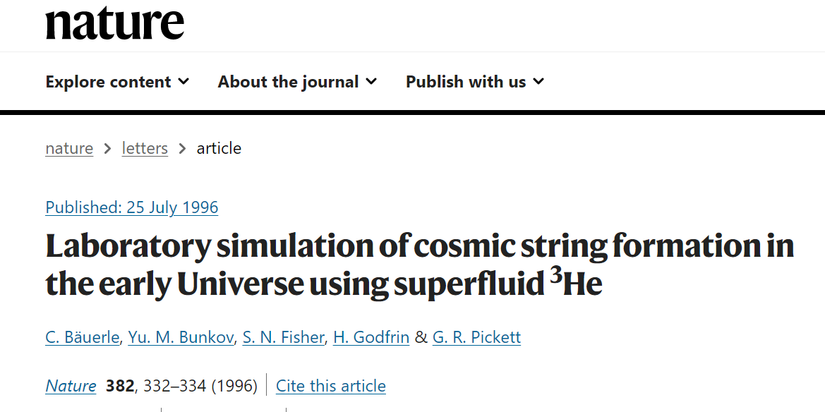
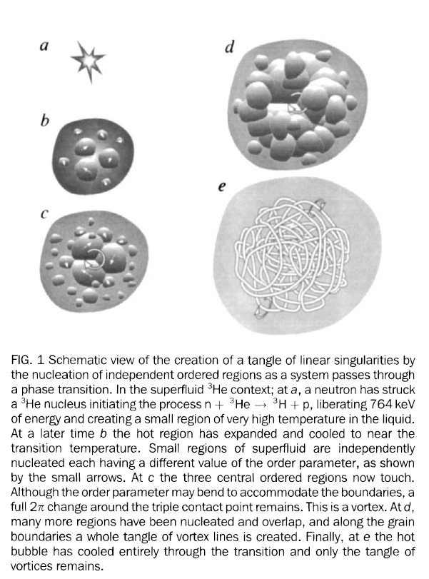

Slide 17
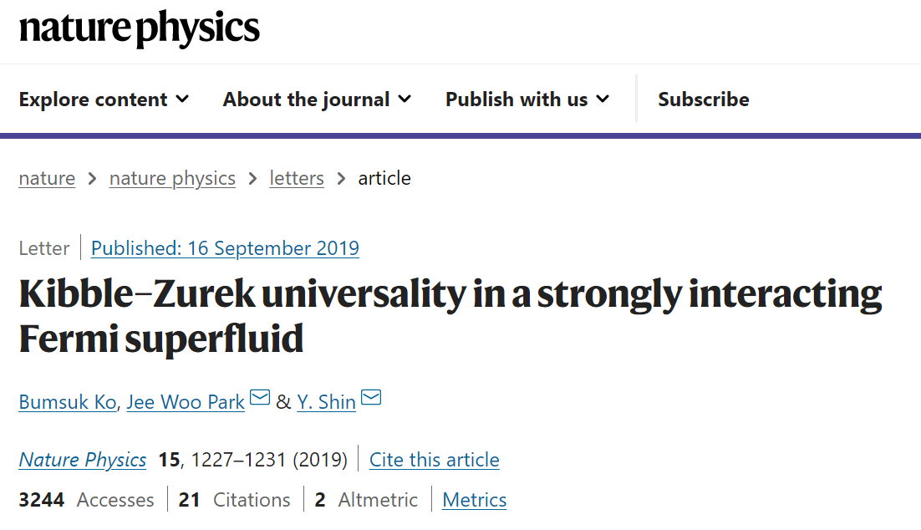
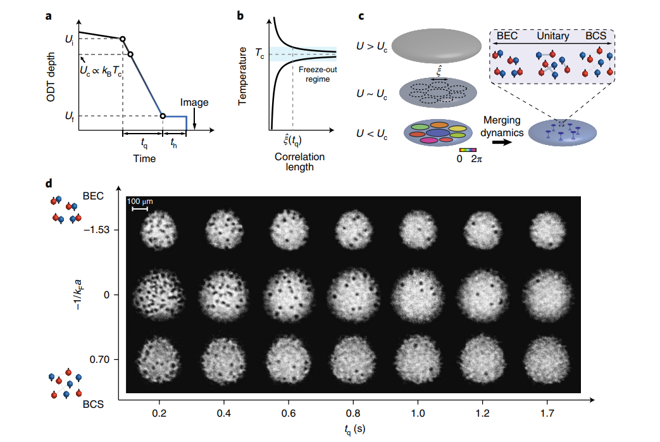
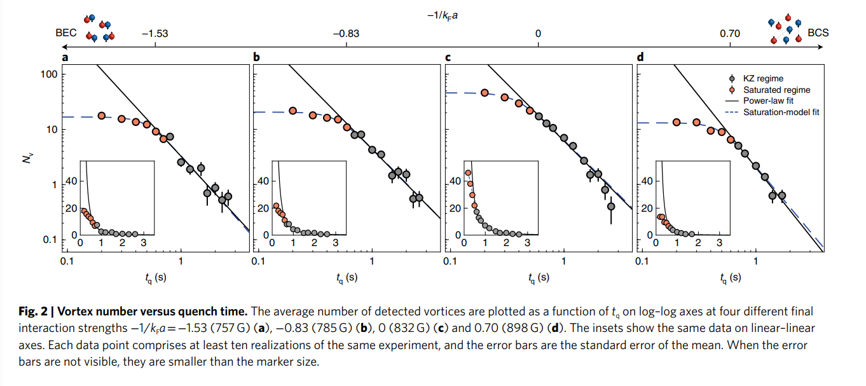

Slide 18





Slide 19
KIbble-Zurek机制与AdS/CMT
Einstein-Higgs model in an AdS_{d+1} black hole
First principle simulation
求解物质场在bulk中的动力学方程得到边界上超导、超流体的动力学行为

Slide 20


holographic set-up
线性降温
t=0, T=T_i, normal state + thermal fluctuations
(Tf-T_i)/v > t >0, linear decrease of temperature
t>(Tf-T_i)/v，T=T_f

Slide 21











1D：
KIbble-Zurek机制与AdS/CMT

Slide 22



2 D :Superfluid
KIbble-Zurek机制与AdS/CMT
温度淬火
= -1/2
d=2, z=2, \nu=1/2

Slide 23






2D: superconductor

Slide 24
3 D : （work in progress）求解 4+1维非线性偏微分方程组
KIbble-Zurek机制与AdS/CMT
统计总条数或者总的长度
初步的结果发现和KZM也是吻合的

Slide 25


Experiments beyond KZM
fast quench：plateau
BEC

Slide 26
BEC 的实验
What is the exact mechanism leading to the
emergence of the plateau in the defect density?
At what quench rates do the KZM scaling laws break down?
How does the plateau value of the defect density depend on the depth of the quench?
Are any of these features universal?

Slide 27




Finite size：suppression of defects formation
Beyond KZM： -0.125

Slide 28

对偏离KZM的理论解释与数值验证
有限尺寸效应
confirm KZM from the critical size
100000次统计平均的结果
critical C

Slide 29



对偏离KZM的理论解释与数值验证
Finite size effect dominates when N <10
|W|=0,1,2，real independent region size is 5N.

Slide 30


对偏离KZM的理论解释与数值验证
1. Number of real independent regions: N= L/(5 \xi).
2. FInite size effect dominates when N<10 ( Standard
Deviation )or N<5(Variance).

Slide 31
对偏离KZM的理论解释与数值验证
快速淬火与平台产生的机制
Zurek曾认为平台并不是KZM能解释的

Slide 32





对偏离KZM的理论解释与数值验证
对KZM的直接推广，但Zurek曾认为平台并不是KZM能解释的
预测了三个普适规律

Slide 33


对偏离KZM的理论解释与数值验证
快速淬火普适规律在一维全息超导环中的验证

Slide 34



对偏离KZM的理论解释与数值验证
快速淬火普适规律在一维横场伊幸模型中的验证

Slide 35


对偏离KZM的理论解释与数值验证
快速淬火普适规律在ZigZag(锯齿)结构相变模型中的验证，包括一个全息模型
e-Print: 2302.11597 [hep-th]

Slide 36




e-Print: 2302.11597 [hep-th]

Slide 37



对偏离KZM的理论解释与数值验证
快速淬火普适规律在2维BEC中的验证
we consider the stochastic Gross-Pitaevskii equation
在二维全息超导/超流模型中也得到了一致的结果

Slide 38

Kibble-Zurek Mechanism is of great significance for understanding the universal laws in non equilibrium phase transition processes.
New experiments have discovered phenomena that the original KZM cannot explain.
The universal laws of finite size effect and rapid quenching can still be understood within the basic framework of KZM . The existence of new universal laws and numerical calculations of holography (etc.) perfectly verify the universality.
Experiments in progress, with USTC

Slide 39



How to understand the smooth transition from the platform to the KZM
region
KZM and Nonequilibrium Steady State Phase Transition Process Driven by an External Field
KZM and first order phase transition
。。。。。。

Slide 40
THANKS！

