Slide 1
First order phase transition and dynamic critical phenomena in holography
Yu Tian (田雨)
University of Chinese Academy of Sciences
(中国科学院大学)
December 10, 2022
UCAS (online)

Slide 2
Mainly based on
  X. Li, Z.-Y. Nie and YT, JHEP 20 (2020) 63 [arXiv:2003.12987]
  C.-Y. Zhang, Q. Chen, Y. Liu, W.-K. Luo, YT and B. Wang, Phys. Rev. Lett. 128 (2022) 161105 [arXiv:2112.07455]; Phys. Rev. D 106 (2022) L061501 [arXiv:2204.09260]
  Q. Chen, Y. Liu, YT, B. Wang, C.-Y. Zhang and H. Zhang [arXiv:2209.12789], to appear in JHEP

Slide 3
1
Introduction
1st order phase (dynamic) transition
2
Landscape and 1st order PT in holo
3
Concluding remarks
4

Slide 4
Why (applied) holography?
Holography deals with these problems by constructing effective field theories with one extra dimension!
Three key problems to be solved for (quantum) many-body systems:
No (local) equilibrium (hydrodynamics no longer valid)
Strong coupling (perturbative theories no longer valid)
Dissipation (time irreversible)

Slide 5
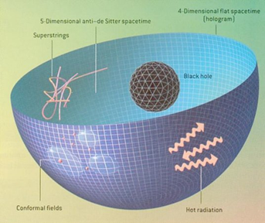

Black hole formation/ accretion
（time irreversible）

Slide 6
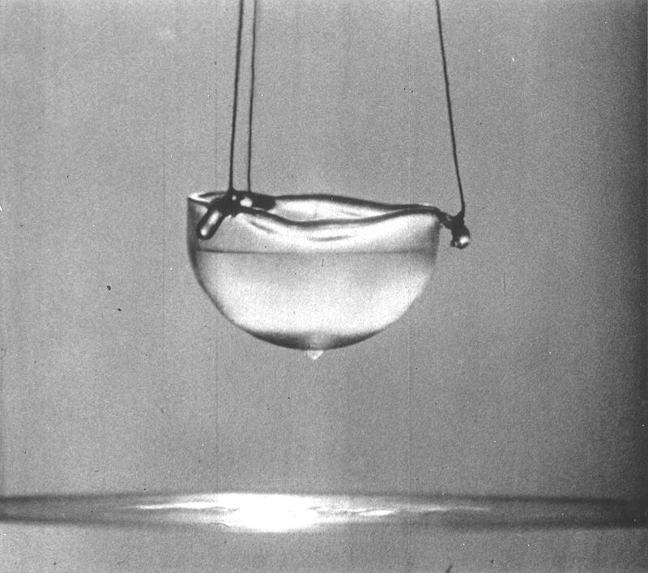
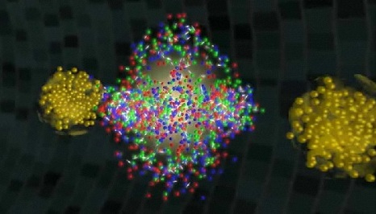
Quantum many-body systems far from equilibrium
Quark-gluon plasma produced in LHC
He_4 superfluid
The simplest holographic model: black hole formation from collision of gravitational waves in the bulk
U(1) symmetry breaking + gravity in the bulk (beyond Landau’s two-fluid model)

Slide 7
Dynamic evolution of (holographic) gravitational systems
Numerical simulation (numerical relativity)
Special features of the numerical relativity used in such kind of study (compared with that used in gravitational-wave physics):
  ﻿Matter sources and/or modified gravity
  Symmetry reduced
  Gauge fixed
  ﻿Null foliation versus space-like foliation (3+1)

Slide 8
Introduction
1
2
1st order phase (dynamic) transition
Landscape and 1st order PT in holo
3
Concluding remarks
4

Slide 9
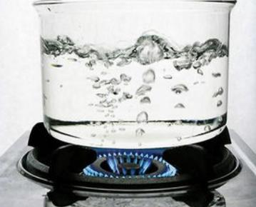
1st order phase transition: importance and complexity
1st order phase transition and its dynamical processes are ubiquitous in our world.
The dynamical processes often go beyond the validity of thermodynamics and hydrodynamics:
  Inhomogeneity (mixture states) during the transition
  Bubble nucleation (evaporation) and collision

Slide 10
1st order phase transitions in holo
Holographic model of 1st order phase transition
[S.S. Gubser & I. Mitra, JHEP 0108 (2001) 018]
Holographic phase separation and inhomogeneous black branes in 1D
[R.A. Janik et al, PRL 119 (2017) 261601]

Slide 11
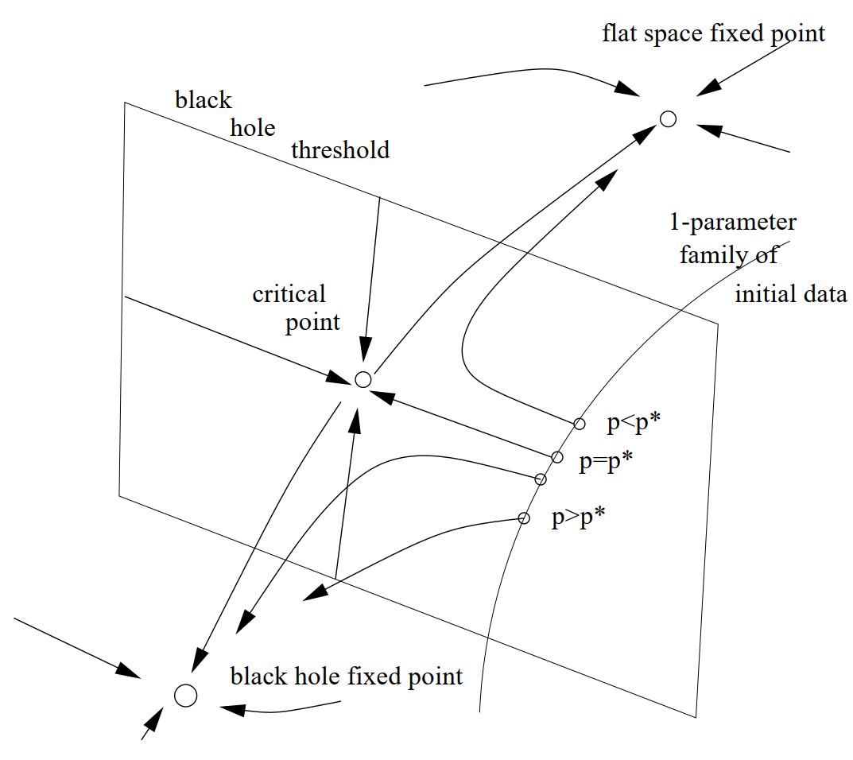
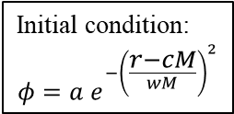
Critical gravitational collapse
(Gundlach 2007 Living Rev. Rel.)
Initial condition:
$$φ=a e^{−{\left(\frac{r−cM}{wM}\right)}^{2}}$$
The phase space picture for the black hole threshold in the presence of a critical point.

Slide 12
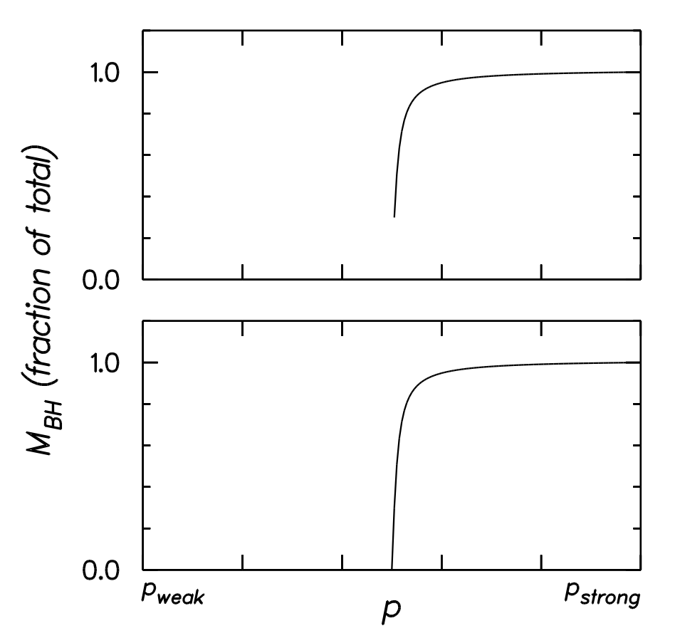

Dynamical phase transitions in gravitational collapse
Similar to thermodynamical phase transitions
Type I: (Choptuik 1996 PRL)
Yang-Mills & Brans-Dicke model
Critical solution: stationary/periodic, attractor
(review 9803075)
Type II: (Choptuik 1993 PRL)
Massless scalar
naked singularity
Critical solution: self-similar, time dependent, attractor
$$X\left(r,t\right)=X\left(e^{Δ}r,e^{Δ}\left(t_{c}−t\right)\right)$$

Slide 13
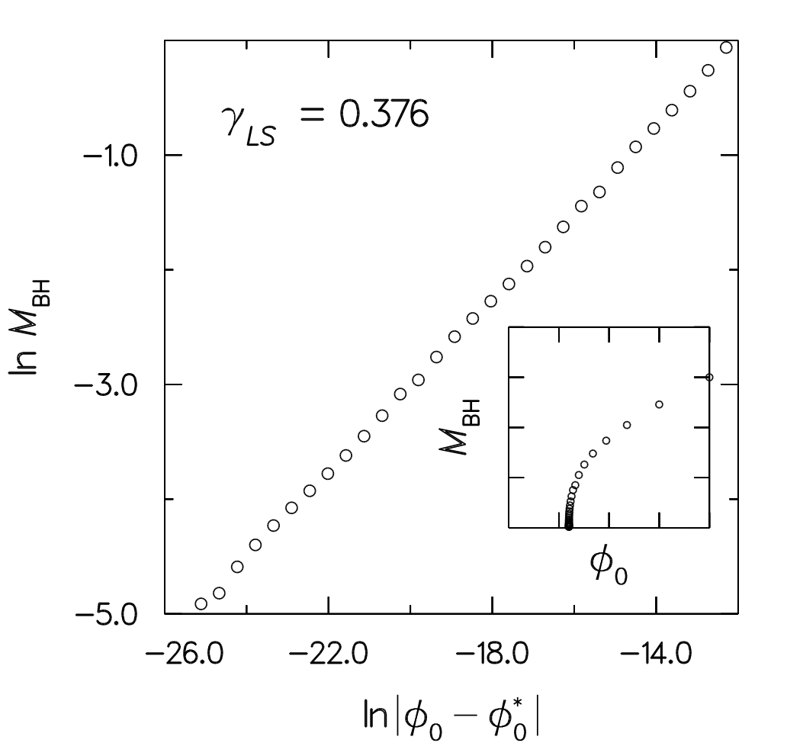
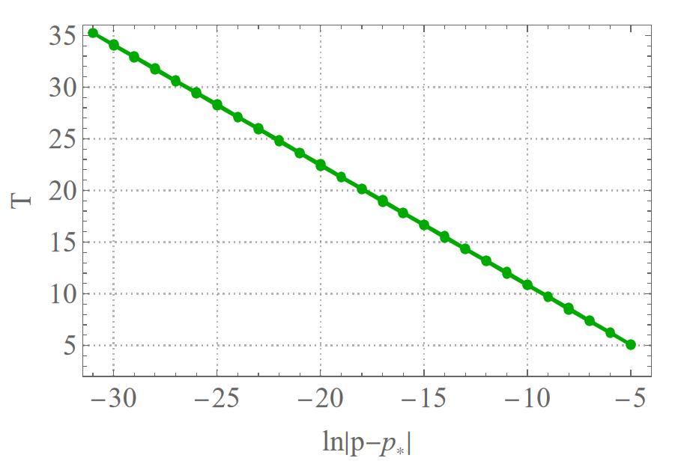
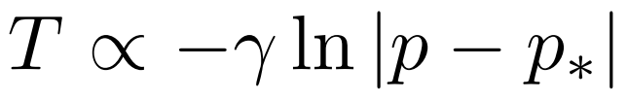

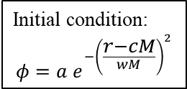
Critical behaviors in gravitational collapse
Type I
Type II
Lifetime of the critical solution (CS):
(Choptuik 1996 PRL)
black hole mass obeys universal power-law:
Initial condition:
$$φ=a e^{−{\left(\frac{r−cM}{wM}\right)}^{2}}$$
$$M_{BH}∝{\left|p−p_{∗}\right|}^{γ}$$
How about 1st order phase transitions?

Slide 14
Scalarization of Black Hole
Evasion of no-hair theorems (Bekenstein, 1972&1996)
GR: with certain matter sources
  conformally-coupled scalar field (1974)
  Yang-Mills (1989)
  …
Beyond GR
  dilatonic BHs (1996, EsGB)
  coloured BHs (1996, EsGB)
  rotating BHs (2011, EsGB)
  …
Spontaneous (type II) and nonlinear (type I) scalarization

Slide 15
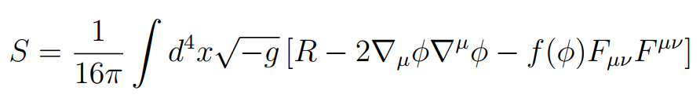
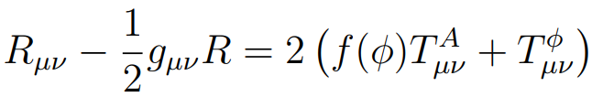
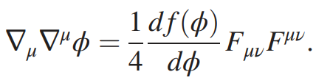


Critical phenomena in type I dynamical scalarization
Our work: PRL 128 (2022) 161105 [arXiv:2112.07455]
$f\left(φ\right)=e^{βφ^{4}}$: the phenomena at the threshold?
Equations:
Full nonlinear dynamics

Slide 16
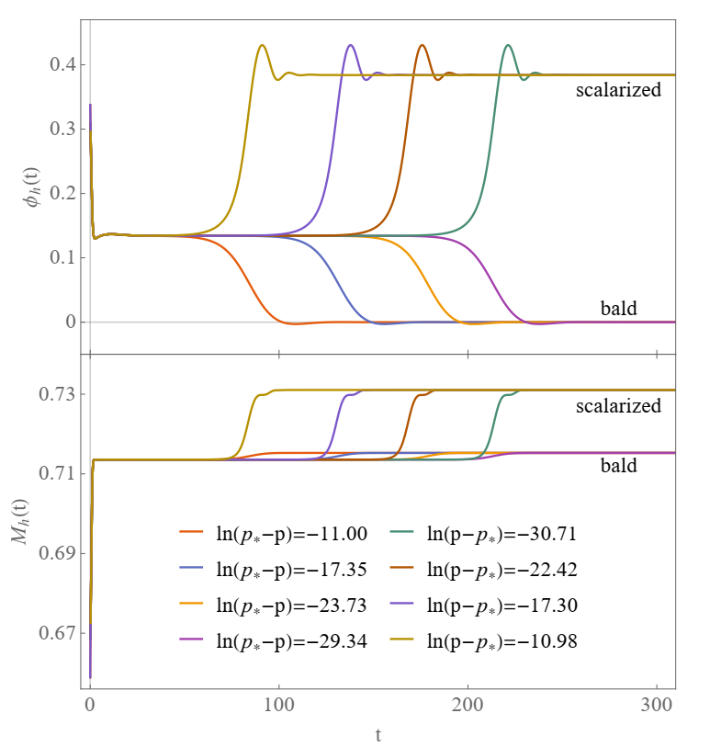
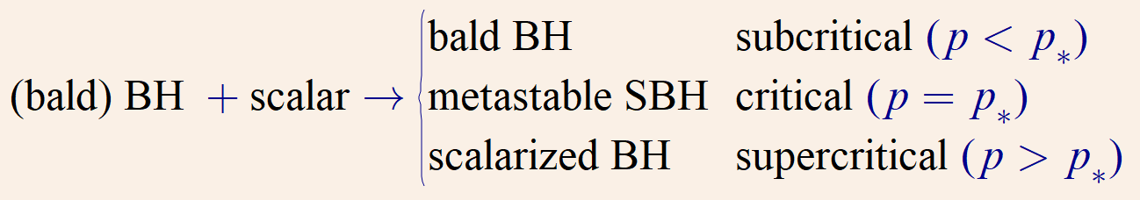
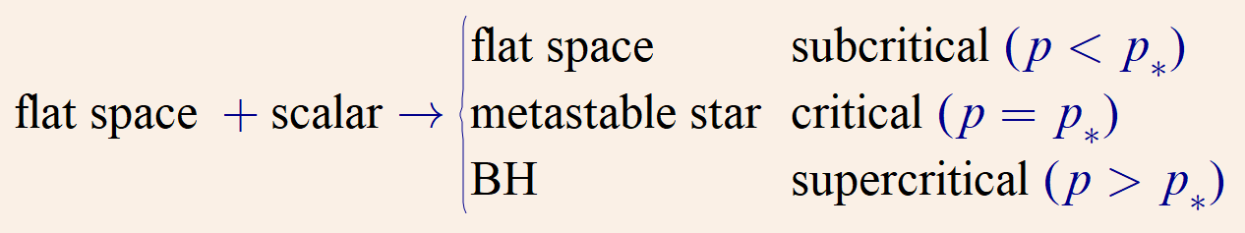



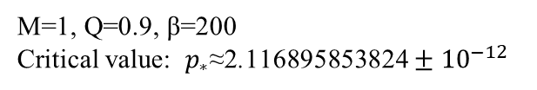
Initial condition : $φ_{0}=0.5e^{{−\left(\frac{r}{pM}\right)}^{2}}$
$$f\left(φ\right)=e^{βφ^{4}}$$
M=1, Q=0.9, β=200
Critical value: $p_{∗}\text{≈}\text{2}\text{.}\text{116895853824}±{10}^{−12}$
BH irreducible mass $M_{h}=\sqrt{A_{h}/4π}=r_{h}$
attractor/CS
New kind of critical phenomena
CS lifetime:
Reminiscent of the type I critical gravitational collapse

Slide 17
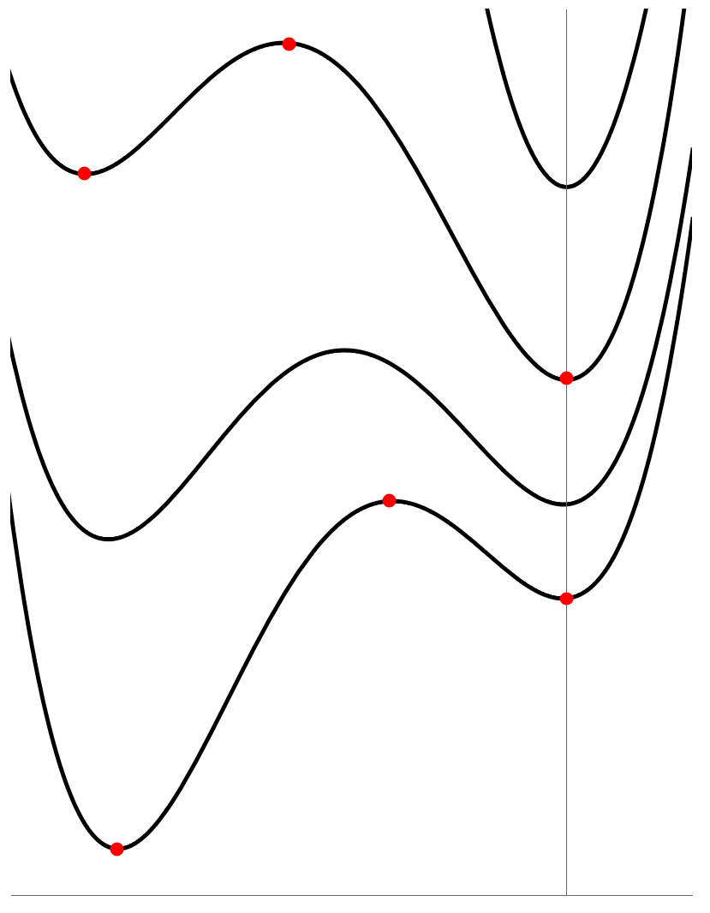
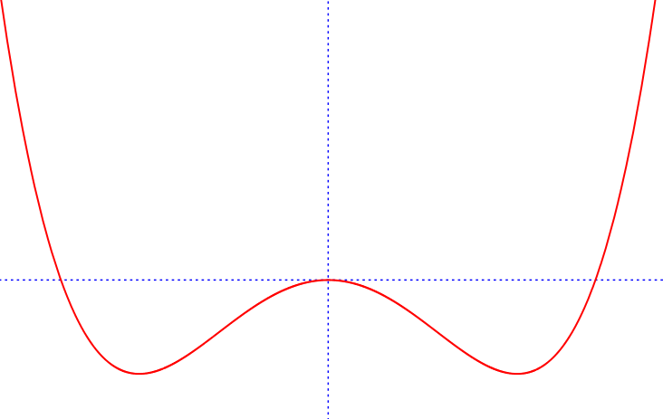

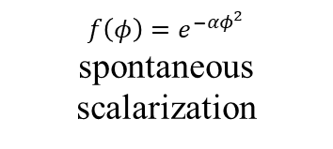
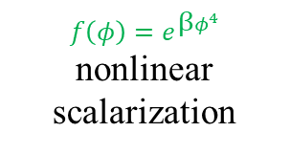

Sketch map for the “free energy”
Free energy
Free energy
bald
$$φ$$
scalarized
scalarized
$$f\left(φ\right)=e^{−αφ^{2}}$$
spontaneous scalarization
bald
$$f\left(φ\right)=e^{βφ^{4}}$$
nonlinear scalarization
scalarized
$$φ$$

Slide 18
Introduction
1
1st order phase (dynamic) transition
2
3
Landscape and 1st order PT in holo
Concluding remarks
4

Slide 19
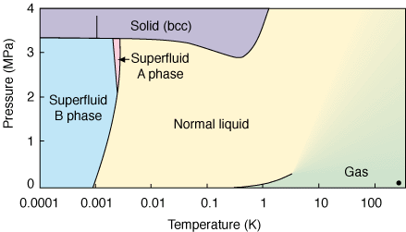
Dynamics of holo 1st order phase transitions
To investigate the 1st order phase transition further (in holography):
The real bubble dynamics (with surface tension) needs higher dimensions;
The superfluid Helium-3 dynamics needs a 1st order phase transition between superfluid phases.

Slide 20
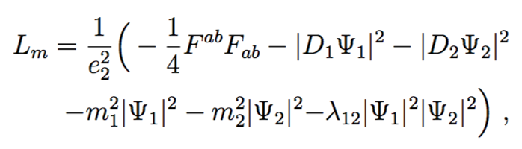
Dynamics of holo 1st order phase transitions (probe limit)
Corresponding to condensate 1
Corresponding to condensate 2
e=4.5, λ₁₂=0.4 for a 1st order phase transition
Interaction term for engineering
Boiling holographic superfluids [X. Li, Z.-Y. Nie & YT, JHEP 2002 (2020) 63]:
The landscape picture of 1st order phase transitions
(1+2)D superfluids with real bubble dynamics
Surface tension of domain walls calculated from holography

Slide 21
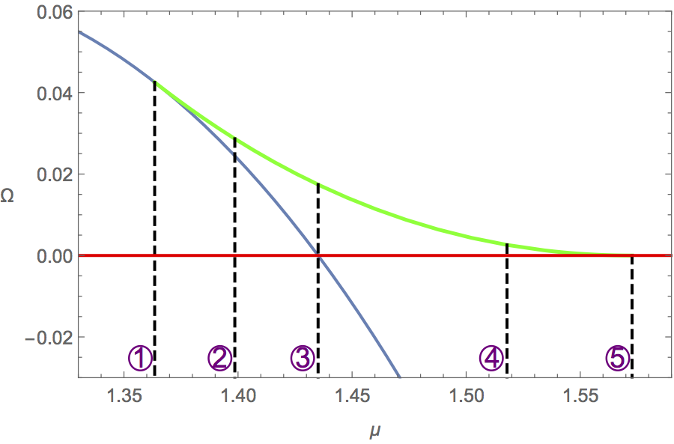
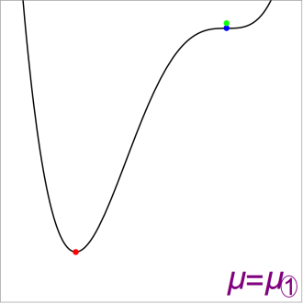
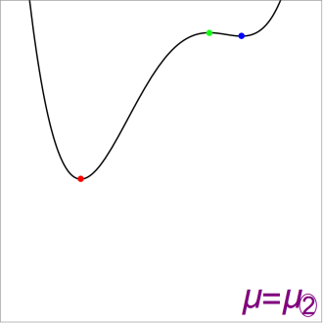
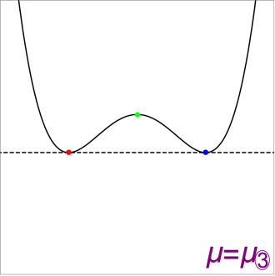
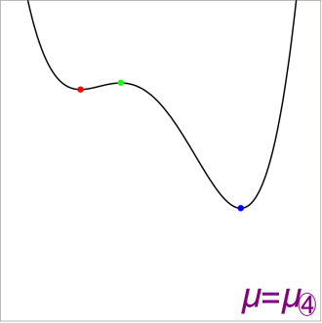
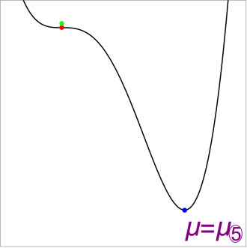
Dynamics of holo 1st order phase transitions
grand potential
versus
chemical potential
Right figure: The ﻿swallow-tail shape of ﻿the grand potential for the 1st order phase transition.
Bottom Figures: Schematic pictures of the landscapes for five different chemical potentials as marked in the right figure, where ﻿the green points are the unstable state.
transition point

Slide 22
﻿The landscape picture for first order phase transitions
  A first order phase transition (not restricted to holographic ones) typically involves three states: the stable one, the meta-stable one and the unstable one.
  The unstable state is the lowest barrier between the stable and meta-stable states.
  Quantitative description of the landscape (probe limit)
  [arXiv:2003.12987]
    The precise description of the configuration space
    The dynamic evolution is expressed in terms of the gradient on the landscape
    The monotonicity of the thermodynamic potential in irreversible processes elegantly derived from the above form of evolution

Slide 23
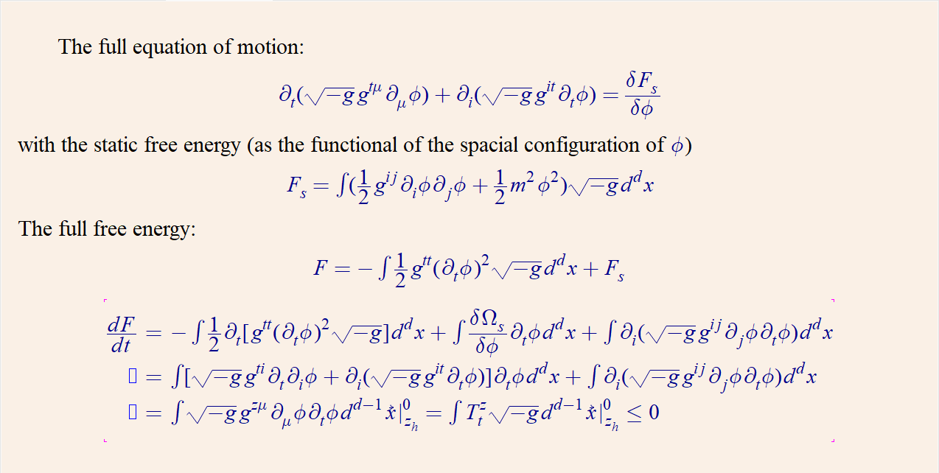
Example: the free energy landscape of a scalar field
[arXiv:2003.12987]

Slide 24
Non-equilibrium holography with backreaction
In the probe limit, we do not have access to some very important quantities, such as (variation of) energy, entropy and temperature.
In particular, in order to invesitigate the ordinary fluid systems with a 1st order PT in holography, we need to include the backreaction and go into the full numerical relativity regime.

Slide 25
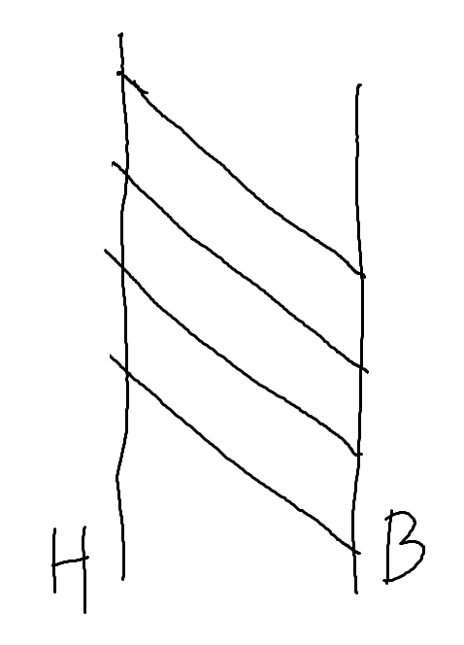
Numerical relativity for holography: formalisms
Space-like time slicing (3+1 formalism):
  BSSN
  CCZ4
Null time slicing (characteristic formalism)
  Eddington-Finkelstein coordinates
  Bondi-Sachs coordinates

Slide 26
Holo 1st order phase transitions with backreaction
Droplets as seeds to trigger 1st order PT in supercooled steam
Dynamical transitions in scalarization (type I) and descalarization through black hole accretion in AdS
[Our work, arXiv:2204.09260]
Critical nuclei (inhomogeneous CS) in holo 1st order phase transitions (the Gubser model)
[Y. Bea et al, arXiv:2007.06467]
[Our work, arXiv:2209.12789]

Slide 27
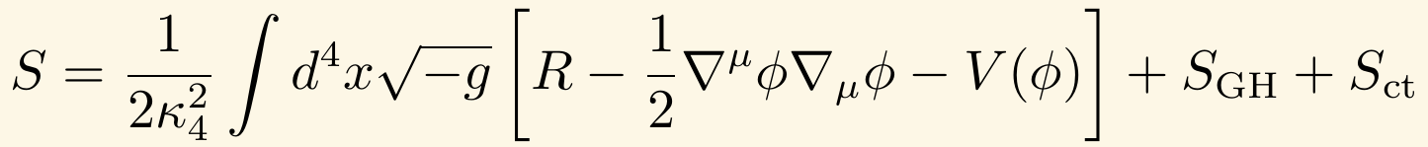
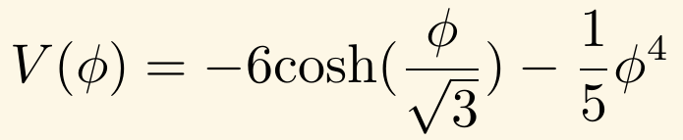
Holographic setup
The action
The potential
The asymptotic behavior of the scalar field
[R.A. Janik et al , Phys. Rev. Lett. 119, 261601（2017）]

Slide 28
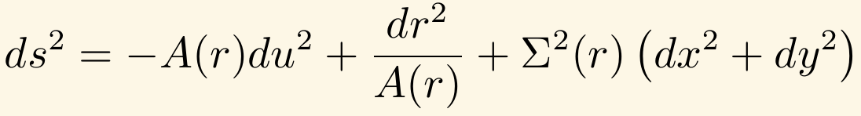
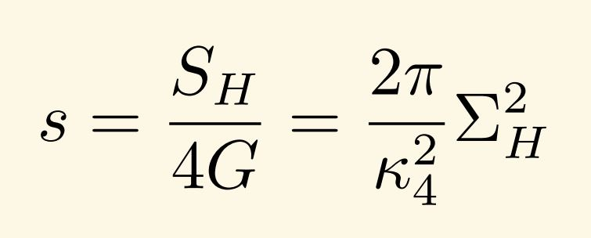
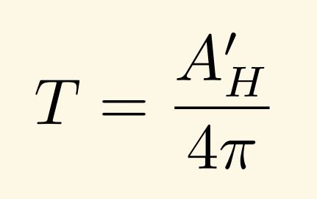
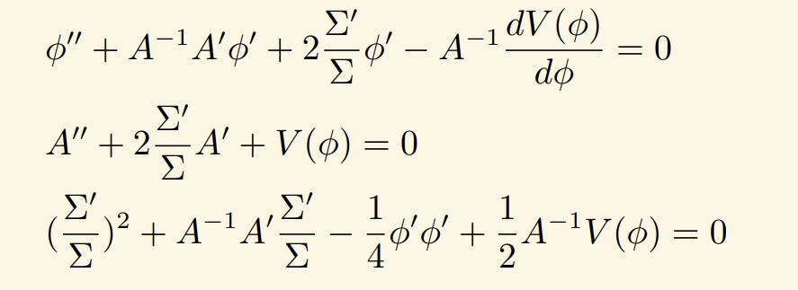
Static homogeneous solutions (Schwarzschild coordinates)
The metric
Entropy and temperature
The equations of motion
Newton-Raphson iteration

Slide 29
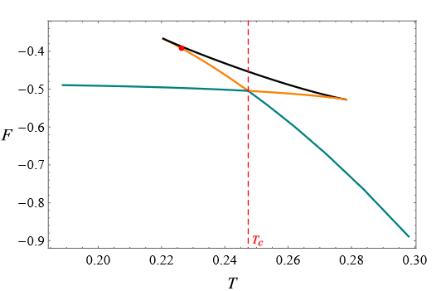
Free energy vs temperature
Spinodal instability
The free energy of the Gubser model (with fixed scalar source) with respect to the temperature, where T_c is the temperature of the 1st order phase transition.

Slide 30



Dynamic evolution
Translation symmetry along the y direction
The Eddington-Finkelstein coordinates
Use the shift freedom to fix the position of the apparent horizon
where

Slide 31











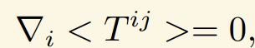

Dynamic evolution – numerical scheme
N
M
N
[P.M. Chesler & L.G. Yaffe, arXiv:1309.1439]

Slide 32
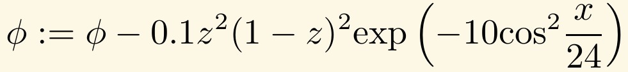
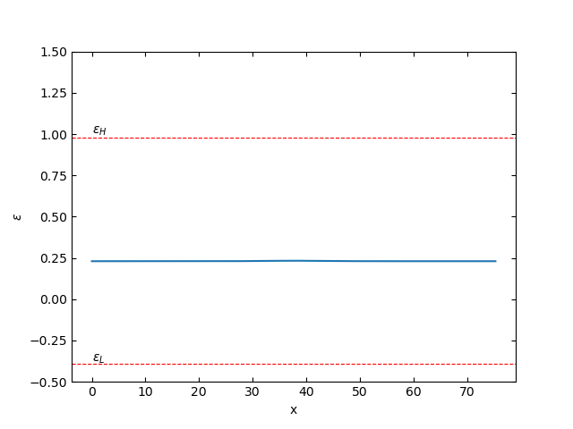
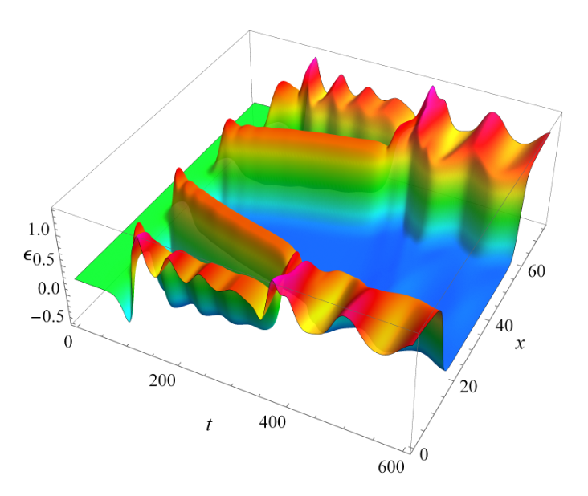
Phase separation from spinodal instability of the unstable state
Initial state + perturbation
Energy density
Phase separation

Slide 33
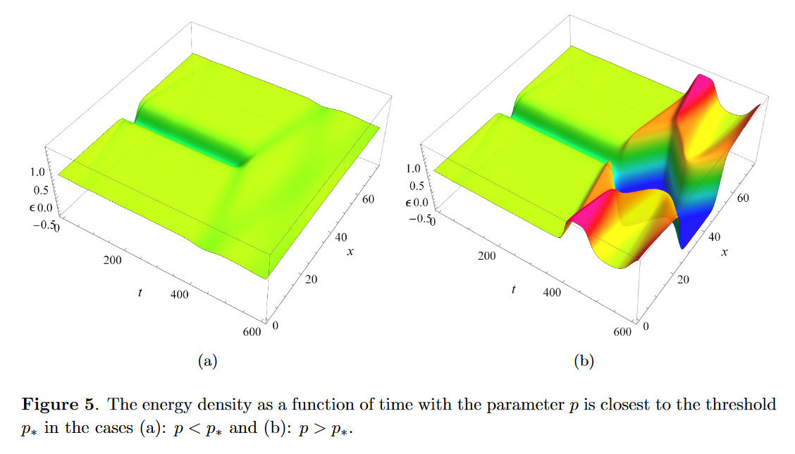
Critical nucleation from the superheated state
Our work, arXiv:2209.12789
Inhomo critical behavior

Slide 34
﻿The quantitative landscape picture for holo systems with backreaction (and more general gravitational systems)?
  The landscape picture is expected to hold universally for gravitational systems
    The three states for 1st order phase transitions
    The critical behavior related to the fact that the critical state (as the unstable one of those states) is the lowest barrier of the transition (a saddle point on the landscape)
  The quantitative description of the landscape in AdS or closed gravitational systems (in progress)
    Entropy landscape for the isolated system
  The difficulties for the dynamical transitions in the asymptotically flat case

Slide 35
Introduction
1
1st order phase (dynamic) transition
2
Landscape and 1st order PT in holo
3
4
Concluding remarks

Slide 36
Concluding remarks
The universal picture and dynamic critical behaviors of 1st order phase transitions (type I dynamical transitions)
The critical behaviors are shown to be present in the inhomogeneous dynamical processes (in systems with 1st order phase transitions)

Slide 37
Concluding remarks
The quantitative description of the landscape for holo systems and more general gravitational systems
Formulations of numerical relativity adapted to different problems

Slide 38
Thanks for your attention!

Slide 39
How does holography work?
One extra dimension
Boundary
Bulk (gravity)
Non-equilibrium
“Complete” dynamics
One extra dimension
Strong coupling
Strong/weak duality
One extra dimension
Dissipation
Black hole formation/ accretion

Slide 40
Bulk picture of non-equilibrium physics (probe limit)
The probe approximation (limit)
Generalized free energy that controls (holographic) dynamical processes:
  ﻿It becomes the standard free energy in the local equilibrium limit;
  ﻿It decreases monotonically in a general (isothermal) dynamical process (no need to be in local equilibrium) without external work (or called driving) done to the boundary system;
  ﻿Its decrease exactly matches the integral of the energy flux across the horizon.
In the probe limit, generalized free energy can be given by (the flux of) the bulk energy current −T^{μν}ξ_{ν}.
[YT, X. Wu (吴小宁) & H. Zhang (张宏宝), arXiv:1912.01159]

Slide 41
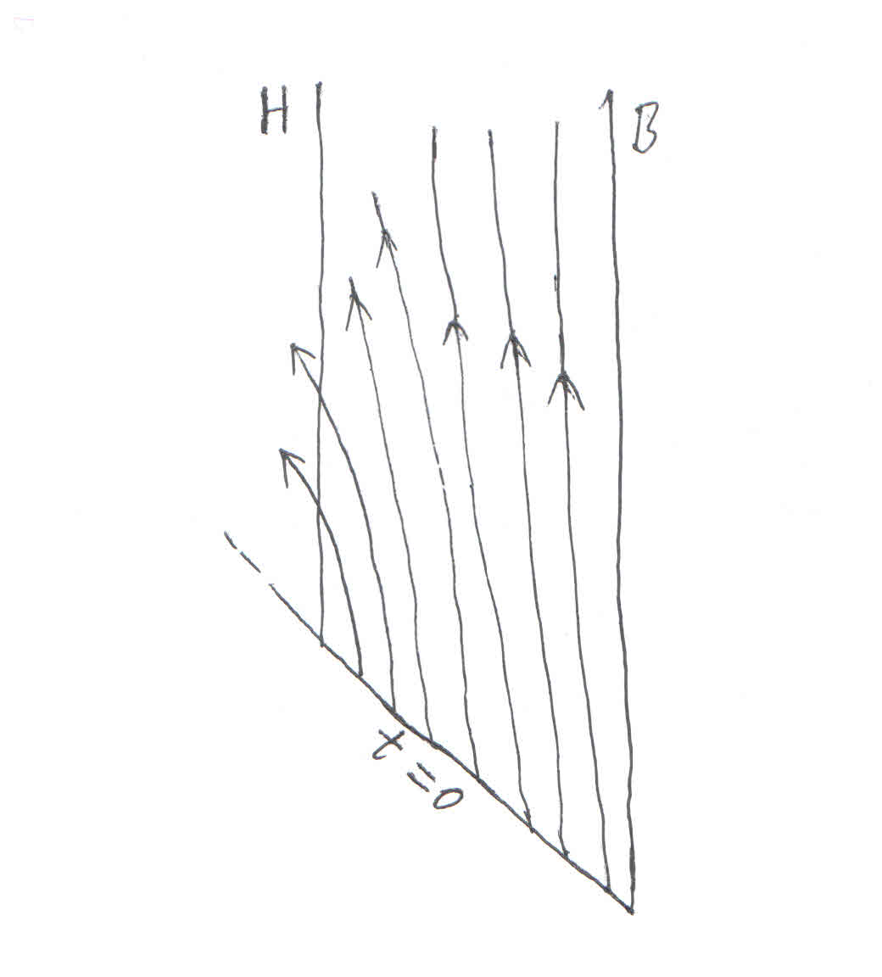
Bulk picture of non-equilibrium physics (probe limit)
Null energy condition
Equilibrium
⬇
Driving
⬇Dissipating⬇
Equilibrium
Driving
≈
Dissipating
Non-equilibrium steady state
Quench
Relaxation
Flux of the energy current across H: dissipating
Flux of the energy current across the AdS conformal boundary B: driving

Slide 42
Bulk picture of non-equilibrium physics (general cases)
The linear response regime (with or without local equilibrium)
[YT, X. Wu & H. Zhang, JHEP 1410 (2014) 170]
The fully back-reacted bulk picture of non-equilibrium physics?
  Conceptual difficulties about non-equilibrium physics
  Event horizon versus apparent horizon (or even other choices?)
  How to characterize dissipation?
Can gravity theories and non-equilibrium physics learn from holography?

Slide 43
Local equilibrium and non-equilibrium
As is well known, hydrodynamics is the low energy, long wavelength effective theory of quantum many body systems. The validity of hydrodynamics depends on local equilibrium, which means that the system is
evolving in time slowly enough
varying in space slowly enough
with respect to all the characteristic (microscopic) time and space scales.
For a CFT without any conserved quantities other than energy, the only characteristic scale is the temperature T, so the validity of hydrodynamics is determined by T.

Slide 44
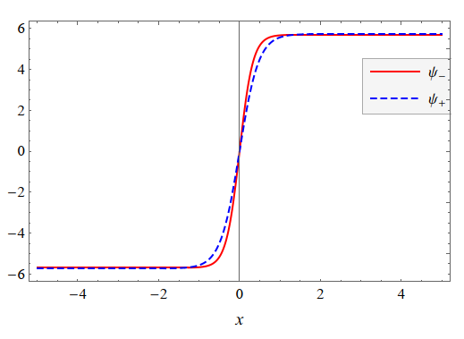
Local equilibrium and non-equilibrium
Holographic superfluid solitons (with backreaction).
Blue: standard quantization;
Red: alternative quantization.
[Z. Xu et al, arXiv:1910.09253]
Restoration of thermodynamics
Non-equilibrium region (gradients not small compared to T
So, even a stable, static system can be in non-equilibrium, if there are local structures, like solitons, vortices, domain walls, etc.

Slide 45

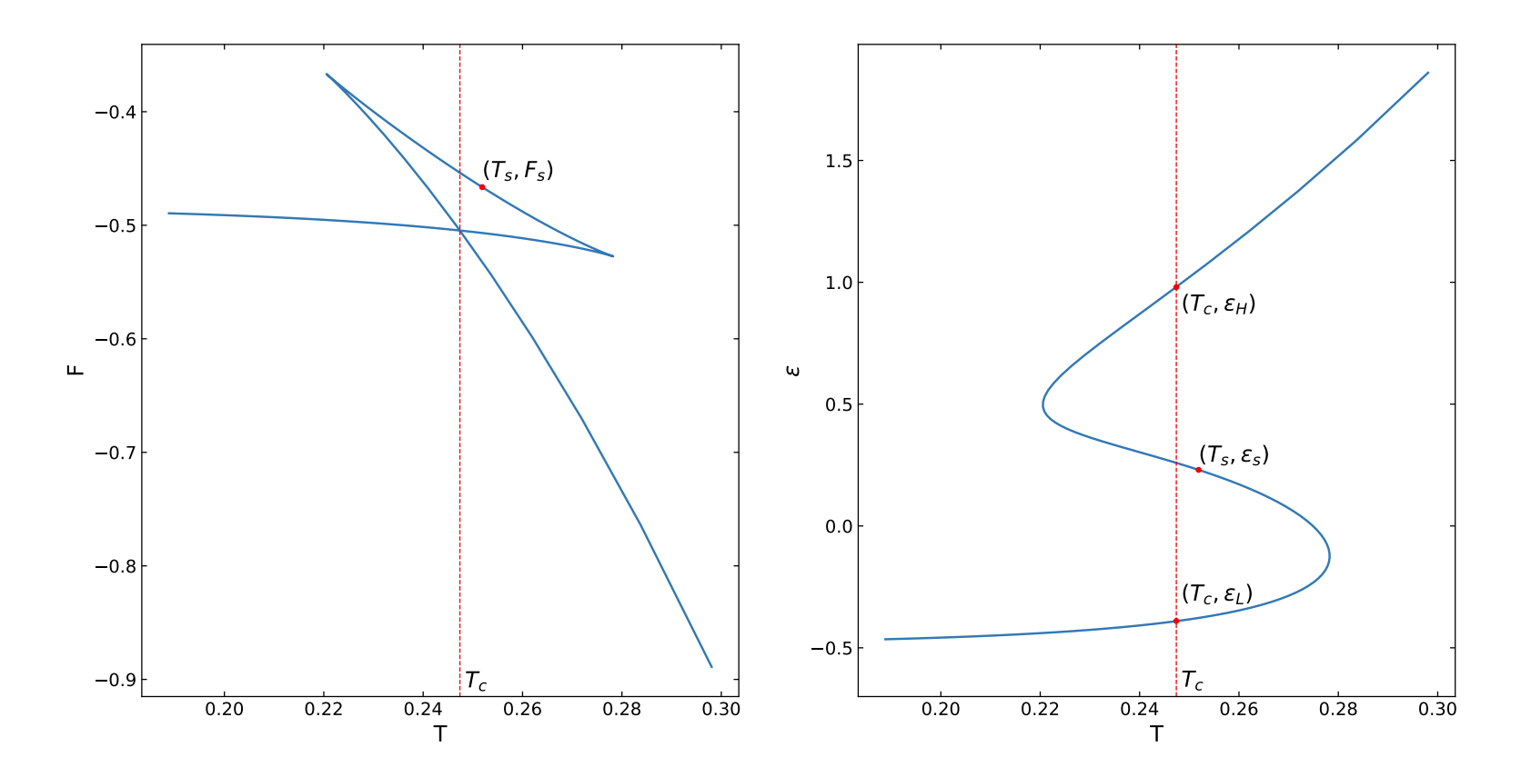
Equation of state
The free energy (left) and the energy density (right) as a function of temperature
with source fixed

