Slide 1
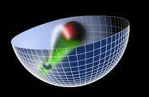
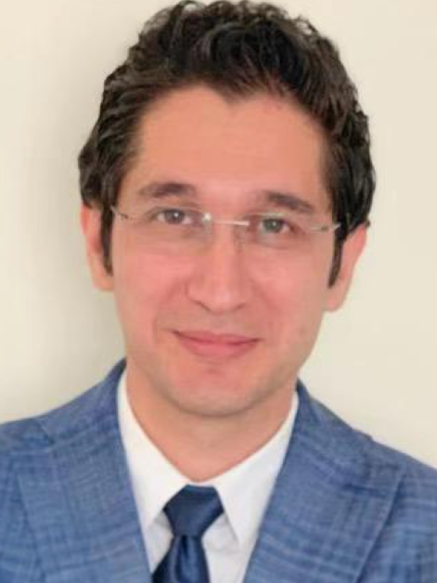
Holographic QCD online
Title：Characteristic momentum of Hydro+ and its application to the QCD critical point
Speaker：Dr. NAVID ABBASI(Lanzhou Uni.)
Time：9:00am（Beijing time）, Nov.19th , 2022
Join the seminar: https://join.skype.com/wSQc12azuipp
Abstract:
Near the critical point in the QCD phase diagram, hydrodynamics breaks down at a momentum where the frequency of the fastest hydrodynamic mode becomes comparable with the decay rate of the slowest non-hydrodynamic mode. Hydro+ was developed as a framework which extends the range of validity of hydrodynamics beyond that momentum. In this talk, we first analyze the analytic structure of the spectrum of linear perturbations in single-mode Hydro+, which contains a single slow mode in addition to the hydro modes. We show that the slow mode falls out of equilibrium if the momentum of flow is greater than a characteristic momentum value. That characteristic momentum turns out to be set by the branch points of the dispersion relations. Applying these results to the hydro+ near the critical point, we discuss how the existence of such a characteristic momentum scale leads a particular class of slow modes to have no remarkable effect on the flow of the plasma. Based on these results, we find a temperature-dependent upper bound for the speed of sound near the critical point in the QCD phase diagram.
Organization Committee: Matteo Baggioli(SJTU), Mei Huang(UCAS), Defu Hou(CCNU), Danning Li(JNU), Li Li(ITP,CAS), Yang Li(USTC), Shu Lin(SYSU), Yawen Sun(UCAS)

